Slide 1
Fabrication in the nanoscale:
principles, technology and applications
Textbook: Nanofabrication: principles, capabilities and limits, by Zheng Cui
Course instructor: Bo Cui
Office: EIT 4012 Ext. 38754
Office hour: 11-12pm, Monday & Thursday
ECE 730: Fabrication in the nanoscale: principles, technology and applications
Instructor: Bo Cui, ECE, University of Waterloo; http://ece.uwaterloo.ca/~bcui/
Textbook: Nanofabrication: principles, capabilities and limits, by Zheng Cui

Slide 2
Course outline
Overview of nanofabrication. (3 hours)
Lithographies.
Thin film deposition techniques.
Etching techniques.
High resolution photon-based lithography. (7h)
Deep UV lithography with high NA and/or low k1 factor.
Extreme UV lithography, why selected as next generation lithography by industry.
X-ray lithography, X-ray optics, mask, LIGA process.
Electron beam lithography. (4h)
Electron optics, e-beam sources, instrumentation.
Electron-matter interaction, proximity effect, pattern design, alignment.
Resists and developers, resolution limits, contrast, sensitivity, etching selectivity.
Nano-patterning by focused ion beam. (6h)
Ion source, ion optics, instrumentation.
Ion-matter interaction, focused ion beam etching and lithography.
Focused ion beam induced deposition, mechanism and applications.
Focused electron beam induced deposition.
Nanoimprint lithography (NIL). (4h)
Thermal NIL, resist, thermoplastic properties of polymers, tools.
UV-curable NIL, resist, whole wafer vs. step-and-flash imprint, tools.
Alignment, mold fabrication, defects, limits.
Reverse NIL, NIL using thermal-set resist, pulsed laser assistant NIL of metals.

Slide 3
Nano-patterning by scanning probes. (4h)
AFM-based, local oxidation and dip-pen lithography.
NSOM-based, near field optics, exposure of resist.
STM-based, manipulation of atoms and exposure of resist.
Soft lithography. (1h)
Micro-contact printing of chemical patterns, capabilities and resolution limits.
Nano-transfer printing.
Nano-patterning by self assembly. (4h)
Anodized aluminum oxide, application as template for nano-wire growth.
Nano-sphere lithography, fabrication of nanostructure of various shapes.
Block copolymer self assembly, how to achieve long-range ordering.

Slide 4
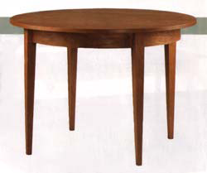
Nanofabrication - two principal approaches
Top Down:
Implementation of various techniques to remove, add or redistribute atoms or molecules in a bulk material to create a final structure.
Miniaturizing existing processes
at the macro/micro-scale
Bottom up
Atomic and molecular scale directed
assembly to create larger scale
structures with engineered properties
E.g. chemical self -assembly
Machined
Assembled

Slide 5
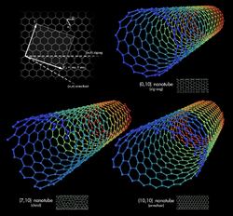
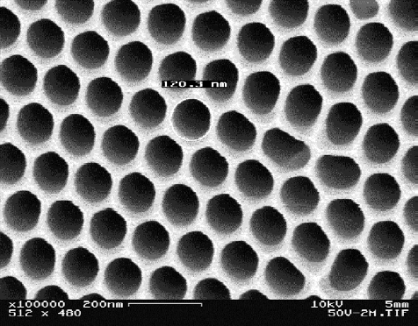
Bottom-up nanofabrication
Chemical synthesis
Nanotubes and nanowires
Quantum dots and nanoparticles
Polymers
Proteins
Nanofibers produced by proteins
Functional arrangement
Self assembly
Mono-layers, e.g. nano-sphere lithography
Block copolymers
Functionalized nanoscale structures
Fluidic or field assisted assembly
Surface tension directed assembly
Templated growth
Step edges and defect or strain fields
Porous materials, e.g. anodized aluminum oxide
Scanning probe manipulation
AFM, STM with atomic resolution
Carbon nanotube
Anodized aluminum oxide

Slide 6
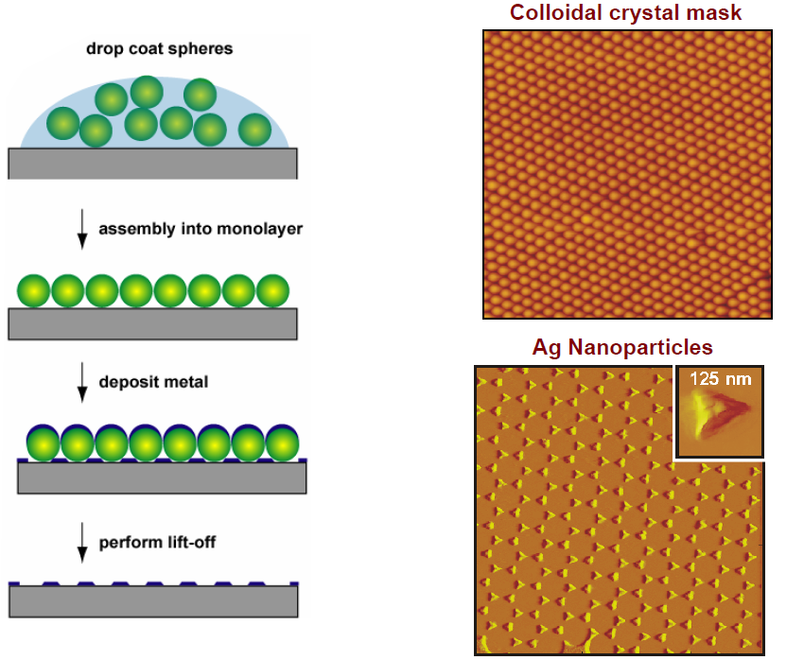
Nanosphere lithography (bottom up, self assembly)

Slide 7
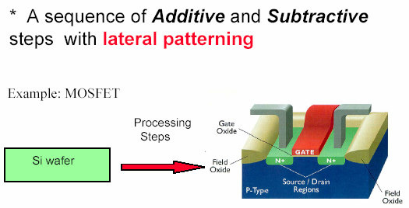
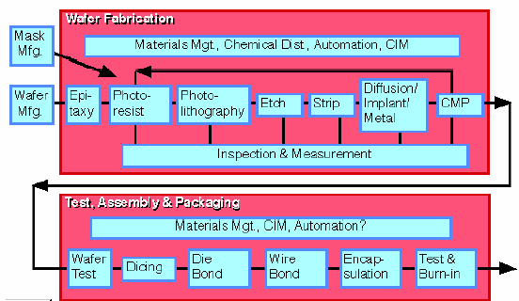
Top-down nanofabrication (semiconductor industry)
Additive: thin film deposition/ growth.
Subtractive: material removal, etching/polishing.
Lateral patterning: lithography.
CMP: chemical mechanical polishing

Slide 8
Top down nanofabrication: one example
metal nanostructures
Metal nanostructures
side view
substrate
substrate
Direct etch process
Liftoff process
resist
(polymer)
resist
(polymer)
1. Thin film growth
1. Thin film growth
2. Lithography
2. Lithography
3. Etching
3. Deposition
4. Etching (dissolve resist)
4. Etching (dissolve resist)

Slide 9
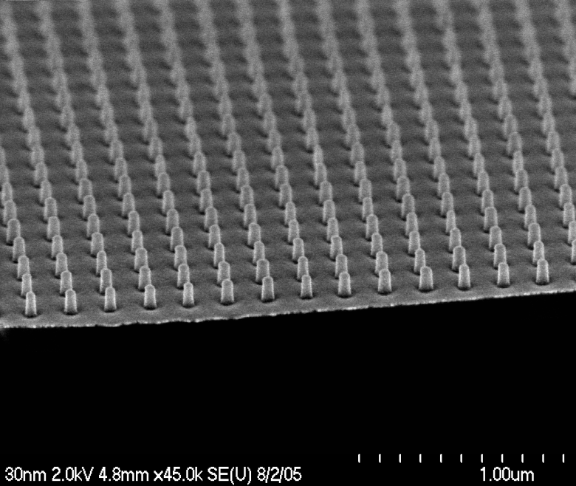
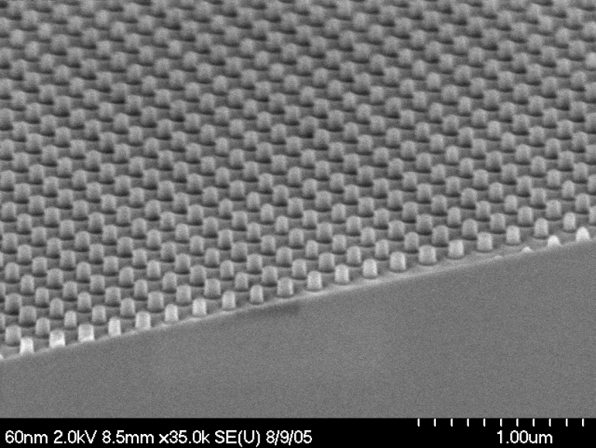
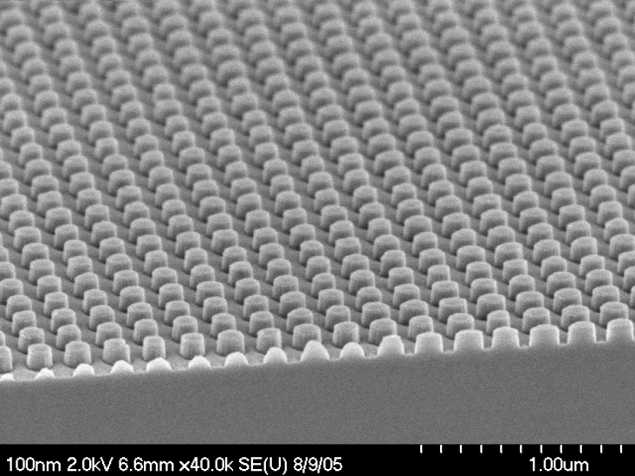
One more step: pillar array with various diameters
Pitch: 200nm
Cr
35 nm diameter
silicon
1. Cr dots by liftoff
2. RIE silicon and remove Cr
(RIE: reactive ion etching)
70 nm diameter
115 nm diameter

Slide 10
Additive methods
Thin film deposition
Physical vapor deposition (PVD): sputtering, e-beam or thermal evaporation
Chemical vapor deposition (CVD): metal-organic CVD, plasma-enhanced CVD, low pressure CVD…
Epitaxy: molecular beam epitaxy (MBE), liquid-phase epitaxy…
Electrochemical deposition: electro- and electroless plating (of metals)
Oxidation (growth of thermal SiO₂)
Spin-on and spray-on film coating (resist coating)
Printing techniques: ink-jet, micro-contact printing
Assembly: wafer bonding, surface mount, wiring and bonding

Slide 11
Subtractive and modifying methods
Subtractive methods:
Etching: wet chemical etching, reactive ion etching; ion beam sputter etching, focused ion beam etching.
Tool-assisted material removal: chemical-mechanical polishing, chipping, drilling, milling, sand blasting.
Radiative and thermal treatment: laser ablation, spark erosion.
Modifying methods:
Radiative treatment: resist exposure, polymer hardening
Thermal annealing: crystallization, diffusion, change of phase
Ion beam treatment: implantation, amorphization
Mechanical modification: plastic forming and shaping, scanning probe manipulation

Slide 12
Lithography – general distinction
Lithography with particles or waves
Photons: photolithography
X-rays: from synchrotron, x-ray lithography
Electrons: electron beam lithography (EBL)
Ions: focused ion beam (FIB) lithography
Imprint lithography (molding)
Soft Lithography: micro-contact-printing…
Hot embossing
UV-curable imprinting
SPM-lithography
AFM
STM
DPN (dip-pen nanolithography)
Pattern replication: parallel
(masks/molds necessary)
High throughput, but not easy to change pattern
Optical lithography
X-ray lithography
Imprint lithography
Stencil mask lithography
Pattern generation: serial
(Slow, for mask/mold making)
E-beam lithography (EBL)
Ion beam lithography (FIB)
SPM-lithography
AFM, STM, DPN
Multiple serial (array)
Electron-beam micro-column array (arrayed EBL)
Zone plate array lithography
Scanning probe array
Lithography on surfaces
Optical/UV lithography
E-beam lithography
FIB lithography
X-ray lithography
SPM-lithography
AFM
STM
DPN (dip-pen nanolithography)
Imprint lithography
Soft lithography
Hot embossing
UV imprinting
Stencil mask lithography
Lithography in volume
Two photon absorption
Stereo-lithography

Slide 13
Key requirements of lithography (for manufacturing ICs)
Critical dimension (CD) control
Size of features must be controlled within wafer and wafer-to-wafer
Overlay (alignment between different layers)
For high yield, alignment must be precisely controlled
Defect control
Other than designed pattern, no additional patterns must be imaged
Low cost
Tool, resist, mask; fast step-and-repeat
30-40% of total semiconductor manufacturing cost is due to lithography (masks, resists, metrology)
At the end of the roadmap, micro-processor will require 39 mask levels

Slide 14
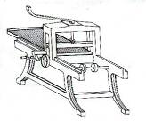
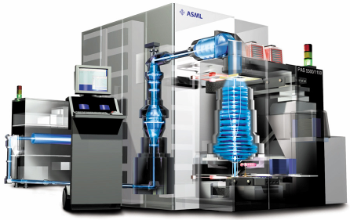
How lithography started
State-of-art lithography tool for IC industry
Reticle
(Mask)
Wafer
193 nm Excimer Laser Source
Computer Console
Exposure Column
(Lens)
Lithography (Greek for "stone drawing"); based on repulsion of oil and water.
Invented by Alois Senefelder in 1798.
Used for book illustrations, artist's prints, packaging, posters, etc.
In 1825, Goya produced a series of lithographs.
In the 20th and 21st century, become an important technique with unique expressive capabilities in the art field.
Nowadays used in semiconductor manufacturing (integrated circuit - IC).

Slide 15
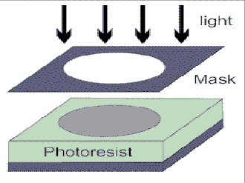
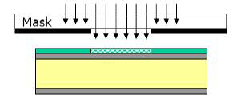
Optical/UV lithography (= photolithography)
Process used to transfer a pattern from a photomask to the surface of a substrate
Formation of images with visible or ultraviolet radiation in a photoresist
No limitation of substrate (Si, glass, metal, plastic...)
Working horse of current chip manufacturing processes (45nm feature size)
Most widely used lithography system for R&D (~1μm feature size, micro-fabrication)
Block radiation where it is not wanted i.e. absorb radiation
Need opaque material at the desired wavelength
Transmit radiation where it is needed
Need material with high transmission at the desired wavelength
For optical lithography, mask is quartz glass (transparent) + Cr (opaque)

Slide 16
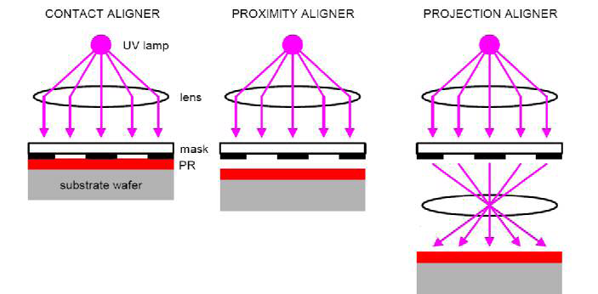
Three optical lithography methods
Contact aligner Proximity aligner Projection aligner
Mask in contact with photo-resist film
(Gap=0 μm)
Gap (order 10μm) between mask photoresist
Like photography, imaging
PR = photoresist
Photoresist is a light-sensitive material to form a patterned coating on a surface
Photoresists are classified into two groups: positive and negative resists.
Positive resists become more soluble on exposure to radiation (e.g. PMMA, S1805).
Negative resists become less soluble on exposure to radiation (e.g. SU-8).

Slide 17
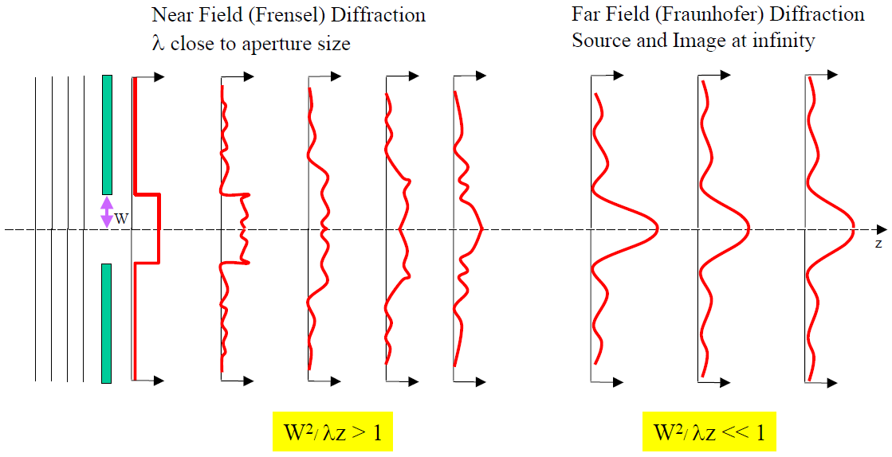
Fresnel & Fraunhofer diffraction (from an aperture)
Light intensity profile
Contact Proximity Projection

Slide 18
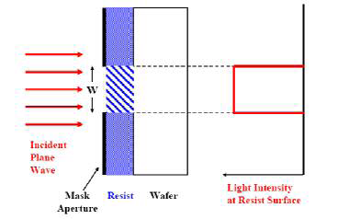
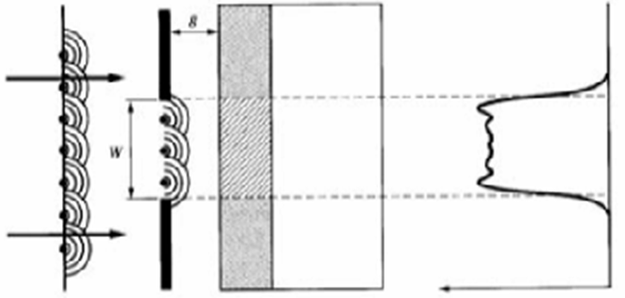
Contact and proximity photolithography
Contact
Proximity
g (=gap between mask and resist top surface)
light mask resist wafer light intensity
light mask resist wafer light intensity
Mask is brought into physical contact with photoresist
Mask image : resist image is 1:1
Not limited by diffraction
Damage of mask possible
Highest resolution: (t is resist thickness)
Small gap (2-20μm) between mask and photoresist (mask damage eliminated).
Near-field (Fresnel) diffraction effects.
Loss of exact mask reproduction for small feature size (i.e. reduced resolution).
As mask separation g (=gap) increases, quality of image degrades.
Resolution: (t is resist thickness)
(<λ)
(>>λ)

Slide 19
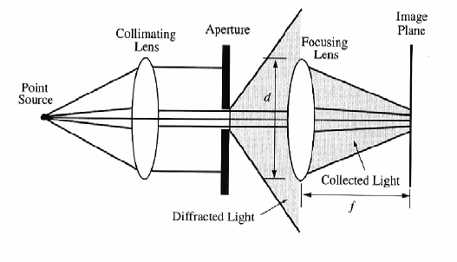
Projection printing
Rayleigh resolution:
Numerical aperture, NA
Similar to photography: image formation on the resist surface
Resolution is limited by far field diffraction (Fraunhofer), need good lens for high resolution.
Usually print small area (e.g. ¼ reduction), then step and repeat.
Very expensive, used mainly by semiconductor industry, unpopular for academic research.
Currently, IC industry uses λ=193nm deep UV light from ArF excimer laser (10s nano-second incoherent pulse) for exposure, with resolution (half-pitch of dense line array) 45nm.

Slide 20
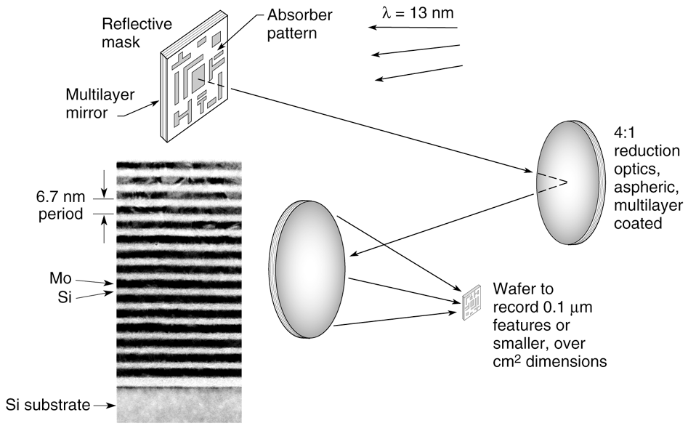
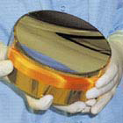
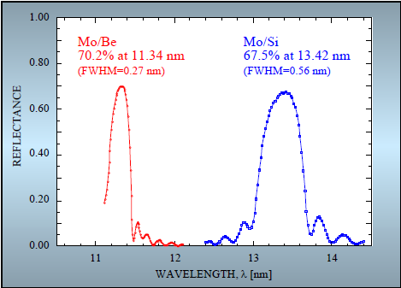
Extreme ultraviolet (EUV) lithography (λ=13.5nm)
Short wavelength (13.5 nm) permits high resolution even with small numerical apertures.
One candidate for next generation lithography
EUV mirror
Lens (transmission) is not possible at EUV.
So use reflection lens.
Bragg reflector made of alternating Mo/Si layers that enables high efficiency (68% at normal incidence) reflection of 13.5 nm light.

Slide 21
X-ray lithography (XRL)
λ ∼ 1nm (extremely short wavelength for high resolution).
X-rays are produced by synchrotron radiation in a high energy electron storage ring.
Contamination becomes a smaller concern because X-rays will penetrate most dust particles (low atomic number).
No need for vacuum (little absorption of x-ray by air).
No lens (transmission or reflection), because for X- ray, refractive index n≡1; thus only proximity printing.
Proximity printing can still achieve high resolution (<30nm) due to small λ (proximity has much longer mask life than contact printing).
Deep penetrating power of the x-rays into the photoresist and low diffraction (spread of beam), thus good for creating microstructures with great height (high aspect ratio).
Popular resist (PMMA) has very low sensitivity to X-rays (SU-8 is much more sensitive).
Resolution:
(>>λ)

Slide 22
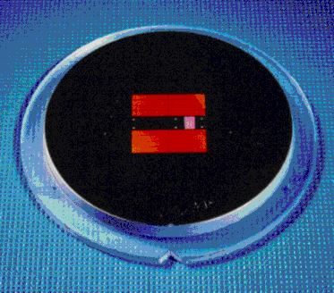
X-ray lithography (XRL) masks
XRL masks are composed of thin membrane substrate/support (Si, Be, or SiC, Si₃N₄ (few μm, very thin!) ) and X-ray absorbers (high Z atoms such as Au, W).
Strain in the thin membrane may warp the patterns.
Masks degrade due to repeated exposure to X-rays.
In one word, the high cost of membrane mask is the most serious issue that prevents XRL from application for semiconductor industry. (The other issue is bright X-ray source, need synchrotron radiation)
XRL mask
http://www.xraylith.wisc.edu/overview/cxrlibm.html

Slide 23
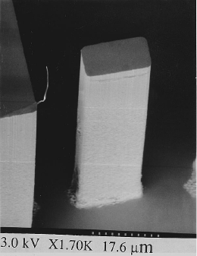
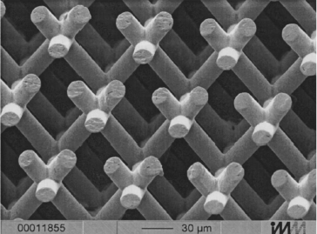
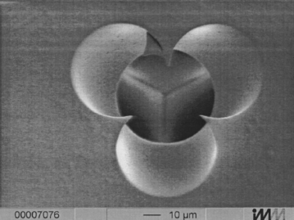
XRL: advantages and disadvantages
Advantages
Good resolution (down to 30 nm)
No interference from dust
Relatively fast
Deep penetration to resist, high aspect ratio
No depth of focus problem
Disadvantages
X-ray masks are very difficult to make
Conventional lenses cannot focus X-rays
Expensive (synchrotron radiation source)
High aspect ratio micro-structures by XRL
Intersection of the three beams
Three-cylinder photonic crystal structure in
ceramic. Exposed by repeated exposures at
different tilt angles between the mask and
synchrotron. Almost like mechanical drilling.
G. Feiertag, APL, 71 (11) 1997.
80μm resist structure with aspect ratio > 10.
White, APL, 66 (16) 1995.

Slide 24
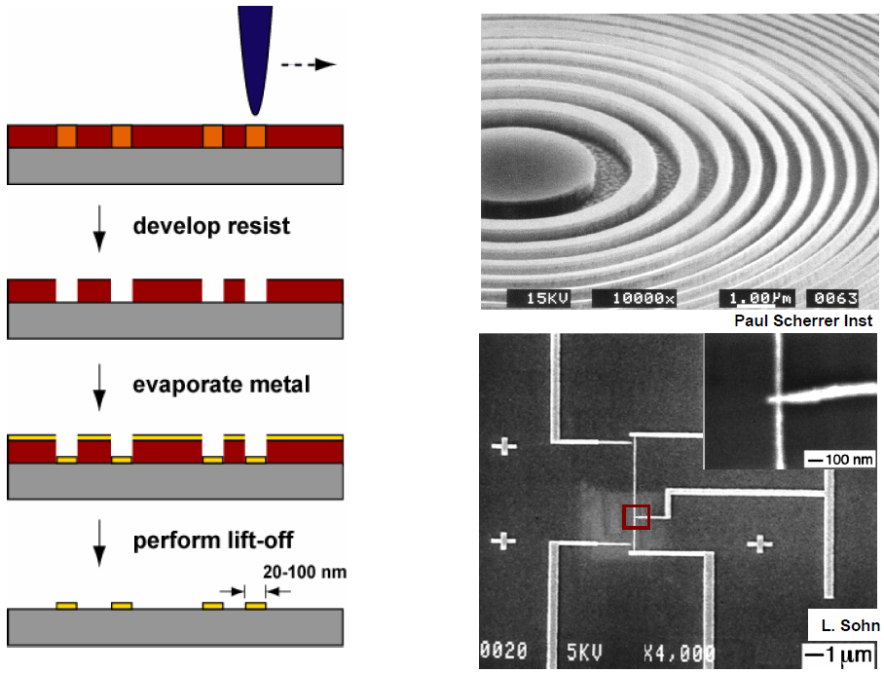
Lithography using charged particles I: electron beam lithography (EBL)
Finely focused electron beam, φ=2-5nm
Resist
(PMMA…)
Metal patterning by EBL and liftoff

Slide 25
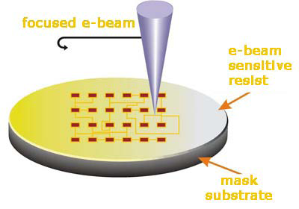
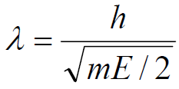
Electron beam lithography (EBL)
Electron beam has a wavelength so small that diffraction no longer defines the lithographic resolution.
Tool is just like an SEM with on-off capability controlled by a “beam blanker”.
Accurate positioning, “see” the substrate first, then exposure.
Beam spot diameter of 2nm can be achieved, at typical acceleration voltage of >20keV.
Typical resolution ~15nm, limited by proximity effect and lateral diffusion of secondary electrons (SE, energy ~tens of eV; actually, SE, rather than the primary electrons, contribute to the exposure of resist).
Most popular prototyping tool for R&D, but too slow for mass production.
Wavelength of electrons
Where V is electron energy in eV unit.
For example, 30keV → λ=0.007nm!

Slide 26
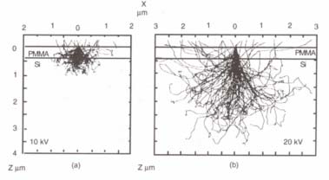
E-beam lithography resolution
(Why can’t we write 2nm lines when the beam width is 2nm?)
Interaction of electrons and resist leads to beam spreading
Elastic and in-elastic scattering in the resist and substrate.
In-elastic scattering generates secondary electrons.
Lateral diffusion of secondary electrons.
The result: 2nm e-beam becomes 15nm line.
Features as small as 10nm are possible, but rarely demonstrated.
Monte Carlo simulation of electrons trajectory, showing forward and back scattering.
Advantages
Direct write technique (no mask)
Computer controlled
Can image surface before exposing
High resolution
Disadvantages
Slow (but multiple beams can be used)
Expensive
Proximity effect (dense pattern ≥ 50nm pitch)
Lift off can be difficult for negative resists

Slide 27
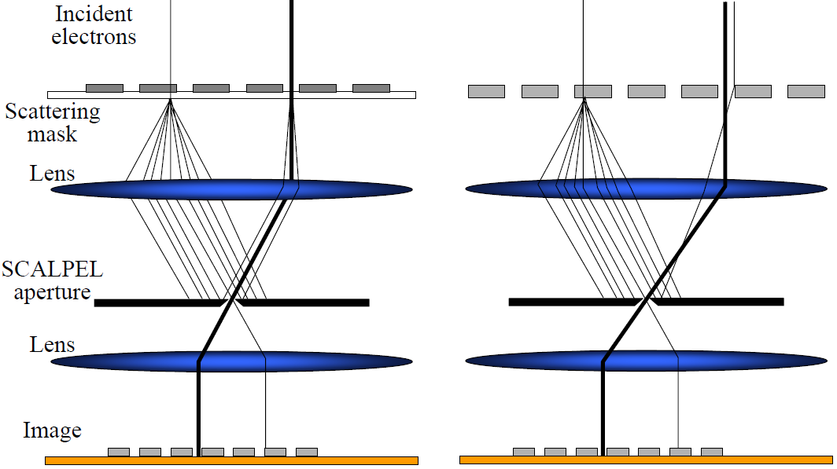
Parallel e-beam lithography, faster.
SCALPEL masks - membrane & stencil
(electron projection lithography - EPL)
SCAPEL: Scattering with angular limitation projection electron beam lithography.
Dark and light regions differentiated by their scattering strength at the SCALPEL aperture.
Harriott, JVST B, 15(6), 2130-2135 (1997)

Slide 28
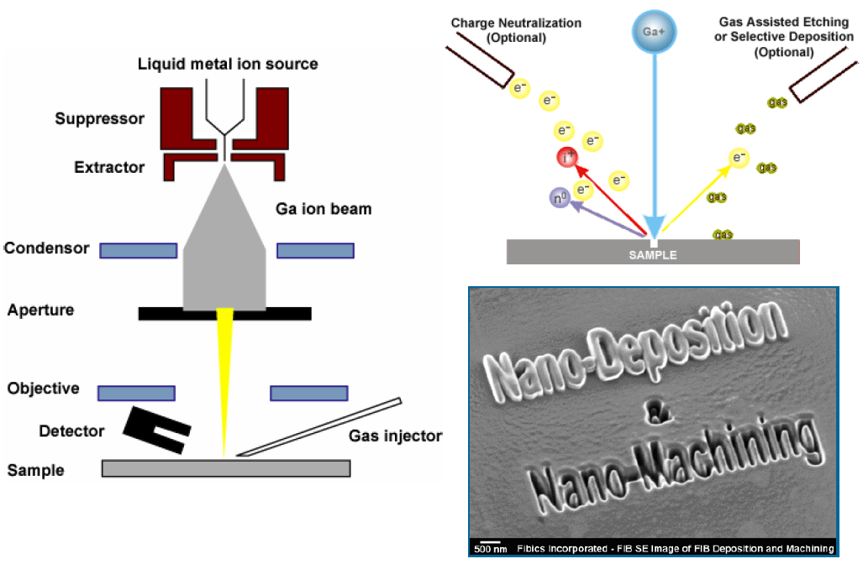
Lithography using charged particles II: focused ion beam (FIB)
Ga⁺ ion beam (down to 5nm) to raster over the surface.
FIB can cut away (mill, sputter) material (electron is too light for this).
By introducing gases, FIB can selectively etch or deposit a metal or oxide.

Slide 29
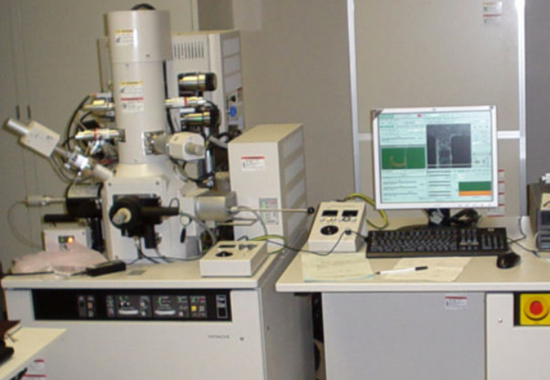
Focused ion beam (FIB)
Like electron beam lithography (EBL), direct write technique – no masks necessary.
Can expose a resist with higher sensitivity than EBL, but very low penetration depth (resist<<100nm, pattern transfer difficult).
In principle, FIB has better resolution than e-beam lithography because secondary electrons have lower energy (but it is easier to focus electron beams).
Re-deposition of sputtered material to other part of the device is a problem.
In summary, very versatile (deposition, etching, lithography, all in one tool); but slow and expensive, more complicated than EBL.
A FIB system is similar to SEM, but ion source is used to replace electron source.
Most lab systems have both ion source and electron source (dual beam).
SIM: scanning ion microscopy, similar to SEM except that now the secondary electrons (signal to form image) is generated by ion – matter interaction.
No back scattering, so no BSE image.
(BSE: back scattered electrons)

Slide 30
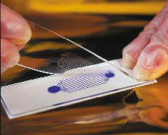
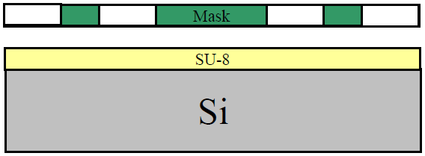
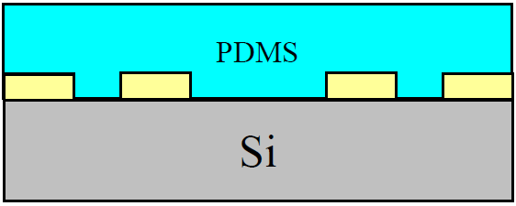
Lithography by molding/material transferring I: soft lithography (pattern duplication)
A master mold is made by lithographic techniques and a stamp is cast from this master.
Poly di-methyl siloxane (PDMS) is most popular material for stamps.
Image reversal: fill PDMS stamp with PDMS pre-polymer, then peeled from PDMS stamp.
Stamp (mold) production
PDMS properties:
Soft and flexible.
Can be cured to create a robust PDMS stamp.
Chemically inert, non-hygroscopic, good thermal stability.
Can be bonded to a glass slide to create micro-fluidic components.
(hygroscopic: readily taking up and retaining moisture)
PDMS stamp (mold) after peel off from SU-8 master
Photolithography pattern SU-8
Cast PDMS pre-polymer and cure

Slide 31
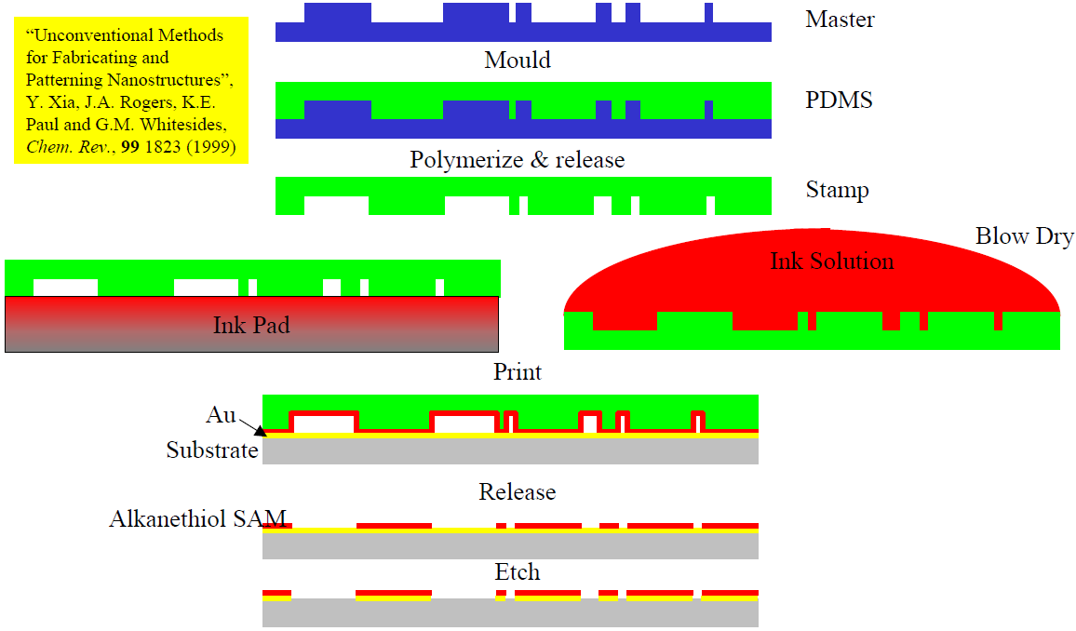
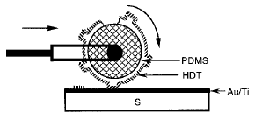
Soft-lithography I: micro-contact printing (μCP)
Chemical patterning.
The chemical can be used as etching mask, or for bio-molecule attachment.
The “ink” itself can also be bio-molecules.
Roller μCP
Minimum resolution affected by diffusion of molecules, can reach sub-50nm.
PDMS is deformable – can accommodate rough surfaces or spherical substrates.
Self assembled mono-layers (SAM) are efficient barriers against chemical etches.
For example, SAM monolayer can be used as etching mask to pattern Au using wet-etch.

Slide 32
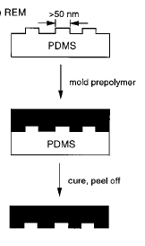
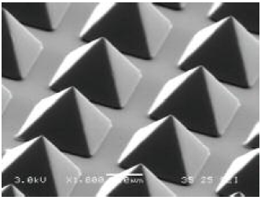
Soft lithography II: replication molding (REM)
Replication molding transfers features from master to replica by curing a liquid.
Uses UV or thermally curable pre-polymers that contain no solvent.
Pre-polymer poured on top of master mold and cured.
The resulting polymer can be peeled off.
It can be repeated to generate 3-D features in a single step.
REM
>50nm
Master
Mold pre-polymer
Master
Cure, peel off
Mold for REM, typically PDMS, SU-8 or Si

Slide 33
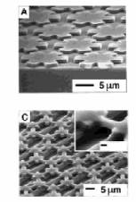
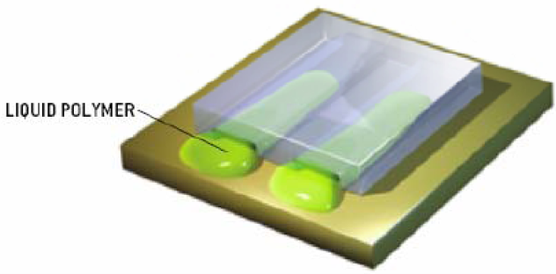
Soft lithography III: micro-molding in capillaries (MIMIC)
PDMS mold is placed directly on top of the substrate and pre-polymer is placed at the open ends of the channel.
Due to the capillary effect, the pre-polymer completely fills in the channels of the stamp.
Pre-polymer: must have low viscosity and strong interactions with the PDMS mold; this ensures proper filling of channels.
After the pre-polymer has filled the channels of the PDMS mold, it is cured.
Can be used with UV- curable prepolymers, inorganic salts, colloidal particles, and other materials
Liquid pre-polymer

Slide 34
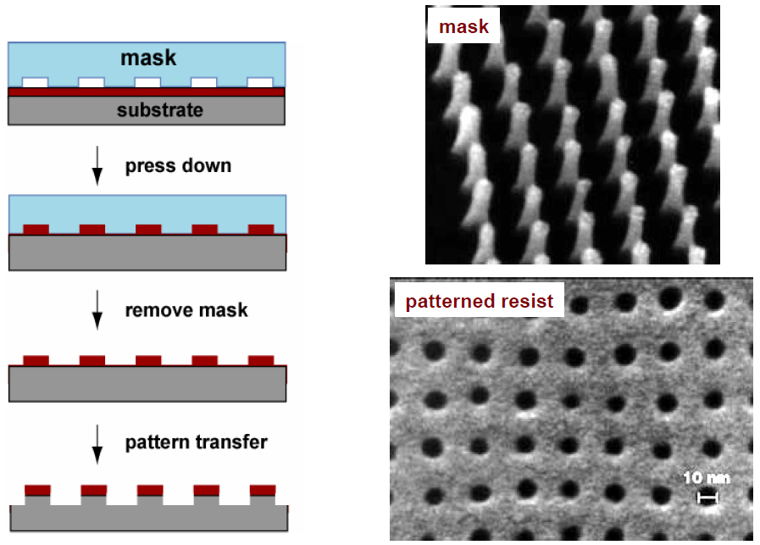
Lithography by molding/material transferring II: nanoimprint lithography (thermal/hot embossing)
mold
Heat-up polymer resist and press down
Cool-down and remove mold
Pattern transfer to substrate
Mold = mask = template = stamp

Slide 35
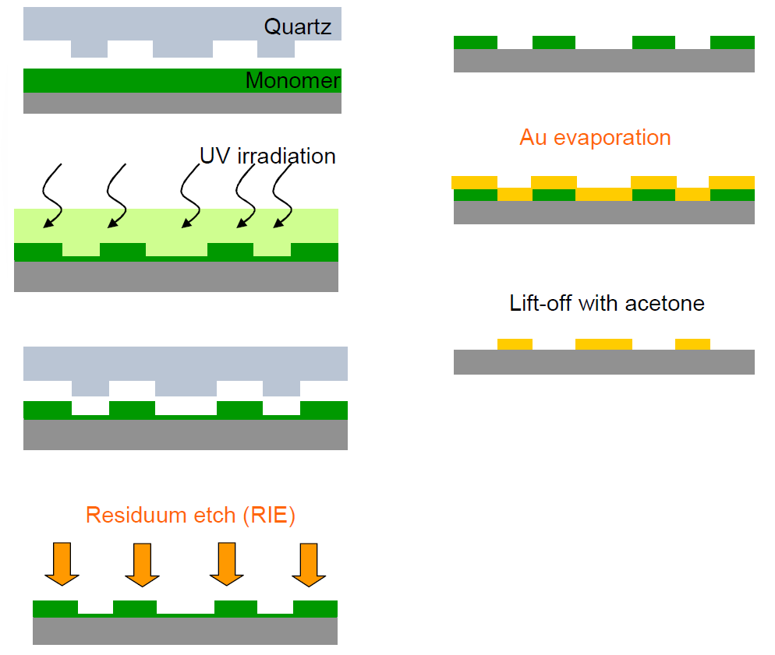
UV-curable nanoimprint lithography
(Au patterning by liftoff as an example)
Liquid resist, soft and deformable by mold.
Hardened by UV-curing (polymerization).
Molds must be transparent (PDMS, Quartz).
No temperature (thermal cycle) necessary.
Thus a very gentle process, and thermal expansion mismatch no longer an issue.
Many UV-curable resists are sensitive to oxygen – exposure under inert conditions.

Slide 36
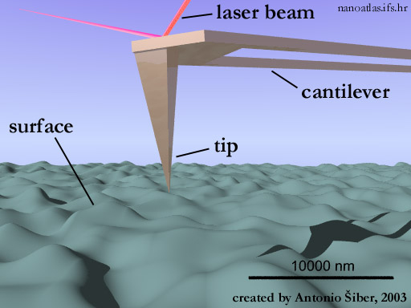
Scanning probe lithography (SPL)
Mechanical patterning: scratching, nano-indentation
Chemical and molecular patterning (dip-pen nanolithography, DPN)
Voltage bias application
Field enhanced oxidation (of silicon or metals)
Electron exposure of resist materials
Manipulation of atoms/molecules by STM, or nanostructures by AFM
AFM: atomic force microscopy (X-Y positioning by piezo; Z deflection by optical measurement)

Slide 37
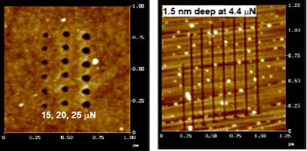
AFM lithography – scratching
(simplest, mechanical lithography)
Material is removed from the substrate leaving deep trenches with the characteristic shape of the tip used.
The advantages of nano-scratching for lithography
Precision of alignment, see using AFM imaging, then pattern wherever wanted.
The absence of additional processing steps, such as etching the substrate.
But it is not a clean process (debris on wafer), and the AFM tip cannot last long.

Slide 38
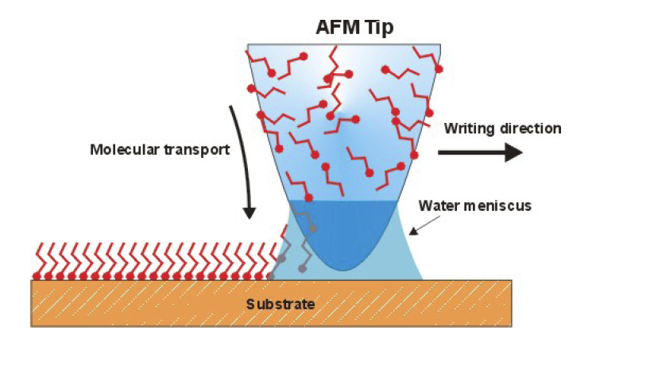
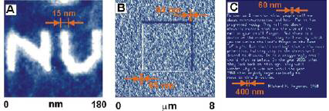
Dip-pen nanolithography (DPN)
Similar to micro-contact printing, and writing using a fountain pen.
AFM tip is “inked” with material to be deposited
Material is adsorbed on target
<15nm features
Multiple DPN tip arrays for higher throughput production

Slide 39
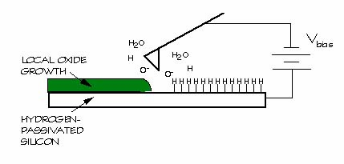
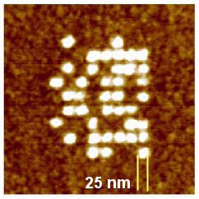
AFM lithography: oxidation
(local electrochemical anodization)
Resulting oxide affected by experimental parameters
Voltage (typically from 5-10V)
Tip scan speed (stationary to tens of µm/s)
Humidity (20% to 80%)
Detected current can be used for process control
Changes in translational velocity influence current flow

Slide 40
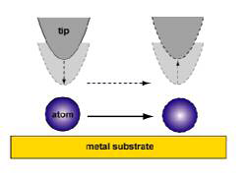
STM lithography (STM: scanning tunneling microscopy)
By applying a voltage between tip and substrate it is possible to deposit or remove atoms or molecules.
Van der Waals force used to drag atoms/molecules.
Advantages of STM Lithography
Information storage devices (one atom per bit, highest storage density).
Nanometer patterning technique (highest resolution, ~Å).
Manipulations of big molecules and individual atoms.
Iron on copper (111)

Slide 41
Scanning probe lithography (STM)
Xenon on Nickel (110)
Iron on copper (111)
STM manipulation of atoms/molecules
M.F. Crommie, C.P. Lutz, D.M. Eigler. Science 262, 218-220 (1993)

Slide 42
Pattern transfer (next step after lithography)
Direct etch
Liftoff
Electroplating…
Lithography create patterns generally in a resist (polymer) layer.
For device application, pattern needs to be transferred to another layer (metal, semiconductors…).

Slide 43
Pattern transfer: summary
Use resist as etching mask
Stencil mask
Liftoff is most popular for patterning metals.
Metal can either be used for device application, or as etch mask for further pattern transfer.
Etching is popular for patterning dielectric materials (Si…) that may etch faster than resist.

Slide 44
Pattern transfer by liftoff
Problems
Tailoring of the resist profile: undercut desirable
Directional deposition : evaporation is preferred
Bi-layer resist for undercut:
Two layers with different sensitivity
– PMMA 15K/PMMA 950K
– MMA Copolymer / PMMA
– PMMA/PMGI (liftoff layer)
Non-directive deposition in sputtering
Shadowing
Under-cut profile for easy liftoff
Directive deposition with different sources
PMGI: http://www.microchem.com/products/pmgi.htm

Slide 45
Controlled shadow evaporation (large undercut for liftoff)
(PMGI is developed by diluted PR developer)
PR=photoresist
a
ZEP is an EBL resist
PMGI is an EBL resist AND liftoff layer
c
b
d

Slide 46
Controlled shadow evaporation (for tunnel junction)
Circuit of SQUIDs and Josephson Tunnel Junctions (Al/Al₂O₃/Al), tunnel barrier is Al₂O₃

Slide 47
Controlled shadow evaporation (for spin-valve)
Useful for lateral devices (tunnel junctions, superconductor circuitry…)
Lateral overlap determined by resist thickness and angle
In-situ interface
Ex : lateral spin-valve
T. Kimura et al.,
PRL 100, 66602 (2008)
Py = permalloy, NiFe alloy

