Slide 1
Electron beam lithography (EBL)
Overview and resolution limit.
Electron source (thermionic and field emission).
Electron optics (electrostatic and magnetic lens).
Aberrations (spherical, chromatic, diffraction, astigmation).
EBL systems (raster/vector scan, round/shaped beam)
Interaction of electrons with matter (scattering, x-ray, Auger).
Proximity effect and how to reduce it.
Resist contrast and sensitivity.
Several popular resist materials.
High resolution EBL, resolution limit.
Grey-scale EBL for 3D structure fabrication.
Anti-charging techniques.
ECE 730: Fabrication in the nanoscale: principles, technology and applications
Instructor: Bo Cui, ECE, University of Waterloo; http://ece.uwaterloo.ca/~bcui/
Textbook: Nanofabrication: principles, capabilities and limits, by Zheng Cui

Slide 2
Interactions of electrons with matter
Unlike X-rays, electrons interact very strongly with matter
Elastic scattering of electrons can be treated classically as a form of Rutherford backscattering
Inelastic scattering arises from numerous interactions:
Low energy secondary electrons generation.
Inner shell excitations (x-ray fluorescence and Auger electrons)
Electron-hole pair creation and recombination
Phonon excitation (heat)

Slide 3
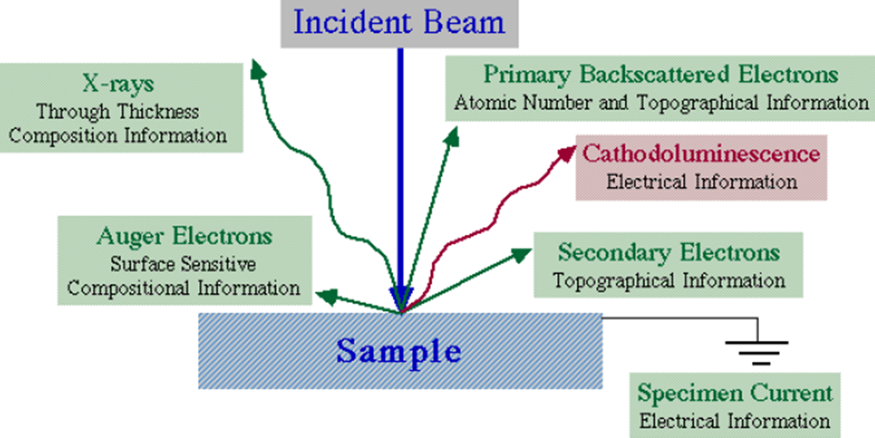
Information from electron beam-specimen interactions
When electron beam strikes the sample, both photon and electron signals are emitted.

Slide 4
Interaction volume

Slide 5
Which region is for which application
Secondary electron region for imaging
(SE is actually produced wherever primary electron goes, but only those near surface can go to SE detector for imaging)
Back-scattered electron region for imaging
(Again, BSE is actually produced wherever primary electron goes. It has higher energy, so travel longer than SE)
X-ray region for EDX
(x-ray is actually produced wherever primary electron goes. It travels farther than BSE)
Best spatial resolution for SEM
Better Z contrast for SEM
(brighter for higher Z)
Best analytical for EDX
Notes:
Both SE and BSE can be generated in a large interaction volume (wherever primary electrons go), but BSE from a deeper (thus wider) region can contribute to image signal due to its higher energy/penetration length, so BSE has lower resolution than SE signal, and is used only when chemical contrast is wanted.
In principle, SE electrons may have high energy (>1000eV, still much less than primary electron energy), but somehow people always say that SE has very low energy (<100eV), perhaps because 1) higher energy SE is fewer in number; 2) they are not collected by SE detector; 3) they are less efficient in exposing resist; 4) such high energy SE is categorized into back-scattered electrons (anyway, impossible to tell whether a high energy electron is from original primary electron or from SE).
Why TEM gives much higher resolution than SEM? This is because much lower interaction volume of the high energy electrons (200keV!) passing the thin samples.

Slide 6
Excitation depth profile and its relevance for SEM
Back-scattered electron
X-ray
Primary electron beam
BSE
Secondary electron (detector)
SED
CL
Cathode luminescence
Different emission mechanisms arise from different depths.
For SEM imaging, both SE and BSE can be used, but with different information.
Backscattered electrons (BSE):
Specular reflection (of primary electron)
Higher energy (so travels further)
Low resolution (since travels further)
Encode some chemical information
(material contrast, high Z high signal)
Secondary electrons (SE):
Isotropic emission
Low energy
High resolution
Better structural contrast
Notes:
Cathodoluminescence, which arises from the recombination of electron-hole pairs generated by the incident beam, consists of visible photons. These can only escape the sample when emitted very close to the surface. Hence, the CL detector is very surface specific.

Slide 7
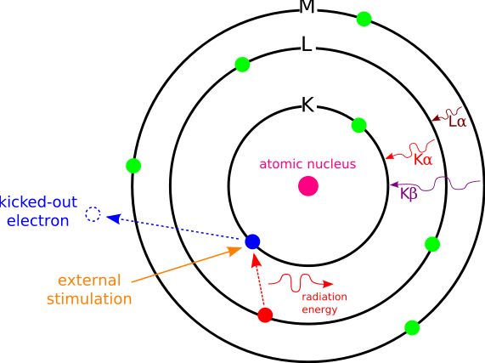
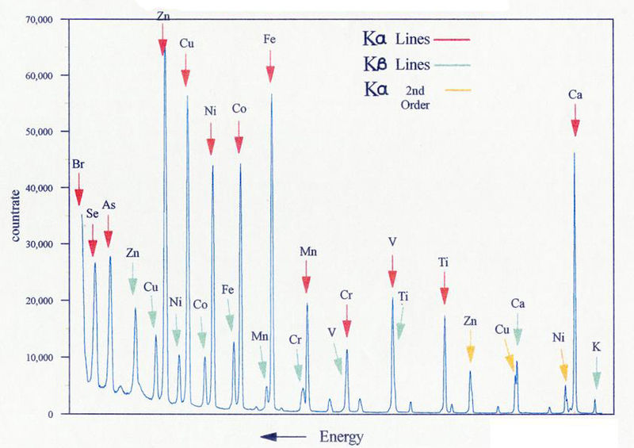
X-ray generation by electron bombardment
Energy levels:
C is a constant depending on e, h, ε₀.
σ∼1 is due to screening (σ=0 for ideal model).
n=1 (K-shell), 2 (L-shell), 3 (M-shell)….
Emitted x-ray energy E_{x-ray}
K_{α}: E_{x-ray}=E₁-E₂
K_{β}: E_{x-ray}=E₁-E₃
L_{α}: E_{x-ray}=E₂-E₃
….

Slide 8
Energy-dispersive x-ray spectroscopy (EDS, EDX)
SEM is often equipped with EDX that detect x-ray emitted (needs only extra ∼$50K).
Each element has its characteristic x-ray, so EDX is for elemental analysis.
Since both primary electrons and emitted x-ray can penetrate certain depth (up to many μm), EDX is not for top surface analysis (AES is, see next slides).
The principle is the same as electron impact x-ray source, but here a focused electron beam is used to “impact or bombard” the sample, thus capable of mapping surface element with high spatial resolution.
Light element (Z≤4) usually cannot be detected, since their characteristic energy is lower and thus cannot go through the x-ray detector window. (We know that longer wavelength → shorter attenuation length).
EDX is similar to x-ray fluorescence (XRF). The only difference is that, for EDX inner shell electrons are kicked off by high energy electrons; for XRF by high energy x-ray with energy ≥ emitted characteristic x-ray energy, or even by γ-ray.
But (excitation) x-ray is hard to focus thus XRF has no spatial resolution.

Slide 9
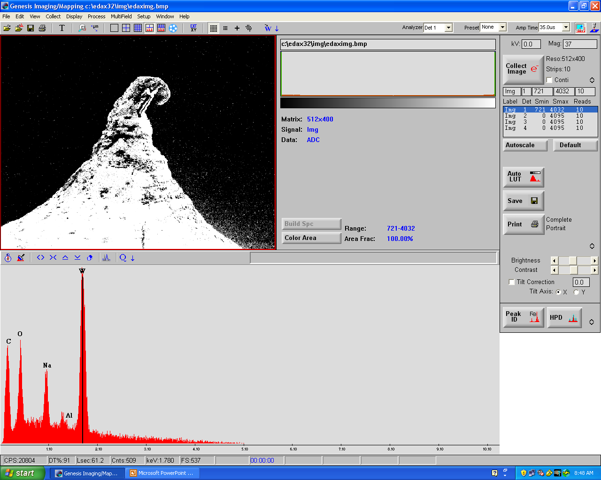
EDX analysis of a material
The peak for W could be Lα (Kα energy is much higher)

Slide 10
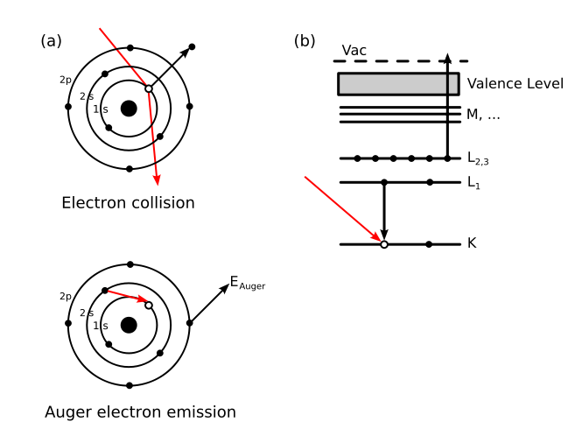
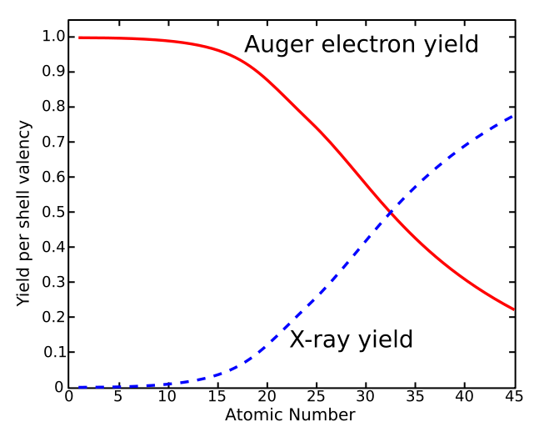
Auger electron emission
For AES
For EDX
Fluorescence and Auger electron yields as a function of atomic number for K shell vacancies.
Kinetic energy of ejected electron:
E_{kin} = E_{Core State} − E_{B} − E_{C}'
E_{Core State}, E_{B}, E_{C}': core level, first outer shell, second outer shell electron energies.
E_{Core State} − E_{B} is the same energy as the characteristic x-ray energy.
Since orbital energies are unique to an atom of a specific element, analysis of the ejected electrons can yield information about the chemical composition of a surface.
http://en.wikipedia.org/wiki/Auger_electron_spectroscopy

Slide 11
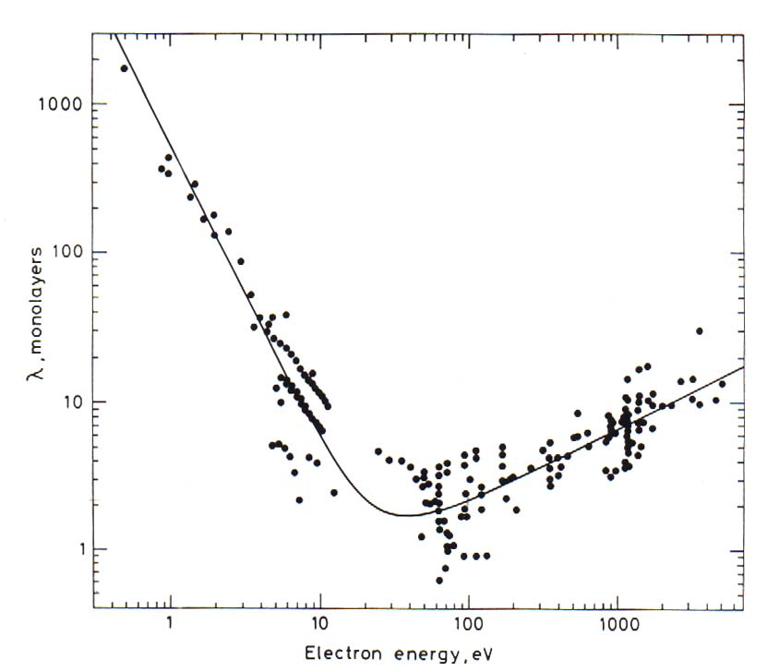
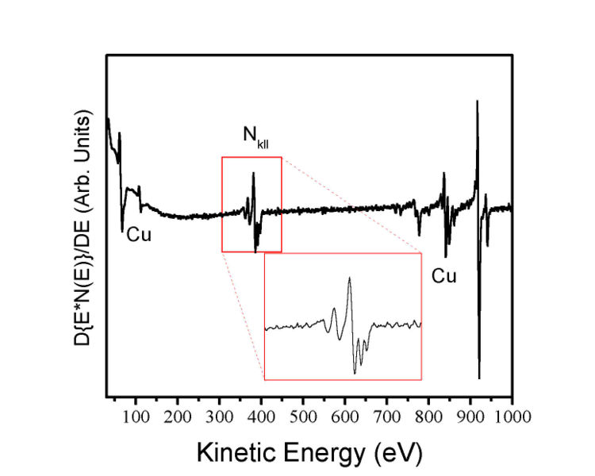
Auger Electron Spectroscopy (AES)
Auger spectrum of a copper nitride film
(weak signal, need derivative to show the peaks)
Attenuation length as a function of energy (depends on Z)
Auger electron
from Briggs and Seah, Practical Surface Analysis 2nd Edition John Wiley & Sons, 1990, p. 207.
1-10 monolayer
sampling depth
Electron energy (eV)
AES is good for light element (e.g. Li) where Auger electron dominate x-ray emission yield.
It is for surface analysis, able to analyze only the top surface (2-5nm).
For lighter material such as PMMA, attenuation/penetration depth is large, ∼40nm for 0.8kV.
“Fortunately”, lighter material also has lower Auger electron energy (∝(Z-σ)², <0.8kV), so its penetration depth is <<40nm.
Moreover, those coming from sub-surface would lose energy during its relatively long path, so its energy won’t be characteristic energy of the element - they are thus considered as background noise.

Slide 12
Scanning Auger Microscope (SAM)
Uses energy dispersive electron detector to map elements with ~100 nm spatial resolution.
200nm
SEM for nano-contacts
SAM-W
SAM-Si
Scanning Auger Microscope (SAM) is a type of AES, but with focused electron beam to give high resolution spatial information of element distribution.
However, unlike EDX, common SEM has no SAM, perhaps due to the ultrahigh vacuum needed for SAM and/or the quite different detection technique (not only the current like SE and BSE detector, but also its kinetic energy needs to be quantified).
On the other hand, dedicated SAM tool is installed with SE/BSE detector for SEM image.
http://www.uwo.ca/ssw/services/sam.html
http://en.wikipedia.org/wiki/Auger_electron_spectroscopy

Slide 13
Electron beam lithography (EBL)
Overview and resolution limit.
Electron source (thermionic and field emission).
Electron optics (electrostatic and magnetic lens).
Aberrations (spherical, chromatic, diffraction, astigmation).
EBL systems (raster/vector scan, round/shaped beam)
Interaction of electrons with matter (scattering, x-ray, Auger).
Proximity effect and how to reduce it.
Resist contrast and sensitivity.
Several popular resist materials.
High resolution EBL, resolution limit.
Grey-scale EBL for 3D structure fabrication.
Anti-charging techniques.

Slide 14
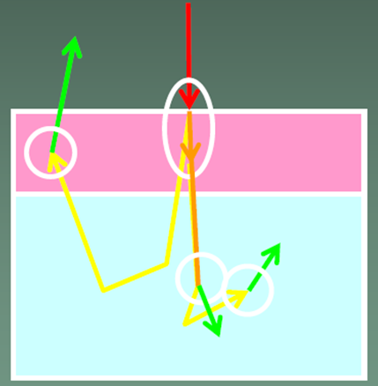
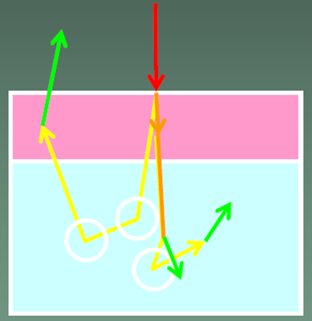
Forward/back scattering events
Scattering: spreading of the beam, lost of resolution
Resist
Substrate
Forward scattering
Back scattering
Properties:
Very often
Small angle
Very inelastic (i.e. lose energy)
Generation of SE with low energy.
Properties:
Occasionally (collision with nucleus)
Large angles, thus mainly elastic
High energy, same range as primary electrons.
Large travel length, cause proximity effect.
SE with few eV are responsible for most resist exposure. Such SE diffuses laterally few nm.
Backscattering is responsible for resist exposure far from incidence (proximity effect).

Slide 15
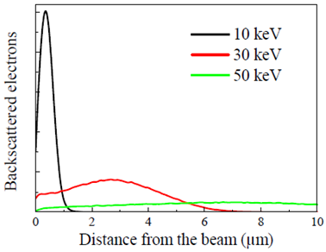
Monte-Carlo simulations of electron trajectory
Scattering probability varies as square of atomic number Z, and inversely as the incident kinetic energy.
Greater penetration depth for low Z materials.
BSE emission branch increases with Z.
Low Z
High Z
Number of backscattered electrons is not dependent on energy, but its spatial distribution is.
Proximity effects are “diluted” (spread over larger area) at high energies.

Slide 16
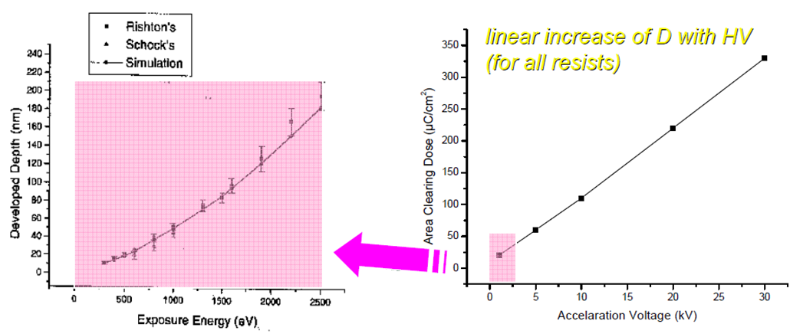
Effect of voltage on dose
(∼penetration depth)
(Sensitivity)
At small kV, penetration depth is low, so cannot expose thick resist. (e.g. at 0.8kV, penetration depth only ∼40nm in PMMA).
At >2kV, resist sensitivity is higher for lower kV, so faster writing.
But lower kV has larger beam spot size due to aberrations, and more serious forward scattering, both of which reduces resolution.
In addition, lower kV has lower attainable beam current that reduces writing speed.
Therefore, typical EBL is done at 30kV or higher.

Slide 17
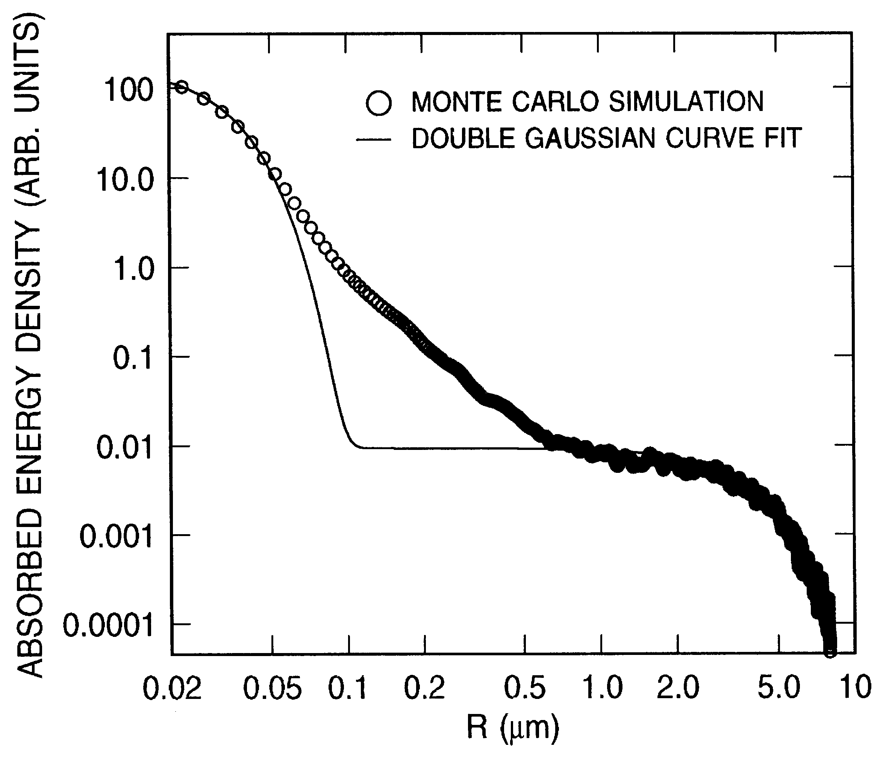
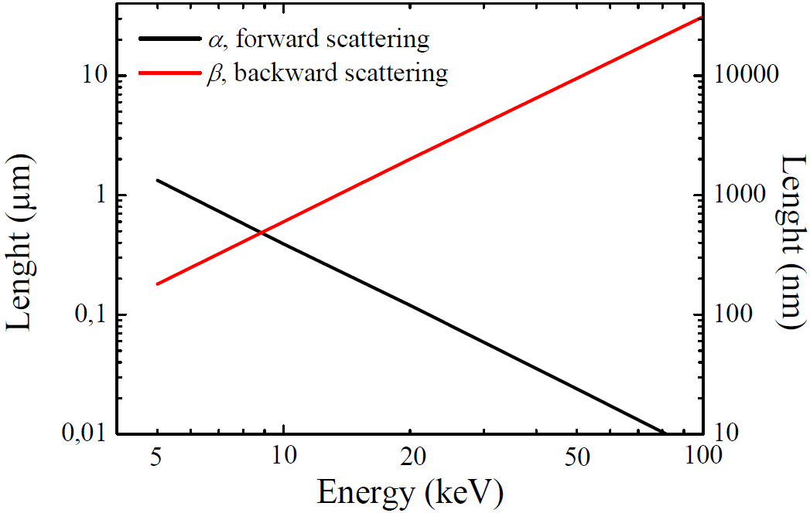
Double Gaussian model
α: range of forward scattering (in μm)
β: range of backscattering (in μm)
η: ratio of backscattering to forward scattering
Bad fit here
Forward scattering
Back- scattering

Slide 18
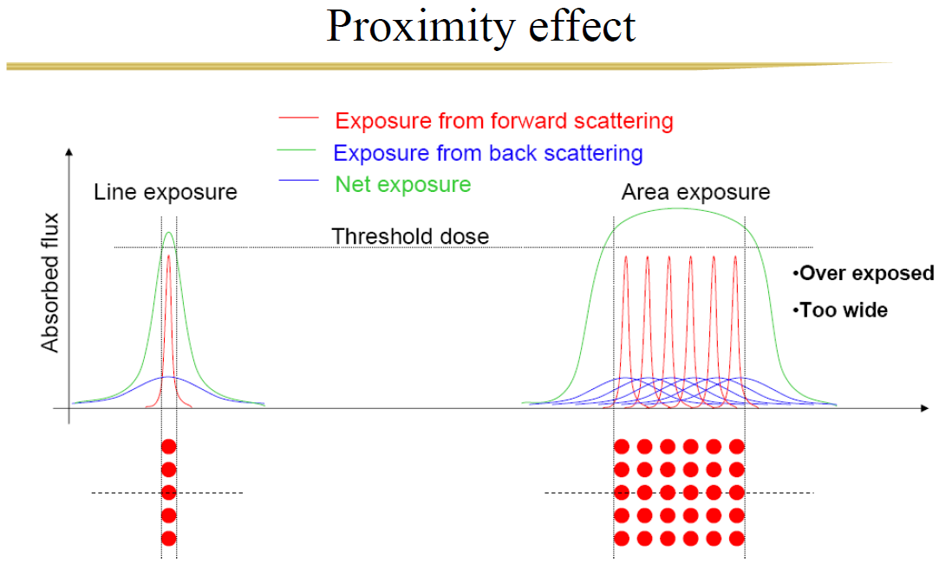
Proximity effect
(similar to that in OPC – optical proximity correction)
Real dose D=E(1+b)
E is as-exposed dose
b is due to proximity effect
b∼2 (not small) for large area exposure
Proximity effect is negligible for isolated/sparse fine features.
It is good for areal exposure (e.g. pad >>1μm), since pixel can be much larger than beam spot size (right figure). E.g., beam step size (pixel) of 50nm is usually enough even with a beam spot size only 5nm.
Proximity effect is worst for dense and fine patterns, such as grating with sub-50nm pitch.

Slide 19
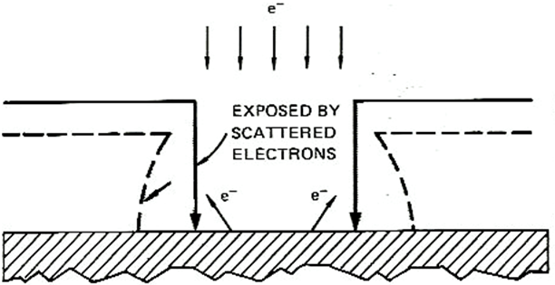
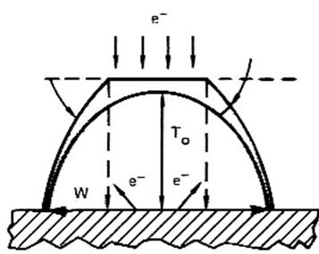
Resist profile
A thin layer may be developed due to exposure by proximity effect
Original thickness
Developed profile
Due to forward scattering and (to a less degree) proximity effect, positive resist has always an undercut profile, good for liftoff.
Negative resist always has a tapered profile, bad for liftoff.
For patterning dense fine features, an undercut profile often causes resist structure to collapse due to capillary force when developer is dried.
That is, proximity effect makes patterning dense fine features difficult.
Resist
Substrate
Positive resist
Dense AND fine structures
Resist (positive) profile, not stable
substrate
Negative resist

Slide 20
How to reduce proximity effects
(extremely high resolution, 1.5nm, see later slide for resist)

Slide 21
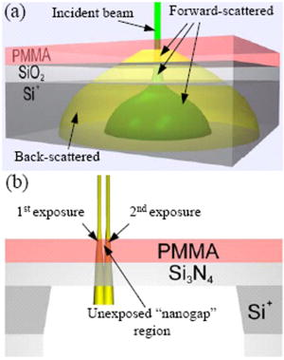
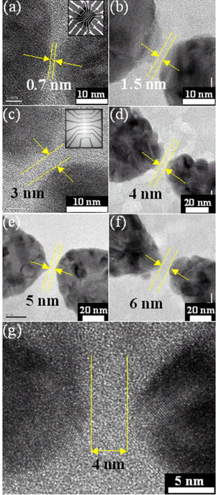
Eliminate proximity effect using resist on membrane
Standard PMMA-SiO₂-Si⁺ substrate. An incident electron beam "forward-scatters" slightly in the PMMA and SiO₂ layers. Strong scattering in the Si⁺ results in broadly distributed "back-scattered" electrons which expose a wide region of the PMMA.
PMMA-Si₃N₄ substrate used to make nanogaps with EBL. Two nearby areas are shown being sequentially exposed to an electron beam while the small "nanogap" region between them is left unexposed.
TEM image of nano-gaps with gaps 0.7-6nm
Fischbein, “Nanogaps by direct lithography for high-resolution imaging and electronic characterization of nanostructures”, APL 88, 063116 (2006)

Slide 22
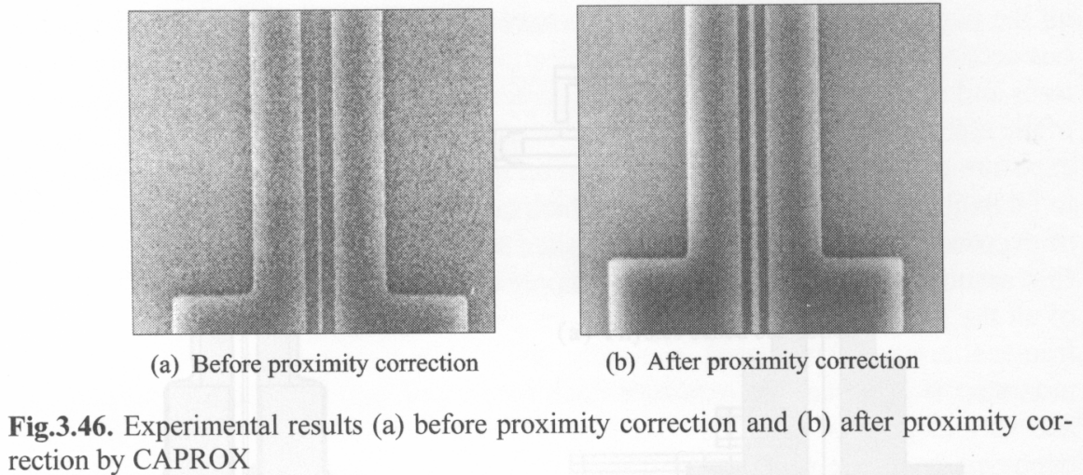
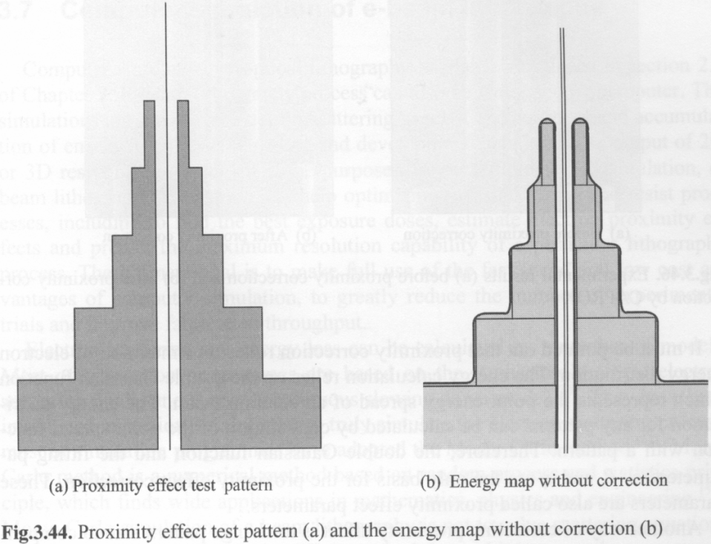
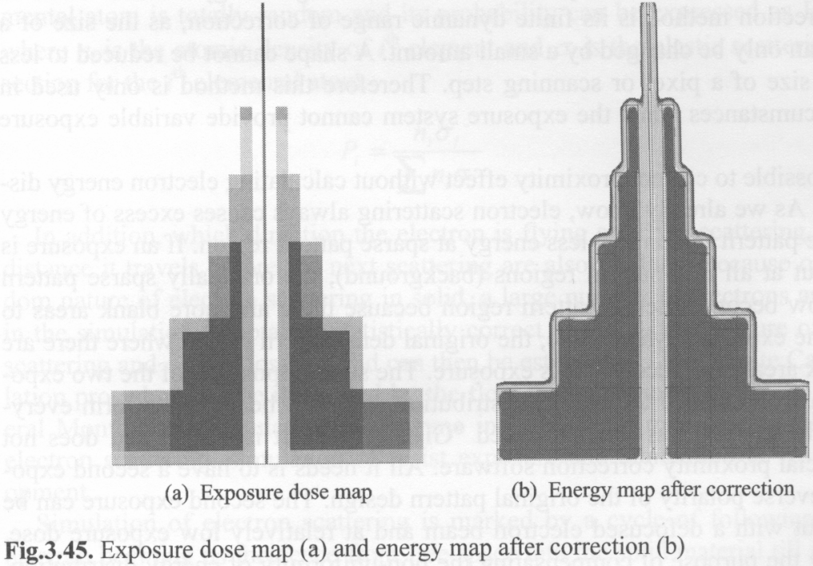
Proximity effect correction
Similar idea to OPC (optical proximity correction), but here proximity extends many μm.

Slide 23
Electron beam lithography (EBL)
Overview and resolution limit.
Electron source (thermionic and field emission).
Electron optics (electrostatic and magnetic lens).
Aberrations (spherical, chromatic, diffraction, astigmation).
EBL systems (raster/vector scan, round/shaped beam)
Interaction of electrons with matter (scattering, x-ray, Auger).
Proximity effect and how to reduce it.
Resist contrast and sensitivity.
Several popular resist materials.
High resolution EBL, resolution limit.
Grey-scale EBL for 3D structure fabrication.
Anti-charging techniques.

Slide 24
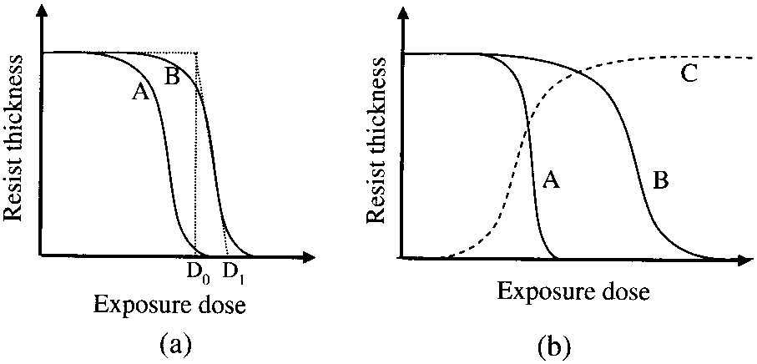
EBL resist: sensitivity and contrast
Resist development curves:
Resist A is of higher sensitivity than B.
A is of higher contrast than B; C is negative resist.
Here D₁ and D₀ is defined for B
negative
positive
thickness
substrate
Sensitivity:
For positive resist: D₁ value, or dose required to fully develop the resist to bottom, close to D₁ value.
For negative resist: dose that results in half resist thickness remaining after development.
Contrast γ: defined as slope of the development curve.
For “perfect” resist, D₁=D₀, so γ=∞.
Usually γ>2.0 is good
For PMMA, γ=5-10.

Slide 25
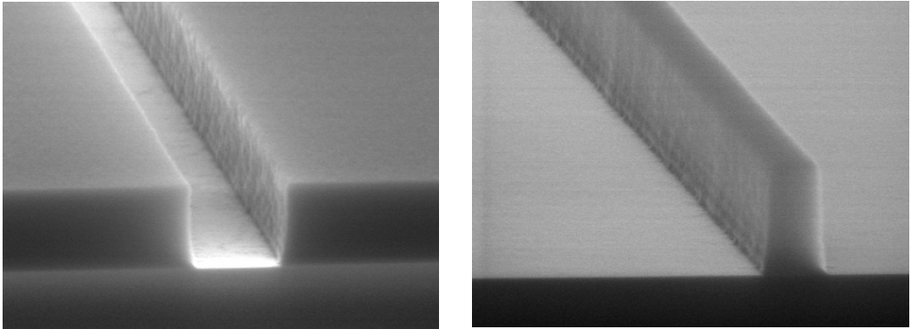
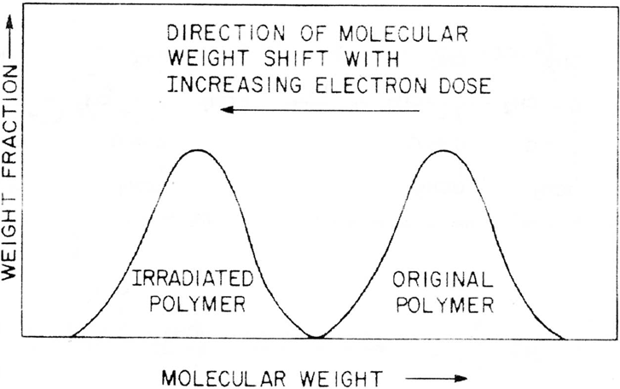
Positive vs. negative resist
Positive resist (trench)
Negative resist (line)
Positive: long molecular chains are broken by energized electrons into short chain (chain secession).
Negative: initial short chain molecules are joined upon exposure to form long chains (cross-linking), so become insoluble in developer.
Molecular weight shift of positive resist

Slide 26
Which resist to choose
Which resist to choose depends on which will give the minimum exposure area.
For isolated sparse features, positive resist is suitable for liftoff process, while negative for direct etch process.
To pattern Si (or SiO₂…), either Cr liftoff then RIE using Cr as mask, or direct etch of Si using resist as mask will work, though Si can be etched deeper with more vertical sidewall using Cr as mask.
Liftoff process using positive resist
Direct etch process using negative resist
resist
(polymer)
resist
(polymer)
1. Spin on positive resist
1. Spin on negative resist
2. EBL
2. EBL
3. Cr deposition
3. RIE substrate
4. Liftoff Cr
5. RIE substrate using Cr as mask (not shown)

Slide 27
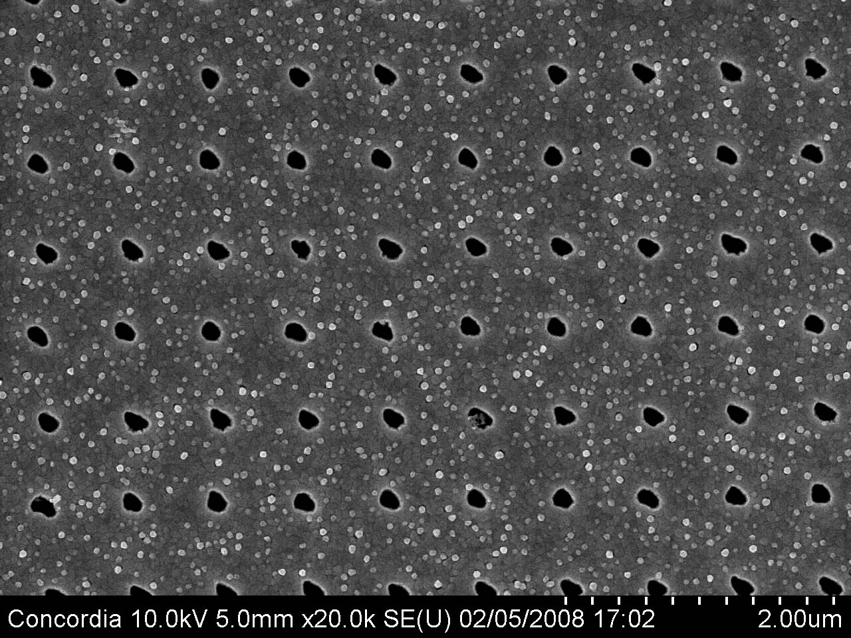
Resist tone reversal process
Very useful if one has only one cheap positive resist: PMMA
Resist
Under-layer (polymer such as PMGI)
substrate
Profile in resist
For positive resist, trench (or hole) formed after EBL.
substrate
Liftoff a hard material (Cr, SiO2)
substrate
Profile in under-layer
RIE under-layer.
The resulted polymer structure is a line (or pillar), as if negative resist is used.
substrate
Hole array in 100nm-thick Au with pitch 600nm, by liftoff using PMMA resist.
substrate
After metal liftoff

Slide 28
Sensitivity
Sensitivity depends on:
Electron energy keV (or acceleration voltage kV). Higher energy requires higher exposure dose, so lower sensitivity.
For example, sensitivity for PMMA is 250μC/cm² with 30kV, but ∼600 μC/cm² with 100kV (high energy electrons pass fast through the resist, generating fewer low energy secondary electron (SE) to expose the resist, or they are just not efficient to generate SE due to the large energy differece.
Substrate material: high density substrate (high Z) material results in more back scattering of electrons into resist layers, leading to higher sensitivity (e.g. PMMA on Au sensitivity is ∼2× that on Si). But of course more severe proximity effect.
Process conditions: post exposure baking conditions for chemically amplified resist; strength of developer, development temperature and time.
Note: higher sensitivity means one needs lower dose to fully expose the resist.

Slide 29
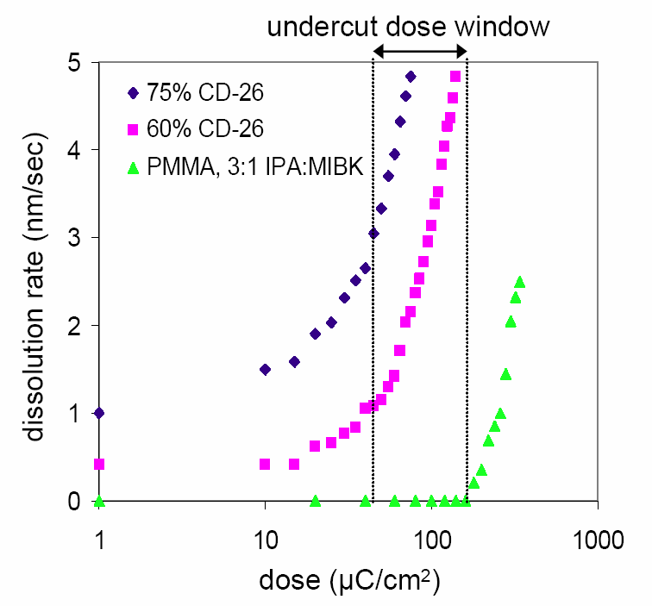
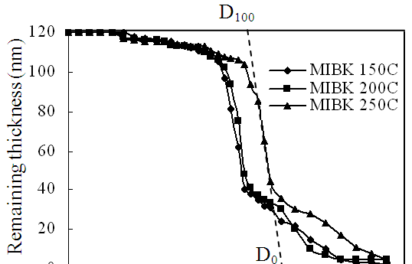
Sensitivity depends on developer used and its strength
Base developer for PMGI
Solvent developer for PMGI
PMGI development curve for MIBK:IPA=1:3 developer.
PMGI is baked at 150ºC, 200ºC, 250ºC.
Compared to base developer, sensitivity is reduced to ∼1000μC/cm², but contrast is increased to above 6.
Figure 4-4: Contrast curves (dissolution rate as a function of electron dose) for PMGI in two dilutions of CD-26 developer (diluted NH₄OH or alike), as well as PMMA in its standard 3:1 IPA:MIBK developer for reference. When 60% solution of CD-26 is used, electron exposure of PMGI can increase its dissolution rate to up to 10× the rate of unexposed PMGI. The “undercut dose window” indicates dose regime where dissolution rate of PMGI is increased but that of PMMA is unaffected.
Cord, “Robust shadow-mask evaporation via lithography controlled undercut”, JVST B, 24(6), 31393143(2006).
Bo Cui, Teodor Veres, “High resolution electron beam lithography of PMGI using solvent developers”, Microelectronic Engineering, 2008.

Slide 30
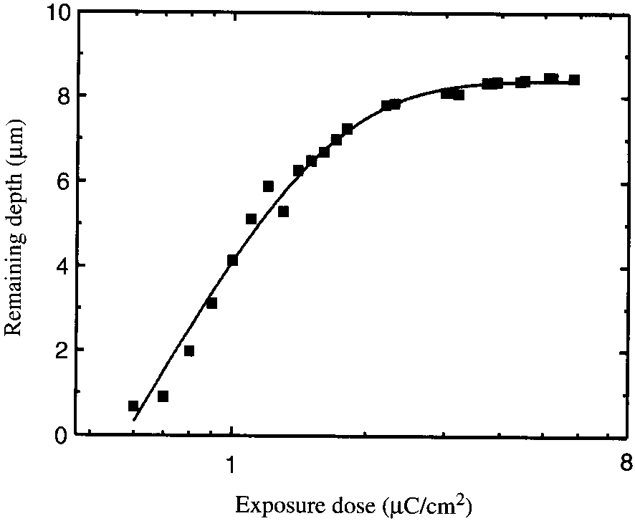
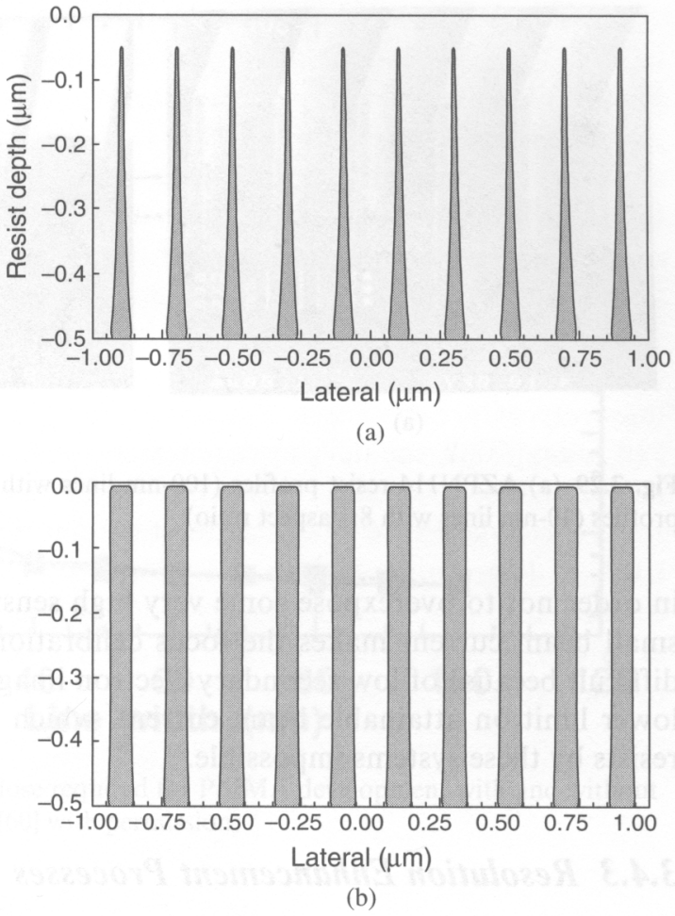
Contrast
Low contrast resist profile
Contrast curve of SU-8
Contrast only 0.92
High contrast resist profile
High contrast:
Steeper sidewalls
Greater process latitude
Better resolution
Higher aspect ratio structure
Less sensitivity to proximity effect, high density pattern.
Low contrast: good only for 3D gray scale lithography

Slide 31
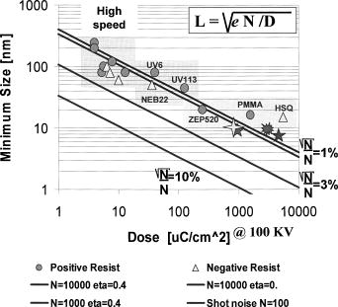
Sensitivity vs. contrast: a dilemma
L: resolution
D: dose (sensitivity)
This dilemma is same to that for EUV resist, where due to shot noise, higher sensitivity has higher LER (line-edge roughness).
(sensitivity)
Ocola LE and Stein A, JVST B, 24(6), 3061-3065 (2006).
No resist has both high sensitivity and high contrast.
This is not always that bad, because, anyway, even though such resist exist, it cannot be exposed using an inexpensive EBL system – too short dwell time (since high sensitivity) for exposing each tiny pixel (since high resolution), beam blanker cannot follow.

Slide 32
Electron beam lithography (EBL)
Overview and resolution limit.
Electron source (thermionic and field emission).
Electron optics (electrostatic and magnetic lens).
Aberrations (spherical, chromatic, diffraction, astigmation).
EBL systems (raster/vector scan, round/shaped beam)
Interaction of electrons with matter (scattering, x-ray, Auger).
Proximity effect and how to reduce it.
Resist contrast and sensitivity.
Several popular resist materials.
High resolution EBL, resolution limit.
Grey-scale EBL for 3D structure fabrication.
Anti-charging techniques.

Slide 33
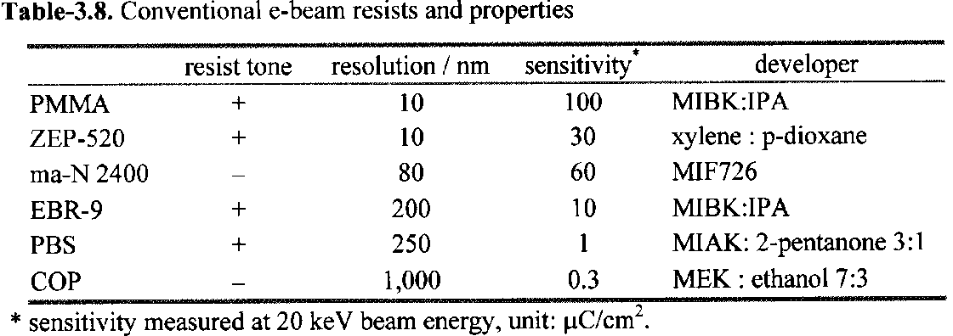
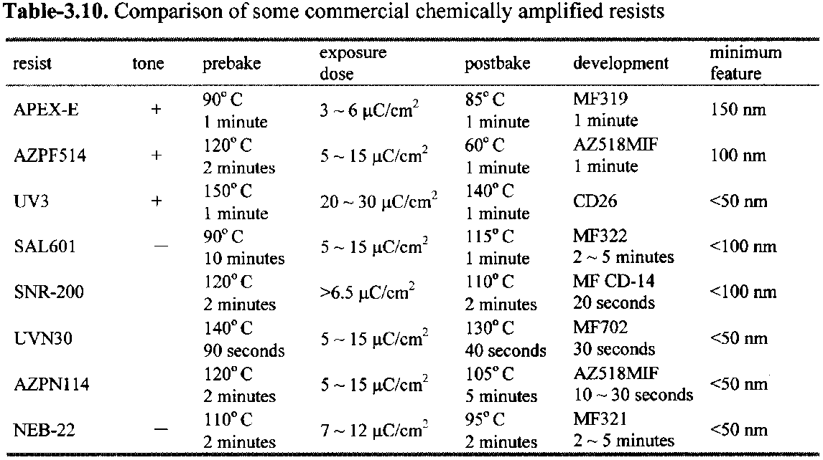
Conventional and chemically amplified resists
They are more popular

Slide 34
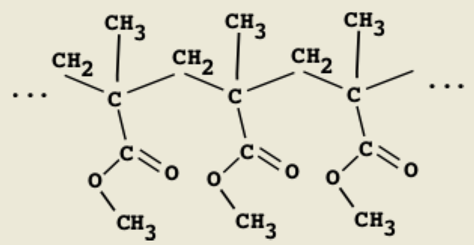
The standard EBL resist: PMMA (positive)
The most popular e-beam resist, very cheap and last forever, easy handling.
Don’t buy it (expensive), mix them by yourself.
Very high-resolution and contrast.
Typical molecular weight is 950kg/mol. Lower M_{w} (e.g. 15kg/mol) leads to higher sensitivity and lower contrast.
Usually dissolved in a solvent: chlorobenzene or anisole (less toxic, 2-4%).
Developer mixtures can be adjusted to control contrast and sensitivity.
The downside: low sensitivity, poor dry etch resistance (good for liftoff, not for direct etch pattern transfer).

Slide 35
PMMA developer
(Methyl isobutyl ketone)
MIBK : IPA (isopropanol)=1:3 for typically 60sec, most popular developer.
Cellosolve (2-ethoxyethanol): methanol=3:7 for 7-10sec, claimed by some to have slightly higher contrast than MIBK.
MEK (methyl ethyl ketone) : ethanol=26.5:73.5 for 2-5 second.
IPA : H₂O=7:3, co-solvent system, i.e. neither IPA nor water alone dissolves exposed PMMA. Claimed by some to have better performance than MIBK.
[1] “Enhanced sensitivity in the electron beam resist PMMA using improved solvent developer”, Mohsin and Cowie, Polymer, 1988, page 2130.
[2] “New high-contrast developers for PMMA”, Bernstein and Hill and Liu, J Appl. Phys., 71(8), 1992, page 4066.
[3] “Comparison of MIBK/IPA and water/IPA as PMMA developers…”, Microelectronic Engineering, 61-62, 745-753 (2002).

Slide 36
PMMA dose table
 | 10kV | 20kV | 30kV
Area dose (μC/cm²) | 100 | 180 | 250
Line dose (nC/cm) | 0.5 | 0.9 | 1.3
Dot dose (fC) |  |  | 1.5
Doses for MIBK:IPA=1:3 developer 60second.
All values are good starting points, need dose test before each writing.
Use above area dose only for large features (>proximity effect range).
Otherwise, e.g. when writing 1μm stripes, 250μC/cm² is not enough.
Proximity effect factor b can be estimated roughly from the above table:
Real dose D=E(1+b)
E is as-exposed dose
b is due to proximity effect
b∼2 (not small) for areal exposure
For line dose 1.3nC/cm, written line-width is ∼15nm.
So area dose 1.3nC/(15nm×1cm)=867μC/cm².
Therefore, 1+b=867/250, and b=2.5.
B=1.7 if estimated from the dot dose ((15nm)² dot).

Slide 37
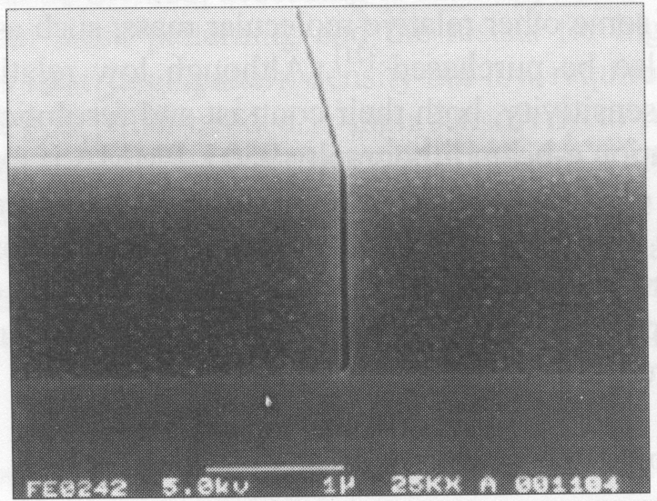
The most popular commercial resist: Zep-520 (positive)
Developed by ZEON in Japan to replace PMMA.
Higher sensitivity (3-5x faster), and higher etch resistance (3x)
For ultrahigh resolution (sub-10nm), PMMA might still be better.
Expensive: $1000/100ml.
One-year shelf time, making it more expensive compared to PMMA.
Composition: methyl styrene/chloromethyl acrylate copolymer.
Developer:
ZED-N50 (100% n-Amyl Acetate)
Xylene (o-,m-,p- mixed)
Solvent:
Anisole, for liftoff or diluting the resist for thinner film.
Line in ZEP-520 written at 75keV.
Resist thickness 1.5μm, line-width 50nm

Slide 38
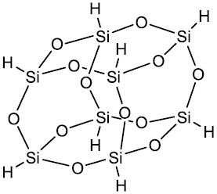
HSQ: hydrogen silsesquioxane (negative)
Silicon dioxide based inorganic material (not polymer).
Sensitivity and contrast similar to that of PMMA (depends on developer strength).
Very high resolution and very dense pattern when using <25nm-thick film.
Exposed HSQ is in the form of amorphous oxide, good etching mask.
Product of Dow Corning under product code Fox12™.
It is an unusual resist: development by chemical reaction (un-exposed HSQ reacts with diluted NH₄OH or NaOH developer to produce H₂), not by dissolution; and development “saturates” (i.e. no more reaction) after a certain time.
Salty developer (add NaCl to NaOH solution) increases contrast.

Slide 39
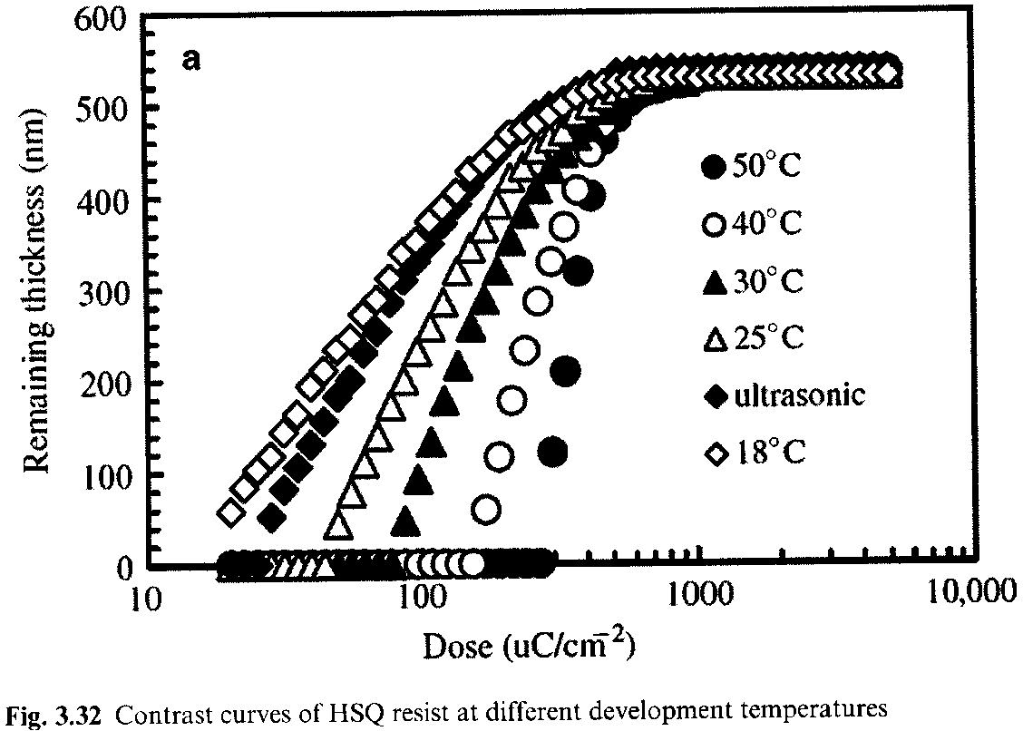
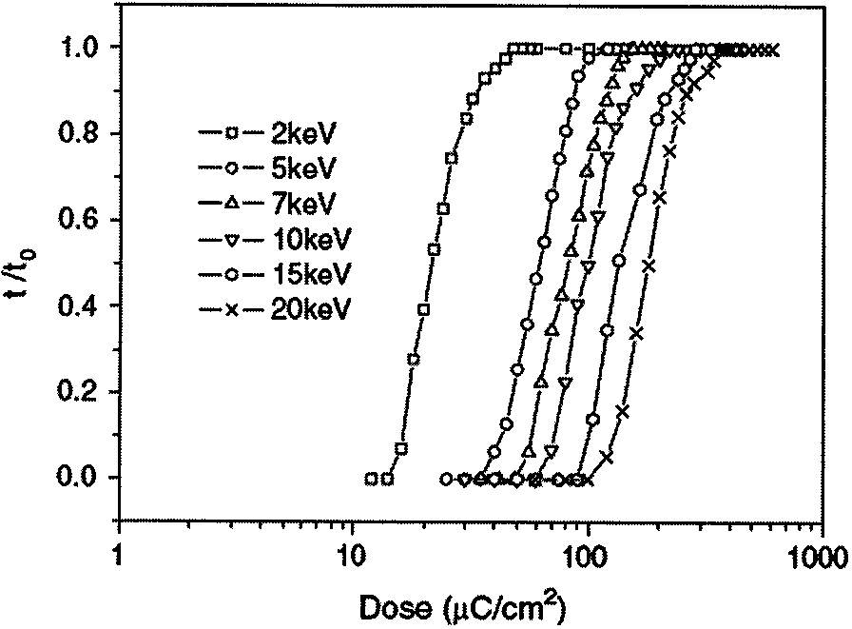
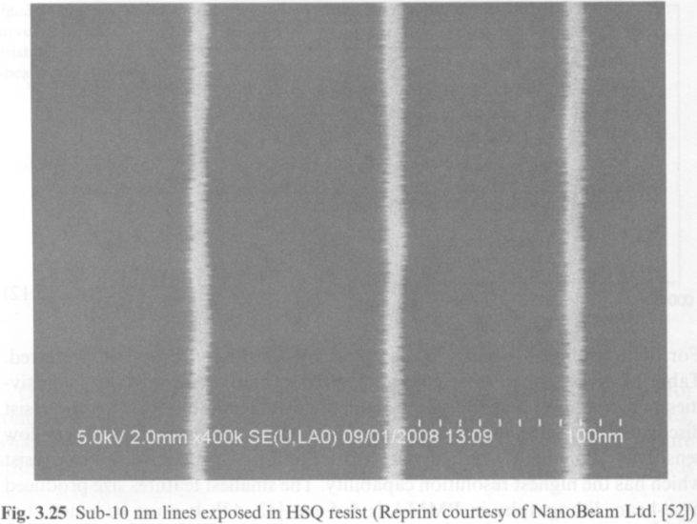
Contrast curves of HSQ
Contrast curves of HSQ at different development temperatures
Contrast curves of HSQ at different exposure energies
High T → higher contrast
HSQ is not stable. So spin-coating, baking, writing and development must be done quickly.
E.g. 1 hour delay for development can increase feature size by 60%.
It is worse for delay between sample preparation and e-beam writing, going >100% increase in feature size.
Sub-10nm lines in HSQ
Clark, “Time-dependent exposure dose of hydrogen silsesquioxane…”, JVST B, 24(6), 3073-3076 (2006).

Slide 40
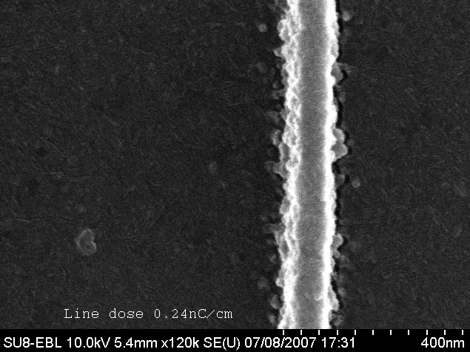
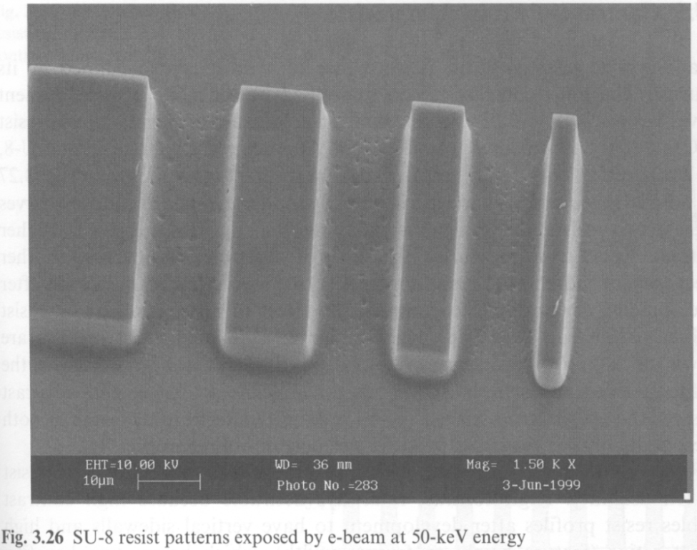
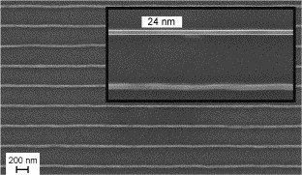
SU-8 (very high sensitivity, but low contrast)
Chemically amplified negative tone resist
Epoxy-based, mostly used as photo-resist
Extremely high sensitivity – over 100x that of PMMA
Low contrast (0.9), unsuitable for dense patterning
High resolution possible for sparse patterns at high kV
Rough edges and “residues” due to random exposure from back scattering electrons and random photo-acid diffusion.
Ideal for low resolution writing over large area (fast).
10keV
50keV
100keV
24nm line at pitch 300nm in 100nm thick SU-8
Kristensen A, “High resolution 100 kV electron beam lithography in SU-8”, Microelectronic Engineering, 83, 1609-1612(2006)

Slide 41
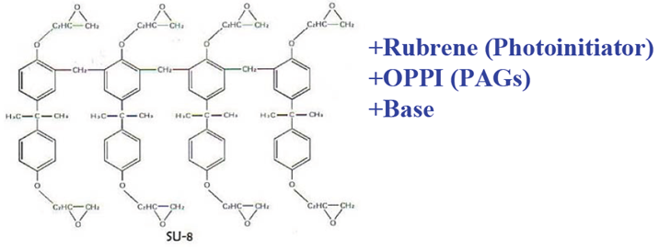
SU-8 resist formulation and process
Glass transition temperature of SU-8
Un-cross-linked: 50ºC.
Fully cross-linked: 230ºC
Like all chemically amplified resist, post exposure baking temperature and time is very critical.
Typically 90ºC for 2-3min on hotplate.
Spin-coating, bake, exposure, post-bake and development need to be done quickly without much delay.
Don’t let SU-8 exposed to room light for long (will be exposed by UV light).

Slide 42
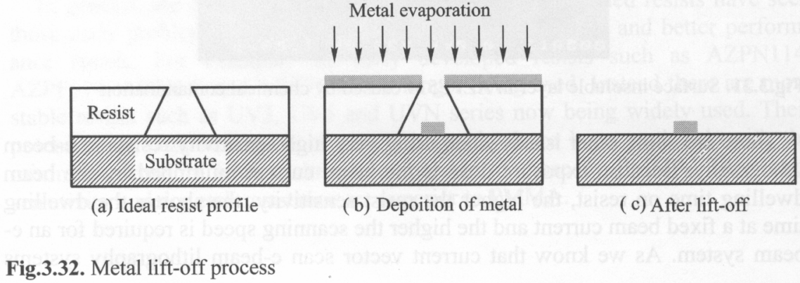
Undercut profile for liftoff
Metal liftoff process
Process of double layers resist for easy liftoff

Slide 43
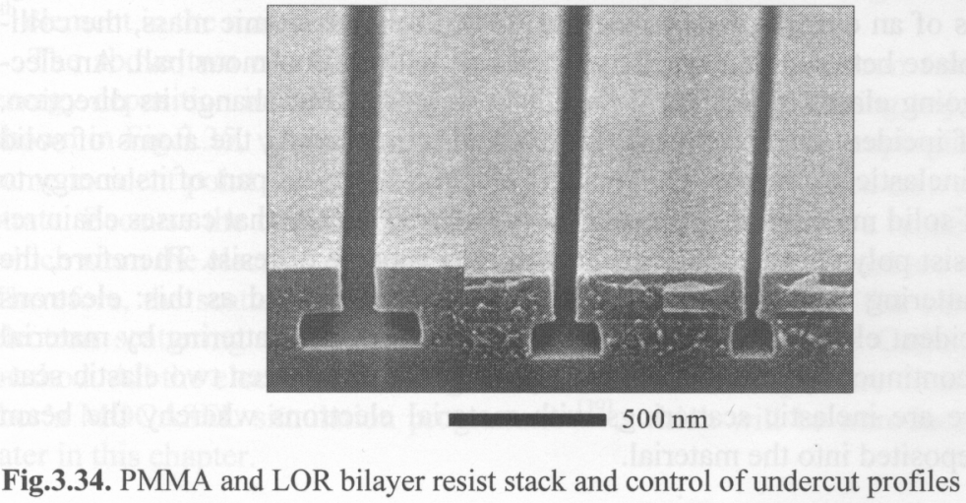
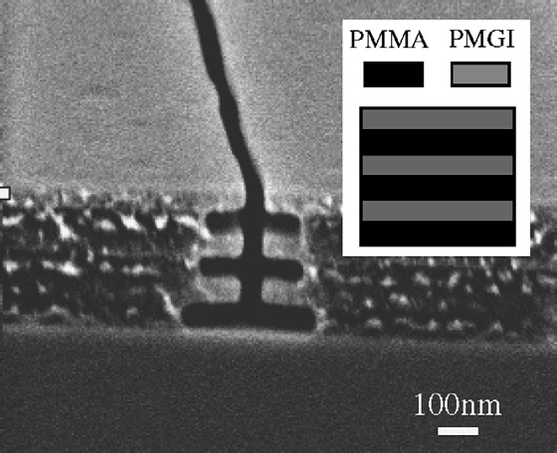
Undercut profile for liftoff
PMMA is developed by MIBK, LOR is dissolved by alkaline developer (same as photo-resist developer) that doesn’t attack PMMA.
LOR composed mainly of PMGI (a thicker format of PMGI), and can be dissolved even though not exposed to electrons, though dissolution rate increases rapidly with exposure
Microelectronic Engineering, 73-74, 278-281 (2004).
PMMA
PMGI
Line in a stack of PMMA and PMGI by EBL. (5.7 nC/cm)
Wider line at bottom due to forward scattering.
When using MIBK developer, PMMA is more sensitive than PMGI, so wider developed line.
PMGI
(narrow)
PMMA
(wide)
Dose profile
Bo Cui, Teodor Veres, “High resolution electron beam lithography of PMGI using solvent developers”, Microelectronic Engineering, 2008.
A third choice for undercut profile is to use PMMA/MMA bi-layer.

Slide 44
Extremely high resolution, since only primary (not secondary) high energy beam is responsible for exposure.
However, probably HSQ is the only useful inorganic resist.
Inorganic resists listed here: very thin film, making liftoff difficult; very low sensitivity, need long writing time.

Slide 45
Electron beam lithography (EBL)
Overview and resolution limit.
Electron source (thermionic and field emission).
Electron optics (electrostatic and magnetic lens).
Aberrations (spherical, chromatic, diffraction, astigmation).
EBL systems (raster/vector scan, round/shaped beam)
Interaction of electrons with matter (scattering, x-ray, Auger).
Proximity effect and how to reduce it.
Resist contrast and sensitivity.
Several popular resist materials.
High resolution EBL, resolution limit.
Grey-scale EBL for 3D structure fabrication.
Anti-charging techniques.

Slide 46
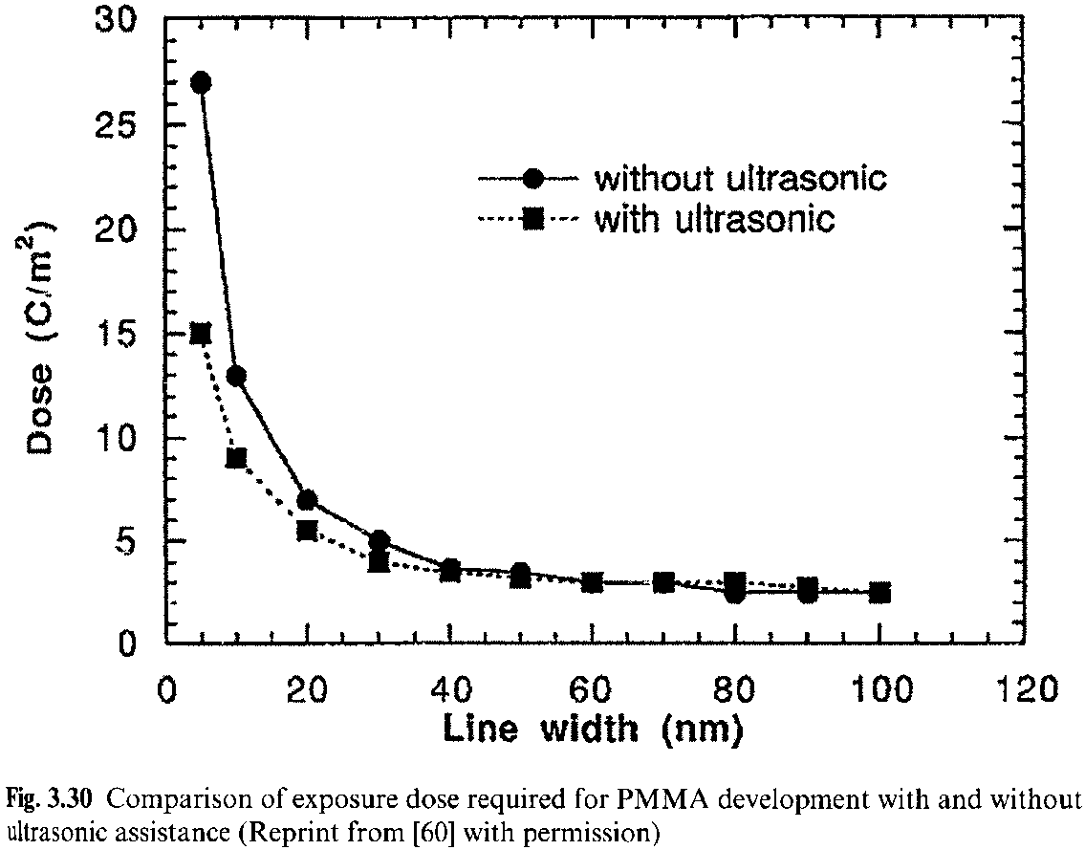
Resolution enhancement process: ultrasonic development
Ultrasonic helps to remove exposed resist (for positive tone) from inside narrow trenches.

Slide 47
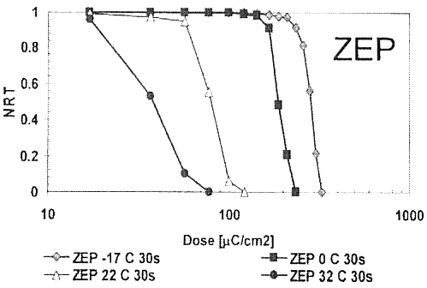
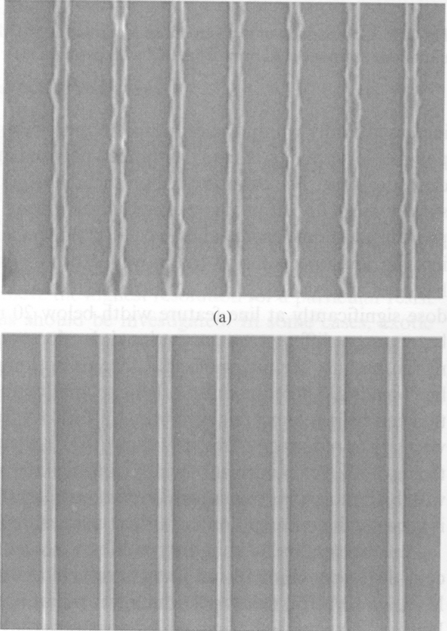
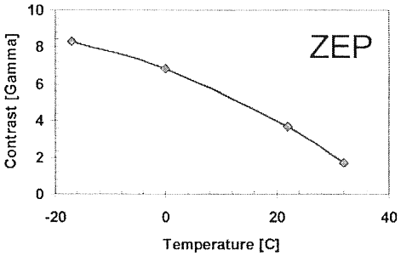
Resolution enhancement process: low temperature development (ZEP)
Contrast curve for ZEP-520
Contrast as a function of development temperature.
Comparison of edge roughness of ZEP-520 resist lines (40nm wide) developed at (top) room temperature; (bottom) -4ºC.
Low T development increases contrast, but decreases sensitivity

Slide 48
Resolution enhancement process: low temperature development (PMMA)
Figure 2-6: Schematic illustration of one possible explanation of resolution-enhancing mechanism of cold development.
When a feature is exposed in PMMA, the soluble resist in the exposed region is surrounded by a boundary region of resist that, due to the initial polydispersity of the PMMA and random nature of chain scission, contains both soluble and insoluble polymer chains.
During development, this region phase-separates, with the soluble chains diffusing toward the soluble region and the insoluble chains diffusing toward the insoluble region.
The result is a region of soluble PMMA that is larger than the initial exposed feature, resulting in a degradation in resolution.
Cold development helps prevent this by limiting the diffusion that can occur in the boundary region, since diffusion is a thermally-dependent process.
The exact mechanism of cold development is still not clear. Another possible mechanism: colder developer is weaker solvent, so less attack to unexposed or partly exposed resists.
PhD thesis, Bryan M. Cord, MIT, June 2009

Slide 49
Cold development of PMMA
Best contrast (steepest slope) at -15ºC.
Because, at even lower temperature, need higher dose to expose, but PMMA becomes negative at doses >∼3000 μC/cm² (i.e. the already exposed PMMA with short chain begins to cross-link upon further exposure).
Figure 2-10: Measured contrast curves for PMMA developed in 3:1 IPA:MIBK at various temperatures. The initial resist film thickness was 160 nm and the development time was 60 seconds, except in the -40°C and -50°C cases (120 seconds) and the -60°C case (600 seconds), where longer development times were needed to show any measurable dissolution at all.
PhD thesis, Bryan M. Cord, MIT, June 2009

Slide 50
Forward scattering
α: forward scattering range, corresponds to standard deviation of electron distribution
Figure 3-5: Forward scattering coefficients (α is the standard deviation of the final beam distribution) as a function of beam energy for various thicknesses of PMMA, calculated using CASINO, a free Monte Carlo modeling program. For simplicity, the initial beam profile was assumed to be a delta function (zero width) in this simulation. The scattering width decreases dramatically as the beam energy is increased, but using thicker resist results in more scattering.
PhD thesis, Bryan M. Cord, MIT, June 2009

Slide 51
Resolution limit: forward scattering and lateral diffusion
Secondary electrons and its lateral diffusion
Figure 3-7: Schematic illustration of the effect of forward scattering, secondary electrons, and initial spot size on resolution. The weights of the red lines represent the relative thickness of the resist in each case. The minimum feature size at low beam energies is limited by forward scattering, while the spot size are the primary limiter at high energies.
Figure 3-6: Schematic illustration of secondary electrons (SE), which typically travel/diffuse normal to the beam. (low energy SE is responsible for resist exposure)
Whether it is forward scattering or beam spot size that limits the minimum line-width, the effect of SE diffusion is to further broaden the line.

Slide 52
Resolution limit: forward scattering and beam diameter
Figure 3-19: Beam diameter as a function of beam energy as measured in the MIT Raith-150 system. While beam diameter is inexplicably large at voltages below 10kV, it seems to be reasonably close to its 3-4 nm specification at 20kV and only slightly larger at 10kV, suggesting that beam diameter is not the limiting factor in our resolution.
Figure 3-11: “Critical thickness” of resist as a function of beam energy. At resist thicknesses above critical thickness, forward scattering limits resolution, whereas below the critical thickness the only resolution limiter is the beam diameter, which is at least theoretically energy-independent.
A third limiting factor is resist swelling by developer.
PhD thesis, Bryan M. Cord, MIT, June 2009

Slide 53
The highest resolution by far: 9nm pitch grating
Backscattering/proximity effect is not important here, since pattern area only ∼50nm.
For large area (>>1μm) grating, such a small pitch may not be achieved due to proximity effect.
Here resist very thin, 25nm.
Figure 3-20: 9-nm-pitch nested-L structure fabricated in HSQ on Si and imaged in the MIT Raith-150 system (left) and on the Raith-150^{TWO} prototype tool. The left image shows minimal to nonexistent modulation, while the discrete lines of the structure are clearly visible in the right image. Since the 150^{TWO}’s environment has much better vibration isolation and control than the MIT facility, it seems likely that low-frequency vibrations are a significant source of imaging resolution degradation on the MIT tool.
PMMA should have similar resolution, but difficult to image (too soft, whereas exposed HSQ is SiO₂, rigid and not deformed during imaging), PMMA doesn’t stick to substrate well (may be lifted off during development), and lines may fall due to capillary force during drying after development.
PhD thesis, Bryan M. Cord, MIT, June 2009

Slide 54
Electron beam lithography (EBL)
Overview and resolution limit.
Electron source (thermionic and field emission).
Electron optics (electrostatic and magnetic lens).
Aberrations (spherical, chromatic, diffraction, astigmation).
EBL systems (raster/vector scan, round/shaped beam)
Interaction of electrons with matter (scattering, x-ray, Auger).
Proximity effect and how to reduce it.
Resist contrast and sensitivity.
Several popular resist materials.
High resolution EBL, resolution limit.
Grey-scale EBL for 3D structure fabrication.
Anti-charging techniques.

Slide 55
Gray-scale electron beam lithography
AFM of a blazed grating in resist
E-beam with variable beam stepping frequencies (i.e. variable doses)
5μm
RIE pattern transfer into Si
PMMA
Silicon
Fresnel zone lens (plate) in silicon

Slide 56
Which resist is best for gray-scale EBL?
Negative tone
PES
Exposure response of PES on Si wafer to 10keV electron beam. The sensitivity was found to be ∼200μC/cm², with contrast only γ∼0.8.
Contrast curve of PMMA
Ideal resist has positive tone with very low contrast (ideally γ<1) and high sensitivity.
High contrast leads to very narrow process/dose window (tiny dose change → large depth change).
When using negative resist, make sure that the electron can reach resist bottom (otherwise, resist at bottom will be dissolved by developer, lifting off all the resist above).
Bryce, “Poly(ether sulfone) as a negative resist for electron beam lithography”, APL, 90, 203110 (2007).

Slide 57
Micro and nano optical elements in silicon and silica by gray scale e-beam lithography

Slide 58
Electron beam lithography (EBL)
Overview and resolution limit.
Electron source (thermionic and field emission).
Electron optics (electrostatic and magnetic lens).
Aberrations (spherical, chromatic, diffraction, astigmation).
EBL systems (raster/vector scan, round/shaped beam)
Interaction of electrons with matter (scattering, x-ray, Auger).
Proximity effect and how to reduce it.
Resist contrast and sensitivity.
Several popular resist materials.
High resolution EBL, resolution limit.
Grey-scale EBL for 3D structure fabrication.
Anti-charging techniques.

Slide 59
Charging during e-beam writing
Even though most resists are insulating, charging is not an issue for typical resist thickness of <500nm, because most electrons penetrate deep into the conducting substrate at 30kV. (more serious charging for lower kV)
When electron beam lithography must be performed on insulating substrates (quartz, SiO₂/Si…), negative charge buildup can occur on substrate surface, causing beam deflection, and thus pattern distortion.
Initial Condition
Future Condition
electron beam
electron beam
repulsive electric potential lines
ma-N 2403 negative resist
Glass substrate
negative charge
accumulation

Slide 60
Anti-charging technique: coat conducting layer
To eliminate charging effect, one can coat a conducting layer on top of or beneath the resist.
Typically 10nm metal is enough, such as Al, Ti, Cr or Au; conducting polymer may also work.
Lighter metal (Al) causes less (forward) scattering of electron beam than the heavier one (Au), so is preferred.
Al and Ti can be removed easily by diluted HF (1:100 diluted).
Some resist (such as SU-8) is sensitive to UV light generated during e-beam evaporation (thermal evaporation or sputtering is OK).
GOOD
(no charging)
BAD
(moderate charging)
BAD
(severe charging)
Coat metal
ESpacer > 24 hours
(a conducting polymer?)
no anti-charging layer

Slide 61
Anti-charging technique: variable pressure (VP) EBL
It is the same idea as VP-SEM, i.e. introducing gas (H₂O, N₂, Ar, He) into the chamber.
Gas molecules ionized by electron impact, these positive gas ions migrate to negatively charged surface and balance surface charge.
Primary electron beam will be scattered to some extent by collision with gas molecules, forming a beam “skirt” around the focused primary beam at sample surface.
Higher energy e-beam has less “skirt”; it is shown that “skirt” didn’t reduce resolution.
(For SEM only) Gas also amplifies secondary electron (SE) signal by “gas cascade” effect.
VP-SEM images of 15nm Au/Pd film patterned on a glass substrate with a 30keV primary beam energy under
high vacuum
0.4 Torr (water vapor pressure)
1 Torr
The dashed red line indicates the pattern dimensions as written.
The pattern exposed with 1Torr pressure shows no significant distortion or displacement.
“Variable pressure electron beam lithography (vp-ebl): A new tool for direct patterning of nanometer-scale features on substrates with low electrical conductivity”, Nano Lett. 6(5), 963-968(2006).

Slide 62
Anti-charging technique: critical energy EBL
How to find E₂?
“Scan square” or variable magnification SEM images after dropping the magnification from ×500 to ×200.
0.5keV
1.3 keV
2.0 keV
Total electron yield (σ) vs beam energy for a typical resist.
positively charged
Virtually no charge
negatively charged
Bulk insulating material is positive charged when σ > 1 and negatively charged when σ < 1. Charge buildup is zero at critical energy/crossover voltage (E₁, E₂), where σ is unity.
In between, σ>1, so >1 electron (including SE and BSE) ejected for each incident electron.
E₁ is too small, E₂ depends on resist thickness and substrate material.
For 65nm PMMA on glass, E₂=1.3keV. Such low kV can penetrate such thin resist.
“Nanoscale Patterning on Insulating Substrates by Critical Energy Electron Beam Lithography”, Nano Lett. 6(9), 2021-2025 (2006).

Slide 63
Anti-charging technique: critical energy EBL
No deflection at 1.3keV
Result of EBL writing
100nm
Line deflection determined by SEM measurement at various voltages based on methods reported by Craighead.
(Two parallel single-pass reference lines were first patterned with a 1μm gap, followed by charge pads written at 30μC/cm². Finally, a third single-pass line was patterned between the pad and the reference line)
SEM images of 5nm thick Au after lift-off. The minimum feature size was 60nm with an area dose 10μC/cm².
Notes:
At low voltage is more difficult to get high resolution. Here only 60nm. But the sensitivity becomes very high (only 10uC/cm2, was 250uC/cm2 for 30kV).

