Slide 1
Focused ion beam (FIB)
Overview.
Ion source and optics.
Ion-solid interaction, damage.
Scanning ion beam imaging.
ECE 730: Fabrication in the nanoscale: principles, technology and applications
Instructor: Bo Cui, ECE, University of Waterloo; http://ece.uwaterloo.ca/~bcui/
Textbook: Nanofabrication: principles, capabilities and limits, by Zheng Cui

Slide 2
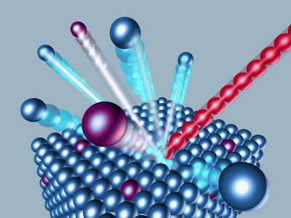
Focused ion beam overview
Mainly developed in 1970’s and 80’s (Escovitz, Levi-Setti, Orloff, Swanson…)
Ion column structure similar to that of SEM.
Source: Liquid Metal Ion Source (LMIS). Ga, Au, Be, Si, Pd, B, P, As, Ni, Sb, alloy …
Principle: a strong electromagnetic field causes the emission of positively charged ions.
FIB is based on similar technology as SIMS
Secondary ions
Primary ion beam
Secondary Ion Mass Spectrometry (SIMS) is a analytical tool with high spatial resolution and high sensitivity.
It uses a highly focused ion beam (generally oxygen or cesium ions for inorganic samples) which “sputters” material from a selected area on sample surface.
The ejected “secondary ions” pass through a mass spectrometer, which separates the ions according to their mass/charge ratio, in effect providing chemical analysis of a very small sampling volume.

Slide 3
Comparison of electrons and ions

Slide 4
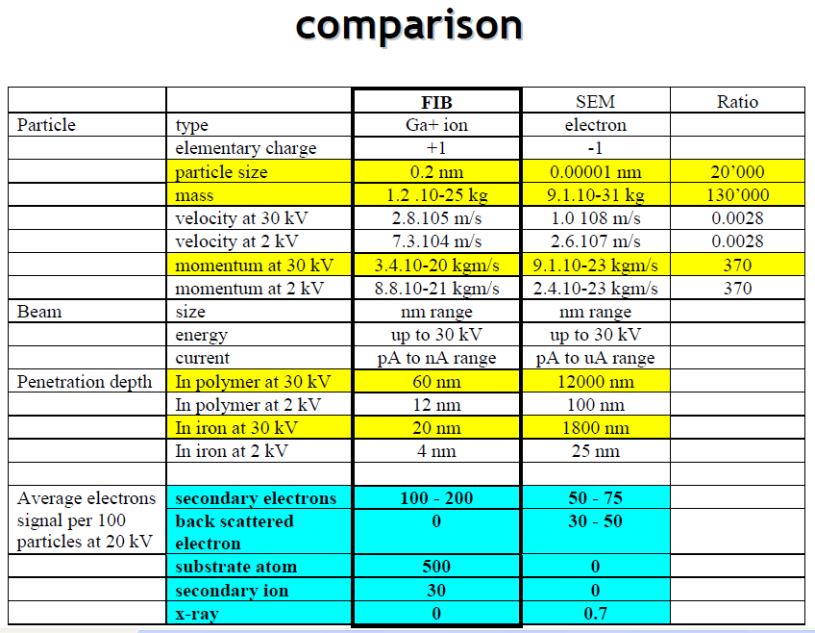
Comparison of electrons and ions
Energy E=½mv² momentum=mv=(2mE)^{1/2}∝m^{1/2} for same E.

Slide 5
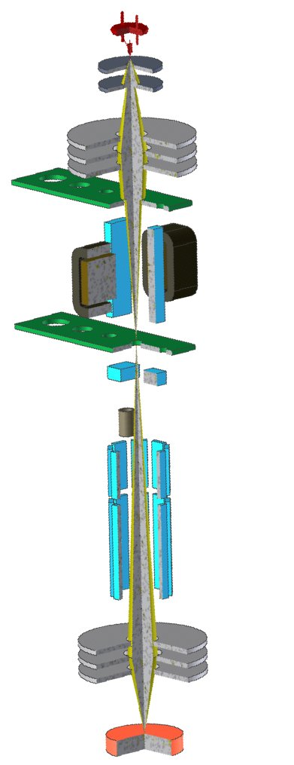
Focused ion beam (FIB)
Gun with LMIS ion source
Ion source
Extraction electrodes
Condensor lens
Ion current selection aperture
Wien filter
Mass selection aperture
Ion optics
Blanking plates
Faraday cup
Scanning and
Stigmation octupole
Objective lens
Chamber
Sample stage

Slide 6
Focused ion beam (FIB)
Overview.
Ion source and optics.
Ion-solid interaction, damage.
Scanning ion beam imaging.

Slide 7
Ion sources
Early ion sources were developed for mass spectrometry and nuclear physics research, then for ion implantation for semiconductor manufacturing. Four types.
Electron bombardment ion sources. Gas molecules bombarded by electrons become ionized, producing a stream of ions. Small ion current and small ion energy spread, used in mass spectrometry.
Gas discharge ion source. High current, used in nuclear physics instrumentation such as high energy accelerators and ion implanters.
Field ionization source. Gas molecules absorbed on the surface of a fine needle tip can be directly ionized at extremely high electrical field near the tip apex. Used as field ion microscope to study atomic structure of a material.
Liquid metal ion source (LMIS). A field emission source from liquid metal under a strong electrical field.

Slide 8
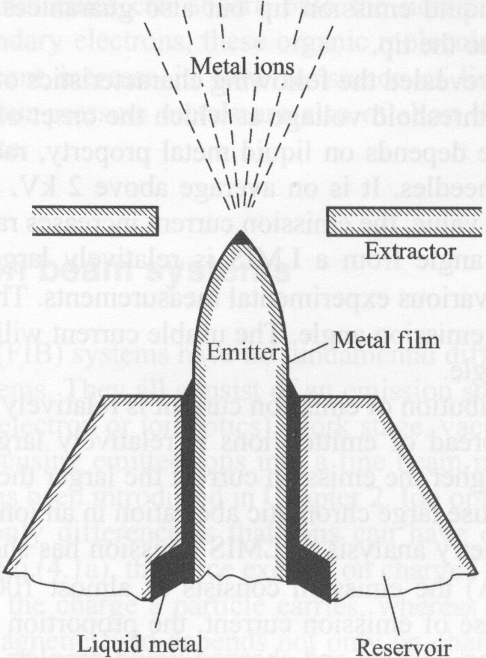
Liquid metal ion source (LIMS)
W wire electrochemically etched into a needle with tip radius 5-10μm.
The needle wetted by molten metal.
The electrical field at the liquid apex can reach 10⁸V/cm.
At this field, metal atoms at the apex become ionized and escape in the form of field evaporation.
Experiment has shown the following.
There exists a threshold voltage (∼2kV) for ion emission.
The emission angle is large, around 30º.
The angle distribution of emission current is rather uniform.
Energy spread of emitted ions is large, ∼15V, leading to large chromatic aberration in an ion optical system.
At current <10μA, almost 100% ions are single charged.

Slide 9
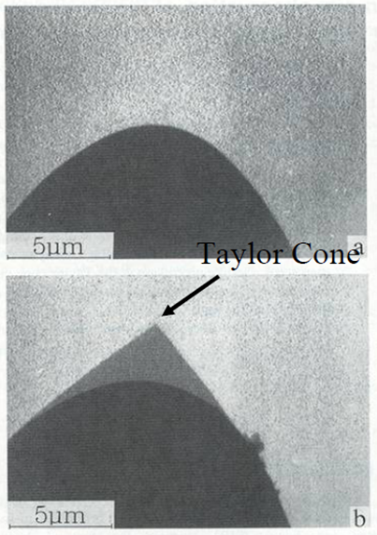
TEM image of operating LIMS
The W wire is not sharp at all!
LMIS emitter substrate
The W wire is not sharp at all!
But the “Taylor” cone of the liquid metal induced by electric field is very sharp.
As a result, electric field at cone apex is very high for field emission.
Electric field
AuGe
W
LMIS emitter substrate with AuGe Taylor cone
Driesel W, Dietzsch C, Muhle R, J. Vac. Sci. Technol. B, 14, 3367(1996)

Slide 10
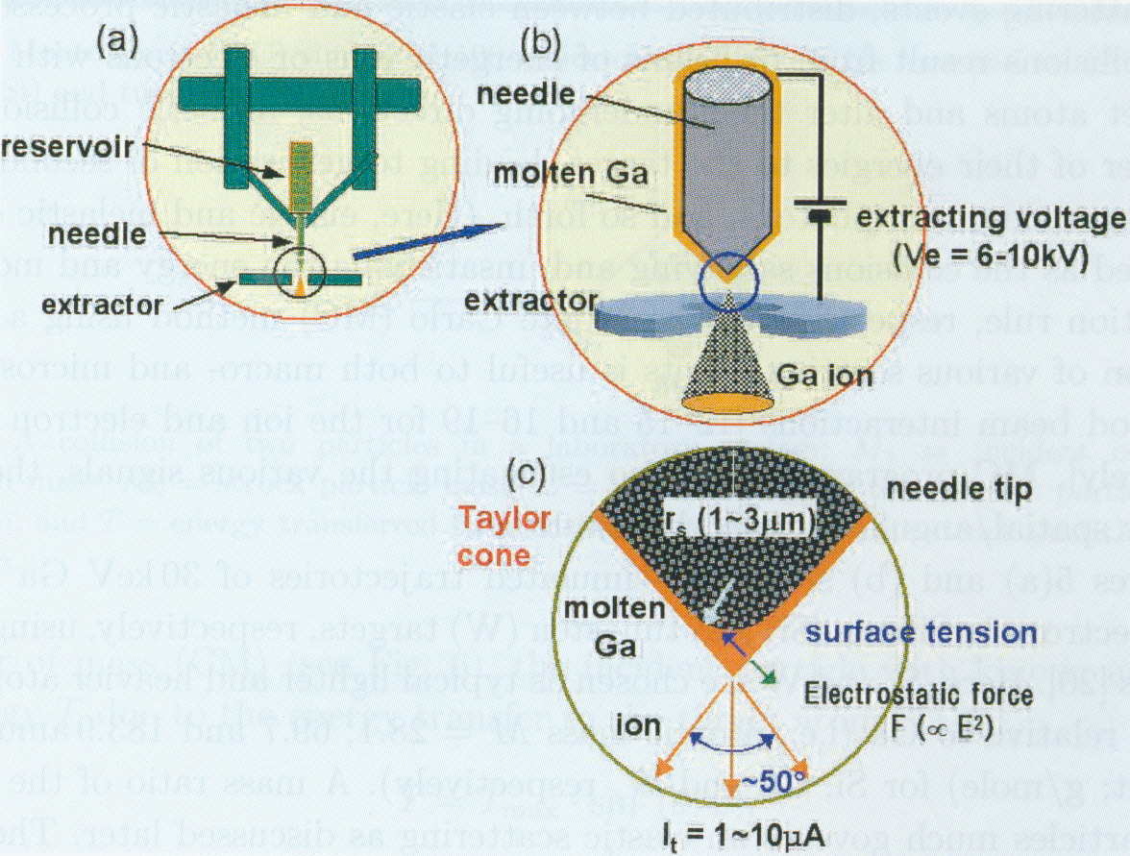
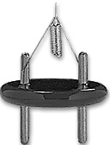
Liquid metal ion source
Heating current
10 mm

Slide 11
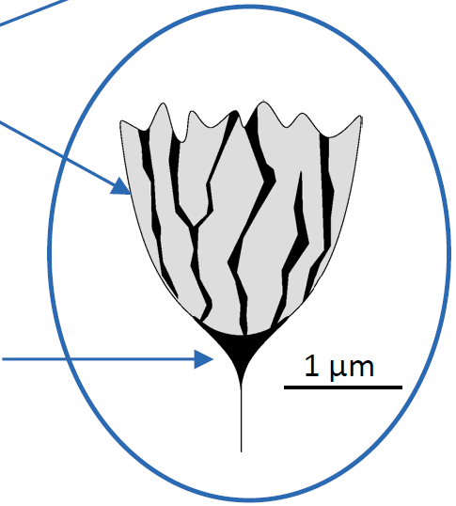
Liquid metal ion source: why Ga
Melting point at 30°C → liquid around room temperature.
Low vapor pressure → applicable in high vacuum.
[Ga²⁺]/[Ga⁺] ∼ 10^{‐4} at 10μA → narrow energy distribution.
Long life (up to 1500 hr sources).
Heavy ion for sputtering (Z=31).
Blunt W with grated
surface for Ga transport
Ga forms a Taylor‐
Gilbert cone

Slide 12
Ion optics: overview
Similar to electron optics.
But use only electrostatic lens and deflectors to focus and deflect ion beam, because for magnetic lens (though they have superior optics):
It must be fabricated impractically large to focus 30kV Ga ions.
The focusing plane depends on mass/charge ratio.
There is not much room for improvement in electrostatic lens performance given that working distances must remain ≥ 10 mm to allow room for gas injectors etc.
Higher space charge effect, as the repulsion of particles of same charge is inversely proportional to their speed (ion is a lot slower than electrons). This leads to:
Large energy spread (5-15eV) and thus large chromatic aberration.
Enlarged focused ion beam.
State-of-the-art FIB has focal spot size below 5nm at current of few pA.
At medium current (60pA, 1mrad), chromatic aberration (=C_{c}⋅α⋅dE/E) dominates.
At large current (5nA, 10mrad), spherical aberration (=0.5Cs⋅α³) dominates.
Force independent of m, same for electron and ion.
v is speed, much smaller for ions than for electrons; so much smaller force, need impractically large B to focus.
V is acceleration voltage.

Slide 13
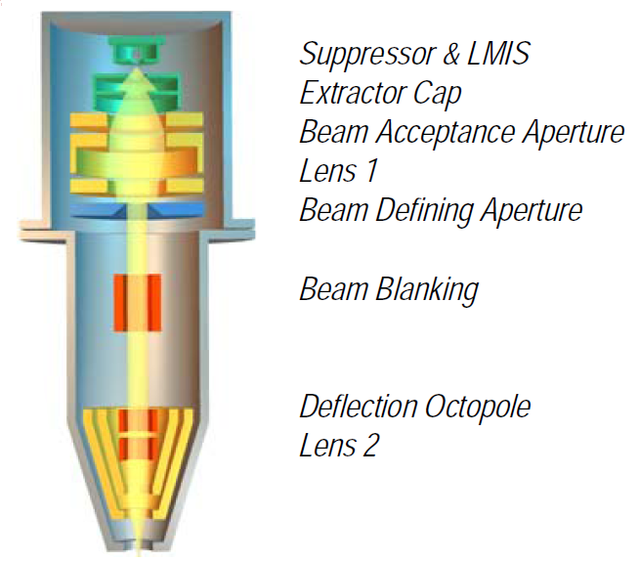
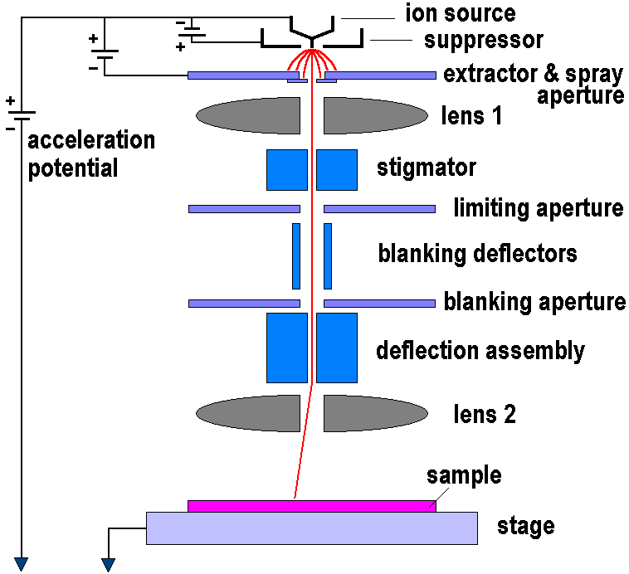
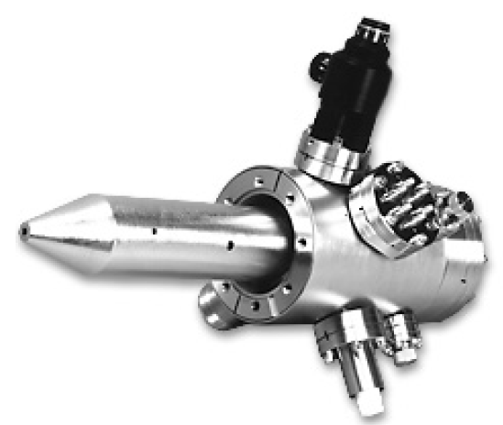
Ion source and optics

Slide 14
Beam size vs. current
Spot size 20nm at 100pA.
For electron, spot size < 10nm at 1nA.
Source spot size is about 50nm (fixed).
Small aperture → small beam current (slow) and narrow beam (high resolution). Need a tradeoff.
Beam tails can extend up to some μm, is one limiting factor when milling deep high aspect ratio (depth/width) trenches/holes (the other factor is re-deposition of sputtered material).

Slide 15
Focused ion beam (FIB)
Overview.
Ion source and optics.
Ion-solid interaction, damage.
Scanning ion beam imaging.

Slide 16
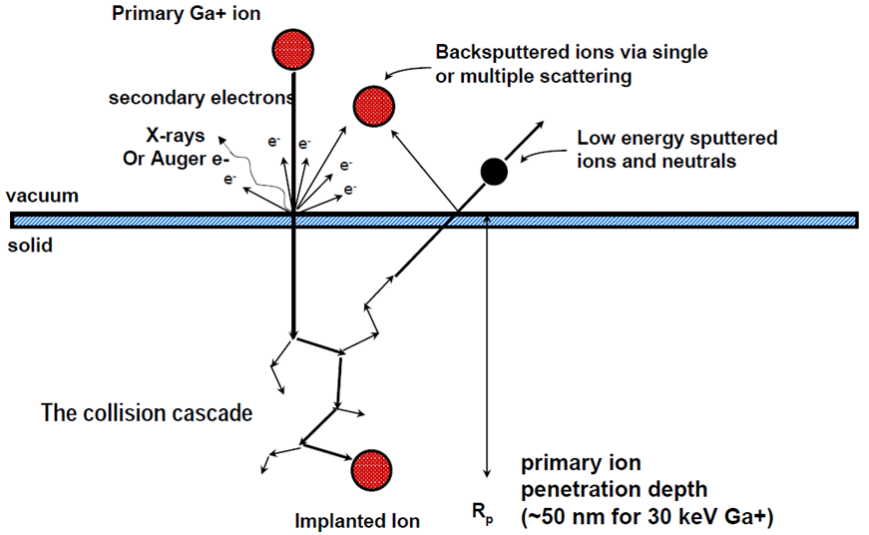
Ion-solid interactions
?
Imaging (secondary electron image, 2-3 SE per ion), milling and deposition simultaneously.
Leads to lattice defects (vacancies, interstitials, dislocations).
Leads to damages, amorphization, re-crystallization.

Slide 17
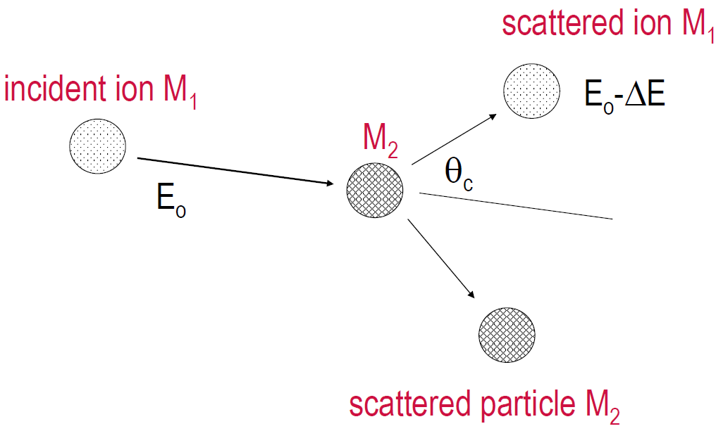
Ion-ion and ion-electron scattering: the equations
Nuclear differential scattering cross-section, used to calculate scattering angle distribution.
ΔE_{n}: energy loss to solid atom (nucleus), lead to sputtering, dislocation, recoiling…
ΔE_{e}: energy loss to electrons, leads to secondary electron emission, ionization…
L: mean free path between two collisions.
N: atomic density of solid material.

Slide 18
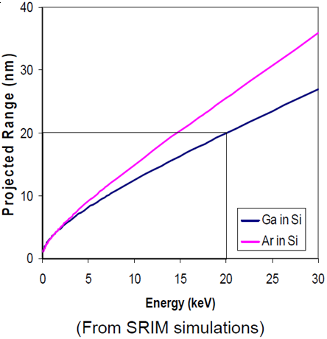
Ion-solid interactions
Three regimes of ion-solid interactions
Regime I (knock-on regime)
M₁<<M₂ or E₀ is low, minimum sputtering
Regime II (linear cascade regime), where FIB operates.
M₁∼M₂, E₀ is moderate, governed by nuclear effects
Regime III (spike-on regime)
M₁>M₂ and/or E₀ is high, majority of atoms move in collision cascade
Ion range (penetration/attenuation depth)
Ion range varies with ion energy and substrate material, order 1nm/keV
(for electron, a few μm at 30keV)

Slide 19
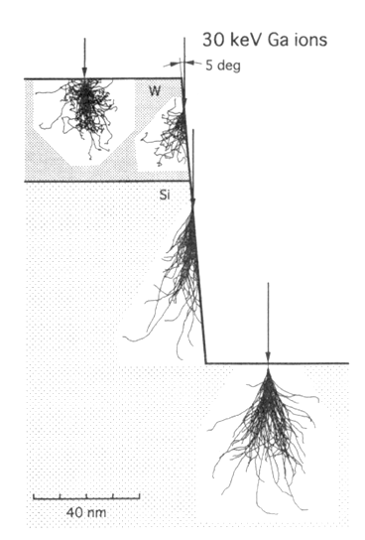
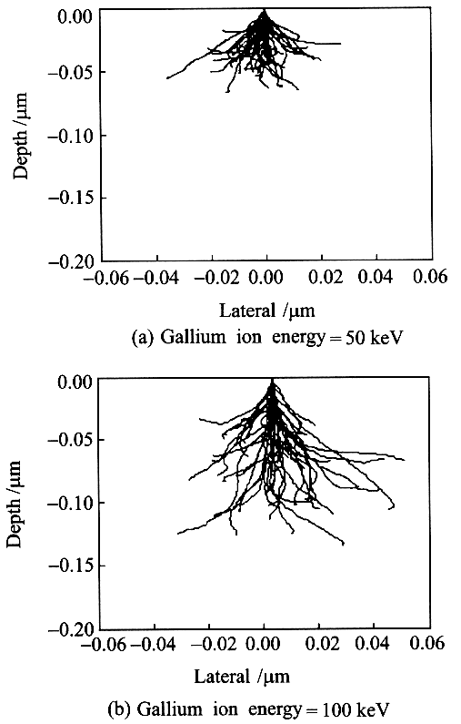
Trajectories for Ga⁺ bombardment
30 keV Ga⁺ on Si sample
30 keV Ga⁺ on W/Si sample
Grazing angle, less damage, fast milling rate
Penetrate deeper inside Si than W
T. Ishitani, et al., J. Vac. Sci. Technol. B16, 1907 (1998)

Slide 20
Damage by Ga⁺ bombardment
Ion Implantation - Ga atoms remain in the sample target and may reach critical composition for second phase formation.
Amorphization of surface – loss of crystallinity
Lattice defects
Vacancies – displaced or “missing” atoms from their equilibrium lattice positions
Interstitials – atoms which are positioned in between equilibrium lattice positions
Dislocations – a missing “half-plane” of atoms
Local heating due to large displacement of atoms that may occur within the collision cascade (10’s of nanometers from surface)
Concentration of primary radiation defects (knock-outs from lattice sites) can be evaluated by Kinchin-Pease formula: n_{D} = kE/2E_{d}, where k ≈ 0.8 is a coefficient, E is ion energy, E_{d} is displacement energy. Average 1000 defects per ion.
Ga in most semiconductors is acceptor, affecting electronic, optical, magnetic and thermal properties. Concentration of Ga in the irradiated zone can be given by: C_{Ga} = 1/(1+γ), where γ is sputter yield.

Slide 21
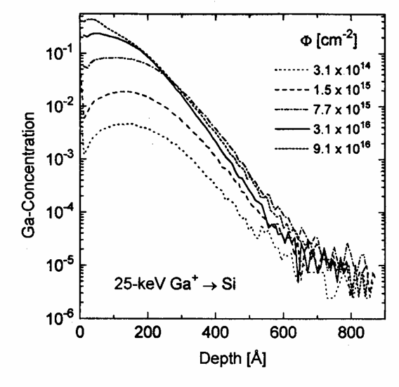
25keV Ga⁺ depth distribution for silicon (implantation)
Ga⁺ flux
SIMS data, concentration is relative fraction of Ga
H. Gnaser et al., J. Vac. Sci. Technol. B13, 19 (1995)

Slide 22
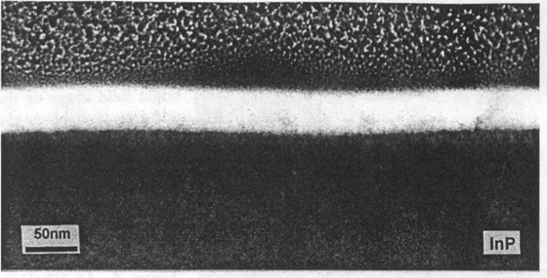
Damage by Ga⁺ bombardment
InP, 40 nm damage layer thickness
Amorphization depth
10 keV 30 keV
Si 6 nm 28 nm
GaAs 4 nm 24 nm
InP 15 nm 40 nm
J. F. Walker and R. F. Broom, Inst. Phys. Conf. Ser. 157, 473 (1996)

Slide 23
Use low keV FIB milling to reduce ion damage
Reduced amorphous layer with reduced FIB energy
What material? GaAs?
30keV 5keV 2keV
∼21nm ∼2nm 0.5-1.5nm∼

Slide 24
Focused ion beam (FIB)
Overview.
Ion source and optics.
Ion-solid interaction, damage.
Scanning ion beam imaging.

Slide 25
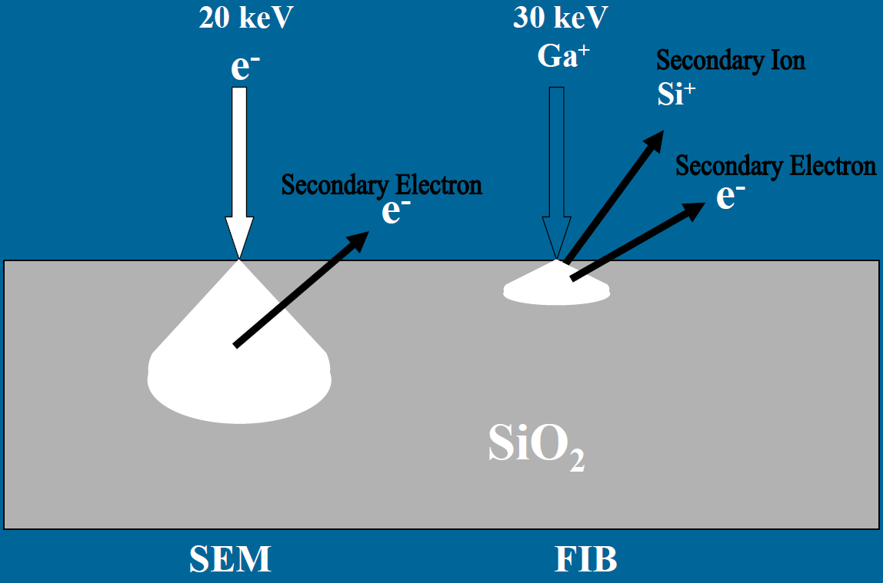
Ion beam imaging
FIB imaging is destructive, yet may be used to remove (insulating) oxide layer.
Topographic contrast.
Secondary electron and secondary ion images.
Ion channeling contrast for grain size measurements.
Material contrast - local compositional differences.
Voltage contrast - electrical state differences - passive and active voltage contrast.
Scanning ion microscope (SIM)
Secondary electron mode
Detector biased positive
Emitted from top 5-10 nm
Typically 30kV 40pA for optimal resolution and signal
Only charging up a few volts to go dark (electrons cannot escape)
Grounded metals very bright, oxides dark
Secondary ion mode
Detector biased negative
Emitted from top 0.5-1nm (very surface sensitive)
No voltage-contrast
Oxides brighter
Lower yield, so images noisier.

Slide 26
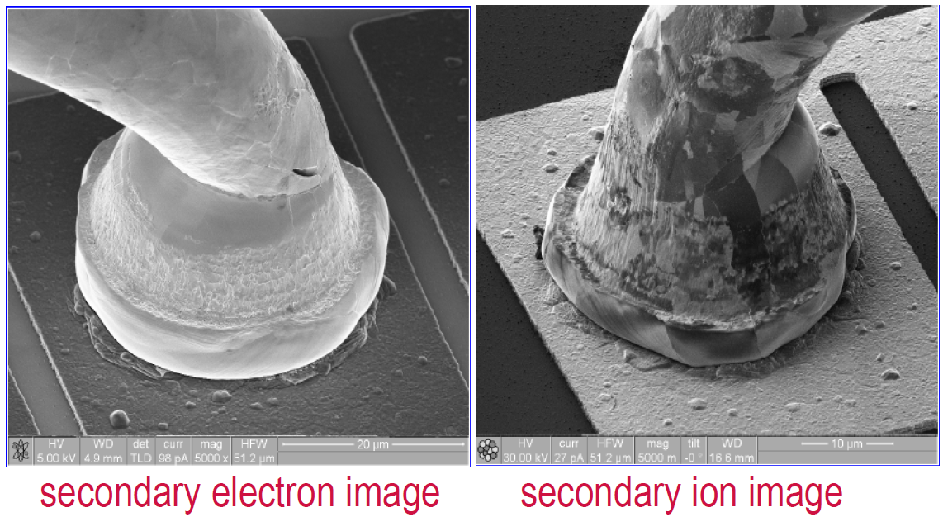
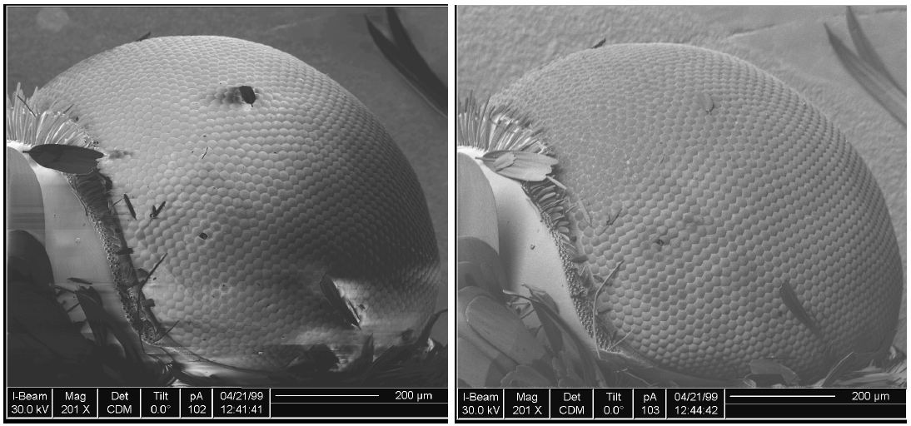

Slide 27
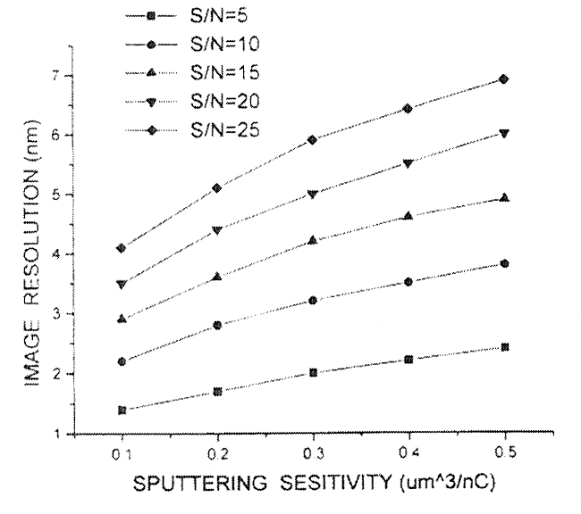
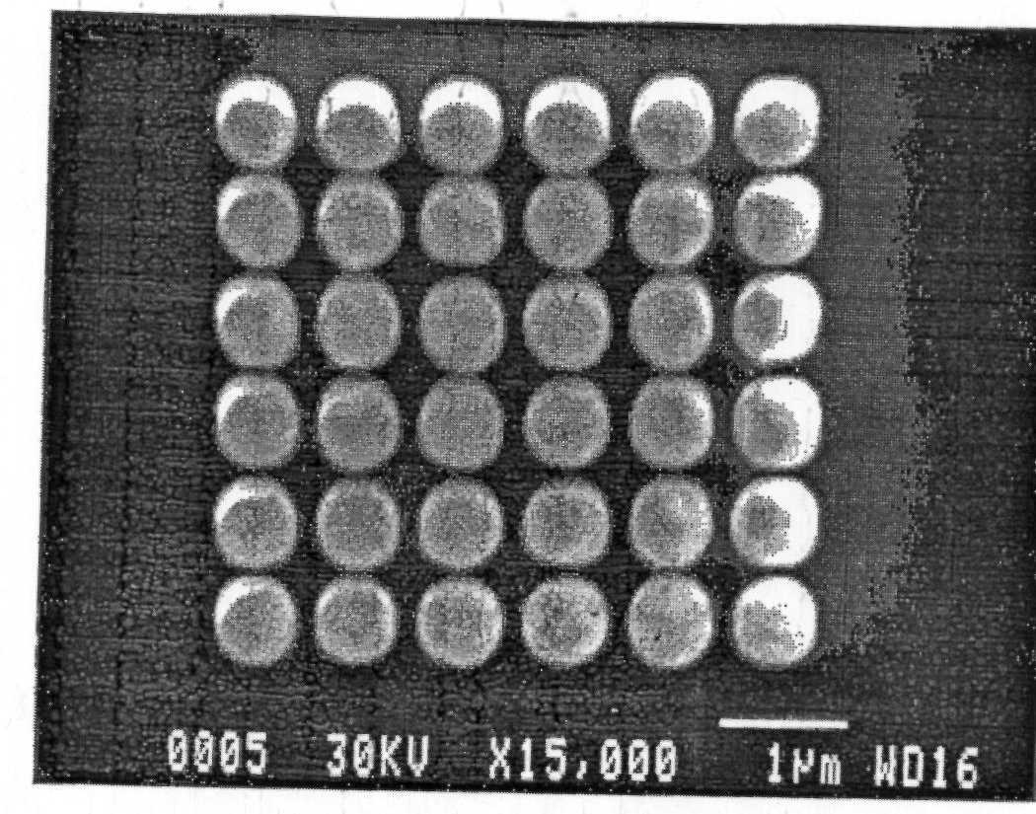
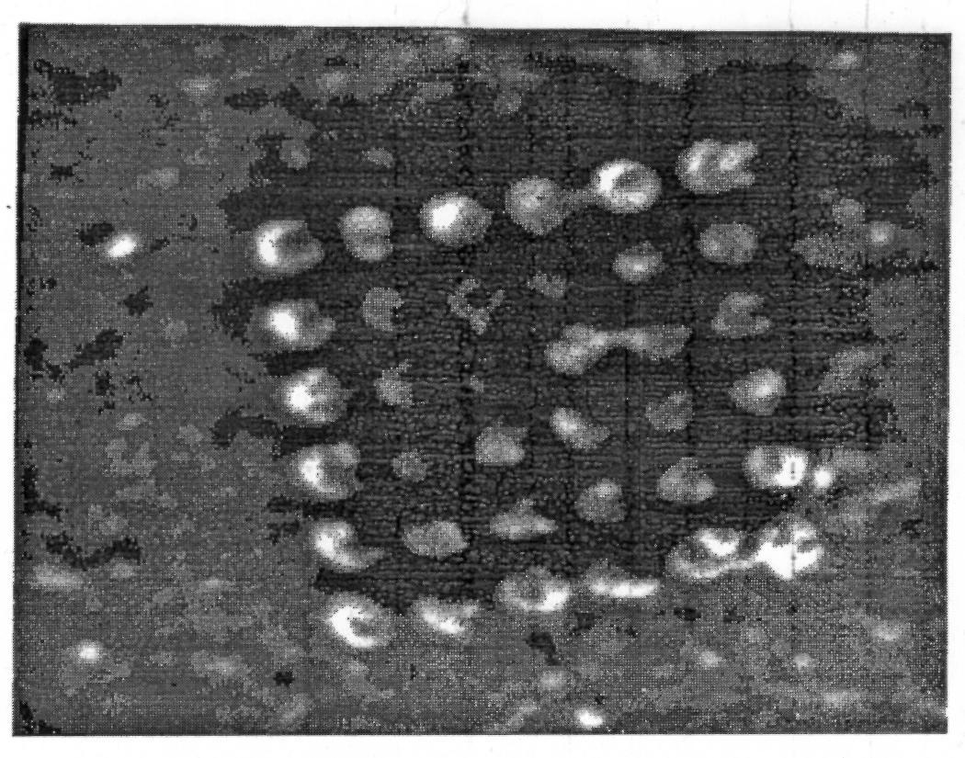
Imaging resolution vs. sputtering yield
Problem with FIB imaging resolution: if an object is small enough, it will be sputtered away before sufficient signal (secondary electrons) can be collected to resolve it.
Before imaging
Image resolution (nm)
After 1min imaging
Sputtering rate (μm³/nC)
Orloff et al., JVST (1996)

Slide 28
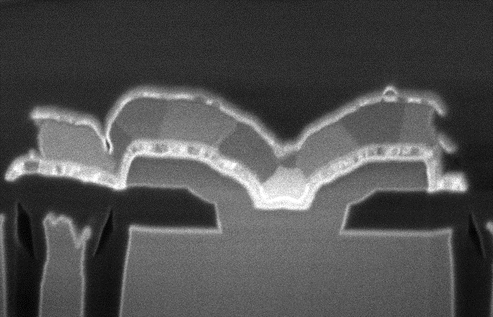
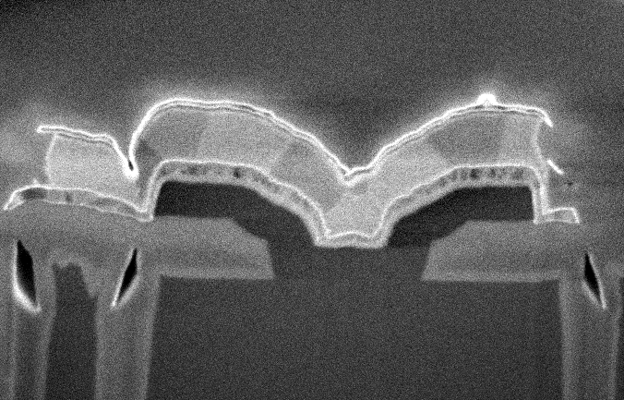
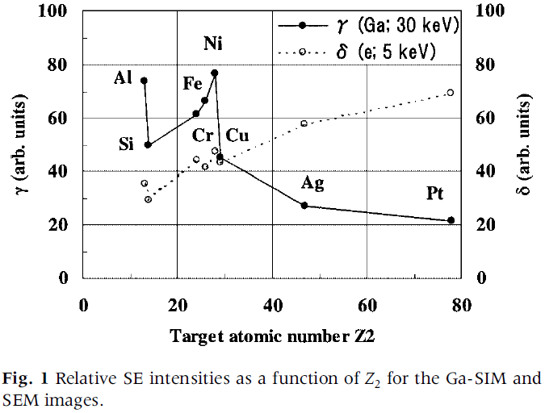
Materials contrast
SEM (secondary electron image)
Scanning ion microscopy (SIM)
Secondary electron image
SIM image has higher material contrast than SEM image, and with fine structure (peaks and valleys in the curve).
Unlike SEM, the signal brightness is lower for heavier materials (larger Z).
For SEM, heavier materials have higher SE yield since there are more electrons for high Z materials.
Relative secondary electron (not ion) intensity
“Origin of material contrast in scanning ion microscope”, J Electron Microscopy, 2002.

Slide 29
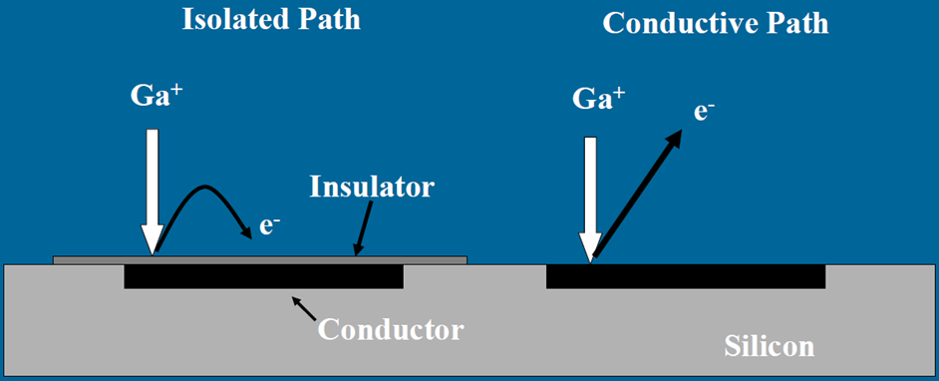
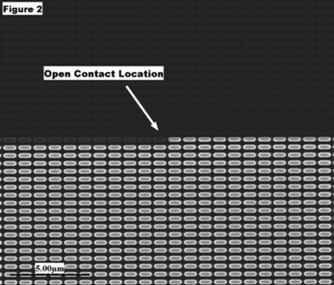
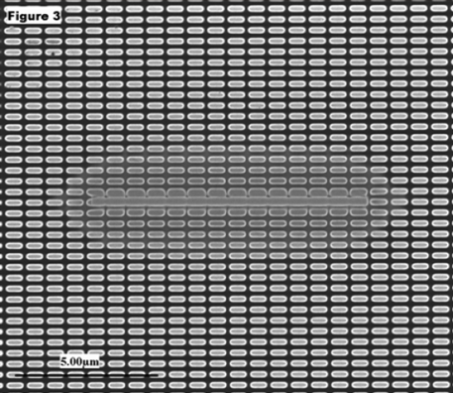
Passive voltage contrast
SE cannot escape, dark region
Positively charged
Bridging open contact with metal deposition indicates remaining contacts are good.
Open contact in chain shown by charging.

Slide 30
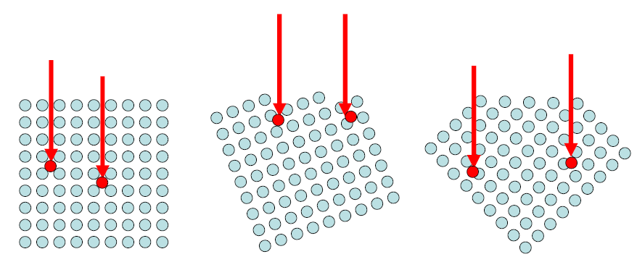
Ion channeling contrast

Slide 31
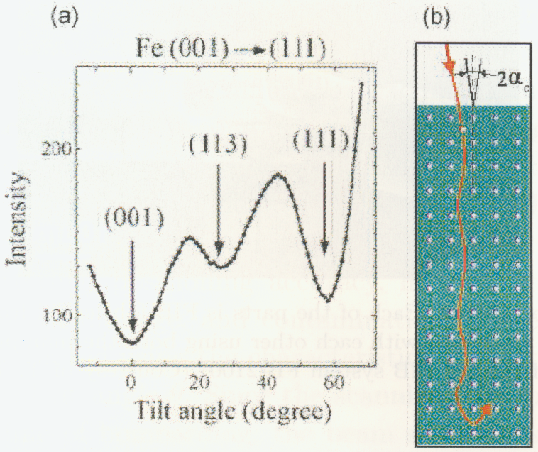
Ion channeling contrast
Ions penetrate deeper in crystalline material for certain grain orientations.
Those channeled ions have lower sputtering yield (slower milling rate).
Secondary electron (SE) yields are also lower for areas that channel better.
Polycrystalline materials have grains with different orientations.
Grain size can be determined by images at different incidence angles.
Typical SE intensity with respect to tilt angle for Fe single crystal sample under 30keV Ga-FIB bombardment.

Slide 32
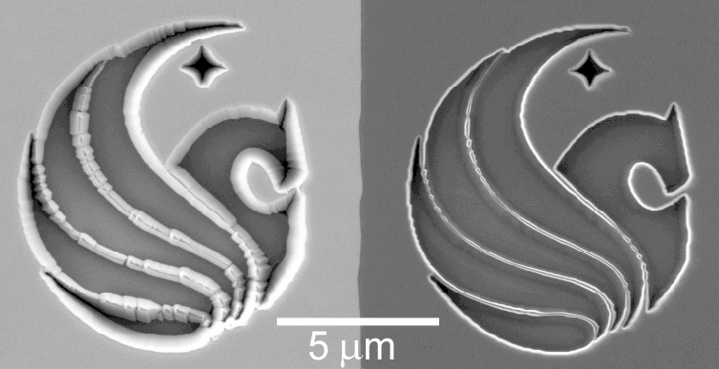
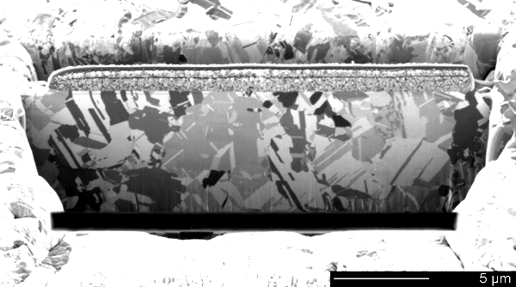
Ion channeling contrast
Left: not aligned with crystal direction
Right: channeled (aligned)
Ion channeling contrast

Slide 33
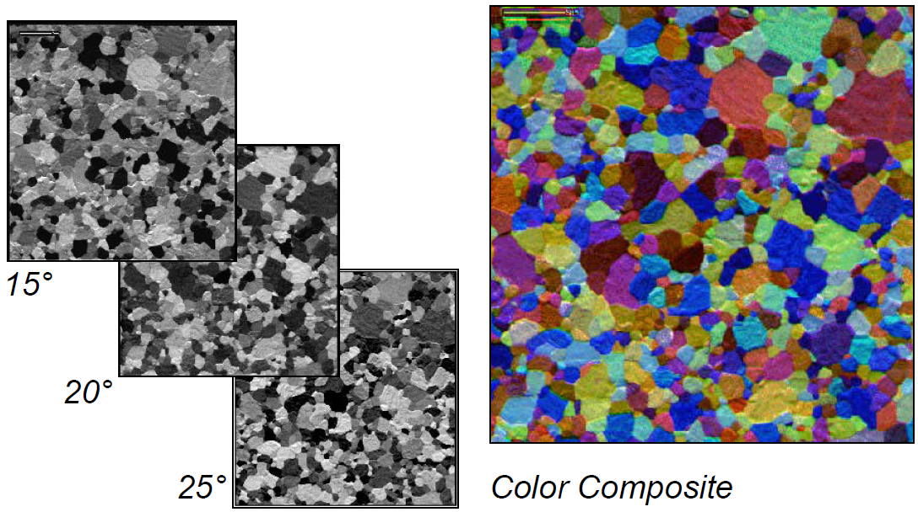
Channeling contrast for grain size analysis

