Slide 1
Focused ion beam (FIB)
Overview.
Ion source and optics.
Ion-solid interaction, damage.
Scanning ion beam imaging.
FIB lithography using resist.
FIB milling, sputtering yield.
Redeposition.
Single line milling.
Other types of FIB lithographies (implantation, intermixing…).
Gas-assisted FIB patterning.
ECE 730: Fabrication in the nanoscale: principles, technology and applications
Instructor: Bo Cui, ECE, University of Waterloo; http://ece.uwaterloo.ca/~bcui/
Textbook: Nanofabrication: principles, capabilities and limits, by Zheng Cui

Slide 2
Focused ion beam (FIB) lithography overview
FIB lithography resembles e-beam lithography, but with more capabilities:
Write pattern in a resist, like EBL.
Etch atoms away locally by sputtering, with sub-10nm resolution (subtractive), most popular application of FIB.
Deposit a material locally, with sub-10nm resolution (additive).
Ion implantation to create an etching mask for subsequent pattern transfer.
Material modification (ion-induced mixing, defect pattern…).
Simultaneous observation of what is happening for resist-less lithography (i.e. local etch and deposit).

Slide 3
Pretty fast beam-blanker, though for advanced EBL, it can be 50MHz.
This project didn’t achieve its goal.
FIB can by no means replace EBL.
http://www.nanofib.com/

Slide 4
Comparison: EBL and FIB lithography (with resist)
Like EBL, ion-matter interaction can also generate low-energy secondary electrons, which can expose the resist for lithography.
Naturally, in principle all EBL resists can also be used as FIB lithography resist.
Proximity effect of FIB lithography is negligible, no electron backscattering.
Forward scattering is also weaker.
This means writing pixel size ∼ beam spot size, beam blanker may not follow. (For EBL, pixel size >> beam spot size, exposure by proximity effect.)
For the same beam spot size, higher resolution than EBL, due to shorter ion range, smaller lateral straggling, weaker secondary electron generation, lower energy of secondary electrons.
Greater resist sensitivity than EBL that increases throughput.
Ion-beam electron-beam

Slide 5
Comparison: EBL and FIB lithography (with resist)
However, it is more difficult to focus ion beam (chromatic aberration, no magnetic lens…).
So one must use low beam current for the same resolution, which offset its high sensitivity and reduces writing speed.
Impurity of source ions within resist is an issue.
The biggest disadvantage of FIB lithography: limited exposure depth in resist (<100nm for 100keV); thin resist makes following liftoff or etching process difficult.
Spot size of a FEI FIB system. (Spot size for EBL can be <10nm at current several nA)
Beam current (pA) | 1 | 10 | 30 | 50 | 100 | 300 | 500 | 1000 | 3000 | 5000 | 7000 | 20000
Spot size (nm) | 7 | 12 | 16 | 19 | 23 | 33 | 39 | 50 | 81 | 110 | 141 | 427

Slide 6
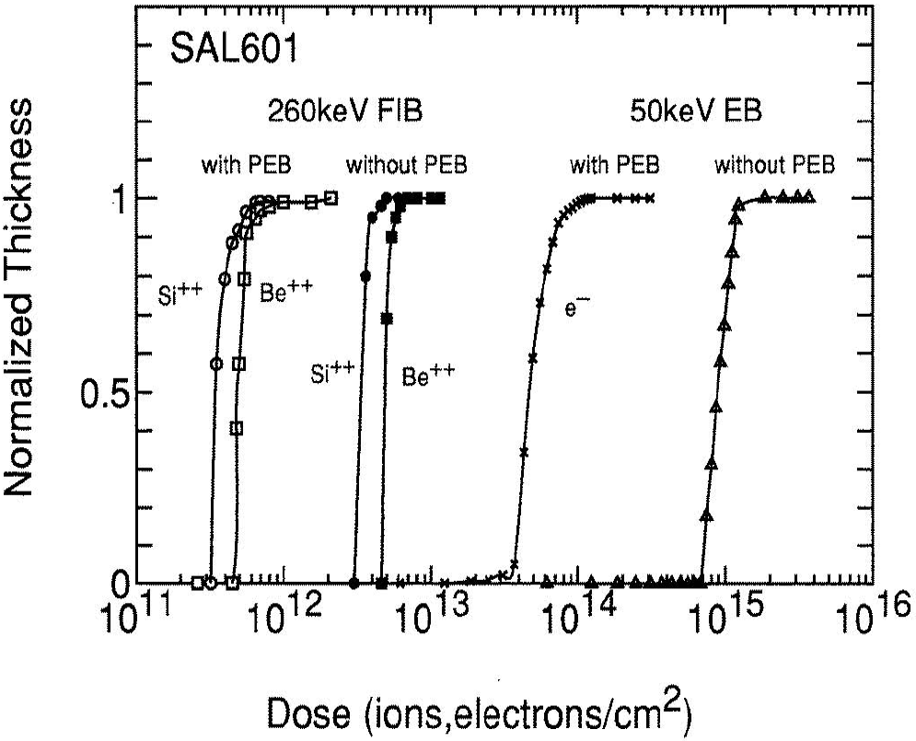
Comparison to EBL: resist sensitivity
PEB: post exposure bake
SAL-601:
High sensitivity (∼10μC/cm²) chemically amplified negative resist, with good resolution (sub-100nm), high contrast, and moderate dry etch selectivity. But not so stable with short shelf lifetime.
http://snf.stanford.edu/Process/Lithography/ebeamres.html
Very high ion beam energy (260kV), so this comparison of sensitivity may not be typical.
Here the resist sensitivity is about 2 orders higher than that of EBL.

Slide 7
Focused ion beam (FIB)
Overview.
Ion source and optics.
Ion-solid interaction, damage.
Scanning ion beam imaging.
FIB lithography using resist.
FIB milling, sputtering yield.
Redeposition.
Single line milling.
Other types of FIB lithographies (implantation, intermixing…).
Gas-assisted FIB patterning.

Slide 8
FIB milling

Slide 9
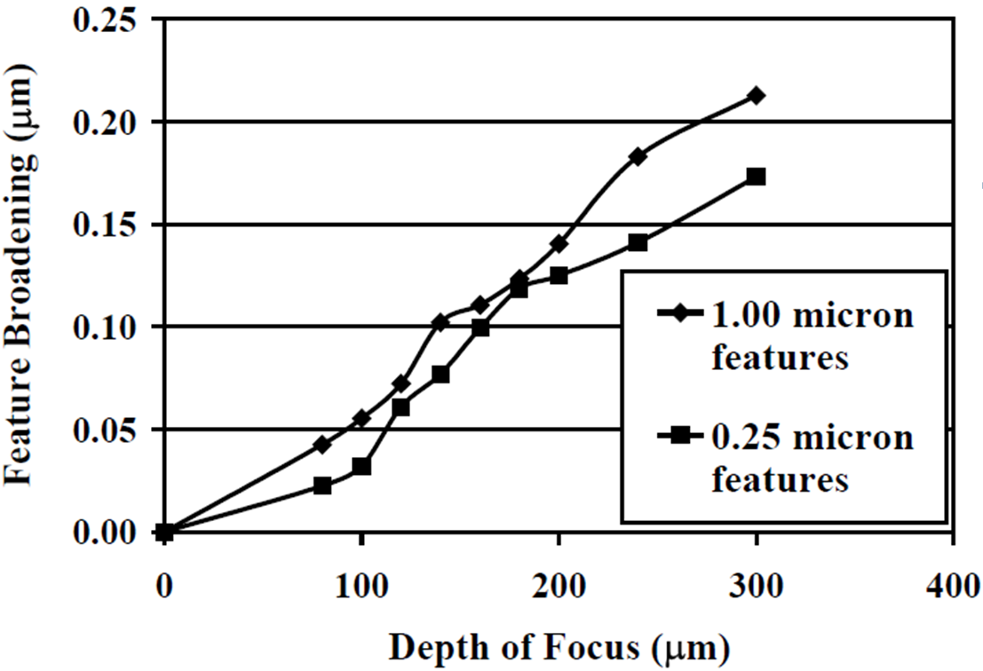
FIB milling
Sputter process.
Less damage at cutting surface for small currents.
Resolution better for small current but high currents mill faster - use series of decreasing currents.
Significant redeposition - milling strategy is important.
High depth of focus (ion shorter wavelength than electron) – mill features with high aspect ratio, rough surface OK.
Coupling with SIMS gives in-situ information on chemical content.

Slide 10
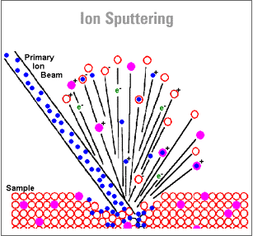
Sputtering by ion beam
Sputtering rate depends on ion energy, mass, crystal orientation, substrate nature.
One Ga ion of energy 30 keV sputters a few atoms from Si surface.
Sputtered feature is broader than beam size: 10nm beam causes 20 to 30 nm sputtered recess.
With a 1nA ion beam current, sputtering ∼1μm³/sec.
Optimal ion energy 10-100keV.
Higher energy leads to more implantation.
For energy >1MeV, backscattering and nuclear reaction become dominant.

Slide 11
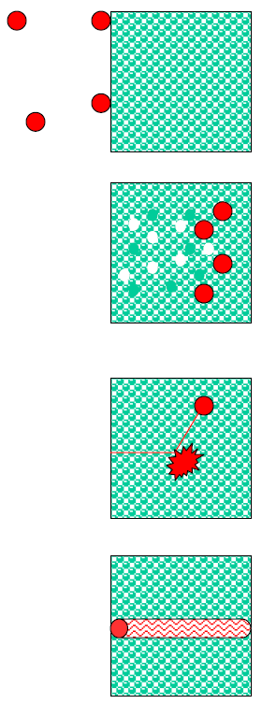
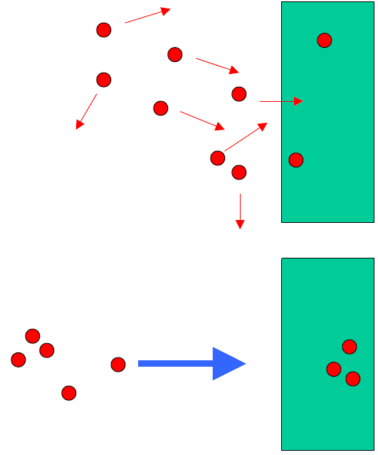
Materials modification with ion beams
0-1 eV:
adsorption
Rp ≈ 0
Chemistry:
(several eV)
15-10² eV:
atomic displacements
Rp ≈ 1-10 nm
10³-10⁵ eV:
dense cascades, local melting
Rp ≈ 10-1000 nm
Physics:
(10¹-10⁷eV)
10⁶-10⁹ eV:
no-collisions, electronic excitation
Rp ≈ 1-100 μm

Slide 12
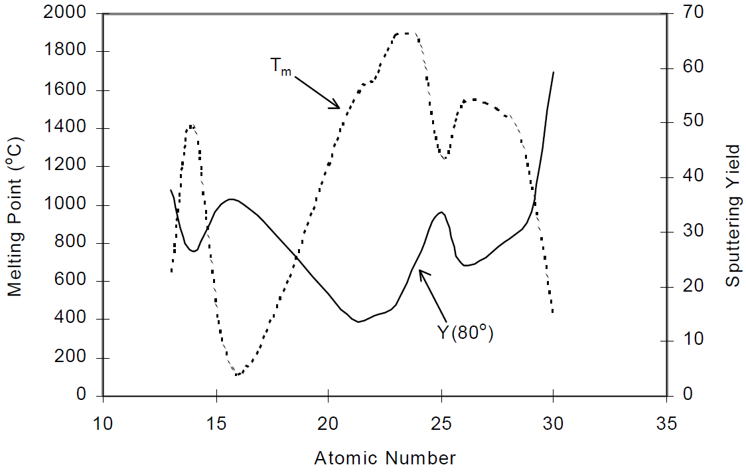
Sputtering yield
Y = number of recoiling atoms out of the target surface per incident ion = 1-50
Sputtering yield is correlated with melting point.

Slide 13
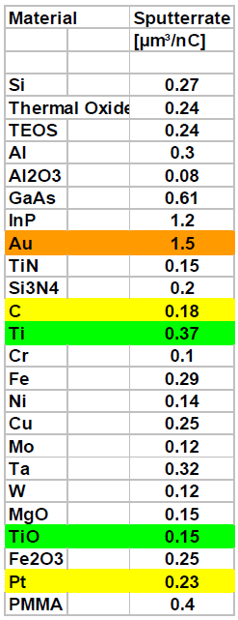
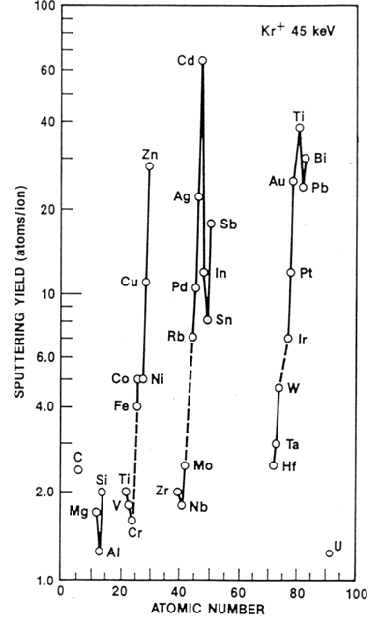
Sputtering yield of different material
Sputtering yield varies with material, orders of magnitude difference across periodic table.
Sputter rate (μm³/sec) = yield(atoms/ion) × flux(# of ions/sec)/number density(atoms/μm³).
Actual rate much lower due to re-deposition of sputtered material.

Slide 14
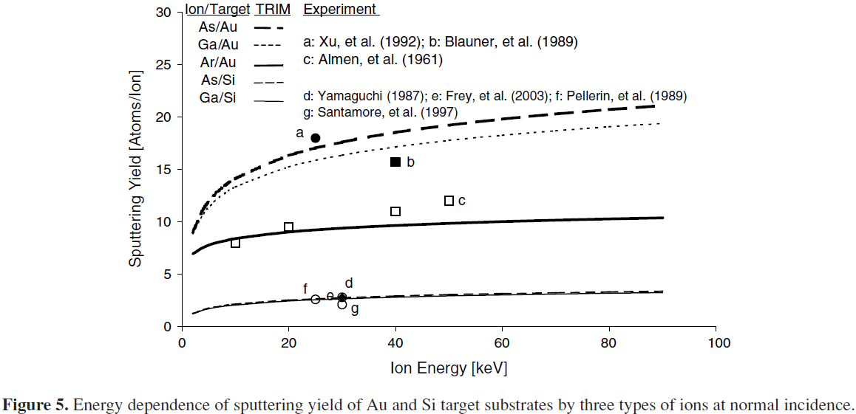
Energy dependence of sputtering yield
Ar: Z=18
Ga: Z=31
As: Z=33
As/Au
Ga/Au
Ar/Au
As/Si
Ga/Si
Sputter yield “saturates” at ∼100keV, higher energy leads to significant implantation
“Recent developments in micromilling using focused ion beam technology”, Tseng, 2004

Slide 15
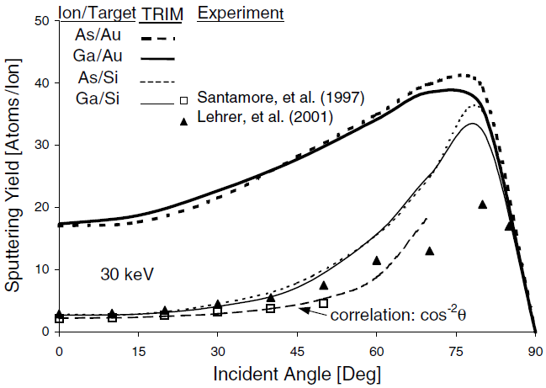
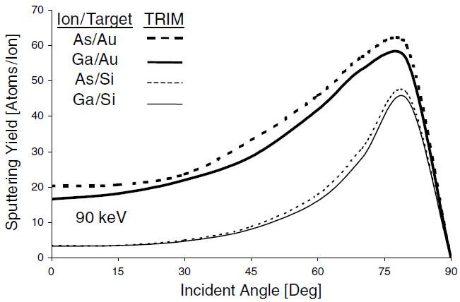
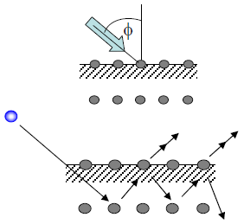
Angular dependence of sputtering yield
Au sputtering rate is less angle-dependent than Si.
Au
Si
90keV
30keV
Maximum sputter yield at 75-80º.
However, FIB milling is usually done at normal incidence for vertical trench profile.
Actually no longer “normal” once milling started – inclined incidence on tapered sidewall.

Slide 16
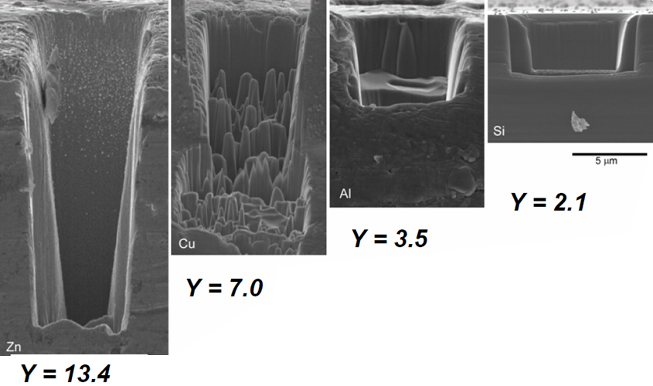
Rate of material removal: constant dose different materials
Constant dose of ∼7.5×10¹² Ga⁺, delivered with 1nA beam current.
Ga ion into Zn, Cu, Al, and Si at normal incidence.
SEM cross sections at 90º tilt.
Trench depth varies with material.
Zn has highest sputtering rate.
Cu shows topography formation.
Si has smoothest crater bottom.
Brenda Prenitzer, University of Central Florida, PhD dissertation (1999).

Slide 17
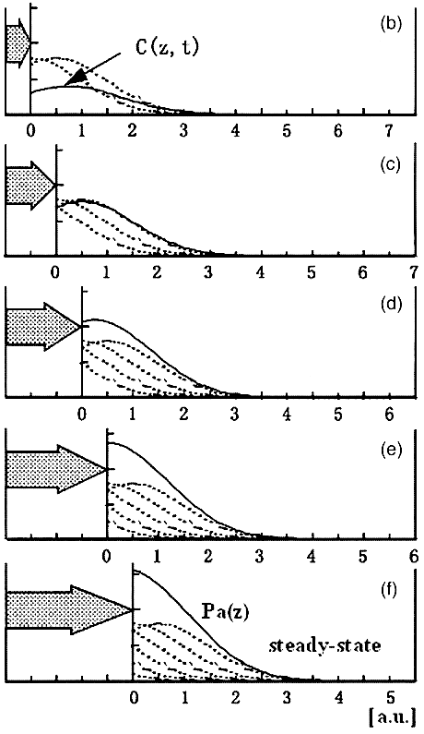
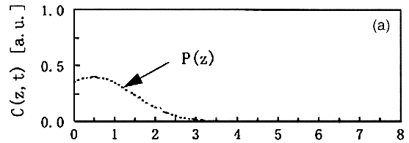
Steady state ion implantation
Implant profile with steady state sputtering
Implant profile if without sputtering
Increasing dose does not implant more ions to the surface, but rather, only recedes the “same” steady state surface with time.

Slide 18
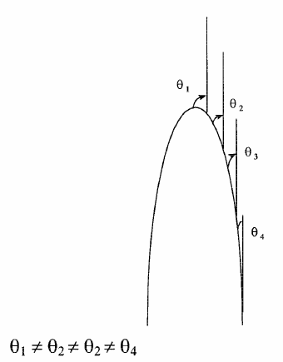
Effect of incidence angle
Ion
Asperities on a surface will be FIB milled at different rates due to topographic effects on milling
The topographic effects will grow and exacerbate as FIB milling continues
This is why (even for normal ion incidence) surfaces are “never” FIB milled from top-down; but rather, are created by FIB milling at high incident angles (as if milling from sidewall and propagate along beam).

Slide 19
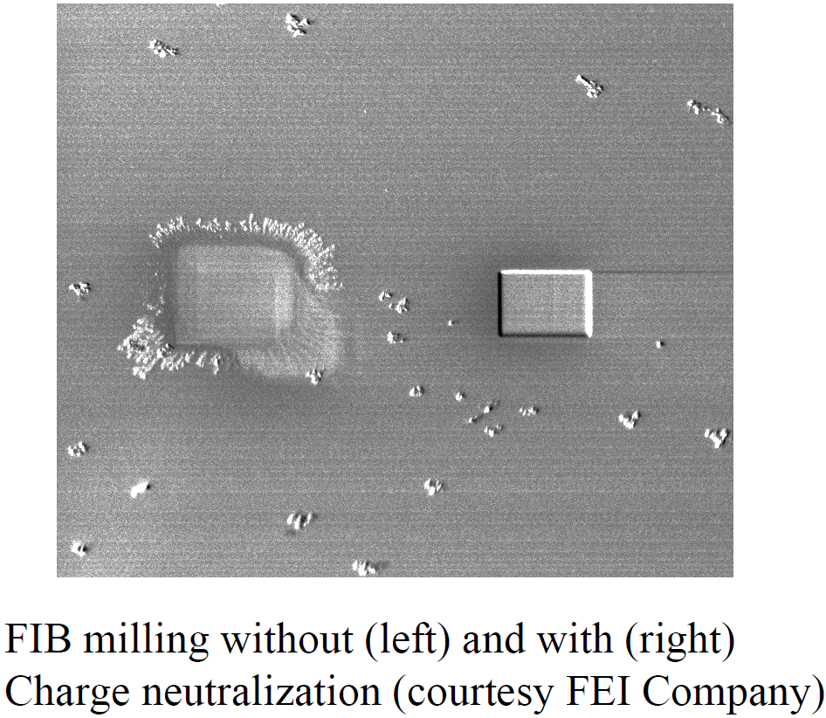
Charging effect when milling insulator
Charging can be eliminated by electron beam bombardment of surface.
(most FIB is equipped with SEM – DualBeam system)

Slide 20
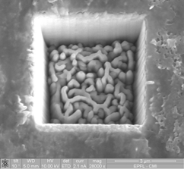
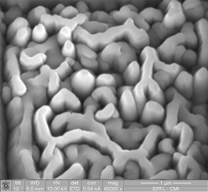
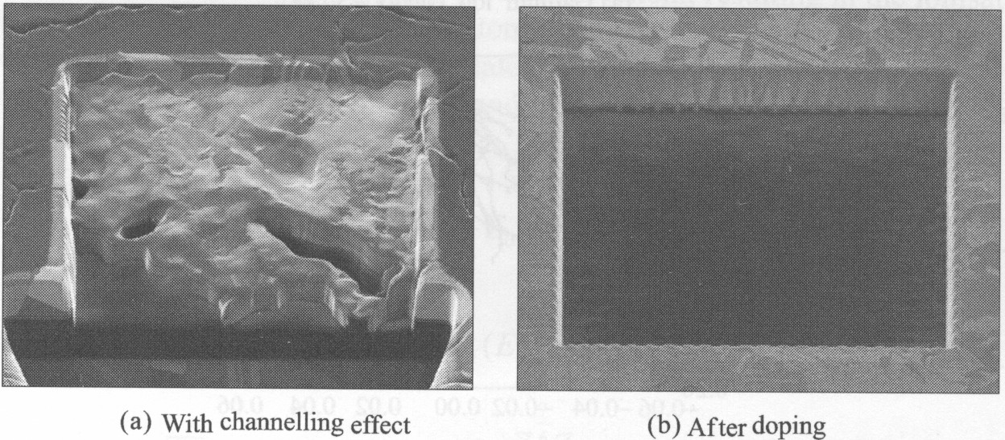
Channeling effect when milling crystalline material
Box milling of poly crystalline material (steel), rough surface.
Box milling of poly crystalline Cu.
Channeling effect suppressed by doping with impurity atoms that block the ion channels.

Slide 21
Thin membrane

Slide 22
Focused ion beam (FIB)
Overview.
Ion source and optics.
Ion-solid interaction, damage.
Scanning ion beam imaging.
FIB lithography using resist.
FIB milling, sputtering yield.
Redeposition.
Single line milling.
Other types of FIB lithographies (implantation, intermixing…).
Gas-assisted FIB patterning.

Slide 23
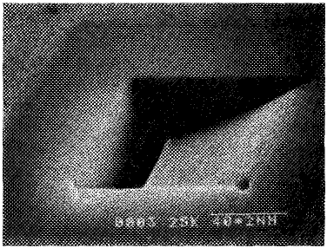
Re-deposition
Redeposition depends on:
Kinetic energy of atoms leaving surface
Sticking coefficient of target
Sputtering yield of target
Geometry of feature being milled
Factors that increase sputtering rate tend to increase redeposition:
Beam current
Incident ion kinetic energy
Incident ion attack angle
Target material properties
Scan direction
2μm
Si milled by 30keV Ga⁺, slow single pass at 2s per line with 300 scan lines.
Scanning beam
redeposition

Slide 24
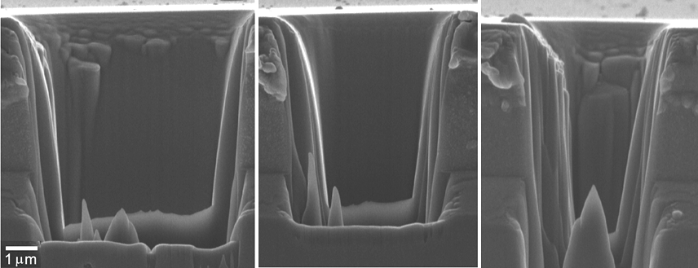
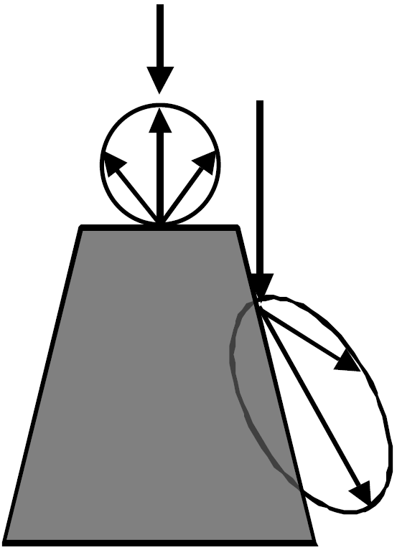
Geometry effect of re-deposition
Constant dose variable area, milling of (100) Si at normal incidence with 1.5x10¹¹ Ga⁺/μm³.
Slope of sidewall increases (less steep) as trench width decreased, as sputtered atoms have less chance to get out of the trench.
B. Prenitzer, Univ. Cent. Florida dissertation (1999)

Slide 25
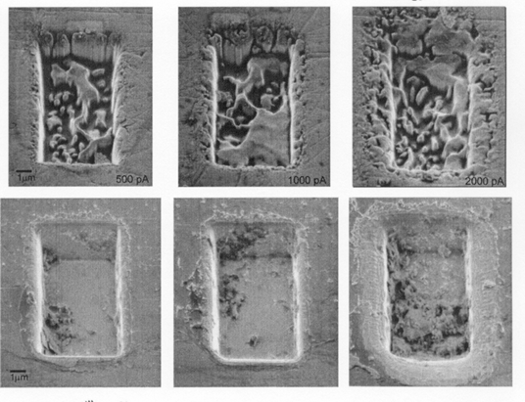
Effect of beam current on re-deposition
500pA
1000pA
2000pA
Cu
(110)
Si
(100)
10μm
For higher beam current, re-deposition increase, sidewall definition worse. For Cu, rough surface at all beam currents.

Slide 26
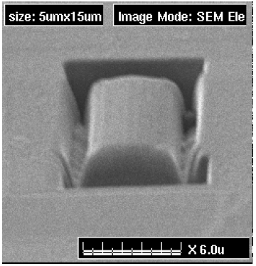
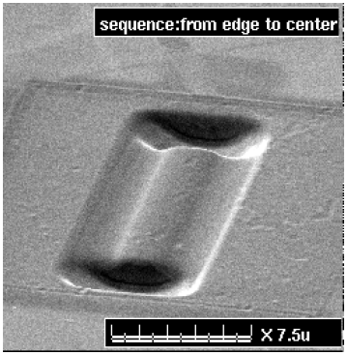
Effect of scan sequence
BK7 glass
Milled from center to edge
Milled from edge to center
The earlier the region is milled, the more re-deposited material is accumulated there.
“Recent developments in micromilling using focused ion beam technology”, Tseng, 2004

Slide 27
How to deal with re-deposition
Si milled by 30keV Ga⁺, total dose 1.9×10¹⁸ ions/cm².
Fast 200 repetitive passes at 10ms per line with 300 scan lines.
Slow single pass at 2s per line with 300 scan lines.
“Characteristics of Si removal by fine focused gallium ion beam”, Yamaguchi, JVST, 1985.

Slide 28
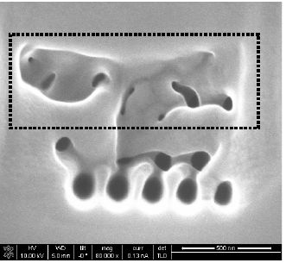
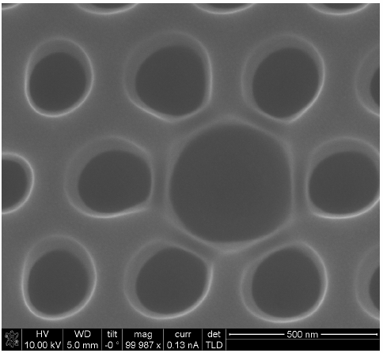
How to deal with re-deposition, another example
Parallel: mill all pixels to a small depth, then return to mill deeper … until targeted depth achieved, re-deposited material milled away by following mills.
Serial: mill each pixel all the way through before milling the next, re-deposited material covers holes milled previously.
Summary for minimizing re-deposition effect:
Mill large and less critical pattern first, using high beam current.
Use multiple passes, not single pass.
Mill fine and critical pattern last, using low beam current and multiple pass.

Slide 29
Focused ion beam (FIB)
Overview.
Ion source and optics.
Ion-solid interaction, damage.
Scanning ion beam imaging.
FIB lithography using resist.
FIB milling, sputtering yield.
Redeposition.
Single line milling.
Other types of FIB lithographies (implantation, intermixing…).
Gas-assisted FIB patterning.

Slide 30
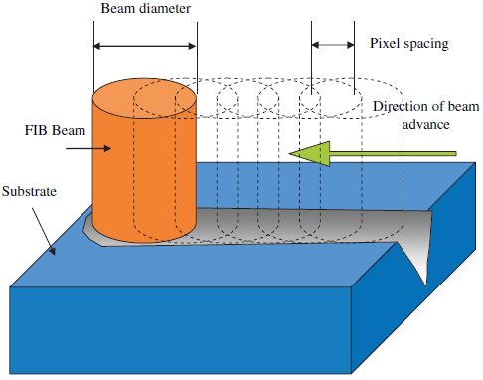
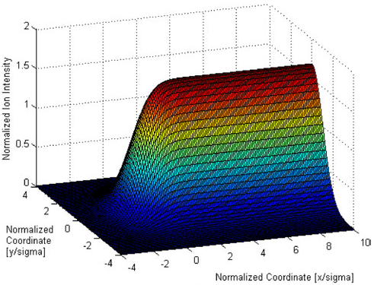
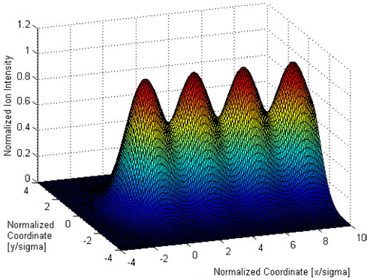
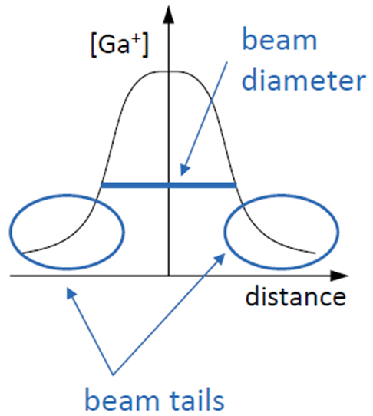
Pixel size vs. beam size
As a rule, for continuous non-wavy milling, pixel spacing/beam diameter ≥ 1.5
Ion flux distribution along a scan line with pixel/diameter=1.5 (top), 3.0(bottom)
“Recent developments in micromilling using focused ion beam technology”, Tseng, 2004

Slide 31
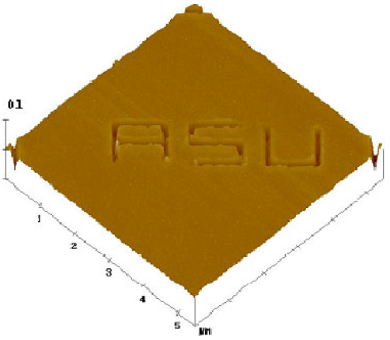
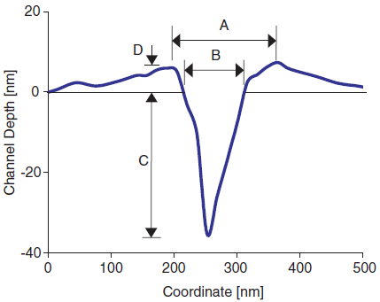
Channel milling using single pass
Channel profile by AFM
redeposition
Milled into Au by 90keV As²⁺ FIB with 5ms dwell time. I=5pA, pixel spacing 14.5nm, beam diameter 50nm. Single pass, aspect ratio ∼1/3 and is insensitive to dwell time.
Due to re-deposition, channel depth cannot be calculated simply by sputter yield.
V-shaped channel profile is the inherent shape obtained by single-pass FIB milling.
At long dwell time, the mouth width of the channel (B) can be one order larger than beam size, because the “tail” of the beam can mill sizable amount material.

Slide 32
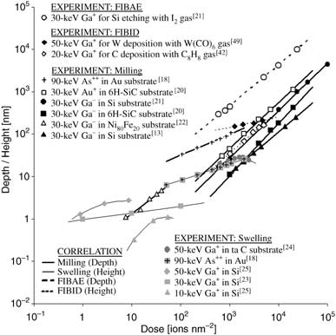
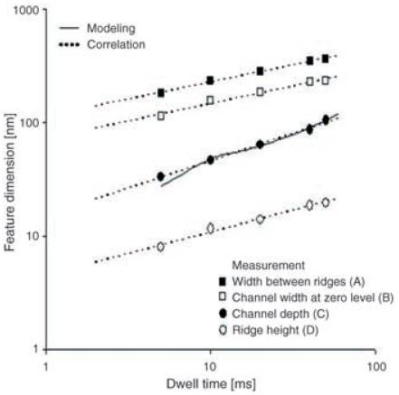
Channel milling using single pass
Relationship between feature size (depth by milling and etching or height by swelling and deposition) and ion doses for various ion species and materials.
Dwell time ∝ ion dose D
Almost universally log(M)=a+b⋅log(D)
M is milling depth or any feature size in milling experiment.
Then milling yield: Y=dM/dD=b(M/D)

Slide 33
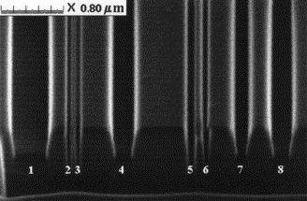
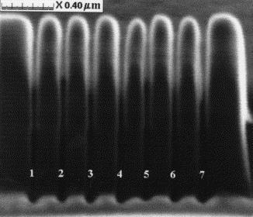
How to mill high aspect ratio narrow trench
FIB milled trenches in ta-C film using beam current (from left to right) of 32, 3, 3, 32, 7, 7, 32 and 32 pA, respectively.
Trenches with width 30–40 nm, aspect ratio up to 25, beam current 1.8-3pA
For high aspect ratio, use small beam current and large number of repetitive passes.
“Focused ion beam patterning of diamond-like carbon films “, Stanishevsky, 1999.

Slide 34
Focused ion beam (FIB)
Overview.
Ion source and optics.
Ion-solid interaction, damage.
Scanning ion beam imaging.
FIB lithography using resist.
FIB milling, sputtering yield.
Redeposition.
Single line milling.
Other types of FIB lithographies (implantation, intermixing…).
Gas-assisted FIB patterning.

Slide 35
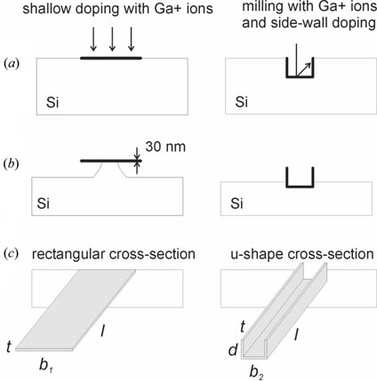
Patterning etching mask by ion implantation
High concentration p⁺ doping in Si drastically reduces the etch rate by KOH.
The implantation depth is roughly 1nm/keV (e.g. 30nm for 30keV Ga⁺ ion).
The critical dose for the etch mask to be effective is ∼1×10¹⁵ ions/cm² (=160μC/cm²=10 ions/nm²).
The implanted region is completely amorphous (amorphization dose is 1×10¹⁴ ions/cm² ).
At higher doses such as 1×10¹⁶ ions/cm² , sputtering (milling) of sample surface becomes significant.
Fabrication of cantilevers by shallow doping (left-hand side) and milling and sidewall doping (right-hand side): (a) FIB exposure (milling and/or implantation), (b) during KOH etching and (c) after etching is completed.
Reyntjens and Puers, “A review of focused ion beam applications in microsystem technology”, J. Micromech. Microeng. 11, 287-300 (2001).

Slide 36
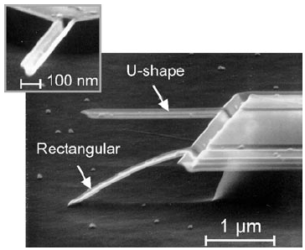
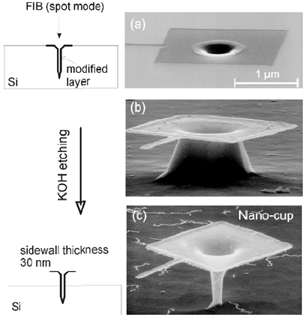
FIB implantation and pattern transfer: results
Nano-cup by extending vertical FIB milling to several μm.
SEM photomicrographs of cantilevers (2 μm long, 100 nm wide and 30 nm thick).
Tseng, “Recent developments in nanofabrication using focused ion beams”, Small, 1(10), 924-939 (2005).

Slide 37
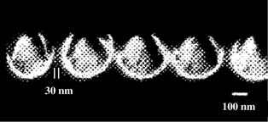
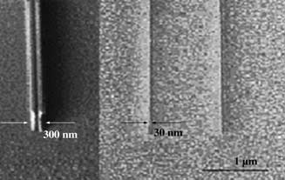
FIB implantation and pattern transfer: results
Rounded (wider interior, narrower near surface ) groove array fabricated by Si-FIB implantation on AlGaAs substrates.
Si⁺ ion implantation at 200keV energy, high energy leads to large grooves.
Hot (70ºC) HCl etches highly doped (1000 ions/nm) region much faster.
Implantation can also irradiating polymer resist materials to increase its etching resistance.
Here 30 keV Ga⁺ FIB with 117C/cm² doses to make implanted patterns in Shipley SPR660 positive photoresist layers.
Ga₂O₃ is formed that can be used as RIE etch mask using O₂ plasma.
FIB images of double 100 nm (left) and 30 nm (right) lines patterned by FIB implantation in SPR660 photoresist after O₂ RIE.

Slide 38
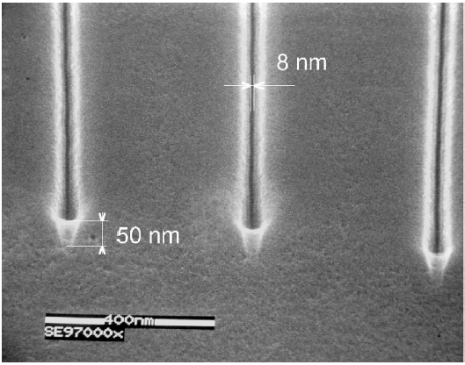
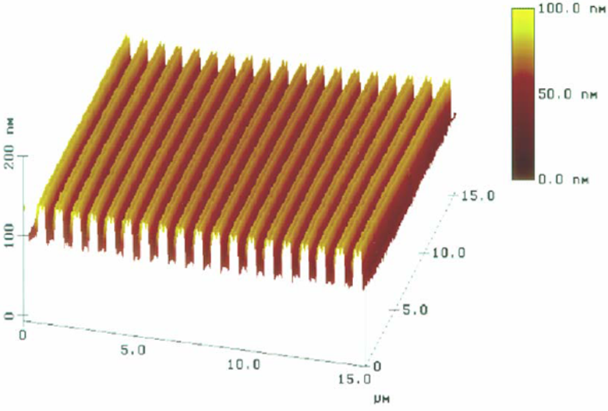
Ion beam lithography on AlF₃ resist
AlF₃: inorganic e-beam lithography resist.
Form F₂ gas upon exposure, leaving behind Al.
High-resolution direct machining: FIB etched lines on AlF₃(50nm)/GaAs, ion dose ∼92nC/cm. The edges of the resist etched layer appear transparent and the lines in GaAs display a very reproducible width of ∼8nm.
Explanation of this high resolution: flux-dependent vaporization of AlF₃, which is acting as a filter versus the tails of the ion-probe current distribution.
AlF₃ inorganic resist using 30kV Ga ion, large features, pitch ∼1μm.
“Nano-fabrication with focused ion beams”, Microelectronic Engineering 57–58, 865–875 (2001)

Slide 39
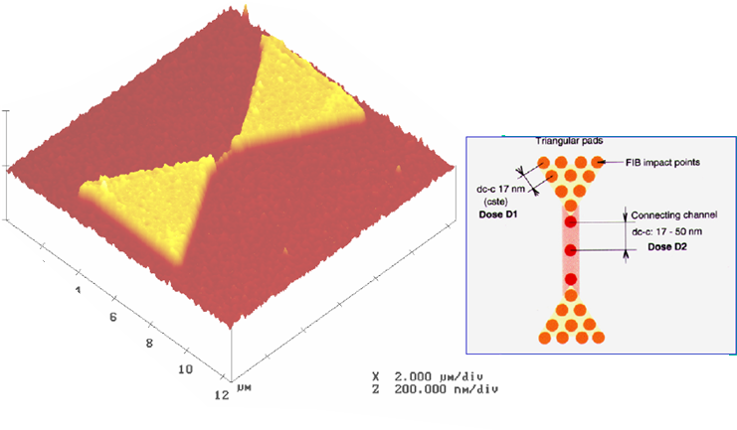
Ion beam lithography on Au₅₅(PPh₃)₁₂Cl₆ resist
Au₅₅(PPh₃)₁₂Cl₆: ion-sensitive negative resist, though recoil atoms and secondary electrons induced by recoils of light atoms in the resist also plays a role for resist exposure.
AFM image of a typical gold-containing butterfly-type pattern, realized by FIB irradiation of a single solid Au₅₅(PPh₃)₁₂Cl₆ resist layer. Dose on big pad is 10¹⁴ ions/cm².
The 3D connecting channel with granular morphology is clearly shown: width 30nm; height 20nm; length 1.5μm.
(Ga ions, energy 30keV, initial thickness for gold cluster compound 50nm)
“Nano-fabrication with focused ion beams”, Microelectronic Engineering 57–58, 865–875 (2001)

Slide 40
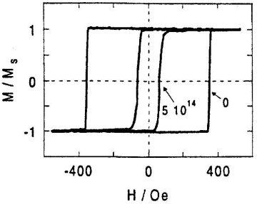
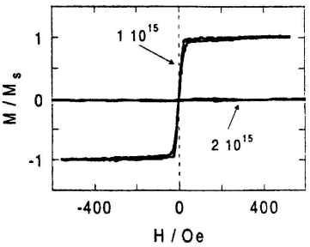
Ion beam induced intermixing
Faraday microscopy image of magnetic patterns of a FIB dot array (Ga ions, 28 keV).
(either bright or dark region is irradiated)
Initial film: Pt(3.4nm)/Co(1.4nm, ferromagnetic)/Pt(4.5nm).
Mechanism: ion-induced atom displacement at the Co/Pt interfaces (ion beam mixing effect).
paramagnetic
Faraday ellipticity loops obtained at room temperature after uniform Ga irradiation. Irradiation reduces coercivity; at even higher dose 2×10¹⁵, the film becomes paramagnetic.

Slide 41
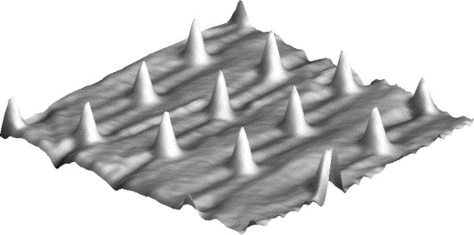
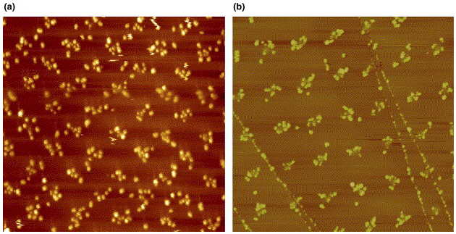
Ion beam patterning of HOPG
HOPG: a kind of graphite, highly oriented pyrolitic graphite.
TM-AFM images (980 nm × 980 nm) of the morphologies of defects created by FIB on a HOPG substrate (35keV Ga⁺ ions, probe size ∼6nm, ion dose 3750 ions/pt.
The surface bumps are organized in a matrix of periodicity L_{def}=250nm, note the very reproducible height (around 1.8nm) of the fabricated structures.
For lower ion doses (as here), only ion-induced defects and subsequent local volume variations corresponding to surface modification are evidenced.
For higher ion doses, holes are etched into the sample, leading to a volcano-crater like morphology.
Use irradiated HOPG substrate to guide the deposition of metal clusters.
TM-AFM (2μm × 2μm) image of morphologies of HOPG surfaces.
After deposition of gold clusters.
After deposition of Co₅₀Pt₅₀ followed by a thermal annealing.

Slide 42
Focused ion beam (FIB)
Overview.
Ion source and optics.
Ion-solid interaction, damage.
Scanning ion beam imaging.
FIB lithography using resist.
FIB milling, sputtering yield.
Redeposition.
Single line milling.
Other types of FIB lithographies (implantation, intermixing…).
Gas-assisted FIB patterning.

Slide 43
Gas-assisted FIB lithography
FIB alone
capabilities
FIB with gas
Ion
Etching
Enhanced
etching
Poor selective
Etching
Selective
etching
Ion
deposition
Material
deposition

Slide 44
Gas-enhanced FIB milling (etching)
Impinging Ga⁺ knocks out atoms and ions from sample
Redeposition is prevented by chemical reaction with the adsorbed gas - formation of volatile species.
Etching gases that react only with certain species - selective milling
Examples of etching gases
XeF₂ enhances Si and insulator milling.
Cl₂, Br₂, I₂ enhances metal milling.
H₂O enhances carbon (polymers, ...) milling.
Sputtering yield enhancement factors

Slide 45
Gas-enhanced FIB milling (etching)
Adsorption of the gas molecules on the substrate
Ion bombardment ionize the absorbed gas atoms, making them reactive.
Interaction of the gas molecules with the substrate
Formation of volatile species: GaCl₃, SiCl₄, SiF₄
No chemical reaction
Formation of non-volatile species: AlF₃, oxide layer
Evaporation of volatile species and sputtering of non volatile species

Slide 46
Gas-assisted selective/enhanced FIB milling
Selective etching using XeF₂
Al
SiO₂
With XeF₂
Without XeF₂
Enhanced etching using XeF₂
Orsay Physics

