Slide 1
Focused ion beam (FIB)
FIB application: lithography using resist, milling, imaging.
FIB TEM sample preparation.
FIB circuit edit and photo-mask repair.
Other applications: superconducting, SPM tip, wrinkling, nano-pore.
Proton (hydrogen ion) beam writing.
Scanning Helium ion microscope
ECE 730: Fabrication in the nanoscale: principles, technology and applications
Instructor: Bo Cui, ECE, University of Waterloo; http://ece.uwaterloo.ca/~bcui/
Textbook: Nanofabrication: principles, capabilities and limits, by Zheng Cui

Slide 2
Focused ion/electron beam application
It is the absolutely the most versatile tool for nanofabrication.
Neither mask nor resist needed.
Capable of both top down (milling/etching) and bottom up (deposition) fabrication.
Ultrahigh resolution.
Substrate doesn’t need to be flat, fabrication anywhere on anything.
One sees what one does using built-in SEM/SIM imaging.
Besides fabrication, can also do FIB-doping to modify material properties.
However,
Low throughput, serial process, like EBL.
The deposited material is usually far from being pure with poor conductivity.
Ga contamination and damage of the sample.

Slide 3
Lithography with resist, comparison to EBL
“In theory” (not in practice), FIB lithography can totally replace EBL.
Almost no proximity effect, higher resist sensitivity.
However,
Low ion penetration depth, need thin resist layer, difficult for pattern transfer.
This problem can be overcome by top-layer milling or writing using bi-layer resist.
Other problems: Ga implantation into resist, larger beam size for same current.
FIB tool is more expensive and less available. (user fee 50% higher than EBL)
Top resist ~50nm
Thin top layer
Thin (10nm)
SiO₂
Thin (5nm)
Cr
Thick bottom layer
Thick bottom layer
substrate
substrate
Lithography and develop top layer
RIE SiO₂ using CHF₃
RIE bottom layer using O₂ gas.
Mill Cr (only 5nm thick, fast)
RIE bottom layer using O₂ gas.

Slide 4
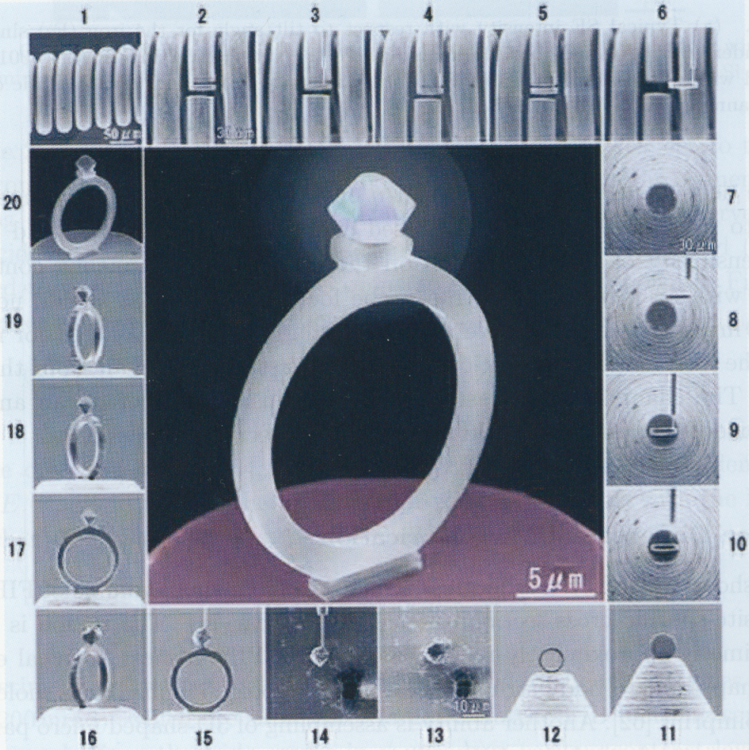
FIB as a micro-nano-machining tool
Micro diamond ring milled from a 20μm diameter W wire.

Slide 5
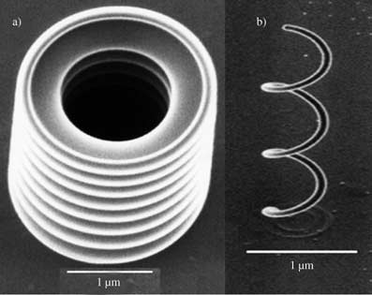
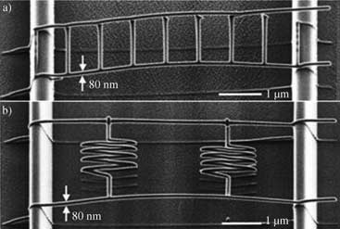
More FIB milled and deposited structures
FIB-induced deposition: a) micro-bellows with 100nm thickness, 800 nm pitch; b) micro-coil with 80nm wire diameter.
SIM images of DLC nanostructures prepared by FIB-induced deposition: a) free-space-wiring with a bridge shape; b) free-space-wiring with parallel resistances
Tseng, “Recent developments in nanofabrication using focused ion beams”, Small, 1(10), 924 – 939(2005)

Slide 6
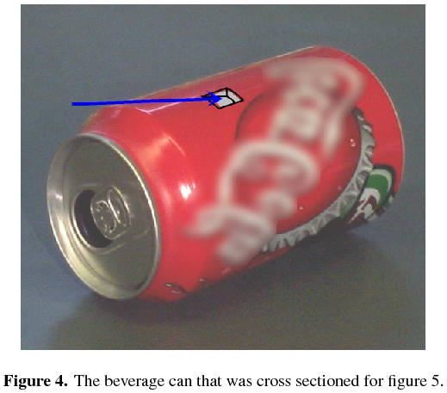
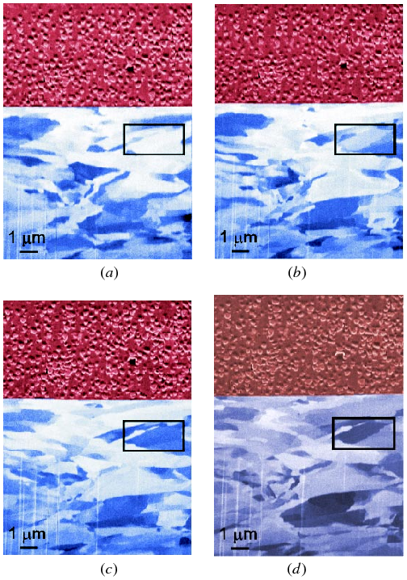
See inside: section by milling, look by imaging
Figure 5. Cross section through an aluminum beverage can, visualized from various tilting angles: (a) 30◦, (b) 35◦, (c) 40◦, and (d) 45◦.
The aluminum grains are clearly visible (lower part), as well as the polymer label (upper part).
The tilt angle-dependent channeling contrast is clearly illustrated by the boxed grain.
“A review of focused ion beam applications in microsystem technology”, Reyntjens, JMM, 2001

Slide 7
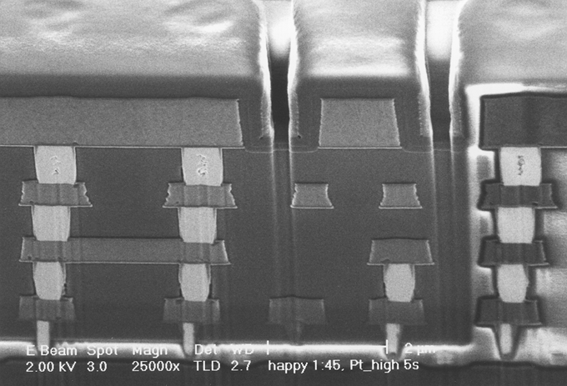
SEM image of integrated circuit cross-section milled by FIB

Slide 8
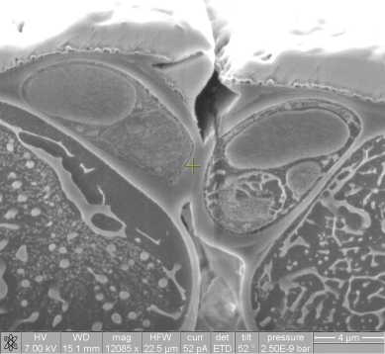
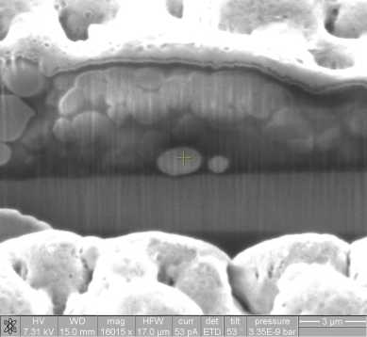
Biomaterial sectioned/milled at very low temperature
Stomata guard cells XS of frozen coriander leaf.
Cobalt particle in nucleus of frozen Human fibroblast nucleus

Slide 9
Focused ion beam (FIB)
FIB application: lithography using resist, milling, imaging.
FIB TEM sample preparation.
FIB circuit edit and photo-mask repair.
Other applications: superconducting, SPM tip, wrinkling, nano-pore.
Proton (hydrogen ion) beam writing.
Scanning Helium ion microscope

Slide 10
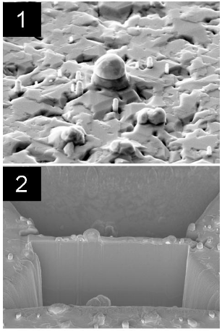
TEM sample preparation
FIB milling is a very powerful tool for preparing thin sections for electron microscopy analysis. In combination with the instrument’s high resolution SEM imaging capabilities, one can prepare site-specific sections of sub-micron sized features.
A feature of interest is located with the Scanning Electron Microscope (SEM) in the FIB/SEM CrossBeam. (Sample courtesy of Prof. Ray LaPierre, McMaster University).
The region of interest is coated with platinum, in-situ, using the CrossBeam’s gas injection system. This layer protects the surface of the feature during subsequent FIB milling. The surrounding substrate is removed by FIB milling, leaving a 1 micron thick lamella containing the feature of interest.
University of Western Ontario, http://www.uwo.ca/fab/facilities/TEMprep.htm

Slide 11
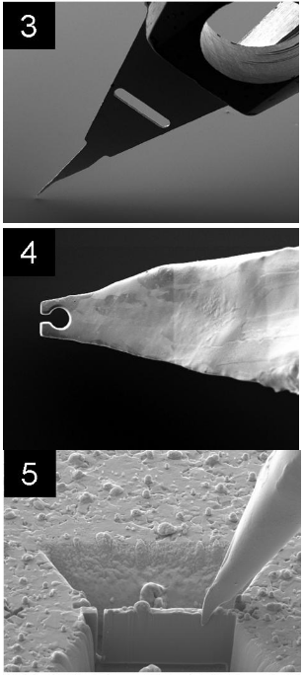
At the tip nano-manipulator rod is mounted an “end effector” – a sharp Mo or Cu tip. The tip is positioned just above the region of interest on the sample.
Using the FIB, a pair of tines are machined at the tip of the end effector. The spacing is slightly less than the thickness of the lamella prepared in step 2.
With the left and bottom sides of the lamella cut free, the end effector is positioned onto the right side of the lamella. This procedure is accomplished by viewing both the SEM and FIB secondary electron images while lowering the end effector onto the sample. The alignment of the tines with the sample in plane of the sample surface is observed and adjusted in the FIB image and the height is visualized in the SEM image.

Slide 12
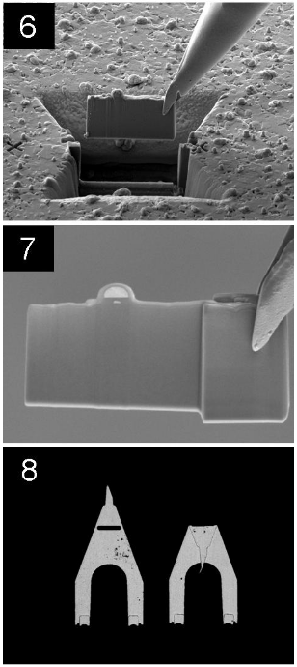
With the lamella securely held between the tines, the right side is cut free and the sample is lifted clear, again while monitoring the position with both the FIB and SEM electron images.
After the lamella is lifted clear of the substrate, the final thinning and polishing is performed by FIB milling. Progress is monitored in situ by SEM – the rod can be rotated to allow both front and back to be imaged and the thickness to be measured. A final thickness of 100nm is typical.
The nanomanipulator rod is withdrawn from the microscope through a loadlock without venting the microscope chamber. After the tip of the end effector is folded over and removed from the nanomanipulator rod, it can be directly mounted in a standard 3mm diameter TEM sample holder.

Slide 13
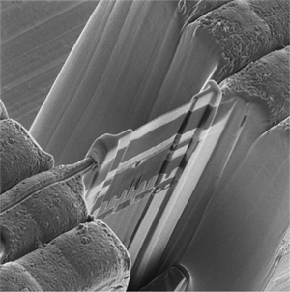
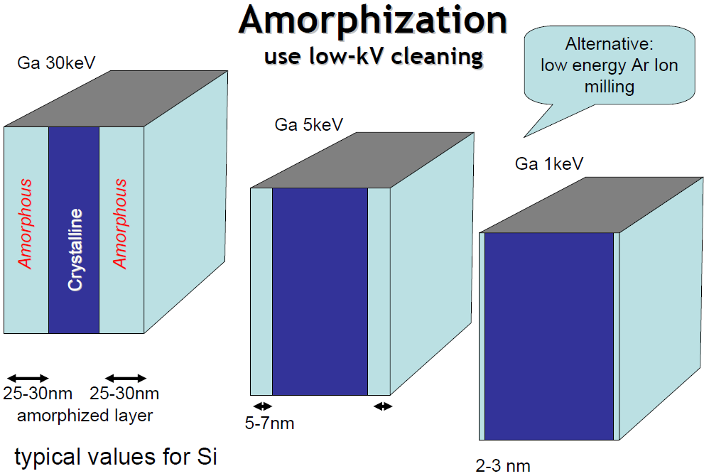
Milling a TEM lamella
Lamella has large (10x5um) flat areas with uniform thickness (50-80nm).
Heterogeneous samples with “difficult” material combinations becomes possible.
High eV Ga ion, large beam current for coarse milling.
Low eV low current for fine trimming.

Slide 14
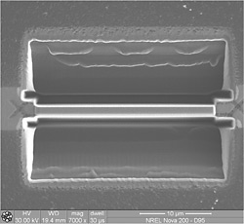
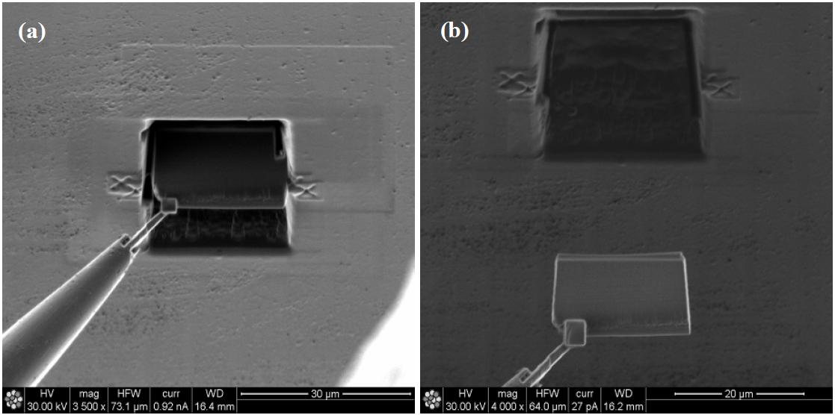
Milling a TEM lamella and lift out by nano-welding
Top view shows the width of the lamella
Weld and lift out by in-situ deposition of Pt
Opposing trenches are milled out and a 1-2 µm thin section is left free standing in the wafer.
The section is welded to the micro-manipulator, extracted from the wafer then transferred and welded to a TEM grid post.
Final thinning down to a thickness of less than 100nm is achieved using low incident angles and low Ga ion current.

Slide 15
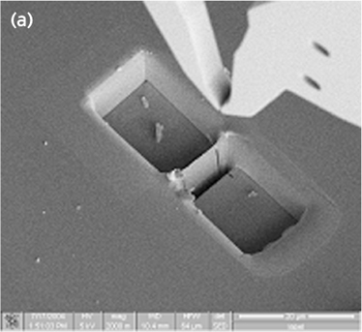
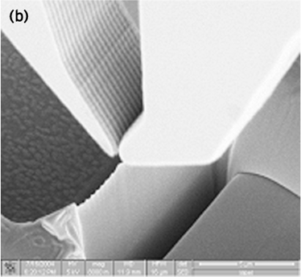
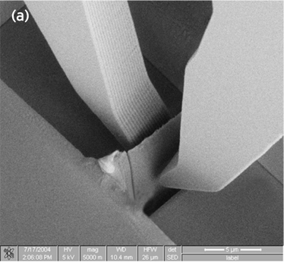
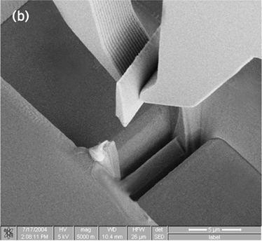
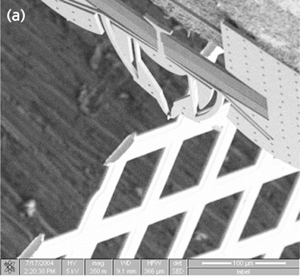
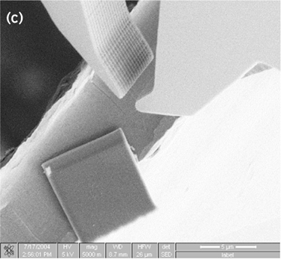
Lift out by nano-gripper
1
2
3
4
5
6

Slide 16
Lift out by electrostatic force using a glass-needle

Slide 17
Focused ion beam (FIB)
FIB application: lithography using resist, milling, imaging.
FIB TEM sample preparation.
FIB circuit edit and photo-mask repair.
Other applications: superconducting, SPM tip, wrinkling, nano-pore.
Proton (hydrogen ion) beam writing.
Scanning Helium ion microscope

Slide 18
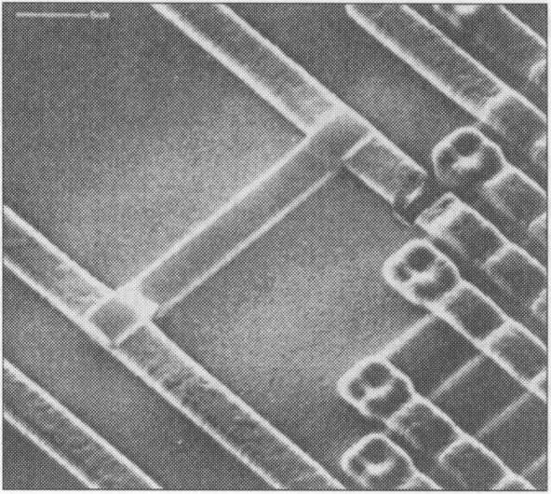
Integrated circuit edit
Errors in circuit design can be diagnosed (milling or sectioning by FIB, seeing by SEM/SIM), and corrected by disconnecting (milling) or connecting (deposition) some parts. After repair, protecting layer of SiO₂ can be deposited.
One metal track was cut and re-connected to the other metal track with a deposited bypass.

Slide 19
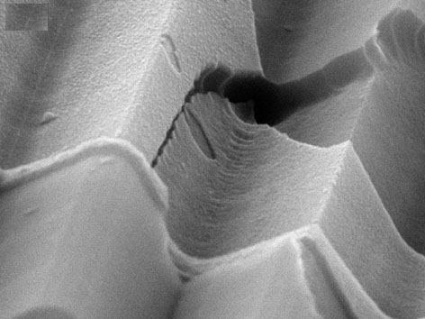
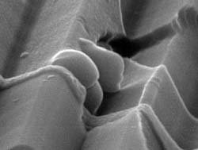
Electrical contact repair by FEB deposition
Electrical contact break After FEB reparation
Even though the film is not pure with low conductivity, it is still quite conductive.

Slide 20
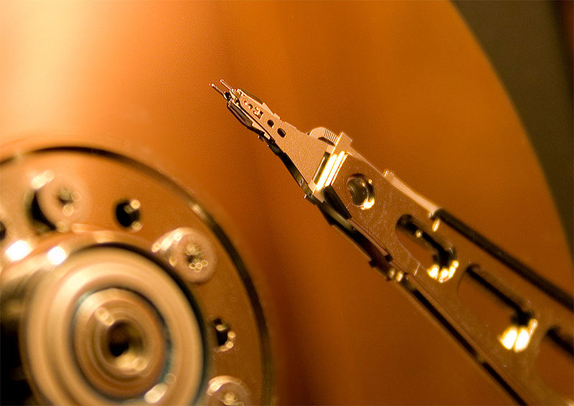
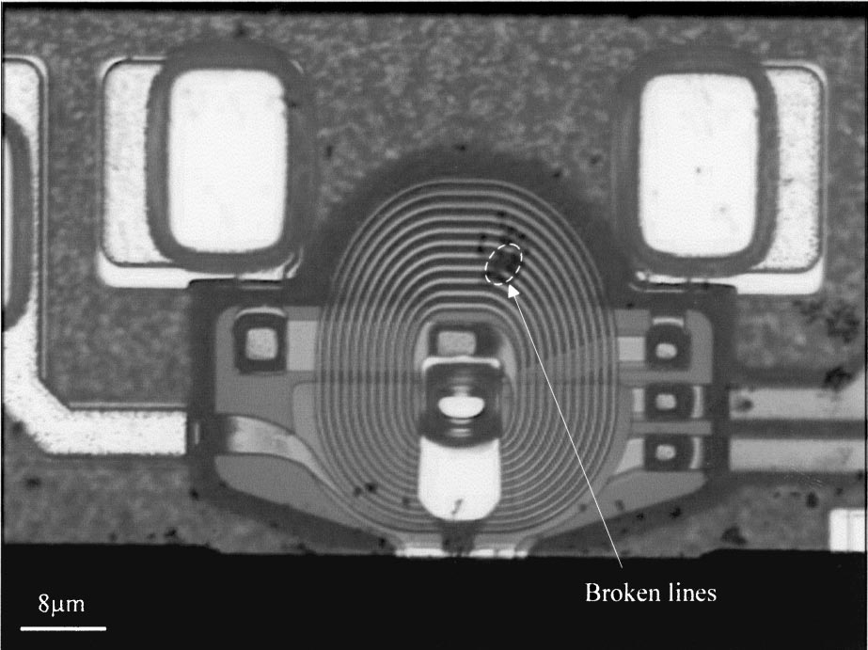
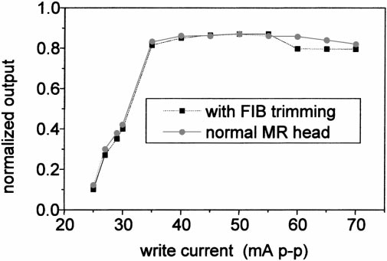
Repair of magneto-resistive (MR) head coil
Hard disk drive
Micro-coil of magnetic head with broken lines
Process:
FIB selective milling of polymer cover using XeF₂
FIB deposition of W lines
FIB deposition of SiO₂ protection layer
Optimal deposition parameters
dwell time: 0.5ms spot size: 25nm
current: 400pA refresh time: 1.5ms
ion dose: 0.6nC/mm² ion energy: 50keV
scanning mode: raster
X and Y pixel space: 71nm and 68nm
After FIB repair, performance close to a normal head
“Characterization of focused ion beam induced deposition process and parameters calibration”, Fu, Sensors and Actuators A, 2001.

Slide 21
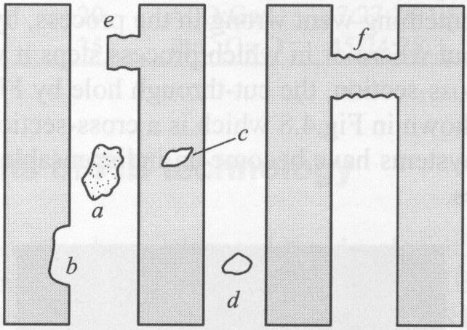
Optical mask defects repair
Types of mask defects: opaque defects a, e, d, f; clear defects: b, c
Clear defect can be easily repaired by FIB induced deposition of carbon (opaque) using hydrocarbon gas. Charge neutralization measure (“spray” electrons to surface) is needed to prevent ion charge accumulation, also need to minimize sputtering.
Opaque defects is more difficult to repair, will be addressed in the following slides.
Phase shifting mask even more difficult to repair, Cr removal (defect f in the figure) will cause additional phase shift.

Slide 22
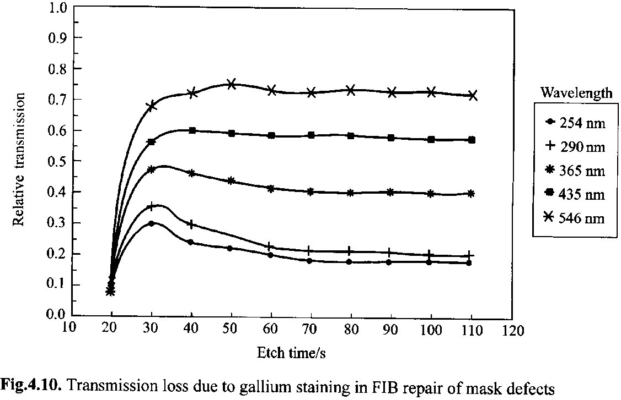
Opaque defects removal by ion milling
Problem: Ga⁺ implantation/staining reduces mask transmission to DUV light

Slide 23
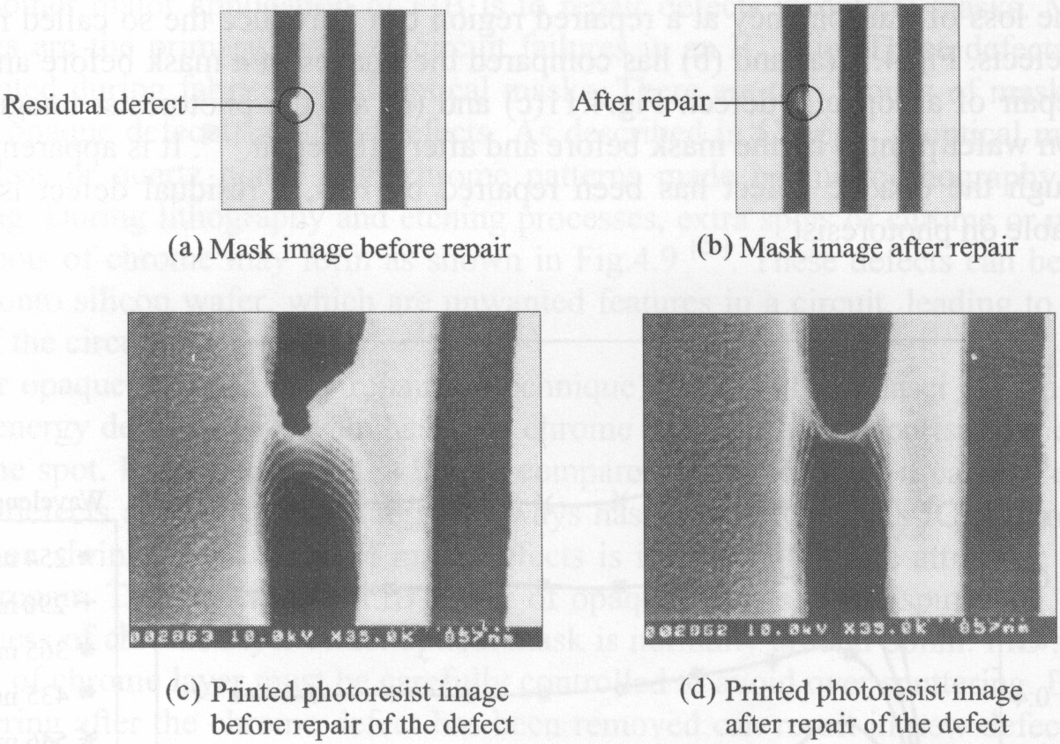
Gallium staining induced residual defect and printed photo-resist image

Slide 24
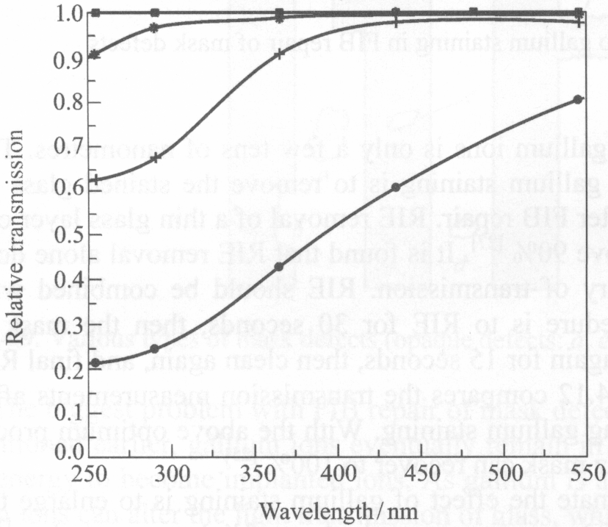
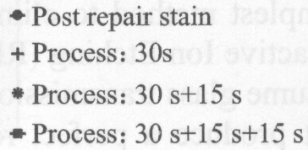
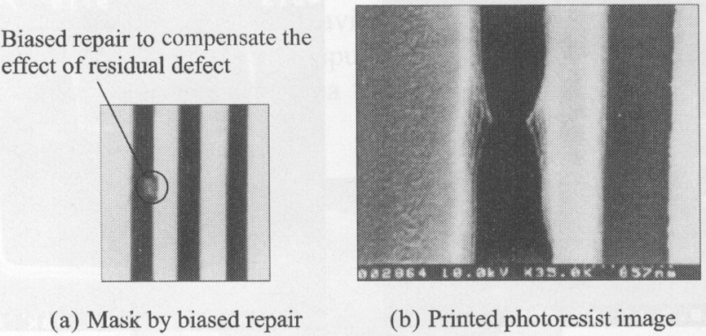
How to reduce Ga⁺ staining effect while repairing opaque defects
Recovery of transmission by RIE and cleaning to remove gallium staining.
RIE the glass using F-chemistry
Etch Ga by acid
Repeat with reduced RIE time.
Biased repair, over-etch to beyond defect area
A third method: (to remove Cr)
use focused electron beam with gas (Cl₂/O₂) enhanced etching to produce volatile compound (CrO₂Cl₂)

Slide 25
Focused ion beam (FIB)
FIB application: lithography using resist, milling, imaging.
FIB TEM sample preparation.
FIB circuit edit and photo-mask repair.
Other applications: superconducting, SPM tip, wrinkling, nano-pore.
Proton (hydrogen ion) beam writing.
Scanning Helium ion microscope

Slide 26
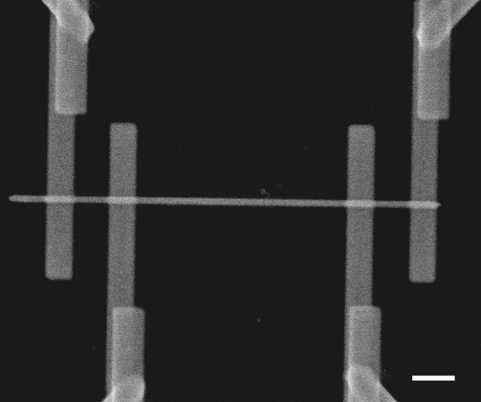
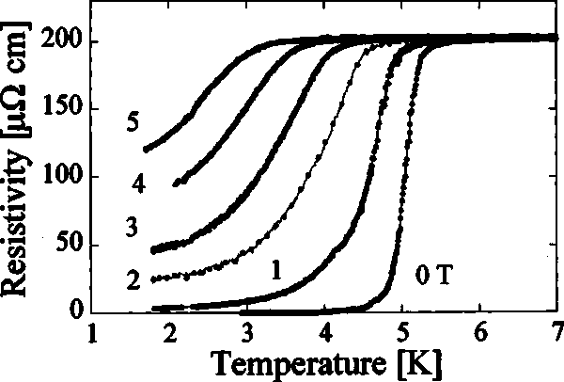
Superconducting W nano-wires by FIB induced deposition
Superconducting wire in a four-point contact configuration for transport measurements.
Wire length 10μm, width 300nm, thickness 120nm
Resistivity vs. temperature for magnetic fields applied perpendicular to the wire from 0 to 5T.
Single crystal pure W Tc=0.01K, here Tc much higher probably because it is amorphous with lots of C and Ga.
W(CO)₆ precursor, 30keV Ga⁺ ion, current 98pA, aperture size 100μm, ion dose 1nC/μm².
Precursor temperature 61°C. During deposition, chamber pressure kept at 2.63×10⁻⁵Torr.
“Focused-ion-beam-induced deposition of superconducting nanowires”, Sadki, APL, 2004

Slide 27
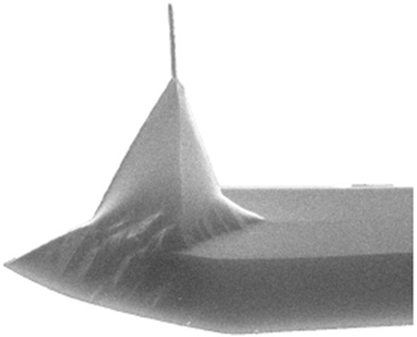
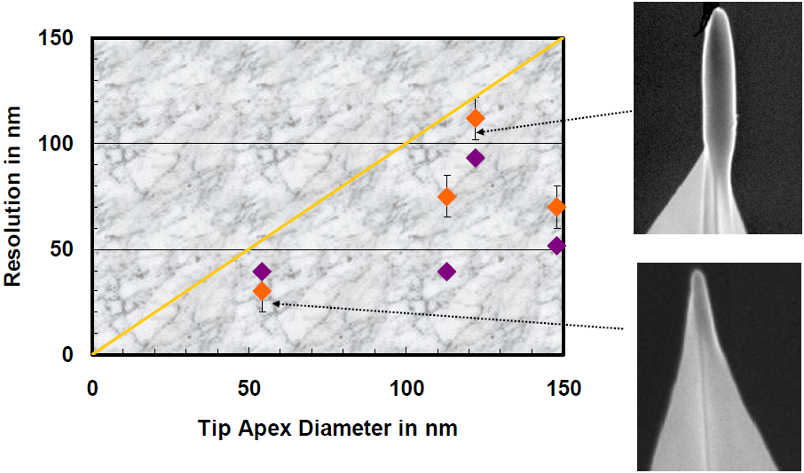
Magnetic force microscopy (MFM) tips by FEB deposition
Tip consists of magnetic nano-crystals of 2-5nm size dispersed in stabilizing carbonaceous matrix.
AES (Auger Electron Microscopy)
Co: 32-36 at%
C: 47-55 at%
O: 13-17 at%
(not pure Co, poor property)

Slide 28
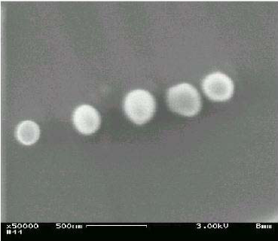
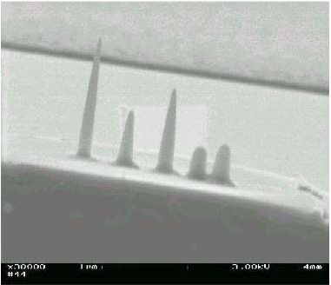
Magnetic force microscopy (MFM) tips by FEB deposition
A more efficient way to prepare MFM tip:
FIB or FEB deposit a sharp non-magnetic tip such as carbon
Evaporate (or sputter) 20nm Co (or Ni) onto the tip apex.
This way one has pure Co (or Ni) with improved magnetic property.
The easiest way to prepare a tip is to use a regular SEM and focus onto an AFM tip apex until sharp carbon contamination tip is grown there.
(i.e. e-beam induced deposition using contamination such as oil in chamber as precursor gas)
Top view
Side view
Those in-situ grown structures are typically used to focus and adjust the e-beam before e-beam lithography. (otherwise, hard to adjust the beam on flat resist surface)

Slide 29
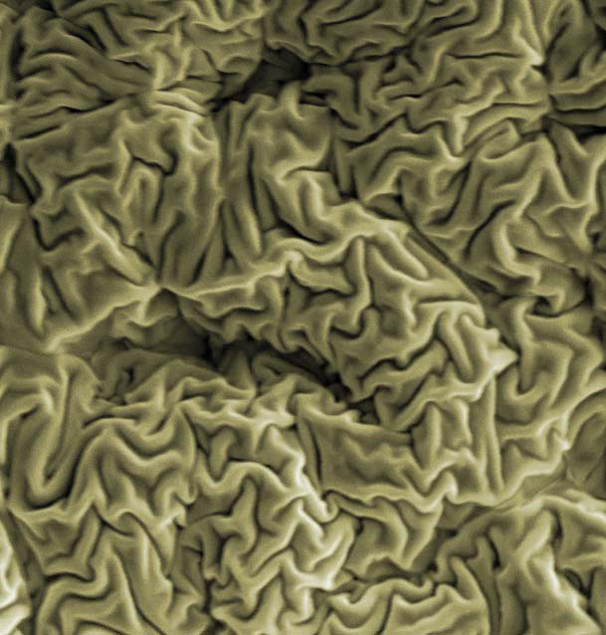
Ion beam modification of material: wrinkled hard skin
Wrinkle with FIB:
One step fabrication
At desired region
With any size
Application:
Cell culturing templates
Nano-channels for protein pre-condensation
Moon, Lee, Sun, Oh, Ashkan, Hutchinson, PNAS 2007

Slide 31
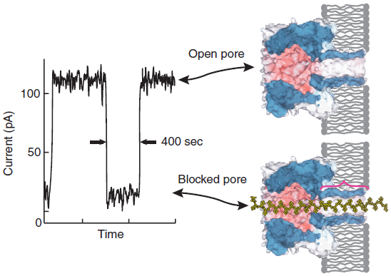
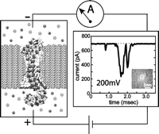
Nano-pores for DNA sequencing
Translocation of a DNA through a biological channel
Translocation of a DNA through a synthetic channel
Application:
DNA sequencing
Separation of ssDNA and dsDNA in solution
Determining polymer chain length
Strand-sequencing using ionic current blockage:
Typical trace of ionic current amplitude (left) through an α-hemolysin pore clearly differentiates between an open pore and one blocked by a strand of DNA.
“The potential and challenges of nanopore sequencing”, Nature Biotechnology, 1146, 2008 (review paper)
physics.uark.edu/journal/SabinaRep08.doc (a good summary of the technique)

Slide 32
Fabrication of nano-pores for DNA sequencing
Si₃N₄ thin membranes are deposited by sputtering on a 4-inch Si wafer.
Photoresist (PR) is applied to both sides of the wafer.
Anisotropic RIE is used to remove the thin layer of Si₃N₄ not protected by the photoresist
Anisotropic wet etching uses KOH to remove bulk material from the wafer
Focused Ion Beam is used to drill a hole through the free standing membrane
Non-flat surface, very difficult to fabricate by other lithographies.

Slide 33
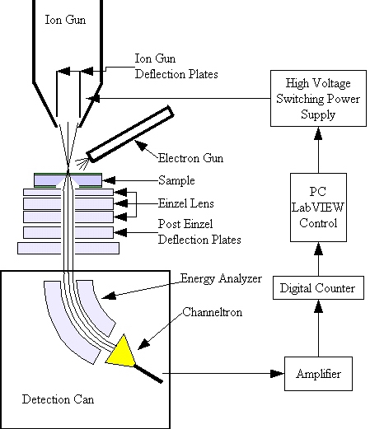
Sculpting of the nano-pore: effect of ion exposure
Ga⁺ implantation in the surface: swelling and hole closing
For hole closing: large scan area, low rate of sputtering
For hole opening: small scan area, high sputtering rate
Signal from ejected particles: monitoring hole formation
Hole opening/closing can be monitored by ion current

Slide 34
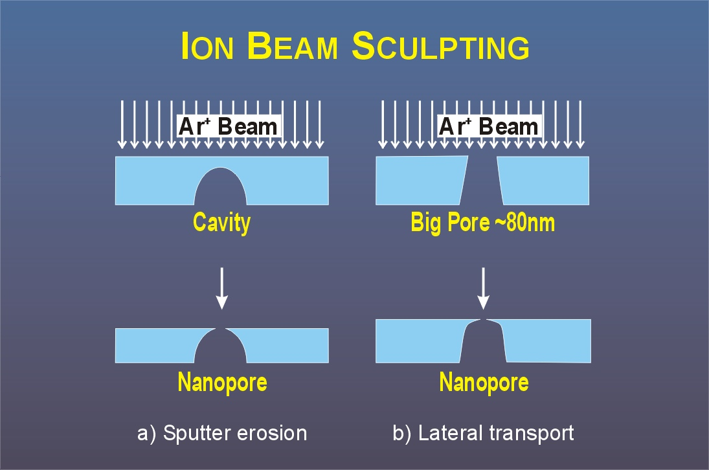
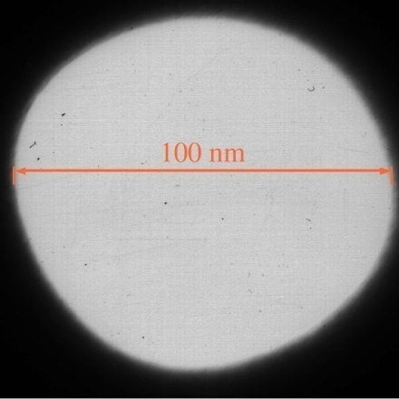
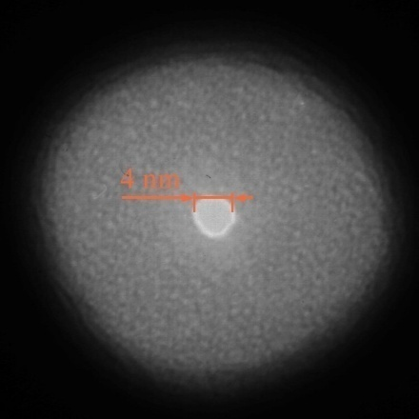
Milling vs. lateral mass transport for nano-pore
Pore opening
Pore closing
Closing of a nano-pore: 100nm → 4nm
Kr⁺ ion, 3keV
TEM image of FIB Hole
Closing of an FIB Hole
“Nanopore Sculpting with Noble Gas Ions”, Cai, JAP, 2006
http://www.mcb.harvard.edu/branton/IonBeamSculptingNanopores.jpg

Slide 35
Focused ion beam (FIB)
FIB application: lithography using resist, milling, imaging.
FIB TEM sample preparation.
FIB circuit edit and photo-mask repair.
Other applications: superconducting, SPM tip, wrinkling, nano-pore.
Proton (hydrogen ion) beam writing.
Scanning Helium ion microscope

Slide 36
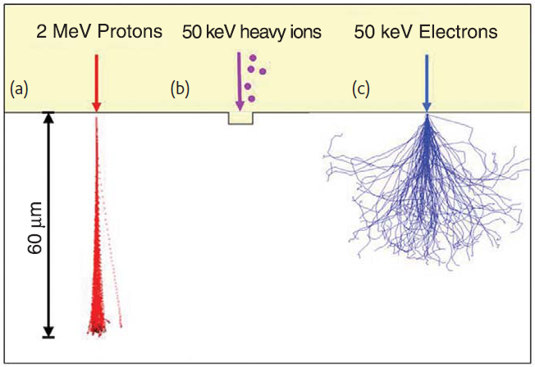
Proton (p-) beam writing
Compared to e-beam lithography:
Proton (H⁺) is heavier, deeper penetration in materials while maintaining a straight path. Almost no proximity effect.
So capable of fabricating three-dimensional, high aspect ratio structures with vertical, smooth sidewalls and low line-edge roughness.
In p-beam writing, typical energy is 0.5-2MeV (very high energy).
(Ga⁺)
Watt, ... van Kan, “Proton beam writing”, MaterialsToday, 10 (6), 20-29, June 2007. Excellent review paper

Slide 37
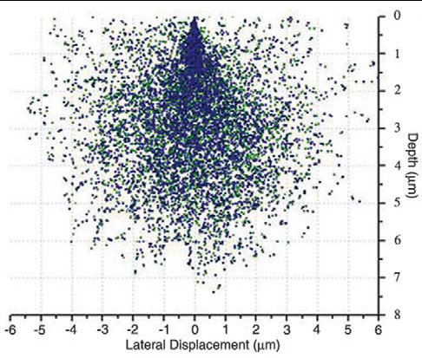
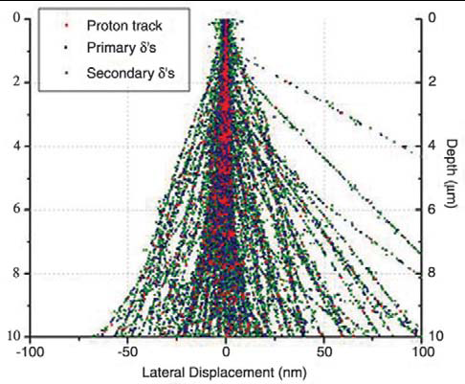
Proton (p-) beam writing
For most of its path (except near its end), the probability that a proton interacts with an electron is a few orders of magnitude larger than for nuclear scattering, so nuclear collisions have little effect on the trajectories.
Due to high mass mismatch, p-e collisions do not significantly deviate proton’s trajectory.
Due to momentum mismatch, energy transfer in each p-e collision is small, so many 1000 collisions will occur before a proton comes to rest.
Near its end (when p has low energy), nuclear collision become more important, thus more broadening.
(μm)
(nm)
δ-simulator profiles of one thousand 20keV electrons penetrating a 10 μm thick PMMA layer (primary electrons are shown in red, secondary electrons in green).
δ-simulator profiles of one thousand 2MeV protons penetrating a 10 μm thick PMMA layer (primary protons are shown in red, secondary electrons in green).

Slide 38
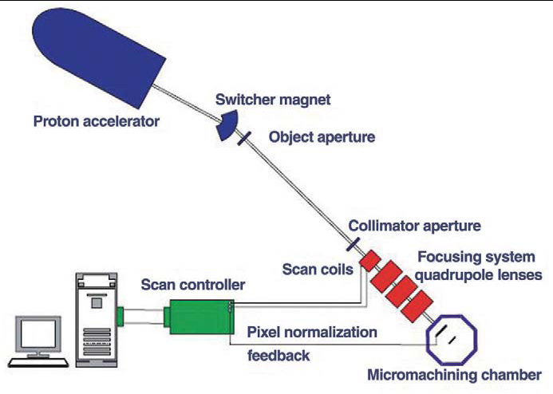
Proton-beam writing systems
For p-beam, diffraction is not an issue: λ∼ 10⁻⁴ nm for 100keV proton.
CIBA claims: “P-beam writing is the only true direct-write, three-dimensional fabrication technique at the nanoscale.”
In the past (before 2003), technical and commercial development has been hampered by the difficulties in focusing MeV ions to sub-100nm dimensions.
P-beam writing facility at CIBA (Singapore).
MeV protons are produced in a proton accelerator, and a de-magnified image of the beam transmitted through an object aperture is focused onto the substrate material (resist) by means of a series of strong focusing magnetic quadrupole lenses (e.g. quadrupole triplet).

Slide 39
P-beam writing in PMMA, SU-8 and HSQ
Exposure is caused by proton-induced secondary electrons.
The proton dose required for exposure varies from 3-15μC/cm² depending on the
resist material, and is ∼80× times faster than e-beam writing.
Parallel lines written in a 350 nm thick PMMA layer using 2MeV p-beam
High aspect ratio structures in SU-8 resist showing 60nm wall structures that are 10μm deep
P-beam writing in hydrogen silsesquioxane (HSQ), high aspect ratio structures down to 22nm.

Slide 40
3D fabrication using proton beam
SU-8 is a negative resist, positive resist won’t work
Low energy, low exposure depth
High energy, exposed to resist bottom
Micro-sized copy of Stonehenge in the UK fabricated using p-beam writing in SU-8 resist. By using the different depth exposure of two different proton energies, 500keV for fabricating the horizontal slabs and 2MeV for exposing the vertical supports, the complete structure can be fabricated in one layer of resist.

Slide 41
P-beam defect patterning
Like FIB using Ga⁺, p-beam can modify the materials, such as inducing atomic displacement and vacancies in crystalline materials.
The damaged region has much lower etching rate in electrochemical etching using diluted HF to produce porous Si. (the porous Si can be etched much faster than Si by KOH)
Again, by using different energy (different penetration depth), 3D structure can be obtained.
Patterning of p-type Si with p-beam writing.
Electrochemical etching to selectively form patterned porous Si.
Removal of porous Si with dilute KOH solution to form a icromachined structure.
Damaged region in Si by proton beam irradiation.
Micro-machined Stonehenge-like structure, 80μm diameter, in Si.

Slide 42
Application in display
When a film is coated on a substrate, light of certain wavelength will be more reflected (so we can see the color of oil film floating on water).
The reflected wavelength (color) depends on the refractive index (n) of the film.
The color is more pure (narrower λ) if there are a periodic (in z-direction) multi-layer films.
In the image below, the n-contrast is created by the fact that n of porous Si is inversely proportional to the electrochemical etch current density. (i.e. n₁ and n₂ layer are etched at different currents)
color 1 color 2
n₁
n₂
n₁
n₂
n₁
n₂
n₁
n₂
n₁
n₂
n₁
n₂
High p-dose, high etching rate, so larger pitch.
Optical reflection images: (a)the painting La Musique by Henri Matisse (1939) created by irradiating a 500 × 500 μm² area. (d) 500 × 500μm² areas showing a dragon .
In each recorded image the sample was illuminated with white light and the reflected light was recorded for 30sec.

Slide 43
Focused ion beam (FIB)
FIB application: lithography using resist, milling, imaging.
FIB TEM sample preparation.
FIB circuit edit and photo-mask repair.
Other applications: superconducting, SPM tip, wrinkling, nano-pore.
Proton (hydrogen ion) beam writing.
Scanning Helium ion microscope

Slide 44
New trend: Scanning Helium Ion Microscope (SHIM)
Compared to SEM for high resolution imaging:
Mass of He ion (Z=2, M=4) is 8000×, so 1/√8000 shorter wavelength (for same eV), which leads to less diffraction for high resolution imaging.
He ion has considerably smaller interaction volume (due to smaller penetration depth). This enables SHIM’s resolution to be directly proportionate to its spot size which is not always the case with SEM.
Like SIM using Ga⁺, SHIM has quite different material contrast than SEM.
SHIM can produce ∼3-9 secondary electrons per ion compared to ∼1 per electron for SEM. Thus SHIM can image properly with ion currents <1pA (small current – small aperture – small beam convergence angle α, so small beam size due to less chromatic and spherical aberration).
Such small current also means little charging,
thus SHIM can image insulating materials better.
Higher depth of focus (by ∼5×).
He ion beam has a DeBroglie wavelength much smaller than an electron beam, resulting in much less diffraction.
http://addictedtonature.wordpress.com/2007/06/04/the-scanning-helium-ion-microscope/

Slide 45
New trend: Scanning Helium Ion Microscope (SHIM)
Compared to FIB using Ga⁺ ion:
He ion is much lighter, so much less damage and no “staining”
That is, He implantation doesn’t hurt much, whereas Ga does. At very high He dose, He bubble will form beneath sample surface, which may eventually blow off the surface.
Little sputtering during imaging, so can image fine structures.
It can still be used to mill material such as TEM sample preparation, without the negative aspects when using Ga⁺ FIB.
Milling is very slow (since He is light), but can be chemically-assisted (add XeF₂ gas…) to get fast.
It can also be used for material deposition.

Slide 46
Gas field ion source (GFIS)
GFIS has actually been researched on for longer than the LMIS. (liquid metal ion source, for Ga⁺)
But until ALIS (bought by Zeiss later on) came into the picture, nobody could achieve the stability, reliability and properties needed for a suitable helium ion beam that could match the spot size of a SEM.
Like (cold) field emission SEM, electric field of >10⁸V/cm is first achieved at the sharpest point of a W tip.
Ionization can then take place at tip apex just like in field ion microscopy.
He are accelerated away once they are ionized to form a beam that is accelerated by the ion column.
Increasing He pressure increases the ion current proportionately, from 1fA to 100pA.
Helium ion source has a very long lifetime due to the fact that the source tip is always kept at a positive potential. The only things attracted to the tip are electrons, which do not cause any ill effects. Positively charged ions are repelled from the tip and other gasses will be ionized before they have a chance to strike the source tip. For this reason, the source lifetime for the helium ion source is well over 1000 hours.

Slide 47
SHIM structure
The “trimmer: for extremely sharp tip
A finely sharpened needle is made even sharper - individual atoms are stripped away from the source until an atomic pyramid is created with just three atoms at the very end.
This repeatable process can be accomplished in-situ. Once the trimmer is formed, the tip is maintained under high vacuum and cryogenic temperatures.
The helium gas is attracted to the energized tip where it is ionized.
With ionization happening in the vicinity of a single atom, the resulting ion beam appears to be emanating from a region <1Å in size.
This produces an extremely bright beam that can be focused to an extraordinarily small probe size.
Image of the atoms at the end of the source tip emitting helium ions. Since each atom can be individually seen, the virtual source size must be much smaller.
Detectors:
Ion (backscattered He); Electron (secondary electron)
Transmission detector (for thin sample, He gets through)
http://www.smt.zeiss.com/nts

Slide 48
Application of SHIM
“(SHIM) is clearly a serious and major breakthrough in “seeing” things. The applications of this technology are immense. Imagine, a microscope, with the resolution of (close to) a TEM, does not require sample preparation, provides higher voltage and material contrast information, inert ion beam with much less volume interaction leaving no artifacts. And to top it all off, it’s still the start whereas electron microscopy and focused ion beam microscopy has been under development for over 40 years.”
Left: SHIM image of a solder bump showing the difference in the lead and tin sections. Right: SEM image of the same sample.
http://addictedtonature.wordpress.com/2007/06/04/the-scanning-helium-ion-microscope/

Slide 49
Application of SHIM
SHIM image of a sample. It is discernible that the material in the cross is different from the outside. Some of the dark specks are actually material from the inside scattered on the outside. Right: SEM image of the same sample.
Left: SHIM backscattered (He ion) image of Benthic Foraminifera. Right: Benthic Foraminifera. Note that both of these samples are insulators and no sample preparation was made.

Slide 50
New record: 0.24nm resolution by SHIM
For demonstration of the image resolution of 0.24nm, a line-scan over the very sharp edge of an asbestos fiber on a thin holey carbon foil is shown. The texture of the holey carbon foil demonstrates the extremely high surface sensitivity of the ORION® which equals or even exceeds the surface sensitivity of an SEM operated at 1kV and below.
(Record resolution for SEM is ∼0.7nm)
http://www.smt.zeiss.com/nts

