Slide 1
Nanoimprint lithography (NIL)
Overview.
Thermal NIL resists.
Residual layer after NIL.
NIL for large features (more difficult than small one).
Room temperature NIL, reverse NIL, inking.
NIL of bulk resist (polymer sheet, pellets).
ECE 730: Fabrication in the nanoscale: principles, technology and applications
Instructor: Bo Cui, ECE, University of Waterloo; http://ece.uwaterloo.ca/~bcui/
Textbook: Nanofabrication: principles, capabilities and limits, by Zheng Cui

Slide 2
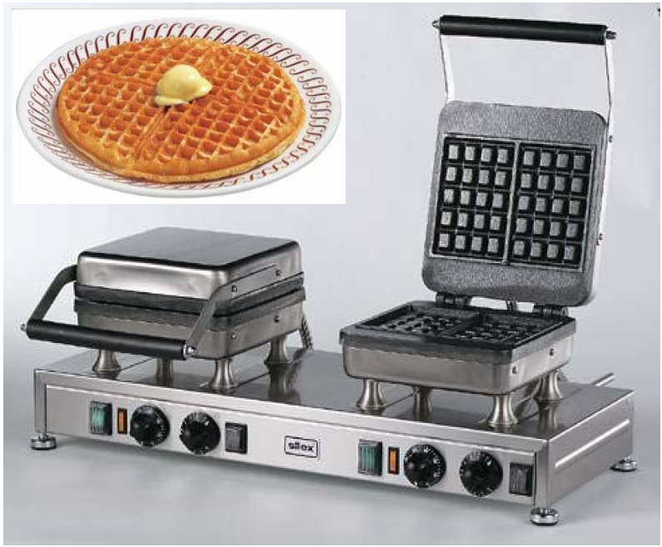
Nanoimprint lithography: patterning by mechanical replication
mold
substrate

Slide 3
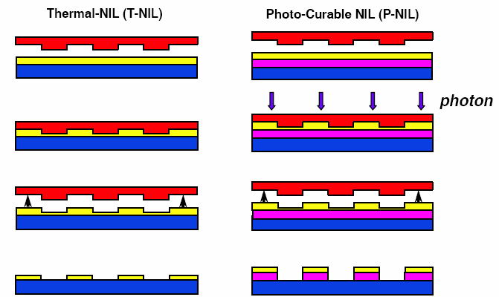
Two NIL approaches
Thermal NIL UV-curable NIL
UV-light
RIE residual layer
RIE residual layer, transfer into under-layer
Heat up to soften the resist, imprint, cool down and separate
Liquid (soft) resist, hardened by UV irradiation due to cross-linking

Slide 4
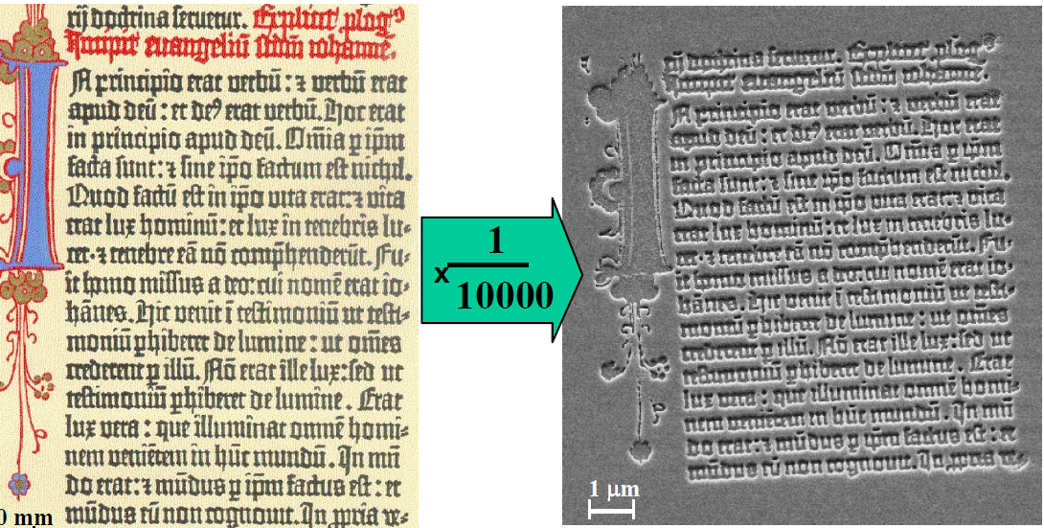
Printing: some history
During 1041-1048, Bi Sheng invented movable type printing technique. Hardened clay as mold.
12th century metal type printing techniques were developed in Korea.
1450 Gutenberg introduced his press. 300 two-volume bibles printed.
………
1970´s compact disks (CD).
1996, Nano-Imprint Lithography (NIL), sub-10 nm feature size, high throughput and low cost.
Today, NIL is one candidate (though not top candidate) for next-generation lithography for IC industry.
The bottom line is, NIL has the highest resolution (sub-5nm) and is fast. It will come into play when no other lithography can do the job.
Gutenberg bible (1450)
Duplicated by NIL (2000)

Slide 5
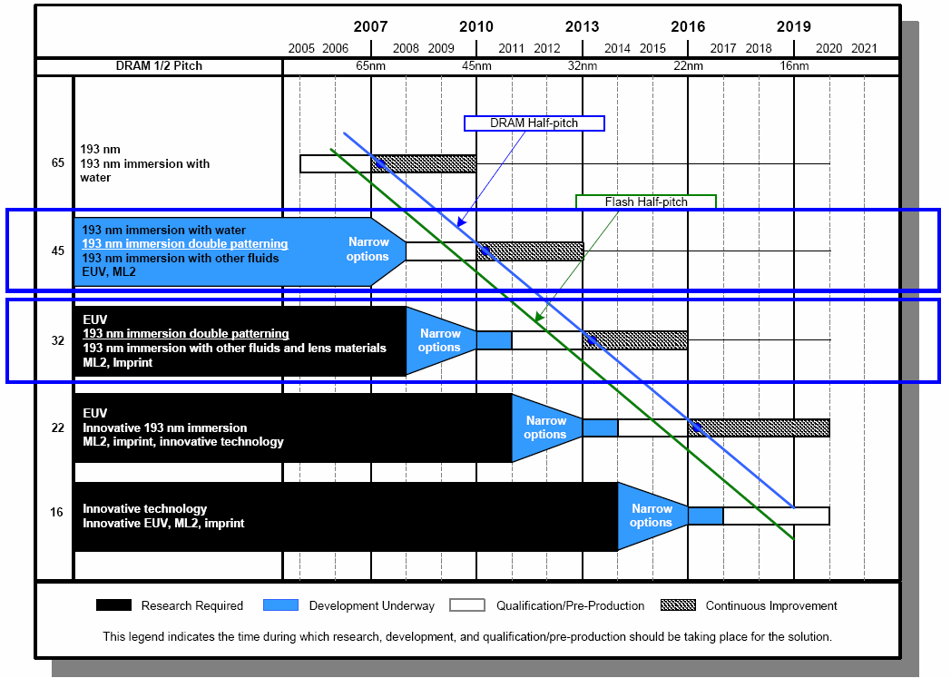
NIL not ready yet for ICs, but never excluded
ML2: maskless lithography (EBL, SPM..)
ITRS (2006) Projections for Lithography Technology

Slide 6
Comparison between thermal and UV NIL
Thermal
UV
Resist material | Thermoplastic or thermal-set (i.e. cured upon heating) | UV-sensitive monomer plus various additives
Resolution | Sub-5nm | 2nm demonstrated, but volume shrinkage after cross-linking
Temperature | 30-100ºC above T_{g} | Room temperature
Pressure | Normally over 10 bar | ~ 1 bar, or higher
Resist application | Spin coating, easy | Spin coating or drop
Resist thickness | Up to many μm, easy for pattern transfer | Typically < 100nm, need an extra transfer layer
Cycle time | 1-30 min, slow | ~1 min
Large features | ~100 μm, difficult | Relatively easy, low viscosity
Alignment | ~ 1 μm, difficult; CTE mismatch | 20nm demonstrated
Application | Broad range, simple and work with many materials | Targeted for semiconductor industry with alignment
T_{g}: glass transition temperature
CTE: coefficient of thermal expansion

Slide 7
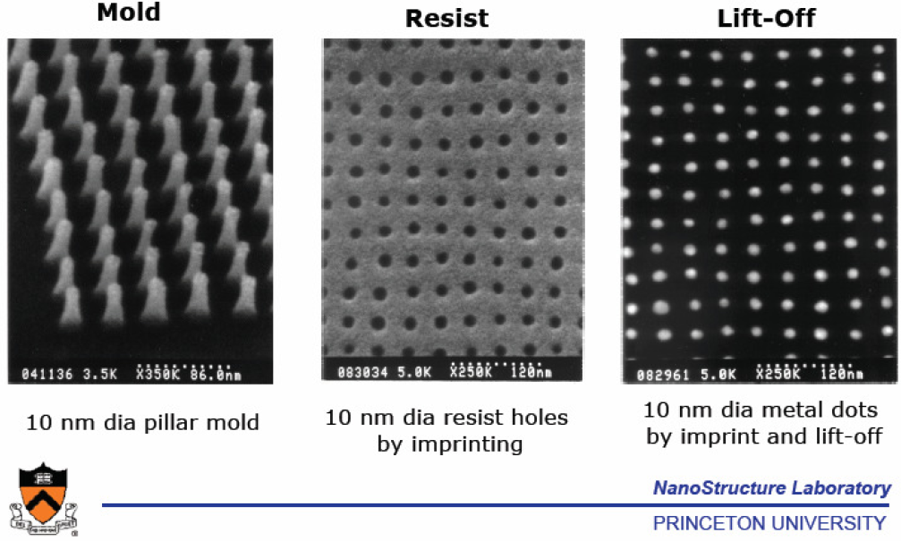
Key advantage of NIL: highest resolution

Slide 8
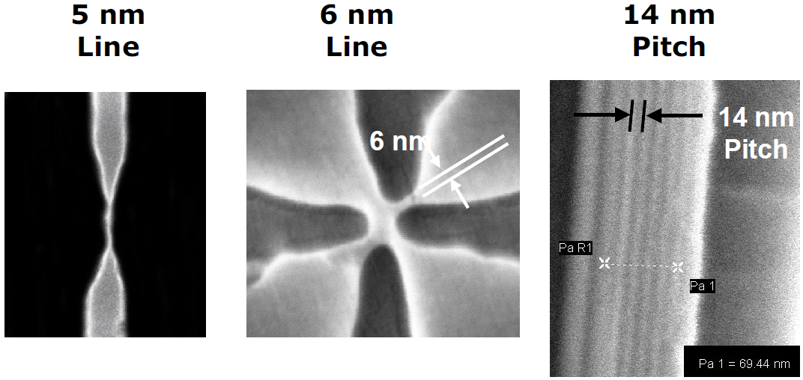
Key advantage of NIL: highest resolution
Sub-5 nm features and 14nm pitch nanoimprint
Yet, feature size and pitch still limited by mold making. They can go smaller.
No more light diffraction limit, charged particles scattering, proximity effect…
Sub-10nm feature size, over a large area with high throughput and low cost.

Slide 9
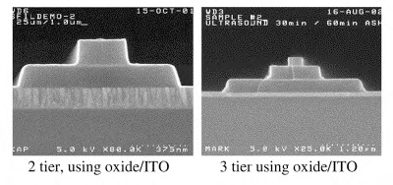
Another key advantage: 3D imprinting
Patterning of the via and interconnect layers simultaneously, in CMOS BEOL .
Potentially reduces the number of masking levels needed in BEOL.
(BEOL: back end of line)
3D mold
Wikipedia: Back end of line (BEOL) is the portion of integrated circuit fabrication line where the active components (transistors, resistors, etc.) are interconnected with wiring on the wafer. BEOL generally begins when the first layer of metal is deposited on the wafer. It includes contacts, insulator, metal levels, and bonding sites for chip-to-package connections.

Slide 10
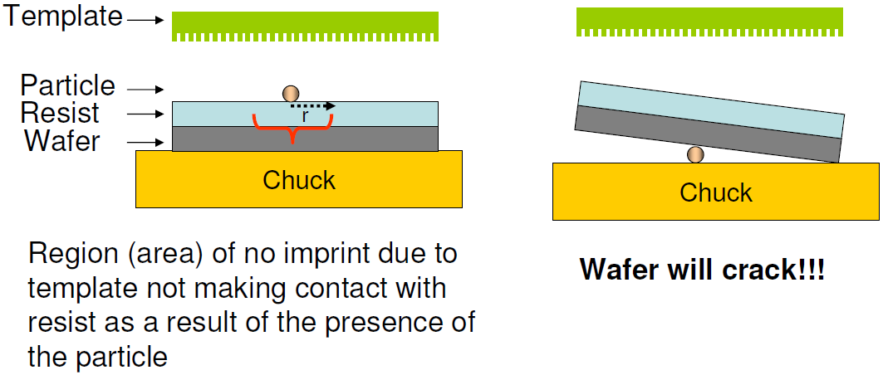
Imprinting in presence of a dust particle
Dust is one of the most serious problem for NIL, defect area>>>>>dust size.
To prevent mold wafer breaking, sandwich the mold/substrate stack with something soft, such as a paper or plastic.

Slide 11
Nanoimprint lithography (NIL)
Overview.
Thermal NIL resists.
Residual layer after NIL.
NIL for large features (more difficult than small one).
Room temperature NIL, reverse NIL, inking.
NIL of bulk resist (polymer sheet, pellets).

Slide 12
Desired resist properties
Good adhesion to the substrate, uniform film thickness, easy spinning.
High pattern transfer fidelity, no adhesion to the mold during seperation.
Low viscosity during imprinting.
Low imprint pressure and temperature.
But sufficient thermal stability in subsequent processes, e.g. RIE, lift-off.
High plasma etch resistance for pattern transfer into under-layers.
Soluble in non-toxic solvents, deposition by spin-coating.
Minimal shrinkage (for UV and thermal curable resist).
Mechanical strength and tear resistance.

Slide 13
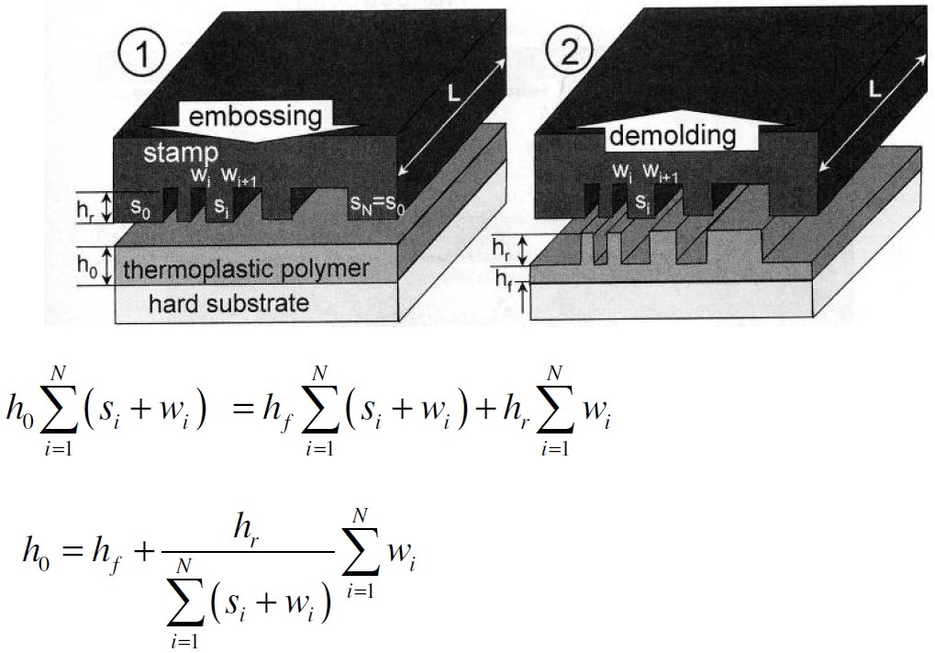
How much initial material (resist) is needed?
Polymer is not compressible, so conservation of volume.
Too thick h₀ leads to large h_{f}, difficult for pattern transfer.
Too thin h₀ increases mold wear and damage.
Alternative Lithography: Unleashing the Potentials of Nanotechnology (book), 2003.

Slide 14
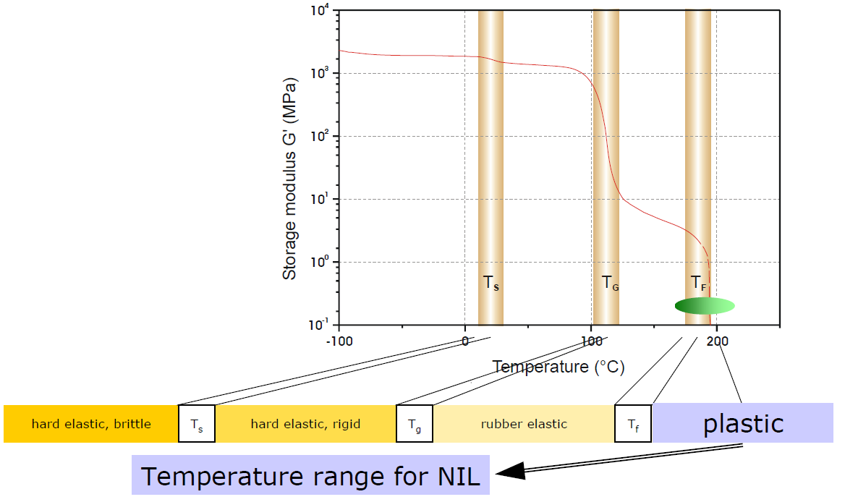
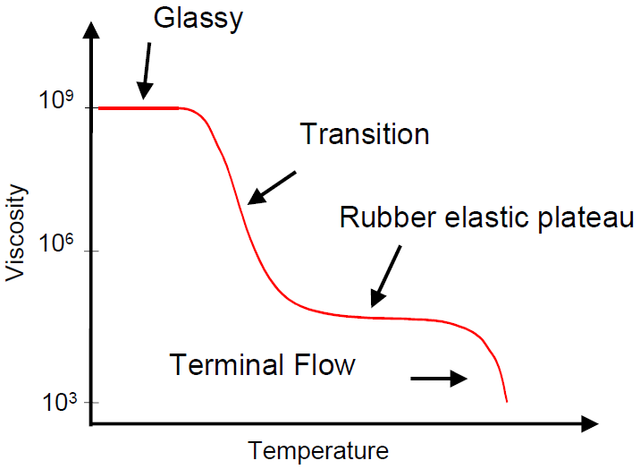
“Standard” resist for NIL: PMMA
Glass transition and flow temperature of PMMA
T_{S}: sub-transition
T_{G}: glass transition
T_{F}: flow
However, PMMA is far away from being an ideal NIL resist. It is popular simply because people are familiar with it (since it is resist for many other lithographies).

Slide 15
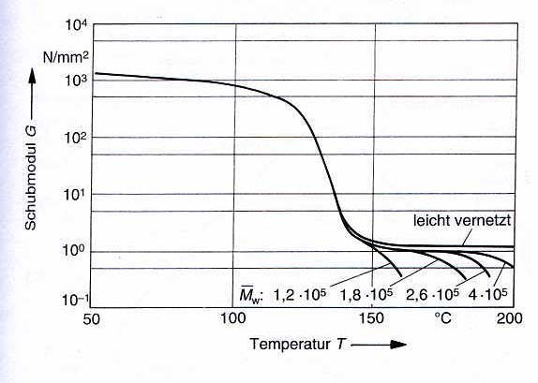
Shear modulus of different molecular weight PMMAs
Flow temperature of PMMA (and other amorphous polymers) increases with increasing molecular weight.
Comments:
PMMA is the choice for beginners, not optimized for NIL. T_{g}=105ºC, NIL at >150ºC.
Polystyrene (T_{g} close to PMMA) is slightly better – easy separation due to lower surface energy.
Poly(vinyl phenyl ketone) is comparable to polystyrene but with T_{g} only 58ºC. NIL at 95ºC.

Slide 16
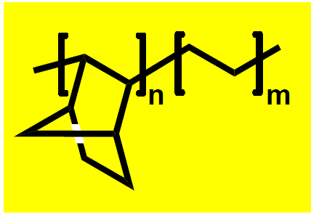
Another thermal NIL resist: TOPAS polymers
TOPAS: Cyclic olefinic copolymer (norbornene and ethylene)
Attractive properties:
– very un-polar
– very low water absorption
– high optical transparency (>300 nm)
– high chemical resistance
– low surface energy
– high plasma etch resistance
But finding solvent system giving homogeneous and stable solutions is not an easy task (chemical resistance, hard to dissolve)
Applications: lab-on-a-chip micro-fluidic system…
Commercial Topas solutions: (from Micro-Resist)
mr-I T85 with Topas grade 8007
mr-I T65 with Topas grade 9506
Similar product: Zeonor from Zeon or Zeonex

Slide 17
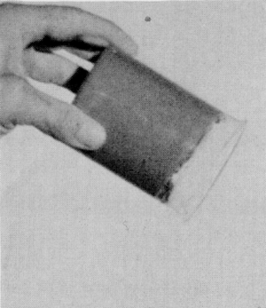
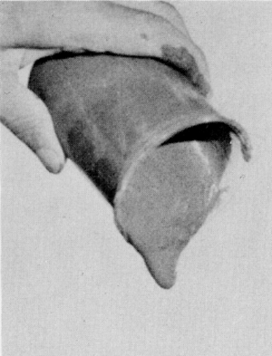
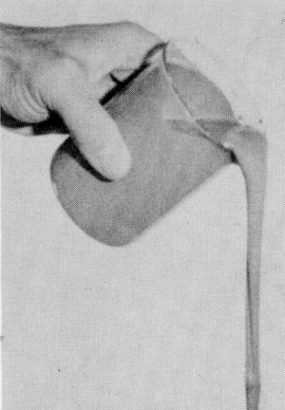
T_{g} can be lowered by adding plasticizer into the resist
no plasticizer
+ plasticizer
+ lots plasticizer
plasticizer
Plasticizer: monomers, solvents, small molecules
Plasticizer: decreased chain entanglement
increased chain motion

Slide 18
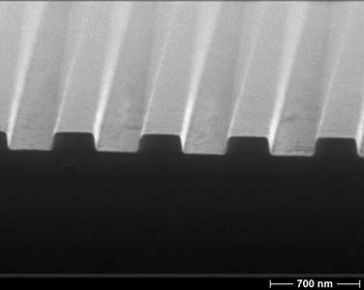
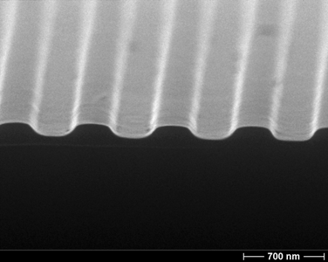
Polymer with low T_{g}
Low imprint temperature
Good polymer flow at moderate temperature
Less problems with thermal expansion
Shorter cycle time due to faster reaching the imprint temperature (?)
Not always, cooling to ambient temperature takes long time, not heating.
Example: thermoplastic with T_{g} 40 °C
Left: 400 nm lines and trenches: immediately after imprinting Right: same patterns after heating the imprint to 60°C for 5min.
Thermal stability of imprinted patterns (deterioration by thermal flow) is determined by the glass transition temperature.
Sufficient thermal stability of imprinted patterns is necessary in subsequent processes such as metal evaporation for liftoff or plasma etching.

Slide 19
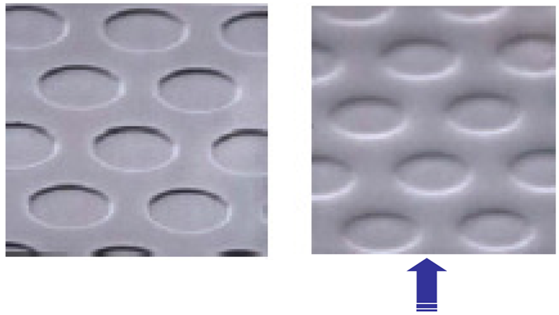
If T_{g} is too low…
10 days after imprinting a low T_{g} resist

Slide 20
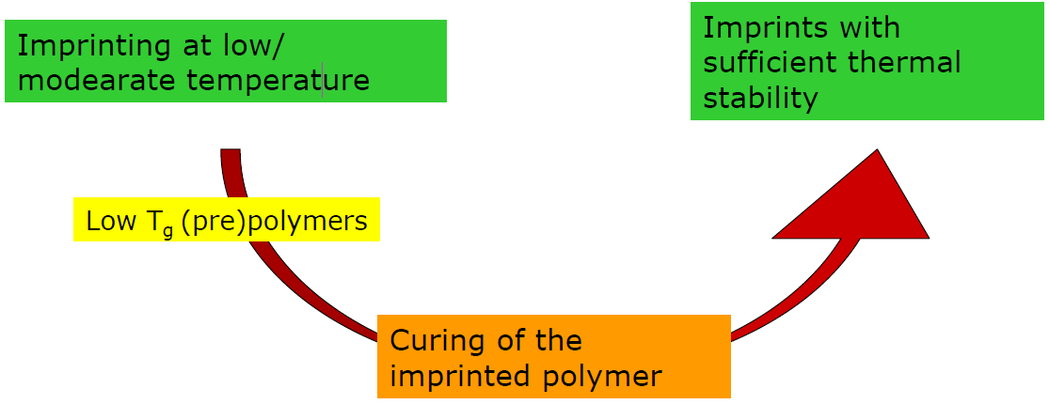
Approach to thermal stability
Thermal-set/curable resist: polymer is cured (cross-linked) upon heating, making it stable at very high temperatures.

Slide 21
Thermal and photochemical curing
Linear or branched thermoplastic
(pre)polymer
Cured polymer
Curing:
Cross-linking of the macromolecules, generation of a spatial macromolecular network.

Slide 22
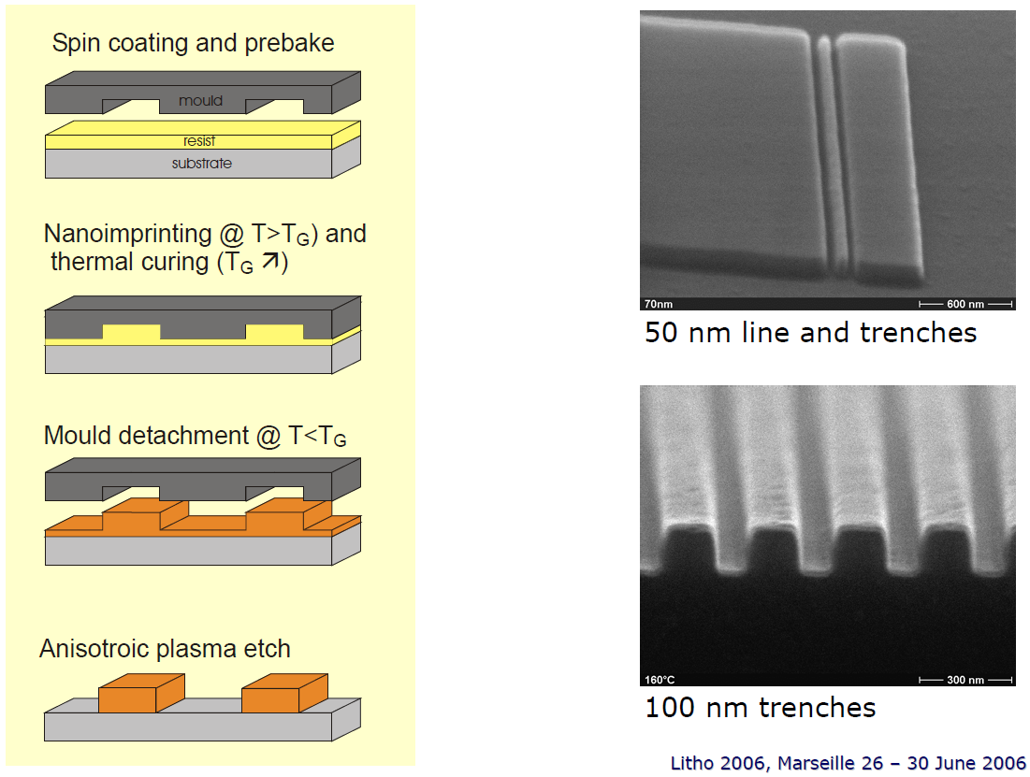
Imprinting thermally curing polymer mr-I 9000E

Slide 23
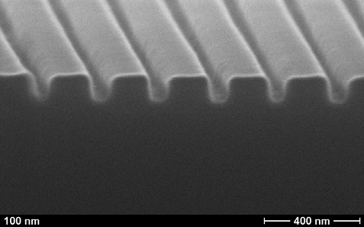
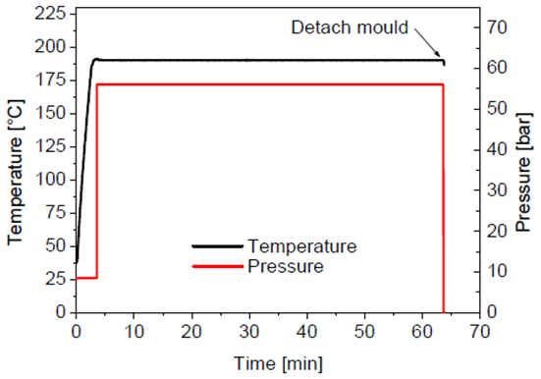
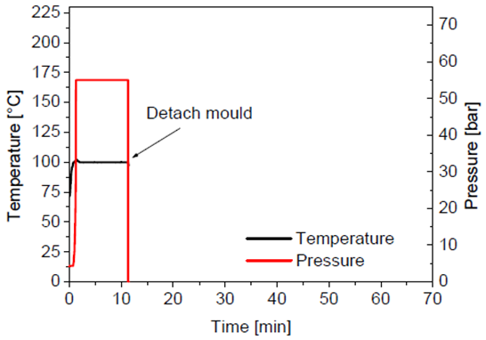
Fast iso-thermal nanoimprint lithography (NIL without thermal cycle)
Isothermal imprinting due to increase in T_{g} during imprinting.
Reduce issues of thermal expansion.
Decrease considerably imprint time (since no cooling).
Starting model system:
Best imprint results (no displacement of patterns) when mold is detached at imprint temperature (i.e. no cooling).
NIL at 190ºC for 1 hour (sufficient curing) necessary for excellent patterns
Add initiator A + plasticizer 1:
Imprint at 100ºC for 10min, no cooling.
Film thickness 170nm, 100nm trenches, 10-20nm residual layer.
(Initiator to increase curing speed; plasticizer to lower imprint temperature)

Slide 24
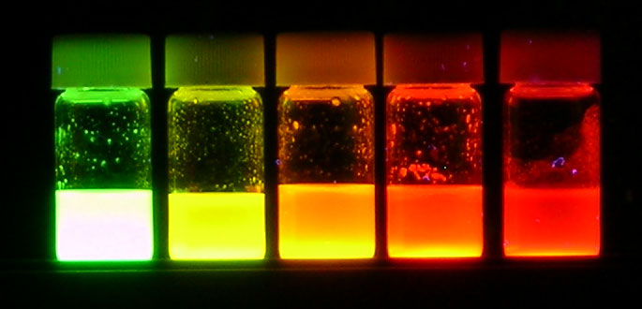
Functional resist: nano-crystal(NC)/polymer based materials
Synthesis and functionalisation of colloidal nano-particles for incorporation into thermoplastic or thermal-curing (i.e. thermal-set) polymers.
Tuning of functional properties:
Optical absorption and emission
Mechanical Stability
Conductivity
Processability…
Size dependent luminescent CdSe NCs (quantum dot)
http://en.wikipedia.org/wiki/Cadmium_selenide

Slide 25
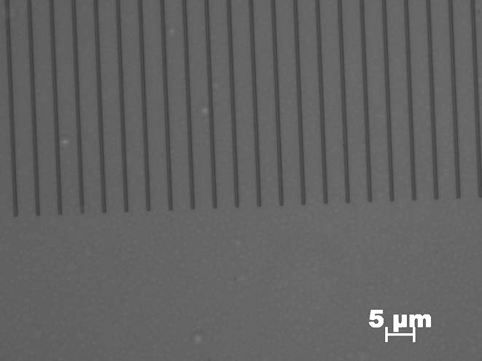
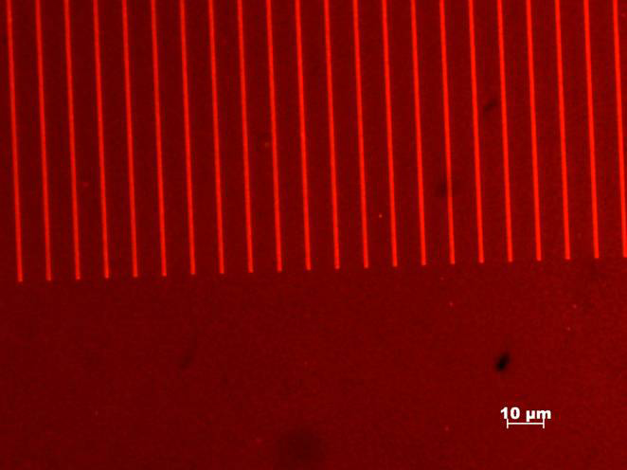
Imprinting on luminescent nano-crystal/PMMA based co-polymer composites
No illumination
Under illumination
CdSe@ZnS nano-crystals (NC) in PMMA modified co-polymer.
Homogeneous distribution of NCs inside the polymer matrix.

Slide 26
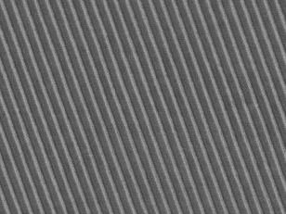
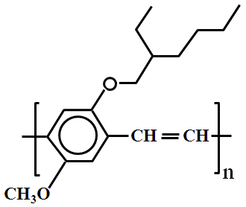
Functional “resist”: semiconducting polymer
SEM image of 200nm period MEH-PPV grating R-P3HT grating with 200nm period
1 μm
MEH-PPV T_{g}=65ºC.
Hot embossing at 120ºC and 20bar.
MEH-PPV spun on a PEDOT/ITO/glass.
R-P3HT 200nm period grating.
NIL at 160ºC and 35 bar.
Strong physical bond, high transition temperature.

Slide 27
Nanoimprint lithography (NIL)
Overview.
Thermal NIL resists.
Residual layer after NIL.
NIL for large features (more difficult than small one).
Room temperature NIL, reverse NIL, inking.
NIL of bulk resist (polymer sheet, pellets).

Slide 28
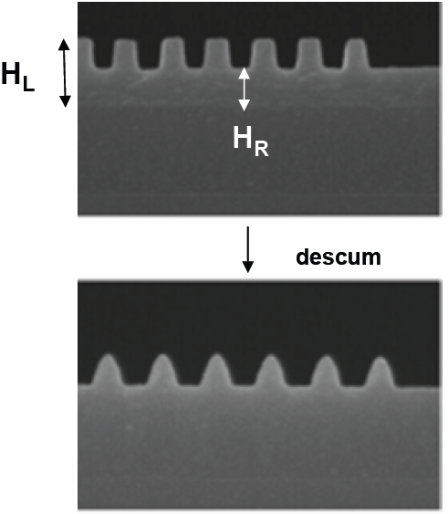
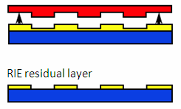
Residual layer: thinner is better for easier pattern transfer
Resist
Substrate
RIE
Too thick residual layer makes subsequent RIE more demanding: hard to control profile, pattern size shrinkage (CD loss).
So resist thickness should be ∼ pattern height of mold.
CD: critical dimension.
Such a tapered profile makes liftoff almost impossible

Slide 29
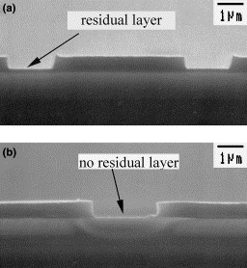
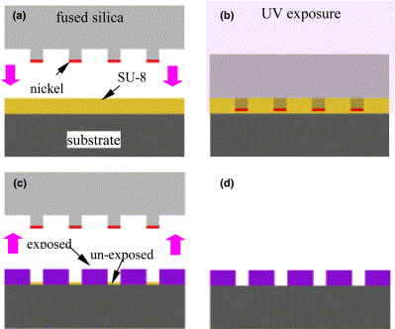
How to get rid of residual layer
Light-blocking metal layer, use a developer solution instead of the separate O₂ RIE step.
Comparison of residual layers in micro-scale resist pattern obtained by: (a) conventional NIL; (b) the current technique where no residual layer is left.
Un-exposed area developed
(since SU-8 is negative resist)
Cheng and Guo, “A combined-nanoimprint-and-photolithography patterning technique”, MEE, 2004.

Slide 30
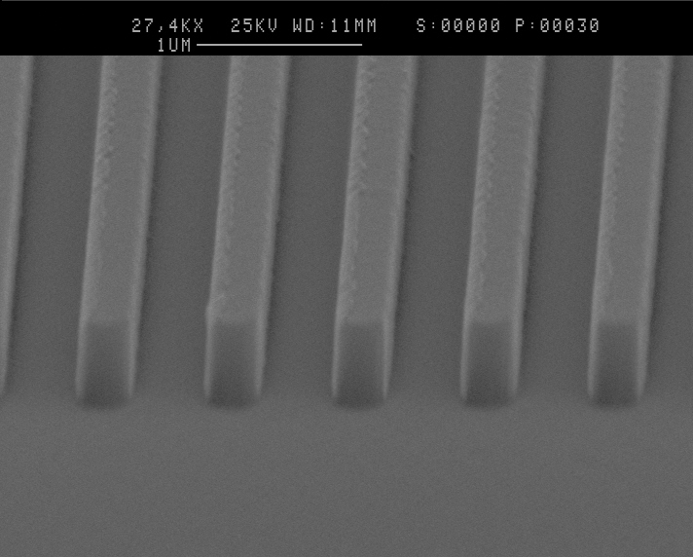
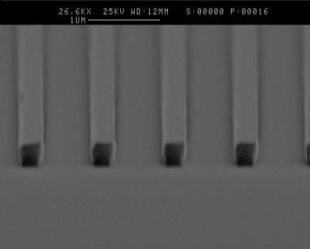
ICP etching of residue layer
ICP: inductively coupled plasma, high plasma density and etching rate, better control
(According to an ICP tool seller)
ICP provides the best performance for etching residual layer:
Low pressure processing minimizes isotropic (lateral) etching and loss of profile.
Lower temperature processing also helps.
Low bias processing minimizes faceting at the top of the lines.
Polystyrene Nano-imprint descum (i.e. residue removal) on Al. 200nm residual removed in 2 minutes using a pure O₂ ICP plasma – linewidth remains constant at 0.35μm (??)

Slide 31
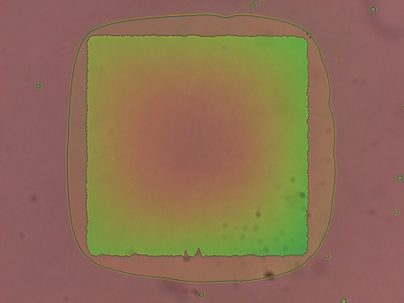
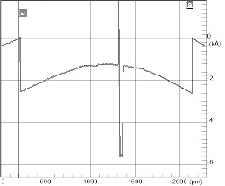
Another way to reduce residue layer effect: use tri-layer (or bi-layer) resist
Square (mm) imprinted into PMMA
Optical image
Profile
But for nanoscale features…
200nm
2mm
after excessive etch
Schematic
mold wafer
Such a profile makes liftoff difficult.
Solution: use tri-layer resist system
resist need to etch
Tri-layer resist
silicon wafer
PMMA
PMMA
thin
SiO₂
Need excessive etch to remove the thick resist at the square center
bottom polymer layer

Slide 32
Nanoimprint lithography (NIL)
Overview.
Thermal NIL resists.
Residual layer after NIL.
NIL for large features (more difficult than small one).
Room temperature NIL, reverse NIL, inking.
NIL of bulk resist (polymer sheet, pellets).

Slide 33
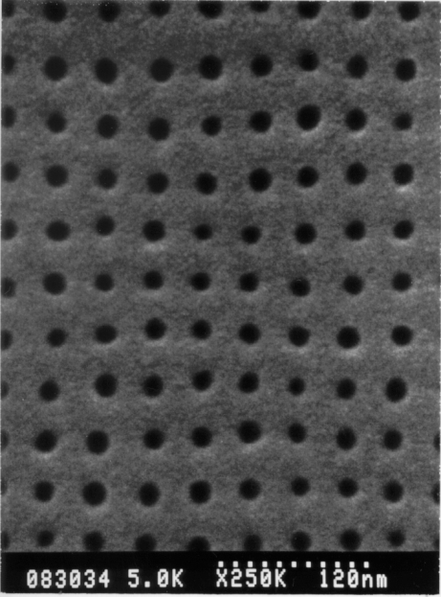
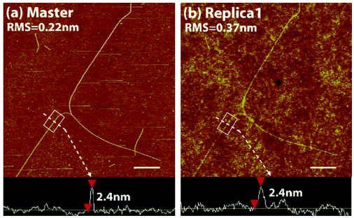
NIL for small features/high resolution (<10nm)
Press liquid into a nano-hole
Pressure (P)
Thermal NIL into PMMA
(10nm pillar array mold)
F=γ×2πR
Surface tension (γ)
• Pressure ∝ 1/diameter.
• But for protruded mold features (pillars…), local pressure at the pillar is much higher than average - easy to imprint.
UV-curable NIL, 2nm carbon nanotube mold
Hua … Rogers, “Polymer imprint lithography with molecular-scale resolution”, Nano Lett. 2004

Slide 34
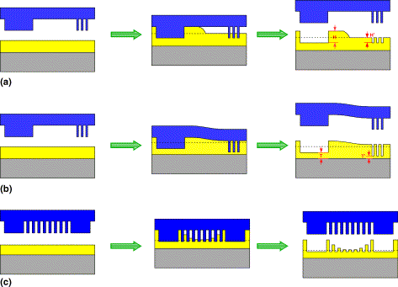
NIL for large features (>100 μm) - simultaneous pattern duplication of large and small features
Application: large features are needed to connect small ones to the outside world (electrodes…).
Challenge: more polymer must be displaced over longer distances.
A popular approach: two-step process - small features by NIL, large ones by photolithography with alignment.
Problems when both small and large features are present
Schematics of pattern failure mechanisms in NIL as a result of: (a) non-uniform pattern height; (b) non-uniform residual layer thickness; (c) incomplete nano-pattern replication.
Cheng, “One-step lithography for various size patterns with a hybrid mask-mold”, Microelectronic Engineering 71, 288–293 (2004).

Slide 35
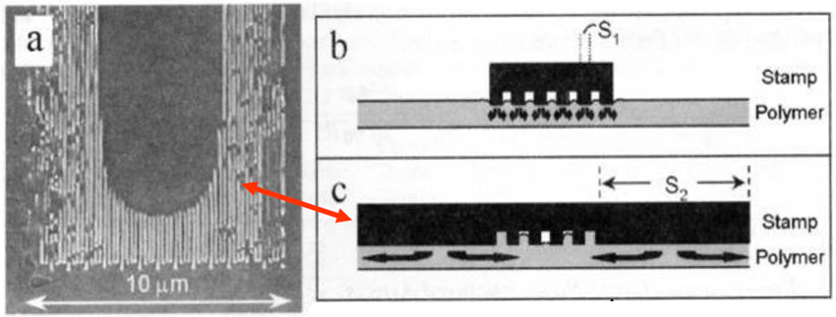
NIL pattern uniformity
Etch some dummy holes/trenches here
The fill factor should be kept constant: better flow and shorter imprint time.
Different fill factor across mold leads to different sinking rates.
Mold bending leads to non-uniform residual layer on substrate.
One solution: fabricate dummy cavities/protrusions to create constant fill factor.

Slide 36
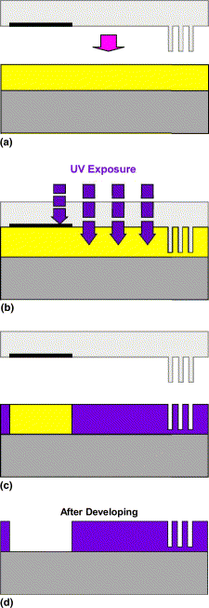
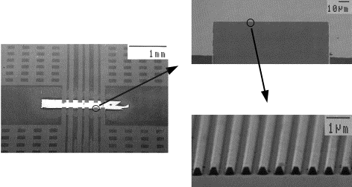
Combined UV (for macro) and nanoimprint lithography (for nano)
hybrid mask-mold
SU-8 is used both as a photo-resist and thermal NIL resist.
(SU-8 is a photo-resist, but not a UV-NIL resist (hard to imprint at RT). Instead, it can be used as a thermal NIL resist, T_{g}∼50ºC)
Schematics of the technique by using a hybrid mask-mold for one-step lithography of both large- and nano-patterns
SEM micrograph of resist patterns obtained by the technique with hybrid mask-mold.
Cheng, “One-step lithography for various size patterns with a hybrid mask-mold”, Microelectronic Engineering 71, 288–293 (2004).

Slide 37
Modeling of liquid flow for large features (>>pattern depth)
L
L
L
mold
h₀
h₀
Liquid
Substrate
Assumptions:
Periodic mold structure (period 2L)
Ignore inertial, gravitational forces and surface tension
Resist film thickness = mold trench depth = h₀
L: achievable feature size
p: pressure
τ: imprinting time
μ: viscosity
h₀: film thickness

Slide 38
Strategy to imprint large features (mm)
L: achievable feature size
p: pressure
τ: melting time
μ: viscosity
For thermoplastic polymer PMMA at T>T_{g}
M_{w}: molecular weight
n=1 for M_{w}<M_{C}, un-entangled molecules
n=3.4 for M_{w}>M_{C}, entangled molecules
Viscosity for PMMA (M_{c}=30kg/mol)
a) 12 kg/mol, 200ºC; b) 12 kg/mol,150ºC; c) 120 kg/mol, 200ºC
μ_{a}:μ_{b}:μ_{c}=1:126:278
Use low molecular weight PMMA and imprint at high temperature

Slide 39
Strategy to imprint large features (mm)
Square (mm) imprinted into PMMA
But for nanoscale features…
Optical image
Profile
200nm
after excessive etch
2mm
Schematic
mold wafer
Such a profile makes liftoff difficult.
Solution: use tri-layer resist system
resist need to etch
Tri-layer resist
silicon wafer
PMMA
PMMA
thin
SiO₂
Need excessive etch to remove the thick resist at the square center
bottom polymer layer

Slide 40
Fabrication process flow
Mold
tri-layer resist
PMMA
SiO₂
4. RIE ARC (O₂ gas, etch little SiO₂)
ARC
Cr
silicon wafer
1. Imprint
ARC:
Anti-reflection coating, cross-linked polymer.
5. Evaporate Cr
2. RIE PMMA (excessive etch)
6. Liftoff Cr (dissolve ARC)
3. RIE SiO₂ (CHF₃ gas)
7. RIE Si (etch little Cr)

Slide 41
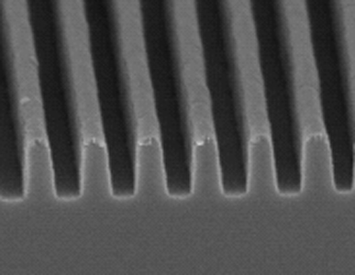
Result
1.6mm square
Line-width in the mold is 80nm
Line-width in the duplicated pattern is 98nm
50
40
30
98nm
Line-width change (nm)
1.3mm square
20
10
0
90
120
150
180
210
240
270
PMMA etched (nm)
(RIE PMMA 180nm)
For small features, line-width increased by ∼18nm (acceptable).
For large features, 1.3mm squares were faithfully duplicated.
Cui and Veres, “Pattern replication of 100 nm to millimeter-scale features by thermal nanoimprint lithography”, MEE, 2006

Slide 42
Nanoimprint lithography (NIL)
Overview.
Thermal NIL resists.
Residual layer after NIL.
NIL for large features (more difficult than small one).
Room temperature NIL, reverse NIL, inking.
NIL of bulk resist (polymer sheet, pellets).

Slide 43
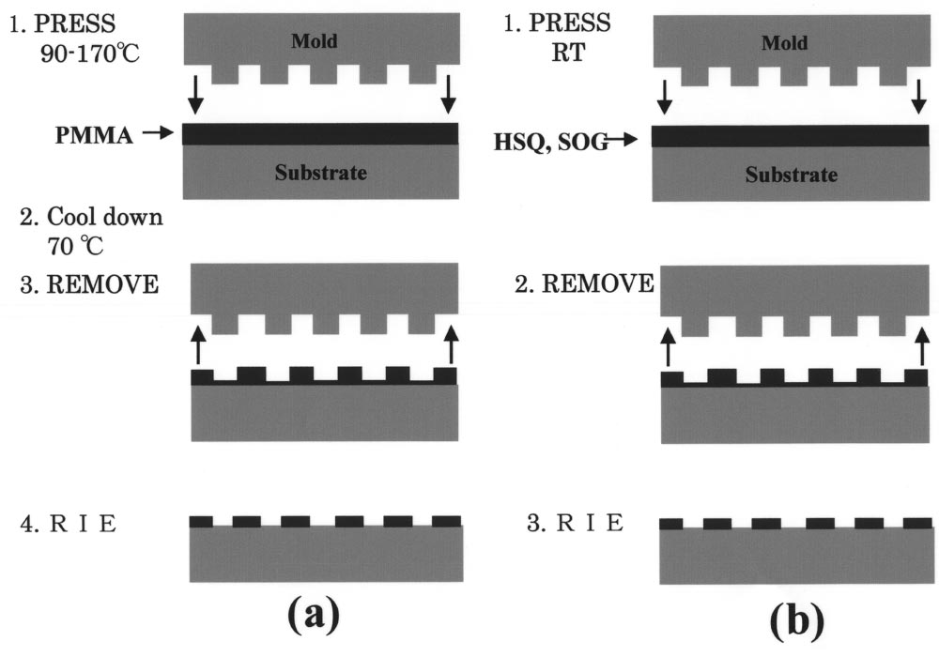
Room temperature (“thermal”) NIL
RT-NIL process does not require a resist thermal cycle when pressing a mold onto the resist.
Use special material, such as hydrogen silsequioxane (HSQ), or ultrahigh pressure.
SOG: spin on glass
Matsui, “Room-temperature nanoimprint and nanotransfer printing using hydrogen silsequioxane”, JVST B, 2003

Slide 44
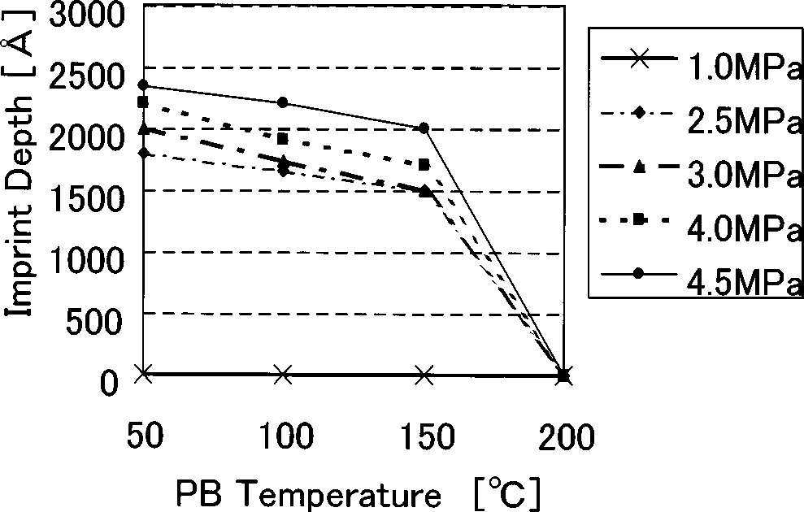
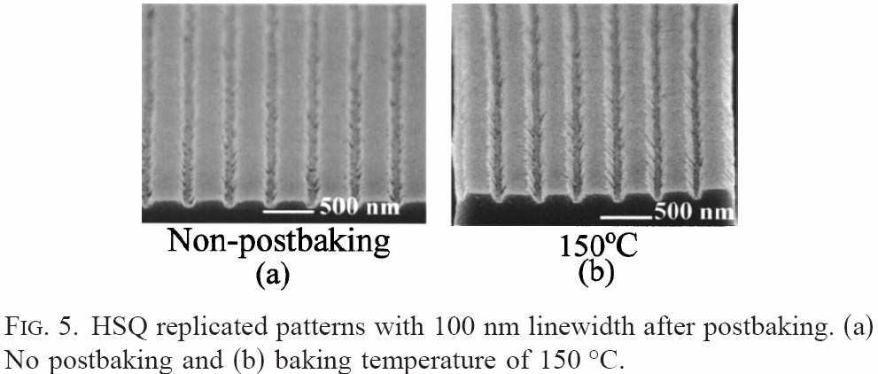
Room temperature (“thermal”) NIL
Pre-baking is important:
HSQ has a high viscosity without prebaking.
The effect of prebaking HSQ is to remove the solvent init.
The hardness of HSQ increases at around 150°C (so don’t bake at higher T).
“Nanoimprint and nanocontact technologies using hydrogen silsequioxane”, JVST B, 2005

Slide 45
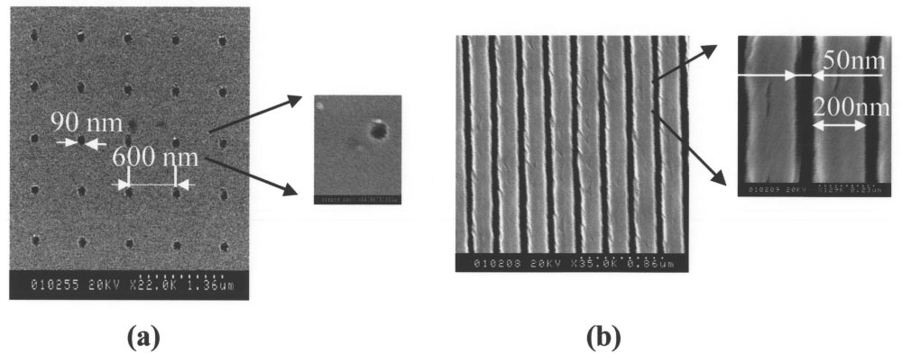
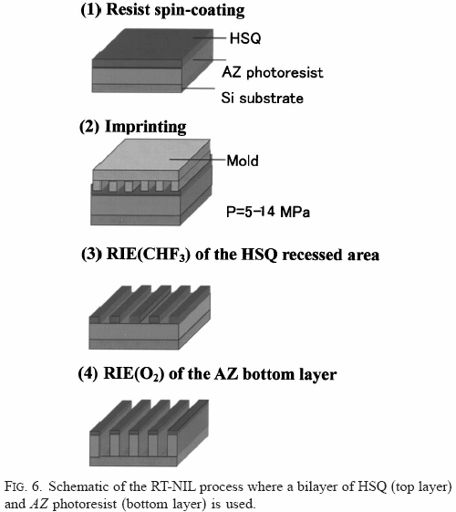
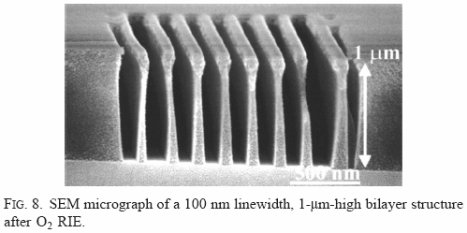
NIL results into HSQ at RT
1 min press time by RT-NIL at 40atm pressure.
Etch rate ratio for AZ photoresist to HSQ (like SiO₂) is >100.

Slide 46
Reverse NIL and multi-dimensional patterning of polymer nanostructures
Layer-by-layer NIL (repeated reverse NIL)
L. J. Guo, J. Phys. D 37, R123 (2004)

Slide 47
Imprint by inking
Mold
Inking process
PDMS pad impregnated with medium surface energy film
Selectively Surface Treatment
Protrusions with medium surface energy treatment
Sidewalls and trenches with lower surface energy treatment
T∼T_{g}
Spin coat polymer and annealing
Ink to substrate
Bao…Guo, “Polymer inking as a micro- and nanopatterning technique”, J. Vac. Sci. Tech. B, 2003, 21, 2749

Slide 48
Nanoimprint lithography (NIL)
Overview.
Thermal NIL resists.
Residual layer after NIL.
NIL for large features (more difficult than small one).
Room temperature NIL, reverse NIL, inking.
NIL of bulk resist (polymer sheet, pellets).

Slide 49
Hot embossing pellets
Cheap setup
V. Studer, A. Pépin, Y.Chen, Appl. Phys. Lett. 80, 3614 (2002)

Slide 50
Hot embossing PMMA pellets: results
NIL at 180°C, 50bar pressure for ∼10 min
For fabricating micro- and nano-fluidic channels in thermoplastic polymers.

Slide 51
Hot embossing polystyrene pellets
Polystyrene is bio-compatible (cell culturing Petri-dish is made of polystyrene perhaps plus some additives).
grating substrate
4μm period grating
Application: contact guidance of cell growth
Definition: anisotropic topographic features induce cells to align along the direction of the anisotropy.
Importance: in tissue engineering, if tissue is to be repaired, the new cells must be aligned and positioned correctly.
cell

Slide 52
Tissue engineering: corneal and dermal cell growth
Corneal cell
Dermal cell
grating
Day 1
first layer
first layer
Day 12
second layer
First layer: both cells aligned with the grating (as expected).
Second layer:
Corneal cells - oriented at 60° relative to first layer, as in a native cornea
Dermal cells - no orientation

