Slide 1
Nanoimprint lithography (NIL)
UV-curable NIL.
Resists for UV-NIL.
Mold fabrication for thermal and UV-NIL.
Alignment.
NIL into metals.
NIL systems (air press, roller, roll-to-roll, EFAN…)
ECE 730: Fabrication in the nanoscale: principles, technology and applications
Instructor: Bo Cui, ECE, University of Waterloo; http://ece.uwaterloo.ca/~bcui/
Textbook: Nanofabrication: principles, capabilities and limits, by Zheng Cui

Slide 2
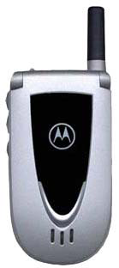
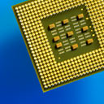
Alignment (overlay)
Electronic devices such as transistors/chips require multiple levels of materials and processing.
For NIL, there is no distortion due to lens since no lens is used.
Challenges for sub-100nm alignment:
Smaller error budget for mold pattern placement since it is 1×.
Alignment mark fabrication error has to be <10nm.
Features are too small to be seen optically ∼10nm.
Alignment is sensitive to the gap between mold and substrate.
Mold distortion/drift due to pressure, temperature and defects is big problem.
Generally, alignment for NIL is much more difficult than other lithographies.
Thermal NIL is worse due to thermal expansion mismatch.

Slide 3
Possible alignment methods
Direct imaging, as in optical lithography.
Amplitude-sensitive schemes.
Phase-sensitive schemes.
Temporal phase detecting.
Spatial phase detecting – Moiré pattern (simple, insensitive to gap)
(Wikipedia) In physics, a moiré pattern is an interference pattern created, for example, when two grids are overlaid at an angle, or when they have slightly different mesh sizes.
A moiré pattern, formed by two sets of parallel lines, one set inclined at an angle of 5° to the other.

Slide 4
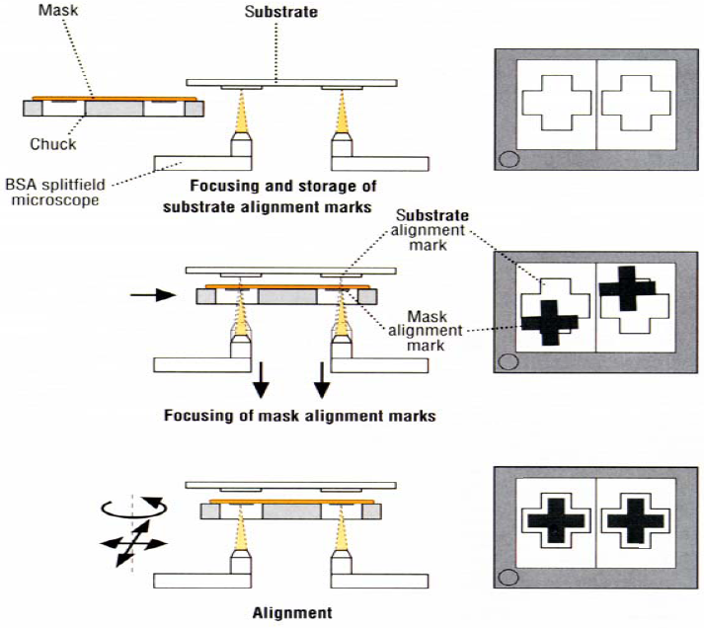
Direct imaging
Backside alignment because silicon substrates are not transparent to visible light.
Sub-micron precision is demonstrated.
Precision is limited by optical resolution and thermal, mechanical noises.
For thermal (or UV) NIL that requires high pressure, alignment is easily destroyed due to lateral drift of mold or substrate.

Slide 5
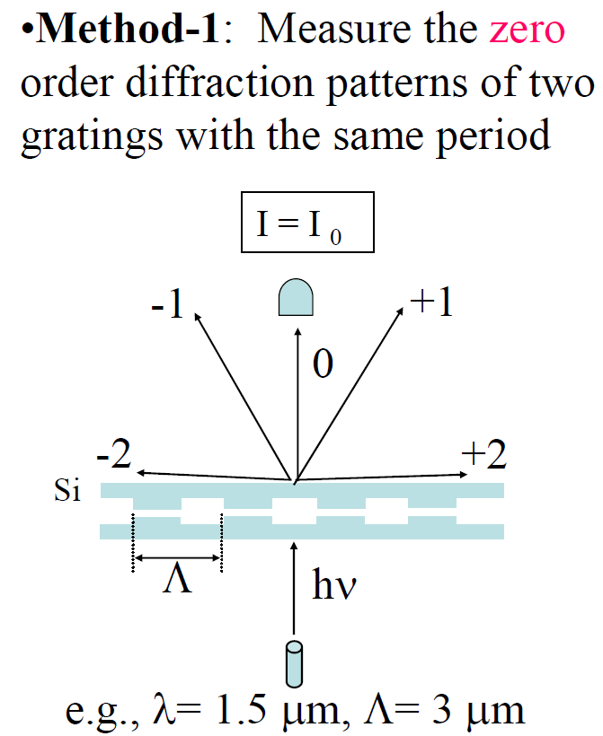
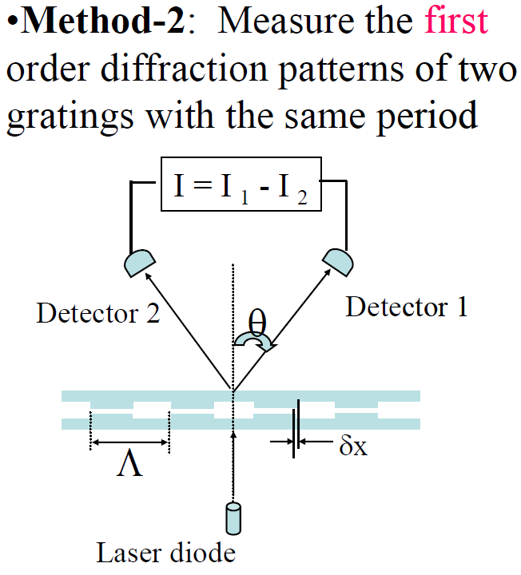
Amplitude sensitive alignment scheme
Maximum signal when aligned. Minimum signal when aligned (I₁=I₂)
William Moreno, Princeton

Slide 6
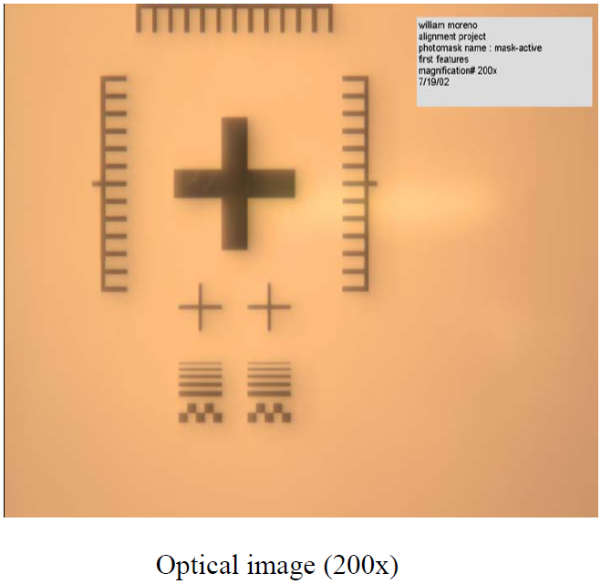
Two step alignment using cross marks and Moiré patterns
Moiré patterns: optical image of superposition of two patterns.
Advantage: slight displacement of one of the objects creates a magnified change in their Moiré patterns.
For sub-100nm alignment:
Coarse alignment using cross marks and boxes or circular gratings.
Fine alignment using interferometric spatial phase matching (Moiré).
Same as alignment in contact/proximity optical lithography.
Cross mark provide alignment of ∼0.5μm.
Cross marks are relatively big and easy to locate.
Coarse alignment marks

Slide 7
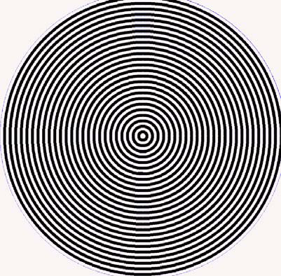
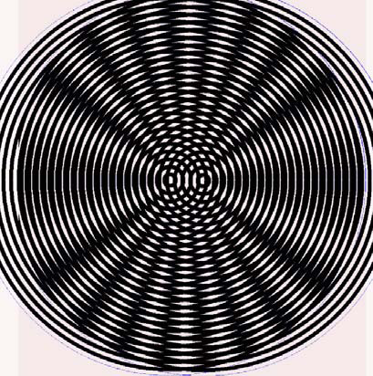
Circular gratings
Misaligned
Aligned
Circular patterns produce more precision for the coarse alignment in the x and y axis.
They are more sensitive to displacement than cross marks.
M. King and D. Berry were the first who start alignment using moiré concentric circles in 1972 ( Appl. Opt.11. 2455).

Slide 8
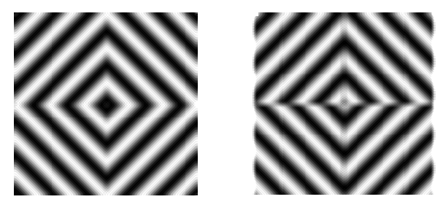
Fine alignment using Moiré: concept and simulation
Sub-10 nm alignment accuracy
Interference
Pattern P3
To frame
grabber
And
computer
P₁
P₂
P₂
P₁
CCD
P₂
P₁
P₁
P₂
Substrate
Stamp
Partially
reflecting
mirror
Light
source
Aligned
Out of align
Mask
Imaging Lens
P₁
P₂
Simulations of alignment/misalignment
Substrate
P₃ = (P₁ x P₂) / |P₁ – P₂|

Slide 9
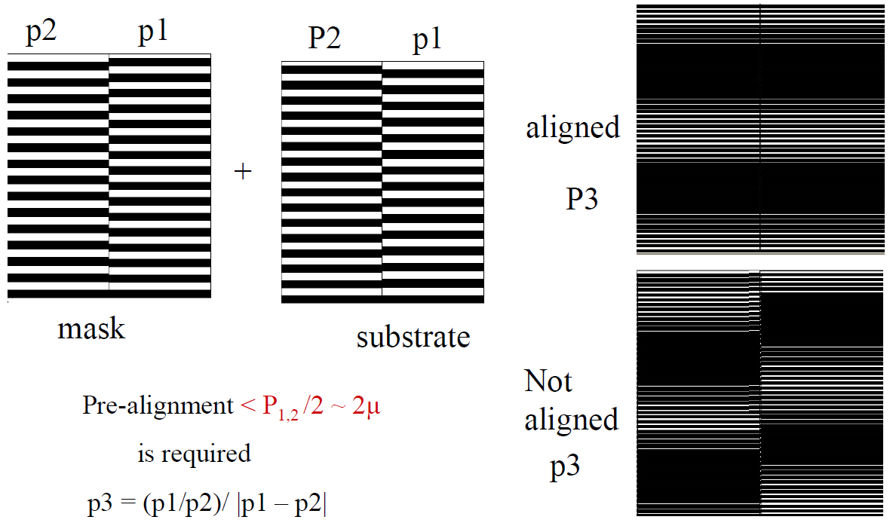
Interferometric spatial phase matching of linear gratings
Challenges:
Precise alignment in tilting.
Grating fabrication error need to be very small, smaller than 10nm.
E. Moon, J. Vac. Sci. Tech. 1993A. MoelJ. Vac. Sci. Tech. 1995

Slide 10
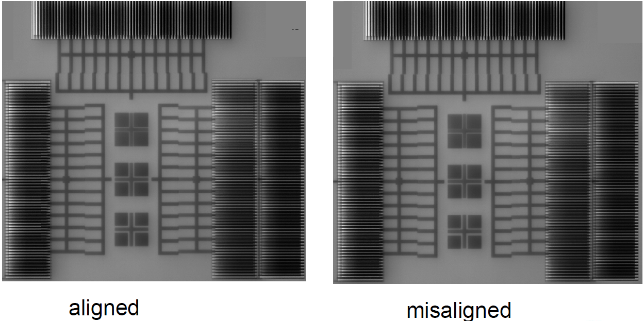
Moiré alignment marks for NIL

Slide 11
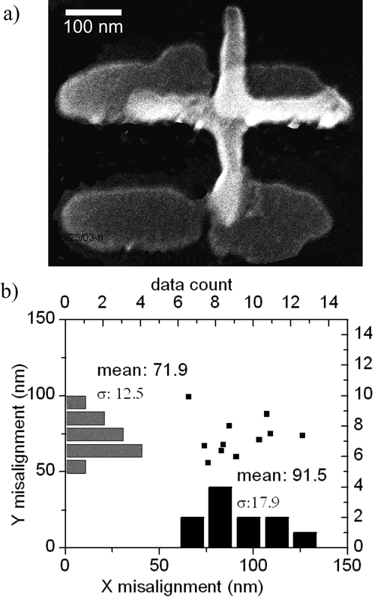
Result of sub-100nm alignment in NIL
For UV-NIL, sub-100nm alignment can be achieved readily, but this is still too far away from requirement for IC production (few nm).
“Sub-20-nm Alignment in Nanoimprint Lithography Using Moiré Fringe”, Li, Nano Lett., 2006.

Slide 12
Nanoimprint lithography (NIL)
UV-curable NIL.
Resists for UV-NIL.
Mold fabrication for thermal and UV-NIL.
Alignment.
NIL into metals.
NIL systems (air press, roller, roll-to-roll, EFAN…)

Slide 13
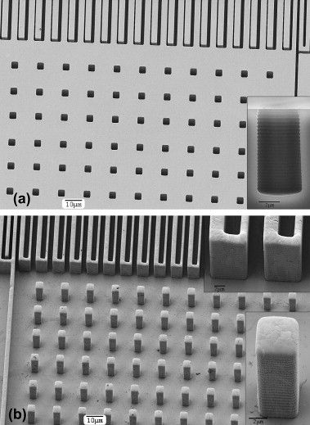
NIL directly into metals
Silicon mold (inset: cross-section) produced by ICP-DRIE (26 cycles), with lines of thickness 1 or 2μm (depth 6μm) and holes with edge length 4μm (depth 8μm).
Microstructured silver plate after forming at 400°C with a pressure of 300MPa, and Si mold removal by KOH etching.
(Typical thermal NIL pressure is 2MPa)
“Metal direct nanoimprinting for photonics”, Buzzi, MEE 2008

Slide 14
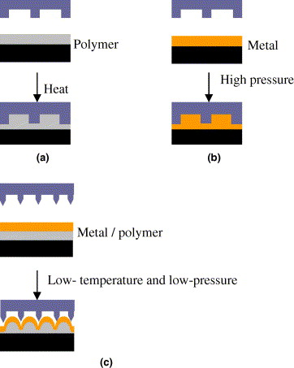
NIL directly into metals: bi-layer and sharp mold
Fig. 1. Schematic diagrams of imprint technologies.
Conventional nanoimprint lithography.
Direct imprint metal films.
Nanoimprint in metal/polymer bi-layer (NIMB).
“Directly patterning metal films by nanoimprint lithography with low-temperature and low-pressure”, Chen, MEE 2006

Slide 15
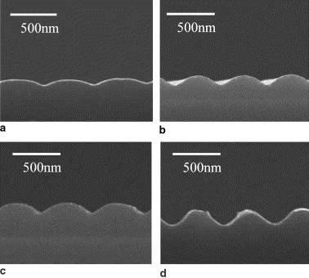
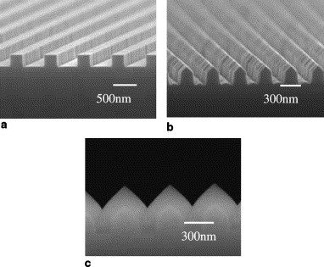
Results
Fig. 5. The depth of surface-profile in metal films can be tuned by using different imprint pressure (a) 7 MPa, (b) 12 MPa, (c) 14 MPa, (d) 17 MPa.
Fig. 2. SEM images of molds (a) the conventional binary mold with flat top, (b) the sharp mold, (c) the triangle mold.

Slide 16
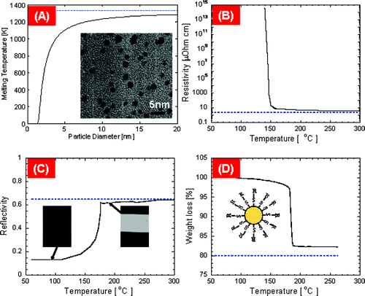
NIL into metal nano-particles at low temperature & pressure
Thermal (melting) characteristics of SAM-protected Au nano-particles (NPs).
NP can be melted/imprinted at rather low temperature.
Melting temperature of Au NPs with different sizes.
Resistivity (dotted line represents bulk gold resistivity 2.65μΩ·cm). Melt to form continuous film with low resistivity.
Reflectivity at 514.5 nm wavelength. Insets represent the optical images of NP film before (left) and after (right) the melting.
Mass change at various heating temperatures.
TEM
“Direct Nanoimprinting of Metal Nanoparticles for Nanoscale Electronics Fabrication”, Ko, Nano Lett. 2007

Slide 17
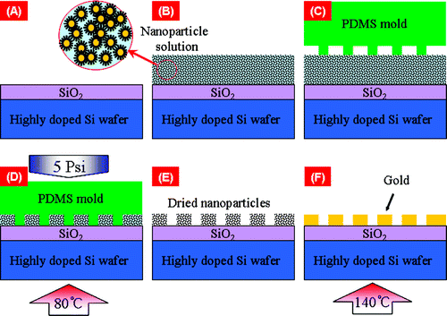
NIL into Au nano-particles and melting of NPs
(A, B) Dispensing NP solution on SiO₂/P+ Si wafer.
(C, D) Pressing PDMS mold on NP solution under 5psi pressure at 80°C. (1atm=14psi)
(E, F) Removal of mold and induce NP melting on hot plate at 140 °C.
(The SAM-protected NPs are suspended in an organic solvent that is extremely viscous (like a solid) at RT, but its viscosity drops drastically with temperature.)

Slide 18
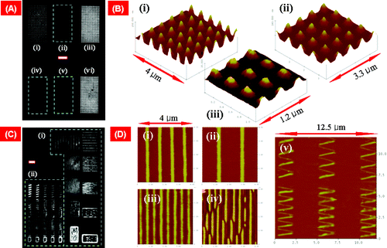
Results of NIL into Au
Optical dark field images of (A) nanodots and (C) nanowires (inset scale bar corresponds to 5 μm).
AFM topography images of (B) nanodots, (D(i−iv)) straight nanowires, and (D(v)) serpentine nanowires.

Slide 19
Laser-assisted direct imprint (LADI) of metals
Metal can be readily melted and patterned by a pulsed laser.
One-step patterning process:
Replaces the steps of resist patterning, pattern transfer by etching, and resist removal all into one single step. And this step takes only order 100 ns!
Minimal heating of the substrate
Mold and substrate can have different thermal expansion.
Application:
IC interconnect, flexible/durable NIL metal mold.
mold
substrate
c
a
d
molten layer
b
e

Slide 20
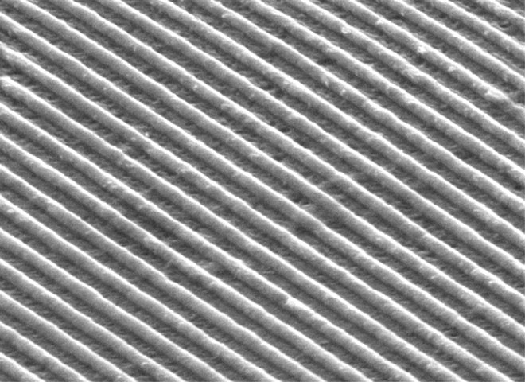
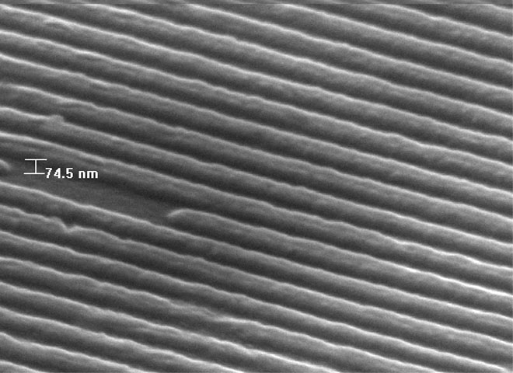
200 nm period grating patterned by LADI
Cu, 0.24J/cm²
Al, 0.22J/cm²
Pattern height: 100 nm.
XeCl excimer laser, λ=308nm, 20ns pulse, laser fluence 0.24J/cm² = 12MW/cm²)
Line was rounded due to surface tension and volume shrinkage upon solidification.

Slide 21
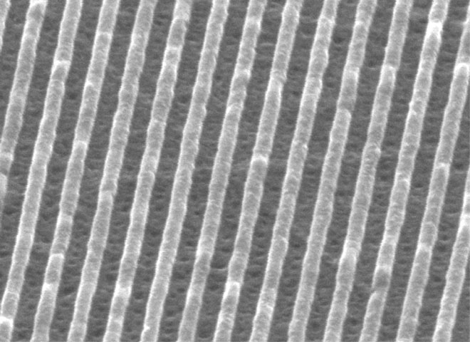
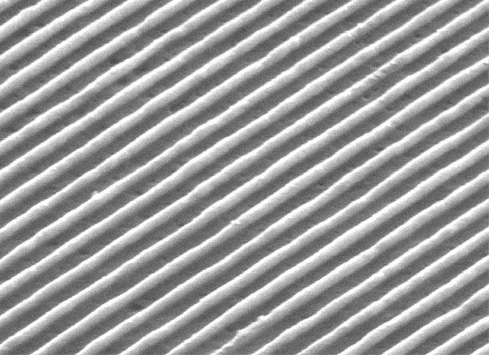
200 nm period grating patterned by LADI: Ni
Front side illumination, 0.41 J/cm²
Back side illumination, 0.60 J/cm²
Ni
quartz
Ni
quartz

Slide 22
How much pressure needed
F=γ×2πR
F=γL
L
W
r
Pressure ∝ surface tension / dimension.
Order 10² atm is needed for 100 nm feature size, due to the high surface tension of metals.
Considerably smaller pressure is possible by pre-coating a wetting lining layer.

Slide 23
How big feature can be patterned
(how far the liquid can flow before it freezes)
L
L
L
y
Quartz mold
x
h₀
Inertial force is ignored.
p: pressure.
τ: melting time.
μ: viscosity.
h₀
Liquid metal
Solid metal
Substrate
Material | L | Assume: P=400atm τ=100ns h₀=200nm
Cu | 4.9 μm
Ni | 4.2 μm
Si | 12.0 μm
Experiment: 17 μm Si has been patterned, but failed for several tens of μm.
Impact: pattern density averaged over area ~L² should be uniform.

Slide 24
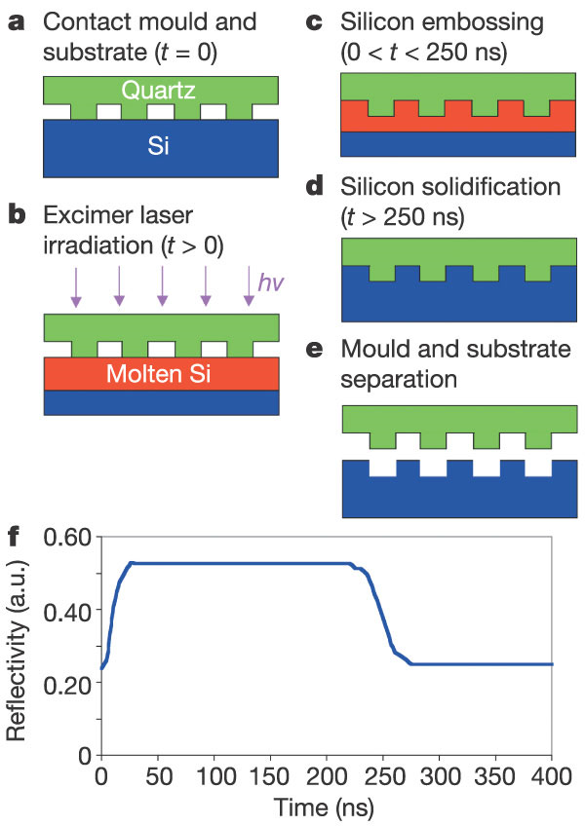
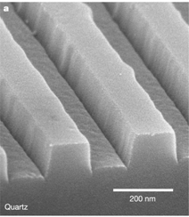
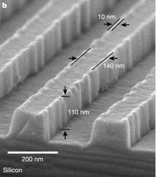
Direct imprint into Si
Faithful duplication of sub-10nm features in the quartz mold due to RIE trenching effect.
The reflectivity of a HeNe laser beam from the silicon surface versus the time, when the silicon surface is irradiated by a single laser pulse with 1.6mJ/cm² fluence and 20ns pulse duration.
Molten Si, becoming a metal, gives a higher reflectivity. The measured reflectivity shows the silicon in liquid state for about 220ns.
Chou, “Ultra fast and direct imprint of nanostructures in silicon”, Nature, 2002

Slide 25
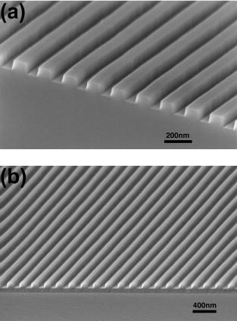
Ultrafast (order 100ns) thermal NIL into polymer resist using laser pulse
LAN: laser assisted nanoimprint lithography.
Resist need to be dye-doped for optical energy absorption (transparent otherwise).
Scanning electron microscope (SEM) image of 200 nm period grating quartz mold.
NPR-69 (a NIL resist) gratings on a Si substrate produced by LAN with a single laser pulse of 0.4J/cm². The gratings have a line-width of 100nm and height 90nm.
“Ultrafast patterning of nanostructures in polymers using laser assisted nanoimprint lithography”, Xia, APL, 2003

Slide 26
Nanoimprint lithography (NIL)
UV-curable NIL.
Resists for UV-NIL.
Mold fabrication for thermal and UV-NIL.
Alignment.
NIL into metals.
NIL systems (air press, roller, roll-to-roll, EFAN…)

Slide 27
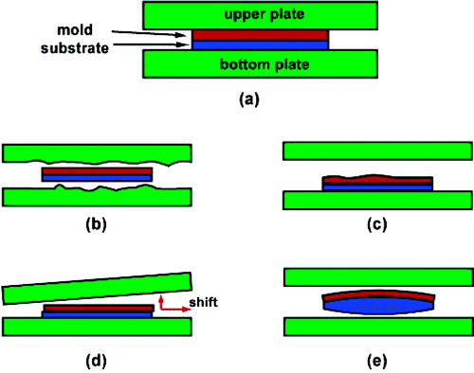
Limitations of solid parallel plate (SPP) press
ideal SPP
imperfect plate surfaces
uneven mold/substrate backside
Non-parallelism between plates
curved sample surfaces
Fortunately, most of the problems can be solved by putting a piece of clean room paper, plastics, or graphite sheet above/below mold/substrate.

Slide 28
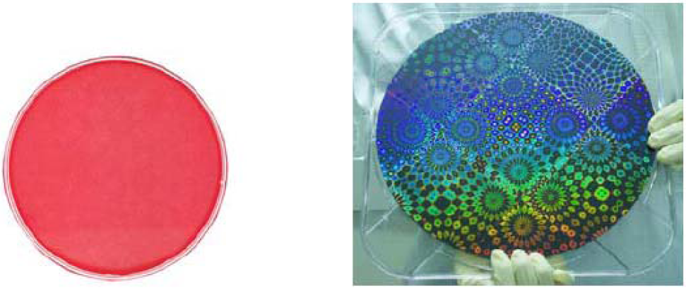
Air cushion press (ACP) nanoimprint
8-in. pressure indicating papers (gas pressure= 5kg/cm²). Uniform color means uniform pressure.
A 12-inch imprinted wafer
One can get similar imprint result using solid plate press, but needs higher pressure to make sure the pressure is high enough everywhere across the wafer.
J. Vac. Sci. Technol. A, Vol. 23, No. 6, pp. 1687-1690, Nov. 2005.

Slide 29
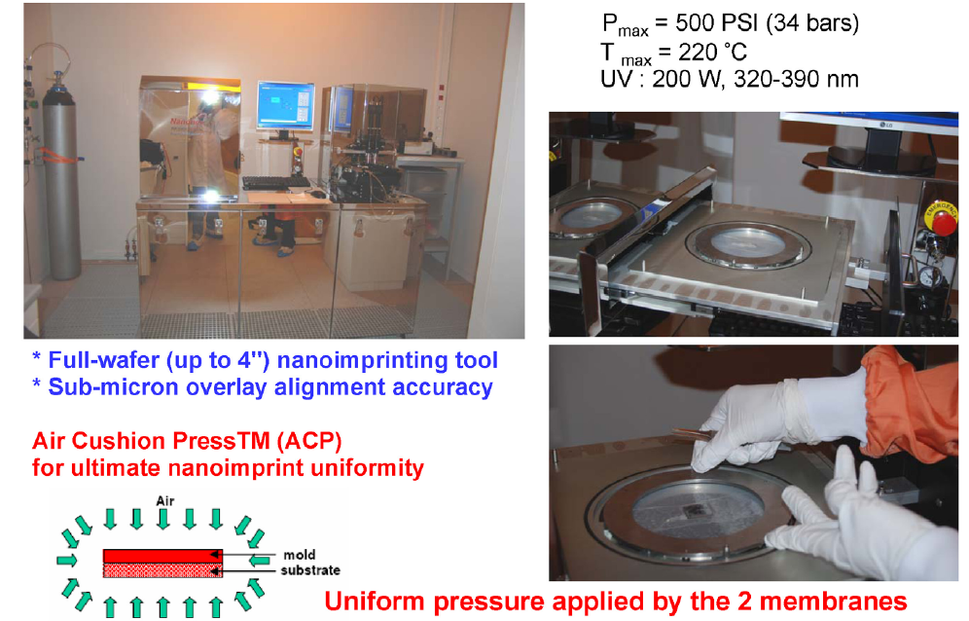
NIL tools: air-press
Air press has uniform pressure, but for most applications parallel plate press can also achieve good result (may need something soft like a paper for more uniform pressure).
“Air Cushion Press for Excellent Uniformity, High Yield, and Fast Nanoimprint Across a 100 mm Field”, Nano Lett. 2006.

Slide 30
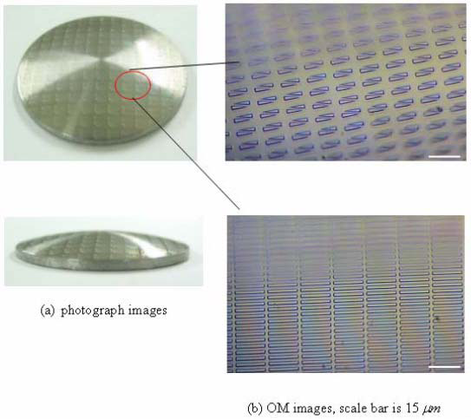
NIL onto curved surface
Imprinted patterns on 2-inch convex surface.
Using flexible PDMS mold and uniform gas pressure, the patterns can be transferred onto curved surface successfully.

Slide 31
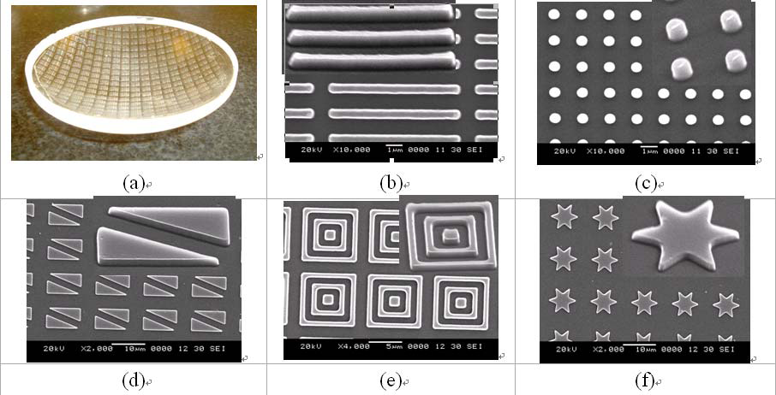
Curved surface imprint
SEM images of detailed imprinted patterns on curved substrate.
J. Vac. Sci. Technol. B, Vol. 24, No. 4, Jul/Aug, pp. 1724-1727, Nov. 2006.

Slide 32
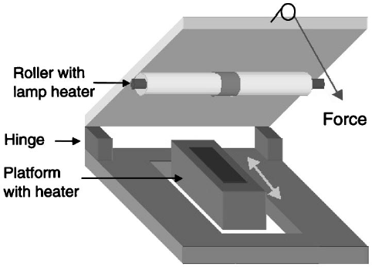
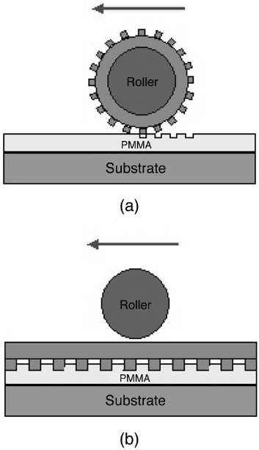
Roller NIL
imprints using a cylinder mold.
imprints using a flat mold: putting the mold directly on the substrate, and rotating the roller on top of the mold.
For schema (a), infinitely large surface area can be imprinted using one (small) mold.
For schema (b), NIL can be done at very low force.

Slide 33
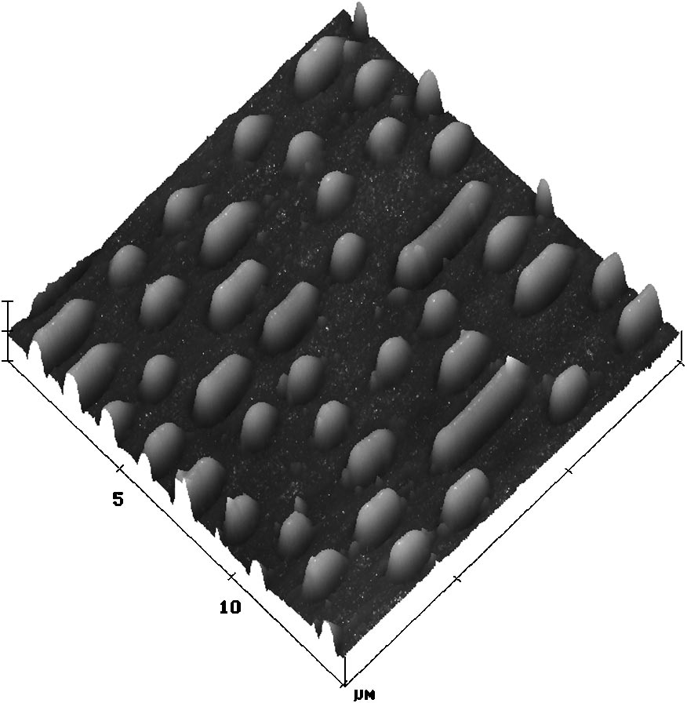
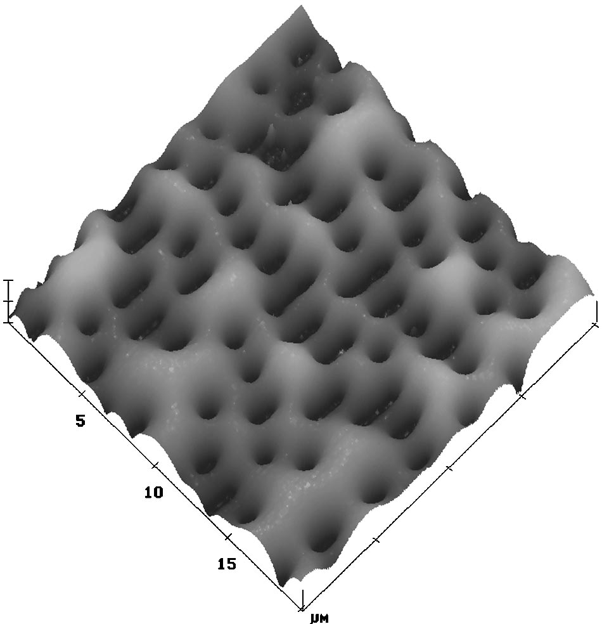
Results of roller NIL
AFM graph of a compact disk mold before bent into a cylinder: 700nm tracks pattern on the surface of compact disk.
PMMA imprinted by a cylinder mold, showing sub-100nm accuracy in pattern transfer.
“Roller nanoimprint lithography”, Tan, JVST B, 1998.

Slide 34
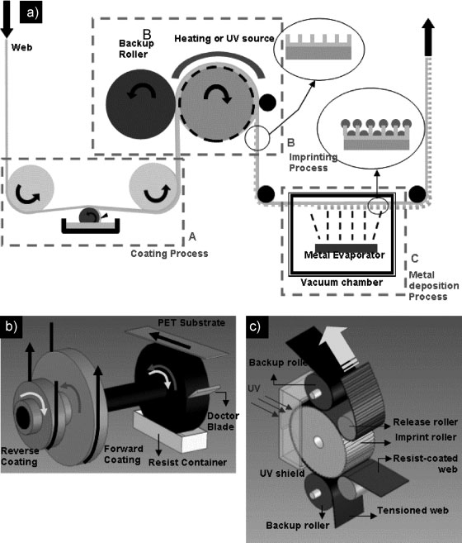
Roll-to-roll nanoimprint lithography
Mold
Schematic of the R2R-NIL process, and the continuous fabrication of a metal wire-grid polarizer as one of its applications.
The coating unit.
The Imprint unit of the R2R-NIL apparatus.
Application: large area electronics or optical devices (with nano-features) on flexible plastic substrates.
“High-Speed Roll-to-Roll Nanoimprint Lithography on Flexible Plastic Substrates”, Guo, Adv. Mater. 2008.

Slide 35
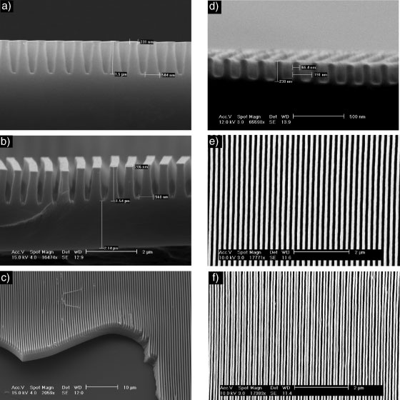
Results of roll-to-roll imprint
a) The original Si mold.
b-c) Epoxy-silicone gratings replicated from the ETFE mold.
d,e) SEM pictures of 200nm period 70nm line- width epoxy-silicone pattern.
f) 100nm period 70nm line-width epoxy-silicone pattern

Slide 36
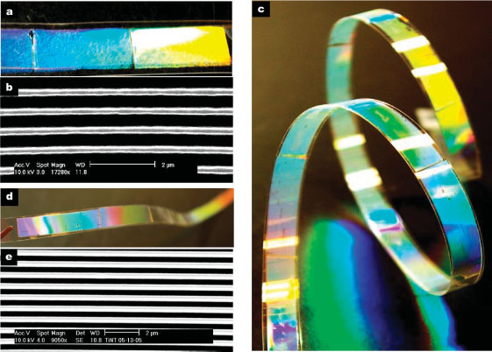
Results of roll-to-roll imprint
Thermal R2R-NIL results: a-b) Photograph and SEM of a 700nm period 300nm line-width PDMS grating pattern imprinted on PET strip.
UV R2R-NIL results: c-e) Photographs and SEM of 700nm period 300nm line-width epoxy-silicone grating pattern imprinted on PET strip, showing bright light diffraction. Total length is 570mm.

Slide 37
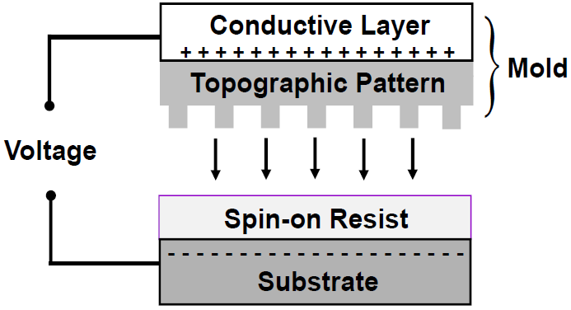
Electric field assisted NIL (EFAN)
Principle of EFAN: a voltage is applied between the conductive layers on the mold and the substrate, generating an electrostatic force to press the mold into the resist layer.

Slide 38
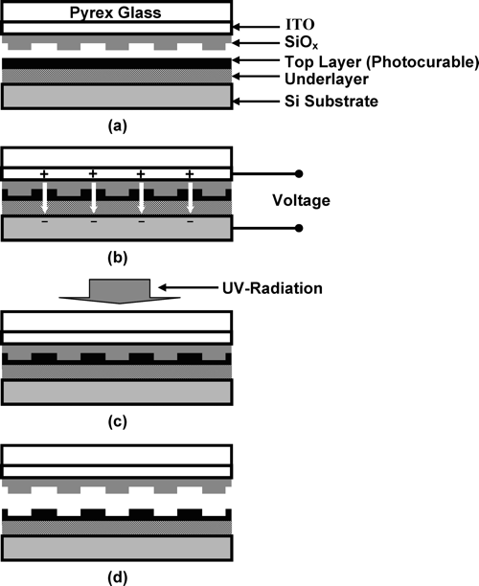
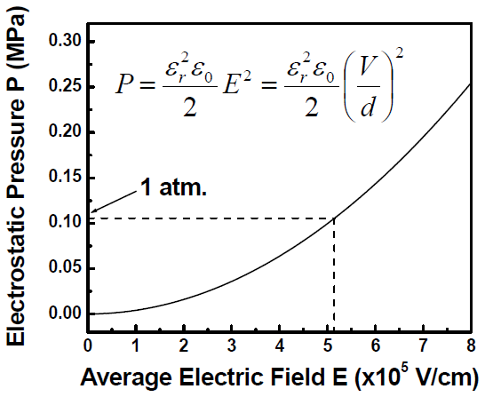
EFAN process flow
Calculated effective electrostatic pressure (P) versus the required strength of the electric field.

Slide 39
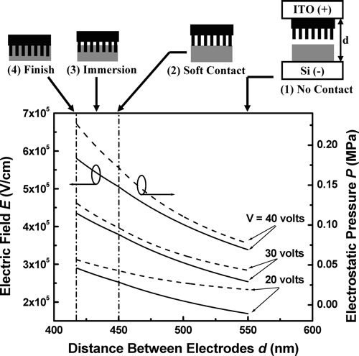
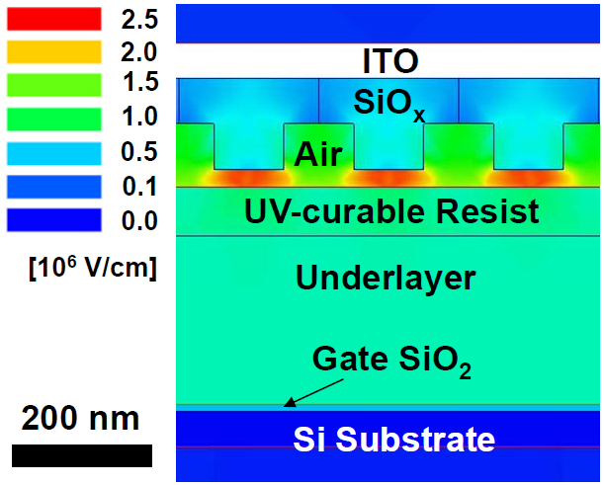
A more accurate calculation
A 2D simulation of EFAN, which adds complete details of dielectric structures into the calculation of electric field.

Slide 40
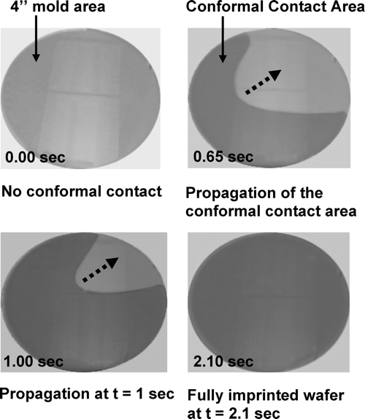
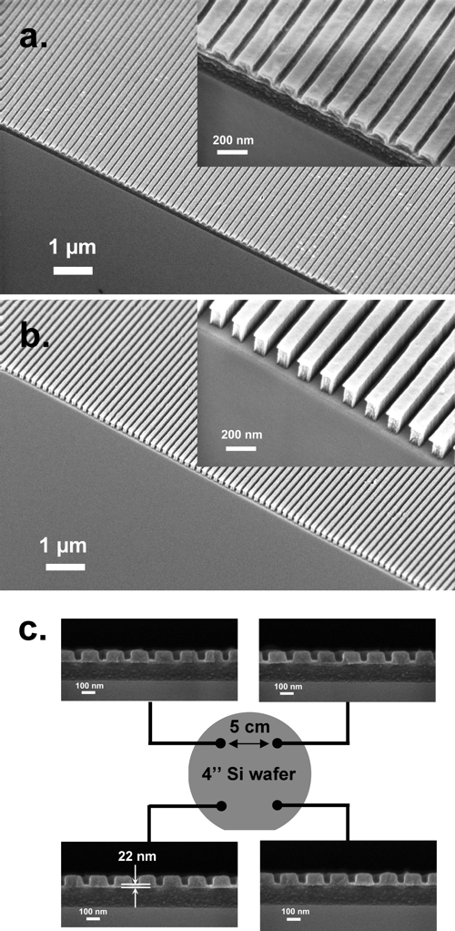
Propagation of contact area and imprint results

Slide 41
Electron and ion projection lithography (EPL and IPL)
Maskless lithography using electron beam arrays

Slide 42
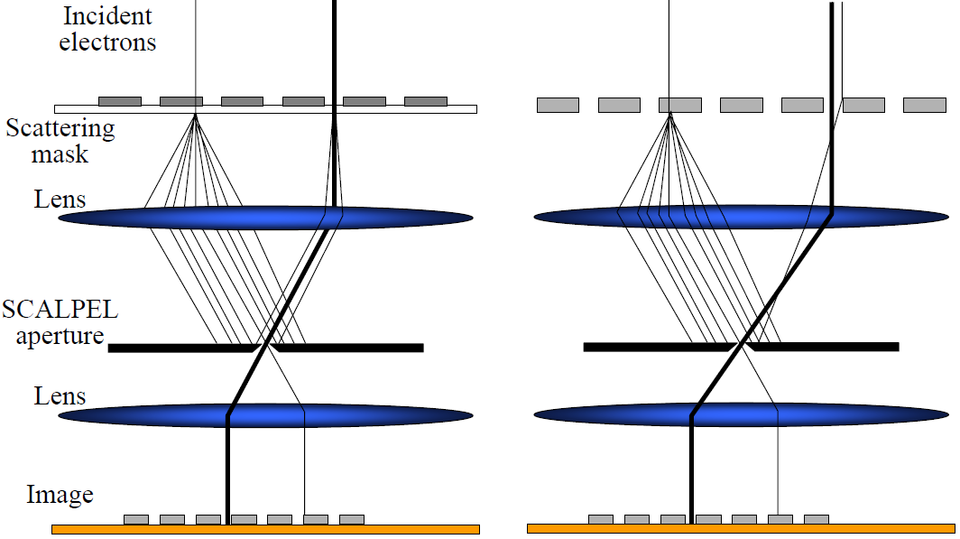
Parallel e-beam lithography, faster.
SCALPEL masks - membrane & stencil
(electron projection lithography - EPL)
SCAPEL: Scattering with angular limitation projection electron beam lithography.
Dark and light regions differentiated by their scattering strength at the SCALPEL aperture.
Harriott, JVST B, 15(6), 2130-2135 (1997)

Slide 43
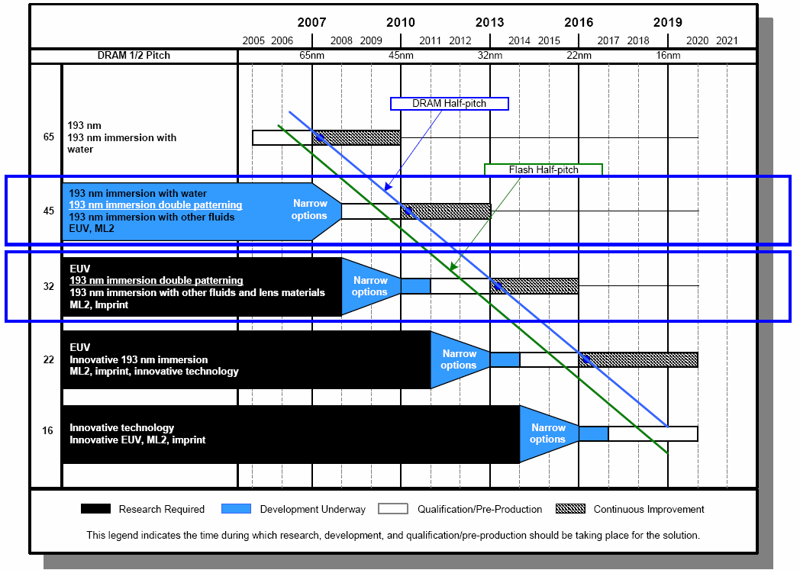
NIL not ready yet for ICs, but never excluded
ML2: maskless lithography (EBL, SPM..)
ITRS (2006) Projections for Lithography Technology

Slide 44
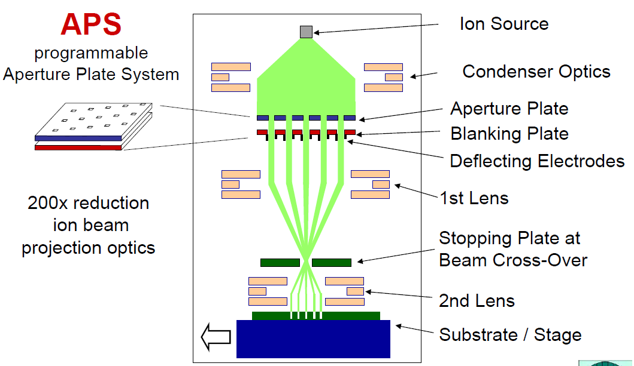
Projection Mask-Less Patterning (PMLP)
In principle, can also be electron source

Slide 45
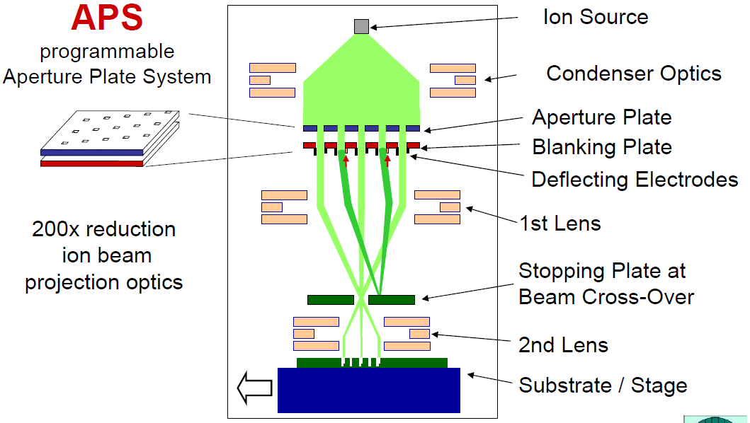

Slide 50
Multiple e-beam maskless lithography (ML2)
MEMS-based electron emitters
Micro-channel amplifier array
For the video, see http://www.mapperlithography.com/technology.html

