Slide 1
Those slides will not be covered in the lecture. You can go through it in order to gain some idea on how nanoimprint lithography (NIL) can be used for different applications.
Basically, NIL can be used for virtually any applications involving nanofabrication.
In fact, it would be the only choice for high volume production of nano-devices except those in IC (integrated circuit) industry and those don’t need precise patterning (i.e. no need of long range ordering, they can then be patterned by chemical synthesis or self assembly, namely “bottom –up” methods).
This is simply because other nano-lithographies (EBL, FIB, scanning probe…) don’t have the throughput needed for mass production.
The major challenges for NIL: mold fabrication (1×), alignment, defect control. It still has a long way to go for IC manufacturing.
Many slides here are collected by Dr. Wengu Zhang.
ECE 730: Fabrication in the nanoscale: principles, technology and applications
Instructor: Bo Cui, ECE, University of Waterloo; http://ece.uwaterloo.ca/~bcui/
Textbook: Nanofabrication: principles, capabilities and limits, by Zheng Cui

Slide 2
NIL applications
HD-DVD
Compact disk
Magnetic disk
Polymer reactor
DNA electrophoresis chips
Data storage
Nanoimprint lithography
Bio-medical
Others
Opto-
electronics
Display
Nano-
electronics
Nano integrated
probe array
SAW
MLCC
Lotus effect product
Gecko tape
Active field emitting cooling device
Photonic crystal
Waveguide
WDM
Grating
QD
OE
HOE
Liquid crystal alignment
Polarizer
Diffuser
Diffractive grating
FED
SET
Nano resist pattern
Molecular electronics
Single electron devices

Slide 3
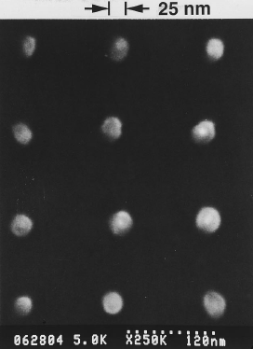
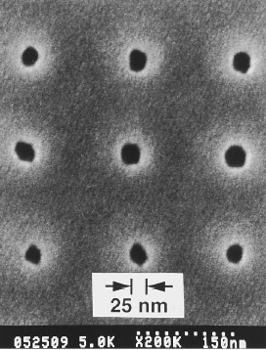
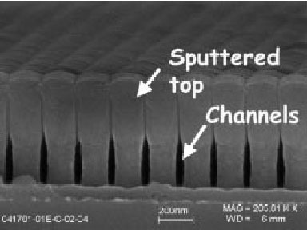
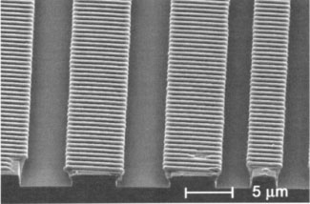
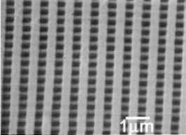
Various nanostructures fabricated by NIL

Slide 4
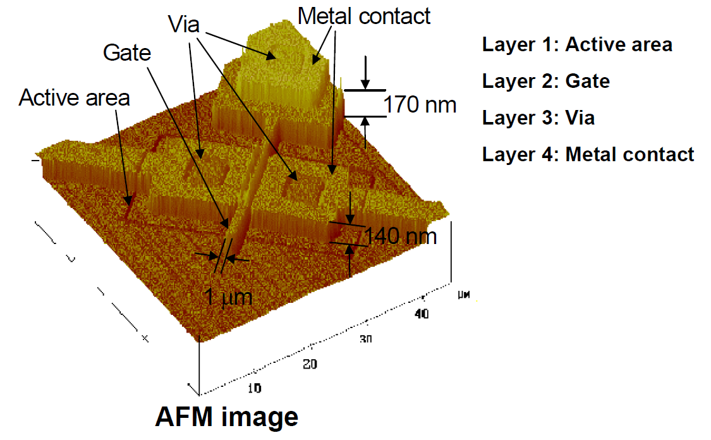
MOSFETs with 60nm channel on 4” wafer using NIL at all lithography levels
The device is fabricated using thermal NIL.
NIL is suitable for electronics because it is a rather “gentle” process:
Temperature <200ºC, low;
Pressure <3MPa, much lower than the hardness of Si (10GPa).
Chou, “Fabrication of 60-nm transistors on 4-in. wafer using nanoimprint at all lithography levels”, APL 2003

Slide 5
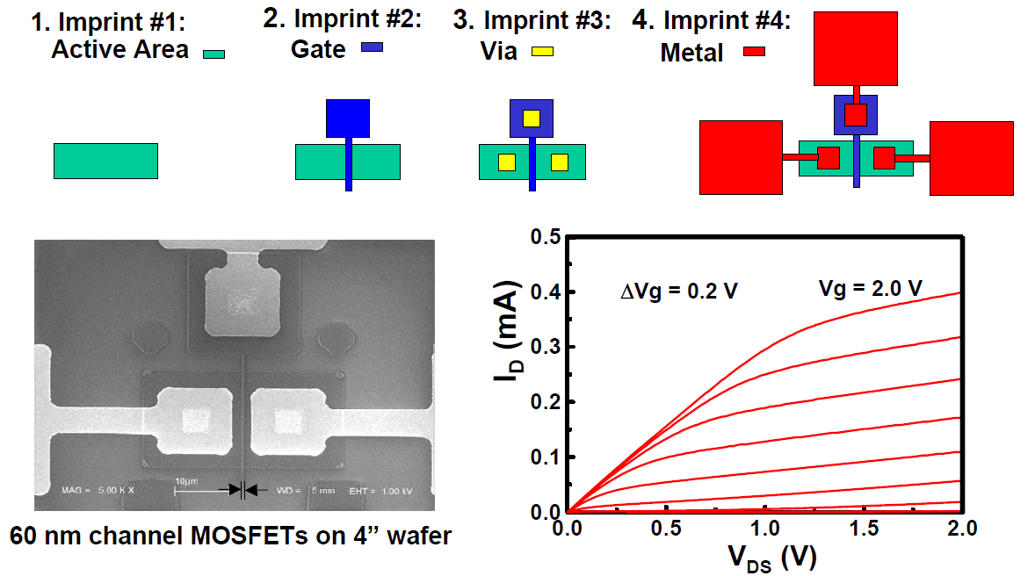
Fabrication steps and device characteristics
Alignment accuracy ~0.5μm, done using a mask aligner (wafer stacks then transferred to NIL chamber)

Slide 6
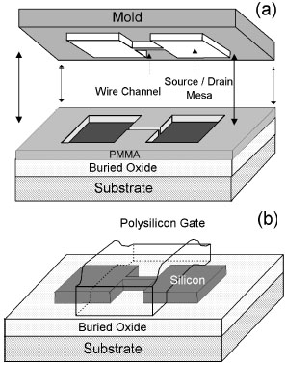
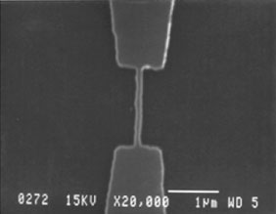
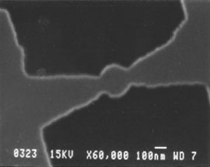
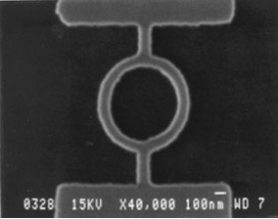
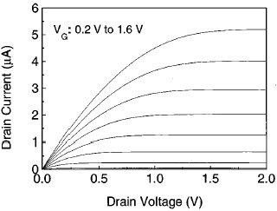
MOSFET
175°C, 45 bar
100nm wide wire channel
250nm diameter quantum dot channel
100nm wide ring channel
200 nm
100 nm-wide wire channel
Guo, “Nanoscale silicon field effect transistors fabricated using imprint lithography”, Appl. Phys. Lett. 71, 1881-1883 (1997).

Slide 7
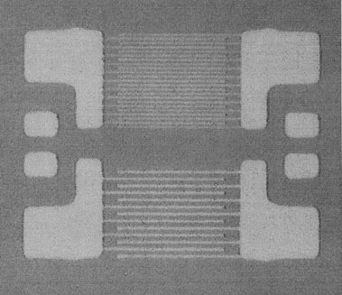
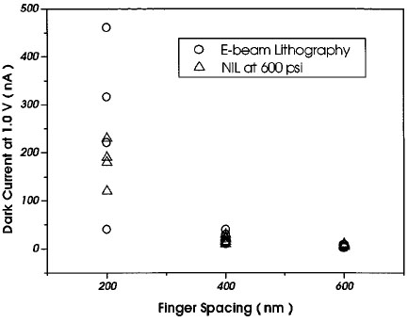
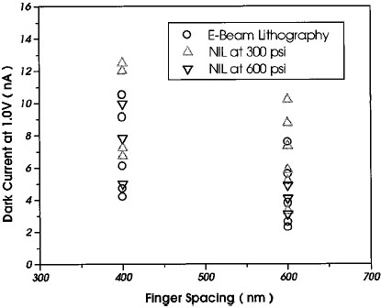
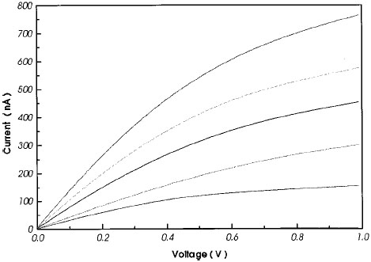
GaAs metal-semiconductor-metal (MSM) photo-detector
Finger spacing：300 nm、600 nm
175°C
Area: 14×14 μm
different incident light intensities
175°C
Yu, “Nanoscale GaAs metal–semiconductor–metal photodetectors fabricated using nanoimprint lithography”, APL 74, 2381-2383 (1999)

Slide 8
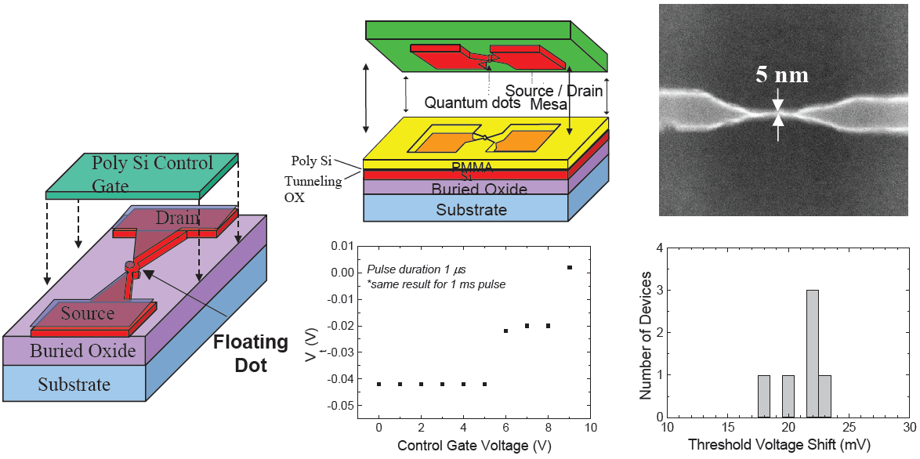
First single-electron memory with 8nm dot using NIL
For single electron devices, the size of the quantum dot is very critical. It is achieved by e-beam lithography and size shrinkage techniques, which has very low yield. By using NIL, once the “right” size is achieved, it can be duplicated many times faithfully.

Slide 9
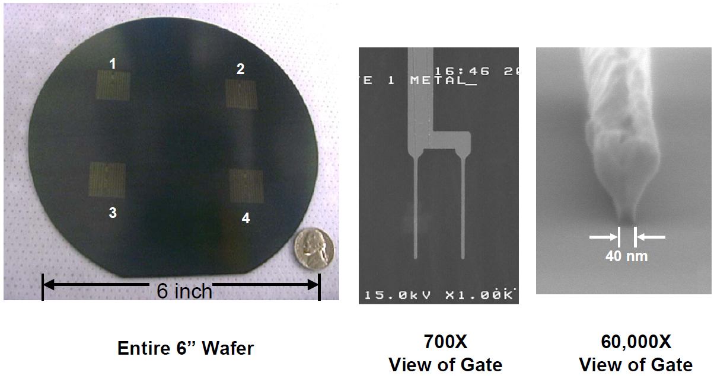
Microwave MESFETs with 40nm gate by (3D) NIL and liftoff
T-gate
T-shaped gate: top is wide for low resistance; bottom is narrow for small gate/ channel length (faster switching).

Slide 10
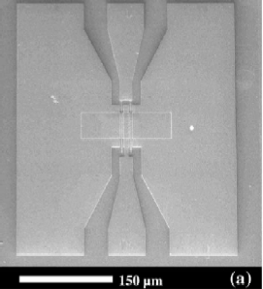
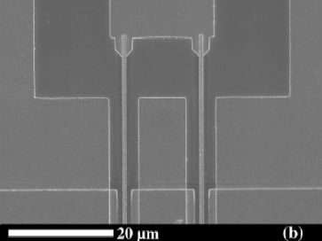
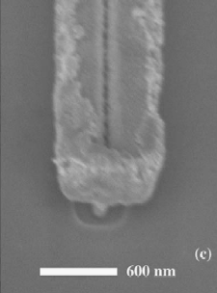
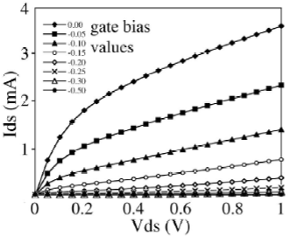
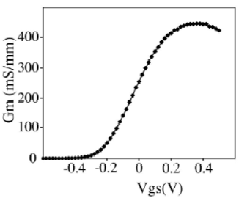
High frequency low noise III-V transistor using T-gate
Chen, “High electron mobility transistors fabricated by nanoimprint lithography”, Microelectronic Engineering 67–68, 189–195 (2003)

Slide 11
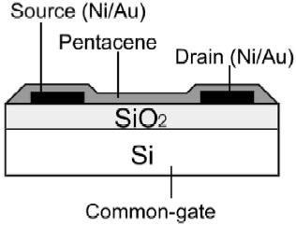
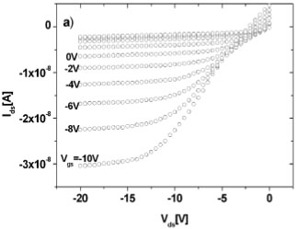
Organic thin film transistor (OTFT)
(40~80nm)
(100~300nm)
Contact: Ni
W: 1000μm
L: 5μm
Pentance: 60nm
(4“ P-type)
PMMA thickness
1000nm→400nm
Pressure100 bar
Residual100nm
O₂ RIE 2min
Hard-bake 130°C 45min
1 HCl : 3 HNO₃
“Nanometer scale organic thin film transistors with Pentacene”, Microelectron. Eng. 67-68 (2003) 845-852

Slide 12
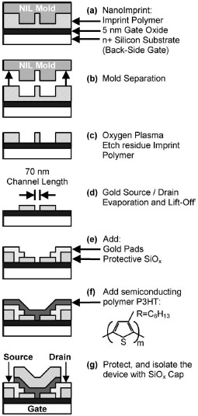
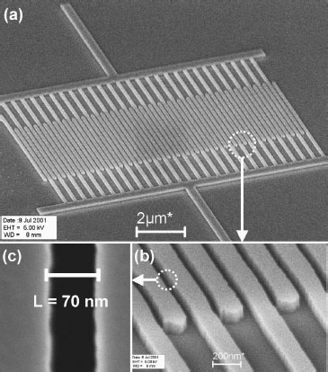
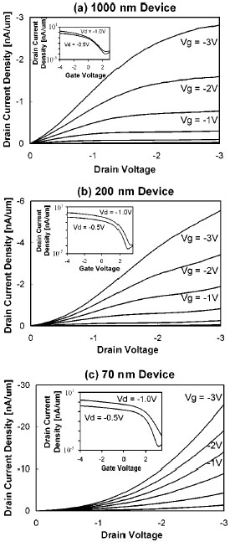
Organic thin film transistor (OTFT)
Resist thickness:100nm
Contact: 4nm-Cr/20nm-Au
P3HT thickness
- spin coating 50nm
mobility10⁻⁵ cm²/Vs
- casting 5-10nm
mobility10⁻³ cm²/Vs
Austin and Chou, “Fabrication of 70 nm channel length polymer organic thin-film transistors using nanoimprint lithography”, Appl. Phys. Lett. 81, 4431-4433 (2002).

Slide 13
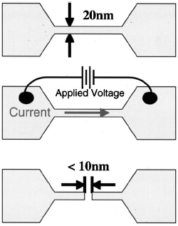
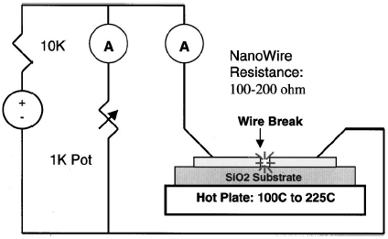
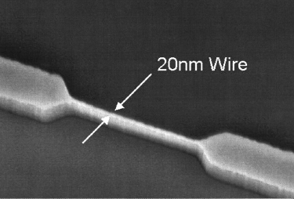
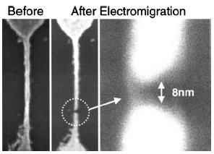
Nano-contact for molecular electronics
Austin and Chou, “Fabrication of nanocontacts for molecular devices using nanoimprint lithography”, J. Vac. Sci. Technol. B, 20, 665-667 (2002)

Slide 14
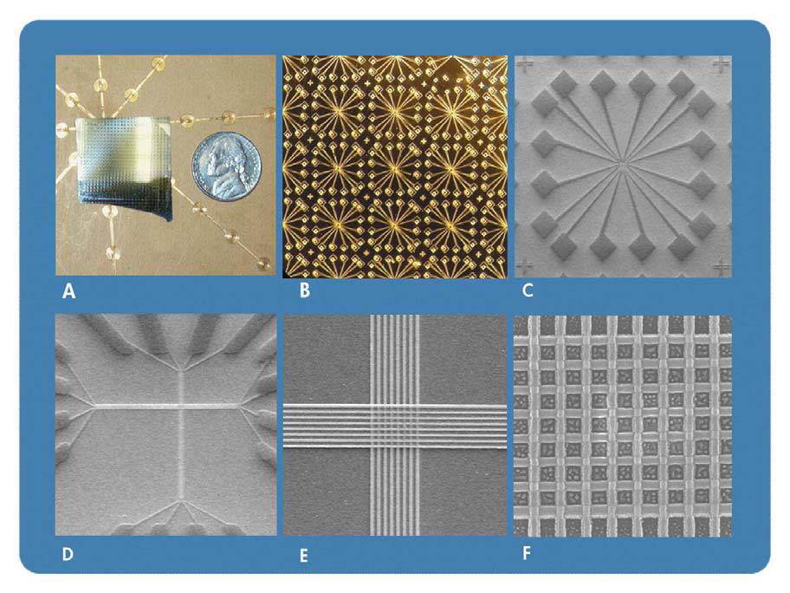
Molecular memory with ultra-high density 6.4Gbits/cm²
Advantage: simplicity, high resolution, low cost and large surface area.
Disadvantage: alignment, temperature, pressure, life-time.
This work is from HP. However now they realized that this is not molecular memory, but a memristor.
http://en.wikipedia.org/wiki/Memristor

Slide 15
Sub-wavelength optical elements – optical chips by NIL
Zone plate of 70 nm min. feature

Slide 16
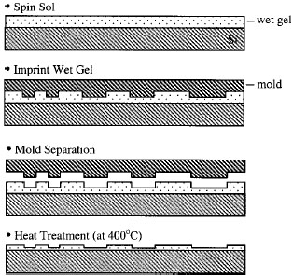
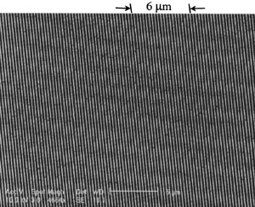
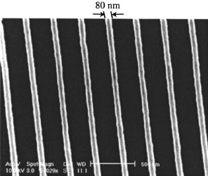
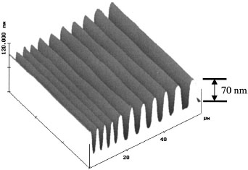
Grating waveguide SiO₂-TiO₂
300nm pitch
70nm depth
80nm line-width
Material：635nm liquid SiO₂-TiO₂ gel
Pressure：645 psi
Temperature：17°C → 200°C° (9°C/min)
100、150、200°C hold 7min
Post-bake：400°C 15min
Shrinkage：61%
4-10μm pitch
Li and Chou, “Large area direct nanoimprinting of SiO2–TiO2 gel gratings for optical applications” J. Vac. Sci. Technol. B 21, 660-663 (2003).

Slide 17
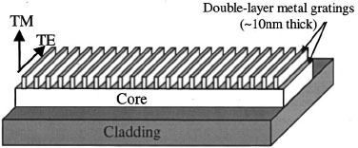
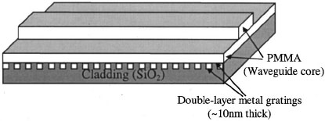
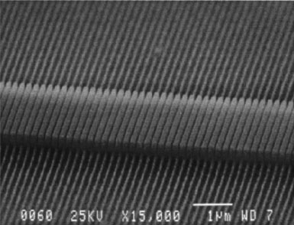
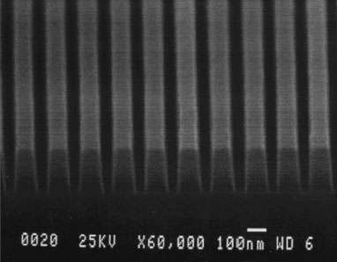
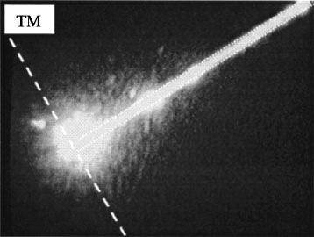
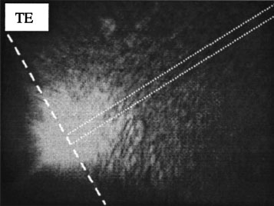
Broadband waveguide polarizer
(Al)
(SiN: n~1.95)
(SiO₂)
Top cladding: air
(Al)
Grating pitch：190nm
height：200nm
SiN thickness：1000nm
Band-width：2-20μm
Pitch：190 nm
height：200 nm
PMMA thicness：900 nm
Band-width：2-20 μm
Wavelength：710-820 nm
Extinction ratio (TM/TE)
>50 dB/mm
TM loss：2 dB/mm
Wang and Chou, “Fabrication of a new broadband waveguide polarizer with a double-layer 190 nm period metal-gratings using nanoimprint lithography” J. Vac. Sci. Technol. B, 17, 2957-2960 (1999)

Slide 18
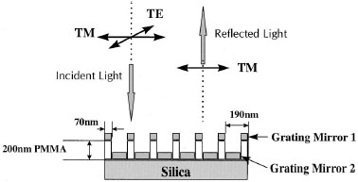
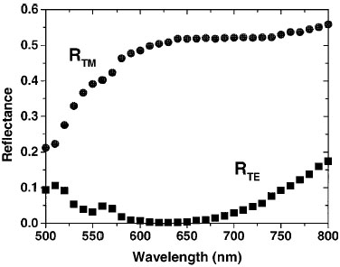
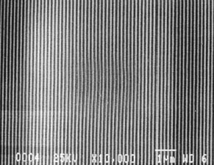
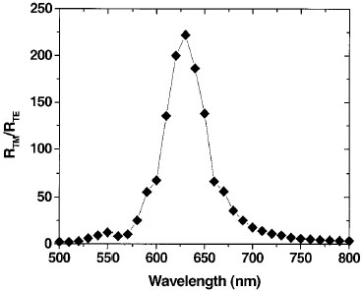
Thin film reflective polarizer
Resist: 15k PMMA
200nm-thick
Temperature: 175°C
Metal grating
5nm-Cr/70nm-Au
Grating pitch：190nm
Line-width: 70nm
Depth: 200nm
Yu and Chou, “Reflective polarizer based on a stacked double-layer subwavelength metal grating structure fabricated using nanoimprint lithography”, Appl. Phys. Lett. 77, 927-929 (2000).

Slide 19
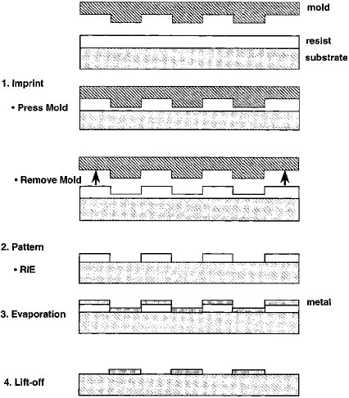
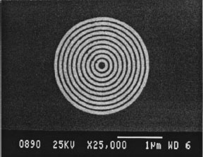
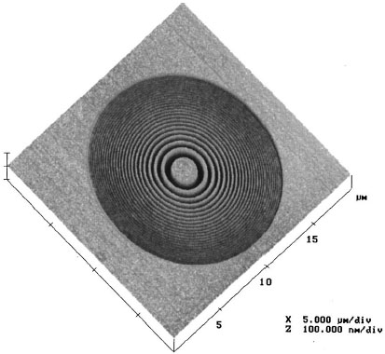
Fresnel Zone Plate (for x-ray focusing)
120nm-PMMA
Resist: 120nm PMMA
Thermal NIL: 175°C、645psi
Pitch: 100nm, 150nm
Cr/Au
Li and Chou, “Fabrication of circular optical structures with a 20 nm minimum feature size using nanoimprint lithography”, Appl. Phys. Lett. 76 (2000) 673-675

Slide 20
Micro-ring resonator
Resonant condition: optical path of the ring = nλ
Chao and Guo, “Polymer microring resonators fabricated by nanoimprint technique” J. Vac. Sci. Technol. B, 20, 2862-2866 (2002)

Slide 21
Nanoimprint of organic light emitting materials
200nm週期
300nm週期
Material: 200nm-Alq₃/DCMII
Subtrate: PMMA
Thermal NIL: 800 psi、150°C、<15min
PL spectrum
200nm週期
Want and Chou, “Direct nanoimprint of submicron organic light-emitting structures”, Appl. Phys. Lett. 75, 2767-2769 (1999)

Slide 22
Organic light emitting diode (OLED)
50 kg/cm², 175°C, 5 min
ITO/PEDOT-PPS/red emissive/Al
Device area: 5 mm²
O₂ RIE
Cheng and Guo, “High-resolution organic polymer light-emitting pixels fabricated by imprinting technique” J. Vac. Sci. Technol. B, 20, 2877-2880 (2002).

Slide 23
OLED: application of photonic crystals
Photonic crystal (PC) enhanced OLED’s extrinsic quantum efficiency by >50%
Without PC with PC
“A high-extraction-efficiency nanopatterned organic light-emitting diode”, Appl. Phys. Lett. 82, 3779-3781 (2003)

Slide 24
Commercial CD
CD is made by hot-embossing into polycarbonate using a Ni mold, very similar to NIL.
Compact Disc 650 MB, 48 Mbit/cm²

Slide 25
Nano-CD
CD areal density: 400 Gbit/in²
Krauss and Chou, “Nano-compact disks with 400 Gbit/in² storage density fabricated using nanoimprint lithography and read with proximal probe”, Appl. Phys. Lett. 71, 3174-3176 (1997).

Slide 26
Membrane with nano-holes
140 nm直徑
Heyderman, “High volume fabrication of customised nanopore membrane chips ”, Microelectron. Eng. 67-68, 208-213 (2003)

Slide 27
Application: diffractive security elements
Example for diffractive colors:
Tropical butterflies
Periodic diffractive elements produced
by “roll-embossing” to be laminated into
credit cards, bank notes etc.

Slide 28
Liquid crystal alignment
Nano-patterns for liquid crystal displays
Aim: Achieve liquid crystal alignment by defined topographical or chemical patterning instead of rubbing.
Use: Bi-stable switching
(lower power consumption)

Slide 29
Chemical patterning by liftoff for liquid crystal displays
Stamp:
AFM image
Embossed
structure:
AFM image
Chemical
patterns
after lift-off:
LFM image
tridecafluoro-1,1,2,2-tetrahydrooctyl)trichlorosilane (TFS)

Slide 30
Particle guided self-assembly
D=100nm (left), 120nm (middle), >99% yield
CNRS-LPN

Slide 31
Particles transfer using micro-contact printing

Slide 32
Template self-assembly

Slide 33
Nano-channel DNA sorter by NIL

