Slide 1
Scanning probe microscopy (SPM) and lithography
Scanning tunneling microscopy.
Piezoelectric positioning.
Atomic force microscopy (AFM) overview.
AFM tip and its fabrication.
Tapping mode AFM.
Other forms of AFM (LFM, EFM, MFM, SCM…)
“Scanning probe microscopy and spectroscopy” by Roland Wiesendanger is a good comprehensive reference book. It can be found at (read only, no download):
http://books.google.ca/books?id=EXae0pjS2vwC&pg=PA561&lpg=PA561&dq=liquid-metal-covered+tungsten+needle&source=bl&ots=Yy9A2saE3M&sig=KIDbgh_HQLg4LQPA4XIVh7TD3kQ&hl=en&ei=4cdkSsjqMYLWtgOX_ehm&sa=X&oi=book_result&ct=result&resnum=1
ECE 730: Fabrication in the nanoscale: principles, technology and applications
Instructor: Bo Cui, ECE, University of Waterloo; http://ece.uwaterloo.ca/~bcui/
Textbook: Nanofabrication: principles, capabilities and limits, by Zheng Cui

Slide 2
Scanning probe microscopy (SPM) overview
Normally used for characterization of topographic, physical and chemical properties, though they can also be used as a lithography tool with high resolution yet low throughput.
For imaging purpose, compared to SEM:
Extremely accurate in the z-dimension (<<1Å); whereas for SEM to see the vertical cross-section profile one has to cut the sample and tilt it, and the resolution is much worse than 1nm.
For lateral (xy-) dimension, SPM is accurate only when the surface is relatively flat, then the resolution is better than SEM (atomic resolution for SPM vs. few nm resolution for SEM).
For non-flat surface, there are often artifacts for SPM imaging because the tip is not infinitely thin and long. As a result, a vertical profile always appears slopped when imaged using SPM.
AFM generally don’t need vacuum and can image any surface (insulation or not) and even inside liquid (extremely important for bio-imaging).
AFM is much cheaper than high resolution field emission SEM and is thus more available (>10 AFMs on campus).

Slide 3
Scanning probe microscopy (SPM) family
Scanning Tunneling Microscopy(STM): topography, local DOS (density of state)
Atomic Force Microscopy (AFM): topography, force measurement
Lateral Force Microscopy (LFM): friction
Magnetic Force Microscopy (MFM): magnetism
Electrostatic Force Microscopy (EFM): charge distribution
Nearfield Scanning Optical Microscopy (NSOM): optical properties
Scanning Capacitance Microscopy (SCM): dielectric constant, doping
Scanning Thermal Microscopy (SThM): temperature, conductivity
Spin-polarized STM (SP-STM): spin structure
Scanning Electro-chemical Microscopy (SECM): electro-chemistry
Scanning Tunneling Potentiometry: potential surface
Photon Emission STM (PESTM): chemical identification

Slide 4
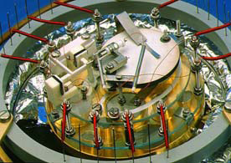
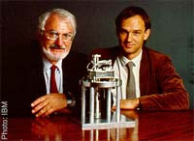
The first STM Instrumentation
Exact copy of first Scanning Tunneling
Microscope of Binnig and Rohrer
STM inventors Rohrer and Binnig, IBM, Zurich, Nobel Prize in Physics in 1986.

Slide 5
Operation of an STM

Slide 6
Two basic scanning modes
Feedback off/constant height: Scan over surface with constant z₀ (piezo voltage), control signal changes with tip-surface separation. For relative smooth surface, faster.
Feedback on/constant current: circuit regulates z piezo voltage to constant value of control signal (constantly changes tip-surface separation). Irregular surfaces with high precision, slower. Constant current STM image corresponds to a surface of constant state density.

Slide 7
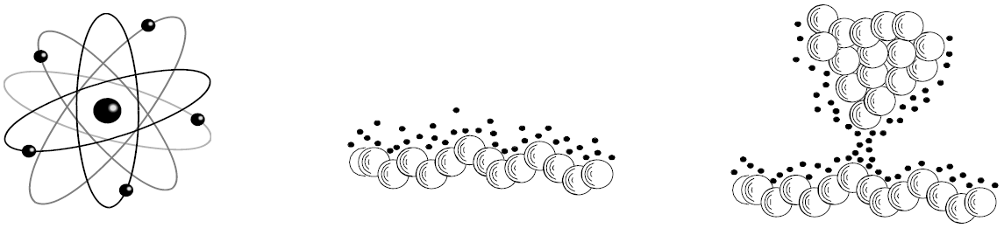
Quantum mechanical tunneling
A voltage applied between two conducting bodies leads to an electrical current even if the two bodies not quite touch: the tunneling current
Interaction: (tunneling-) current (down to pA)
  Atomic scale surface topography of electrical conductors
  Electronic properties of the surface (“conductivity”)
The tunneling current is strongly dependent on the distance of the two bodies: 1Å changes the current by a factor of 10!
Atom Surface STM

Slide 8
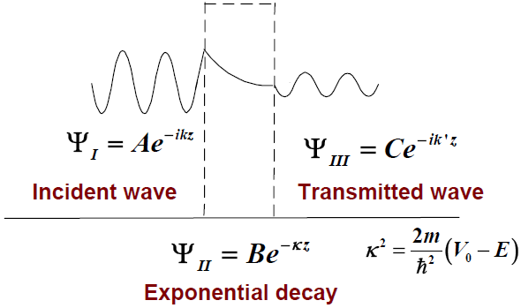
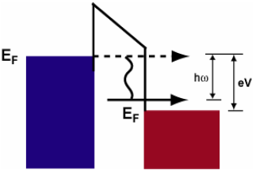
Quantum mechanical tunneling
Tunneling through a rectangular barrier
Elastic tunneling vs. inelastic tunneling
Elastic: energy of tunneling electrons conserved.
Inelastic: electron loses a quantum of energy within the tunneling barrier.

Slide 9
Modelling an STM
Unknown:
Chemical nature of STM tip
Relaxation of tip/surface atoms
Effect of tip potential on electronic surface structure
Influence of magnetic properties on tunnelling current/surface corrugation
Theoretical issues:
Open system, carrying non-zero current.
Macroscopic device depends on very small active region.
No simple “inversion theorem” to deduce surface structure from STM signal.
Needed: extensive simulations

Slide 10
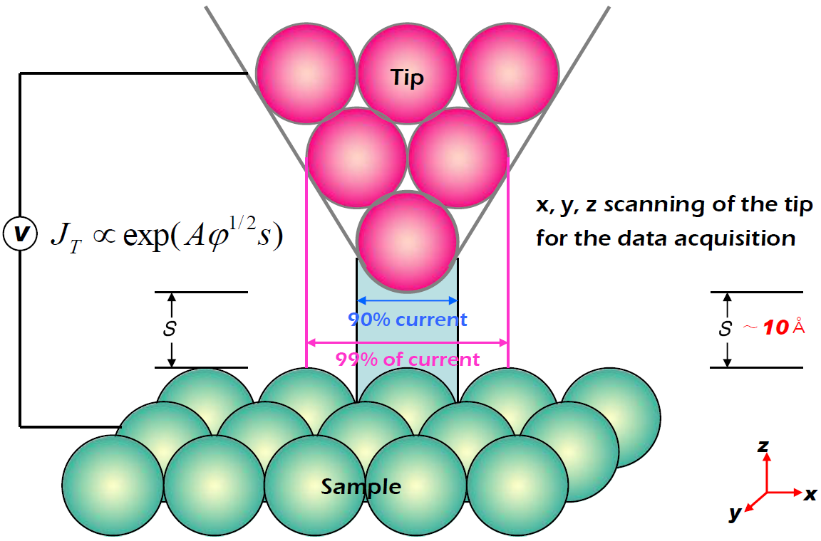
Why atomic resolution?

Slide 11
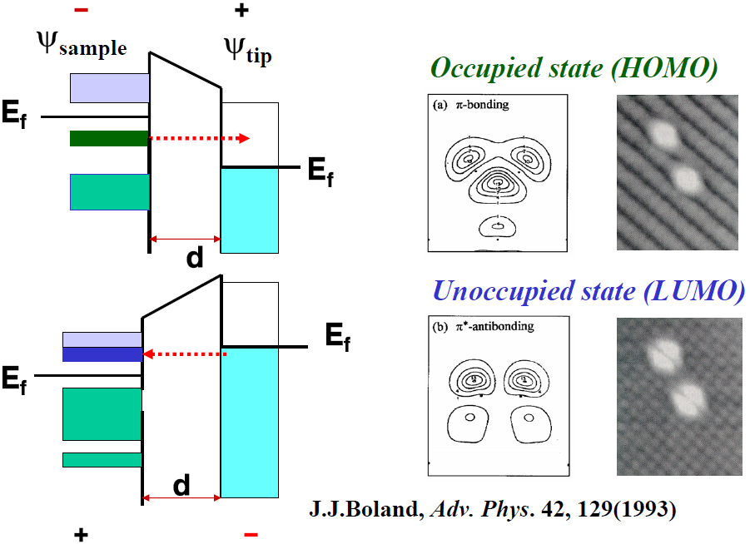
Bias polarity : probing filled and empty states

Slide 12
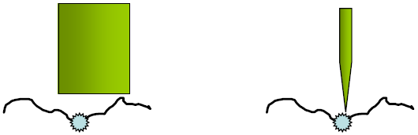
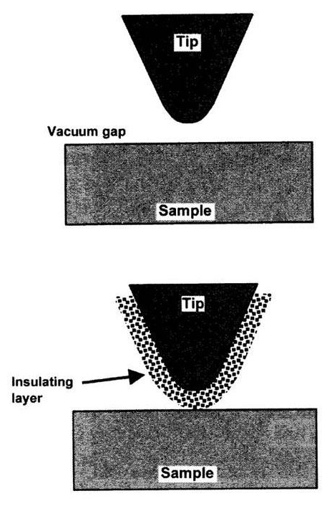
Tip is the key
The resolution is determined by:
Dimension of probe ⇒ probes are small
Distance of probe to sample ⇒ probe is a point
Oxide or insulating contamination layers of thickness several nanometers can prevent vacuum tunneling.
This may lead to mechanical contact between tip and sample. (the servo will force the tip to collide in an effort to achieve the set-point current)
Tunneling through the oxide or contamination layer may damage tip.

Slide 13
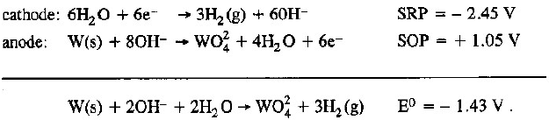
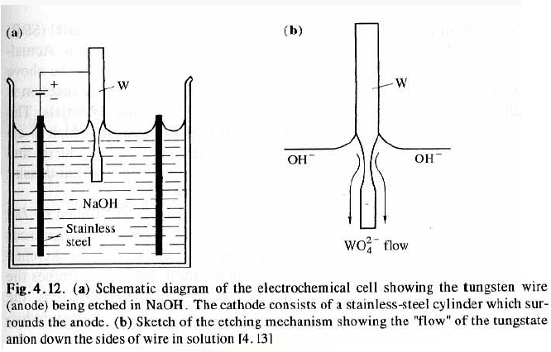
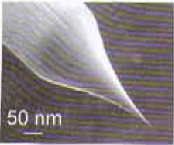
STM tip preparation
How to make sharp STM tips?
Wire of W or Pt-Ir, with 200μm diameter.
Cut or etch to ∼40nm diameter tip.
Hand-made, no micro-fabrication process.
Can be sharpened by focused ion beam milling.
Very sharp tips can be obtained, ideally terminated by a single atom.

Slide 14
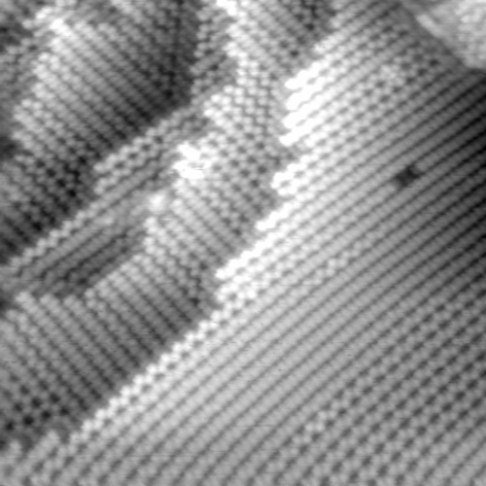
Applications of STM
Surface Structure with atomic resolution
Surface geometry
Molecular structure
Local electronic structure
Local spin structure
Single molecular vibration
Electronic transport
Nano-fabrication
Atom manipulation
Nano-chemical reaction
Various reconstructions of Ge(100)-2x1

Slide 15
Scanning probe microscopy (SPM) and lithography
Scanning tunneling microscopy.
Piezoelectric positioning.
Atomic force microscopy (AFM) overview.
AFM tip and its fabrication.
Tapping mode AFM.
Other forms of AFM (LFM, EFM, MFM, SCM…)

Slide 16
Piezoelectric tube scanner
Displacement ∝ electric field

Slide 17
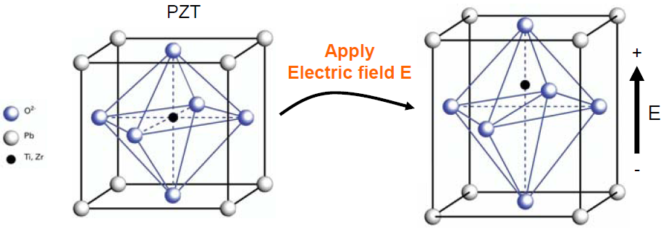
Piezo driving technology: the basics
Piezoelectric effect:
changing the size of an object results in a voltage generated by the object.
Inverse piezoelectric effect
Discovered in 1880 by Pierre and Jacques Curie
Most common material: PZT
PZT: Lead zirconium titanate
Piezoelectric materials have an asymmetric unit cell like a dipole.
If these crystals are grown in the presence of a strong electric field then the crystal grains will align and the piezoelectric effect is created.
Typical achievable strain ratio: 1/1000, e.g. 1μm stroke for 1mm PZT.

Slide 18
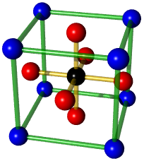
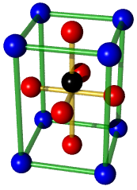
Unit cell with dipole
The central atom is displaced resulting in a unit cell with a dipole moment.
Cubic
T > T_{c}
Tetragonal
T < T_{c}
T_{c} is Curie temperature, above which the material becomes para-electric (no longer ferroelectric, no dipole moment at the absence of external electric field).

Slide 19
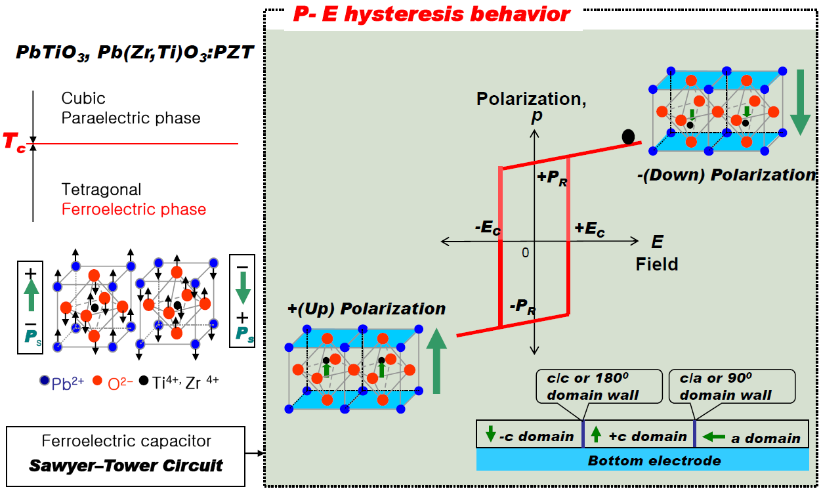
Ferro-electricity (analog to ferromagnetism)
Domain structure, hysteresis, coercivity, Curie temperature…

Slide 20
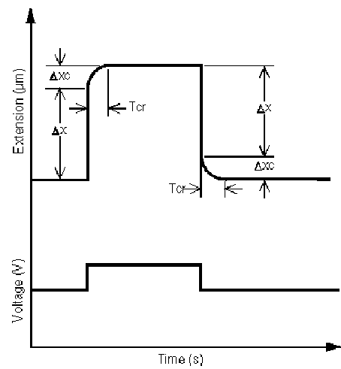
Piezo-ceramics drawbacks
Non-linear
Nonlinearity
Creep
Hysteresis
Aging
Hysteresis
Creep

Slide 21
Scanning probe microscopy (SPM) and lithography
Scanning tunneling microscopy.
Piezoelectric positioning.
Atomic force microscopy (AFM) overview.
AFM tip and its fabrication.
Tapping mode AFM.
Other forms of AFM (LFM, EFM, MFM, SCM…)

Slide 22
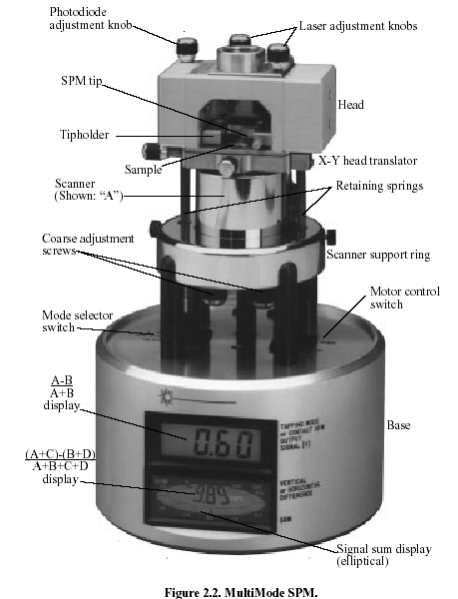
Digital Instruments (DI, now Veeco)
multi-mode head, scanner and base
For DI multi-mode head, sample is put on piezo stage.
For DI dimension 3000 head, tip is put on piezo stage.

Slide 23
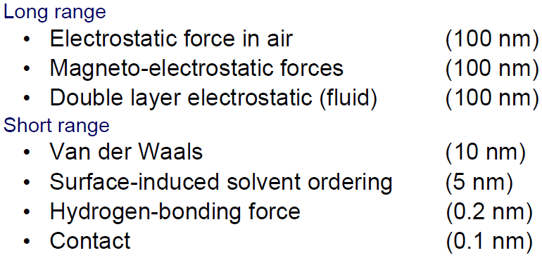
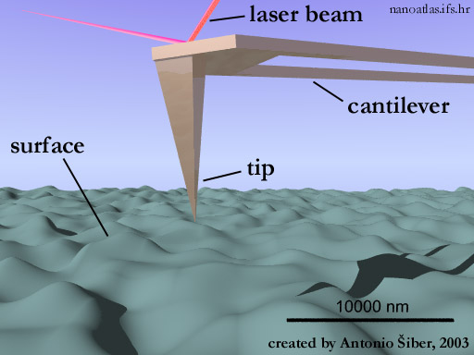
Probe-sample interaction and detection system
Forces and their range of influence

Slide 24
Probe-sample interaction detection system
Detect deflection in z-direction
(to maintain constant force for normal AFM operation)
Detect defection in the x-y direction, for lateral force/friction microscopy.
Measure
(A+B-C-D)/(A+B+C+D)
Measure
(A+C-B-D)/(A+B+C+D)
Photo-diode
(divided into four parts)

Slide 25
Feedback loop for constant force AFM
ΔZ is equivalent to the topography of the sample
Photo-diode
(divided into four parts)
Tiny deflection of cantilever leads to large shift of the beam spot position on the photo-diode, so extremely sensitive for z-dimension detection (sensitivity ΔZ << 1Å)

Slide 26
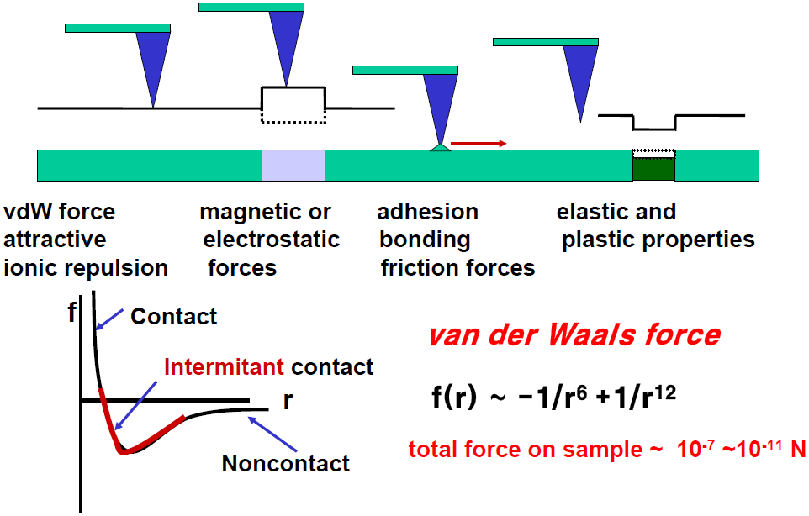
Interactions between sample and tip in force microscopy
Far (50-100nm)
Close (<10nm)
Contact
Contact

Slide 27
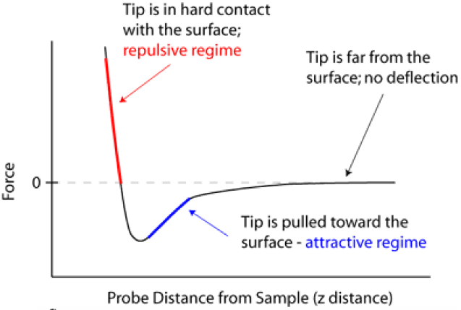
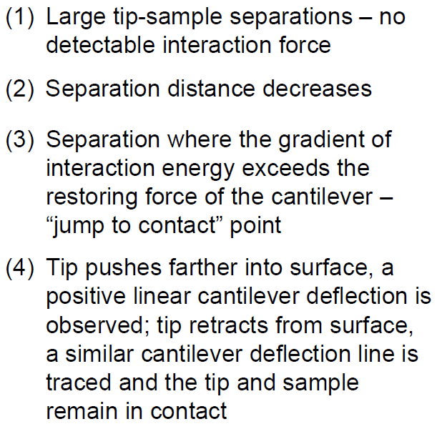
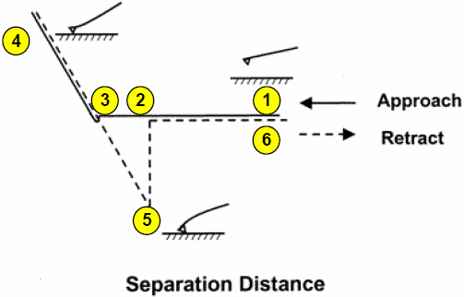
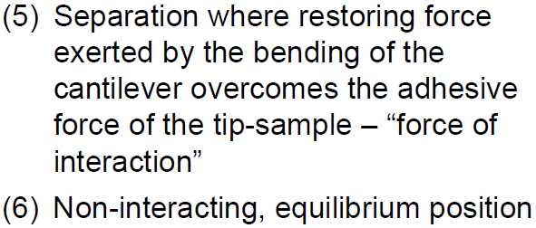
AFM tip-sample interaction

Slide 28
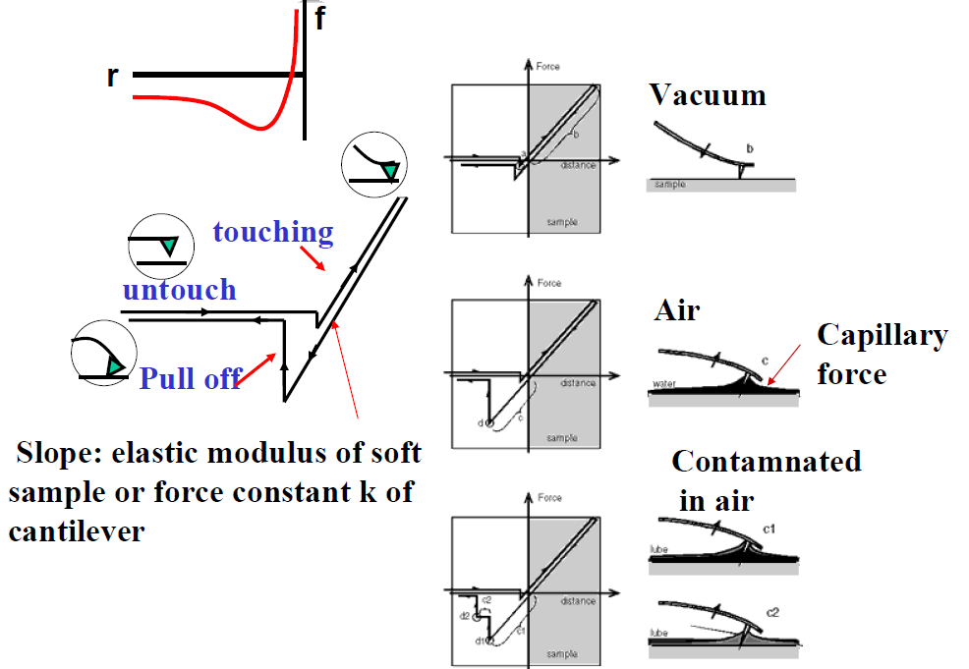
Force vs. distance
AFM can also be used for nano-indentation study to investigate mechanical properties (stress-strain curve, Young’s modulus) of the sample, though force is not as accurate as dedicated nano-indentation tools.

Slide 29
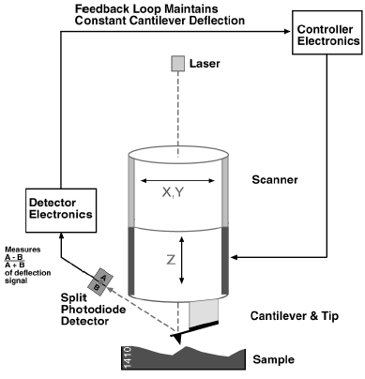
Atomic Force Microscope (AFM)
Two basic AFM Modes:
Contact mode (no vibrating tip)
Tapping mode (vibrating tip)
Many variations on Scanning Force Microscopy:
Liquid AFM
Magnetic Force Microscopy (MFM)
Latteral Force Microscopy (LFM)
Intermitant and non-contact AFM
Force Modulation Microscopy (FMM)
Electrostatic Force Microscopy (EFM)
Sample: conductor, nonconductor, etc
Force sensor: cantilever
Deflection detection: photodiode
Here tip on piezo-stage, also possible sample on piezo-stage.

Slide 30
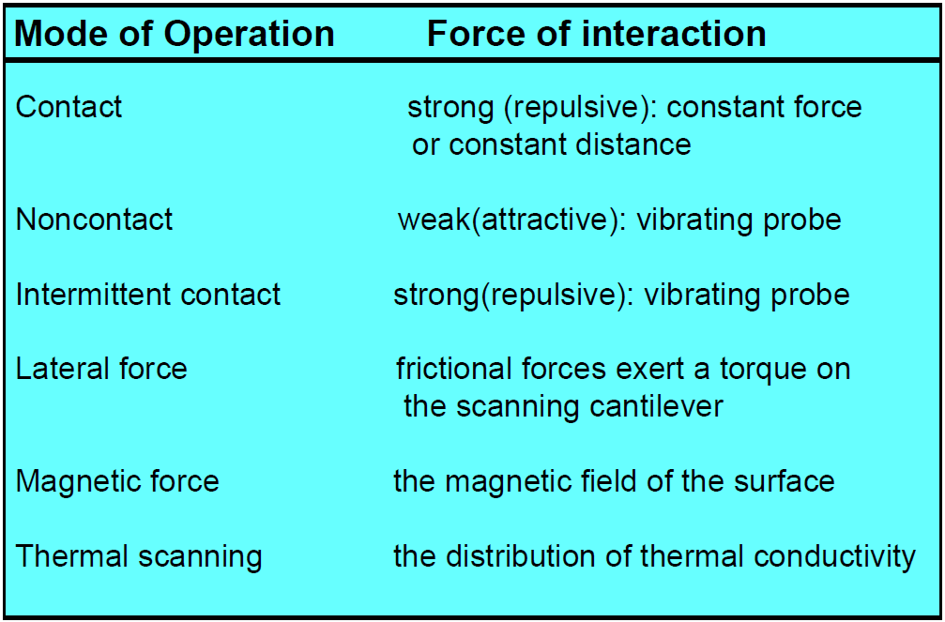
AFM mode of operation
Intermittent contact and thermal scanning are less popular.

Slide 31
Scanning probe microscopy (SPM) and lithography
Scanning tunneling microscopy.
Piezoelectric positioning.
Atomic force microscopy (AFM) overview.
AFM tip and its fabrication.
Tapping mode AFM.
Other forms of AFM (LFM, EFM, MFM, SCM…)

Slide 32
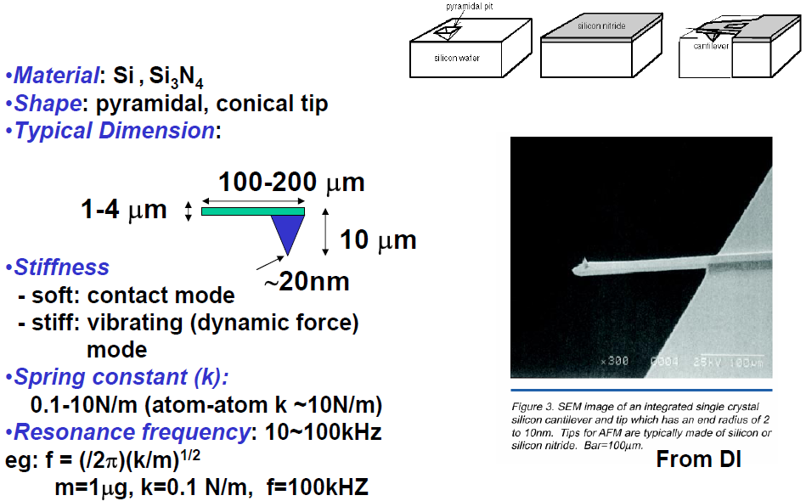
Force sensor: cantilever

Slide 33
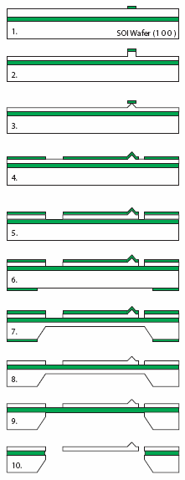
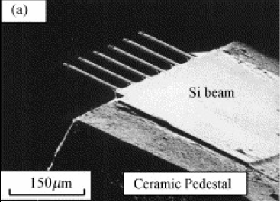
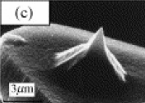
AFM tip fabrication
1. SiO₂ mask
2. RIE Si dry-etch
3. KOH Si wet-etch
4. SiO₂ mask
5. RIE Si dry-etch
6. SiO₂ mask on backside
7. KOH Si wet-etch, passivation on front-side
8. BHF (buffered HF) SiO₂ wet-etch
9. RIE Si dry-etch
10. Release of cantilever in BHF
T. Wakayama, T. Kobayashi, N. Iwata, N. Tanifuji, Y. Matsuda, and S. Yamada, Sensors and Actuators a-Physical, vol. 126, pp. 159-164, 2006.

Slide 34
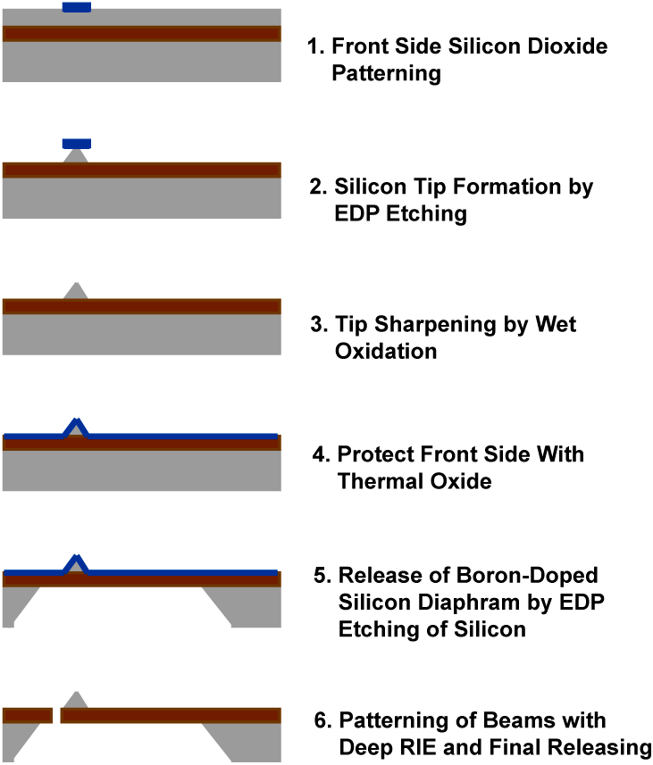
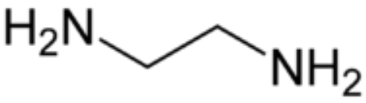
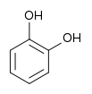
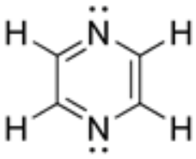
AFM tip fabrication
Use EDP instead of KOH.
Add oxidation sharpening.
EDP: ethylene-diamine pyrocatechol, is an anisotropic etchant solution for silicon, consisting of ethylene-diamine, pyrocatechol, pyrazine and water.
Ethylene-diamine
Pyrocatechol
Pyrazine

Slide 35
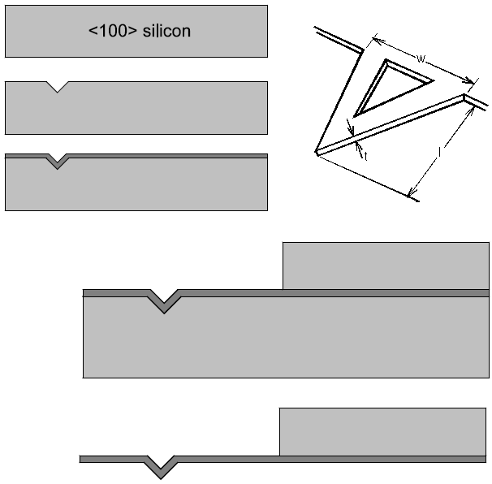
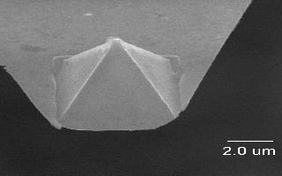
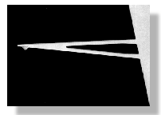
Cantilever fabrication – silicon micro-machined probe
Silicon nitride
This type of tip is for contact mode AFM.

Slide 36
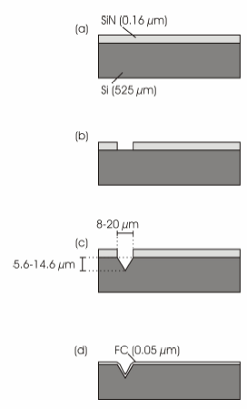
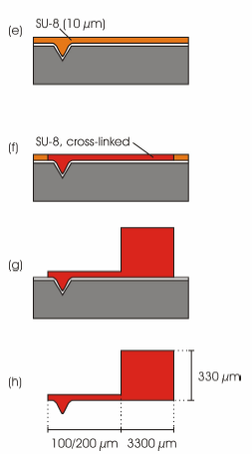
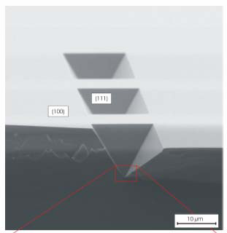
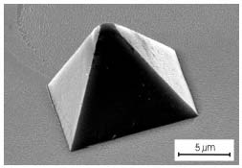
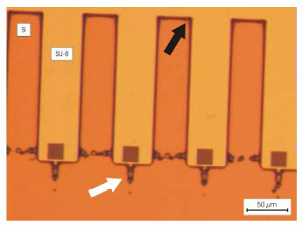
Polymer SU-8 tip fabrication
KOH etched
Si-mould
Released tip
Spikes

Slide 37
Probe (tip, cantilever) summary
Tip array for fast lithography tip for tapping mode AFM tip for contact mode AFM

Slide 38
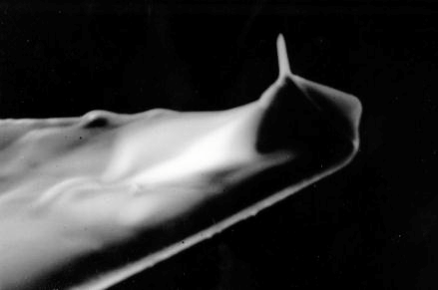
Electron beam deposited super tip
Standard silicon nitirde pyramidal tips which are available commercially are not always sharp enough for some experiments.
By focusing the electron beam in a scanning electron microscope onto the apex of the unmodified pyramid tip, a sharp spike of any desired length can be grown.
(i.e. growth of carbon from contamination by focused electron beam induced deposition, not necessarily very sharp, but with very high aspect ratio to reach deep holes/trenches.)

Slide 39
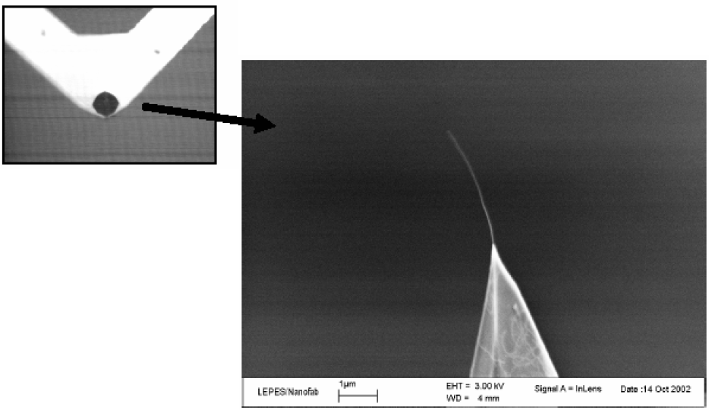
Using carbon nanotube to improve resolution
Vibration problem: need short tube ∼0.2μm

Slide 40
Scanning probe microscopy (SPM) and lithography
Scanning tunneling microscopy.
Piezoelectric positioning.
Atomic force microscopy (AFM) overview.
AFM tip and its fabrication.
Tapping mode AFM.
Other forms of AFM (LFM, EFM, MFM, SCM…)

Slide 41
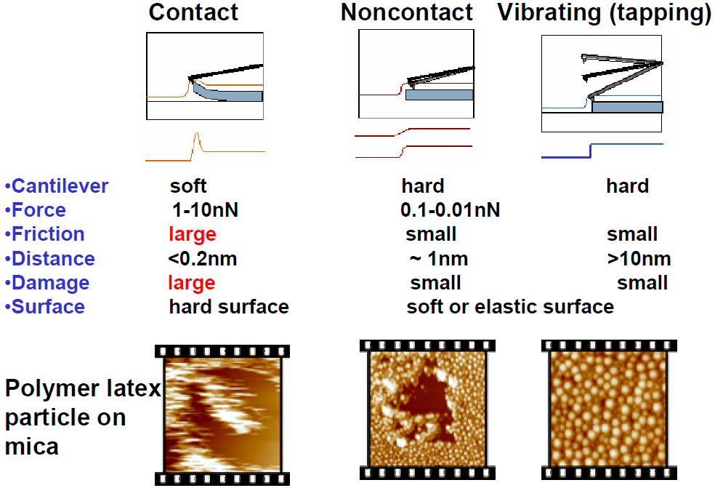
Scanning modes of AFM
Not popular

Slide 42
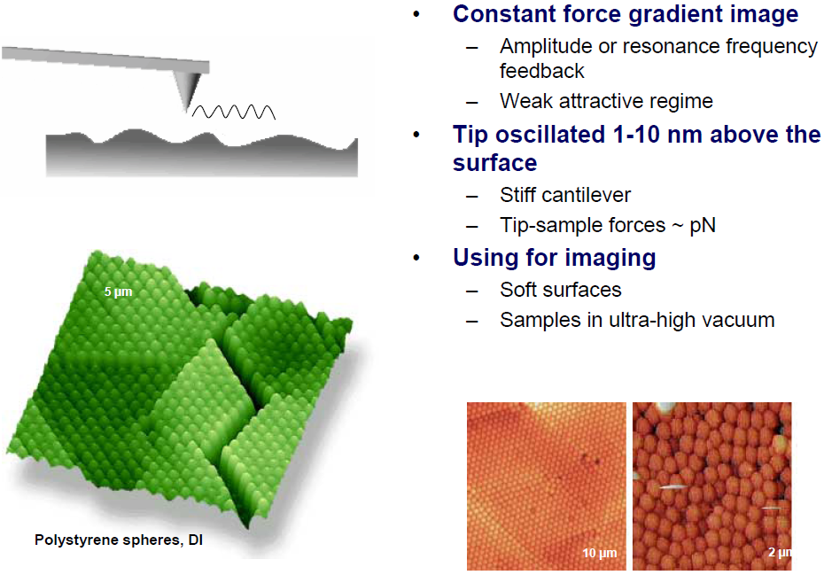
Non-contact mode imaging
Raspberry polymer

Slide 43
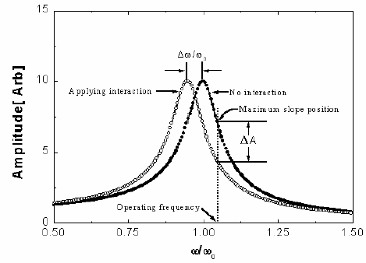
Vibrating cantilever (tapping) mode: most popular
Vibration of cantilever around its resonance frequency (often hundreds of kHz)
Change of frequency due to interaction between sample and cantilever
Resonance frequency:
k_{eff} = k₀ - dF/dz (F is force)
f_{eff} = 2π(k_{eff} /m)^{1/2}
Cantilever oscillate and is positioned above the surface so that it only taps the surface for a very small fraction of its oscillation period.
When imaging poorly immobilized or soft samples, tapping mode may be a far better choice than contact mode.
But for the AFM we have, we operate at
ω₀∼300kHz

Slide 44


Vibrating cantilever (tapping) mode
Cantilever oscillates at resonant frequency and “taps” sample surface, where feedback loop maintains constant oscillation amplitude.
Reduces normal (vertical) forces and shear (lateral) forces, thereby reducing damage to softer samples.
Can image surface with weak adhesion.
But much slower than contact mode.
Free oscillation
Large amplitude
Hitting surface
Lower amplitude
Amplitude imaging (for AFM)
Phase imaging (also for MFM and EFM)

Slide 45


Phase imaging
Measure the phase lag of the cantilever driving frequency vs. actual oscillation.
Contrast depends on the physical properties (Young’s modulus…) of the material.
Polymer blend
(Polypropylene & EDPM)
Topography
Phase
Measure relative elastic properties of complex samples

Slide 46


Atomic resolution AFM
AFM (contact mode):
Au(111) polycrystalline film
on a glass substrate
AFM (non-contact mode):
Atomic resolution on Si(111)7x7

Slide 47


Applications to biological system
Many types: DNA and RNA analysis, protein-nucleic acid complexes, chromosomes, cellular membranes, proteins and peptides, molecular crystals, polymers and biomaterials, ligand-receptor binding.
Bio-samples have been investigated on lysine-coated glass and mica substrate, and in buffer solution (SEM… all in vacuum).
By using phase imaging technique one can distinguish the different components of the cell membranes.

Slide 48

Applications to biological system

Slide 49
Scanning probe microscopy (SPM) and lithography
Scanning tunneling microscopy.
Piezoelectric positioning.
Atomic force microscopy (AFM) overview.
AFM tip and its fabrication.
Tapping mode AFM.
Other forms of AFM (LFM, EFM, MFM, SCM…)

Slide 50

Conductive AFM
Conductive AFM is used for collecting simultaneous topography imaging and current imaging.
Standard conductive AFM operates in contact AFM mode.
Variations in surface conductivity can be distinguished using this mode.
One can also operate AFM in STM mode: maintain constant current or height. Some AFM tool can be used as STM (no vacuum), though with different type of tip (may use a regular STM W-tip, rather than a Si or Si₃N₄ cantilever).

Slide 51

Lateral (friction) force microscopy
Possibility to discriminate different materials at the atom level.
Nano-tribology investigations can be carried out.

Slide 52


Lateral force microscopy
High resolution topography (top) and lateral force mode (bottom) images of a commercially available PET film. The silicate fillers show increased friction in the lateral force image.
LFM image of patterned SAM (50μm x 50μm, self-assembled monolayer), formed by micro-contact printing of alkatheniols onto Au surface using an elastomeric stamp

Slide 53

Force modulation microscopy (FMM)
FMM is used to characterize a sample's mechanical properties. It allows simultaneous acquisition of both topographic and material-properties data.
In FMM mode, the AFM tip is scanned in contact with the sample, and the z feedback loop maintains a constant cantilever deflection (as for constant-force mode AFM).
In addition, a periodic signal is applied to either the tip or the sample. The amplitude of cantilever modulation that results from this applied signal varies according to the elastic properties of the sample.
More “damping”

Slide 54

Chemical force microscopy
Two routes to assembly organic group R to the tip and substrate
-SH to form R-S-Au binding
-SiCl₃ react and bind to SiO₂
Polar molecules (e.g. COOH) tend to have the strongest binding to each other, followed by non-polar (e.g. CH₃-CH₃) bonding, and a combination being the weakest.
A. Noy et al, Ann. Rev. Mater. Sci. 27, 381 (1997)

Slide 55



Lateral/friction force detection
Chemical force microscopy
Utilizing CFM for the unfolding of complex proteins.
(Right) Carbon nanotube terminated tip functionalized at the nanotube end.
CH3 COOH
Topography
Friction force using a tip modified with a COOH-terminated SAM,
Friction force using a tip modified with a methyl-terminated SAM.
Light regions in (B) and (C) indicate high friction; dark regions low friction.

Slide 56

Lift mode AFM
For MFM/EFM, lift 30-100nm. Too far will reduce resolution; too close will be affected by van der Waals force.

Slide 57

Magnetic force microscopy (MFM)

Slide 58


Magnetic force microscopy (MFM)
Ferromagnetic tip: Co, Ni…
van de Waals force: short range force
Magnetic force: long range force, small force gradient
Close imaging (tapping mode): topography
Distant imaging (lift mode): magnetic properties
MFM detects changes in the resonant frequency of the cantilever induced by the magnetic field's dependence on tip-to-sample separation.
It detects the magnetic field gradient (dB/dz, no frequency change for constant magnetic field with zero gradient).
Besides frequency change, phase change (correlated to frequency change) is actually often detected to generate MFM image.
(left) AFM image of hard disk drive
(right) MFM image of the same area

Slide 59



Electrostatic force microscopy (EFM)
Contrary to MFM, EFM doesn’t use ferroelectric material.
Instead, charge is generated by applied bias voltage on metal tip.
Difficult to extract the useful information due to mirror charges…
Variants:
Scanning Kelvin Probe Microscopy (SKPM)
Scanning Tunneling Potentiometry (STP)
Scanning Maxwell Microscopy (SMM)
EFM maps locally surface charge distribution on the sample surface, similar to how MFM plots the magnetic domains of the sample surface.
EFM can also map the electrostatic fields of an electronic circuit as the device is turned on and off.
This technique is known as "voltage probing" and is a valuable tool for testing live microprocessor chips at the sub-micron scale.
The sub-surface structure of electrical contacts and doping trenches in this SRAM sample can be revealed using EFM

Slide 60


Scanning capacitance microscopy (SCM)
SCM can map doping concentration and local dielectric constant.
For parallel plate capacitor: C=ε₀ε_{r}S/d (S: surface area; d: separation)
Transistor oxide thickness
Metallic tip
contact
Topography SCM
Can gain topographic image by adjusting the tip or sample height while maintaining a constant capacitance (good for uniform ε_{r} and doping).
Or by fixing the tip-sample separation, gain doping and dielectric properties of the sample (good for flat surface).

Slide 61
Scanning thermal microscopy
SThM can be used in two different operating modes, allowing thermal imaging of sample temperature and thermal conductivity.
There are different types of cantilever available. For example, cantilever composed of two different metals. The materials of the cantilever respond differently to changes in thermal conductivity, and cause the cantilever to deflect. The system generates a SThM image, which is a map of the thermal conductivity, from the changes in the deflection of the cantilever.
A topographic non-contact image can be generated from changes in the cantilever's amplitude of vibration (like tapping mode AFM). Thus, topographic information can be separated from local variations in the sample's thermal properties, and the two types of images can be collected simultaneously.

Slide 62


Scanning thermal microscopy
Topographic (upper left) and thermal (upper right) images of a “hot spot” in a powered IC. The images were added together to get a composite image (bottom) which indicates the location of the failed region.
Here one uses thermocouple junction to measure sample temperature distribution.

Slide 63
Summary
STM
Real space imaging
High lateral and vertical resolution
Probe electronic properties
Sensitive to noise
Image quality depends on tip conditions
Not true topographic imaging
Only for conductive materials
AFM and others
Apply to non-conducting materials: bio-molecules, ceramic.
Real topographic imaging.
Probe various physical properties: magnetic, electrostatic, hydrophobicity, friction, elastic modulus, etc.
Can manipulate molecules and fabricate nanostructures.
Lower lateral resolution.
Contact mode can damage the sample.
Image distortion due to the presence of water.

