Slide 1
Material removal: etching processes
Etching is done either in “dry” or “wet” methods:
Wet etching uses liquid etchants with wafers immersed in etchant solution.
Wet etch is cheap and simple, but hard to control (not reproducible), not popular for Nano for pattern transfer purpose.
Dry etching uses gas phase etchants in a plasma, both chemical and physical (sputtering process).
Dry plasma etch can be used for many dielectric materials and some metals (Al, Ti, Cr, Ta, W…).
For other metals, ion milling (Ar⁺) can be used, but with low etching selectivity. (as a result, for metals that cannot be dry-etched, it is better to pattern them using liftoff)
Etching selectivity:
The ratio of etching rates between different materials, usually the higher the better. Generally, chemical etching has high selectivity, physical etching (sputtering, milling) has low selectivity.
ECE 730: Fabrication in the nanoscale: principles, technology and applications
Instructor: Bo Cui, ECE, University of Waterloo; http://ece.uwaterloo.ca/~bcui/
Textbook: Nanofabrication: principles, capabilities and limits, by Zheng Cui

Slide 2
Basic concepts
Etching is consisted of 3 processes:
Mass transport of reactants (through a boundary layer) to the surface to be etched
Reaction between reactants and the film to be etched at the surface
Mass transport of reaction products from the surface through the surface boundary layer

Slide 3
Types of etching processes: isotropic vs. anisotropic
Generally speaking, chemical process (wet etch, plasma etch) leads to isotropic etch; whereas physical process (directional energetic bombardment) leads to anisotropic etch.
Isotropic:
Best to use with large features when sidewall slope does not matter, and to undercut the mask (for easy liftoff).
Large critical dimension (CD, i.e. feature size) loss, generally not for nano-fabrication.
Quick, easy, and cheap.
Anisotropic:
Best for making small features with vertical sidewalls, preferred pattern transfer method for nano-fabrication and some micro-fabrication.
Typically more costly.

Slide 4
Wet etching
Etching is only chemical: great selectivity
Very easy and fast (μm/min)
Under etching, good for undercut (liftoff), but not well suited for nanostructures.
Poor process control, not well reproducible.
Etching rate:
The etch rate can be controlled by any of the three serial processes (reactants transport to the surface, reaction, reaction products transport from the surface).
Preference is to have reaction rate controlled process because
Etch rate can be increased by temperature
Good control over reaction rate – temperature of a liquid is easy to control
Mass transport control will result in non-uniform etch rate: edge etches faster.
Etchant is stirred to minimize boundary layer and make etching more uniform.

Slide 5
Isotropic wet etching (silicon dioxide)
Etch is isotropic and easily controlled by dilution of HF in H₂O.
Thermally grown oxide etches at
120nm/min in 6H₂O:1HF
~1 μm/min in 49 wt% HF (i.e. undiluted HF).
Faster etch rate for doped or deposited oxide.
High etch selectivity (SiO₂/Si) > 100
Buffered HF (BHF) or buffered oxide etchant (BOE) provides consistent etch rates
In regular HF etches, HF is consumed and the etch rate drops.
Serious process control issue.
HF buffered with NH₄F to maintain HF concentration 6NH₄F:1HF
NH₄F→NH₃↑+ HF

Slide 6
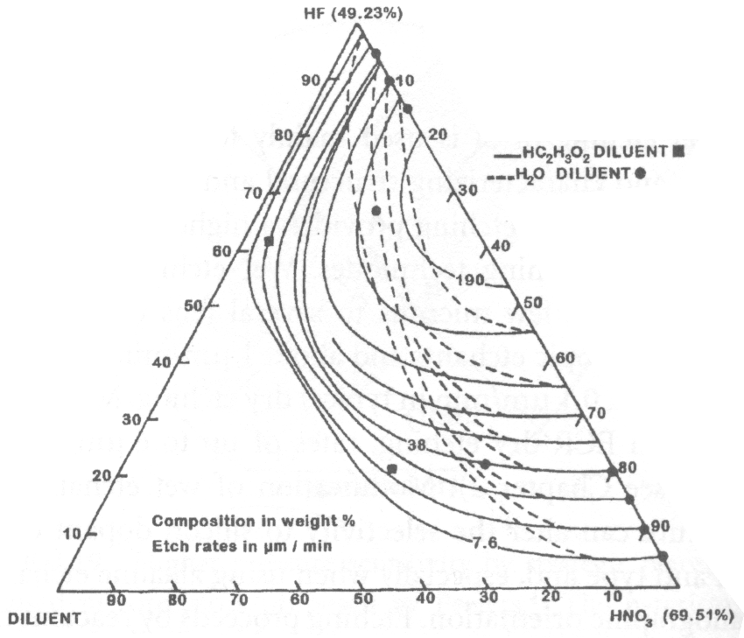
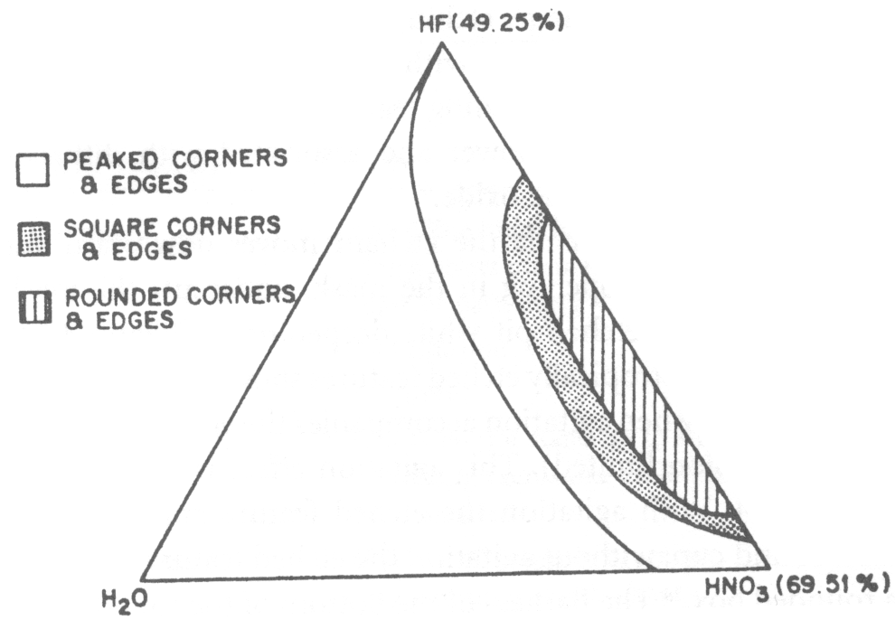
Isotropic etch (silicon)
Silicon is etched by nitric acid and hydrofluoric acid mixtures
Use oxidant HNO₃ to oxidize silicon to form silicon dioxide, followed by HF etch of silicon dioxide.
Excess nitric acid results in a lot of silicon dioxide formation and etch rate becomes limited by HF removal of oxide (polishing).
CH₃COOH or H₂O can be added as diluent, but etch differently (acetic acid does not reduce oxidization power of the nitric acid, but water does).
H₂O₂ (oxidant) and HF mixture can also etch Si.
Si + HNO₃ + 6HF → H₂SiF₆ + HNO₂ + H₂O +H₂
polish
Si iso-etch curves using CH₃COOH or H₂O diluent
Topology of etched Si surfaces
Marc Madou, “Fundamentals of microfabrication”, 1997 page 164-165

Slide 7
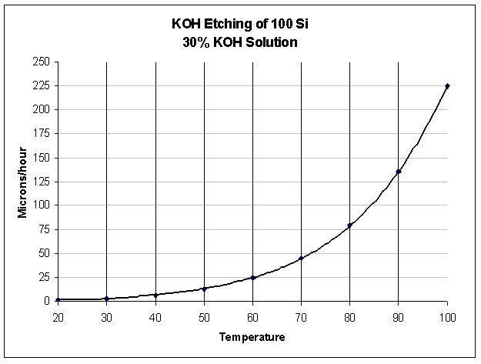
An-isotropic wet etching (silicon)
Orientation selective etch of silicon occur in hydroxide solutions because of the close packing of some orientations relative to other orientations
Density of planes: <111> > <110> > <100>
Etch rate: R(111) < R(110) < R(100)
<100> direction etches faster than <111> direction, with etch rate
R(100)= 100 × R(111)
It is reaction rate limited
Most useful for Si₃N₄ membrane fabrication (etch through Si wafer thickness, stop at nitride).
Etch mask: SiO₂ or Si₃N₄ or Cr/Au
Popular etchant:
KOH, TMAH
(tetra methyl ammonium hydroxide)
(100) Silicon wafer
Etch “stops” at (111) direction

Slide 8
Isotropic etch (silicon nitride)

Slide 9
Isotropic etching (aluminum)
50H₃PO₄:20H₂O:1HNO₃:1CH₃COOH
Aluminum etches in water, phosphoric, nitric and acetic acid mixtures.
Converts Al to Al₂O₃with nitric acid (evolves H₂).
Dissolve Al₂O₃ in phosphoric acid.
Gas evolution leading to bubbles.
Local etch rate goes down where bubble is formed, leading to non-uniformity.
Al can also be etched in diluted HCl, HNO₃, H₂SO₄, NaOH, KOH, but less controllable (etch oxide slowly and uncontrollablly, then once oxide all etched away, etch Al metal very fast).

Slide 10
Isotropic wet chemical etch: summary
Etchant |  |  |  | Etches |  |  |  | Doesn't etch
H₃PO₄(19), Hac(1), HNO₃(1), H₂O (2) |  |  |  | Al, SiN, M |  |  |  | SiO2, Si, PR
HF, BOE (HF, NH₄F) |  |  |  | SiO₂, M |  |  |  | Si, SiN, Au
H₂SO₄(3), H₂O₂(1) pirahna |  |  |  | Organics, M |  |  |  | Si, SiO2, SiN
I₂(I),KI(2),H₂O(10) |  |  |  | Au, M |  |  |  | Si, SiO2, SiN, M, PR
NH₄OH(5), H₂O₂(1) |  |  |  | Polymers, Al |  |  |  | Si, SiO2, SiN, M
HNO₃(64), NH₄F(3),H₂O(33) |  |  |  | Si, M |  |  |  | SiN, PR
HCl(3), HNO₃(1) aqua regia |  |  |  | all M
M: metal; PR: photoresist

Slide 11
Wet “etch” for wafer cleaning
Solvent cleaning: acetone, then methanol, then iso-propanol (2-propanol).
Pirahna: H₂SO₄ : H₂O₂ = 3 : 1, remove organic and metals, can heat to >60ºC.
RCA clean: (all three steps are needed for thermal oxidation or LPCVD nitride)
H₂O₂:NH₄OH:H₂O=1:1:5, 80ºC for 10min. (remove organics and particles)
H₂O₂:HCl:H₂O=1:1:5, 80ºC for 10min. (remove metals)
HF:H₂O=1:50, 30sec (for Si, remove native oxide and contaminants on top).
Usually, only the first step is enough for such as nanoimprint mold fabrication.

Slide 12
Dry (plasma) etching
Directional etching due to presence of ionic species in plasma and (self-) biased electric field. (The self-bias electric field is not applied externally, but is created spontaneously in RF plasma)
Two components existed in plasma
Ionic species results in directional etching.
Chemical reactive species results in high etch selectivity.
Control of the ratio of ionic/reactive components in plasma can modulate the dry etching rate and etching profile.
Plasma
Neutrals (etchant gas)
Ions
Free radicals
Gaseous products
Plasma consists of: ionized atoms/molecules, free electrons, free radicals (neutral).
adsorb
react
surface

Slide 13
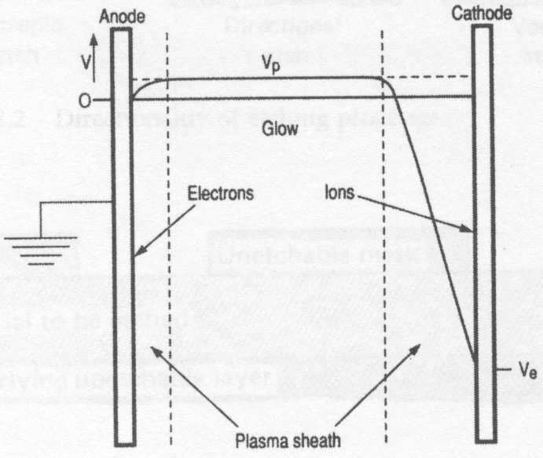
DC plasma (glow discharge)
Why self-bias?
J is flux of ions/electrons that hit the electrodes, n is number density, v is velocity.
Structure of glow discharge in a DC diode system
Electrons move much faster than ions, thus in the plasma region there are fewer electrons; i.e. the plasma is positively self-biased with respect to the electrodes.
DC glow discharge is used for sputter deposition, sputter cleaning, or ion beam etching/milling (ion source in triode configuration).
Voltage distribution in equilibrium

Slide 14
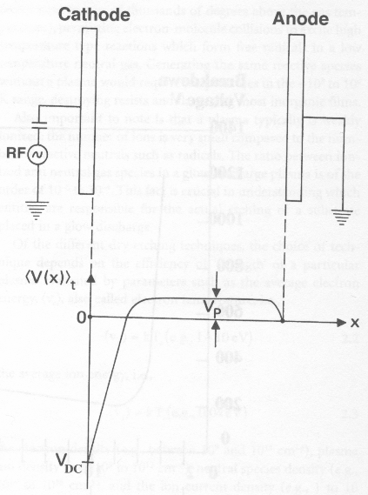
RF plasma (RF: radio frequency)
Due to blocking capacitor, electrons build up on the cathode, but not on anode (grounded). So large self-bias only near cathode.
Plasma
(13.56 MHz)
If BOTH electrodes are blocked by a capacitor:
Relative voltage drop near each electrode depends on its area A. In theory, V∝(A)⁻⁴; but experimentally V∝(A)⁻².
Thus if connect anode to chamber wall (very large A), DC voltage drop near cathode will be very high.
V_{DC}: self-bias of cathode
V_{P}: plasma potential
Time-averaged potential distribution
In a plasma, electrons and ions are NOT in thermal equilibrium.
Electrons don’t lose energy efficiently by collision due to the huge mass difference, so electrons are very “hot” with energy 1-10eV (equivalent to 10³-10⁴K); to a certain degree, plasma is very reactive because the electrons are “hot”, as if the reactants were heated.
(ions lose energy by collision, so they are “cold” with energy ~0.04eV)

Slide 15
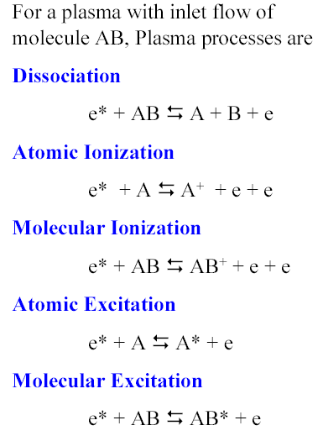
RF plasma chemistry
RF plasma is more widely used for dry etching pattern transfer in nanofabrication than DC plasma. (RF plasma is also used for thin film deposition as in plasma enhanced CVD (PECVD) and RF-sputtering)
CF₄ plasma
photon (glow)

Slide 16
RF plasma chemistry
In a plasma, reactive neutral chemical species (free radicals, e.g. F atoms or molecular species) are mainly responsible for the chemical reaction partly due to their great numbers compared to ions.
Those free radicals are more abundant than ions because: 1) they are generated at lower threshold energy (e.g. <8eV; in comparison, Ar is ionized at 15.7eV); and 2) they (uncharged radicals) have longer lifetime in the plasma.
The neutral radicals arrive at cathode surface by diffusion (so non-directional).
Charged ions are accelerated to the cathode due to self-bias. (Unless with very high energy of >100eV as in ion beam etching), ion itself doesn’t contribute significantly to the chemical reaction mostly due to its very low concentration, but ion bombardment can greatly enhance the chemical reaction in reactive ion etching (RIE).
In RIE, ion energy is low ~10eV due to collision energy loss. The name reactive “ion” etching is very misleading since ions don’t contribute directly to etching.

Slide 17
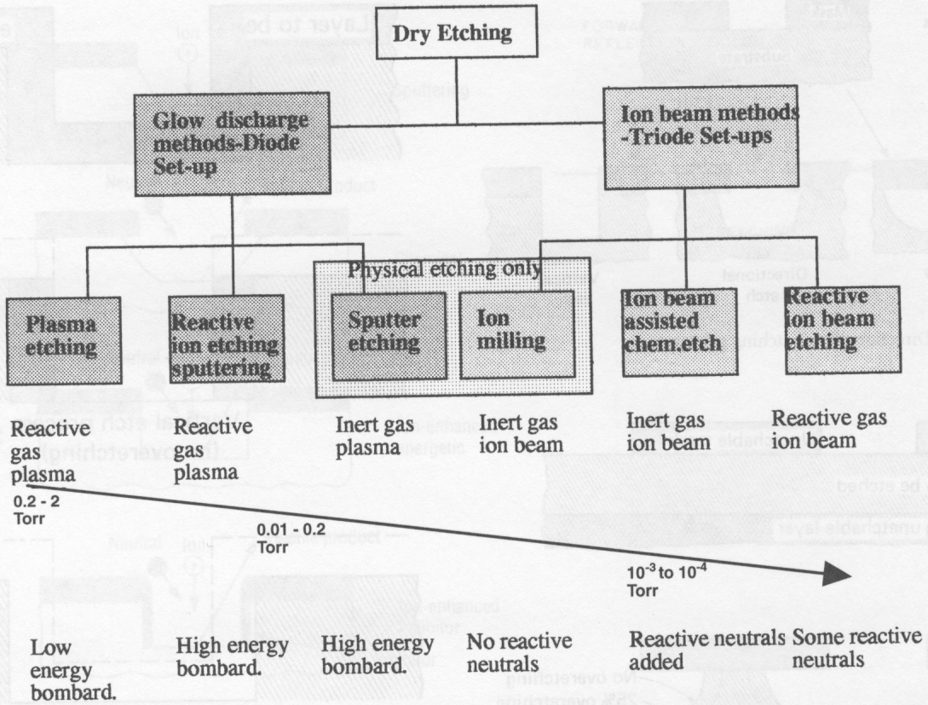
Various dry etching techniques

Slide 18
Types of dry etching processes
(e.g. XeF₂ gas etch Si even without plasma)
(e.g. ion beam etching/milling using Ar⁺)
RIE is most popular for nanofabrication.
Plasma etching can be used to remove a layer such as photoresist residue.

Slide 19
Plasma etching mechanism
Chemical etching: free radicals react with material to be removed. E.g. plasma etching at high pressure close to 1Torr.
Physical etching or sputtering: ionic species, accelerated by the built-in electric field (self-bias), bombard the materials to be removed. E.g. sputter cleaning using Ar gas in sputter deposition system.
Ion enhanced etching: combined chemical and physical process, higher material removal rate than each process alone. E.g. reactive ion etching (RIE), which is the most widely used dry etching technique.
Physical Process
Chemical Process
Reactive Ion etching
High density plasma etching
Ion milling & Sputter etching
Wet etching
Plasma etching
Pressure
Energy (power)
Selectivity
Anisotropicity

Slide 20
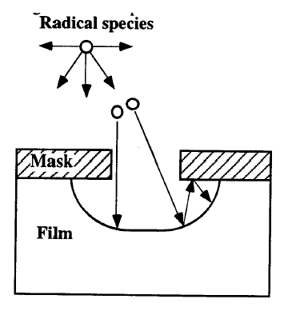
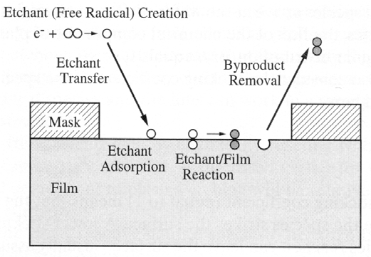
Chemical etch
Free radicals are electrically neutral species that have incomplete outer shells e.g. CF₃and F
Free radicals react with film to be etched and form volatile by-products.
Mass transport of reactive species from the gas stream to the reaction surface, reaction takes place at the surface, followed by mass transport of reaction products back to the gas stream.
Pure chemical etch is isotropic or nearly isotropic, and the etching profile depends on arrival angles and sticking coefficients of free radicals. Free radicals (un-charged) in plasma systems have isotropic arrival angles and low sticking coefficients (bounce back for under-etch).

Slide 21
Si etching with F radicals
Isotropic etching
XeF₂ or SF₆ plasma, no side-wall passivation, so large undercut profile.

Slide 22
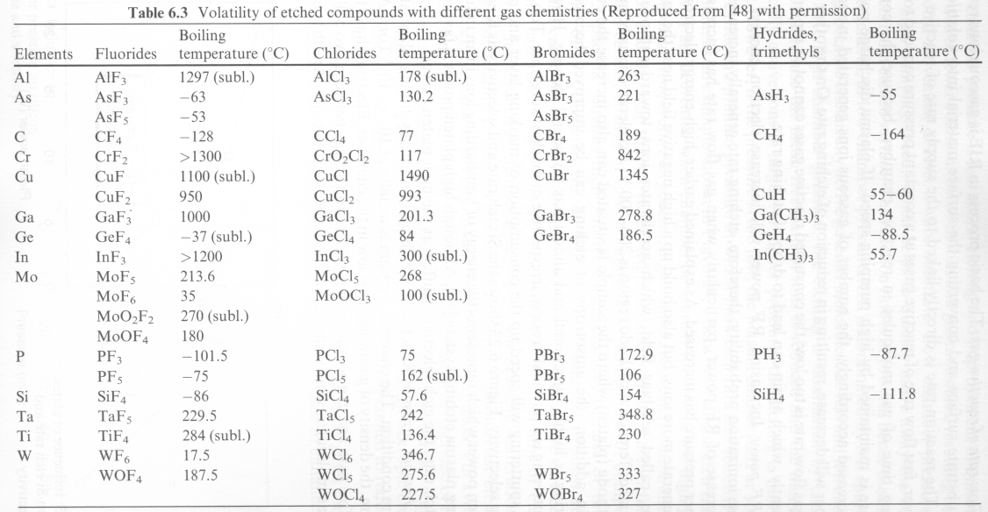
Plasma etch methods for various films
Most reactant gasses contain halogens: Cl, F, Br, or I
Exact choice of reactant gasses to etch each specific film depends on
Ability to form volatile by-products that can be removed by pumping
Etch selectivity to resist and underlying films
Anisotropicity
Boiling points are good indicators of volatility of species
Lower boiling point, higher tendency to evaporate.
High boiling point may need etching at elevated tempartures.

Slide 23
Physical etch component in a plasma etch system
(much less important than chemical etch)
Ionic species are accelerated towards each electrode by built-in self-bias.
The ionic species such as Cl₂⁺, CF₄⁺, CF₃⁺ (or Ar⁺ in a purely physical sputter etch) strike the wafer surface and remove the material to be etched.
Physical etch is directional and non-selective (sputter yield does not vary much for different materials).

Slide 24
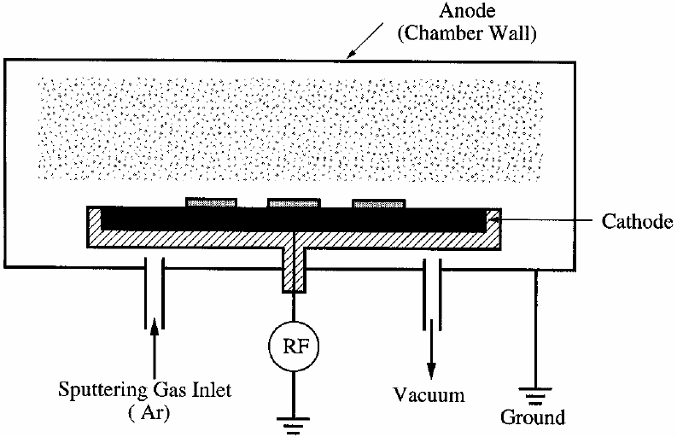
Pure physical etch: sputter etching system
Ar plasma
Use inert gas, usually for in-situ substrate surface cleaning before sputter deposition.
Self-bias few 100V, but low ion energy (order 10V) due to collision energy loss.
Therefore, very low mill rate in a sputter system, for surface cleaning only.

Slide 25
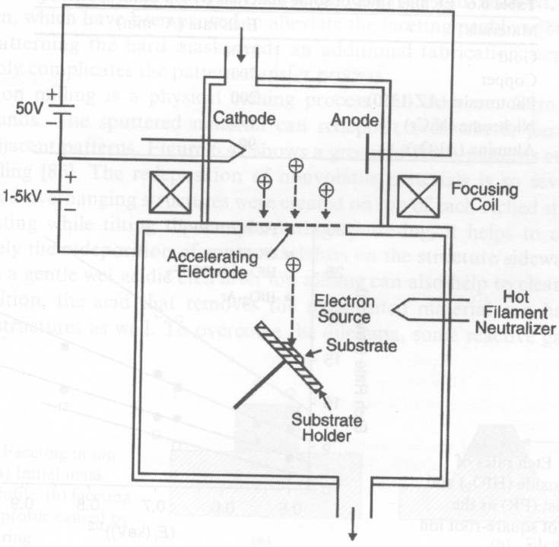
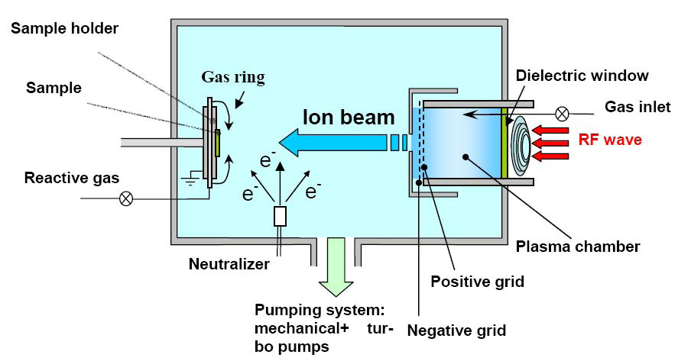
Ion beam etching (IBE) system: triode configuration
DC plasma ion beam source
RF plasma ion beam source
Electron beam is first generated by hot filament.
Ions is generated by electron bombardment, then accelerated to bombard the substrate.
Can be pure physical milling or chemical assisted.
Used for milling metals that cannot be plasma-etched.
Plasma is involved to generate ion beam (but typically not considered as plasma etching).
Low pressure ~10⁻⁴Torr, so large mean free path and less energy loss due to collision.
High acceleration voltage (>1kV), leading to mill rate ~10-30nm/min.
Physical milling when using heavy inert gases (Ar).
CAIBE: chemical assisted ion beam etching, introduce chemical etching component by adding reactive gases (O₂, Cl₂).
Unlike RIE, ions are responsible for etching; and the etch product can be non-volatile.

Slide 26
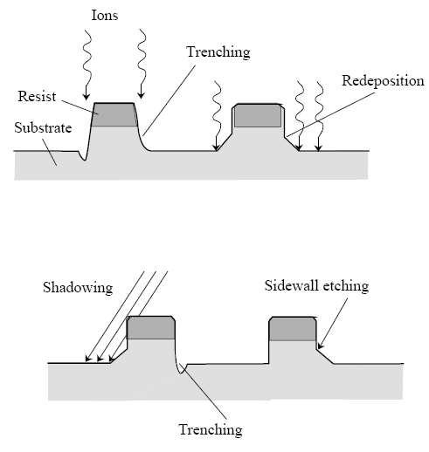
Ion beam etching (IBE) issues
Purely physical sputtering process – poor selectivity and high anisotropic
High ion energy (>500eV)
Issues:
Physical or radiation damage
Re-deposition
Faceting (sputter yield is a function of incident angle)
Reactive IBE (RIBE), chemically assisted IBE (CAIBE)
Increase in selectivity by chemical etch
For RIBE, reactive gases are introduced into plasma region, so ionized.
For CAIBE, reactive gases are introduced into lower chamber, so not ionized. (some ionized by Ar⁺ bombardment)
(since non-volatile)
(also exist for RIE)

Slide 27
Ion enhanced plasma etch (IEE):
chemical etch assisted by physical bombardment
IEE is an anisotropic and highly selective etching process.
Reactive ion etch (RIE) is the most popular IEE.
Ion bombardment can enhance one of the following steps during chemical etch: surface adsorption, etching reaction, by-product formation, by-product removal (inhibitor layer) and removal of un-reacted etchants.
Example: formation of inhibitor layer which consists of polymer formed from CHF₃ during RIE of SiO₂.

Slide 28
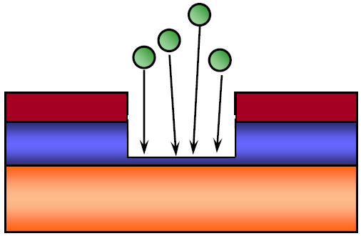
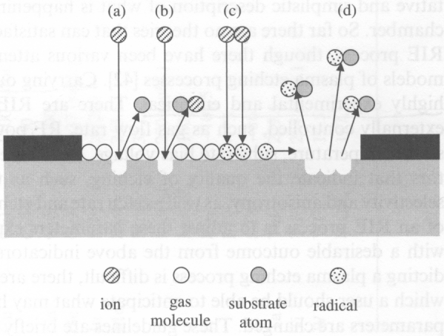
Reactive ion etch (RIE)
Anisotropic etching with vertical sidewall
Schematic RIE process
Etching mask
a) Ion sputtering, b) reactive etching, c) radical formation, d) radical etching
(most important)
The high anisotropy in RIE is due to the directional nature of the ion bombardment.
High selectivity arises from the chemical interactions.
Volatile product of etching prevent redeposition.
Intensively used in the microelectronic industry.
Well known for semiconductors and dielectrics.
OK for few metals : Al (form AlCl₃), Cu (CuCl₂), Ti (TiF_{x}, TiCl₄), W (WF₆), Cr (CrO₂Cl₂).

Slide 29
RIE: first proof of etching mechanism
Gas phase etch, NO plasma
Silicon etch rate (Å/min)
XeF₂
XeF₂+Ar⁺
Ar⁺
Very slow etch when pure chemical or physical etch alone
Time (sec)
g: gas, p: ?, s: solid
Note: XeF₂ gas can etch Si even without plasma

Slide 30
Anisotropy due to ion bombardment
Anisotropic etch with vertical sidewall is desired for micro- and nano-fabrication.
But directional ion bombardment doesn’t always lead to noticeable anisotropic etch.
For instance, SF₆ etch of Si is pretty isotropic with large undercut like wet etch.
To achieve anisotropy, there are two mechanisms:
Energy-driven anisotropy: bombardment by ions disrupts an un-reactive substrate and causes damages such as dangling bonds and dislocations, resulting in a substrate more reactive towards etchant species (electrons or photons can also induce surface activation). E.g. CAIBE (chemical assisted ion beam etching)
Inhibitor-driven anisotropy: in this case etching leads to the production of a surface covering agent (a passivation/inhibition layer). Ion bombardment removes this layer from horizontal surface (vertical surface - sidewall remain passivated), and reaction with neutrals proceed on these un-passivated surfaces only. E.g. RIE of SiO₂ using CHF₃ gases to form fluorocarbon passivation layer.

Slide 31
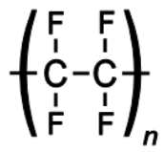
Etching profile: sidewall passivation by inhibitor deposition
High inhibitor deposition rate
Low inhibitor deposition rate
Inhibitor deposits both on sidewall and on bottom.
Inhibitor on bottom can be removed by ion bombardment.
So only sidewall is protected by inhibitor, leading to anisotropic etch without undercut.
Nearly vertical sidewalls is possible.
Fluoropolymer (like Teflon) in CHF₃ or CF₄+H₂ RIE of Si or SiO₂ is the inhibitor.
Teflon

Slide 32
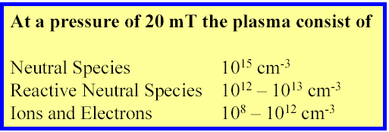
Parallel plate etchers (regular RIE, low density plasma)
Both chemical reaction and physical sputtering process occur.
Plasma etch mode:
Pressure: 100 – 1000mTorr
Voltage drop (self-bias) 10 - 100V
Reactive ion etch (RIE) mode:
Pressure: 10 - 100mTorr
Voltage drop 100 - 700V
RIE has high voltage drop, so is more directional/anisotropic than plasma etch.
This is sputter deposition configuration; for etching, the blocking capacitor… should be connected to the bottom electrode on top of which sit the wafers.
Parallel plate etcher is low density plasma system: the reactive species and ions have very low density, leading to low etch rate.

Slide 33
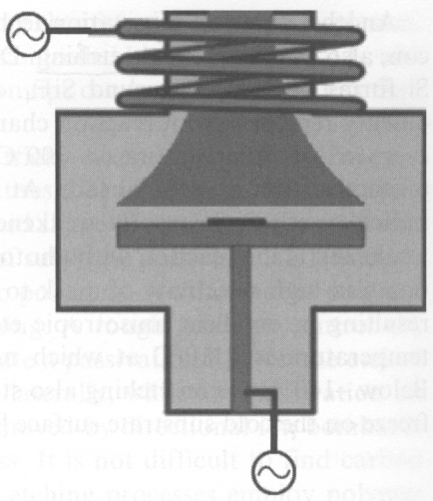
High density plasma system
Inductively coupled plasma (ICP)
(four systems at Waterloo)
Electron cyclotron resonance plasma
(less common)
ICP power
(for dense plasma)
plasma
RF bias power
(similar to RIE, parallel plate)
High magnetic field in the coil, so electrons move in circles with long path, leading to higher collision and ionization probability.
Plasma density 10¹¹ - 10¹² ions/cm³; may have low operation pressure 1 - 10mTorr.
Independent control of RF bias (ion energy, directionality) and ion density (plasma density, chemical etching rate).
High etching rate than RIE, but may be less anisotropic due to increased chemical etching.
ICP etcher can be used as a pure RIE etcher by turning off the ICP component.

Slide 34
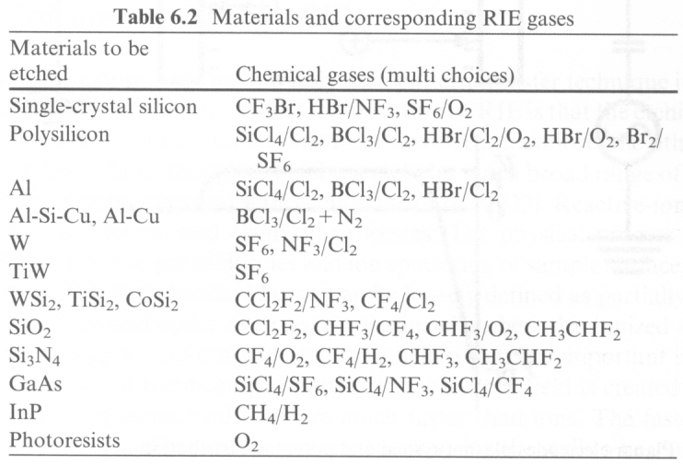
RIE/plasma etch gases
Most lab systems have only fluorine-based gases (SF₆, CF₄, CHF₃) since they are relatively safe; chlorine-based gases are corrosive. Most RIE has Ar and O₂ gas, some has H₂ and He.

Slide 35
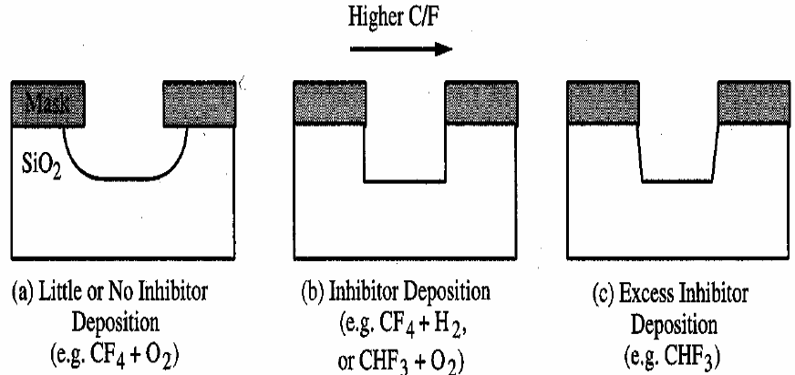
Plasma etching (silicon dioxide)
CF₄ etch is isotropic; anisotropic etching can be achieved by adding H₂ to reduce F free radicals.
Use of CHF₃ or C₂F₆ results in more C-F (Teflon) polymer deposition on sidewalls.
High bias voltage (400 - 500eV) can enhance vertical etch rate.
In general, use of O₂ to increase F concentration and H₂ to reduce F concentration. (O reacts with CF₃and CF₂ and hence reduce the recombination rate of F)
Reduction of F/C ratio of the etch gas improves selectivity of SiO₂ over Si.
Polymer inhibitor on sidewalls needs to be removed with O₂ or CF₄.
Effect of C/F ratio
Inhibitor: Teflon like fluorocarbon polymer

Slide 36
Plasma/RIE etching (silicon)
Fluorine based chemistry (CF₄, NF₃ and SF₆) tend to be isotropic.
When anisopicity is not important, SF₆/O₂ is a good chemistry for high selectivity.
When anisotropicity is desired, start with CF₄/H₂ and followed by CF₄/O₂ (undercutting may occur).
Chlorine based chemistry (Cl₂, HCl, SiCl₄, BCl₃) result in anisotropic and selective etching (etch rate lower than F chemistry).
Etch rate increased by ion bombardment
Can be anisotropic without polymer inhibitor formation
Selectivity to oxide is high (100:1)
Anisotropicity enhanced by adding small amount of O₂
Bromine based chemistry (HBr, Br₂) are similar to chlorine based etchants (etch rate slower than F or Cl).
Anisotropic and selective to oxide without polymer inhibitor
Adding O₂ promotes inhibitor formation (forming SiO₂ from Si and removal of C from resist erosion

Slide 37
Plasma/RIE etching (aluminum)
Presence of native oxide Al₂O₃ on Al surface requires a breakthrough etch before the main etch.
Use Ar sputter
Use BCl₃, SiCl₄, CCl₄ or BBr₃ to scavenge O₂ & H₂O
Fluorine is not used because AlF₃ is not volatile.
Cl₂ etches Al isotropically.
For anisotropic etching, sidewall inhibitor formation is needed
CHCl₃, CFCl₃, CCl₄
Al/Cu alloys are used in interconnects but Cu does not etch in Cl.
Etch requires ion bombardment or high temperature
Corrosion of Al line occurs when exposed to ambient because Cl on sidewall and resist react with water to form HCl which etches Al. To passivate Al surface after etch before exposure to atmosphere
Heat wafer to 100-150ºC to drive-off Cl
Bury Cl with CHF₃ polymer and remove the polymer later
Expose to F ambient such as SF₆ plasma to replace Cl with F
O₂ plasma followed by DI water rinse

Slide 38
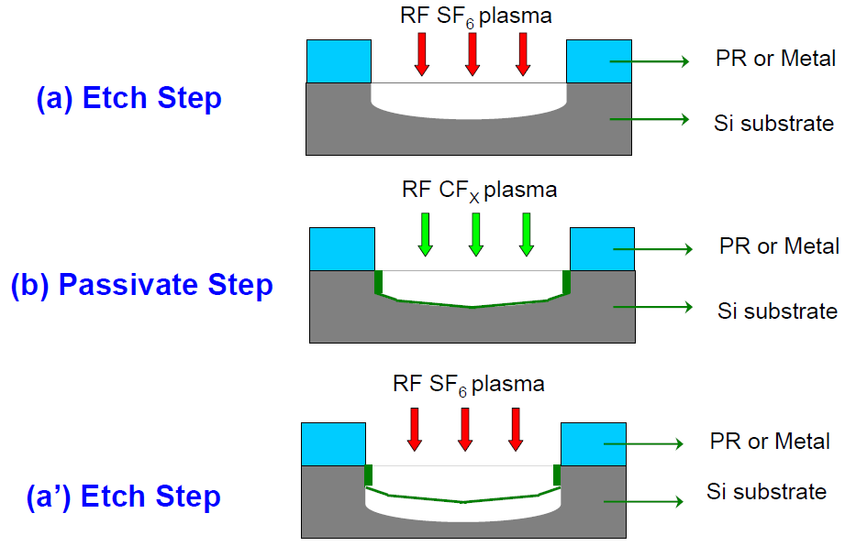
Deep Si etch: ICP - “BOSCH” process
Alternating etch and (inhibitor) deposition step.
SF₆ etch 5-13 sec; followed by C₄F₈ fluorocarbon polymer deposition 5-10 sec.
Etch rate several 𝝁m/min, capable of etching several hundred 𝝁m with vertical walls.
Side wall is rough, depending on cycle times (longer cycle, rougher).
More popular for MEMS, less common for nano-fabrication due to sidewall roughness.
MEMS: micro electro mechanical system

Slide 39
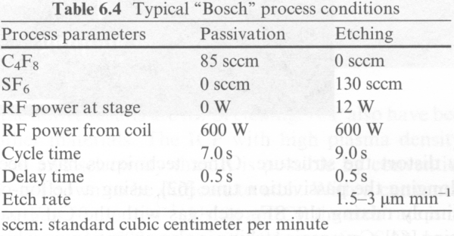
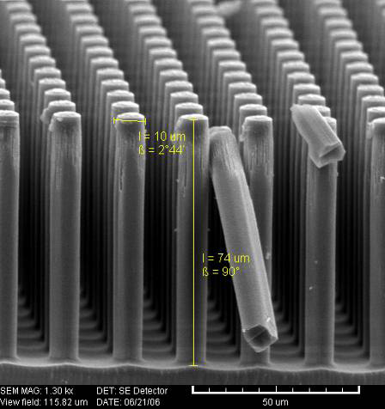
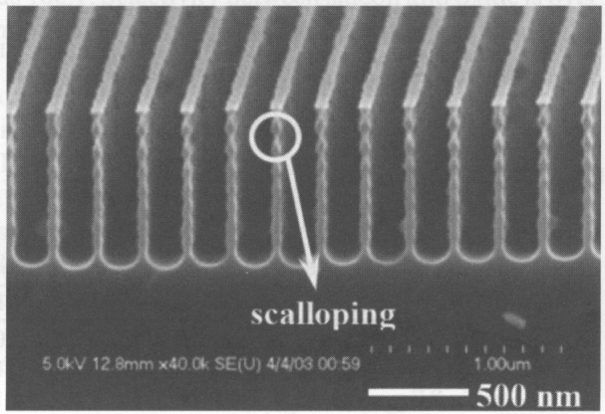
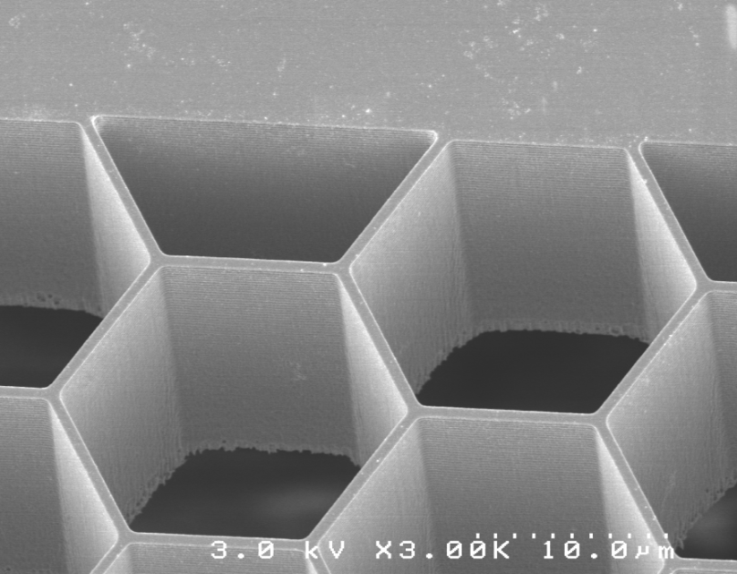
Deep Si etch - Bosch process
Rough sidewall due to scalloping effect.
20 𝝁m deep pores
1 cycle

Slide 40
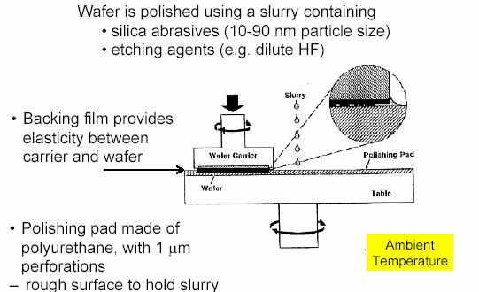
Chemical mechanical polishing (CMP)
Pure physical polishing: low polish rate.
Pure chemical reaction: cannot achieve smooth surface.
The combination of the two provides efficient polishing.

Slide 41
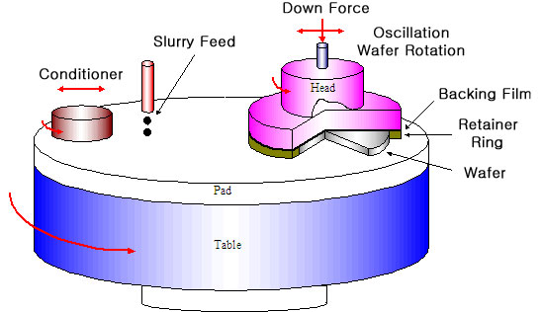
Chemical mechanical polish (CMP)

Slide 42
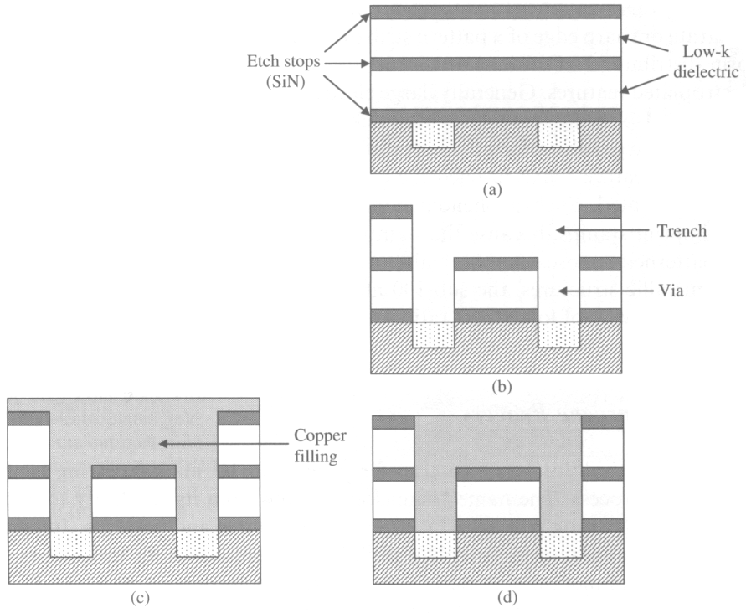
Dual damascene process for IC interconnection
Initial layer structure.
Two-step lithography to pattern both the trenches and via holes.
Metal filling the trench and via holes by electroplating of Cu.
Polish (CMP) back to make the surface flat for next level of interconnects patterning
a
b
Cu
c
d
Al is replaced by Cu around year 2000 for IC interconnection due to Cu’s higher conductivity.
Unlike Al, Cu is hard to etch by RIE, so CMP is adopted for the “dual damascene process”.

Slide 43
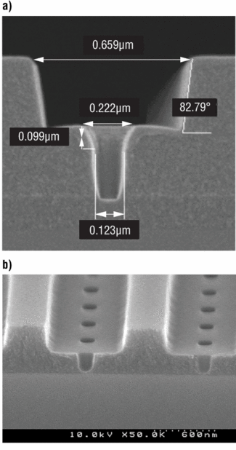
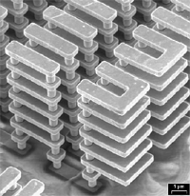
CMP of Cu interconnects for IC industry
trench
via
Cu
SiO₂
Non-smooth surface after Cu plating into trench/via holes.
Via-holes and trenches before Cu filling.
Cu structure after removing dielectric materials.

