Slide 1
“Soft” lithography
Soft lithography and PDMS.
Micro-contact printing.
Replica molding.
Micro-molding in capillary.
Micro-transfer molding/printing.
Solvent assisted microcontact molding.
ECE 730: Fabrication in the nanoscale: principles, technology and applications
Instructor: Bo Cui, ECE, University of Waterloo; http://ece.uwaterloo.ca/~bcui/
Textbook: Nanofabrication: principles, capabilities and limits, by Zheng Cui

Slide 2
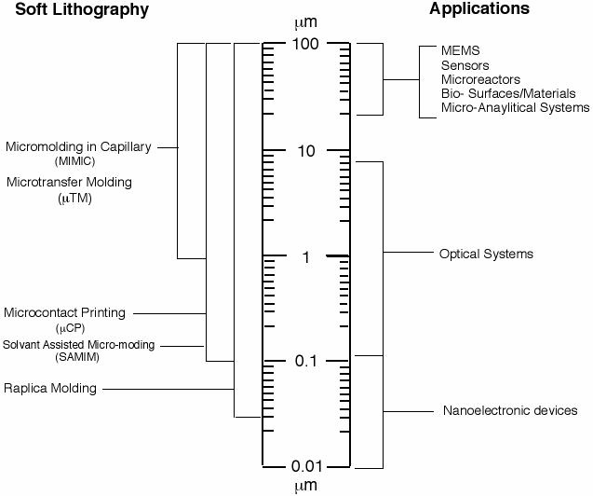
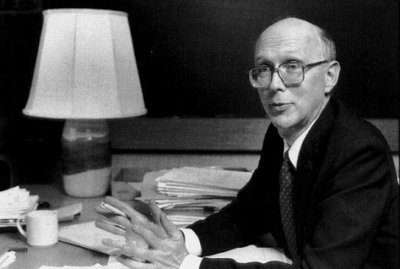
Soft lithography
“Soft” means no energetic particles (electron, ions) or radiation (UV, X-ray) is involved. Instead, soft elastomeric stamp is used.
Soft lithography opportunity assessment
Soft lithography:
Low cost
Molding, printing or transferring
Resolution usually not very high
Application in microfluidic, biomedical …
George M. Whitesides (Harvard)
“Size is not the only thing that matters, function is more important” (something like this), Whiteside

Slide 3
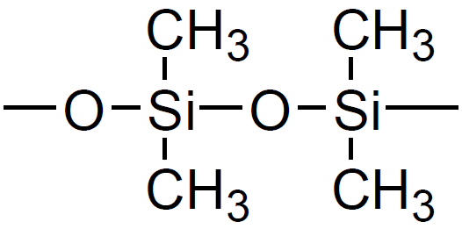
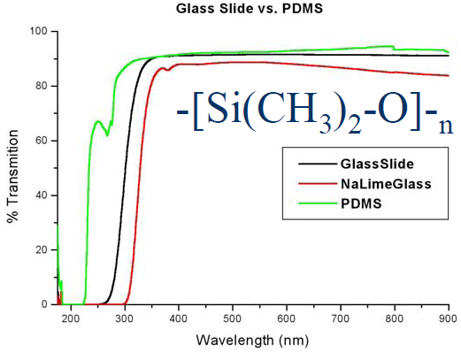
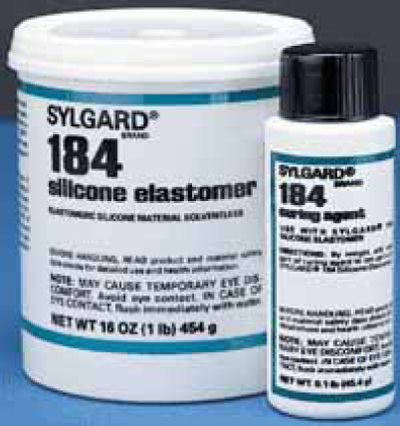
PDMS: poly(dimethyl-siloxane)
PDMS properties:
Silicone elastomer with range of viscosities
Flexible (1 MPa Young’s modulus, typical polymer 1 GPa) and easy to mold.
Elastomer, conforms over the surface over large areas.
Chemically inert, optically transparent
Low surface energy: bonds reversibly (or permanent).
Seals to flat and clean surfaces for micro-fluidics
Durable (reusable), low thermal expansion
Biocompatible (even for food additive)
No particulates, environmentally safe
Best Resolution: 2-10 nm (for hard PMDS)
Dow Corning brand

Slide 4
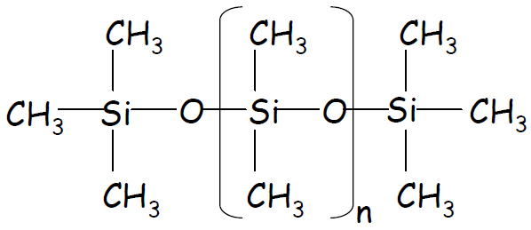
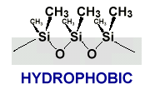
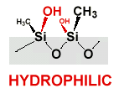
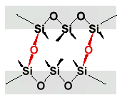
PDMS surface treatment
Upon treatment in oxygen plasma, PDMS seals to itself, glass, silicon, silicon nitride, and some plastic materials.
Plasma oxidation
Air (∼10 min)
contact PDMS surfaces
Irreversible seal:
formation of covalent bonds
Biggest issue: it becomes hydrophobic quickly, very bad for micro-fluidic applications.
(liquid hard to get into the channels once it becomes hydrophobic)

Slide 5
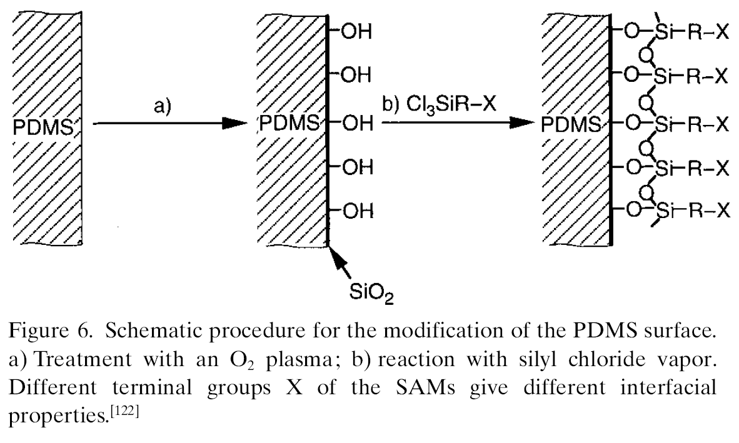
PDMS surface treatment
PDMS has a low interfacial free energy such that molecules of most polymers won’t stick on or react with its surface.
The interfacial free energy can be manipulated with plasma treatment.
For nano-imprint or soft lithography mold, plasma can make PMDS surface like SiO₂, easy for mold release agent coating using silane chemistry.

Slide 6
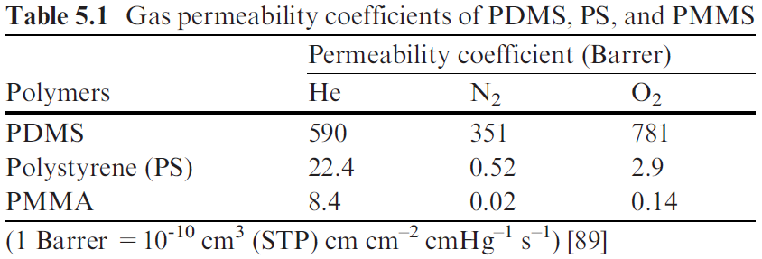
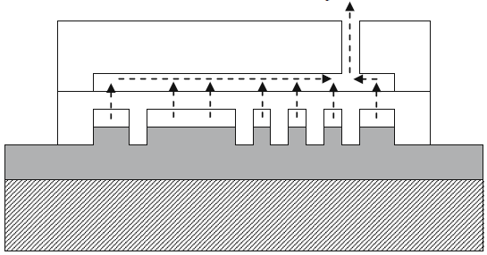
PDMS is permeable to solvent and gas
Solvent permeability: for example, PDMS can absorb propylene glycol mono ether acetate (PGMEA) up to 27wt.% of its weight and 30wt.% of absorbed PGMEA will diffuse into air in 1 h.
This property is good for cell culture within PDMS channel/cavity, since cell can “breath” the air.
Micro-aspiration assisted lithography (MAAL)
PDMS membrane (20μm)
Aspiration
PDMS (5mm)
Molded structure after UV curing and de-molding
UV-curable pre-polymer

Slide 7
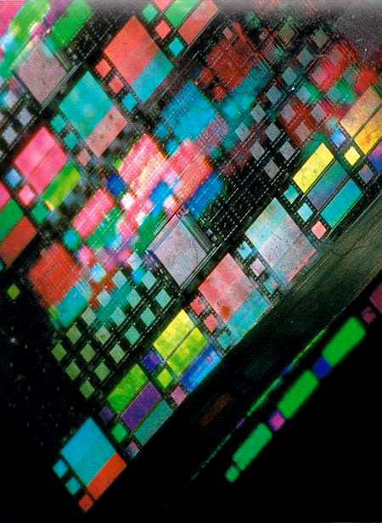
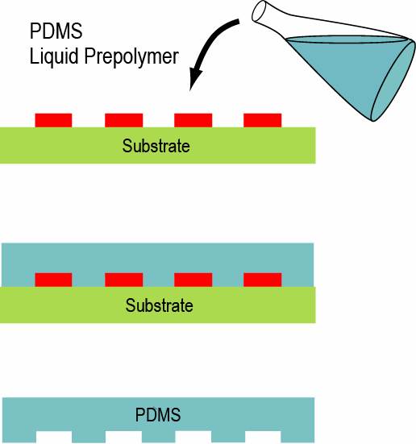
PDMS fabrication
Cure on hotplate for few hours
Peel off PDMS
Master pattern (red color) can be in: photoresist (SU-8), silicon, glass…
Silanization of master mold needed to obtain low surface energy for easy separation.
Besides casting, PDMS can also be spin-coated to form thin (few μm) films

Slide 8
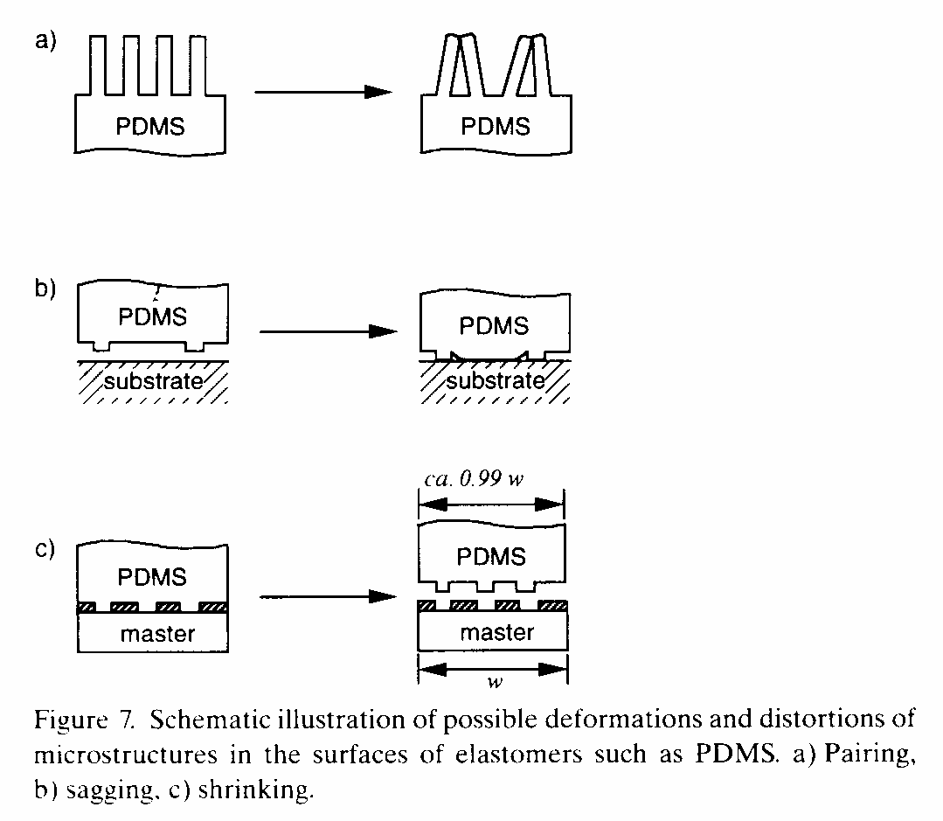
PDMS problems: soft, low Young’s modulus
Shrinking makes accurate (< few μm) alignment very difficult.

Slide 9
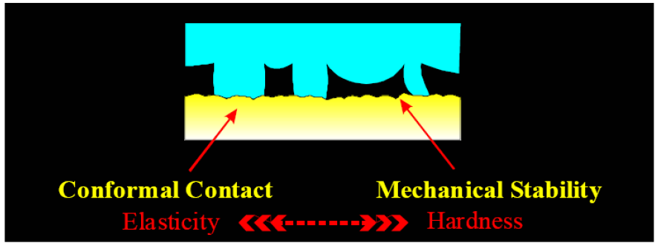
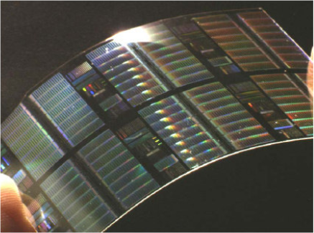
Hard PDMS (h-PDMS)
(“Filler” added for more cross-linking)
More cross-linked polymer, so harder.
Less flexible than regular (soft) PDMS, more brittle.
Must have a support in order to not crack the stamp, use thick layer PDMS or glass as support.
Flexible Brittle

Slide 10
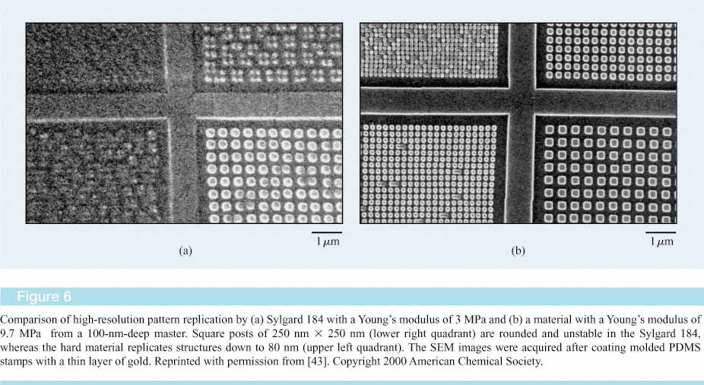
Hard PDMS (h-PDMS)
hard PDMS, E_{Young}: 2 → 2000 MPa (is 3000 MPa for polystyrene)
80nm
80nm
250nm
Young’s modulus = 3.0 MPa
9.7 MPa
Michel, B.; Bernard, A., et al. “Printing meets lithography: soft approaches to high-resolution patterning” IBM J. Res. & Dev. 2001, 45, 697.
Ref. 43: H. Schmid and B. Michel, “Siloxane polymers for high-resolution, high-accuracy soft lithography,” Macromolecules 33, 3042 (2000).
Odom, T. W. et al. Langmuir 2002, 18, 5314.

Slide 11
“Soft” lithography
Soft lithography and PDMS.
Micro-contact printing.
Replica molding.
Micro-molding in capillary.
Micro-transfer molding/printing.
Solvent assisted microcontact molding.

Slide 12
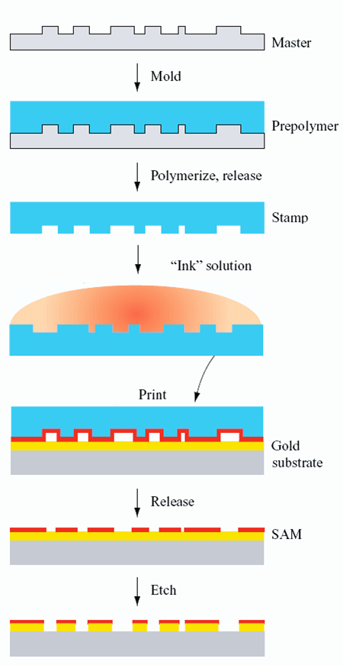
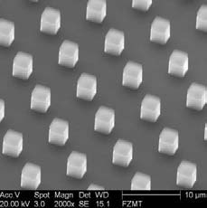
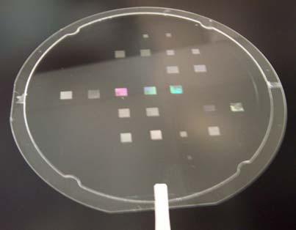
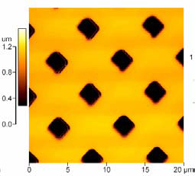
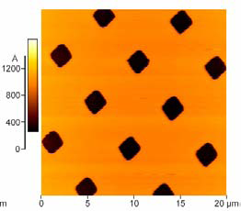
Micro - contact printing (μCP)
20μm
100mm stamp

Slide 13
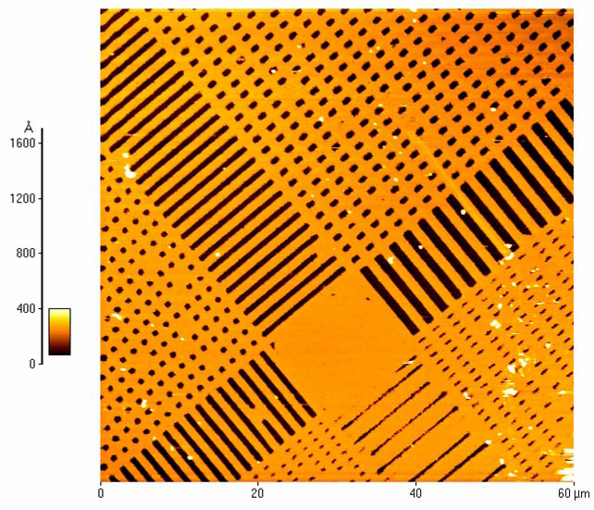
Micro - contact printing (μCP)
Test structures in Au, smallest dimension 400nm

Slide 14
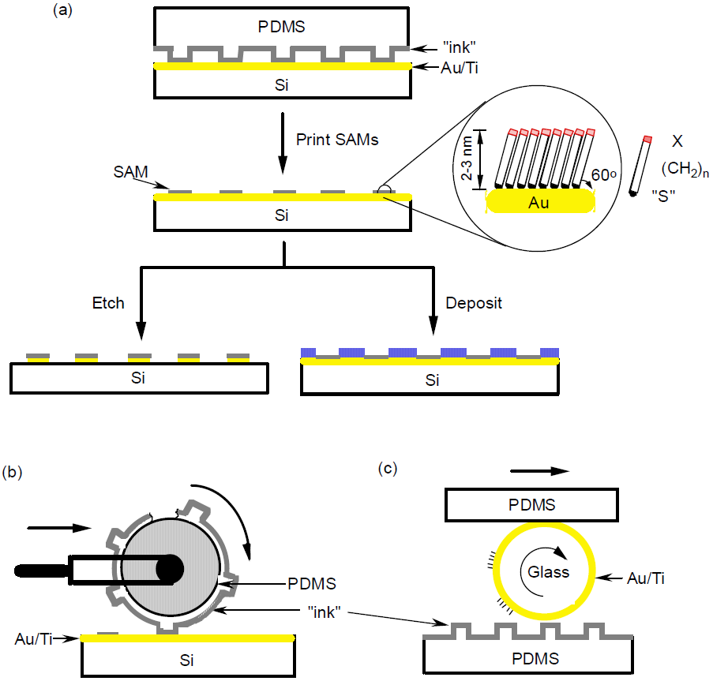
Micro - contact printing (μCP), with roller
Printing on a planar surface with a planar stamp.
Printing on a planar surface with a rolling stamp
Printing on a non-planar surface with a planar stamp
Xia & Whitesides, Angew. Chem. Int. Ed. 1998, 37, 550-575.
A. Kumar & G. Whitesides, Applied Physics Lett. 1993

Slide 15
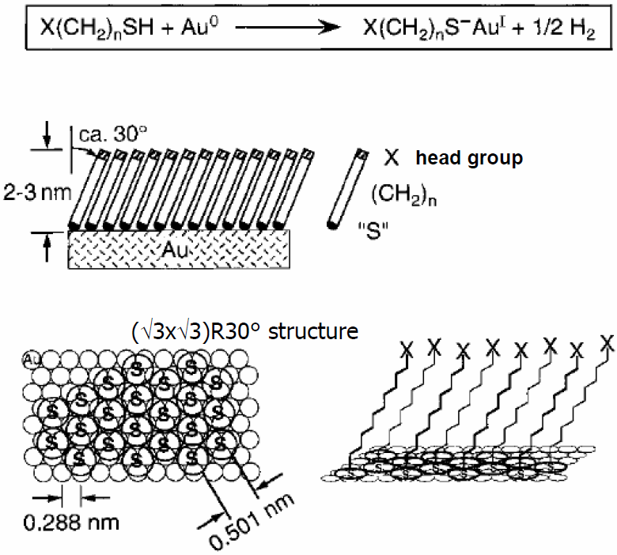
Self - assembling, classical –SH and Au bonding
Definition: spontaneous organization of molecules (objects) into stable, well-defined structures by non-covalent forces.
Driving force: thermodynamic equilibrium.
Final structure: determined by the subunits.
Biological 3D self assembly: folding of proteins, formation of DNA helix…
Self assembled monolayer (SAM)
Chemi-sorption and self-organization of long-chain organic molecules on flat substrates.
Alkanethiolates CH₃(CH₂)_{n}S-Au(111)
-SH also bond to Ag, but Ag surface not as stable as Au.
Laibinis,Whitesides, et al. JACS 1991, 113, 152

Slide 16
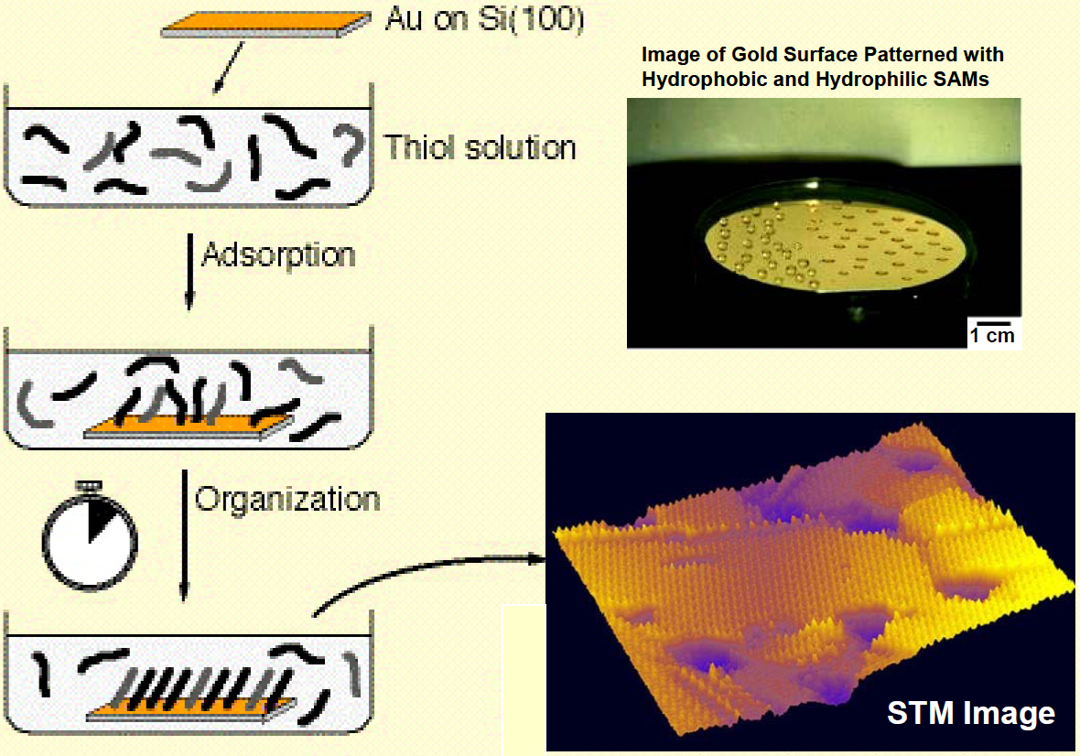
Applying alkanethiols on stamp to form SAM
These monolayers allow control over wettability, adhesion, chemical reactivity, electrical conduction, and mass transport to underlying metal
Linear alkanethiols with various molecular weights
158 g/mol (dodecanethiol, DDT)
258 g/mol (hexadecanethiol, HDT)
314 g/mol (eicosanethiol, ECT)
in ethanol
Xia, Y.; Whitesides, G. M. Angew. Chem., Int. Ed. 1998, 37, 550.
Michel, B.; Bernard, A., et al. IBM J. Res. & Dev. 2001, 45, 697.

Slide 17
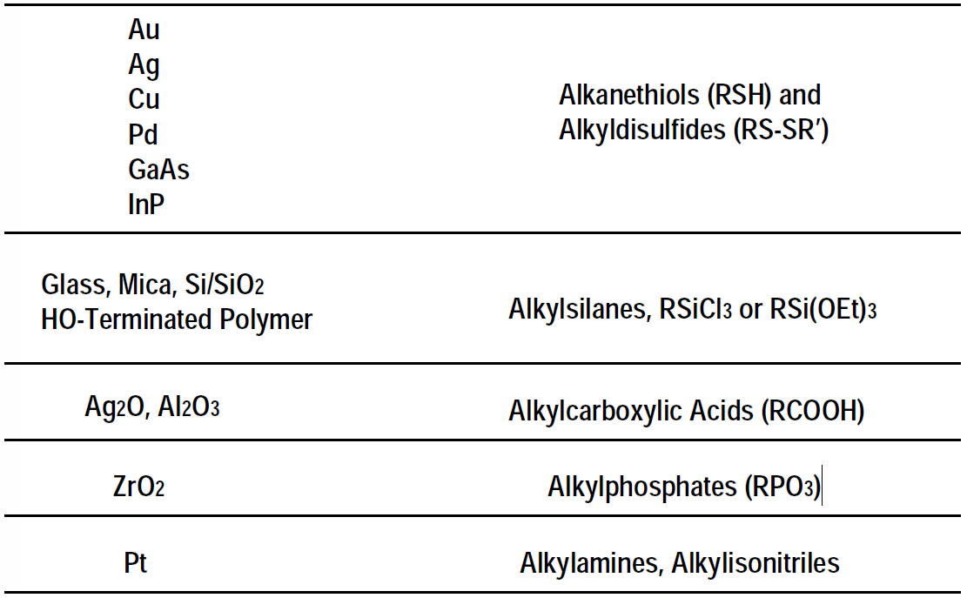
Popular “ink” molecules
Substrate Molecules

Slide 18
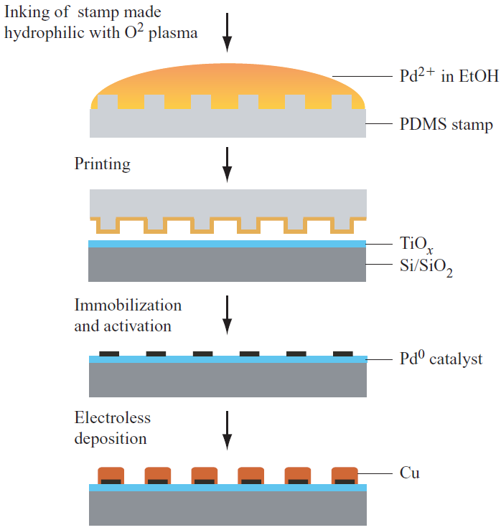
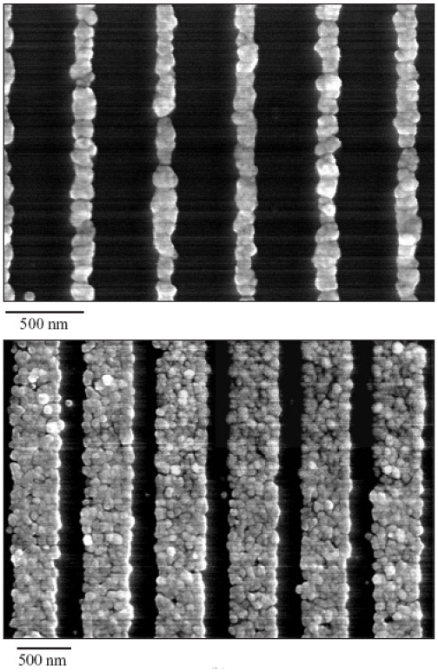
Patterning of palladium catalyst for electroless Cu plating
Ink: bis-(stearonitrile)palladium-dichloride
SEM images of Cu deposited onto catalytic Pd lines

Slide 19
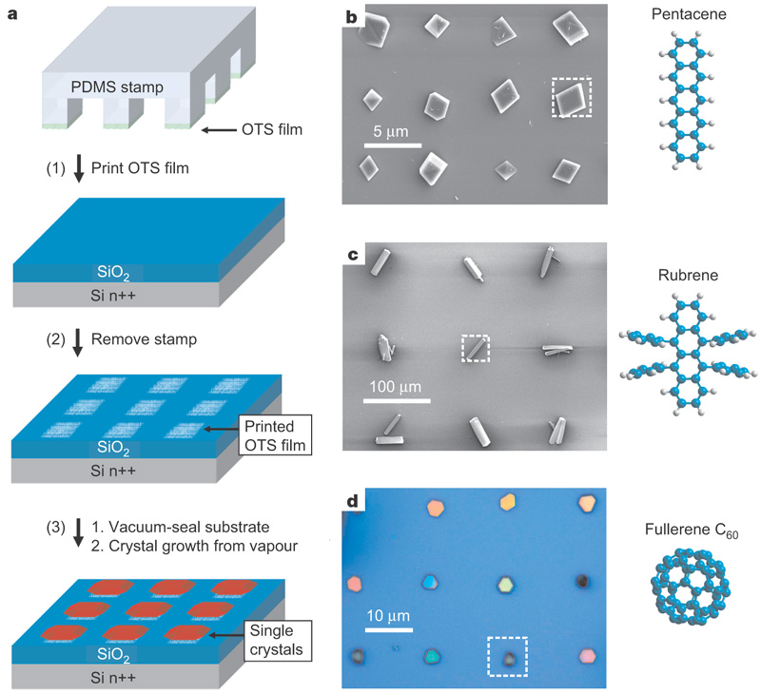
Patterning of organic single crystals
a. Procedure used to grow organic single crystals on substrates that have been patterned by microcontact printing. To grow the patterned single crystals, the patterned substrate is placed in a glass tube with the organic source material, vacuum-sealed (0.38 mmHg), and placed in a temperature gradient furnace tube.
b–d, Patterned single-crystal arrays of different organic semiconductor materials. The dotted square in each image indicates the size and location of one of the OTS-stamped domains, while the molecular structure of the organic material used is shown next to the image of its single-crystal array.
The above three materials are all hydrophobic and they binds/sticks to OTS
OTS: octadecyltrichlorosilane
(optical micrograph)
Nature 444, 913-917 (14 December 2006)
http://www.nature.com/nature/journal/v444/n7121/pdf/nature05427.pdf

Slide 20
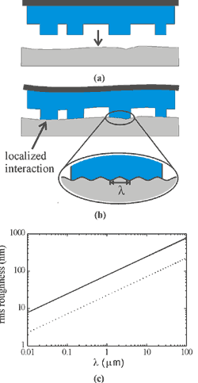
Conformal micro-contact printing on rough surfaces
Conformal contact between a soft stamp and a hard substrate.
Dependence of maximal roughness amplitude for spontaneous formation of conformal contact on the roughness wavelength (λ) for a stamp with Young's modulus of 2.5 MPa and work of adhesion of 0.1J/m² (Sylgard 184, solid line) and for a stamp with modulus of 9 MPa and work of adhesion of 0.03J/m² (dotted line).
Larger λ allows for higher roughness.

Slide 21
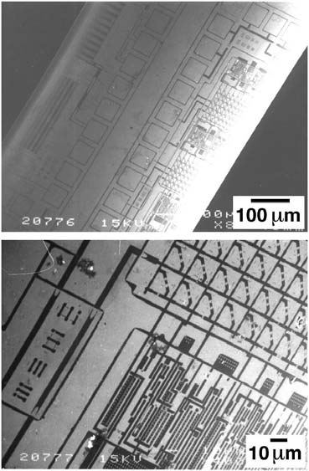
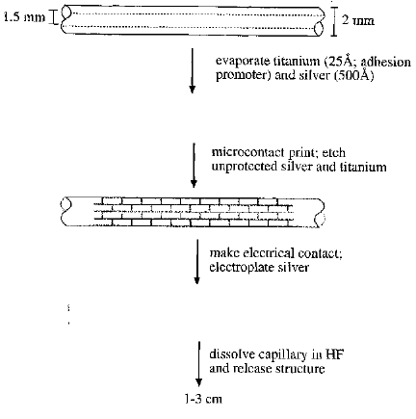
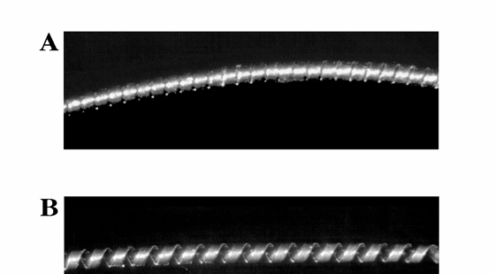
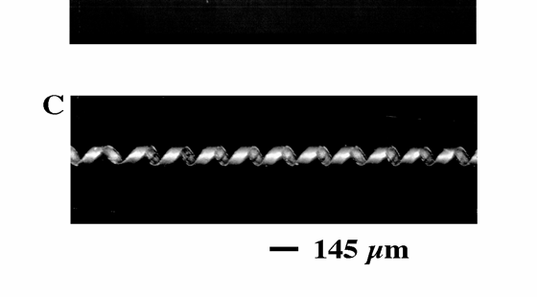
Micro-contact printing on curved substrates
PDMS is soft, it can roll onto curves
Whitesides, “Fabrication of submicrometer features on curved substrates by microcontact printing”, Science, 269, 664 (1995); Rogers and Whitesides, “Microcontact Printing and Electroplating on Curved Substrates: Production of Free-Standing Three-Dimensional Metallic Microstructures”, Adv. Mater. 9, 475 (1997).

Slide 22
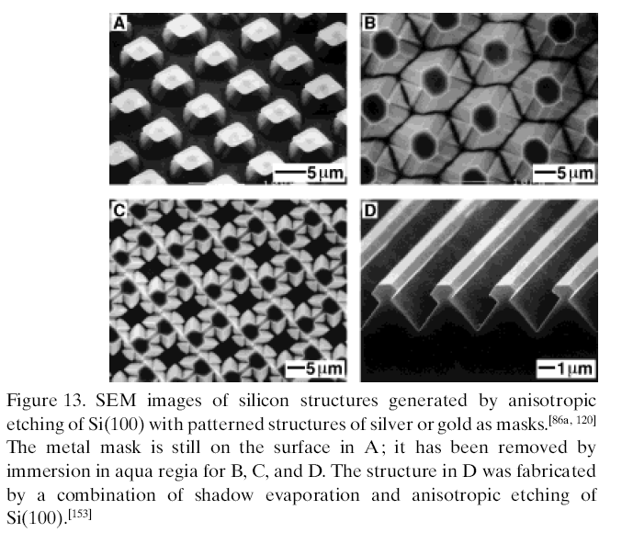
Pattern transfer into Si(100) by anisotropic etching
Au
Si
KOH anisotropic etching of Si is the most popular pattern transfer technique when the etching mask is too thin for liftoff or direct etch.
But it is limited to Si along certain crystalline directions.

Slide 23
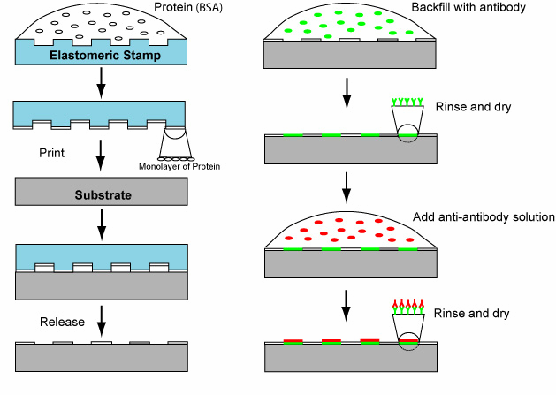
Microcontact printing of proteins
BSA: bovine serum albumin, bovine albumin

Slide 24
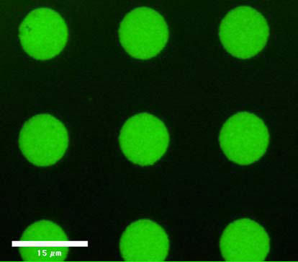
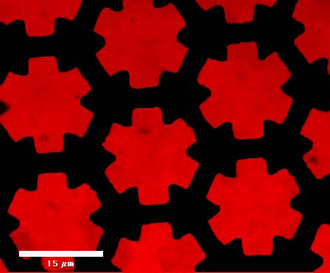
Microcontact printing of proteins
Fluorescent image
(anti-Goat IgG – Alexa 488 and 594)

Slide 25
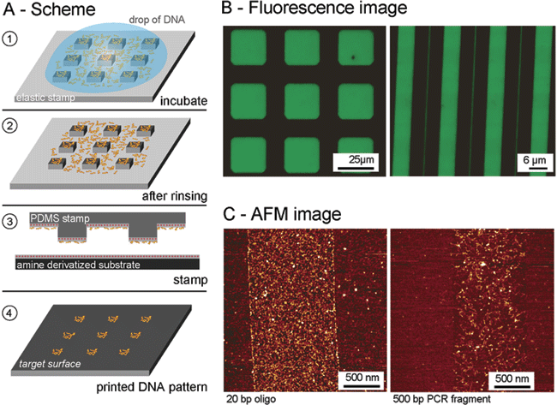
Micro-contact printing of DNA
Scheme of DNA printing. The surface of PDMS was modified such that it exposed positive charges on its surface. The stamp was incubated with target DNA molecules in a solution of low pH. The stamp was then rinsed, blown dry, and printed to deliver the DNA to the target surface.
Fluorescence images of patterned FITC-labeled DNA on a glass surface after printing.
AFM images revealing the printed DNA molecules deposited as patterns on mica substrates. AFM images (tapping mode in air) of stamped 1-μm lines of oligonucleotides (left, 20-bp oligos; right, 500-bp PCR fragments).
S.A. Lange, V. Benes, D.P. Kern, J.K.H. Horber, A. Bernard, Anal. Chem. 2004, 76, 1641.

Slide 26
“Soft” lithography
Soft lithography and PDMS.
Micro-contact printing.
Replica molding.
Micro-molding in capillary.
Micro-transfer molding/printing.
Solvent assisted microcontact molding.

Slide 27
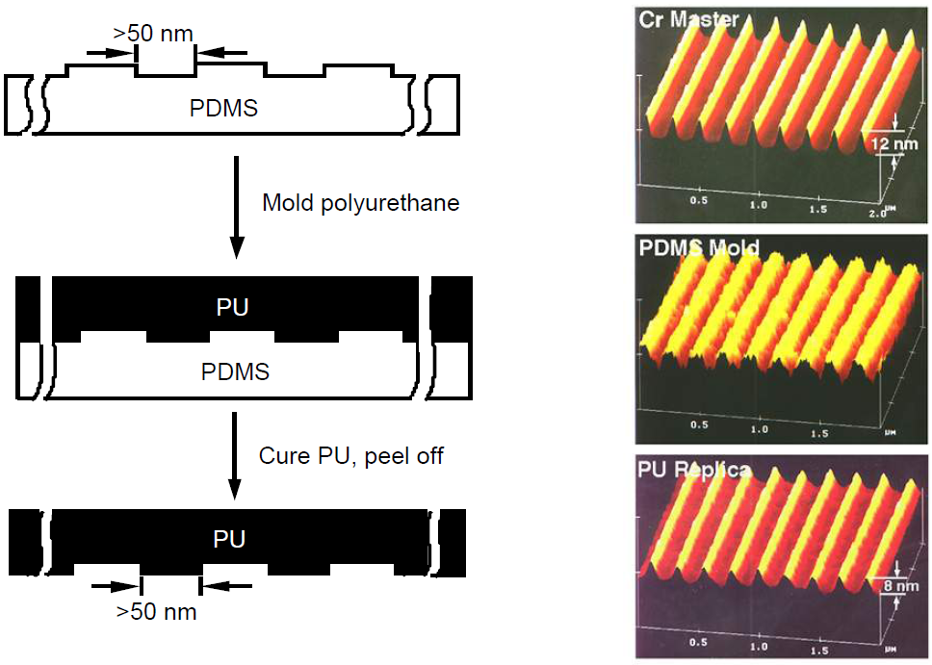
Replica molding (REM)
It is similar to UV-curable nanoimprint lithography
PU = polyurethane
Xia & Whitesides et al, Advanced Materials, 1997, 9, 147

Slide 28
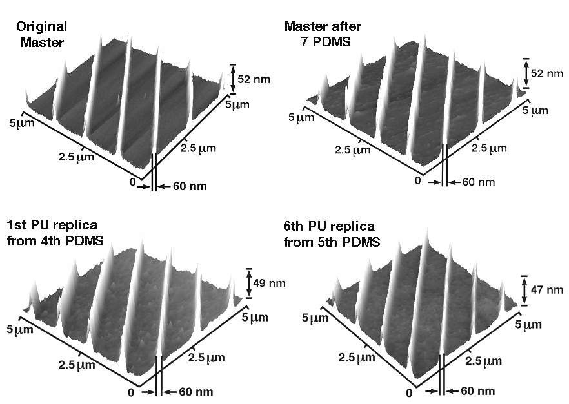
Replica molding (REM)
The patterning process has high fidelity, with little feature size loss.

Slide 29
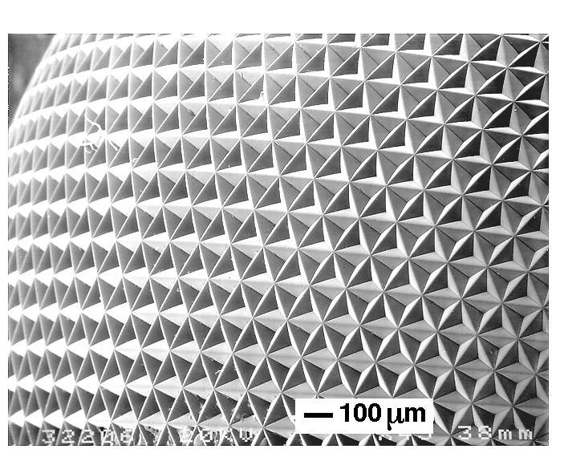
Replica molding (REM)

Slide 30
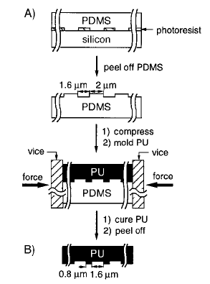
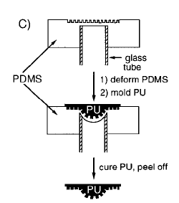
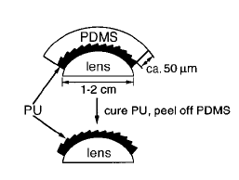
Using mold elasticity
Molding on curved surface
Creating curved surface
Mechanical compression for feature size reduction
Y. Xia et al., Science 1996

Slide 31
“Soft” lithography
Soft lithography and PDMS.
Micro-contact printing.
Replica molding.
Micro-molding in capillary.
Micro-transfer molding/printing.
Solvent assisted microcontact molding.

Slide 32
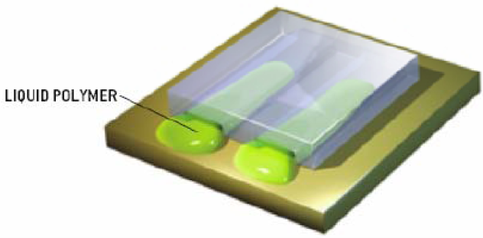
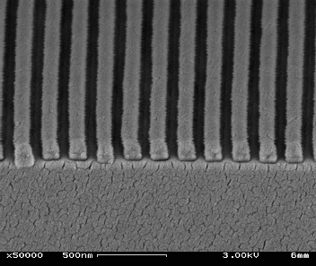
Micro-molding in capillary (MIMIC)
Uses capillary forces to fill the gaps between substrate and PDMS master.
The PDMS master is pressed tightly on a planar substrate.
Elastic PDMS seals off walls and creates capillary channels.
A drop of liquid prepolymer is placed at the ends of these channels and fills them automatically due to capillary force.
PDMS can absorb the solvent, which creates a partial vacuum inside the PDMS cavity and helps to draw in liquid polymer.
Cure and peel of the PDMS master.
Liquid pre-polymer
Nano-molding in capillaries is possible
Line-width: 100nm

Slide 33
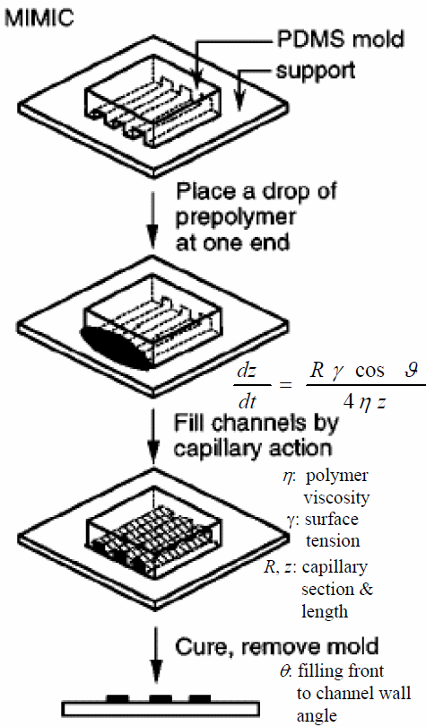
Micro-molding in capillary (MIMIC)
a: PU (polyurethane) on Si b: polyaniline c: ZrO₂ d: polystryene colloids e+f: free standing PU
Kim & Whitesides et al, Nature, 1995, 376, 581
Xia, Y.; Whitesides, G. M. Ann. Rev. Mater. Sci 1998, 28, 153.

Slide 34
“Soft” lithography
Soft lithography and PDMS.
Micro-contact printing.
Replica molding.
Micro-molding in capillary.
Micro-transfer molding/printing.
Solvent assisted microcontact molding.

Slide 35
Micro - transfer molding (μTM)
Pre-polymer
PDMS
Substrate
Apply the liquid prepolymer
Planarize the prepolymer
Place the master on a planar substrate
UV exposure or heating solidifies the prepolymer that sticks to the substrate
μTM fabrication of a). one-layer microstructures; b). three-layer polymer microstructures.

Slide 36
Micro - transfer molding (μTM)
Microstructures fabricated using μTM.
An SEM image of a fractured sample showing a pattern of isolated stars of UV-cured polyurethane (NOA 73) on Ag.
An array of parallel lines of spin-on glass on Si with an aspect ratio (height/width) of ∼8.
A two-layer structure: isolated micro-cylinders (1.5μm in diameter) on 5μm-wide lines, supported on a glass cover slide.
A two-layer structure: a continuous web over a layer of 5μm-wide lines, supported on a glass cover slide.
A three-layer structure on a glass cover slide. The layers of 4 μm-wide lines are oriented at ∼60º from each other.
Structures in c-e were made of heat-cured epoxy (F109CLR).
Zhao & Whitesides et al, Advanced Materials, 1996, 8, 837.

Slide 37
Metal transfer assisted nanolithography
SEM image of the transferred metal grating onto PMMA layer with period of 700nm on SiO₂ substrate.
Period 220nm on PET substrate.
After O₂ RIE of b.
After metallization and lift-off process of c.
Guo, “Metal transfer assisted nanolithography on rigid and flexible substrates”, JVST B, 2008

Slide 38
Metal transfer assisted nanolithography: line-width reduction
SEM image of the metal grating on PET substrate after line-width reduction. The inset is a zoom-in view showing that the line-width was reduced to 50nm.
Schematic of shadow (angle) evaporation of metals to reduce pattern line-width. The line-width is reduced by the thickness of the metal on the PDMS grating sidewall.

Slide 39
“Soft” lithography
Soft lithography and PDMS.
Micro-contact printing.
Replica molding.
Micro-molding in capillary.
Micro-transfer molding/printing.
Solvent assisted microcontact molding.

Slide 40
Solvent assisted microcontact molding (SAMIM)
(solvent assisted imprinting)
Substrates
Silicon
Glass
Flexible transparency
Polymer
SU-8 (∼1μm)
Shipley 1805 Photoresist (∼500nm)
3% PMMA (∼70nm)
Solvent
SU-8 (ethanol)
Shipley 1805 photoresist (ethanol)
3% PMMA (acetone)
The molded polymer structure becomes solidified in a few minutes after evaporation of solvent, while the stamp is still in conformable contact with the substrate.
Uses a solvent to wet the PDMS stamp and soften the structure polymer.
Dissipate and evaporate the solvent through PDMS.
(PDMS stamp can absorb the solvent because of the solvent permeability of PDMS.)
Kim & Whitesides et al, Advanced Materials, 1997, 9,651.

Slide 41
SAMIM of SU-8 in ethanol
2μm diameter
SU-8

Slide 42
SAMIM of PMMA in acetone
Au structure fabrication

Slide 43
SAMIM of PMMA in acetone
Hole array in PMMA
Au dot array after liftoff
Dot diameter 160nm.

Slide 44
Injection molding
Very old technology, capable of micro-resolution, much higher throughput than hot embossing, good for microfluidic channel fabrication using thermoplastic polymers.
(Thermoplastic polymer is better than PDMS for its “clean non-sticky” channel wall)
Mold material: metal
Required pressure: 500-200bars
The mold is heated to the softening temperature of the polymer to prevent the injected polymer material from hardening too early.
The reciprocating screw shears, melts, and pumps the polymer into the accumulation zones.
After cooling, the melt solidifies, and can be taken out from the mold.

Slide 45
Soft lithography: advantages and disadvantages
Advantages:
Convenient and low cost
Based on self assembly
Rapid prototyping
Deformation of PDMS provides route to complex patterns
No optical diffraction limit
Non-planar or curved surfaces
Generation of 3D μ-structures
Control over surface chemistry
A broad range of materials
Applicable to manufacturing
Patterning over large areas
Disadvantages:
Distortion of patterns
Poor registration/alignment
Compatibility with IC processes
Defects and their densities
μCP can only be applied to a number of surfaces
MIMIC is a relatively slow process
μTM and replica molding may leave thin polymer films between the relief structures

Slide 46
PDMS elastomer for mold making

Slide 47
PDMS elastomer for mold making

Slide 48
PDMS elastomer for mold making

Slide 49
PDMS elastomer for mold making

Slide 50
PDMS elastomer for mold making
(coat mold release agent)
University of Washington

