Slide 1
Block copolymer self assembly
Di-block copolymer self assembly overview.
Guided (directed, aligned) self assembly.
Block copolymer lithography.
ECE 730: Fabrication in the nanoscale: principles, technology and applications
Instructor: Bo Cui, ECE, University of Waterloo; http://ece.uwaterloo.ca/~bcui/
Textbook: Nanofabrication: principles, capabilities and limits, by Zheng Cui

Slide 2
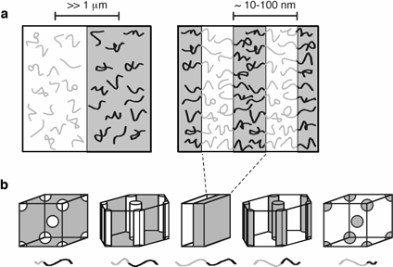
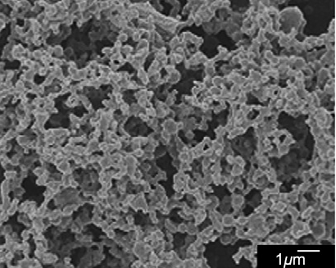
Phase separation of block copolymers
Phase separation of a blend of PMMA and PS homo-polymer
A mixture of PMMA (M_{w}=93.9 kg/mol) and polystyrene (PS, M_{w}=194.9 kg/mol) (PS/PMMA=70/30, w/w) was dissolved in tetrahydrofuran (THF) to form a 5 wt% solution.
Polymer film was made by spin-cast the solution on glass slide.
Exposure to cyclohexane at 70ºC to dissolve PS.
A blend of two incompatible homo-polymer separates into distinct phases on a large scale (left), whereas block copolymers micro-phase separate into periodic domains (right).
Basic morphologies obtained by different block copolymer compositions.
Ma, “Fabrication of super-hydrophobic film from PMMA with intrinsic water contact angle below 90º”, Polymer, 48, 7455-7460 (2007).

Slide 3
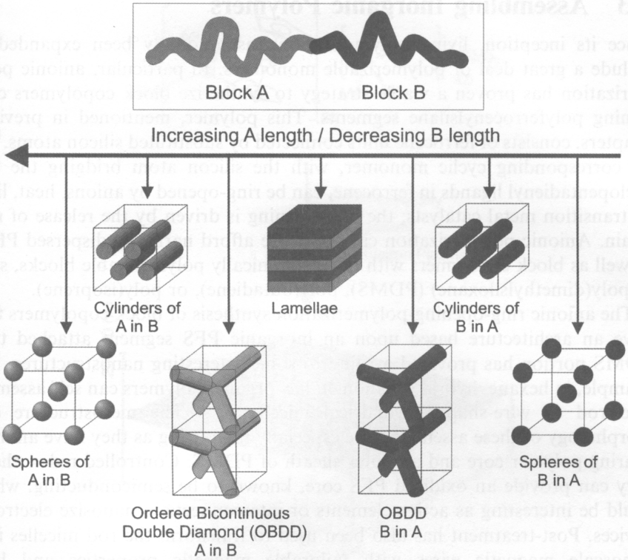
Typical self assembly behavior for linear block copolymers
“Nanochemistry: a chemical approach to nanomaterials” by Ozin

Slide 4
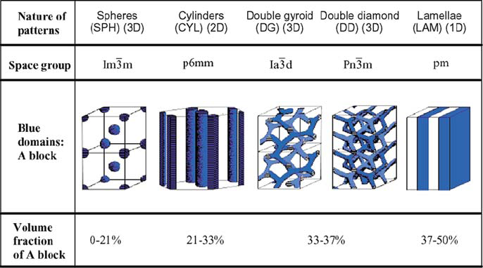
Typical self assembly behavior for linear block copolymers

Slide 5
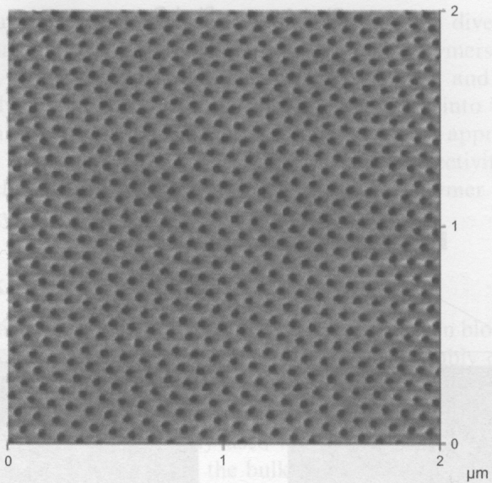
Block copolymer thin films
Block copolymer self-assembly study is started in the bulk phase.
Thin film is desired for nanofabrication and device application.
Film applied by drop casting, dip coating, and spin coating.
Film is then treated to increase the degree of ordering.
Such as annealing above the order-disorder transition temperature for several days.
Or annealing at the presence of solvent vapor (toluene...) to swell the film and make the polymer more mobile.
One way to achieve alignment is through directional solidification strategy, such as using a temperature gradient – the film is heated to above order-disorder transition and cooled in the presence of such gradient; so that the ordered phase nucleates at the cool end that serves as a template and orient the rest of the film.
Annealing film in the presence of a gradient in solvent vapor can have similar effect. (see SEM image).
Film ordered by controlled solvent evaporation.
Advanced Material, 16, 226 (2004)

Slide 6
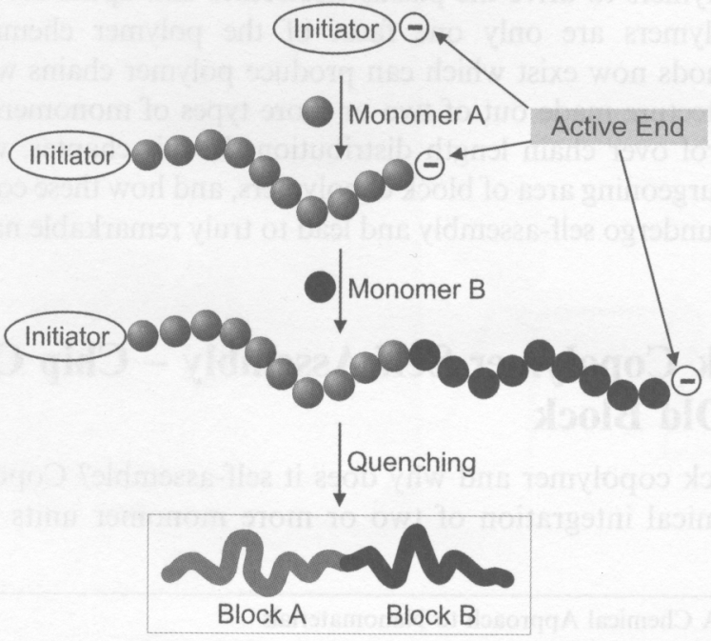
Synthesis: anionic living polymerization

Slide 7
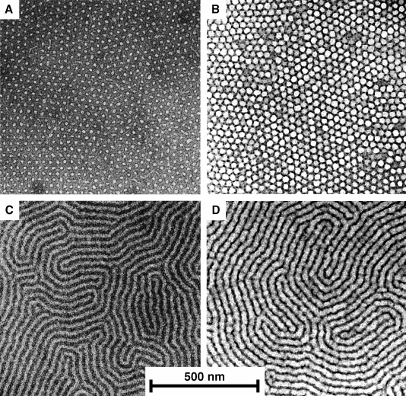
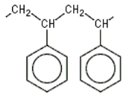
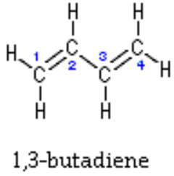
Self-assembly of PS-PB di-block copolymer
PS: polystyrene
PB: polybutadiene
The most attractive feature of block copolymer self assembly is the extremely high resolution, easily get features down to 10nm.
TEM micrographs of polystyrene-polybutadiene diblock copolymer film masks (a,c) and lithographically patterned silicon nitride (b,d).
C. Harrison, Science

Slide 8
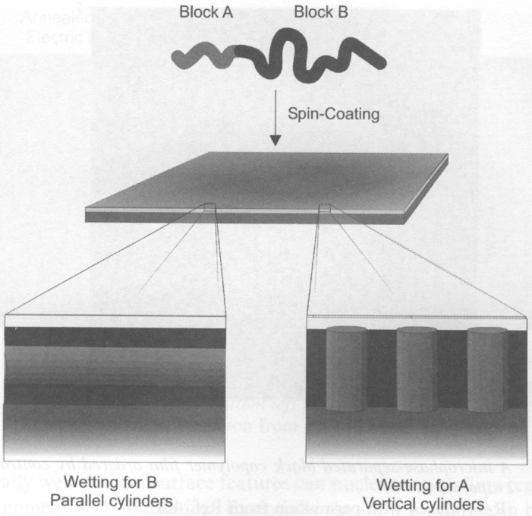
Block copolymer thin films: effect of substrate wetting
Block A is shorter than B
Arranged to minimize surface (interface) energy
B
A
B
A B A

Slide 9
Block copolymer self assembly
Di-block copolymer self assembly overview.
Guided (directed, aligned) self assembly.
Block copolymer lithography.

Slide 10
Guided block copolymer self assembly for long range ordering and periodicity
Micro-phase separated block copolymer can be directed/aligned by:
Electric field
Shearing force
Surface control of wettability
Chemical pattern on surface
Nano-structured surface
Spatial confinement by surface relief pattern in substrate and mold
Void in a range of porous host

Slide 11
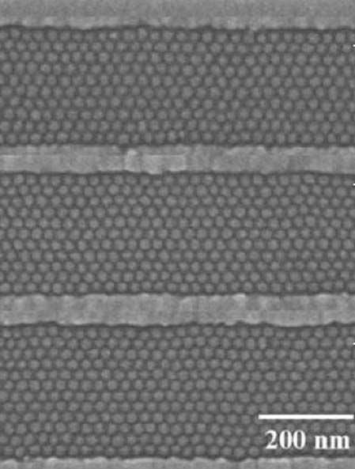
Alignment by pre-patterning the substrate
Spherical domains assembled from PS–PFS (polystyrene-polyferrocenyldimethylsilane) block copolymer inside patterned SiO₂ grooves.
The 1.5 wt.% PS-PFS block copolymer in toluene solution was spin-coated onto the grooved substrate and then annealed at 140ºC for 48h to obtain a monolayer of spherical PFS domains in a PS matrix within the substrate grooves.
Ross, “Templated self-assembly of block copolymers: effect of substrate topography”, Adv. Mater. 15, 1599–1602 (2003).

Slide 12
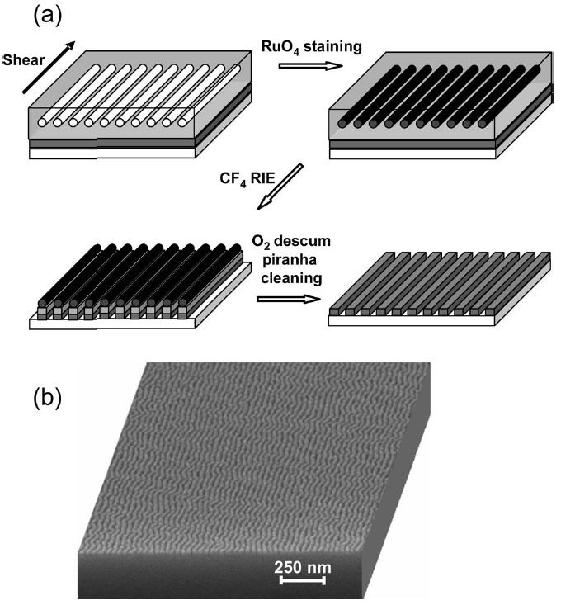
Alignment by shear force
(here for silicon nano-wire fabrication)
Press
Co-polymer on substrate
Pull
One way to create shear force.
Fabrication process for a Si nano-wire grid polarizer using block copolymer lithography.
SEM image of the finished Si nano-wire grid on fused silica.
Here the etch contrast is increased by staining the block copolymer by 2 min exposure to the vapor from 0.5% aqueous RuO₄, which selectively reacts with the PS block and increases its etch resistance, thus permitting Si nanowires of greater aspect ratio to be fabricated.

Slide 13
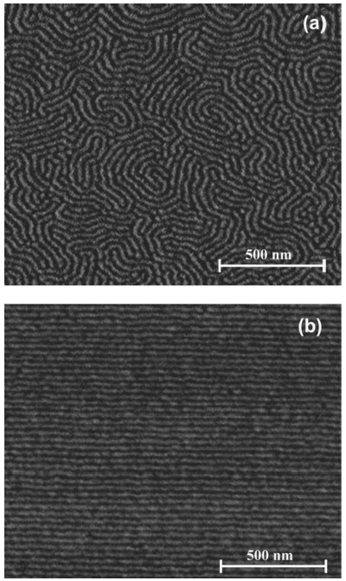
Alignment by shear force (for silicon nano-wire fabrication)
Tapping mode atomic force microscopy (TM-AFM) phase images of PS–PHMA thin films on top of an α-Si layer on a fused silica substrate:
Quiescently annealed
Shear aligned.
Glassy PS cylinders are shown as light in a dark rubbery PHMA matrix.
Polystyrene-b-poly(n-hexyl methacrylate) (PS–PHMA) diblock copolymer with a molar mass of 21 and 64 kg/mol for the respective blocks.
Pitch=30nm
Chaikin, “Silicon nanowire grid polarizer for very deep ultraviolet fabricated from a shear-aligned diblock copolymer template”, Optics letters, 32(21), 3125-3127 (2007).

Slide 14
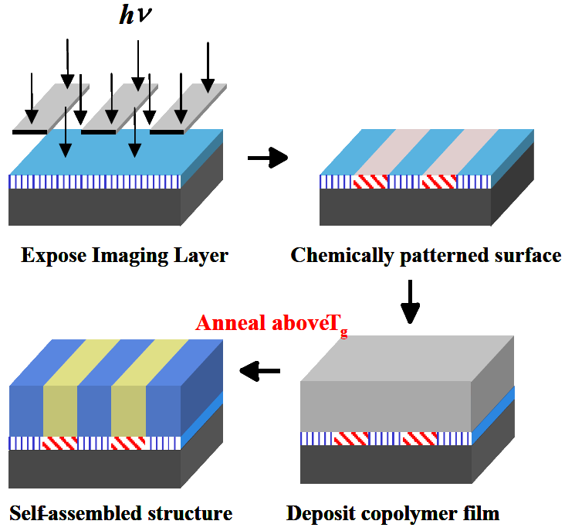
Templated self-assembly of block copolymers
Polystyrene “brushes” by EUV-IL (interference lithography) and surface initiated nitroxide mediated living free radical polymerization
The PS brush pitch should match that of PS-PMMA self assembly pitch.

Slide 15
Polymerization of block-copolymers on
chemically pre-patterned substrates
Polystyrene-block-methyl meth acrylate (PS-b-PMMA), L₀ = 48nm
Thermodynamics dominates interface widths and domain sizes.
When L_{s}=47.5nm≈L_{o}=48nm, block copolymer is almost defect free.
P. F. Nealey, H. H. Solak et al. Nature 424 (2003)

Slide 16
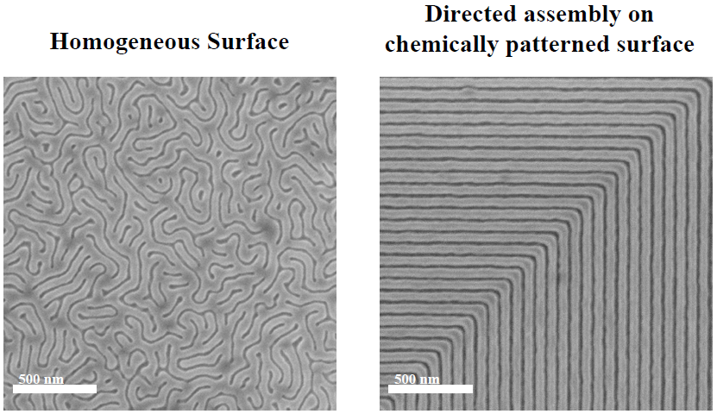
Directed assembly of block copolymer blends into non-regular device oriented structure
Block copolymer materials that naturally form simple periodic structures were directed to assemble into non-regular device oriented patterns (here an elbow) on chemically nano-patterned substrates.
Mark P. Stoykovich, Marcus Müller,Sang Ouk Kim, Harun H. Solak, Paul F. Nealey, Science, 308, 1442-1446 (2005).

Slide 17
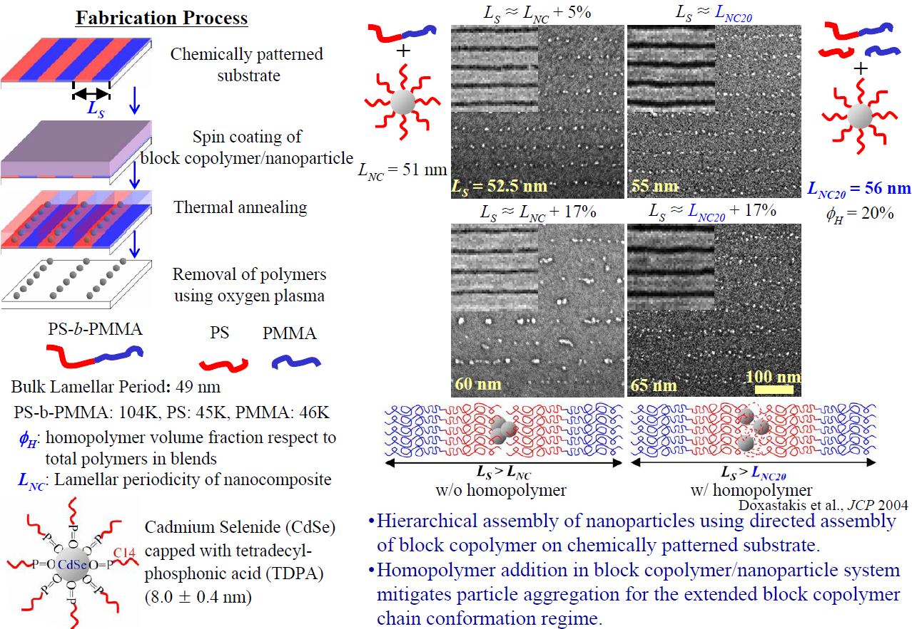
Directed assembly of nanoparticle filled block copolymer

Slide 18
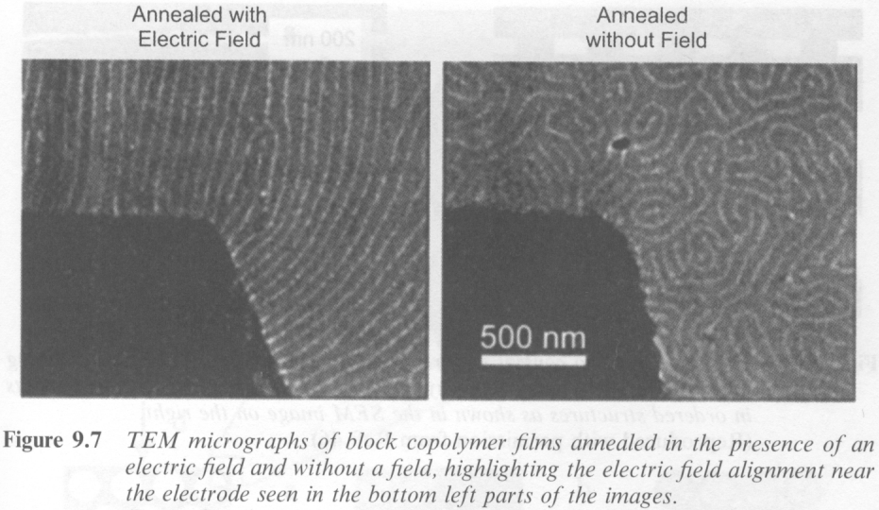
Alignment by electric field
“Local control of microdomain orientation in diblock copolymer thin films with electric fields”, Science, 273, 931 (1996)

Slide 19
Block copolymer self assembly
Di-block copolymer self assembly overview.
Guided (directed, aligned) self assembly.
Block copolymer lithography.

Slide 20
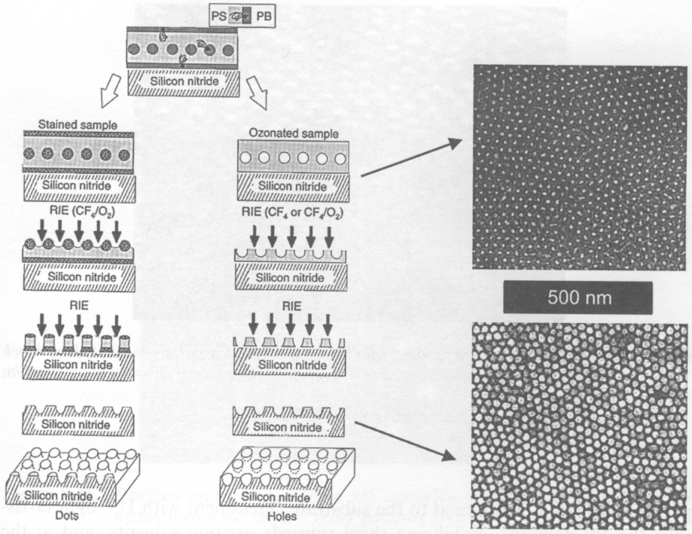
Block copolymer lithography (i.e. with pattern transfer)
PS: polystyrene
PB: polybutadiene
Ozone breaks down PB’s C=C double bond.
OsO₄ vapor reacts with PB’s double bond.
Stain with OsO₄
Degrade with ozone

Slide 21
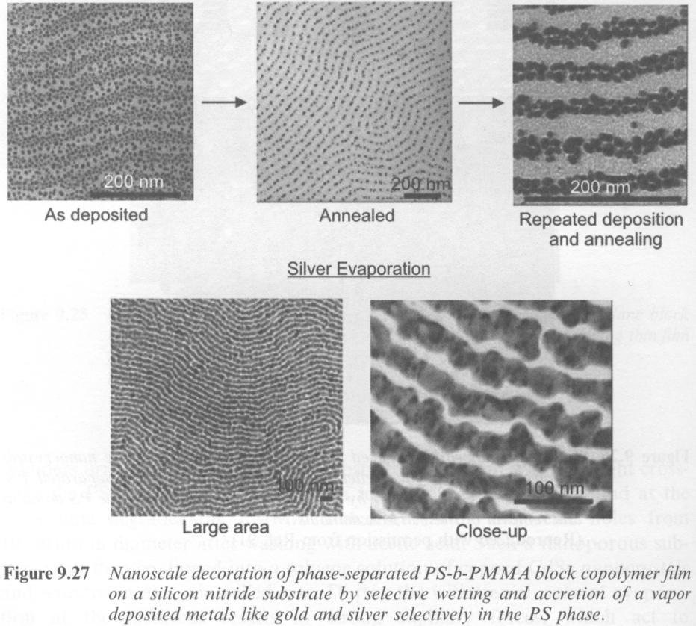
Synthesis of nanowires by wetting
Wettability masks:
Au and Ag to PS phase
In, Pb, Sn to PMMA phase
Gold metal vapor-deposited onto a preformed PS-b-PMMA template.
After annealing at 180°C for 1 min., gold nanoparticles segregate selectively to the PS domains and form chains.
Repeated deposition and short-time annealing increases the metal loading, forming continuous conductive nanowires.
Nature, 414, 735 (2001).

Slide 22
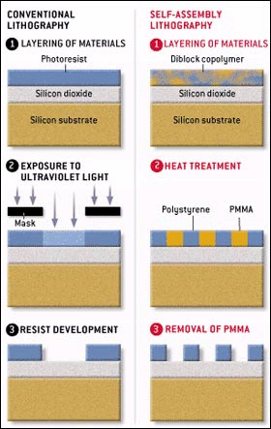
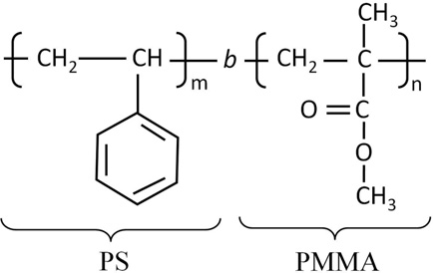
Block copolymer lithography
After deep UV-exposure, polymer chain of PMMA is cut (PMMA is a positive deep UV lithography resist), making it more soluble in solvent.
Whereas the polystyrene (PS) chain is cross-linked, making it hard to dissolve by solvent.
Therefore, PMMA can be selectively removed by solvents like acetic acid afterwards.
(PMMA chain can also be broken by UV light at λ=365nm, but need very long time exposure, ∼1 h at 40mW/cm² intensity)

Slide 23
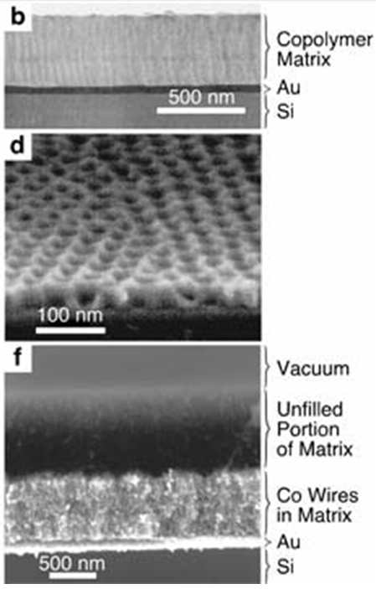
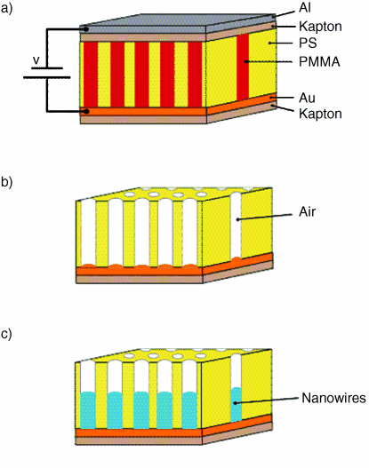
Nanofabrication of vertical nanowires by electroplating
Electric field for vertical alignment
Aligned by electric field during annealing.
Styrene 71%, to obtain 14nm PMMA cylinder.
Deep UV simultaneously degrades PMMA and cross-link PS.
Acetic acid dissolve PMMA but not cross-linked PS.
Methanol is added to aqueous plating solution to better wet hydrophobic PS membrane.
Science, 290, 2126 (2000)

Slide 24
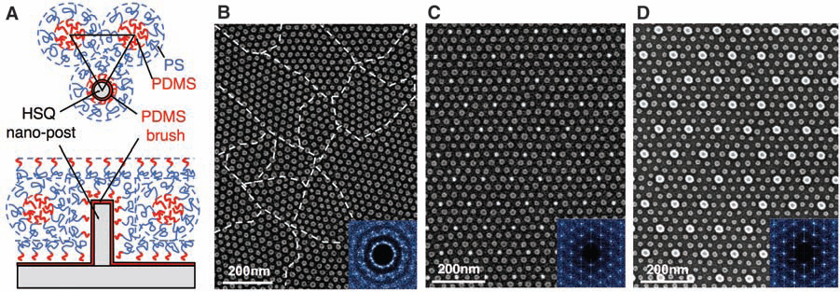
Density multiplication (here by 9×) lithography
Top-down and side-view schematics showing the arrangement of PS-b-PDMS block copolymer molecules in the region surrounding a single post made from cross-linked HSQ resist (by e-beam lithography). The post and substrate surfaces have been chemically functionalized by a monolayer of short-chain PDMS brush.
A poorly ordered monolayer of BCP (block co-polymer) spherical domains formed on a flat surface, that is, without templating. The boundaries between different grain orientations are indicated with dashed lines. The inset is a 2D Fourier transform of the domain positions that shows the absence of long-range order.
C-D. SEM images of ordered BCP spheres formed within a sparse 2D lattice of HSQ
For the moment, this is considered as the most promising route for bit-patterned magnetic recording media fabrication (make the mold for nanoimprint lithography), up to 10Tbits/in² for pitch ∼8nm.
Ross, “Graphoepitaxy of self-assembled block copolymers on two-dimensional periodic patterned templates”, Science, 321, 939-943 (2008).

