Slide 1
Thin film deposition: key performance indices
Deposition rate
Film uniformity
Film conformality: step coverage (e.g. evaporation has worst step coverage)
Electrical properties: resistivity, dielectric characteristics, breakdown voltage, …
Mechanical properties: residual stress, adhesion, yield strength, …
Optical properties: transparency, refractive index, …
conformal
non-conformal
Poor step coverage is good for liftoff.
Conformal film is good for electrical connection…
ECE 730: Fabrication in the nanoscale: principles, technology and applications
Instructor: Bo Cui, ECE, University of Waterloo; http://ece.uwaterloo.ca/~bcui/
Textbook: Nanofabrication: principles, capabilities and limits, by Zheng Cui

Slide 2
Thin film deposition processes
Physical vapor deposition (PVD)
Evaporation
Sputtering
Chemical vapor deposition (CVD)
Low pressure CVD
Plasma enhanced CVD
Epitaxial deposition
MBE (molecular beam epitaxy)
MOCVD (Metal-Organic CVD)

Slide 3
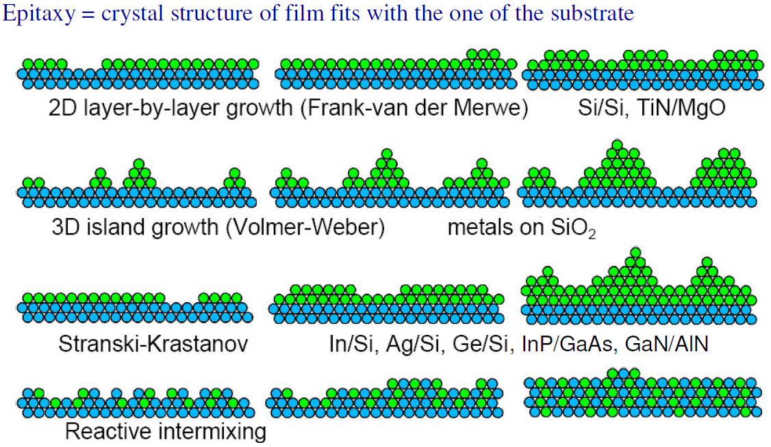
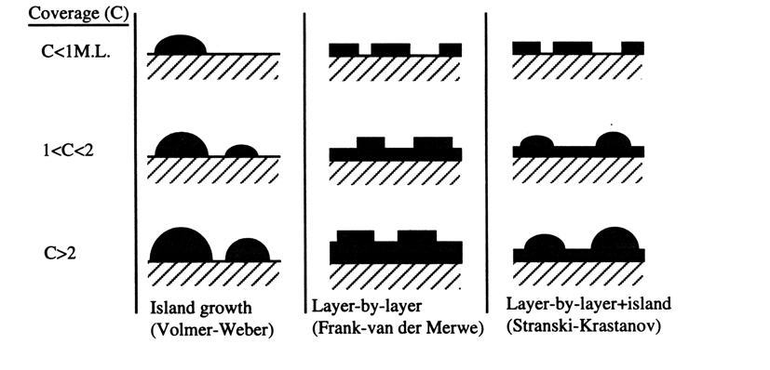
Four equilibrium growth/deposition modes

Slide 4
Equilibrium growth modes
(important only for epitaxy)
(wetting properties)
Noble metals don’t bond (“wet”) to Si/SiO₂ substrate, so tend to have island growth.
Ag always form island (not continuous film); Au is better than Ag.
Adhesion layer Ti or Cr can reduce island formation, but for Ag surface is still very rough.
Here, higher adhesion is because Ti or Cr bond chemically to O in SiO₂.

Slide 5
Physical vapor deposition (PVD): evaporation and sputtering
Evaporation:
Material source is heated to sublimation temperature in vacuum either by thermal or e-beam methods.
Material is vapor transported to target in vacuum.
Easier to change evaporation material than sputtering target.
Sputtering:
Material is removed from target by momentum transfer.
Gas molecules are ionized in a glow discharge (plasma), ions strike target and remove mainly neutral atoms.
Sputtered atoms condense on the substrate.
Not in vacuum, gas (Ar) pressure 5-50mTorr.

Slide 6
Evaporation: vacuum pressure and mean free path
Assume a particle of diameter σ, moving in speed v,
wafer
Collision cross-section=πσ²
Collision volume swept=πσ²vdt
Collision freq=(n/V)πσ²vdt
v
Average mean free path λ=vΔt = [(n/V)πσ²]⁻¹
In more rigorous treatment,
2σ
source
Assume σ = 3Å, T= 300K
P(Torr)×λ(m) = 7.8x10⁻⁵
If λ=30 cm, then a pressure <2.6x10⁻⁴ Torr is required. Typical vacuum <5×10⁻⁶Torr
1Torr = 1mmHg = 1/760atm

Slide 7
Mean-free path of varied gases

Slide 8
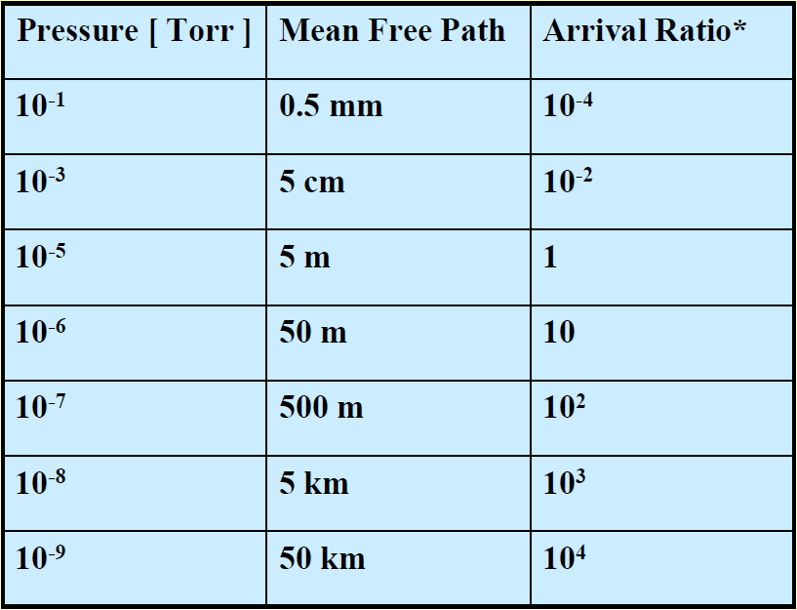
Arrival ratio
Arrival Ratio: ratio of molecular vapor arrival at 1nm/sec deposition rate to molecular impact of residual gas.

Slide 9
Deposition uniformity
E.g: for 100mm wafer, if R_{o}=40cm, tanφ=5/40, significant shadow effect at wafer edge.
This shadowing effect makes liftoff difficult, and modifies feature size.

Slide 10
Thermal evaporation
Materials are evaporated from heated crucible (resistance heating).
Suitable for high vapor pressure metals, e.g. Au, Al,…
Good for organic materials (organic semiconductors…)
Major issues
High contamination level
Can’t work on composite films
Limited choice of materials
High contamination: the crucible is heated as well, so may deposit to the substrate.
On the contrary, e-beam evaporation heats only the evaporate material from the top.

Slide 11
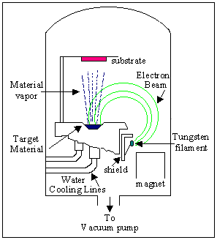
Electron beam evaporation
Using a focused electron beam to heat and evaporate metals, electron temperature can be as high as 10,000 K.
Suitable for high T_{melt} metals like W, Ta, …
Evaporation occurs at a highly localized point on the source surface, so little contamination from the crucible
Composite films can be deposited using dual e-beams with dual targets
Thickness uniformity can be improved by substrate rotation.
Issues: radiation damage; not suitable for organic materials.

Slide 12
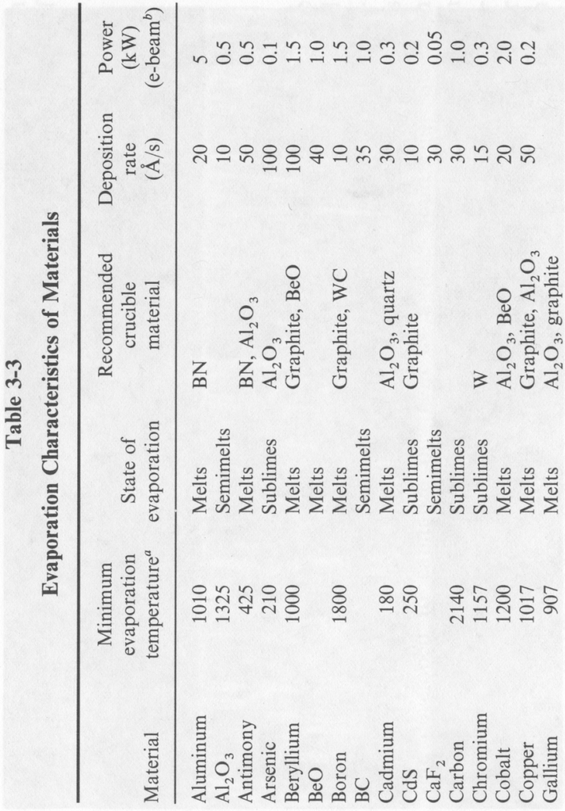
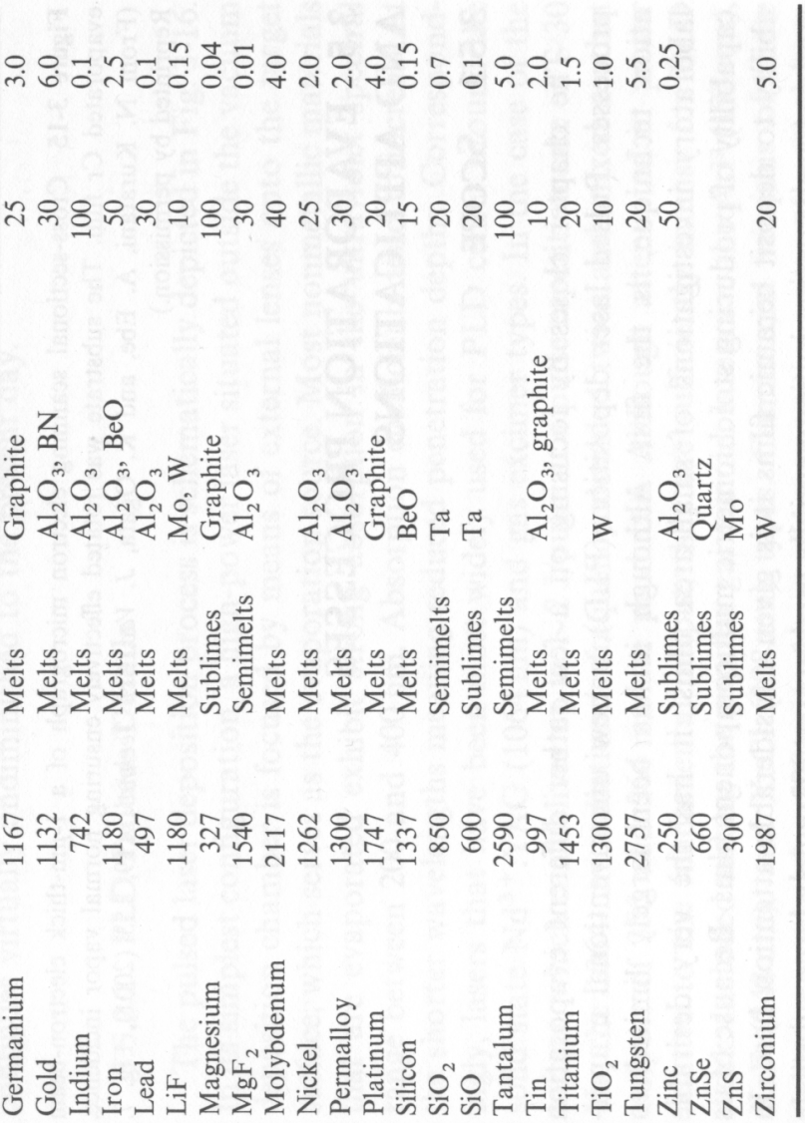
Evaporation characteristics of materials
For research, typical deposition rate is only 1Å/sec, for film thickness <100nm.
For crucible, one can just use graphite for most materials, unless carbon contamination is a major issue.
. From “Materials science of thin films” by Ohring, 2002.

Slide 13
Key considerations of evaporation
Deposition rate.
Temperature: some metals requires excessive high temperature.
Contamination control.
Residual stresses: usually of CTE and micro-structures transformation. (CTE: coefficient of thermal expansion)
Evaporation is the most useful thin film deposit techniques for nanofabrication, because:
It is directional (poor step coverage), good for liftoff.
It is directional, good for shadow evaporation.
The film thickness can be monitored precisely using a quartz balance.
Best suitable for elemental materials (metals, silicon, Ge…), not so good for composite (SiO₂ → SiO_{x}). Sputtering is suitable for deposition of composite materials.
Film quality is generally not as good as sputtered film (that involves energetic bombardment of ions to the as-deposited film, which makes the film denser).

Slide 14
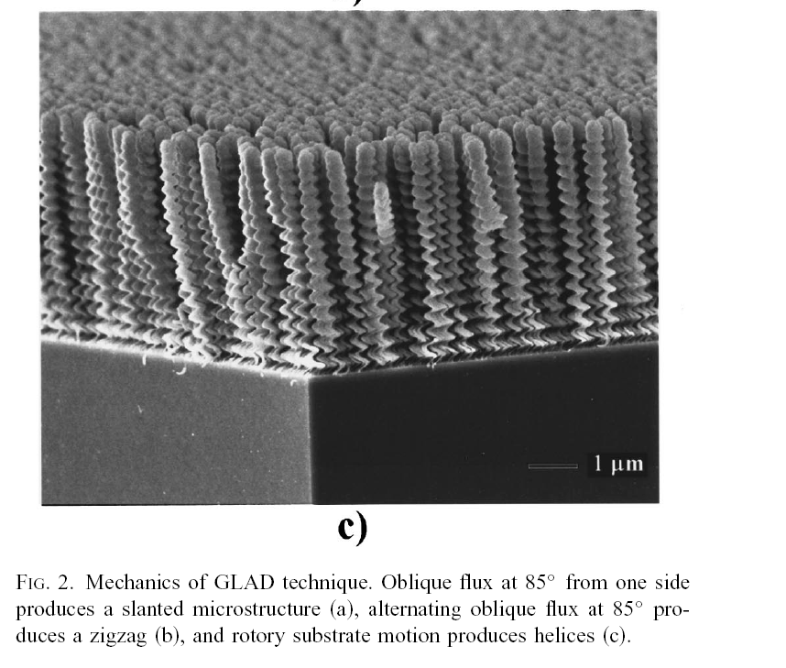
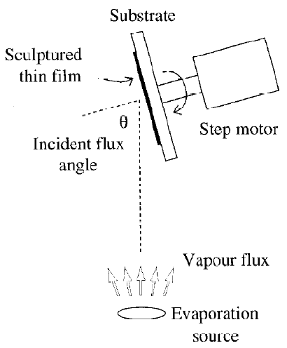
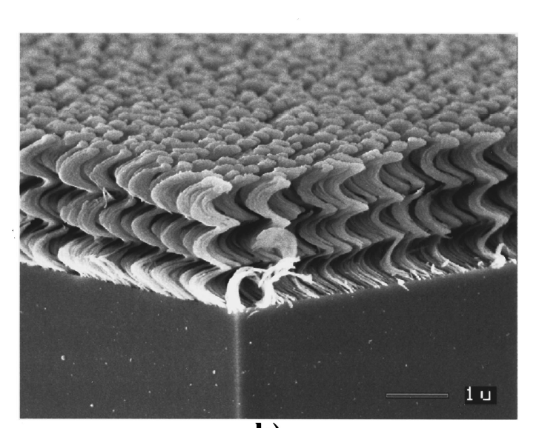
GLAD (glancing angle deposition): self assembly of film
Angle >80º, with substrate rotation.
Self assembly mainly due to shadowing effect that magnifies the otherwise grain structures.
Invented by Michael Brett from University of Alberta
http://www.ece.ualberta.ca/~glad/lab.html

Slide 15
Sputtering (overview)
Sputter is carried out in a self-sustained glow discharge (plasma).
The ionized atoms bombard the target and cause the transport of sputtered atoms onto the substrate.
Advantages:
Able to deposit a wide variety of metals, insulators and composites.
Replication of target composition in the deposited films.
Capable of in-situ cleaning prior to film deposition by reversing the potential on the electrodes .
Better film quality and step coverage than evaporation, preferred deposition technique for micro-fabrication (semiconductor industry…).
Disadvantages:
Substrate damage due to bombardment
Vacuum chamber
Substrate
Target
Electrode
Electrode
Flow rate controller
RF power generator

Slide 16
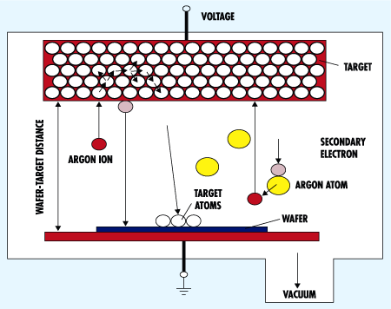
Sputtering process
Heavy inert gas is the major carrier, e.g. Ar.
Reactive chemical species (e.g. O₂ to deposit oxide) may be introduced – reactive sputtering
Sputtering process can be run in DC or RF mode (insulator must be run in RF mode)
Major process parameters:
Operation pressure (~10-100mTorr)
Power (few 100W)
Substrate bias (in addition to self-bias)
Substrate temperature (20-500ºC)
Dielectric materials can also be deposited, but are usually formed by sputtering metals in O₂ , N₂, CH₄ gases, forming AlN, Al₂O₃, TiN, TiC…
A wide range of industrial products use sputtering: CD,LCD, computer disks, hard coatings for tools, metals on plastics.

Slide 17
Sputter yield (higher yield → higher deposition rate)
Sputter yield: the number of sputtered atoms per impinging ion.
Energy of each incoming ion is 500-1000eV. Energy of sputtered atoms is 3-I0eV. Sputter yield is 1-3.
Thus, 95% of incoming energy goes to target heating & secondary electron.
High rate sputter processes need efficient cooling techniques to avoid target damage from overheating.
Ion energy↑, sputtering yield↑
Sputter yield vs. ion energy for Ar ions

Slide 18
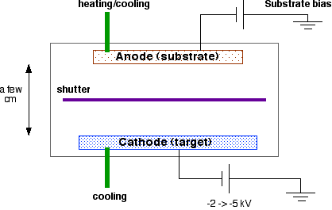
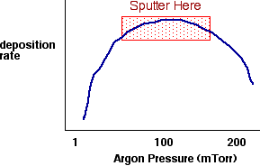
DC Sputtering
Deposition parameters:
Process pressure: compromise between the number of Ar ions and the scattering of Ar ions with neutral Ar atoms
Sputter voltage: maximum yield, typical -2 to -5 kV, for high deposition rate.
Substrate bias: control ion bombardment characteristics.
Substrate temperature: modify deposited film properties.
For conducting materials only.

Slide 19
RF Sputter
Good for insulating materials because, positive charge builds up on the cathode (target) in DC sputtering systems. Alternating potential can avoid charge buildup
When frequencies less than about 50kHz, electrons and ions in plasma are mobile
DC sputtering of both surfaces
When frequencies above about 50kHz, ions (heavy) can no longer follow the switching
Electrons can neutralize positive charge build up.
Capable of running in lower pressure (1-15 mTorr)
13.56MHz RF source, same as RIE or PECVD

Slide 20
Comparison of evaporation and sputtering
EVAPORATION | SPUTTERING
low energy atoms | higher energy atoms
high vacuum path few collisions line of sight deposition little gas in film | low vacuum, plasma path many collisions less line of sight deposition gas in film
larger grain size | smaller grain size
fewer grain orientations | many grain orientations
poorer adhesion | better adhesion

Slide 21
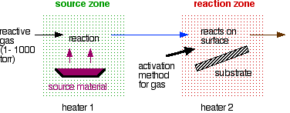
Chemical vapor deposition (CVD)
Form thin films on the surface of a substrate by thermal decomposition and/or reaction of gaseous compounds
Usually performed at high temperature
Can be performed at various pressure and with assistance of plasma (PECVD)
CVD film growth steps
Source production of appropriate gas
Transport of gas to surface
Adsorption of gas on substrate
Reactions on substrate
Transport of by-products away from substrate

Slide 22
Types of CVD reactions
Thermal decomposition
AB(g) ---> A(s) + B(g)
ex: Si deposition from Silane at 650ºC: SiH₄(g) → Si(s) + 2H₂(g)
Reduction (using H₂)
AX(g) + H₂(g) <===> A(s) + HX(g)
W deposition at 300ºC: WF₆(g) + 3H₂(g) <===> W(s) + 6HF(g)
Oxidation (using O₂)
AX(g) + O₂(g) ---> AO(s) + [O]X(g)
SiO₂ deposition from silane and oxygen at 450ºC (lower temp than thermal oxidation): SiH₄(g) + O₂(g) ---> SiO₂(s) + 2H₂(g)
Compound formation (using NH₃ or H₂O)
AX(g) +NH₃(g) --> AN(s)+HX(g) or AX(g)+H₂O(g)-->AO(s)+HX(g)
Deposit wear resistant film (BN) at 1100ºC: BF₃(g) + NH₃(g) ---> BN(s) + 3HF(g)

Slide 23
CVD sources and substrates
Types of sources
Gasses (easiest)
Volatile liquids
Sublimable solids
Combination
Source materials should be
Stable at room temperature
Sufficiently volatile
High enough partial pressure to get good growth rates
Reaction temperature < melting point of substrate
Produce desired element on substrate with easily removable by-products
Low toxicity
Substrates
Need to consider adsorption and surface reactions
For example, WF₆ deposits on Si but not on SiO₂

Slide 24
Mass transport in gas
Two flow Regimes
Molecular flow (diffusion in gas)
Viscous flow (laminar flow and turbulent flow)
Laminar flow is desired.
Reactants diffuse through stagnant layer to surface
Mass Transport depends on
fundamental parameters | experimental parameters
reactant concentration | pressure
diffusivity | gas velocity
boundary layer thickness | temperature distribution
 | reactor geometry
 | gas properties (viscosity . . .)
D is diffusivity
dc/dx is the concentration gradient across the boundary layer that separates the bulk flow (source) and the substrate surface (sink).
In a LPCVD reactor (~1Torr), the diffusivity (D) of the gas species is increased by a factor of 1000 over that at atmospheric pressure, resulting in one order of magnitude increase in the transport of reactants to the substrates.

Slide 25
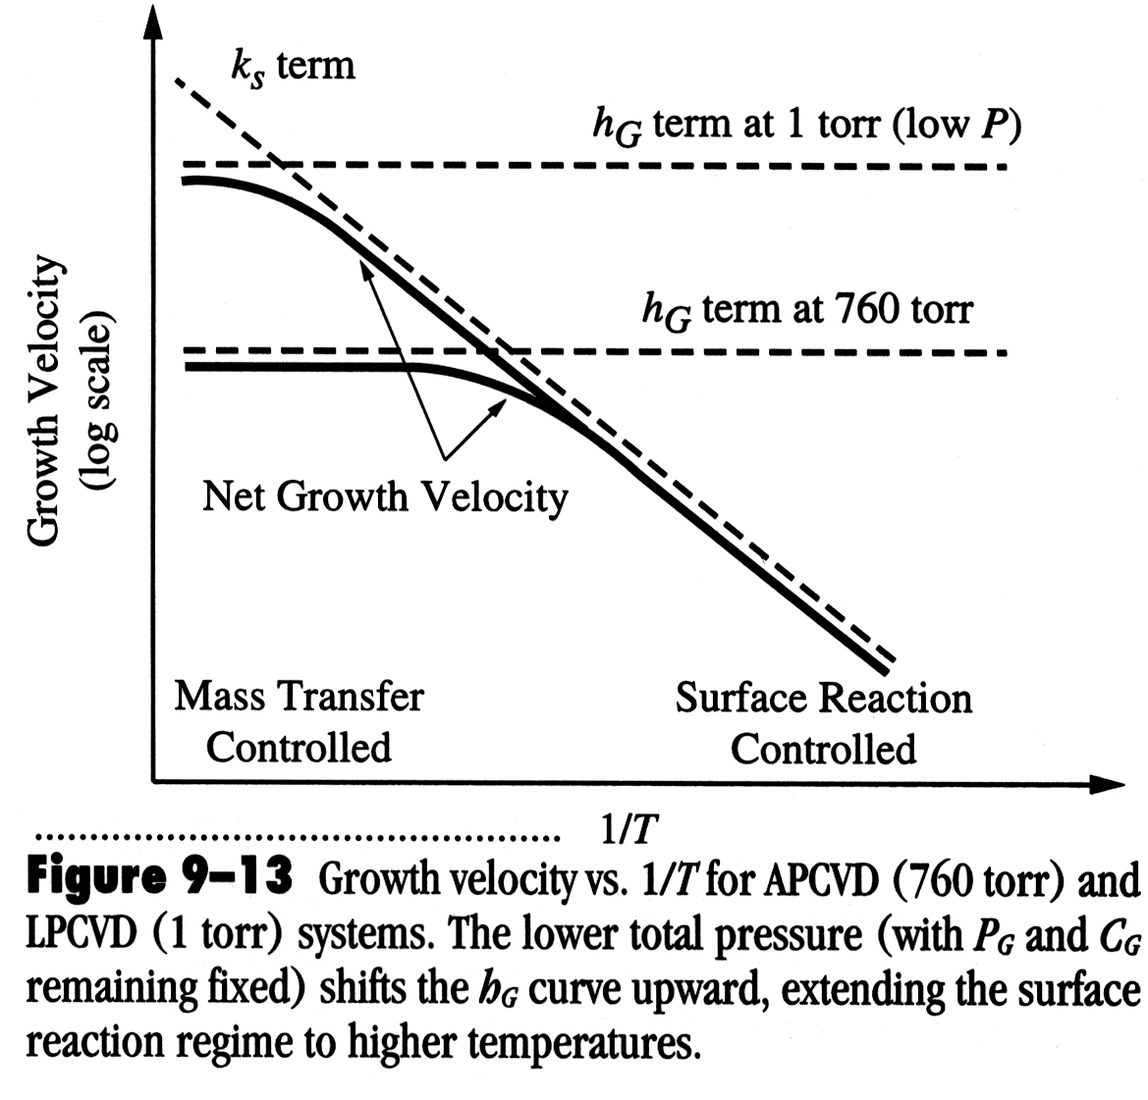
Growth limiting step
At lower temperature, surface reaction is the control mechanism: temp↑, growth rate ↑
At higher temperature, bulk transportation/ diffusion is the control mechanism: flow rate ↑, growth rate ↑
Mass transfer control
Growth rate
Surface reaction control
Pressure dependence of CVD deposition rate
Substrate temperature, 1/T
LPCVD: low pressure CVD
APCVD: atmospheric pressure CVD high gas pressure, high deposition rate, limited by mass transport.

Slide 26
CVD process
Advantages:
High growth rates possible
Can deposit materials which are hard to evaporate
Good reproducibility
Can grow epitaxial films (in this case also termed as “vapor phase epitaxy (VPE)”. For instance, MOCVD is also called OMVPE.)
Generally better film quality than PVD films.
Disadvantages:
High process temperatures
Complex processes
Toxic and corrosive gasses
Film may not be pure (hydrogen incorporation…).

Slide 27
Types of CVD
APCVD (Atmospheric Pressure CVD) (not very popular for nanofabrication), mass transport limited growth rate, leading to non-uniform film thickness.
LPCVD (Low Pressure CVD)
Low deposition rate limited by surface reaction, so uniform film thickness (many wafers stacked vertically facing each other; in APCVD, wafers have to be laid horizontally side by side.
Gas pressures around 1-1000mTorr (lower P => higher diffusivity of gas to substrate)
Better film uniformity & step coverage and fewer defects
Process temperature ≥500°C
PECVD (Plasma Enhanced CVD)
Plasma helps to break up gas molecules: high reactivity, able to process at lower temperature and lower pressure (good for electronics on plastics).
Pressure higher than in sputter deposition: more collision in gas phase, less ion bombardment on substrate
Can run in RF plasma mode: avoid charge buildup for insulators
Film quality is poorer than LPCVD.
Process temperature around 100 - 400°C.
MOCVD (Metal-organic CVD, also called OMVPE - organo metallic VPE), epitaxial growth for many optoelectronic devices with III-V compounds for solar cells, lasers, LEDs, photo-cathodes and quantum wells.

Slide 28
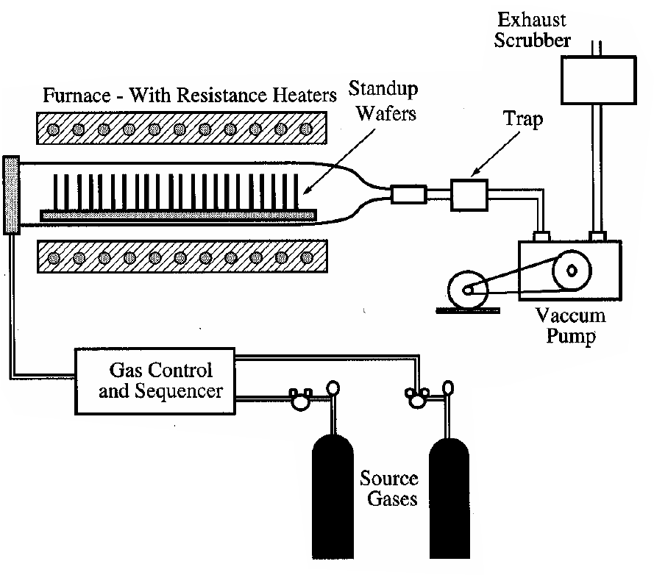
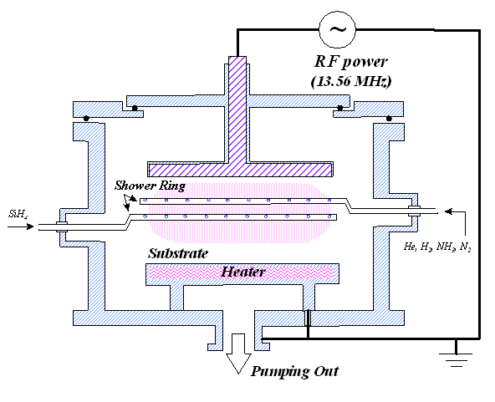
CVD reactors
LPCVD
PECVD
plasma
Reaction at high temperature
Reaction rate (determined by temperature) limited deposition rate.
Reaction at low temperature, assisted by plasma

Slide 29
PECVD process parameter
Substrate temperature
Control by external heater, very little heating from PECVD process
Gas flow
Higher flow rates can increase deposition rate and uniformity
Pressure
Changes the energy of ions reaching electrodes
Can change deposition rate
Increases pressure may lead to chemical reactions in the gas
Effects also depend on gas concentration
Power
Affects the number of electrons available for activation and the energy of those electrons
Increased power may lead to chemical reactions in gas
Increased power increases deposition rate
Frequency (for PECVD)
Changes plasma characteristics
Changes ion bombardment characteristics

Slide 30
Polycrystalline silicon and silicon dioxide deposition
Si
Application: gate of MOSFET, surface micromachining
Usually deposited in a LPCVD chamber at 25-150Pa, 600-650ºC, 10-20nm/min.
In situ doping can be performed: usually perform thermal diffusion right after poly-silicon deposition.
SiO₂
Silane based
TEOS (LPCVD 650-700°C) (PECVD 350°C)
Silane based PECVD

Slide 31
Comparison of varied silicon dioxide
Property | Plasma | SiH₄+O₂ | TEOS | SiCl₂H₂+N₂O
Deposition temp | 200°C | 450°C | 700°C | 900°C
Composition | SiO₂(H) | SiO₂(H) | SiO₂ | SiO₂(Cl)
Dielectric Strength (10⁶ V/cm) | 5 | 8 | 10 | 10
Etch Rate (Å/min) (100H₂O:1 HF) | 400 | 60 | 30 | 30
Step coverage | Non-conformal | Non-conformal | Conformal | Conformal
Lower HF etch rate means better film quality (denser film)

Slide 32
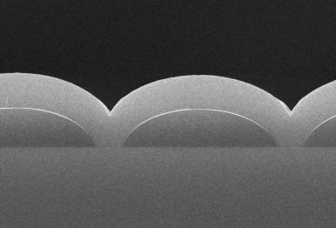
Silicon nitride deposition
Application:
Masks to prevent oxidation for LOCOS process
Final passivation barrier for moisture and sodium contamination
Etch stop for Cu damascene process
Popular membrane material by Si backside through-wafer wet etch.
PECVD
LPCVD
LPCVD conformal Si₃N₄ films

Slide 33
Silicon nitride properties

Slide 34
Atomic layer deposition (ALD, break CVD into two steps)
Similar in chemistry to chemical vapor deposition (CVD), except that the ALD reaction breaks the CVD reaction into two half-reactions, keeping the precursor materials separate during the reaction.
The precursor gas is introduced into the process chamber and produces a monolayer of gas on the wafer surface. A second precursor of gas is then introduced into the chamber reacting with the first precursor to produce a monolayer of film on the wafer surface.
Film growth is self-limited (monolayer adsorption/reaction each half-cycle), hence atomic layer thickness control of film grown can be obtained.
That is, one layer per cycle; thus the resulting film thickness may be precisely controlled by the number of deposition cycles.
Two fundamental mechanisms:
Chemi-sorption saturation process
Sequential surface chemical reaction process
Introduced in 1974 by Dr. Tuomo Suntola and co-workers in Finland to improve the quality of ZnS films used in electroluminescent displays.
Recently, it turned out that ALD also produces outstanding dielectric layers and attracts semiconductor industries for making High-K dielectric materials.

Slide 35
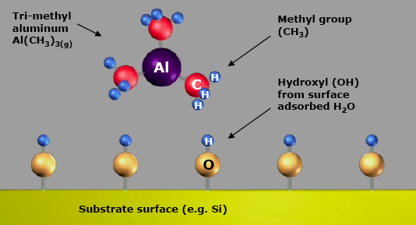
ALD cycle for Al₂O₃ deposition
1. Introduce TMA.
(tri-methyl aluminum)
In air, H₂O vapor absorb on Si to form Si-O-H.
2. TMA reacts with hydroxyl groups to produce methane.

Slide 36
ALD cycle for Al₂O₃ deposition
3. Reaction product methane is pumped away, leaving an OH⁻ passivation layer on surface.
2. After three cycles.
One TMA and one H2O vapor pulse form one cycle. Here ~1A/cycle, each cycle including pulsing and pumping takes few seconds.
Two steps each cycle

Slide 37
Closed system chambers (most common) for ALD
The reaction chamber walls are designed to effect the transport of the precursors.

Slide 38
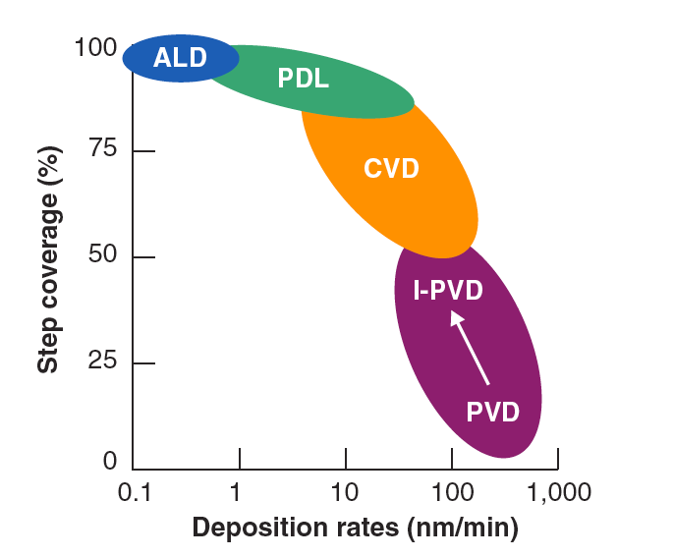
Advantages and disadvantages
ALD: slowest, best step coverage
Advantages
Stoichiometric films with large area uniformity and 3D conformality.
Precise thickness control.
Low temperature deposition possible.
Gentle deposition process for sensitive substrates.
Disadvantages
Deposition rate slower than CVD.
Number of different material that can be deposited is fair compared to MBE.

Slide 39
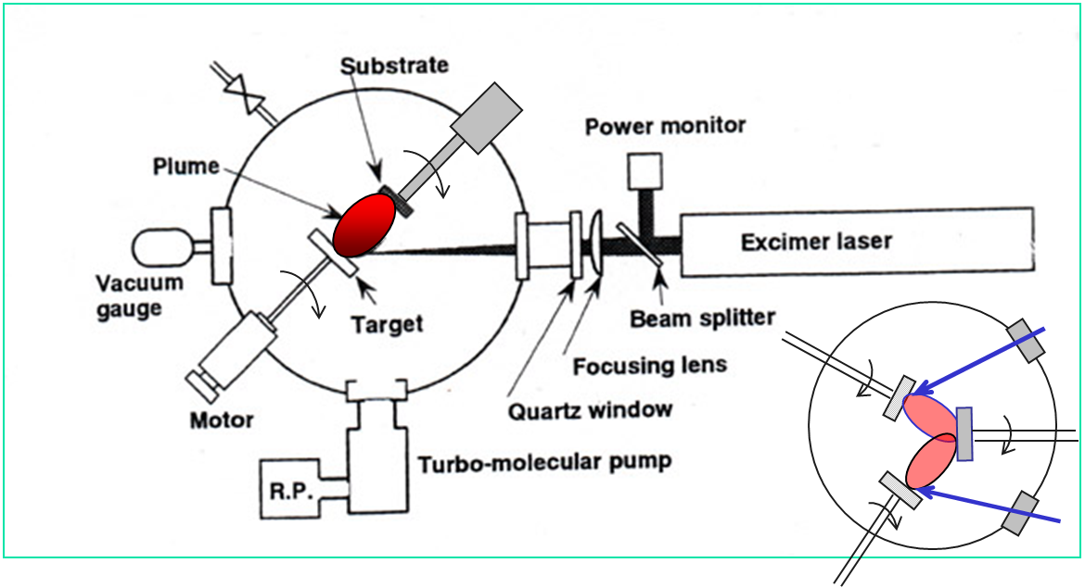
Pulsed laser deposition (PLD)
Co-deposition

Slide 40
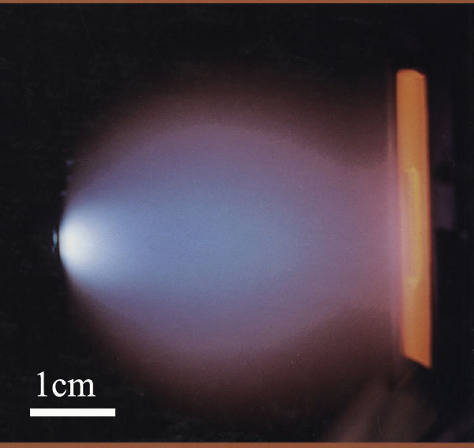
Plume generated by laser ablation with different tiny or micro-particles
Pulse of fs to ns with peak power high enough (hundreds of MW/cm²) to melt → boil → vaporize → ablate the target surface material, to atoms, ions, electrons, and clusters.
Laser Beam
Target
Plume
(Plasma)
(a)
(b)
(c)
(d)
Figure 5.1. Schematic laser-material interaction. (a) Absorption and heating; (b) Melting and flowing; (c) Vaporization; (d) Plasma formation in front of the target. Under certain conditions the plasma can detach from the target and propagate toward the laser beam.
Substrate
PLD Characteristics:
Reproduce the composition of the target
Fabricate multi-component multilayer structures
Fast response and well controlled deposition rate
Environmentally benign technique

Slide 41
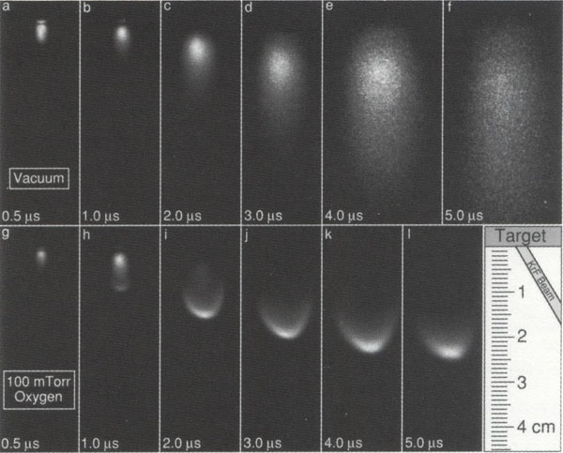
Transient plume development with and without reaction gas
10⁻⁶Torr vacuum
100 mTorr O₂
D. Geohegan, Appl. Phys. Lett. 60, 2732 (1992)

Slide 42
Pulsed laser deposition (PLD) system (pulsed excimer laser and chamber)
View Windows
Laser
Chamber

Slide 43
Nano-film by electro-deposition (electroplating)
I
V
cathode
anode
Working
Electrode
(WE)
CuSO₄ dissolved in water
Counter
Electrode
(CE)
If using an inert Pt electrode:
2 H₂O –>
O₂ + 4H⁺ + 4e⁻
“Reduction"
“Oxidation"
Cu²⁺ + 2e⁻ –> Cu⁽⁰⁾
Cu⁽⁰⁾ –> Cu²⁺ + 2e⁻

