Slide 1
Photolithography and resolution enhancement techniques (RET)
Photolithography and resolution limit
Immersion lithography
Off-axis illumination (OAI)
Phase-shift mask (PSM)
Optical proximity correction (OPC)
Double processing
ECE 730: Fabrication in the nanoscale: principles, technology and applications
Instructor: Bo Cui, ECE, University of Waterloo; http://ece.uwaterloo.ca/~bcui/
Textbook: Nanofabrication: principles, capabilities and limits, by Zheng Cui

Slide 2
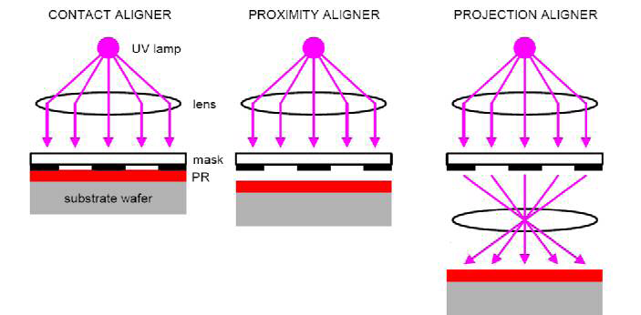
Optical lithography
Contact aligner Proximity aligner Projection aligner
Mask in contact with photo-resist film
(Gap=0 μm)
Gap (order 10μm) between mask photoresist
Resolution:
Like photography, imaging
(g=gap, t=resist thickness)
Contact and proximity is for research (simple, cheap equipment).
Projection for IC production, long mask life, image reduction.
Notes:
Image reduction: e.g. to pattern 45nm line on resist, mask has pattern 4×45=180nm, much easier to make, by laser writing or e-beam writing. E-beam writing is faster for large features because it allows higher beam current or shaped beam.

Slide 3
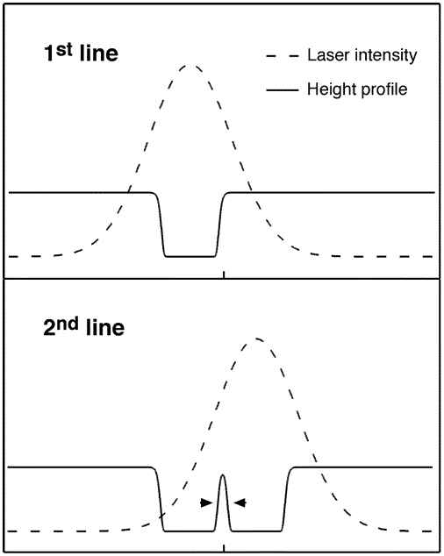
It is easy to make small, but difficult to make dense
To put a lot of transistors on a chip, they need to be close to each other.
Pitches are limited by physics – minimum line-widths are not!
The IC term for lithography is “half pitch”, though “resolution” is still used.
Threshold intensity here will give W<<2.5μm
W
2.5 μm
Linewidth + spacewidth = pitch
HP: half pitch
80nm
2.5μm laser beam can pattern 80nm line-width!
But it won’t be able to pattern a grating with pitch <2.5 μm.
Nano. Lett. 6(10), 2358(2006)
Notes:
Today’s IC HP is 45nm, with CMOS channel length much smaller than this (<20nm?)

Slide 4
What is hard about nanolithography?
light
light
mask
lens
Ideal light
intensity
Actual light
intensity
Sharp dose profile “blurred” dose profile
photoresist
Θ

Slide 5
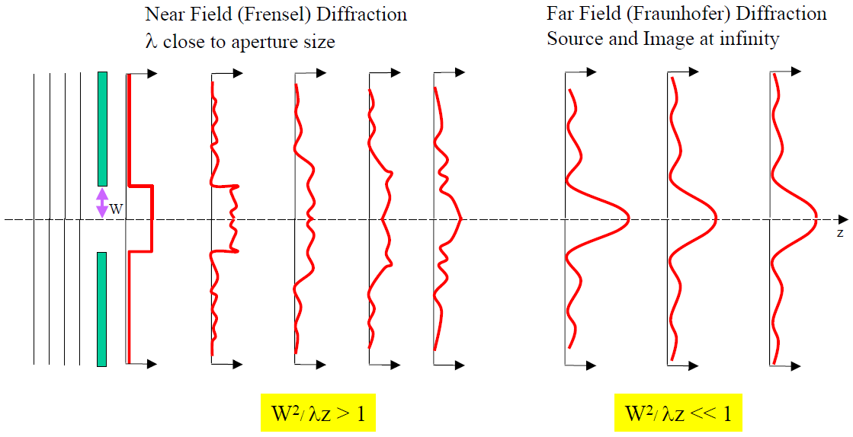
Fresnel & Fraunhofer diffraction (from an aperture)
Light intensity profile
Contact Proximity Projection

Slide 6
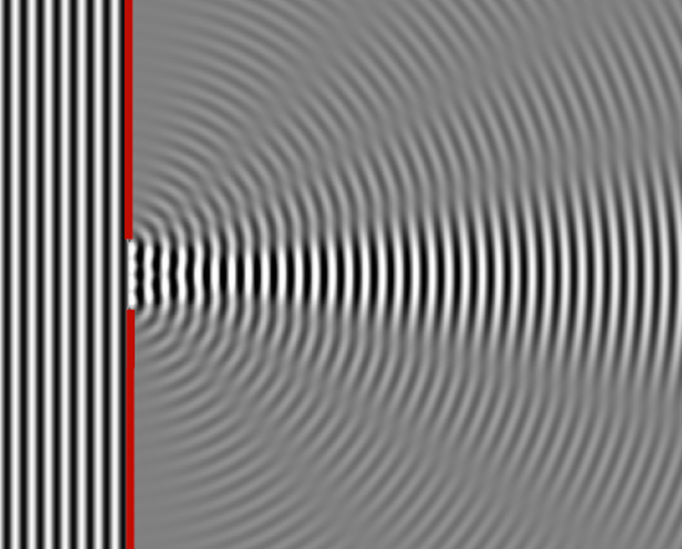
Fresnel & Fraunhofer diffraction (from an aperture)
Near field Far field
Notes:
The HP (half pitch, ~resolution) is limited by diffraction of light.

Slide 7
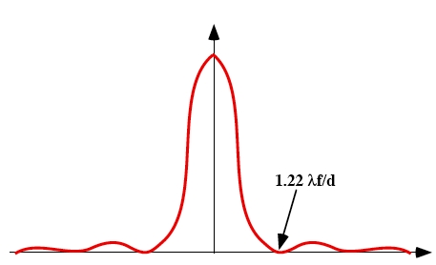
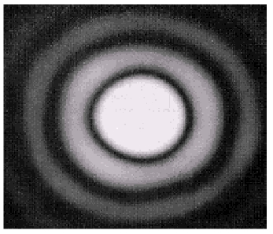
Light diffraction through a small circular aperture (Airy disk)
Airy pattern
Image by a point source forms a circle with diameter 1.22λf/d surrounded by diffraction rings (Airy pattern).
1.22 λf/d

Slide 8
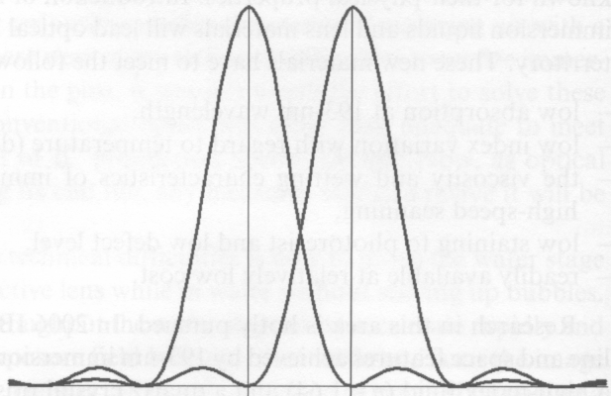
Rayleigh resolution criteria (for circular aperture)
Rayleigh resolution
R
NA= n⋅sinα, numerical aperture
NA: the ability of the lens to collect diffracted light
Notes:
Rayleigh suggested that a reasonable criterion for resolution (R = distance between A and B) is that the central maximum of one point source lies at the first minimum of the Airy pattern of the other point (R = diameter of circle).
Here just shows the rough idea, nothing strict. For instance, if A’ B’ are on the focal plane (coincide with the image plane), then A B should be infinitely far away from the lens, which is not true. One need Fourier optics to understand the complete physics.

Slide 9
Generalized resolution (half pitch)
k₁ represents the ability to approach physical limits depending on:
Lenses: aberrations.
Resists: contrast.
Equipment and process control in manufacturing.
To increase resolution: reduce λ and k₁, increase NA;
But this also reduces depth of focus (a bigger issue for lithography).
For NA ≤ 0.5
For NA > 0.5
Depth of Focus or Depth of Field (DOF):
Notes:
The effect of aperture (NA) on DOF can be understood from photography. A big lens (higher NA) always gives an image with low DOF – a very blurred background as desired by the professional photographer.

Slide 10
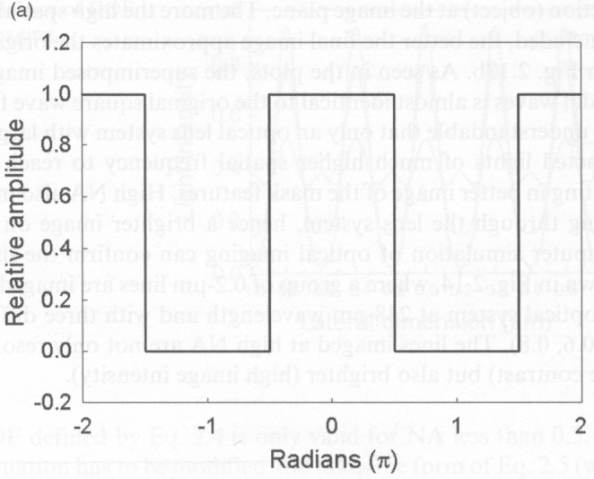
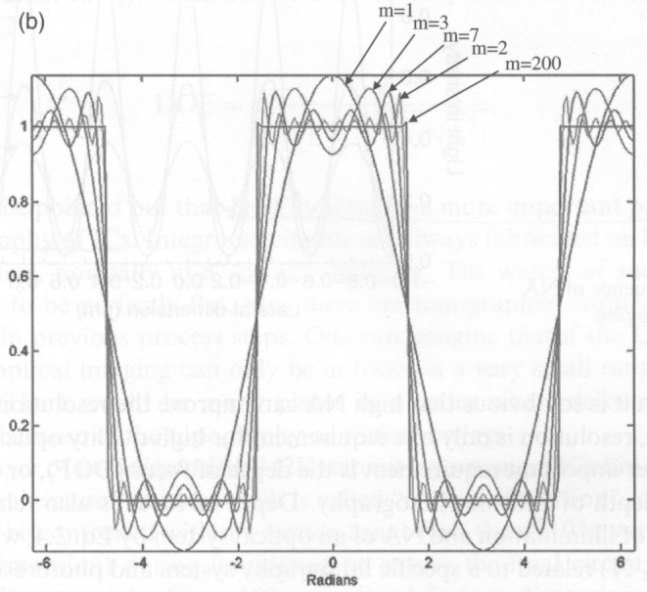
NA: effect of including increasing numbers of diffracted orders on the image of a slit
Mask image without diffraction
Mask image with diffraction
0
d
θ
Minimum when d⋅sinθ=mλ
For a slit, the diffraction has a dark fringe when sinθ=mλ/d, m=1,2… and d is slit width.
For smaller NA (smaller sinθ), fewer diffracted orders (smaller m) will be collected to form the image, so the details of the slit (sharp corners) are lost.
When talking about resolution, we need at least m=1, so d ∼ λ/sinθ.
The way to increase resolution is to increase the NA of the lens (and reduce λ).
Notes:
The diffraction limit is not treated rigorously here (d ∼ λ/sinθ, here θ is on the “left”-side of the lens).

Slide 11
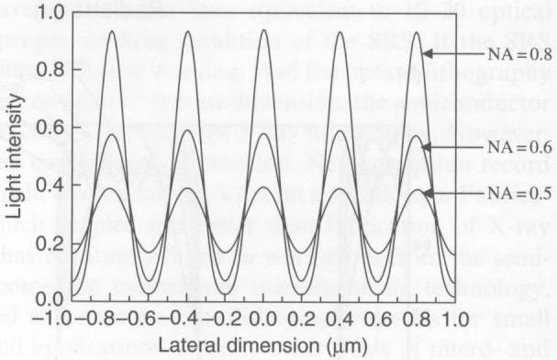
NA: its influence on optical imaging by numerical simulation
0.2μm pitch grating imaged through a projection optical system at λ=248nm.
Increase NA:
Resolve better the line image (higher image contrast)
Gives brighter image (higher image intensity).

Slide 12
Increase resolution by reducing λ
Mercury arc lamps
Excimer lasers (nanosecond pulse)
g-line → i-line → KrF → ArF
436 nm → 365 nm → 248 nm → 193 nm
1
0.44×
R>>λ R>λ R∼λ R<<λ

Slide 13
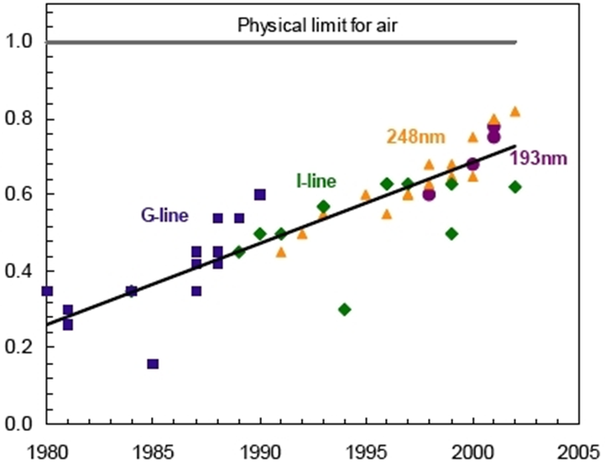
Increase resolution by increasing numerical aperture NA to approach 1
The physical limit to NA for exposure systems using air as a medium between the lens and the wafer is 1.
The practical limit is somewhere ~0.93 (collecting angle α=68º, huge lens ~1000kg).
Therefore, the resolution limit for 193nm exposure systems.
Numerical aperture (NA)
NA=numerical aperture
=n⋅sinθ
Year of system introduction
Notes:
Thus a highly optimized ArF exposure system has an absolute maximum resolution of 52nm, sufficient for 65nm line-width node, but not capable of meeting the 45nm half-pitch node.

Slide 14
Photolithography and resolution enhancement techniques (RET)
Photolithography and resolution limit
Immersion lithography
Off-axis illumination (OAI)
Phase-shift mask (PSM)
Optical proximity correction (OPC)
Double processing

Slide 15
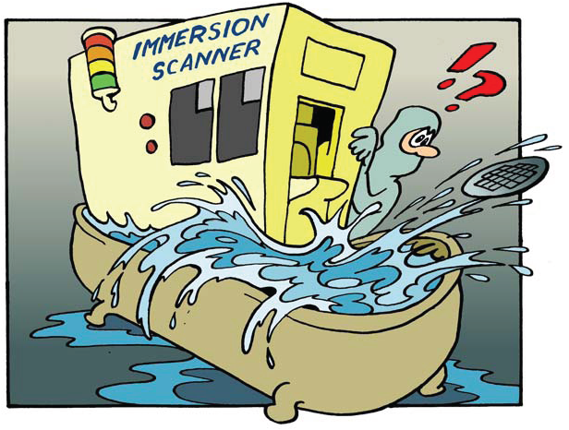
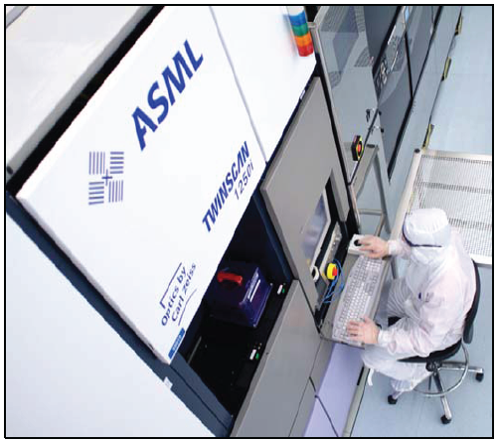
Increase resolution by increasing NA to beyond 1: immersion lithography
Very simple idea. Indeed, immersion is NOT new for optical imaging: oil immersion in optical microscope has been used for a century.
But Immersion lithography is highly complex, and was adopted by semiconductor industry only recently (since 2004).
From research idea to development
Like chemical mechanical polishing (CMP) used for IC interconnection, immersion lithography has been considered as impractical at the beginning.
Notes:
For the case of CMP, people has been scared at the beginning. They believed that the abrasive particle contained in the slurry would scratch the device and destroy everything.

Slide 16
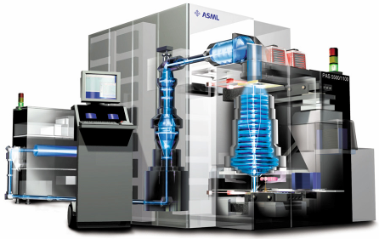
“Total” immersion
In principle, one can put the entire exposure system inside water and use lens having n multiplied by n_{water}.
This is equivalent to use a light source having λ reduced by a factor n_{water}.
Water
Reticle
(Mask)
n_{water} =1.44 at 193nm.
So λ: 193→134nm.
Wafer
193 nm Excimer Laser Source
Computer Console
Exposure Column
(Lens)
However, total immersion is not practical, and is not necessary.

Slide 17
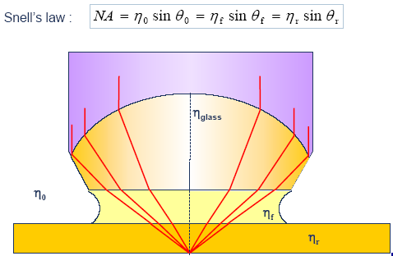
Immersion between projection lens and wafer
n>1
The medium between the lens and the wafer must:
Have an index of refraction >1
Have low optical absorption at 193nm
Be compatible with photoresist and the lens material
Be uniform and non-contaminating
Surprisingly, ultrapure water meets all of these requirements:
n = 1.44, absorption of <5% at working distances of up to 6mm, compatible with photoresist and lens, non-contaminating in it’s ultrapure form.
NA=n × sinα ∝ n
Can be >1 for n>1

Slide 18
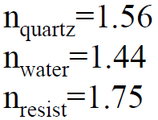
Why immersion lithography increases resolution?
Air
Water immersion
θ
For NA=0.9, inside lens sinθ=0.9/1.56=0.58 (θ=35.5º)
Total internal reflection for sinθ>1/1.56=0.64 (θ=39.8º)
Inside lens sinθ=1.44 × 0.9/1.56=0.83 (θ=56º)
So light, which is internally total-reflected for air, can now be collected to form image in the resist.
Collect light up to 35.5º; Collect light up to 56º (angle inside lens)
NA=0.9 in air; NA=1.3 in water

Slide 19
For the same resolution, immersion also increases depth of focus (DOF)
For NA ≤ 0.5
For NA > 0.5
Depth of Focus or Depth of Field (DOF):
But when at higher resolution by n×, depth of focus will become an issue.
Notes:
This is not so obvious if looking at the DOF equation, because same resolution means same NA thus should have same DOF. However, the above DOF is for uniform media but now an interface of air/resist or water/resist is involved; and the real physics is very complicated and a simple argument may not work.
Some people even mention that “The depth of focus, is also 40-70% better (proportional to the refractive index of the imaging medium considered) than a corresponding "dry" tool at the same resolution”, which I think is not true.

Slide 20
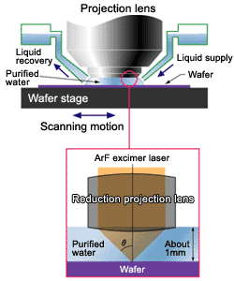
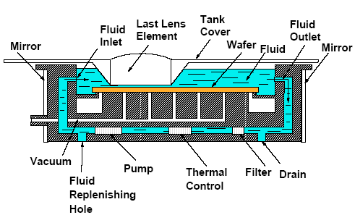
Immersion lithography system: $30M
Water out
Water in

Slide 21
Immersion at higher refractive indices
Limitations of water immersion:
nsinθ ≤ 0.93×min(n_{glass}, n_{fluid}, n_{resist})
Indices of refraction for water immersion.
SiO₂: 1.56
Water: 1.435
Resists ~ 1.70
n_{glass} > n_{fluid}
θ
1
0.93 × 1.435 = 1.33
n
glass
NA≤1.33 for water
n
fluid
θ
2
High-index fluid needs high-index lens material.
Options for high index immersion lithography
Glass.
BaLiF₃: 1.64
Lutetium aluminum garnet (Lu₃Al₅O₁₂, LuAG): 2.1
Pyrope (Mg₃Al₂Si₃O₁₂): 2.0
Fluid: cyclic organics, such as decalene: 1.64 - 1.65

Slide 22
Issues with immersion lithography
Mechanical issues and hydrodynamics
Throughput 100 wafer/hour, order of 50 dies each wafer, so 5000 exposures/hour, or <1sec for each exposure. Therefore, water in, expose, water out, stage move, all within 1sec.
Bubble formation disturbing the image (defect)
Stage vibrations transferred to lens
Heating of immersion liquid upon exposure
New defect mechanisms at wafer level
Interaction of photoresist with immersion liquid
Fluid contamination (defect)
Polarization effects degrading contrast

Slide 23
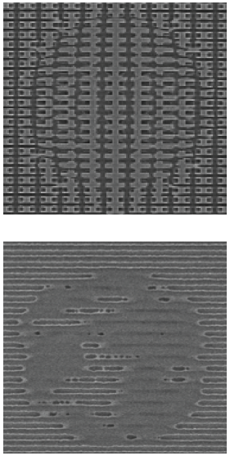
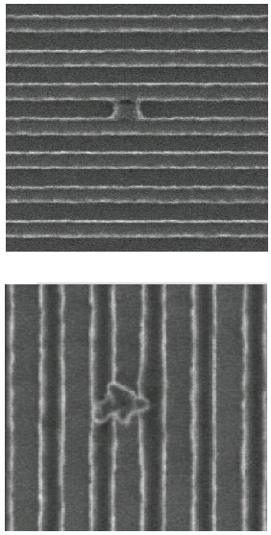
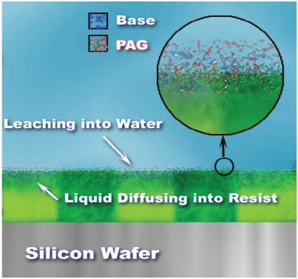
Major challenge: defect in immersion lithography
Resist/TC – water interaction
(TC=top coating?)
Air bubbles
Water marks and drying stains
(Try to make super-hydrophilic surface)
Particles from water

Slide 24
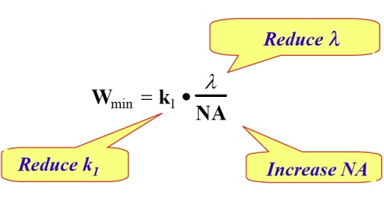
Photolithography - k₁
k₁ is a complex factor of several variables in the photolithography process such as:
Quality of the photoresist
Use of resolution enhancement techniques (RET)
Off-axis illumination (OAI)
Phase shift masks (PSM)
Optical proximity correction (OPC).
The practical lower limit for k₁ is thought to be about 0.25 (for single exposure).
Notes:
Quality of the photoresist: contrast, sensitivity, line-edge roughness due to photo-acid diffusion… Contrast is most important for high resolution.

Slide 25
Photolithography and resolution enhancement techniques (RET)
Photolithography and resolution limit
Immersion lithography
Off-axis illumination (OAI)
Phase-shift mask (PSM)
Optical proximity correction (OPC)
Double processing

Slide 26
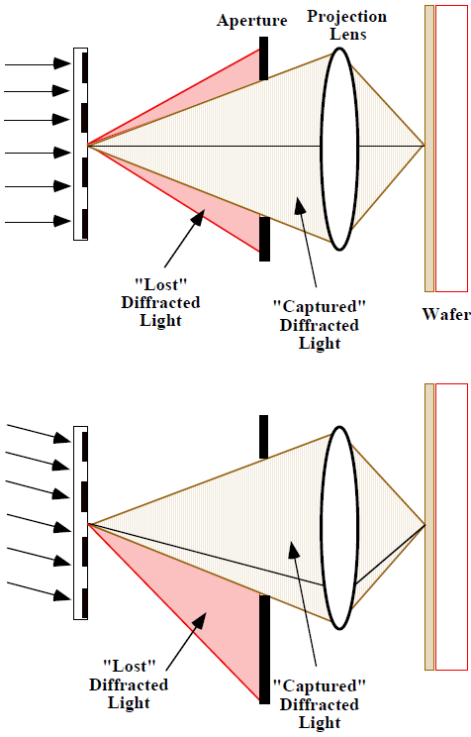
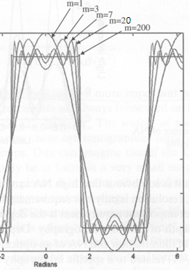
Off-axis illumination (OAI)
“Off-axis illumination” allows some of the higher order diffracted light to be captured and hence can improve resolution.
(OAI also improves depth of focus)
Along axis
“Lost” diff-racted light
“Captured” diffracted light
Off axis
axis
“Lost” diff-racted light
“Captured” diffracted light
Higher order contains feature details

Slide 27
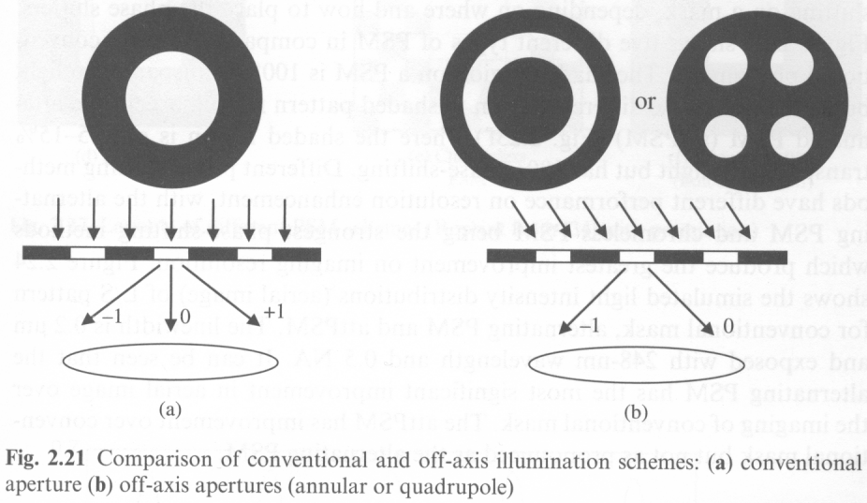
Off-axis illumination
Conventional illumination Off-axis illumination
Annular
Quadrupole
Diffracted light collected up to first order
Now second order diffracted light can be collected, so higher resolution
-2
-1
Quadrupole: most effective for line/space pattern (depends on line orientation, best for vertical or horizontal line/space pattern), less for isolated features.
Annular OAI: less resolution enhancement, but orientation independent.
Easiest and cheapest RET, state-of-art OAI apparatus are programmable for each set of masks.

Slide 28
Photolithography and resolution enhancement techniques (RET)
Photolithography and resolution limit
Immersion lithography
Off-axis illumination (OAI)
Phase-shift mask (PSM)
Optical proximity correction (OPC)
Double processing

Slide 29
Phase shift masks (PSM)
No phase shift
λ/2 phase shift
Constructive interference
Destructive interference
Reduced contrast
Reduced line-width
Improved contrast, higher resolution (HP)
PSM changes the phase of light by 180° in adjacent patterns, leading to destructive interference rather than constructive interference.
Improves contrast of aerial image on wafer. Making k₁ smaller.

Slide 30
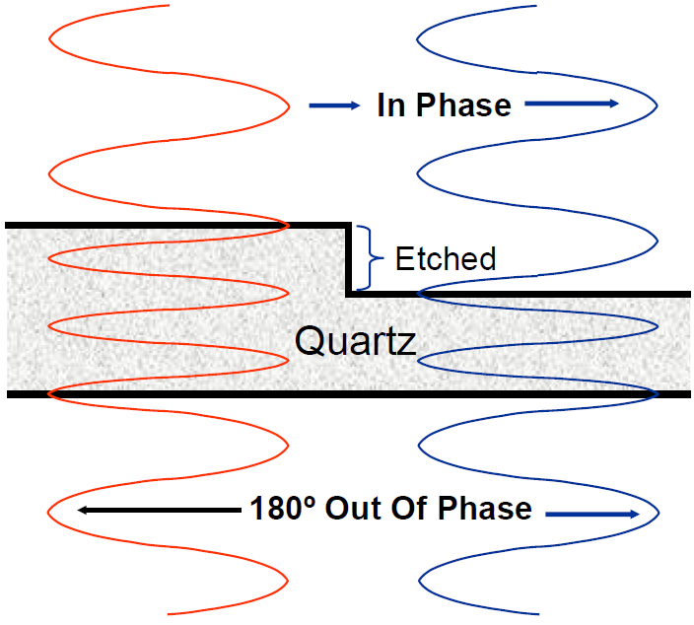
Phase shift masks fabrication
Standard mask
Chrome
Etch depth:
(λ/2)/(1.56-1)=172nm
n(quartz)=1.56
Quartz
0º
180º
Phase-shift mask
Quartz etched to induce shift in phase
Need two patterning steps with accurate alignment.
Fabrication cost 10× that of binary mask.

Slide 31
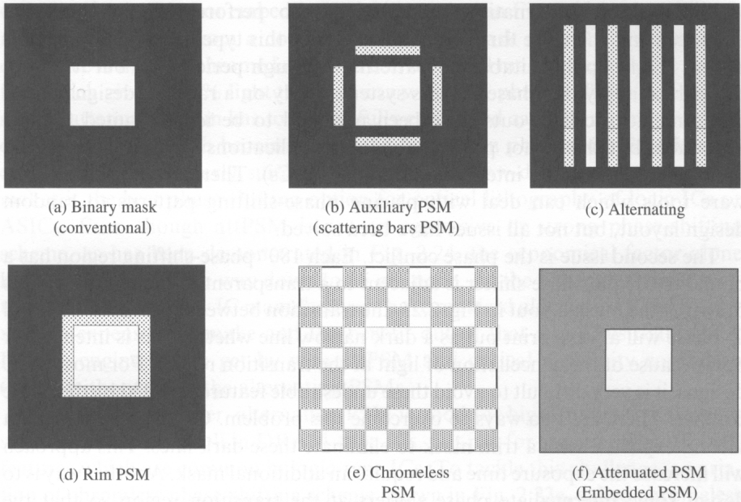
Different phase-shift mask schemes
Shaded region: 100% transparent, but 180º phase shift
0% transparent
100% transparent
5-15% transparent, 180º phase shift
similar to (b) (auxiliary PSM)
No Cr metal: 100% transparent everywhere

Slide 32
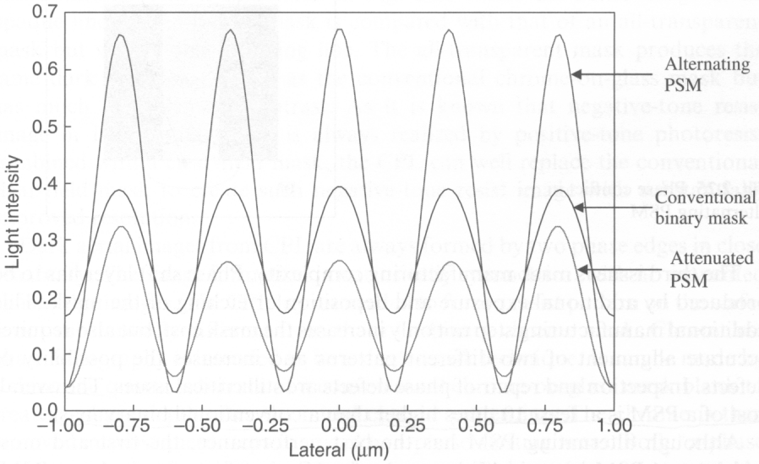
Comparison of binary, alternating and attenuated PSM
Phase conflict
0º
Mask
0º
0º
180º
Resist
Positive resist after development
Alternating PSM gives highest contrast, but
It is good only for periodic structures (memory cell), not for random patterns (CMOS).
Phase conflict may happen → undesired dark regions at the boundary of 0º and 180º phase.
In reality, the attenuated PSM is most widely used.

Slide 33
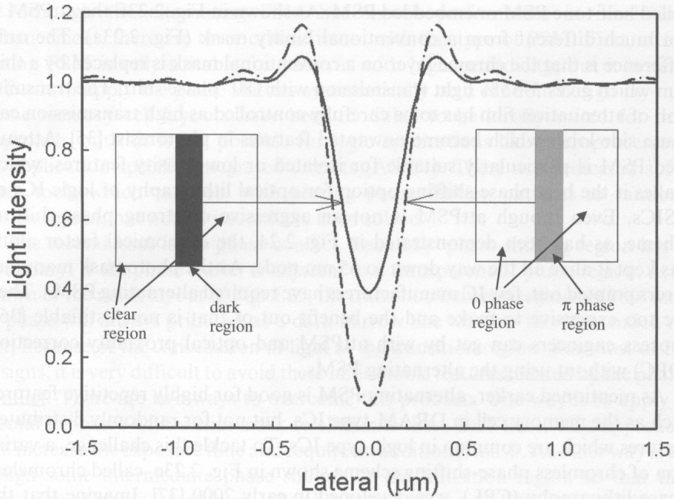
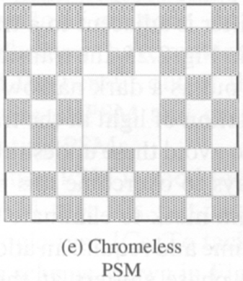
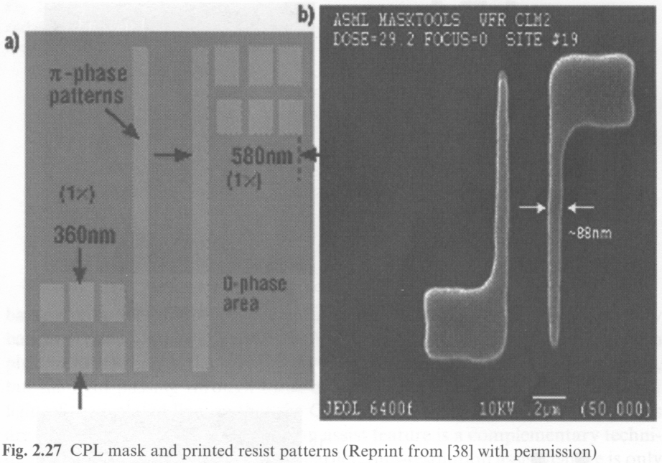
Chromeless phase lithography (CPL)
Binary mask
Cr-less phase mask
0º
0º
180º
No Cr metal: 100% transparent everywhere
Printed resist pattern
Comparison of CPL with conventional binary mask
CPL has better image contrast, thus higher resolution.
CPL mask
Notes:
It is more costly to make CPL mask, since now everything is sub-resolution. The worst scenario is for a big pad that is easy to make for binary mask, but now it needs to be divided into many sub-resolution features.

Slide 34
Photolithography and resolution enhancement techniques (RET)
Photolithography and resolution limit
Immersion lithography
Off-axis illumination (OAI)
Phase-shift mask (PSM)
Optical proximity correction (OPC)
Double processing

Slide 35
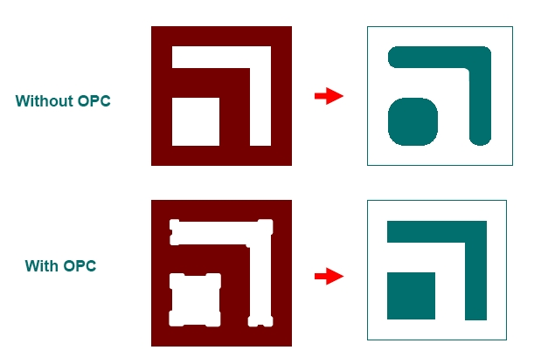
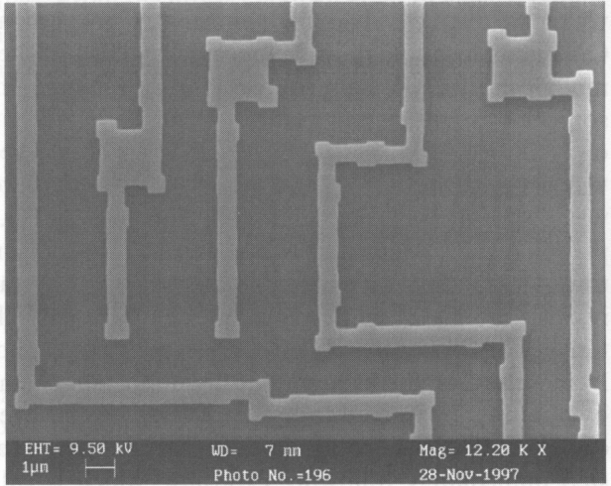
Optical proximity correction (OPC)
Presence or absence of other features nearby (proximity) will affect the optical behavior.
Sharp features are lost because higher spatial frequencies are lost due to diffraction.
These effects can be calculated and can be compensated for.
This improves the resolution by decreasing k₁.
Photo-mask
Pattern for negative resist
Transparent
SEM image of photomask with OPC features

Slide 36
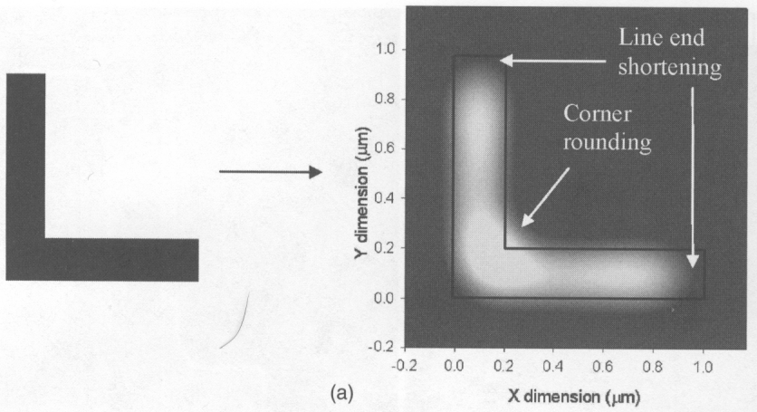
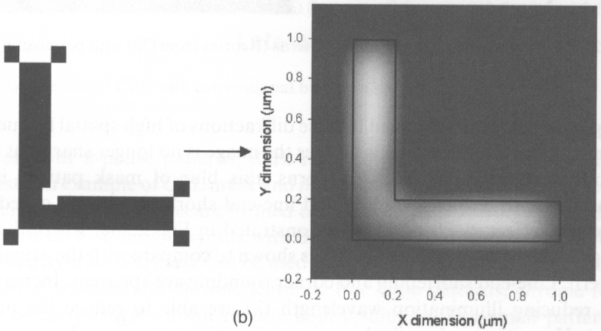
Optical proximity effect and its compensation by adding/taking away sub-resolution features
Optical proximity effect result in corner rounding and line-end shortening.
Sub-resolution squares
Optical proximity correction: modifies the mask design to restore the desired pattern.
The sub-resolution features won’t appear in the resist.

Slide 37
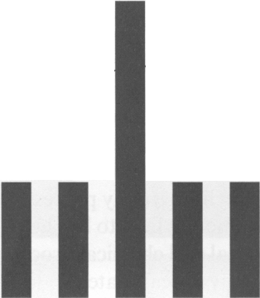
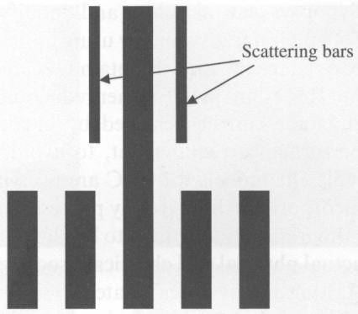
Optical proximity correction: biasing or adding scattering bars
Desired dose in resist
Biasing (making isolated line wider) Adding (sub-resolution) scattering bars
Scattering bars

Slide 38
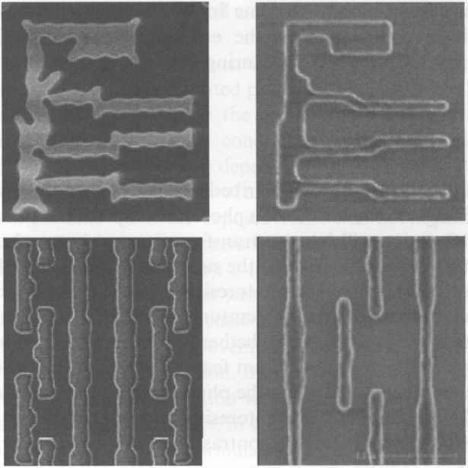
Inverse lithography technology (ILT)
(ultimate solution for OPC)
Mask
Resist pattern
Design the photomask by working out how an ideal image is generated. I.e. working backwards to find the “perfect” mask that can generate the ideal image.
Very complicated math, data file for such a mask ~1000GB.
Still limited by the resolution (pixel size) of the lithography used to make the mask.
Top: aggressive ILT mask.
Bottom: non-aggressive OPC mask.
Notes:
In ILT, every pixel of the mask is optimized, lots of calculation. For less aggressive OPC, only feature edges/corners need to be considered for modification.

Slide 39
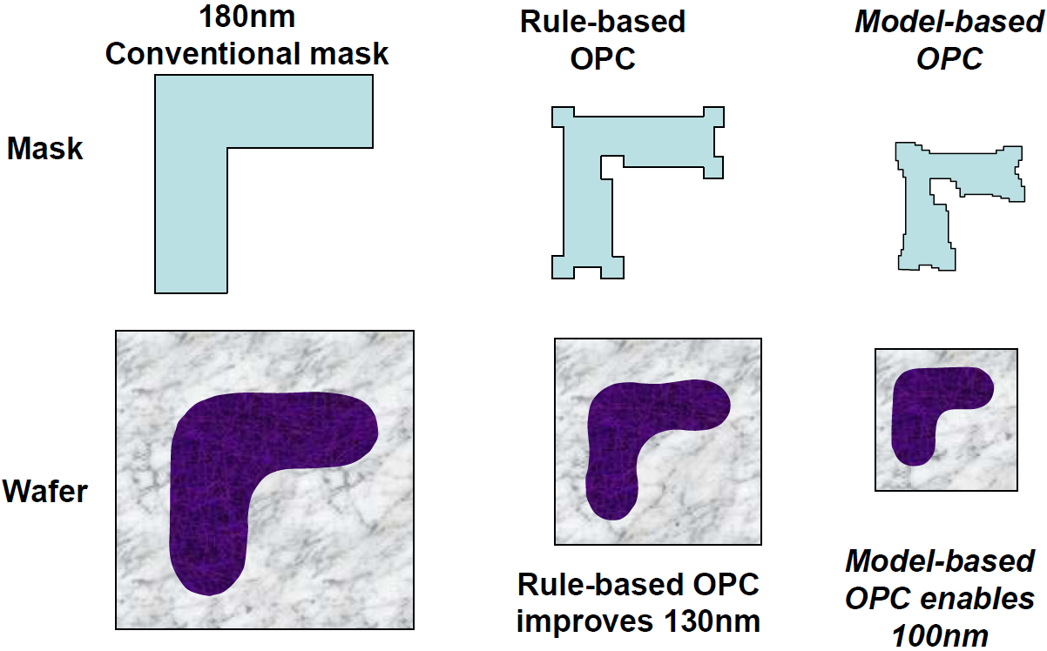
Optical proximity correction (OPC): summary

Slide 40
OPC vs PPC (process proximity correction)
Other processes (like etch) also have proximity effect.
Presence or absence of neighbor will affect how a process behaves for a particular feature
Lithography ‘neighborhood’ is about 1μm.
Etch neighborhood is probably few microns (free radical diffusion length).
CMP (chemical mechanical polishing) neighborhood can be few mm.
Correcting for optical (lithography) and few other processes is called process proximity correction (PPC).
Typically lithography + etch corrections are used for PPC.
CMP corrections are at a different (larger) scale: dummy features added to make the feature distribution more even across the wafer.

Slide 41
Photolithography and resolution enhancement techniques (RET)
Photolithography and resolution limit
Immersion lithography
Off-axis illumination (OAI)
Phase-shift mask (PSM)
Optical proximity correction (OPC)
Double processing

Slide 42
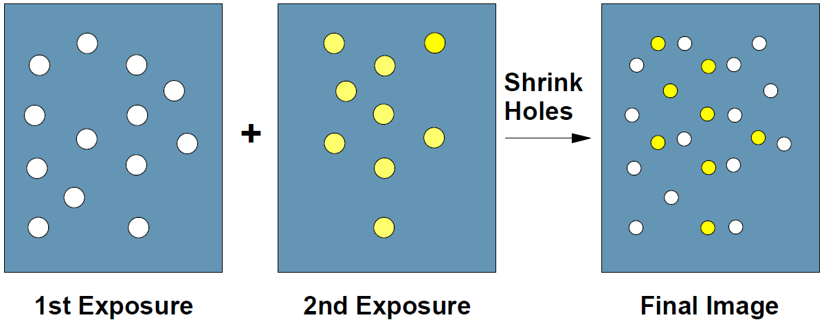
Pitch splitting to improve resolution (half pitch)
Divide patterns on a mask into two masks, resulting in larger separation between features.
Expose the resist twice using the two masks. (double exposure)
For complete separation of cross talk, two exposures and two pattern transfers by etching is carried out. (double patterning)
Finally, feature sizes are trimmed back (optional).

Slide 43
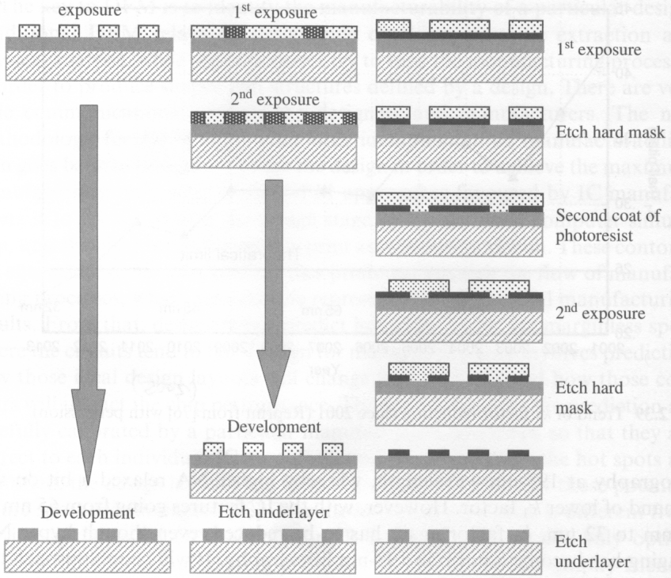
Double processing (double exposure and double patterning)
Single processing
Double exposure
Double patterning

Slide 44
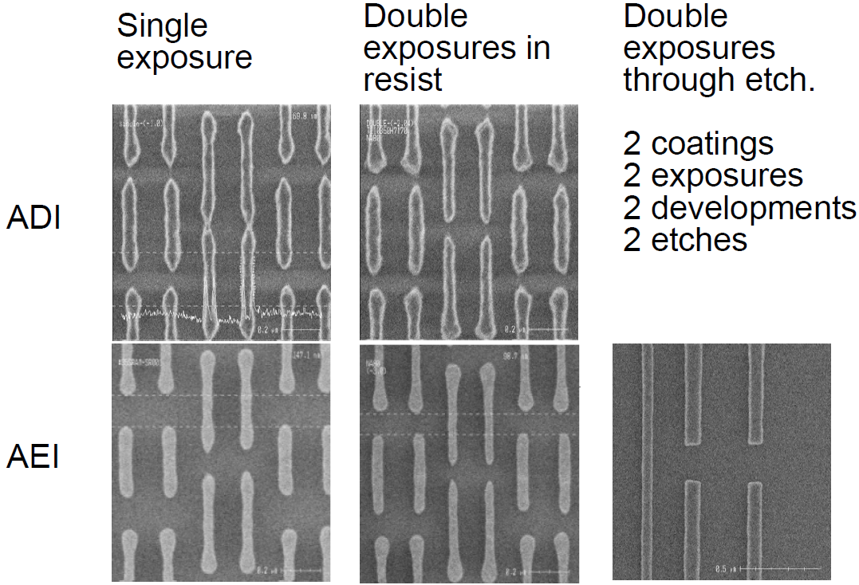
Comparison: single exposure, double exposure, double patterning
Resist
After resist development
After etch into sub-layer
Double patterning

Slide 45
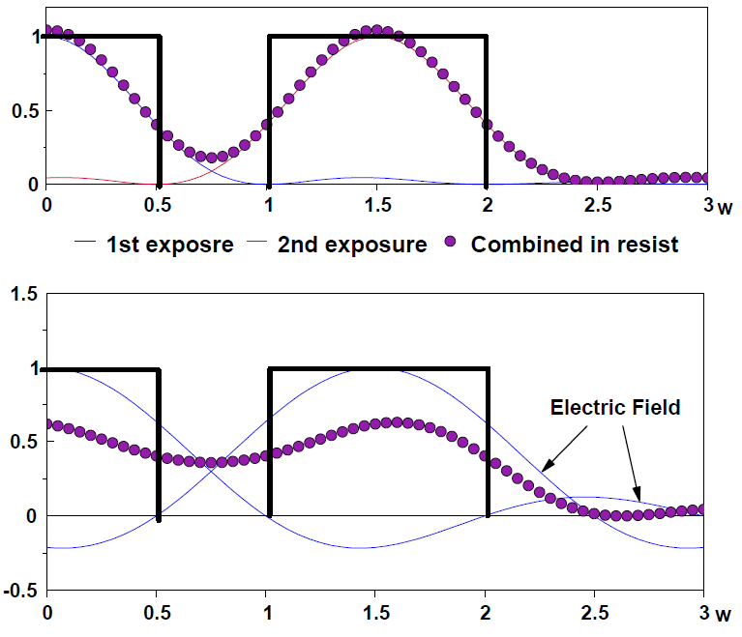
Why double exposure has higher resolution than single exposure?
Combined intensity in resist
Incoherent combination of light with double exposure.
(Intensity=E₁²+E₂²)
Coherent combination with single exposure.
(Intensity in gap=(E₁+E₂)²>E₁²+E₂²
Intensity ↓ in the pattern area)
In IC industry partial coherence is used that is better than coherence for high resolution, but still worse than incoherence.
Ideally, the resist is memory-less and/or non-linear, then double exposure = double patterning

Slide 46
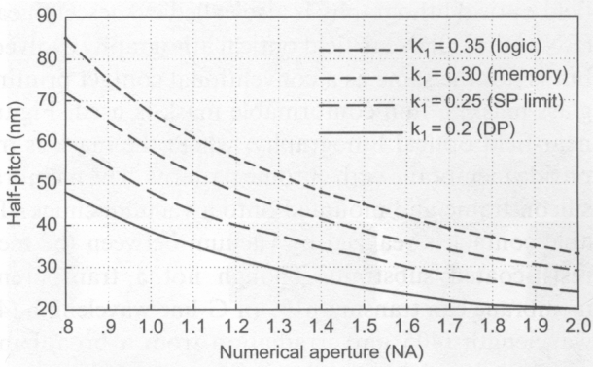
Doubling patterning outlook (as of 2006)
K₁ factor:
The practical limit for single processing is 0.25
Double processing can bring it to < 0.2
Lowest risk route to 32nm half pitch in time
But worst in terms of CoO (cost of ownership)
Two masks per critical layer
Reduced throughput by a factor of 2
Add cost to second etch step
Need very precise alignment between the two exposures.
Therefore, any development improving CoO is a plus for double processing

Slide 47
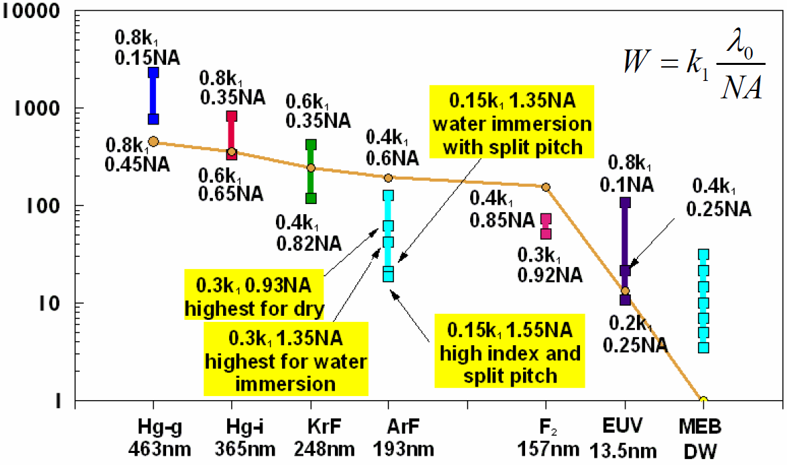
Resolution of exposure tools
R
Resolution in half pitch (nm)
Wavelength
MEB DW=multiple electron beams direct write

