Slide 1
Other photon-based lithographies
Near field optical lithography
Interference lithography
Phase-mask lithography
Laser beam direct writing and micro-mirror array lithography
Two-photon lithography
ECE 730: Fabrication in the nanoscale: principles, technology and applications
Instructor: Bo Cui, ECE, University of Waterloo; http://ece.uwaterloo.ca/~bcui/
Textbook: Nanofabrication: principles, capabilities and limits, by Zheng Cui

Slide 2
Near field lithography: contact mode photolithography
Light illumination
Membrane mask is flexible, for good contact.
Use the evanescent wave (near field) to exposes the resist.
No/little diffraction, so high resolution.
Membrane mask
Vacuum
Membrane
NiCr absorber
Light
Photoresist
d<<λ
Metal Slit
Mask
Limitation of near field lithography:
The evanescent field penetrates only ~10’s nm into the resist.
A two-layer resist process may be utilized to make this work.
I.e. top thin layer for exposure, then transfer the pattern into a thick bottom layer.
~10’s nm
Resist
Substrate
Evanescent near field region
Figure 2. Evanescent near field region

Slide 3
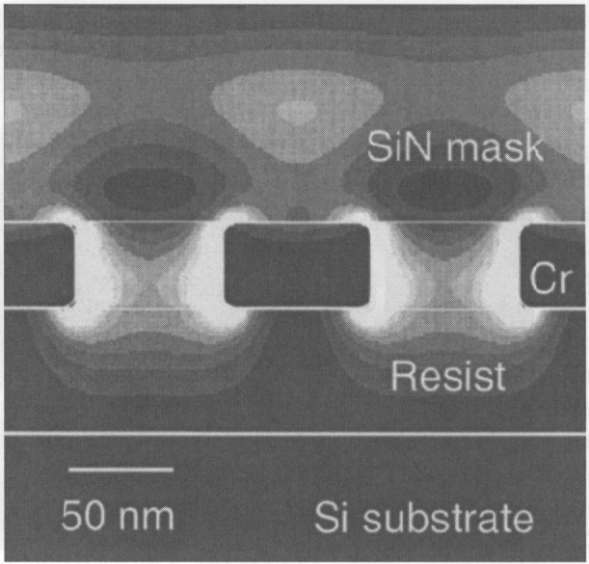
Light intensity after metal absorber
The e-field at the edge of the Cr structure is higher than incident e-field because of surface plasmon polariton (SPP, collective oscillation of free electrons, excited by the electromagnetic (EM) field of the light).
The EM-field from charge oscillation is just like the EM-field of the light, so it can expose the photo-resist.
This leads to high exposure near the edge. (and high line edge roughness (LER) in photoresist if the Cr edge is not smooth, due to the very high EM-field variations near the rough Cr line edges)
Computer simulated contours of |E|²/ |E_{o}|², |E|²/ |E_{o}|² >1 at the edge of Cr structures.
Whether one wants it or not, surface plasmon (SP) is always involved in the near field of metal structures.
So near field lithography is sometimes called surface plasmon lithography.
Notes:
Cr has high absorption, so no “propagating” SP, namely SP (charge oscillation) is confined to the Cr structures.

Slide 4
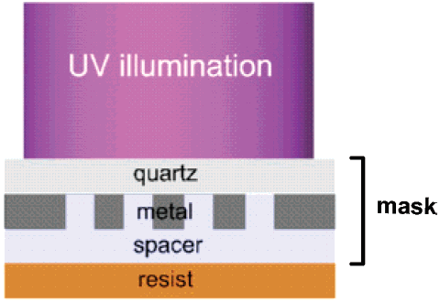
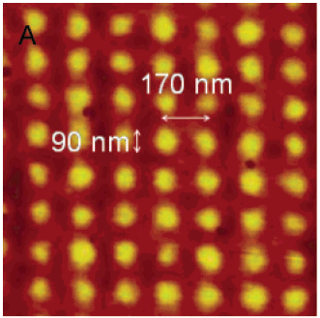
Near field lithography of hole array
Illumination 365nm.
Spacer PMMA as matching dielectric material.
Metal is Al.
(that can sustain surface plasmon in the UV-range).
λ=365nm
90nm feature size in resist from 365nm illumination.
In the experiment, to assure “near”-field, the resist is spun on the spacer PMMA that is spun on the quartz mask. Therefore, now the “gap” between the mask and “substrate” is the thickness of the spacer (~40nm).
W. Srituravanich, et al, Nano. Lett. 4, 1085 (2004)

Slide 5
Other photon-based lithographies
Near field optical lithography
Interference lithography
Phase-mask lithography
Laser beam direct writing and micro-mirror array lithography
Two-photon lithography

Slide 6
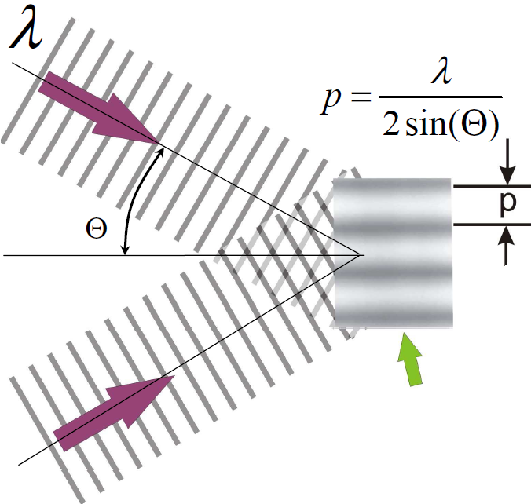
Interference lithography: overview
Intensity modulation in the region of the overlapping of two or more coherent beams.
Advantages:
Simple and fast, no photomask or lenses.
Disadvantage:
Difficult to create anything other than a periodic structure.
Requirements:
High spatial and temporal coherence of the source.
Applications:
Guided wave optics.
Distributive-feedback or distributed Bragg-reflector lasers.
Sub-wavelength optical elements.
Characterization of photoresist.
Production of nano-channel devices
Nanomagnetic structures for data storage.
Two beams with same wavelength
Overlapping region

Slide 7
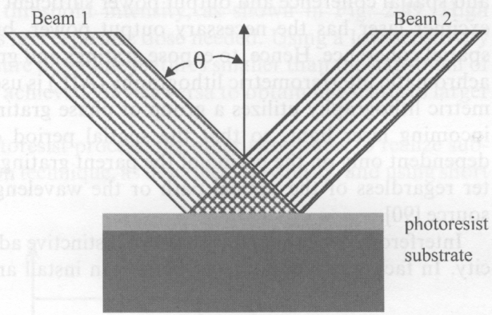
Interference lithography: grating pitch
Light intensity on photoresist:
For E out of plane (TE polarization).
For E-field in plane (TM polarization).
Pitch P = λ/2nsinθ > λ/2 (for n=1).
For TM polarization, no interference for θ=45º since now the two E-field is perpendicular.
Notes:
What will be the pitch if the incident angles of the two beams are different?

Slide 8
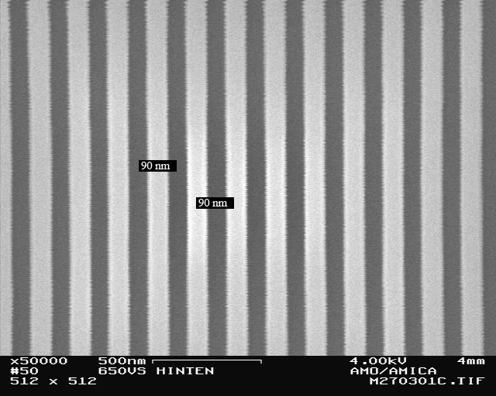
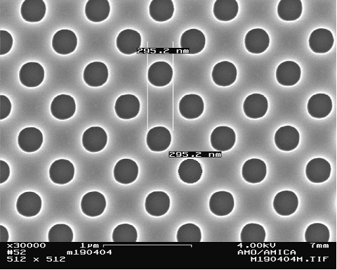
1D and 2D structures by interference lithography (IL)
Hole array by 4-beam IL
(or two exposures at orthogonal directions)
Grating of 200nm pitch by 2-beam IL

Slide 9
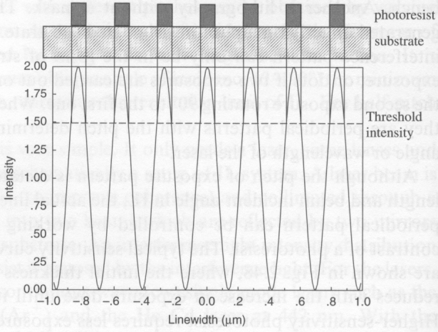
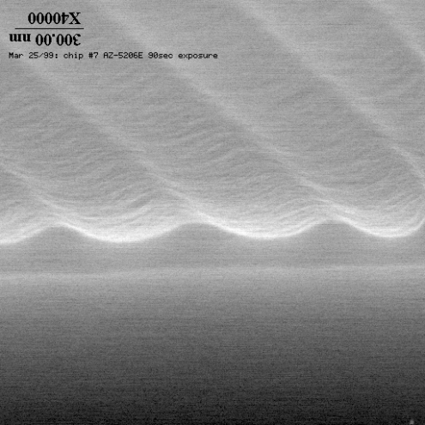
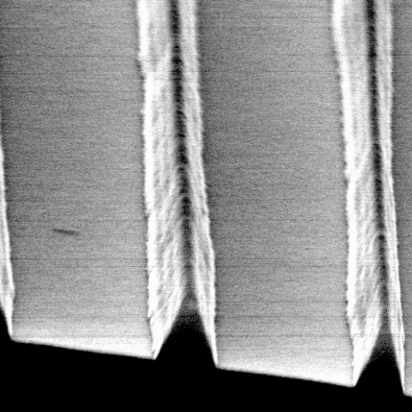
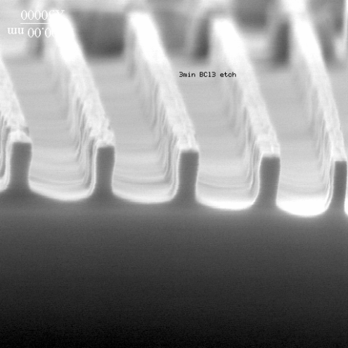
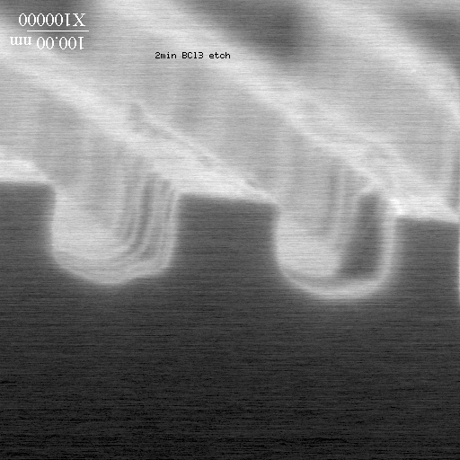
Feature size control by tuning exposure dose
It is a grayscale lithography (sinusoidal exposure dose profile); not binary (either no exposure or full exposure).
Profile in resist Profile in substrate after pattern transfer by etching
underexposed
overexposed
20% duty cycle
50% duty cycle (equal line/space)

Slide 10
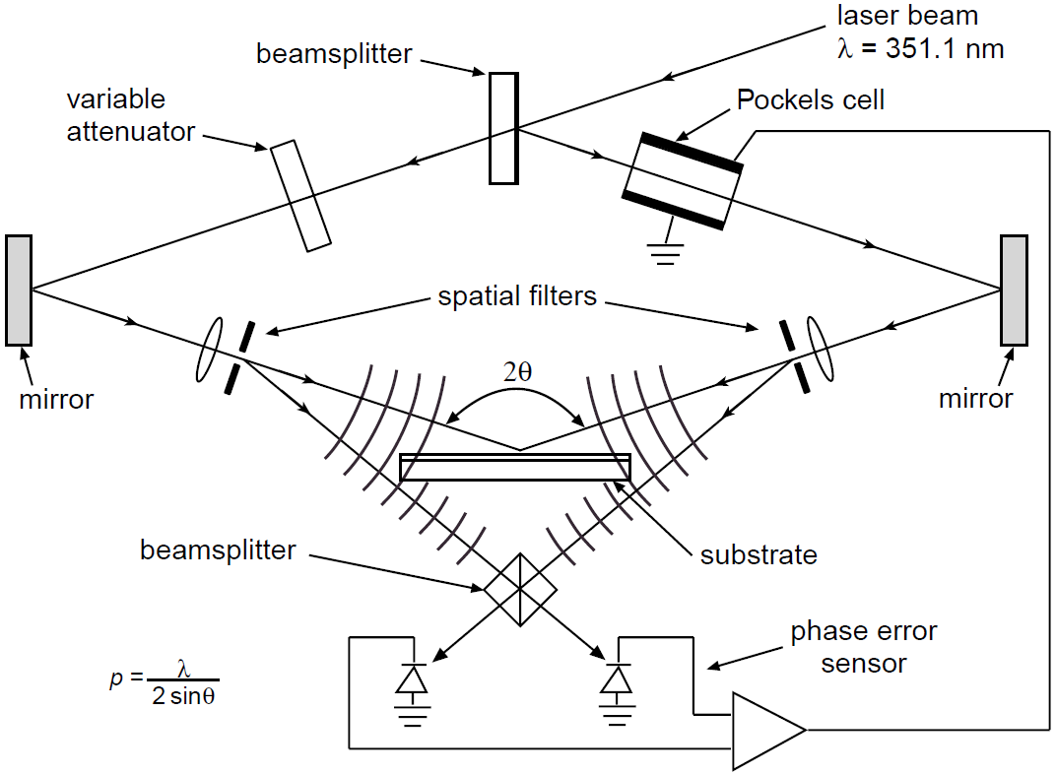
Optical setup: amplitude split interference lithography
Amplitude split by beam-splitter
(Ar⁺ laser)
(pinhole for spatial coherence)
It is very challenging to expose large area with target pitch close to λ/2. During exposure the system must be mechanically and optically stabilized to sub-wavelength precision.
Notes:
Vibration with 10’s nm amplitude would greatly decrease the contrast, so experiment at night at Princeton (no feedback/phase error sensor is used)

Slide 11
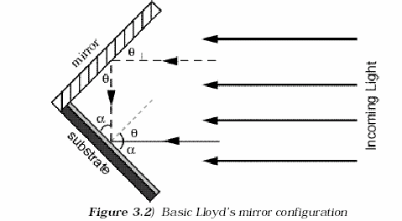
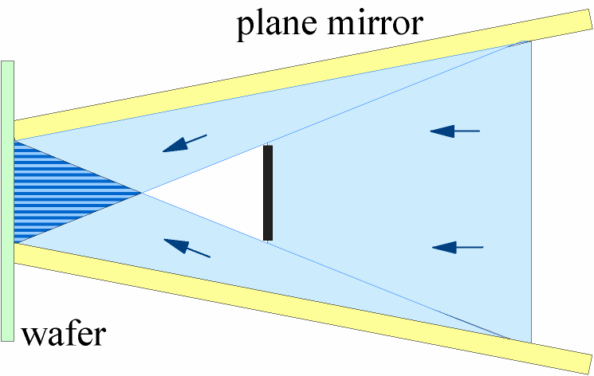
Optical setup: wave-front split interference lithography
Lloyd’s mirror:
Easy to tune the pitch, simply by rotating the mirror/substrate.
Only one optical branch, so more tolerant to environmental perturbations.
But more defects are found due to dusts/contaminations on the mirror, which is very close to the resist surface.
resist
Another type of wave-front split IL setup using two mirrors. Better than Llolyd in that Lioyd setup will have problem if mirror is not 100% reflective.

Slide 12
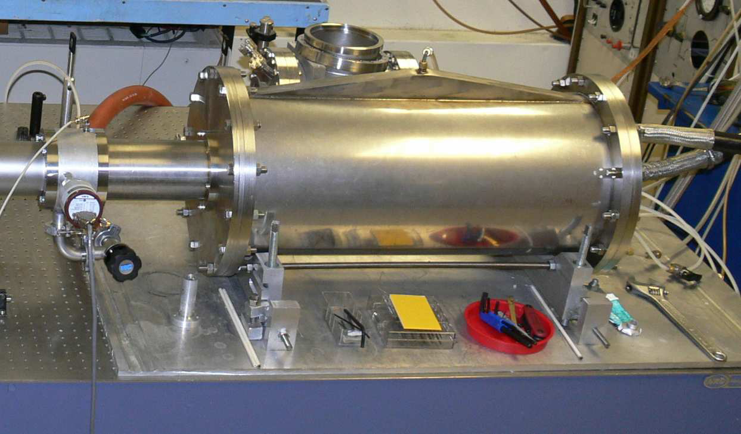
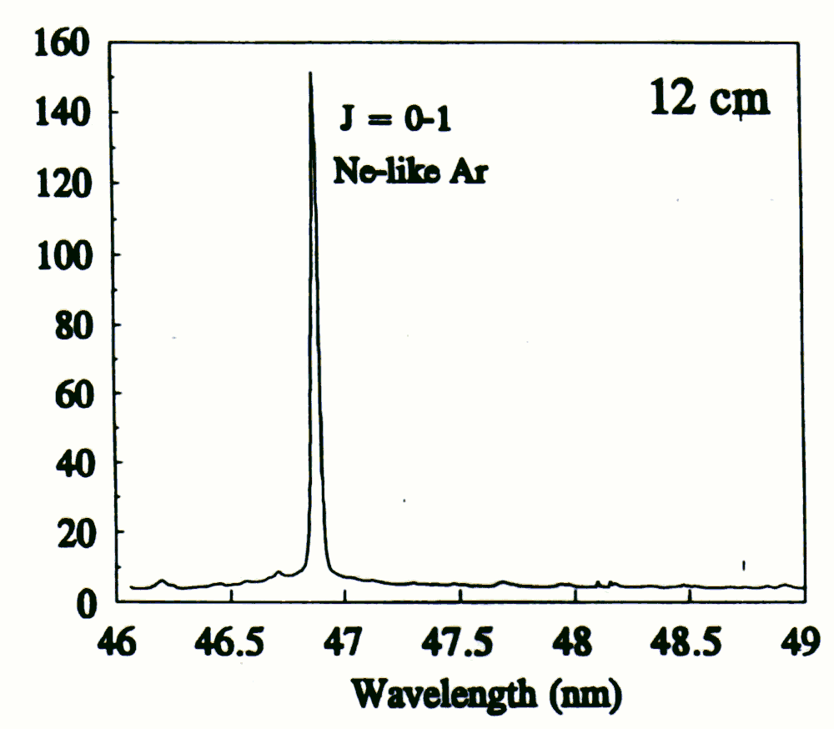
Coherence limitations to the printing area
(λ=46.9nm as an example)
Capillary discharge-pumped laser: λ=46.9nm, partial coherence.
Repetition rate: 4 Hz
High energy per pulse max - 0.8 mJ
Average power ~ 3 mW
High monochromacity: Δλ/λ=1×10⁻⁴.
Coherence radius: Rc = 550μm at 0.157m from 36cm capillary.
Very compact.

Slide 13
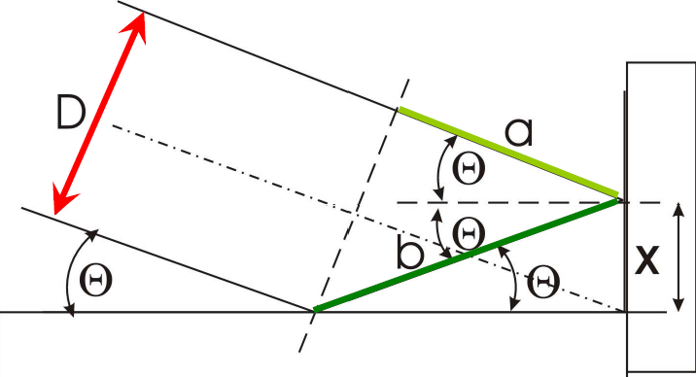
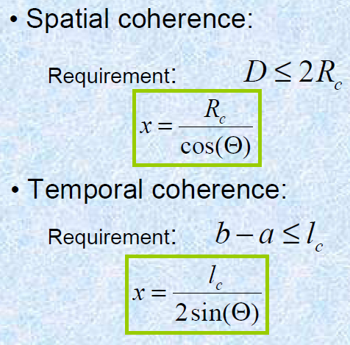
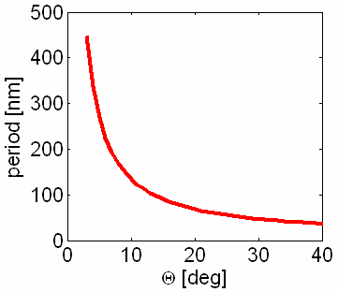
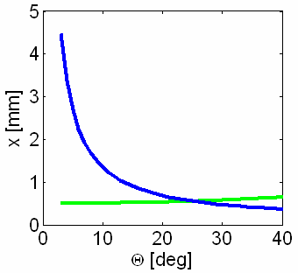
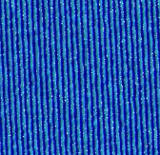
Coherence limitations to the printing area
resist
mirror
Larger Θ: smaller pitch, but smaller pattern area (smaller x).
Temporal
coherence
Spatial
coherence
Period 95nm
Capeluto, “Nanopatterning with interferometric lithography using a compact λ=46.9-nm laser”, IEEE Trans. Nanotechnol. 3-6(2006)

Slide 14
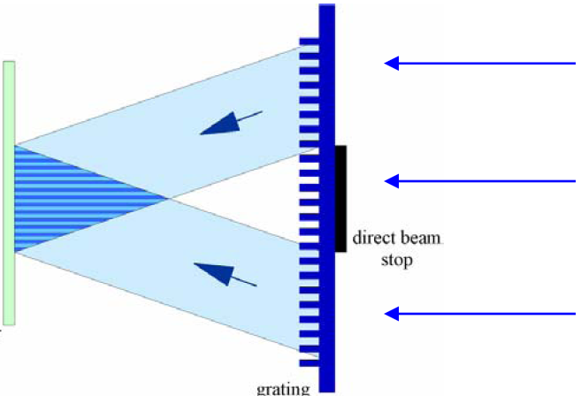
Interference lithography using incoherent light source
At λ<257nm (frequency doubled Ar⁺ laser), no good coherent source with high output power exists.
Phase grating can be used to relax/eliminate coherence requirement.
Wafer
Diffracted light
θ
L₁
x
Direct-beam stop
(n is refractive index)
L₂
p is pitch of phase grating.
P is pitch of grating on wafer.
P≡p/2, independent of λ.
(but must λ<p)
Phase grating
For an arbitrary position X on the wafer, the two beams have the same optical path (L₁=L₂), so no need of temporal coherence (spatial coherence is still needed).
Notes:
How to achieve a high spatial coherence? Use a pinhole “filter” on the beam path then let the beam spread after the pinhole.

Slide 15
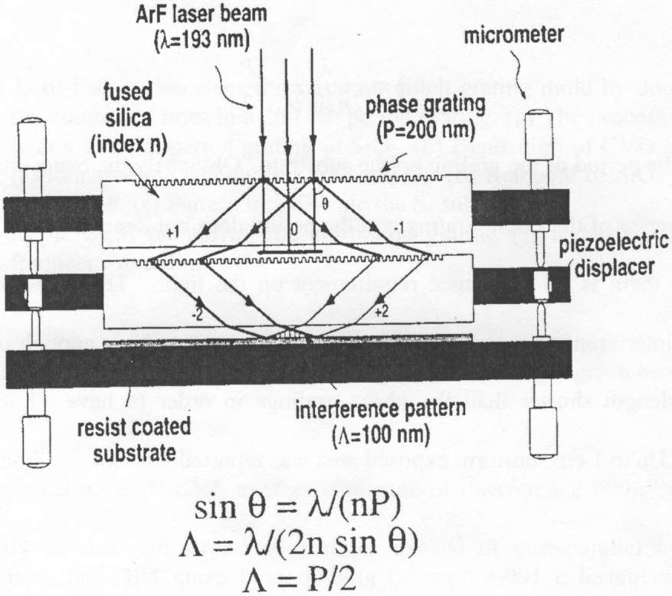
Achromatic interference lithography
Partly coherent pulse (ns) laser source
For any point X on the wafer, not only the optical path L₁=L₂ (so no need of temporal coherence);
but also the two beams come from the same source location Y (so no need of spatial coherence).
In addition, the laser source doesn’t need to be monochromatic (very narrow Δλ), so the name “achromatic”.
Y
L₁
L₂
X

Slide 16
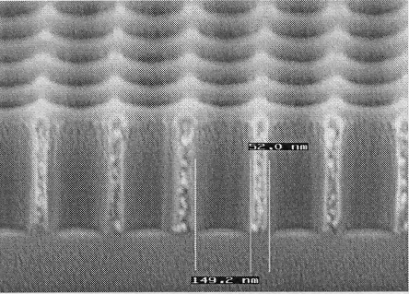
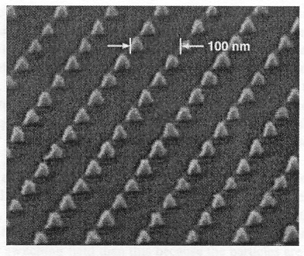
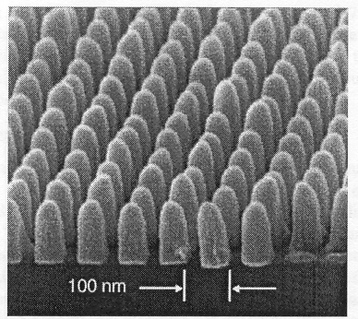
Patterned 100nm-pitch nanostructures by achromatic IL using 200nm-pitch phase grating
Those structures have been used to fabricate bit-patterned magnetic recording media. But 100nm-pitch is too large for today’s hard drive
T.A. Savas, M. Farhoud, H.I. Smith, M. Hwang, C.A. Ross, J. Appl. Phys. 85 (1999) 6160.

Slide 17
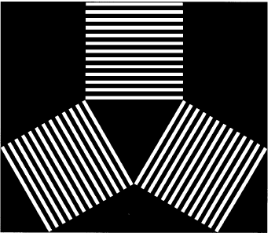
Three beams interference lithography: hexagonally close-packed arranged structures
Layout of three phase gratings Exposed pattern in photo-resist

Slide 18
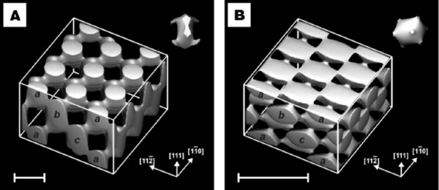
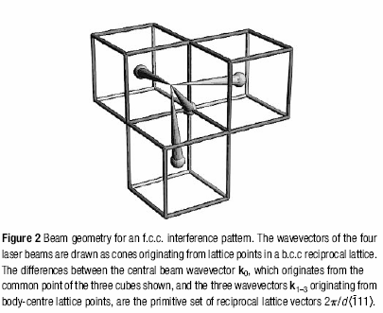
Four-beam interference/holographic lithography for 3D structures
Figure 1. Calculated constant-intensity surfaces in four-beam laser
interference patterns, designed to produce photonic crystals at
visible spectrum.
Beam arrangement
Campbell et al., Nature, 404, 53, 2000.

Slide 19
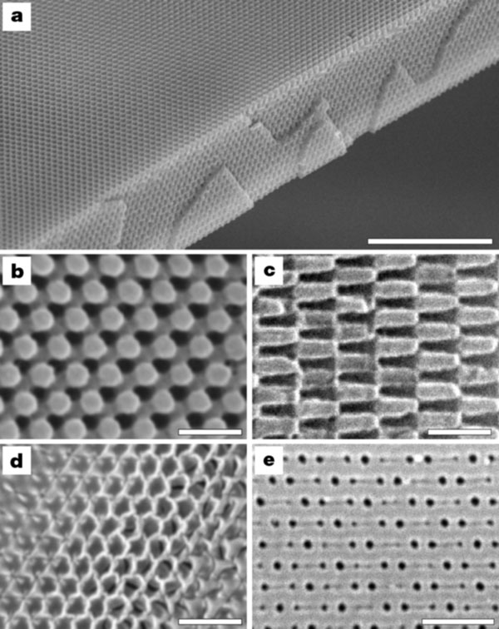
3D interference lithography: results
Polymeric photonic crystal generated by exposure of a 10μm film of photoresist to the interference pattern shown in Fig. 1A. The top surface is a (111) plane.
Close-up of a (111) surface.
Close-up of a (111) surface.
Inverse replica in titania made by using the polymeric structure as a template. The surface is slightly tilted from the (111) plane.
(102) surface of a b.c.c. polymeric photonic crystal.
10μm
1μm
1μm
1μm
1μm
Notes:
This is a photonic crystal, but for most applications one need to introduce defects inside the crystal, which cannot be realized by 3D interference lithography.

Slide 20
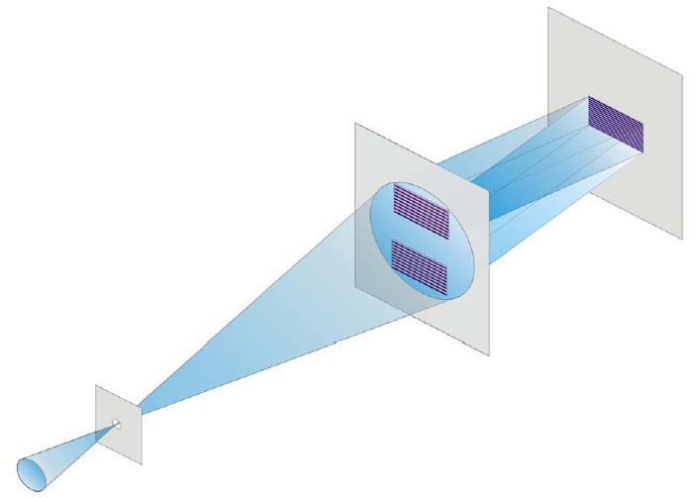
Scale down the pitch: EUV interference lithography at λ=13.5nm (EUV: extreme UV, also called soft x-ray)
Resist coated substrate
Diffraction
phase grating membrane mask by e-beam lithography
Lithographic performance:
Resolution: 25-50 nm period(!!)
Minimum features: 3.5nm(!!)
Exposure area: up to mm’s
Substrate size: up to 8” wafers (scan stage)
Exposure time: 5-30 secs
Throughput: 1 wafer/hour (for 100 fields)
Pinhole
(for spatial coherence)
Focused x-rays from coherent synchrotron radiation

Slide 21
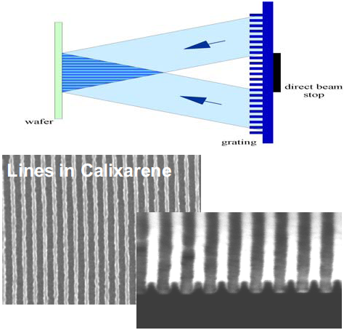
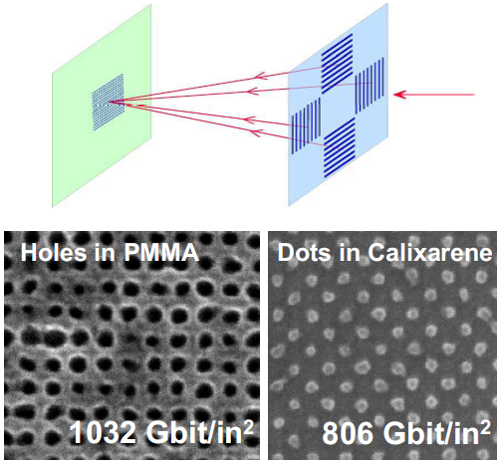
EUV-lithography results: line gratings and dot arrays
2 beams
4 beams
Period: 32.5 nm
Period: 25 nm 28.3 nm
Calixarene is a negative resist for electron beam lithography and for EUV lithography.
Notes:
What is the pitch of the phase grating mask? Twice the pitch in the resist.

Slide 22
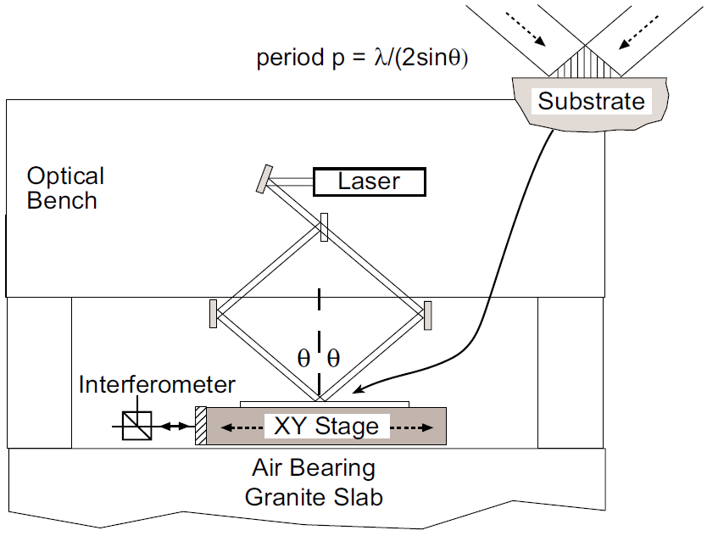
Scale up the pattern area: scanning beam interference lithography
Ar⁺ UV laser
λ = 351.1 nm
Mark L. Schattenburg, MIT

Slide 23
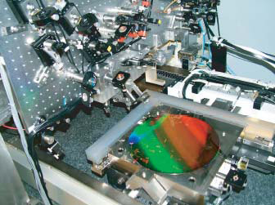
“Nano-ruler” setup for scanning beam IL: super-precise stage
Grating over entire 30cm wafer, color is due to light diffraction by the grating.
Grating Period: 401.251nm ± 1 pm
"Ruling" time: 25-50 min.
Stage positioning accuracy needs to be << targeted grating pitch.
Laser interference for accurate stage control.

Slide 24
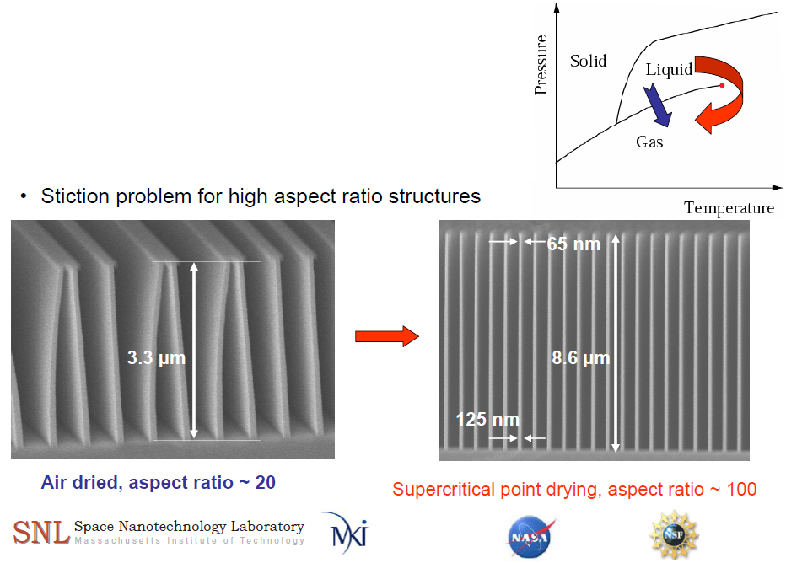
Critical angle transmission grating
(for space application)
KOH etch into (110) silicon wafer
High KOH concentration: 50 wt%
Low temperature: 50ºC
Etch rates: R<110> ≈ 185nm/min
R<111> ≈ 1.49 nm/min
Anisotropy (R<110>/R<111>) =124
(1,1,0)
(-1,1,1)
(-1,1,-2)
MIT

Slide 25
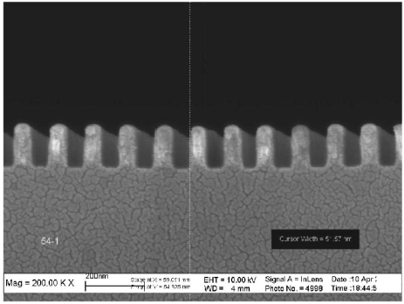
Immersion interference lithography
Higher n → smaller minimum pitch
Liquid
Won’t work since nsinθ=constant
Glass
Refractive index matching fluid
This will work, but liquid vibration/bubble can be a problem(?)
This is even better (?)
Grating with 118nm period, λ=266nm (532/2), total immersion (left setup) in water (n≈1.35).
Wang, “High-performance, large area, deep ultraviolet to infrared polarizers based on 40 nm line/78 nm space nanowire grids”, APL 2007.

Slide 26
Other photon-based lithographies
Near field optical lithography
Interference lithography
Phase-mask lithography
Laser beam direct writing and micro-mirror array lithography
Two-photon lithography

Slide 27
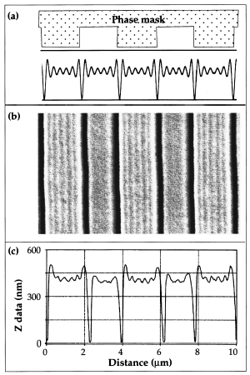
Phase-shift mask lithography
0º
180º
Similar idea to chromeless phase lithography (CPL) for projection lithography, but in contact mode.
At the corners of the phase mask in contact with the resist, light interferes destructively and there is a dip in intensity.
This can be quite sharp, possibly less than 1/4 the wavelength of the light, so 100nm features are possible.
J. Aizenberg et al. Appl. Phys. Lett 71, 3733 (1997).

Slide 28
How to fabricate phase-shift mask for lithography
Photoresist
Cure PDMS, remove
elastomer mask from master
Si
Photolithography
Expose through elastomer mask
RIE
PDMS casting
Develop
PDMS
H. Jiang et al., Spring MRS Meeting 1999

Slide 29
Other photon-based lithographies
Near field optical lithography
Interference lithography
Phase-mask lithography
Laser beam direct writing and micro-mirror array lithography
Stereo-lithography
Two-photon lithography

Slide 30
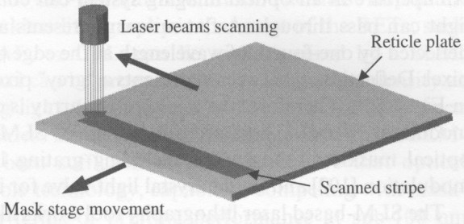
Mask-less optical lithography: focused laser beam direct writing
Why mask-less?
A set of mask cost ∼$10M.
32 individually addressable beams spitted from a single beam at λ=257nm (frequency-doubled continuous-wave Ar-ion laser)
Serial writing process, very slow.
Use multiple-beams to increase throughput.
Over 2× faster than e-beam lithography, with resolution enough for 90nm-generation lithography mask (pattern on mask is 4×90 = 360nm > λ = 257nm).
As a result, over 75% of masks are produced by laser writing (the rest by e-beam writing).
But for later lithography generation (<90nm), can laser-writing fabricate the mask?
Notes:
This technology is similar to CD/DVD burning, but into photoresist.

Slide 31
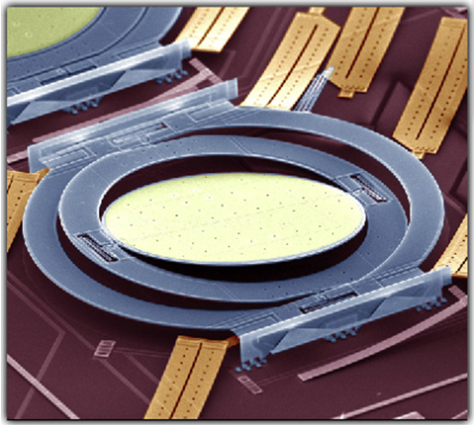
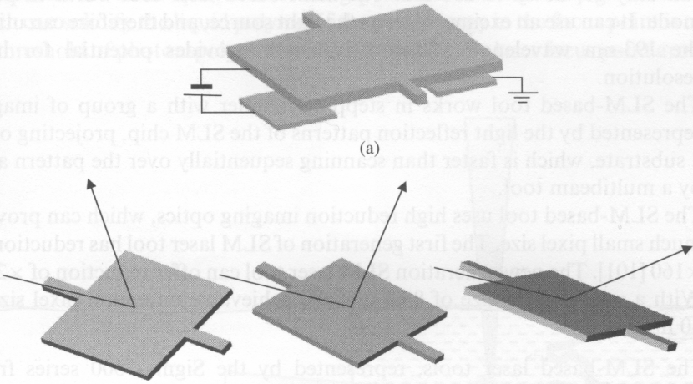
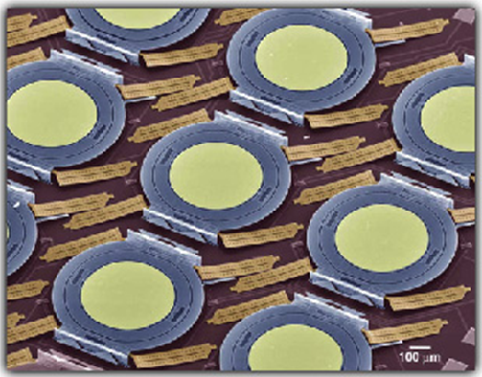
Mask-less optical lithography:
spatial light modulator (SLM) using mirror array
Deflection individually controlled by underlying electrodes
mirror
Micro-mirror structure
white
grey
black
Photo-resist
lens
White, grey, and black pixels, represented by different deflections of mirror surfaces.
Similar to DMDs (digital micro-mirror devices) that has been widely used in video projectors.
The reflected light pattern is imaged through a de-magnifying optical system onto photo-resist.
Unlike laser direct write, SLM can use pulsed laser with short wavelength for high resolution, such as 193nm.
1,000,000 mirrors
Notes:
This technology is developed around year 2000. It is basically a MEMS technology.

Slide 32
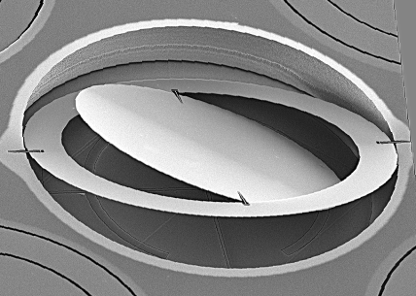
Mask-less optical lithography:
spatial light modulator (SLM) using mirror array
MEMS 3D SOI
Mirror Switch
Perspectives:
New generation tool have image reduction 267×, so 8μm micro-mirror size gives 30nm (!!) pixel size.
Since both phase and intensity of light reflected by each pixel can be controlled, SLM can easily realize most RETs (resolution enhancement technology) such as phase-shifting, optical proximity correction (OPC), sub-resolution assist features (SRAF), and chromeless phase lithography (CPL).
When using RET, SLM have demonstrated 30nm isolated features.
It is now a serious competing technology to laser direct write for photo-mask making for 45nm and beyond - generation lithography.
With a throughput of 5 wafer/hour (30cm wafer), it might even compete with mask-based optical lithography for patterning sub-100nm features.

Slide 33
Other photon-based lithographies
Near field optical lithography
Interference lithography
Phase-mask lithography
Laser beam direct writing and micro-mirror array lithography
Two-photon lithography

Slide 34
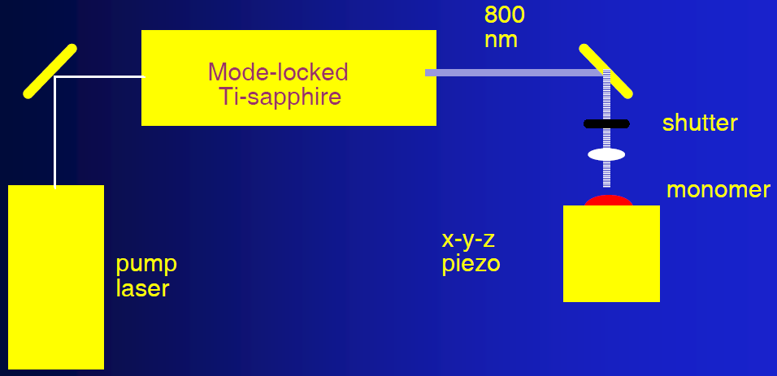
Two photon absorption photolithography
Photo-polymerization only occurs in small volumes corresponding to the focal spot of a laser beam where the intensity is high enough to produce absorption of two photons.
Two photon absorption to create photon with λ close to 800/2=400nm (UV light), which can expose (cure or crosslink) the monomer resist.

Slide 35
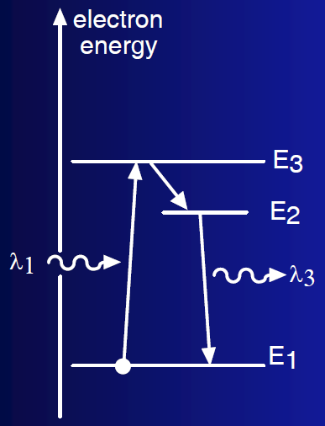
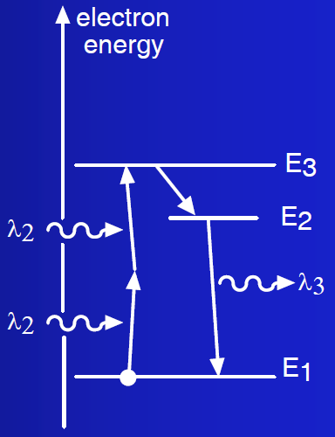
Absorption of light of one and two photons
Normal optical absorption
(α has units of cm⁻¹)
Two-photon (non-linear) absorption
(β has units of cm/Watt)
One-photon absorption and luminescence λ₁ < λ₃
Two-photon absorption and luminescence λ₂ = 2 λ₁(>λ₃)

Slide 36
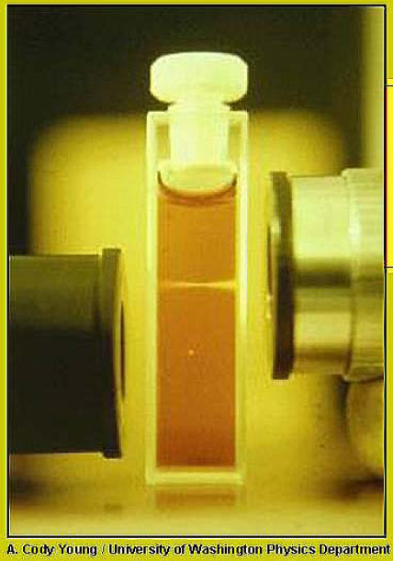
Two photon excitation (or luminescence)
Upper beam from right:
luminescence from one-photon absorption at λ=400nm.
Lower beam from left:
luminescence from two-photon absorption at λ=800nm.
Absence of out-of-focus absorption.
The infrared excitation light suffers less scattering.
Two-photon excitation arises from the simultaneous (10⁻¹⁸ seconds) absorption of two photons in a single quantitized event.
Fluorescence emission (at λ₃) varies with the square of the excitation intensity.
The photon density must be approximately one million times required to generate the same number of one photon absorptions.
The focal point of mode-locked pulsed lasers (very high peak power) can have such photon density.

Slide 37
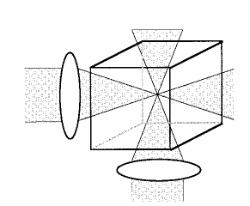
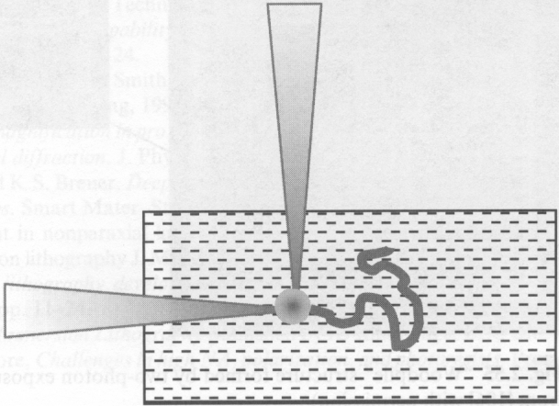
Two-photon lithography for 3D fabrication in volume
Two beams can further confine the focal point in both directions, so higher resolution.
X-Y-Z stage
Objective lens
Chain with smallest feature size 120nm
3D woodpile structure (for photonic crystal) with smallest feature size 60-70nm using 520 nm femto-second pulsed excitation.
Optics Express, Vol. 15, No. 6, 3426 (2007)
Notes:
Unlike interference lithography, defects can be introduced into the photonic structure for real applications.

Slide 38
Two photon photolithography (2PP): more examples
All structures need to be connected to other structures, no isolated structures possible.
2μm
SEM micrometer-scale image of (a) Venus fabricated by 2PP. (b) photonic crystal
structure fabricated by 2PP.
A titanium sapphire laser operating in mode-lock at 76 MHz and 780 nm with a 150-femtosecond pulse width was used for exposure.
Satoshi Kawata, Nature, 412, 697(2001)

Slide 39
Current and future research on two-photon lithography
Future research directions:
Polymerize conducting materials
Polymerize semiconducting materials
Construct contiguous regions of conductors, semiconductors and insulators (with 50nm features)!
Integrate organic light emitters and other photonic devices in 3D photonic circuits
Different materials may be polymerizable simultaneously using different wavelengths, by attaching the different monomers to chromophores with different absorption bands.
Challenge:
The technique is inherently a unit by unit slow fabrication method.
Is there a compelling application?
Can devices by made cost-effectively?
Will other techniques catch up?

