Slide 1
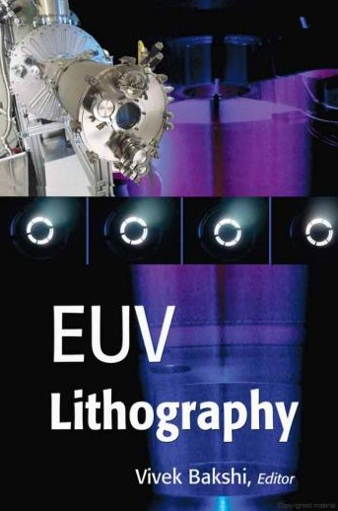
Extreme UV (EUV) lithography
Overview, why EUV lithography?
EUV source (hot and dense plasma).
Optics (reflection mirrors).
Mask (absorber on mirrors).
Resist (sensitivity, LER, out-gassing).
Contamination control.
http://books.google.ca/books?id=91XeKLC9MUEC&pg=PA393&lpg=PA393&dq=Elemental+absorption+at+13.5nm&source=bl&ots=u2vsBa2dgr&sig=a1JKcj0vE6Gx7X-_6m_zUR9CT5k&hl=en&ei=QZsQSpTVKZS8M5aT2FI&sa=X&oi=book_result&ct=result&resnum=1#PPR7,M1
Use Firefox to open the file, since somehow IE doesn’t work properly
ECE 730: Fabrication in the nanoscale: principles, technology and applications
Instructor: Bo Cui, ECE, University of Waterloo; http://ece.uwaterloo.ca/~bcui/
Textbook: Nanofabrication: principles, capabilities and limits, by Zheng Cui

Slide 2
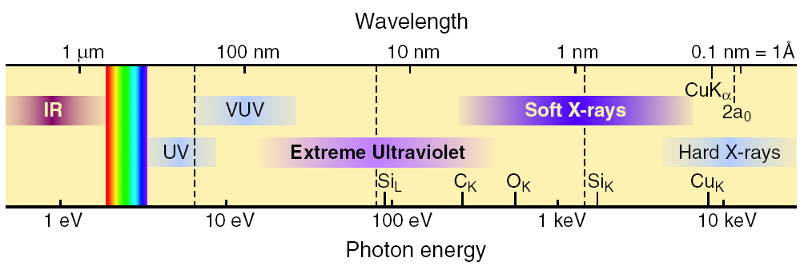
Electromagnetic spectrum
Visible is 400 - 700nm (1.7 to 3eV)
UV down to about 170 nm (∼7eV)
VUV- Vacuum UV (starts where N₂ is absorbing) then there is FUV (far UV) & EUV
EUV/soft x-ray, 2-50nm
  47nm is the λ for the Ne-like-Ar X-ray Laser (capillary discharge laser).
But for EUV lithography, it is at ∼13.5nm (92eV).

Slide 3
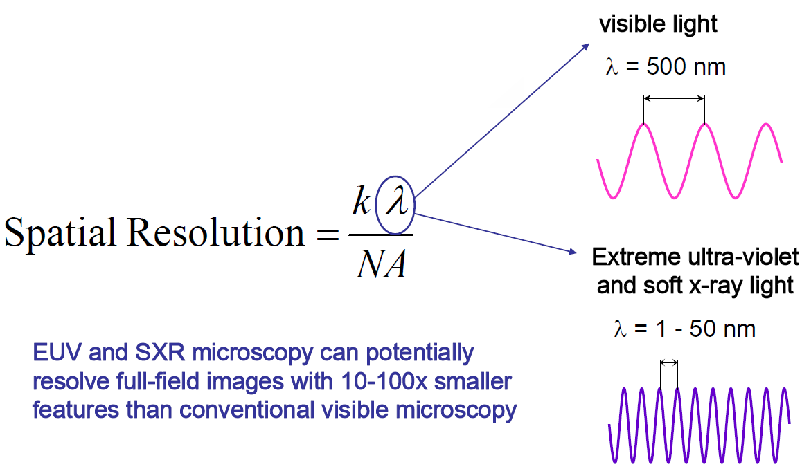
Why EUV lithography?
Shorter λ gives higher resolution.
No need of resolution enhancement techniques.
Relax the requirement for NA.
For EUV lithography, λ=13.5nm where efficient “lens” (reflected mirror) exists.

Slide 4
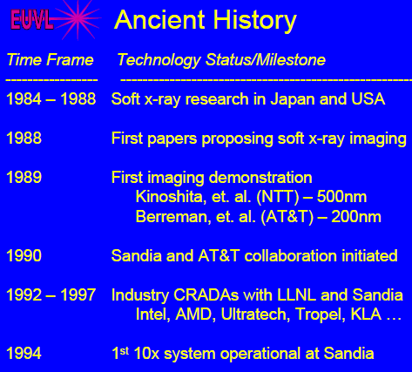
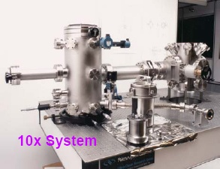
Some history of EUVL (not long)
10× reduction, namely feature size in mask is 10× that of in resist
In 1994, EUVL is not considered as a feasible lithography; instead x-ray lithography and e-beam lithography are believed to be the successors to optical lithography.
Today, EUVL is regarded the most promising next generation lithography.

Slide 5
Transitions to EUV is a big jump
Big jump from 193 to ~13 nm. Before this has about ¼ increase in energy. Now >10x
There are only so many “tricks” to increase this gap, and they are very expensive … we must go to a shorter wavelength!
Mask Maker’s Holiday: “large” k₁
Mask Maker’s Burden: “small” k₁
In 2004, it is predicted that EUVL will become mass production tool in 2009. Today it is believed that DUV lithography (λ=193nm) with double processing will be used for 32nm generation production, thus delaying the need for EUV.

Slide 6
Transitions in optical lithographic technologies

Slide 7
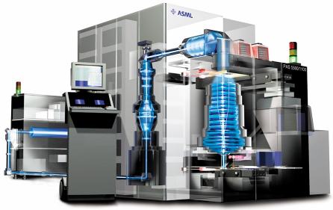
Why not the next excimer line?
Current 193nm DUV lithography
Lenses are very effective and perfectly transparent for 193nm and above, so many are used: a single “lens” may be up to 60 fused silica surfaces.
System maintained at atmospheric pressure.
Exposure field 26x32mm².
Steppers capable of exposing 109 steps per 300mm wafer, and produce >100 wafers per hour. Exposure times ∼10-20ns (one pulse of excimer laser).
Reticle
(Mask)
Wafer
193 nm Excimer Laser Source
Exposure Column
(Lens)
Computer Console
www.tnlc.ncsu.edu/information/ceremony/lithography.ppt

Slide 8
Current 193nm deep UV (DUV) lithography: mask material
Photo-masks today are made from fused silica.
Fused silica has a number of advantageous properties.
    Chemical stability.
    Transparency for ultraviolet light.
    No intrinsic birefringence.
    A low coefficient of thermal expansion.
A low coefficient of thermal expansion: 0.5ppm/ºC.
      If a mask changes temperature by 0.1ºC, then the distance between two features separated by 50mm will change by 2.5 nm.
      This change in registration can be absorbed into overlay budgets, after reduction by 4× (i.e. pattern on resist misaligns by 2.5/4=0.6nm, OK).

Slide 9
Why not the next excimer line (157nm) or 46nm?
Why not a stop at 157nm?
Fused silica and atmospheric oxygen become absorptive by 157nm, so even incremental decreases in wavelength (by only 36nm) start to require a major system modification: vacuum exposure, use CaF₂ as lens material.
The coefficient of thermal expansion of CaF₂ is 19ppm/ºC, versus 0.5ppm/ºC for fused silica.
The 2.5nm of mask registration error now becomes nearly 100 nm (25nm after ¼ reduction, still too high).
Below 157nm, no excimer laser line has the required output power.
Why not a stop at 46nm?
Ne-like-Ar X-ray Laser (capillary discharge laser developed at CSU) produces EUV at this wavelength.
The wavelength is >3× longer than 13.5nm, so lower resolution.
Still need reflectance optics, but hard to get high reflectance.
Materials and thicknesses issues (high absorption).

Slide 10
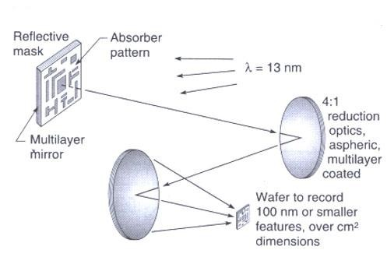
EUV lithography characteristics
EUV radiation is strongly absorbed in virtually all materials, even gases, so EUV imaging must be carried out in a near vacuum.
There is no refractive lenses usable - EUVL imaging systems are entirely reflective.
But EUV reflectivity of individual materials at near-normal incidence is very low, so distributed Bragg reflectors (period about λ/2) are used.
The best of these function in the region between 11 and 14nm (Si/Mo material)
EUV absorption in standard optical photo-resists is very high (low penetration depth into resist), so new resist and processing techniques will be required

Slide 11
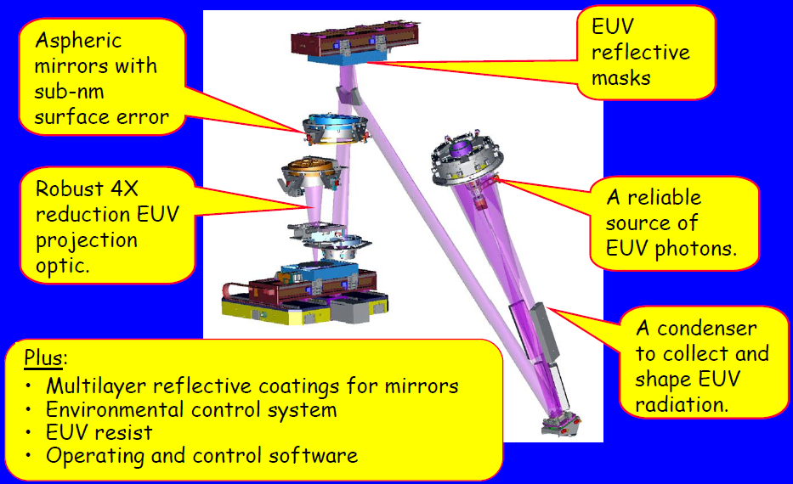
Schematic of EUV lithography system
EUVL alpha-tool

Slide 12
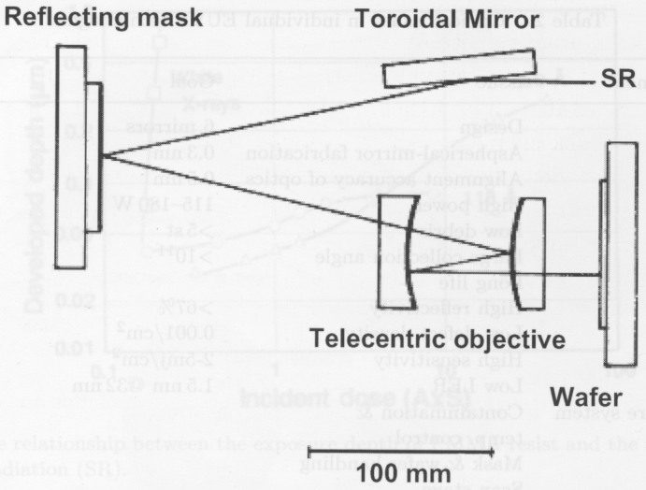
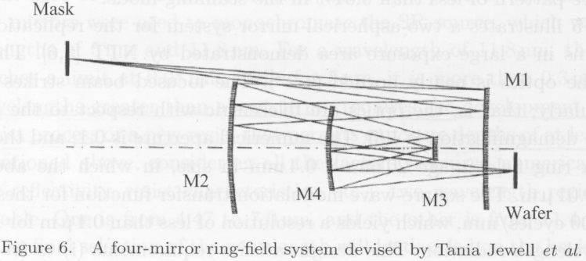
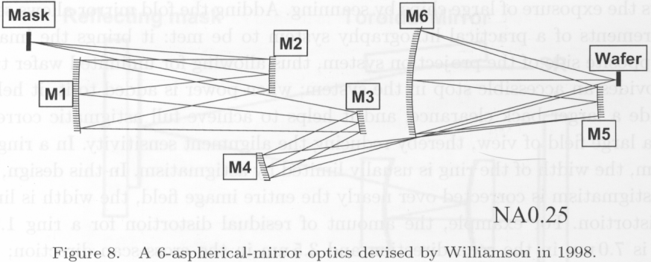
A few optical designs (using reflective lens/mask)
Synchrotron radiation
An early simple two-mirror system
A four-mirror system, holes in M4 to let light pass through.
A six-mirror system having NA 0.25

Slide 14
Extreme UV (EUV) lithography
Overview, why EUV lithography?
EUV source (hot and dense plasma).
Optics (reflection mirrors).
Mask (absorber on mirrors).
Resist (sensitivity, LER, out-gassing).
Contamination control.

Slide 15
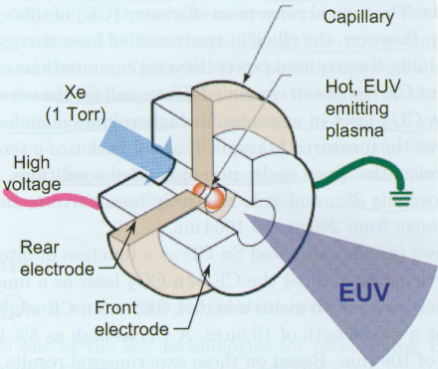
EUV @13.5nm plasma radiation source
Light sources must match the wavelengths at which Mo/Si multi-layers have high reflectivity.
The only viable source for 13.5nm photons is a hot and dense plasma
  Powerful plasma: temperature of up to 200,000ºC, atoms ionized up to +20 state.
  Emit photons by (e - ion) recombination and de-excitation of the ions.
  Plasma must be pulsed: pulse length in pico- to nanosecond range
  Plasma is produced by powerful pulsed laser or electric arc (discharge) of up to 60,000A peak current.
Laser Produced Plasma (LPP)
Discharge Produced Plasma (DPP)
plasma
target
(or Sn vapor)
laser pulse (ns)
laser
∼100μm

Slide 16
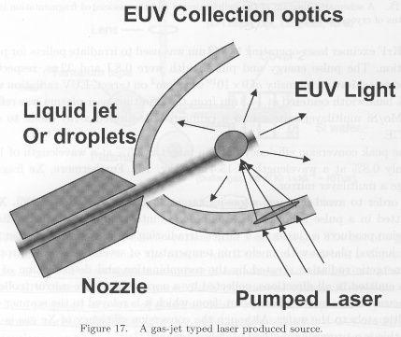
Laser (LPP) and discharge (DPP) produced plasma
DPP: change electrical energy directly into EUV light, so high power, high efficiency; but ablation of electrode and more debris.
LPP: higher collection efficiency (larger collection angle), high repetition rate (more pulses/sec), more manageable thermal loads and debris, more scalable to HVM (high volume manufacturing).
EUV lithography tools using both DPP and LPP have been built.
Challenges:
Radiate from IR to x-ray: need filter.
Large source size into 4π spherical angles:
need collector optics.
Debris and thermal issues: may damage the optics.
For EUV lithography, ideally:
Power > 110W
Maximum in-band emission with narrow bandwidth (≤ ±2%).
Forward directed, no collector
Low (μW) to mid-power (1W) has application in other fields:
Interference lithography, spectroscopy, microscopy, other metrology, testing EUV resist.

Slide 17
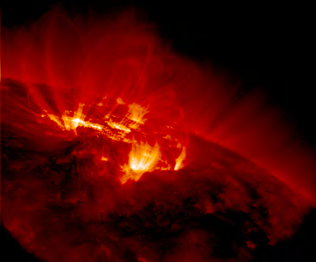
Hot and dense plasma system: the sun
EUV Image of the Solar Corona showing loops near the solar limb
The loop is due to the magnetic field that bends the electrons/ions
http://vestige.Imsal.com/TRACE

Slide 18
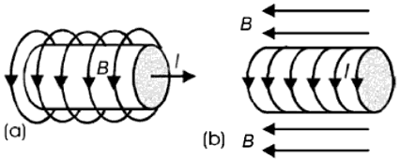
Discharge produced plasma (DPP)
Hot plasma is created by magnetic compression of low-temperature plasma.
Plasma is compressed with the magnetic field generated by the current used to heat the plasma, with two common geometries (see figure below).
Because plasma is compressed by magnetic field B of current I, which generates the plasma, plasma is “self-heating”.
Two forces are present: the magnetic field pressure B²/2μ_{o} and the plasma pressure.
When these two forces are equal, the plasma achieves an equilibrium.
Equilibrium:
I: total current (B∝I), supplied by a capacitor in a pulsed mode; T_{e}: electron temperature
N_{i}=πr²n_{i}, n_{i}=ion density; Z_{eff}: mean charge of the ions.
Two plasma compression geometries.

Slide 19
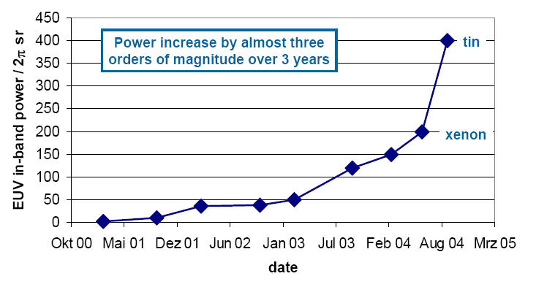
Gas discharge produced plasmas source scaling
two orders

Slide 20
Laser produced plasma (LPP): overview
LPP is generated by focusing a laser beam on a target material.
Initial ionization occurs through photo-ionization, and the electric field of the laser accelerates these electrons (inverse Bremsstrahlung, see next slides).
Non-elastic collision further ionize the plasma, whereas elastic collision transfers the electron’s kinetic energy into ionic kinetic energy.
As plasma expands, thermal energy is converted into kinetic energy and charge density decreases. (Expansion velocity of Sn plasma at ∼30eV is about 2×10⁶cm/s, so order 100μm in front of target for 10ns pulse.)
This decreases both the further absorption of laser energy and energy conversion efficiency (CE).
Therefore, the laser pulse length should not be very long: 10ns is a good time scale.
The corresponding optimum laser intensity for maximum CE is 1×10¹¹W/cm² for Nd:YAG laser (1.06μm), and 1×10¹⁰W/cm² for CO₂ laser (10.6μm).
Modeling shows that CE depends on laser wavelength -- CE (10.6μm laser):CE (1.06μm laser):CE(0.26μm laser)=1.9:1.0:0.55.
This is because: CE depends on a balance between emissivity and opacity; at longer wavelength laser absorption occurs at lower plasma (electron) density that is more transparent for EUV to escape.

Slide 21
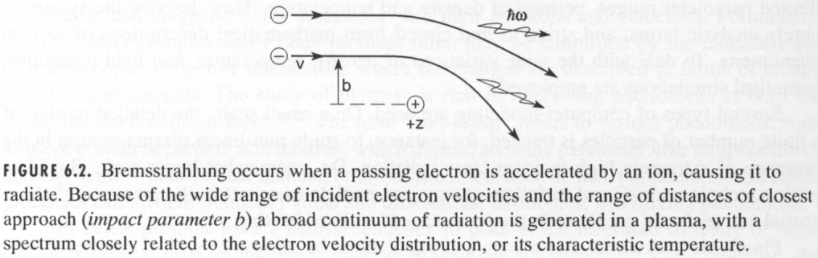
Laser produced plasma: a clean, bright, narrow source
Plasma temperature:
T_{e} ∝ Z^{1/5} (λ²φ)^{3/5}. Longer wavelength is more efficient to heat up plasma, so higher CE.
λ: laser wavelength; φ: laser flux (Watt/cm²); Z: target atomic number.
Energy levels:
Transitions and energy levels are calculated using Hartree-Fock methods. The UTA continuum spectra is due to 4p⁶4d^{n} – 4p⁵4d^{n+1} + 4d^{n-1}4f line transitions.
Atomic processes (routes for radiation):
Ionisation and recombination between successive ion stages.
UTA line radiation from bound-bound transitions (excitation and de-excitation).
Continuous Bremsstrahlung occur as well (Bremsstrahlung: electron emits photon when it is accelerated by the positively charged ions).
Same idea as synchrotron radiation where electrons are accelerated radially by magnetic field.
From: Soft x-rays and extreme ultraviolet radiation, written by David Attwood

Slide 22
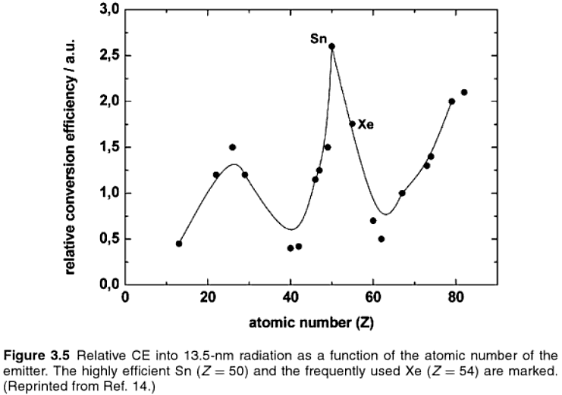
Energy conversion efficiency (CE) into 13.5nm radiation
Sn is most efficient, followed by Li (?), then Xe.

Slide 23
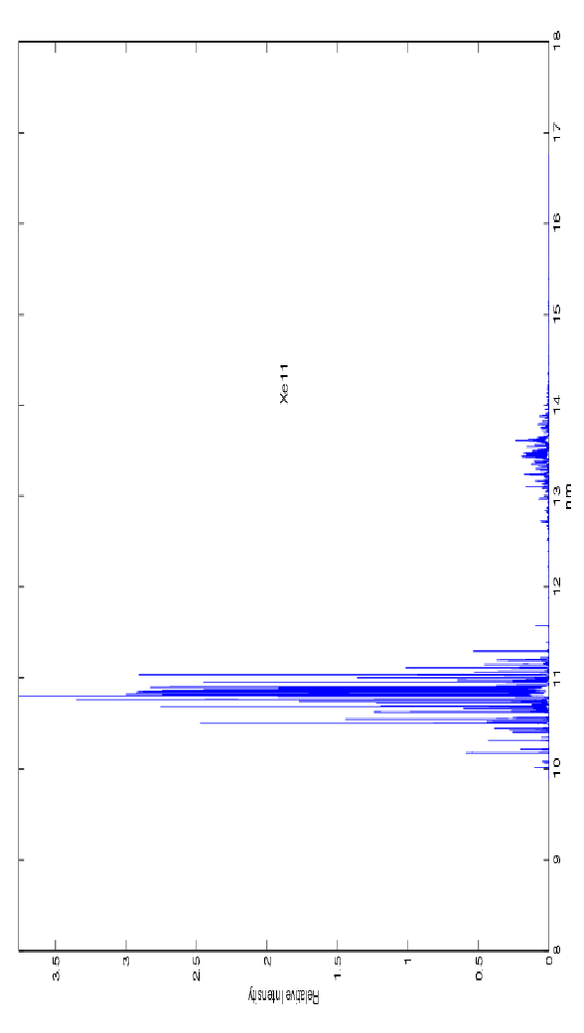
Plasma radiation source for 13.5nm: Xe
10.8nm
13.5nm
13.5nm photons only generated by one ion state (Xe¹¹⁺).
Maximum population of this state is 45%.
Even this state emits 10 times more at 10.8nm than 13.5nm.
That is, xenon is inefficient: to produce 100W at 13.5nm, kilowatts of other wavelengths would have to be removed.
On the plus side, xenon is very clean and easy to work with (no debris).

Slide 24
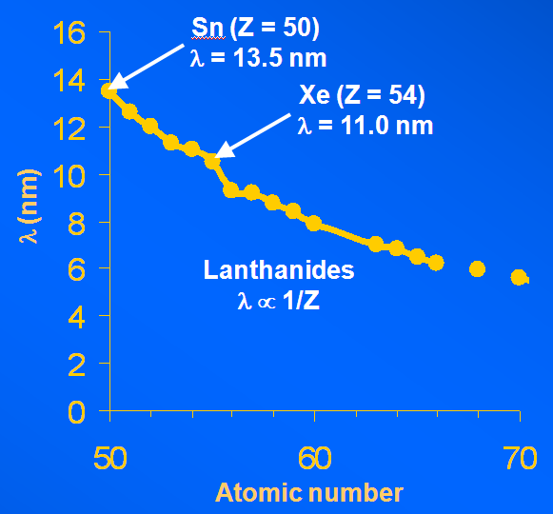
Plasma radiation source for 13.5nm: Sn
Peak wavelength emission decreased with increasing atomic number (λ ∝ 1/Z).
UTA peak wavelength (nm)
versus atomic number
Laser produced Sn plasma
Target, Z=50 [Kr]5s²4d¹⁰5p² Sn
Laser wavelength, λ 1.064μm
Laser flux, φ 1 x 10¹¹ W/cm²
Electron temperature, T_{e} 48.8eV
Electron density, n_{e} 9.88 x 10²⁰ cm⁻³
(300K is 26meV, 1eV is 1.15×10⁴K)
Ion distribution
Sn X 0.046
Sn XI 0.243
Sn XII 0.306
Sn XIII 0.330
Sn XIV 0.068
UTA: unresolved transition array, consisting of tens of thousands of lines (unresolved, overlapping 4d–4f transitions).

Slide 25
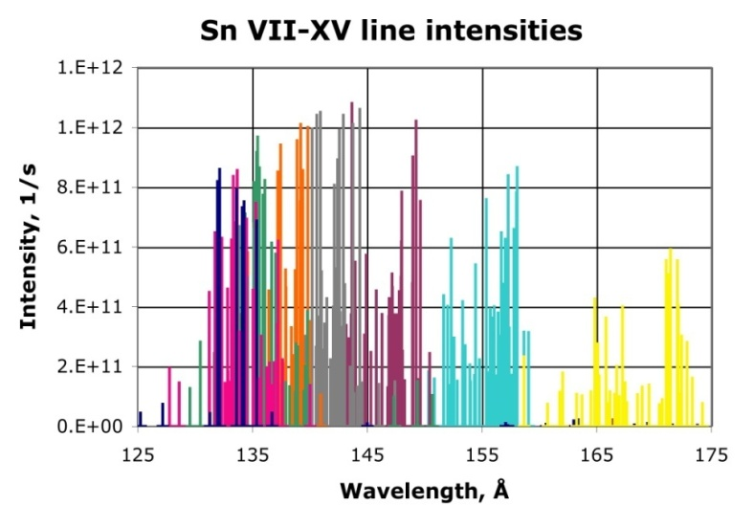
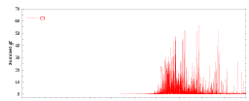
Plasma compositions for 13.5nm: Tin
Sn⁺⁸
Sn⁺⁷
Sn⁺⁶
Optimum emission when tin is a low-percentage impurity.
Light comes from transitions between 4p⁶4d^{n} and 4p⁵4d^{n+1} or 4d^{n-1}(4f,5p).
All ion states from Sn⁸⁺ to Sn¹³⁺ can contribute.
Lighting up these transitions, and only these transitions requires exquisite control of laser plasma.
But tin (debris) tends to condense on optics.
In summary, tin is great as a 13.5nm source, if one can control the debris (yes).

Slide 26
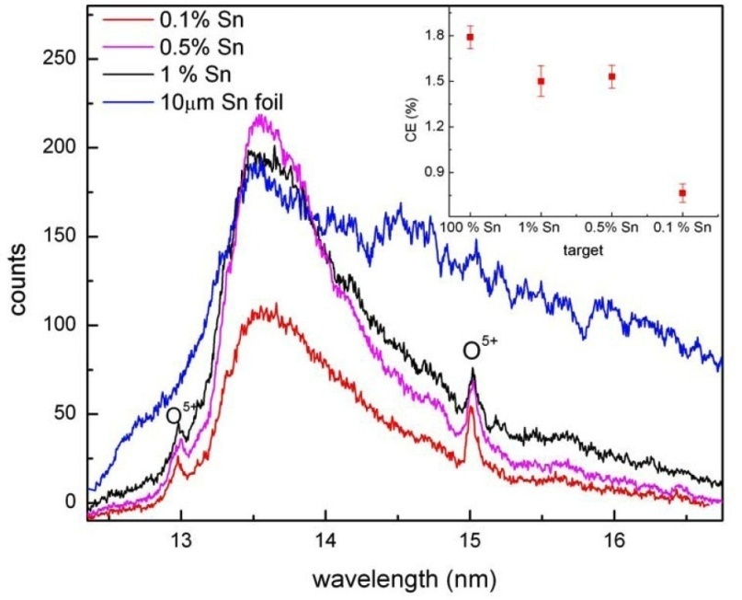
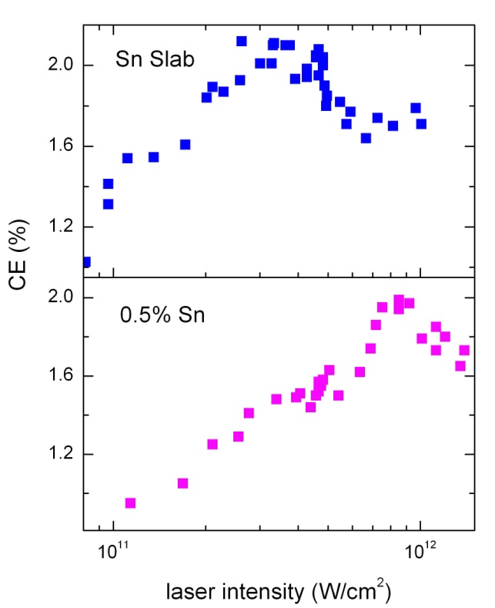
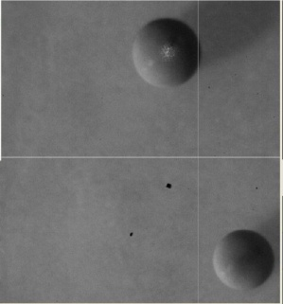
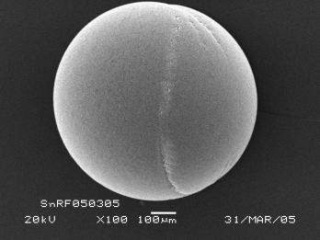
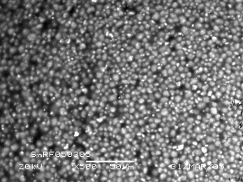
Low density (diluted) targets leads to narrow UTA
Radiation spectrum
0.5%
0.1%
100%
1%
CE: (energy) conversion efficiency
Low density tin also reduces debris contamination to optics.
The optical depth at 13.5 nm is only ~7 nm of full density Sn. Beyond that, light is reabsorbed.
CE (conversion efficiency) slightly reduced with low density Sn.
Tin targets from General Atomics
100 mg/cc RF foam
0.1-1% solid density Sn
e.g., 0.5%Sn = Sn_{1.8}O_{17.2}C₂₇H₅₄

Slide 27
Extreme UV (EUV) lithography
Overview, why EUV lithography?
EUV source (hot and dense plasma).
Optics (reflection mirrors).
Mask (absorber on mirrors).
Resist (sensitivity, LER, out-gassing).
Contamination control.

Slide 28
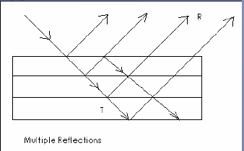
Optics for EUV lithography (EUVL): overview
All solids, liquids, and gasses absorb 13.5nm photons, so no longer refracting lens.
A beam of EUV light is absorbed in 100nm of H₂O.
Even worse, conventional optical devices will not reflect EUV light.
EUVL uses concave and convex mirrors coated with multiple layers of molybdenum and silicon -- this coating can reflect nearly 70 percent of EUV light at 13.5nm.
The other 30 percent is absorbed by the mirror.
Without the coating, light would be almost totally absorbed before reaching the wafer.
The mirror surfaces have to be nearly perfect - even small defects in coatings can destroy the shape of the optics and distort the printed pattern in resist.
If the thicknesses and compositions of all films are carefully controlled, the reflected light will constructively interfere resulting in the brightest possible reflection.
Multiple reflections

Slide 29
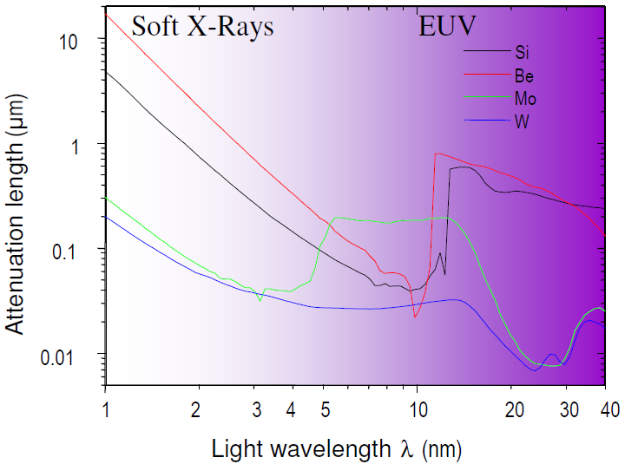
Why Si/Mo and 13.5nm?
Absorption in solids for EUV and soft x-rays
For high reflection, the absorption should be low (i.e. attenuation length should be large). So Mo, Si, Be are good candidates at ∼10-15nm.
Mo/Si ∼40 layer pairs ~70% reflectance where Mo and Si are most transparent.
Mo/Be is higher (at λ=11nm) but narrower; and more importantly, Be is toxic.
Multi-layer coating is more difficult to control for shorter wavelength. Till now mirror for λ=4.7nm has been fabricated, though less reflectivity and narrower bandwidth.

Slide 30
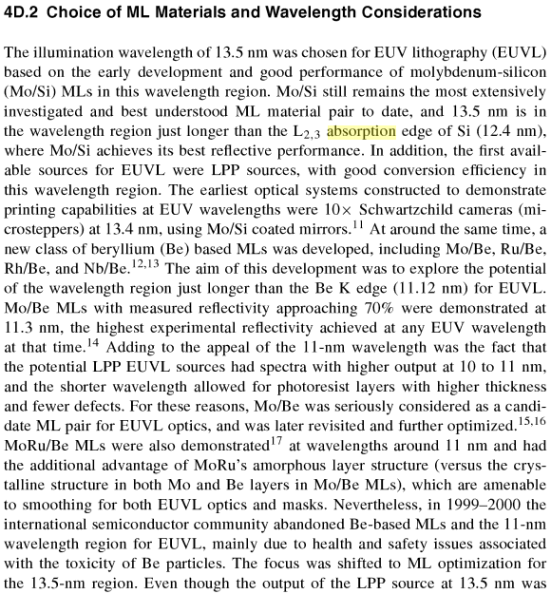
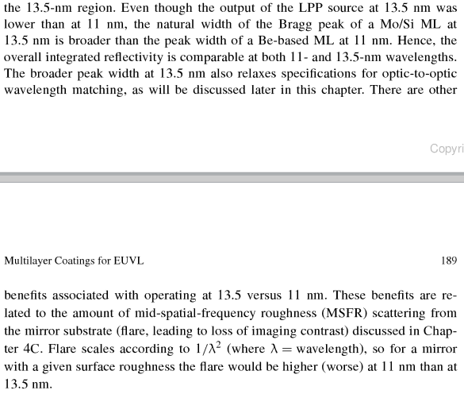
Why Si/Mo and 13.5nm?

Slide 31
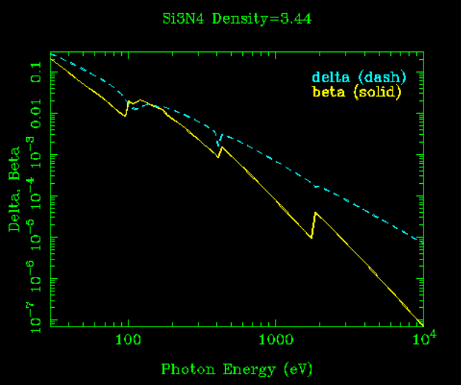
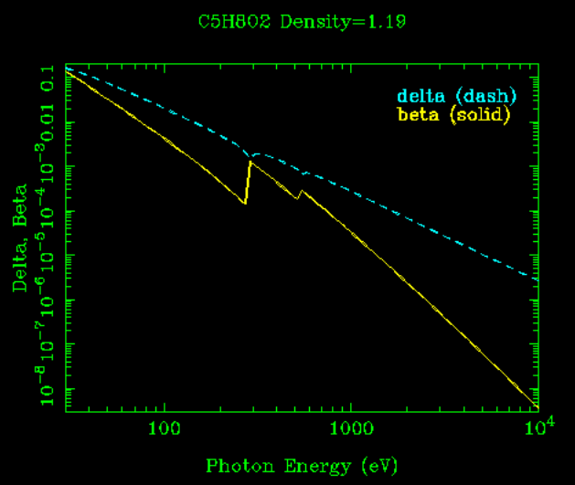
Refractive index at EUV
n=1-δ-iβ (δ, β<<1), n is close to 1, so low reflection
Si₃N₄
PMMA
Refractive index is closer to 1.0 for shorter wavelength. So no “optics” for x-ray.
For λ=13.5nm, photon energy = 92eV, so δ, β is not negligible, making reflective optics possible.
Amplitude reflection r=(n₁-n₂) /(n₁+n₂) for normal incidence at each interface.
http://www-cxro.lbl.gov/, lots of information there

Slide 32
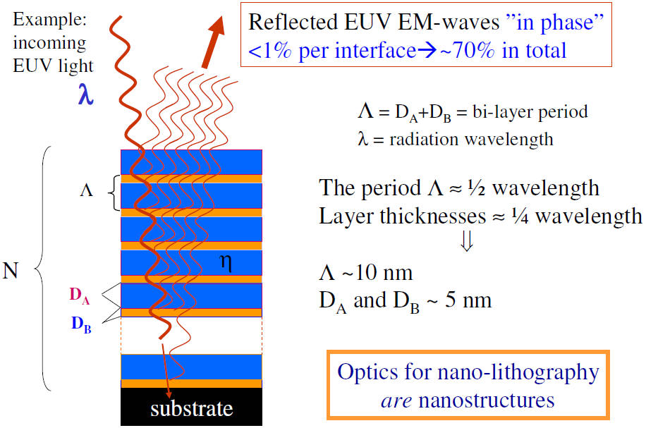
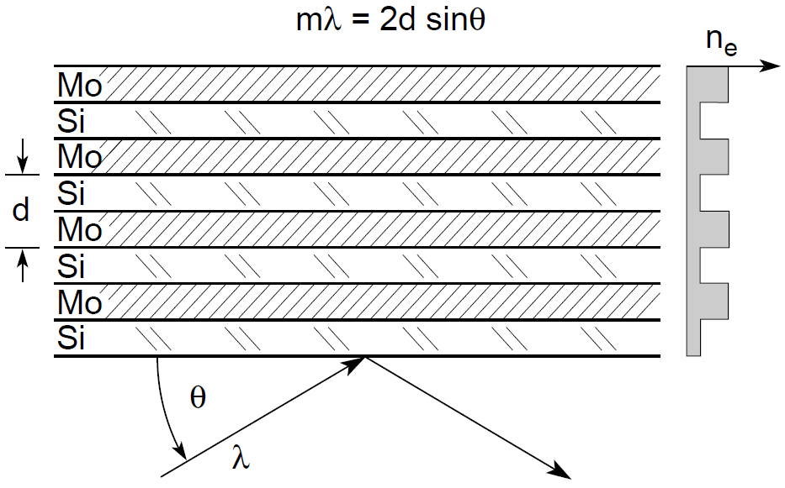
Multilayer EUV mirrors – Bragg reflectors
(for normal incidence)
m=1, 2…
Amplitude reflection r=(n₁-n₂) /(n₁+n₂) for normal incidence at each interface.
The mirror is aspheric
For normal incidence, if D_{A} ∼ D_{B}, then each layer ∼3.4nm for λ=13.5nm.
Since the angle of incidence changes across the mirror, so do the required Mo/Si layer thicknesses.
Acceptable surface roughness: 0.2nm RMS, corresponding to a phase shift error of 10º.

Slide 33
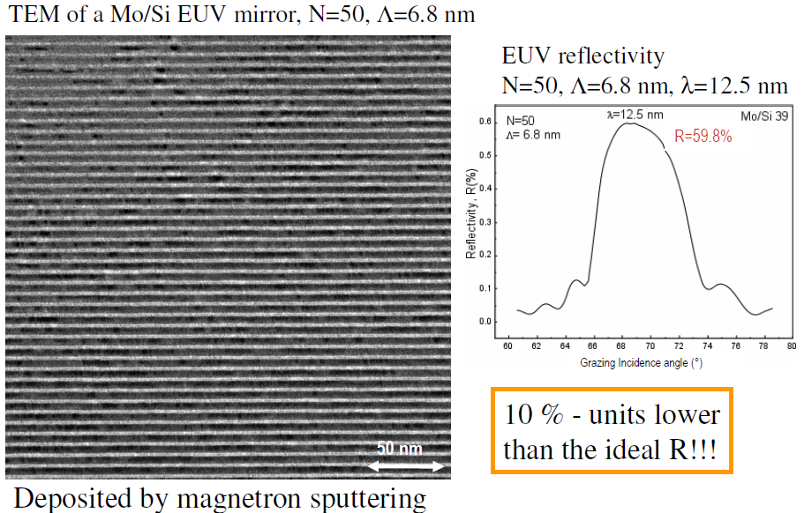
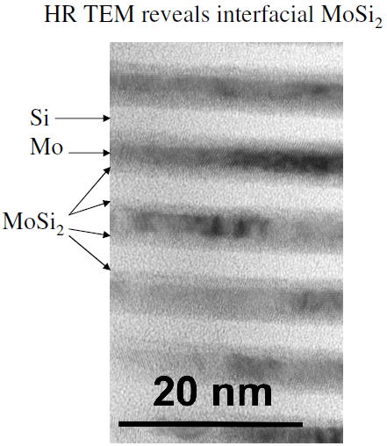
TEM images of EUV mirrors

Slide 34
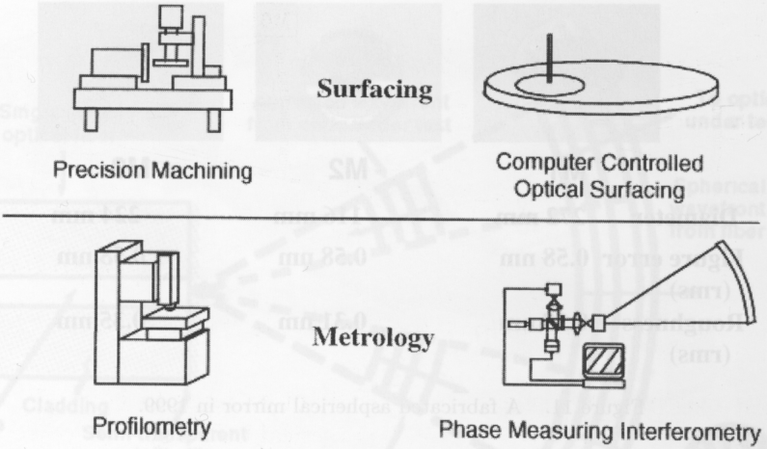
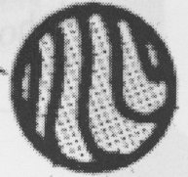
Fabrication and measurement of aspheric mirror
Interference fringe pattern
Mirror accuracy sub-1nm globally, GREAT engineering achievement.
Analyze the interference fringe, compare it pixel-by-pixel with the calculated interference fringe pattern for an ideal perfect mirror.
Analyzing the Fourier transformed pattern rather than the wave front directly gives improved accuracy.

Slide 35
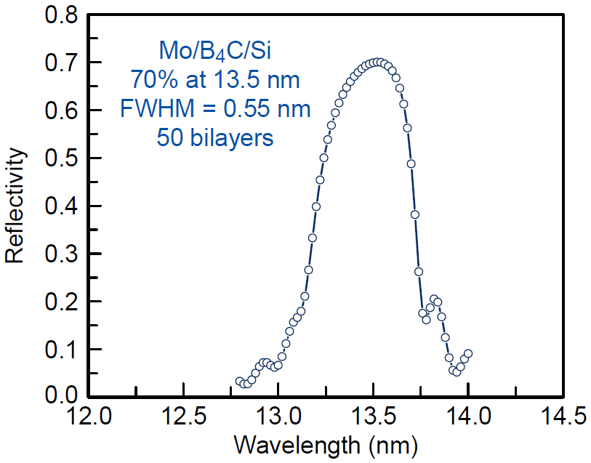
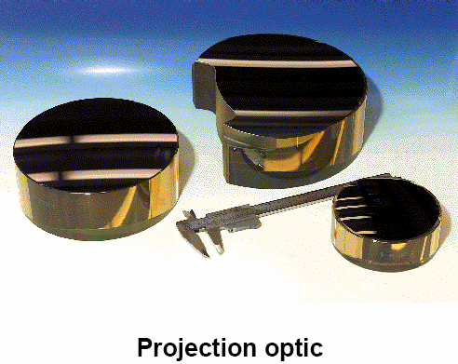
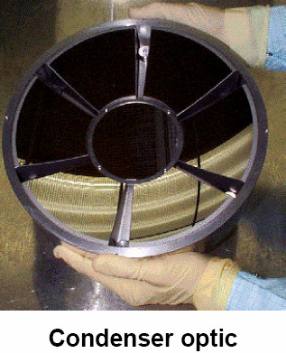
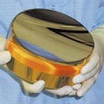
Photos of EUV mirrors

Slide 36
Extreme UV (EUV) lithography
Overview, why EUV lithography?
EUV source (hot and dense plasma).
Optics (reflection mirrors).
Mask (absorber on mirrors).
Resist (sensitivity, LER, out-gassing).
Contamination control.

Slide 37
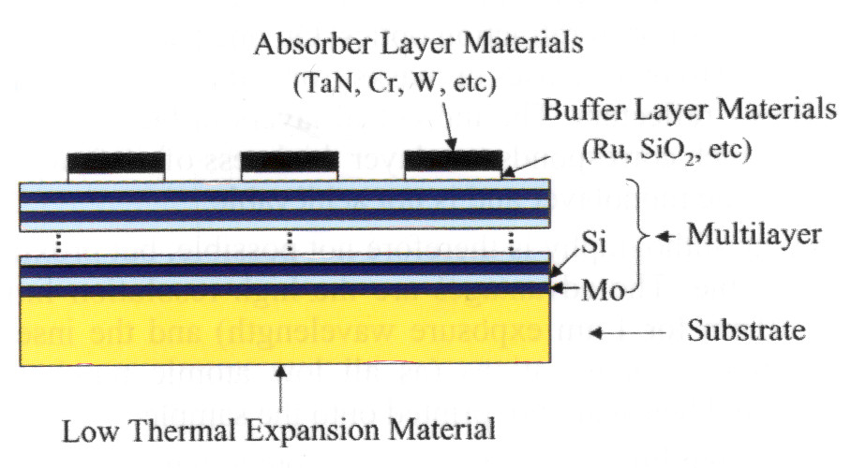
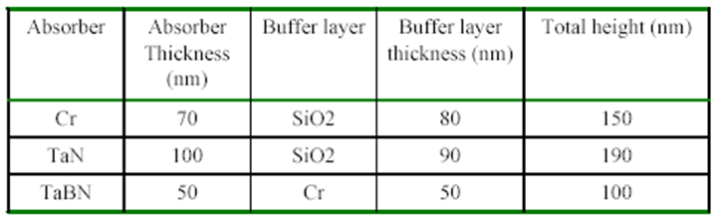
Mask for EUV lithography
There can be a capping layer (11nm Si) above the multilayer, to protect the multilayer during the following mask-making processes.
(TiO₂ doped SiO₂ amorphous glass from Corning)
Typical thickness

Slide 38
EUV mask fabrication: multi-layer mask blank fabrication

Slide 39
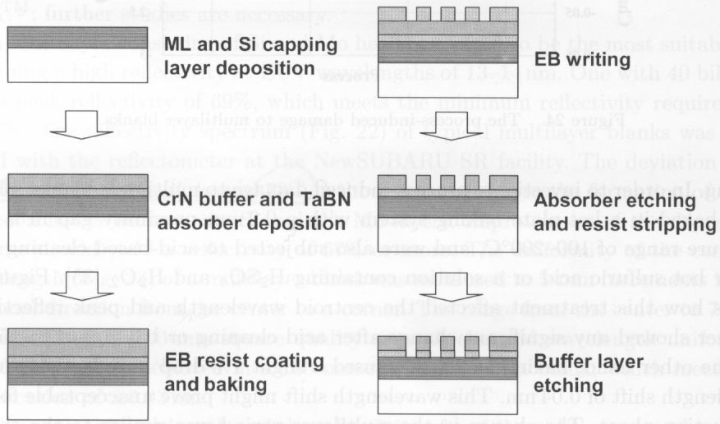
EUV mask fabrication: pattern by e-beam lithography
(by DC magnetron sputtering)
(use ICP RIE Cl₂ gas)
(use ICP RIE Cl₂/O₂ gas)
Defects easy to print into resist, so NO defect is allowed in a completed mask.
Many defects can be repaired by local heating, focused ion beam milling….

Slide 40
Extreme UV (EUV) lithography
Overview, why EUV lithography?
EUV source (hot and dense plasma).
Optics (reflection mirrors).
Mask (absorber on mirrors).
Resist (sensitivity, LER, out-gassing).
Contamination control.

Slide 41
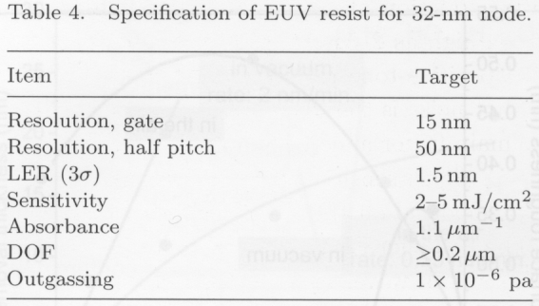
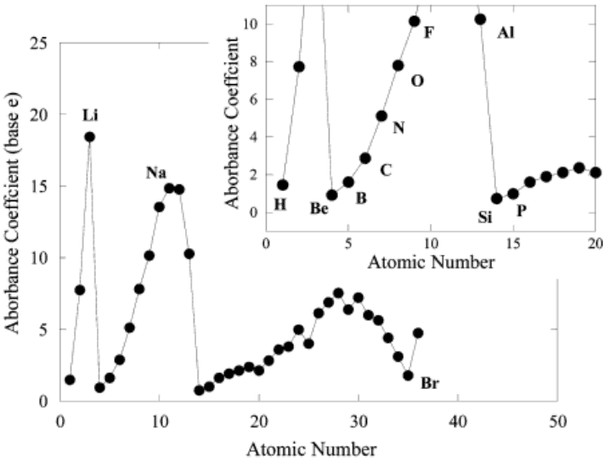
Resist for EUV lithography
Resist requirements:
High Sensitivity (so allowing weak sources)
High resolution (for small feature sizes)
Low LER (line edge roughness)
Minimal out-gassing (contaminate optics)
Most conventional resists are patternable at EUV.
(32nm?)
Absorbance in EUV
The EUV absorbance in organic materials occurs by inner-shell electrons and is therefore - differently from optical lithography - independent of molecular structure.
The absorption of molecules is then equal to the sum of the atomic absorptions.
The strongest absorbing atoms in resists and PAGs are F > O >> N > C, Cl, S, H.
(μm⁻¹)
(PAG: photo-generated acid, for chemically amplified resist)

Slide 42
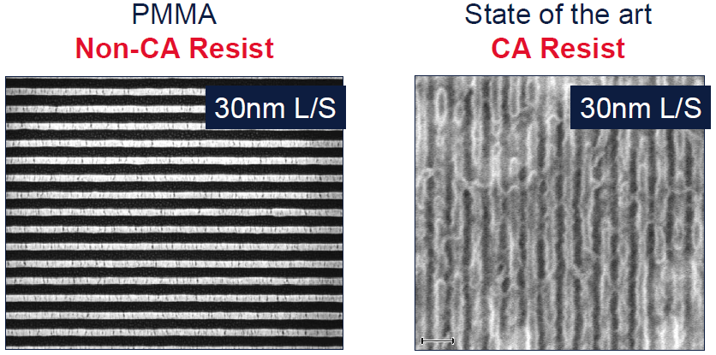
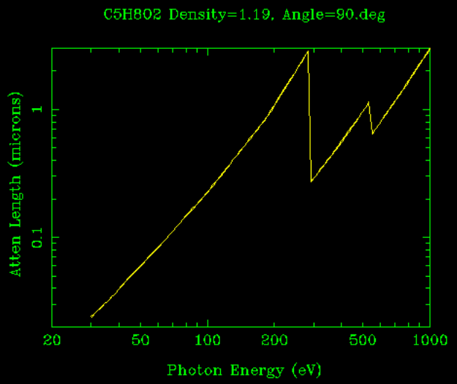
PMMA has highest resolution, but too slow (low sensitivity)
CA: chemically amplified
L/S: line/space
PMMA
C₅H₈O₂
Another issue for PMMA and most other resists is the low penetration depth (order 100nm, need ∼200nm) into resist at 13.5nm(92eV).
So might (or not) need a bi-layer resist process (top for lithography, bottom layer for pattern transfer).
Attenuation length (μm)
Photo-electron absorption edge for inner shell (K, L, M…)

Slide 43

Resist LER (line edge roughness)
LER is due to:
Shot (statistical) noise. At EUV, photons have high energy, therefore low counts and high LER due to statistical photon number fluctuation.
Shot noise needs to be compromised with resist sensitivity. High sensitivity (fewer photons per exposure) leads to high shot noise. Roughly LER∝(dose)^{-1/2}.
Uncontrolled diffusion of photo-acid (also limit resolution).
Scattering of secondary electrons in resist and substrate (leads to image blur).
For 32nm node, need
Sensitivity: 2-5mJ/cm²
LER: 1.5nm
2mJ/cm²→1.36 photon/nm²(!!)

Slide 44
Extreme UV (EUV) lithography
Overview, why EUV lithography?
EUV source (hot and dense plasma).
Optics (reflection mirrors).
Mask (absorber on mirrors).
Resist (sensitivity, LER, out-gassing).
Contamination control.

Slide 45
Contamination and damage to EUV optics
Debris with low velocity will deposit to the mirrors, causing contamination. (debris for Sn or Li source, not for Xe gas source)
Debris with high velocity could damage the optics by sputtering material off the lenses.
Many methods have been tried to manage high energy debris particles:
  Gas stopping
  Magnetic stopping
  Gas plus magnet
Contamination of lens (due to resist out-gassing…): EUV irradiation leads to photochemical reactions that cause hydrocarbons to adsorb to the mirror and mask, reducing mirror’s reflectivity.
Contamination removal methods includes:
  UV (λ>185nm) irradiation in ozone atmosphere at 150ºC.
  Synchrotron radiation.
  DUV (deep UV, λ=172nm) radiation (simple and efficient).

Slide 46


Gas stops ions, but also stops EUV photons
Ion yield at 10˚, 15 cm
Faraday cup vs. SRIM estimate
Conversion efficiency (CE) at 45˚, 78 cm
E-mon vs. attenuation calculation
Calculated
(T: transmission)
For instance, for He gas at 100mTorr, 80% ions are stopped at 15cm from source, with CE dropped from 2% to 1.6% at 78cm from source.

Slide 47



Magnetic diversion is partially effective, but not sufficient
Magnetic field deflects the moving charged ions and clusters (debris), with no effect to photons.
Force on charge=qv × B
(q: charge, v: velocity, B: magnetic field)
5 GW/cm²
aluminum
free expansion velocity v=6x10⁶ cm/s

Slide 48


Magnetic field plus background gas is most efficient
Faraday cup time-of-flight measurements
at 10˚, 15 cm from target
Photo-ionization peak appears when gas is present
(100% dense)
No B, no He
With B, no He
No B, with He
With B and He
Magnetic field alone (no He) effectively delays the arrival of ions/debris without stopping them.
Notes:
Another way to stop debris is to insert a shutter (fast rotating slit), which lets pass the light (fast), then closes quickly to block the debris (slower, arrive later).

Slide 49



Hydrocarbon contamination removal by 172nm excimer DUV (deep UV) lamp
DUV at this short wavelength produces oxygen radicals directly from molecular O₂, which react with oxygen gas to form ozone. The reactive ozone & DUV oxidize contaminants and they evaporate.
(Longer wavelength, e.g. 185nm, won’t work)

Slide 50

EUVL alpha demo systems and results
As of 2007, two alpha demo tools are at research centers

Slide 51


