Slide 1
X-ray lithography (XRL)
Overview and resolution limit.
X-ray source ( electron impact and synchrotron radiation).
X-ray absorption and scattering.
X-ray lithography resist (PMMA and SU-8).
X-ray lithography mask (absorber on membrane).
LIGA process (for high aspect ratio metal structure).
Zone plate for focused x-ray beam array lithography.
ECE 730: Fabrication in the nanoscale: principles, technology and applications
Instructor: Bo Cui, ECE, University of Waterloo; http://ece.uwaterloo.ca/~bcui/
Textbook: Nanofabrication: principles, capabilities and limits, by Zheng Cui

Slide 2
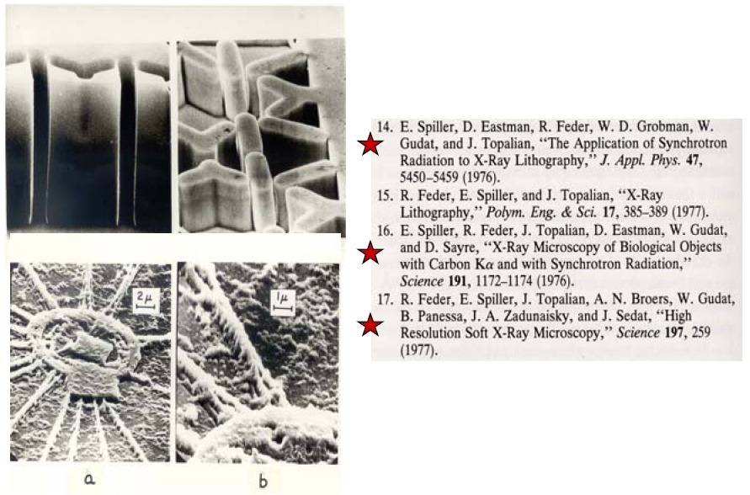

X-ray lithography history
D. L. Spears and H. I. Smith, “High resolution pattern replication using soft x-rays”, Electronic Letters, 8, 102 (1972).
H. I. Smith
(MIT)

Slide 3
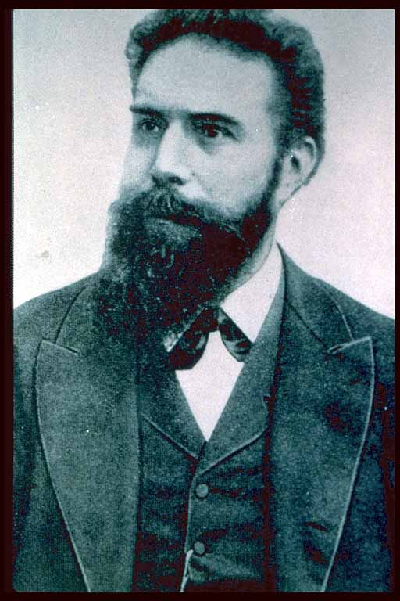
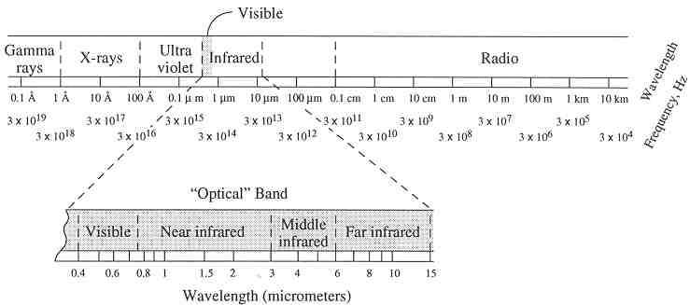
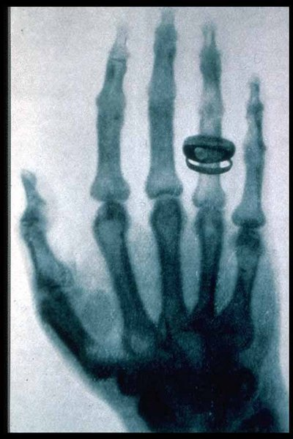
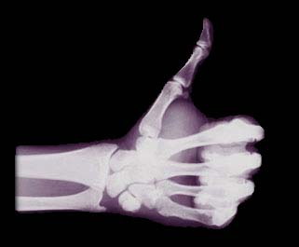
What is X-ray?
Microwave
Cell phone, PCS
X-ray
FM
AM
Wilhelm Conrad Roentgen (1845-1923)
Roentgen discovered an unknown ray in 1895 (X-ray) that can cause barium platinocyanide-coated screen to glow.
He won the first Nobel prize in physics in 1901.

Slide 4
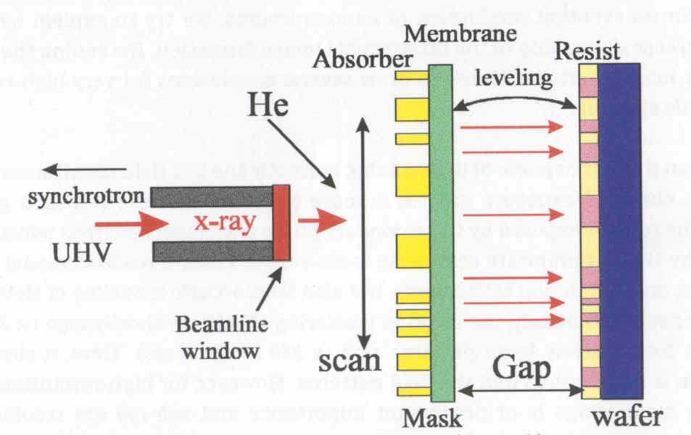
Setup of proximity x-ray lithography

Slide 5
X-ray lithography advantages
Wavelength: λ∼ 10’s nm (soft x-rays) down to ≤1Å (subatomic).
Little diffraction effects when using such small λ.
No backscatter or reflections: very fine features with vertical sidewalls.
Very large depth of focus: topography on the wafer is nearly irrelevant.
Tolerant to (low atomic weight) dust & particulates: they are transparent to x-ray.
Simpler (in principle) than optical or e-beam lithography: no complex optics (don’t really have x-ray optics now).
All that needed is an x-ray source and an x-ray mask.

Slide 6
X-ray lithography limits
1X mask technology because refractive index for all materials is (almost) absolutely 1.0 (no lens for demagnification). (4× for DUV lithography mask, easier to make)
Mask difficult to fabricate with many issues: fragile, defects, aspect ratio, bending due to heating.
Strong, stable, collimated, single frequency x-ray sources are hard to find. X-rays produced in synchrotrons fit this criteria and can support many exposure stations, but with high cost and huge size.
Alignment/registration is nontrivial.
Resolution is still limited by Fresnel diffraction and scattering of secondary electrons in the resist.
Typical resist is insensitive, need long time to expose.
w
h
Aspect ratio=pattern height/width=h/w.

Slide 7
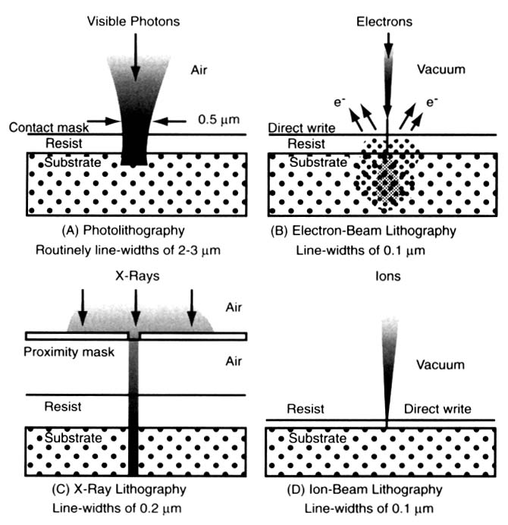
Comparison to other lithographies
E-beam lithography (scattering, proximity effect)
Photolithography, R∼λ
X-ray lithography, no diffraction, high depth of focus
Ion beam lithography, low penetration depth (very thin resist)
The physics of microfabrication, I. Brodie and J. J. Murray, Plenum Press, 1982

Slide 8
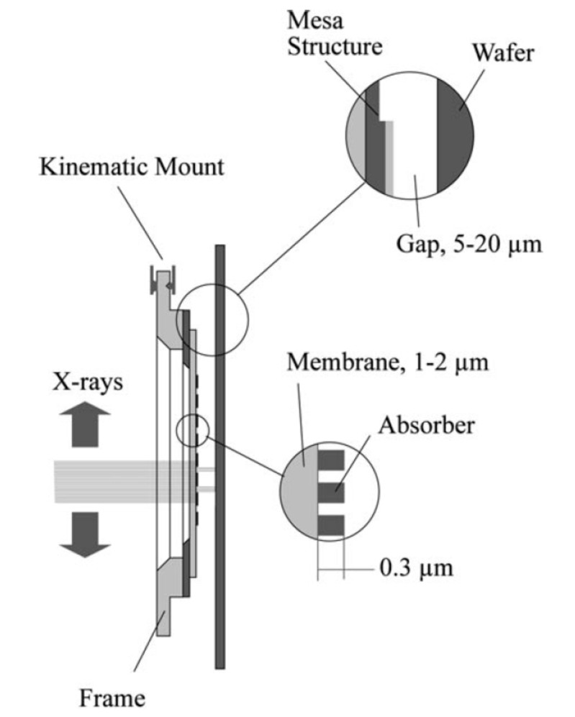
X-ray lithography: resolution limit due to diffraction
Precise gap must be maintained: too close will damage membrane mask, too far reduce resolution.
Resolution limit due to Fresnel diffraction R=3/2[λ⋅(g+t/2)]^{1/2}, g: gap; t: resist thickness.
E.g. 100nm feature size requires λ=1nm, g=4.4μm.
Beam scanned over mask
Mask
Resist
Cerrina, J Phys D, 2000

Slide 9
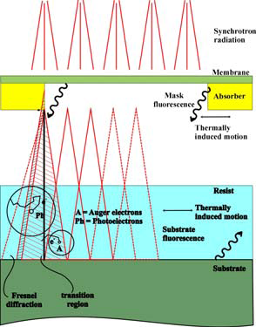
Resolution limit due to secondary effects
Secondary effects:
X-ray fluorescence of mask and substrate that exposes resist.
Lateral diffusion of photoelectron and Auger electron.
Thermal induced mask or resist motion or distortion.
Non-vertical sidewall of the Au absorber on mask, leading to blurred edge.

Slide 10
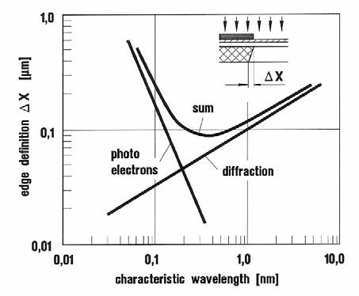
How to achieve high resolution?
Photo-electron lateral diffusion:
Diffraction:
R=3/2[λ⋅(g+t/2)]^{1/2}∝λ^{1/2}
To achieve high resolution:
Use longer wavelength (e.g. 1nm) to reduce photo-electron lateral diffusion.
Longer wavelength also means thinner Au absorber, which can be patterned accurately. (thick Au may not have vertical sidewall, leading to blurred edge.)
Use smaller gap and thinner resist. Thinner resist is good for longer wavelength that has smaller penetration depth (more absorbing).
Lateral widening due to photoelectrons and diffraction
Ph.D. Thesis Dieter Muenchmeyer, IMT/FZK, 1984
However, it is found that the Auger electron (low energy) is 10× more efficient to expose the resist than photo-electron (high energy); and the Auger electron diffuse only <5nm.
Therefore, the photo-electron is not that important in determining the final resolution, and high resolution (<20nm) can be achieved provided such a mask can be made (VERY difficult).

Slide 11
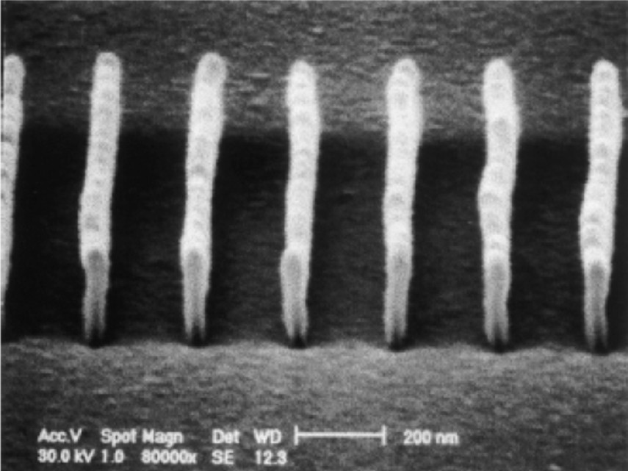
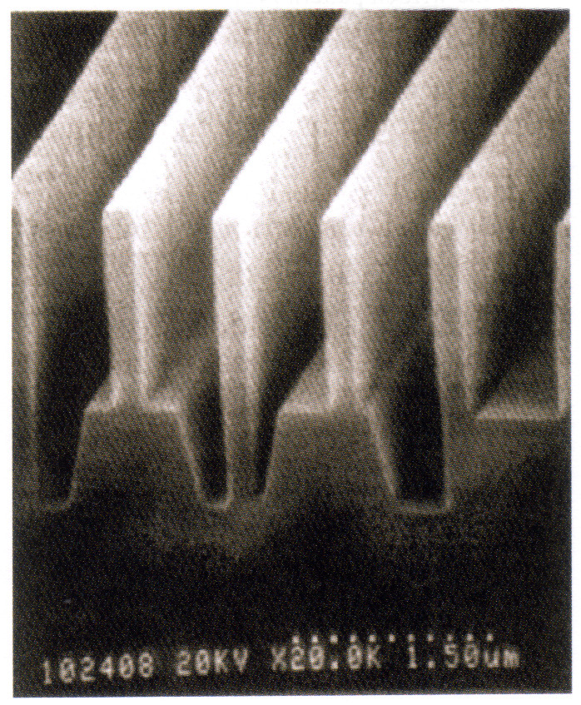
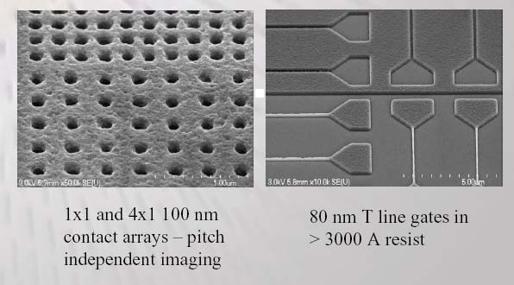
High resolution resist structures by x-ray lithography
∼50nm lines
∼150nm lines
R. Waser (ed.), Nanoelectronics and Information Technology

Slide 12
X-ray lithography (XRL)
Overview and resolution limit.
X-ray source ( electron impact and synchrotron radiation).
X-ray absorption and scattering.
X-ray lithography resist (PMMA and SU-8).
X-ray lithography mask (absorber on membrane).
LIGA process (for high aspect ratio metal structure).
Zone plate for focused x-ray beam array lithography.

Slide 13
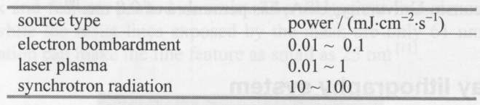
Laser produced plasma x-ray source
X-ray source and their irradiation power
(impact)
high power
laser
metal
tape
Same idea as laser produced plasma (LPP) EUV source, but shorter wavelength (a few nm).
High power-density laser pulses generate a hot and dense plasma, which emits x-rays when free electrons recombine with ions, or bond electrons jump to a lower energy level.
LPP source is brighter than rotating anode source (electron impact source).
More complicated than electron bombardment source, less powerful than synchrotron radiation.

Slide 14
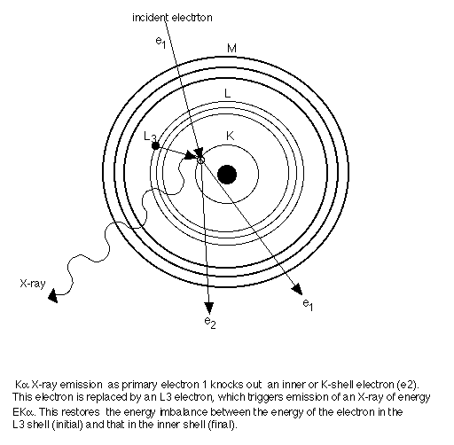
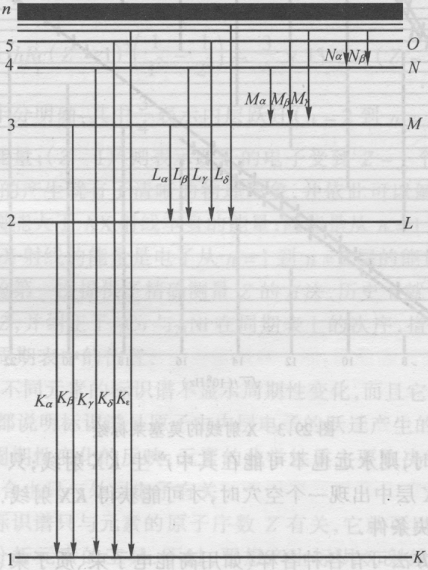
X-ray generation by electron impact (bombardment)
e₁
X-ray
e₁
e_{2 (photo-electron)}
When electron jumps from L to K-shell, it either emits x-ray (as shown in the figure), or gives its energy to an outer-shell electron that escapes subsequently (Auger electron, not shown).
For K_{α} line: Hz, energy E=hν.
((Z-1) instead of Z due to screening effect of the other electron in n=1 level)

Slide 15
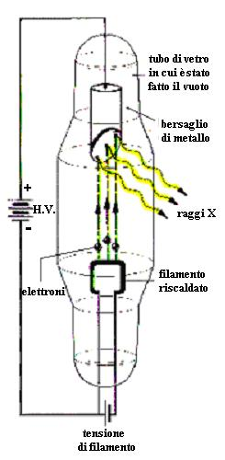
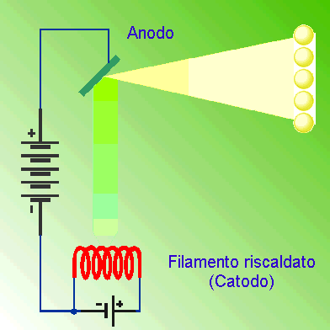
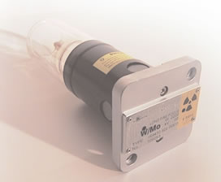
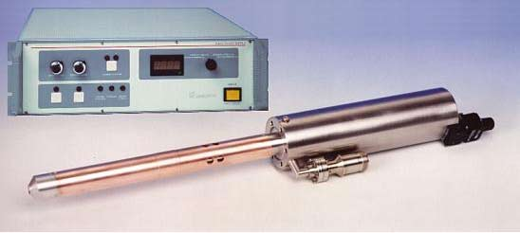
Electron impact: sealed tube x-ray source (point source)
Developed by Coolidge (at GE) around 1912.
Electron accelerated at high energy to the anode.
Core electrons in the anode excited and x-rays emitted when they fall back to the core levels.
Low power, tuned to maximize for narrow emission range (for example, Mg or Cu K_{α}).
For material characterization by x-ray diffraction and medical imaging
X-ray
e
Hot filament emits electrons

Slide 16
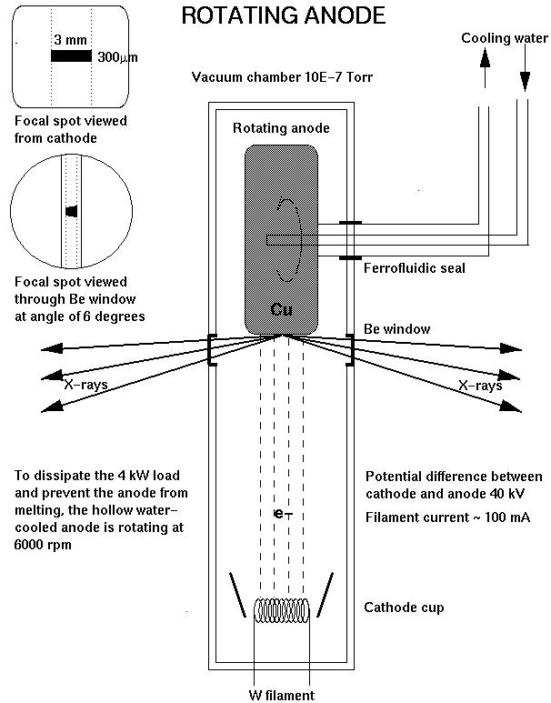
Electron impact: rotating anode source
-50kV
H₂O in
and out
Refractory anode rotating at ∼6000rpm
Rotating anode source:
Same principle as sealed tube x-ray source, but with much higher power due to greater thermal capacity – cooling wafer, rotating, refractory metal.

Slide 17
Synchrotron radiation x-ray source: the choice for x-ray lithography
Storage Ring
Shield Wall
Synchrotron radiation (SR):
Electromagnetic radiation (light) emitted from electrons (positrons) moving with relativistic velocities on macroscopic circular orbits.
First observed in 1947 from a 70MeV electron accelerator at the GE.
In earlier times, it was just considered as waste product limiting accelerator performance.
However, other researchers soon realized that SR was the brightest source of infrared, ultraviolet, and x-rays, very useful for studying matter on the scale of atoms and molecules.
Irradiation is highly polarized and pulsed (e.g. nanosecond pulse).
Due to extreme collimation of light, observer sees only a small portion of electron trajectory. The pulse length is the difference in times it takes an electron and a photon to cover this distance.

Slide 18
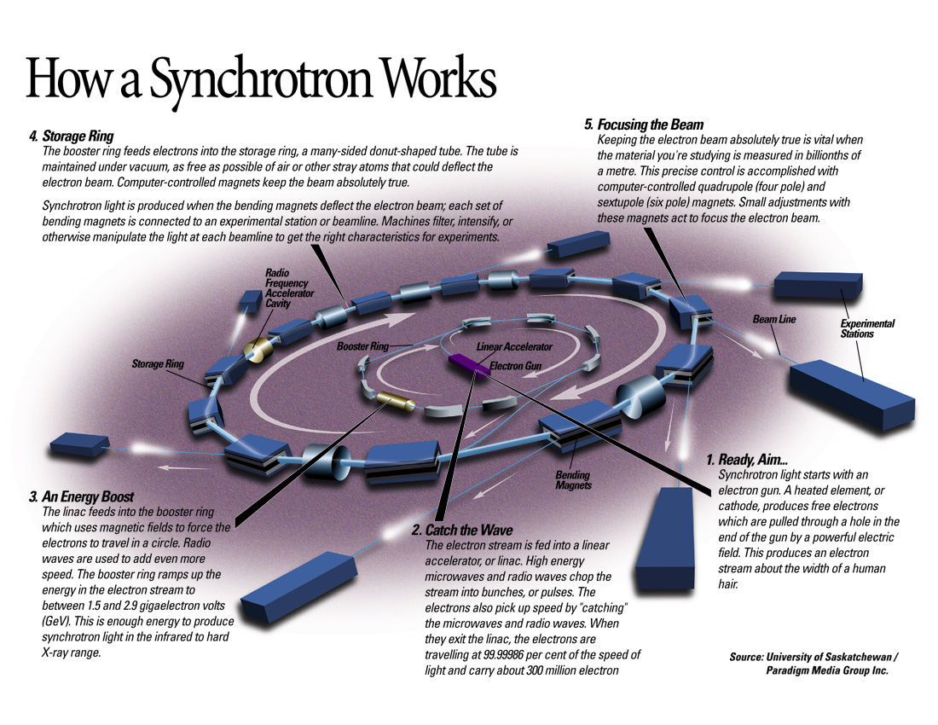

Slide 19
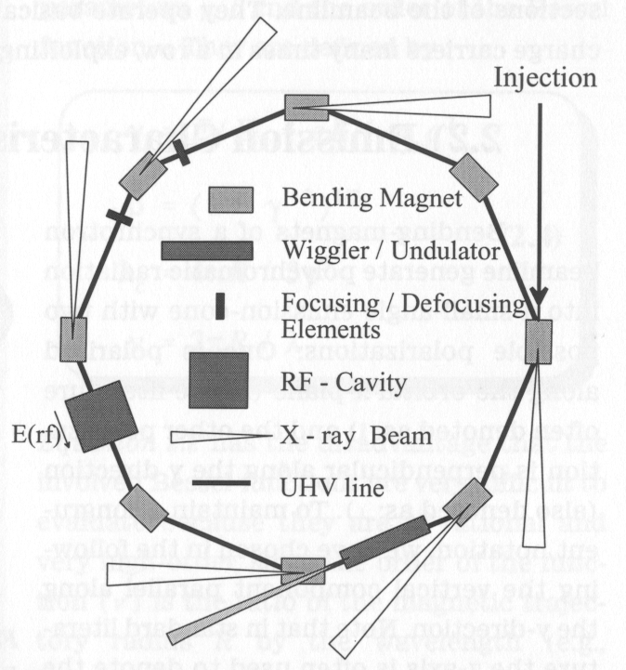
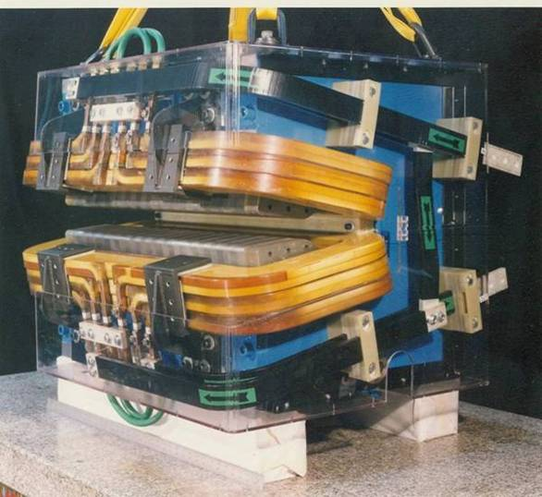
How synchrotron radiation works?
Bending magnet:
For normal-conductive B≤∼1.5 Tesla.
“C” shaped allowing radiation to exit
Typically a low-energy accelerator injects “bunches” of electrons into a storage ring; the charged particle are in pico-second pulses space nanoseconds apart.
Acceleration is produced by an alternating (RF) electric field that is in synchronism with orbital frequency.
A broad continuum of radiation is emitted by each bunch when it changes direction, with the median (or “critical”) wavelength given by

Slide 20
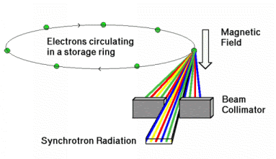
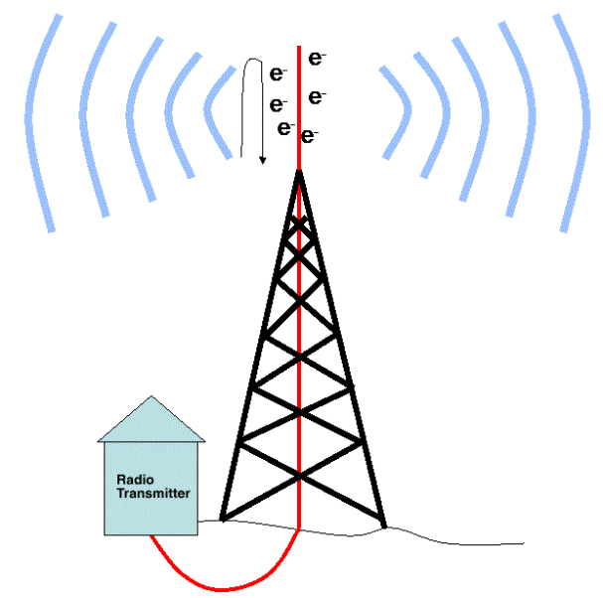
Radiation is due to charge acceleration
Synchrotron radiation:
electromagnetic radiation emitted when charged particles are radially accelerated (move on a curved path)
Antenna:
electrons accelerating by running up and down in a radio antenna emit radio waves (long wavelength electromagnetic waves
Radial acceleration a=v²/R (v is speed, R is radius)
Both cases are manifestation of the same physical phenomenon:
Charged particles radiate (only) when accelerated.

Slide 21
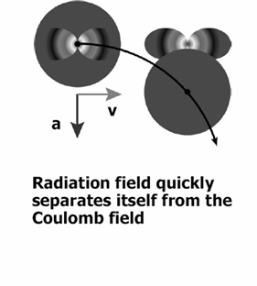
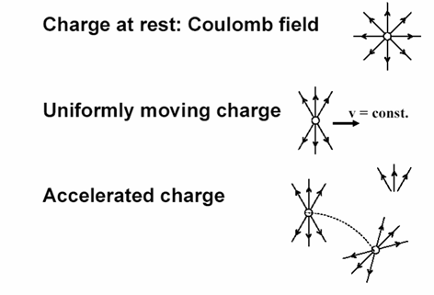
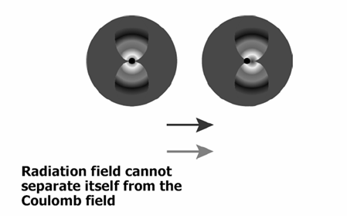
Why particle radiate under acceleration
According to quantum field theory, a particle moving in the free space can be considered as “surrounded” by a cloud of virtual photons that appear and disappear and travel with it.
When accelerated, the particle receives a “kick” that can separate it from the photons that become real and independently observable.
Transverse acceleration is more efficient for radiation.
Transverse (radial) acceleration
Longitudinal acceleration
No radiation even though moving very fast
Slides modified from lecture by Fernando Sannibale
Advanced Light Source Accelerator Physics Group
Ernest Orlando Lawrence Berkeley National Laboratory

Slide 22
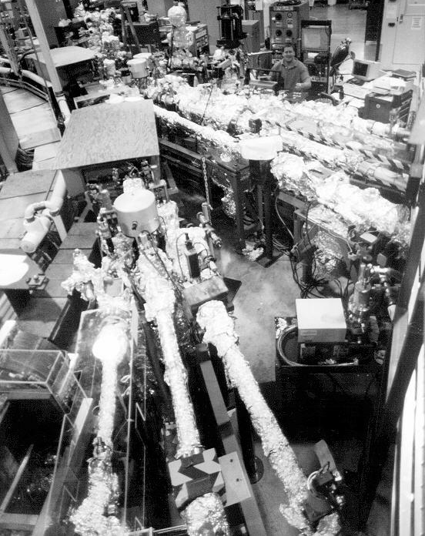
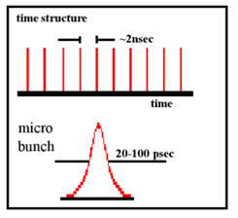
Advantages of synchrotrons for X-ray lithography
Extremely high intensity - can be increased by the addition of “insertion devices” into the storage ring.
Extremely high brilliance - small effective source size situated a long distance from the experimental station.
Very low divergence out of the plane of storage ring.
Tunable, specific energies can be chosen.
Highly polarized and short pulses.
It offers many characteristics of visible lasers but into the x-ray regime - partial coherence, high stability.

Slide 23
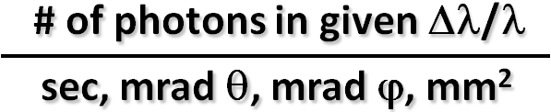
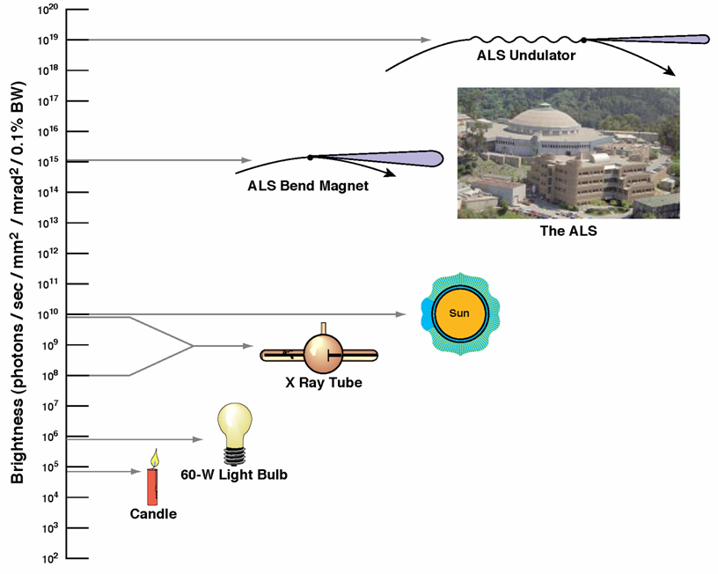
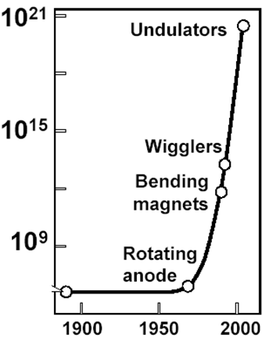
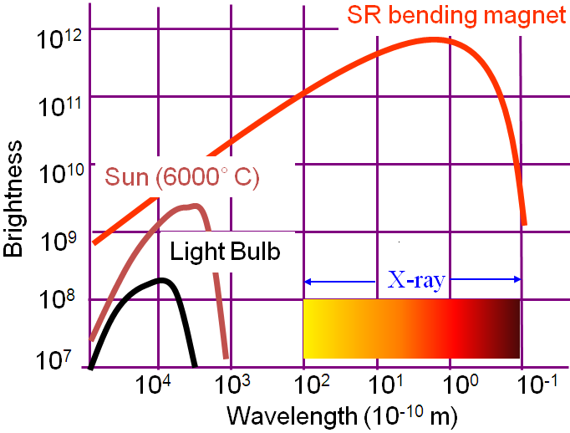
Comparison of brightness ( )
ALS: Advanced Light Source @ Berkeley
@LBNL
Rontgen
(electron impact source)
Slides modified from lecture by Fernando Sannibale
Advanced Light Source Accelerator Physics Group
Ernest Orlando Lawrence Berkeley National Laboratory

Slide 24
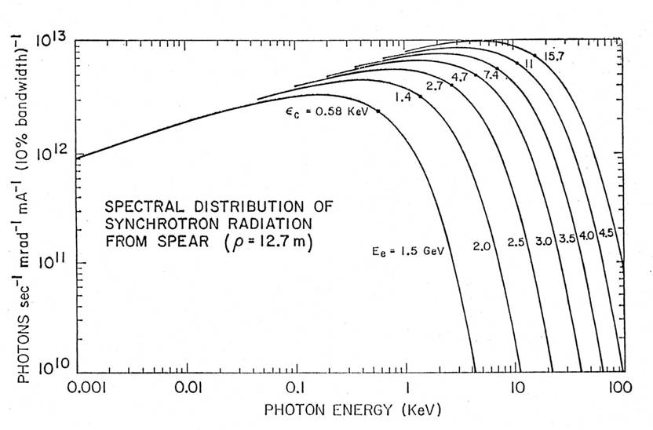

Spectrum of synchrotron radiation (bending magnet)
Bending Magnet
(critical energy)
(energy=hf=hc/λ=qV)
1.24nm
Electron rest energy=mc²=(9.1×10⁻³¹)(3×10⁸)²=8.19×10⁻¹⁴J=0.511MeV (very small).
Total electron energy=γmc², with γ=1/(1-v²/c²)^{1/2}.
For 1.0GeV energy, γ=1000/0.511=1957, so v/c=0.99999987, indeed v is very close to c.

Slide 25
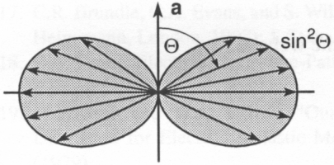

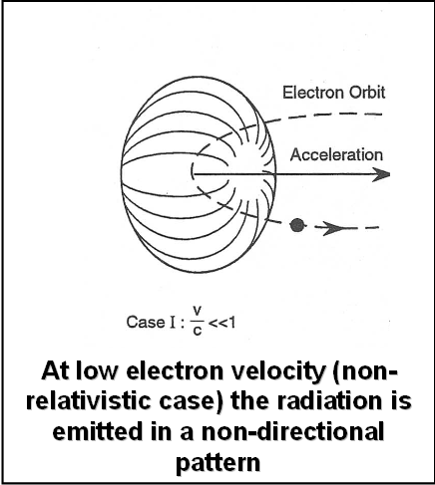
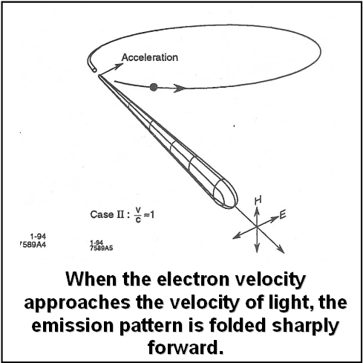
Synchrotron radiation angular distribution
p: power
a: acceleration
Ω: spherical angle
(no radiation along acceleration direction)
Cone aperture
~ 1/γ
Radiation becomes more focused and directional at higher energies

Slide 26
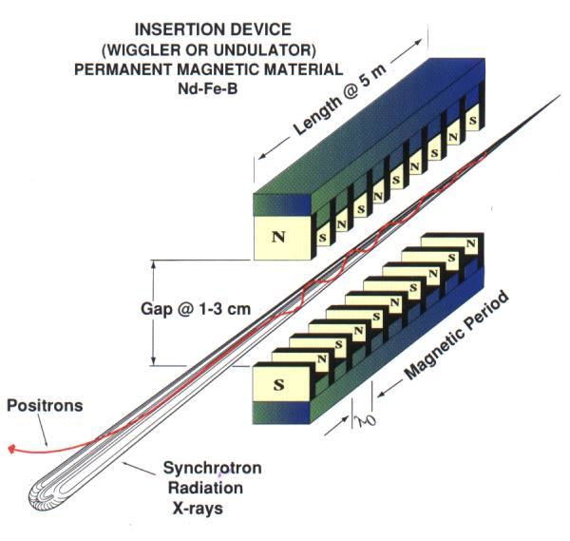
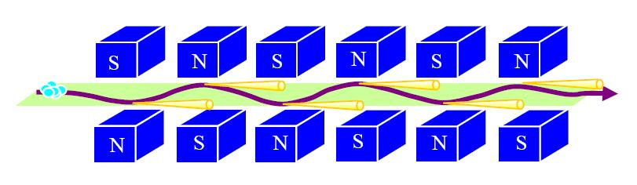
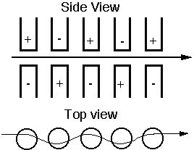
“Wiggler or undulator” radiation
For bending magnet radiation, electrons are accelerated/bended by uniform magnetic field (B along +z direction, circular electron trajectory).
By putting an array of permanent magnets like below, magnetic field alternates up (+z direction) and down (-z), causing the particles to bend back and forth along the horizontal plane.
At each bend, the electrons emit synchrotron radiation in the x-ray part of the spectrum.
(positive electron)
Particle
trajectory

Slide 27
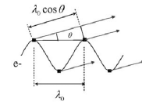
From undulator radiation to wiggler radiation
Bending magnet, uniform B-field
(here B-field means magnetic field)
(t: time)
Small B field, small “wiggling”, coherent, radiation “peaks”
undulator - coherent interference
Large B field, large “wiggling”, incoherent
wiggler - incoherent superposition
For small B, photons emitted by different poles interfere coherently, transforming the
continuous dipole-like spectrum into a discrete spectrum (undulator).
The interference condition requires that, while traveling along one period of the undulator, the electrons slip by one radiation wavelength with respect to the (faster) photon.
But when B is increased (by reducing gap between magnets), “wiggling” inside the undulator increase, and the spatial overlap between the radiated field decreases that reduces the interference, eventually becoming wiggler radiation (continuous spectrum).

Slide 28
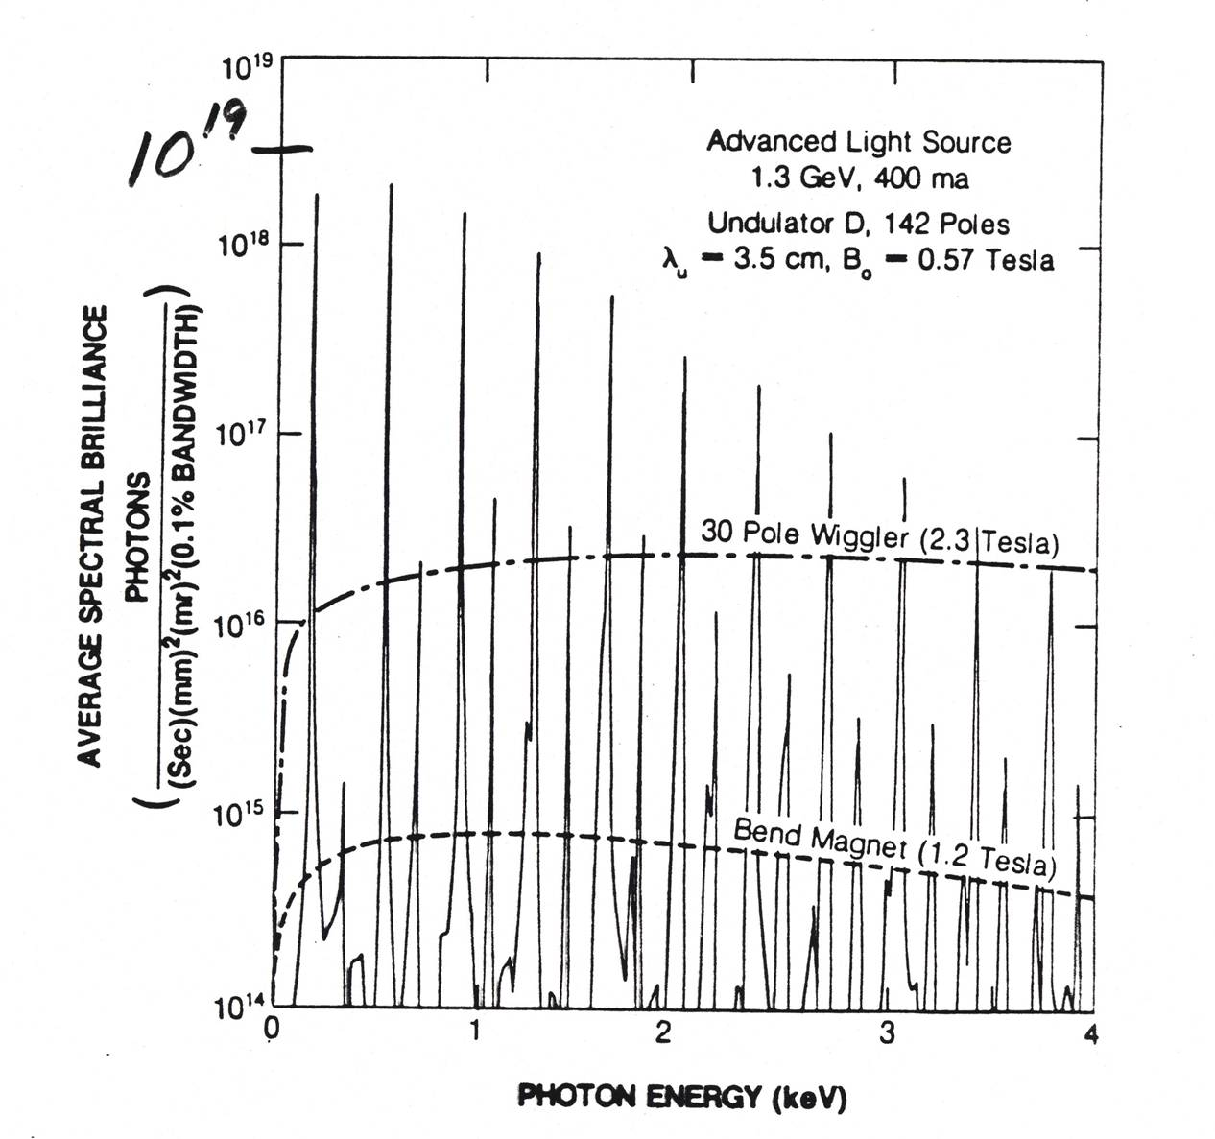
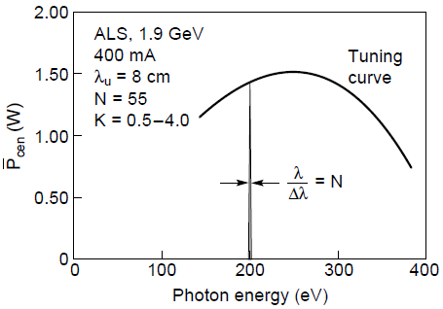
Spectrum comparison: bending magnet, undulator, wiggler
Undulator peaks
Undulator “peaks” at λ where light interfere constructively.
Wiggler
N is number of magnet pairs
Bend magnet
Wiggler uses high magnetic field (high force/acceleration), so higher total radiation power; but undulator radiation power is higher at certain wavelengths (peaks).
X-ray lithography typically uses undulator radiation (?).

Slide 29
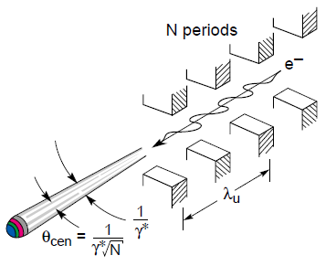
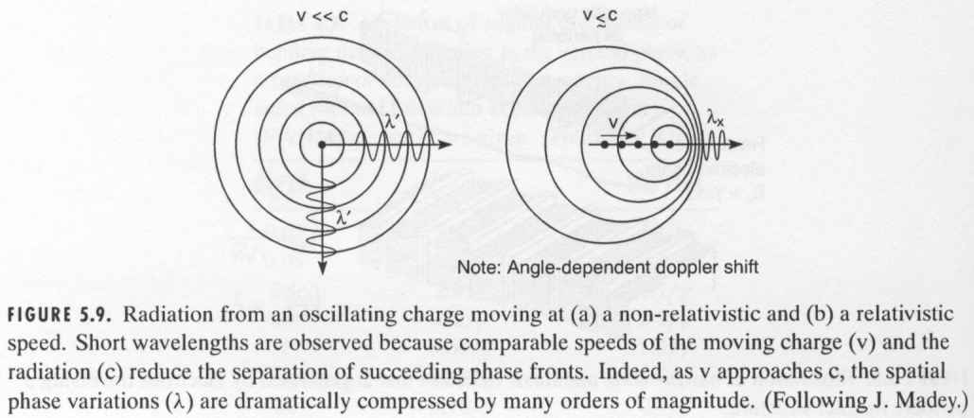
Undulator radiation: Doppler shift to x-ray wavelength
Synchrotron radiation from relativistic electrons
In the frame moving with the electron, electron “sees” a periodic magnet structure moving toward it with a relativistically contracted period λ’=λ_{u}/γ (λ_{u} is magnet period, γ≡1/(1-β²)^{1/2}, β≡v/c)
The frequency of this emitted radiation is f’=c/λ’=cγ/λ_{u}.
To the observer, the relativistic form of Doppler frequency formula is: f=f’/(γ(1-β))=c/(λ_{u}(1-β))≈2γ²c/λ_{u}. (for β≈1, 1-β≈1/2γ²)
So the observed wavelength is: λ=c/f= λ_{u} /2γ².
E.g, for 1.9GeV, γ=1900/0.511=3718; with λ_{u} =5cm, gives λ=1.8nm (x-ray).

Slide 30
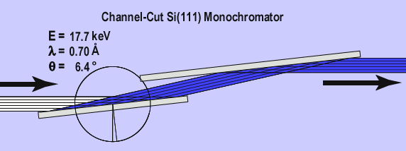
Wavelength selection: mono-chromator by x-ray diffraction
n=1, 2, 3…
This works only for high energy x-ray.
(λ=2dsinθ/n<2d, d∼1Å)

Slide 31
X-ray lithography (XRL)
Overview and resolution limit.
X-ray source ( electron impact and synchrotron radiation).
X-ray absorption and scattering.
X-ray lithography resist (PMMA and SU-8).
X-ray lithography mask (absorber on membrane).
LIGA process (for high aspect ratio metal structure).
Zone plate for focused x-ray beam array lithography.

Slide 32
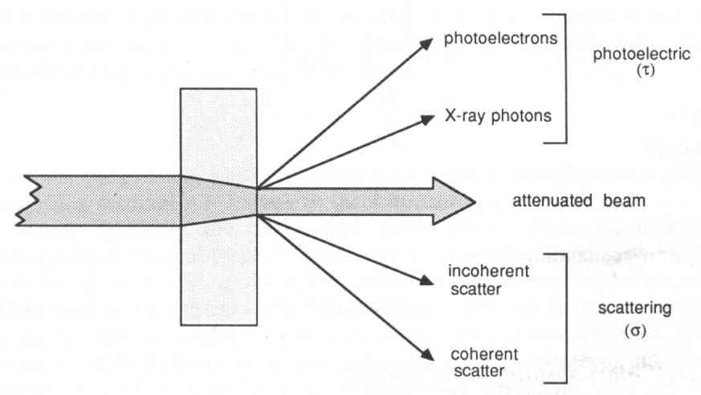
X-ray absorption / attenuation
TARGET
characteristic
Intensity I₀
X-ray
α: absorption coefficient
1/ α: attenuation length
(Compton)
t
(Rayleigh)
In addition to photoelectric absorption (producing photoelectrons and characteristic x-rays or Auger electrons), the original x-rays may be scattered by electrons.
There are two kinds of scattering: coherent (Rayleigh, no energy loss) and incoherent (Compton).

Slide 33
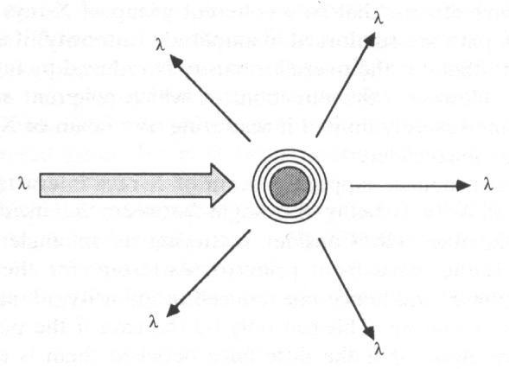


X-ray scattering
Coherent scattering: happens when the x-ray collides with an atom and deviates without a loss in energy. An electron in an alternating electromagnetic field (e.g. x-ray photon) will oscillate at the same frequency in all directions. This is useful for understanding x-ray diffraction (coherent addition of scattered x-ray).
Incoherent scattering: incident x-ray loses some of its energy to the scattering electron. As total momentum is preserved, the wavelength of the scattered photon increases by the equation
(in Å)
where φ is the scatter angle.
(Here 0.0243=h/m_{e}c, h=6.63×10⁻³⁴ is Plank’s constant, m_{e}=9.1×10⁻³¹kg is electron’s mass)
Coherent
λ
λ+Δλ
Incoherent
Photo-electron dominates
e⁺-e⁻ pair generation dominates
λ
Compton dominates
Photon-electron interaction depends on atomic number Z and photon energy

Slide 34


X-ray absorption
At the energies commonly used in X-ray lithography (10keV and below) photoelectric absorption dominates other processes (Compton scattering).
In the relaxation process, the lower energy photon is a fluorescent x-ray, while the lower energy electron is an Auger electron.
X-ray
(fluorescent x-ray)
Photon (x-ray)
atom
1. A high energy x-ray
photon impinges on
an atom
(Auger electron)
Electron (low energy)
Photon
(fluorescent x-ray)
Photo-electron
3. The atom relaxes to
its ground state by
emission of a
photon or electron
2. An inner-shell (here K-shell) electron (photo-electron) is knocked out of the atom.
Auger-electron
Electron
(Auger electron, emitted from M-shell)

Slide 35
X-ray lithography (XRL)
Overview and resolution limit.
X-ray source ( electron impact and synchrotron radiation).
X-ray absorption and scattering.
X-ray lithography resist (PMMA and SU-8).
X-ray lithography mask (absorber on membrane).
LIGA process (for high aspect ratio metal structure).
Zone plate for focused x-ray beam array lithography.

Slide 36
X-ray interaction with resist
Absorption of x-ray does not lead directly to resist modification.
Photoelectrons and Auger electrons are responsible for resist modification.
Therefore, x-ray lithography resist is similar to that for e-beam lithography.
That is, any e-beam lithography resist can also be used as x-ray lithography resist.
In general, high energy x-rays (e.g. λ=0.3-5Å) do not interact strongly (low absorption) with low atomic number materials
  The good news: x-ray resists will be uniformly illuminated (top to bottom) for not-so-thick resist.
  The bad news: x-ray masks will be hard to make opaque (many μm Au).
  The worse news: powerful x-ray sources are needed.
  To reduce exposure time substantially, one can use chemically amplified resist (SU-8) having high sensitivity.

Slide 37


X-ray absorption by PMMA resist
X-ray absorption of PMMA
Transmission of PMMA
Linear absorption coefficient (1/μm)
Transmission of PMMA sheets of different thickness
1.24nm
Photon energy (eV)
Photon energy (eV)
100eV (12.4nm, EUV) ∼0.23 μm
1keV (1.24nm) ∼3μm
10keV (1.24Å) ∼3mm
Medical imaging, need many cm, so λ≤0.1Å
For the same resist thickness:
Higher energy → less absorption, more uniform dose profile throughout the thickness, but low resist sensitivity and needs longer exposure time.
So tradeoff must be made when choosing energy.

Slide 38

X-ray lithography resist: PMMA (poly(methyl methacrylate))
PMMA is the most commonly used resist (positive tone) for x-ray lithography with good quality in accuracy and sidewall roughness, but
extremely insensitive.
PMMA: 500μm thick
Scan length: 6cm
Synchrotron at CAMD: 1.3GeV
Storage ring current: 150mA
Exposure time: 6 hours
Chain scission in poly(methyl methacrylate)

Slide 39


Change of mean molecular weight in PMMA
Exposure to x-ray (that generates Auger electrons…) cut the PMMA chains, leading to smaller molecular weight (M_{w}) that dissolves faster in developers.
Dissolvable by developer
Initial distribution of
high M_{w} PMMA
(500kg/mol)
M_{w} distribution at the substrate (bottom dose). (5.7kg/mol)
M_{w} distribution at the surface (top dose).
(2.8kg/mol)
Solubility of PMMA
in GG-developer, nearly ideal at room temperature.

Slide 40

Characteristic doses: definition and their values for PMMA

Slide 41
High sensitivity x-ray lithography resist: SU-8
SU-8 is a negative tone chemically amplified (so high sensitivity but low resolution) resist for optical lithography, x-ray lithography and e-beam lithography.
Low absorption at λ>400nm or deep x-ray, making high aspect ratio deep resist structure possible by optical or x-ray lithography.
On the other hand, low absorption is disadvantages for thin resist process due to low energy deposition in the resist layer.
It consists of three parts: EPON SU-8 resin, GBL (gamma-butyrolactone) solvent and triaryl sulfonium salt initiator.
One big “problem” is that, once cross-linked by exposure, SU-8 is extremely difficult to remove by chemicals (RIE not practical for etching thick >>1μm polymers).

Slide 42

Characteristic doses for SU-8
Should be 20000J/ccm!
(ccm: cubic centimeter)

Slide 43




Quality and accuracy of SU-8 microstructures
AFM image of sidewall
400 μm tall SU-8
grating with 20μm
steps
No more than
0.1 μm variations
on heights of steps
Roughness of sidewall, Ra= 26 nm

Slide 44

Summary: what wavelengths for what application
(Si₃N₄…)
(Au…)
Absorption in PMMA
Membrane mask
Mask
Resist
The selection of x-ray wavelength depends on resolution and resist height (aspect ratio).
Longer wavelength (1-5nm): shorter penetration depth, so thinner resist, thinner Au absorber, thinner membrane (fragile). Long λ means more serious diffraction that limits resolution.
Shorter wavelength (0.3-5Å): thicker resist/absorber/membrane, more lateral diffusion of (high energy) photo-electrons. Low absorption means low resist sensitivity/longer exposure time.
Therefore:
  For high resolution applications, longer wavelength will be better, and keep everything thinner and gap smaller.
  For high aspect ratio application (resist thickness > 100μm), shorter wavelength must be used. The resolution is then limited by diffraction (since resist is very thick or gap is big), lateral diffusion of photo-electron (insignificant), or non-vertical sidewall of the thick (>10μm) Au absorber (leads to blurred edge, difficult to make vertical sidewall except mask itself is also made by x-ray lithography).

