Slide 1
Electron beam lithography (EBL)
Overview and resolution limit.
Electron source (thermionic and field emission).
Electron optics (electrostatic and magnetic lens).
Aberrations (spherical, chromatic, diffraction, astigmation).
EBL systems (raster/vector scan, round/shaped beam)
ECE 730: Fabrication in the nanoscale: principles, technology and applications
Instructor: Bo Cui, ECE, University of Waterloo; http://ece.uwaterloo.ca/~bcui/
Textbook: Nanofabrication: principles, capabilities and limits, by Zheng Cui

Slide 2
E-beam lithography (EBL) overview
(direct writing with a focused e-beam)
Use resist like optical lithography, but resist exposed by electrons.
Positive resist by polymer chain cutting, negative by cross-linking or polymerization.
Electron beam is focused to spot size <5nm using electron optics.
Very small wavelength: resolution less limited by diffraction.
Generate pattern by direct writing: ne need of mask.
Sequential pixel-by-pixel writing: low throughput , unsuitable for mass production.
For electron:
(V is electron kinetic energy in eV)
For light:
For EBL at 30kV acceleration voltage
λ=0.007nm
For an electron with kinetic energy of 1eV, the associated DeBroglie wavelength is 1.23nm, about a thousand times smaller than a 1eV photon.
(Note: electron rest mass energy is mc²=511keV, so relativity is unimportant for <50kV)

Slide 3
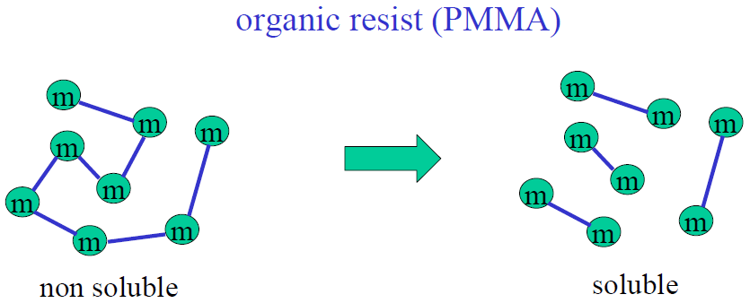
Exposure of resist
Typical energy for breaking a bond: 10eV
But typical energy of the beam: 10-100kV
(problems of aberration at low energy that leads to large beam spot size and low resolution, so use high energy for EBL)
Bond is broken by secondary (including Auger) electrons with low energy.

Slide 4
E-beam lithography facts
Developed in 1960s along with scanning electron microscope (SEM).
Breakthrough made in 1968 when a polymer called PMMA (poly methyl meth acrylate) was discovered to have high resolution.
Fast growth in 1990s when “nano” began to become “hot” and computer became more available for automatic lithography control.
Since around 2000, focused ion beam (FIB) patterning began to compete with EBL in some applications.
Today EBL is still the most popular nano-patterning techniques for academic research and prototyping.

Slide 5
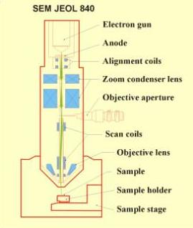
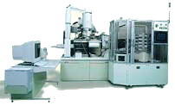
SEM/EBL system components
An electron gun or electron source that supplies the electrons.
An electron column that 'shapes' and focuses the electron beam.
A mechanical stage that positions the wafer under the electron beam.
(optional) A wafer handling system that automatically feeds wafers to the system and unloads them after processing.
A computer system that controls the equipment.

Slide 6
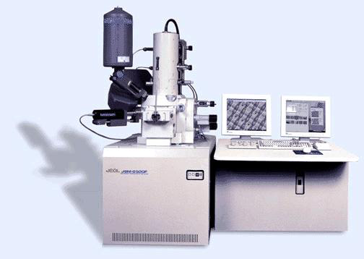
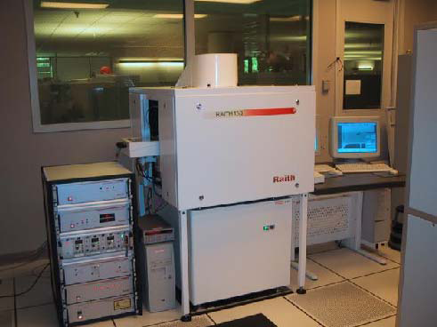
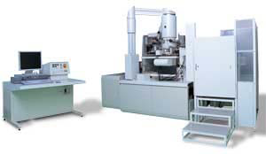
EBL systems: most research tools are based on SEM
SEM conversion
Conventional SEM (≤30kV)
Almost no SEM modification
Add beam blanker
Add hardware controller
Low cost: <$100K
Dedicated EBL system
Based on SEM system
With perfect integration
Interferometer stage
Focus correction (laser sample height control)
Cost $1-2M
E-beam writer
High energy column (100kV)
Dedicated electron optics
High reproducibility
Automatic and continuous (over few days) writing
High cost (>$5M)
NPGS system Raith system Vistec system

Slide 7
Electron beam lithography (EBL)
Overview and resolution limit.
Electron source (thermionic and field emission).
Electron optics (electrostatic and magnetic lens).
Aberrations (spherical, chromatic, diffraction, astigmation).
EBL systems (raster/vector scan, round/shaped beam)

Slide 8
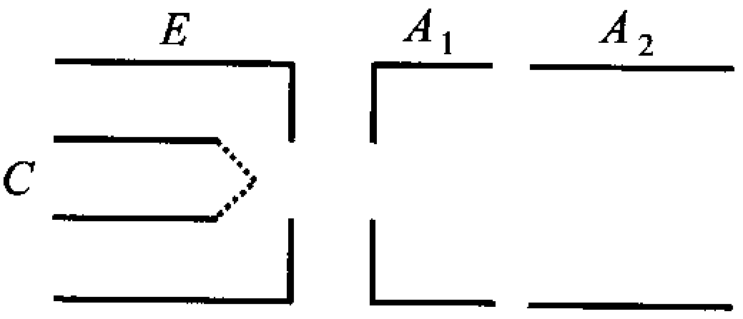
Electron guns/source
Schematic structure of electron gun
Electrons can be emitted from a filament (emitter or cathode) by gaining additional energy from heat or electric field.
C: cathode for emitting electrons
E: extraction electrode
A1, A2: cathode lens electrode to focus the emitted electrons
Three types of electron guns:
Thermionic emission gun (W, LaB₆, not-sharp tip).
Field emission gun (cold, very sharp W tip, tunneling current).
Schottky gun (field assisted thermionic emission, sharp tip).
Whether it is field emission or not depends on the electric field near the tip apex, which determines whether tunneling is important or not.
Sharper tip leads to higher electric field near tip apex, so field emission (by tunneling) plays a major role, it is thus called field emission gun (FEG).
Even thermionic emission relies on the electric field from the extraction electrode, but here thermionic emission plays a major role.

Slide 9
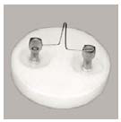
Electron gun: thermionic emission (tungsten hairpin filaments)
The long time source of choice has been the W hairpin source
Working at high temperature, some electrons have thermal kinetic energy high enough to overcome the energy barrier (work function, but kT still << work function).
Escaped electron is then extracted by the electric field generated by the nearby extraction electrode.
Current density J_{c} depends on the temperature and cathode work function  φ.
Cheap to make and use ($12.58 ea) and only a modest vacuum is required. Last tens of hours.
W filament
Vacuum level
Work func-tion φ (eV)
Thermionic electrons
Schematic model of thermionic emission

Slide 10
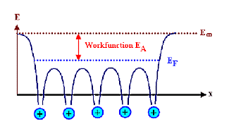
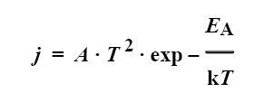
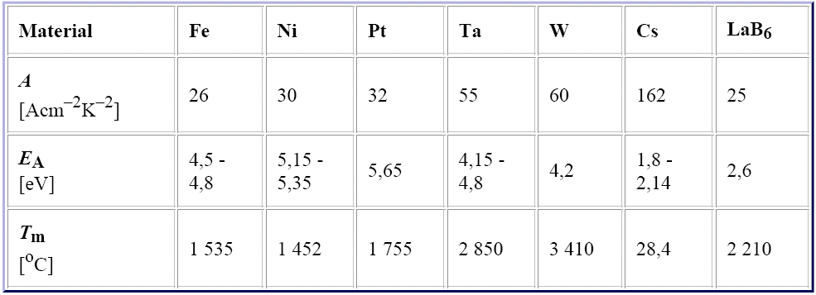
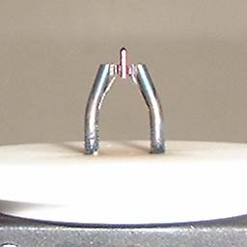
Electron gun: thermionic emission (LaB₆ tip)
Richardson’s equation for emission current
( )
(Here work function is noted as E_{A}, instead of φ)
Low work function, high melting point is good.
LaB₆ tip
Besides W, single crystal LaB₆ is another popular tip material for thermionic emission guns.
About 5-10× more expensive than W, but last 5-10× longer and is brighter, but higher vacuum is required (since LaB₆ is very reactive).
Notes:
Lanthanum Hexaboride

Slide 11
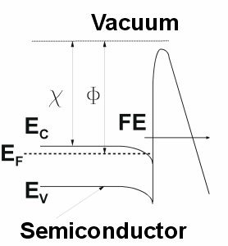
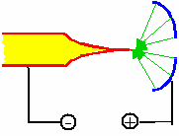
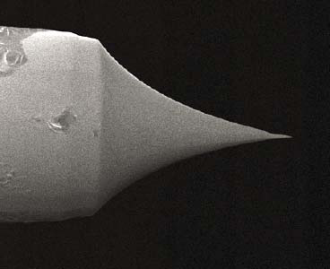
Field emission guns (FEGs)
Field emitter
tunneling
(But FEG tip material is NOT semiconductor)
Current density (Fowler-Nordheim equation ):
J = A·F²·φ⁻¹exp (-Bφ^{1.5}/F) here A=1.5×10⁻⁶; B=4.5×10⁷; F>10⁷(V/cm)
Work function depends on temperature T and electric field F by:
Field emission (i.e. tunneling) becomes important for electric field F>10⁷V/cm.
Need very high vacuum to prevent arc-over at tip apex.
Strong nonlinear current-voltage characteristic.
Very short switching time (t<ns).
Small beam spot size, since field is high enough for tunneling only near tip apex.
Notes:
Epsilon0=8.854x10^(-12) in SI units.

Slide 12
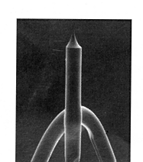
Cold field emission guns (FEG)
Electrons “tunnel out” from a tungsten wire because of the high field (∼10⁸V/cm) obtained by using a sharp tip (100nm) and a high voltage (3-4kV).
The emission current is temperature independent (pure tunneling current, operate at room temperature, so the name “cold”).
Needs ultra-high vacuum (UHV), but gives long life and high performance.
Vacuum level
Sharp tip, high electric field
Δφ
Work func-tion φ(eV)
Field F (V/cm)
Work function is lowered by Δφ, but this plays insignificant role for tunneling current.

Slide 13
Cold field emission gun (FEG) behavior
The tip must be very clean to perform properly as a field emitter.
Even at 10⁻⁶Torr, a monolayer of gas is deposited in just 1 sec.
So tip needs higher vacuum, ∼10⁻¹⁰Torr vacuum.
At this vacuum, the tip is usually covered with a mono- layer of gas in 5-10 minutes.
Cleaning is performed by “flashing” - heating the tip for a few seconds to desorbs gas.
The emission then stabilizes for a period of 2-5 hours.
On the stable region (hour 4 to hour 6), total noise + drift is a few percent over a few minutes, still not stable. (Right after flashing, current may drop ∼50% within a hour)
Flash is typically done automatically every morning, and SEM is good for 8-10 hours.
For e-beam lithography that need more stable current, good only during hour 4 to hour 8.
Because of the current instability, cold FEG is not good choice for e-beam lithography, though it is the best for SEM imaging applications.
Cold FEG is more expensive than Schottky emission guns, but last longer, up to 5 years.
Notes:
Hitachi and JEOL make cold-FEG microscopes, e.g. Hitachi S-4700 and S-4800 SEM

Slide 14
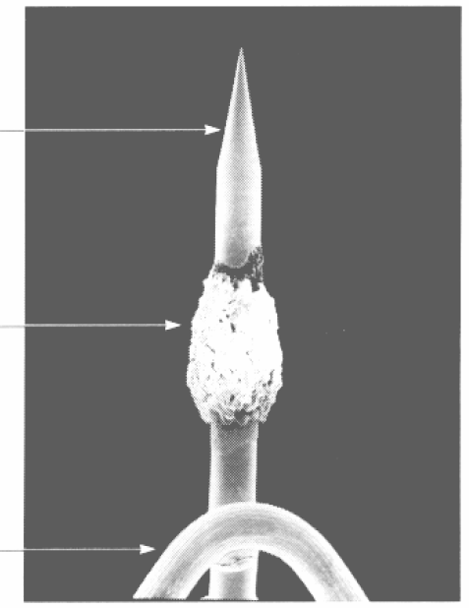
Schottky emitters: field assisted thermionic source
In the Schottky emitter, the field F reduces the work function φ by an amount of Δφ = 3.80×10⁻⁴F^{1/2}eV (e.g. Δφ=0.5eV for 1.7×10⁶V/cm).
Cathode behaves like a thermionic emitter with φ*= φ-Δφ (emission NOT by tunneling).
The cathode is also enhanced by adding ZrO₂ to further lower the value of φ.
Lifetime 1-2 years, kept hot (1750K) and running 24/7.
Vacuum level
Δφ
Work func-tion φ(eV)
<100> W crystal
ZrO₂ reservoir
Polycrystalline W heating filament
Field F (V/cm)

Slide 15
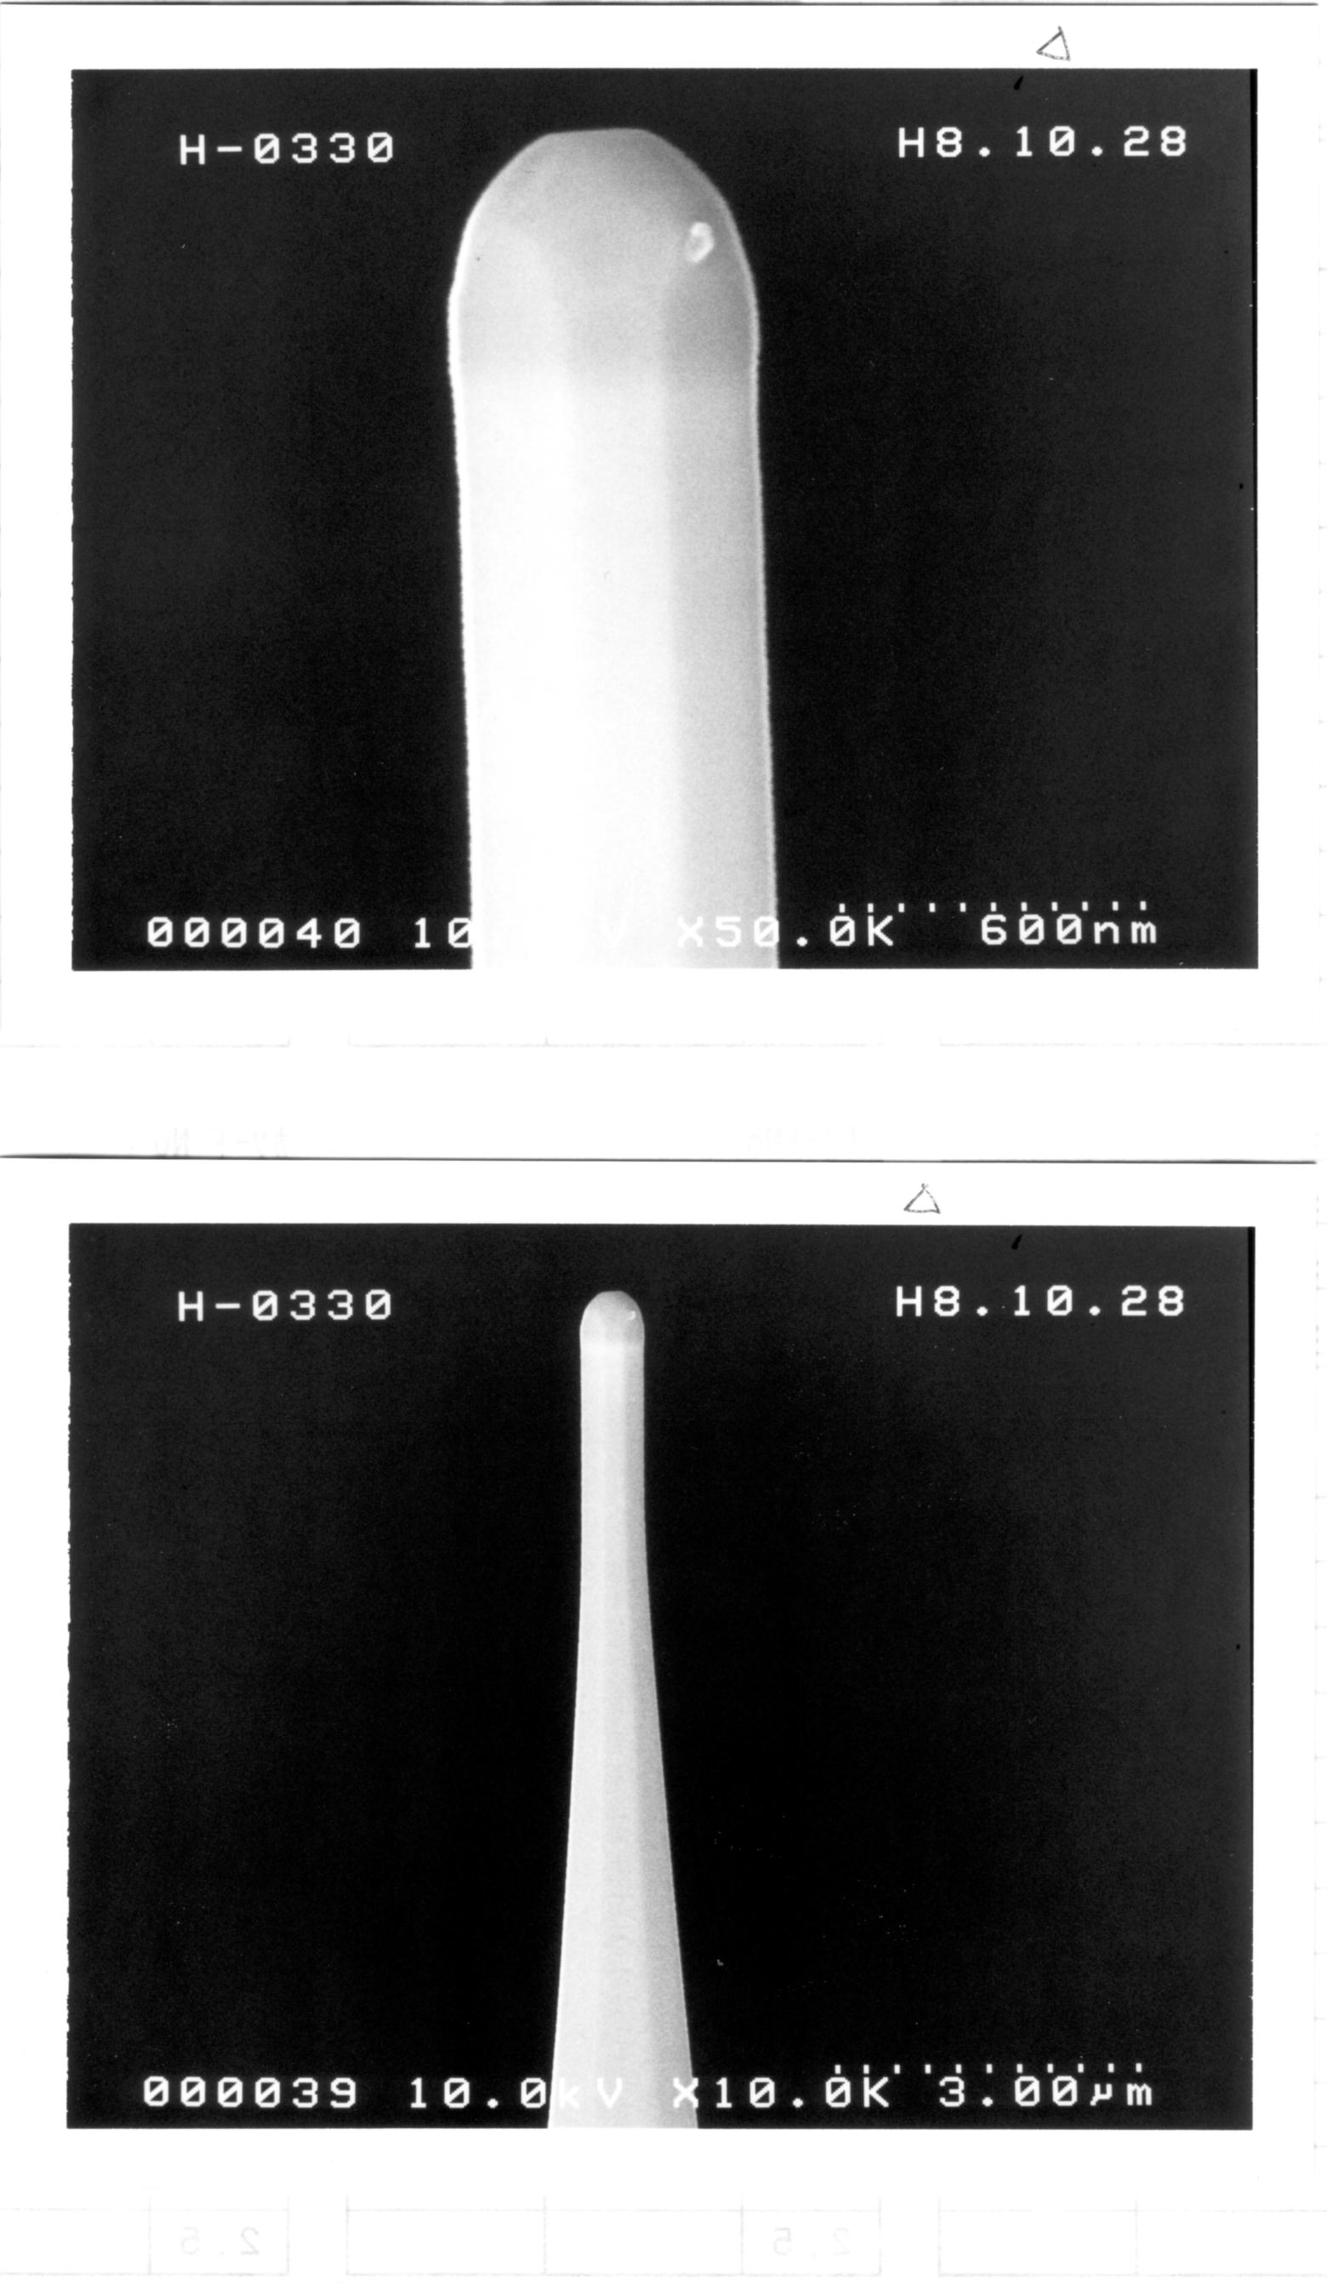
Schottky emitters: field assisted thermionic source
It is usually misleadingly called thermal or Schottky field emission guns.
But it is not a truly field emission gun, because the tip is blunt and if the heat is turned off there is no emission (tunneling) current.
A Schottky source is actually a field assisted (to lower φ) thermionic source.
Schottky emitters can produce larger amounts of current compared to cold FEG systems, so more useful for e-beam lithography.
Because they are always on (hot), organic contamination is not an issue, hence they are very stable (few % per week change in current)
They eventually fail when the Zirconia reservoir is depleted, within 1-2 years.
Hitachi Schottky Emitter Tip

Slide 16
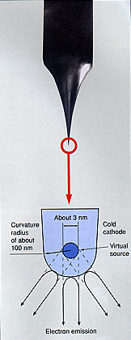
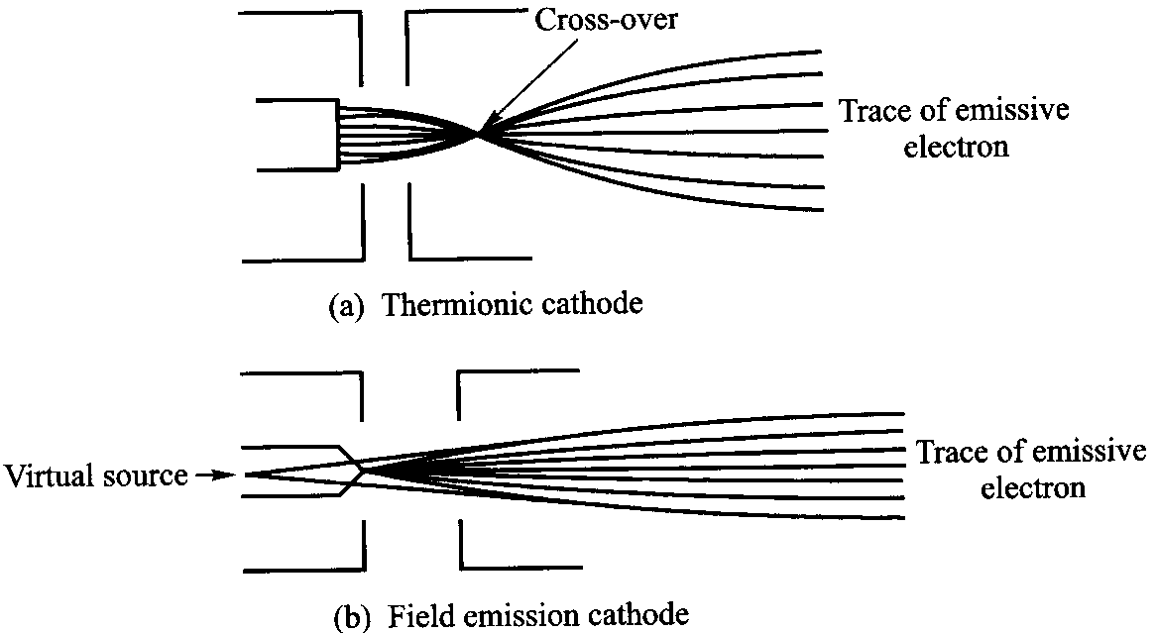
Source size
The cross-over is an effective real or virtual source for the downstream electron optical system.
(real source)
Cold field emission gun
(cold and thermal FEG)
The source size is the apparent width of the disc from which the electrons appear to come.
The tip physical size does NOT determine the source size.
Small is good for high resolution SEM, because less demagnification is needed to attain a given probe size.
But too small is not necessary, because anyway demagnification is needed to minimize effects of vibration and stray fields.

Slide 17
Source brightness β
Brightness is defined as current per unit area per solid angle, with unit amp/cm²/steradian.
Brightness is the most useful measure of gun performance.
Brightness varies linearly with energy, so one must compare different guns at the same beam energy (acceleration voltage).
High brightness is not the same as high current.
E.g. thermionic emission can have very high beam current, but low brightness (due to large d).
Most current will then be blocked by an aperture (to limit α) in order to have an acceptable small beam spot onto the specimen for high resolution imaging.
e
Measuring β at the specimen

Slide 18
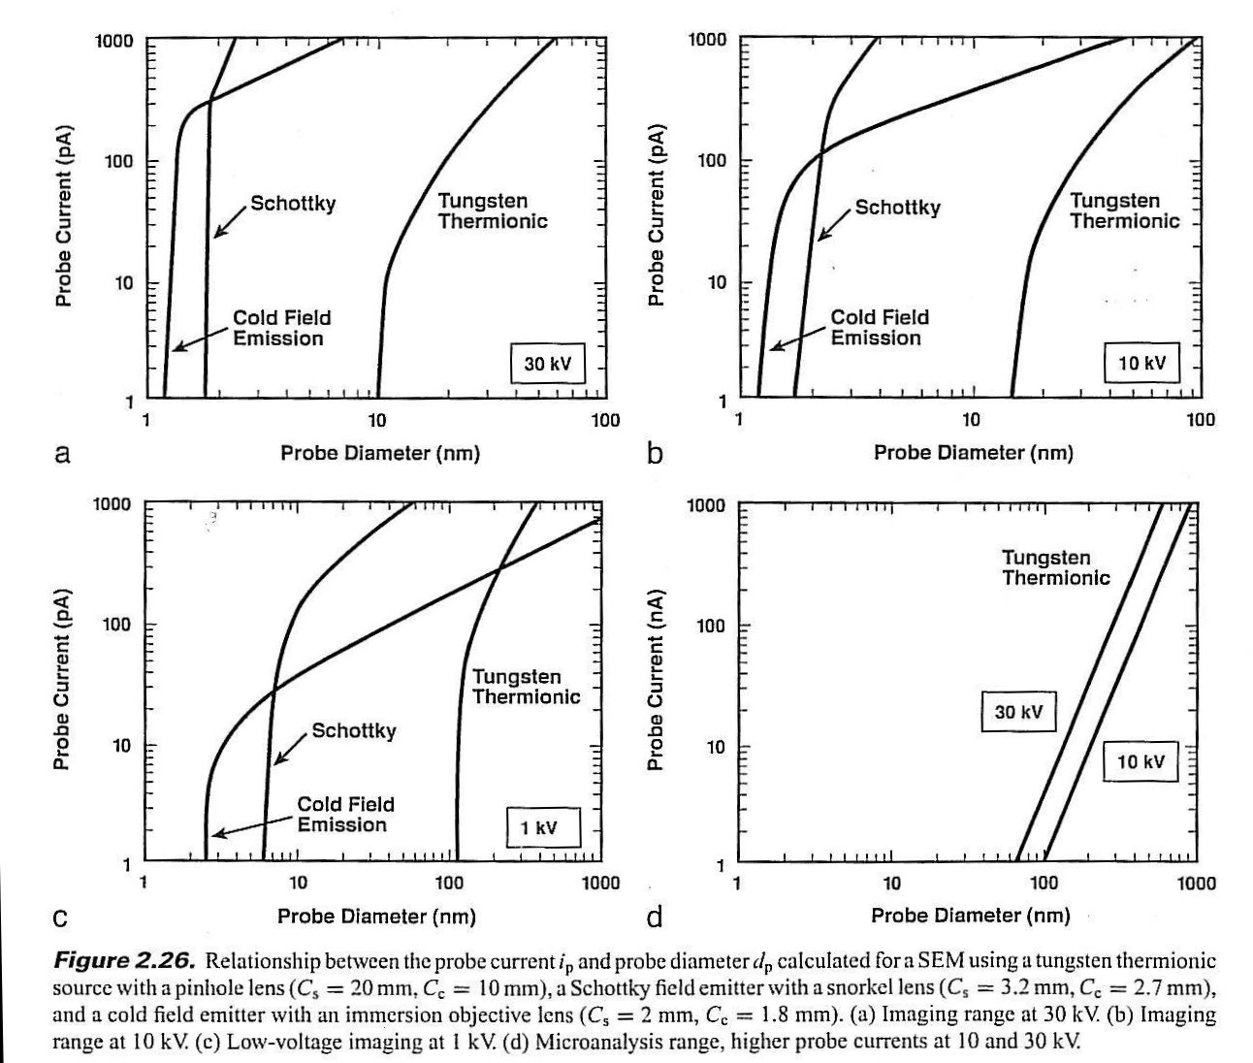
Relationship between probe current and probe diameter
For typical EBL at 30kV, probe current is 20-1000pA.
The resolution is usually NOT limited by beam spot size (<10nm).
It is more limited by lateral diffusion of secondary electrons and proximity effect due to backscattering.
pA
nA

Slide 19
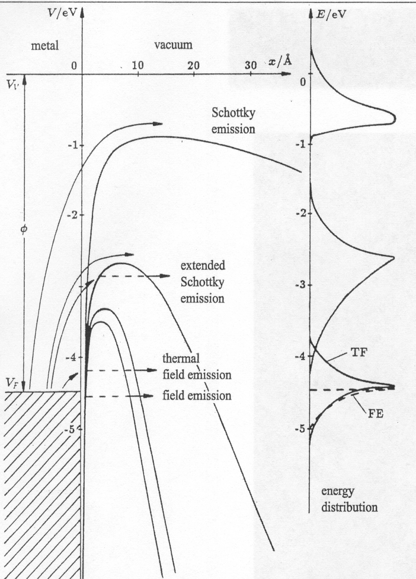
Energy Spread
0.7eV
Electrons leave guns with an energy spread that depends on the cathode gun type.
Lens focus varies with energy (chromatic aberration), so a high energy spread hurts high resolution low energy images.
The energy spread of a W thermionic emitter is about 2.5eV, and 1eV for LaB₆.
For field emitters the energy spread varies with temperature and mode of use.
1.5eV
0.3eV
Notes:
Not clear about the figure

Slide 20
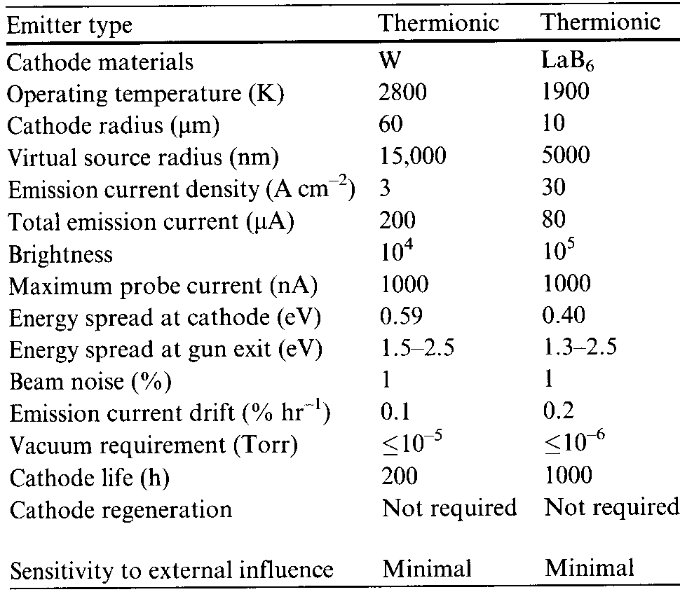
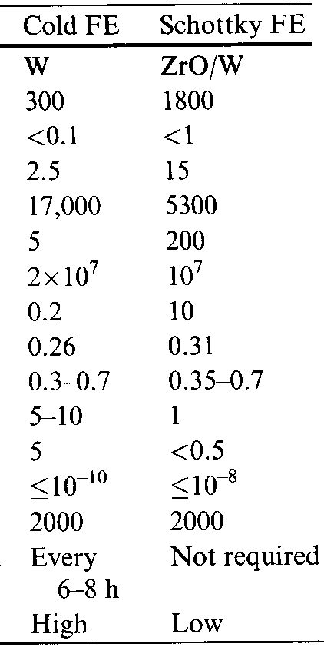
Comparison of electron emission sources
Key parameters of electron sources:
virtual source size, brightness, energy spread of emitted electron
*
(flashing)
*Hitachi cold FEG SEM can go to 2nA.

Slide 21
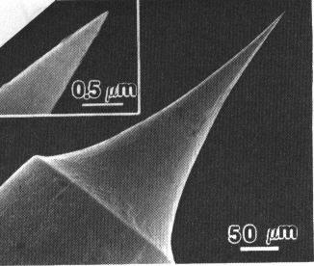
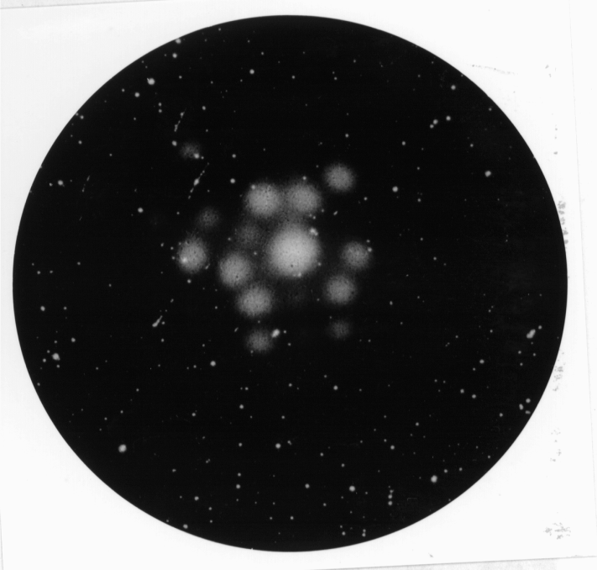
Nano tips - atomic sized FEG
Etched tungsten tip
Nano-tips are field emitters in which the size of the tip has shrunk to a single atom.
They can be made by processing normal tungsten field emission tips.
Or they are made from carbon nanotubes.
They can operate at energies as low as 50eV, and have a very small source size.
The technique is not mature.
Field ion image of a W nano-tip emitter

Slide 22
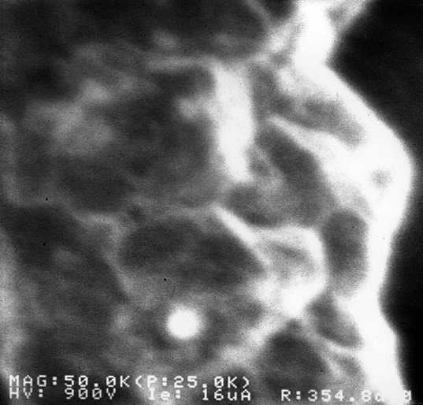
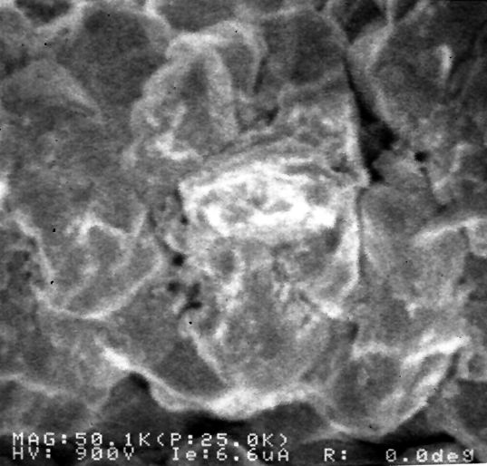
Regular and nano tips: comparison
Copper alignment grid sample in S6000 CD-SEM
Regular tip
Nano-tip

Slide 23
Summary
The cold FEG offers high brightness, small size and low energy spread, but is least stable, generates limited current and must be flashed daily.
Schottky emitters are stable, reliable, with high resolution and beam current. So they are most popular for EBL.
Nano-tips may be the source of the future if they can be made reliably.
For imaging, W-hairpins or LaB₆ guns (i.e. thermionic emission gun) are adequate for many applications not demanding highest resolution, or can operate at high acceleration voltage without sample damage/deformation (3nm imaging resolution at 30kV).
For e-beam lithography that always operates at relatively high voltage (typically 30kV for SEM conversion system), thermionic emission gun can be a reasonable inexpensive choice.
Field emission gun SEM (cold and Schottky) costs >2× that of thermionic gun SEM.

Slide 24
Electron beam lithography (EBL)
Overview and resolution limit.
Electron source (thermionic and field emission).
Electron optics (electrostatic and magnetic lens).
Aberrations (spherical, chromatic, diffraction, astigmation).
EBL systems (raster/vector scan, round/shaped beam)

Slide 25
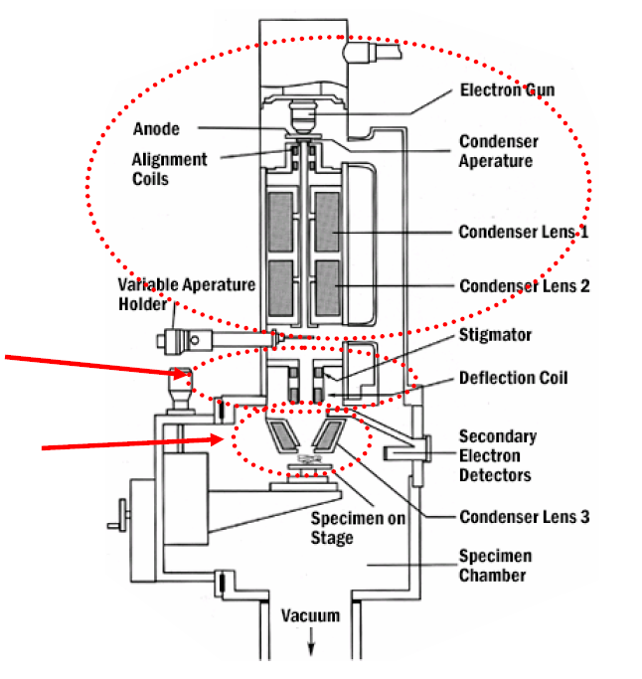
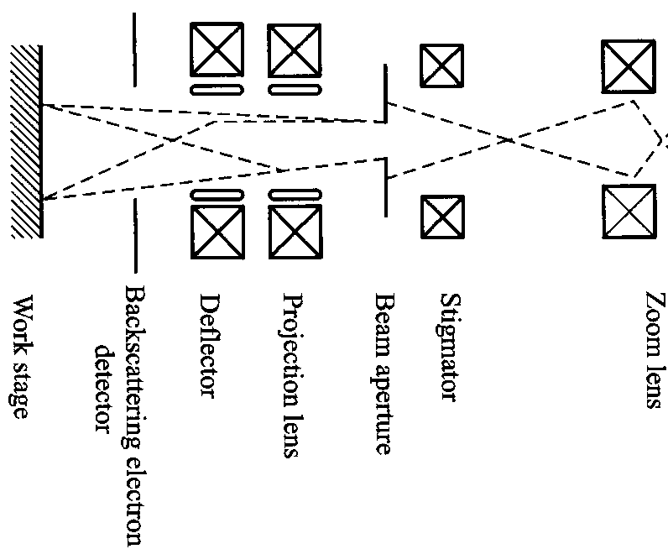
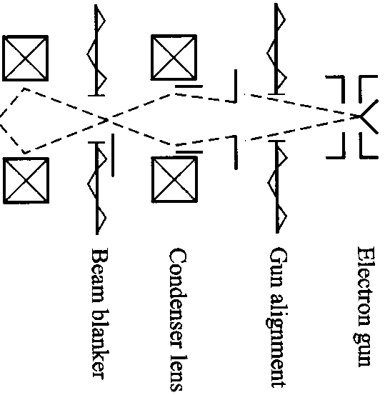
SEM/EBL electron optics
Preparation of proper illuminating beam
Electron Optics
XY scanning
Focusing objective
Notes:
The graph here is just to give you a rough idea, real system will be different.

Slide 26
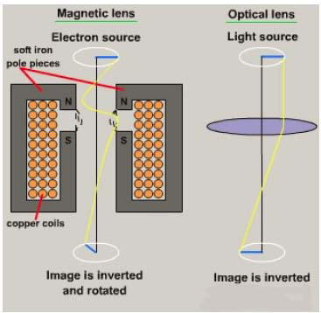
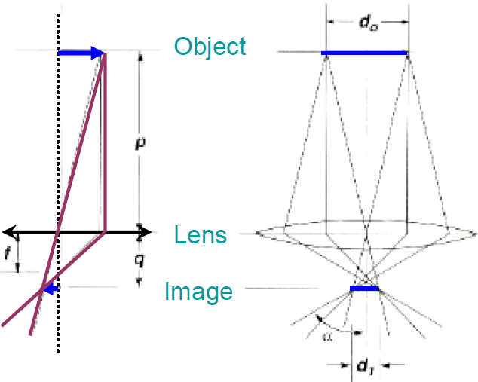
Electromagnetic lens
An electromagnetic lens can manipulate electron trajectory to form either a small electron probe (condenser for SEM) or an enlarged image of a specimen (for TEM).
If the image rotation is ignored, the behavior of the electromagnetic lens can be described by the formula used for optical lens: 1/p+1/q=1/f.

Slide 27
Electron optics: electrostatic lens
Force in electric field: F=qE
For light, λ∝1/n, where n is refractive index.
Accordingly, in electron optics using electrostatic lens, n∝√V∝√energy.
n is continuous function of space coordinates, no abrupt change as is on the surface of optical lens for light.
Possible n>>1.
In a rotationally symmetric electrostatic field E(z,r) (no magnetic field)

Slide 28
“Focusing” by a point charge
Like light optics, when the contour of potential (∼refractive index) is lens-like (spherical surface), there will be some focusing effect.
High potential V(r,z) reduces focusing action because electrons pass the lens fast.
Lens
Cross-over, focal point, relatively good focus
Light
Cross-over, focal point, but very poor focus for point charge “lens”.
+
Electron
Positive point charge

Slide 29
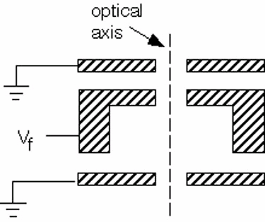
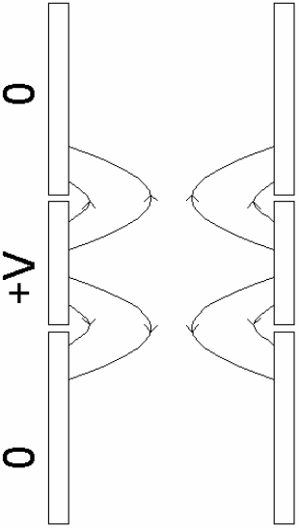
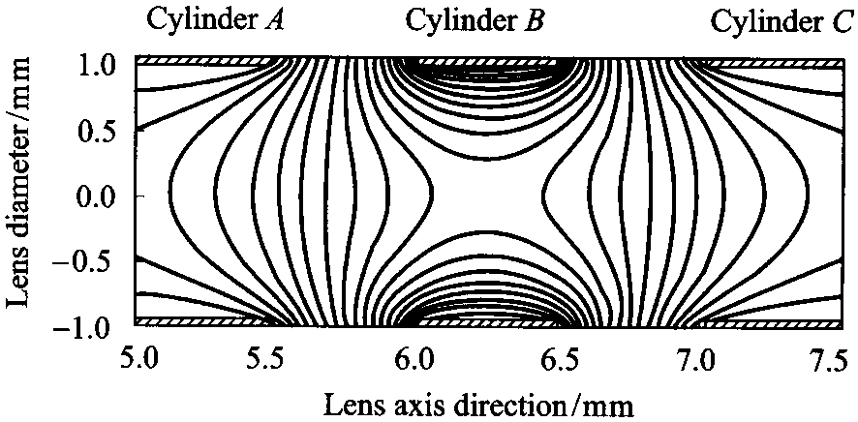
Electrostatic lens
Lens structure
Electron trajectory
V₁=0
V₂
V₃=0
Electric field
Potential contour
(0V)
(100V)
(0V)

Slide 30
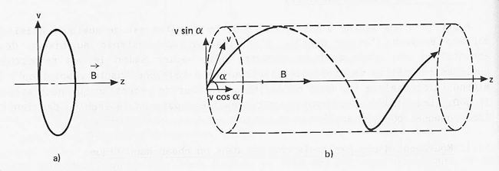
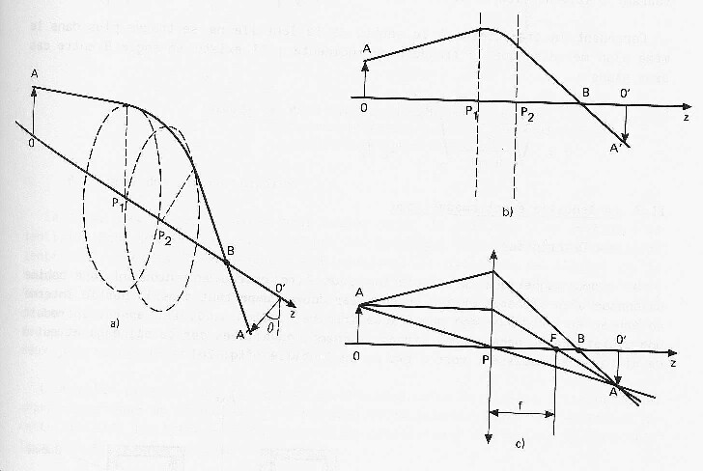
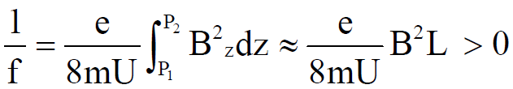
Magnetic lens
For rotationally symmetric magnetic field
F=q v x B
Uniform field
Variable field
Magnetic lens good for focusing electrons, but not for ions with different charge/mass ratio.
Modern EBL uses only magnetic lens, since electrostatic lens using high field may lead to electrical breakdown at the gaps.

Slide 31
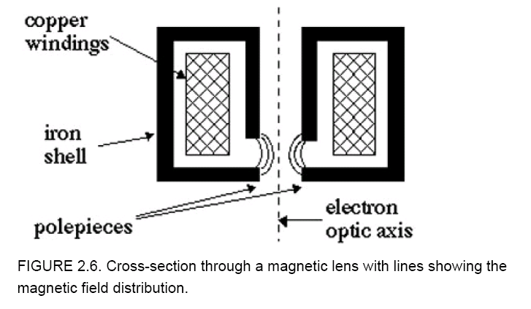
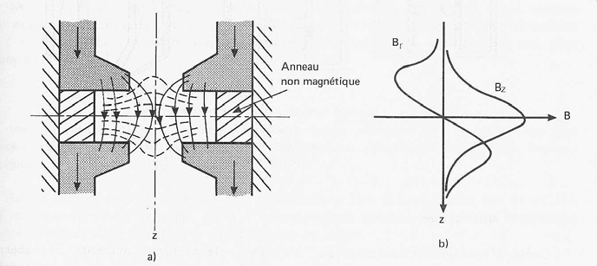
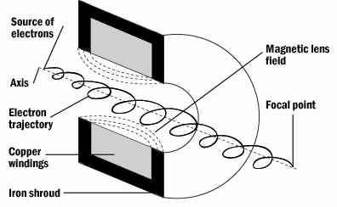
Magnetic lens: cylindrically (rotationallly) symmetric magnetic field with radial gradients
Lens structure
Electron trajectory schematic
Electron trajectory
Magnetic field and potential contour
Axial and radial field distribution

Slide 32
Electron beam lithography (EBL)
Overview and resolution limit.
Electron source (thermionic and field emission).
Electron optics (electrostatic and magnetic lens).
Aberrations (spherical, chromatic, diffraction, astigmation).
EBL systems (raster/vector scan, round/shaped beam)

Slide 33
Aberrations
A ideal lens would produce a demagnified copy of the electron source at its focus.
The size of this spot could be made as small as desired.
But no real lens is ideal (or even close).
Aberration is defined as deviation from idea case.
Geometric aberrations: spherical aberration, coma, field curvature, astigmatism and distortion.
Non-geometric aberrations: chromatic aberration, diffraction.
In light optics, the geometric aberration can be eliminated by changing arbitrarily the curvature of refractive surfaces. It may have hundreds of lens.
But in electron optics the electromagnetic field in space cannot be arbitrary changed. It has just a few lens.

Slide 34
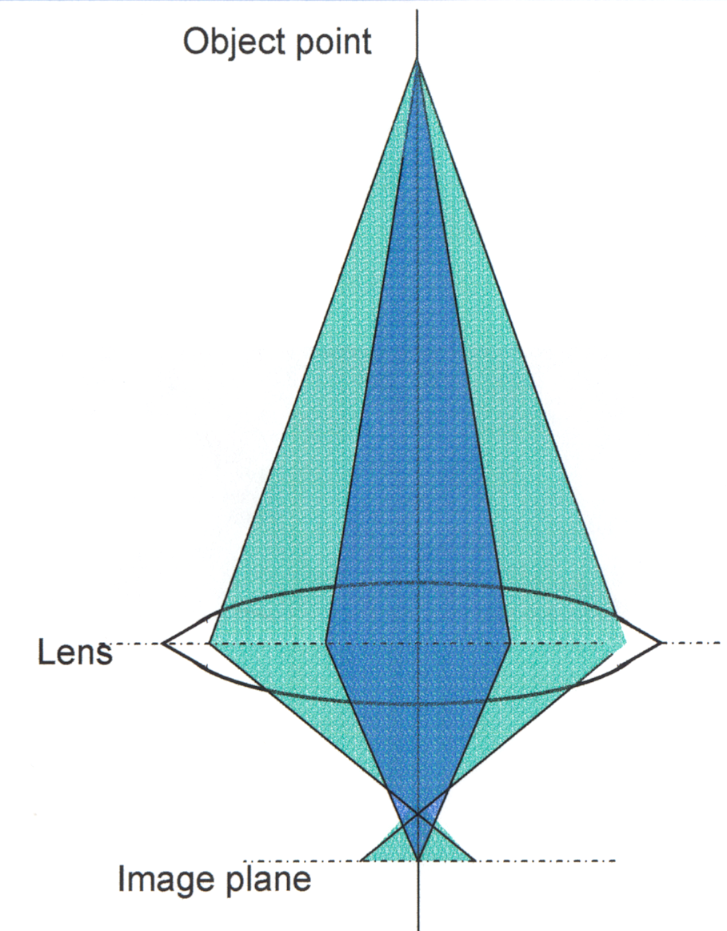
Spherical aberrations
The focal length of near axis electrons is longer than that of off axis electrons.
All lenses have spherical aberration, with minimum spot size
d_{s} = 0.5C_{s}α³
C_{s} is a lens constant related to the working distance of the lens. (so minimizing working distance minimizes spherical aberration).
Spherical aberration makes the probe larger and degrades the beam profile.
To reduce it, one needs to limit the numerical aperture (α) of the probe lens; but this also reduces the current I_{B} that varies as α².
α
DOLC
Gaussian focus plane
DOLC: disk of least confusion

Slide 35
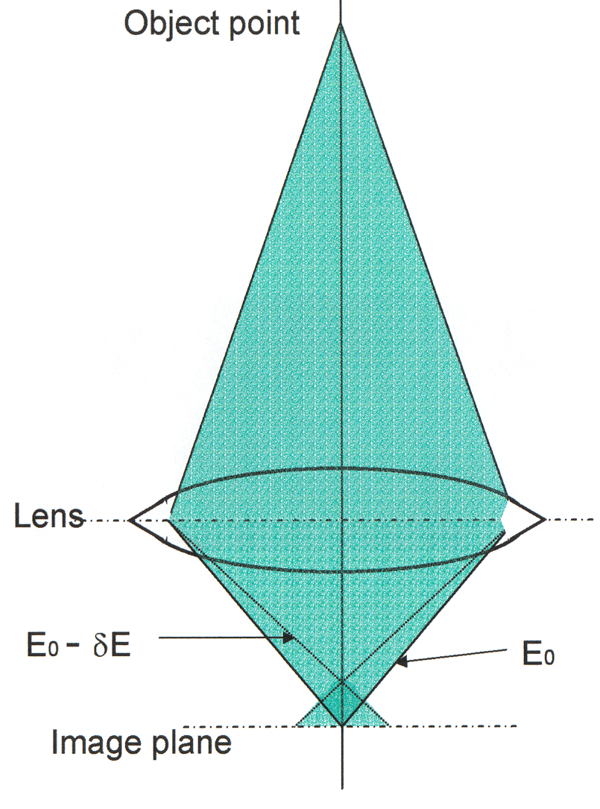
Chromatic aberrations
α
The focal length of higher energy electrons is longer than that for lower energy electrons.
The minimum spot size at DOLC is
d_{c}= C_{c}α⋅ΔE/E₀ (or ΔV/V) which increase at low energies E₀, or when using thermionic emitters with high energy spread ΔE.
DOLC
DOLC: disk of least confusion

Slide 36
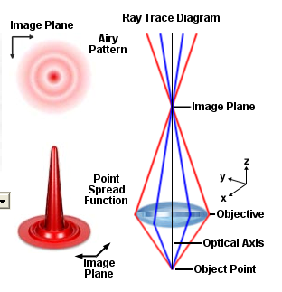
Diffraction
Electrons are waves so at focus they form a diffraction limited crossover.
The minimum diameter d_{d}=0.61λ/NA=0.61λ/sinα≈0.61λ/α
(Rayleigh criteria, same as optical lens).
At low energies the wavelength becomes large (0.04 nm at 1keV) so diffraction is a significant factor because α is typically only 10 milli-radians or less in order to control spherical and chromatic aberrations

Slide 37
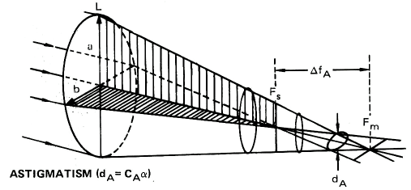
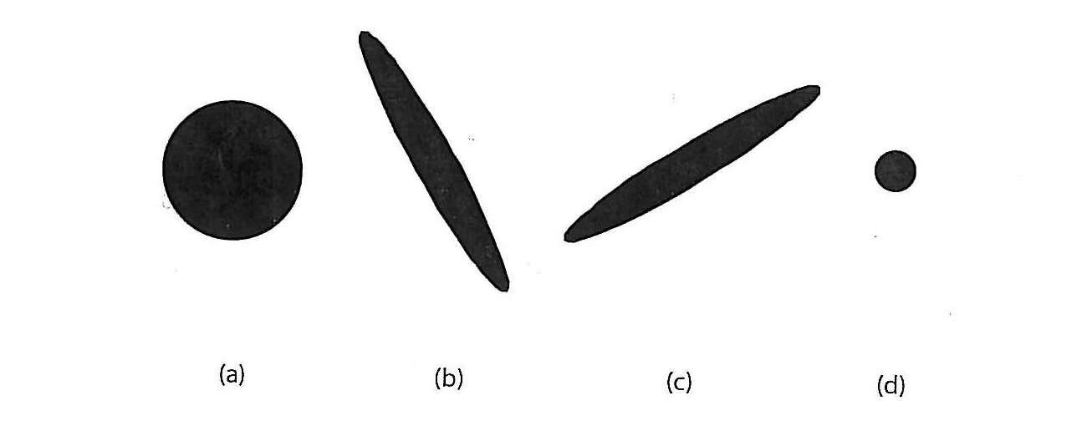
Astigmation
Minimum spot size d_{a}=C_{a}⋅α
Astigmation:
different focal points for x- and y-directions
Beam shape at different planes
Astigmatism occurs when a magnetic lens is not perfectly round.
Every time one switch on or adjust an electron lens, the magnetization of the metal in the lens changes.
Because of hysteresis, the lens never quite goes back to where it was.
The lens will then have non-round features due to different magnetization around the pole-piece, which is the focusing part of the electron lens.
Apertures tend to charge up if they have dirt on them, leading to another source of asymmetry.
Stigmators eliminate/compensate astigmation by adding a small quadrupole distortion to the lens.
When beam is well optimized, astigmation causes negligible beam spot broadening.

Slide 38
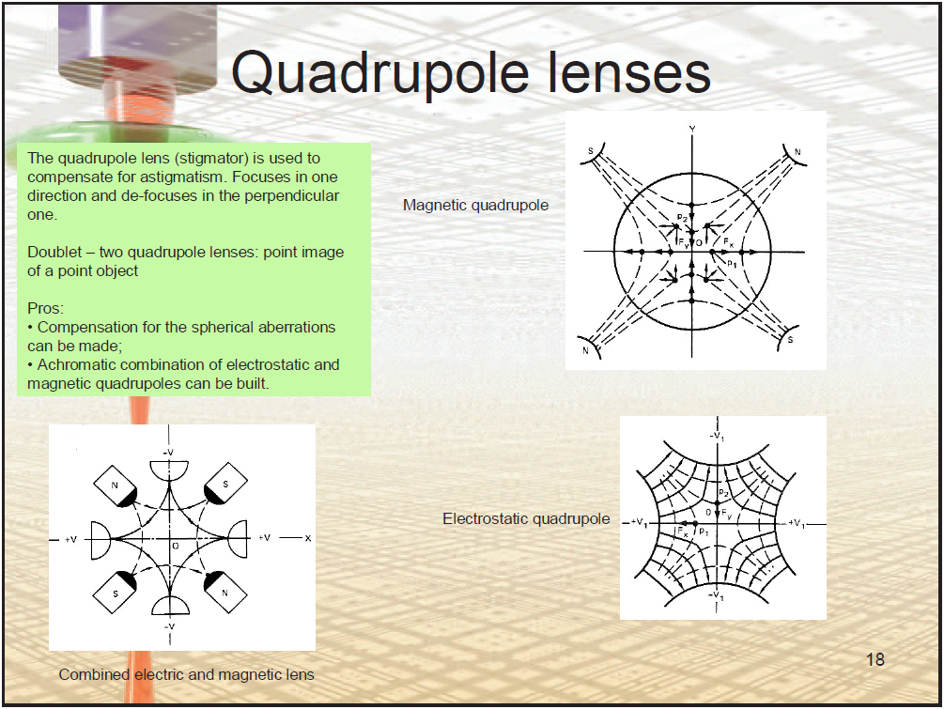
for stigmation adjustment

Slide 39
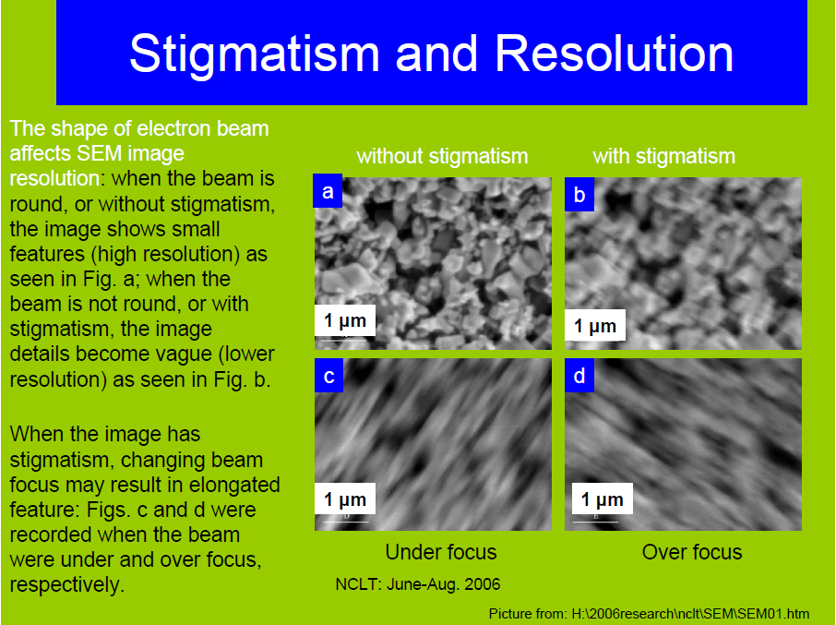
Notes:
Stigmation and focus needed to be adjusted at the same time. Need to focus on a “circular” pattern for stigmation adjust. Otherwise, for a non-circular pattern, one doesn’t know whether the elongation is due to the pattern shape or astigmation.
When adjusting stigmation, one should try to adjust such that the pattern is most symmetric (rather than most clear), then adjust focus to get the clearest pattern. May need several stigmation/focus cycles to get the best image.

Slide 40
Overall beam spot diameter
(assume no astigmation)
d_{v}: virtual source diameter
M: demagnefication
Spherical aberration
Chromatic aberration
Diffraction
Beam spot size depends on acceleration voltage, because higher voltage leads to: smaller chromatic aberration, and shorter λ thus smaller diffraction.
This is particular true for thermionic emission guns, where high resolution (<5nm) can only be achieved at 30kV.
Such resolution can be achieved at ∼5kV for field emission (cold and Schottky) guns.

Slide 41
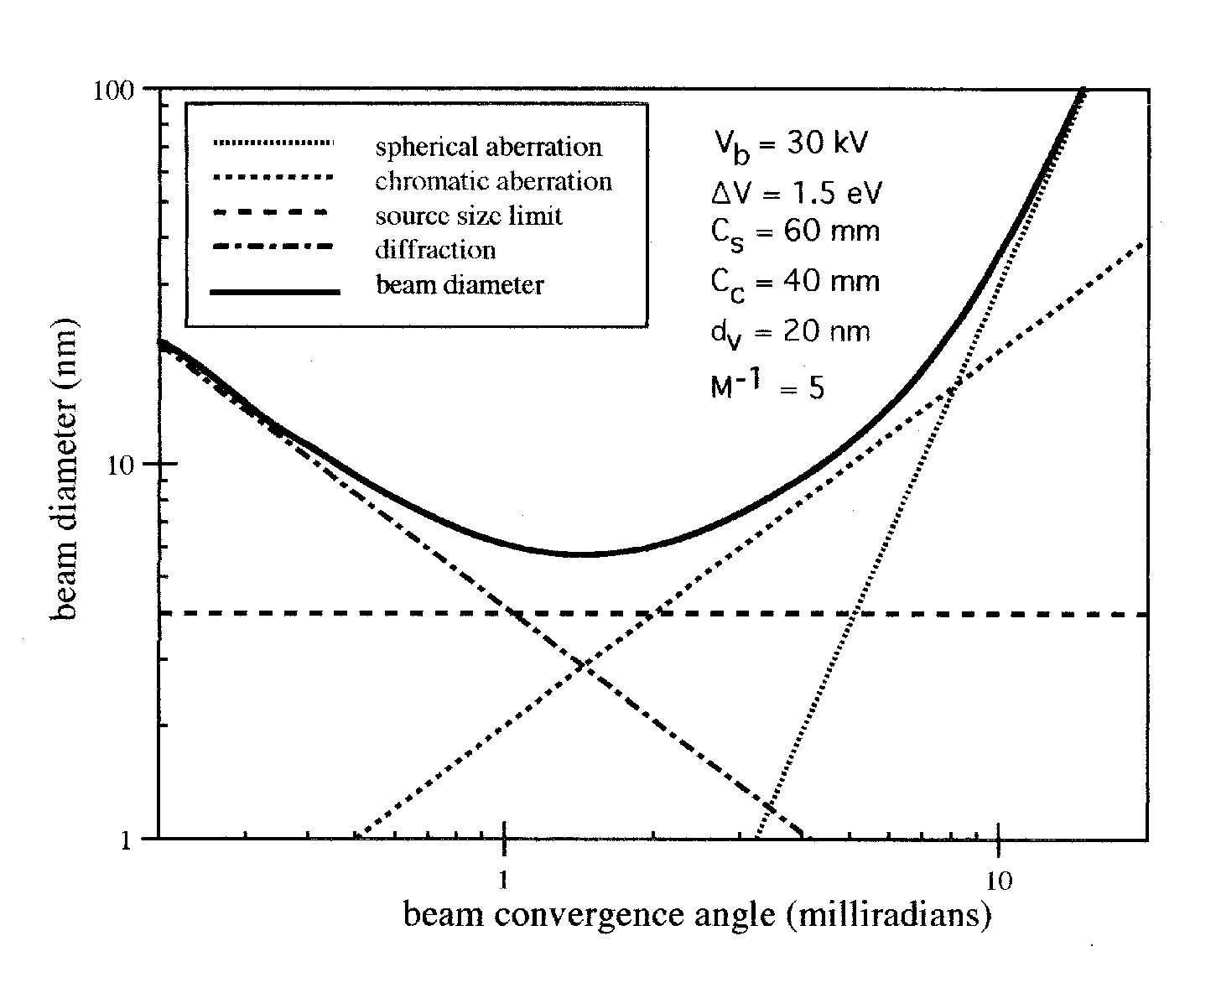
Beam spot diameter: a real example
total beam diameter
spherical
source size limit
chromatic
diffraction
α is determined by aperture size (∼10-100μm), which should be selected wisely.
Typically beam diameter is NOT the limiting factor for high resolution, then large α is good for high beam current and thus fast writing (assume beam blanker can follow).
But large α also reduces depth of focus (∝1/α²), leading to large beam spot size (low resolution) if beam not well focused due to wafer non-flatness or tilt.

Slide 42
Electron beam lithography (EBL)
Overview and resolution limit.
Electron source (thermionic and field emission).
Electron optics (electrostatic and magnetic lens).
Aberrations (spherical, chromatic, diffraction, astigmation).
EBL systems (raster/vector scan, round/shaped beam)

Slide 43
Raster scan vs. vector scan
Raster scan:
The e-beam is scanned in only one direction, and the stage is
mechanically translated in the perpendicular direction.
Vector scan:
The e-beam is scanned in both x- and y-directions with beam blanking, writing the pattern pixel-by-pixel.
No stage movement within each writing field.
After each writing field, the substrate/stage moves to the next location.
Beam blanker: parallel plate with voltage 42V that can deflect (turn off) the beam.
42V

Slide 44

Raster scan versus vector scan
Raster scan:
Very simple and fast.
Very repeatable
But sparse patterns take as long as dense patterns.
Difficult to adjust dose during writing.
For photo-mask making.
Raster scan
Vector scan:
Fast writing of sparse patterns (unwritten areas skipped).
Easy dose variation from shape to shape.
Settling time & hysteresis, need to wait at beginning of each pattern.
For nanolithography and R&D.
Settling time:
Waiting period at beginning of each element
Vector scan

Slide 45
3rd scan scheme: stage movement scan
No beam scanning.
Instead, the stage is moved in the path required to create the lithographic shapes.
Useful to make long lines without stitching error, e.g. to pattern a long micro-fluidic channel.
With vector scan system without laser interferometer stage, the channel would be discontinuous at the boundary between writing fields due to stitching error.
Discontinuous line due to stitching error between adjacent writing fields.
Note: stitching ≈ alignment ≈ overlay ≈ registration ≈ positioning

Slide 46

Round (Gaussian beam) vs. shaped beam
Beam is focused to spot size as small as possible for high resolution.
Slow since each pixel is small (order 10nm).
Used for R&D.
Beam is shaped to a rectangular shape for fast writing.
Fast since each “pixel” is large.
Mainly used for photo-mask making.
With each square pixel order 100nm.
Gaussian beam
shaped beam

Slide 47


Laser interferometer stage
For conventional SEM, stage accuracy is about 5μm, so good stitching is not possible.
Precise alignment of different layers requires local alignment marks (like photolithography).
For advanced EBL system, use interferometry to precisely position the stage.
Better than 5nm positioning accuracy, thus different writing fields are nearly perfectly aligned.
Interferometry stage cost $0.5-1M, as expensive as a SEM.
Using laser beam, sample height can also be monitored to maintain focusing (constant sample height).

