Slide 1
Chapter 1 Introduction and Historical Perspective
Introduction.
Growth of IC – Moore’s law.
Some history in IC industry.
Semiconductors.
Semiconductor devices, semiconductor technology families.
NE 343: Microfabrication and thin film technology
Instructor: Bo Cui, ECE, University of Waterloo; http://ece.uwaterloo.ca/~bcui/
Textbook: Silicon VLSI Technology by Plummer, Deal and Griffin

Slide 2
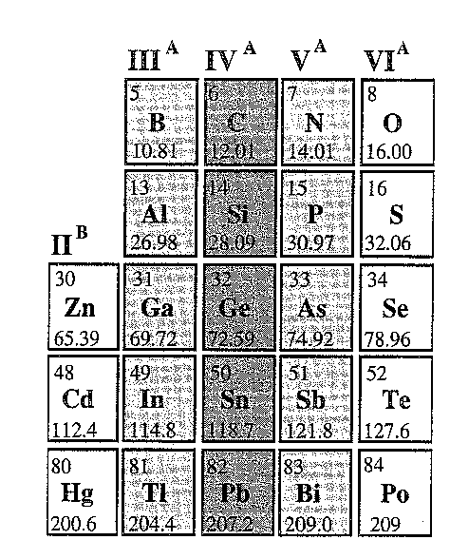
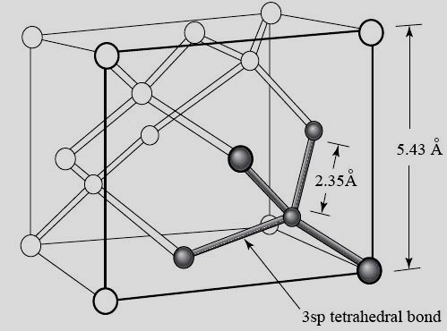
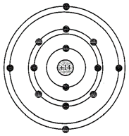
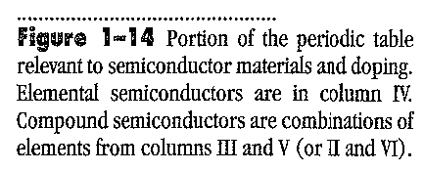
Silicon
“Diamond” structure
Si # density:
8/(5.43Å)³=5×10²²cm³

Slide 3
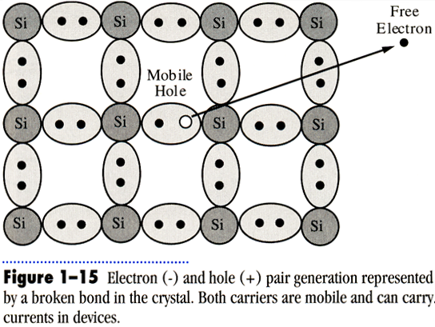
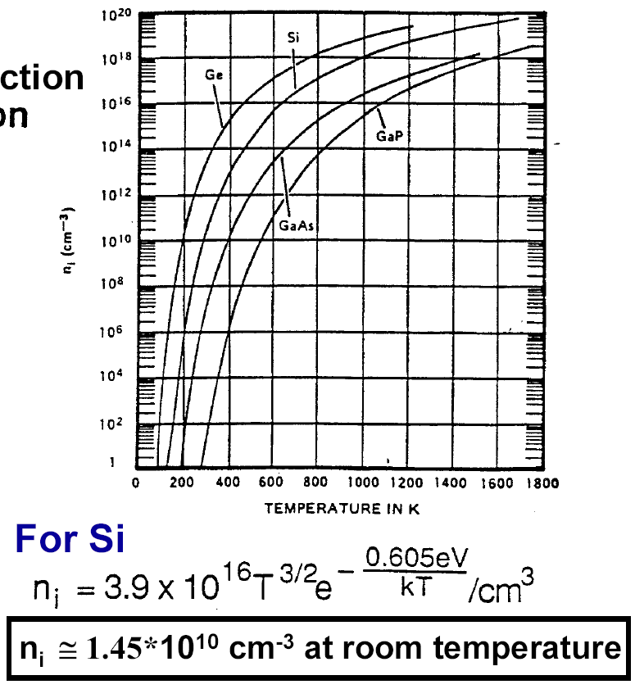
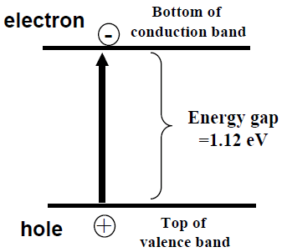
Carrier concentrations of intrinsic (undoped) Si
n=p=n_{i}
n_{i} (cm⁻³)
Temperature in K
1.12eV >> kT =0.026eV for T=300K, so n_{i} is very low at room temperature.
Notes:
From the right figure, bandgap for Ge is higher or lower than Si? How about GaAs?

Slide 4
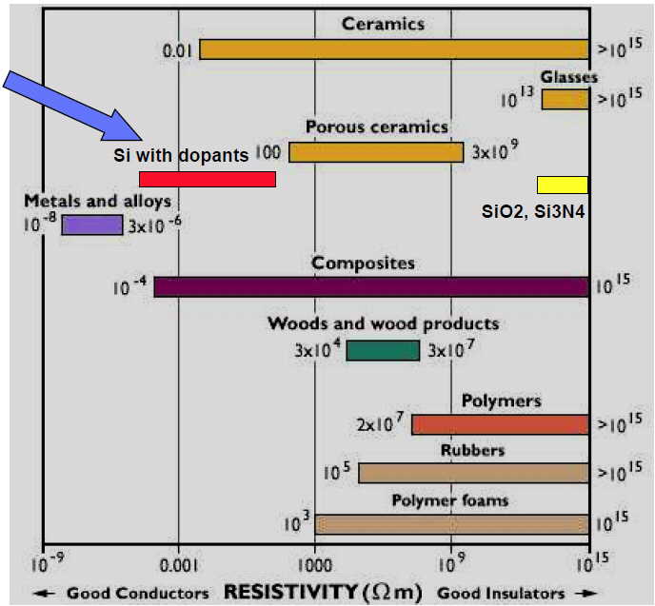
Doping of silicon
Adding parts/billion to parts/thousand of “dopants” to pure Si can change resistivity by 8 orders of magnitude !
The key to building semiconductor devices and integrated circuits lies in the ability to control the local doping and hence local electronic properties of a semiconductor crystal.
1Ω⋅m = 100 Ω⋅cm

Slide 5
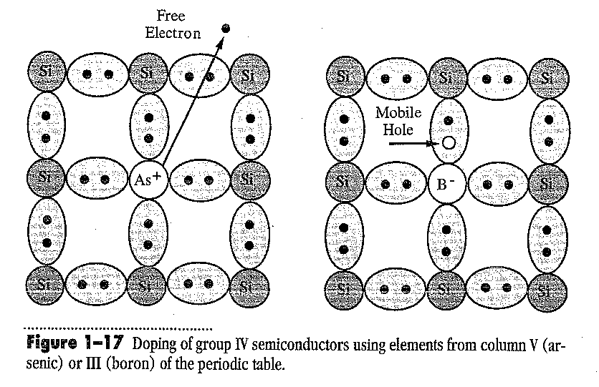
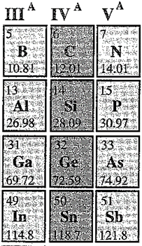
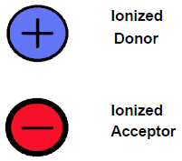
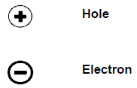
Doping of silicon
By substituting a Si atom with a special impurity atom (Column V for donor, Column III for acceptor), a conduction electron or hole is created.
Semiconductor with both acceptors and donors has 4 kinds of charge carriers
Immobile, DO NOT contribute to current flow with electric field is applied. However, they affect the local electric field
Mobile, contribute to current flow when electric field is applied.

Slide 6
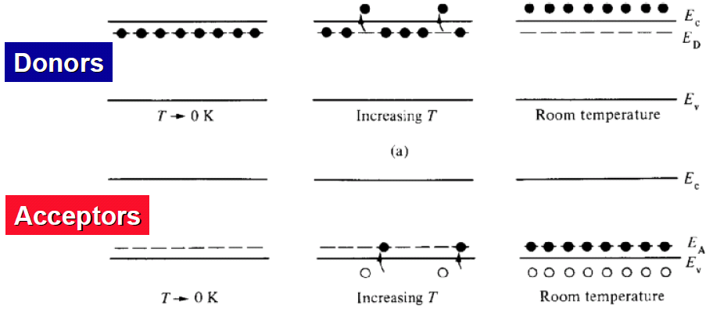
Energy band description of electrons and holes contributed by donors and acceptors
E_{C} = bottom of conduction band
E_{V} = top of valence band
E_{D} = Donor energy level
E_{A} = Acceptor energy level
At room temperature, the dopants of interest are essentially fully ionized.

Slide 7
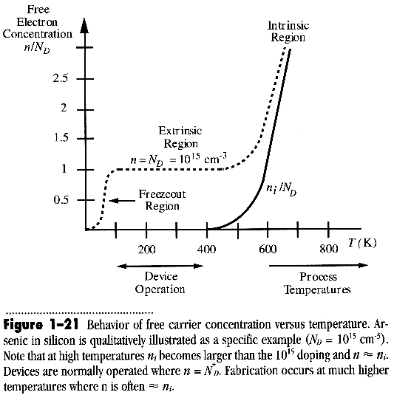
Intrinsic and extrinsic silicon
Intrinsic: un-doped, or doping level lower than n_{i}.
Extrinsic: carrier density determined/controlled by doping level.
For semiconductor device, it is usually extrinsic at room temperature.
But the semiconductor often becomes intrinsic at device fabrication temperatures (e.g. oxidation is done at >900ºC).
Approximate definition of doping levels:
N⁻⁻ or P⁻⁻ : N_{D} or N_{A} < 10¹⁴ cm⁻³
N⁻ or P⁻ : 10¹⁴ cm⁻³ < N_{D} or N_{A} < 10¹⁶ cm⁻³
N or P : 10¹⁶ cm⁻³ < N_{D} or N_{A} < 10¹⁸ cm⁻³
N⁺ or P⁺ : 10¹⁸ cm⁻³ < N_{D} or N_{A} < 10²⁰ cm⁻³
N⁺⁺ or P⁺⁺: N_{D} or N_{A} > 10²⁰ cm⁻³
Si # density : 5×10²² cm⁻³
Intrinsic Si at RT: n_{i}=1.45× 10¹⁰ cm⁻³

Slide 8
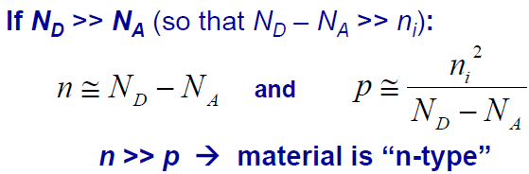
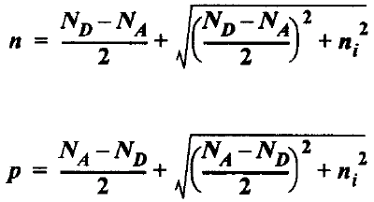
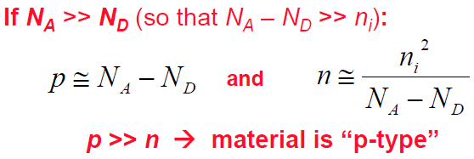
Electron and hole concentrations for homogeneous semiconductor
n: electron concentration (cm⁻³)
p : hole concentration (cm⁻³)
N_{D}: donor concentration (cm⁻³)
N_{A}: acceptor concentration (cm⁻³)
Charge neutrality: N_{D}⁺ + p = N_{A}⁻ + n
At thermal equilibrium, np = n_{i}²
(for intrinsic semiconductor n=p=n_{i}, so np=n_{i}². This same relation also holds for extrinsic case)
Note: Carrier concentrations depend on NET dopant concentration (N_{D} - N_{A})!
Therefore: p-type doping can be realized on n-type substrate if N_{A} > N_{D}, and vice versa.

Slide 9
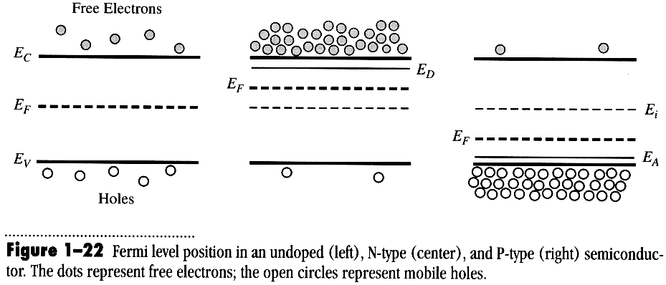
Fermi level and carrier concentration
The probability of an electron occupying any particular energy level E is given by:
F(E) = [1 + exp((E-E_{F})/kT))]⁻¹ ≈ exp(-(E-E_{F})/kT) for E > E_{F} + a few kT.
The probability of an electron not occupying any particular energy level E, or the probability of finding a hole there, is given by:
1 - F(E) = 1 - [1 + exp((E-E_{F})/kT))]⁻¹ ≈ exp(-(E_{F}-E)/kT) for E < E_{F} - a few kT.
m_{e,h}* is density of states effective mass.
For Si at RT, N_{C} = 2.8×10¹⁹cm⁻³, N_{V} = 1.04×10¹⁹cm⁻³

Slide 10
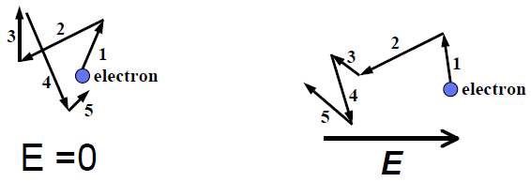
Carrier drift and carrier mobility
When an electric field is applied to a semiconductor, mobile carriers will be accelerated by the electrostatic force.
This force superimposes on the random thermal motion of carriers:
E.g. electrons drift in the direction opposite to the E-field.
Average drift velocity = |v| = μE, μ is carrier mobility.
Electron current density: J_{n} = (-q)nv_{n} = qnμ_{n}E, n is free electron concentration.
Hole current density: J_{p} = (+q)pv_{p} = qpμ_{p}E, p is hole concentration.
Total current density: J = J_{n} + J_{p} = σE, conductivity σ = (1/ρ) = qnμ_{n} + qpμ_{p}
ρ is resistivity. Usually either n or p dominates. E.g. if n >> n_{i}, then p = n_{i}²/n << n_{i}.
For Si at RT, with low doping concentration and small fields, maximum values:
μ_{n} = 1500cm²/V⋅sec; μ_{p} = 500cm²/V⋅sec < μ_{n}, so NMOS is faster than PMOS.

Slide 11
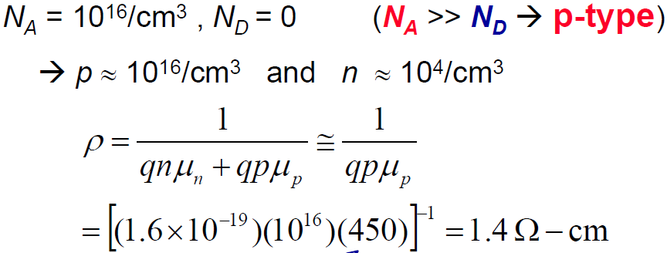
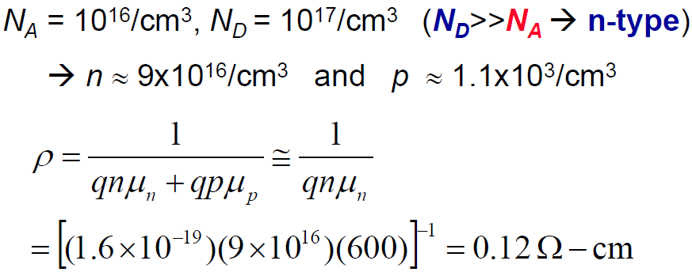
Example: dopant compensation
Consider a Si sample doped with 10¹⁶/cm³ Boron. What is its electrical resistivity?
Carrier mobility: μ_{p}=450cm²/V⋅sec.
Consider the same Si sample (with 10¹⁶/cm³ Boron), doped additionally with 10¹⁷/cm³ Arsenic. What is the new resistivity?
Carrier mobility: μ_{n}=600cm²/V⋅sec. (lower μ_{n} because higher doping reduces mobility)
The sample is converted to n-type material by adding more donors than acceptors, and is said to be “compensated”.

Slide 12
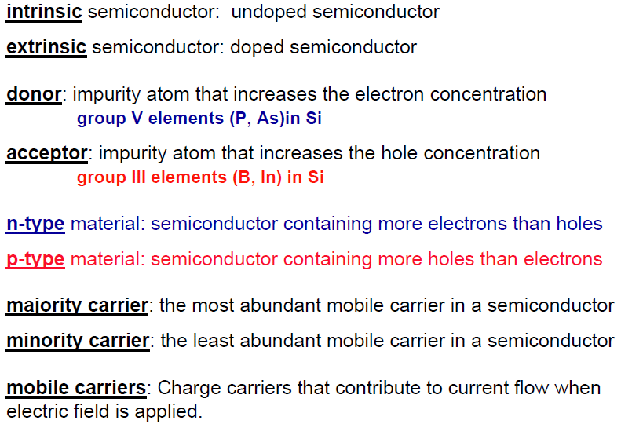
Summary of doping terminology

Slide 13
Chapter 1 Introduction and Historical Perspective
Introduction.
Growth of IC – Moore’s law.
Some history in IC industry.
Semiconductors.
Semiconductor devices, semiconductor technology families.
NE 343 Microfabrication and thin film technology
Instructor: Bo Cui, ECE, University of Waterloo
Textbook: Silicon VLSI Technology by Plummer, Deal and Griffin

Slide 14
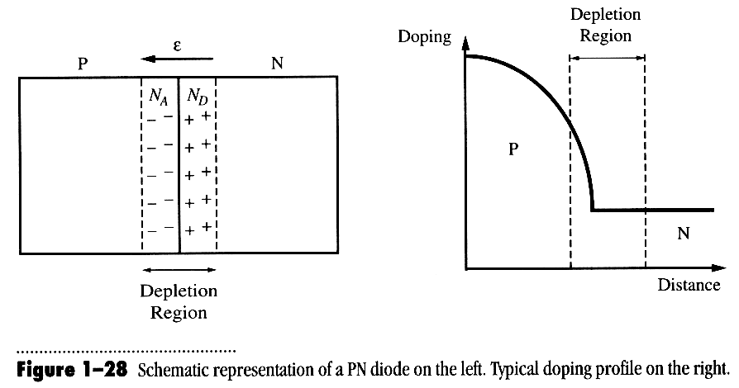
p - n junction diode
(depletion: no free carriers)
In equilibrium (no bias), drift current (due to ‘built-in’ electric field ε) and diffusion current (due to free carrier concentration gradient) exactly balance, so that no net current flows.
For forward bias, the applied field partially cancels the built-in field, allowing majority carriers from both sides to diffuse across the junction.
For reverse bias, the depletion region is widened, only very small leakage current flows.
The overall I-V relation is simply:

Slide 15
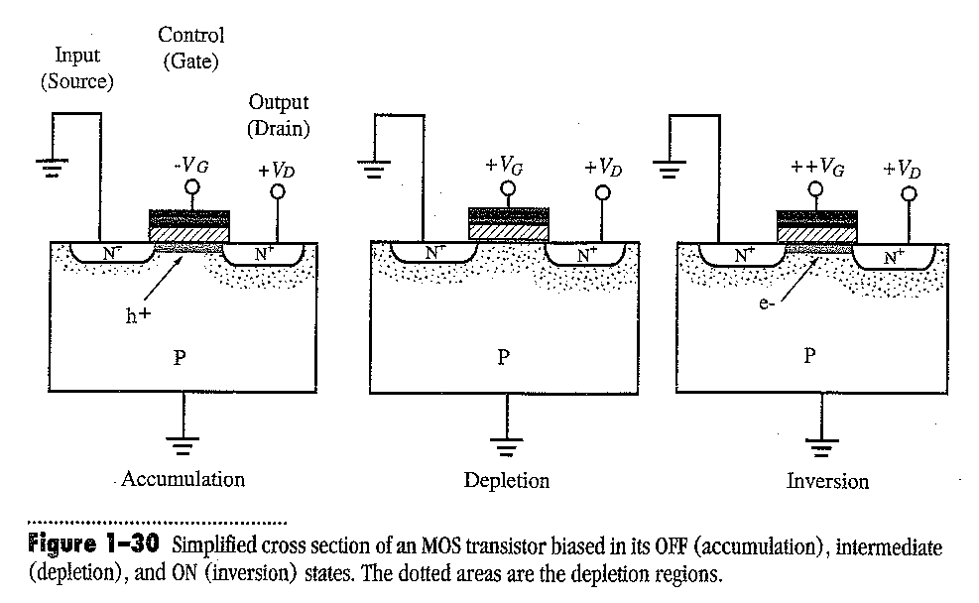
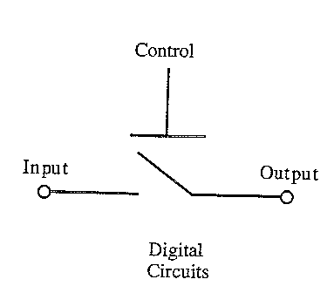
MOS transistor
MOS: metal oxide semiconductor.
MOSFET: MOS field effect transistor.
G: gate
S: source
D: drain
OFF
Intermediate
ON
depletion region
(holes h⁺ accumulate to surface)
(electrons e⁻ appeared at surface)
In accumulation, the channel is rich with holes with little free electrons, and the two PN⁺ diodes are either zero bias or reverse biased, so there is no/little current between source and drain. The same is true for depletion state where there is no carrier in the channel.
In inversion, the gate voltage is very high which attracts electrons to the very top surface of the channel, so now there is a conduction path of free electrons between source and drain.

Slide 16
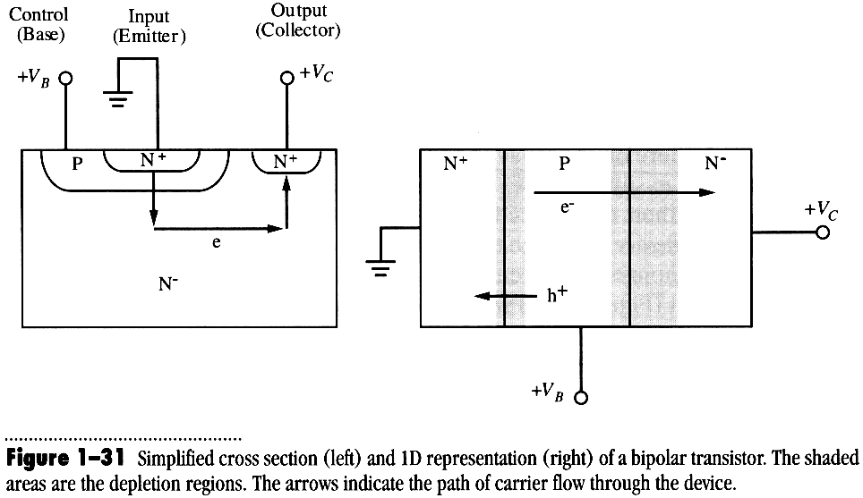
Bipolar junction transistor (BJT)
Emitter Base Collector
Figure 1-31 Simplified cross section (left) and 1D representation (right) of a bipolar transistor. The shaded areas are the depletion regions. The arrows indicate the path of carrier through the device.
The key is that the base is very narrow, so it is totally different from two independent p-n junctions (one forward, one reverse biased) connected through the base region.
In operation, the emitter is grounded, a small positive voltage to base, and a large positive voltage applied to the collector.
A tiny change of V_{B} leads to a large (exponential) change of I_{E} that is very close to collector current I_{C}. (i.e. V_{B} to control I_{C})
Since most of the current in a BJT flows below the silicon surface, the device is much less sensitive to passivation/protection problems than is the MOS transistor.
For this reason, BJT was used in the earliest ICs in the 1960s while researchers were trying to understand the stability problems of the Si/SiO₂ interface for MOS transistor.

Slide 17
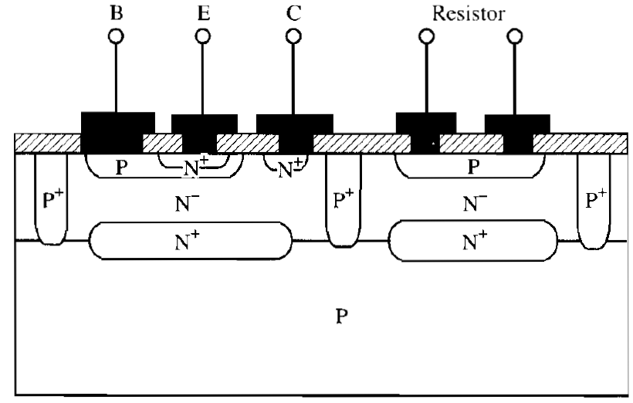
Semiconductor technology families
1960s, BJT:
BJT: bipolar junction transistor.
Gas phase diffusion for doping.
N⁻ layer grown on P by epitaxy.
Reverse biased p-n junction for device isolation.
6-8 photolithography steps.
Figure 1-32 Technology typical of the 1960s. Bipolar transistors and resistors were the dominant components.
1970s, E/D NMOS:
E/D = enhancement/depletion mode
LOCOS (local oxidation) isolation.
NMOS is used since electron mobility is ∼3× that of hole mobility.
Depletion NMOS took small area, thus denser circuit.
Again, 6-8 photolithography steps.
Left: enhancement (regular) NMOS (device is OFF at zero gate bias).
Right: depletion mode NMOS (device is ON at zero gate bias).

Slide 18
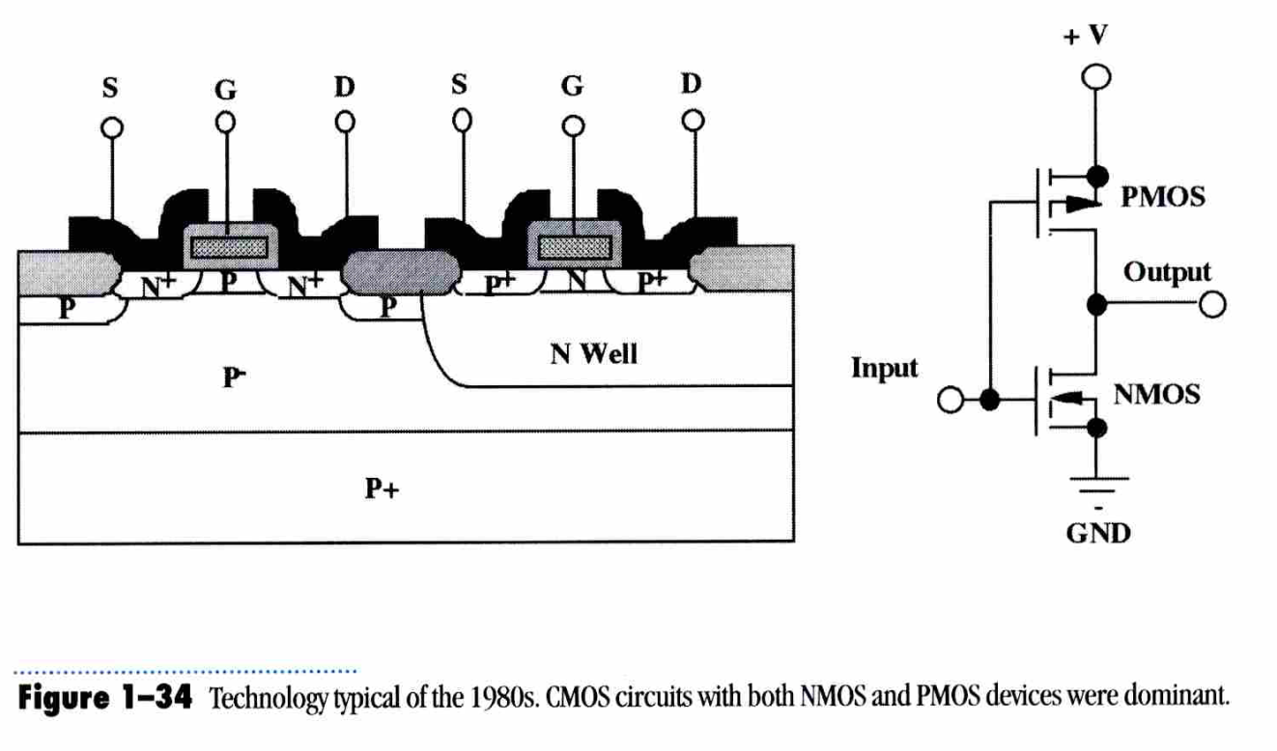
Semiconductor technology families
1980s, CMOS:
CMOS: complementary (equal number of NMOS and PMOS) MOS.
Low power consumption, low heating.
E.g. the CMOS inverter consumes no DC current in either state (no DC power).
Higher level integration.
12-14 photolithography steps.
Figure 1-34 Technology typical of the 1980s. CMOS circuits with both NMOS and PMOS devices were dominant.
BJT
CMOS
1990s, BiCMOS:
Bipolar and CMOS.
CMOS for highly integrated internal circuit.
BJT for driving circuit.
>20 photolithography steps.
BJT: bipolar junction transistor
poly = poly-crystalline Si.
TiSi Un-doped poly p⁺ poly n⁺ poly metal

