Slide 1
Chapter 1 Introduction and Historical Perspective
Introduction.
Growth of IC – Moore’s law.
Some history in IC industry.
Semiconductors.
Semiconductor devices, semiconductor technology families.
NE 343: Microfabrication and thin film technology
Instructor: Bo Cui, ECE, University of Waterloo; http://ece.uwaterloo.ca/~bcui/
Textbook: Silicon VLSI Technology by Plummer, Deal and Griffin

Slide 2
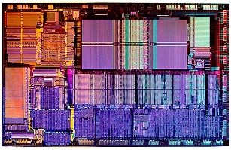
Introduction
State of art ICs manufactured in the 1990s.
This course is basically about silicon chip fabrication, the technologies used to manufacture ICs (CPU, memory – DRAM, flash…).
However, the same technology is also widely used for applications other than ICs, such as large area displays (LCD), hard disk drive, semiconductor lasers, MEMS (microelectromechanical systems), lab-on-a-chip, solar cell….
For nano-application, microfabrication is the basis for nanofabrication; with the major differences is that photolithography is used for microfabrication whereas nano-lithography (electron beam lithography…) is used for nanofabrication.
Therefore, you will find this course very useful even though most of you will not work in the IC industry after graduation.

Slide 3
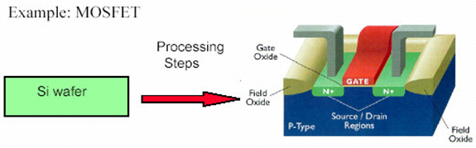
Basic fabrication components
A sequence of additive and subtractive steps with lateral patterning.
Three components for micro- and nano-fabrication:
Lithography (lateral patterning): generate pattern in a material called resist
photolithography, electron-beam lithography, nanoimprint lithography…
Thin film deposition (additive): spin coating, chemical vapor deposition, molecular beam epitaxy, sputtering, evaporation, electroplating…
Etching (subtractive): reactive ion etching, ion beam etching, wet chemical etching, polishing…
Other techniques such as doping (ion implantation) is also important for semiconductor device.

Slide 4
One fabrication example
metal nanostructures
Metal nanostructures
side view
substrate
substrate
Direct etch process
Liftoff process
resist
(polymer)
resist
(polymer)
1. Thin film growth
1. Thin film growth
2. Lithography
2. Lithography
3. Etching
3. Deposition
4. Etching (dissolve resist)
4. Etching (dissolve resist)

Slide 5
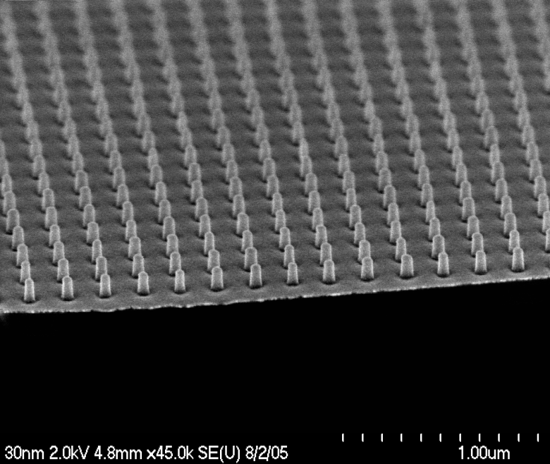
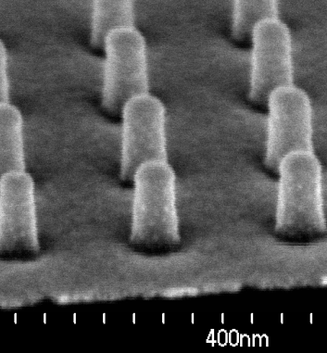
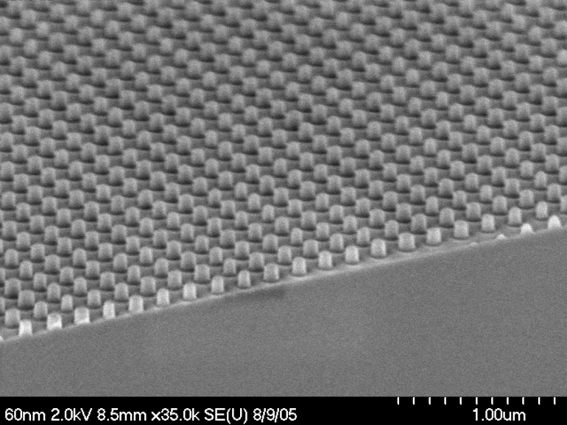
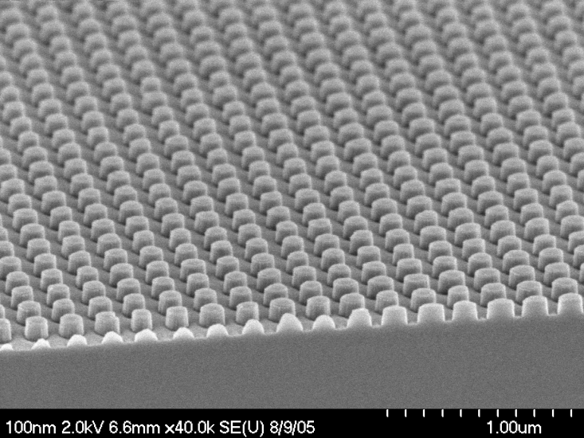
One more step: pillar array with various diameters
Pitch: 200nm
Cr
35 nm diameter
silicon
1. Cr dots by liftoff
2. RIE silicon and remove Cr
(RIE: reactive ion etching)
70 nm diameter
115 nm diameter

Slide 6
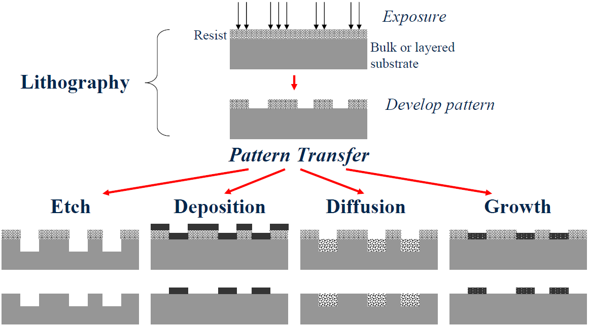
Summary of general fabrication process
or doping
Direct etch
Liftoff
Electroplating…

Slide 7
Chapter 1 Introduction and Historical Perspective
Introduction.
Growth of IC – Moore’s law.
Some history in IC industry.
Semiconductors.
Semiconductor devices, semiconductor technology families.
NE 343 Microfabrication and thin film technology
Instructor: Bo Cui, ECE, University of Waterloo
Textbook: Silicon VLSI Technology by Plummer, Deal and Griffin

Slide 8
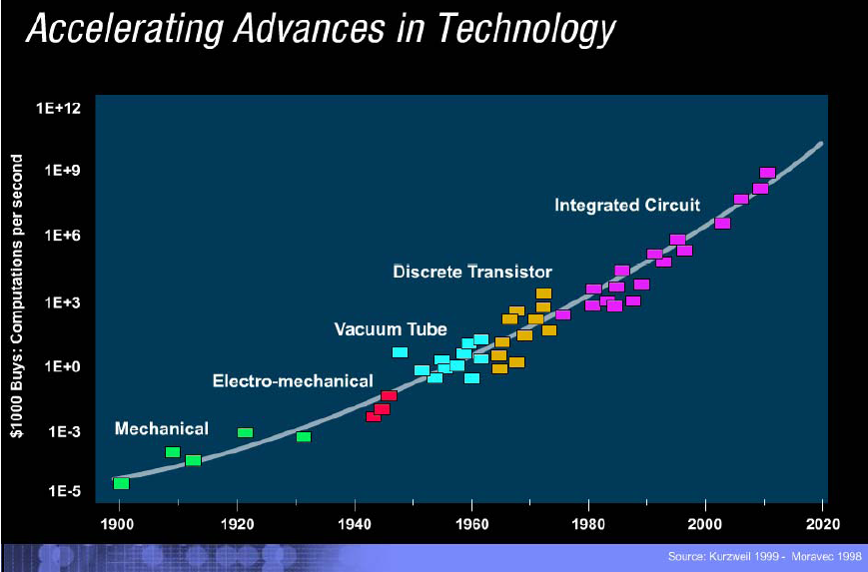
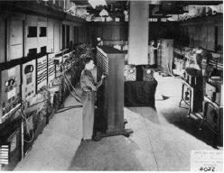
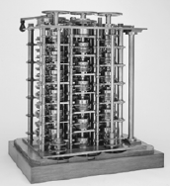
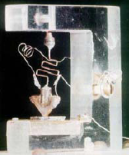
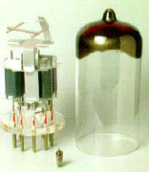
Explosive growth of computing power
1st electronic computer
ENIAC (1946)
Pentium IV
1st computer(1832)
1st transistor
1947
Vacuum Tuber
Macroelectronics Microelectronics Nanoelectronics

Slide 9
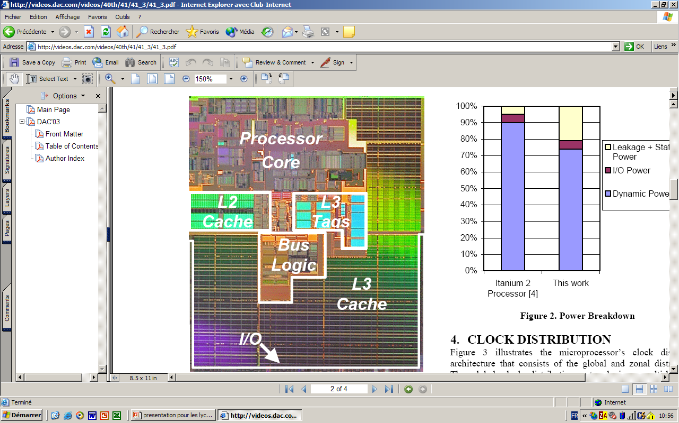
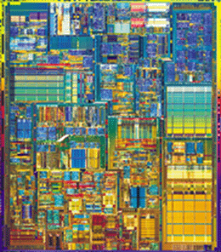



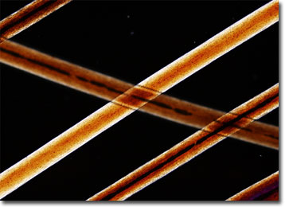
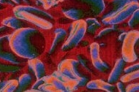
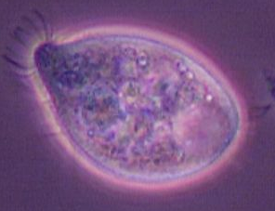
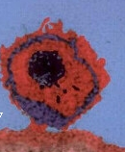
Explosive growth of computing power
1971
4004 ®
1989
386 ®
1991
486 ®
2001
Pentium IV ®
2003
Itanium 2®
410M
42M
transistor /chip
1.2M
134 000
2300
10 µm 1 µm 0.1 µm
transistor size
Human hair Red blood cell Bacteria Virus

Slide 10
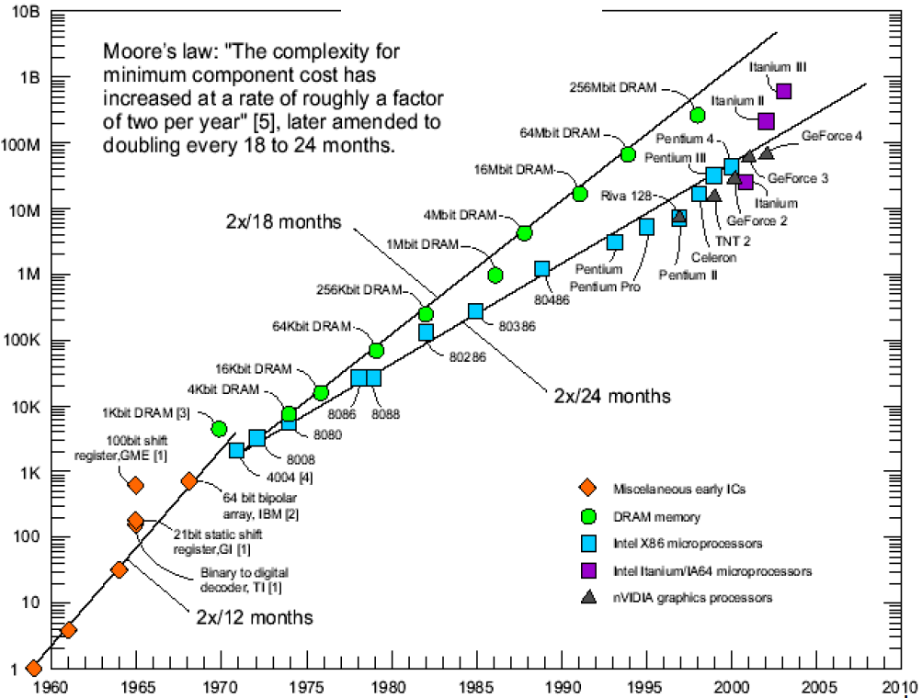
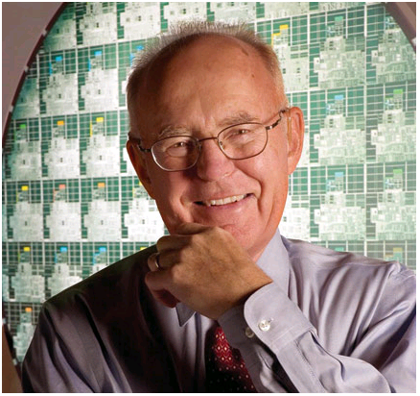
Device scaling down over time in IC industry
Moore’s law: doubling of the number of transistors on a chip roughly every two years.
This is realized by:
Making transistor smaller - smallest lateral feature size decreases by 13% each year.
Making chip bigger – chip/wafer size increases 16%/year.
Number of transistors
Gordon Moore:
born 3 January 1929, co-founder and Chairman Emeritus of Intel Corporation; author of Moore's Law published in 1965.
Miscellaneous early ICs
DRAM memory
Intel x86 microprocessors
Intel Itanium/IA64 microprocessors
nVIDIA graphics processors

Slide 11
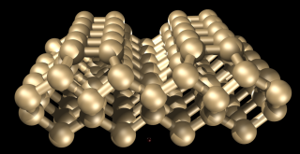
Device scaling down over time in IC industry
Era of Simple Scaling
Cell dimensions
Scaling + Innovation
(ITRS)
Invention
Atomic dimensions
The era of “easy” scaling is over.
We are now in a period where technology and device innovations are required.
Beyond 2020, new currently unknown inventions will be required.

Slide 12
Device scaling down over time in IC industry
Assumes CMOS technology dominates over entire roadmap.
2 year cycle moving to 3 years (scaling + innovation now required).
SIA-NTRS:
2 year cycle
3 year cycle
Each node half pitch ×(1/√2), area per transistor ×(1/2), i.e. for same chip size, # of transistors doubled
(MPU - microprocessor unit)
Scaling down supply voltage because otherwise, as transistors get smaller, the electric fields (voltage/feature size) in these devices will increase to unacceptable levels.
In addition, the number of levels of interconnection and photo-mask also increases.
SIA: Semiconductor Industry Association
NTRS: National Technology Roadmap for Semiconductors.
ITRS: International Technology Roadmap for Semiconductors, http://www.itrs.net

Slide 13
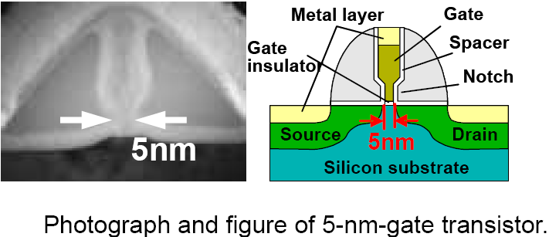
Fabrication of truly tiny transistor
NEC
However, the key is how to fabricate them with high yield and low cost.
More importantly, even though it can be fabricated, it may not function the way we want (quantum effect, leak current…).

Slide 14
Chapter 1 Introduction and Historical Perspective
Introduction.
Growth of IC – Moore’s law.
Some history in IC industry.
Semiconductors.
Semiconductor devices, semiconductor technology families.
NE 343 Microfabrication and thin film technology
Instructor: Bo Cui, ECE, University of Waterloo
Textbook: Silicon VLSI Technology by Plummer, Deal and Griffin

Slide 15
IC fabrication technology: brief history
1940s - setting the stage - the initial inventions that made integrated circuits possible.
In 1945, Bell Labs established a group to develop a semiconductor replacement for the vacuum tube. The group led by William Shockley, included, John Bardeen, Walter Brattain and others.
In 1947 Bardeen and Brattain and Shockley succeeded in creating an amplifying circuit utilizing a point-contact "transfer resistance" device that later became known as a transistor.
In 1951 Shockley developed the junction transistor, a more practical form of the transistor.
By 1954 the transistor was an essential component of the telephone system and the transistor first appeared in hearing aids followed by radios.

Slide 16
Some history in IC industry: first transistor
1st transistor in 1947 by Bell Lab, it is a point contact transistor.
J. Bardeen
W. Brattain
W. Shockley
Bipolar transistor in polycrystalline Germanium, 1956 Nobel Prize in physics.
Base is n-type Ge.
Emitter and collector are two metal wires, which are very thin and pushed onto the Ge base.
Distance between the two metal wires: 200-250μm.

Slide 17
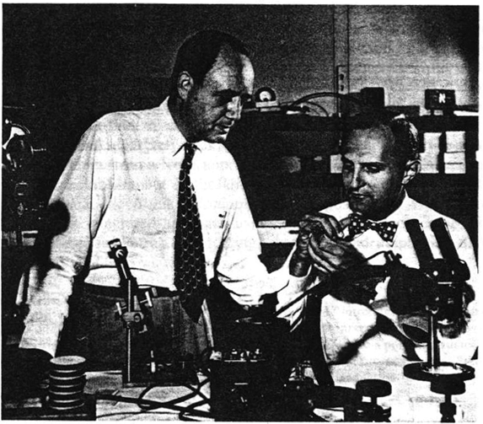
First junction transistor
Gordon Teal and Morgan Sparks made the first junction transistor, the construction of which eliminated many of the reliability problems of the point contact transistors.
Grown junction transistor technology of the 1950s, in single crystalline Si or Ge.
For Si device, Al wire is used to connect to the middle P base region (it doesn’t matter if Al is also contacted to the N-regions due to the high contact resistance with N).

Slide 18
Alloy junction technology of the 1950s
Indium melts at 157ºC, and it is a P-type dopant.
(In is in the same group as B, the most popular P-type dopant. B, Al, Ga, In…)
It is a very simple idea.

Slide 19
Doubled diffused mesa transistor technology of the late1950s
Gas phase diffusion (e.g. PH₃ gas to dope with P) to dope the silicon.
Many devices could be produced from a single substrate.
But exposed junctions were present on the wafer surface or at wafer edges.

Slide 20
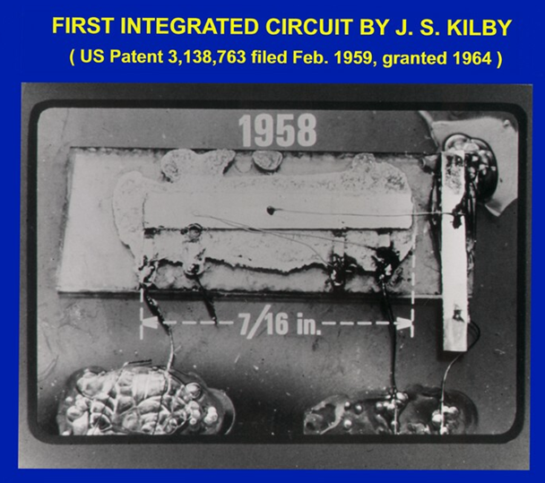
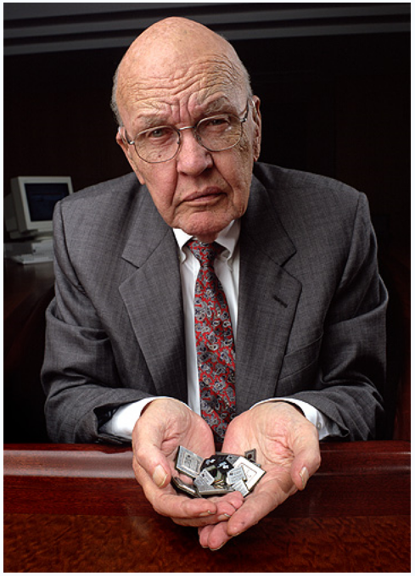
Integrated Circuit (IC) invented by Kilby from TI
IC: integrate multiple components on the same chip and to interconnect them to form a circuit.
A simple oscillator IC with five integrated
components (resistors, capacitors, distributed
capacitors and transistors) on Ge substrate.
Jack Kilby, Nobel Prize in Physics in 2000
To read (if interested) “Turning Potential into Realities: The Invention of
the Integrated Circuit (Nobel Lecture)” http://www3.interscience.wiley.com/cgi-bin/fulltext/85010385/PDFSTART
TI: Texas Instrument

Slide 21
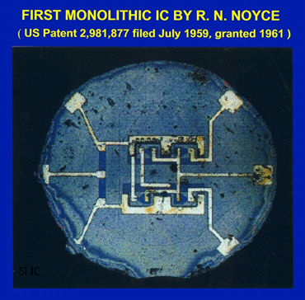
Planar process invented in the late 1950s
Kilby's invention had a serious drawback, the individual circuit elements were connected together with gold wires making the circuit difficult to scale up to any complexity.
By late 1958 Jean Hoerni at Fairchild had developed a structure with N and P junctions formed in silicon. Over the junctions a thin layer of silicon dioxide was used as an insulator and holes were etched open in the silicon dioxide to connect to the junctions.
In 1959, Robert Noyce also of Fairchild had the idea to evaporate a thin metal layer over the circuits created by Hoerni's process.
The metal layer connected down to the junctions through the holes in the silicon dioxide and was then etched into a pattern to interconnect the circuit.
Planar technology set the stage for complex integrated circuits and is the process used today.
Monolithic: made from same substrate
Planar technology

Slide 22
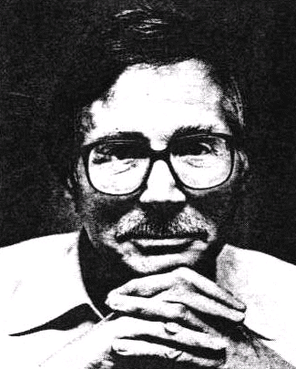
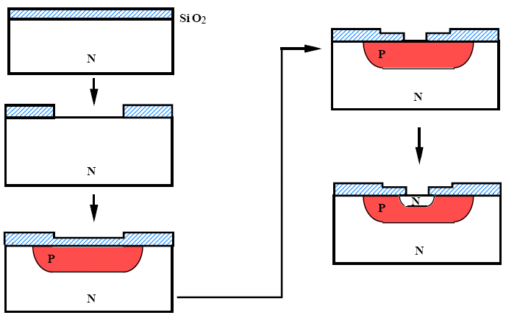
Planar process invented in the late 1950s
Gas phase diffusion masked by SiO₂.
SiO₂ patterned by photolithography.
Since only Si has this perfect oxide that can block the diffusion, technology was shifted from Ge to Si.
Junction is under SiO₂ surface (no longer exposed to surface/edges), it is thus passivated/protected.
Boron diffusion
Jean Hoerni from Fairchild, inventor of planar process
Phosphorus diffusion
Oxidation and drive-in diffusion

Slide 23
IC and basic photolithography process
Integrated circuit use photolithography and masking to fabricate multiple components in a common substrate.
Here are one bipolar transistor and two resistors.
Resistor
Base
Contact to collector
Emitter
Collector
The IC pattern is transferred from a mask to the silicon by printing it on the wafer using a light sensitive resist material.

Slide 24
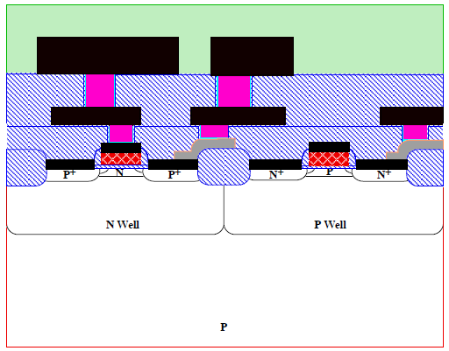
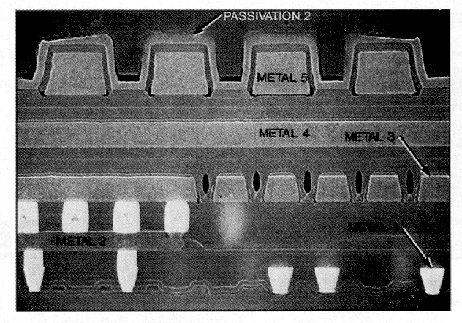
Modern integrated circuit
Actual cross-section of a modern microprocessor chip.
Note the multiple levels of metal. The active parts of the transistors are barely visible at the bottom of the photography.
Schematic cross-section of a modern silicon IC. Here is a CMOS with an NMOS device on the right, and PMOS on the left. There are two levels of wiring shown.

Slide 25
Breakthroughs in IC history (summary)
Bardeen, Brattain, Shockley, First Ge-based bipolar transistor invented 1947, Bell Labs. Nobel prize in 1956.
Atalla, First Si-based MOSFET invented 1958, Bell Labs.
Kilby (TI) & Noyce (Fairchild), Invention of integrated circuits 1959, Nobel prize in 2000.
Planar technology, Jean Hoerni, Fairchild, 1959
First CMOS circuit invented 1963, Fairchild
“Moore’s law” coined 1965, Fairchild
Dennard, scaling rule presented 1974, IBM
First Si technology roadmap published 1994, USA
Intel was founded in 1968, by Gordon Moore and Robert Noyce, both from Fairchild.
For Fairchild’s history, go to
http://en.wikipedia.org/wiki/Fairchild_Semiconductor

