Slide 1
Chapter 10 Etching
Introduction to etching.
Wet chemical etching: isotropic.
Anisotropic etching of crystalline Si.
Dry etching overview.
Plasma etching mechanism.
Types of plasma etch system.
Dry etching issues.
Dry etching method for various films.
Deep Si etching (can etch through a wafer).
NE 343: Microfabrication and thin film technology
Instructor: Bo Cui, ECE, University of Waterloo; http://ece.uwaterloo.ca/~bcui/
Textbook: Silicon VLSI Technology by Plummer, Deal and Griffin

Slide 2
Material removal: etching processes
Etching is done either in “dry” or “wet” methods:
Wet etching uses liquid etchants with wafers immersed in etchant solution.
Wet etch is cheap and simple, but hard to control (not reproducible), not popular for nanofabrication for pattern transfer purpose.
Dry etch uses gas phase etchants in plasma, both chemical and physical (sputtering process).
Dry plasma etch works for many dielectric materials and some metals (Al, Ti, Cr, Ta, W…).
For other metals, ion milling (Ar⁺) can be used, but with low etching selectivity. (as a result, for metals that cannot be dry-etched, it is better to pattern them using liftoff)
Etching is consisted of 3 processes:
Mass transport of reactants (through a boundary layer) to the surface to be etched.
Reaction between reactants and the film to be etched at the surface.
Mass transport of reaction products from the surface through the surface boundary layer.
Figures of merit: etch rate, etch rate uniformity, selectivity, and anisotropy.

Slide 3
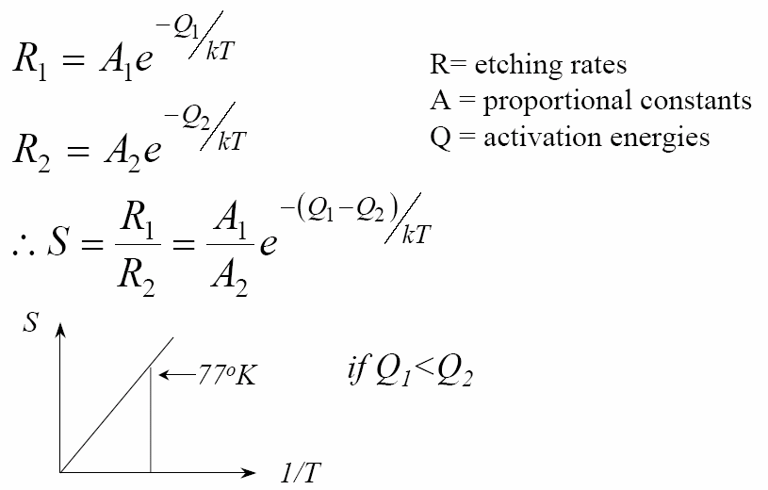
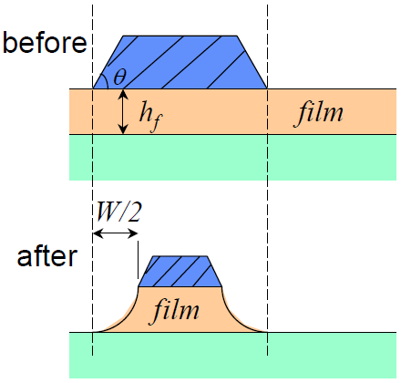
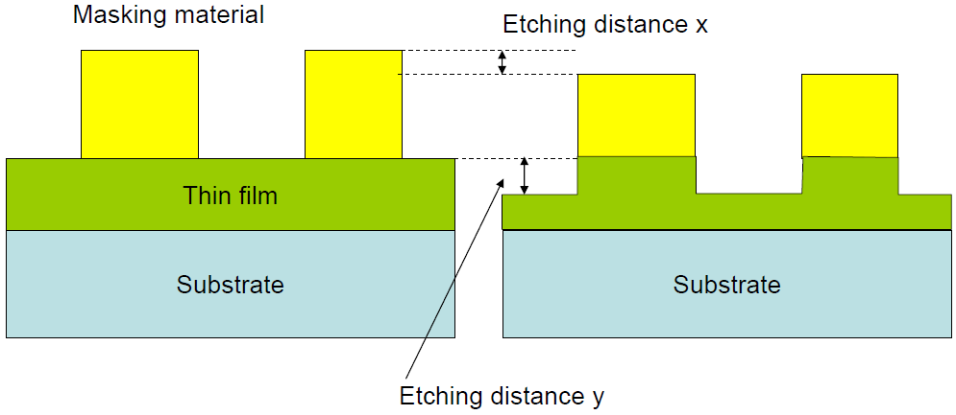
Figures of merit: selectivity
Etching selectivity:
The ratio of etching rate between different materials, usually the higher the better.
Generally, chemical etching has high selectivity, physical etching (sputtering, milling) has low selectivity.
For fabrication, the selectivity is usually between film material and mask material, and is defined by S_{fm}. (f: film; m: mask)
Temperature affects selectivity
Etching with mask erosion

Slide 4
Selective over-etch of different materials
The film is etched through to the bottom, plus over-etch to etch laterally for under-cut profile.

Slide 5
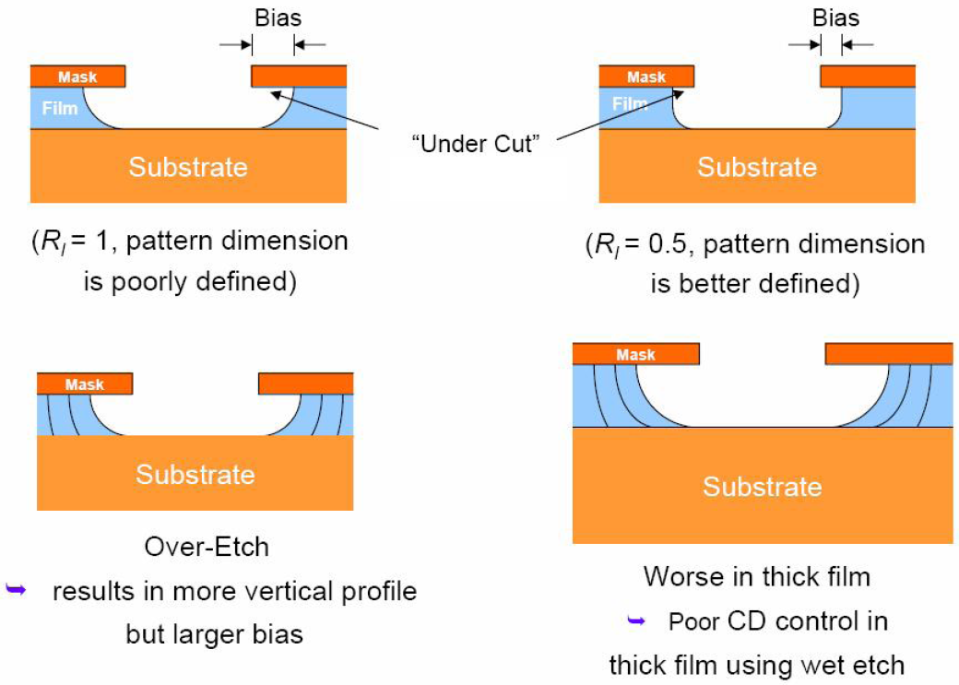
Figures of merit: anisotropy
Isotropic: etch rate is the same along all directions.
Anisotropic: etch rate depends on direction, usually vertical vs. horizontal.
For isotropic, R_{I}=1.
For complete anisotropic, R_{I}=0.
CD: critical dimension

Slide 6
Figures of merit: anisotropy
Generally speaking, chemical process (wet etch, plasma etch) leads to isotropic etch; whereas physical process (directional energetic bombardment) leads to anisotropic etch.
Isotropic:
Best to use with large features when sidewall slope does not matter, and to undercut the mask (for easy liftoff).
Large critical dimension (CD, i.e. feature size) loss, generally not for nano-fabrication.
Quick, easy, and cheap.
Anisotropic:
Best for making small features with vertical sidewalls, preferred pattern transfer method for nano-fabrication and some micro-fabrication.
Typically more costly.

Slide 7
Chapter 10 Etching
Introduction to etching.
Wet chemical etching: isotropic.
Anisotropic etching of crystalline Si.
Dry etching overview.
Plasma etching mechanism.
Types of plasma etch system.
Dry etching issues.
Dry etching method for various films.
Deep Si etching (can etch through a wafer).
NE 343: Microfabrication and Thin Film Technology
Instructor: Bo Cui, ECE, University of Waterloo, bcui@uwaterloo.ca
Textbook: Silicon VLSI Technology by Plummer, Deal, Griffin

Slide 8
Wet etching
Wet etching was used exclusively till 1970’s when feature size >3um.
For small scale features, large etch bias leads to significant CD (critical dimension) loss.
For today’s IC industry, wet etching is used for noncritical feature sizes.
Advantages: high selectivity, relatively inexpensive equipment, batch system with high throughput, etch rate can be very fast (many μm/min).
Disadvantages: generally isotropic profile, high chemical usage, poor process control (not so reproducible), excessive particulate contamination.
The etch rate can be controlled by any of the three serial processes: reactants transport to the surface (depends on chemical concentration and stirring…), reaction rate (depends on temperature), reaction products transport from the surface (depends on stirring…).
Preference is to have reaction rate controlled process because
Etch rate can be increased by temperature
Good control over reaction rate – temperature of a liquid is easy to control
Mass transport control will result in non-uniform etch rate: edge etches faster.
Etchant is often stirred to minimize boundary layer and make etching more uniform.

Slide 9
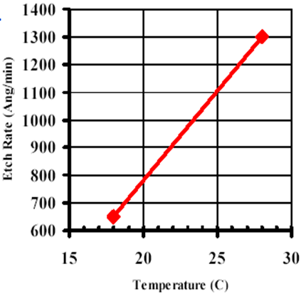
Isotropic wet etching (silicon dioxide)
SiO₂ + 6HF → H₂SiF₆+2H₂O
SiO₂ etch rate
Etch is isotropic and easily controlled by dilution of HF in H₂O.
Thermally grown oxide etches at
120nm/min in 6H₂O:1HF
∼1 μm/min in 49 wt% HF (i.e. undiluted as purchased HF).
Faster etch rate for doped or deposited oxide.
High etch selectivity (SiO₂/Si) > 100
Buffered HF (BHF) or buffered oxide etchant (BOE) provides consistent etch rate
In regular HF etches, HF is consumed and the etch rate drops.
HF buffered with NH₄F to maintain HF concentration, typically 6NH₄F : 1HF
NH₄F→NH₃↑+ HF
HF is very dangerous! Because:
It is not a so strong acid (you don’t feel the pain for diluted HF).
Deceptive: it looks just like water.
It penetrates skin and attacks slowly the flesh and the bone.
It might be too late when you begin to feel the pain.

Slide 10
Isotropic etch (silicon)
Silicon is etched by nitric acid and hydrofluoric acid mixtures (HNO₃ may be replaced by other strong oxidants like H₂O₂)
HNO₃ partially decomposes to NO₂, which oxidizes the surface of Si.
The HF then dissolves the SiO₂. The overall reaction is:
Excess nitric acid results in a lot of silicon dioxide formation and etch rate becomes limited by HF removal of oxide (polishing).
CH₃COOH (acetic acid) or H₂O can be added as diluent, but etch differently.
Acetic acid is preferred because it prevents HNO₃ dissociation.
Si + 2NO₂ + 2H₂O → SiO₂ + H₂ + 2HNO₂
Si + HNO₃ + 6HF → H₂SiF₆ + HNO₂ + H₂O + H₂

Slide 11
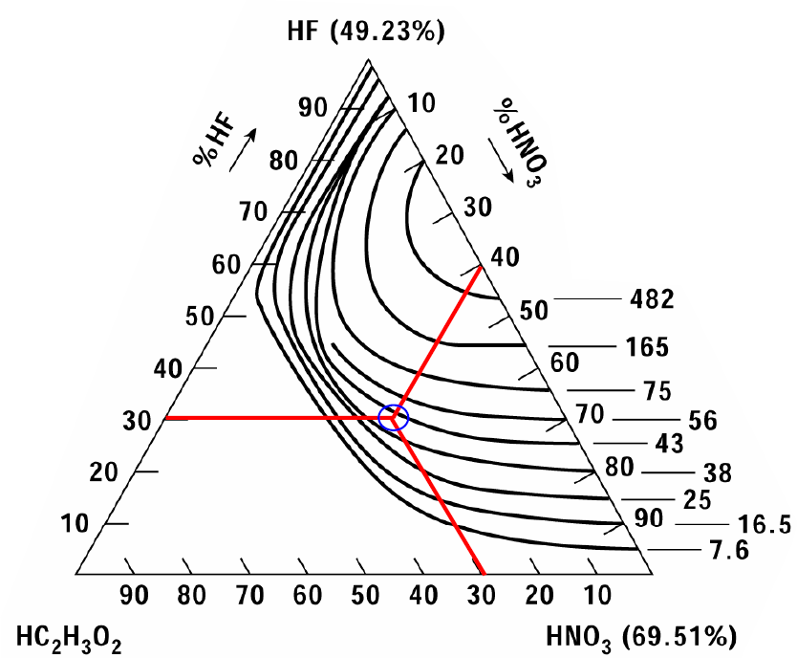
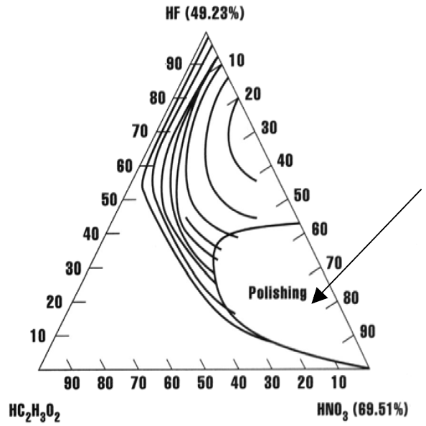
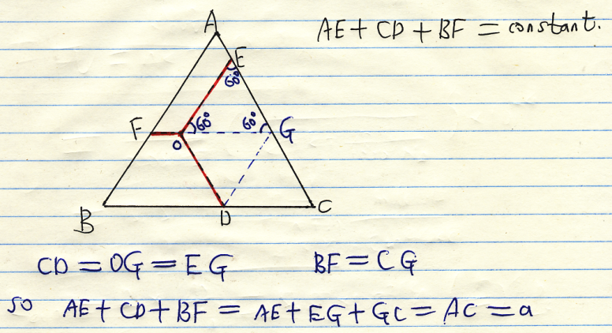
Si iso-etch curves
Etch rate (μm/min), VERY fast
Regions exist where the reduction reaction is so slow, the surface is very planar and ends up being “polished” after the etch.
1
2
As-purchased HF is 49.23%, and HNO₃ 69.51%)
Region 1:
High HF concentrations, reaction limited by HNO₃, follow constant HNO₃% lines.
Rate limited by oxidation, etched wafer surface have some oxide.
Region 2:
High HNO₃ concentrations, reaction limited by HF, follow constant HF % lines.
Rate limited by reduction, etched wafer surface have more oxide.

Slide 12
Isotropic etch (silicon nitride)

Slide 13
Isotropic etching (aluminum)
50H₃PO₄ : 20H₂O : 1HNO₃ : 1CH₃COOH
Al³⁺ is water-soluble
Aluminum etches in water, phosphoric, nitric and acetic acid mixtures.
Converts Al to Al₂O₃with nitric acid (evolves H₂).
Dissolve Al₂O₃ in phosphoric acid.
Gas evolution leading to bubbles.
Local etch rate goes down where bubble is formed, leading to non-uniformity.
Al can also be etched in (diluted) acid or base, such as HCl, HNO₃, H₂SO₄, NaOH or KOH, but less controllable (etch the native oxide slowly and un-controllably, then once oxide all etched away, etch Al metal very fast).
The etch seems more repeatable in diluted HF (1:100 diluted), if one doesn’t bother to mix the above mixture (50H₃PO₄…).

Slide 14
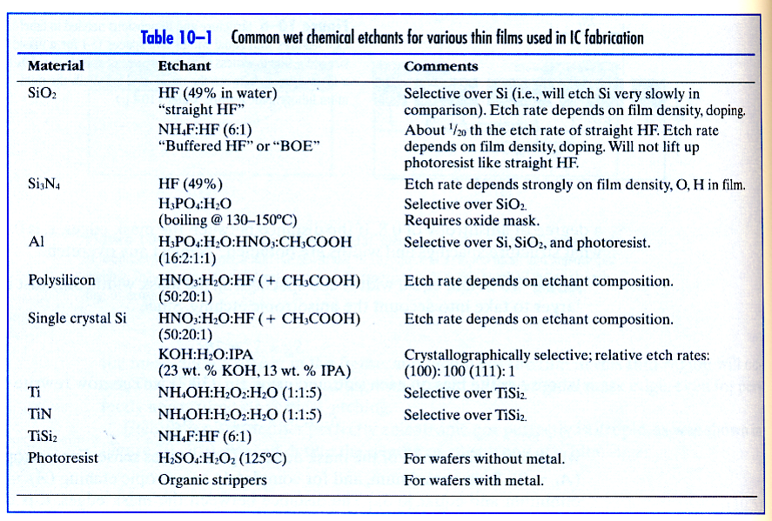
Etchant |  |  | Etches | Doesn't etch
H₃PO₄(19), Hac(1), HNO₃(1), H₂O(2) |  |  | Al, SiN, M | SiO₂, Si, PR
HF, BOE (HF + NH₄F) |  |  | SiO₂, M | Si, SiN, Au
H₂SO₄(3), H₂O₂(1) pirahna |  |  | Organics, M | Si, SiO₂, SiN
I₂(I),KI(2),H₂O(10) |  |  | Au, M | Si, SiO₂, SiN, M, PR
NH₄OH(5), H₂O₂(1) |  |  | Polymers, Al | Si, SiO₂, SiN, M
HNO₃(64), NH₄F(3), H₂O(33) |  |  | Si, M | SiN, PR
HCl(3), HNO₃(1) (aqua regia) |  |  | Au, other M | Cr, Si, SiN, SiO₂
Summary
M: metal;
PR: photoresist;
Hac: acetic acid
Those are just starting point, can use different ratios.
E.g. the ratio for the Al etchant is different from previous slide.
In addition, most metals can be etched by (diluted) acid, except Ti and Cr that form a dense stable oxide on top.
Ti can be etched by HF; Cr by ceric ammonium nitrate plus acid.

Slide 15
Chapter 10 Etching
Introduction to etching.
Wet chemical etching: isotropic.
Anisotropic etching of crystalline Si.
Dry etching overview.
Plasma etching mechanism.
Types of plasma etch system.
Dry etching issues.
Dry etching method for various films.
Deep Si etching (can etch through a wafer).
NE 343: Microfabrication and Thin Film Technology
Instructor: Bo Cui, ECE, University of Waterloo, bcui@uwaterloo.ca
Textbook: Silicon VLSI Technology by Plummer, Deal, Griffin

Slide 16
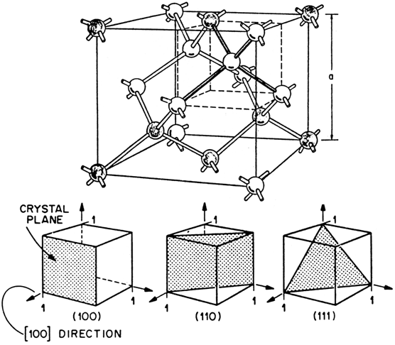
An-isotropic wet etching of Si: overview
Orientation selective etch of silicon occur in hydroxide solutions partly because of the closer packing of some orientations relative to other orientations
Density of planes: <111> > <110>, <100>
Etch rate: R(111) << R(110), R(100)
<100> direction etches faster than <111> direction, with etch rate
R(100) = few 100 × R(111)
It is reaction rate limited
Used very widely in MEMS (micro electro mechanical systems), since it is inexpensive, fast etching and easy to control.
{100} and {110} have 2 bonds below surface & 2 dangling bonds that can react.
{111} plane has three of its bonds below surface & only one dangling bond to react → much slower etch rate.

Slide 17
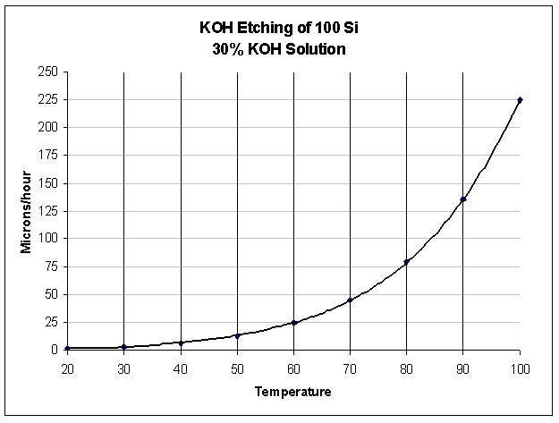
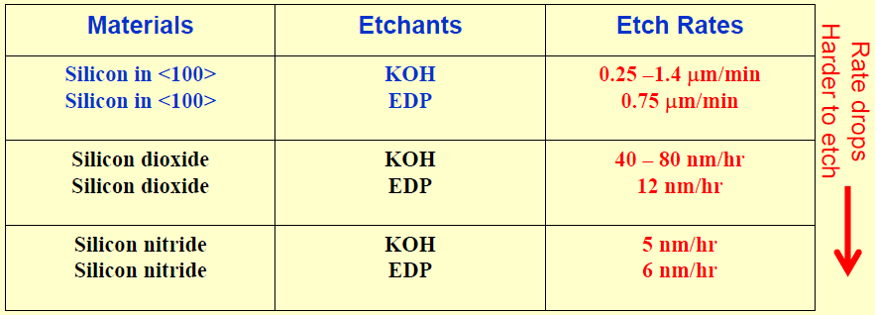
An-isotropic wet etching of Si
KOH etch example:
250 g KOH: 200 g 2-propanol, 800 g H₂O at 80ºC
1000 nm/min of [100]
Etch stops at p++ layers
Selectivity: {111}:{110}:{100} ∼ 1:600:400
KOH etching of <100> Si, 30% KOH solution
Seidel’s etching model:
Si + 2OH⁻ → Si(OH)₂²⁺ + 2e⁻
Si(OH)₂²⁺ + 2OH⁻ → Si(OH)₄ + 2e⁻
Si(OH)₄ + 4e⁻ + 4H₂O → Si(OH)₆²⁻ + 2H₂
This is a model, real reaction is complicated.
Si(OH)₄ is soluble.
H₂ is generated and form bubbles.
μm/hour
temperature
EDP: see later slides

Slide 18
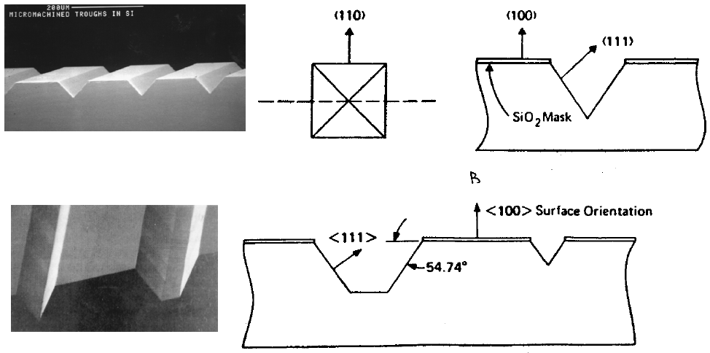
Examples: for (100) wafer
Effect of slow {111} etching with KOH: etching virtually stops at {111} plane.
Etched trench
Etching selectivity to thermal oxide ∼1000, to LPCVD nitride ∼infinity (>10⁴!).
Etch mask: SiO₂ or Si₃N₄ or Cr/Au
But KOH attacks PECVD oxide and nitride.
(100) Silicon wafer
Etch “stops” at (111) direction

Slide 19
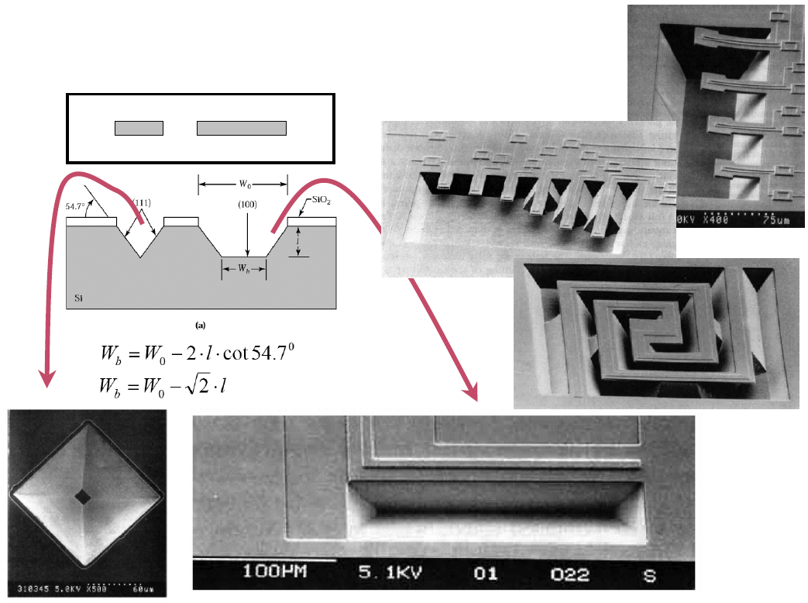
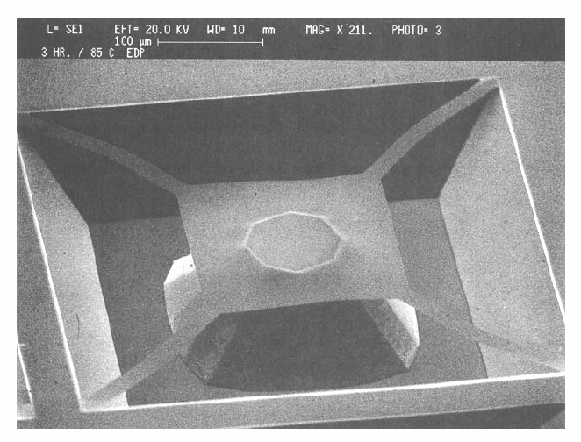
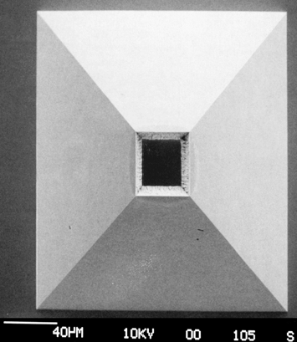
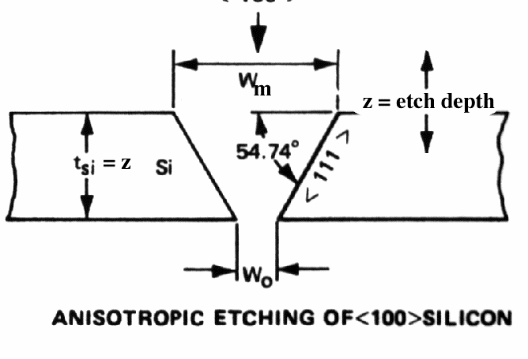
Examples: for (100) wafer
Have been used to make bubble-jet printer nozzle.

Slide 20
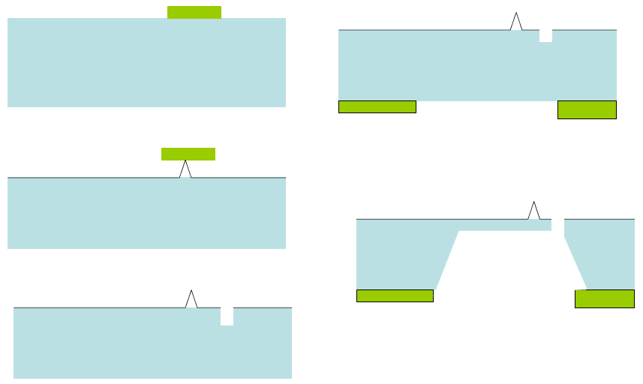
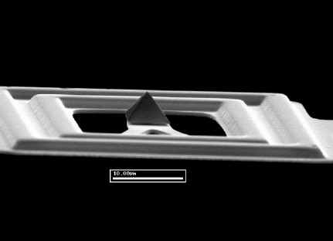
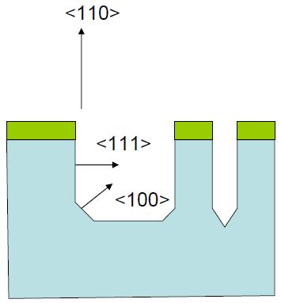
AFM (atomic force microscope) tips
(100) wafer
For (110) (not (100)) wafer, vertical (not tapered) trench possible.
What is the direction along the grating lines?

Slide 21
Other anisotropic silicon etchants
Tetramethyl Ammonium Hydroxide (TMAH)
Used widely as positive photoresist developer (since it contains no metal like K or Na, which are harmful for device.)
Typical etching at 80-90ºC.
Etching rate ∼0.5-1.5 μm/min (10-40%w.t)
Selectivity <100> : <111> ∼ 10 - 35, much lower than KOH.
Result in rough surface(H₂ bubble), KOH etch is smoother.
Like KOH, attacks aluminum
Like KOH, can use boron-stop-etching technique (etching rate decreases 40 times for 10²⁰/cm³ boron doping).
Excellent selectivity of <100>Si : oxide/nitride (1: 5000-50000)
Ethylene Diamine Pyrochatechol (EDP)
Typical etching temperature 115ºC.
Etching rate 1μm/min.
Selectivity of <100>Si : oxide/nitride ∼ 3000-7000.
Doesn’t attack metal (Au, Cr, Cu, Ta) but attacks Al.
Selectivity <100> : <111> ∼35; (100) etches faster than (110), ((110) etches faster for KOH).
Excellent for boron stop technique, etching rate drops 50 times for 7x10¹⁹/cm³ boron doping.
Carcinogenic.
http://en.wikipedia.org/wiki/Ethylenediamine_pyrocatechol

Slide 22
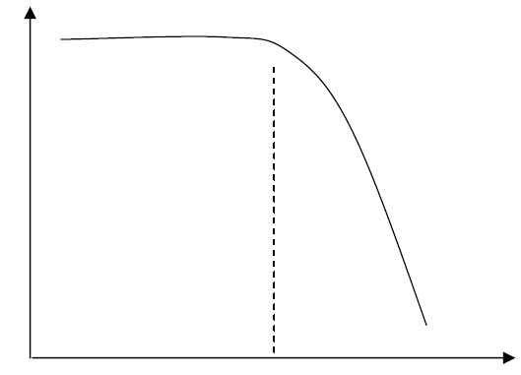
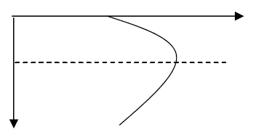
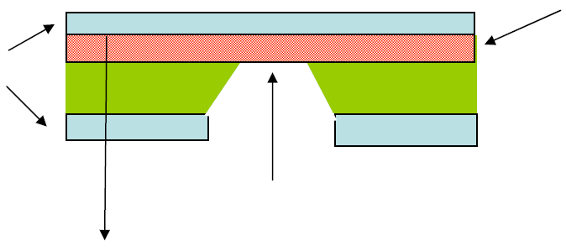
Etch stop
In wet etching process, etching depth is hard to control, so need etch stop layer.
Besides oxide and nitride, etching may be stopped by the following two methods, both related to doping of the silicon substrates.
Controlled by doping: doped Si dissolved slower than pure Si.
Controlled by electrochemical etch stop.
Etching stop by boron doping
Etch rate
Boron concentration
5μm
Boron concentration
10¹⁹ - 10²⁰
x
Heavily doped boron layer (5-10μm)
mask
Etching direction
x

Slide 23
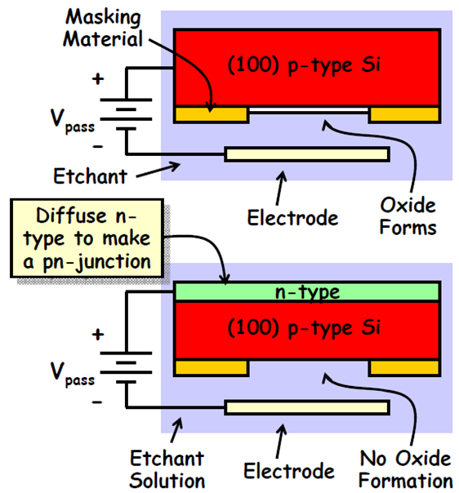
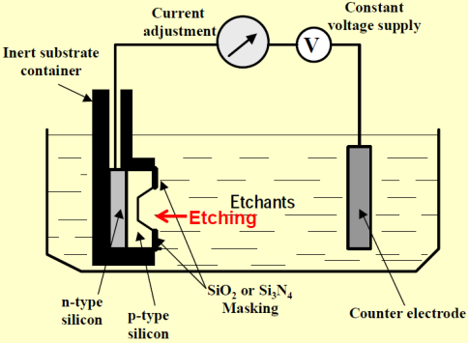
Electrochemical etch stop
When silicon is biased with a sufficiently large anodic potential relative to the etchant, it get oxidized due to electrochemical passivation, which then prevents etching.
For passivation to occur, current flow is required.
So if current flow can be prevented, there will be no oxide growth and etching can proceed.
Current flow can be prevented by adding a reverse-biased diode structure.
When n-type exposed to solution, oxide forms and etch stops.

