Slide 1
Chapter 10 Etching
Introduction to etching.
Wet chemical etching: isotropic.
Anisotropic etching of crystalline Si.
Dry etching overview.
Plasma etching mechanism.
Types of plasma etch system.
Dry etching issues.
Dry etching method for various films.
Deep Si etching (can etch through a wafer).
NE 343: Microfabrication and thin film technology
Instructor: Bo Cui, ECE, University of Waterloo; http://ece.uwaterloo.ca/~bcui/
Textbook: Silicon VLSI Technology by Plummer, Deal and Griffin

Slide 2
Why dry etching?
Dry etching advantages
Eliminates handling of dangerous acids and solvents
Uses small amounts of chemicals
Isotropic or anisotropic/vertical etch profiles
Directional etching without using the crystal orientation of Si
Faithful pattern transfer into underlying layers (little feature size loss)
High resolution and cleanliness
Less undercutting
Better process control
Dry etching disadvantages:
Some gases are quite toxic and corrosive.
Re-deposition of non-volatile compound on wafers.
Expensive equipment ($200-500K for R&D, few million for industrial tools ).
Types of dry etching:
Non-plasma based - uses spontaneous reaction of appropriate reactive gas mixture.
Plasma based - uses radio frequency (RF) power to drive chemical reaction.

Slide 3
Non-plasma based dry etching
This is very rare. For example,
Although there is a large gain in free energy, the large activation energy does not allow low temperature processes - reaction is only effective above ∼ 800°C.
In order to succeed with “gas” etching, one has to go out of equilibrium.
The solution is plasma etching.
One exception is room temperature XeF₂ etching of Si. (same for BrF₃ & ClF₃)
4Si(s) + 2Cl₂ (g) ---> 4SiCl₄ (g) + 130 kcal/mole
Xenon di-fluoride (XeF₂) etching of Si:
2XeF₂ + Si → 2Xe (g) + SiF₄ (g)
XeF₂ is a white powder, with vapor pressure ∼3.8 Torr at 25ºC.
Isotropic etching, non-polish etching (rough)
High selectivity for Al, SiO₂, Si₃N₄, photoresist, and PSG (phospho-silicate glass).
Typical etch rate ∼1μm/min
Heat is generated during exothermic reaction
XeF₂ reacts with water (or vapor) to form HF
Gas phase etching, no stiction between freed structure and substrate (no liquid involved like KOH etch, so no need of drying that collapses pattern due to capillary force).
Popular for MEMS application.
MEMS: micro electro mechanical systems

Slide 4
Plasma-based etching
Directional etching due to presence of ionic species in plasma and (self-) biased electric field. (The self-bias electric field is not applied externally, but is created spontaneously in RF plasma)
Two components exist in plasma
Ionic species result in directional etching.
Chemical reactive species result in high etch selectivity.
Control of the ratio of ionic/reactive components in plasma can modulate the dry etching rate and etching profile.
Plasma
Neutrals (etchant gas)
Ions
Free radicals
Gaseous products
adsorb
react
surface

Slide 5
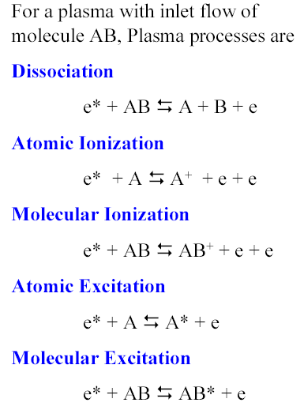
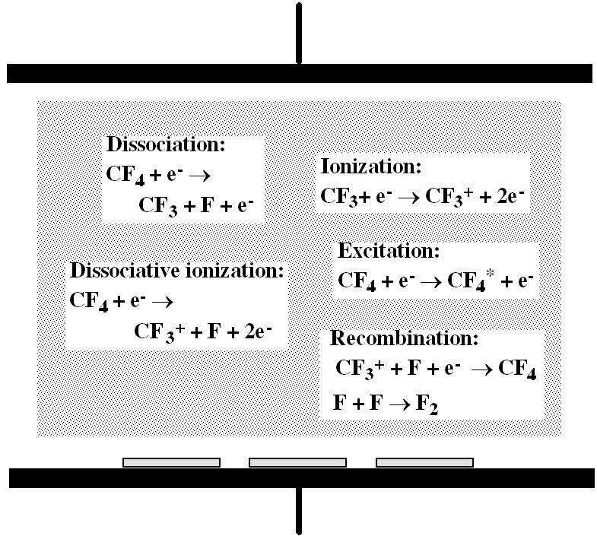
RF plasma chemistry
RF plasma is more widely used for dry etching than DC plasma – is there DC plasma dry etching?
CF₄ plasma
Figure 10-9

Slide 6
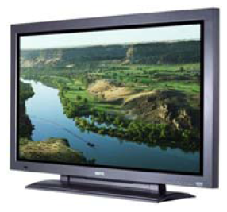
Loss mechanisms
As seen in previous slide, in a plasma, unstable particles are continuously generated.
The concentrations of ions, radicals, active atoms, & electrons increase until their loss rate is equal to the generation rate, forming a steady-state plasma.
Recombination of ions and electrons: they attract each other and are annihilated.
Drift, diffusion to walls: electrons are lost at conductive surfaces, chamber walls or electrodes. Ions are lost (converted to neutral particles) by contact with conductive surfaces, especially positive electrode.
Recombination of radicals: e.g. 2O → O₂.
Chemical reaction (what we want): e.g. 4F + Si → SiF₄ (fluorine radical combines with silicon wafer to produce silicon tetra-fluoride gas. This is a typical dry etching process.)
In equilibrium, degree of ionization typically 10⁻³ - 10⁻⁶, very low, meaning majority gas not ionized.
(plasma density = number of ions/cm³ ∼ typically 10⁹ – 10¹³/cm³.)
Plasma TV
In a plasma TV, the recombination of ion-electron or radical, or de-excitation of atom or molecule, generates the colorful light we see.

Slide 7
Chapter 10 Etching
Introduction to etching.
Wet chemical etching: isotropic.
Anisotropic etching of crystalline Si.
Dry etching overview.
Plasma etching mechanism.
Types of plasma etch system.
Dry etching issues.
Dry etching method for various films.
Deep Si etching (can etch through a wafer).
NE 343: Microfabrication and Thin Film Technology
Instructor: Bo Cui, ECE, University of Waterloo, bcui@uwaterloo.ca
Textbook: Silicon VLSI Technology by Plummer, Deal, Griffin

Slide 8
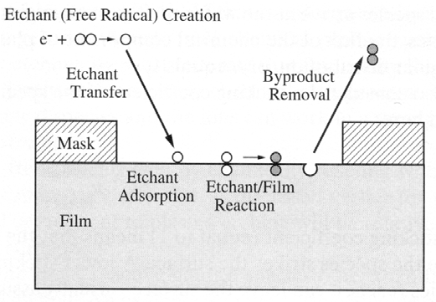
Plasma etching mechanism overview
In a plasma, reactive neutral chemical species (free radicals, e.g. F atoms or molecular species CF₃) are mainly responsible for the chemical reaction due to their much greater numbers compared to ions (e.g. CF₃⁺ is also reactive, but with low concentration in a plasma. But Ar⁺ is not reactive, and etches/sputters much slower than chemical etching, even when ion energy is high -- generally chemical etching is much faster than physical).
Those free radicals and molecules also serve as primary deposition species in PECVD.
Those free radicals are more abundant than ions because: 1) they are generated at lower threshold energy (e.g. < 8eV; in comparison, Ar is ionized at 15.7eV); and 2) they (uncharged radicals) have longer lifetime in the plasma.
The neutral radicals arrive at cathode surface by diffusion (thus non-directional).
Charged ions are accelerated to the cathode due to self-bias.
(Unless with very high energy of >100eV as in ion beam/sputter etching), ion itself doesn’t contribute significantly to the chemical reaction mostly due to its very low concentration, but ion bombardment can greatly enhance the chemical reaction in ion-enhanced etching.
Figure 10-10

Slide 9
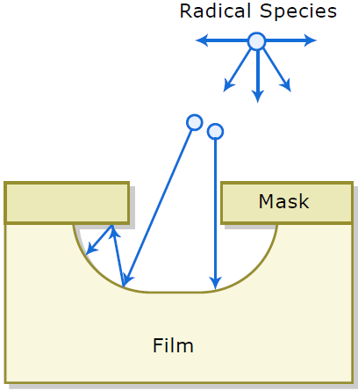
Chemical etch: highly selective, but isotropic
Due to their incomplete bonding (incomplete outer shells), free radicals (neutral, e.g. CF₃ and F from CF₄ plasma) are highly reactive chemical species.
Free radicals react with film to be etched and form volatile by-products.
Pure chemical etch is isotropic or nearly isotropic, and the etching profile depends on arrival angle and sticking coefficients of free radicals.
Free radicals (un-charged) in plasma systems have isotropic arrival angles.
The sticking coefficient S is very low, typically only S∼0.01 (i.e. most free radicals adsorb then just bounce back without reaction).
This leads to isotropic character of etch, as free radicals can etch area beneath the mask due to bouncing, as seen in the figure. The resulted profile has large undercut.
Adsorption rate onto surface

Slide 10
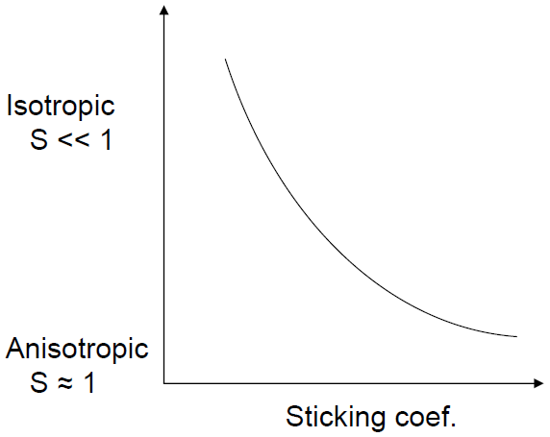
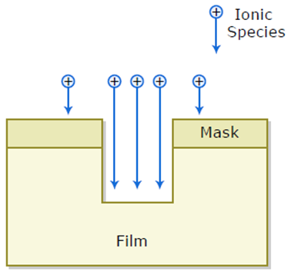
Sticking coefficient S
Most adsorbed species just left the adsorption site without doing anything, so S<<1.
Figure 10-11
“Reaction”, here momentum transfer by physical bombardment, takes place at every shot, usually sputter off a few atoms, so S∼1.

Slide 11
Si etching with F radicals
Isotropic etching

Slide 12
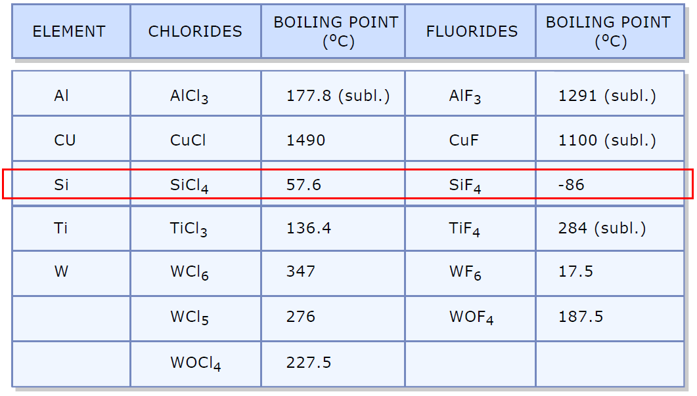
Etch byproducts should have low boiling point
Low boiling point means very volatile, so it can be pumped away.
This is not necessary for physical etching/sputtering, where etch product is sputtered off that ideally doesn’t fall on the other part of the wafer (re-deposition).
Boiling points of typical etch products

Slide 13
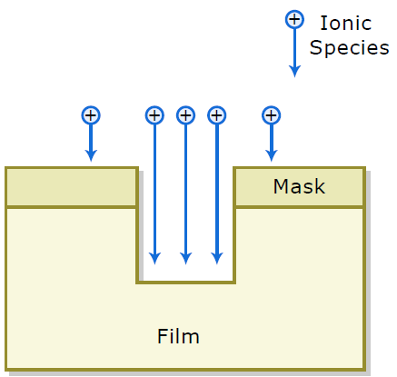
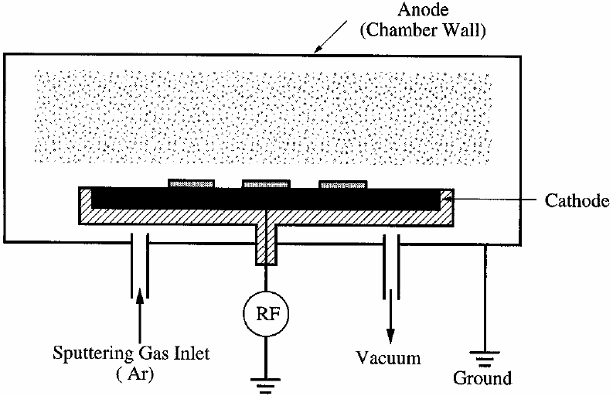
Physical etch component in a plasma etch system
(much less important than chemical etch)
Ionic species are accelerated toward each electrode by built-in self-bias.
The ionic species such as Cl₂⁺, CF₄⁺, CF₃⁺ (or Ar⁺ in a purely physical sputter etch) strike wafer surface and remove the material to be etched.
Directional, non-selective - similar sputter yield for different materials. (But CF₃⁺ can also etch Si chemically, then with high selectivity)
It may result in significant re-deposition.
Pure physical etch: sputter etching system
Self-bias few 100V, but low ion energy (order 10V) due to collision energy loss.
Thus very low milling rate in a sputter system, often for surface cleaning only.
Here is the case for sputter etching system with gas pressure order 10mTorr.
For a dedicated ion milling system (no plasma, see later slides), the pressure is ∼10⁻⁴Torr or even lower (cannot sustain a plasma), leading to large mean free path, high ion energy and high milling rate.
Ar plasma

Slide 14
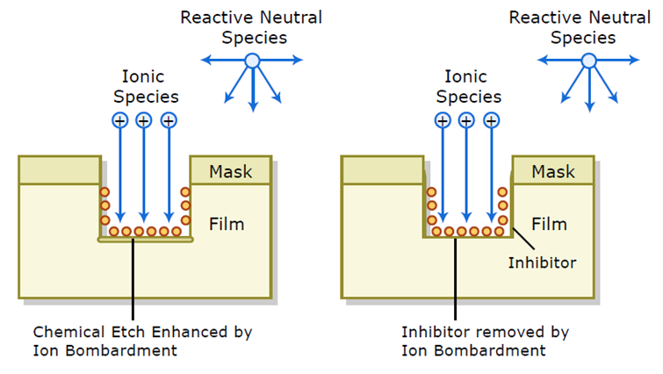
Ion enhanced etching (IEE):
chemical etch assisted by physical bombardment
IEE is an anisotropic (due to directional ion bombardment) and highly selective (due to chemical reaction) etching process.
Reactive ion etch (RIE) is the most popular form of IEE.
Ion bombardment can enhance one of the following steps during chemical etch: surface adsorption, etching reaction (by physically damaging/weakening the chemical bond of the material to be etched), by-product (inhibitor layer) removal, and removal of un-reacted etchants.
Inhibitor layer: e.g. fluorocarbon polymer formed from CHF₃ during etching of SiO₂.
When removal rate << deposition rate, net deposition will occur, then the process becomes similar to PECVD!!
Indeed, the RIE and PECVD are pretty similar tools, except PECVD is typically heated.
Chemical etch enhanced by ion bombardment
Inhibitor removed by ion bombardment
Figure 10-13

Slide 15
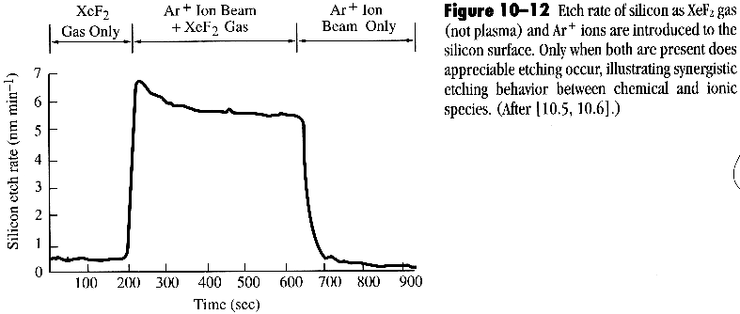
IEE: first proof of etching mechanism
Gas phase etch, with or without the aid of Ar ion beam.
NO plasma.
Very slow etch when pure chemical or physical etch alone
The ion enhancement could be due to the damage/weakening of silicon lattice by ion bombardment, which makes the etching by XeF₂ easier.
The resulted profile will be anisotropic since the horizontal surfaces are much more bombarded than vertical ones.
This is one example of CAIBE (chemically assisted ion beam etching), see later slides

Slide 16
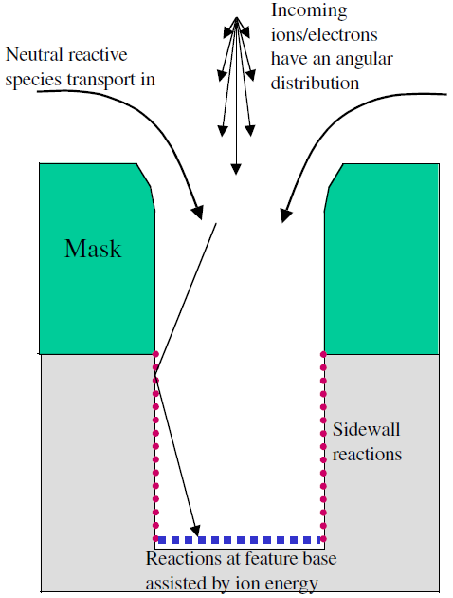
Ion enhanced etching is highly anisotropic
Sidewall reactions can lead to an isotropic etch component.
To prevent sidewall etching, one can build up a passivation (inhibitor – inhibit chemical reaction) layer that protects it.
Then there is a competition between passivating and etching reaction.
For the feature base/horizontal surfaces, etch rates tend to be temperature independent because of ion energy input (i.e. inhibitor sputtered away by ions).
On sidewall, substrate temperature can play an important role as sidewall passivation depends on the volatility of the inhibitor that is controlled by temperature (cryo-etcher at below -100ºC is available recently, then the sidewall passivation layer is not volatile).
Even without sidewall passivation, lower temperature still increases anisotropy since chemical attack of sidewall is suppressed at low temperature. (Attack of horizontal surfaces are assisted by ion bombardment)

Slide 17
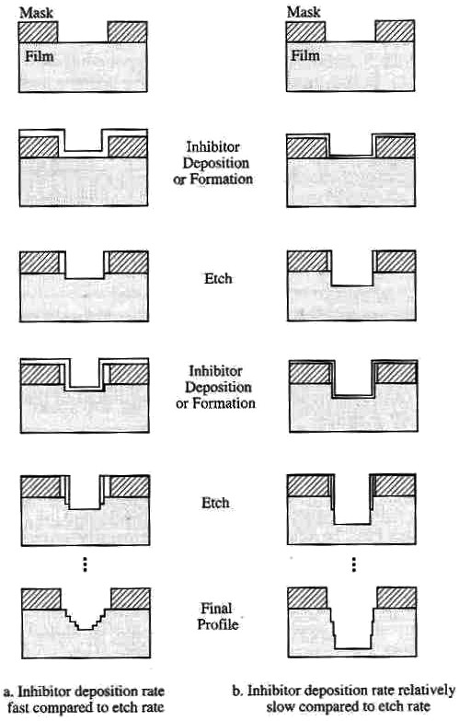
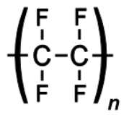
Example:
etching profile of Si or SiO₂
High inhibitor deposition rate
Low inhibitor deposition rate
Teflon
Fluoropolymer (like Teflon) in CHF₃ or CF₄+H₂ RIE of Si or SiO₂ is the inhibitor.
If Ar gas is added, inhibitor is mainly removed by ion bombardment. So less attack of inhibitor on sidewall.
If O₂ gas is added, inhibitor on sidewall is removed at faster rate than Ar ion, but the etch of inhibitor at horizontal surface is even faster.
Yet at very low temperature, inhibitor SiO_{x}F_{y} (not act as inhibitor at higher temperature when it is volatile) forms when O₂ is added, which is the mechanism for fast anisotropic etching of Si using cryo-etcher. (deep Si etcher, popular for MEMS – micro electro mechanical systems)
Figure 10-14

Slide 18
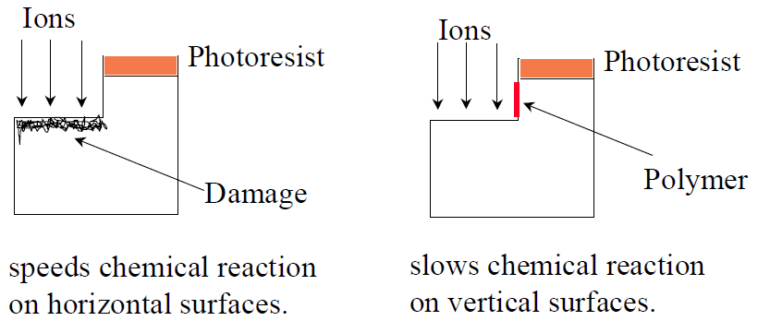
Anisotropy due to ion bombardment: summary
Due to its extremely low density, ions don’t contribute much to etching; neutral radicals do.
So even with directional ion bombardment, the overall etching can still be pretty isotropic.
For instance, SF₆ etch of Si is very isotropic with large undercut like wet etch.
To achieve anisotropy, there are two mechanisms:
Energy-driven anisotropy: bombardment by ion disrupts an un-reactive substrate and causes damages such as dangling bonds and dislocations, resulting in a substrate more reactive towards etchant species (electron or photon can also induce surface activation).
Inhibitor-driven anisotropy: ion bombardment removes the inhibitor layer from horizontal surface (sidewall remain passivated), and reaction with neutrals proceed on these un-passivated surfaces only.
One may think that ions won’t help much due to its much lower density than radicals. But ion has sticking coefficient S∼1 (every ion bombardment counts), whereas radicals S∼0.01 (most radicals hit the surface and left without doing anything).
Inhibitor-driven anisotropy
Energy-driven anisotropy

Slide 19
Chapter 10 Etching
Introduction to etching.
Wet chemical etching: isotropic.
Anisotropic etching of crystalline Si.
Dry etching overview.
Plasma etching mechanism.
Types of plasma etch system.
Dry etching issues.
Dry etching method for various films.
Deep Si etching (can etch through a wafer).
NE 343: Microfabrication and Thin Film Technology
Instructor: Bo Cui, ECE, University of Waterloo, bcui@uwaterloo.ca
Textbook: Silicon VLSI Technology by Plummer, Deal, Griffin

Slide 20
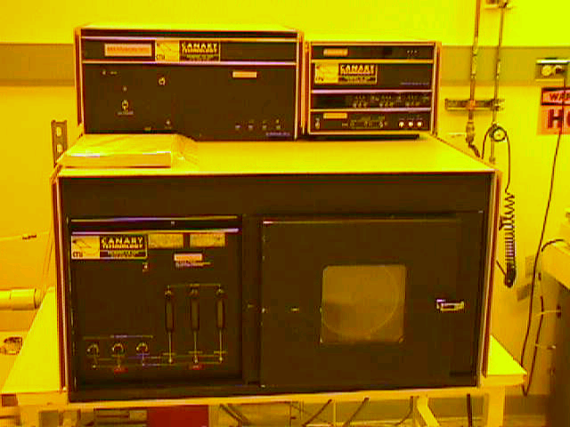
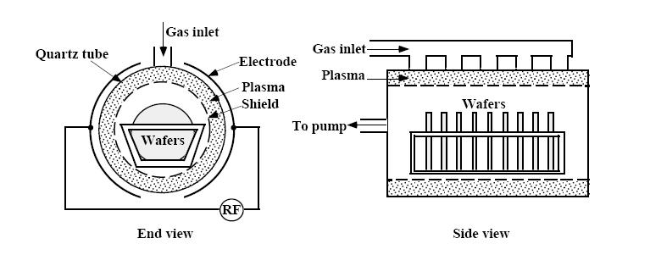
Plasma etching in barrel etchers
Barrel etcher:
Chemical etching only, isotropic and selective like pure wet etch.
Use plasma shield to keep ion bombardment from wafers, thus very little damage.
Poor uniformity edge to center.
Used in non-critical steps such as photoresist removal by O₂ plasma (Barrel “asher” Polymer + O → CO₂ + H₂O).
Quartz tube
Figure 10-15

Slide 21
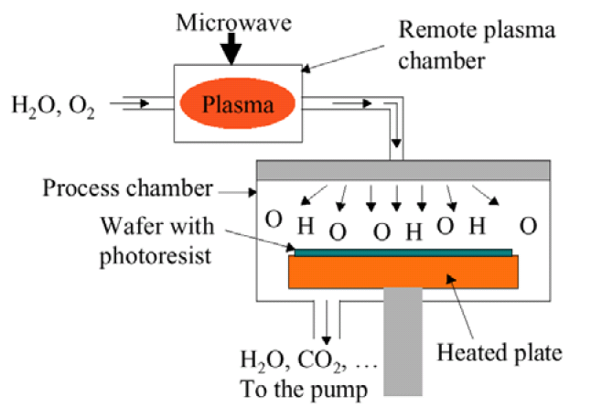
Downstream etchers
Plasma is formed in a cavity which is separated from the etching chamber.
Wafers are shielded from bombardment.
Only neutral free radicals reach wafers.
Etching is completely chemical and isotropic.
High selectivity achievable - Si:SiO2 = 50:1
Plasma may be generated by RF (13.56MHz) or by microwave (2.45GHz).

Slide 22
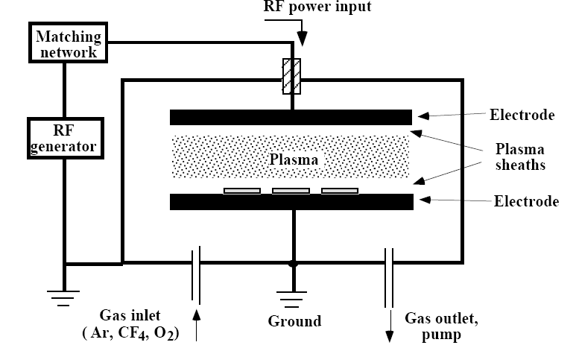
Plasma etching in parallel plate systems – plasma mode
Parallel plate = capacitively coupled plasma (CCP)
You will see later on ICP : inductively coupled plasma
Similar to PECVD except that etch gas is used instead of precursor gas.
Equal or larger (grounded to chamber) wafer electrode (which defines “plasma mode”) gives weaker ion bombardment of wafers (smaller DC voltage drop near larger electrode).
The etch is more uniform than barrel, but typically etches only one or a few wafers (cassette for barrel etcher) at a time.
Both chemical and physical etch occur (wafer “in contact” with plasma), though the later is weak, particularly at higher pressure when DC voltage drop near wafer is smaller.
Etching is fairly isotropic and selective due to the strong chemical component.
Very often, plasma mode etching is considered as just a kind of reactive ion etching (RIE), but done at higher pressure.
Of course, both plasma mode etching and RIE is plasma etching.
Figure 10-7

Slide 23
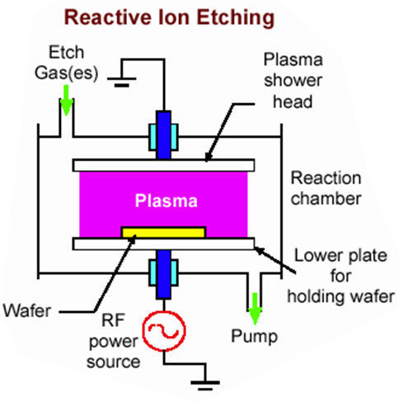
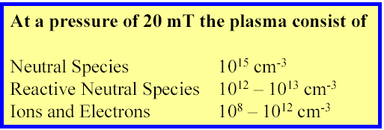
Parallel plate etchers (regular RIE, low density plasma)
Absolutely the most important form of dry etching, though recently ICP (see later slides) is becoming more and more popular.
Compared to plasma mode: smaller wafer electrode (counter electrode grounded to chamber wall), lower pressure (<100mTorr), more physical bombardment (voltage drop many 100V).
Ion enhanced etching mechanism, (usually) directional/anisotropic and selective.
RIE using parallel plate setup is low density plasma system (ions 10⁸ – 10¹⁰/cm³), thus low etch rate.
Here low (ion) density plasma also implies low density of free radicals. Thus low etching rate.
VERY roughly, one can say that plasma consists of order 1% radicals (reactive neutral species) and 0.01% ions.

Slide 24
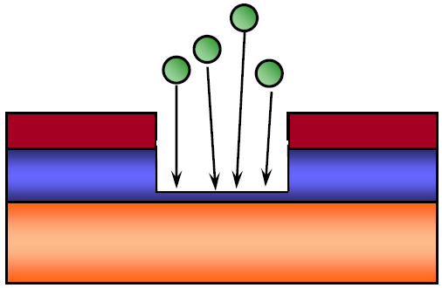
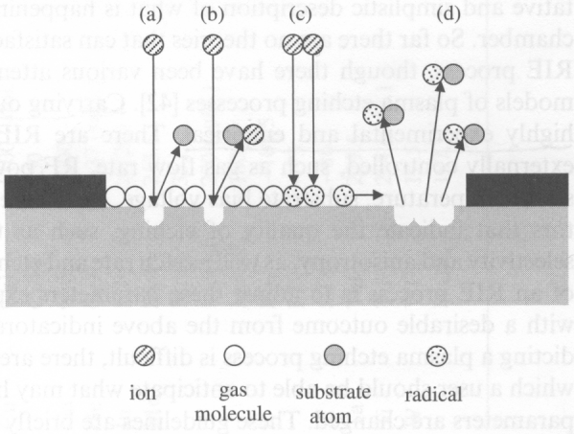
Reactive ion etch (RIE)
Schematic RIE process
Etching mask
Due to its simultaneous anisotropy and selectivity, RIE is intensively used.
Works for most semiconductors and dielectrics.
OK for few metals that form volatile etch products: Al (form AlCl₃), Cu (CuCl₂) (not really), Ti (TiF₄, TiCl₄), W (WF₆), Cr (CrO₂Cl₂).
a) Ion sputtering, b) reactive ion etching, c) radical formation (?), d) radical etching (most important)
In RIE, ion energy is low (several 10s eV, << voltage drop near wafer surface, due to collision energy loss), and its number density is very low, thus negligible etching by ion bombardment.
The name reactive “ion” etching is very misleading since ions don’t contribute directly to etching – it just “helps” chemical etching.

Slide 25
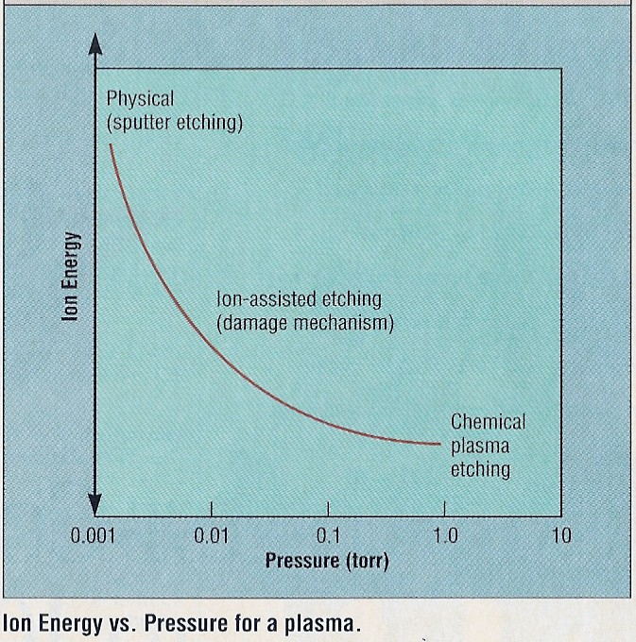
Ion energy vs. pressure for a plasma
Lower pressure (<10mTorr) increases mean free path as well as voltage drop near wafer electrode, both of which leads to more energetic and directional ion bombardment, thus more anisotropic, but less selective and slower etching rate due to low ion/free radicals density.
High pressure (>100mTorr), short mean free path, low voltage drop, isotropic chemical etching.
Thus it is desirable to have a low pressure plasma with high ion density.
Plasma mode: >100mTorr
RIE mode: 10-100mTorr
Sputter etching: pressure as low as possible, as long as plasma can be sustained, but still very slow etching rate.
RIE with tilted wafer, will etch vertically or not?

Slide 26
Etching in high density plasma (HDP) systems
Ion flux and ion bombarding energy can be independently controlled. For regular RIE, they are tightly coupled (e.g. higher power increases both).
High plasma (ion) density (> 10¹¹) enhances etch rate.
Since ionization is much more efficient, can operate at lower pressure, which leads to less ion collision, so more directional/anisotropic, thus enhances profile control.
As ion energy is independently controlled, it can be kept low if desirable.
Then the extent and amount of damage will be reduced, without sacrificing etching rate that is still high for high density plasma.
Currently HDP represents an optimum compromise in high etch rates, good selectivity, good directionality, while low ion energy and damage (??).
(What I think) For sidewall profile control and selectivity, hard to say which one (regular RIE vs. HDP) is better. But if wanted one can always turn off the HDP power, then the machine operates like a regular RIE.
The bottom line: for deep etching (>>1μm) that needs very high etching rate, HDP is the only choice.

Slide 27
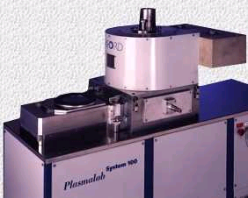
Electron cyclotron resonance (ECR) and inductively coupled plasma (ICP)
ECR was introduced in 1985.
ICP was introduced much later (1991- 1995).
Dual plasma source:
Top one (ECR or ICP RF power) generates HDP, determines ion density/current.
Bottom one (CCP RF power) generates bias voltage like regular RIE, determines ion energy.
Typical parameters for HDP and conventional plasma etcher
ions/cm³
should be lower
CCP: capacitively coupled plasma, parallel plate, used for conventional regular RIE.

Slide 28
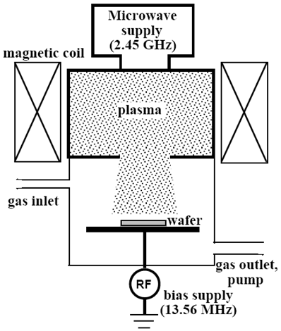
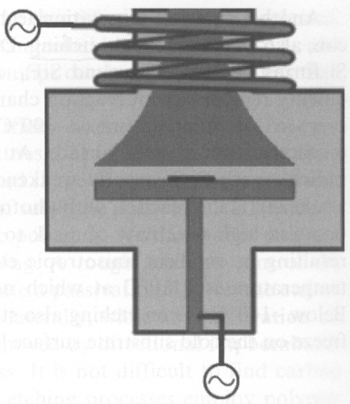
ECR and ICP
Electron cyclotron resonance plasma
(less common nowadays)
Inductively coupled plasma (ICP)
(four systems at Waterloo)
ICP RF power
(for dense plasma)
plasma
RF bias power
(similar to RIE, parallel plate)
High magnetic field in the coil, so electrons move in circles with long path, leading to higher collision and ionization probability, and much less electron loss to chamber wall and the bottom plate where sit the wafer. Moreover,
For ICP, AC magnetic field induces circular electrical field, which accelerates electrons.
For ECR, DC magnetic field, electron cyclotron ω=qB/m; electrons accelerated if this frequency matches the microwave frequency.

Slide 29
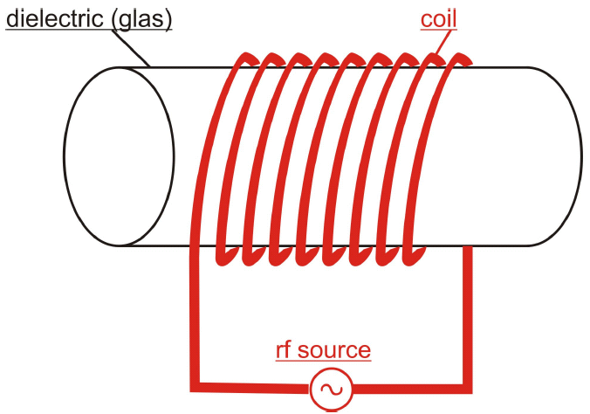
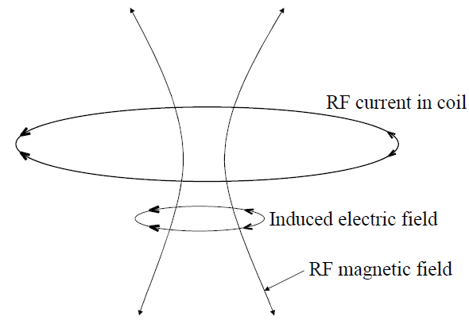
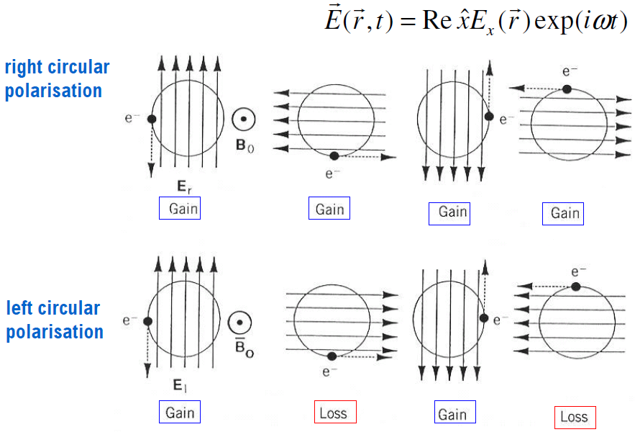
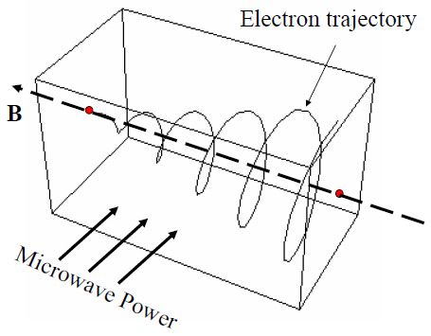

Slide 30
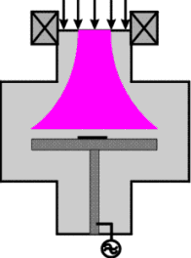
Schematic of ECR etcher
Microwave source 2.45 MHz
Quartz window
Wave guide
Plasma chamber
Diffuser
Cyclotron magnet
Wafer
Additional magnet
13.56 MHz
Electrostatic chuck
Vacuum system

Slide 31
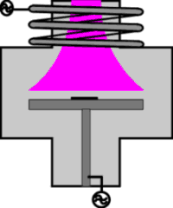
Schematic of ICP etcher
RF generator
Inductive coil
Dielectric window
Plasma chamber
Electromagnet
Biased wafer chuck
Bias RF generator
As you see, there is practically no top plate as in parallel plate regular RIE.
The wafer sees the ICP power – the two power sources are not physically separated. Otherwise, even though the plasma density in the upper part is high, it will get lost due to re-combination and de-excitation when it travels through the bottom part.

Slide 32
Magnetically enhanced reactive ion etch (MERIE)
Like regular parallel plate RIE, but magnetic field forces electron to go circles, increasing collision with gas molecules and decreasing loss to chamber walls or top/bottom plates.
However, now that electrons don’t loss to bottom plate, no or little bias voltage – need to apply an external bias to accelerate ions.
I haven’t seen any MERIE, so it is not popular.
On the contrary, magnetron sputtering is very popular.
This is probably because there are many ways to increase etching rate; but sputter without magnetron is always very slow:
few nm/min, vs. 10s to 100s nm/min RIE etching rate.
Electromagnet (1 of 4)
Wafer
Biased wafer chuck
13.56 MHz

Slide 33
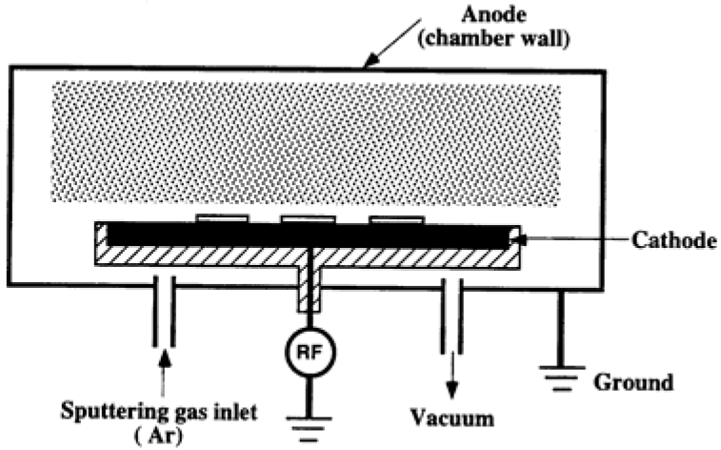
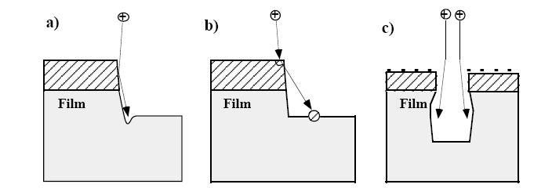
Sputter etching and ion milling
Sputter etching: (etch inside plasma)
The etch mechanism is purely physical and ion energies are greater than 500 eV.
Very similar in principle to sputter deposition, but now the target becomes substrate to etch.
Poor selectivity (2:1 or 1:1), very anisotropic.
Sputtering rate depends on sputter yields which can be a function of incident angle.
Problems include faceting (sputter yield is a function of incident angle), trenching, re-deposition, charging and ion path distortion, radiation damage.
Not popular, etches too slow, though reactive gas (CF₄, CCl₄, O₂) can be added to slightly improve selectivity and etching rate.
Figure 10-8 Problems associated with sputter etching (or any etching that has a high degree of physical/ionic etching): a) trenching at bottom of sidewalls; b) redeposition of photoresist and other materials; c) charging and ion path distortion.

Slide 34
Ion milling or ion beam etching (IBE)
Used to call ion milling, seems now more called as ion beam etching.
Physical milling when using heavy inert gases (Ar).
Plasma is used to generate ion beam (Ar⁺), which is extracted and accelerated to etch the sample. (i.e. sample outside of plasma)
Thus the ion density (determined by plasma source) and ion energy (determined by DC acceleration voltage – bias by applied DC voltage, not by RF bias as in high density plasma etching system), can be controlled independently.
Low pressure ∼10⁻⁴Torr (>1 order lower than RIE), so large mean free path and less energy loss due to collision. (such low pressure cannot sustain a plasma, so ion milling is not plasma etching)
High acceleration voltage (>1kV), leading to mill rate ∼10-30nm/min.
Despite the high voltage and low pressure, such a rate is still < typical RIE rate where chemical etching dominates.
Used whenever RIE is not possible (due to the lack of volatile species formation). Usually employed to etch Cu, Ni, Au, superconducting materials containing metals…

Slide 35
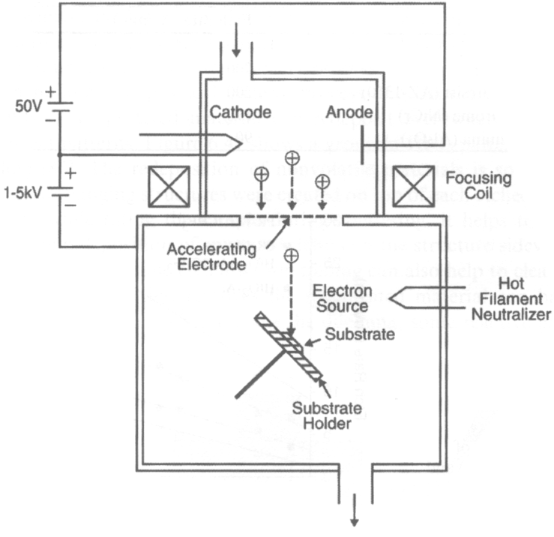
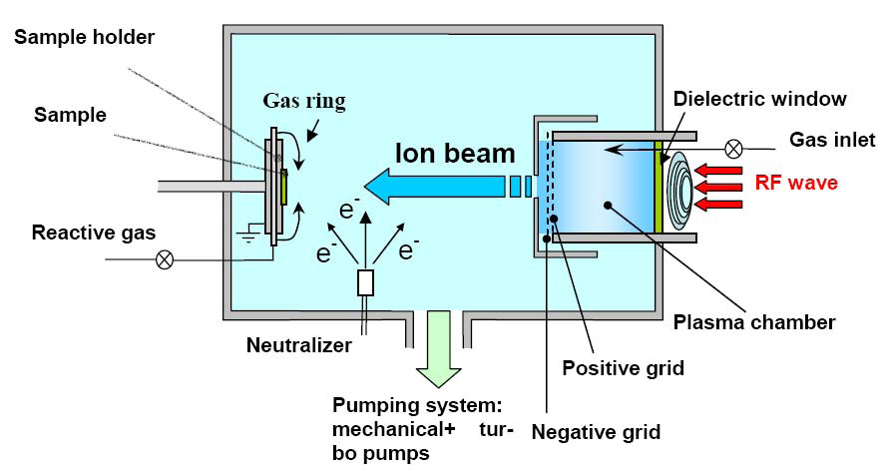
Ion beam etching system: triode configuration
Electron beam is first generated by hot filament.
Ions are generated by electron bombardment, then accelerated to bombard the substrate.
RF plasma ion beam source
(here reactive gas added, so it is actually a CAIBE, see next slide)
DC plasma ion beam source
Electrons sprayed to sample to neutralize ions.
Tilted sample to greatly increase milling rate.
But then shadowing may become a problem when milling high aspect ratio structures.

Slide 36
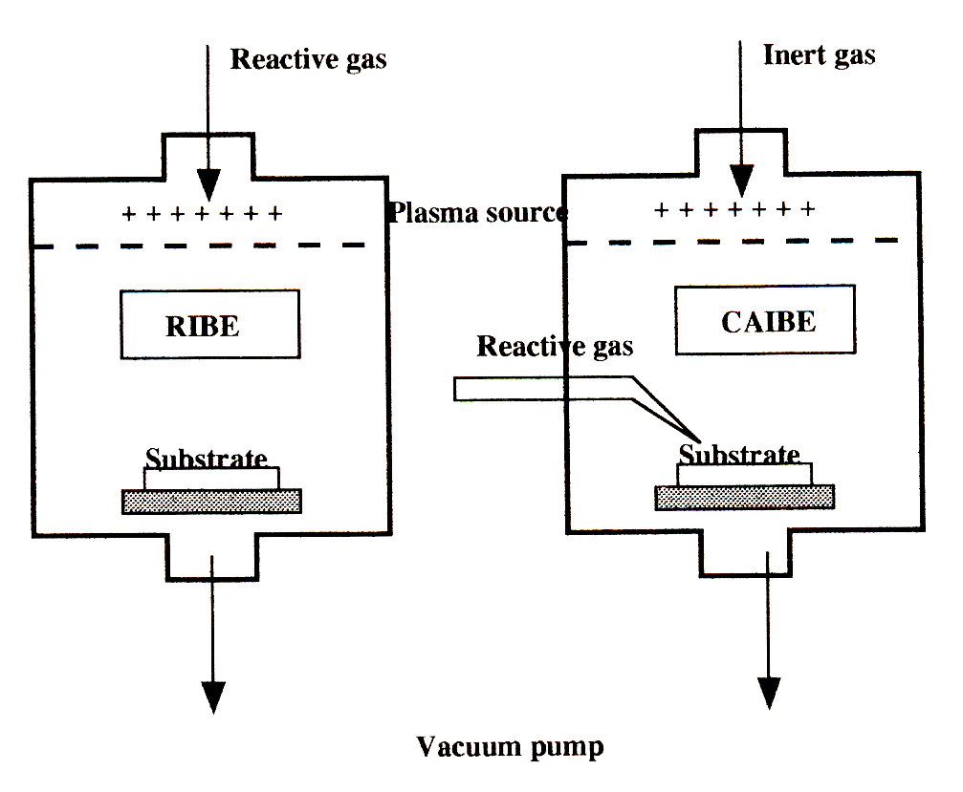
Chemically assisted ion beam etching system
Adding reactive gases (CF₄, CCl₄, O₂, Cl₂) to increase etching rate and selectivity.
Usually physical etching still dominates, no need of volatile etch product.
But for some special situations, like gas phase (no plasma) XeF₂ etching of Si assisted by ion bombardment, chemical etching dominates with very high etching rate. But there the etch product SiF₄ is volatile.
Here it is chemically assisted physical etching, different from RIE that is a kind of physically assisted chemical etching.
CAIBE: chemically assisted ion beam etching, inert Ar ion, neutral reactive gas is introduced into lower chamber, so not ionized, though some may be ionized due to backflow into plasma region or bombardment by Ar ion.
RIBE: reactive IBE, reactive gases are introduced into plasma region together with Ar gas, so they are ionized. RIEB is virtually the only example where the same ion has both a physical (ion impact) and chemical (reactive etching) component.

Slide 37
Summary: plasma etching mechanism
Chemical etching: free radicals react with material to be removed. E.g. plasma etching at high pressure close to 1Torr.
Physical etching or sputtering: ionic species, accelerated by the built-in electric field (self-bias), bombard the materials to be removed. E.g. sputter cleaning using Ar gas in sputter deposition system.
Ion enhanced etching: combined chemical and physical process, higher material removal rate than each process alone. E.g. reactive ion etching (RIE), which is the most widely used dry etching technique.
Physical Process
Chemical Process
Reactive Ion etching
High density plasma etching
Ion milling & Sputter etching
Wet etching
Plasma etching
Pressure
Energy (power)
Selectivity
Anisotropicity
Figure 10-19

Slide 38
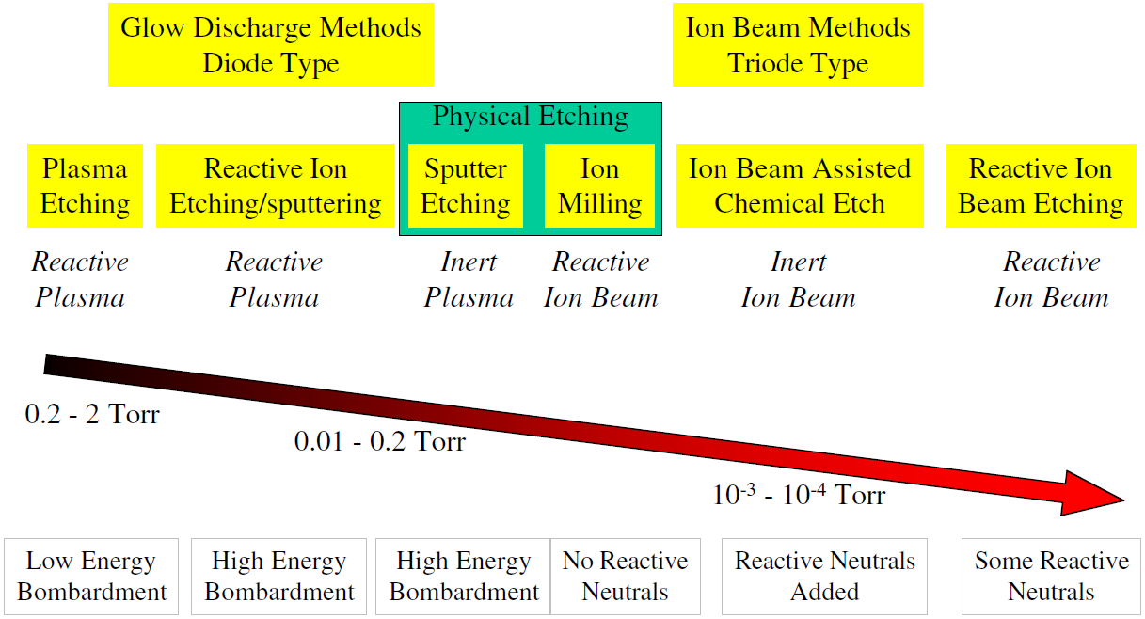
Dry etching techniques: summary

Slide 39
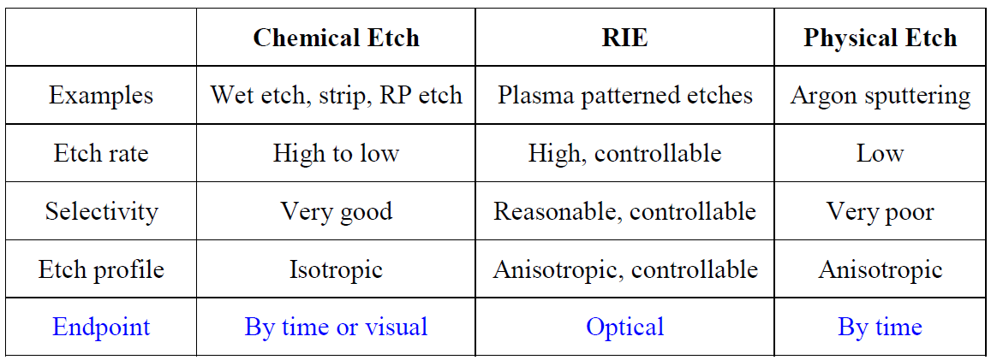
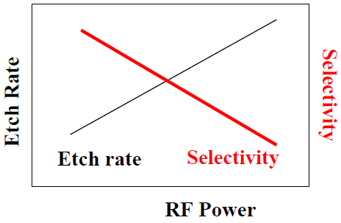
Three etch process
Here strip and PR (photoresist) etch refers to barrel or downstream etch.
(e.g. XeF₂ gas etch Si even without plasma)
Etch rate and selectivity conflict in RIE
(e.g. ion beam etching/milling using Ar⁺)

Slide 40
Modes of plasma etching

Slide 41
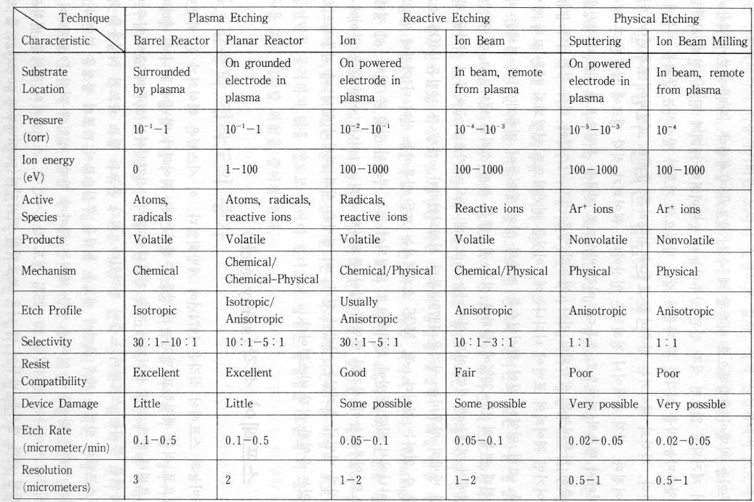
Dry etching techniques: summary

Slide 42
Dry etcher configurations

