Slide 1
Chapter 10 Etching
Introduction to etching.
Wet chemical etching: isotropic.
Anisotropic etching of crystalline Si.
Dry etching overview.
Plasma etching mechanism.
Types of plasma etch system.
Dry etching issues.
Dry etching method for various films.
Deep Si etching (can etch through a wafer).
NE 343: Microfabrication and thin film technology
Instructor: Bo Cui, ECE, University of Waterloo; http://ece.uwaterloo.ca/~bcui/
Textbook: Silicon VLSI Technology by Plummer, Deal and Griffin

Slide 2
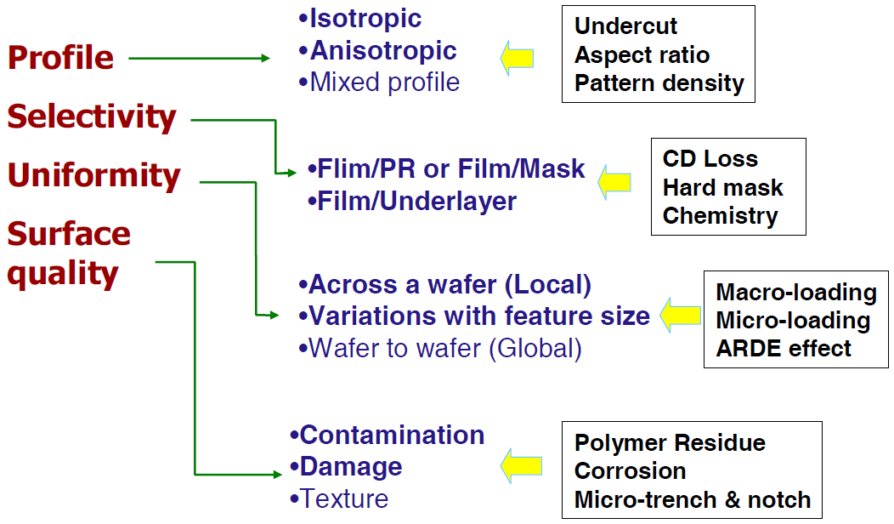
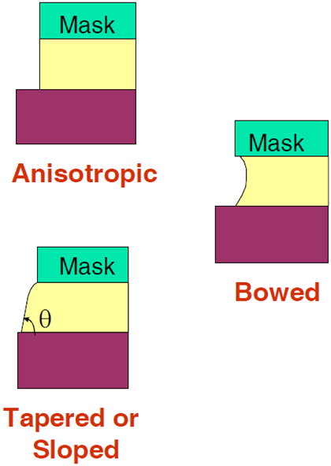
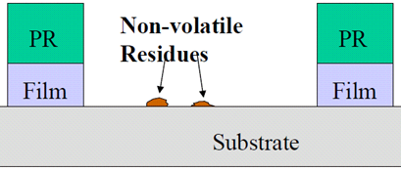
Main issues in plasma etching
PR: photoresist
CD: critical dimension
Etch profiles

Slide 3
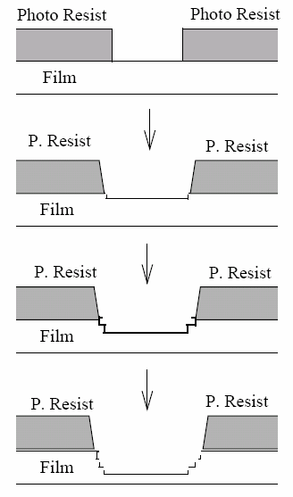
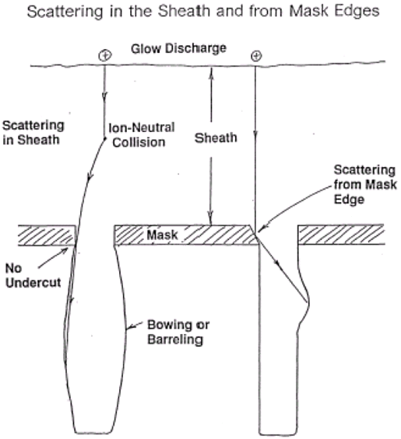
Etched profile control
Lateral etch of resist widens the opening gradually.
Ion trajectory problem causes bowing profile

Slide 4
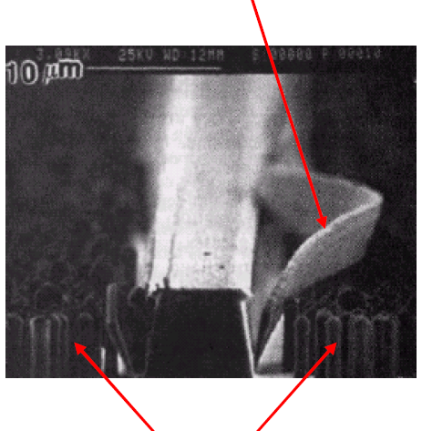
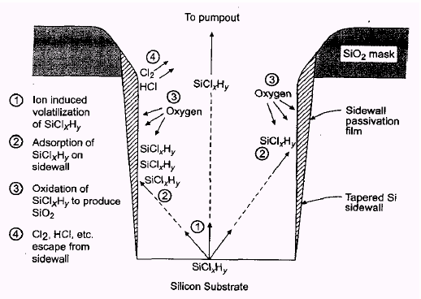
Profile control by sidewall passivation
Si etched in BCl₃/HCl/O₂ plasma
Too much passivation
Micro-masking
For Cl- or Br- based etching of Si, need to remove the hard-mask such as SiO₂ first, before etching the Si. Here it is not completely removed.

Slide 5
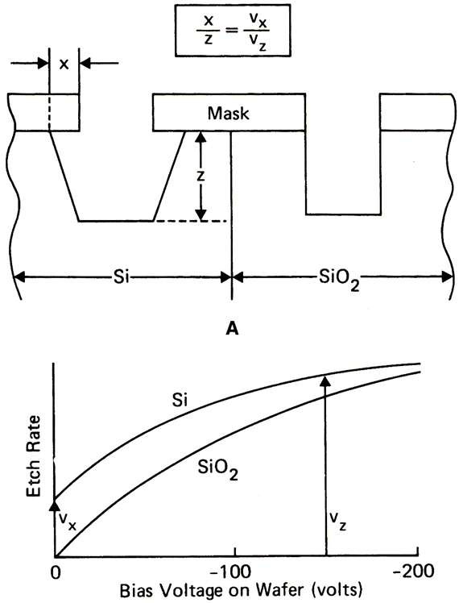
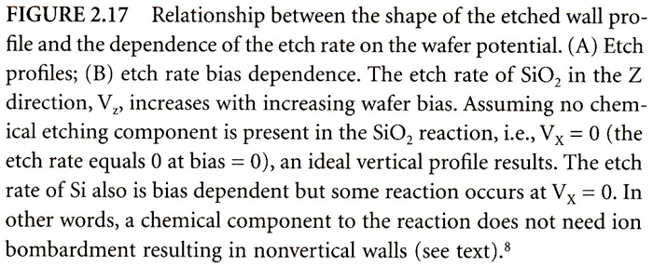
Profile control by “substrate bias”
The bias is the self-bias in RF plasma, not applied DC voltage.
For Si, slight etch even without ion bombardment, so sidewall is always etched as well. Ideally, bias voltage increases etch rate V_{z}, but not V_{x}.
For SiO₂, no (actually some) etch without ion bombardment, so always vertical sidewall (in reality, some bombardment on sidewall, thus some lateral etch).

Slide 6
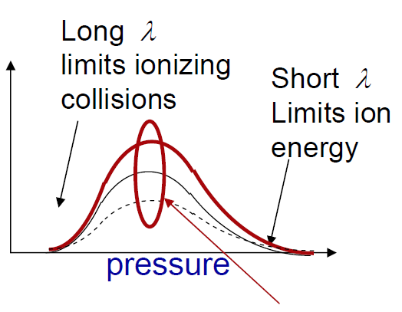
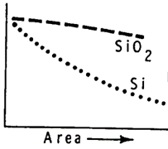
Etch rate affected by gas pressure and loading effect
Etch rate ∝ reactive species flux (neutrals and ions) J = CV
C ∝ plasma density & pressure; V ∝ bias ∝ RF power
Plasma density
An optimal pressure exists for maximum etching rate.
However, in reality, etching rate is not the only issue.
For example, if anisotropy is the most important factor, one should use lower pressure.
Moreover, sometimes etching rate doesn’t depend on pressure very much, because the rate is limited by chemical reaction (depends on temperature) .
RF power + inductively coupled power
Etching uniformity: loading effect
“Bull’s eye”: wafer etches faster at outside, slower inside (e.g. Barrel etcher).
“Macro-loading”: too many wafers rob others of etchant (long-range gas transport problem). “Bull’s eye” effect is one type of macro-loading effect.
“Micro-loading”: unmasked large areas consumed too much etchant (short-range gas transport problem).
Rate

Slide 7
Aspect ratio and micro-loading effect
Micro-loading: etch rate depends on local pattern density.
Aspect-ratio dependent etching, RIE-lag: smaller features etch more slowly, because:
Etchants are more difficult to pass through the smaller hole.
Etch byproducts are harder to diffuse out.
Lower pressure can minimize the effect: more directional and longer mean free path, easier for etchants to reach the trench/hole bottom and for etch byproducts to get out.
Micro-loading and sidewall bowing in Si etched with HSQ/AZPN114 bi-layer mask in Cl₂/HBr plasma.
mask
silicon

Slide 8
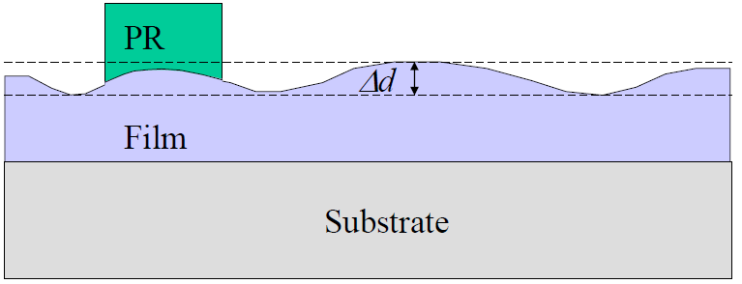
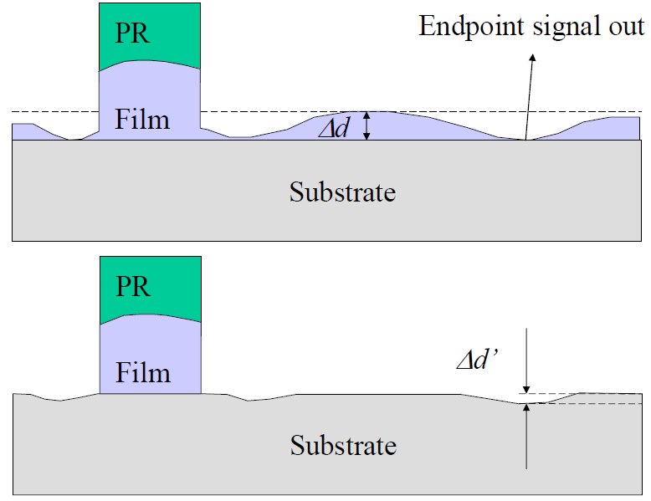
When to stop etching: main etch & over etch
Film thickness and etch rate is not uniform, needs over-etch to remove possible leftover film.
Selectivity of etched film and substrate is very important.
RIE uses optical endpoint detection to switch from main etch to over etch.
Start main etch
For R&D tool, usually no endpoint detection installed, thus often one does a lot of over-etch to make sure etching is finished.
This requires high selectivity to minimize substrate etch.
Before over etch
After over etch

Slide 9
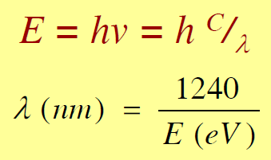
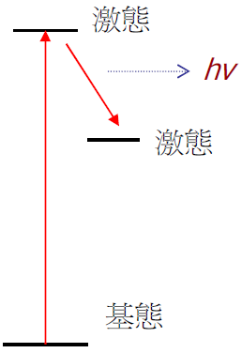
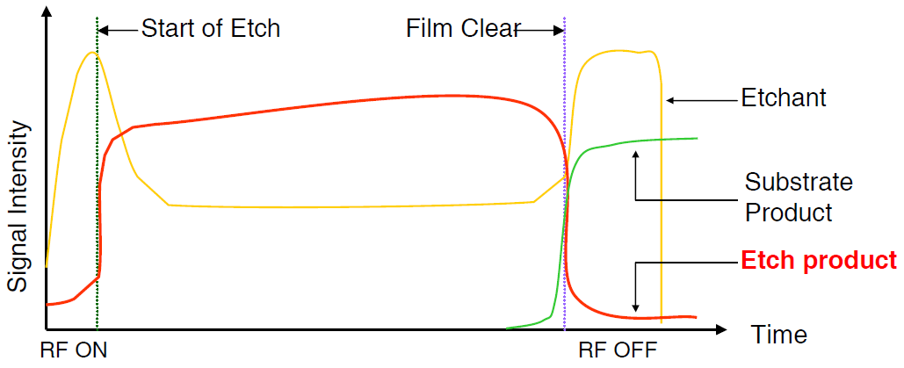
Etching endpoint detection by optical emission spectroscopy
Each atom/molecule has its own emission wavelength.
Color of plasma changes when etch different materials
Optical sensors can be used to detect the change and indicate the endpoint for plasma etch processes.
Excited state I
Excited state II
Ground state

Slide 10
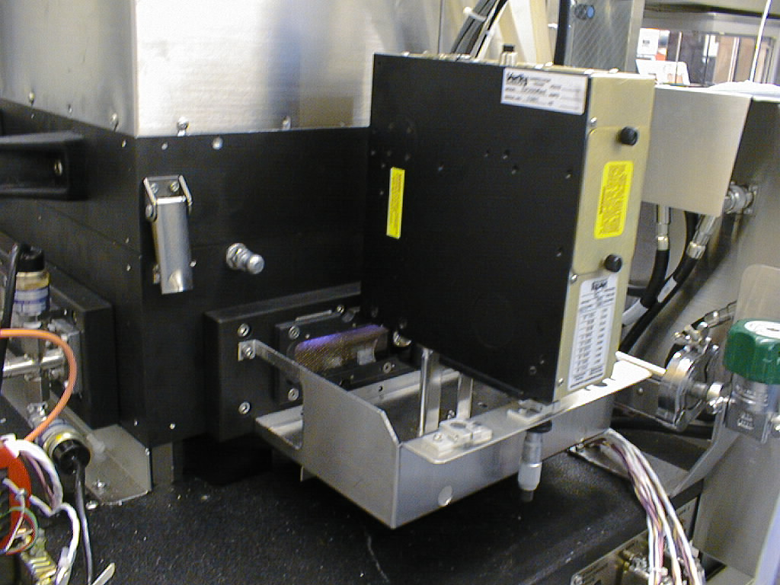
Etching endpoint detection setup
Easy accomplished, in-situ, non-intrusive.
Spectrum 200-900 nm is usually detected.
Good sensitivity for endpoint detection.
The light emitted from plasma is sent to the mono-chromator via lens and/or optical fiber.
Mono-chromator can be replaced by Optical Multi-channel Analyzer (OMA).
Detector can be a CCD or Photo-Multiplier Tube (PMT).
Etching chamber
Endpoint detection

Slide 11
Chapter 10 Etching
Introduction to etching.
Wet chemical etching: isotropic.
Anisotropic etching of crystalline Si.
Dry etching overview.
Plasma etching mechanism.
Types of plasma etch system.
Dry etching issues.
Dry etching method for various films.
Deep Si etching (can etch through a wafer).
NE 343: Microfabrication and Thin Film Technology
Instructor: Bo Cui, ECE, University of Waterloo, bcui@uwaterloo.ca
Textbook: Silicon VLSI Technology by Plummer, Deal, Griffin

Slide 12
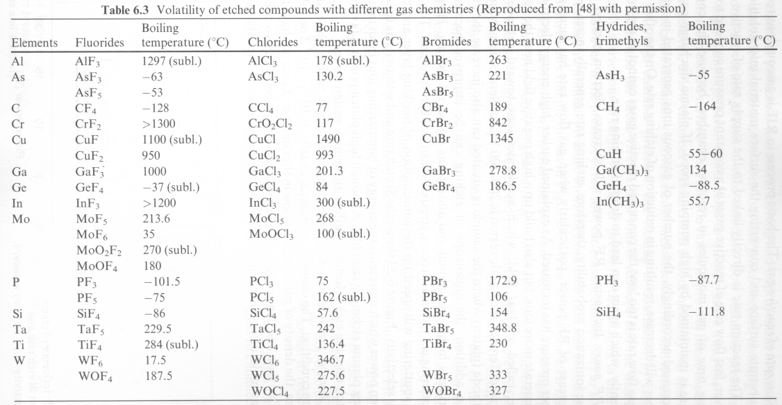
Plasma etch methods for various films: overview
Most reactant gasses contain halogens: F, Cl, Br, or I
Exact choice of reactant gasses to etch each specific film depends on
Ability to form volatile by-products that can be removed by pumping
Selectivity and anisotropy.
Boiling points are good indicators of volatility of species
Lower boiling point, higher tendency to evaporate.
High boiling point may need etching at elevated temperatures.

Slide 13
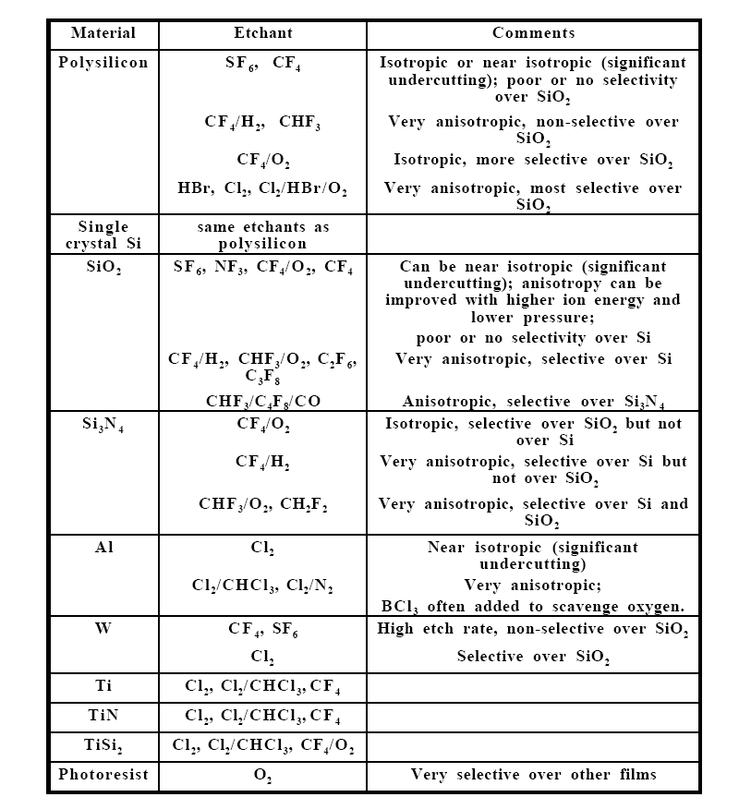
Typical or representative plasma etch gases for films used in IC fabrication
Table 10-3

Slide 14
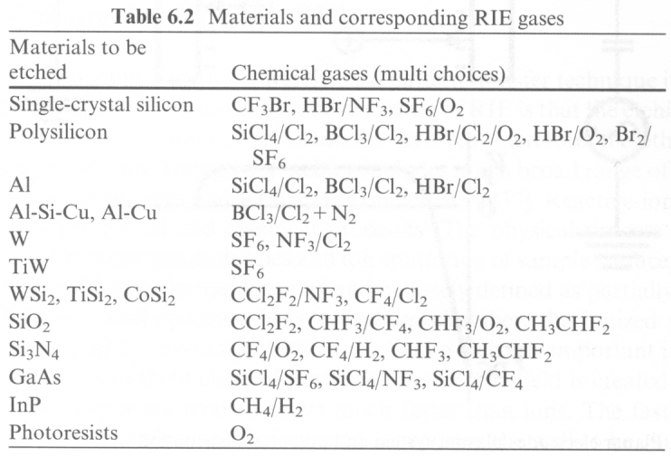
RIE/plasma etch gases: from another book
Most lab systems have only fluorine-based gases (SF₆, CF₄, CHF₃) since they are relatively safe; chlorine-based gases are corrosive. Most RIE has Ar and O₂ gas, some has H₂ and He.

Slide 15
Plasma etching of silicon dioxide (using CF₄)
Etching is mostly done by reactive neutral species - free radicals such as F.
Additives like O₂ can be used that react with CF₃ (and CF₂, form CO and CO₂) and reduce CF₃ + F recombination, thus higher F concentration and higher etch rate.
However, too much O₂ reduces etch rate due to dilution effect, competition of O with F for surface sites, and reversal of the second reaction (form oxide with SiF₄).
These processes are chemical (spontaneous, can etch without ion bombardment) and are therefore pretty isotropic and selective.
Nonetheless, for low pressure where ion energy is high, damage-driven ion-enhanced attack dominates, thus anisotropic etching.
The situation is similar for SF₆ and NF₃ gas.
The key to promote anisotropy as well as increasing selectivity over Si is to reduce F and increase C, because then:
Etching is more done by CF₃ or CF₂ (than by F), which is strongly ion-enhanced (appreciable etching happens only where ion bombardment occurs).
Polymer inhibitor formation is increased, which protects the sidewall.
This is realized by adding H₂ that reacts with/consumes F to form HF.
Or by using fluorine-poor and carbon-rich gases such as CHF₃, C₃F₈ and C₂F₆.

Slide 16
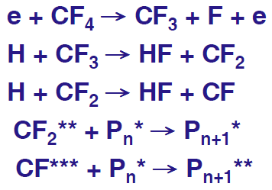
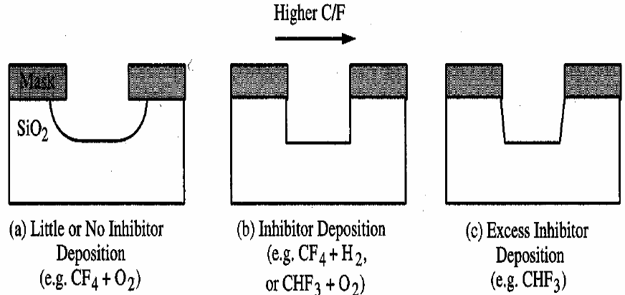
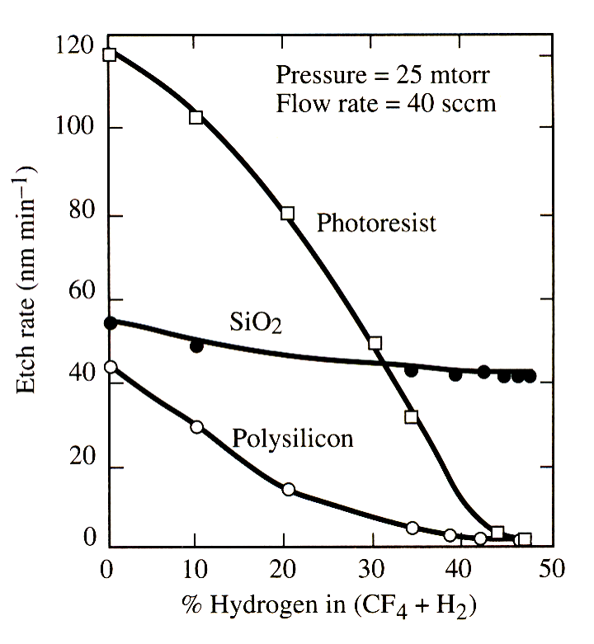
Effect of C/F ratio
Effect of C/F ratio
Inhibitor: Teflon like fluorocarbon polymer
Figure 10-24.
Fluorocarbon polymer
High bias voltage (400 - 500eV) can enhance vertical etch rate by removing inhibitor at bottom.
Ar⁺ (heavy) can also be used to remove inhibitor at pattern bottom. Because it is inert, this does not effect the chemistry of the plasma.
Reduction of F/C ratio of the etch gas improves selectivity of SiO₂ over Si.
For some applications, polymer inhibitor on sidewalls needs to be removed with O₂ or CF₄ after etching is done.

Slide 17
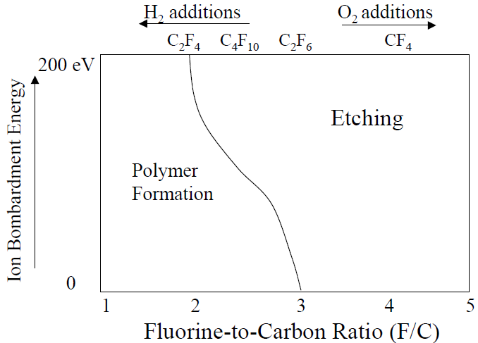
Too low F/C ratio leads to net inhibitor deposition
(kind of like PECVD)
like PECVD, net film deposition rather than etching
The addition of H₂ removes F from the system by forming stable HF (not very reactive) gas, which reduces F/C ratio and slows down the formation of SiF₄ and thus the etching rate.
With less F, the chance of CF_{2,3} to combine with F to form CF₄ is lower, thus higher CF_{2,3} concentration, which promotes the formation of fluorocarbon polymer.
Addition of H₂ increases selectivity of SiO₂ with respect to silicon. Because:
Increased polymerization tends to inhibit etching. However, on horizontal surfaces , ionic bombardment provides enough energy, causing the carbon/hydrogen (1-2nm F-C polymer on oxide surface) to combine with surface oxygen, releasing CO and H₂O.
Once O in Si-O is gone, Si has a dangling bond, which is removed by combining with released fluorine radicals.
Silicon will not be etched (if H₂ is high enough) because of the absence of oxygen at the surface. The F-C polymer on surface can be very thick (>15nm), stopping etching.

Slide 18
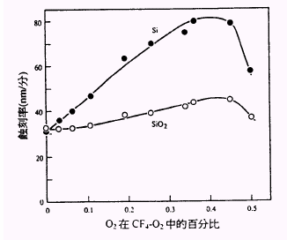
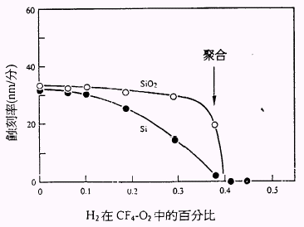
Effect of F/C ratio on selectivity between SiO₂ and Si
Si
Net polymer deposition
SiO₂
Etching rate (nm/min)
Etching rate (nm/min)
SiO₂
Si
Percentage of O₂ in CF₄/O₂
Percentage of H₂ in CF₄/H₂
Adding O₂ enhances Si etch: O₂ combines with CF₃, CF₂ reducing their recombination with F. But too much O₂ dilutes F, O competes with F for surface sites (equivalent to oxidization of Si, knowing that SiO₂ etches slower than Si by F), and O₂ may react with SiF₄ to form SiO₂.
For CHF₃, one F bond with H to form HF that is pumped away. So ratio is 1:2 (not 1:3).

Slide 19
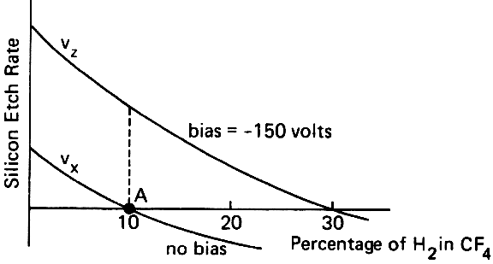
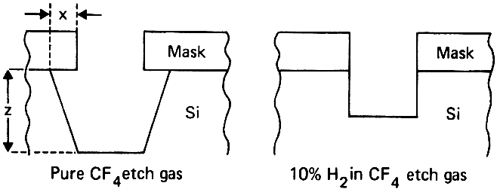
Plasma/RIE etching of silicon
F-based chemistry (CF₄, SF₆, NF₃) tend to be isotropic.
When anisotropy is not important, SF₆/O₂ is a good chemistry for high selectivity.
When anisotropy is desired, one can use CF₄/H₂ (or CHF₃), but undercutting may still occur.
Or just use low pressure to promote ion-damage enhanced etching.
Hard to achieve using F simultaneously high anisotropy and selectivity over SiO₂.
Cl-based chemistry (Cl₂, HCl, SiCl₄, BCl₃) result in anisotropic and selective etching (yet etch rate lower than F chemistry).
Etch needs to be ion bombardment-enhanced.
Thus anisotropic without polymer inhibitor formation.
Selectivity to oxide is very high (100:1).
Anisotropy enhanced by adding small amount of O₂ (form SiO₂ inhibitor on sidewall, those formed on bottom bombarded away)
Br-based chemistry (HBr, Br₂) are similar to chlorine based etchants (etch rate slower than F or Cl).
More anisotropic and selective to oxide than F- and Cl-based RIE without polymer inhibitor
Adding O₂ promotes inhibitor formation (forming SiO₂ from Si) and increase selectivity over oxide (due to removal of C from resist erosion).
Effect of H₂ on profile.
(good book)

Slide 20
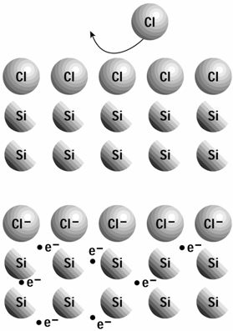
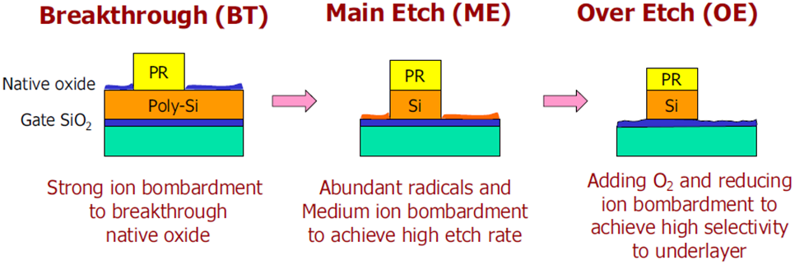
Chlorine Si RIE: doping is also very important
Un-doped Si etch slowly in Cl/Cl₂ ambient without addition of ion bombardment.
Heavily n-type doped Si etches without bombardment in Cl, but not in Cl₂.
Doping implies that Cl etching involves electron transfer from substrate.
Atomic Cl chemisorbs on Si. Once surface Cl becomes negatively charged, it can bond ionically with the substrate. This frees additional chemisorption sites and increases probability that Cl atoms penetrate surface and produce volatile silicon chlorides.
Cl penetration is increased by ion bombardment, leading to energy-driven anisotropy.
Charge transfer produces isotropic etch in heavily doped layers. Yet one can obtain anisotropic etch by sidewall polymerization.
Polymerization is done by adjusting relative concentrations of Cl₂ and BCl₃, CCl₄ or SiCl₄. Like CF₄ plasma, in Cl₂/CCl₄ gas, etching is mainly by atom (Cl), and polymerization by molecule radial (CCl₃, CCl₂).
ICP plasma etching of poly-Si usually consists of three steps
For un-doped Si (top), once a monolayer of Cl builds on surface, it impedes any Cl addition.

Slide 21
Plasma/RIE etching aluminum
Al etching using CCl₄,
(Cl₂ is more popular)
Fluorine is not used because AlF₃ is not volatile.
Presence of native oxide Al₂O₃ on Al surface requires a breakthrough etch before the main etch: Ar sputter, or use BCl₃, SiCl₄, CCl₄ or BBr₃ to scavenge O₂ & H₂O and remove Al₂O₃ by both physical and chemical means.
Cl₂ etches Al isotropically (pure chemical, no need of ion bombardment for etching).
For anisotropic etching, need form sidewall inhibitor: add CHCl₃, CFCl₃, CCl₄, BCl₃ or N₂ (form CN polymer from resist erosion).
Al/Cu alloys are used in interconnects but Cu does not etch in Cl.
Etch requires ion bombardment or high temperature
Corrosion of Al line occurs when exposed to ambient because Cl or AlCl₃ on sidewall and resist react with water to form HCl which etches Al.
To passivate Al surface after etch before exposure to atmosphere:
Heat wafer to 100-150ºC to drive-off Cl.
Bury Cl with CHF₃ plasma-induced C-F polymer and remove the polymer later.
Expose to F ambient such as CF₄ plasma to replace Cl with F.
Then O₂ plasma to remove photoresist, followed by DI water rinse.

Slide 22
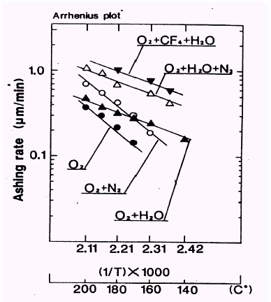
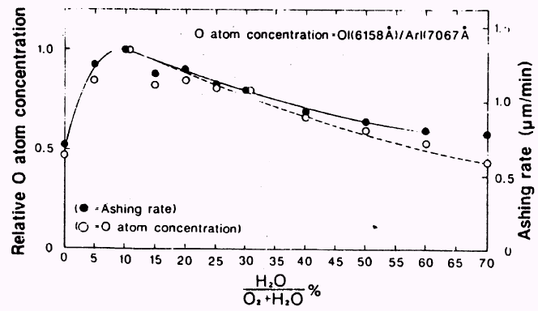
Photoresist(PR) stripping by oxygen plasma
This is also very frequently used for surface cleaning.
PR
Film
Si
The etch product is CO, CO₂ and H₂O…
Adding CF₄, N₂, H₂, or H₂O to oxygen plasma can increase O-atom concentration and hence the PR stripping rate.
For few % addition of CF₄, F takes H from chain forming HF, which makes O easier to cut chain. (O replace H and bond to C1, then C1-C2 breaks to form double bond O=C1)
Etching can be anisotropic if pressure is low.

Slide 23
Chapter 10 Etching
Introduction to etching.
Wet chemical etching: isotropic.
Anisotropic etching of crystalline Si.
Dry etching overview.
Plasma etching mechanism.
Types of plasma etch systems.
Dry etching issues.
Dry etching methods for various films.
Deep Si etching (can etch through a wafer).
NE 343: Microfabrication and Thin Film Technology
Instructor: Bo Cui, ECE, University of Waterloo, bcui@uwaterloo.ca
Textbook: Silicon VLSI Technology by Plummer, Deal, Griffin

Slide 24
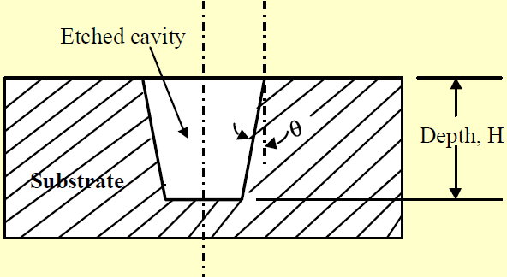
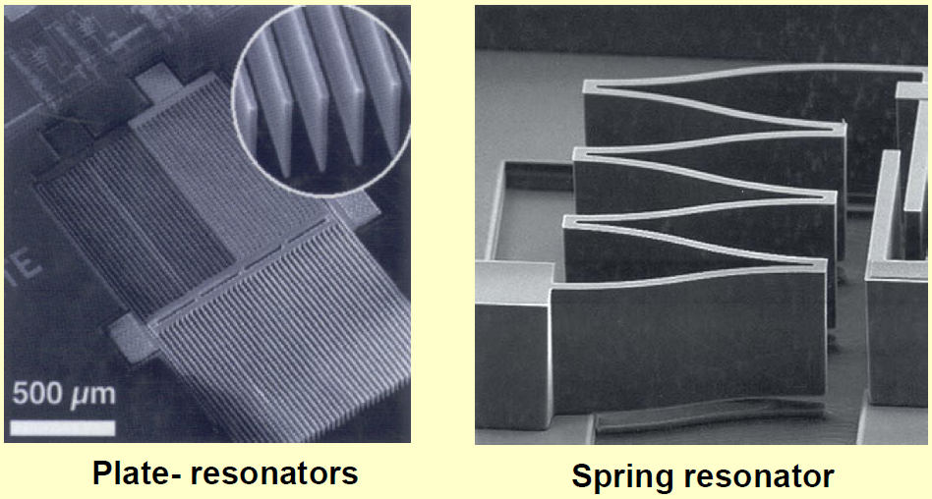
Why deep RIE (DRIE)?
Plasma etching can produce deeper trenches than wet etching, but with tapered angles.
Tapered trenches are not desirable in many applications such as resonators that involve pairs of “centipedes-like” micro-devices with overlapped “fingers”.
DRIE process may produce deep high aspect ratio structures with vertical sidewall (θ ≈ 0º).
It is the most important breakthrough in drying etching in recent years, popular for MEMS (micro electro mechanical systems) fabrication.
Working principle:
The DRIE process provides thin film of a few microns protective coating on the sidewalls during the etching process.
It involves the use of a high-density plasma source.
The process allows alternating process of plasma (ion) etching of the substrate material and the deposition of etching-protective material on the sidewalls.

Slide 25
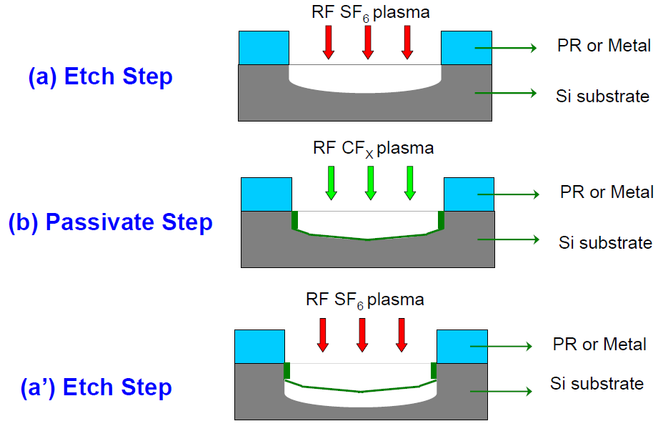
Deep Si etch: ICP - “Bosch” process
ICP: inductively coupled plasma
ECR: electron cyclotron resonance
Besides Bosch process, the other very popular deep Si etch is cryo-etch (i.e. at very low temperature, order -100ºC, SiO_{x}F_{y} as inhibitor).
Often a deep RIE tool can do both processes.
Uses high density plasma (ICP is used, but ECR also works) to alternatively etch silicon and deposit an etch-resistant polymer on sidewalls.
SF₆ etch 5-13 sec; followed by C₄F₈ fluorocarbon polymer deposition 5-10 sec.
Etch rate several 𝝁m/min, capable of etching several hundred 𝝁m with vertical walls.
Sidewall is rough, depending on cycle times (longer cycle, more zigzag).
Process recipe depends on geometry (aspect ratio…).
More popular for MEMS, less common for nano-fabrication due to sidewall zigzag.

Slide 26
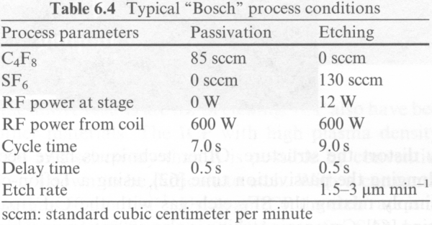
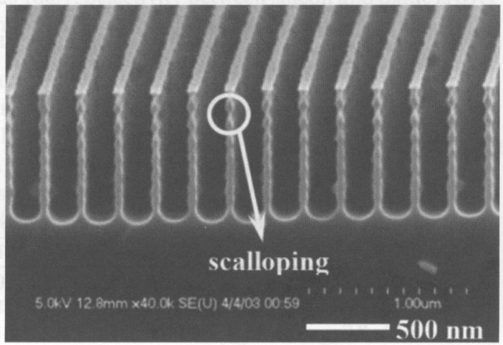
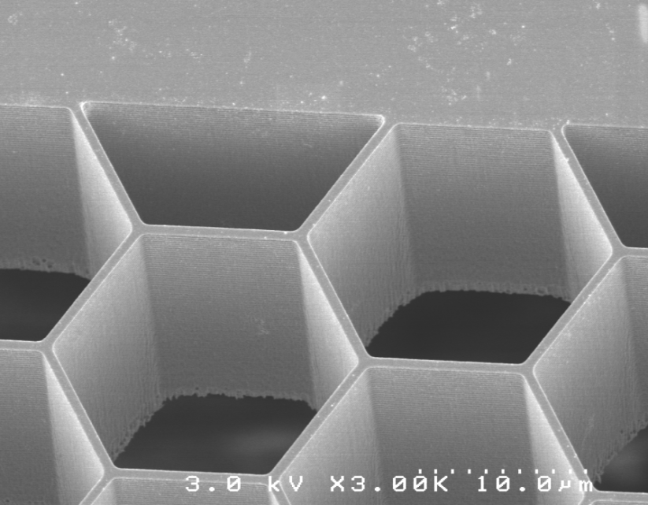
Deep Si etch - Bosch process
DRIE uses lower energy ions → less damage and higher selectivity.
Plasma maintained at 0.5 to 3mTorr.
Rough sidewall due to scalloping effect.
20 𝝁m deep pores
1 cycle

Slide 27
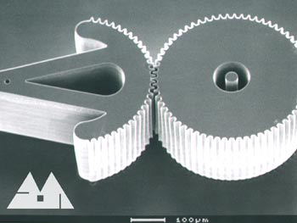
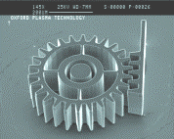
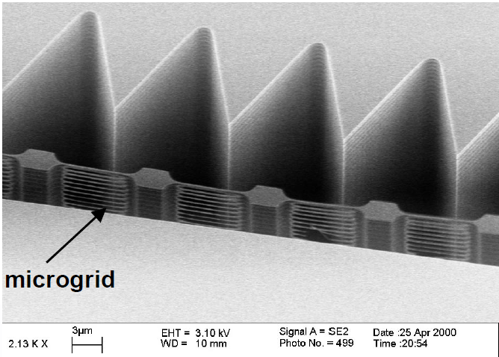
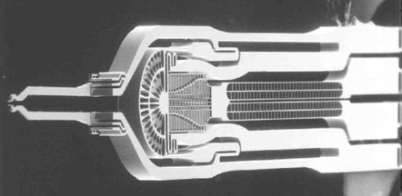
More examples of deep Si etch
High aspect ratio
Micro-gripper
Zigzag sidewall profile

Slide 28
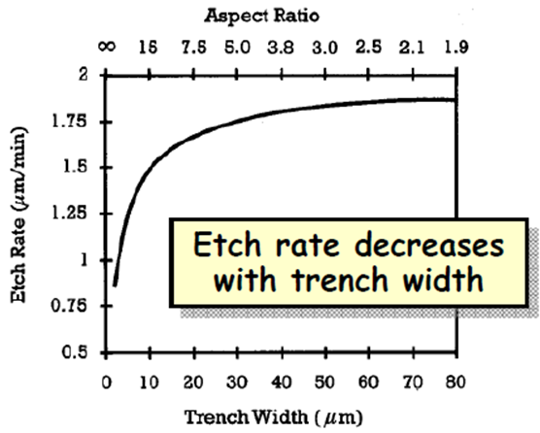
DRIE issues: etch rate variance (micro-loading effect)
Etch rate is diffusion-limited and drops for narrow trenches.
One can adjust mask layout (add “dummy” features) to eliminate disparities.
Or adjust process parameters (slow down the etch rate to that governed by slowest feature).

Slide 29
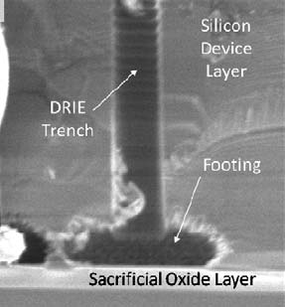
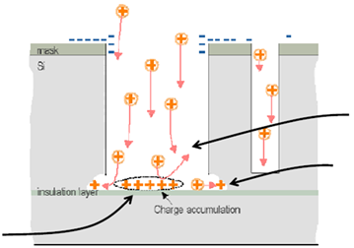
DRIE issues: “footing”
Due to 200:1 selectivity, the (vertical) etch practically just stops when it reaches SiO₂ stop layer.
Problem: lateral undercut at Si/SiO₂ interface → “footing” caused by charge accumulation at the insulator.
Charging-induced potential perturbs the electric field, distorts the ion trajectory.
Result: strong and localized damage (“footing”) to the structure at Si-SiO2 interface.
Poor charge relaxation and lack of neutralization by electrons at insulator leads to ion flux into substrate builds up positive potential.

Slide 30
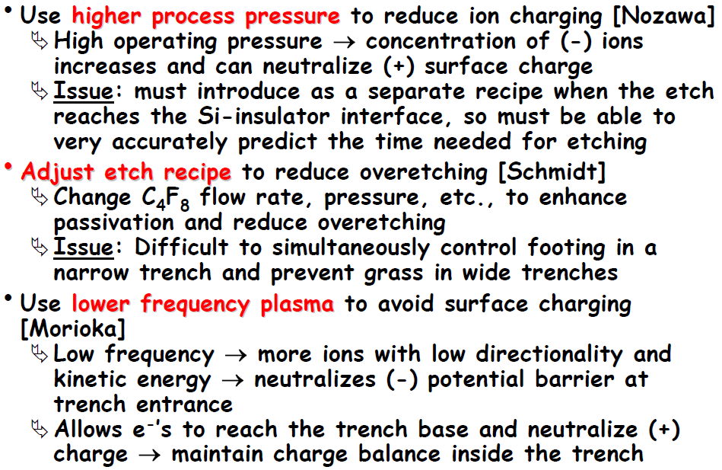
Recipe-based suppression of “footing”

Slide 31
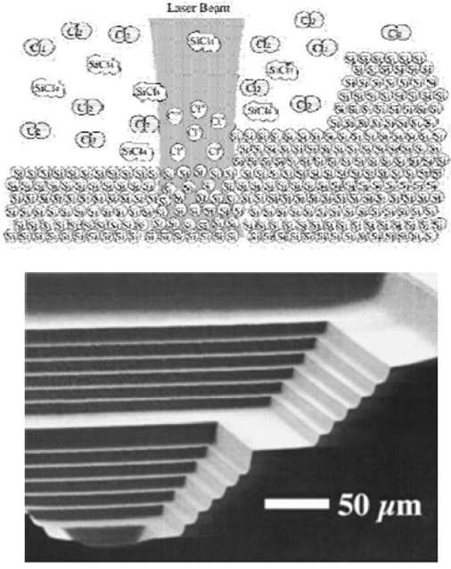
Laser-assisted chemical etching
Laser creates Cl radicals from Cl₂, which react with Si to form SiCl₄.
Etch rate: 100,000 μm³/sec. (3min to etch a 500×500×125 μm³ trench)
Surface roughness: 30nm rms.
Direct patterning, no need to pattern mask first.
(not popular – I have never seen this in cleanroom)
Laser assisted etching of a 500μm×500μm terraced silicon well, with each step 6μm deep.

Slide 32
Historical perspective: poly-silicon etch technology evolution

