Slide 1
Chapter 2 Modern CMOS technology
Introduction.
CMOS process flow (continued).
NE 343: Microfabrication and thin film technology
Instructor: Bo Cui, ECE, University of Waterloo; http://ece.uwaterloo.ca/~bcui/
Textbook: Silicon VLSI Technology by Plummer, Deal and Griffin

Slide 2
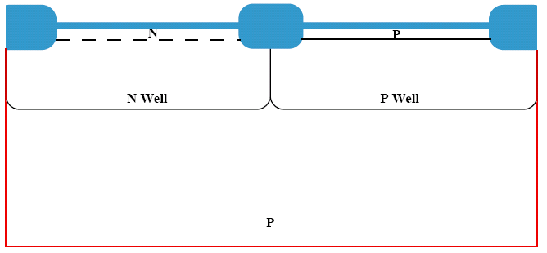
Gate oxide growth
Remove resist, etch oxide, re-grow thermal oxide
The ‘old’ oxide (to compensate stress of Si₃N₄) is too thick, and may be damaged during the several implantation steps.
Figure 2-24
The thin oxide over the active regions is stripped and a new gate oxide grown, typically 3 - 5nm, which could be grown in 0.5 - 1 hrs @ 800˚C in O₂.

Slide 3
Poly-crystalline silicon deposition
MOSFET: metal oxide semiconductor field effect transistor
But actually metal is no longer used, instead, low resistance heavily doped poly-Si is used.
LPCVD poly-Si: SiH₄ → Si + 2H₂.
Poly-silicon is deposited by LPCVD ( ≈ 0.5 µm).
An unmasked P⁺ or As⁺ implant dopes the poly (typically 5 x 10¹⁵ cm⁻², high doping to reduce gate resistance).
Both P and As have high solubility in Si, good for heavy doping.
When heated, they will diffuse quickly through grain boundary (now that poly) to achieve uniform doping.

Slide 4
Gate formation
Spin resist, photolithography, selective anisotropic etch of poly-Si.
Poly: poly-crystalline
(not single crystal)
Poly-Si can also be used for local wiring. But not for long wiring as it is resistance is still much higher than metal.
Mask #6 is used to protect the MOS gates.
The poly-Si is plasma etched using an anisotropic etch.
The photolithography in this step is the most demanding since it requires the finest
resolution to create the narrow MOS channels.

Slide 5
Tip or extension/LDD (lightly doped drain) formation
Strip resist, spin resist, photolithography, ion implantation
When channel length shrinks more than drive voltage, electric field in the channel may become very high, creating “hot electrons” that may create additional hole-electron pair or inject into gate oxide.
LDD (graded doping) allows drain voltage to be dropped over larger distance, thus reducing peak electric field/hot electron effect.
Figure 2-27
Mask #7 protects the PMOS devices.
A P⁺ implant forms the LDD regions in the NMOS devices.
Typically 5 x 10¹³cm⁻² @ 50 KeV.
The polysilicon gate acts like a barrier for this implant to protect the channel region.
This is thus a self-aligned process.

Slide 6
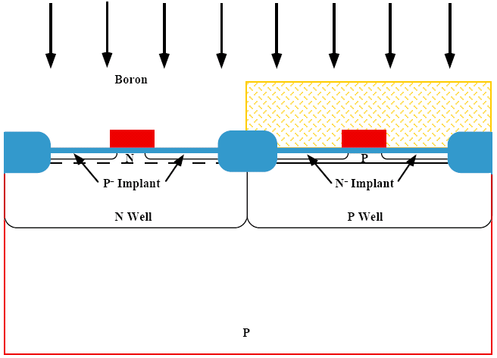
Tip or extension/LDD (lightly doped drain) formation
Remove resist, spin resist, photolithography, B⁺ ion implantation
As LDD is shallower than N⁺ and P⁺ source/drain doping, it also reduces “short channel effect” due to the shallower channel.
Mask #8 protects the NMOS devices.
A B⁺ implant forms the LDD regions in the PMOS devices.
Typically 5 x 10¹³cm⁻² @ 50 KeV.

Slide 7
Sidewall spacer formation
Deposit conformal SiO₂ (or nitride)
LPCVD: SiH₄ + O₂ → SiO₂ + 2H₂ at ∼400ºC
SiH₂Cl₂ + N₂O → SiO₂ + 2N₂ + 2HCl at ∼900ºC
Conformal layer of SiO₂ is deposited using LPCVD (typically 0.5 µm).

Slide 8
Sidewall spacer formation
Selective anisotropic dry etching
This works because deposition is conformal (isotropic), whereas etching is anisotropic (faster etching along vertical direction, little along horizontal direction).
Anisotropic etching leaves “sidewall spacers” along the edges of the poly gates.
Timed etch of oxide/nitride using very directional etch (RIE).
Just enough time to remove oxide from the source, drain and gate regions.

Slide 9
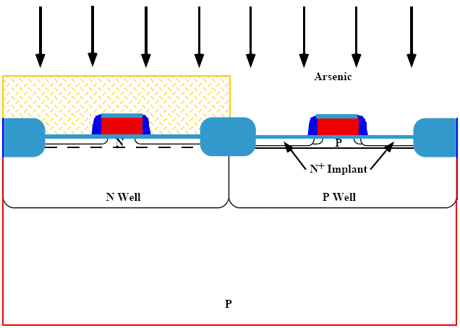
Source/drain formation for NMOS
Thermal oxidization, spin resist, photolithography, As⁺ ion implantation
Grow a thin oxide to reduce “channeling effect” during ion implantation, as well as protect the Si surface from contaminants.
As atom has low diffusion coefficient, good for shallow junction.
Mask #9 protects the PMOS devices.
An As⁺ implant forms the NMOS source and drain regions.
Typically 2-4 x 10¹⁵cm⁻² @ 75 KeV.

Slide 10
Source/drain formation for PMOS
Strip resist, spin resist, photolithography, B⁺ ion implantation
Again, high dose implant to reduce parasitic resistance in the source/drain region.
Figure 2-32
Mask #10 protects the NMOS devices.
A B⁺ implant forms the PMOS source and drain regions.
Typically 1-3 x 10¹⁵cm⁻² @ 50 KeV.

Slide 11
Drive-in anneal
Remove resist and anneal (diffusion, damage repair and dopant activation)
Anneal is always needed after ion implantation to repair Si lattice damage caused by energetic ion, and active dopant (bring it to crystalline sites).
A final high temperature anneal drives-in the junctions and repairs implant damage.
Typically 30 min @ 900˚C or 1 min RTA @ 1000˚C.
(RTA: rapid thermal annealing)

Slide 12
Contact and local interconnect formation
Etch away oxide, deposit Ti
Figure 2-35
An unmasked oxide etch allows contacts to Si and poly regions.
Ti is deposited by sputtering (typically 100nm).

Slide 13
Contact and local interconnect formation
TiN
(conductive)
TiSi₂
Anneal in nitrogen
TiSi₂ is an excellent conductor.
TiN is also conductive, good enough for local interconnects.
The Ti is reacted in an N₂ ambient, forming TiSi₂ and TiN.
Typically RTP 1 min @ 600 - 700˚C. (RTP: rapid thermal processing)
This process is called self-aligned silicide (salicide), since TiSi₂ is formed only on the Si surface at source, drain and gate. TiN is formed at SiO₂ surface.
Salicide reduces gate resistance, source/drain contact resistance.

Slide 14
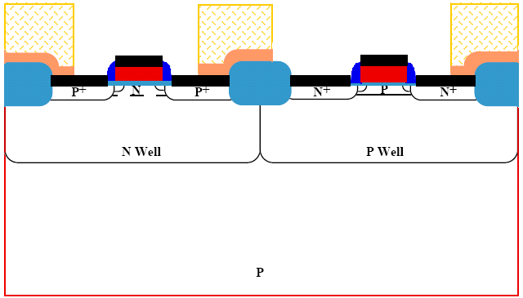
Contact and local interconnect formation
Spin resist, photolithography, TiN selective etching
Mask #11 is used to etch the TiN, forming local interconnects.
TiN etched by NH₄OH:H₂O₂:H₂O (1:1:5)
Then an anneal at ∼800ºC in Ar for 1 minute to reduce the resistivity of TiN and TiSi₂ to their final values.

Slide 15
Multi-level metal formation
Remove resist, deposit SiO₂
The SiO₂ layer is often doped with P (PSG – phosphosilicate glass) that protects the device against mobile ions like Na⁺.
B may also be added (BPSG – borophosphosilicate glass) to reduce the flowing temperature of the glass (flow to smooth out the surface, good for planarization).
A conformal layer of SiO₂ is deposited by LPCVD (typically 1 µm).

Slide 16
Surface planarization
Chemical mechanical polishing (CMP)
In CMP, besides mechanical polishing (by nanoparticles in the slurry), chemical reaction (e.g. by adjusting pH) is also important.
The total polishing rate is much higher than mechanical polishing rate and chemical reaction rate alone.
Besides CMP, planarization can also be done by spinning resist and etching back, using a recipe where etching rates for resist and glass are the same.

Slide 17
Multi-level metal formation
Spin resist, photolithography, oxide etching
Figure 2-40
Mask #12 is used to define the contact holes.
The SiO₂ is plasma etched (reactive ion etching).

Slide 18
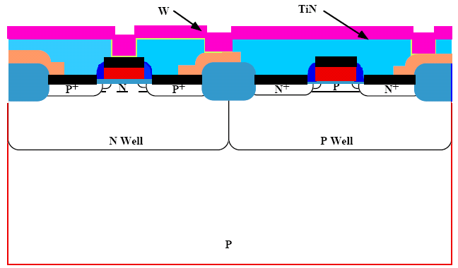
W stud (via) formation
Remove resist, deposit TiN diffusion barrier/adhesion layer and W
W CVD (chemical vapor deposition):
WF₆ (gas) + 3H₂ → W + 6HF (gas)
A thin TiN barrier layer is deposited by sputtering (typically a few tens of nm), followed by W CVD deposition.

Slide 19
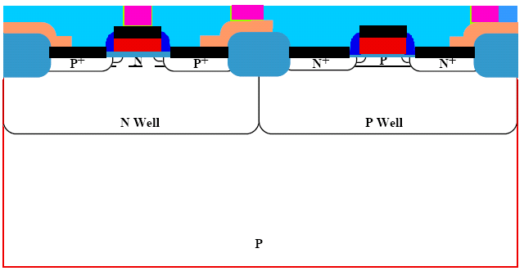
W stud (via) formation
Polishing
Damascene process: the process where contact holes are etched, filled, and planarized.
CMP is used to planarize the wafer surface, completing the “damascene process”.

Slide 20
Multi-level metal formation
Deposit Al, spin resist, photolithography, selectively etch Al
Usually small percentage of Si and Cu is added to Al.
Add Si because Si is soluble in Al up to a few percent, and if not added now, Al will take/corrode Si from device region.
Add Cu to prevent eletromigration in Al thin films (Al atoms move around, leaving behind voids)
Al is deposited on the wafer by sputtering.
Mask #13 is used to pattern the Al and plasma etching is used to etch it.
(Al is one of the few metals that can be etched by plasma)

Slide 21
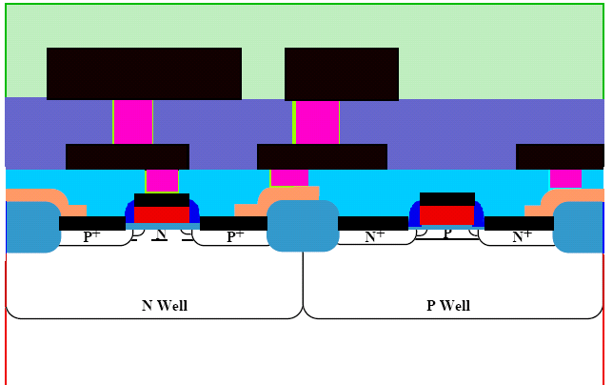
Multi-level metal formation
Strip resist, deposit insulator layer, W stud and Al wire formation,Si₃N₄ passivation layer deposition.
P
Inter-metal dielectric and second level metal are deposited and defined in the same way as level #1.
Mask #14 is used to define contact via-holes.
Mask #15 is used to define metal 2.
Passivation/protection layer of Si₃N₄ is deposited by PECVD and patterned with Mask #16.
Final anneal (400-500ºC, 30min, in forming gas – 10% H₂ in N₂) to alloy the metal contacts and reduce electrical charges in the Si/SiO₂ interfaces.

Slide 22
Finish the device
Wire bonding and packaging
(source gate drain)
P

Slide 23
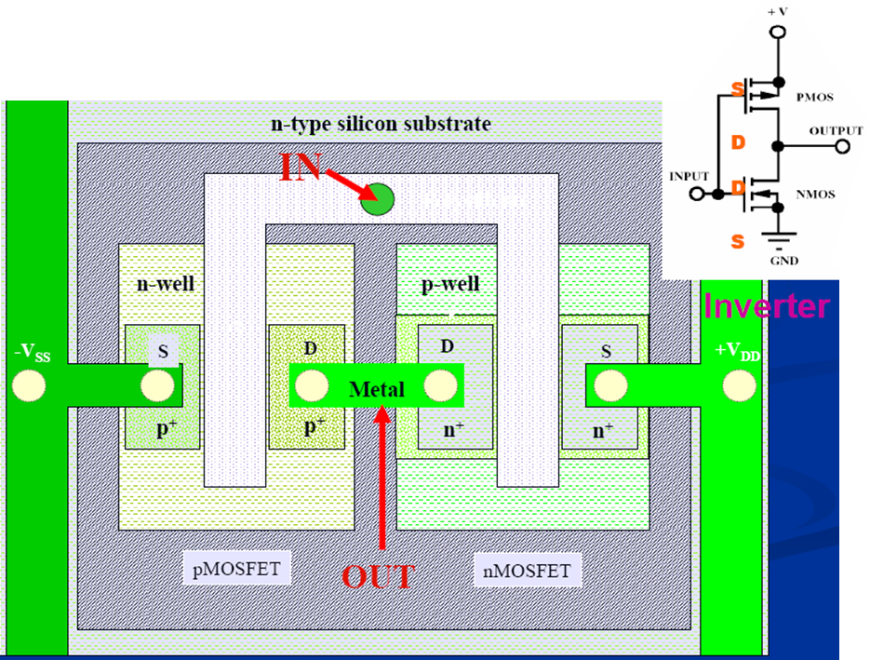
Top view of an inverter

Slide 24
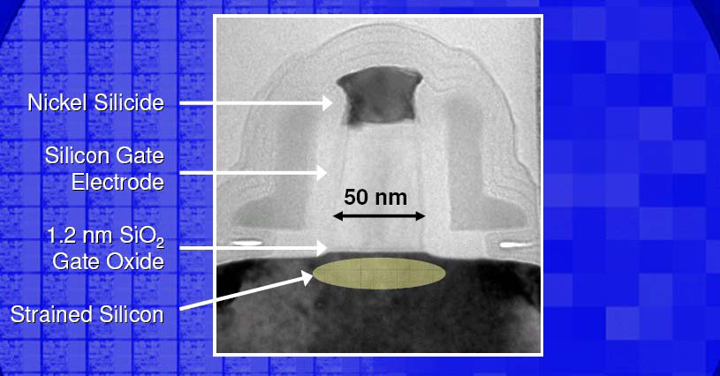
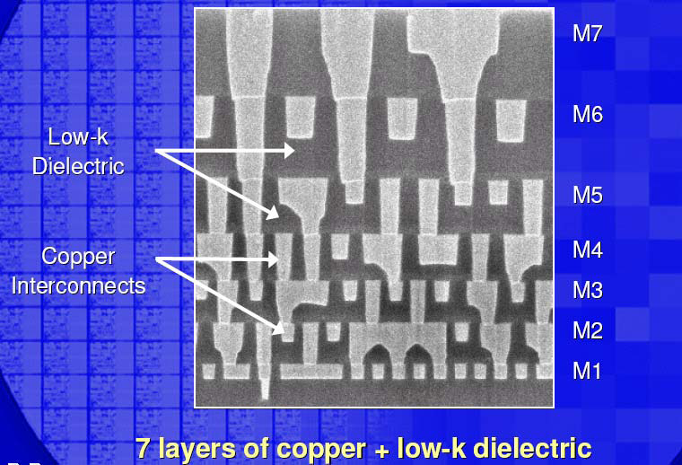
90 nm generation transistor and interconnect
Carrier moves faster in strained Si
Ni silicide (not Ti silicide).
Only 1.2nm gate oxide.
Strained silicon.
Low-k dielectric (lower ε, than SiO_{2,}) to reduce capacitance and RC delay for faster circuit.
Copper interconnect (not Al) by electroplating and chemical mechanical polishing (see next slide).

Slide 25
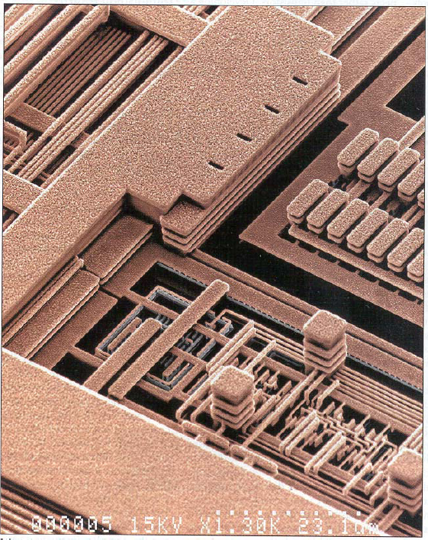
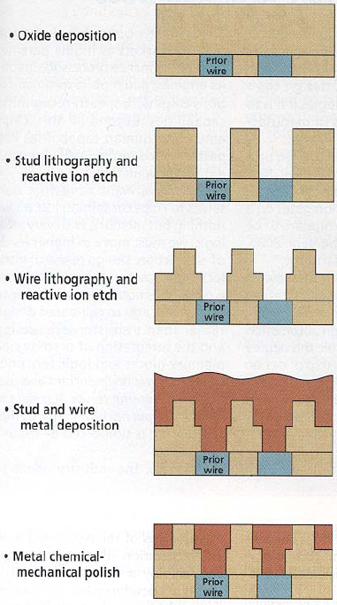
Advanced metallization: Cu based
Dual damascene IC process

Slide 26
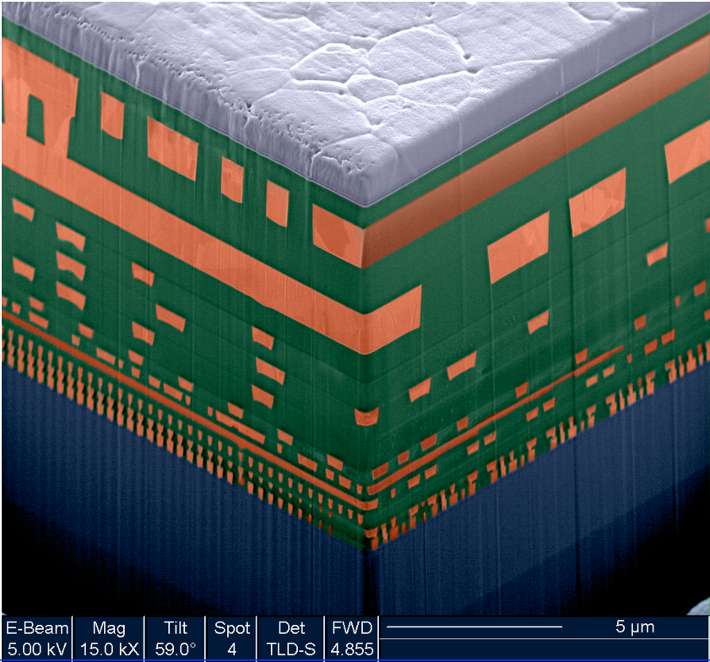
CMOS interconnects
Modern processes use several levels of metal, separated by layers of deposited oxide or other low-k materials.

