Slide 1
Chapter 3 Crystal growth, wafer fabrication and basic properties of silicon wafers
Silicon crystal structure and defects.
Czochralski single crystal growth.
Growth rate and dopant incorporation for CZ method.
Float zone single crystal growth and doping.
Wafer fabrication.
Measurement methods.
NE 343: Microfabrication and thin film technology
Instructor: Bo Cui, ECE, University of Waterloo; http://ece.uwaterloo.ca/~bcui/
Textbook: Silicon VLSI Technology by Plummer, Deal and Griffin

Slide 2
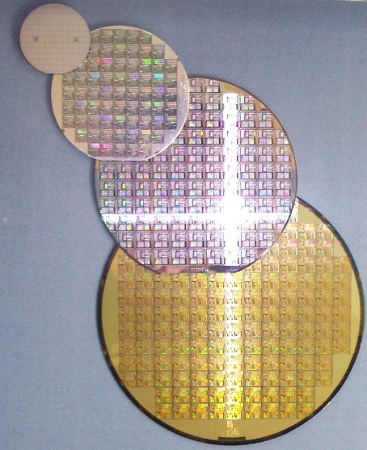
Single crystal silicon
Three types of solids - amorphous, polycrystalline, mono-crystalline (single-crystal).
Semiconductor devices and VLSI (very large scale integrated) circuits require high-purity single-crystal semiconductors. Because:
Difficult to control properties of amorphous or poly-crystals.
By doping, electronic properties (carrier density, mobility, conductivity, carrier lifetime) of a single crystal can be controlled more precisely.
Amorphous silicon is used in photovoltaic cells, electronic displays (large-area).
Polycrystalline silicon is used as a gate contact in MOSFETs (VLSI circuits).
Single crystal Si wafers
Diameters: currently up to 300mm (500mm?)
Wafer thickness: ∼650μm
Wafer purity: 150 parts/trillion
Impurities: 99.99999999% Si

Slide 3
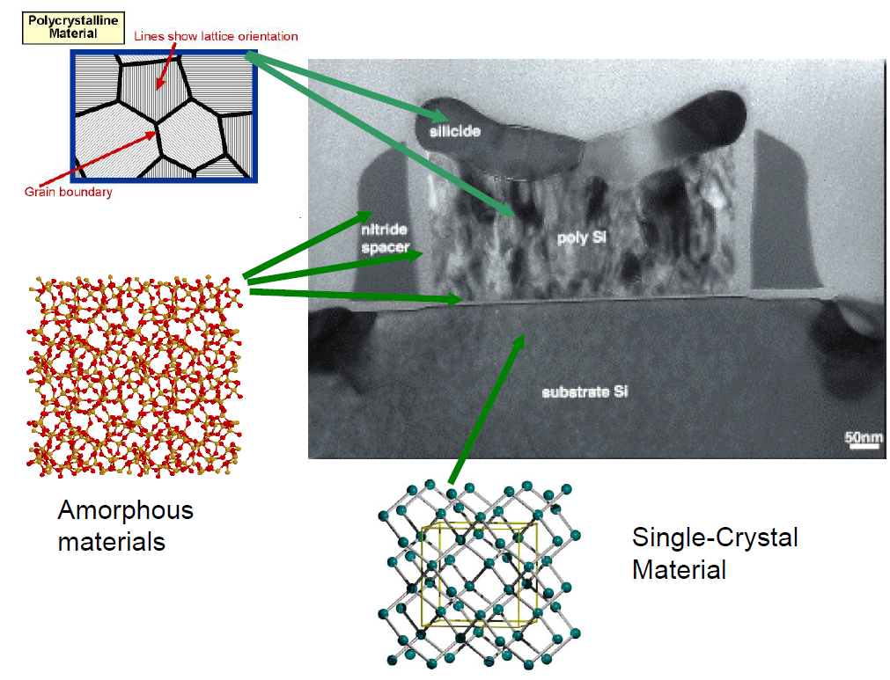
Microstructure of electronic materials
Polycrystalline materials
SiO₂
gate oxide

Slide 4
Crystallography - introduction
Crystals are characterized by a unit cell which repeats in the x, y, z directions.
Planes and directions are defined using an x, y, z coordinate system.
[111] direction is defined by a vector having components of 1 unit in x, y and z.
Planes are defined by Miller indices - reciprocals of the intercepts of the plane with the x, y and z axes.
For the (110) plane, it has intercepts with x, y, z-axis of 1, 1, ∞ (i.e. no intercept with z-axis). So its Miller indices are (1/1, 1/1, 1/∞)=(1,1,0).
For any plane (l, m, n), it is always perpendicular to the direction [l, m, n].
E.g. [111] direction is perpendicular to (111) plane.

Slide 5
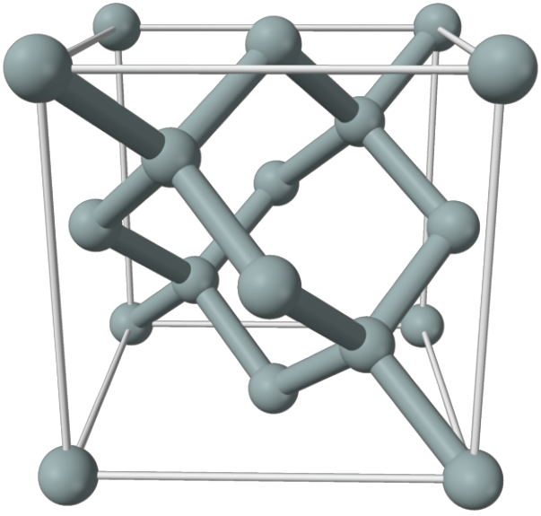
Diamond Structure of Si
Silicon has the basic diamond crystal structure:
Two merged FCC cells offset by a/4 in x, y and z.
http://jas.eng.buffalo.edu/education/solid/unitCell/home.html
This website has a 3D structure at various viewing angles.

Slide 6
Defect in crystals
Point defects: vacancy, interstitial, substitutional, Frankel defects
Linear defects: edge and screw dislocations
Planar defects: stacking fault, grain boundaries, surfaces
Bulk defects: cracks and pores, precipitate

Slide 7
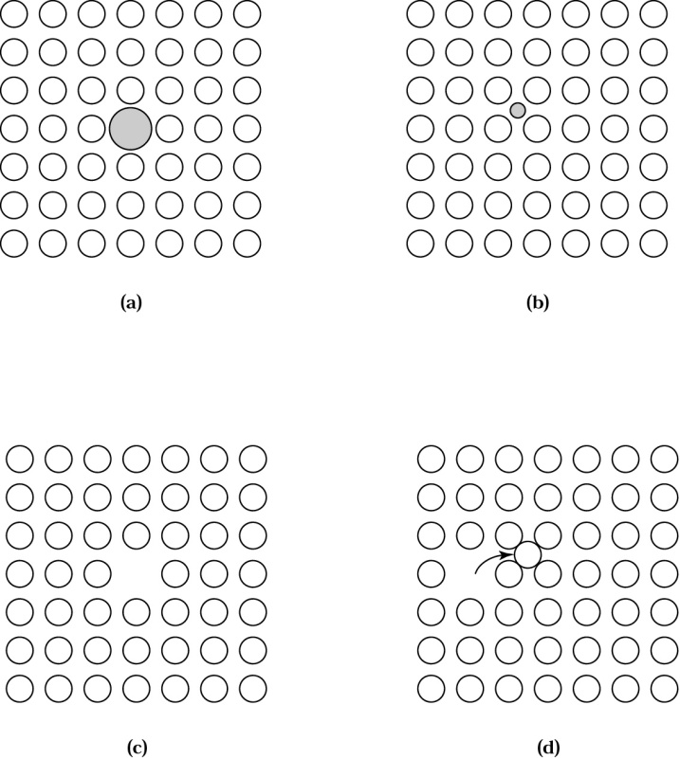
Point defects
Point defects.
Substitutional.
Interstitial.
Vacancy (Schottky defect).
Frenkel-type defect (interstitial - vacancy pair).
Point defects dictate most dopant diffusion mechanisms, and thus determine the impurity profile.

Slide 8
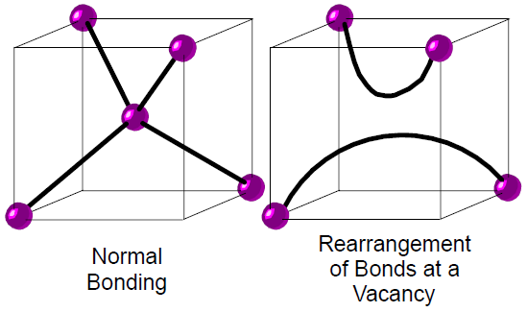
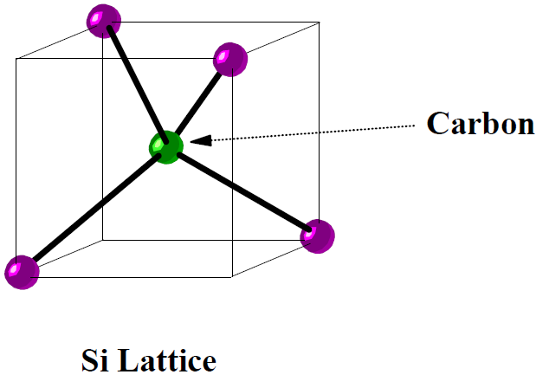
Point defects: vacancies and substitutional
The number of neutral vacancies is thermodynamically determined by,
where N_{o} is the density of atoms/cm³ and E_{a} is the activation energy for the formation of the vacancy (in silicon, N_{o}=5.02×10²²/cm³ and E_{a}=2.6 eV)
Substitutional can be foreign unwanted impurities, or intentionally introduced impurities.
You may want a dopant impurity to be on a substitutional site, but you may not want a heavy metal atom or other unwanted impurity to be on a substitutional site (harder to remove).

Slide 9
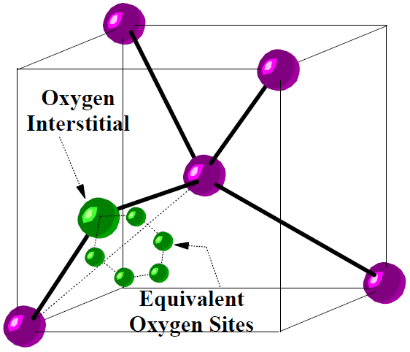
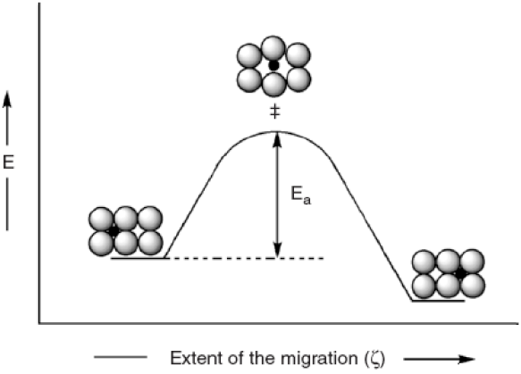
Point defects: interstitial
Interstitials can be foreign unwanted impurities, intentionally introduced impurities, or “misplaced” host atoms (an intrinsic defect, the self-interstitial).
Dopant atoms diffuse through the semiconductor faster as interstitials, but we need to place them in substitutional sites to make use of them (i.e. they act as dopants only when in substitutional sites).
Energies involved for the atomic diffusion of interstitial impurities

Slide 10
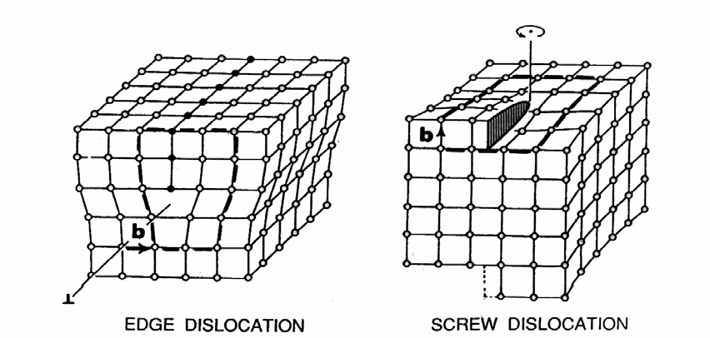
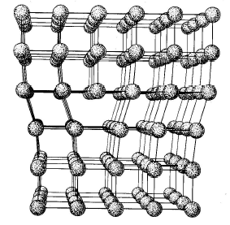
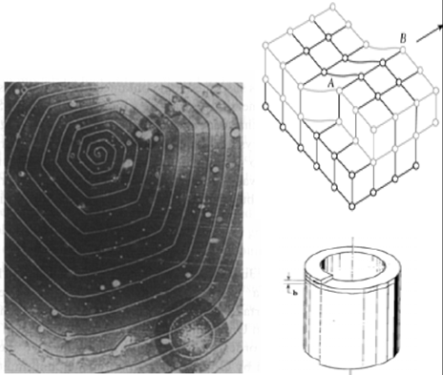
Line defects: dislocation
A missing line or additional line of atoms is called a dislocation.
Dislocations are either pure edge, pure screw or a combination of both types.
Screw dislocations give a helical structure to the planes, often show up in crystal growth

Slide 11
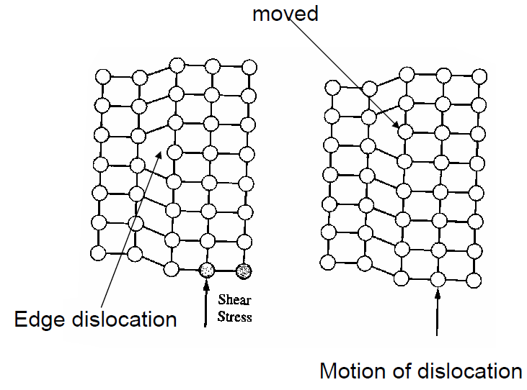
Dislocation move
Dislocation affects deformation properties - to slide upper block over lower now only requires a line of bonds to break at a time, not a whole plane process of slip.
It causes low yield strength of solids.
Dislocation sources: by stress due to temperature gradient, due to agglomeration.

Slide 12
Planar defects: stacking faults
Volume defects: precipitates
A stacking fault is a disruption in the stacking of layers in the crystal.
It is terminated by dislocation.
Precipitates are three dimensional defects that have a different chemical makeup from the host lattice.
They can result from an impurity exceeding the maximum solubility of the crystal (much like super-saturation of sugar in water).

Slide 13
Chapter 3 Crystal growth, wafer fabrication and basic properties of silicon wafers
Silicon crystal structure and defects.
Czochralski single crystal growth.
Growth rate and dopant incorporation for CZ method.
Float zone single crystal growth and doping.
Wafer fabrication.
Measurement methods.

Slide 14
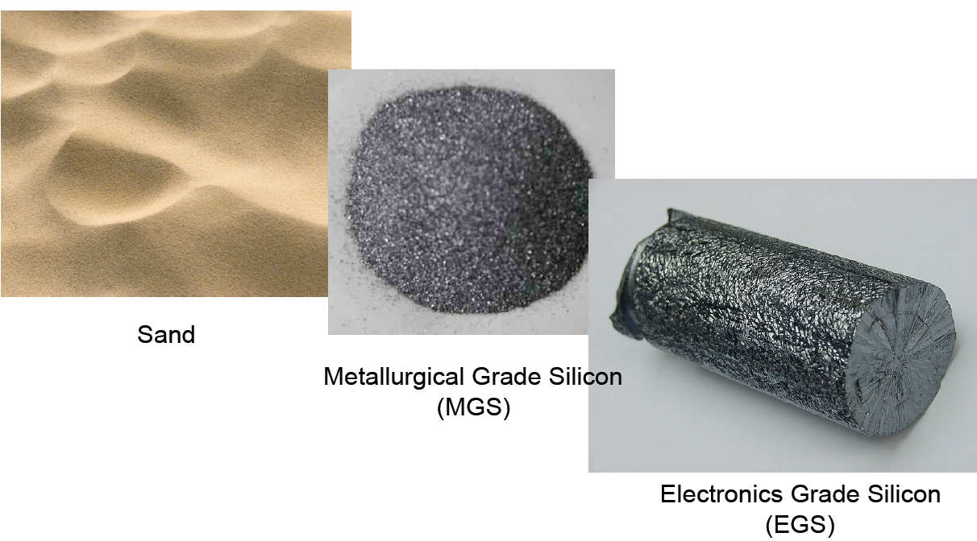
Raw material preparation

Slide 15
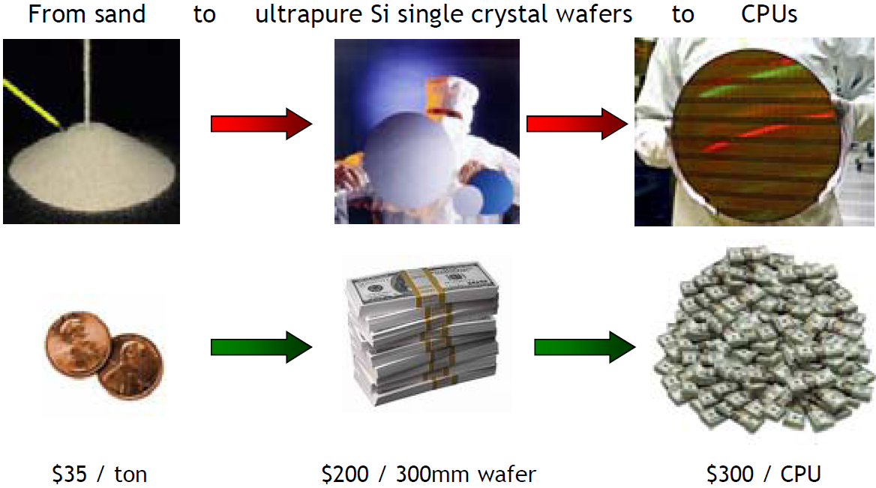
Economical value

Slide 16
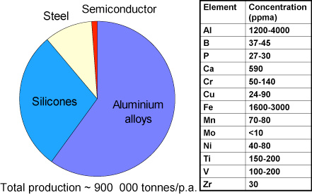
Metallurgical grade silicon
Quartzite (sand, SiO₂) is placed in a hot (∼1800ºC) furnace with carbon releasing materials, and reacts as shown, forming metallurgic grade silicon (MGS):
2SiO₂(solid) + 2C(solid) → Si(liquid) + 2CO(gas)
Metallurgical grade silicon (~98% pure) production and typical impurity levels.
Over 50% MGS is used to make Al alloys.
The fraction used for semiconductors is very small.

Slide 17
Electrical grade silicon (polycrystalline)
Basically, the solid Si is first converted into a liquid form (SiHCl₃) for purification, then converted back into solid Si.
Both reactions occur at high temperatures.
Metallurgical grade silicon is treated with hydrogen chloride to form trichlorosilane:
Si + 3HCl → SiHCl₃(g) + H₂(g) (use catalyst)
SiHCl₃ is liquid at room temperature, boiling point 32ºC. Multiple distillation of the liquid removes the unwanted impurities (99.9999% pure).
The purified SiHCl₃ is then used in a hydrogen reduction reaction to prepare the electronic grade Si (EGS):
SiHCl₃(g) + H₂(g) → Si(s) + 3HCl(g)
(this is the reverse reaction of the above reaction)
EGS is the raw material for Si single crystal production.

Slide 18
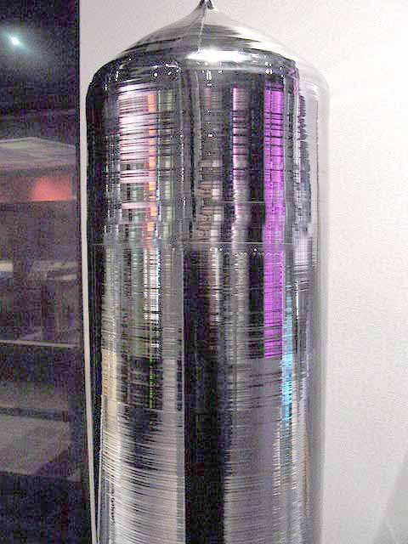
Si single crystal growth
Two methods used: Czochralski (CZ) and float zone (FZ).
Jan Czochralski (cho-HRAL-skee) (1885 - 1953) was a Polish chemist who invented the Czochralski process, which is used to grow single crystals and is used in the production of semiconductor wafers.
He discovered the Czochralski method in 1916 when he accidentally dipped his pen into a crucible of molten tin rather than his inkwell. He immediately pulled his pen out to discover that a thin thread of solidified metal was hanging from the nib. The nib was replaced by a capillary, and Czochralski verified that the crystallized metal was a single crystal.
http://en.wikipedia.org/wiki/Jan_Czochralski

Slide 19
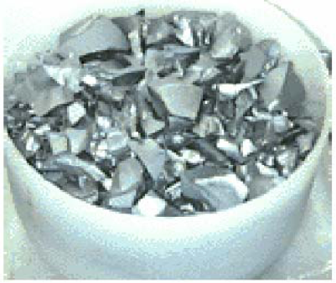
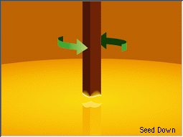
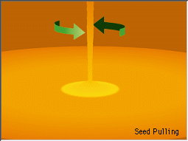
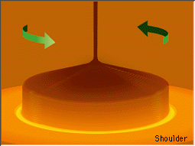
Czochralski method (CZ)
It is widely employed for Si, GaAs, and InP.
The EGS is broken into small pieces and placed in an SiO₂ crucible.
In an argon ambient, the crucible is heated to just above 1417ºC.
Dopant is added to the melt to intentionally dope the resulting crystal.
A single crystal seed is then lowered into the melt (crystal orientation and wafer diameter determined by seed orientation and pull rate), and withdrawn slowly.
Melt flows up the seed and cools as crystal begins to grow.
Seed rotated about its axis to produce a circular cross-section crystal. The rotation inhibits the natural tendency of the crystal to grow along certain orientations to produce a faceted crystal.
Long ingots (boules) ∼100 kg, with very good circular cross-section are produced.
The oxygen and carbon (from graphite furnace components), contribute about 10¹⁷-10¹⁸/cm³ contaminants.

Slide 20
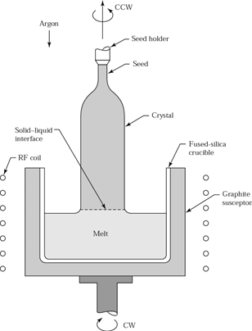
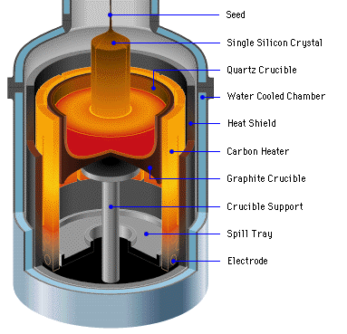
Czochralski method (CZ)

Slide 21
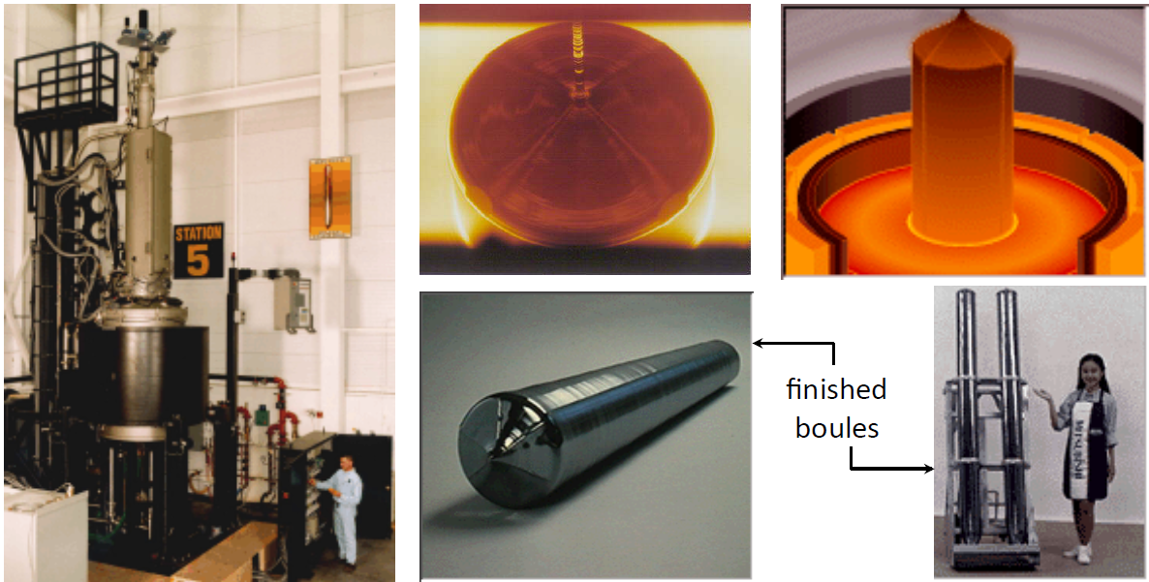
Czochralski growth of silicon
A commercial CZ puller Early in the growth process Later in the growth process

Slide 22
Oxygen and carbon in CZ silicon
The CZ growth process inherently introduces O (from SiO₂ crucible) and C (from graphite susceptor/supporter).
Typically, C_{O} ≈ 10¹⁸ cm⁻³ and C_{C} ≈ 10¹⁶ cm⁻³.
The O in CZ silicon often forms small SiO₂ precipitates in the Si crystal under normal processing conditions.
O and these precipitates can actually be very useful: provide mechanical strength, internal gettering.
Figure 3-25 Point defect and diffusion mechanisms that contribute to the growth or shrinkage of SiO₂ precipitates in silicon.
Critical size is about 1nm: stable precipitates above 1nm, may shrink and disappear below 1nm.

