Slide 1
Chapter 4 Clean room, wafer cleaning and gettering
Introduction.
Clean room.
Wafer cleaning.
Gettering.
Measurement methods.
NE 343: Microfabrication and thin film technology
Instructor: Bo Cui, ECE, University of Waterloo; http://ece.uwaterloo.ca/~bcui/
Textbook: Silicon VLSI Technology by Plummer, Deal and Griffin

Slide 2
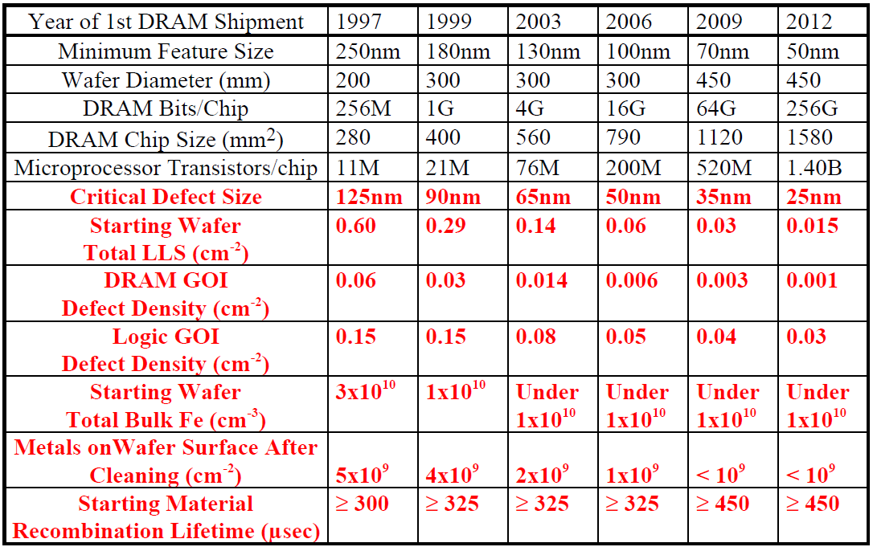
Effect of defect and contamination on semiconductor industry
LLS: localized light scatters (use laser to detect and count particles)
GOI: gate oxide integrity, by electrical measurement
Requirement different for DRAM and logic chip, due to greater gate insulator area on DRAM chip.
10⁹/cm² ∼ 0.0001% monolayer
Importance of unwanted impurities increases with shrinking geometries of devices.
75% of the yield loss is due to defects caused by particles (1/2 of the min feature size).

Slide 3
Type of contaminants
Contaminants may consist of particles, organic films, photoresist, heavy metals or alkali ions.
Modern IC factories employ a three tiered approach to controlling unwanted impurities:
clean factories
wafer cleaning
gettering

Slide 4

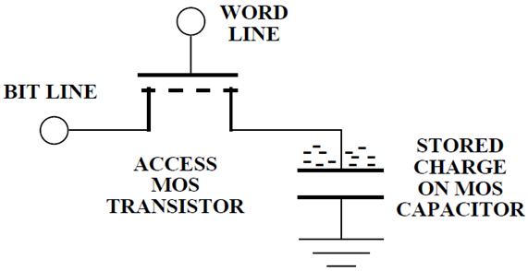

Effects on MOSFET: two examples
MOSFET threshold voltage is given by:
If t_{ox}=10nm, then a 0.1V V_{th} shift can be caused by Na⁺ or K⁺ of Q_{M}=2.15×10¹¹ ions /cm² (<0.1% monolayer or 10ppm in the oxide).
ε₀=8.85×10⁻¹²F/m, ε_{ox}=3.9
For MOS DRAM, refresh time of several msec requires a generation lifetime of
This requires trap density N_{t}≈10¹²/cm³, or 0.02ppb (10¹²/(5×10²²)=0.02ppb).
(σ is trap capture cross-section, v_{th} is minority carrier thermal velocity; V_{th}∼10⁷cm/sec, σ∼10⁻¹⁵cm⁻²)
Deep-level traps (Cu, Fe, Au etc.) pile up at the surface where the devices are located. This causes leak current. Need refresh/recharge the MOS capacitor.
DRAM: Dynamic Random Access Memory

Slide 5
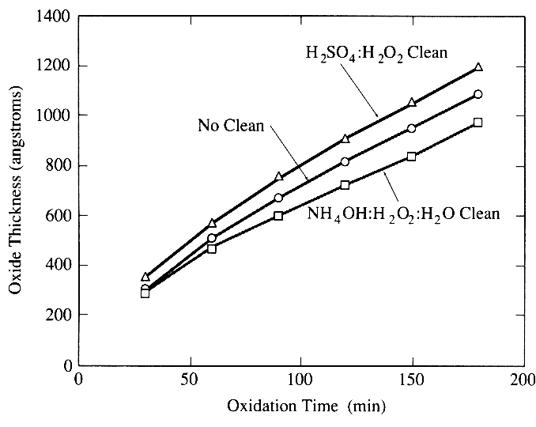
Effects of cleaning on thermal oxidation
Residual contaminants affect kinetics of processes, here oxidation.

Slide 6
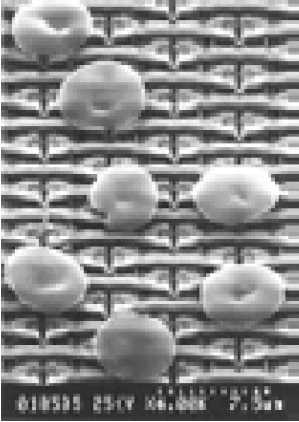
Particle contaminants
Particle sources: air, people, equipment and chemicals.
A typical person emits 5-10 million particles per minute.
Particle density (number/ml) for ULSI grade chemicals
 | >0.2μm | >0.5μm
NH₄OH | 130-240 | 15-30
H₂O₂ | 20-100 | 5-20
HF | 0-1 | 0
HCl | 2-7 | 1-2
H₂SO₄ | 180-1150 | 10-80
ULSI: ultra-large-scale integration

Slide 7

Metal contamination
Sources: chemicals, ion implantation, reactive ion etching, resist removal, oxidation.
Effects: defects at interface degrade device; leads to leak current of p-n junction, reduces minority carrier life time.
Fe, Cu, Ni, Cr, W, Ti…
Na, K, Li…
Ion implantation
Dry etching
Photoresist removal
Fe Ni Cu
Wet oxidation
9
10
11
12
13
Log (concentration/cm²)

Slide 8
Chapter 4 Clean room, wafer cleaning and gettering
Introduction.
Clean room.
Wafer cleaning.
Gettering.
Measurement methods.
NE 343 Microfabrication and thin film technology
Instructor: Bo Cui, ECE, University of Waterloo
Textbook: Silicon VLSI Technology by Plummer, Deal and Griffin

Slide 9
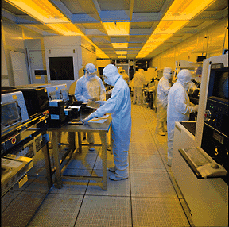
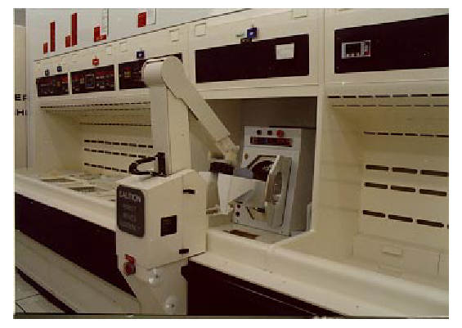
Clean factory is the first approach against contamination
Modern IC factories employ a three tiered approach to controlling unwanted impurities:
clean factories
wafer cleaning
gettering
Clean factory Wafer cleaning Gettering

Slide 10
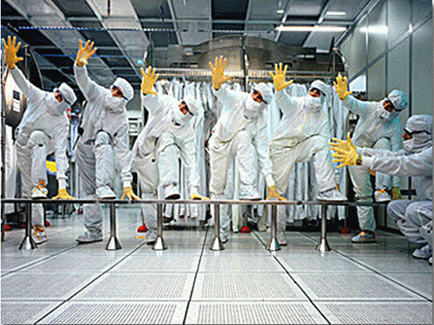
Clean room
Factory environment is cleaned by:
  HEPA filters and recirculation for the air.
  “Bunny suits” for workers.
  Filtration of chemicals and gases.
  Manufacturing protocols.
HEPA: High Efficiency Particulate Air
HEPA filters composed of thin porous sheets of ultrafine glass fibers (<1μm diameter).
It is 99.97% efficient at removing particles from air.
Room air forced through the filter at 50cm/sec.
Large particles trapped, small ones stick to the fibers due to electrostatic forces.
The exit air is typically better than class 1.

Slide 11
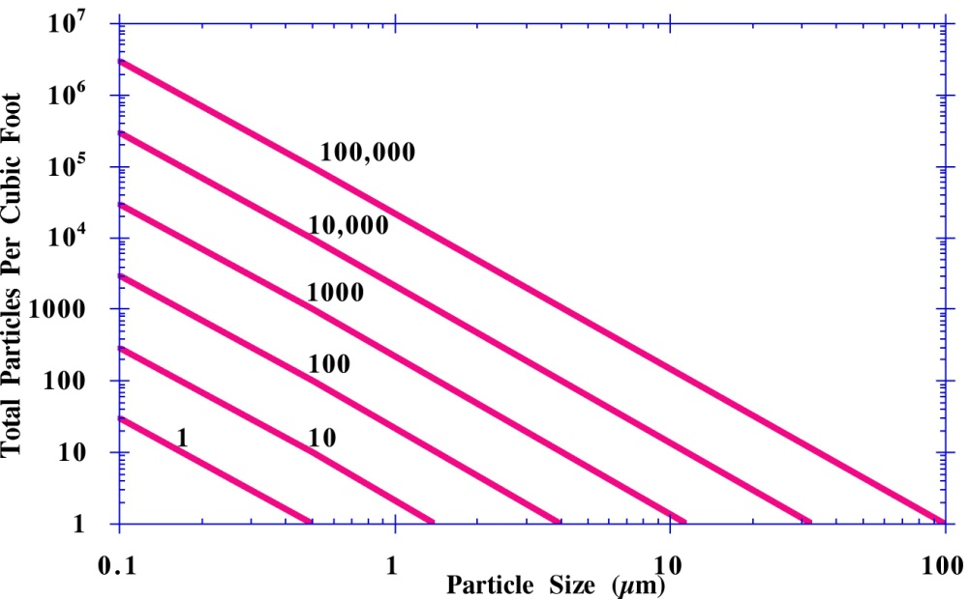
Class of a clean room
Air quality is measured by the “class” of the facility.
Class 1-100,000 mean number of particles, greater than 0.5μm, in a cubit foot of air.
A typical office building is about class 100,000.
The particle size that is of most concern is 10nm – 10μm. Particles <10nm tend to coagulate into large ones; those >10μm are heavy and precipitate quickly.
Particles deposit on surfaces by Brownian motion (most important for those <0.5μm) and gravitational sedimentation (for larger ones).
Particle diameter (μm)
Class | 0.1 | 0.3 | 0.5 | 5.0
1 | 35 | 3 | 1
10 | 350 | 30 | 10
100 |  | 300 | 100
1000 |  |  | 1000 | 7
10000 |  |  | 10000 | 70
100000 |  |  | 100000 | 700
by definition

Slide 12
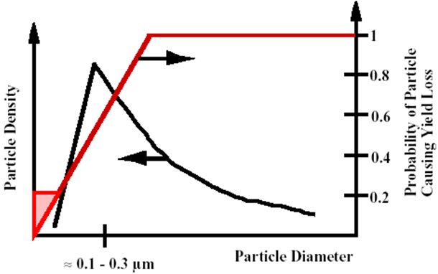
Particle contamination and yield
Generally, particles on the order of the technology minimum features size or larger will cause defect.
≈75 yield loss in modern VLSI fabrication facilities is due to particle contamination.
Yield models depend on information about the description of particles.
Particles on the order of 0.1-0.3μm are the most troublesome: larger particles precipitate easily; smaller one coagulate into larger particles.

Slide 13
Chapter 4 Clean room, wafer cleaning and gettering
Introduction.
Clean room.
Wafer cleaning.
Gettering.
Measurement methods.
NE 343 Microfabrication and thin film technology
Instructor: Bo Cui, ECE, University of Waterloo
Textbook: Silicon VLSI Technology by Plummer, Deal and Griffin

Slide 14
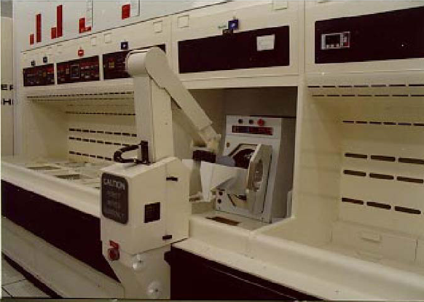
Modern wafer cleaning
Cleaning involves removing particles, organics and metals from wafer surfaces.
Particles are largely removed by ultrasonic agitation during cleaning.
Organics (photoresist) are removed in O₂ plasma or in H₂SO₄/H₂O₂ (Piranha) solutions.
The “RCA clean” is used to remove metals and any remaining organics.
A cassette of wafers
Typical person emit 5-10 million particle per minute.
Most modern IC plants use robots for wafer handling.

Slide 15
Standard RCA cleaning procedure
RCA clean is “standard process” used to remove organics, heavy metals and alkali ions.
Ultrasonic agitation is used to dislodge particles.
SC: Standard Cleaning
RCA: Radio Corporation of America, now makes TV, stereos…
and all contaminants on top of it, but induces H passivated surface (bad)
Less NH₄OH will reduce surface roughness
not removed by SC-1
DI water: de-ionized water
HF dip added to remove oxide

Slide 16
Standard cleaning (SC)
SC-1:
NH₄OH(28%):H₂O₂(30%):H₂O=1:1:5 - 1:2:7; 70-80°C, 10min, high pH.
Oxidize organic contamination (form CO₂, H₂O…)
Form complex such as Cu(NH₃)₄⁺² with metals (IB, IIB, Au, Ag, Cu, Ni, Zn, Cd, Co, Cr).
Slowly dissolve native oxide and grow back new oxide, which removes particles on oxide.
But NH₄OH etches Si and make the surface rough, thus less NH₄OH is used today.
SC-2:
HCl(73%):H₂O₂(30%):H₂O=1:1:6 - 1:2:8; 70 - 80°C; 10min, low pH.
Remove alkali ions and cations like Al⁺³, Fe⁺³ and Mg⁺² that form NH₄OH insoluble hydroxides in basic solutions like SC-1.
These metals precipitate onto wafer surface in the SC-1 solution, while they form soluble complexes in SC-2 solution.
SC-2 also complete the removal of metallic contaminates such as Au that may not have been completely removed by SC-1 step.

Slide 17
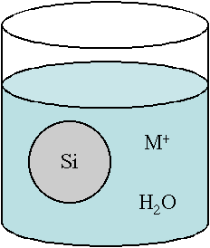
Principles of metal cleaning
If we have a water solution with a Si wafer and metal atoms and ions, two reactions take place.
The two reactions will proceed in opposite directions, one providing electrons, which will then be consumed by the other (forming an oxidation/reduction couple). In this couple, the stronger reaction will dominate.
Generally, (2) is driven to the left and (1) to the right so that SiO₂ is formed and M plates out on the wafer.
Good cleaning solutions drive (2) to the right since M⁺ is soluble and will be desorbed from the wafer surface.
(1)
(2)

Slide 18
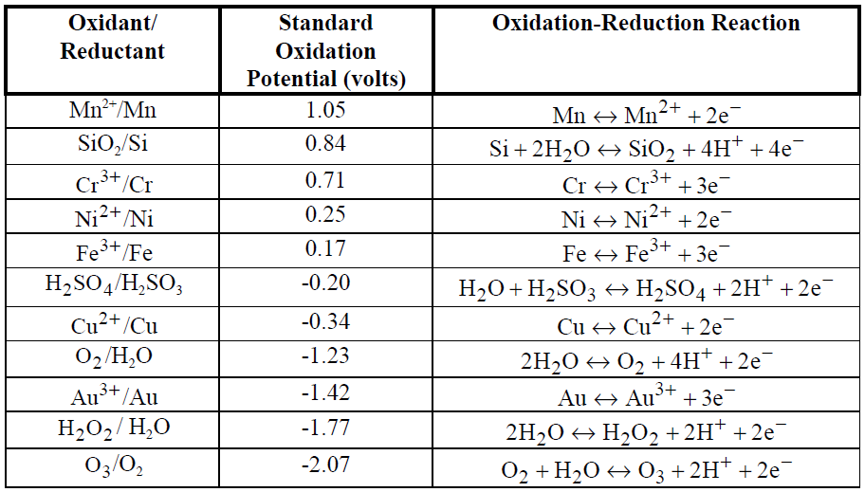
Principles of metal cleaning
The strongest oxidants are at the bottom (H₂O₂ and O₃). These reactions go to the left, grabbing electrons and forcing (2) in previous slide to the right.
Fundamentally the RCA clean works by using H₂O₂ as a strong oxidant.
Reaction goes to the left

Slide 19
Ultrasonic cleaning and DI water
RCA cleaning with ultrasonic agitation is more effective in removing particles.
Ultrasonic cleaning:
Highly effective for removing surface contaminants
Mechanical agitation of cleaning fluid by high-frequency vibrations (between 20 and 45 kHz) to cause cavitation - formation of low pressure vapor bubbles that scrub the surface.
Higher frequencies (>45kHz) form smaller bubbles, thus less effective.
However, megasonic (1MHz) cleaning is also found effective in particle removal.
DI (de-ionized) water is used for wafer cleaning.
One monitors DI water by measuring its resistivity, which should be >18MΩcm.
H₂O ↔ H⁺+OH⁻ [H⁺]=[OH⁻] = 6x10⁻¹³cm⁻³
Diffusivity of: H⁺ ≈ 9.3x10⁻⁵cm²s⁻¹ → µ_{H+}=qD/kT=3.59cm²V⁻¹s⁻¹
of : OH⁻ ≈ 5.3x10⁻⁵cm²s⁻¹ → µ_{OH-}=qD/kT=2.04cm²V⁻¹s⁻¹
Einstein relation: µ=qD/kT, http://en.wikipedia.org/wiki/Einstein_relation_%28kinetic_theory%29

Slide 20
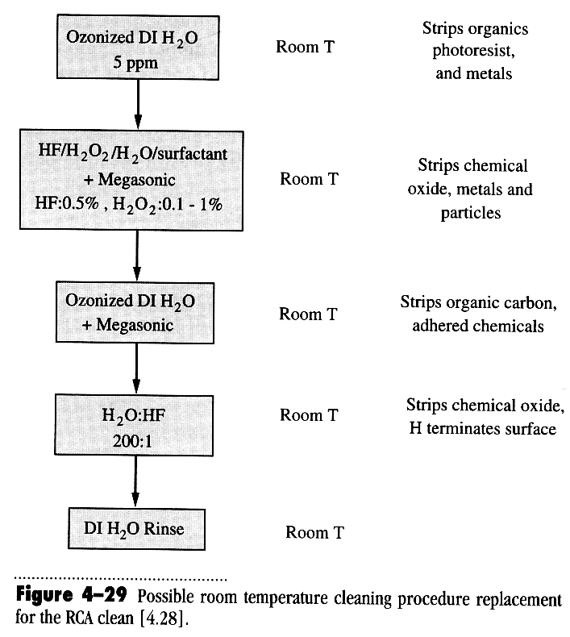
Other cleaning methods
Ohmi cleaning: room temperature, fewer chemicals
Dry (vapor phase) cleaning:
Energy may come from plasma, ion beam, short-wavelength (UV) radiation or heating.
HF/H₂O vapor cleaning
UV-ozone cleaning (UVOC)
H₂/Ar plasma cleaning
Thermal cleaning

Slide 21
Chapter 4 Clean room, wafer cleaning and gettering
Introduction.
Clean room.
Wafer cleaning.
Gettering.
Measurement methods.
NE 343 Microfabrication and thin film technology
Instructor: Bo Cui, ECE, University of Waterloo
Textbook: Silicon VLSI Technology by Plummer, Deal and Griffin

Slide 22
Gettering
For the alkali ions, gettering generally uses dielectric layers on the topside; PSG for trapping, or Si₃N₄ layer for blocking them from getting into the device region.
For metal ions, gettering generally uses traps on the wafer backside or in the wafer bulk. Here gettering works because the metals (Au…) do not “fit” in the silicon lattice easily because of their very different atomic size, thus they prefer to stay at defect sites.
Therefore, the idea of gettering is to create such defect sites outside of active device region.
Backside = external gettering: roughing/damaging the backside of the wafer, or depositing a poly-silicon layer, to provide a low energy “sink” for impurities.
Bulk = intrinsic (or internal) gettering: using internal defects to trap impurities, thus moving them away from the active region of the wafer.
PSG: phosphosilicate glass, is a P₂O₅/SiO₂ glass that is normally deposited by CVD, usually contains 5% by weight phosphorus.
PSG traps alkali ions (Na⁺, K⁺) and form stable compounds.
At higher than room temperature, alkali ions can diffuse into PSG from device region and trapped there.
Problems with PSG: it affects electric fields since dipoles exist in PSG, and it absorb water, leading to Al corrosion.

Slide 23
Gettering
Deep level impurities in silicon:
large diffusivity, easily trapped by mechanical defects or chemical traps.
Figure 4-6 Periodic table indicating the elements that are of most concern in gettering.

Slide 24
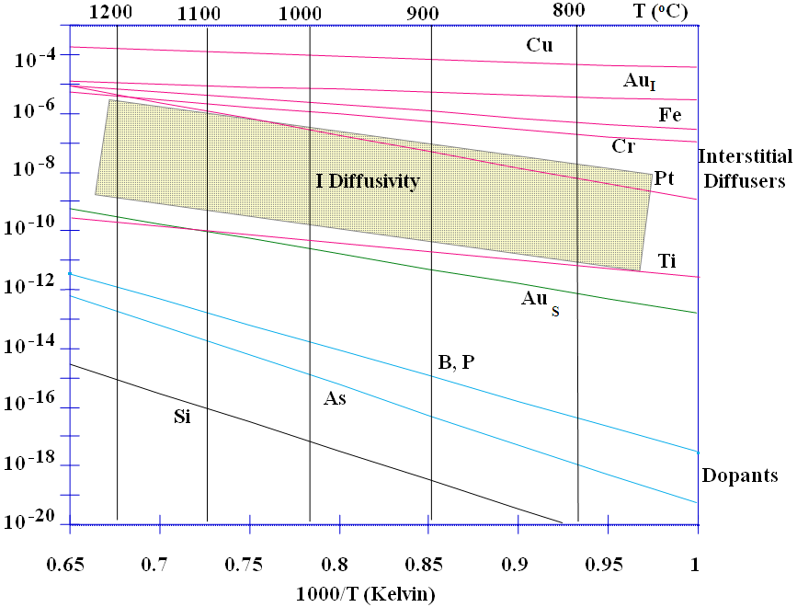
Fast diffusion of various impurities
They can diffuse from front-side to backside of the wafer (>0.5mm distance)
Those metal diffuses fast because they do so as interstitials.
Whereas dopants are substitutional and diffuse by interacting with point defects.
Diffusivity (cm²/sec)
I: interstitial
S: substitutional
Heavy metal gettering relies on metal’s very high diffusivity (when in interstitial sites) in silicon, and its preference to segregate to “trap” sites.

Slide 25
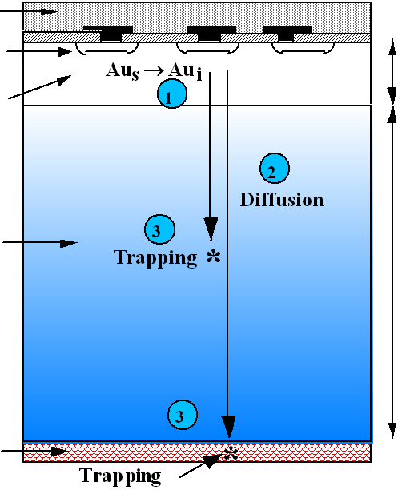
Gettering mechanism
PSG layer
Devices in near surface region
Denuded zone or epitaxy layer
Intrinsic gettering region
Backside gettering region
500+μm 10-20μm

Slide 26
Gettering mechanism
Gettering consists of:
    Making metal atoms mobile.
    Migration of these atoms to trapping sites.
    Trapping of atoms.
Step 1 generally happens by kicking out the substitutional (s) atom into an interstitial (i) site. One possible reaction is: (I = interstitial Si)
Step 2 usually happens easily once the metal is interstitial since most metals diffuse rapidly in this form.
Step 3 happens because heavy metals segregate preferentially to damaged regions (dislocation or stacking fault) or to N⁺ regions, or pair with effective getters like P (AuP).
Step 1 can be facilitated by introducing large amount of Si interstitials, by such as high density phosphorus diffusion, ion implantation damage or SiO₂ precipitation.

Slide 27
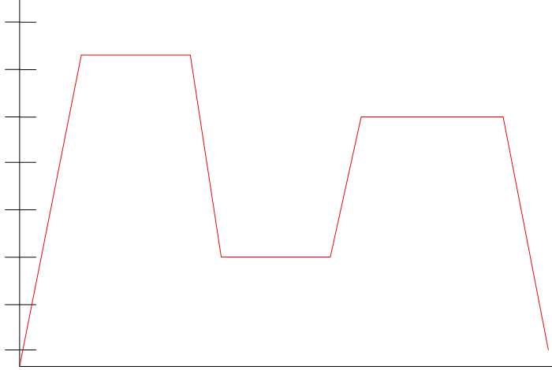
Intrinsic gettering
Precipitates (size) grow @ high T
Density of nucleation sites grow @ low T
Therefore, low T to increase density, and high T to grow its size.
Out-diffusion of O
1100
900
700
500
Precipitation
(growth of SiO₂)
denuded zone = oxygen free; thickness several tens of µm
Slow ramp
Temperature ºC
50-100nm in size
Oxygen diffusivity:
D₀ >> D_{dopants} but D₀<< D_{metals}
Nucleation of SiO₂
1-3 nm min size of nuclei, concentrations ≈ 10¹¹cm⁻³
Time
In intrinsic gettering, the metal atoms segregate to dislocations (formed because of volume mismatch of SiO₂ and host Si lattice) around SiO₂ precipitates.
15 to 20 ppm oxygen wafers are required:
<10 ppm - precipitate density is too sparse to be an effective getterer.
>20 ppm - wafers tend to warp during the high temperature process.
Note: devices that use the entire wafer as the active region (solar cells, thyristors, power diodes, etc...) can not use this technique, but can use extrinsic gettering.
Today, most wafer manufactures perform this intrinsic gettering task that is better controlled.

Slide 28
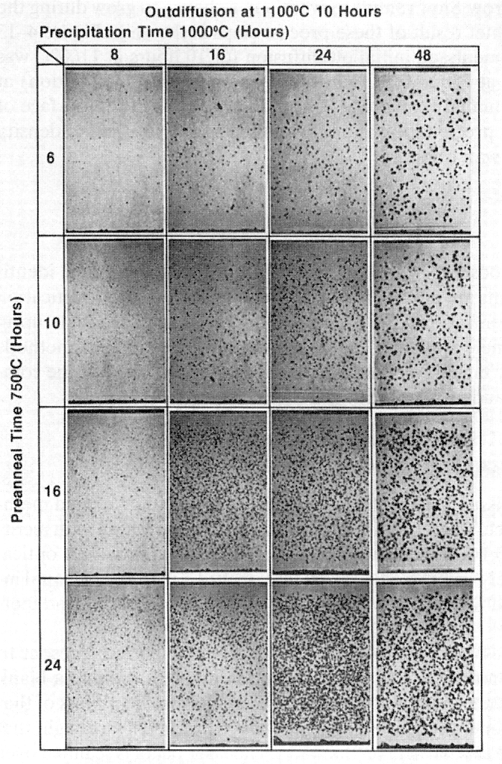
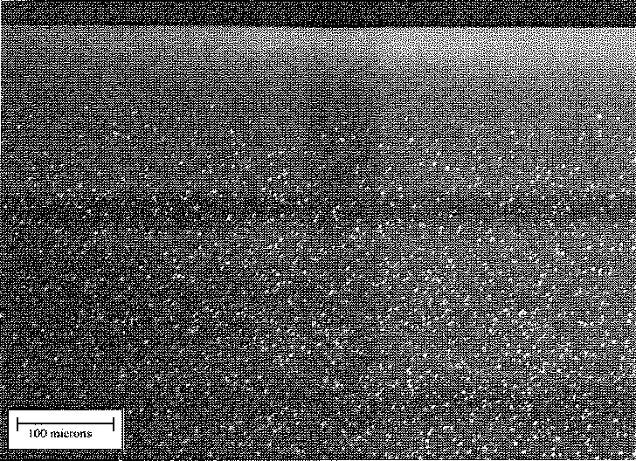
Intrinsic Gettering: SiO₂ precipitates
No SiO₂ on top surface
(denuded zone)
no SiO₂
SiO₂ precipitates (50-100nm)
SiO₂ precipitates (white dots) in bulk Si
Figure 4-13

Slide 29
Chapter 4 Clean room, wafer cleaning and gettering
Introduction.
Clean room.
Wafer cleaning.
Gettering.
Measurement methods.
NE 343 Microfabrication and thin film technology
Instructor: Bo Cui, ECE, University of Waterloo
Textbook: Silicon VLSI Technology by Plummer, Deal and Griffin

Slide 30
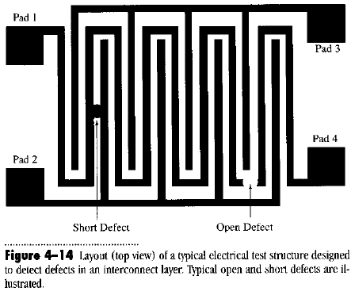
Particle contamination detection
Un-patterned wafers (blank)
  Count particles in microscope
  Laser scanning systems that give maps of particles down to ≈ 0.2 µm
Patterned wafers
  Optical system compares a die with a “known good reference” die (adjacent die, chip design - its appearance)
  Image processing identifies defects
  Test structure (not in high volume manufacturing)
Test structures design to detect defects

Slide 31
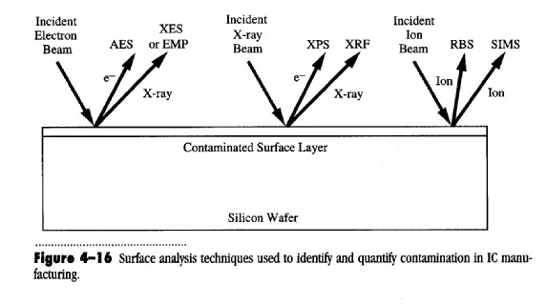
Monitoring the wafer cleaning efficiency
Concentrations of impurities determined by surface analysis.
Excite → Identify (unique atomic signature) → Count concentrations
works with SEM
He⁺ 1-3 MeV
O⁺ or Cs⁺ sputtering and mass analyses
emitted
Primary beam electron good lateral resolution (e can be focused, but not x-ray)
Detected beam electron good depth resolution and surface sensitivity
X-ray poor depth resolution and poor surface sensitivity
ions (SIMS) excellent
ions (RBS) good depth resolution, reasonable sensitivity (0.1 atomic%)

