Slide 1
Chapter 6 Thermal oxidation and the Si/SiO₂ interface
Si(s) + O₂(g) → SiO₂(s)
SiO₂ properties and applications.
Thermal oxidation basics.
Manufacturing methods and equipment.
Measurement methods.
Deal-grove model (linear parabolic model).
Thin oxide growth, dependence on gas pressure and crystal orientation
Cl-containing gas, 2D growth, substrate doping effect .
Interface charges, dopant redistribution.
NE 343: Microfabrication and thin film technology
Instructor: Bo Cui, ECE, University of Waterloo; http://ece.uwaterloo.ca/~bcui/
Textbook: Silicon VLSI Technology by Plummer, Deal and Griffin

Slide 2
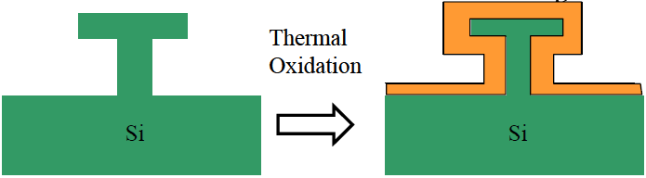
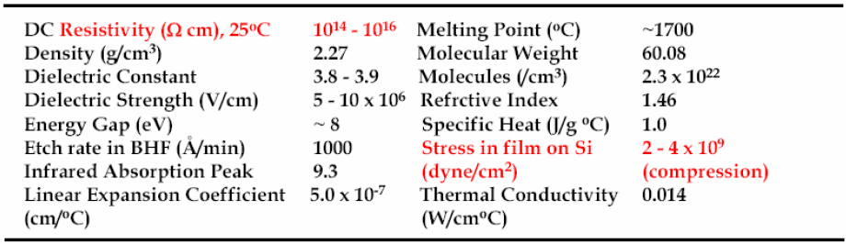
Properties of thermally grown SiO₂
It is amorphous.
Stable, reproducible and conformal SiO₂ growth
Melting point: 1700°C
Density: 2.21 g/cm³ (almost the same as Si that is 2.33 g/cm³)
Crystalline SiO₂ [Quartz] = 2.65gm/cm³
Atomic density: 2.3×10²² molecules/cm³
(For Si, it is 5×10²² atoms/cm³)
Refractive index: n=1.46
Dielectric constant: ε=3.9 (why not =n²?)
Excellent electrical insulator: resistivity ρ > 10²⁰ Ωcm, energy gap E_{g}=8-9 eV.
High breakdown electric field: >10⁷ V/cm
Conformal growth

Slide 3
The Si/SiO₂ interface
Thermal oxide (amorphous)
Si substrate
(single crystal)
The perfect interface between Si and SiO₂ is one major reason why Si is used for semiconductor devices (instead of Ge…)

Slide 4
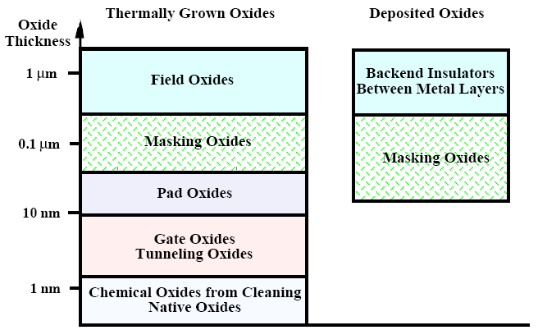
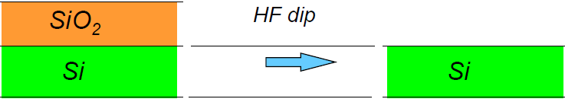
Application of SiO₂ in IC industry
STI
STI: shallow trench isolation
Very good etching selectivity between Si and SiO₂ using HF

Slide 5
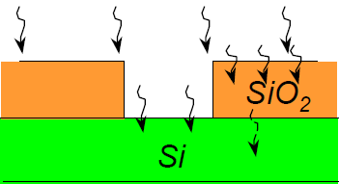
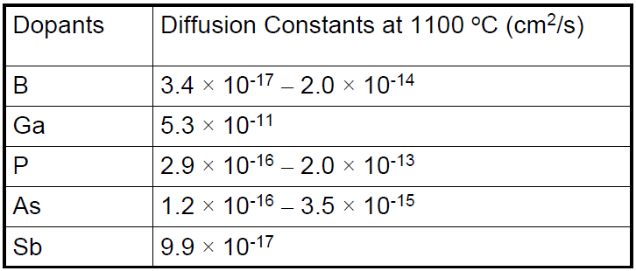
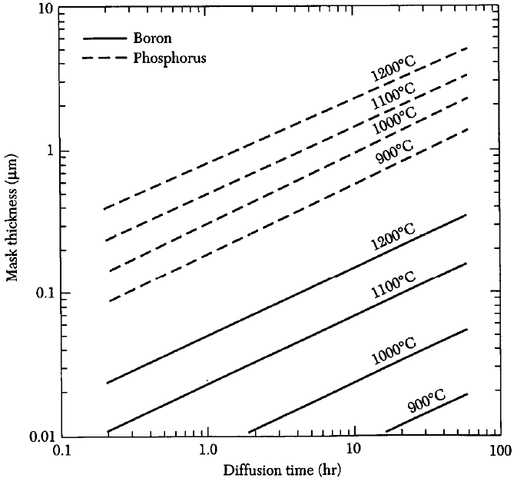
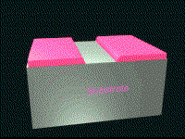
Diffusion mask for common dopants
SiO₂ can provide a selective mask against
diffusion at high temperatures. (D_{SiO2} << D_{si})
Oxides used for masking are ∼0.5-1μm thick.
(not good for Ga)
Mask thickness (μm)
Can also be used for mask against ion implantation
Diffusion time (hr)
SiO₂ masks for B and P

Slide 6
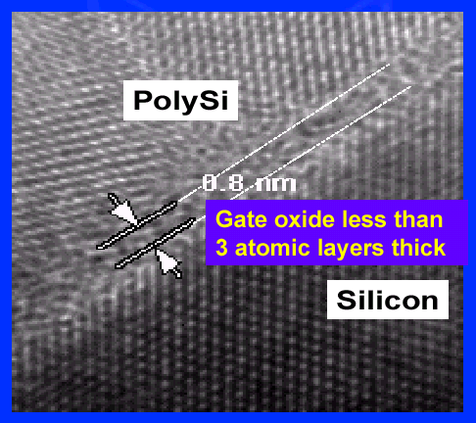
Use of oxide in MOSFET
Gate oxide, only 0.8nm thick!
As insulation material between interconnection levels and adjacent devices
LOCOS: local oxidation isolation; STI: shallow trench isolation

Slide 7
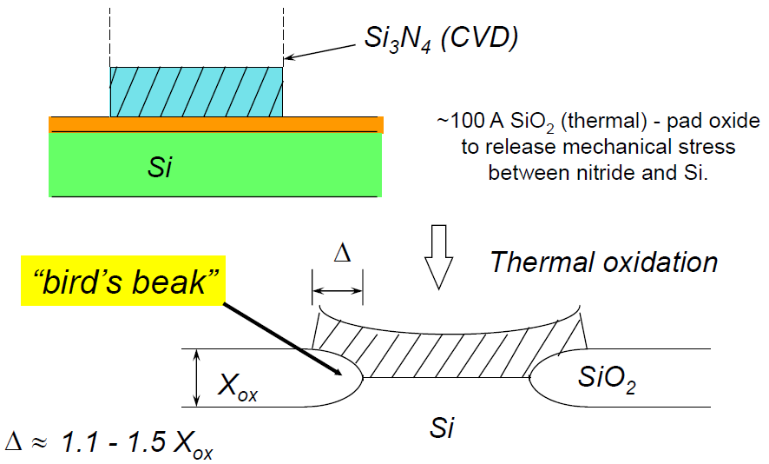
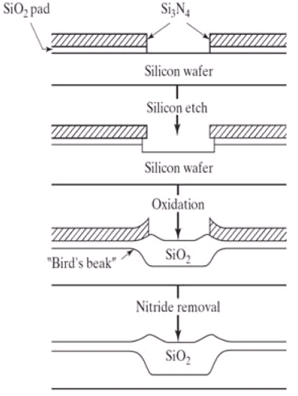
Local Oxidation of Si (LOCOS)
Fully recessed process attempts to minimize bird’s peak.

Slide 8
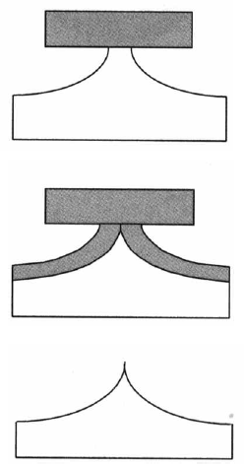
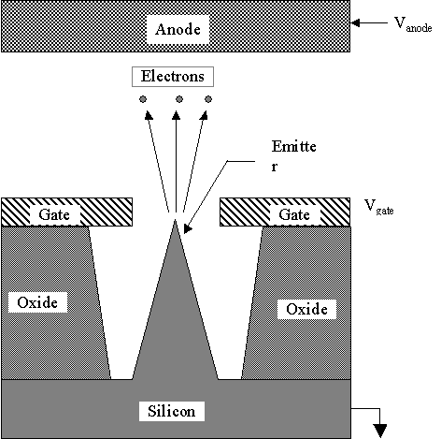
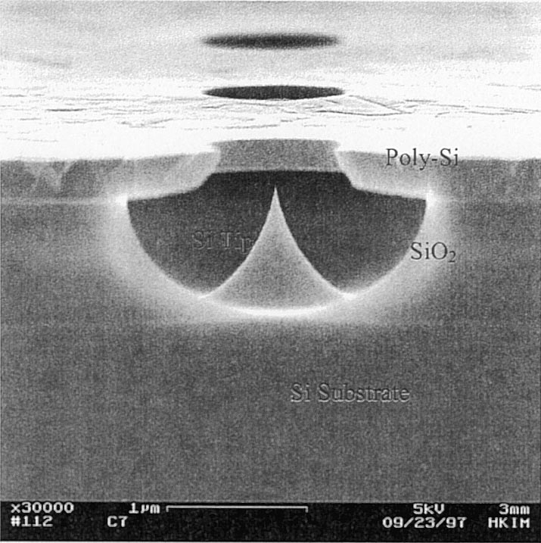
For nanofabrication: oxidation sharpening for sharp AFM tips or field emitters for display
Si
SiO₂
Field emission display (FED)
Ding, “Silicon Field Emission Arrays With Atomically Sharp Tips: Turn-On Voltage and the Effect of Tip Radius Distribution”, 2002.

Slide 9
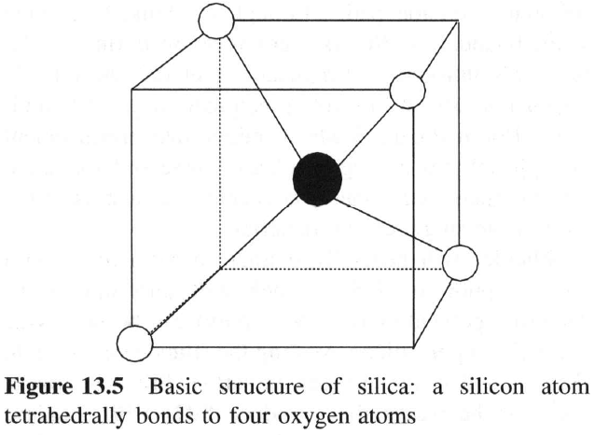
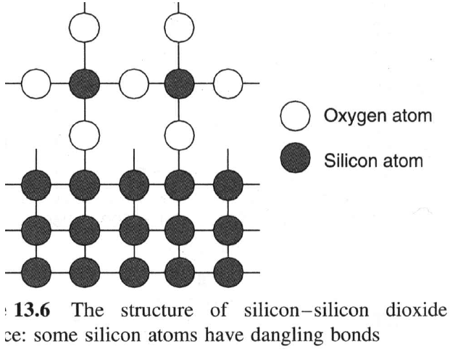
Oxide Structure
Amorphous tetrahedral network
桥联氧
非桥联氧
Bridging oxygen Non-bridging
Basic structure of silica: a silicon atom tetrahedrally bonds to four oxygen atoms
The structure of silicon-silicon dioxide interface: some silicon atoms have dangling bonds.

Slide 10
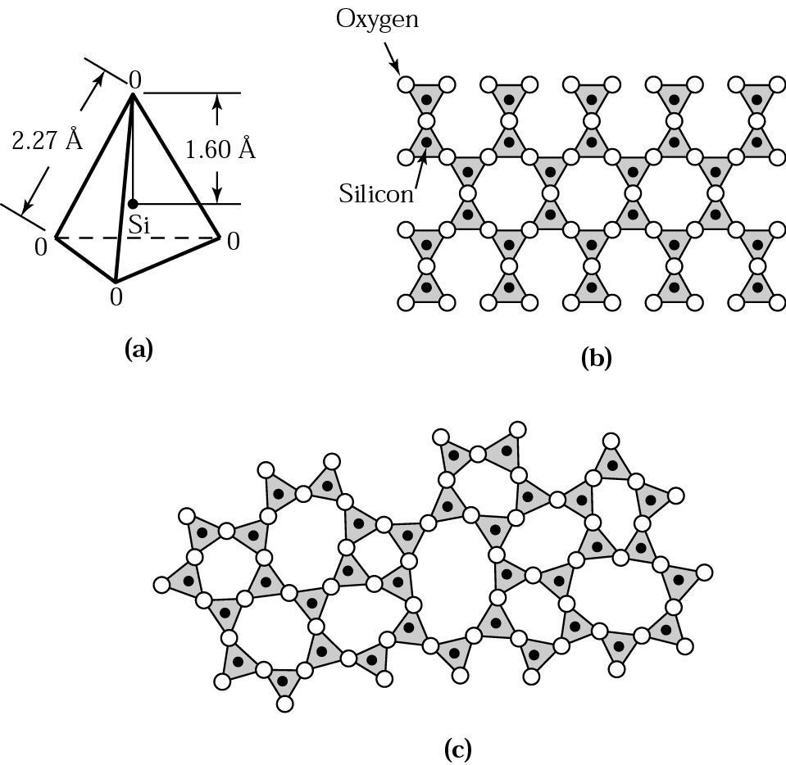
Oxide Structure
Single crystal (quartz)
2.65 g/cm³
Amouphous (thermal oxide). 2.21 g/cm³

Slide 11
Chapter 6 Thermal oxidation and the Si/SiO₂ interface
SiO₂ properties and applications.
Thermal oxidation basics.
Manufacturing methods and equipment.
Measurement methods.
Deal-grove model (linear parabolic model).
Thin oxide growth, dependence on gas pressure and crystal orientation
Cl-containing gas, 2D growth, substrate doping effect .
Interface charges, dopant redistribution.
NE 343 Microfabrication and thin film technology
Instructor: Bo Cui, ECE, University of Waterloo
Textbook: Silicon VLSI Technology by Plummer, Deal and Griffin

Slide 12
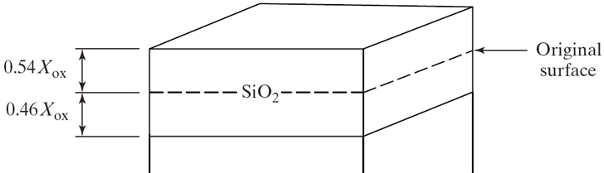
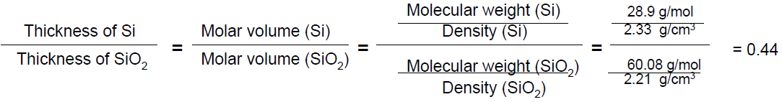
Dry and wet oxidation
Dry oxidation: Si(s) + O₂(g) → SiO₂(s); Wet/steam oxidation: Si(s) + 2H₂O(g) → SiO₂(s) + 2H₂(g)
Both typically 900-1200°C, wet oxidation is about 10× faster than dry oxidation.
Dry oxide: thin 0.05-0.5μm, excellent insulator, for gate oxides; for very thin gate oxides, may add nitrogen to form oxynitrides.
  Wet oxide: thick <2.5 μm, good insulator, for field oxides or masking. Quality suffers due to the diffusion of the hydrogen gas out of the film, which creates paths that electrons can follow.
Room temperature Si in air creates “native oxide”: very thin ∼1-2nm, poor insulator, but can impede surface processing of Si.
Volume expansion by 2.2× (=1/0.46), so SiO₂ film has compressive stress.
Si wafer
X_{ox} is final oxide thickness
= 0.46

Slide 13
Chapter 6 Thermal oxidation and the Si/SiO₂ interface
SiO₂ properties and applications.
Thermal oxidation basics.
Manufacturing methods and equipment.
Measurement methods.
Deal-grove model (linear parabolic model).
Thin oxide growth, dependence on gas pressure and crystal orientation
Cl-containing gas, 2D growth, substrate doping effect .
Interface charges, dopant redistribution.
NE 343 Microfabrication and thin film technology
Instructor: Bo Cui, ECE, University of Waterloo
Textbook: Silicon VLSI Technology by Plummer, Deal and Griffin

Slide 14
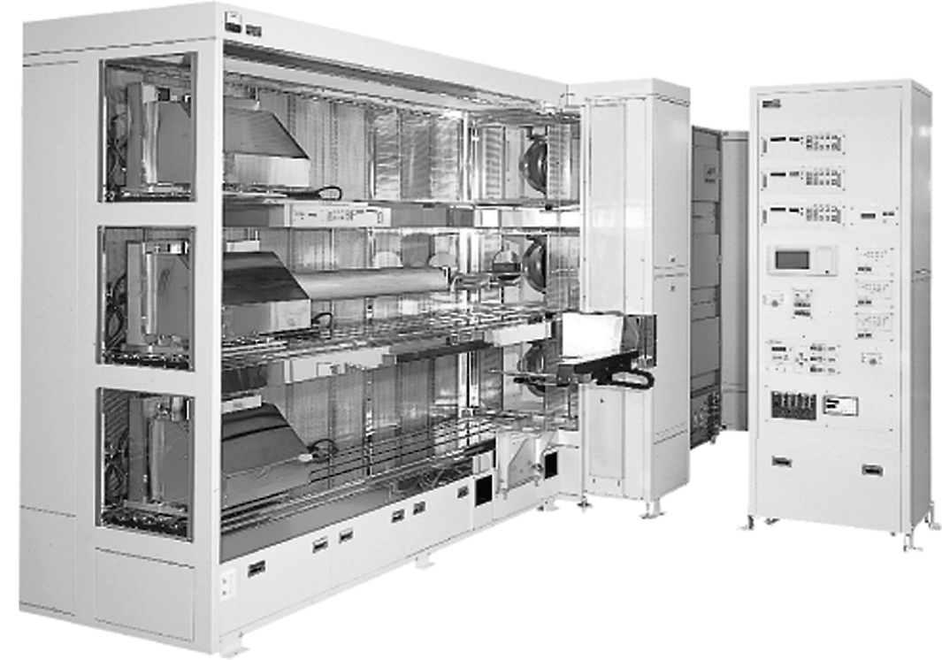
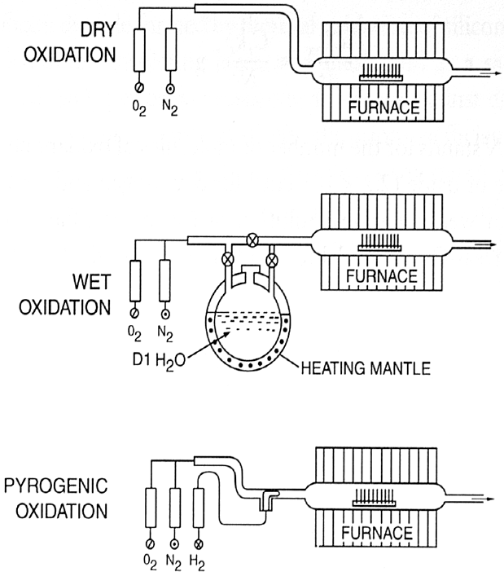
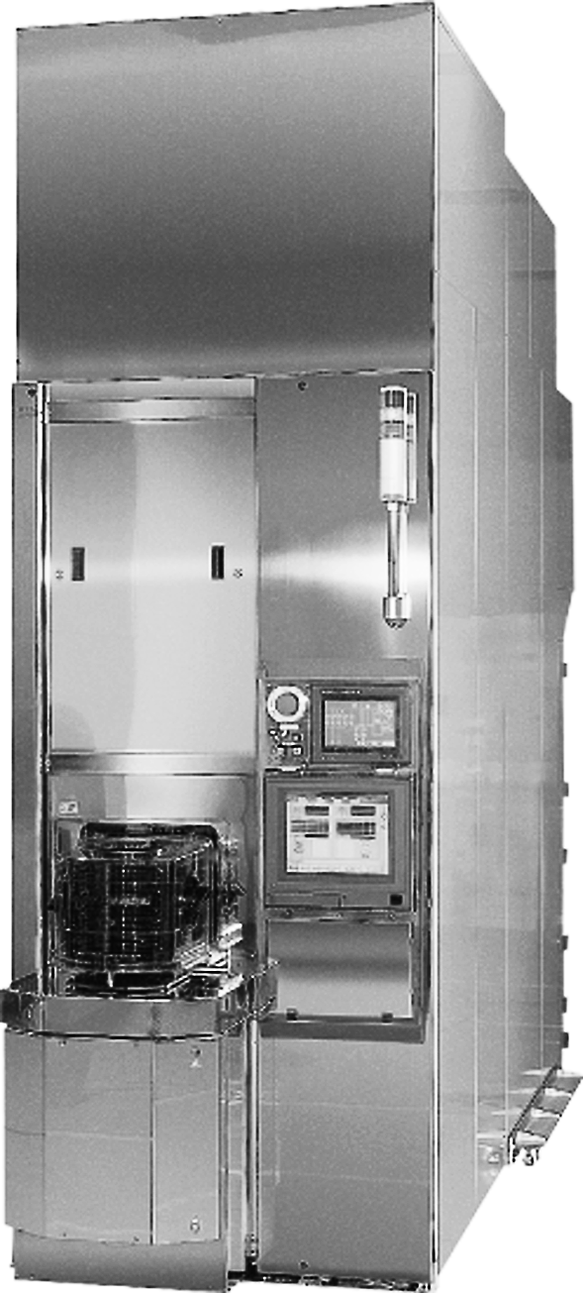
Thermal silicon oxidation methods
A three-tube horizontal furnace with multi-zone temperature control
Vertical furnace
(not popular)
Wet oxidation using H₂ and O₂ is more popular (cleaner) than using H₂O vapor.

Slide 15
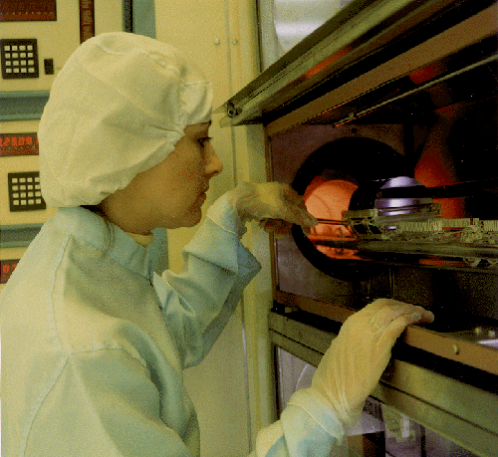
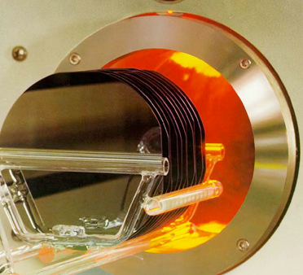
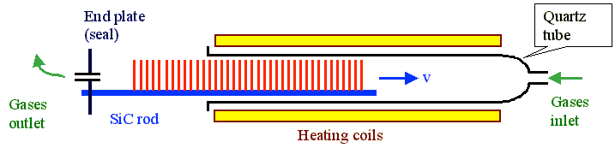
Thermal oxidation equipment
The tubular reactor made of quartz or glass, heated by resistance.
Oxygen or water vapor flows through the reactor and past the silicon wafers, with a typical velocity of order 1cm/s.

Slide 16
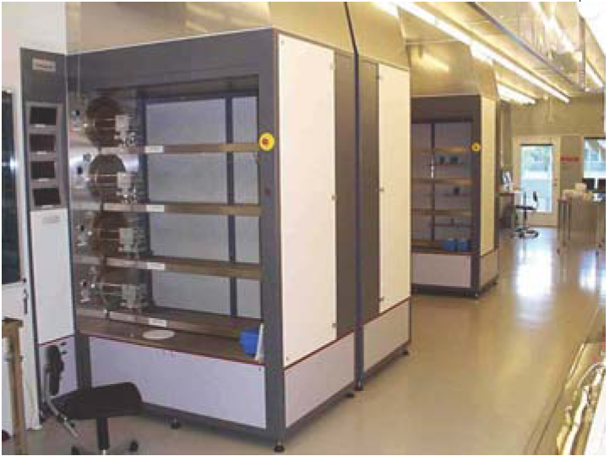
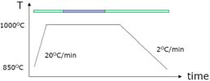
Thermal oxidation in practice
Clean the wafers (RCA clean, very important)
Put wafers in the boat
Load the wafers in the furnace
Ramp up the furnace to process temperature in N₂ (prevents oxidation from occurring)
Stabilize
Process (wet or dry oxidation)
Anneal in N₂. Again, nitrogen stops oxidation process.
Ramp down

Slide 17
Chapter 6 Thermal oxidation and the Si/SiO₂ interface
SiO₂ properties and applications.
Thermal oxidation basics.
Manufacturing methods and equipment.
Measurement methods (mechanical, optical, electrical).
Deal-grove model (linear parabolic model).
Thin oxide growth, dependence on gas pressure and crystal orientation
Cl-containing gas, 2D growth, substrate doping effect .
Interface charges, dopant redistribution.
NE 343 Microfabrication and thin film technology
Instructor: Bo Cui, ECE, University of Waterloo
Textbook: Silicon VLSI Technology by Plummer, Deal and Griffin

Slide 18
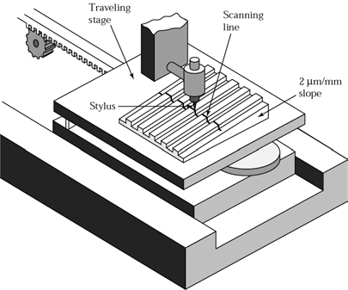
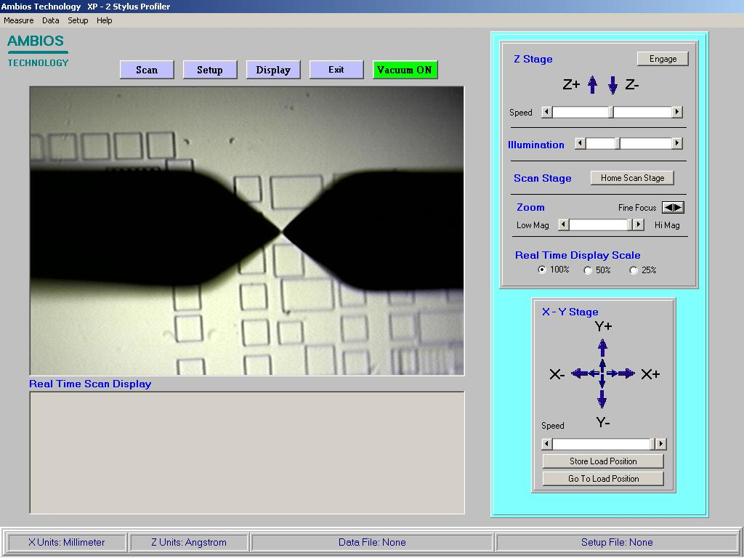
Surface profilometry (Dektak): mechanical thickness measurement
Oxide etched away by HF over part of the wafer and a mechanical stylus is dragged over the resulting step.
Stylus
Mirror image of stylus
stylus
AFM can also be used for thickness measurement.
(AFM: atomic force microscopy)

Slide 19
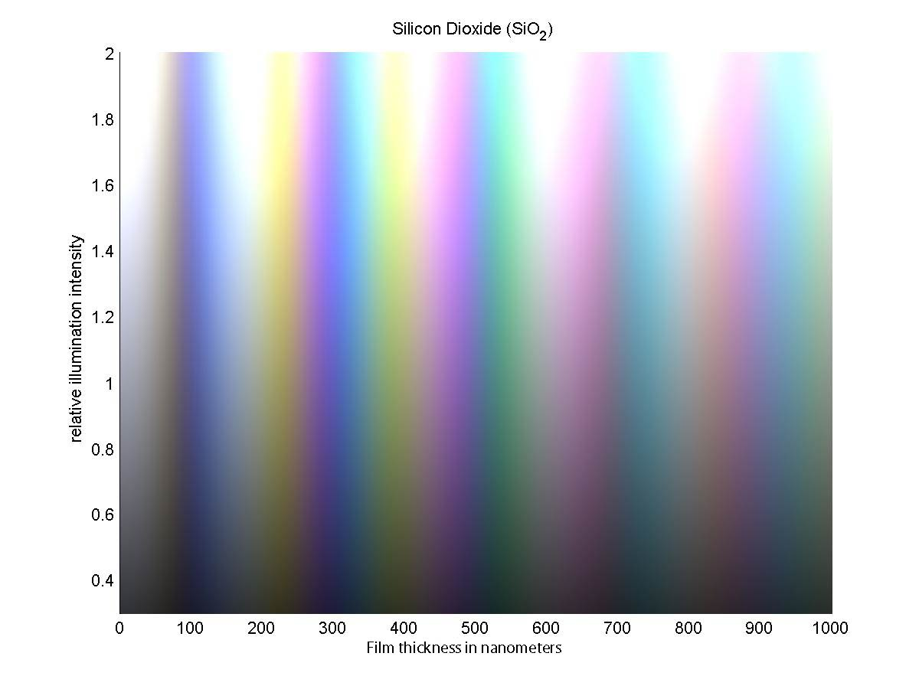
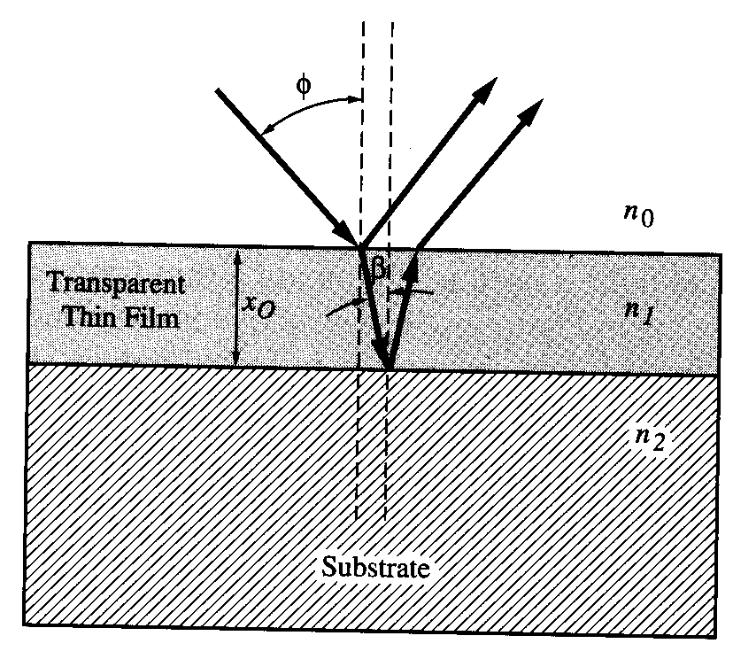
Thickness determination by looking the color
Relative illumination intensity
Film thickness (nm)
Oxide thickness for constructive interference (viewed from above φ=0º) X_{o}=kλ/2n, n=1.46, k=1, 2, 3…
Our eye can tell the color difference between two films having 10nm thickness difference.

Slide 20
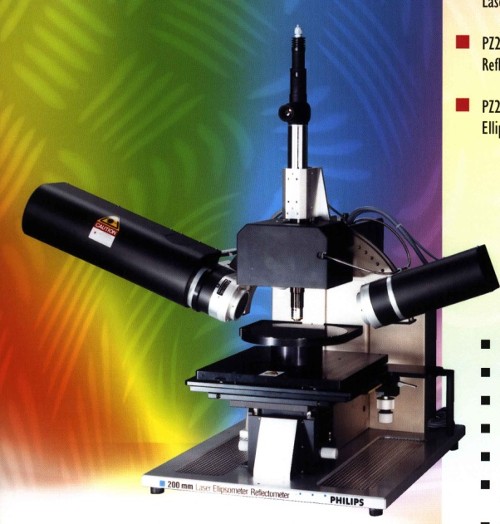
Optical thickness measurement: ellipsometry
Very accurate (1nm accuracy)
After quarter wave plate, the linear polarized light becomes circular polarized, which is incident on the oxide covered wafer.
The polarization of the reflected light, which depends on the thickness and refractive index (usually known) of the oxide layer, is determined and used to calculate the oxide thickness.
Multiple wavelengths/incident angles can be used to measure thickness/refractive index of each film in a multi-film stack.

Slide 21
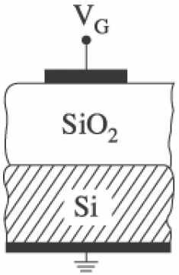
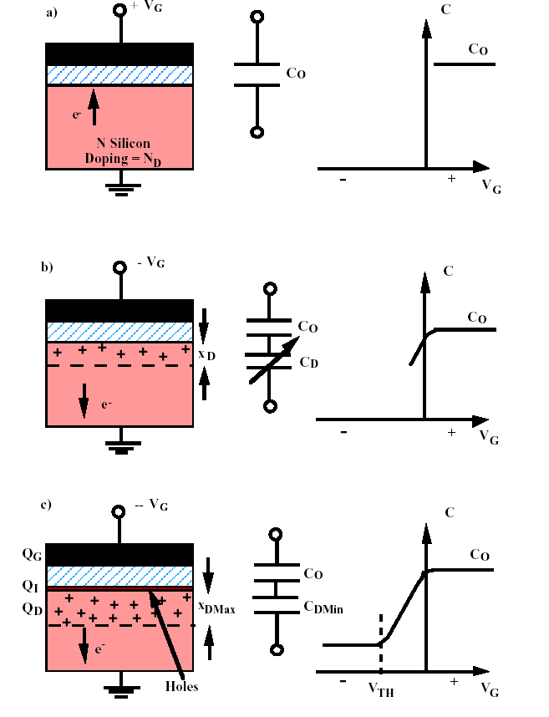
Electrical thickness measurement: C-V of MOSFET
Small AC voltage is applied on top of the DC voltage for capacitance measurement.
Substrate is N-type. Electron is majority carrier, hole is minority carrier.
Accumulation: positive gate voltage attracts electrons to the interface.
Depletion: negative gate bias pushes electrons away from interface. No charge at interface. Two capacitance in series.
Inversion: further increase (negative) gate voltage causes holes to appear at the interface.

Slide 22
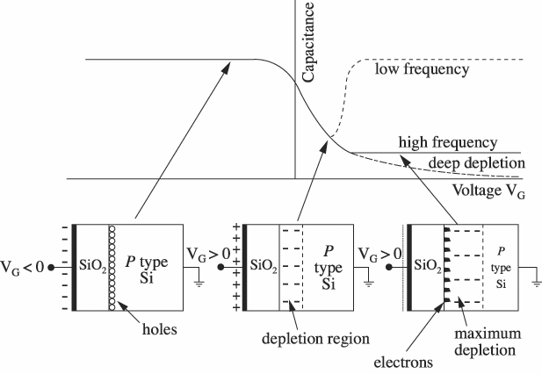



Effect of frequency for AC capacitance measurement
At/after inversion:
For low frequency, (minority) charge generation at the interface can follow the AC field to balance the charge at the gate, so C_{inv}=C_{ox}.
For high frequency, the gate charge has to be balanced by the carrier deep below the interface, so C_{inv}⁻¹ = C_{ox}⁻¹ + C_{Si}⁻¹.
Deep depletion: for high scanning speed (the DC voltage scan fast into large positive voltage), depletion depth X_{d} must increase to balance the gate charge.
P-type substrate here
(previous slide N-type)
Parameter from C-V measurement:
Dielectric constant of Si & SiO₂
Capacitor area
Oxide thickness
Impurity profile in Si
Threshold voltage of MOS capacitor

