Slide 1
Chapter 6 Thermal oxidation and the Si/SiO₂ interface
SiO₂ properties and applications.
Thermal oxidation basics.
Manufacturing methods and equipment.
Measurement methods (mechanical, optical, electrical).
Deal-Grove model (linear parabolic model).
Thin oxide growth, dependence on gas pressure and crystal orientation
Cl-containing gas, 2D growth, substrate doping effect .
Interface charges, dopant redistribution.
Textbook page 313.
NE 343: Microfabrication and thin film technology
Instructor: Bo Cui, ECE, University of Waterloo; http://ece.uwaterloo.ca/~bcui/
Textbook: Silicon VLSI Technology by Plummer, Deal and Griffin

Slide 2
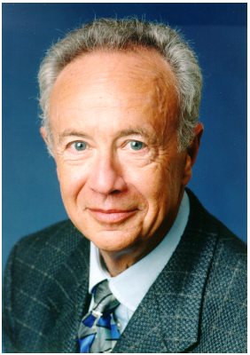
Bruce Deal and Andrew Grove
Time Magazine's Man of the Year (1997)
As a young researcher at Fairchild Semiconductor, he “wrote the book” on SiO₂ growth: the Deal-Grove model.
Grove worked at Fairchild Semiconductor before becoming the fourth employee at the nascent Intel Corporation. He became Intel's president in 1979, its CEO in 1987, and its Chairman and CEO in 1997.
Grove is credited with having transformed Intel from a manufacturer of memory chips into one of the world's dominant producers of microprocessors. During his tenure as CEO, Grove oversaw a 4,500% increase in Intel's market capitalization from $4 billion to $197 billion, making it, at the time, the world's most valuable company.
http://en.wikipedia.org/wiki/Andrew_Grove

Slide 3
Overview
Deal-Grove model: linear-parabolic model for 1D oxide growth (along z-direction) from un-patterned wafer surface.
It is applicable to:
Oxidation temperature 700-1200ºC
Gas pressure at wafer surface 0.1-25 atm.
Oxide film thickness 20-2000nm.
H₂O is for wet oxidation
O₂ for dry oxidation
O gets in or Si gets out for reaction?
Considering dry oxygen molecules as the oxidant species, by radio active tracer, it has been shown that oxidation proceeds by inward movement of O₂ molecules through SiO₂ to the Si − SiO₂ interface where the reaction Si(solid) + O(gas) → SiO₂ takes place.
This forms a contrast with the case of Copper whose oxidation proceeds by the outward motion of the metallic ion and also with the case of anodic oxidation of silicon, where silicon moves outward.

Slide 4
D-G model: three flux at equilibrium
F (oxidant flux): number/(cm²-s); C (oxidant concentration): number/cm³
Gas diffusion Solid state diffusion SiO₂ formation
Concentration of main gas flow
Concentration at (inside) the oxide surface. C_{o} ≠ C_{s}.
C_{s} > C_{o}
F₁: flux of oxidizing species transported from the gas phase to the gas-oxide interface.
F₂: flux across the existing oxide toward the silicon substrate.
F₃: flux reacting at the SiO₂ interface (this term is not strictly flux/flow).
In steady state, the three fluxes are equal.

Slide 5
D-G model: three flux at equilibrium
h_{g} is mass transfer coefficient in cm/sec.
For ideal gas, P_{S}V=NK_{B}T, so C_{s}=N/V=P_{s}/KT.
According to Henry’s law, the concentration of a gas species dissolved in a solid is proportional to the partial pressure of that species at the solid surface. So C_{o}=HP_{s}, where H is Henry’s constant.
(this is something similar to the law of segregation of dopant at an interface)
Define h=h_{g}/HkT, C*=HkTC_{G}=HP_{G}，then

Slide 6
D-G model: three flux at equilibrium
Using Fick’s law of diffusion, D (cm²/sec) is oxidant diffusivity in the oxide, x is oxide thickness, then
The effective diffusivities of both O₂ and H₂O are on the same order (about 5×10³μm²/hr at 1100ºC).
The rate of reaction should be proportional to the oxidant concentration at the Si/SiO₂ interface C_{I}, K_{s} interface reaction rate constant (cm/sec), then
In steady state, the three fluxes are equal.
Now we have two equations to solve two unknown C_{O} and C_{I}.

Slide 7
Deal-Grove model
This means the gas absorption rate at the oxide surface is much faster than chemistry occurring at the Si/SiO₂ interface.
k_{s}x/D≅1 corresponds to oxide thickness 50-200 nm.
Figure 6-16
k_{s}x/D << 1, reaction rate limited
k_{s}x/D >> 1, diffusion limited

Slide 8
Deal-Grove model
Assume N₁ as the number of oxidant molecules incorporated per unit volume of oxide grown.
For O₂ (dry) oxidation, N₁=2.2×10²² cm⁻³; for H₂O (wet) oxidation, N₁=4.4×10²² cm⁻³ (2× that of dry, since H₂O has only one oxygen atom).
Then the oxidation rate R (F is flux, F=F₁=F₂=F₃=K_{S}C_{I}, unit is number/(cm²⋅s); unit for R is cm/s).
Let B=2DC*/N₁，A=2D(1/k_{s}+1/h),
B/A≅C*k_{s}/N₁,(h>>k_{s})
X_{i} account for any oxide present at the start of the oxidation.

Slide 9
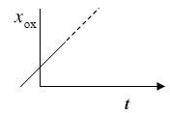
Deal-Grove model
Rewrite the above equation,
B =2DC*/N₁—parabolic rate constant, contribution of flux F₂.
B/A ≅C*k_{s}/N₁—linear rate constant, contribution of flux F₃.
Two limiting forms, when one of the two terms dominates.
For short time/thin oxide, linear. For long time/thick oxide, parabolic.
x₀
t
τ

Slide 10
Determine B and B/A from experiment
It is difficult to calculate B and B/A, mainly because we don’t know the K_{S} value.
The oxidation rate depends on the processes of Si-Si bond breaking, Si-O bond formation, and possibly O₂ or H₂O dissociation. All of these effects and others are lumped into K_{S}, the interaction rate constant (cm/sec).
So B and B/A is determined experimentally.
Assume τ=0?
Figure 6-17 Extraction of rate constants from oxide thickness versus time experimental data.

Slide 11


Arrhenius expression for B and B/A
D-G model is applicable for: oxidation on flat un-patterned surface, lightly doped substrates, using simple O₂ or H₂O ambient, and when the oxide thickness is larger than about 20nm.
Experimentally it is found:
B=2DC*/N₁∝D, D depends on T exponentially.
B/A≅C*k_{s}/N₁∝k_{s}. From table below, E₂ is independent of whether O₂ or H₂O oxidation, as well as crystalline direction – E₂ represents a fundamental process only related to the substrate (e.g. Si-Si bond breaking).
Table 6.2 Rate constants describing (111) silicon oxidation kinetics at 1 atm total pressure.
For the corresponding values for (100) silicon, all C₂ values should be divided by 1.68.
O₂ bubble through 95°C H₂O
Mostly H₂O, but some O₂, no longer popular
H₂+O₂ reacts to form H₂O
H₂O only, more popular now

Slide 12
Arrhenius expression for B and B/A

Slide 13
Calculated dry oxidation rate from D-G model
x_{i}＝0
Figure 6-19
(100) silicon. The initial fast oxidation for the first ∼20nm is not included (i.e. x_{i}, τ=0).

Slide 14
Calculated wet (H₂O) oxidation rate from D-G model
x_{i}＝0
Figure 6-20

Slide 15
Dry vs. wet oxidation
Wet oxidation: a mixture of O₂ and H₂O (O₂ bubble through hot water) used as oxidant.
Advantage: higher growth rate than dry oxidation.
Reason for higher rate: much larger solubility in oxide (Henry’s constant H) for H₂O compared with O₂. C*(bulk concentration, =HP_{G}) for H₂O: 3x10¹⁹/cm³; and for O₂: 5x10¹⁶/cm³.
Disadvantage: oxides grown wet are less dense, with a more open structure, because out-diffusion of H₂ creates ‘voids’ along its path.
Thus wet oxidation is typically used when a thick oxide is required that will not be subjected to any significant electrical stress that may lead to electrical breakdown.
Dry oxidation: slow, higher quality than wet oxidation, used for gate oxide.
Note that dry oxidation ‘appears’ to always have some initial oxide present (i.e. x_{i}≠0).

Slide 16
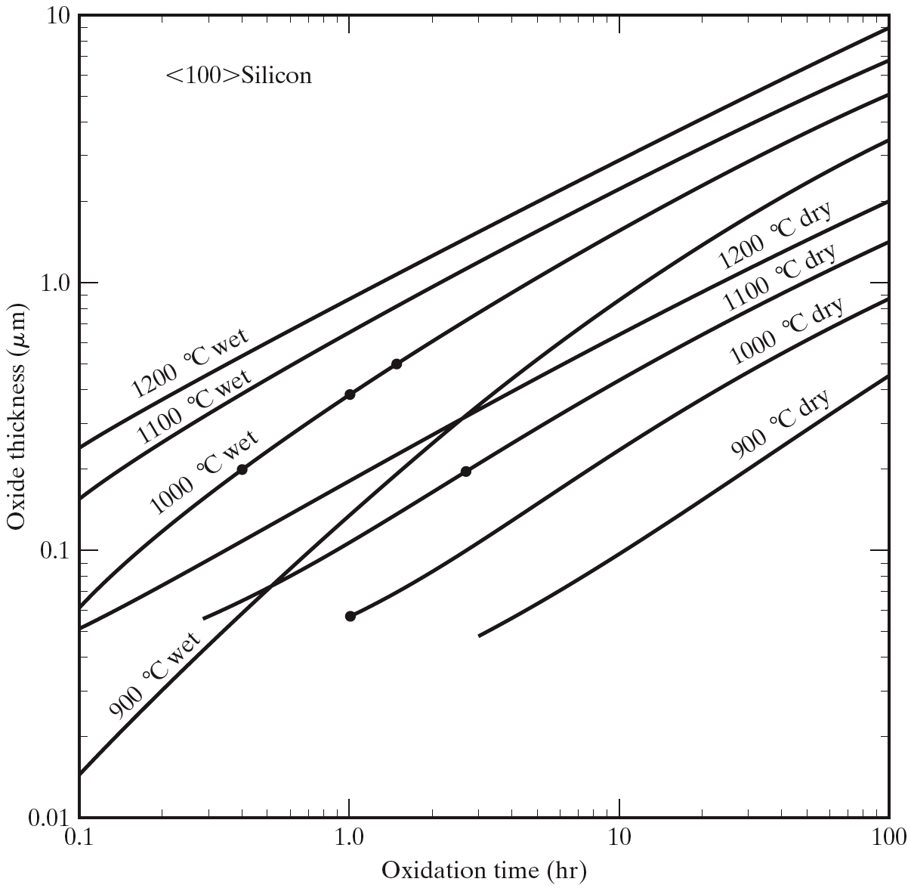
Thermal oxidation example
A <100> silicon wafer has a 2000-Å oxide on its surface
How long did it take to grow this oxide at 1100º C in dry oxygen?
The wafer is put back in the furnace in wet oxygen at 1000º C. How long will it take to grow an additional 3000 Å of oxide?
According to the figure, it would take 2.8hr to grow 0.2μm oxide in dry oxygen at 1100º C.
The total oxide thickness at the end of the oxidation would be 0.5 μm which would require 1.5hr to grow if there was no oxide on the surface to begin with. However, the wafer “thinks” it has already been in the furnace 0.4hr (to grow the first 200nm oxide). Thus the additional time needed to grow the 0.3 mm oxide is 1.5-0.4 = 1.1 hr.
Graphic solution
Notes:
This problem is also solved numerically, that slide is put into leftover slides.

Slide 17
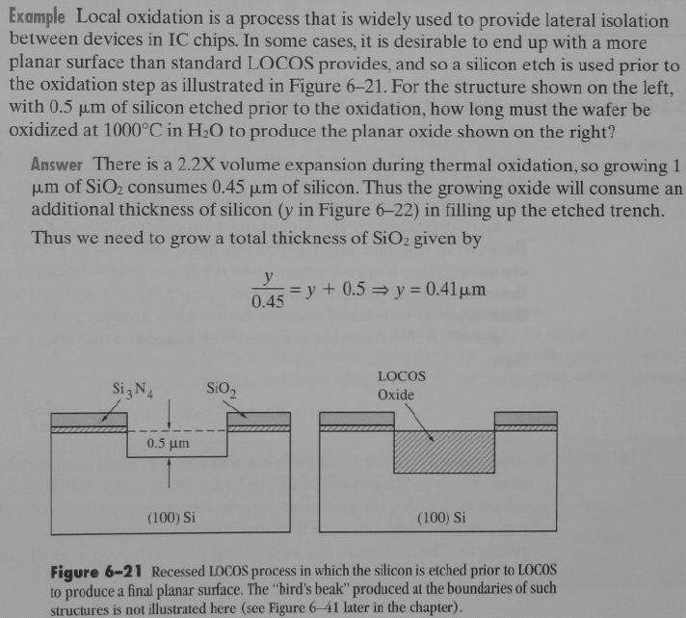
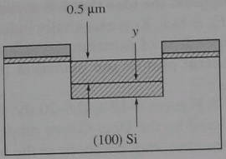
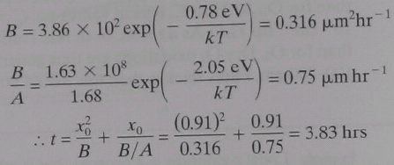
Thus we need to grow a total of 0.91μm of SiO₂.
At 1000ºC in H₂O we have

