Slide 1
Chapter 6 Thermal oxidation and the Si/SiO₂ interface
SiO₂ properties and applications.
Thermal oxidation basics.
Manufacturing methods and equipment.
Measurement methods (mechanical, optical, electrical).
Deal-Grove model (linear parabolic model).
Thin oxide growth, dependence on gas pressure and crystal orientation.
Cl-containing gas, 2D growth, substrate doping effect .
Interface charges, dopant redistribution, rapid thermal oxidation.
NE 343: Microfabrication and thin film technology
Instructor: Bo Cui, ECE, University of Waterloo; http://ece.uwaterloo.ca/~bcui/
Textbook: Silicon VLSI Technology by Plummer, Deal and Griffin

Slide 2
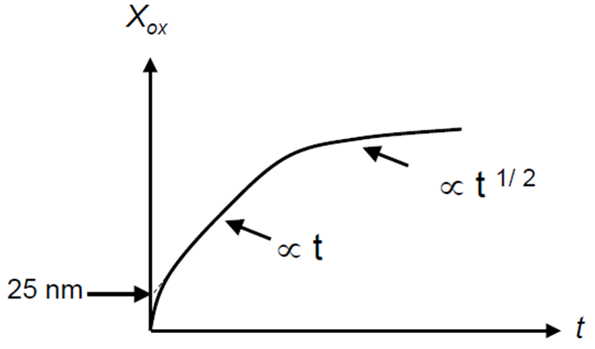
Thin oxide growth
The Deal-Grove model provides excellent agreement with experimental data except for thin (<20nm) SiO₂ grown in dry O₂.
When using the D-G equations for thick oxides grown in O₂ on bare Si (X_{i}=0), one needs to “assume” X_{i}=25nm.
Or equivalently, one can use τ (≠0) to correct the Deal-Grove model to compensate for the excess growth that occurs in the initial growth regime.
D-G (τ= 40hr)
∼25nm
D-G (τ= 0)

Slide 3
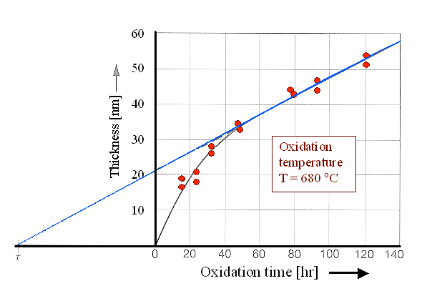
Mechanism for initial oxidation regime
Models to explain the excess growth of thin oxidation
An electric field exists across oxide that enhances diffusion (if diffusing species is O₂⁻, but it is not.) during early states of oxidation.
Thin micro-channels in oxide aid in the movement of O₂ to the Si surface.
Mismatch in thermal expansion coefficients of oxide and Si causes stress in oxide and this stress may enhance the diffusivity of the oxidizing species.
But NONE of these mechanism gained wide acceptance. The exact mechanism is still unknown.

Slide 4
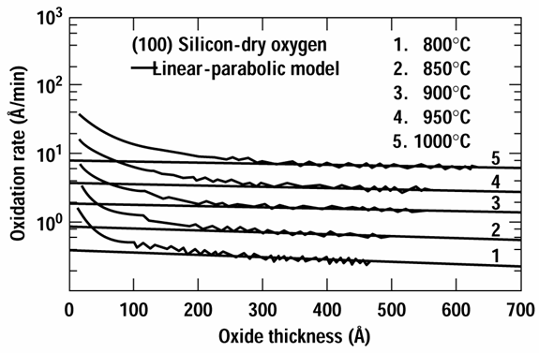
Model of Massoud et. al.
For D-G model:
Massoud model:
C=C⁰exp(-E_{A}/kT)
C⁰≅3.6×10⁸ μm/hr
E_{A} ≅ 2.35 eV
L ≅ 7 nm
For X_{o}>>7nm, Massoud model approaches DG model.

Slide 5
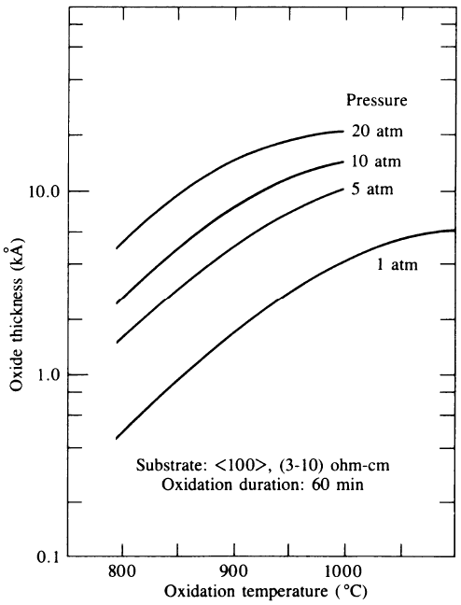
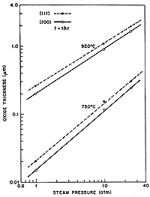
High gas pressure oxidation
(111) --------
(100)
t=1hr
Oxide thickness (μm)
920ºC
750ºC
steam
Steam pressure (atm)

Slide 6
High gas pressure oxidation
High pressure increases the oxide growth rate, by increasing the linear and parabolic rate constants, which arises from the increased C* (=HP_{G}).
Both B/A and B is proportional to P_{G}, the gas pressure.
Up to 25atm, to reduce temperature/thermal budget in thick oxide fabrication
  ΔP=1atm leads to ΔT=-30ºC for the same oxidation rate.
  Or, to grow a given oxide thickness at same temperature, time can be reduced.
However, still not used in the VLSI fabrication, due to safety concerns at high pressure, as well as reduced film thickness uniformity.
Experiment shows that:
For H₂O oxidation, the growth rate is proportional to P_{G}.
For O₂ oxidation, the relationship is not linear.
n=0.7 – 0.8
Here “i” indicate the value at 1atm.
Wet oxidation Dry oxidation

Slide 7
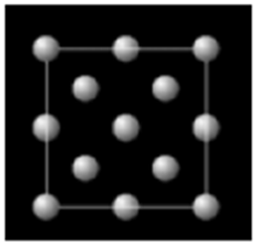
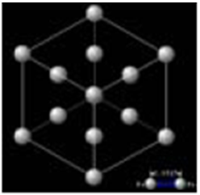
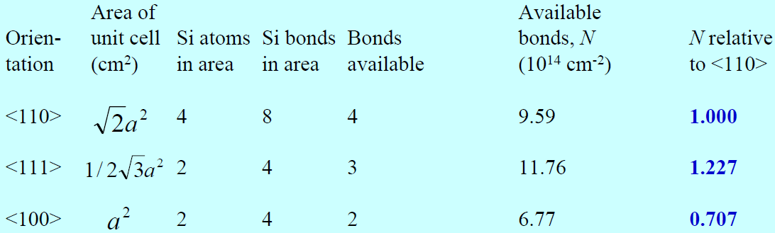
Dependence on crystal orientation
Oxidation rate depends on the availability of reaction sites on the silicon substrate.
Oxidation on the <111> crystal plane occurs at a higher rate because there are a higher number of surface atoms/chemical bonds than the <100> plane.
Most IC made of <100> silicon.

Slide 8
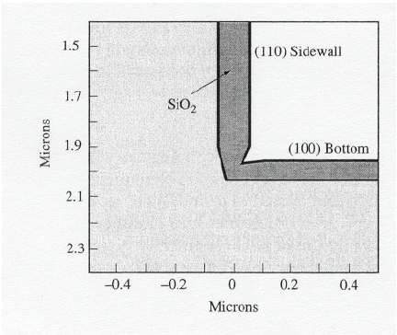
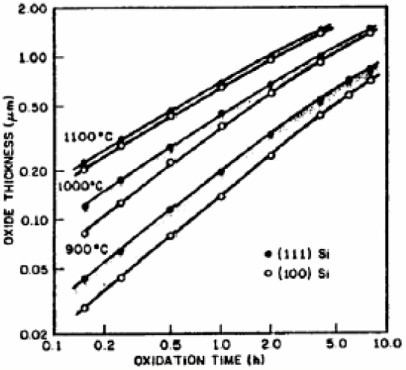
Dependence on crystal orientation
K_{S0} is a constant, roughly proportional to the number of available Si bonds for reaction per unit area.
Interface reaction rate constant K_{s} (cm/sec) depends on crystal orientation.
So the liner grown rate B/A depends on crystal orientation. (B/A)₁₁₁= 1.68 (B/A)₁₀₀
(1.68 ≠ 1.227/0.707=1.735, see previous slide)
The parabolic rate constant B is NOT dependent on crystal orientation.
So this effect decreases for high temperature and/or long time oxidation when oxide become thick.
Figure 6-27
Simulation, (100) Si, in H₂O at 900°C for 30 min

Slide 9
Chapter 6 Thermal oxidation and the Si/SiO₂ interface
SiO₂ properties and applications.
Thermal oxidation basics.
Manufacturing methods and equipment.
Measurement methods (mechanical, optical, electrical).
Deal-Grove model (linear parabolic model).
Thin oxide growth, dependence on gas pressure and crystal orientation.
Cl-containing gas, 2D growth, substrate doping effect .
Interface charges, dopant redistribution, rapid thermal oxidation.
NE 343 Microfabrication and thin film technology
Instructor: Bo Cui, ECE, University of Waterloo
Textbook: Silicon VLSI Technology by Plummer, Deal and Griffin

Slide 10
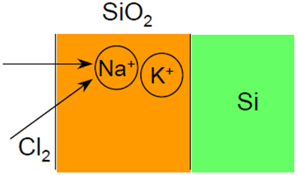

Oxidation using Cl-containing gas mixture
Addition of Cl (1-3%) bearing species to oxidation ambient leads to:
Faster oxide growth. Both B/A and B increases, because bond energy of Si-O is 4.25eV, Si-Cl is 0.5eV, so Cl₂ reacts with Si first to form Si-Cl, which then reacts with O₂ to form SiO₂. Here Cl₂ is a kind of catalyst.
Cleaner oxide, less metallic contamination, since Cl is a metal getter. Most heavy metal atoms react with Cl to form volatile metal chloride. Metallic contaminants originate from heating elements and insulation around the fused silica flow tube in which the oxidation is done.
Enhanced dielectric strength, reduced oxide density, improved Si/SiO₂ interface with lower interface state density, thus improved device performance.
Chlorine species:
Anhydrous chloride (CI₂)
Anhydrous hydrogen chloride (HCI)
Trichloroethylene – TCE (C₂HCl₃)
Trichloroethane – TCA (C₂H₃Cl₃)

Slide 11

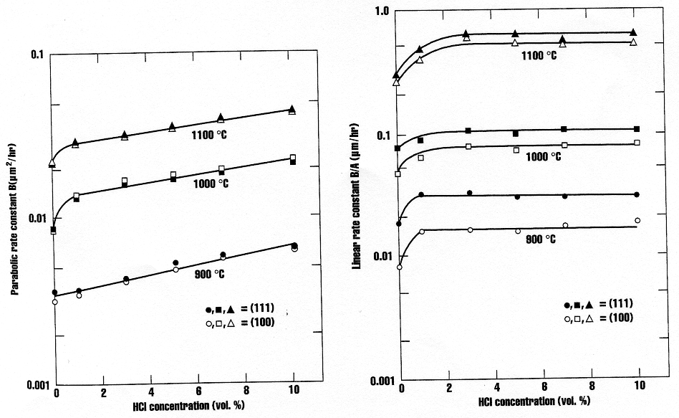
Oxidation using Cl-containing gas mixture
The generated H₂O makes the growth B faster (?)
Parabolic rate constant B (μm²/hr)
Linear rate constant B/A (μm/hr)
HCl concentration (vol. %)
HCl concentration (vol. %)

Slide 12
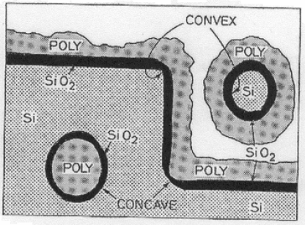
Two dimensional oxidation
Experiment shows that:
Oxidation is slower for convex or concave corners.
Concave corner is even slower than convex corner.
The smaller the curvature radius is, the slower.
More serious for low temperature oxidation, no effect for high temperature 1200ºC (when oxide can “flow”).
Figure 6-29
Experiment Drawing to show the structure

Slide 13
Fabrication steps for the structure in previous slide
Etch Si ring by reactive ion etching.
Side view
Grow oxide and deposit poly-silicon
Polish

Slide 14
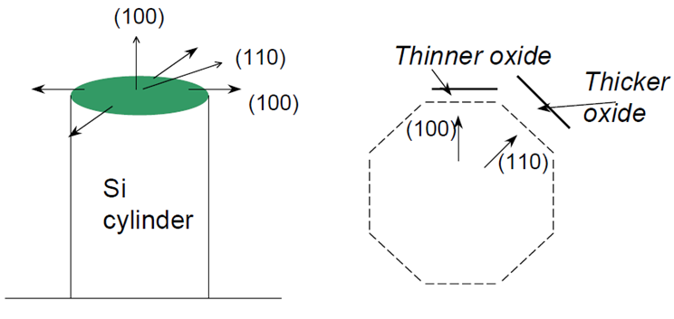
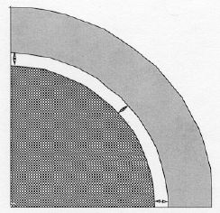
Two dimensional oxidation mechanism
Several physical mechanisms are important in explaining these results.
Crystal orientation dependant rate.
2D oxidant diffusion (different from 1D).
Stress due to volume expansion (we know when Si oxidizes, it expands). As the oxide grows, the “newly” formed oxide pushes out the “old” oxide which rearranges itself through viscous flow. Stress occurs typically on curved surfaces.
To model the stress effects, Kao et. al. suggested modifying the Deal Grove parameters.
Newly grown
SiO₂
SiO₂
Si
Top view

Slide 15
Effect of stress
σ_{n} and σ_{t} are stress along normal and tangential direction.
P is the hydrostatic pressure in the growing oxide.
V_{R}, V_{T} , V_{D} and V_{S}(≈0) are volume fitting parameters.
Sheer stress in oxide
Viscosity of SiO₂
Stress-independent viscosity
(You are not required to remember or well understand those equations)

Slide 16
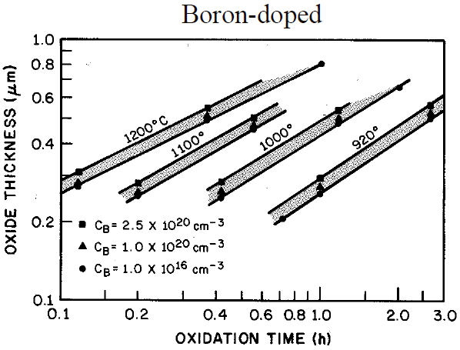
Dopant dependence
Common Si dopants all tend to enhance oxidation rate of Si when present in the substrate in high concentrations.
The effect is particularly important at lower temperatures and for thinner oxides, and is more important for N⁺ doping than P⁺ doping.
The oxidation rate depends on:
The dopant concentration in SiO₂ for diffusion controlled oxidation (B dominates).
The dopant concentration at Si surface for reaction controlled oxidation (B/A dominates).
B segregates into oxide, weakens SiO₂ bond structure, increases oxidant diffusivity D.

Slide 17
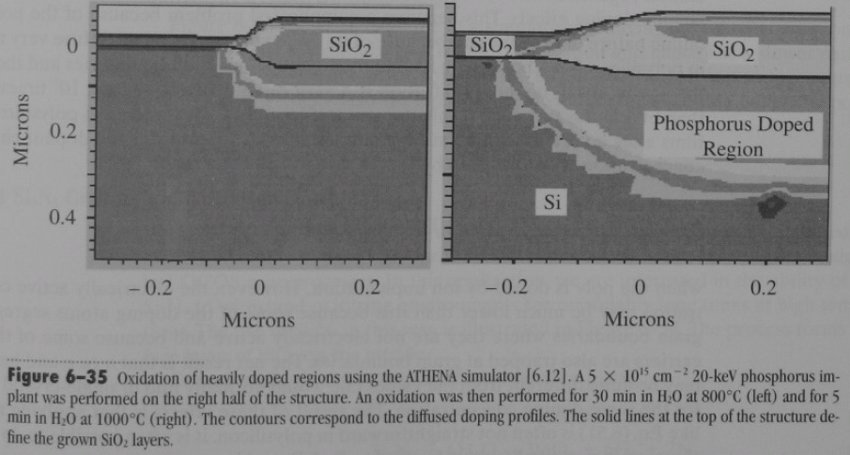
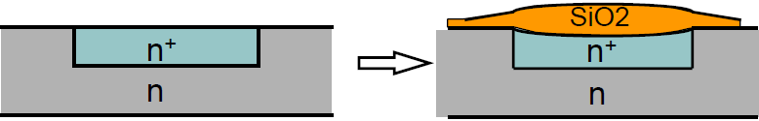
Dopant dependence: phosphorus
Phosphorous piles up at Si surface, leads to more vacancies in Si (oxidation process need space/vacancies), enhances oxidation rate in the reaction controlled regime (increase k_{s}).
Linear rate coefficient increases rapidly for surface doping levels greater than 10²⁰/cm³.
Parabolic rate coefficient B shows only modest increases.
5× thicker for the heavily doped region (right side) than lightly doped region (left side)
2× thicker

Slide 18
Chapter 6 Thermal oxidation and the Si/SiO₂ interface
SiO₂ properties and applications.
Thermal oxidation basics.
Manufacturing methods and equipment.
Measurement methods (mechanical, optical, electrical).
Deal-Grove model (linear parabolic model).
Thin oxide growth, dependence on gas pressure and crystal orientation.
2D growth, Cl-containing gas, substrate doping effect.
Interface charges, dopant redistribution, rapid thermal oxidation.
NE 343 Microfabrication and thin film technology
Instructor: Bo Cui, ECE, University of Waterloo
Textbook: Silicon VLSI Technology by Plummer, Deal and Griffin

Slide 19
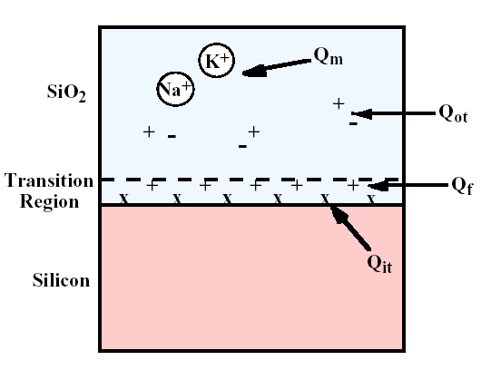
Oxide charge definitions
Interface trapped charge (Q_{it}): located at Si/SiO₂ interface.
Fixed oxide charge (Q_{f}): positive charge located within 3nm of Si/SiO₂ interface.
Oxide trapped charges (Q_{ot}): associated with defects in the SiO₂.
Mobile ionic charges (Q_{m}): result from contamination from Na or other alkali ions.

Slide 20
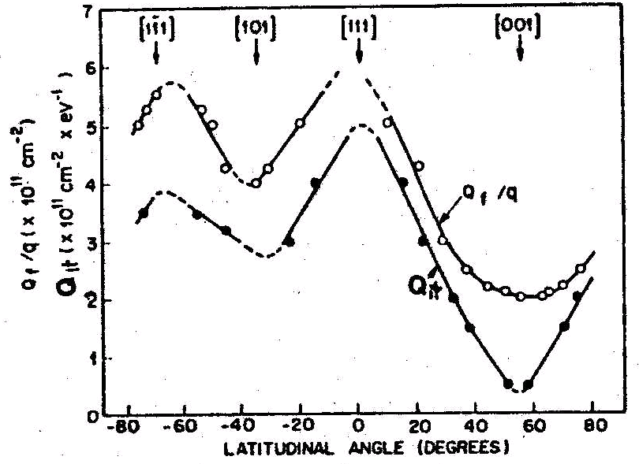
Fixed oxide charges (Q_{f})
Located in the oxide within approximately 3nm of the SiO₂/Si interface.
Q_{f} cannot be charged or discharged easily (unchanged during device operation), and it is reproducible/predictable.
It is positive charge, with density 10⁹-10¹¹/cm².
It is due to incomplete oxidation of Si.
Q_{f} depends on temperature, smaller for higher temperature.
Smaller Q_{f} for faster cooling or cooling down in inert gas N₂ or Ar.
Addition of Cl-containing gas also reduces Q_{f}.
Q_{f} <111> : Q_{f}<110> : Q_{f} <100>=3 : 2 : 1
≡Si·
This is why IC uses <100> Si.

Slide 21
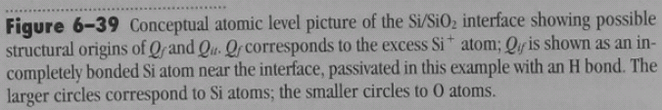
Interface trapped charge (state) Q_{it}
Energy of those interface states are within the band gap, so Q_{it} can be positive, negative or neutral, depending on bias voltage. (i.e. those states can be filled with electrons or holes)
They originate from structural defects related to the oxidation process, metallic impurities, and bond-breaking processes (dangling bond ≡Si·).
It has the same origin as Q_{f}, so high Q_{f} always means high Q_{it}.
Low temperature hydrogen (“forming gas”, 10% H₂ + 90% N₂) anneal at 400-450ºC after metallization process effectively neutralizes most interface-trapped charges.

Slide 22
Mobile ionic charge Q_{m}
Mobile ion charges (Q_{m}) are attributed to alkali ions such as Na, K, and Li, as well as negative ions and heavy metals.
It can shift MOSFET threshold voltage and cause device stability problems.
It can be anywhere in the oxide layer, can move at high temperature or bias voltage.
They originate from processing materials, chemicals, ambient, or handling.
Common techniques employed to minimize Q_{m} include:
  Cleaning the furnace tube in a chlorine ambient
  Addition of cl-containing gas during oxidation
  Gettering with phospho-silicate glass (PSG) to replace quartz tube
  Using masking layers such as Si₃N₄ to prevent the contaminants from getting into the oxide.
It was a big problem in 1960s, nowadays no longer a serious issue.

Slide 23
Oxide trapped charge (state) Q_{ot}
Oxide-trapped charges (Q_{ot}) may be positive or negative, due to holes or electrons being trapped in the bulk of the oxide.
It is caused by broken Si-O, Si-H or Si-OH bonds, due to ionization irradiation and other energetic processes during evaporation (generate x-ray for e-beam evaporation), sputtering (plasma), RIE and ion implantation.
They can be annealed out by low-temperature (300ºC) treatment in H₂ or inert gas.
1000ºC dry oxidation improves oxide structure and make it less susceptible to irradiation.
Oxide can also be protected from irradiation by covering with Al₂O₃ and Si₃N₄ that are resistant to irradiation.
Q_{ot} received more attention in recent years because, as the device shrinks, the electric field within the oxide is increased. The high field may cause electrons to inject to the traps in the oxide (charge trapping), which shifts the threshold voltage.

Slide 24
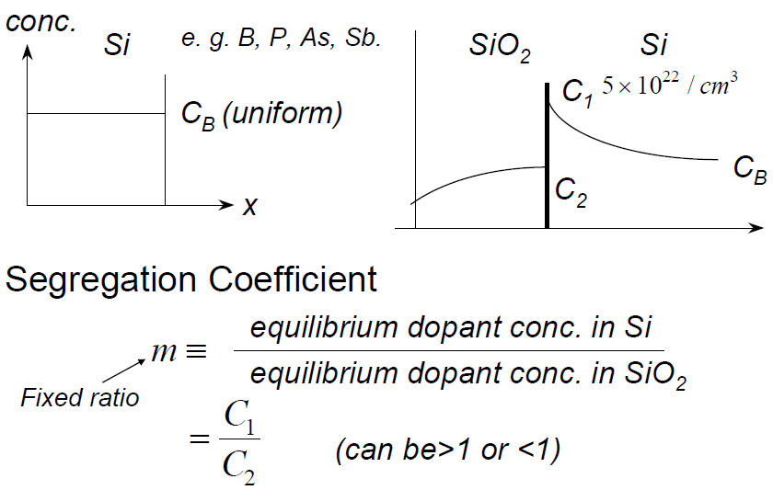
Dopant re-distribution during oxidation
The ratio of the equilibrium concentration of the impurity in silicon to that in SiO₂ at the interface is called the equilibrium segregation coefficient.
Two additional factors influence the redistribution process:
  The diffusivity of the impurity in the oxide (if large, the dopant can diffuse through the oxide rapidly, thereby affecting the profile near the Si-SiO₂ interface).
  The rate at which the interface moves with respect to the diffusion rate.

Slide 25
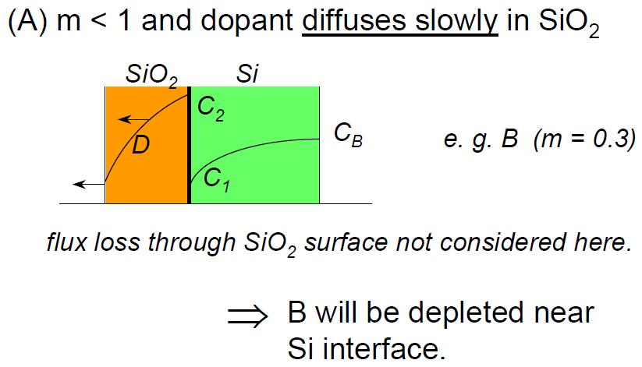
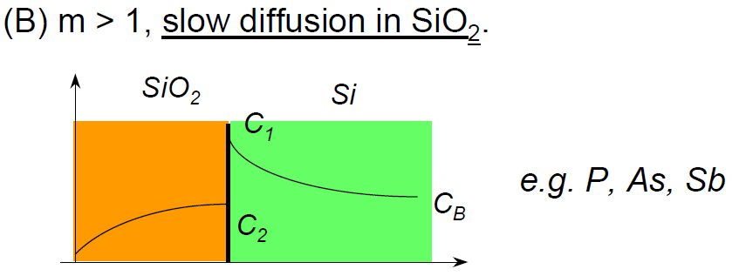
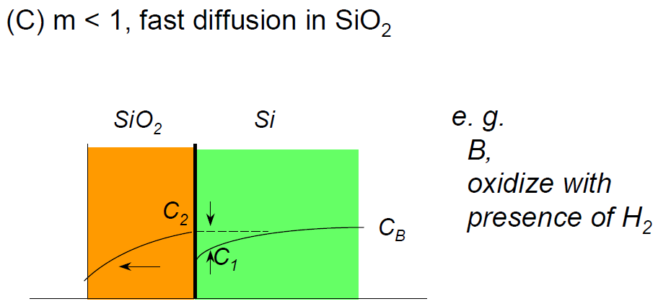
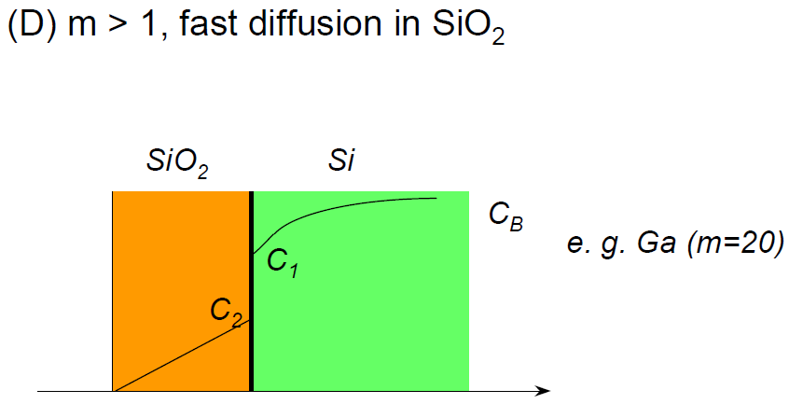
Four cases of interest
Dopant piling up near Si interface

Slide 26
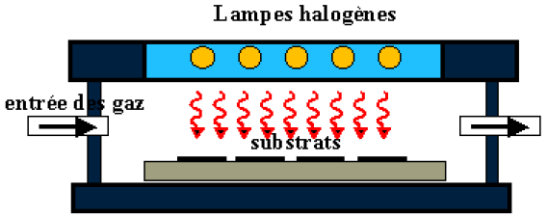
Rapid thermal oxidation (RTO)
Conventional thermal oxidation for gate oxides < 30 Å must be performed at < 800°C, which increases Si/SiO₂ interfacial roughness and reduces channel mobility.
Solution: RTO at around 1050°C using radiation heating source, time can be < 1min.
RTO also reduces dopant re-distribution.
RTO may be influenced by both thermally activated processes and a photon-induced process involving mono-atomic O atoms generated by UV, thus creating a parallel oxidation reaction that dominates at lower temperature.
RTO growth kinetics exhibit activation energies differing from conventionally grown oxides.
In the initial stage (∼20 seconds), the RTO growth rate is linear followed by nonlinear growth. Duration of the linear region is hardware dependent, particular the heating source.
Halogen lamps

