Slide 1
Chapter 7 Dopant Diffusion
Introduction and application.
Dopant solid solubility and sheet resistance.
Microscopic view point: diffusion equations.
Physical basis for diffusion.
Non-ideal and extrinsic diffusion.
Dopant segregation and effect of oxidation.
Manufacturing and measurement methods.
NE 343: Microfabrication and thin film technology
Instructor: Bo Cui, ECE, University of Waterloo; http://ece.uwaterloo.ca/~bcui/
Textbook: Silicon VLSI Technology by Plummer, Deal and Griffin

Slide 2
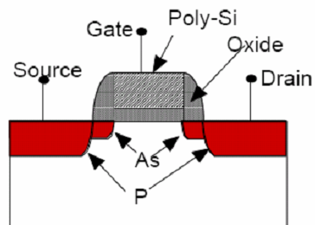
Doping in MOS and bipolar junction transistors
NMOS
BJT
Base Emitter Collector
p
n+
n+
p+
n-
p+
n+
p
p well
Doping is realized by:
Diffusion from a gas, liquid or solid source, on or above surface. (no longer popular)
Ion implantation. (choice for today’s IC)
Nowadays diffusion often takes place unintentionally during damage annealing…
“Thermal budget” thus needs to be controlled to minimize this unwanted diffusion.
In this chapter, diffusion means two very different concepts: one is to dope the substrate from source on or above surface – the purpose is doping; one is diffusion inside the substrate – the purpose is re-distribute the dopant.

Slide 3
Application of diffusion
Diffusion is the redistribution of atoms from regions of high concentration of mobile species to regions of low concentration.
It occurs at all temperatures, but the diffusivity has an exponential dependence on T.
In the beginning of semiconductor processing, diffusion (from gas/solid phase above surface) was the only doping process except growing doped epitaxial layers.
Now, diffusion is performed to:
Obtain steep profiles after ion implantation due to concentration dependent diffusion.
Drive-in dopant for wells (alternative: high-energy implantation), for deep p-n junctions in power semiconductors, or to redistribute dopants homogeneously in polysilicon layers.
Denude near-surface layer from oxygen, to nucleate and to grow oxygen precipitates.
Getter undesired impurities.

Slide 4
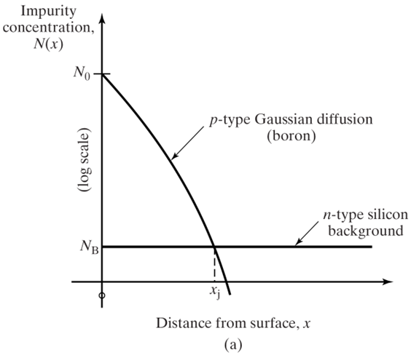
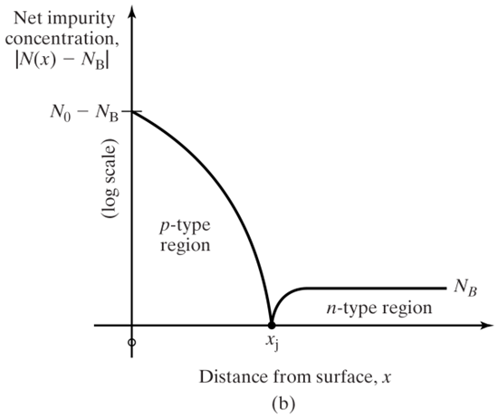
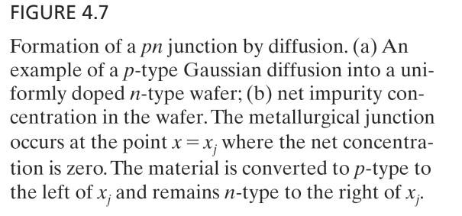
Doping profile for a p-n junction

Slide 5
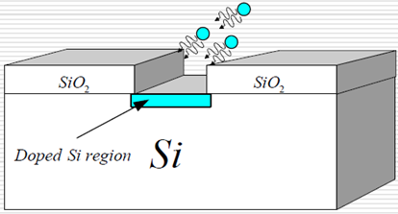
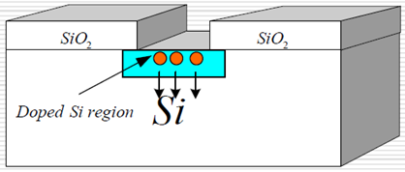
Diffusion from gas, liquid or solid source
Pre-deposition (dose control) Drive-in (profile control)
Silicon dioxide is used as a mask against impurity diffusion in Silicon.
The mixture of dopant species, oxygen and inert gas like nitrogen, is passed over the wafers at order of 1000ºC (900ºC to 1100ºC) in the diffusion furnace.
The dopant concentration in the gas stream is sufficient to reach the solid solubility limit for the dopant species in silicon at that temperature.
The impurities can be introduced into the carrier gas from solid (evaporate), liquid (vapor) or gas source.

Slide 6
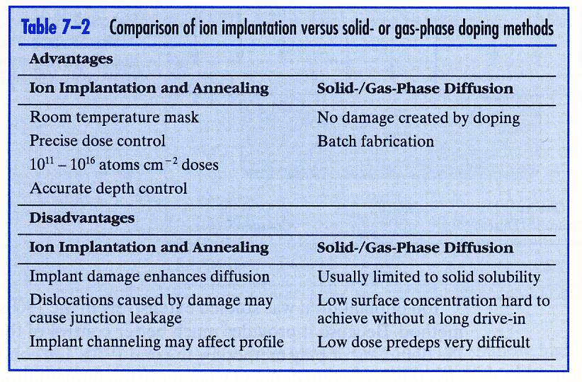
Comparison of ion implantation with solid/gas phase diffusion
Pre-deposition
Drive-in

Slide 7
Chapter 7 Dopant Diffusion
Introduction and application.
Dopant solid solubility and sheet resistance.
Microscopic view point: diffusion equations.
Physical basis for diffusion.
Non-ideal and extrinsic diffusion.
Dopant segregation and effect of oxidation.
Manufacturing and measurement methods.
NE 343 Microfabrication and thin film technology
Instructor: Bo Cui, ECE, University of Waterloo
Textbook: Silicon VLSI Technology by Plummer, Deal and Griffin

Slide 8
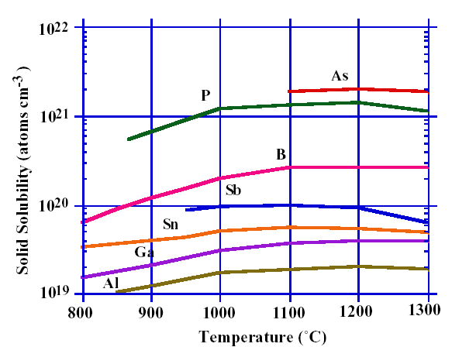
Dopant solid solubility
Solid solubility: at equilibrium, the maximum concentration for an impurity before precipitation to form a separate phase.
Figure 7-4

Slide 9
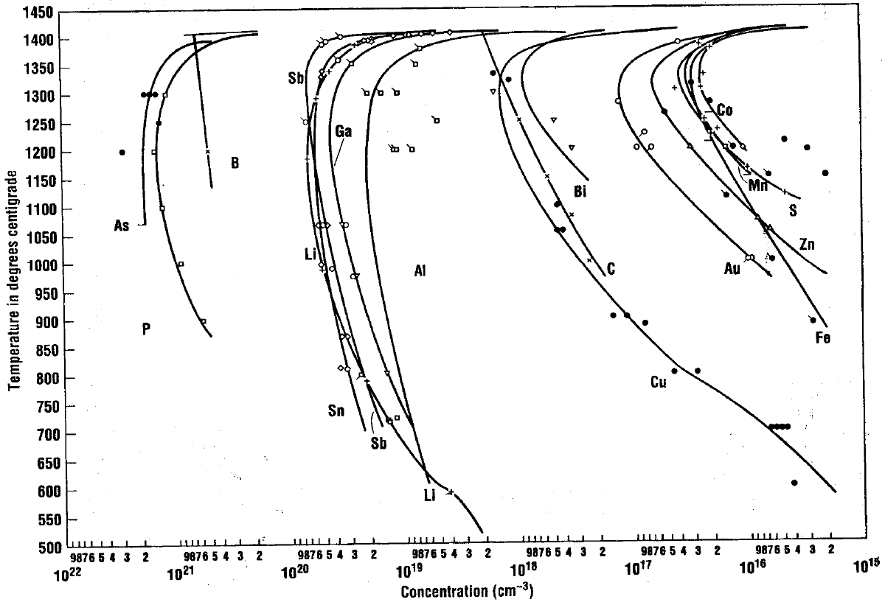
Solid solubility of common impurities in Silicon

Slide 10
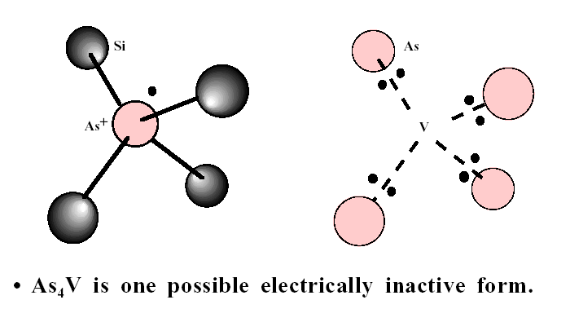
Solubility vs. electrically active dopant concentration
As in substitutional site, active
Inactive
V: vacancy
Figure 7-5
Not all impurities are electrically active.
As has solid solubility of 2×10²¹ cm⁻³.
But its maximum electrically active dopant concentration is only 2×10²⁰ cm⁻³ .

Slide 11
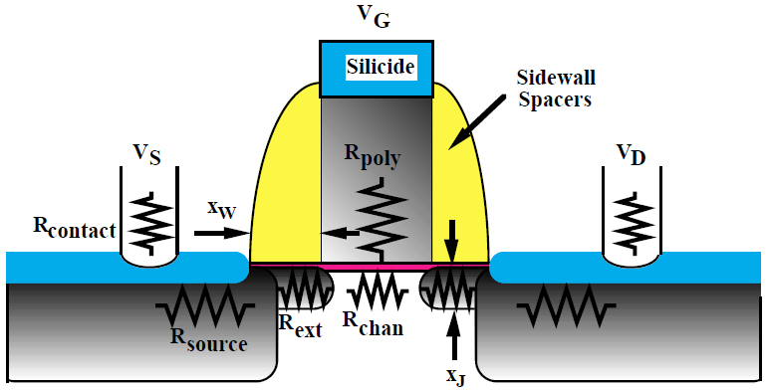
Resistance in a MOS
Figure 7-1
For thin doping layers, it is convenient to find the resistance from sheet resistance.

Slide 12
Sheet resistance R_{S}
: (bulk) resistivity
x_{j}: junction depth, or film thickness…
A
x_{j}
w
l
Figure 7-2
R=R_{s} when l=w (square)

Slide 13
Important formulas
Ohm’s law:
Mobility μ:
By definition:
Therefore:
Finally:
Where:
σ: conductivity; ρ: resistivity; J: current density; E: electrical field
v: velocity; q: charge; n, p: carrier concentration.

Slide 14
Sheet resistance
N is carrier density, Q is total carrier per unit area, x_{j} is junction depth
For non-uniform doping:
This relation is calculated to generate the so-called Irvin’s curves. See near the end of this slide set.

Slide 15
Chapter 7 Dopant Diffusion
Introduction and application.
Dopant solid solubility and sheet resistance.
Microscopic view point: diffusion equations.
Physical basis for diffusion.
Non-ideal and extrinsic diffusion.
Dopant segregation and effect of oxidation.
Manufacturing and measurement methods.
NE 343 Microfabrication and thin film technology
Instructor: Bo Cui, ECE, University of Waterloo
Textbook: Silicon VLSI Technology by Plummer, Deal and Griffin

Slide 16
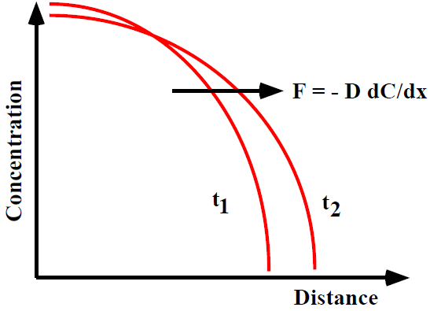
Diffusion from a macroscopic viewpoint
Fick’s first law of diffusion
F is net flux.
This is similar to other laws where cause is proportional to effect (Fourier’s law of heat flow,
Ohm’s law for current flow).
Figure 7-6
C is impurity concentration (number/cm³), D is diffusivity (cm²/sec).
D is related to atomic hops over an energy barrier (formation and migration of mobile
species) and is exponentially activated.
Negative sign indicates that the flow is down the concentration gradient.

Slide 17
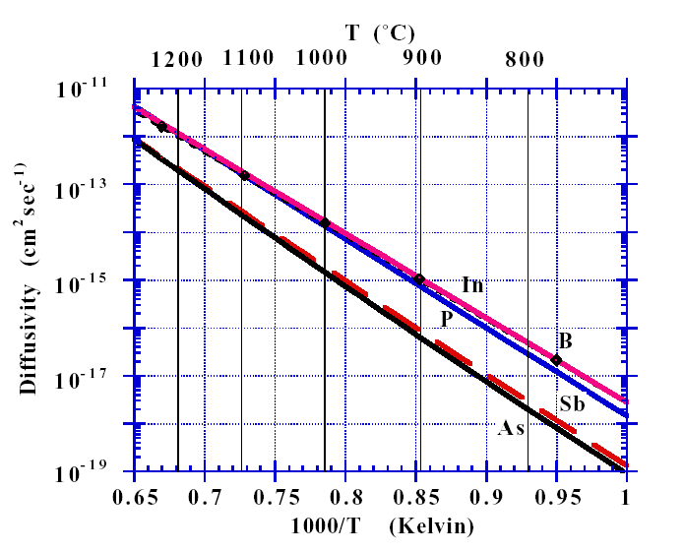
Intrinsic diffusivity D_{i}
Intrinsic: impurity concentration N_{A}, N_{D} < n_{i} (intrinsic carrier density).
Note that n_{i} is quite high at typical diffusion temperatures, so "intrinsic" actually applies under many conditions. E.g. at 1000ºC, n_{i} =7.14×10¹⁸/cm³.
E_{a}: activation energy
  D⁰(cm²/s) E_{a}(eV)
B 1.0 3.46
In 1.2 3.50
P 4.70 3.68
As 9.17 3.99
Sb 4.58 3.88
Figure 7-15, page 387

Slide 18
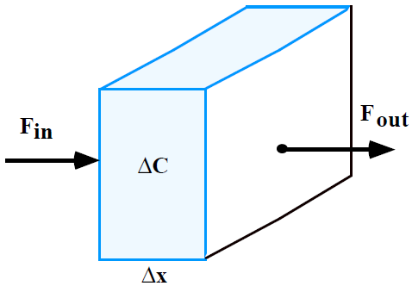
Fick’s second law
The change in concentration in a volume element is determined by the change in fluxes in and out of the volume.
Within time Δt, impurity number change by:
During the same period, impurity diffuses in and out of the volume by:
Therefore:
Or,
Since:
We have:
A
Figure 7-7
If D is constant:

Slide 19
Solution to diffusion equation
At equilibrium state, C doesn’t change with time.
Diffusion of oxidant (O₂ or H₂O) through SiO₂ during thermal oxidation.

Slide 20
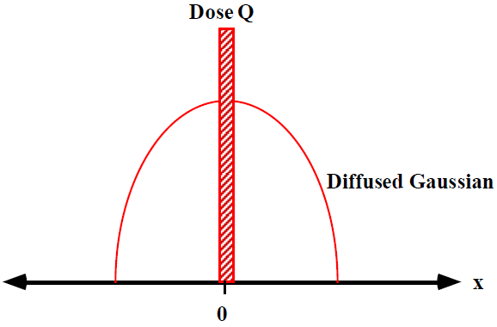
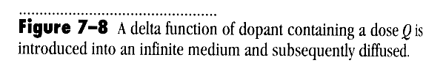
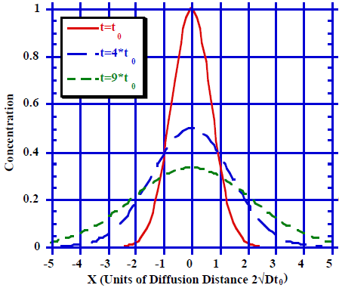
Gaussian solution in an infinite medium
At t=0, delta function dopant distribution.
C→0 as t →0 for x>0
C →∞ as t →0 for x=0
∫C(x,t)dx=Q (limited source)
At t>0
This corresponds to, e.g. implant a very narrow peak of dopant at a particular depth, which approximates a delta function.
Important consequences:
Dose Q remains constant
Peak concentration (at x=0) decreases as 1/ √t
Diffusion distance from origin increases as 2 √Dt
Figure 7-9

Slide 21
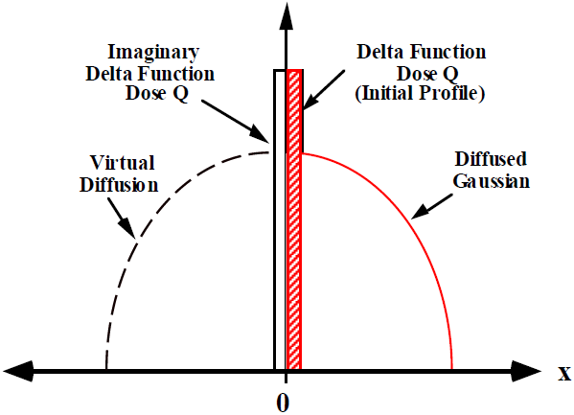
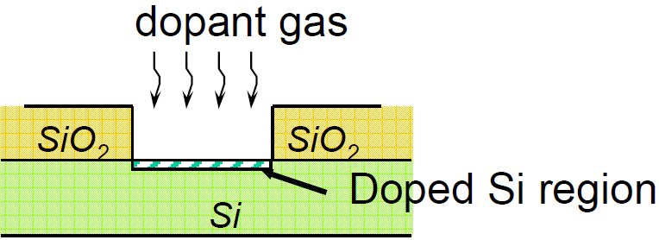
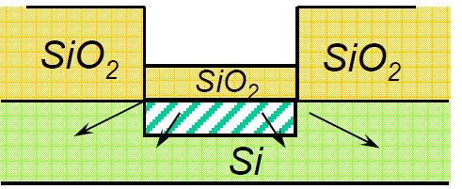
Gaussian solution near a surface
1. Pre-deposition for dose control
2. Drive in for profile control
Figure 7-10
A surface Gaussian diffusion can be treated as a Gaussian diffusion with dose 2Q in an infinite bulk medium.
Note: Pre-deposition by diffusion can also be replaced by a shallow implantation step.

Slide 22
Gaussian solution near a surface
Surface concentration decreases with time
Concentration gradient
Junction depth
At p-n junction

Slide 23
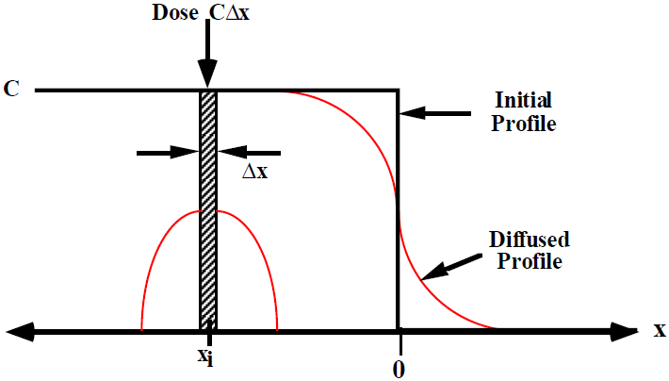
Error function solution in an infinite medium
This corresponds to, e.g. putting a thick heavily doped epitaxial layer on a lightly doped wafer.
At t=0
C=0 for x>0
C=C for x<0.
An infinite source of material in the half-plane can be considered to be made up of a sum of Gaussians. The diffused solution is also given by a sum of Gaussians, known as the error-function solution.
Figure 7-11
erfc: complementary error function

Slide 24
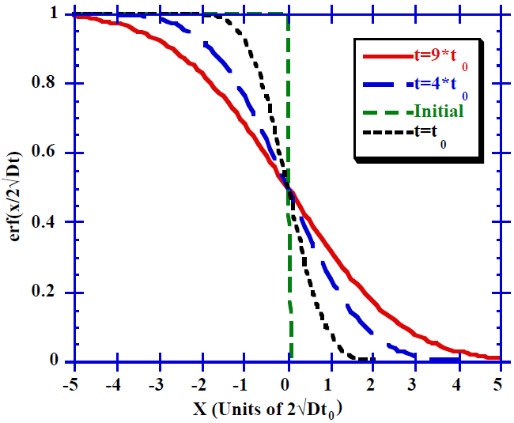
Error function solution in an infinite medium
Evolution of erfc diffused profile
Figure 7-12
Important consequences of error function solution:
Symmetry about mid-point allows solution for constant surface concentration to be derived.
Error function solution is made up of a sum of Gaussian delta function solutions.
Dose beyond x=0 continues to increase with annealing time.

Slide 25
Error function solution in an infinite medium
Properties of Error Function erf(z) and Complementary Error Function erfc(z)
For x << 1
For x >> 1

Slide 26
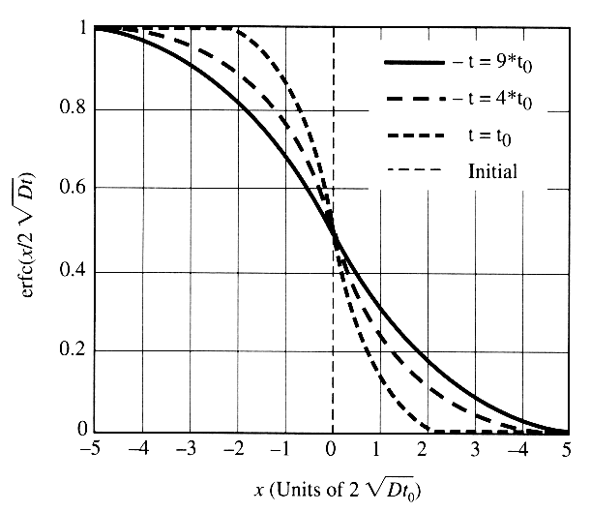
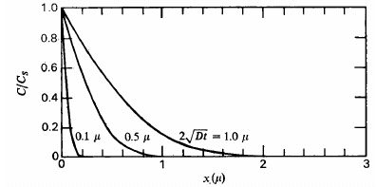
Error function solution near a surface
Constant surface concentration at all times, corresponding to, e.g., the situation of diffusion from a gas ambient, where dopants “saturate” at the surface (solid solubility).
Boundary condition: C(x,0)=0, x≠0; C(0,t)=C_{s}; C(∞,t)=0
Pre-deposition dose
Cs is surface concentration, limited by solid solubility, which doesn’t change too fast with temperature.
Constant 1/2
½

Slide 27
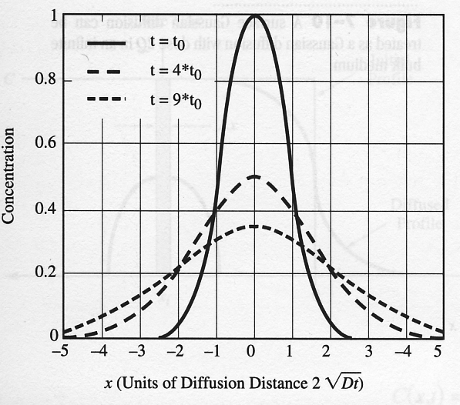
Successive diffusions
Successive diffusions using different times and temperatures
Final result depends upon the total Dt product
For example, the profile is a Gaussian function at time t=t₀, then after further diffusion for another 3t₀, the final profile is still a Gaussian with t=4t₀=t₀+3t₀.
(The Gaussian solution holds only if the Dt used to introduce the dopant is small compared with the final Dt for the drive-in i.e. if an initial δ/delta function approximation is reasonable)
When D is the same (same temperature)
When diffused at different temperatures
As D increases exponentially with temperature, total diffusion (thermal budget) is mainly determined by the higher temperature processes.

Slide 28
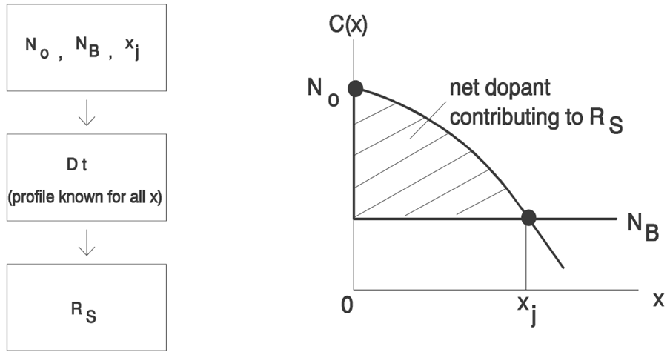
Irvin’s curves
Motivation to generate Irvin’s curves: both N_{B} (background carrier concentration), R_{s} (sheet resistance) and x_{j} can be conveniently measured experimentally but not N₀ (surface concentration). However, these four parameters are related by:
  Irvin’s curves are plots of N₀ versus (R_{s}, x_{j}) for various N_{B}, assuming erfc or half-Gaussian profile. There are four sets of curves for (n-type and p-type) and (Gaussian and erfc).

Slide 29
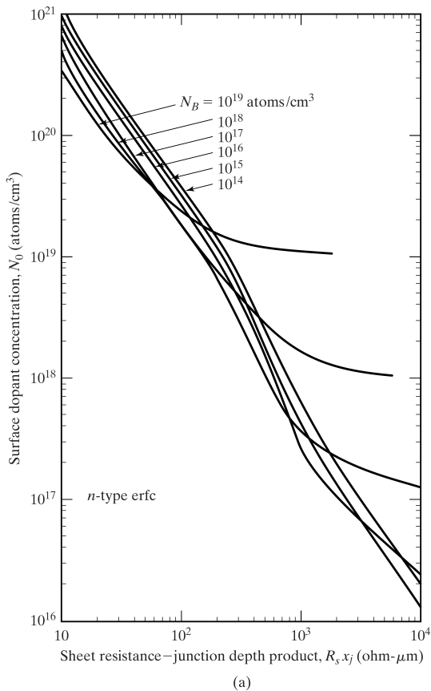
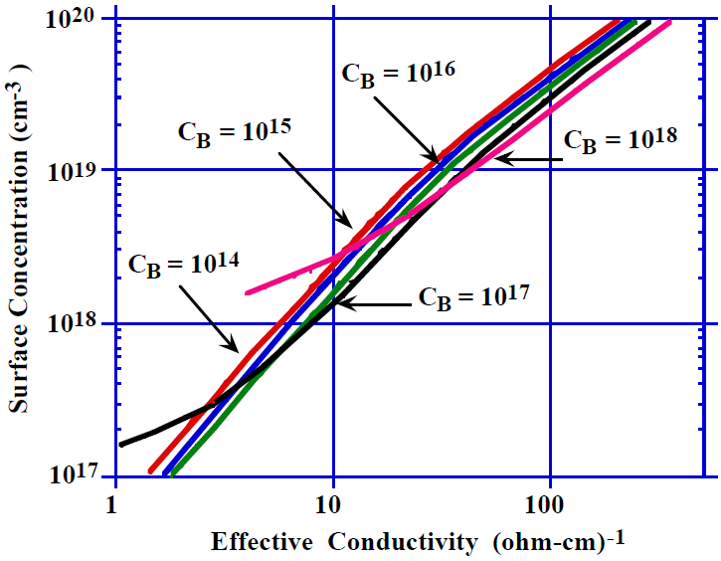
Irvin’s curves
Figure 7-17
Four sets of curves: p-type erfc, n-type erfc, p-type half-Gaussian, n-type half-Gaussian
Explicit relationship between: N₀, x_{j}, N_{B} and R_{S}.
Once any three parameters are know, the fourth one can be determined.

Slide 30


Example
Design a boron diffusion process (say for the well or tub of a CMOS process) such that ρ_{s}=900Ω/square, x_{j}=3μm, with C_{B}=1×10¹⁵/cm³.
The average conductivity of the layer is
From (half-Gaussian) Irvin’s curve, we find
C_{s} << solubility of B in Si, so it is correct to assume pre-deposition (here by ion implantation) plus drive-in, which indeed gives a Gaussian profile.

Slide 31
Example (cont.)
Assume drive-in at 1100ºC, then D=1.5×10⁻¹³cm²/s.
Pre-deposition dose

Slide 32
Example (cont.)
Now if we assume pre-deposition by diffusion from a gas or solid phase at 950ºC, solid solubility of B in Si is C_{s}=2.5×10²⁰/cm³, and D=4.2×10⁻¹⁵cm²/s.
The profile of this pre-deposition is erfc function.
However, the pre-deposition time is too short for real processing, so ion-implantation is more realistic for pre-deposition.

