Slide 1
Chapter 7 Dopant Diffusion
Introduction and application.
Dopant solid solubility and sheet resistance.
Microscopic view point: diffusion equations.
Physical basis for diffusion.
Non-ideal and extrinsic diffusion.
Dopant segregation and effect of oxidation.
Manufacturing and measurement methods.
NE 343: Microfabrication and thin film technology
Instructor: Bo Cui, ECE, University of Waterloo; http://ece.uwaterloo.ca/~bcui/
Textbook: Silicon VLSI Technology by Plummer, Deal and Griffin

Slide 2
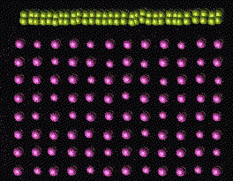
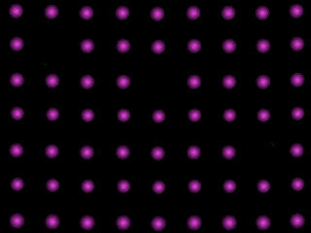
Physical basis for diffusion
Interstitial
Substitutional
Impurities that diffuse by substitutional: As, Al, Ga, Sb, Ge.
Usually there must be a vacancy nearby for this diffusion to happen.
Impurities diffuse by interstitial：O, Au, Ag, Fe, Cu, Ni, Zn, Mg, Li, H.

Slide 3
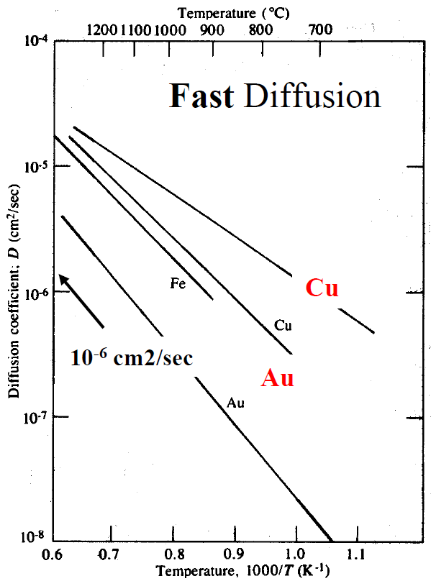
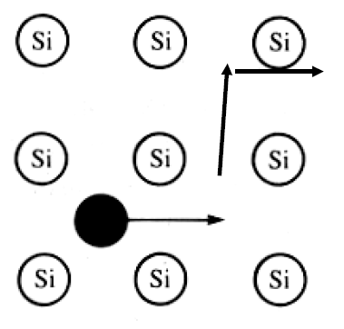
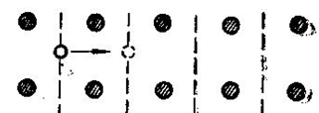

Diffusion mechanisms in Si: interstitial
No Si native point defect required
Very fast diffusion
“Hopping” frequency:
Energy barrier E_{i}: 0.6-1.2eV
Vibration frequency ν₀: 10¹²-10¹⁴/sec.
E_{i}

Slide 4
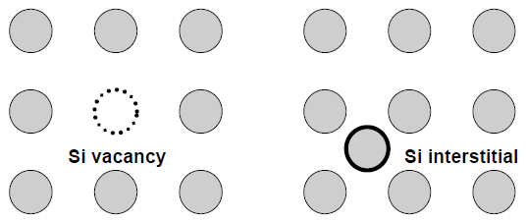
Interstitials and vacancies in Si
Vacancy concentration:
Probability of a site to be vacant:
Thermal-equilibrium values of Si neutral interstitials and vacancies at diffusion temperatures << doping concentration of interest (10¹⁵ –10²⁰/cm³).
Diffusivity of Si interstitials and Si vacancies >> diffusivity of dopants.

Slide 5
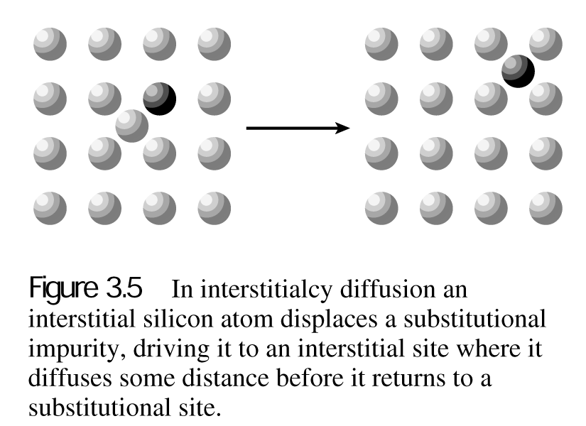
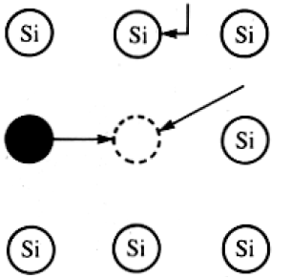
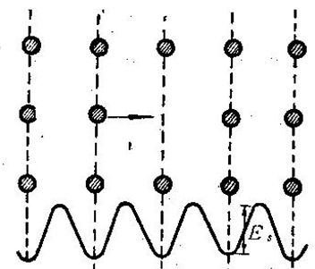
Diffusion mechanisms in Si: substitutional and interstitialcy
Si native point defects required (Si vacancy and Si interstitials); Examples: B, P, As, Sb.
a) Substitutional diffusion
b) Interstitialcy diffusion
Si atom
Substitutional impurity atom
Vacancy
“Hopping” frequency:
E_{s}: 3-4eV

Slide 6
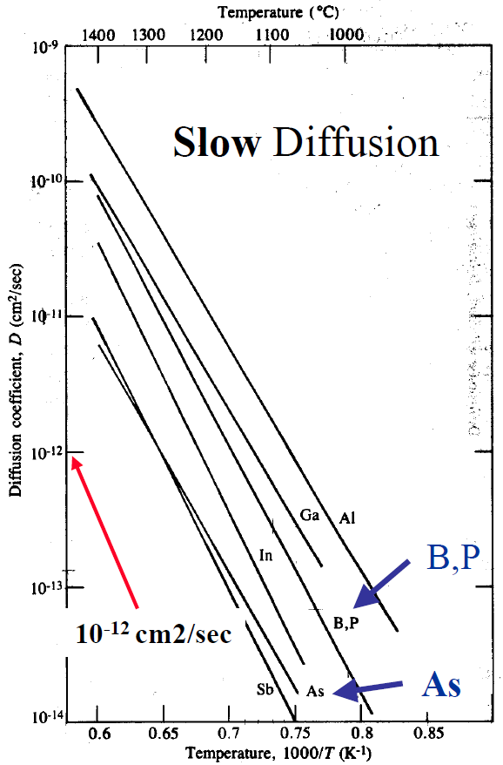
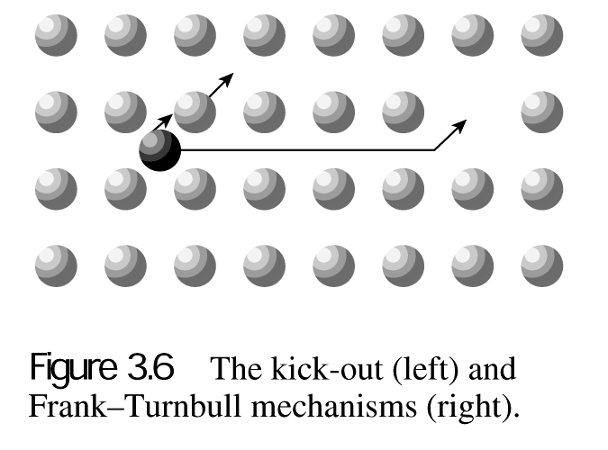
Diffusion mechanisms in Si: kick out and Frank Turnbull
Continued from previous slide
(Si native point defects required…)
Very slow diffusion
(continued from previous slide)
c) Kick out diffusion
d) Frank Turnbull diffusion

Slide 7
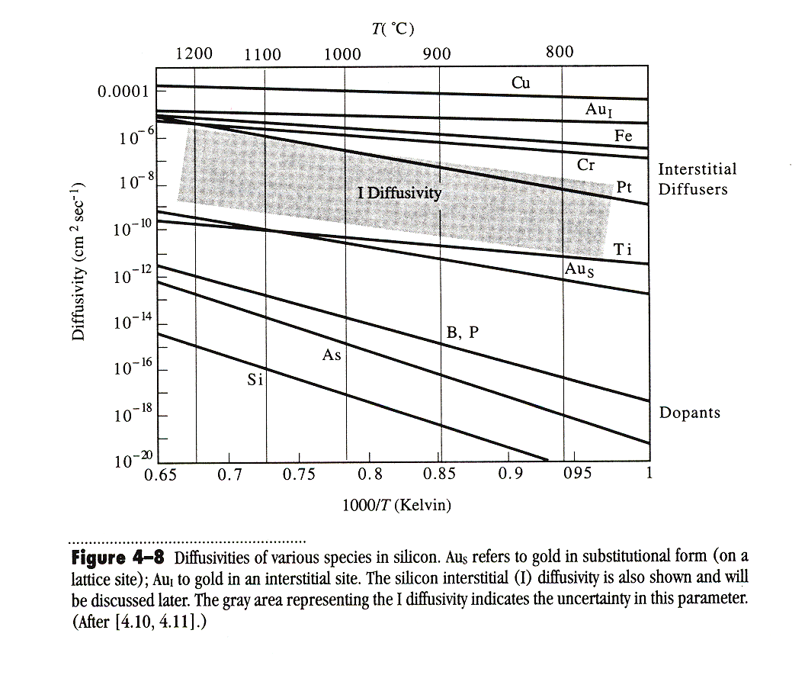
Diffusivity comparison
10⁸ times higher!!
Figure 4-8 Diffusivities of various species in silicon. Au_{s} refers to gold in substitutional form (on a lattice site); Au_{I} to gold in an interstitial site. The silicon interstitial (I) diffusivity is also shown, and the grey area representing the I diffusivity indicates the uncertainty in this parameter.

Slide 8
Chapter 7 Dopant Diffusion
Introduction and application.
Dopant solid solubility and sheet resistance.
Microscopic view point: diffusion equations.
Physical basis for diffusion.
Non-ideal and extrinsic diffusion.
Dopant segregation and effect of oxidation.
Manufacturing and measurement methods.
NE 343 Microfabrication and thin film technology
Instructor: Bo Cui, ECE, University of Waterloo
Textbook: Silicon VLSI Technology by Plummer, Deal and Griffin

Slide 9
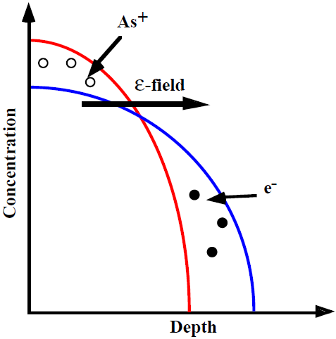
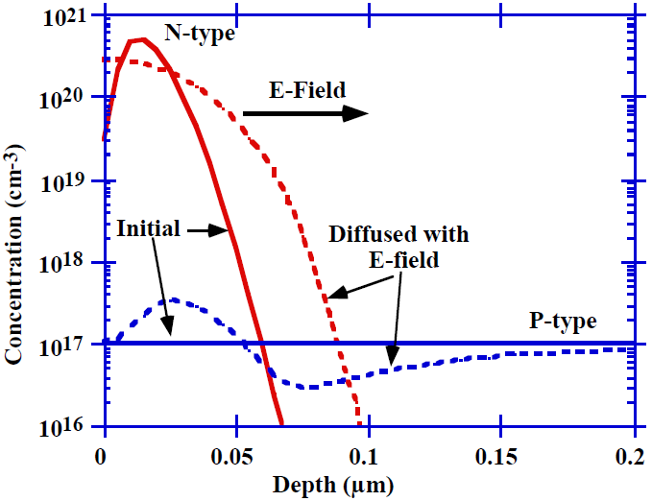
Electric field effect: non-intrinsic/extrinsic diffusion
Fick’s Laws: only valid for diffusion under special conditions.
When the doping is higher than n_{i}, ε-field effects become important .
The field comes from higher mobility of electrons and holes compared to dopant atoms.
Carries move faster than dopants, until an equilibrium is attained due to the electric field that slows down carrier and speeds up dopant.
Field also leads to diffusion of substrate dopants that are negatively charged for P-type.
Figure 7-25, P406
Figure 7-26
N-type dopants are positively charged.

Slide 10
Electric field (ε) effect on dopant diffusion
Total dopant flux contains two parts, drift velocity v=με.
For n-type doping, Ψ is potential.
Therefore.
Einstein relation.
Here μ is for dopant atom, not for carrier (e, h)
(you are not required to know well those equations)

Slide 11
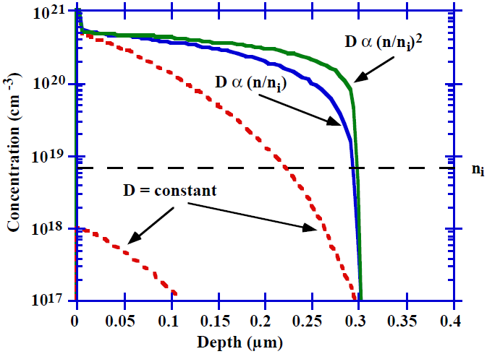
Concentration dependent diffusion
At high doping concentrations, the Fick’s equation must be solved numerically since D≠constant.
The dash line show the erfc profiles.
The solid lines are numerical simulations, which agree with experimental results.
Those box-like (steep) doping profile is often desirable.
Figure 7-28

Slide 12
Chapter 7 Dopant Diffusion
Introduction and application.
Dopant solid solubility and sheet resistance.
Microscopic view point: diffusion equations.
Physical basis for diffusion.
Non-ideal and extrinsic diffusion.
Dopant segregation and effect of oxidation.
Manufacturing and measurement methods.
NE 343 Microfabrication and thin film technology
Instructor: Bo Cui, ECE, University of Waterloo
Textbook: Silicon VLSI Technology by Plummer, Deal and Griffin

Slide 13
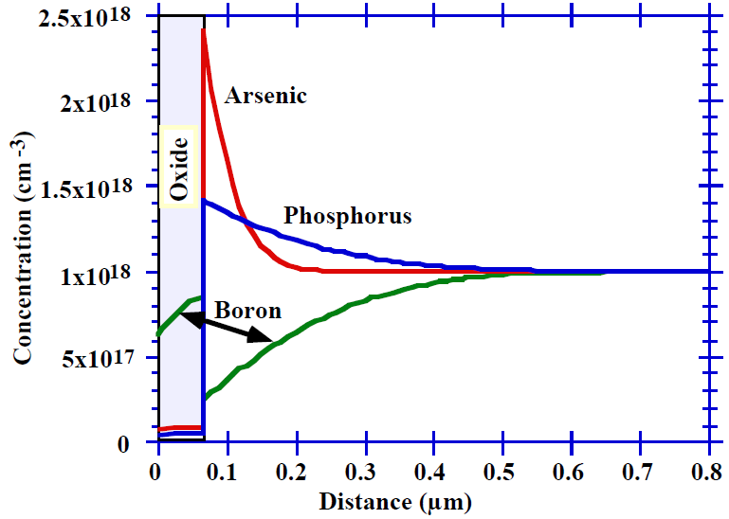
Dopant segregation
0.3 for Boron, B
10 for Arsenic, As
10 for Antimony, Sb
10 for Phosphorus, P
Dopants segregate coefficient k₀.
Oxidation of a uniformly doped boron substrate depletes the boron into the growing SiO₂.
Whereas N-type dopants tend to pile-up near the interface.
Figure 7-31, P416

Slide 14
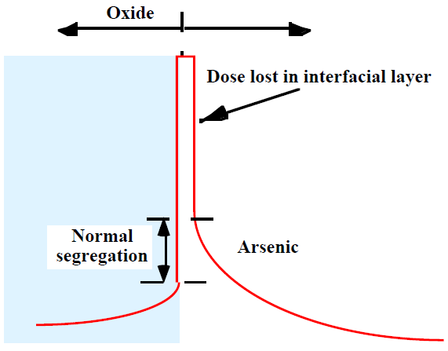
Interfacial dopant pile-up during oxidation
Figure 7-32
Dopants may also segregate to an interface layer, perhaps only a monolayer thick.
They are not active (do not contribute electrons/holes).
This may consume up to 50% of the dose in a shallow layer.

Slide 15
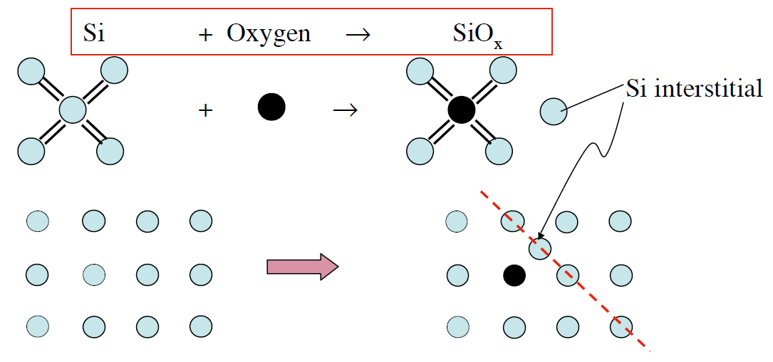
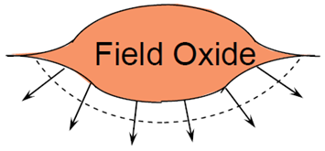

Oxidation enhanced (OED)/retarded diffusion (ORD)
Si interstitials created by oxidation, which recombine with vacancies to reduce its concentration.
P419
Because B and P diffuse mainly by an interstitial process, their diffusion is enhanced by oxidation.
dX_{ox}/dt is oxidation rate
But Sb is large and diffuses only by vacancies, so its diffusion is suppressed/retarded.
Oxidation injects interstitials into Si.

Slide 16
Chapter 7 Dopant Diffusion
Introduction and application.
Dopant solid solubility and sheet resistance.
Microscopic view point: diffusion equations.
Physical basis for diffusion.
Non-ideal and extrinsic diffusion.
Dopant segregation and effect of oxidation.
Manufacturing and measurement methods.
NE 343 Microfabrication and thin film technology
Instructor: Bo Cui, ECE, University of Waterloo
Textbook: Silicon VLSI Technology by Plummer, Deal and Griffin

Slide 17
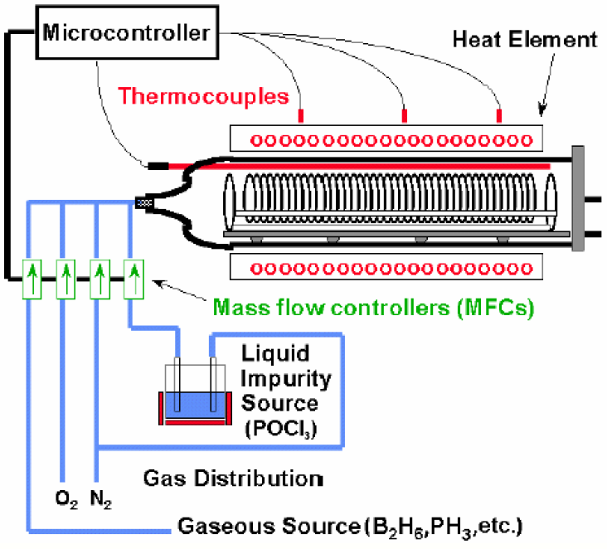
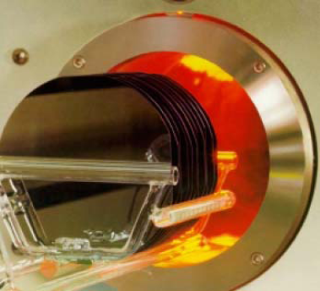
Diffusion furnace: horizontal
Temperature control in 3 to 5 zones by spike thermocouples.
Diffusion tube and boat made from SiO₂, SiC…
Horizontal furnaces were the diffusion work horses up to 200 mm wafers

Slide 18
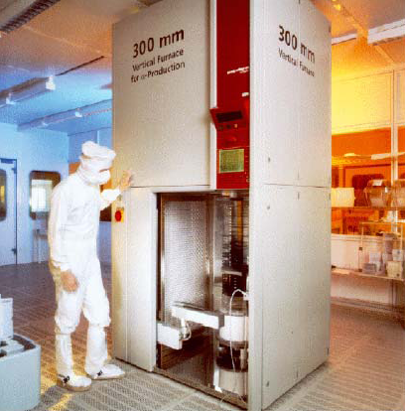
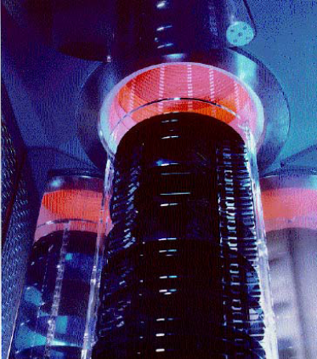
Diffusion furnace: vertical
Vertical furnaces are used for 200mm and above wafers.
Vertical furnace for 300mm wafers. Close view into three tubes

Slide 19
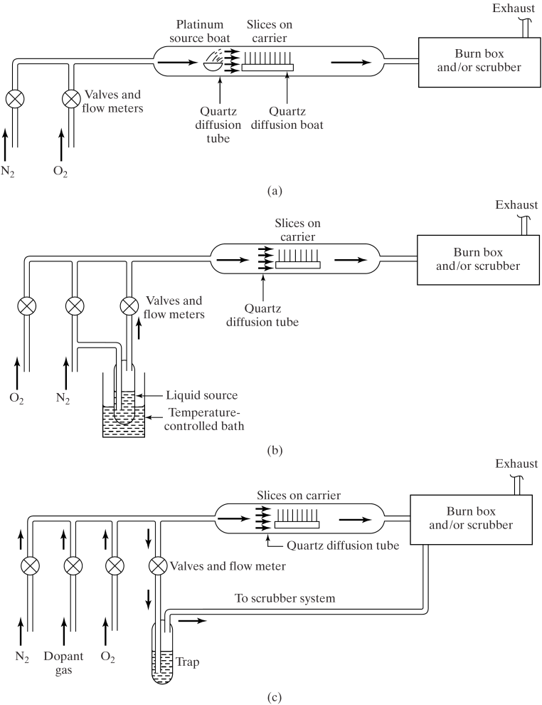
Diffusion methods
Gas source
Liquid source
Solid source
Spin-on glass
Note: for drive-in, a capping layer (SiO₂…) is often used to prevent out-diffusion into air.
Open furnace tube systems
  Solid source in platinum source boat
  Liquid Source - carrier gas passing through bubbler
  Gaseous impurity source

Slide 20
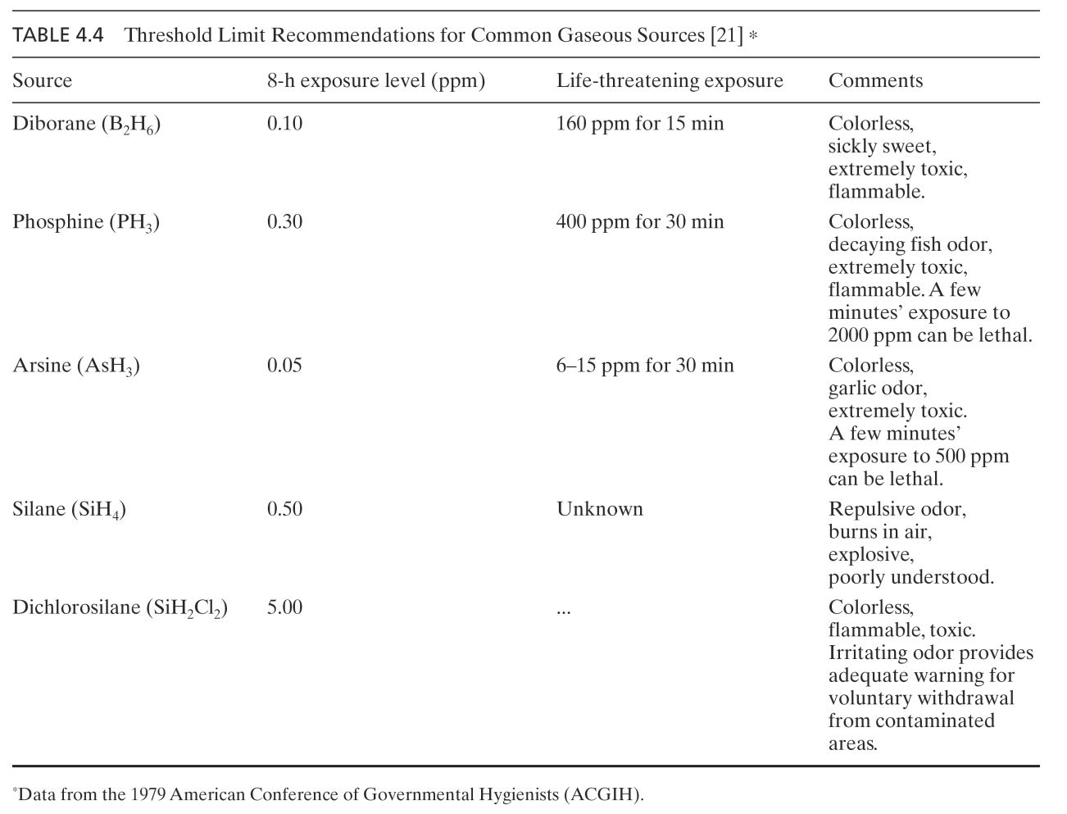
Gas source doping, very toxic gases
Silane and dichlorosilane used for polysilicon deposition

Slide 21
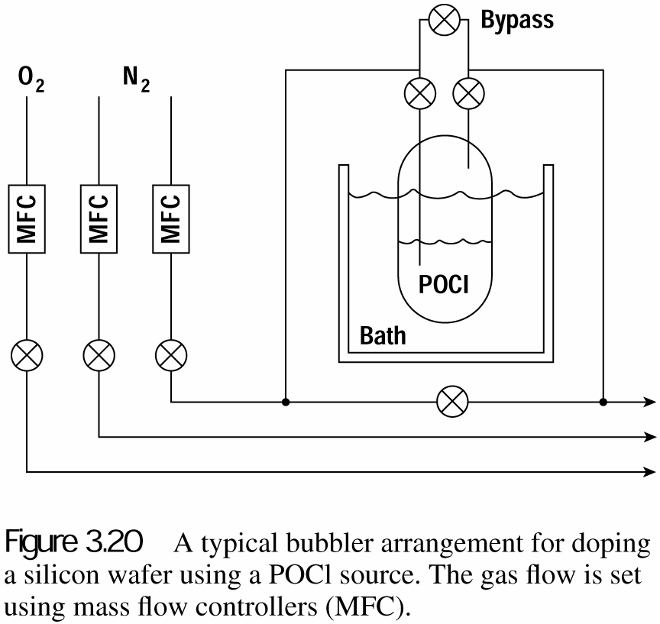
Liquid source doping
Container of the liquid is immersed in a constant temperature bath to produce a known vapor pressure of the dopant above the liquid surface.
An inert gas such as N₂ is injected into the bubbler.
Partial pressure of dopant in furnace is controlled by
  Bath temperature
  Gas pressure above liquid
  Ratio of flow through bubbler to the sum of all other flows into furnace.
Usually an O₂ source is supplied to react with the dopant gas.
Disadvantage of liquid source:
Source is corrosive.
Bubblers must be pressurized and have been known to explode.
Sensitive to bubbler temperature change.
Danger of forming insoluble silicon compounds at wafer surface that are invisible, but are extremely undesirable.

Slide 22
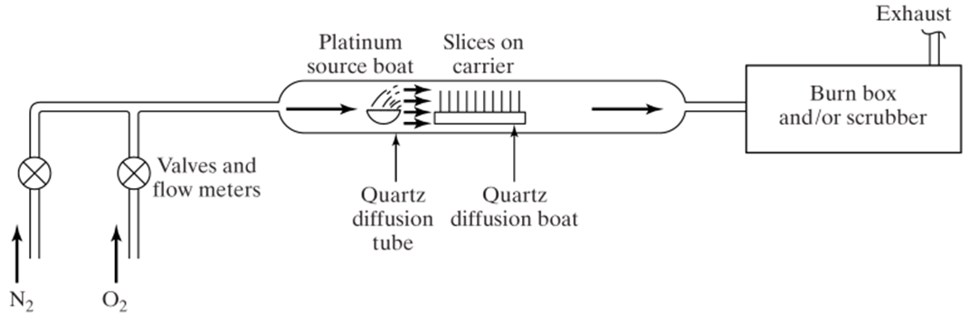
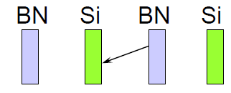
Solid source doping
Another way is to use discs that are side-by-side to the Si wafer.
For example, for diffusing p-type layers in Si, boron nitride (BN) disc is used.
When oxidized at 750-1100℃, a thin film of B₂O₃ forms at the surface.
In presence of H₂, the volatile compound HBO₂ forms and diffuses to wafer surface where a borosilicate glass in formed.
This glass serves as the boron source for diffusion into the substrate.
No carrier gas needed, but protected under N₂ or Ar gas.

Slide 23
Spin on glass doping
Spin-coat an oxide on the wafer (room temperature).
Bake at 200ºC for 15min to remove solvent.
Effectively, the film can be considered as a mixture of SiO₂ and dopant oxide.
Then diffuse into Si at high temperature.
Good for many types of dopant, with a wide range of dose.
This is finite source, whereas gas/liquid/solid are infinite source.
Sources:
As: arsenosilica
Sb: antimonysilica
B: borosilica
P: phosphorosilica

Slide 24
Diffusion system: Boron
Surface reaction:
Solid sources: boron nitride (BN) and trimethylborate (TMB).
TMB has high vapor pressure at room temperature,
so placed outside of furnace.
One can also use BN wafers, pass O₂, 900ºC.
Liquid sources: boron tribromide BBr₃.
Gaseous sources: diborane B₂H₆.
4BN + 3O₂ → 2B₂O₃ + 2N₂

Slide 25
Diffusion system: Phosphorus
Surface reaction:
Solid sources: (can be made into wafers like BN, but not popular)
Phosphorus pentoxide
Ammonium monophosphate NH₄H₂PO₄
Ammonium diphosphate (NH₄)₂H₂PO₄
Liquid source: phosphorus oxychloride POCl₃
Gaseous source: phosphine PH₃.

Slide 26
Diffusion system: Arsenic & Antimony
Arsenic surface reaction:
Solid sources: possible, low surface concentrations.
Gaseous source: arsine AsH₃.
Ion implantation is normally used for deposition.
Antimony surface reaction:
Liquid source: antimony pentachloride Sb₃Cl₅.
Ion implantation is normally used for deposition.

Slide 27
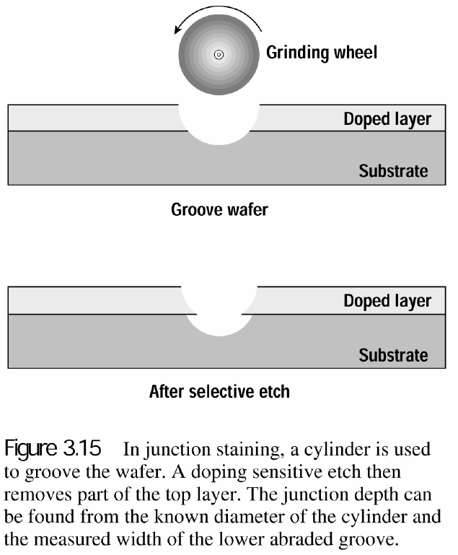
Measurement methods
Sheet resistance measurement using four-point probe.
p-n junction staining for junction depth. (see below, left)
Capacitance-voltage measurement for dopant concentration
Secondary Ion Mass Spectroscopy, SIMS, for impurity concentration
Spreading resistance measurement. (see below, right)
a: effective contact radius
K: empirical parameter
a
Metal needle point-contact with the semiconductor, resistance mainly comes from the volume near the needle tip.

Slide 28
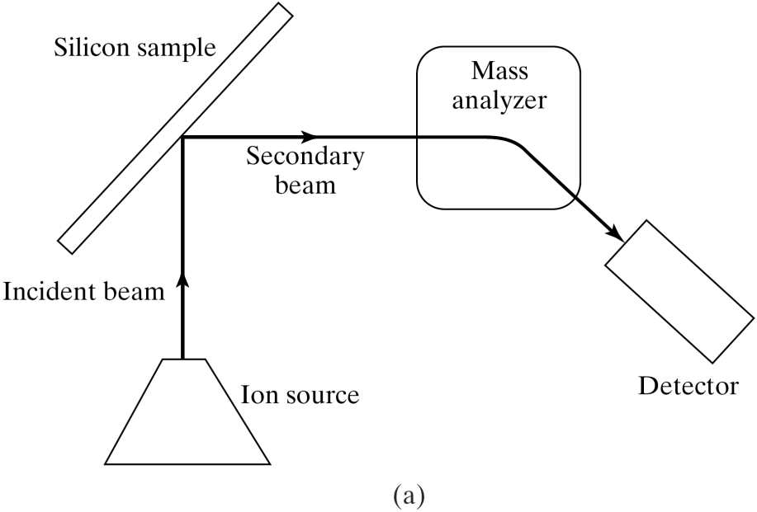
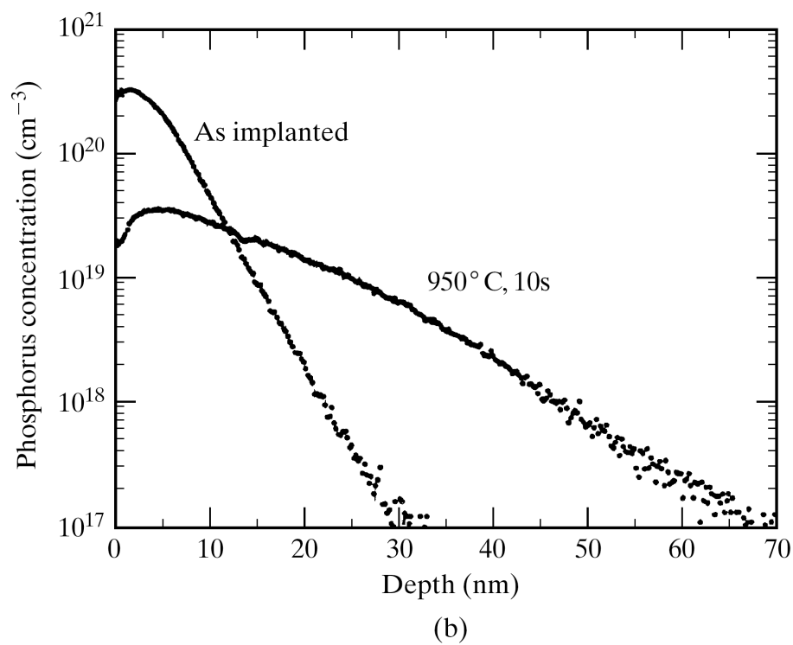
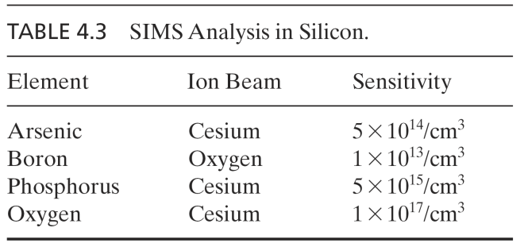
Secondary Ion Mass Spectroscopy, SIMS
Measured by SIMS

