Slide 1
Chapter 8 Ion implantation
Introduction and application.
Ion implantation tools.
Dopant distribution.
Mask thickness and lateral distribution.
Effect of channeling.
Damage caused by ion implantation.
Damage repair.
NE 343: Microfabrication and thin film technology
Instructor: Bo Cui, ECE, University of Waterloo; http://ece.uwaterloo.ca/~bcui/
Textbook: Silicon VLSI Technology by Plummer, Deal and Griffin

Slide 2
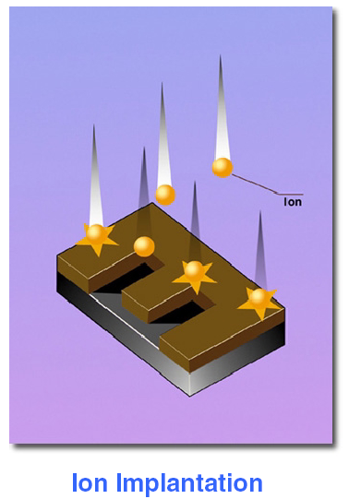
Ion implantation and its history
A gas is ionized, and the ions are accelerated by a high electric field, and injected into the target wafer to hundreds of nm depth.
Typical ion implantation parameters:
Ion: P, As, Sb, B, In, O
Dose: 10¹¹ - 10¹⁸ cm⁻²
Ion energy: 1 - 400 keV
Uniformity and reproducibility: ±1%
Temperature: room temperature
Ion flux: 10¹²-10¹⁴ cm⁻²s⁻¹
Dose (φ) = # of atoms/cm².
Concentration (C) = # of atoms/cm³.
The idea was proposed by Shockley in 1954, but used for mass production only after late 1970s.
Before ion implantation, doping is achieved by diffusion into the bulk silicon from gaseous source above surface, or pre-deposited chemical source on wafer surface.
This approach lacks the flexibility and control required by CMOS processing, and ion implantation quickly gained popularity for the introduction of dopant atoms.
Modern ion implanters were originally developed from particle accelerator technology. Their energy range spans 100eV to several MeV (a few nm’s to several microns in depth range). The implantation is always followed by a thermal activation (600-1100ºC).

Slide 3
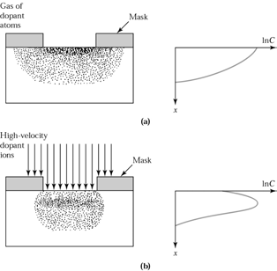
Advantages of ion implantation
Very precise dose control.
The ion implanter forms a simple electrical circuit. By monitoring the current in the circuit (or by a monitoring circuit with Faraday cups), significant accuracy in the implanted dose can be maintained. Assuming a current sensitivity of nA, and a minimum required implantation time of 10 seconds, it can be shown that doses as low as 10¹¹cm⁻², can be measured.
On the contrary, in chemical source predeposits, dose values less than 5×10¹³/cm² are not achievable.
High dose introduction is not limited to solid solubility limit values.
Excellent doping uniformity is achieved across the wafer (< 1% variation across 12” wafer) and from wafer to wafer.
Less dopant lateral diffusion, good for small device (short channel).
Done in high vacuum, it is a very clean process step.
Besides precise dose control, one can also control the profile (peak depth and spread range) better than diffusion (peak concentration always near surface).
(top) Doping by diffusion and “drive-in”.
(bottom) Doping by ion implantation with or without “drive-in”.

Slide 4
Advantages/disadvantage of ion implantation
Advantage:
Low-temperature process (can use photoresist as mask)
Wide selection of masking materials, e.g. photoresist, oxide, poly-Si, metal
Less sensitive to surface cleaning procedures.
Very fast (6" wafer can take as little as 6 seconds for a moderate dose)
Complex profiles can be achieved by multi-energy implants.
Disadvantage:
Very expensive equipment ( $1M or more).
At high dose values, throughput is less than diffusion (chemical source pre-deposition on surface).
Ions damage the semiconductor lattice. Not all the damage can be corrected by annealing.
Very shallow and very deep doping are difficult or impossible.
Masking materials can be “knocked” into the wafer creating unwanted impurities, or even destroying the quality of the interface.

Slide 5
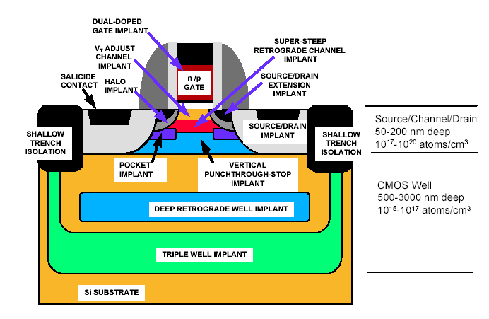
Application of ion implantation in CMOS fabrication
9-10 different implantations!

Slide 6
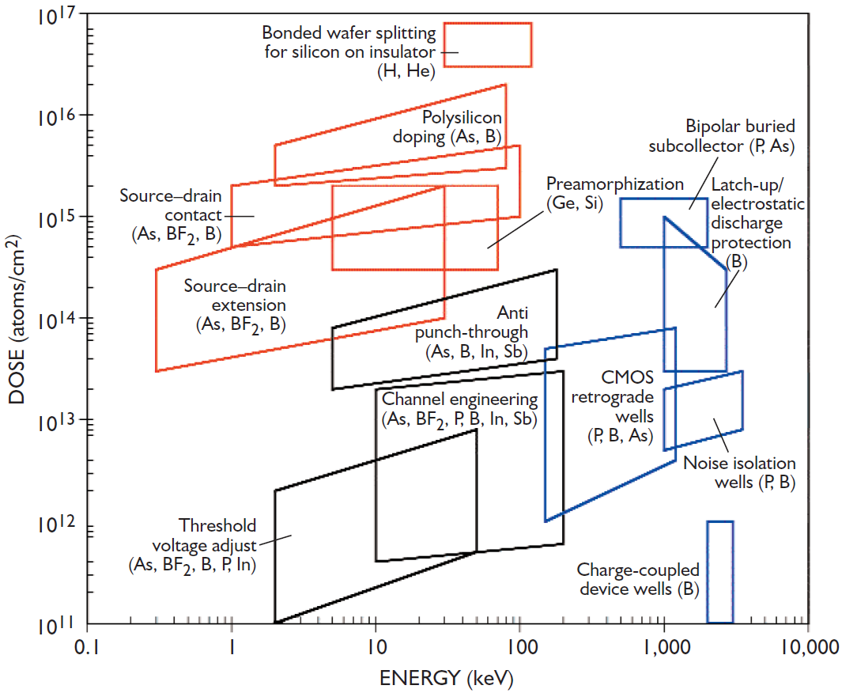
Dose-energy application space
Dose and energy requirements of major implantation applications (species shown roughly in order of decreasing usage).

Slide 7
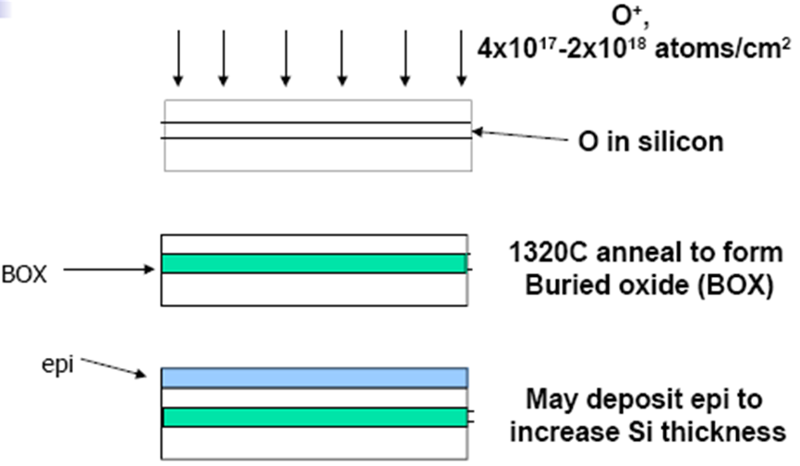
SIMOX (Separation by IMplantation of OXygen) for SOI wafer
SOI wafer =
silicon on insulator
SOI wafers provide better performance for high speed circuits than conventional wafers.
SOI wafer by SIMOX has better yield, but more expensive than wafer bonding and CMP process. (CMP = chemical mechanical polishing)
SIMOX depends on a peaked implant profile. Sharp interface are formed during annealing.
400nm buried oxide requires a high oxygen dose of 2×10¹⁸/cm², which is a slow process.

Slide 8
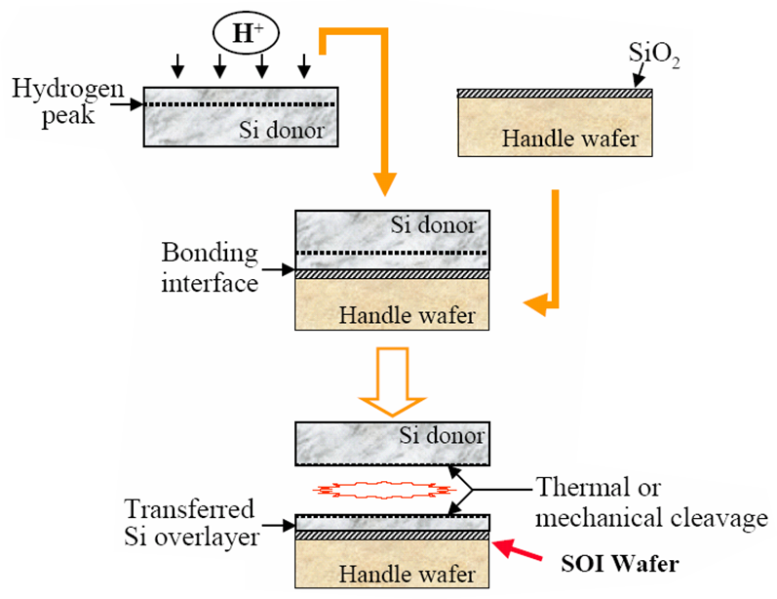
SOI wafer by smart-cut using hydrogen implantation
1. H⁺ ion implantation, 6×10¹⁶/cm² dose.
2. Direct wafer bonding.
3. Donor wafer cleavage with heat treatment or mechanical cleavage.

Slide 9
Chapter 8 Ion implantation
Introduction and application.
Ion implantation tools.
Dopant distribution.
Mask thickness and lateral distribution.
Effect of channeling.
Damage caused by ion implantation.
Damage repair.
NE 343: Microfabrication and Thin Film Technology
Instructor: Bo Cui, ECE, University of Waterloo, bcui@uwaterloo.ca
Textbook: Silicon VLSI Technology by Plummer, Deal, Griffin

Slide 10
Implantation equipment
IBS research implanter (pre-ship)
Applied Materials – Swift and Quantum series

Slide 11
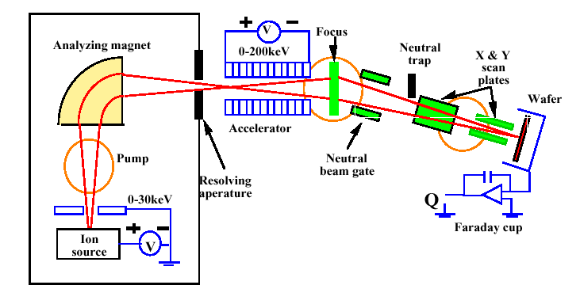
Schematic of an ion implanter
Ion source: operates at a high voltage(25kV) and convert the electrically neutral dopant atoms in the gas phase into plasma ions and undesired species. Some sources: Arsine, Phosphine, Diborane, … Solid can be sputtered in special ion sources.
Mass spectrometer: a magnet bend the ion beam through right angle, and select the desired impurity ion and purge undesired species. Selected ion passes through an aperture.
Accelerator: add energy to beam up to 5MeV. (contained, to shield possible x-ray).
Scanning system: x and y axis deflection plates are used to scan the beam across the wafer to produce uniform implantation of desired dose. The beam is bended to prevent the neutral particles from hitting the target .

Slide 12
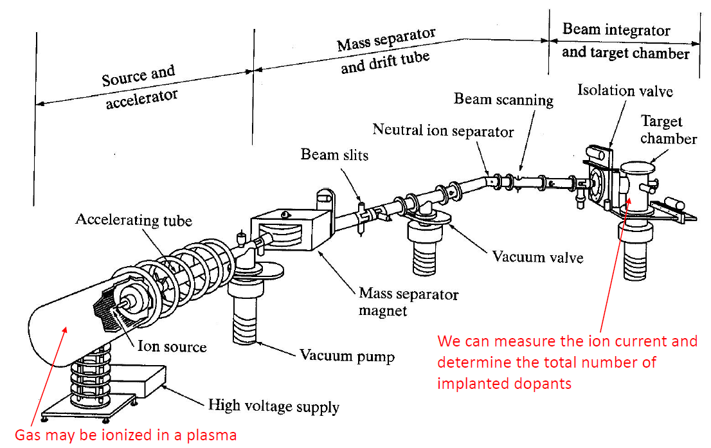
Schematic of an ion implanter

Slide 13
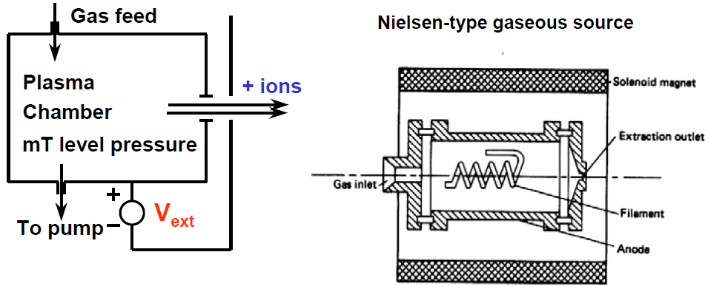
Plasma ion source and ion extraction
(extraction)
Variable extraction voltage
(typically ∼30KV )
Positive ions are attracted to the exit side of the source chamber, which is biased at a large negative potential with respect to the filament.
Filament emits electrons, which are accelerated to gain enough energy.
The electrons collide with the molecules or atoms, and ionize them.
The ions are extracted, rough-focused, then travel toward the magnetic analyzer.

Slide 14
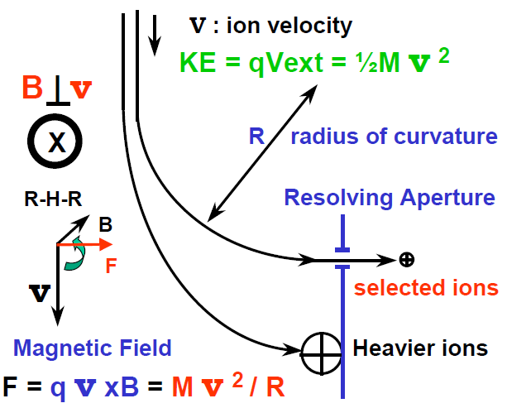
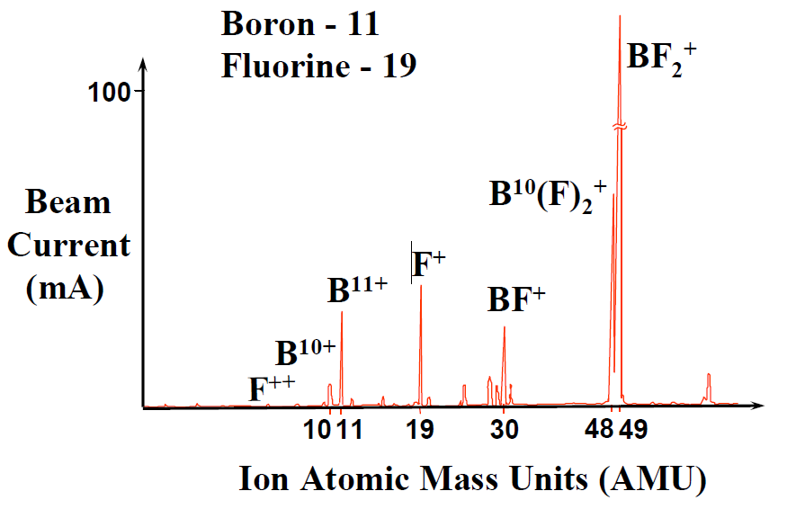
Select implantation species
Dopant gas containing desired species, BF₃, BCl₃, B₂H₆, PH₃, AsH₃, AsF₅.
If using solid or liquid source, they need to be heated to vaporize .
Plasma provides positive ions, (B¹¹)⁺, BF₂⁺, (P³¹)⁺, (P³¹)⁺⁺.
Only one mass will have exactly the correct radius of curvature to exit the source through the slit.
BF₃ gas spectrum

Slide 15
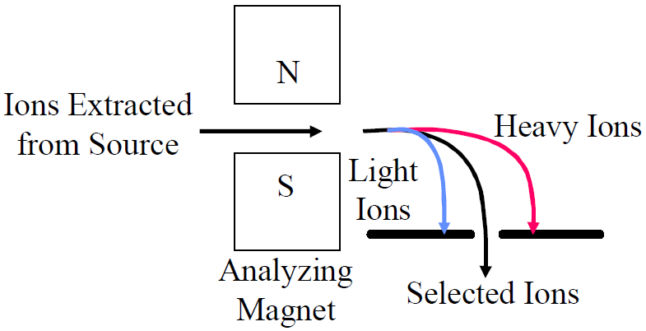
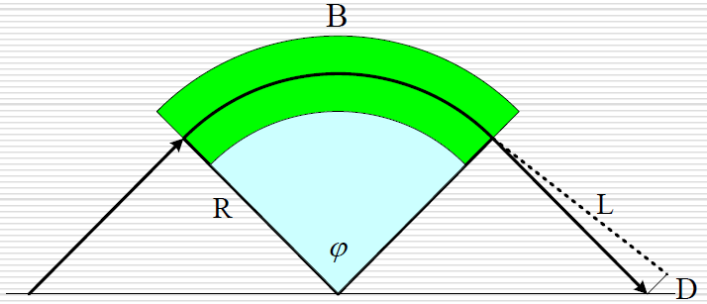
Analyzing magnet
An analyzer magnet bends the ion beam through a right angle to select the desired species.
The equation of forces:
The radius R:
Mass to charge ratio of the selected ions: M/q = R² B² / (2 V_{ext})
The displacement D: (should be 2/R, not 1/2R)
By adjusting the magnetic field, only selected ions will enter the accelerating column.

Slide 16
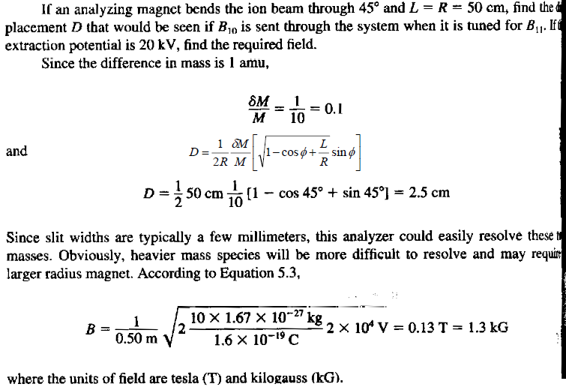
Example : Mass Resolution

Slide 17
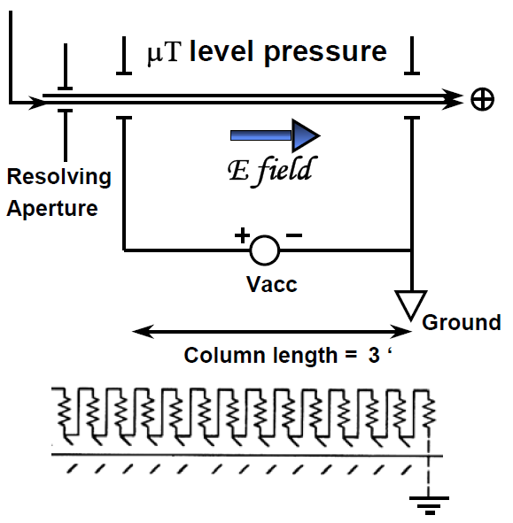
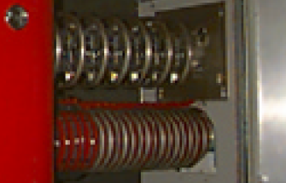
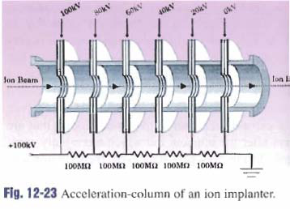
Ion acceleration
Final kinetic energy of the ion =
Q ( V_{ext} + V_{acc})
Example: V_{ext} = 30KV, V_{acc} = 70KV
Energy of the ion = 100 keV
This shows 14 equal acceleration plates.
For example, if the desired acceleration is 70keV, each section would contribute 5k volts.

Slide 18
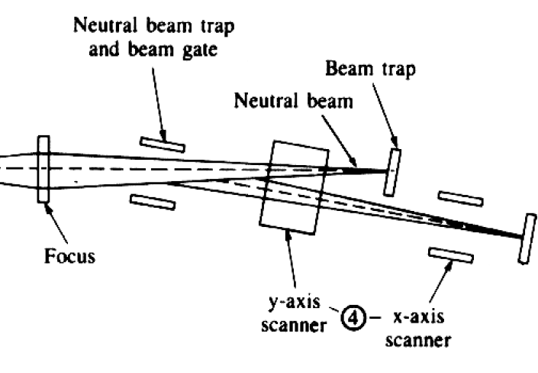
Neutral trap
There may be ions that collided with other ions in the beam, undergoing a charge exchange.
Neutrals are highly undesirable since they will not be deflected in electrostatic end-station scanning mechanisms.
To avoid this problem, most systems are equipped with a bend, i.e. parallel plates of an electrostatic deflection system.
Neutrals are not deflected and so do not follow the beam, but instead strike a beam stop.
The ions are sufficiently deflected by the plates to continue to travel down the tube.

Slide 19
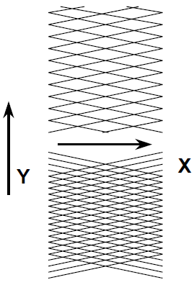
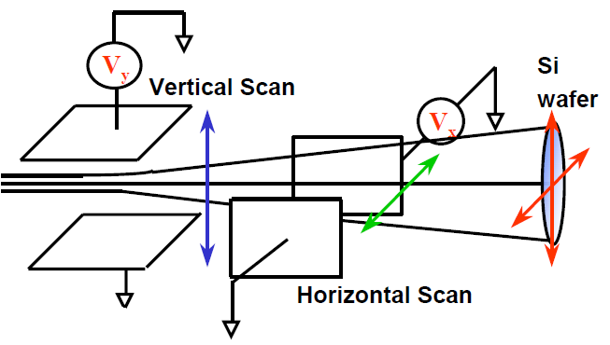
Beam scanning
Scan Patterns
Electrostatic scanning: low/medium beam current implanters, I < 1mA.
This type of implanter is suitable for low dose implants.
The beam current is adjusted to result in t > 10 sec/wafer.
With scan frequencies in the 100 Hz range, good implant uniformity is achieved with reasonable throughput.
The focused ion beam is scanned over the wafer in a highly controlled manner in order to achieve uniform doping.

Slide 20
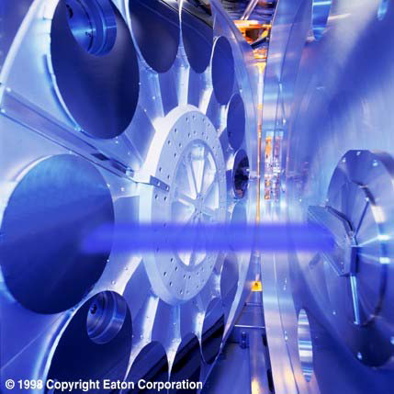
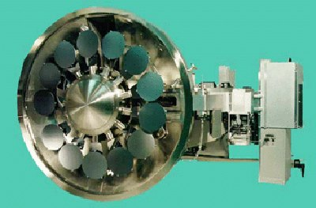
Mechanical scanning
Excellent wafer cooling needed.
Substantial load/unload time.
15 - 25 wafers /disc.
Excellent throughput for high dose implants.
High current (∼20mA)
Scan speed adjustment to insure uniform dose.
Eaton HE3 High Energy Implanter, showing the ion beam hitting the 300mm wafer end-station.
Multi-wafer, mechanical scanning end-station
Rotating disk, 1000rpm (rotations per minute).
Stationary ion beam, beam diameter ∼5cm.

Slide 21
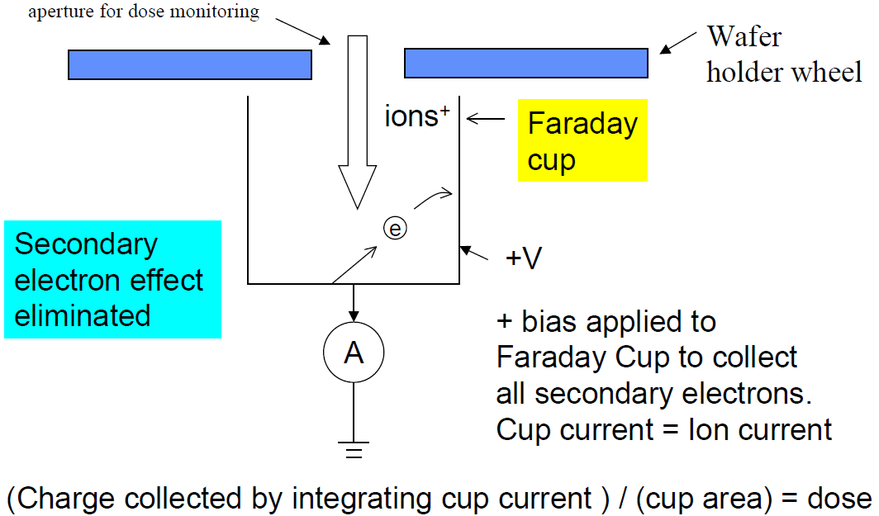
Practical implantation dosimetry (dose measurement)
The implant dose φ is the number of ions implanted per unit area (cm²) of the wafer.
If a beam current I is scanned for a time t , the total implanted charge Q = ( I x t ).

Slide 22
Chapter 8 Ion implantation
Introduction and application.
Ion implantation tools.
Dopant distribution profile.
Mask thickness and lateral distribution.
Effect of channeling.
Damage caused by ion implantation.
Damage repair.
NE 343: Microfabrication and Thin Film Technology
Instructor: Bo Cui, ECE, University of Waterloo, bcui@uwaterloo.ca
Textbook: Silicon VLSI Technology by Plummer, Deal, Griffin

Slide 23
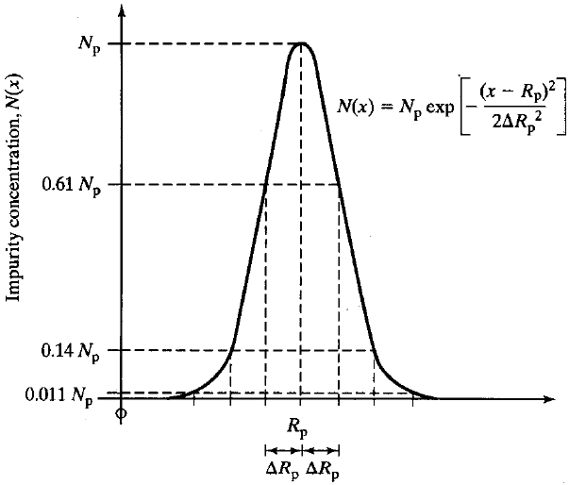
Dopant (impurity) concentration profile
Gaussian distribution for first order approximation.
R_{p}= projected range, is a function of ion energy and mass, and atomic number of impurity as well as target material.
ΔR_{p} = straggle = standard deviation.
N_{p} = peak concentration at x=R_{p}.
Dose Q=∫N(x)dx=(2π)^{1/2}N_{p} ΔR_{p}.
In textbook, C is used for concentration, to replace N used here.
The impurity is shown implanted completely below the wafer surface (x=0).

Slide 24
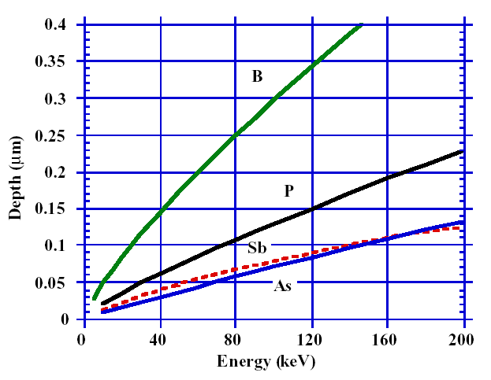
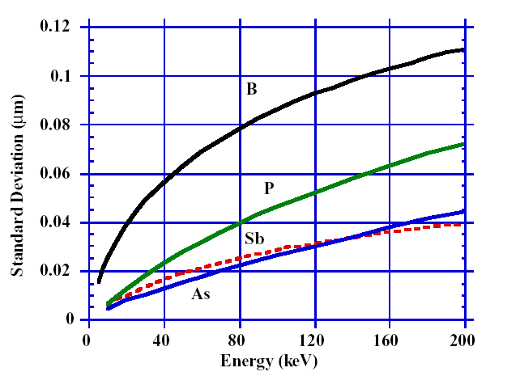
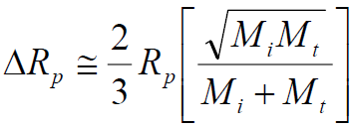
Projection range (depth) and straggle (standard deviation)
M_{i} and M_{t} are the masses for incident and target ion.

Slide 25
Example

Slide 26
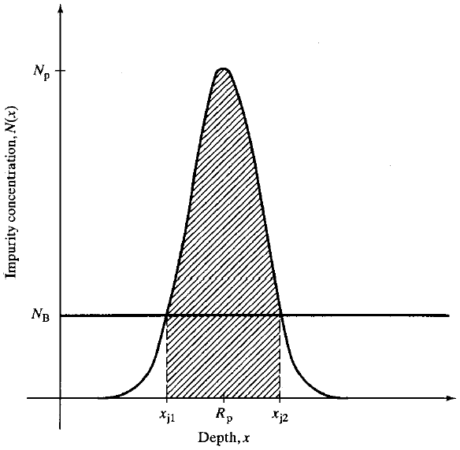
Junction depth in Si
Implant into Si already doped at N_{B}.
E.g. implant P into B-doped Si.
P: n-type doping; B: p-type.
Junction formation by impurity implantation. Two pn junctions are formed at x_{j1} and x_{j2}.

Slide 27
Example calculations

Slide 28
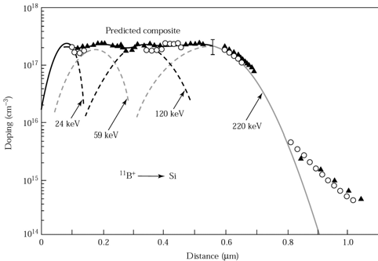
Composite doping profile using multiples implants.
In many application doping profiles other than the simple Gaussian are required.

Slide 29
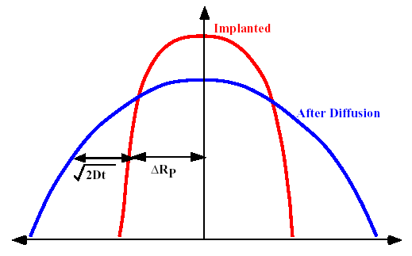
Diffusion during subsequent anneals
During high temperature steps after implant (most commonly an activation anneal), the implanted impurities will begin to diffuse, broadening the implantation profile.
For implantations far away from the surface and for reasonable short characteristic diffusion lengths, the new profile can be approximated by:
Dt ⇔ D₀t₀＋Dt

Slide 30
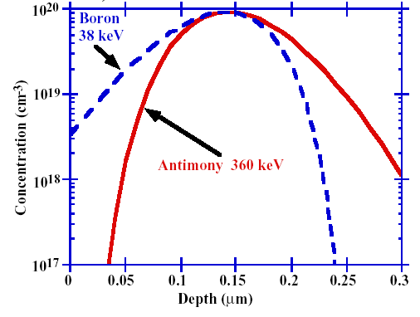
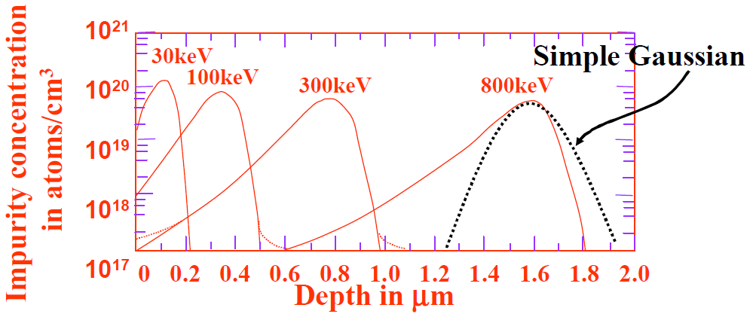
Real impurity distribution
Boron Implanted into Silicon
Light ions such as B experience a relatively large amount of backward scattering and fill in the distribution on the front side of the peak.
Heavy atoms such as antimony, experience a large amount of forward scattering and tend to fill in the profile on the substrate side of the peak.
This asymmetry is usually expressed in terms of the skewness moment.
The different skewness can be visualized by thinking of forward momentum.
A more accurate distribution can be obtained by including kurtosis distribution.
A number of model has been proposed to explain this behavior. The most common one is known as Pearson type – IV (complicated).

Slide 31
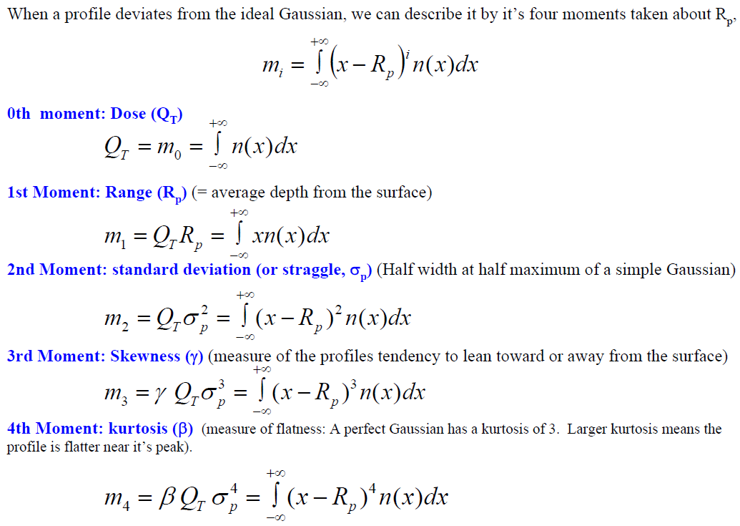
Moments description

Slide 32
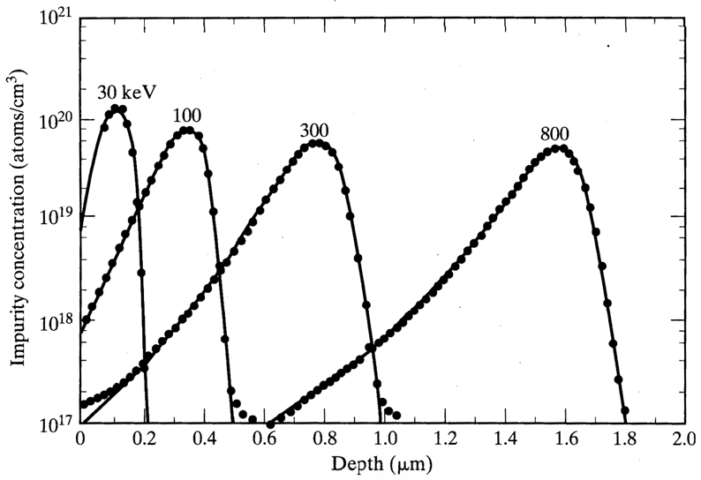
Ion implantation: Pearson IV profile
Measured boron impurity distributions compared with four moments (i.e. Pearson IV) distribution functions. The boron was implanted into amorphous silicon without annealing.
Very good “curve fitting”.

Slide 33
Chapter 8 Ion implantation
Introduction and application.
Ion implantation tools.
Dopant distribution profile.
Mask thickness and lateral distribution.
Effect of channeling.
Damage caused by ion implantation.
Damage repair.
NE 343: Microfabrication and Thin Film Technology
Instructor: Bo Cui, ECE, University of Waterloo, bcui@uwaterloo.ca
Textbook: Silicon VLSI Technology by Plummer, Deal, Griffin

Slide 34
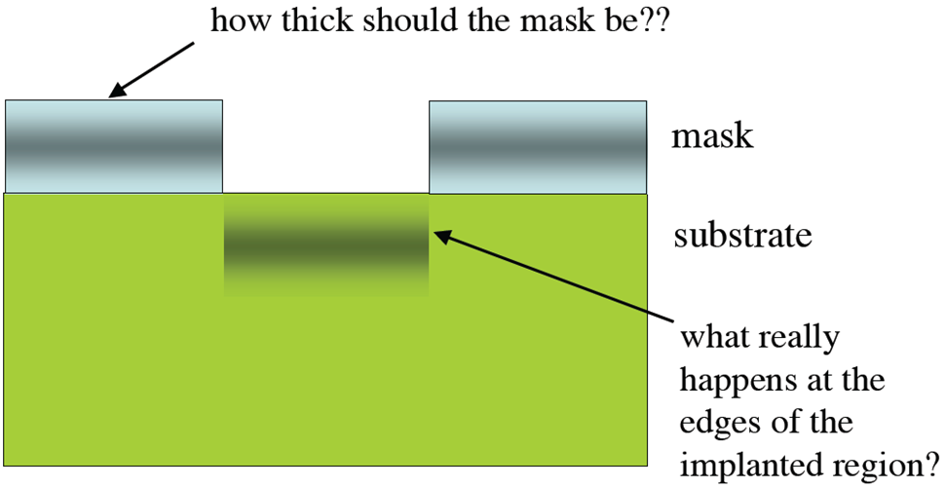
Masking implants
Implant only certain part of the wafer:
Use a mask such that its R_{p} lies within the mask material.
Used to form self-aligned source and drain region (masked by gate) in MOSFET.
(lateral spreading of dopant)

Slide 35
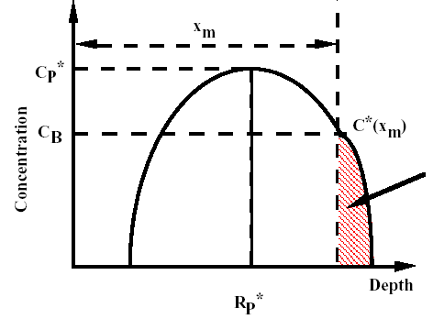
How thick mask is needed?
In order to act as an efficient mask, the thickness of the mask should be large enough that the tail of the implant profile in the silicon should not significantly alter the doping concentration (C_{B}).
Mask Si
(“*” means for value in the mask layer)
Mask thickness x_{m}
Dose penetrating the mask:
Rule of thumb: good masking thickness
X_{m} = R_{p} + 4.3ΔR_{p}, C(x=X_{m})/C(x=R_{p}) ∼ 10⁻⁴.

Slide 36
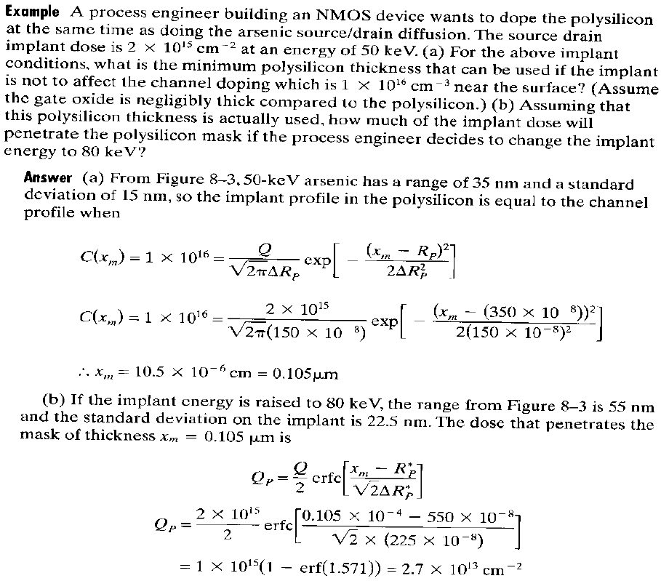

Slide 37
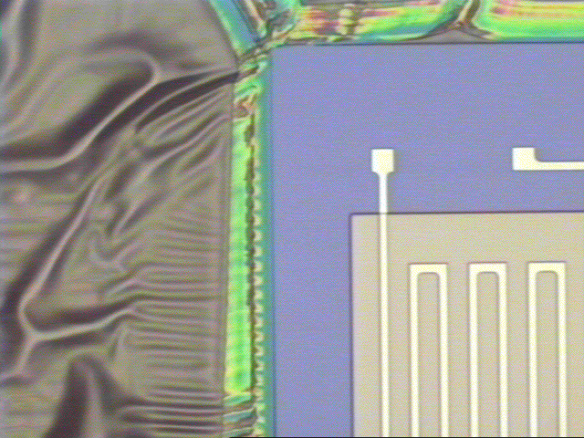
Mask material: resist
Photoresist is commonly used as implant mask.
Resist may flow or be baked to such an extent that it is difficult to remove after implant.
Outgassing: ions striking resist surface break apart the organic molecules in resist, leading to formation of gaseous H₂ that evolves from resist surface, leaving behind involatile carbon.
Heavily implanted resist layers often have a hardened carbonized layer near surface difficult to remove later on.
The outgassing can raise the pressure in the end station sufficiently to cause neutralization of ion beam through impact with the H₂ molecules, resulting in significant dose rate errors.
Resist damage at high implant currents
BF₂⁺ implant at 80μA in Varian 400 without a water cooled chuck
(water cool can reduce the problem)

Slide 38
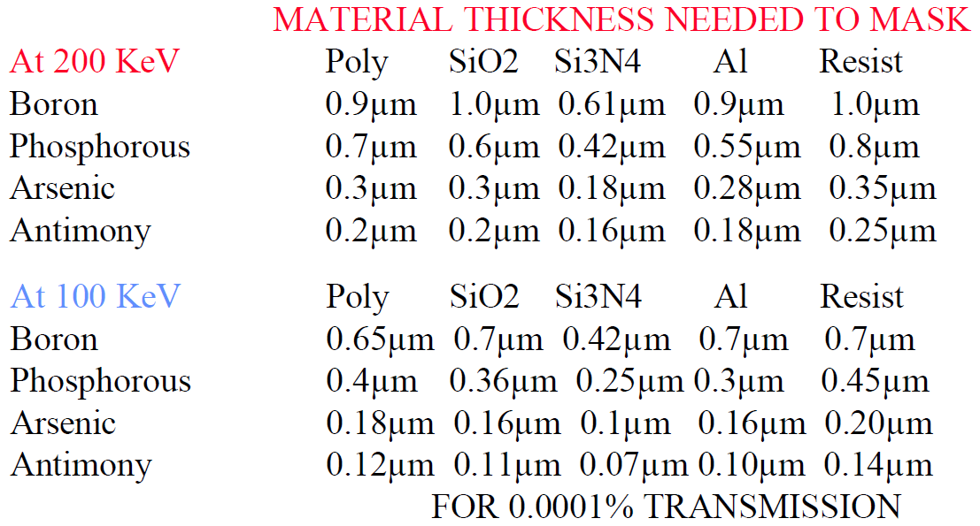
Mask material thickness

Slide 39
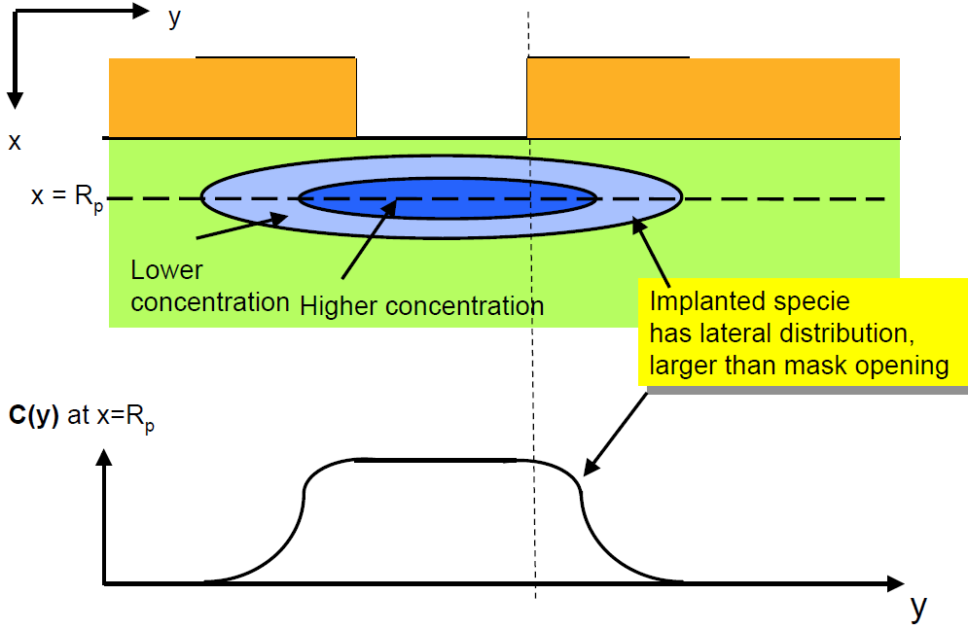
Lateral scattering
The implanted ion also scatter laterally
around the impact point, which can also
be approximated by Gaussian distribution with transverse straggle ΔR_{T}.

Slide 40
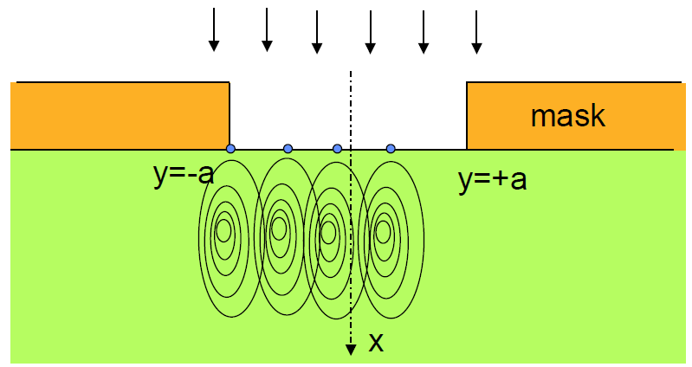
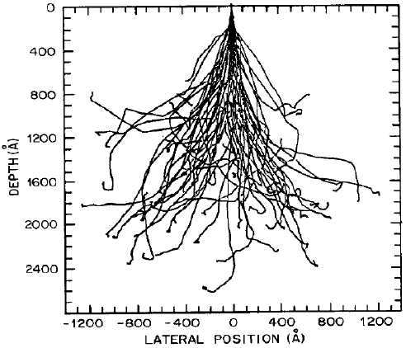
A 2-D formulation of implantation profile
Monte Carlo simulation of many ions into Si

