Slide 1
Chapter 9 Thin film deposition
Introduction to thin film deposition.
Introduction to chemical vapor deposition (CVD).
Atmospheric Pressure Chemical Vapor Deposition (APCVD).
Other types of CVD (LPCVD, PECVD, HDPCVD…).
Introduction to evaporation.
Evaporation tools and issues, shadow evaporation.
Introduction to sputtering and DC plasma.
Sputtering yield, step coverage, film morphology.
Sputter deposition: reactive, RF, bias, magnetron, collimated, and ion beam.
Deposition methods for thin films in IC fabrication.
Atomic layer deposition (ALD).
Pulsed laser deposition (PLD).
Epitaxy (CVD or vapor phase epitaxy , molecular beam epitaxy).
NE 343: Microfabrication and thin film technology
Instructor: Bo Cui, ECE, University of Waterloo; http://ece.uwaterloo.ca/~bcui/
Textbook: Silicon VLSI Technology by Plummer, Deal and Griffin

Slide 2
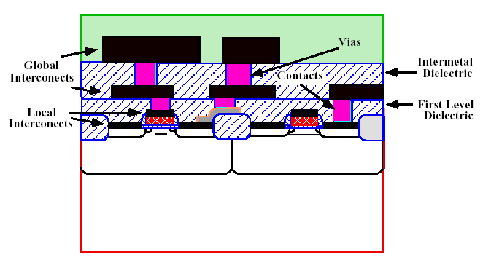
Thin film
Thin film: thickness typically <1000nm.
Special properties of thin films: different from bulk materials, it may be –
Not fully dense
Under stress
Different defect structures from bulk
Quasi ‐ two dimensional (very thin films)
Strongly influenced by surface and interface effects
Typical steps in making thin films:
Emission of particles from source (heat, high voltage . . .)
Transport of particles to substrate
Condensation of particles on substrate
Lithography, thin film deposition and its etching are the three most important processes for micro-nano fabrication.

Slide 3
Thin film deposition methods
Two main deposition methods are used today:
Chemical Vapor Deposition (CVD)
Reactant gases introduced in the chamber, chemical reactions occur on wafer surface leading to the deposition of a solid film.
E.g. APCVD, LPCVD, PECVD, most commonly used for dielectrics and Si.
Physical Vapor Deposition (PVD) (no chemical reaction involved)
Vapors of constituent materials created inside the chamber, and condensation occurs on wafer surface leading to the deposition of a solid film.
E.g. evaporation, sputter deposition, most commonly used for metals.
Other methods that are increasingly gaining importance in ULSI fabrication:
Coating with a liquid that becomes solid upon heating, e.g. spin-on-glass used for planarization.
Electro-deposition: coating from a solution that contains ions of the species to be coated. E.g. Cu electroplating for global interconnects.
Thermal oxidation.

Slide 4
General characteristics of thin film deposition
Deposition rate
Film uniformity:
  Across wafer uniformity.
  Run-to-run uniformity.
Materials that can be deposited: metal, dielectric, polymer.
Quality of film:
  Physical and chemical properties
  Electrical property, breakdown voltage
  Mechanical properties, stress and adhesion to substrate
  Optical properties, transparency, refractive index
  Composition, stoichiometry
  Film density, defect (pinhole…) density
  Texture, grain size, boundary property, and orientation
  Impurity level, doping
Deposition directionality:
  Directional - good for lift-off, trench filling
  Non-directional - good for step coverage
Cost of ownership and operation.

Slide 5
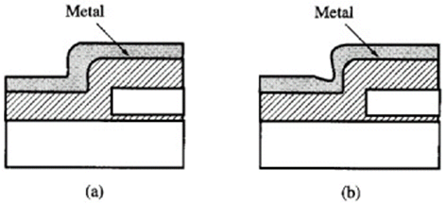
Step coverage
conformal
non-conformal
Poor (non-conformal) step coverage is good for liftoff.
Conformal film is good for electrical connection…
Figure 9-1 Step coverage of metal over non-planar topography.
Conformal step coverage, with constant thickness on horizontal and vertical surfaces.
Poor step coverage, here thinner for vertical surfaces.

Slide 6
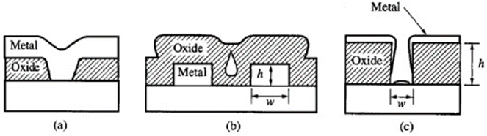
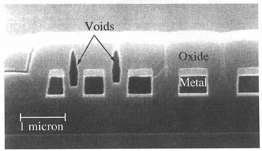
Thin film filling of holes/trenches
Aspect ratio (AR):
AR = feature height/width AR = h/w
Figure 9-2 Thin film filling issues.
Good metal filling of a via or contact in a dielectric layer.
Silicon dioxide filling of the space between metal lines, with poor filling leading to void formation.
Poor filling of the bottom of a via hole with a barrier or contact meal.
Voids in a chemical vapor deposition (CVD) oxide layer for narrow spaces between metal lines.
More difficult to fill without void for higher aspect ratio.
Figure 9-3

Slide 7
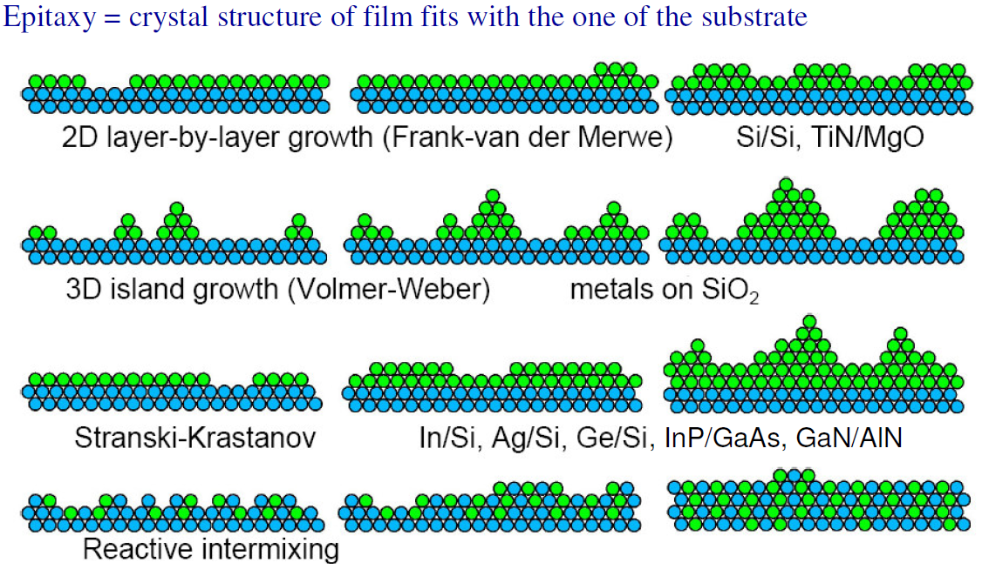
Four equilibrium growth/deposition modes

Slide 8
Four growth modes
Layer by layer growth (Frank ‐ van der Merwe): film atoms more strongly bound to substrate than to each other and/or fast diffusion
Island growth (Volmer ‐ Weber): film atoms more strongly bound to each other than to substrate and/or slow diffusion.
Mixed growth (Stranski ‐ Krastanov): initially layer by layer then forms three dimensional islands.
Thin film types based on crystallinity:
Epitaxial (single‐crystalline, formed layer-by-layer, lattice match to substrate): no grain boundaries, requires high temperatures and slow growth rate. High quality thin films such as III‐V semiconductor films (e.g. GaAs) and complex oxides.
Polycrystalline (island or mixed growth): lots of grain boundaries, e.g. most elemental metals grown near room temperatures.
Amorphous (island or mixed growth): no‐crystalline structures (yet with some short range atomic ordering), no crystalline defects, e.g. common insulators such as amorphous SiO₂.

Slide 9
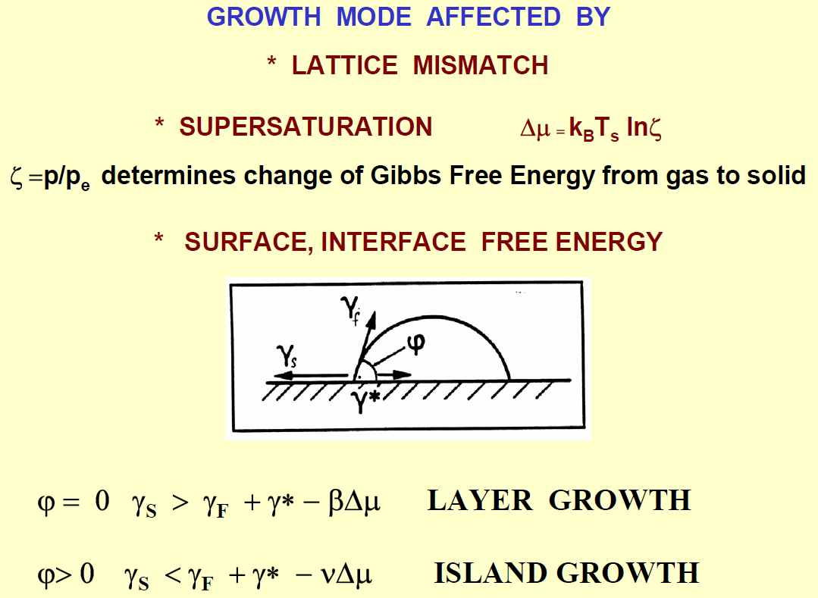
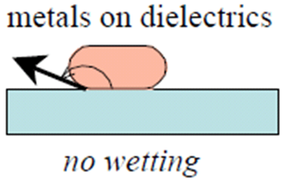
Equilibrium growth modes
(important only for epitaxy)
(wetting properties)
Noble metals don’t bond (“wet”) to Si/SiO₂ substrate, so tend to have island growth.
Ag always form island (not continuous film); Au is better than Ag.
Adhesion layer Ti or Cr can reduce island formation, but for Ag, surface is still very rough.
Here, higher adhesion is because Ti or Cr bond chemically to O in SiO₂.

Slide 10
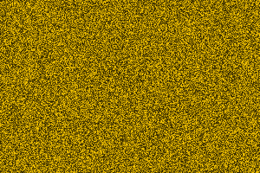
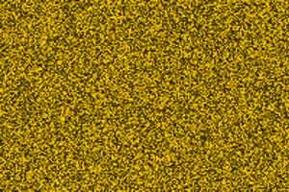

Effect of substrate temperature on the lateral grain size
100 Å thick Au films deposited at 100, 200, and 300℃ by vacuum evaporation
100ºC
200ºC
The small islands start coalescing with each other in an attempt to reduce the surface area.
This tendency to form bigger islands is termed agglomeration and is enhanced by increasing the surface mobility of the adsorbed species, such as by increasing the substrate temperature.
Except under special conditions, the crystallographic orientation and the topographical details of different islands are randomly distributed.
300ºC
Notes:
The Lateral grain size is expected to increase with decreasing super-saturation and increasing surface mobility of the adsorbed species. As a result, deposits with well-defined large grains are formed at high substrate and source temperatures, both of which result in high surface mobility.
Note that increasing the kinetic energy of the incident species, as, for example, by increasing the source temperature in the case of deposition by vacuum evaporation and by increasing the sputtering voltage in the case of deposition by sputtering, also increases the surface mobility.
Under a given set of deposition condition, the grain size of the film increase as its thickness increases.

Slide 11
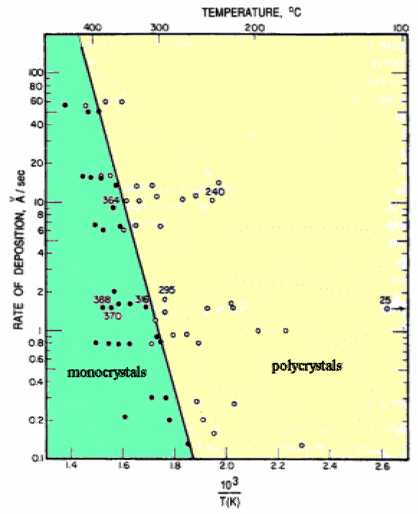
Dependence on substrate temperature and deposition rate
In this case, if equilibrium is achieved for all ad-atoms, film will be mono-crystal (epitaxy).
Higher temperature increases ad-atom’s surface mobility. It will stop once it finds the lowest energy position nearby.
But too fast deposition stops the movement (before the ad-atom finds the lowest energy position nearby) when that ad-atom is covered by a later arrival ad-atom.
Cu films deposited on (111) NaCl substrate.

Slide 12
Chapter 9 Thin film deposition
Introduction to thin film deposition.
Introduction to chemical vapor deposition (CVD).
Atmospheric Pressure Chemical Vapor Deposition (APCVD).
Other types of CVD (LPCVD, PECVD, HDPCVD…).
Introduction to evaporation.
Evaporation tools and issues, shadow evaporation.
Introduction to sputtering and DC plasma.
Sputtering yield, step coverage, film morphology.
Sputter deposition: reactive, RF, bias, magnetron, collimated, and ion beam.
NE 343: Microfabrication and Thin Film Technology
Instructor: Bo Cui, ECE, University of Waterloo, bcui@uwaterloo.ca
Textbook: Silicon VLSI Technology by Plummer, Deal, Griffin

Slide 13
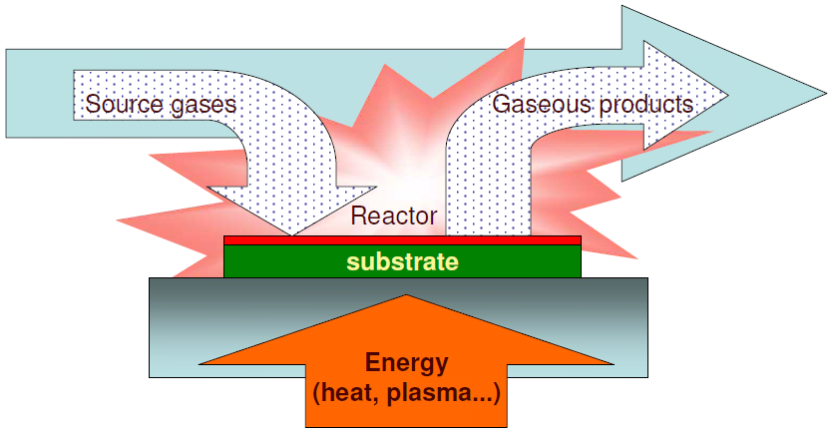
Chemical Vapor Deposition (CVD)
CVD : deposit film through chemical reaction and surface absorption.
CVD steps:
Introduce reactive gases to the chamber.
Activate gases (decomposition) by heat or plasma.
Gas absorption by substrate surface .
Reaction take place on substrate surface, film firmed.
Transport of volatile byproducts away form substrate.
Exhaust waste.

Slide 14
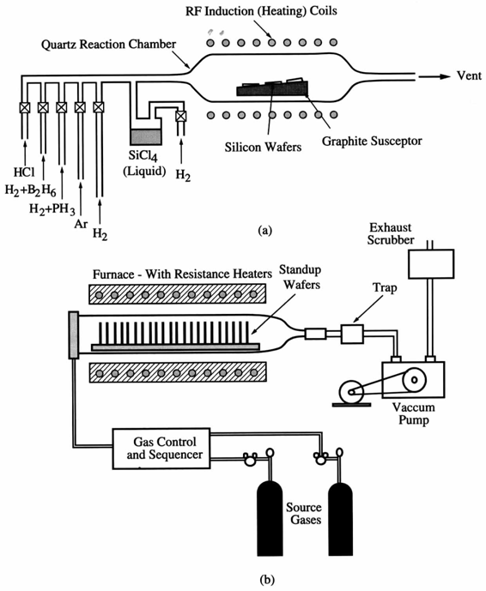
Chemical vapor deposition (CVD) systems
Atmospheric cold-wall system used for deposition of epitaxial silicon.
(SiCl₄ + 2H₂ → Si + 4HCl)
Low pressure hot-wall system used for deposition of polycrystalline and amorphous films, such as poly-silicon and silicon dioxide.
Figure 9-4

Slide 15
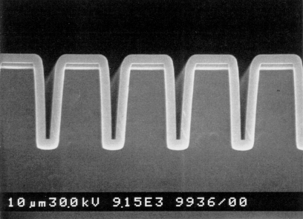
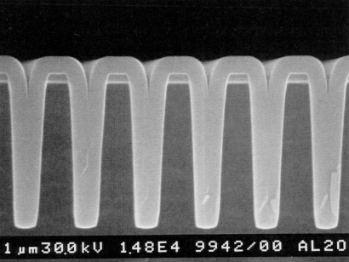
CVD advantages and disadvantages
(as compared to physical vapor deposition)
Advantages:
High growth rates possible, good reproducibility.
Can deposit materials which are hard to evaporate.
Can grow epitaxial films. In this case also termed as “vapor phase epitaxy (VPE)”. For instance, MOCVD (metal-organic CVD) is also called OMVPE (organo-metallic VPE).
Generally better film quality, more conformal step coverage (see image below).
Disadvantages:
High process temperatures.
Complex processes, toxic and corrosive gasses.
Film may not be pure (hydrogen incorporation…).

Slide 16
Types of CVD reactions
Thermal decomposition
AB(g) ---> A(s) + B(g)
Si deposition from Silane at 650ºC: SiH₄(g) → Si(s) + 2H₂(g)
Ni(CO)₄(g) → Ni(s) + 4CO(g) (180ºC)
Reduction (using H₂)
AX(g) + H₂(g) → A(s) + HX(g)
W deposition at 300ºC: WF₆(g) + 3H₂(g) → W(s) + 6HF(g)
SiCl₄(g) + 2H₂(g) → Si(s) + 4HCl (1200ºC)
Oxidation (using O₂)
AX(g) + O₂(g) → AO(s) + [O]X(g)
SiO₂ deposition from silane and oxygen at 450ºC (lower temp than thermal oxidation): SiH₄(g) + O₂(g) ---> SiO₂(s) + 2H₂(g)
2AlCl₃(g) + 3H₂(g) + 3CO₂(g) → Al₂O₃ + 3CO + 6HCl (1000ºC)
(O is more electronegative than Cl)
Compound formation (using NH₃ or H₂O)
AX(g) +NH₃(g) → AN(s) + HX(g) or AX(g) + H₂O(g ) → AO(s) + HX(g)
Deposit wear resistant film (BN) at 1100ºC: BF₃(g) + NH₃(g) → BN(s) + 3HF(g)
(CH₃)₃Ga(g) + AsH₃(g) → GaAs(s) + 3CH₄ (650 – 750ºC)

Slide 17
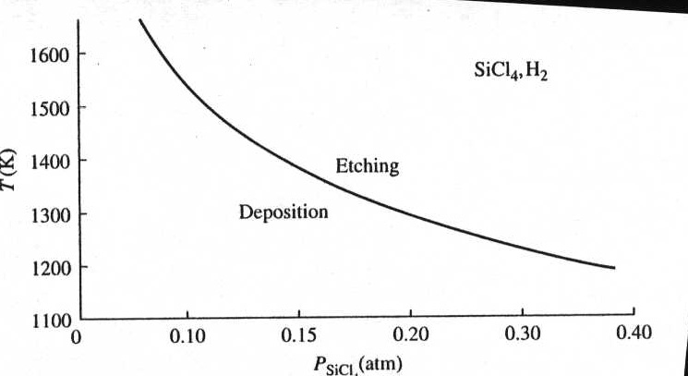
Chemical reactions for silicon epitaxial growth
T(K)
Pressure of SiCl₄ (atm)
(HCl etches Si at high T, which is used to prepare electronic grade Si)
Except SiH₄ decomposition, ALL other reactions are reversible.
Which direction (etching of Si or growth of Si) to go depends on the partial pressures of the reactants and temperature.

Slide 18
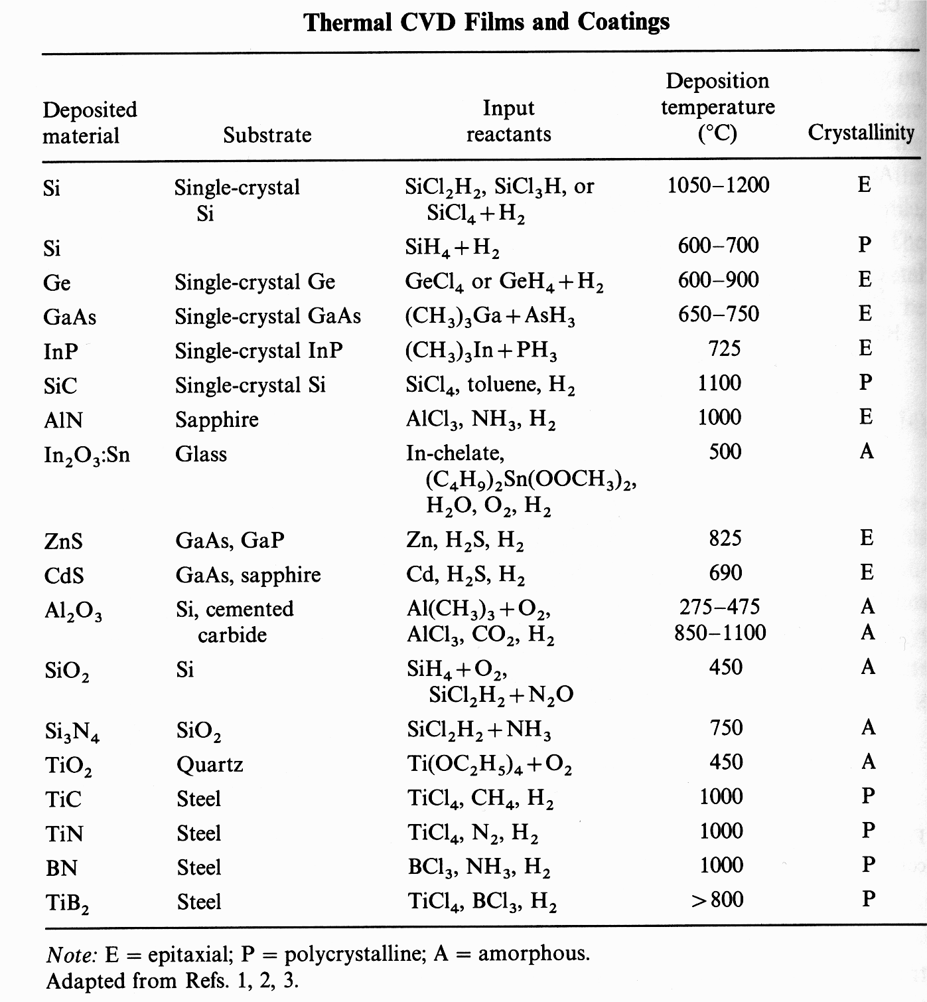
Thermal (not plasma-enhanced) CVD films
(Al₂O₃)

Slide 19
CVD sources and substrates
Types of sources
    Gasses (easiest)
    Volatile liquids
    Sublimable solids
    Combination
Source materials should be
    Stable at room temperature
    Sufficiently volatile
      High enough partial pressure to get good growth rates
    Reaction temperature < melting point of substrate
    Produce desired element on substrate with easily removable by-products
    Low toxicity
Substrates
  Need to consider adsorption and surface reactions
  For example, WF₆ deposits on Si but not on SiO₂

Slide 20
Types of CVD
APCVD (Atmospheric Pressure CVD), mass transport limited growth rate, leading to non-uniform film thickness.
LPCVD (Low Pressure CVD)
Low deposition rate limited by surface reaction, so uniform film thickness (many wafers stacked vertically facing each other; in APCVD, wafers have to be laid horizontally side by side.
Gas pressures around 1-1000mTorr (lower P => higher diffusivity of gas to substrate)
Better film uniformity & step coverage and fewer defects
Process temperature ≥500°C
PECVD (Plasma Enhanced CVD)
Plasma helps to break up gas molecules: high reactivity, able to process at lower temperature and lower pressure (good for electronics on plastics).
Pressure higher than in sputter deposition: more collision in gas phase, less ion bombardment on substrate
Can run in RF plasma mode: avoid charge buildup for insulators
Film quality is poorer than LPCVD.
Process temperature around 100 - 400°C.
MOCVD (Metal-organic CVD, also called OMVPE - organo metallic VPE), epitaxial growth for many optoelectronic devices with III-V compounds for solar cells, lasers, LEDs, photo-cathodes and quantum wells.

Slide 21
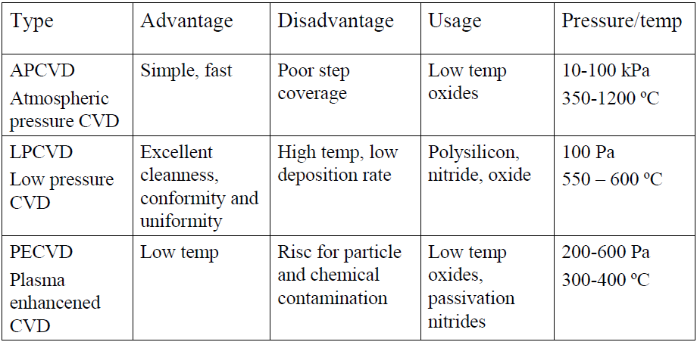
Types of CVD
and epitaxy Si…
(can have high deposition rate)
(can be higher)
For R&D, PECVD is most popular, followed by LPCVD.

Slide 22
Chapter 9 Thin film deposition
Introduction to thin film deposition.
Introduction to chemical vapor deposition (CVD).
Atmospheric Pressure Chemical Vapor Deposition (APCVD).
Other types of CVD (LPCVD, PECVD, HDPCVD…).
Introduction to evaporation.
Evaporation tools and issues, shadow evaporation.
Introduction to sputtering and DC plasma.
Sputtering yield, step coverage, film morphology.
Sputter deposition: reactive, RF, bias, magnetron, collimated, and ion beam.
NE 343: Microfabrication and Thin Film Technology
Instructor: Bo Cui, ECE, University of Waterloo, bcui@uwaterloo.ca
Textbook: Silicon VLSI Technology by Plummer, Deal, Griffin

Slide 23
Steps involved in a CVD process
Reaction rate may be limited by:
Gas transport to/from surface.
Surface chemical reaction rate that depends strongly on temperature.
Figure 9-5
Transport of reactants to the deposition region.
Transport of reactants from the main gas stream through the boundary layer to the wafer surface.
Adsorption of reactants on the wafer surface.
Surface reactions, including: chemical decomposition or reaction, surface migration to attachment sites (kinks and ledges); site incorporation; and other surface reactions (emission and redeposition for example).
Desorption of byproducts.
Transport of byproducts through boundary layer.
Transport of byproducts away from the deposition region.
Steps 2-5 are most important for growth rate.
Steps 3-5 are closely related and can be grouped together as “surface reaction” processes.

Slide 24
Derivation of film growth rate
(similar to/simpler than Deal-Grove model for thermal oxidation)
F₁ = diffusion flux of reactant species to the wafer through the boundary layer (step 2) = mass transfer flux
(1)
where h_{G} is the mass transfer coefficient (in cm/sec).
F₂ = flux of reactant consumed by the surface reaction (steps 3-5) = surface reaction flux,
Figure 9-6
(2)
where k_{S} is the surface reaction rate (in cm/sec).
In steady state: F = F₁ = F₂
(3)
Equating Equations (1) and (2) leads to
(4)
The growth rate of the film is now given by
(5)
where N is the number of atoms per unit volume in the film and Y is the mole fraction (partial pressure/total pressure) of the incorporating species, C_{T} is total concentration of all molecules in the gas phase .

Slide 25
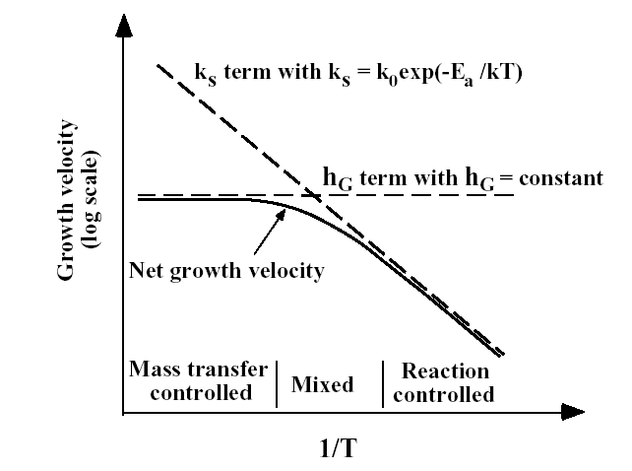
Derivation of film growth rate (continued)
(5)
(a). If k_{S} << h_{G}, then we have the
surface reaction controlled case:
(6)
(b) If h_{G} << k_{S}, then we have the mass transfer,
or gas phase diffusion, controlled case:
(7)
k_{s} increases with temperature.
(Arrhenius with E_{A} depending on the particular reaction, e.g. 1.6 eV for single crystal silicon deposition).
h_{G} ≈ constant
(diffusion through boundary layer is insensitive to temperature)
Higher T.
Lower T.

Slide 26
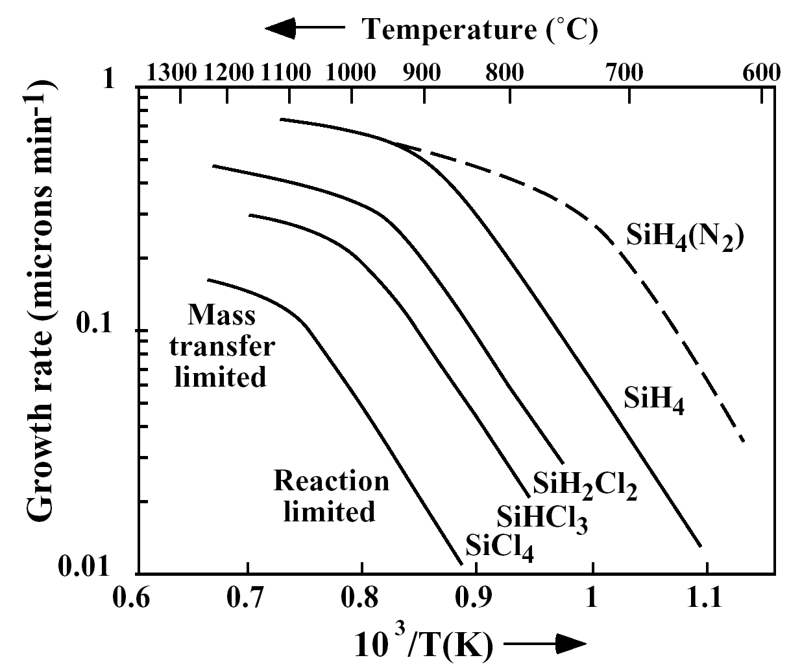
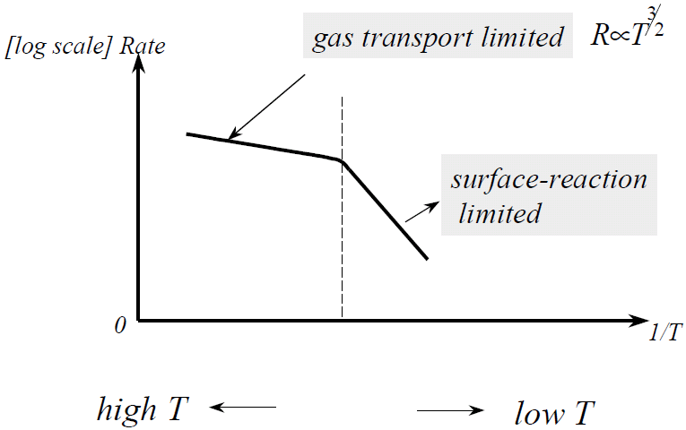
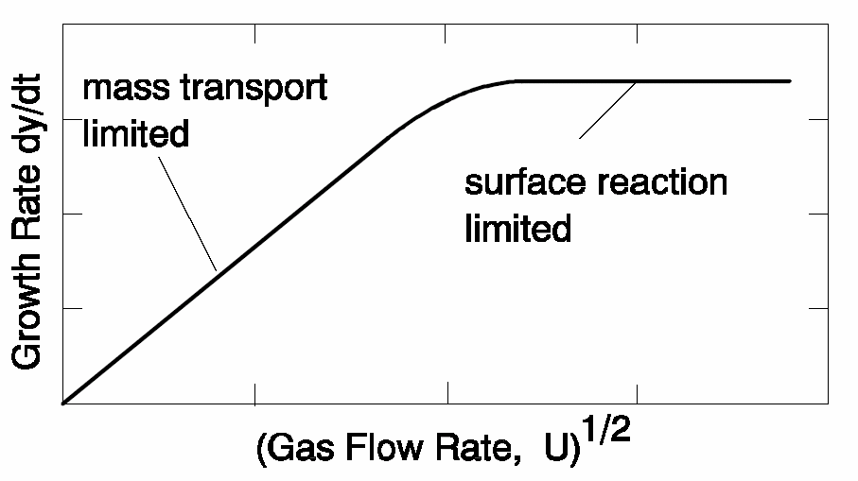
CVD film growth rate
Actually h_{G} is not constant (depends on T)
Figure 9-8
Deposition rate vs. gas glow rate
Figure 9-8 Growth or deposition rate for silicon by APCVD. The partial pressure of the reactant gas is 0.8Torr (1atm=760Torr!!).
H₂ is used as the carrier or diluent gas for the solid curves.
For SiH₄, using N₂ carrier gas increases the growth rate, because the carrier gas H₂ is a reaction product of SiH₄ decomposition, thus slowing down the reaction.

Slide 27
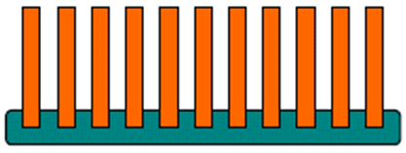
Chemical Vapor Deposition (CVD) growth rate
k_{S} limited deposition is VERY temperature sensitive.
h_{G} limited deposition is VERY geometry (boundary layer) sensitive.
Si epitaxial deposition is often done at high T to get high quality single crystal growth. It is then h_{G} controlled, and horizontal reactor configuration is needed for uniform film thickness across the wafer.
When a high film quality is less critical (e.g. SiO₂ for inter-connect dielectric), deposition is done in reaction rate controlled regime (lower temperature). Then one can greatly increase the throughput by stacking wafers vertically (for research, usually 25 wafers per run; 100-200 for industry).

Slide 28
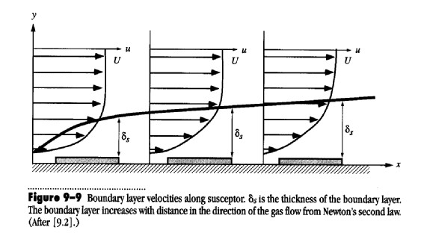


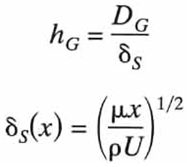
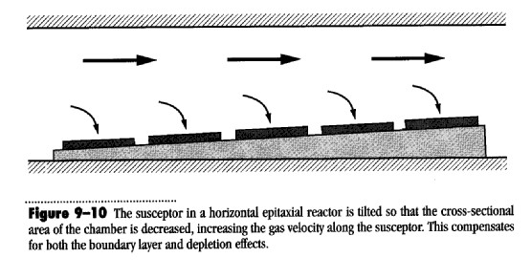
Other factors affecting growth rate: thickness of boundary layer and source gas depletion
Gas moves with the constant velocity U.
Boundary layer (caused by friction ) increases along the susceptor, so mass transfer coefficient h_{G} decreases.
Source gas also depletes (consumed by chemical reaction) along the reactor.
Both decrease growth rate along the chamber.
To compensate for this, one can:
Use tilted susceptor.
Use temperature gradient 5-25°C.
Gas injectors along the tube.
Use moving belt.
D_{G}: diffusivity
μ: gas viscosity
ρ: gas density
U: flow velocity
X: gas flow direction
Should be ∂C/∂y, since diffuse along y-direction
I don’t understand why not operates in the zone where δ→tube radius (independent of x).

Slide 29
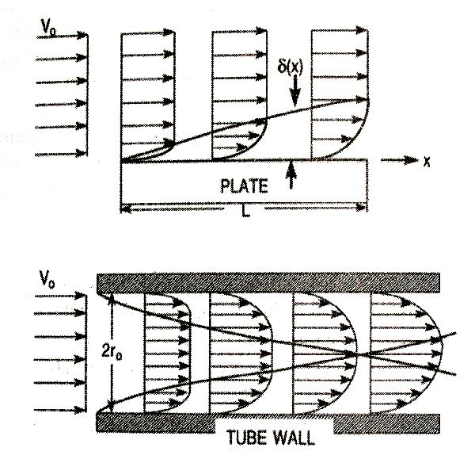
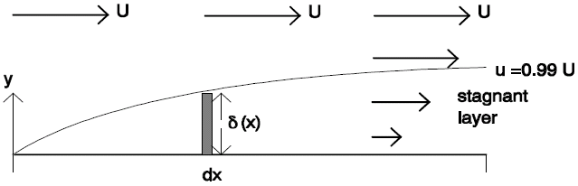
Mass transport in gas
Two flow Regimes
  Molecular flow (diffusion in gas, particle transfer).
  Viscous flow (laminar & turbulent flow, moment transfer).
Laminar flow is desired.
In CVD growth rate model, it was assumed that mass transport across the stagnant layer proceeds by diffusion.
δ→ tube radius when x is large
Mass transport depends on:
Fundamental parameters | Experimental parameters
Reactant concentration | Pressure
Diffusivity | Gas velocity
Boundary layer thickness | Temperature distribution
 | Reactor geometry
 | Gas properties (viscosity . . .)
Transport of reactants:
Flow along x-direction.
Diffusion along y-direction. (anyway, no flow along y-direction)

Slide 30
Doping in CVD films
Doping is usually done for epitaxial (thus single crystal) film during film growth.
Dopant will be grown directly onto crystalline site (no need of dopant activation).
Doping is realized by adding gas containing the dopant. Such as PH₃, B₂H₆, AsH₃ (all gas phase at room temperature); or PCl₃, BCl₃, AsCl₃ (all liquid at RT).
They will go through: dissociation, lattice site incorporation, and burying of dopants by other atoms in the film.
The dopant concentration C: (P is partial pressure of he dopant species, and v growth rate)
However, there is also unintentional doping process:
  Out-diffusion of dopant from heavily doped substrate into the epi-layer.
  Auto-doping – dopant from substrate diffuses into gas stream first, then back into epi-layer.

Slide 31
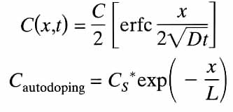
Auto-doping and out-diffusion in CVD film growth
Figure 9-11 Auto-doping processes in an epitaxial reactor. Illustrated are evaporation from 1) the wafer front side; 2) the wafer backside or edges; 3) other wafers; and 4) the susceptor.
Out-diffusion:
Auto-doping:
Film thickness = = characteristic diffusion length.
That is, the growth is faster than diffusion after certain time t.

Slide 32
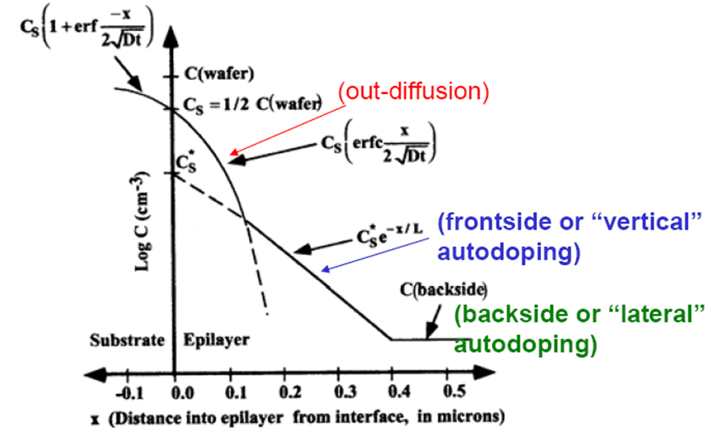
Auto-doping and out-diffusion in CVD film growth
Here substrate is more heavily doped than the epitaxial layer.
Figure 9-12 Dopant profile in a Si epi-layer due to out-diffusion and auto-doping.

Slide 33
Chapter 9 Thin film deposition
Introduction to thin film deposition.
Introduction to chemical vapor deposition (CVD).
Atmospheric Pressure Chemical Vapor Deposition (APCVD).
Other types of CVD (LPCVD, PECVD, HDPCVD…).
Introduction to evaporation.
Evaporation tools and issues, shadow evaporation.
Introduction to sputtering and DC plasma.
Sputtering yield, step coverage, film morphology.
Sputter deposition: reactive, RF, bias, magnetron, collimated, and ion beam.
NE 343: Microfabrication and Thin Film Technology
Instructor: Bo Cui, ECE, University of Waterloo, bcui@uwaterloo.ca
Textbook: Silicon VLSI Technology by Plummer, Deal, Griffin

Slide 34
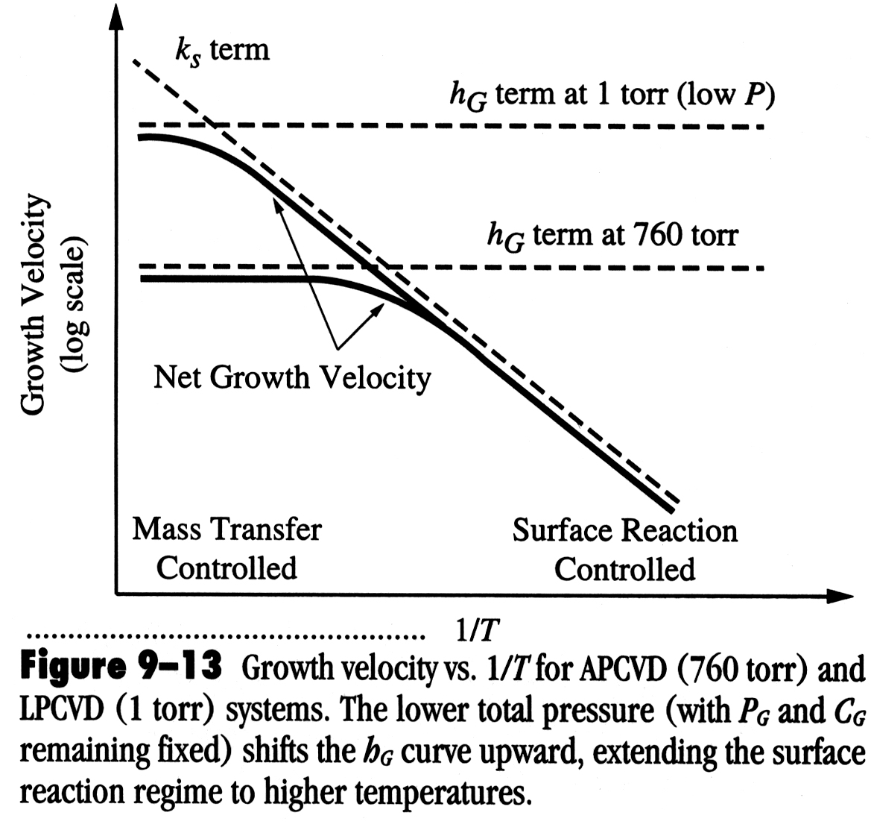

Low Pressure Chemical Vapor Deposition (LPCVD)
Atmospheric pressure systems (APCVD) have major drawbacks:
• At high T, a horizontal configuration must be used (few wafers at a time).
• At low T, the deposition rate goes down and throughput is again low.
The fundamental reason (I think) for the low throughput of APCVD is that only a small percentage of the gas is reactant gases, with the rest carrier/diluent gas.
Obviously, the solution is to operate at low pressure – LPCVD.
In the mass transfer limited regime,
But
(8)
So as P_{total} goes down, D_{G} and hence h_{G} will go up.
E.g. when pressure reduced from 1 atmosphere to 1 Torr (760×), h_{G} increases by ~100× (because δ_{s} increases by only 5-7×).
Higher h_{G} means higher T can be used while still k_{s} < h_{G} (i.e. still in surface reaction controlled regime).
δ Is always < tube radius.
ρ→ρ/760, U↑, μ↓
This is not one expects: lower pressure means less reactants, so lower rate. But for APCVD, the reactant gas is only a small portion of the total gas.

Slide 35
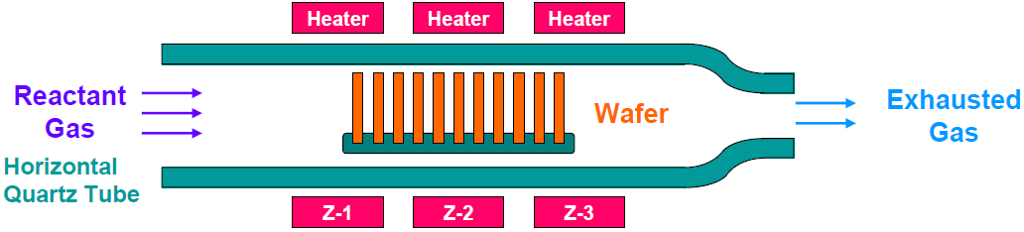
Low Pressure Chemical Vapor Deposition (LPCVD)
LPCVD reactors use: P = 0.25 – 2.0Torr, T = 500 – 900°C.
Transport of reactants from gas phase to surface through boundary layer is still not rate limiting (despite the high T), so wafers can be stacked vertically for high throughput (100-200 wafers per run).
Because LPCVD operates in reaction limited regime, it is VERY sensitive to temperature and so temperature needs to be controlled closely (within +/- 1ºC), so use hot walled reactor for this precise control.
Again, a 5-25ºC temperature gradient is often created to offset source gas depletion effects (or one can use distributed feeding).
Requires no carrier gas, and low gas pressure reduces gas-phase reaction which causes particle cluster that contaminants the wafer and system.
Less auto-doping (at lower P), as out-diffused dopant gas pumped away quickly.

Slide 36
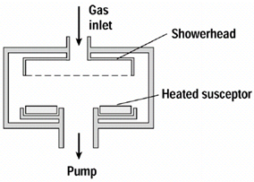
Low Pressure Chemical Vapor Deposition (LPCVD)
Hot-wall
Possible disadvantages:
For too low temperature, deposition rates may be too low, film quality decreases.
Shadowing (less gas-phase collisions) due to directional diffusion to the surface, so deterioration of the step coverage and filling.
Seems cold wall reactors also exist: cold wall reduce deposition on walls, which leads to depletion of deposition species and particle formation that may flake off walls and fall on wafers.
Besides poorer temperature control than hot wall, gas convection is another problem.
Cold-wall

Slide 37
Plasma Enhanced CVD (PECVD)
“Good” quality films (though generally not as good as LP or APCVD films deposited at much higher T): energy supplied by plasma (i.e. ion bombardment of film) increases film density, composition, and step coverage.
Cold-wall
Use RF-induced plasma to transfer energy into the reactant gases, forming radicals that is very reactive. (RF: radio-frequency, typically 13.56MHz for PECVD)
Low temperature process (<300ºC), as thermal energy is less critical when RF energy exists.
Used for depositing film on metals (Al…) and other materials that cannot sustain high temperatures. (APCVD/LPCVD at such low temperatures gives increased porosity and poor step coverage)
Surface reaction limited deposition, thus substrate temperature control is important to ensure uniformity.
At low T, surface diffusion is slow, so one must supply kinetic energy for surface diffusion – plasma (ion bombardment) provides that energy and enhances step coverage.
Disadvantages: plasma damage, not pure film (often lots of H incorporated into film).

Slide 38
PECVD process parameter
Substrate temperature (100-300ºC, up to 1000ºC PECVD available)
  Control by external heater, very little heating from PECVD process
Gas flow (10s to 100s sccm – standard cubic centimeter per minute)
  Higher flow rates can increase deposition rate and uniformity
Pressure (P ≈ 50mTorr – 5Torr )
  Changes the energy of ions reaching electrodes
  Can change deposition rate
  Increases pressure may lead to chemical reactions in the gas
  Effects also depend on gas concentration
Power (10s to 100s watts)
  Affects the number of electrons available for activation and the energy of those electrons
  Increased power may lead to chemical reactions in gas
  Increased power increases deposition rate
Frequency (mostly 13.56MHz, same for plasma etching and sputter deposition)
  Changes plasma characteristics
  Changes ion bombardment characteristics

Slide 39
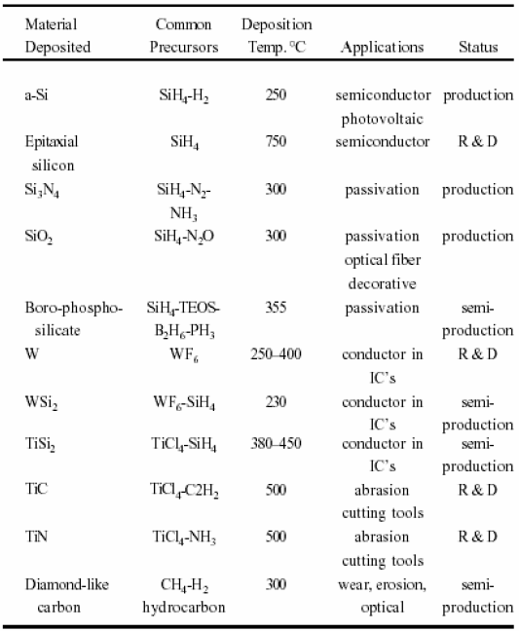
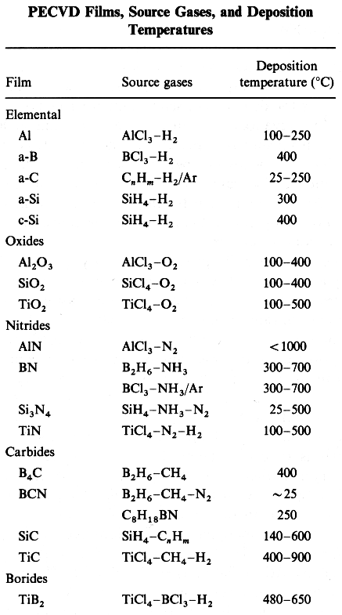
Examples of PECVD systems and applications

Slide 40
High Density Plasma (HDP) CVD
High density plasma CVD gives dense layers (SiO₂) at low T (150 °C) and low P (1- 10 mTorr); T increases to 400°C by bombardment.
Separate RF (gives substrate biasing for bombardment) from plasma generation (electron cyclotron resonance ECR and inductively coupled plasma ICP).
Simultaneous deposition and sputtering/ bombardment. Improved planarization and filling due to preferential sputtering of sloped surface.
Mostly used for SiO₂ deposition in backend processes.

Slide 41
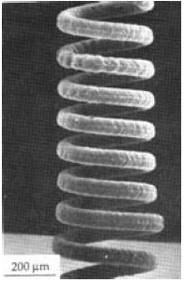
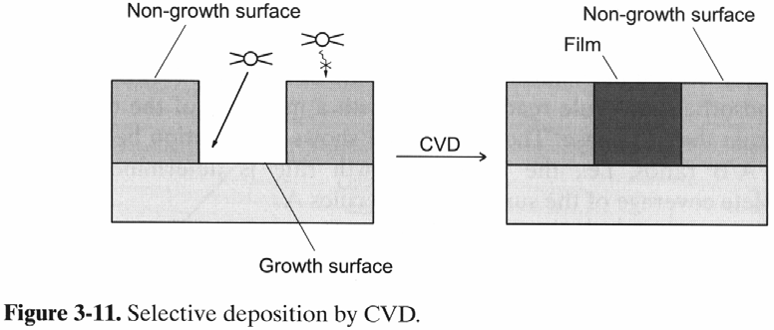
Miscellaneous: selective deposition and laser CVD
Selective deposition:
Especially important in microelectronics, surface patterning and 3D-growth.
Reaction rate of precursor is limited on a non-growth surface. E.g. deposition of Cu from (hfac)Cu(PMe₃) occur on Cu, Pt… but not on SiO₂.
Growth surface acts as co-reactant, and is selectively consumed. E.g. Si reacts with WF₆ or MoF₆, while reaction at SiO₂ or Si₃N₄ is slower.
A chemical reaction of a gaseous co-reactant occur on the growth surface. E.g. H₂ dissociation on a metal surface, but not on SiO₂ or metal oxide surfaces.
Laser CVD
(energy provided by laser)
Tungsten spring grown by laser CVD.

Slide 42
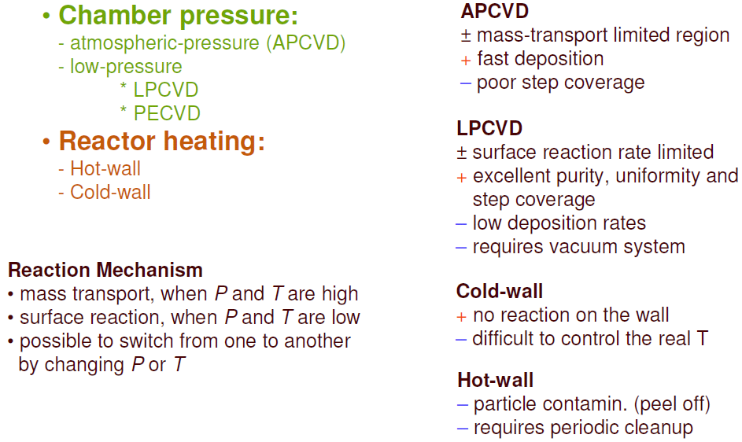
CVD reactor types: quick summary
According to the LPCVD slides, APCVD growth rate should be lower, which is not true. Because: (?? I think)
In APCVD reactive gas partial pressure could be set much higher than that in LPCVD.
Its pressure could be much lower (by 10×) than 1atm and is still called APCVD.
Gas transport actually increases with T as T^{3/2} (APCVD is usually done at higher T than LPCVD).
When putting wafer side-by-side facing the gas, more exposed to gas, thus faster transport.

