Slide 1
Chapter 9 Thin film deposition
Introduction to thin film deposition.
Introduction to chemical vapor deposition (CVD).
Atmospheric Pressure Chemical Vapor Deposition (APCVD).
Other types of CVD (LPCVD, PECVD, HDPCVD…).
Introduction to evaporation.
Evaporation tools and issues, shadow evaporation.
Introduction to sputtering and DC plasma.
Sputtering yield, step coverage, film morphology.
Sputter deposition: reactive, RF, bias, magnetron, collimated, and ion beam.
Deposition methods for thin films in IC fabrication.
Atomic layer deposition (ALD).
Pulsed laser deposition (PLD).
Epitaxy (CVD or vapor phase epitaxy , molecular beam epitaxy).
NE 343: Microfabrication and thin film technology
Instructor: Bo Cui, ECE, University of Waterloo; http://ece.uwaterloo.ca/~bcui/
Textbook: Silicon VLSI Technology by Plummer, Deal and Griffin

Slide 2
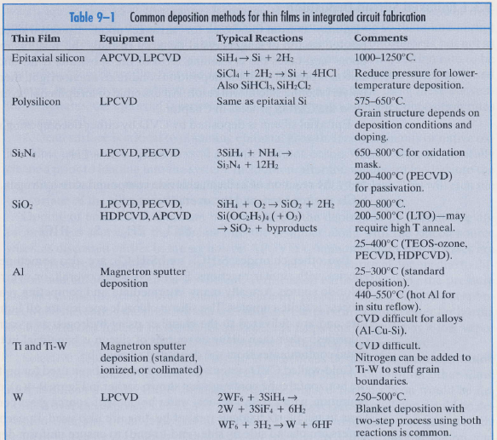
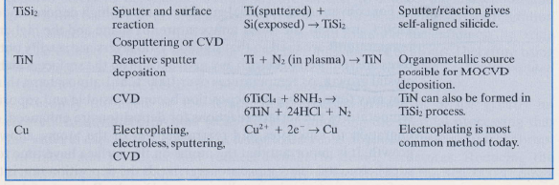
Common deposition methods for thin films in IC fabrication

Slide 3
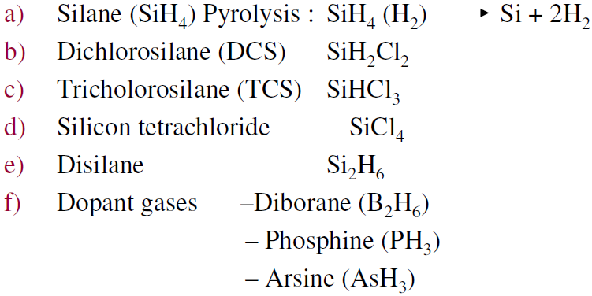
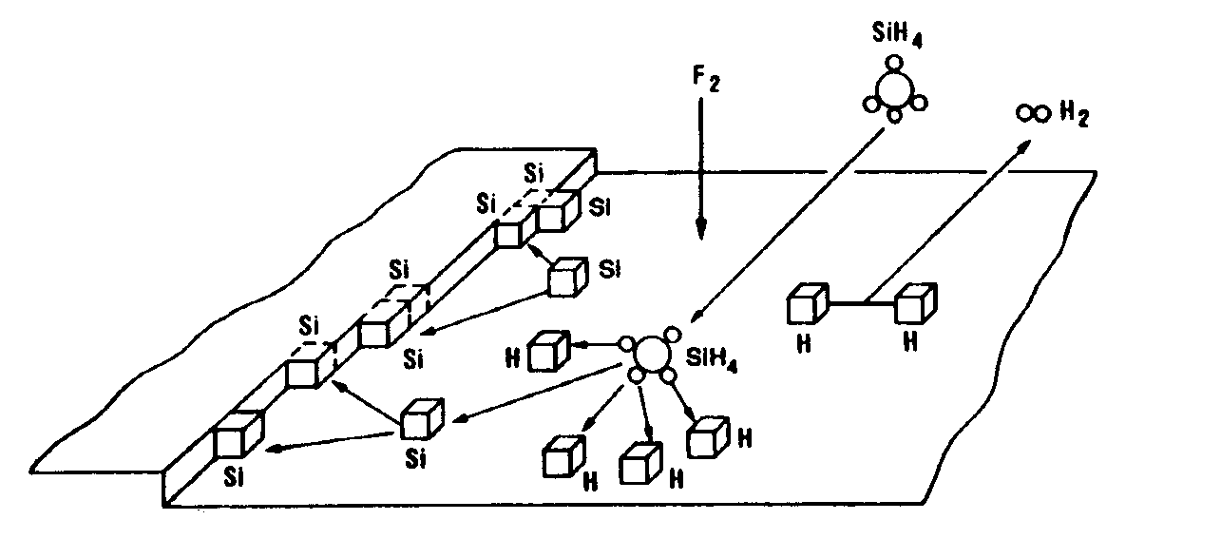
Epitaxial silicon deposition
Advantages of epitaxial wafers over bulk wafers
Offers means of controlling the doping profile (e.g. lightly doped on heavily doped possible)
Epitaxial layers are generally oxygen and carbon free
Gases used iin siilliicon epiittaxy

Slide 4
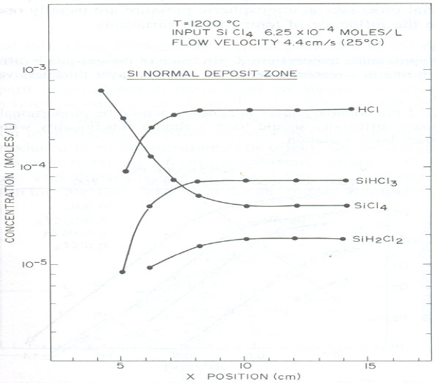
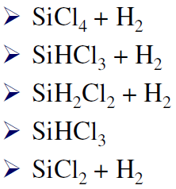
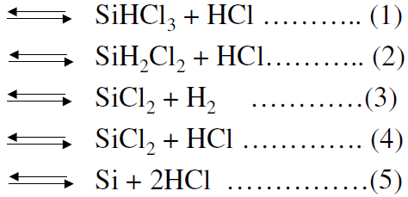
Chemical reactions
Concentration o of species at different positions along a horizontal reactor (carrier gas should be H₂)
SiCl₄ + 2H₂ → Si + 4HCl
SiCl₄ concentration decreases while the other three constituents (SiHCl₃, SiH₂Cl₂, HCl) increase.

Slide 5
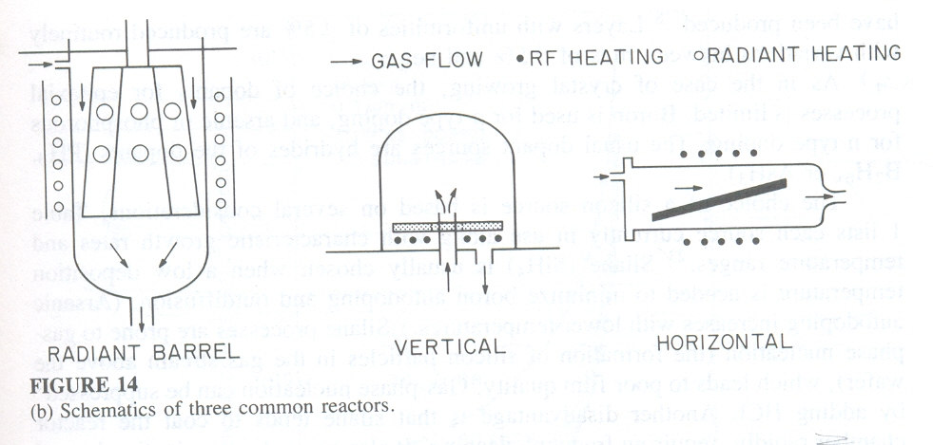
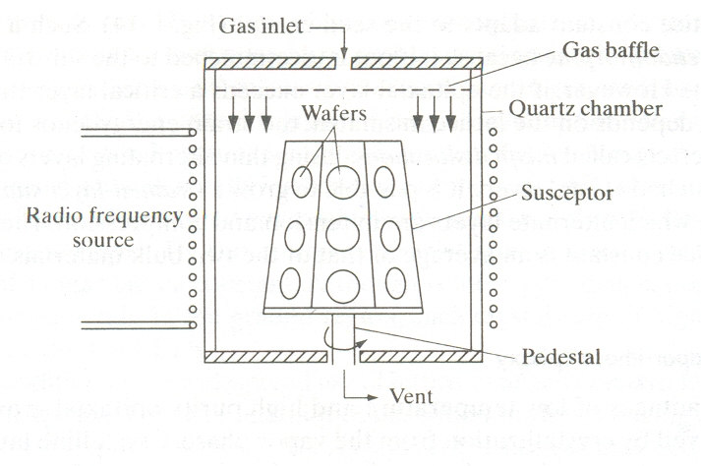
Equipment
Three basic reactor configurations
Weight 2000 Kg
Occupy 2m² or more of floor space.
Quartz reaction chamber with susceptors
Graphite susceptors for physical support.
A coating of silicon carbide (50 to 500 μm) applied by CVD process on susceptors.
RF heating coil or tungsten halogen lamps (cold wall), water cooling.

Slide 6
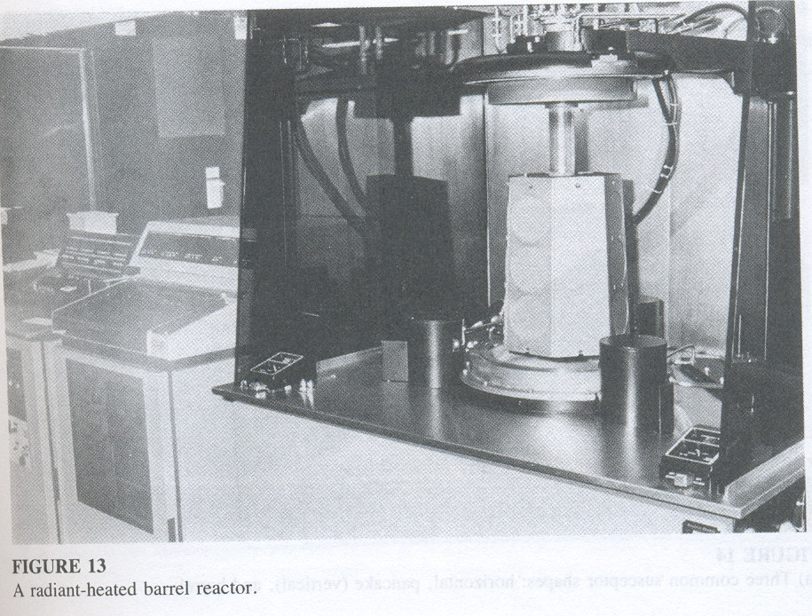

Slide 7
Si APCVD epitaxy growth process
Hydrogen gas purges of air from the reactor.
Reactor is heated to a temperature.
After thermal equilibrium, an HCl etch takes place at 1150ºC and 1200ºC for 3 minutes.
Temperature is reduced to growth temperature.
Silicon source and dopant flows are turned on.
After growth, temperature is reduced by shutting off power.
Hydrogen flow replaced by nitrogen flow.
Depending on wafer diameter and reactor type, 10 to 50 wafers per batch can be formed.
Process cycle times are about one hour.
Epitaxy film need high temperature (>1000ºC) because at high temperature the (amorphous) native oxide will become unstable and desorb from the surface, exposing the single crystalline silicon lattice for epitaxy.

Slide 8
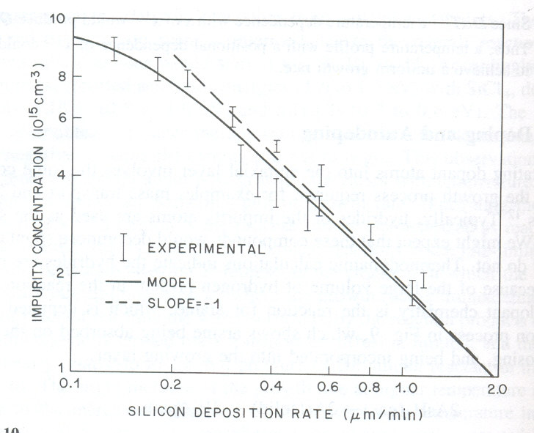
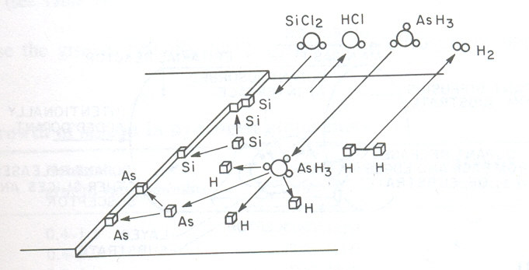
Arsine doping and growth processes
2AsH₃ (gas) → 2As (solid) + 3H₂ (gas)
Interaction between doping process & growth process
Growth rate influences the amount of dopant incorporated in Si
Equilibrium established at low growth rates.
There is also auto-doping, which can be minimized by:
Fast growth to minimize out-diffusion.
Low temperature deposition reduces boron auto-doping (not As however).
Seal backside of substrate with highly doped poly-oxide.
Avoid the use of HCl etching.
Reduced pressure epitaxy.

Slide 9
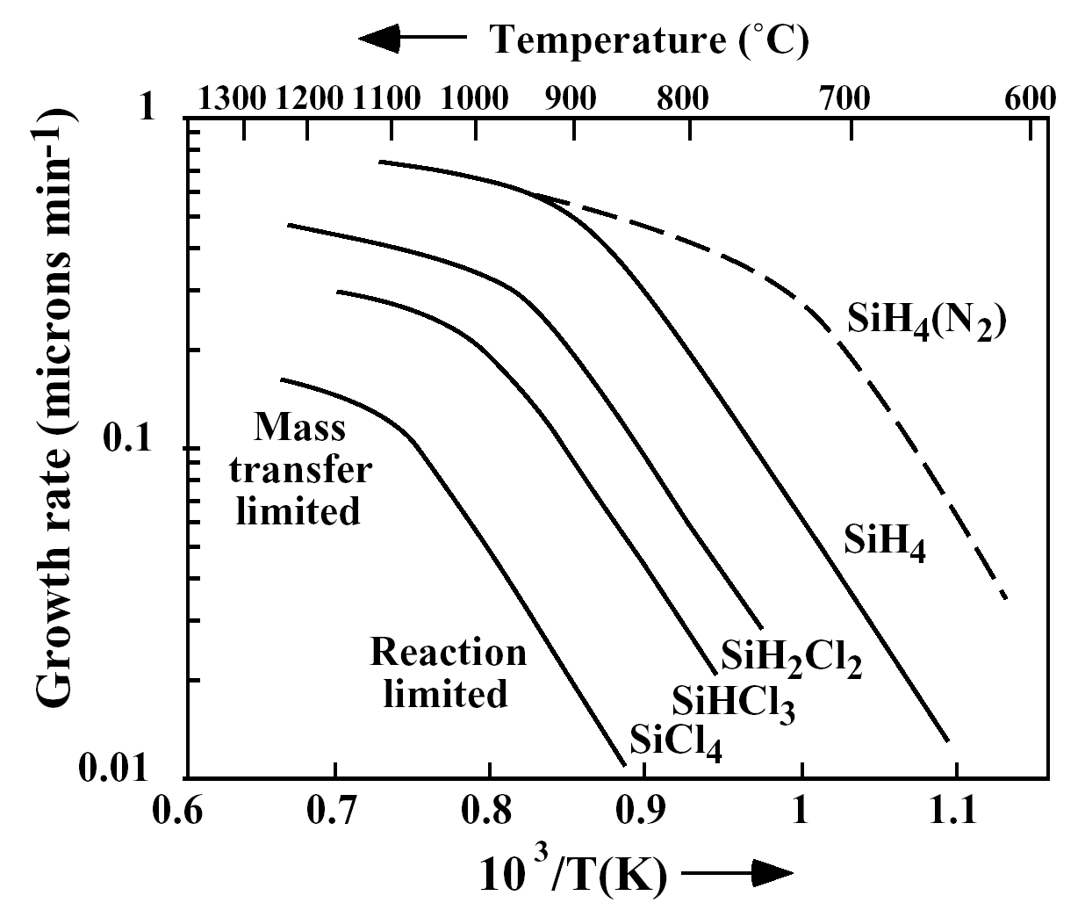
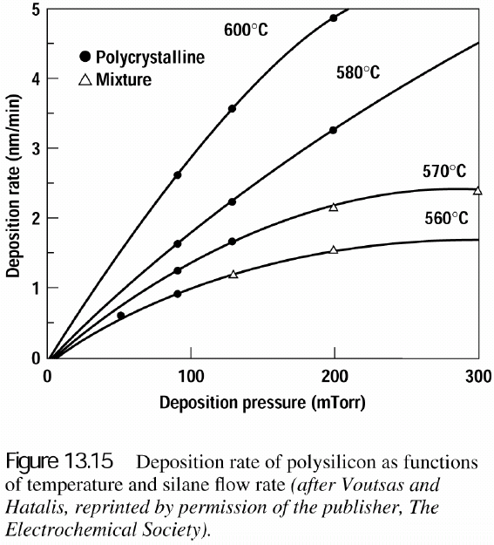
Polycrystalline silicon deposition
Application: gate of MOSFET.
Usually deposited in a LPCVD chamber at 25-150Pa, 600-650ºC, 10-20nm/min.
SiH₄ is preferred because of its lower deposition temperature.
H₂ carrier gas for solid curves
Figure 9-8
Usually amorphous when deposition at <575ºC; but may be polycrystalline if deposition rate is low enough.
Columnar grain structure/texture, and the grain will grow when annealed.
When annealed, amorphous Si will become polycrystalline Si with even large grain size than poly-Si under same annealing.
1Torr = 132 Pa

Slide 10
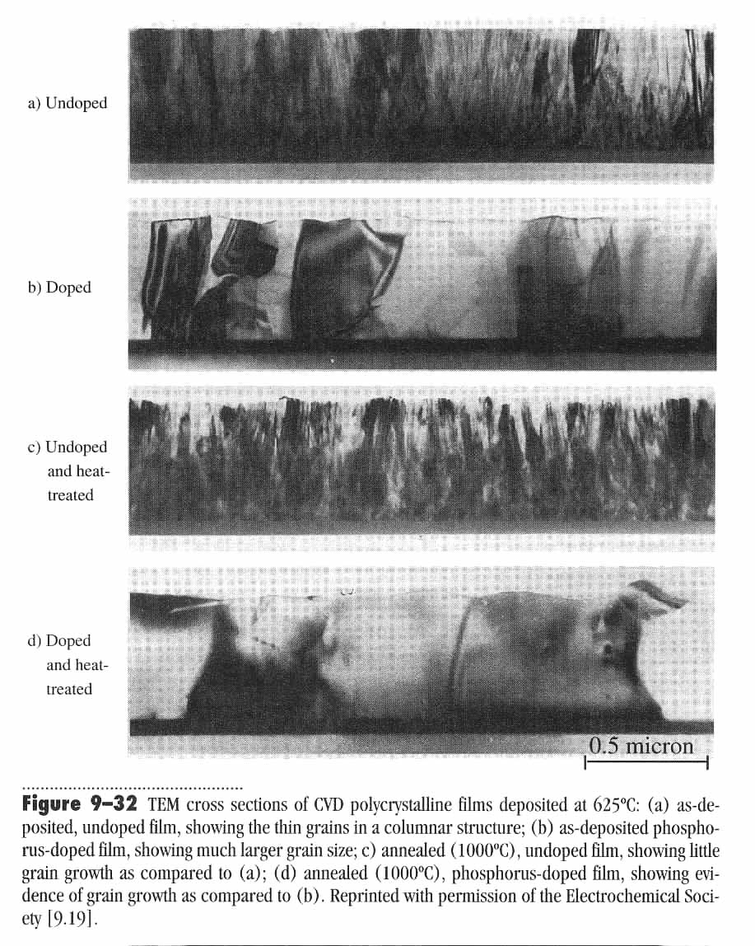
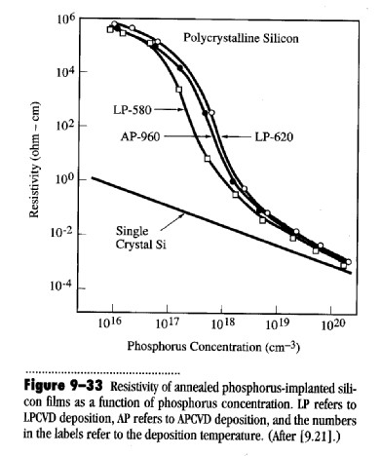
Grain structure and resistivity
Traps states (dopant inactive when trapped there) and scattering at grain boundary limits the resistivity.
At higher doping, trap states are all filled and cannot further reduce active dopant concentration.

Slide 11
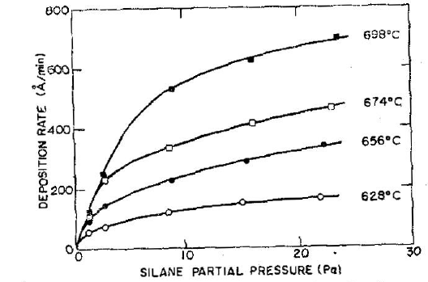
Deposition rate and oxidation of poly-Si
Deposition rate should be ∝ pressure since rate ≈ k_{s}C_{G}/N for h_{G}>>k_{s}, but actually sub-linear.
This is because at higher rate, it is determined by desorption of reaction product H₂ (rather than gas transport onto the surface).
Oxidation of poly-silicon:
Usually 900-1000ºC dry oxidation.
Un-doped or lightly doped poly-Si oxidizes at rate between that of (111) and (100) single crystal Si.
P-doped poly-Si oxidizes faster than un-doped or lightly doped one.

Slide 12
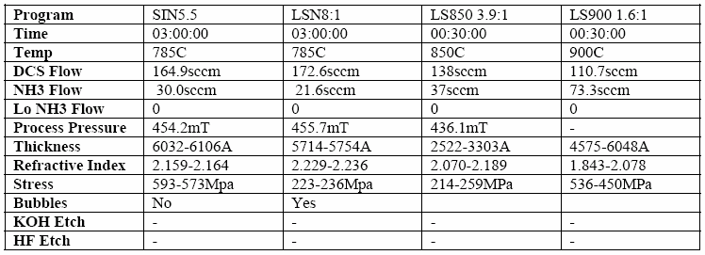
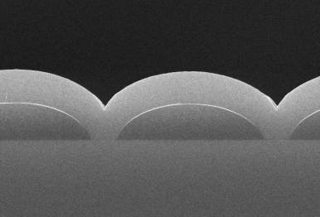
Silicon nitride deposition
Application:
  Masks to prevent oxidation for LOCOS process
  Final passivation barrier for moisture and sodium contamination
  Etch stop for Cu damascene process
  Popular membrane material by Si backside through-wafer wet etch.
PECVD
LPCVD
Can also deposit nitride using silane at 700-900ºC by APCVD; or use N₂ gas instead of NH₃.
LPCVD conformal Si₃N₄ films
Low-stress nitride deposition using DCS (dichloro-silane SiCl₂H₂)

Slide 13
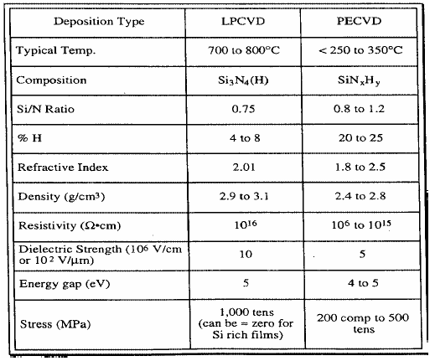
Silicon nitride properties
tensile or
compressive
LPCVD film quality is much better than PECVD in almost every aspect.

Slide 14

Silicon dioxide deposition
Sputtered oxide has poorer step coverage than CVD.
APCVD has been used for many years, but today LPCVD and PECVD are more popular.
Silane based LPCVD
TEOS (tetra-ethoxy-silane). LPCVD 650-800°C, PECVD 350°C. Lower sticking coefficient, thus more conformal film.
Silane based PECVD
Others
SiCl₂H₂ + 2N₂O → SiO₂ + 2N₂ + 2HCl (etches Si), ∼900ºC, film contain Cl.
TEOS + Ozone (O₃). Ozone is more reactive and lowers deposition temperature to ∼400ºC.

Slide 15
Comparison of varied silicon dioxide
Property | PECVD SiH₄+O₂ | LPCVD SiH₄+O₂ | LPCVD TEOS | LPCVD SiCl₂H₂+N₂O | Thermal oxidation
Deposition temp | 200°C | 450°C | 700°C | 900°C | 1000ºC
Composition | SiO₂(H) | SiO₂(H) | SiO₂(C…) | SiO₂(Cl) | SiO₂
Thermal stability | Loses H | Densifies | Stable | Loses Cl | stable
Density (g/cm³) | 2.3 | 2.1 | 2.2 | 2.2 | 2.2
Stress (MPa) | 3C-3T | 3T | 1C | 3C | 3C
Dielectric Strength (10⁶ V/cm) | 5 | 8 | 10 | 10 | 11
Etch Rate (Å/min) (100H₂O:1 HF) | 400 | 60 | 30 | 30 | 25
Step coverage | Non-conformal | Non-conformal | Conformal | Conformal | Conformal
Lower HF etch rate means better film quality (denser film).
For stress, C=compressive, T=tensile

Slide 16
Improve step coverage by PSG reflow
No P
2.2% P
4.6% P
7.6% P
Add PH₃ to source gas to get P- doped oxide: PSG - phosphosilicate glass
PSG is more flow-able than oxide: reflow at 1000-1100ºC to improve step coverage.
Usually 6-8 wt% of P.
Add B can further reduce reflow temperature (BPSG: borophosphosilicate glass)

Slide 17
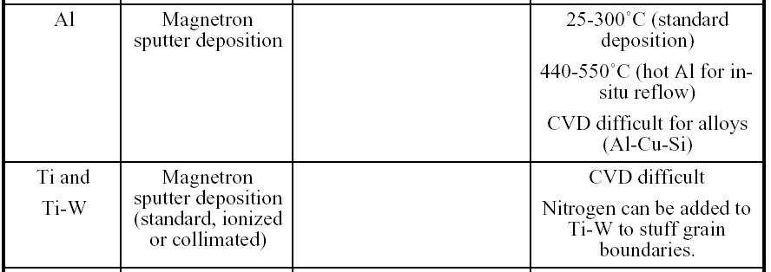
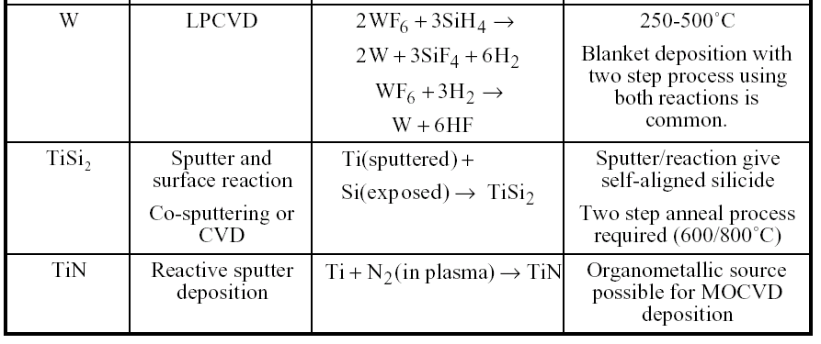
Deposition of metals
MOCVD: metal-organic-CVD

Slide 18
Chapter 9 Thin film deposition
Introduction to thin film deposition.
Introduction to chemical vapor deposition (CVD).
Atmospheric Pressure Chemical Vapor Deposition (APCVD).
Other types of CVD (LPCVD, PECVD, HDPCVD…).
Introduction to evaporation.
Evaporation tools and issues, shadow evaporation.
Introduction to sputtering and DC plasma.
Sputtering yield, step coverage, film morphology.
Sputter deposition: reactive, RF, bias, magnetron, collimated, and ion beam.
Deposition methods for thin films in IC fabrication.
Atomic layer deposition (ALD).
Pulsed laser deposition (PLD).
Epitaxy (CVD or vapor phase epitaxy , molecular beam epitaxy).
NE 343: Microfabrication and Thin Film Technology
Instructor: Bo Cui, ECE, University of Waterloo, bcui@uwaterloo.ca
Textbook: Silicon VLSI Technology by Plummer, Deal, Griffin

Slide 19
Atomic layer deposition (ALD, break CVD into two steps)
Similar in chemistry to CVD, except that the ALD reaction breaks the CVD reaction into two half-reactions, keeping the precursor materials separate during the reaction.
The precursor gas is introduced into the process chamber and produces a monolayer of gas on the wafer surface. A second precursor gas is then introduced into the chamber reacting with the first precursor to produce a monolayer of film on the wafer surface.
Film growth is self-limited (monolayer adsorption/reaction each half-cycle), hence atomic layer thickness control of film growth can be obtained.
That is, one layer per cycle; thus the resulting film thickness may be precisely controlled by the number of deposition cycles.
Two fundamental mechanisms:
    Chemi-sorption saturation process
    Sequential surface chemical reaction process
Introduced in 1974 by Dr. Tuomo Suntola and co-workers in Finland to improve the quality of ZnS films used in electroluminescent displays.
Recently, it turned out that ALD also produces outstanding dielectric layers and attracts semiconductor industries for making High-K dielectric materials.

Slide 20
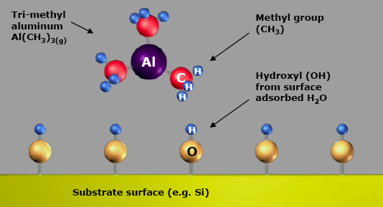
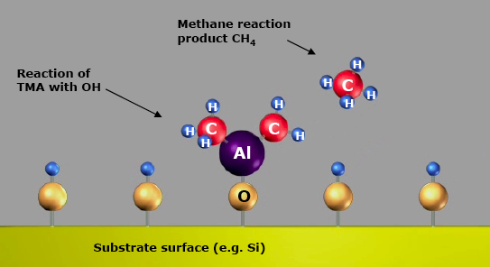
Example: ALD cycle for Al₂O₃ deposition
1. Introduce TMA
(tri-methyl aluminum)
In air, H₂O vapor absorb on Si to form Si-O-H.
2. TMA reacts with hydroxyl groups to produce methane.

Slide 21
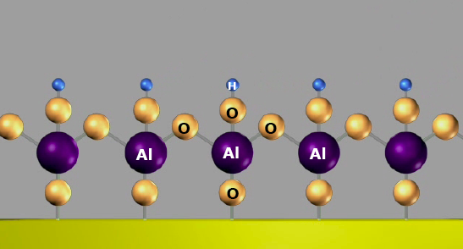
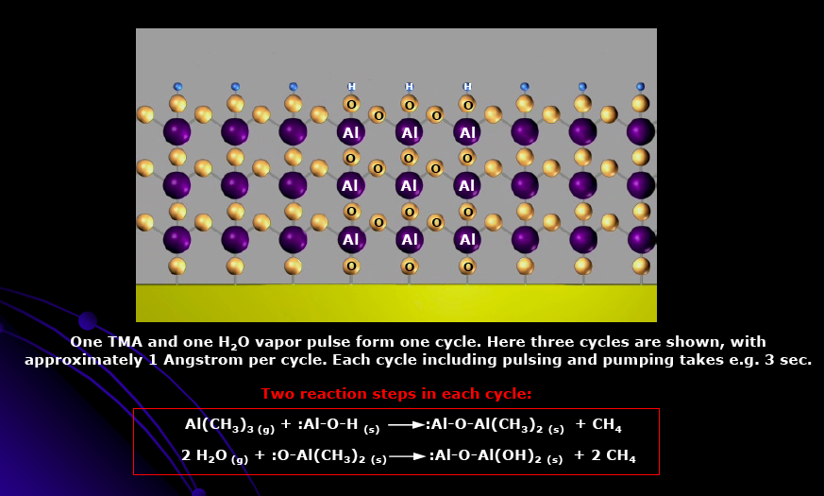
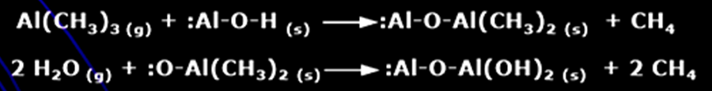
ALD cycle for Al₂O₃ deposition
3. Introduce H₂O. Reaction product methane is pumped away, leaving an OH⁻ passivation layer on surface.
4. After three cycles.
One TMA and one H₂O vapor pulse form one cycle. Here ∼1Å/cycle, each cycle including gas injection and pumping takes few seconds.
Two steps each cycle

Slide 22
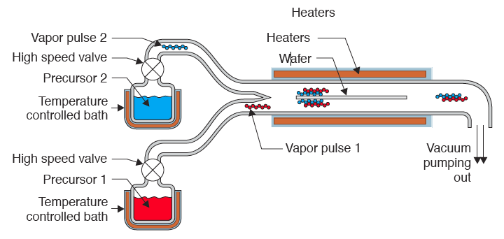
Closed system chambers (most common) for ALD
  The reaction chamber walls are designed to effect the transport of the precursors.

Slide 23
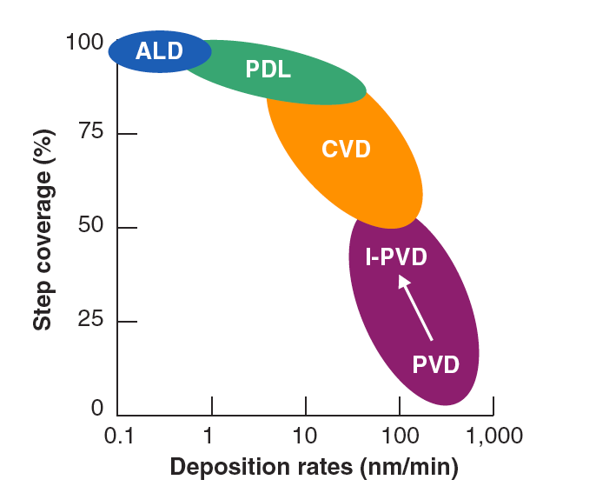
Advantages and disadvantages
ALD: slowest, best step coverage
Advantages
  Stoichiometric films with large area uniformity and 3D conformality.
  Precise thickness control.
  Low temperature deposition possible.
  Gentle deposition process for sensitive substrates.
Disadvantages
  Deposition rate slower than CVD.
  Number of different materials that can be deposited is fair compared to MBE.

Slide 24
Chapter 9 Thin film deposition
Introduction to thin film deposition.
Introduction to chemical vapor deposition (CVD).
Atmospheric Pressure Chemical Vapor Deposition (APCVD).
Other types of CVD (LPCVD, PECVD, HDPCVD…).
Introduction to evaporation.
Evaporation tools and issues, shadow evaporation.
Introduction to sputtering and DC plasma.
Sputtering yield, step coverage, film morphology.
Sputter deposition: reactive, RF, bias, magnetron, collimated, and ion beam.
Deposition methods for thin films in IC fabrication.
Atomic layer deposition (ALD).
Pulsed laser deposition (PLD).
Epitaxy (CVD or vapor phase epitaxy , molecular beam epitaxy).
NE 343: Microfabrication and Thin Film Technology
Instructor: Bo Cui, ECE, University of Waterloo, bcui@uwaterloo.ca
Textbook: Silicon VLSI Technology by Plummer, Deal, Griffin

Slide 25
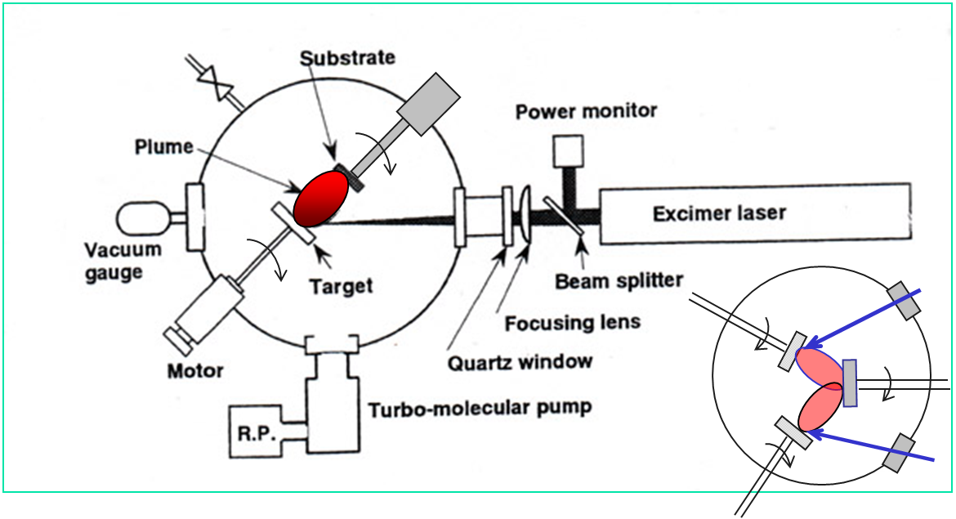
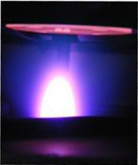
Pulsed laser deposition (PLD)
PLD Characteristics:
  Reproduce the composition of the target
  Fast response, well controlled deposition rate
  Environmentally benign technique
  Flexible, easy to implement.
Growth in any environment.
Atoms arrive in bunches.
Uneven coverage.
High defect or particulate concentration.
Not well suited for large-scale film growth.
Two targets, co-deposition

Slide 26
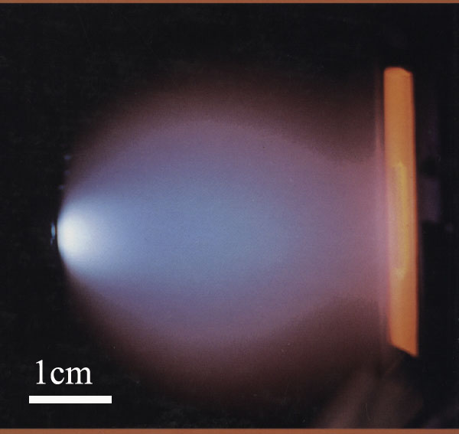
Plume generated by laser ablation
with different tiny or micro-particles
Pulse of fs to ns with peak power high enough (hundreds of MW/cm²) to melt → boil → vaporize → ablate the target surface material, to atoms, ions, electrons, and clusters.
Laser Beam
Target
Plume
(plasma)
(a)
(b)
(c)
(d)
Substrate
Laser-material interaction. (a) Absorption and heating; (b) Melting and flowing; (c) Vaporization; (d) Plasma formation in front of the target. Under certain conditions the plasma can detach from the target and propagate toward the laser beam.
Pulse duration τ < 10 ps
Collisional and multi-photon ionization.
Plasma formation without melting.
Deviation from τ^{1/2} scaling.
Pulse duration τ > 50 ps
Conventional melting, boiling and fracture.
Threshold fluence (J/cm²) for ablation scales as τ^{1/2}.

Slide 27
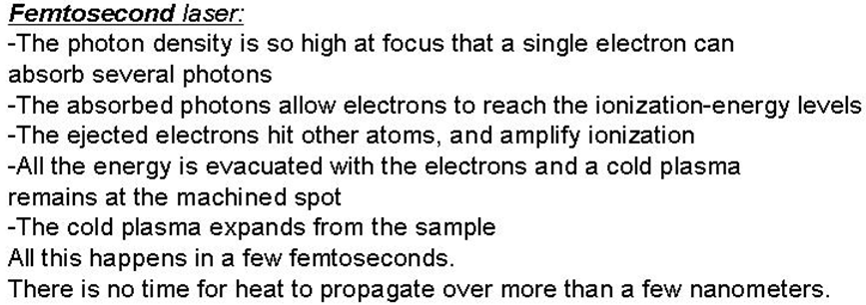
PLD physics
Metals, absorption depth ∼10 nm, depending on wavelength.
Relaxation of energy ∼ 1 ps, electron-phonon interaction.
Incredibly non-equilibrium!!
At peak of laser pulse, temperature on target can reach >10⁵ K (> 40 eV!)
Electric field > 10⁵ V/cm, also high magnetic fields
Plasma temperature 3000-5000 K
Ablated species with energy 1–100 eV
It is also an excellent micro-machining tool, with clean-cut profile.

Slide 28
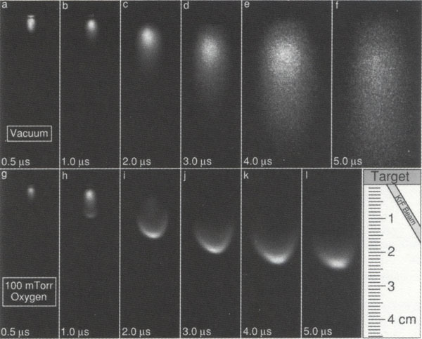
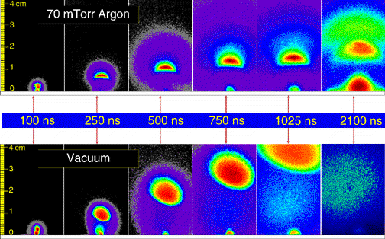
Transient plume development
10⁻⁶Torr vacuum
(plasma of vapor of target material)
100 mTorr O₂
(plasma of O₂ and vapor of target material)
D. Geohegan, Appl. Phys. Lett. 60, 2732 (1992)

Slide 29
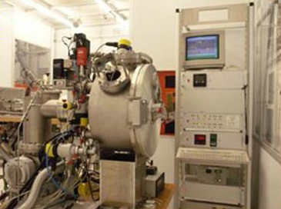
Pulsed laser deposition (PLD) system
View Windows
Excimer laser
Chamber
Another system

Slide 30
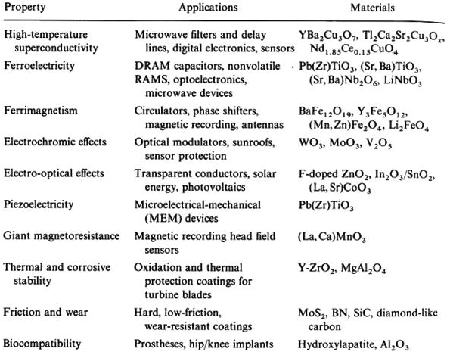
Ceramic films deposited by PLD

Slide 31
DARPA MICE program
(Mesoscopic Integrated Conformal Electronics)
Single (pulsed) laser does surface pretreatment, spatially selective material deposition, surface annealing, component trimming, ablative micromachining, dicing and via-drilling
Direct writing of electronic components- in air!
Rapid process refinement
No masks, pre-forms, or long cycle times
True 3-D structure fabrication possible
DARPA: Defense Advanced Research Projects Agency, major US funding agency

Slide 32
Chapter 9 Thin film deposition
Introduction to thin film deposition.
Introduction to chemical vapor deposition (CVD).
Atmospheric Pressure Chemical Vapor Deposition (APCVD).
Other types of CVD (LPCVD, PECVD, HDPCVD…).
Introduction to evaporation.
Evaporation tools and issues, shadow evaporation.
Introduction to sputtering and DC plasma.
Sputtering yield, step coverage, film morphology.
Sputter deposition: reactive, RF, bias, magnetron, collimated, and ion beam.
Deposition methods for thin films in IC fabrication.
Atomic layer deposition (ALD).
Pulsed laser deposition (PLD).
Epitaxy (CVD or vapor phase epitaxy , molecular beam epitaxy).
NE 343: Microfabrication and Thin Film Technology
Instructor: Bo Cui, ECE, University of Waterloo, bcui@uwaterloo.ca
Textbook: Silicon VLSI Technology by Plummer, Deal, Griffin

Slide 33
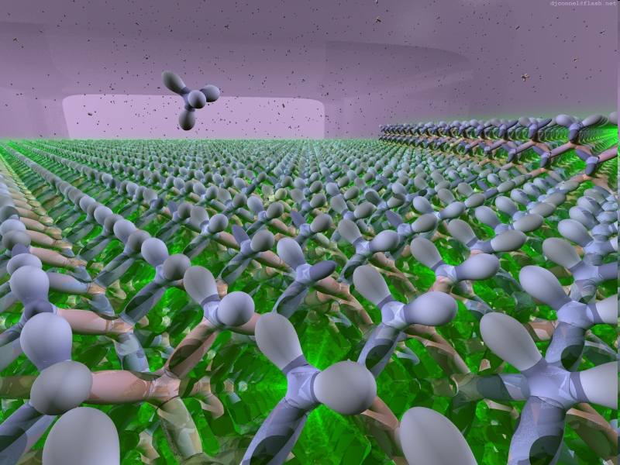
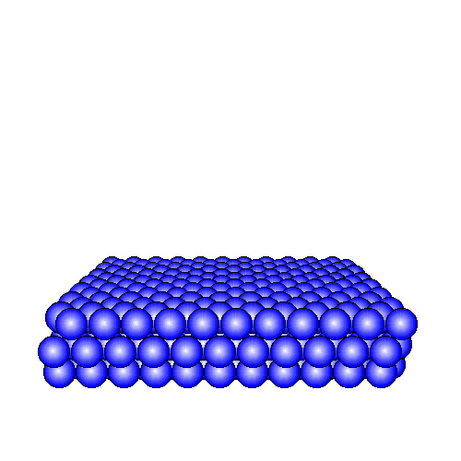
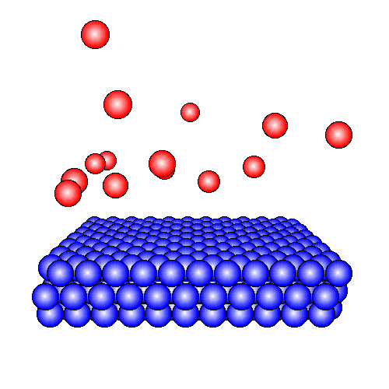
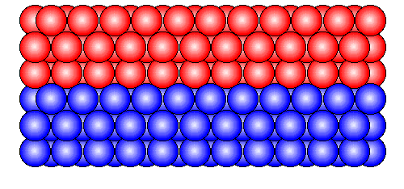
Introduction
Epitaxy refers to the method of depositing a monocrystalline film on a monocrystalline substrate.
The word “epitaxy” comes from the Greek for ‘above’ (epi) and ‘in an ordered manner’ (taxis): to arrange upon.
Autoepitaxy(or Homoepitaxy): extension of the substrate lattice by the overgrowth of a layer of identical material (e.g. Si on Si or GaAs on GaAs) with no problem of compatibility or mismatch.
Heteroepitaxy: any two materials of different crystalline structure and orientation (e.g. (001) GaAs on (001) Si or (001) Si on Sapphire)
Initial substrate
Epitaxy
Epilayer
Most slides in this section prepared by Ehsan Fathi
33

Slide 34
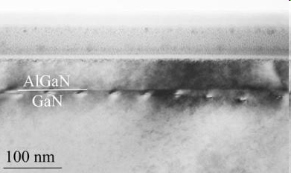
Heteroepitaxy conditions
Heteroepitaxy Conditions:
Substrate must be physically and chemically inert to the growth environment and being prepared with a damage-free surface.
Chemical compatibility between the materials to avoid compound formation or massive dissolution of one layer by the other.
Matched thermal expansion characteristics between the layer and substrate to avoid excess stress upon cooling → formation of dislocation at the interface, or even breaking of the structure
Matched lattice parameters between the layer and substrate → not a serious problem
34

Slide 35
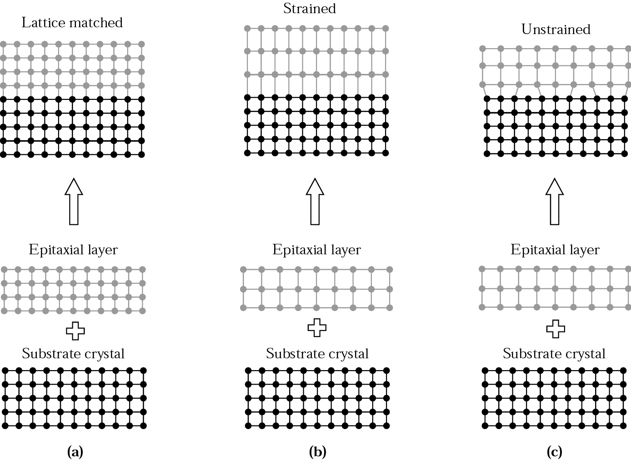
Strained and unstrained
Schematic illustration of (a) lattice-matched, (b) strained, and (c) relaxed hetero-epitaxial structures. Homoepitaxy is structurally identical to the lattice-matched heteroepitaxy.
35

Slide 36
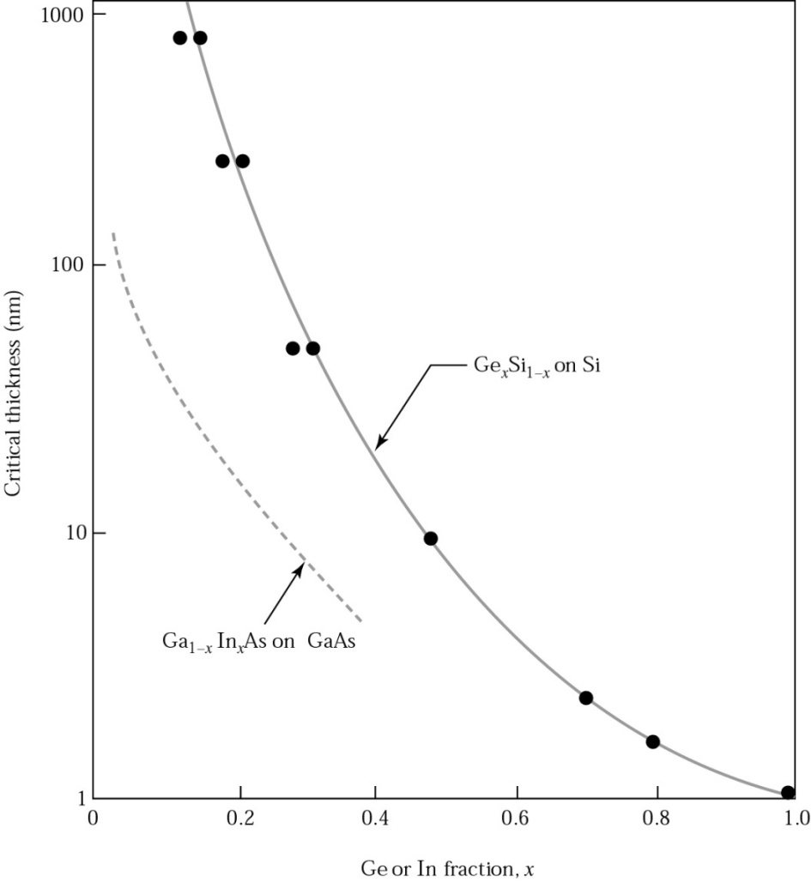
Strained and unstrained
Experimentally determined critical layer thickness for defect-free, strained-layer epitaxy of Ge_{x}Si_{1-x} on Si, and Ga_{1-x}In_{x}As on GaAs.
36

Slide 37
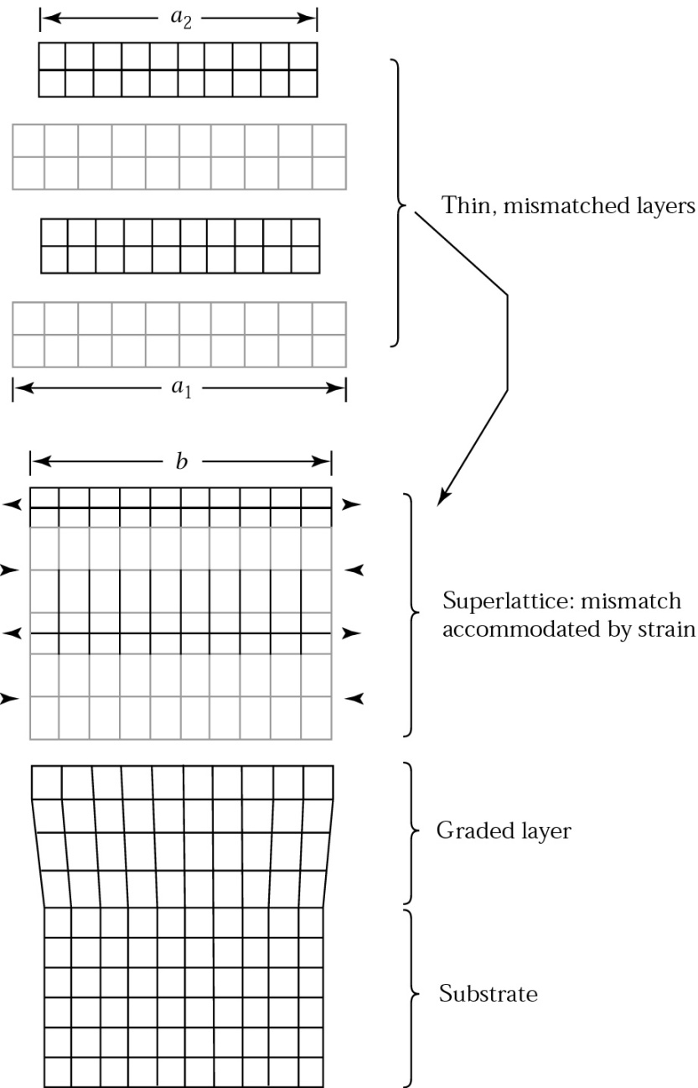
Strained-layer superlattices
Strained-layer superlattices : in some devices we need repeated, regular alternation between two monocrystalline
With these structures we can alter the basic physical properties of the material
Because the layers are sufficiently thin, the lattice mismatch is accommodated by uniform strains in the layers.
The new lattice will have an equilibrium lattice constant b such that a₁ > b > a₂ (for a₁ > a₂)
direction of the strain
37

Slide 38
Growth methods
Vapor-Phase Epitaxy (VPE, a form of CVD): transport of the epilayer constituents (Si, Ga, As, dopants,…) in the form of one or more volatile compounds to the substrate where they react to form the epilayer.
Molecular Beam Epitaxy: physical transport of material to a heated substrate through vacuum evaporation.
Liquid-Phase Epitaxy (LPE): the growth of epitaxial layer on crystalline substrate by direct precipitation from the liquid phase.
38

Slide 39
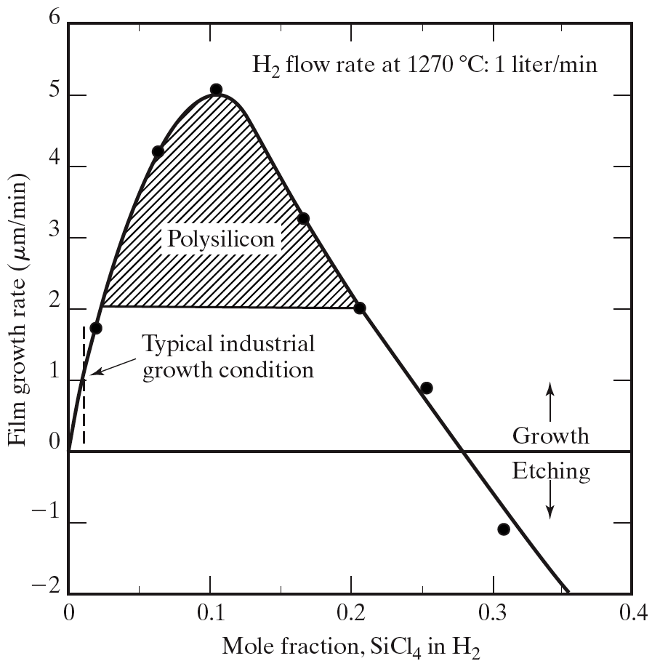
Silicon VPE
SiCl₄, SiH2Cl₂, SiHCl₃, and SiH₄ have been used for VPE growth.
Silicon tetrachloride is the most studied and has the widest industrial use.
Other silicon sources are used because of lower reaction temperature.
@ 1200 ºC
An additional competing reaction is taking place:
If the silicon tetrachloride concentration is too high, etching rather than growth of silicon will take place.
If the carrier gas entering the reactor contains hydrochloric acid, etching will take place.
This etching is used for in-situ cleaning of the Si wafer prior to epitaxial growth.
39

Slide 40
The halide process for GaAs deposition
In this process transport of gallium accomplished by means of the halide, AsCl₃.
Both hydrogen and AsCl₃ vapor enter the system and they react:
This reaction product flow over the gallium source and GaAs formed as a crust on the surface of gallium
The HCl gas resulting from the first reaction transfer gallium to the substrate in the form of GaCl, where the GaAs is deposited @ 750 ºC:
Should be fully saturated with As
40

Slide 41
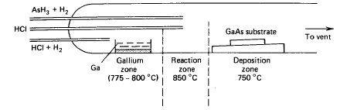
The hydride process for GaAs deposition
Fluxes of gallium and arsenic species formed independently → greater control in the vapor phase, and hence a wider control of the deposition parameters
As₄ for As, and gallium chloride (GaCl) for Ga component are used.
As₄ is generated by thermal decomposition of arsine (AsH₃):
Gallium chloride is generated by the reaction:
For In-situ etching
41

Slide 42
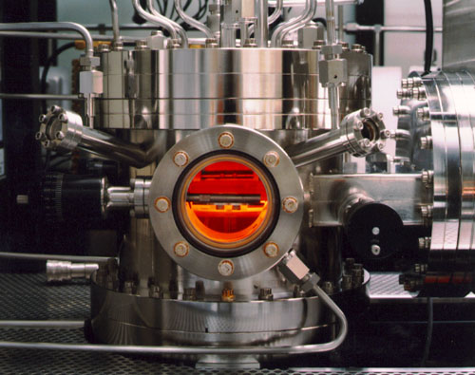
The organometallic process
MOCVD: metal-organic CVD = OMVPE: organo-metallic vapor phase epitaxy
Halide and hydride processes cannot be extended to the growth of AlGaAs by the simultaneous growth of GaAs and AlAs ( growth of AlAs occurs ~ 1100ºC).
This problem avoided in the organometalic process.
Many materials that we wish to deposit have very low vapor pressures and thus are difficult to transport via gases.
One solution is to chemically attach the metal (Ga, Al, Cu, etc…) to an organic compound that has a very high vapor pressure.
• The organic-metal bond is very weak and can be broken via thermal means on wafer, depositing the metal with the high vapor pressure organic being pumped away.
Some MOCVD precursor gases:
Tri-methyl-aluminum, liquid
Tri-methyl-gallium, liquid
Arsine AsH₃, gas
Di-methyl selenide, liquid
Di-methyl zinc, liquid
http://en.wikipedia.org/wiki/Metalorganic_vapour_phase_epitaxy
42

Slide 43
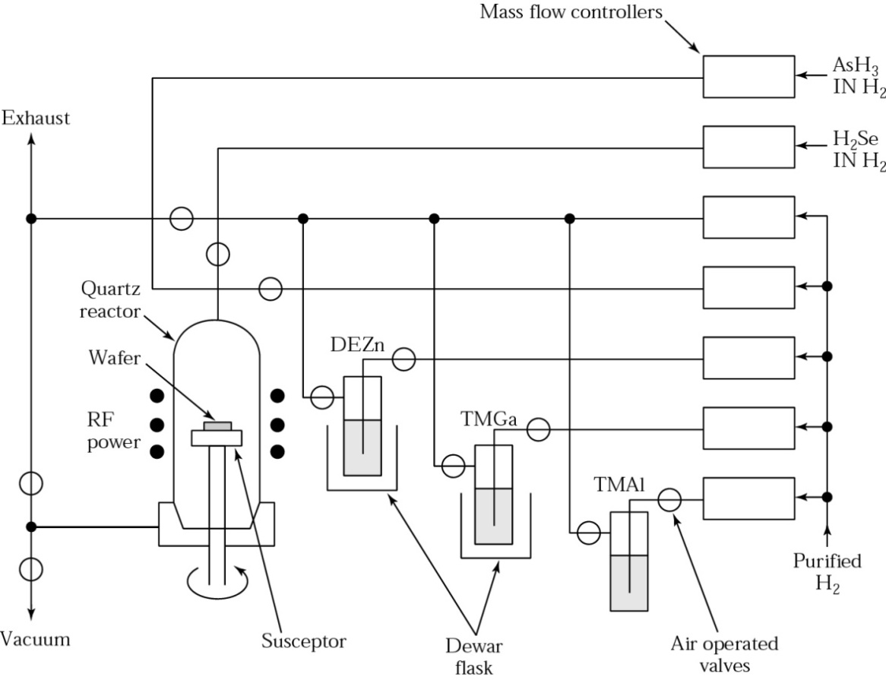
The organometallic process
Advantages: Highly flexible → we can deposit semiconductors, metals, dielectrics
Disadvantages: Highly toxic, very expensive source material, and environmental disposal costs are high.
Material deposited:
III-V semiconductors - AlGaAs, AlGaInP, AlGaN, AlGaP, GaAsP, GaAs, GaN, GaP, InAlAs, InAlP, InSb , InGaN, GaInAlAs, GaInAlN, GaInAsN, GaInAsP, GaInAs, GaInP, InN, InP.
II-VI semiconductors - Zinc selenide (ZnSe), HgCdTe, ZnO, Zinc sulfide (ZnS)
IV semiconductors - Si, Ge, strained silicon
43

Slide 44
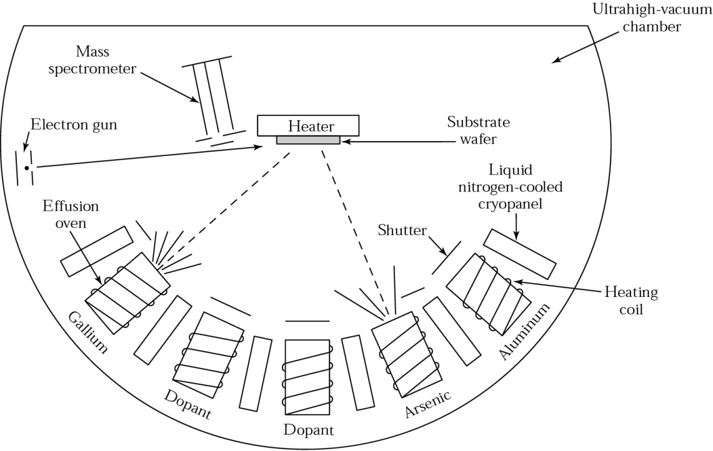
Molecular-beam epitaxy (MBE)
MBE is an epitaxial process involving the reaction of one or more thermal beams of atoms or molecules with a crystalline surface under UHV conditions.
Precise control in both chemical composition and doping profiles.
It has a very low growth rate (e.g. for GaAs, a value of 1μm/hr is typical.)
Single-crystal multilayer structures with dimensions on the order of atomic layers can be made.
Diagnostic tools
44

Slide 45


Effusion cell (Knudsen cell)
The most common type of MBE source is the effusion cell. Sources of this type are sometimes called Knudsen, or K-cells.
The crucible and source material are heated by radiation from a resistively heated filament. A thermocouple is used to allow closed-loop feedback control.
A typical Knudsen cell contains a crucible (made of pyrolytic boron nitride (PBN), quartz, tungsten or graphite), heating filaments (often made of metal tantalum), water cooling system, heat shields and shutter.
PBN crucible
Resistive heater filament
3. Metal foil radiation shields
4. Thermocouple
5. Mounting flange
45

Slide 46

RHEED
Reflection high-energy electron diffraction (RHEED) is a technique used to characterize the surface of crystalline materials.
A RHEED system consist of an electron source (gun), and a photoluminescent detector screen.
The electron gun generates a beam of electrons which strike the sample at a very small angle relative to the sample surface.
Incident electrons diffract from atoms at the surface of the sample, interfere constructively at specific angles and form regular patterns.
46

Slide 47


RHEED
The 3D surface results in a spotty pattern due to the electron transmission through surface roughness.
The more 2D surface giving rise to the commonly observed RHEED streaks.
47

Slide 48
MBE system
48

Slide 49

Liquid-phase epitaxy (LPE)
LPE involves the growth of epitaxial layers on crystalline substrate by direct precipitation from the liquid phase.
In LPE, the substrate is held in contact with the supersaturated solution (As saturated solution of Ga).
Cooling the arsenic saturated solution of gallium causes the arsenic to precipitate in the form of GaAs.
Typical deposition rates for monocrystalline films range from 0.1 to 1 μm/min.
LPE in most cases is a very economic deposition techniques, especially when up-scaled to mass-production
49

