Slide 1
NE 353: Nano Probing and Lithography
Introduction.
Photon-based lithography: DUV (deep UV), EUV (extreme UV), X-ray
Charged-beam based lithography: electron beam, focused ion beam
Nanofabrication by molding/printing: soft lithography, nanoimprint
Scanning probe lithography: AFM, dip-pen, STM atom manipulation
Bottom up “lithography”: nano-sphere lithography, block co-polymer self assembly, anodized aluminum oxide.
ECE 730: Fabrication in the nanoscale: principles, technology and applications
Instructor: Bo Cui, ECE, University of Waterloo; http://ece.uwaterloo.ca/~bcui/
Textbook: Nanofabrication: principles, capabilities and limits, by Zheng Cui

Slide 2
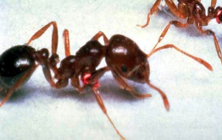
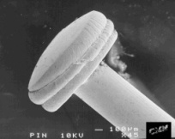
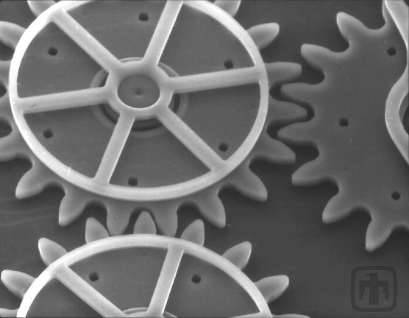
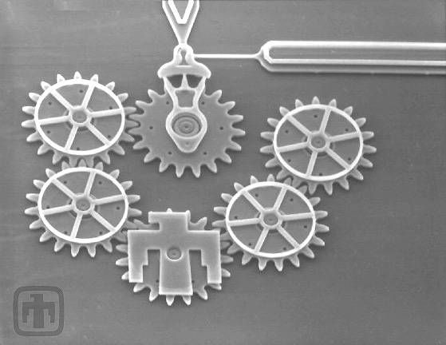
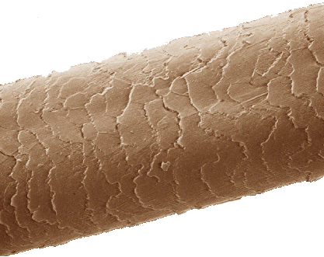
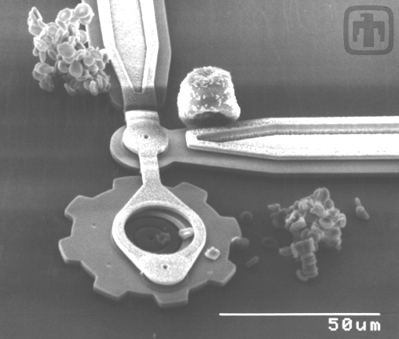
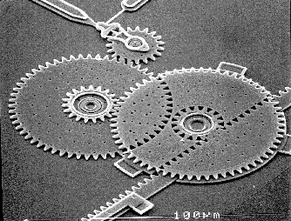
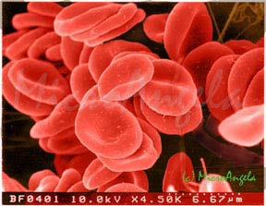
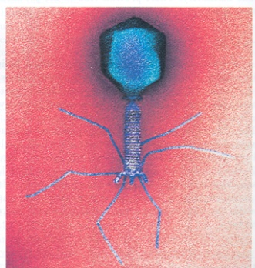
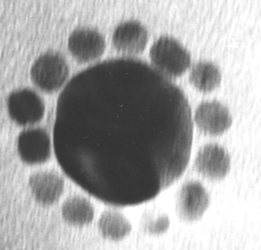
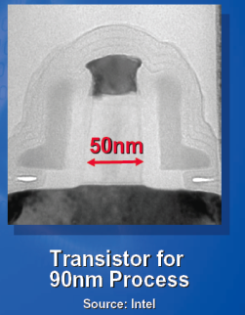
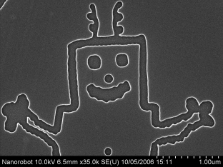
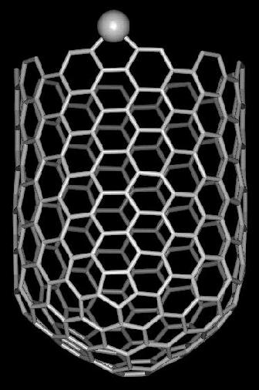
How small is nano?
Things Natural
Things Manmade
10⁻² m
10⁻³ m
Ant ~ 5 mm
Head of a pin 1-2 mm
10⁻⁴ m
MicroElectroMechanical Systems (MEMS)
10 -100 micron wide
Human hair
~50 micron wide
Micro world
10⁻⁵ m
10⁻⁶ m
10⁻⁷ m
Red blood cells
~ 2-5 micron
Nano world
(1-100nm)
10⁻⁸ m
Intel transistor
Nanorobot
Au nanoparticles
13 nm & 50 nm
Virus, ~100nm
10⁻⁹ m
DNA ~2 nm diameter
10⁻¹⁰ m
Carbon nanotube
~2 nm diameter
Adapted from office of Basic Energy Sciences Office of Science

Slide 3
Why go to nano?
L: length
Integrated circuit: faster, more function, lower power consumption
Data storage: higher capacity (∝1/L²), 1Tbits/in² – 25nm×25nm/bit
Semiconductor: quantum confined phenomena (quantum dots/wells…)
Magnetism: single domain formation at
L<magnetic domain wall thickness, super-paramagnetism
Photonics: new phenomena at L<λ
photonic crystal, negative refractive index, near field optics, plasmonics
Biomedical: DNA sorting (nanofluidics), drug delivery (nanoparticles), bio-sensors
Chemistry: higher surface area
higher reactivity for catalyst, higher sensitivity for chemical sensors

Slide 4
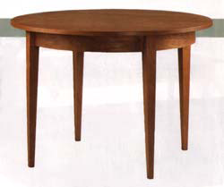
Nanofabrication - two principal approaches
Top Down:
Implementation of various techniques to remove, add or redistribute atoms or molecules in a bulk material to create a final structure.
Miniaturizing existing processes
at the macro/micro/nano-scale
Bottom up:
Atomic and molecular (or larger) scale directed assembly to create larger scale
structures with engineered properties
E.g. chemical self -assembly
Machined
Assembled

Slide 5
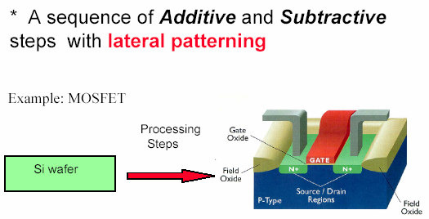
Top-down nanofabrication
Top down approach: three components
Lithography (lateral patterning): generate pattern in a material called resist
photolithography, electron-beam lithography, nanoimprint lithography…
Thin film deposition (additive): spin coating, chemical vapor deposition, molecular beam epitaxy, sputtering, evaporation, electroplating…
Etching (subtractive): reactive ion etching, ion beam etching, wet chemical etching, polishing…

Slide 6
Top down nanofabrication: one example
metal nanostructures
Metal nanostructures
side view
substrate
substrate
Direct etch process
Liftoff process
resist
(polymer)
resist
(polymer)
1. Thin film growth
1. Thin film growth
2. Lithography
2. Lithography
3. Etching
3. Deposition
4. Etching (dissolve resist)
4. Etching (dissolve resist)

Slide 7
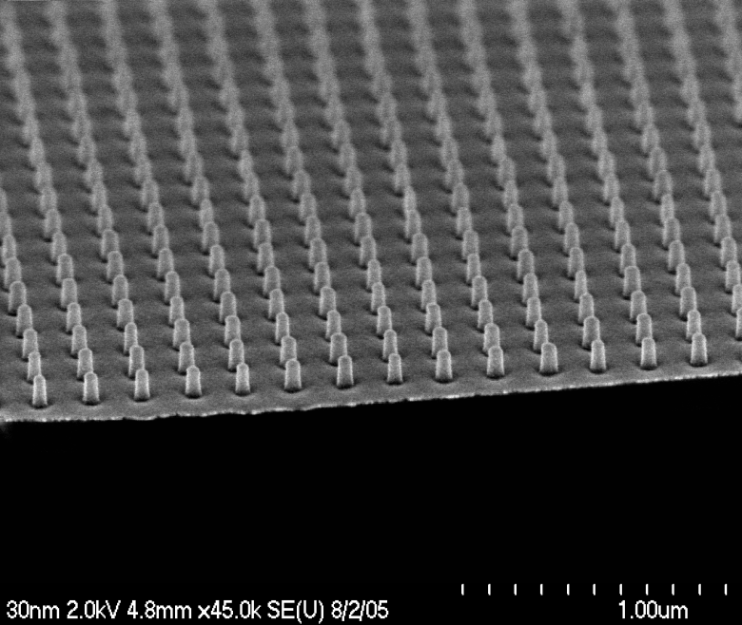
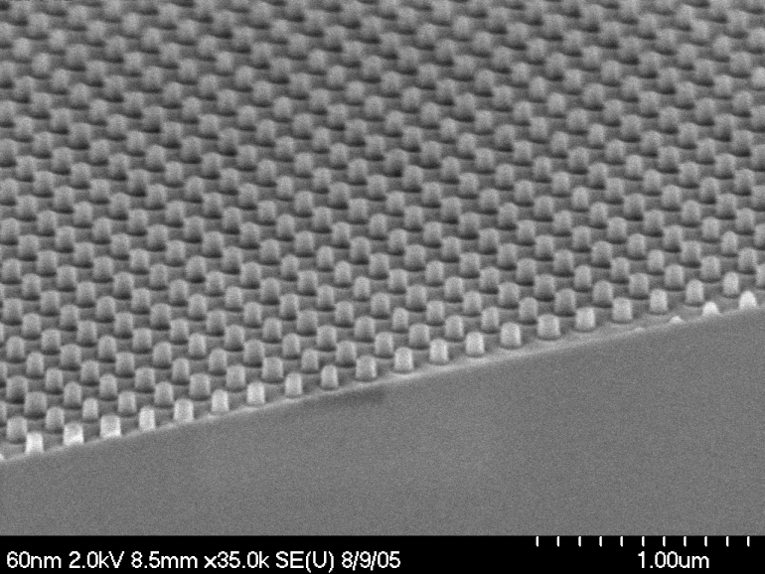
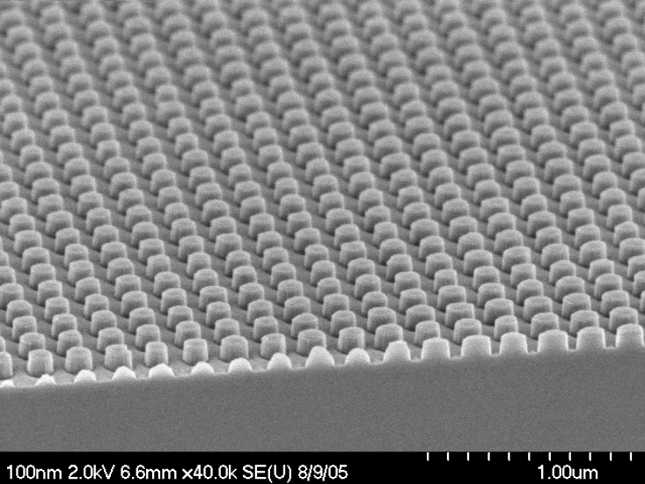
One more step: pillar array with various diameters
Pitch: 200nm
Cr
35 nm diameter
silicon
1. Cr dots by liftoff
2. RIE silicon and remove Cr
(RIE: reactive ion etching)
70 nm diameter
115 nm diameter

Slide 8
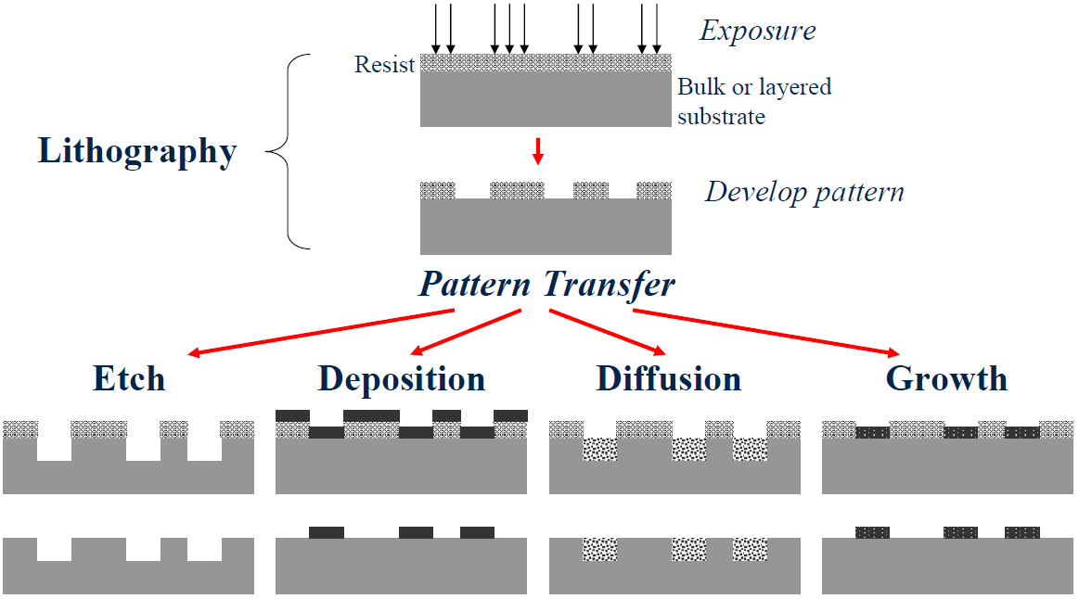
Pattern transfer (next step after lithography)
or doping
Direct etch
Liftoff
Electroplating…

Slide 9
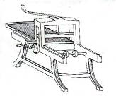
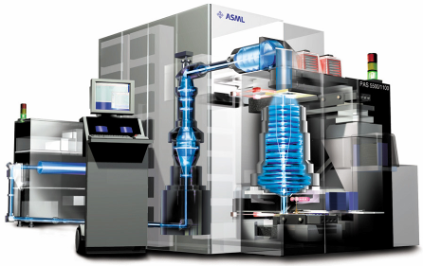
How lithography started
State-of-art lithography tool for IC industry
Reticle
(Mask)
Wafer
193 nm Excimer Laser Source
Computer Console
Exposure Column
(Lens)
Lithography (Greek for "stone drawing"); based on repulsion of oil and water.
Invented by Alois Senefelder in 1798.
Used for book illustrations, artist's prints, packaging, posters, etc.
In 1825, Goya produced a series of lithographs.
In the 20th century, it become an important technique with unique expressive capabilities in the art field.
Nowadays used in semiconductor manufacturing and micro-nanofabrication.

Slide 10
Key requirements of lithography
Critical dimension (CD) control
Size of features must be controlled within wafer and wafer-to-wafer
Overlay (alignment between different layers)
For high yield, alignment must be precisely controlled
Defect control
Other than designed pattern, no additional patterns must be created
Low cost
30-40% of total semiconductor manufacturing cost is due to lithography (masks, resists, metrology)
At the end of the roadmap, micro-processor will require 39 mask levels
Therefore, lithography is the most important part of semiconductor industry, as well as of fabrication micro/nano-devices for R&D.

Slide 11
Introduction.
Photon-based lithography: DUV (deep UV), EUV (extreme UV), X-ray
Charged-beam based lithography: electron beam, focused ion beam
Nanofabrication by molding/printing: soft lithography, nanoimprint
Scanning probe lithography: AFM, dip-pen, STM atom manipulation
Bottom up “lithography”: nano-sphere lithography, block co-polymer self assembly, anodized aluminum oxide.

Slide 12
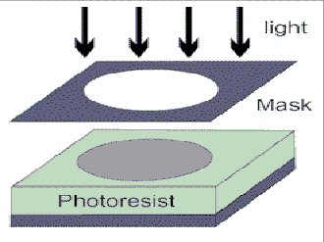
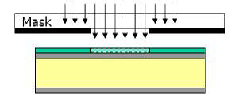
Optical/UV lithography (= photolithography)
Process used to transfer a pattern from a photomask to the surface of a substrate
Formation of images with visible or ultraviolet radiation in a photoresist
No limitation of substrate (Si, glass, metal, plastic...)
Working horse of current chip manufacturing processes (45nm feature size)
For R&D, it is the most widely used lithography system, but with ∼1μm feature size, so only for micro-fabrication.
Block radiation where it is not wanted, i.e. absorb radiation
Need opaque material at the desired wavelength
Transmit radiation where it is needed
Need material with high transmission at the desired wavelength
For optical lithography, mask is quartz glass (transparent) + Cr (opaque)

Slide 13
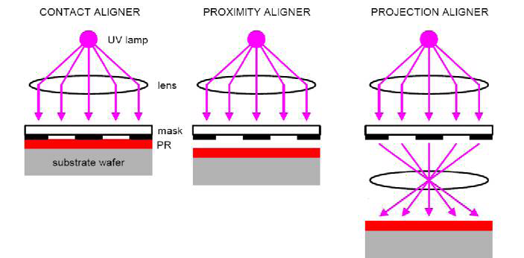
Three optical lithography methods
Contact aligner Proximity aligner Projection aligner
Mask in contact with photo-resist film
(Gap ≈ 0 μm)
Gap (order 10μm) between mask photoresist
Like photography, imaging

Slide 14
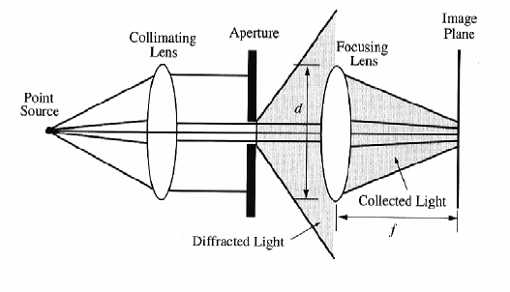
Projection printing
Rayleigh resolution:
Numerical aperture, NA
Similar to photography: image formation on the resist surface
Resolution is limited by far field diffraction (Fraunhofer), need good lens for high resolution.
Usually print small area (e.g. ¼ reduction), then step and repeat.
Very expensive, used mainly by semiconductor industry, unpopular for academic research.
Currently, IC industry uses λ=193nm deep UV light from ArF excimer laser (10s nano-second incoherent pulse) for exposure, with resolution (half-pitch of dense line array) 45nm.

Slide 15
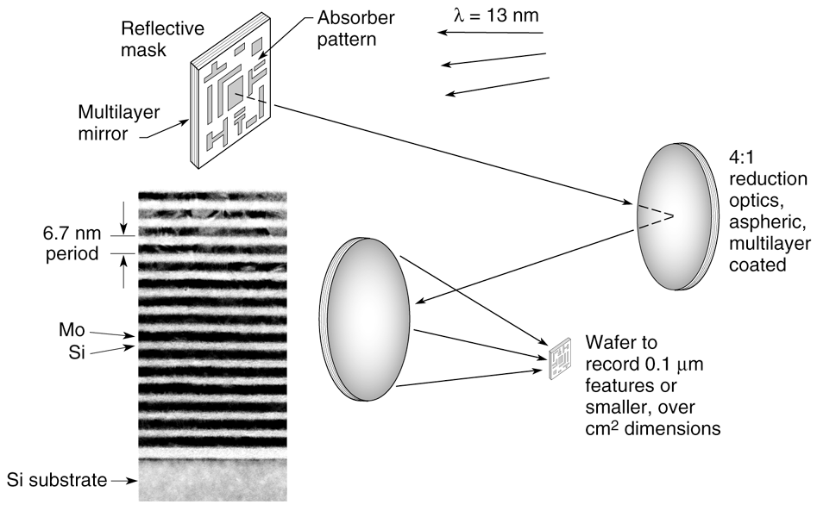
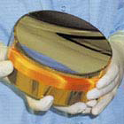
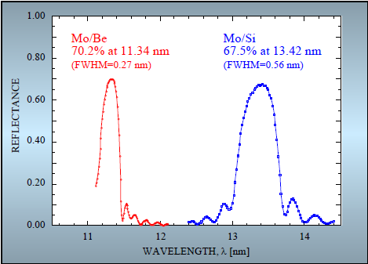
Extreme ultraviolet (EUV) lithography (λ=13.5nm)
Short wavelength (13.5 nm) permits high resolution even with small numerical apertures.
One candidate for next generation lithography
EUV mirror
Lens (transmission) is not possible at EUV.
So use reflection lens (mirrors).
Bragg reflector made of alternating Mo/Si layers that enables high efficiency (68% at normal incidence) reflection of 13.5 nm light.

Slide 16
X-ray lithography (XRL)
Incident x-rays
Mask (membrane and patterned absorber)
Frame (glass..)
Resist
Gap
Wafer
λ ∼ 1nm (extremely short wavelength for high resolution).
X-rays are produced by synchrotron radiation in a high energy electron storage ring.
Contamination becomes a smaller concern because X-rays will penetrate most dust particles (low atomic number).
No need for vacuum (little absorption of x-ray by air).
No lens (transmission or reflection), because for X- ray, refractive index n≡1; thus only proximity printing.
Proximity printing can still achieve high resolution (<30nm) due to small λ.
Resolution:
(R>>λ; g is gap, order 1μm; t is film thickness, order 100nm)

Slide 17
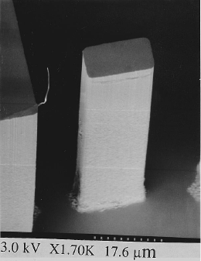
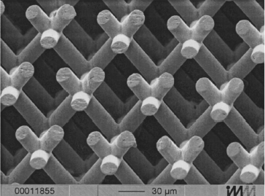
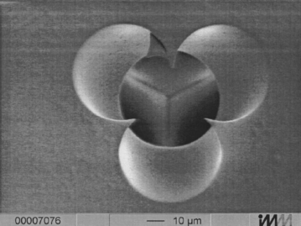
X-ray lithography for high aspect ratio and 3D
Deep penetrating power of the x-rays into the photoresist and low diffraction (spread of beam), thus good for creating microstructures with great height (high aspect ratio).
High aspect ratio micro-structures
Intersection of the three beams
Three-cylinder photonic crystal structure in
ceramic. Exposed by repeated exposures at
different tilt angles between the mask and
synchrotron. Almost like mechanical drilling.
G. Feiertag, APL, 71 (11) 1997.
80μm resist structure with aspect ratio > 10.
White, APL, 66 (16) 1995.

Slide 18
Introduction.
Photon-based lithography: DUV (deep UV), EUV (extreme UV), X-ray
Charged-beam based lithography: electron beam, focused ion beam
Nanofabrication by molding/printing: soft lithography, nanoimprint
Scanning probe lithography: AFM, dip-pen, STM atom manipulation
Bottom up “lithography”: nano-sphere lithography, block co-polymer self assembly, anodized aluminum oxide.

Slide 19
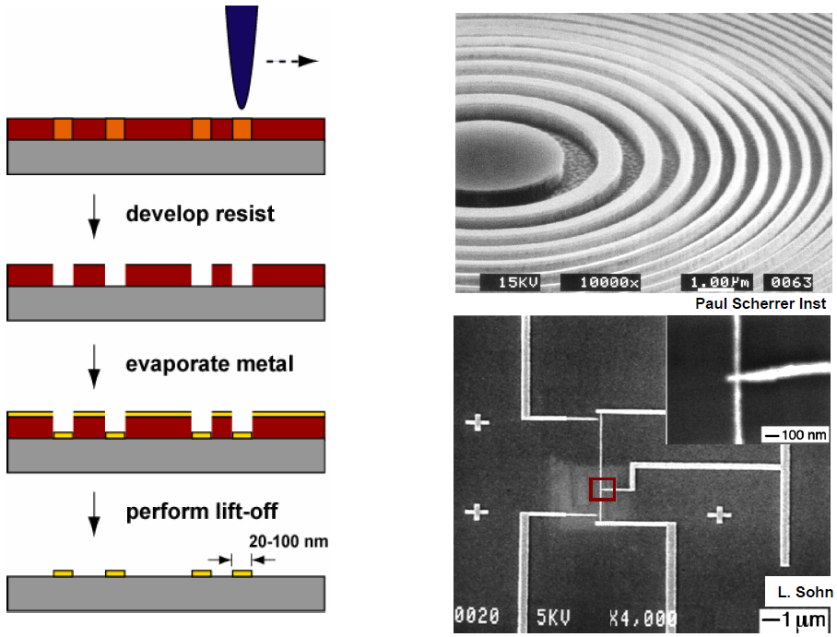
Electron beam lithography (EBL)
Finely focused electron beam, φ=2-5nm
Resist
(PMMA…)
Metal patterning by EBL and liftoff

Slide 20
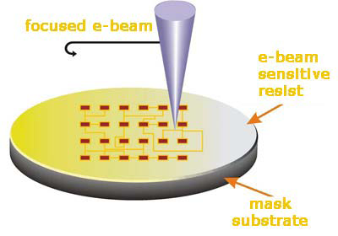
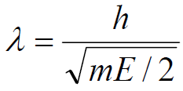
Electron beam lithography (EBL)
Electron beam has a wavelength so small that diffraction is insignificant.
Tool is just like an SEM with on-off capability controlled by a “beam blanker”.
Accurate positioning (alignment): “see” the substrate first, then expose.
Beam spot diameter of 2nm can be achieved, at typical acceleration voltage of >20keV.
But typical resolution ∼15nm (>> beam diameter), limited by proximity effect and lateral diffusion of secondary electrons.
Most popular prototyping tool for R&D, but too slow for mass production.
Wavelength of electrons
Where V is electron energy in eV unit.
For example, 30keV → λ=0.007nm!

Slide 21
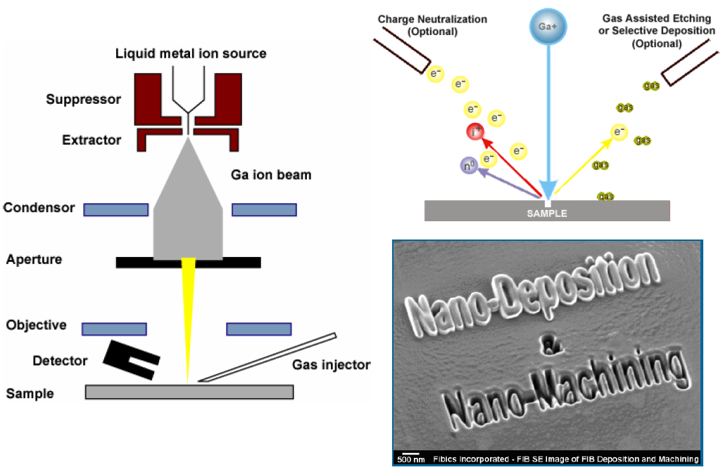
Focused ion beam (FIB)
Ga⁺ ion beam (down to 5nm) to raster scan over the surface.
FIB can cut away (mill, sputter) material (electron is too light for this).
By introducing gases, FIB can selectively etch or deposit a metal or oxide.

Slide 22
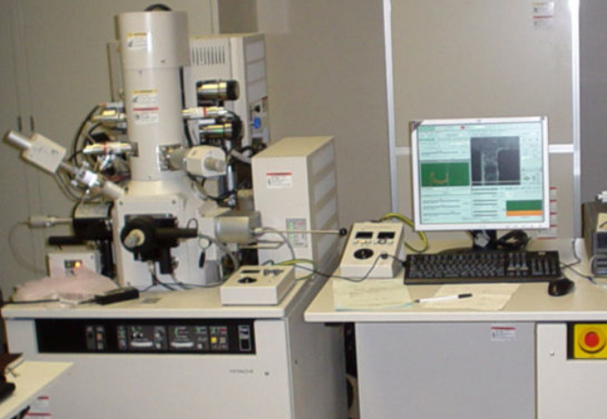
Focused ion beam (FIB)
Like electron beam lithography (EBL), direct write technique – no mask necessary.
Can expose a resist with higher sensitivity than EBL, but very low penetration depth.
In principle, FIB has better resolution than e-beam lithography because secondary electrons have lower energy (but it is easier to focus electron beams).
Re-deposition of sputtered material to other part of the device is a problem.
In summary, very versatile (deposition, etching, lithography, all in one tool); but slow and expensive, more complicated than EBL.
A FIB system is similar to SEM, but ion source is used to replace electron source.
Most lab systems have both ion source and electron source (dual beam).
SIM: scanning ion microscopy, similar to SEM except that now the secondary electrons (signal to form image) is generated by ion – matter interaction.

Slide 23
Introduction.
Photon-based lithography: DUV (deep UV), EUV (extreme UV), X-ray
Charged-beam based lithography: electron beam, focused ion beam
Nanofabrication by molding/printing: soft lithography, nanoimprint
Scanning probe lithography: AFM, dip-pen, STM atom manipulation
Bottom up “lithography”: nano-sphere lithography, block co-polymer self assembly, anodized aluminum oxide.

Slide 24
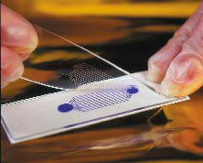
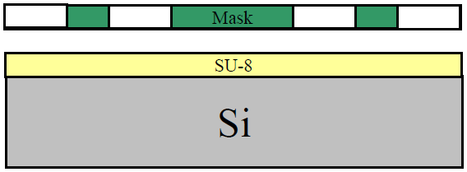
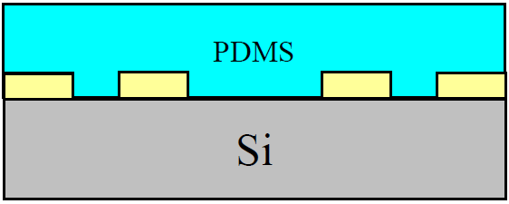
Soft lithography: molding, printing, material transferring
Why it is called soft lithography?
Because no energetic beams (electron, ion) or radiations (DUV, x-ray) are involved.
Stamp (mold) production
A master mold is made by lithographic techniques and a stamp is cast from this master.
Poly di-methyl siloxane (PDMS) is most popular material for stamps.
PDMS stamp (mold) after peel off from SU-8 master
Photolithography pattern SU-8
Cast PDMS pre-polymer and cure

Slide 25
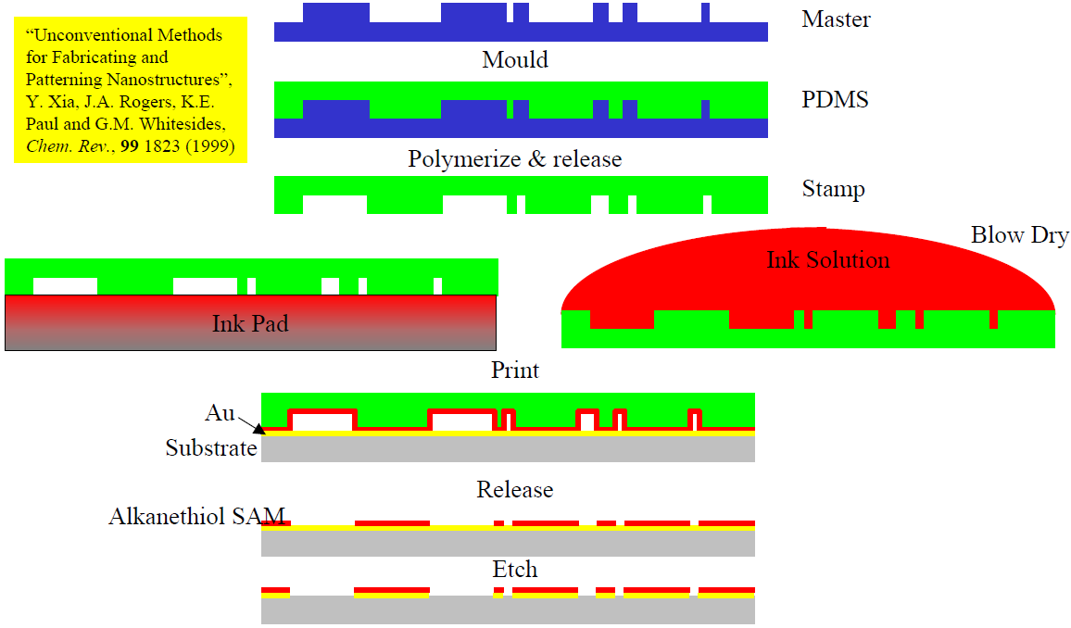
Soft-lithography I: micro-contact printing (μCP)
Minimum resolution affected by diffusion of molecules, can reach sub-50nm.
PDMS is deformable – can accommodate rough surfaces or spherical substrates.
Self assembled mono-layers (SAM) are efficient barriers against chemical etches.
For example, SAM monolayer can be used as etching mask to pattern Au using wet-etch.

Slide 26
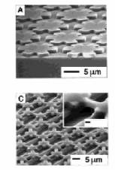
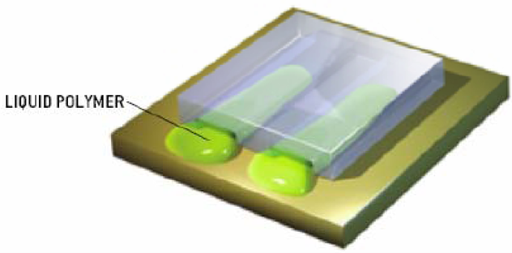
Soft lithography II: micro-molding in capillaries (MIMIC)
PDMS mold is placed directly on top of the substrate and pre-polymer is placed at the open ends of the channel.
Due to the capillary effect, the pre-polymer completely fills in the channels of the stamp.
After the pre-polymer has filled the channels of the PDMS mold, it is cured (become solid, by UV light or baking).
Can be used with UV- curable prepolymers, inorganic salts, colloidal particles, and other materials
Liquid pre-polymer

Slide 27
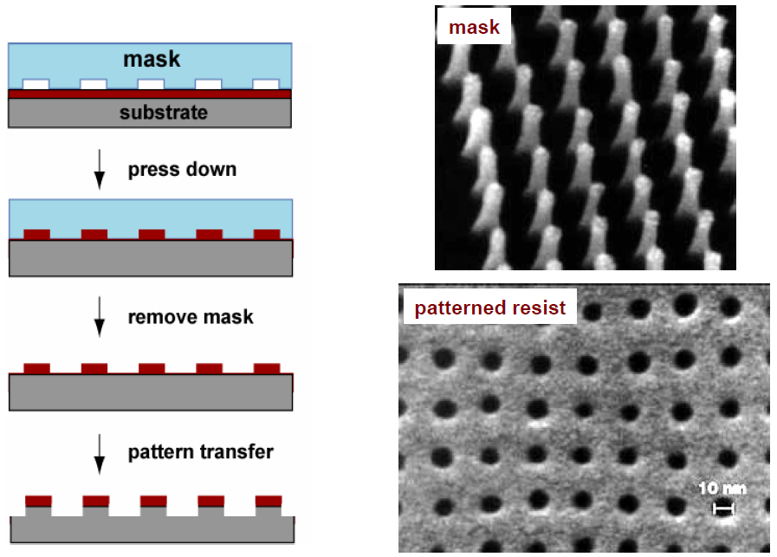
Nanoimprint lithography (thermal/hot embossing)
mold
Heat-up polymer resist and press down
Cool-down and remove mold
Pattern transfer to substrate
Mold = mask = template = stamp

Slide 28
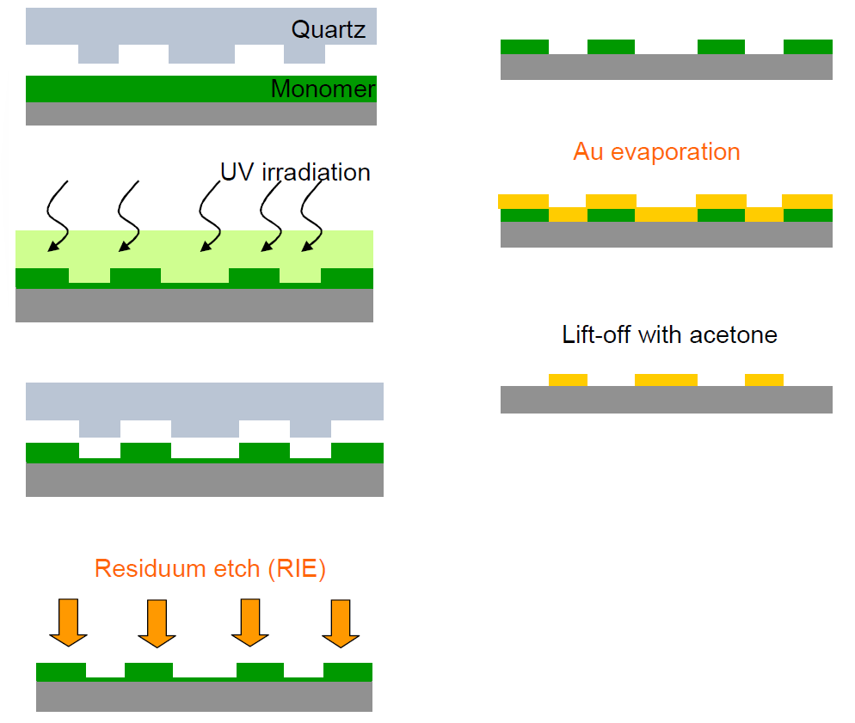
UV-curing nanoimprint lithography
(Au patterning by liftoff as an example)
Liquid resist, soft and deformable by mold.
Hardened by UV-curing (polymerization).
Molds must be transparent (PDMS, Quartz).
No temperature (thermal cycle) necessary.
Thus a very gentle process, and thermal expansion mismatch no longer an issue.

Slide 29
Introduction.
Photon-based lithography: DUV (deep UV), EUV (extreme UV), X-ray
Charged-beam based lithography: electron beam, focused ion beam
Nanofabrication by molding/printing: soft lithography, nanoimprint
Scanning probe lithography: AFM, dip-pen, STM atom manipulation
Bottom up “lithography”: nano-sphere lithography, block co-polymer self assembly, anodized aluminum oxide.

Slide 30
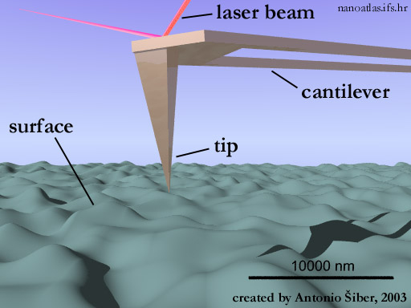
Scanning probe lithography
(also termed “tip-based nanofabrication”)
Mechanical patterning: scratching, nano-indentation
Chemical and molecular patterning (dip-pen nanolithography, DPN)
Voltage bias application
Field enhanced oxidation (of silicon or metals)
Electron exposure of resist materials
Manipulation of atoms/molecules by STM, or nanostructures by AFM
AFM: atomic force microscopy (X-Y positioning by piezo; Z deflection by optical measurement)

Slide 31
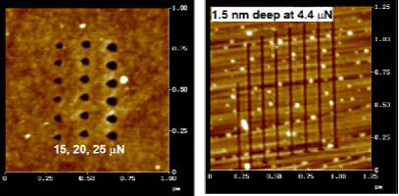
AFM lithography – indentation and scratching
(simplest, mechanical lithography)
Material is removed from the substrate leaving deep trenches with the characteristic shape of the tip used.
The advantages of nano-scratching for lithography
Precision of alignment, see using AFM imaging, then pattern wherever wanted.
The absence of additional processing steps, such as etching the substrate.
But it is not a clean process (debris on wafer), and the AFM tip cannot last long.

Slide 32
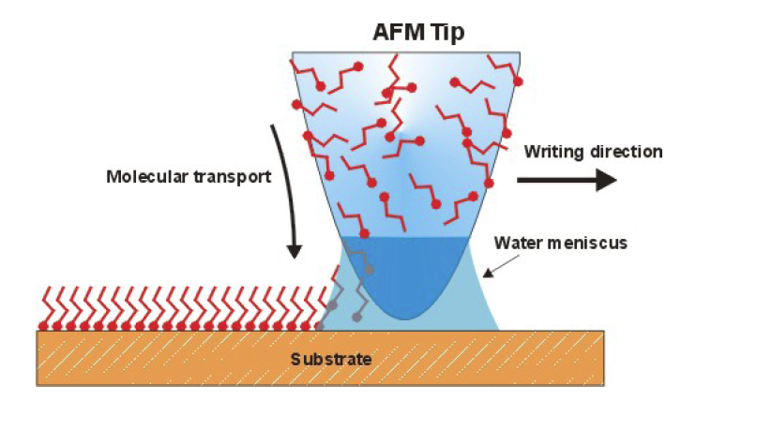
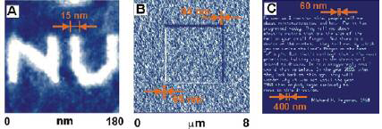
Dip-pen nanolithography (DPN)
Similar to micro-contact printing, writing using a “fountain pen”.
AFM tip is “inked” with material to be deposited
Sub-15nm features demonstrated
Multiple DPN tip arrays for higher throughput production

Slide 33
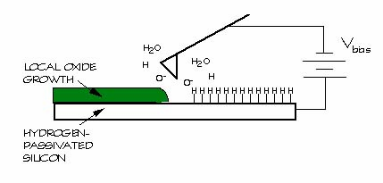
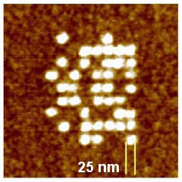
AFM lithography: oxidation
(local electrochemical anodization)
The high field desorbs the hydrogen on the silicon surface and enables exposed silicon to oxidize in air.
Oxidation rate is further enhanced by the high electric field.
Resulting oxide affected by experimental parameters
Voltage (typically from 5-10V)
Tip scan speed (stationary to tens of µm/s)
Humidity (20% to 80%)

Slide 34
STM lithography (STM: scanning tunneling microscopy)
By applying a voltage between tip and substrate it is possible to deposit or remove atoms or molecules.
Advantages of STM Lithography
Information storage devices (one atom per bit, highest storage density possible).
Nanometer patterning technique (highest resolution, ∼Å).
Iron atoms on copper (111) substrate

Slide 35
Summary: lithography – general distinction
Lithography with particles or waves
Photons: photolithography
X-rays: from synchrotron, x-ray lithography
Electrons: electron beam lithography (EBL)
Ions: focused ion beam (FIB) lithography
Imprint lithography (molding)
Soft lithography: micro-contact-printing…
Hot embossing
UV-curing imprinting
SPM-lithography
AFM
STM
DPN (dip-pen nanolithography)
Pattern replication: parallel
(masks/molds necessary)
High throughput, for manufacturing, not easy to change pattern
Optical lithography
X-ray lithography
Imprint lithography
Stencil mask lithography
Pattern generation: serial
(Slow, for mask/mold making or R&D)
E-beam lithography (EBL)
Ion beam lithography (FIB)
SPM-lithography
Multiple serial (array)
Electron-beam micro-column array (arrayed EBL)
Zone plate array lithography
Scanning probe array
Lithography on surfaces
Optical/UV lithography
E-beam lithography
FIB lithography
X-ray lithography
SPM-lithography
Imprint lithography
Stencil mask lithography
Lithography in volume
Two photon absorption
Stereo-lithography

Slide 36
Introduction.
Photon-based lithography: DUV (deep UV), EUV (extreme UV), X-ray
Charged-beam based lithography: electron beam, focused ion beam
Nanofabrication by molding/printing: soft lithography, nanoimprint
Scanning probe lithography: AFM, dip-pen, STM atom manipulation
Bottom up “lithography”: nano-sphere lithography, block co-polymer self assembly, anodized aluminum oxide.

Slide 37
Bottom-up nanofabrication
Low cost, high resolution (∼few nm), 3D (sphere)
Chemical synthesis
Nanotubes, nanowires, nano…any shape
Quantum dots and nanoparticles
Functional arrangement
Self assembly
Mono-layers, e.g. nano-sphere lithography
Block copolymers
Functionalized nanoscale structures
Fluidic or field assisted assembly
Surface tension directed assembly
Templated growth, guided assembly
Step edges and defect or strain fields
Porous materials, e.g. anodized aluminum oxide
Carbon nanotube
Anodized aluminum oxide

Slide 38
Nanosphere lithography (bottom up, self assembly)

Slide 39
Phase separation of block copolymers
Phase separation of a blend of PMMA and PS homo-polymer
A blend of two incompatible homo-polymer separates into distinct phases on a large scale (left), whereas block copolymers separate into periodic domains (right).
Basic morphologies obtained by different block copolymer compositions.
PMMA: poly(methyl methacrylate)
PS: polystyrene
Ma, “Fabrication of super-hydrophobic film from PMMA with intrinsic water contact angle below 90º”, Polymer, 48, 7455-7460 (2007).

Slide 40
Phase separation of block copolymers
Tapping mode atomic force microscopy images of PS-PHMA self assembly on top of α-Si /SiO₂ substrate:
Quiescently annealed
Shear aligned.
Glassy PS cylinders are shown as light in a dark rubbery PHMA matrix.
Polystyrene-b-poly(n-hexyl methacrylate) (PS–PHMA) diblock copolymer with a molar mass of 21 and 64 kg/mol for the respective blocks.
Alignment by shear force
Pitch=30nm
Chaikin, “Silicon nanowire grid polarizer for very deep ultraviolet fabricated from a shear-aligned diblock copolymer template”, Optics letters, 32(21), 3125-3127 (2007).

Slide 41
Anodized aluminum oxide (AAO)
2Al + 3H₂O → Al₂O₃ + 3H₂ [ΔG = -8.65 × 10⁵J]
Anodization:
A direct current is passed through an electrolytic solution where the Al sheet is used as the anode.
Two processes: dissolving and oxidation
Naturally formed triangular pore arrays
Electrolyte:
Oxalic acid, phosphoric acid, sulfuric acid …

Slide 42
AAO membrane production
Al₂O₃
Al
Free standing ∼10μm-thick AAO membrane, with Au plated for better viewing contrast.

