Slide 1
Focused ion beam (FIB)
Overview.
Ion source and optics.
Ion-solid interaction, damage.
Scanning ion beam imaging.
FIB lithography using resist.
FIB milling, sputtering yield.
Redeposition.
Single line milling.
Other types of FIB lithographies (implantation, intermixing…).
Gas-assisted FIB patterning.
Focused ion beam induced deposition.
Focused electron beam induced deposition.
Deposition rate (electron and gas flux-limited regimes)
Deposit composition (carbon/metal)
ECE 730: Fabrication in the nanoscale: principles, technology and applications
Instructor: Bo Cui, ECE, University of Waterloo; http://ece.uwaterloo.ca/~bcui/
Textbook: Nanofabrication: principles, capabilities and limits, by Zheng Cui

Slide 2
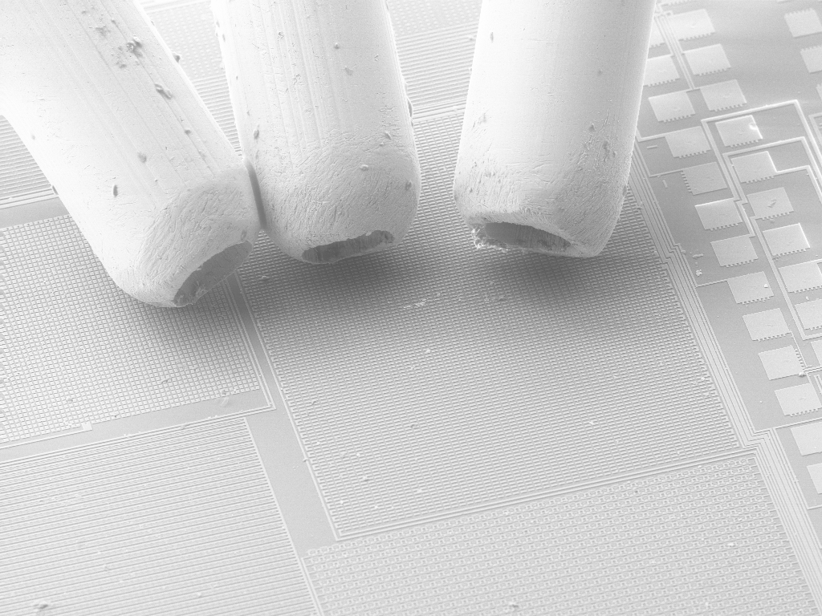
FIB deposition or etching using precursor or reactive gas
GIS: Gas Injection Systems
0.5mm
GIS positioned above a circuit
Gases are delivered to the sample surface via a needle in close proximity to the surface (∼50-150μm).
Gas pressure is of order 10⁻⁵ mbar.
Interaction of ion beam with gas causes either enhanced removal of sample material, or deposition of one of the elements within the gases.
A metal-organic gas is used to deposit metals via ion/electron beam assisted chemical vapor deposition.
An insulator can also be deposited, e.g. SiO₂ from tetra ethyl orthosilicate (TEOS).
Reactive gases are used to enhance sample etching.

Slide 3
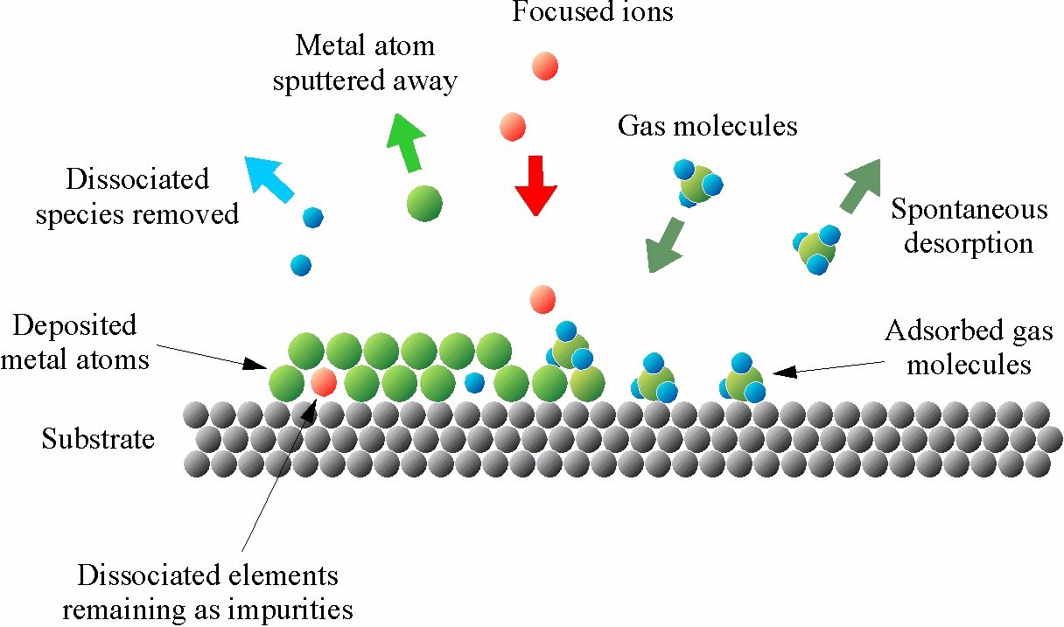
FIB assisted (chemical vapor) deposition process
Primary ions remaining as impurities
Dissociated elements remaining as impurities
Adsorption of gas molecules on substrate
Dissociation/decomposition of gas molecules by the ion beam
Deposition of the material atoms and removal of the organic ligands
“Studies of structures elaborated by focused ion beam induced deposition”, Prestigiacomo, MEE 2004.

Slide 4
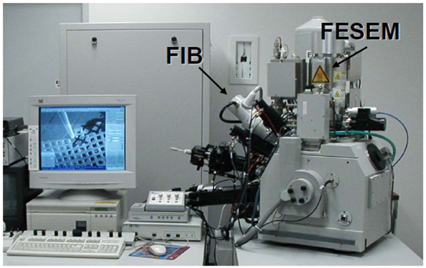
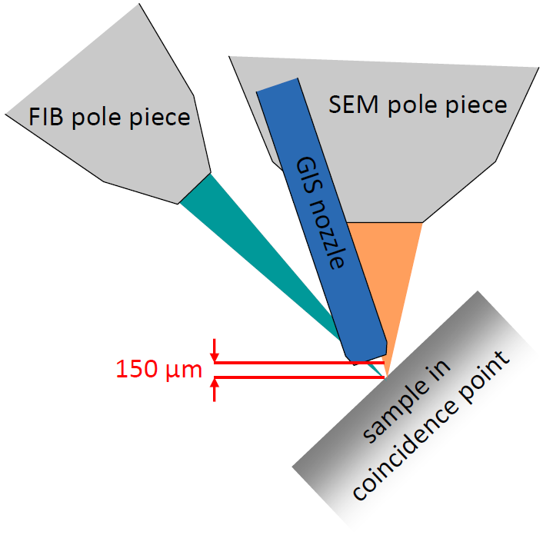
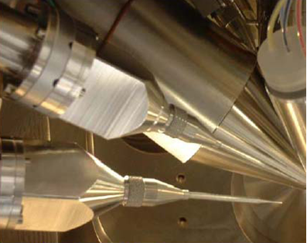
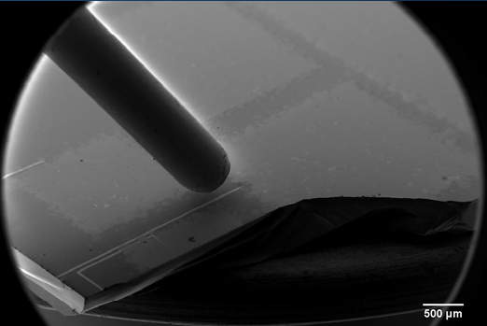
DualBeam FIB/SEM plus GIS
FEI Dual-Beam system
GIS: Gas Injection Systems

Slide 5
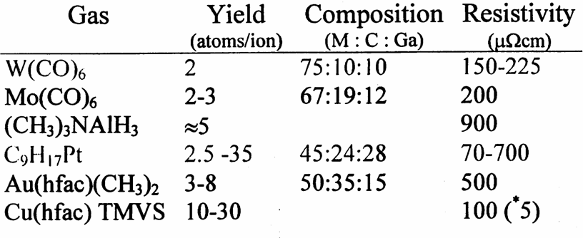
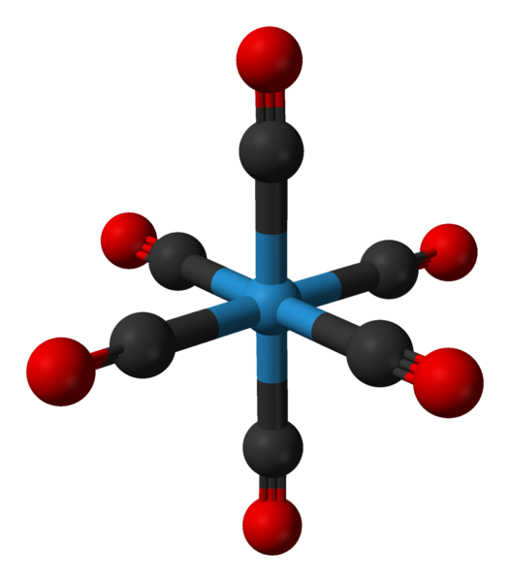
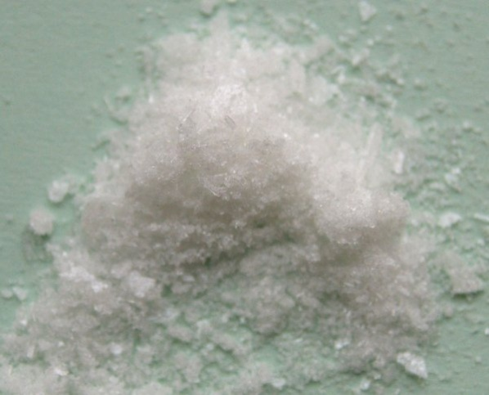
Gases used for metal, oxide and C deposition
W(CO)₆
hfac – hexafluoro acetyl acetanoate
TMVS – trimethyl vinyl silane
More deposition materials:
Al: Trimethylamine alane (TMAA, (CH3)₃N⋅AlH₃), 1Torr vapor pressure at 25°C)
SiO₂: O₂ and tetra meth oxysilane (TMOS) Si(OCH3)₄. (TEOS is also fine, here E=ethyl)
C: phenanthrene, and many other hydrocarbon gases.

Slide 6
Ion beam assisted deposition
Properties:
Resistivity much higher than bulk value (10-5000×)
Carbon contamination
Gallium contamination
Chemistry not well understood

Slide 7
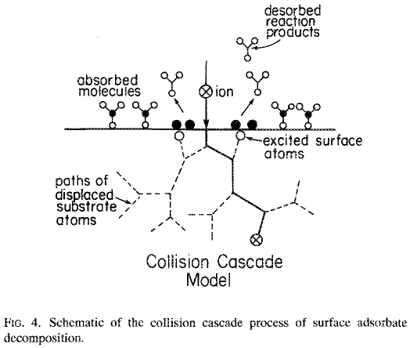
Collision cascade model – Au deposition
In principle, decomposition of precursor gas may take place either in the gas phase or on the surface; but actually deposition rate insensitive to gas pressure, so gas phase decomposition is unimportant.
Deposition go beyond beam spot size with yield higher than would be by only direct ion-molecule collision.
Yield better correlated with energy loss to the nuclei than with energy loss to the electrons.
Therefore, collision cascade has to play an important role in the decomposition.
In the case of gold, for energy E>0.95eV (dissociation energy of the adsorbate), deposition will occur. Sputtering (of excited surface atoms) will occur for E>3.8eV.
The nuclei of the substrate material gains energy from incident ions and becomes “excited”, which causes the gas molecule near it to decompose.
“Mechanism of ion beam induced deposition of gold”, Melngailis, JVST B, 1994.

Slide 8
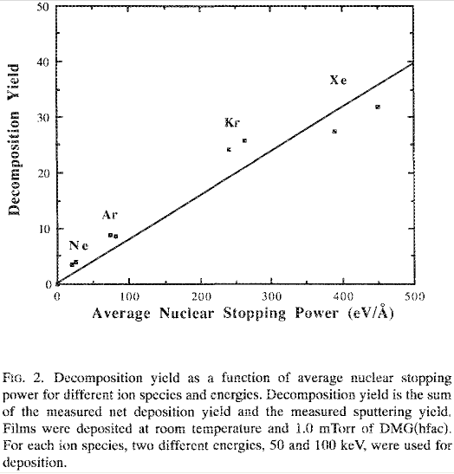
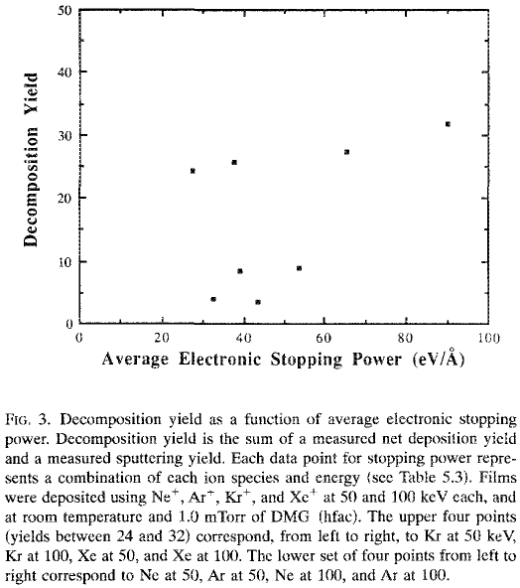
Collision cascade model
Collision cascade is related to nuclear stopping power, which is closely related to decomposition yield.
Electronic stopping power is not related to decomposition yield
Stopping power: energy loss per unit travel distance, eV/Å.
The higher the nuclear stopping power, the more energy gained by substrate nucleus (more nucleus are “excited”, or become more “excited”).
DMG(hfac): dimethyl gold hexafluoro-acetylacetonate C₇H₇F₆O₂Au, liquid at RT.
“Mechanism of ion beam induced deposition of gold”, Melngailis, JVST B, 1994.

Slide 9
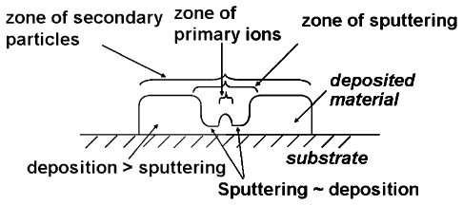
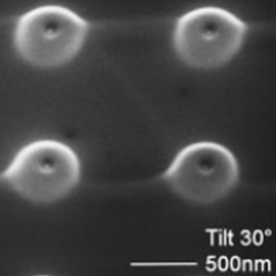
FIB deposition: role of SE and primary ion
Fig. 5. Sketch of reaction zones of different mechanisms involved in IBID.
Though the yield for primary ion induced deposition is low, its contribution is not negligible due to high ion flux (central tip).
Right next to the beam, both sputtering and deposition are important.
Farther away from the beam, sputtering is negligible, leading to faster deposition.
SE is important, causing deposition well beyond beam size. (SE: secondary electron, can go far away from primary beam).
At longer dwell time (1ms), gas is depleted at the beam center and net sputtering occurs, leading to a central nano-hole.

Slide 10
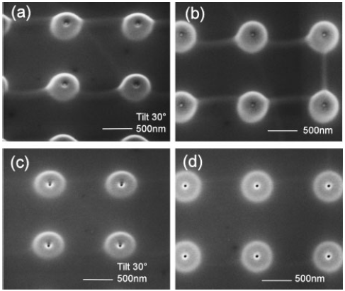
FIB deposition: role of SE and primary ion
Fig. 4. SEM images of doughnut-like structures grown at spot mode with 15pA ion beam current (a,b) with a central tip (dwell time 0.1ms, exposure time 20s per spot); (c,d) with a central nanohole (dwell time 1ms, exposure time 20s).
30keV Ga⁺ FIB using (CH₃)₃Pt(CpCH₃), beam size 13nm
Summary of deposition mechanism:
According to nuclear cascade model, excited nucleus are important for gas decomposition, (secondary) electrons are not. (this picture is incomplete, SE is important)
Here it shows that (secondary) electrons in fact contribute to the deposition far away from primary beam. (this is doubtful, SE can go that far?)
There must be other models, and it is still not clear what happened exactly.
“The Complex Mechanisms of Ion-Beam-Induced Deposition”, Chen, JJAP, 2008

Slide 11
Hi,
Sorry for the late reply. I was out of office last week.
I agree that SE indeed cannot go far away from where they are generated and the discussion of EBL. I also realize that in my article it could be more precise to describe the formation of doughnut in Fig4 and Fig5 by secondary particles, not only SE. For two reasons, experimentally we did not separate secondary atoms (SA) and SE; and theoretically, there is no evidence to support SE can travel longer than SA does.
However, I think it is possible for SA and SE emit from a hundreds of nms range during IBID. btw, I am not saying SA or SE travel hundreds of nm away from where they are generate, but I mean their spread range can be hundreds of nms. According to TRIM simulation, the range of collision cascade caused ion beam bombardment is tens of nms in the case of a flat substrate (without considering an existing milled hole or a deposits which can make the angle of sputtering etc changes). SE emits along SA. In reality, considering Gaussian ion beam profile this range usually can be larger. Therefore, after exposed a few seconds, FIB milled holes and IBID pillars are usually hundreds of nms in diameter, regardless of the 10 nm beam size and tens of nms penetration depth.
Actually, there are still many arguments on IBID mechanism. FYI, a review article summaries this issue in details [Ivo Utke, JVST B 26, 1197, (2008)]. I am also attaching one recent article of mine which particularly discusses the roles of secondary atoms and secondary electrons in IBID. Hopefully it helps.
Ping Chen P.Chen@tudelft.nl
Kavli Institute of Nanoscience Delft University of Technology Lorentzweg 1, 2628 CJ Delft
The Netherlands
phone: +31-15-2789508
fax: +31-15-2786600
Hi,
I am teaching a nanofabrication course, and is interested in the mechanism of IBID. According to your paper, the secondary electrons are important for the deposition far away from primary beam. However, the secondary electrons have energy at most 100eV. At such low energy, it really cannot go very far.
We know that for electron beam lithography, the SE (secondary electron) goes only about 5nm. Yet for electron beam, the backscattered electrons can go very far, and generate SE along its path. That is why SE can be generated very far away from primary electron beam, leading to proximity effect.
In summary, I don’t think SE generated by ion beam can travel to hundreds of nm as shown in your paper. Am I right? Thanks.

Slide 12
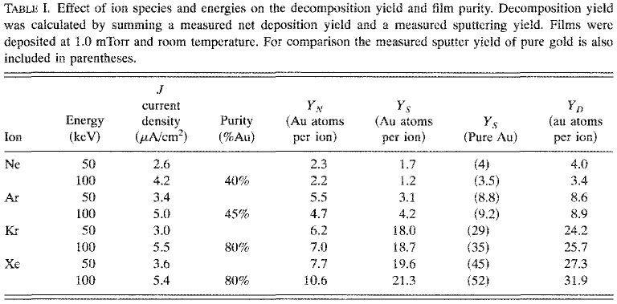
Effect of ion species and energy on yield and purity
Measured yield of pure Au)
Y_{N}=Y_{D}-Y_{S}
Heavier ion, higher yield.
Lighter ion, poorer purity, would be worse for e-beam induced deposition.
Y_{N}=net deposition, Y_{D}=deposition, Y_{S}=sputtering
Melngailis, “Mechanism of ion beam induced deposition of gold”, JVST B, 1994.

Slide 13
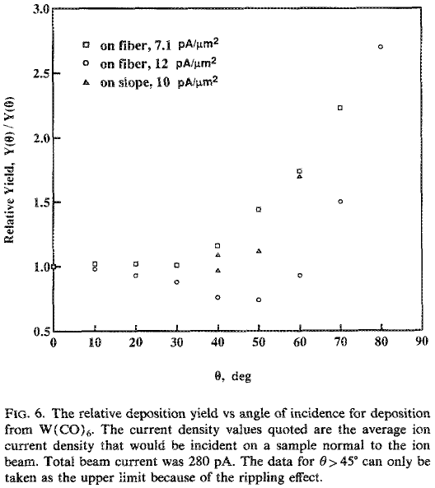
Effect of ion incident angle
According to collision cascade model, deposition yield should be closely related to sputter yield, as atoms come out of the surface (sputtered away) or excited at the surface (not sputtered away) would induce decomposition.
It was found that deposition yield does increase with angle of incidence, but not as fast as milling/sputtering yield.
“Focused ion beam induced deposition and ion milling as a function of angle of ion incidence”, JVST B, 1992.

Slide 14
Deposition parameters
Dwell time: residence time at one point, desire one monolayer deposition per dwell time. About 0.4μs for C; 0.2μs for Pt, depends on beam current.
Refresh time: time between successive dwells at same point
Overlap: amount two consecutive points overlap to obtain uniform deposition. typical 25% (positive overlap) to -100% (negative overlap)

Slide 15
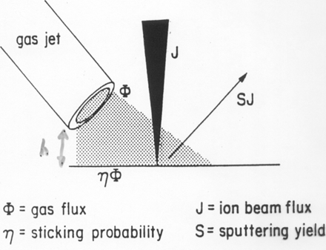
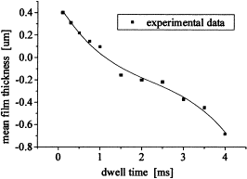
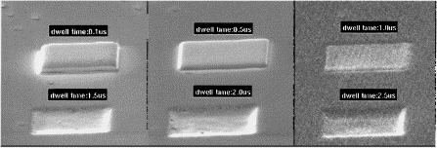
Competition between deposition and sputtering
dN=ηΦ dt₁−SJ dt₂ Here dt₁ can be >>dt₂ if deposition rate is limited by gas adsorption rate (dt₁ can be up to the refresh time)
deposition
milling
Net deposition
0.1μs
Fig. 4. Dwell time vs mean film thickness under ion dose 3nC/μm², spot size 25nm, current 207pA.
(Dwell time is μs, NOT ms)
2.5μs
Net milling
Fig. 3. Deposited tungsten by FIB with different dwell times from 0.1 to 2.5μs, and the same ion dose 6nC/μm², refresh time 1000μs, X and Y step size 71nm and 68nm, beam spot size 25nm.
Fu, “Characterization of focused ion beam induced deposition process and parameters calibration”, Sensors and Actuators A, 2001.

Slide 16
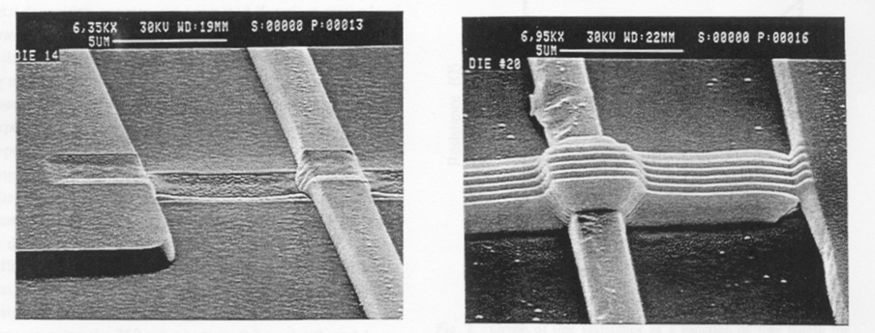
Competition between deposition and sputtering
W: deposition vs. sputtering
W deposited with 15μs dwell and 0.16μm step size, sputtering exceeds deposition.
W deposited with 0.3μs dwell and 0.6μm step size
J. Mohr and R. Oviedo, 19th ISTFA Proceedings, Nov. 1993, p.391

Slide 17
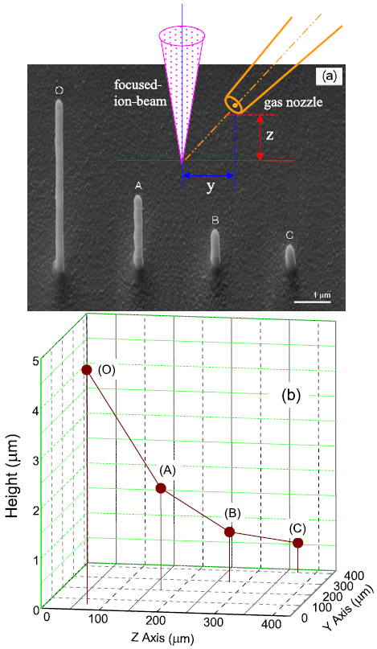
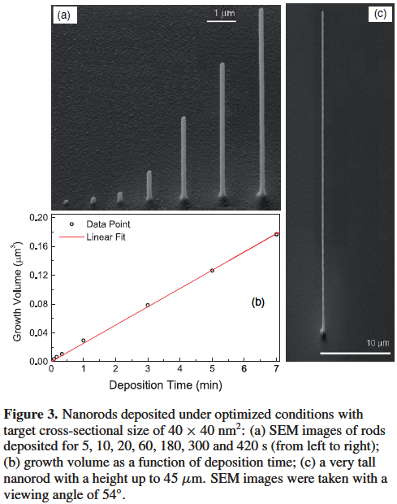
Deposition limited by gas diffusion and adsorption
1pA, beam 7nm
Not limited by gas diffusion under optimal conditions.
Effect of the gas precursor nozzle position on nano-rod growth. Limited by diffusion.
Li and Warburton, Nanotechnology, 2007

Slide 18
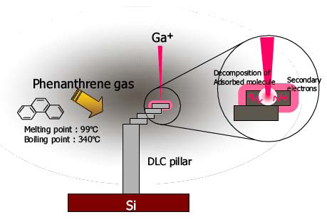
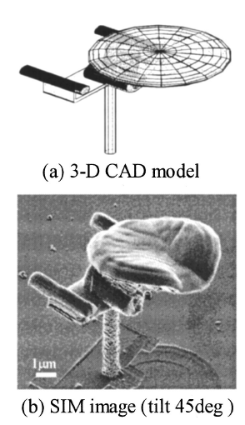
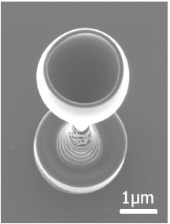
3D structure by FIB deposition

Slide 19
Focused ion beam (FIB)
Overview.
Ion source and optics.
Ion-solid interaction, damage.
Scanning ion beam imaging.
FIB lithography using resist.
FIB milling, sputtering yield.
Redeposition.
Single line milling.
Other types of FIB lithographies (implantation, intermixing…).
Gas-assisted FIB patterning.
Focused ion beam induced deposition.
Focused electron beam induced deposition.
Deposition rate (electron and gas flux-limited regimes)
Deposit composition (carbon/metal)

Slide 20
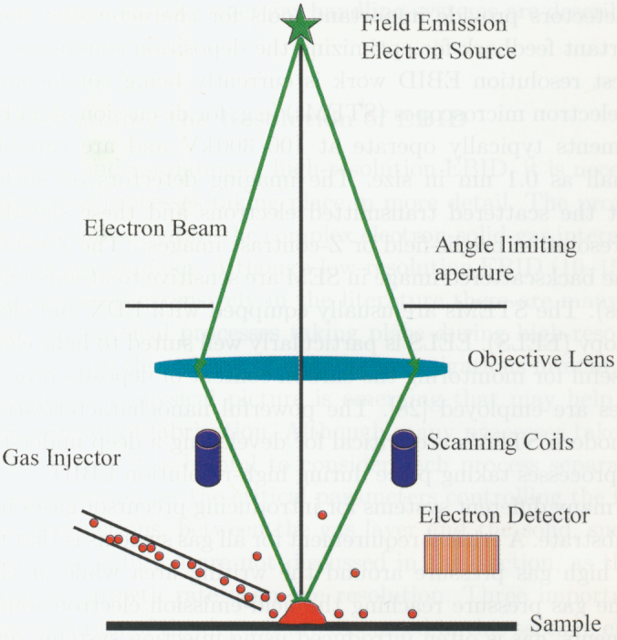
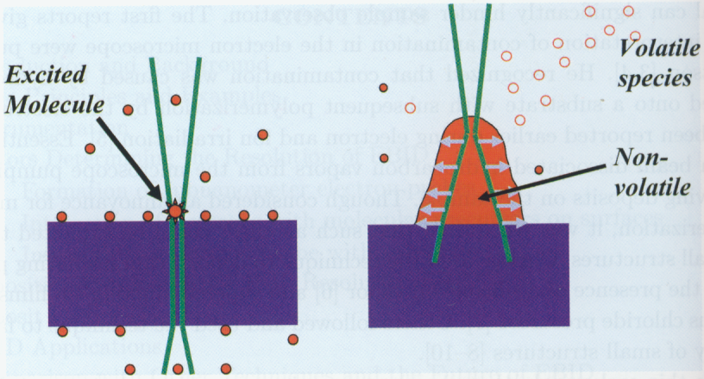
Focused electron beam induced deposition
Tools: DualBeam FIB/SEM, SEM, Scanning TEM
The overall picture of deposition is similar to focused ion beam induced deposition:
Fast electron excites an adsorbed precursor molecule.
Excited molecule dissociates into volatile and non-volatile components.
The volatile component escapes and leaves behind the non-volatile deposit.

Slide 21
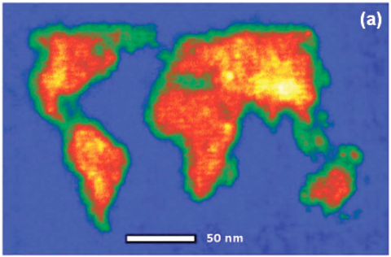
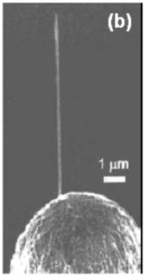
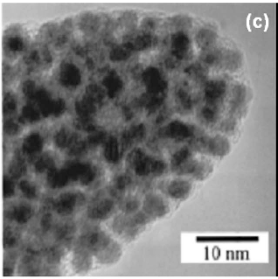
Focused electron beam induced deposition: examples
On non-flat surface with high aspect ratio
Deposit far from being pure metal, up to 90% impurity (mostly carbon)
On flat surface (very high resolution)
A topographical map of the world on a flat substrate.
A tip grown on a scanning tunneling microscopy probe.
High-resolution TEM image of a typical deposit showing a nano-composite material - nanometer-sized metal crystals in an amorphous C matrix.

Slide 22
Comparison to FIB induced deposition
No sputtering/material removal, so always pure deposition, unless reactive gas is introduced (then form volatile species) – gas assisted FEB (focused electron beam) etching similar to gas assisted FIB etching.
Deposit has no Ga impurity, but a lot more amorphous carbon.
Worse electrical conductivity, more important to avoid carbon contamination component (C-H) in the precursor gas.
Deposition speed of FIB-ID is 10× that of FEB-ID for reasons not well understood yet.
For low-aspect ratio deposition, FEB-ID is better for high resolution due to small focused electron beam size.
For high aspect ratio nano-rod deposition, FIB-ID is usually better because ion-solid interaction is well localized near the rod-apex, so is the deposition.
Application side, FIB-ID is more mature and is widely used in industry; FEB-ID is essential for DUV mask repair because in IBID Ga⁺ implantation into mask blocks DUV light.
ID = induced deposition, IBID = ion beam induced deposition, EBID = electron…

Slide 23
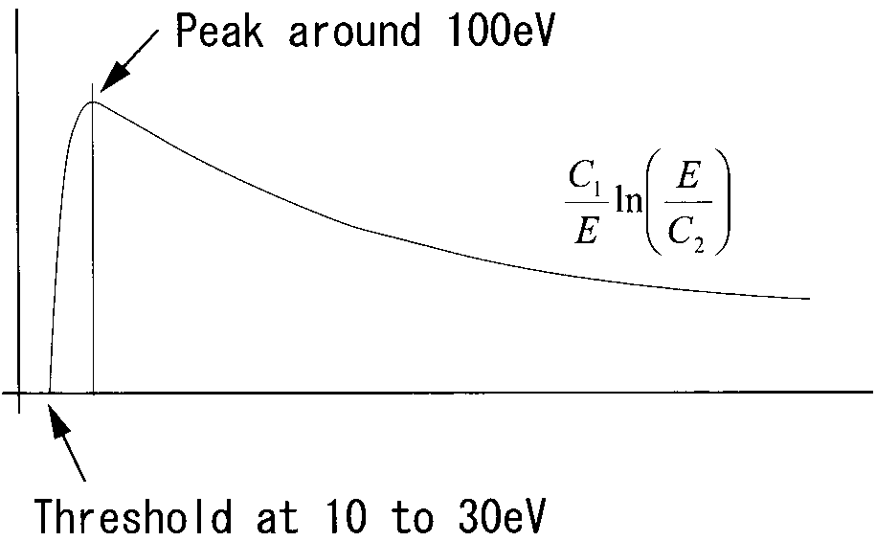
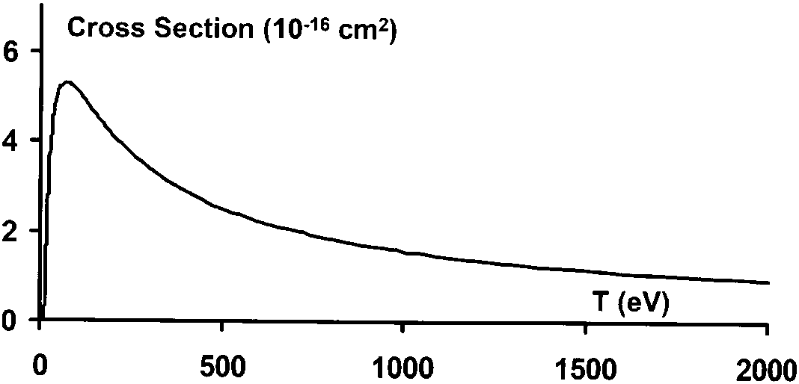
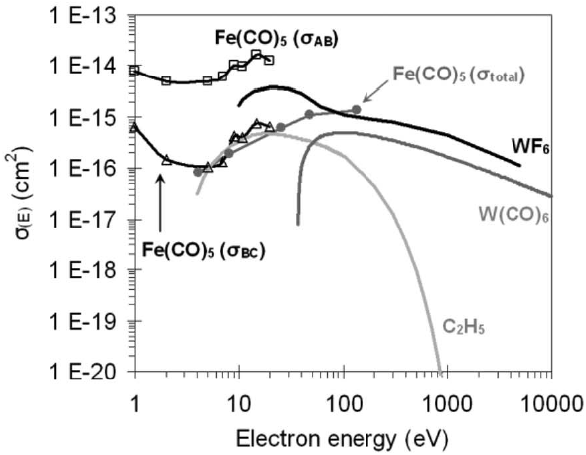
FEB-induced deposition mechanism
Ionization cross-section for GeH₄ gas molecules calculated using binary encounter model. Peak at 50-100V.
Schematic dissociation cross-section showing typical shape.
Dissociative ionization
Dissociation ∼ decomposition of precursor gas molecules
It has generally been assumed that dissociation takes place after ionization of the precursor.
Dissociate cross-section peaks at 50-100eV, so low-energy electrons such as secondary electrons play a central role.
Important processes: dissociative electron attachment (DEA), dipolar dissociation (DD).
Another proof of electron contribution: upon UV irradiation, precursor decomposition yield depends primarily on photoelectron yield of the substrate.
Measured and estimated dissociation cross sections for few precursors. Two step dissociation for Fe(CO)₅, through intermediate state B.
Hagen, “A critical literature review of focused electron beam induced deposition”, JAP 2008.

Slide 24
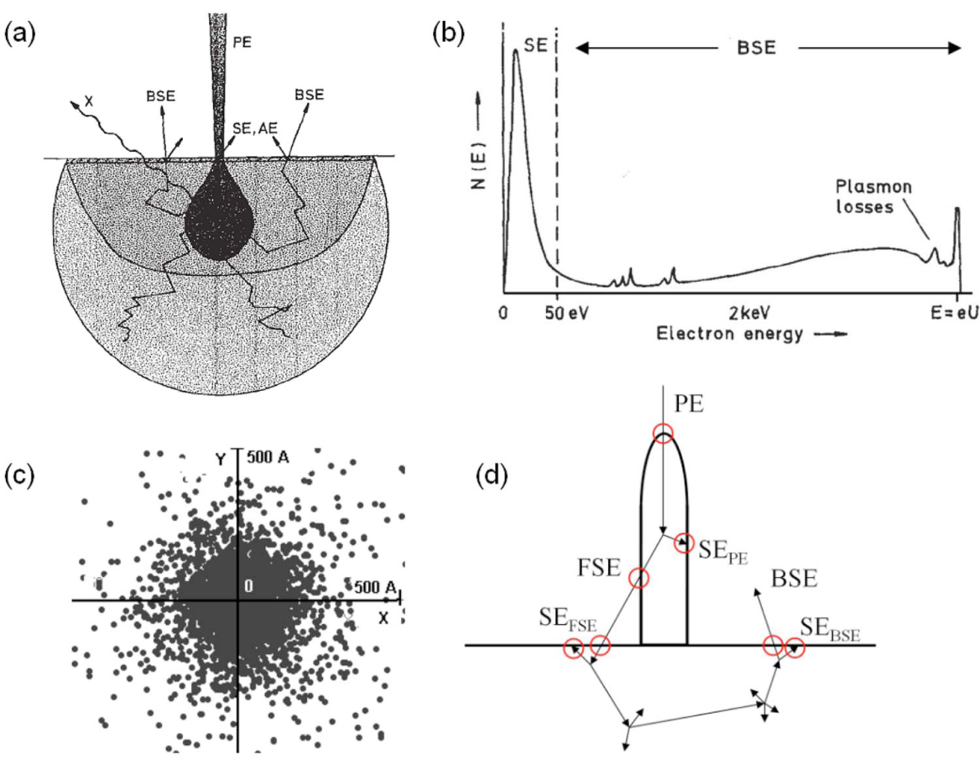
Contribution from PE, SE and BSE
Electron scattering volume
Energy spectrum of electrons
emitted from substrate
PE: primary electron
SE: secondary electron
FSE: forward scattered electron
BSE: back-scattered electron
Top view of simulated SE emission
sites on a flat substrate, showing
spatial distribution.
For 3D deposit, electrons can cross target-vacuum interface in many different ways.
SE/BSE definition: newly generated electrons are called secondary electrons (SE) if their energy is ≤50eV, and backscattered electrons if >50eV.
That is, here SE/BSE is by definition, without strict physical meaning.

Slide 25
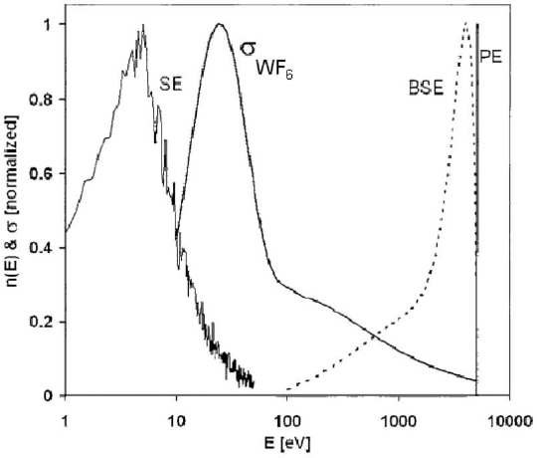
Contribution from PE, SE and BSE
PE: primary electron
SE: secondary electron
FSE: forward scattered electron
BSE: back-scattered electron
Simulated energy distribution of SEs and BSEs emitted from a Ge substrate, and the estimated cross-section for the dissociation of WF₆.
Deposition ∝ number × cross section
SE dominates deposition, PE and BSE not negligible.
PE important within electron beam center.

Slide 26
Focused ion beam (FIB)
Overview.
Ion source and optics.
Ion-solid interaction, damage.
Scanning ion beam imaging.
FIB lithography using resist.
FIB milling, sputtering yield.
Redeposition.
Single line milling.
Other types of FIB lithographies (implantation, intermixing…).
Gas-assisted FIB patterning.
Focused ion beam induced deposition.
Focused electron beam induced deposition.
Deposition rate (electron and gas flux-limited regimes)
Deposit composition (carbon/metal)

Slide 27
Deposition rate
dN/dt=0 at steady state
N (cm⁻²): precursor molecule coverage
g: sticking factor
F (cm⁻²s⁻¹): gas flux arriving at the substrate
N₀: available adsorption site density in a monolayer
σ(E) (cm²): dissociation cross section
J (electrons s⁻¹ cm⁻²): current density
τ (s): residence time
Assume J = J_{PE}+J_{BSE}+J_{SE} = beam current
R(cm/sec): growth rate
V_{molecule} (cm³): volume of deposited molecule
Try to understand the equations, you don’t need to remember them.

Slide 28
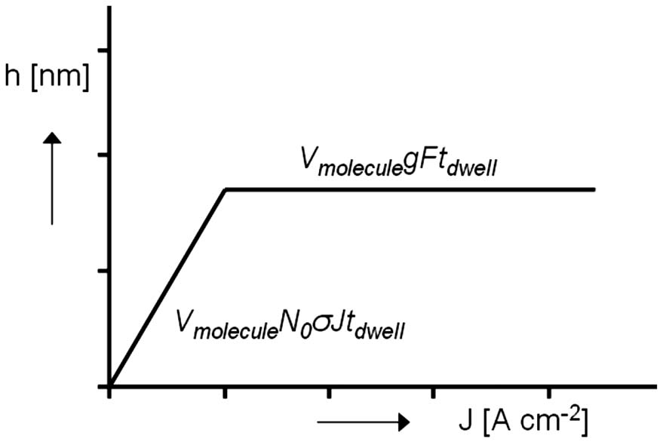
Deposition rate: two regimes
Ignore desorption (τ=∞), two regimes:
Current limited, rate independent of gas flux.
Gas flux limited, rate independent of current density.
In both regimes, height increases with dwell time linearly.
Height for fixed dwell time

Slide 29
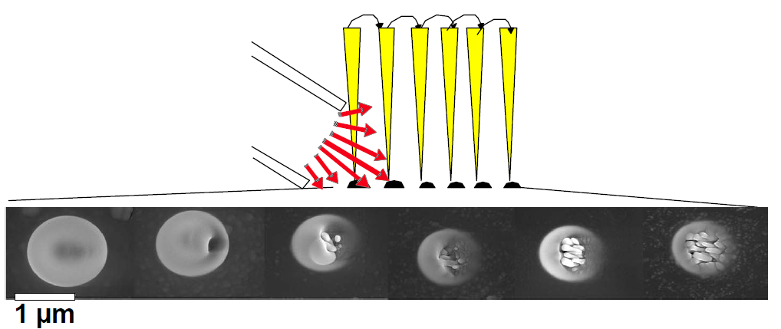
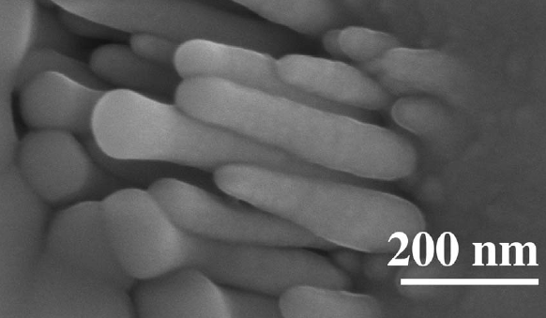
Effect of precursor transport (gas flux)
Increasing
source-beam
distance
10μm-1mm
I_{p}=1000pA
E=25keV
t_{e}=180s
Current limited
Deposition rate decreases with increasing distance, central structure appears
High electron density (beam center, gas flux limited): columnar growth, more metal less carbon.
Low electron density (current-limited): lots of carbon due to “polymerization” by peripheral electrons and BSE/SE.

Slide 30
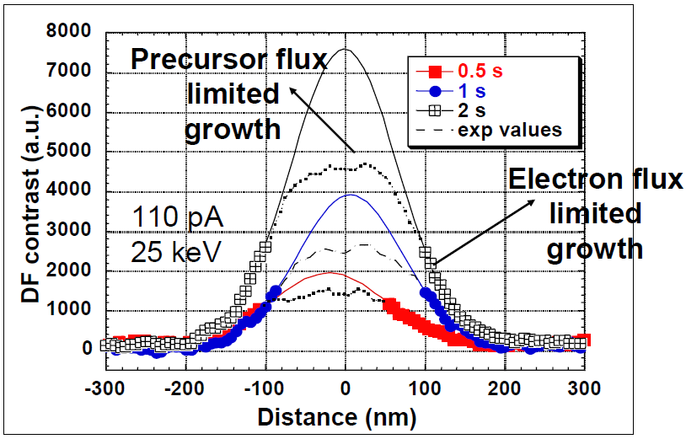
Deposition rate: two limiting regimes
e
Intensity profiles (DF TEM)

Slide 31
Substrate-precursor molecular interaction: diffusion, adsorption/desorption
Absorption may occur as chemi-sorption or physi-sorption.
The gas molecular arrives at/bombards the surface at a rate of ϕ.
Characteristic residence time of precursor molecule on the substrate is τ.
Longer τ gives higher probability of dissociation by electrons.
Once deposition starts, τ becomes that for precursor molecule on deposit surface.
τ Is a sensitive function of temperature, heating reduces τ thus deposition rate.
For W(CO)₆, M=352, at RT and 0.01Torr 10000 times/nm²sec
ν Is the vibration frequency of an adsorbed molecule, E_{des} is the desorption energy (J).

Slide 32
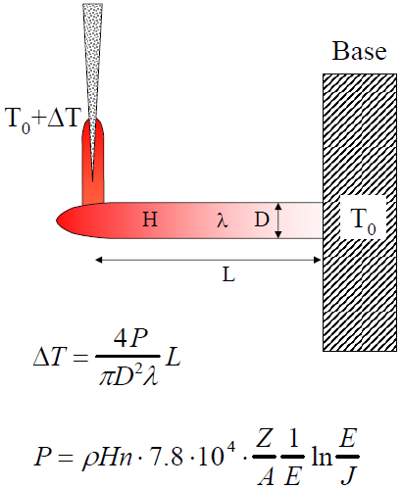
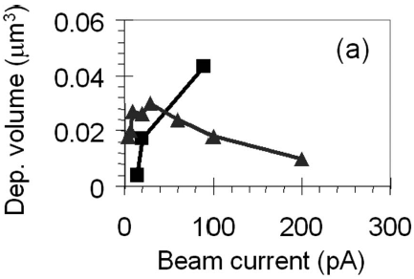
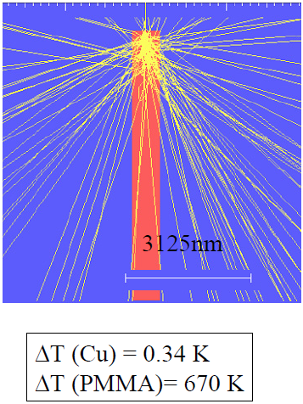
Effect of heating
Rate decreases with current due to heating induced desorption.
TEOS
Carbon contamination deposition
Dwell time fixed at 120sec, slower deposition for C at higher I due to heating.
(if without heating, the volume would be constant at higher I, as deposition is limited by gas flux)

Slide 33
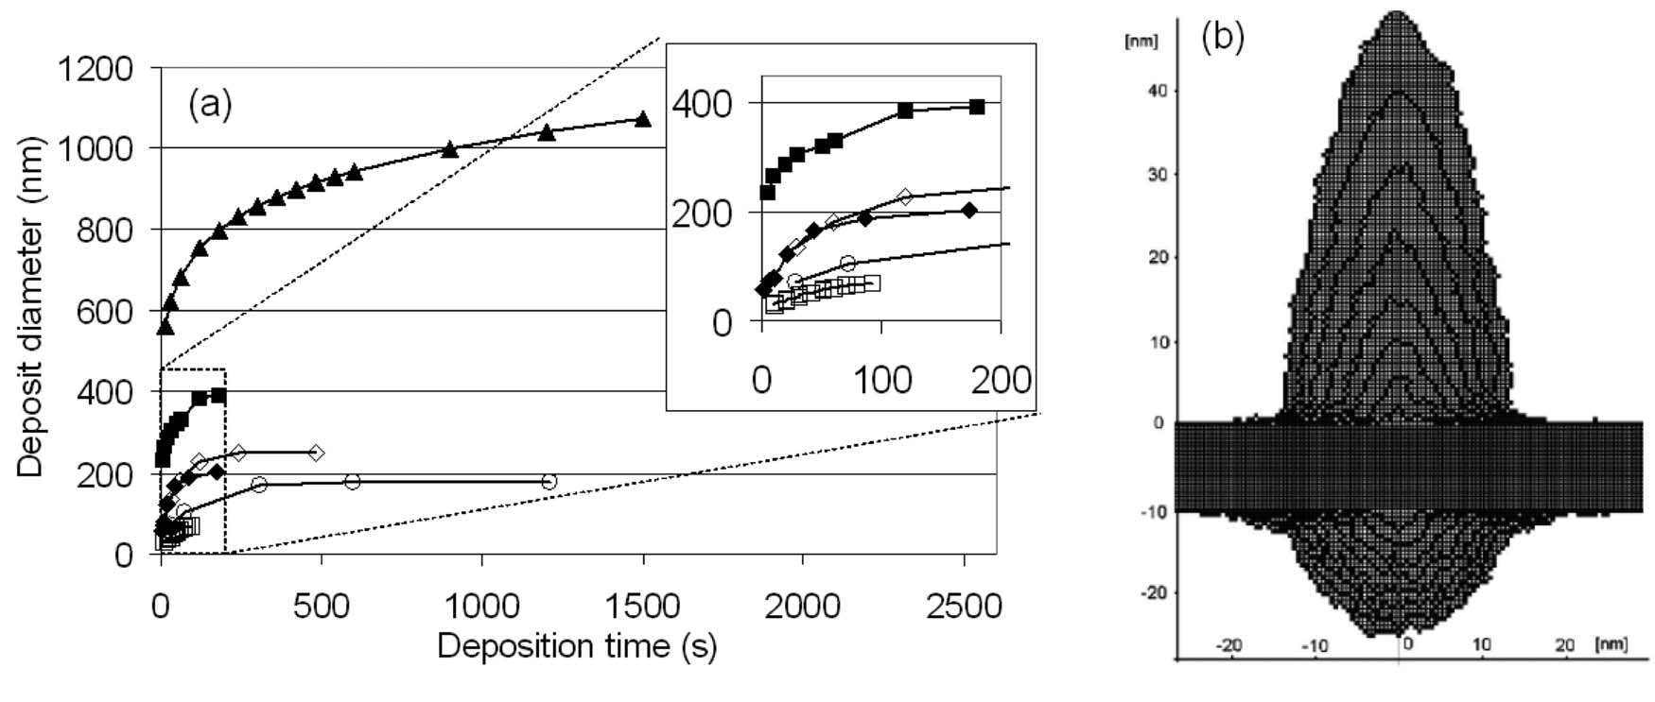
Deposition diameter
Fig. 12. The development of the width of an e-beam deposited structure.
Experimental results. Inset shows the width development for short times.
Result from a Monte Carlo simulation.
Vertical growth is due mostly to direct dissociation by PEs (primary electrons).
Lateral growth is due mostly to SEs.
In principle, lateral growth should stop once d_{deposit}≈d_{beam}+2×SE escape length.
But BSE can go far away and generate SE there, so diameter can go quite large after long time.

Slide 34
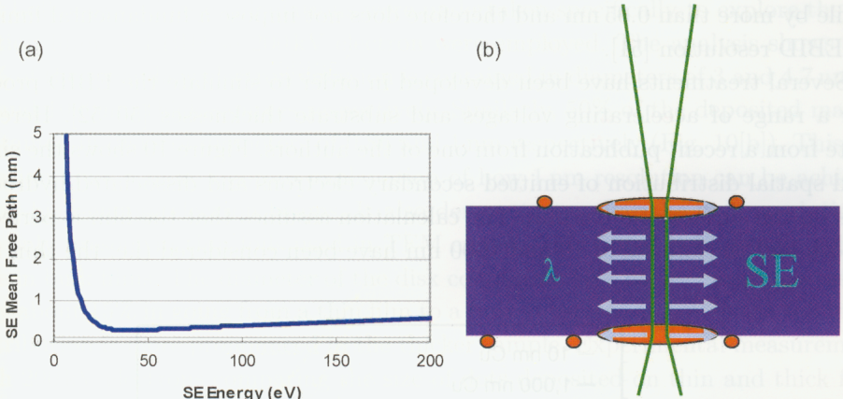
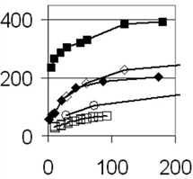
High resolution deposition
The mean free path depends on material, here should be a heavy material (high Z) with very short mean free path.
Strategy:
Use high voltage STEM that has small beam spot size, and short deposit time (but then low aspect ratio).
That is, stop deposition before significant lateral widening (by SE) occurs.
STEM: scanning transmission electron microscopy, beam <0.2nm.
Stop here

Slide 35
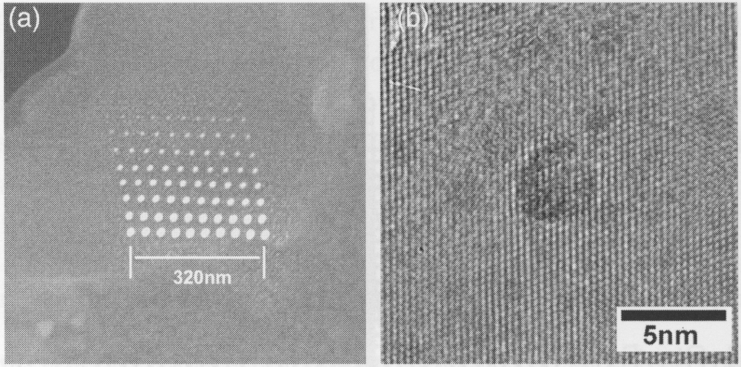
High resolution deposition examples
W deposition using high resolution STEM
25ms
2.5s
275ms, 3.5nm
Resolution is high, but aspect ratio is low, height/width order of 1.

Slide 36
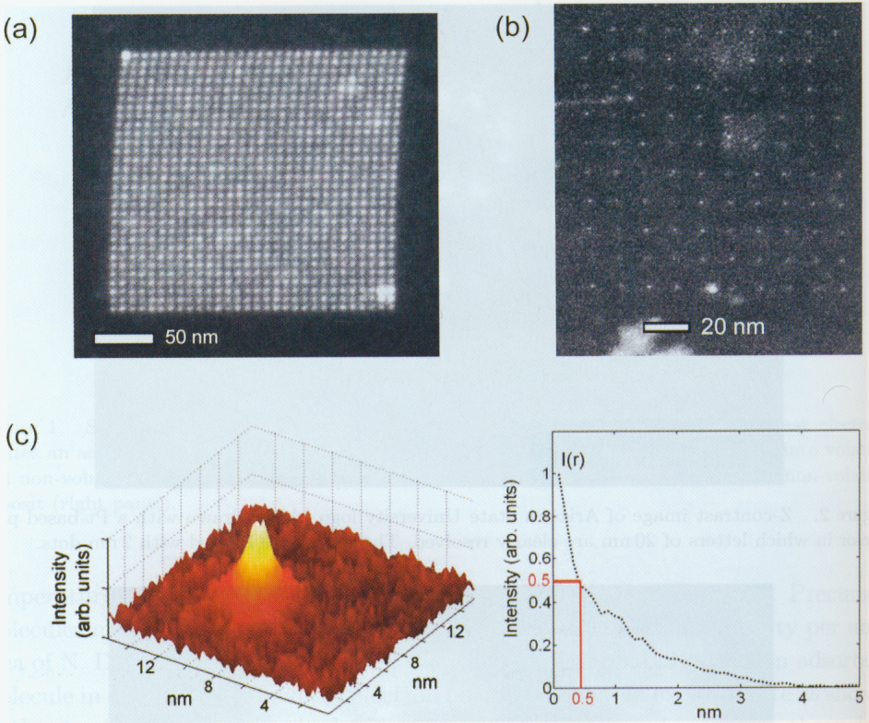
High resolution deposition examples
4.0nm size
1.0nm size
W containing dots with W(CO)₆ precursor

Slide 37
Focused ion beam (FIB)
Overview.
Ion source and optics.
Ion-solid interaction, damage.
Scanning ion beam imaging.
FIB lithography using resist.
FIB milling, sputtering yield.
Redeposition.
Single line milling.
Other types of FIB lithographies (implantation, intermixing…).
Gas-assisted FIB patterning.
Focused ion beam induced deposition.
Focused electron beam induced deposition.
Deposition rate (electron and gas flux-limited regimes)
Deposit composition (carbon/metal)

Slide 38
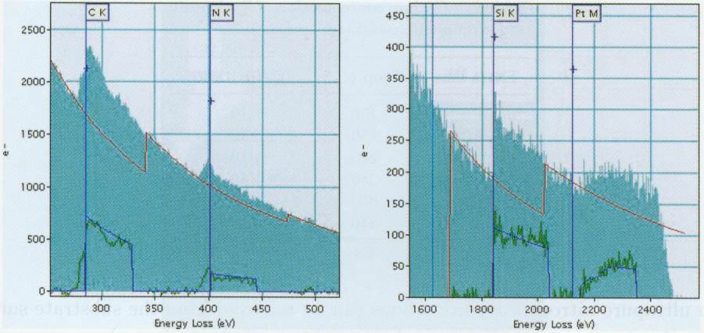
Deposit composition – carbon/metal
For W deposition using W(CO)₆, thermal decomposition (regular CVD process) W(CO)₆ + heat -> W(CO)_{6-n}+nCO, CO removed easily by heating to 200ºC, leading to pure W.
But for FEB induced deposition, large amount carbon (amorphous with high graphene component) always exists in the deposit when using carbonaceous precursors.
Because electrons aggressively excite/activate many of the atoms in the precursor molecule.
Even precursor is carbon-free, carbon gets into deposit easily from chamber contaminants.
Electron energy loss spectra recorded from Pt deposits on a thin film of Si₃N₄, showing 90% of the deposit is carbon, the ratio is similar to C/Pt ratio in the precursor Pt(CH₃)₃CH₃C₅H₄.

Slide 39
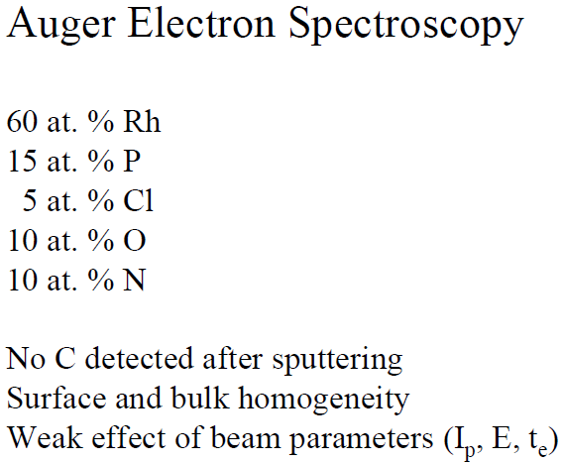
Non-carbon contamination
(Rh deposition using [(PF₃)₂RhCl]₂
Cl
F
P
Rh

Slide 40
Deposit: metallic Rh nano-particles in a lighter amorphous matrix
Z-contrast image
Summary:
FEB deposition is very different from thermal (CVD) deposition.
The deposit composed of nano-particles in protecting matrix.

Slide 41
Electrical properties of the deposit
Typical pure metal resistivity <10μΩ⋅cm
Resistivity
(no C, purer)

Slide 42
How to reduce carbon?
Increase beam current.
Add reactive gas such as H₂ (effective at certain temperatures, see table below).
Post-deposition processing – thermal treatment in oxidization environment to “burn” the carbon.
Deposition

Slide 43
Effect of beam current on metal content and morphology
The metal content as a function of beam current.
Co₂(CO)₈
Me₂-Au-tcac
CpPtMe
Mo(CO)₆
The increase in metal content with beam current can be due to two parallel processes:
Increase in beam current can induce an increase in the desorption of fragments of (initially only partially dissociated) precursor molecules. This can lead to higher concentrations of nonvolatile (among others, metal) components in the final deposit.
E-beam induced heating. A raise in temperature may, for instance, facilitate the desorption of volatile species, as well as change the dissociation mechanism.

Slide 44
Effect of precursor transport (gas flux)
Increasing
source-beam
distance
10μm-1mm
I_{p}=1000pA
E=25keV
t_{e}=180s
Current limited
Deposition rate decreases with increasing distance, central structure appears
High electron density (beam center, gas flux limited): columnar growth, more metal less carbon.
Low electron density (current-limited): lots of carbon due to “polymerization” by peripheral electrons and BSE/SE.

Slide 45
Effect of beam current on morphology
Higher current, rougher
Surface morphologies for high current deposits created with the beam in spot mode.
Mo(CO)₆
hfac-Cu-VMTS
c) Co(CO₃)NO
Co₂(CO)₈.
Generally, at low beam currents, the deposit is smooth and completely amorphous with high impurity concentration.
At high beam currents, the deposit is rougher with irregular shape and is polycrystalline (metal is polycrystalline, carbon can’t be – it is amorphous), the crystallites being between 2nm and 8nm in size.

Slide 46
Contaminant-free deposit is possible, here GaN in UHV
Electron energy loss spectrum
Diameter 4nm, height 5nm.
Precursor gas is D₂GaN₃
D₂GaN₃ + e⁻ -> GaN (solid) + D₂ + N₂
UHV: ultra high vacuum

Slide 47
Proximity effect
Proximity effect is due to backscattering
It leads to deposition over large surface area at the base.
It may cause short circuit.
A halo around a deposited tip due to proximity effect as it is known in e-beam lithography.
Short circuit?

Slide 48
High aspect ratio structures
It is possible, but not as easy as FIB-induced deposition.
Electron penetrate deep inside the nano-rod and can escape from a point far below the rod apex, causing continuous deposition at points well below the apex.
Focused electron beam deposition
Tip diameter: 15nm (W-tip)
V=120kV, beam diameter = 3nm
Focused ion beam deposition, high aspect ratio easy to achieve
S. Matsui and T. Ichihashi, APL 53 (1988) 842

