Slide 1
Nanoimprint lithography (NIL)
Overview.
Thermal NIL resists.
Residual layer after NIL.
NIL for large features (more difficult than small one).
Room temperature NIL, reverse NIL, NIL of bulk resist (polymer sheet, pellets).
UV-curing NIL.
Resists for UV-NIL.
Mold fabrication for thermal and UV-NIL.
ECE 730: Fabrication in the nanoscale: principles, technology and applications
Instructor: Bo Cui, ECE, University of Waterloo; http://ece.uwaterloo.ca/~bcui/
Textbook: Nanofabrication: principles, capabilities and limits, by Zheng Cui

Slide 2
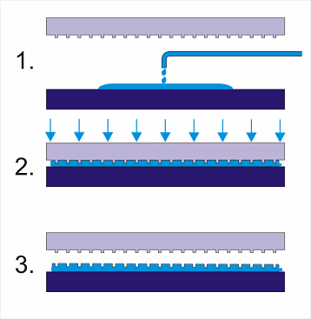
UV-curing NIL
UV-curing NIL is a mechanical molding process, like thermal NIL; but very different from photolithography that is a chemical process, though they both use UV light.
UV-NIL using dispensing resist
Room temperature, low pressure (1 - few atm).
Liquid resist consisting monomer, photo-initiator, coupling agent, surfactant, solvent…
Resist cross-link (become solid) upon UV illumination.
Mold (or substrate) must be transparent to UV. Most popular mold material is quartz.
Easier for alignment than thermal NIL (thermal expansion destroys alignment), closer to optical lithography.
But resist side, thermal NIL resist is closer to optical lithography resist. For example, PMMA and SU-8 is both a photo-resist (PMMA for DUV lithography) and thermal NIL resist.
In fact, UV-NIL resist is closer to UV-curable glue.
UV light

Slide 3
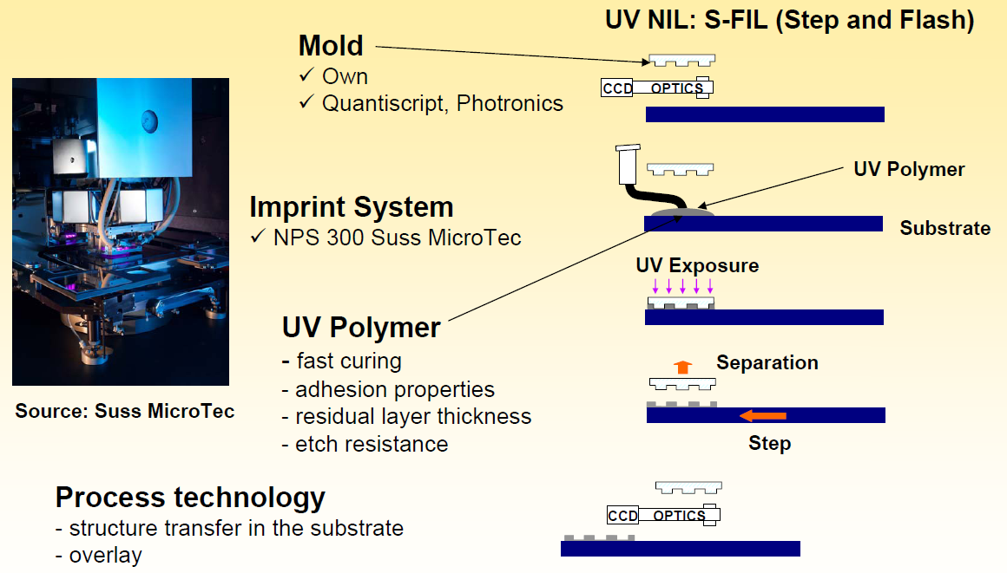
Step and flash UV-NIL
Resist is not applied by spin-coating; but drops by “inkjet”, less uniform thickness!!
(for alignment)
“Inkjet” system
Technology commercialized by Molecular Imprint Inc.
Resembles deep UV stepper, die by die patterning (no need of a BIG expensive mold).
Favored by the semiconductor industry or wherever mold is too expensive.

Slide 4
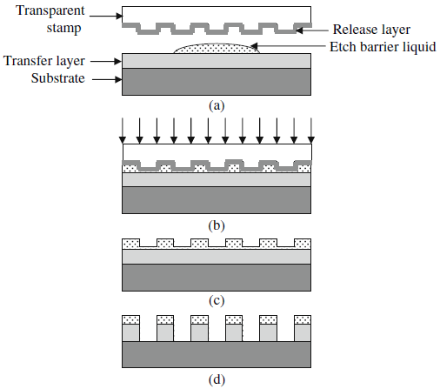
Step and flash UV-NIL using bi-layer resist
(anti-sticking)
UV exposure
RIE residual layer using gas containing F and oxygen
RIE under-layer using O₂
The UV resist can be very thin but contains Si that is resistant to O₂ RIE, then a polymer under-layer can be used for pattern transfer.

Slide 5
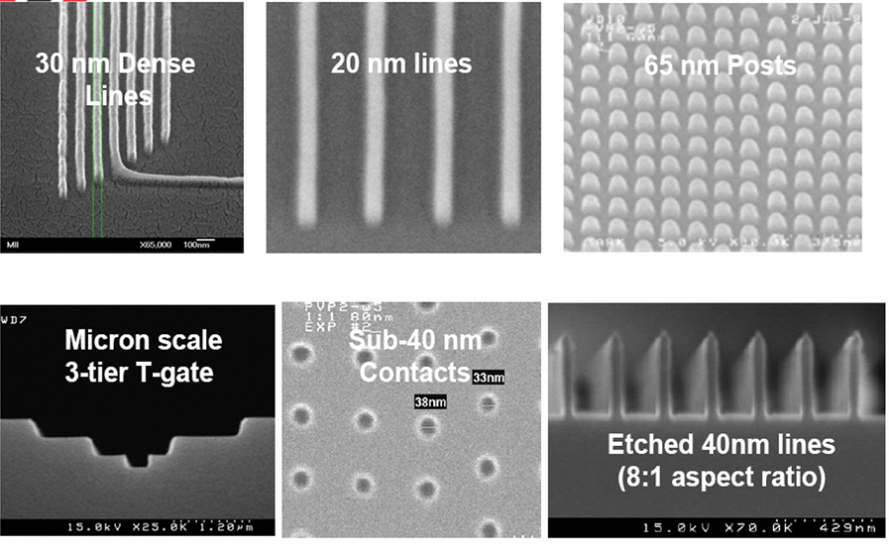
Some examples of step and flash NIL
In principle, UV-NIL has lower resolution than thermal NIL due to resist shrinkage (∼10%) upon cross-linking. In practice, UV-NIL has demonstrated similar resolution to thermal NIL.

Slide 6
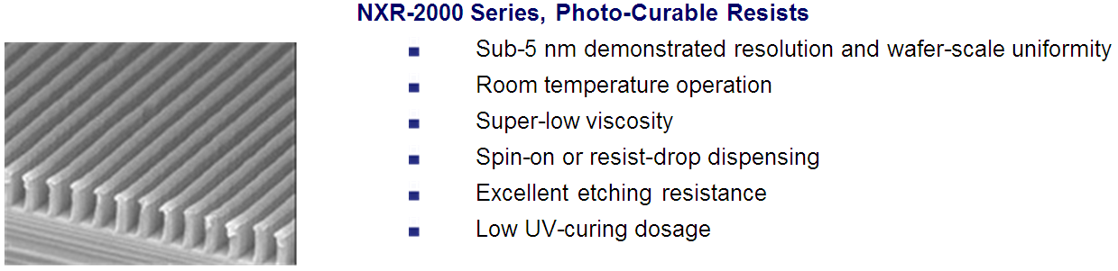

UV-NIL using spin-on resist (uniform thickness)
UV-resist
Under-layer (PMMA, ARC…, also called transfer layer)
Typically bi-layer system, thin UV-resist layer to minimize shrinkage effects.
Resist contains Si, so can be used as a hard mask for etching under-layer with O₂ plasma.
Spin-on resist is not suitable for step-and-flash NIL, because the entire film must be imprinted quickly in one shot (liquid resist not as stable as thermal NIL resist in air, and it takes in dust quickly).
A big expensive mold is needed, but the throughput is also higher.
For R&D, spin-on resist is much more reliable than step-and-flash NIL, because the amplitude and uniformity of residual layer thickness is a big issue for drop-dispensed resist.

Slide 7
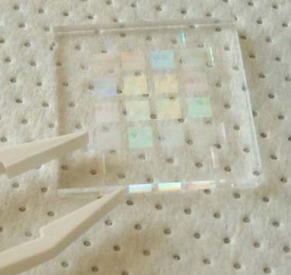
PDMS mold for UV-NIL
Transparent mold (also called stamp or template) in PDMS
Unlike quartz, PDMS is flexible and soft for conformal contact to non-flat substrate.
But not for high resolution (<100nm), because PDMS is not hard enough and thus its nanostructure will deform under pressure.
One solution is using bi-layer, pattern in hard-PDMS or PMMA, which is spun on (regular soft) PDMS.
After oxygen plasma treatment, PDMS surface is like SiO₂, so it is easy for silane anti-sticking treatment.

Slide 8
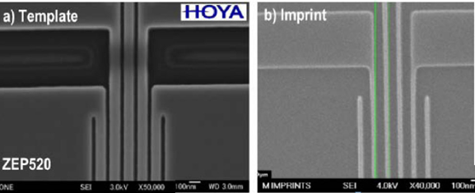
ZEP-520 mold (ZEP is an e-beam lithography resist)
Because UV-NIL uses low pressure and room temperature, thermoplastic EBL resist such as PMMA and ZEP-520 can be used as a mold right after EBL and development.
However, one may need anti-sticking surface treatment with silane, yet the silane treatment is not reliable on ZEP or PMMA, or other thermoplastic polymers.
Therefore, thermoplastic polymers are not popular mold materials.
Mold in ZEP-520 with line-width 50nm Imprint result into a UV-curing resist

Slide 9
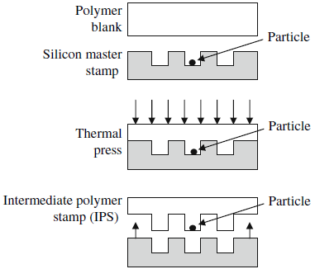
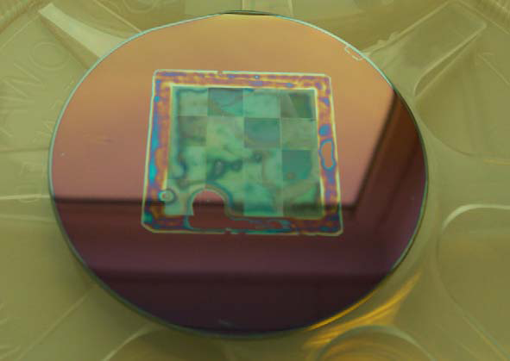
Dust
UV-NIL dust particles
Self-cleaning process: dust particles on the “master mold” can be trapped to the polymer replicate, which can be used as a mold for UV-NIL (called “daughter mold”).
Dust is a bigger issue for UV-NIL than for thermal NIL because:
The liquid resist takes in dust easily from air, and the dust cannot be blown away.
The pressure is lower, leading to larger defect area with same size of dust particle.
So sometimes, UV-NIL is done at higher pressure to reduce defect area.

Slide 10
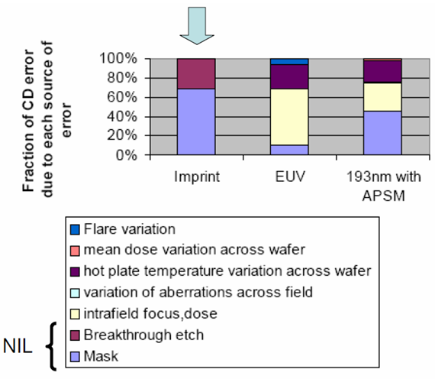
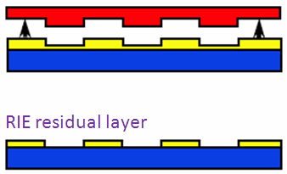
Critical dimension (CD) control in NIL
UV-NIL is one candidate for next generation lithography to replace 193nm lithography.
Advantage of NIL for CD control:
No diffraction or proximity effects.
No lens aberrations.
Disadvantage of NIL for CD control:
1× mask, so CD error on mask is printed onto resist without reduction.
Need a breakthrough etch of the residual layer, which adds CD error due to lateral etch.
But this error could be compensated in mask (mold) design.
CD control error budget comparison

Slide 11
Summary: comparison between thermal and UV NIL
Thermal
UV
Resist material | Thermoplastic or thermal-set (i.e. cured upon heating) | Monomer, photo-initiator plus various additives
Resolution | Sub-5nm | 2nm demonstrated, but volume shrinkage after cross-linking
Temperature | 30-100ºC above T_{g} | Room temperature
Pressure | Normally over 10 bar | ∼1 bar, or higher
Resist application | Spin coating, easy | Spin coating or drop
Resist thickness | Up to many μm, easy for pattern transfer | Typically < 100nm, need an extra transfer layer
Cycle time | 1-30 min, slow | ∼1 min
Large features | ∼100 μm, difficult | Relatively easy, since low viscosity
Alignment | ∼ 1 μm, difficult; CTE mismatch | 20nm demonstrated
Application | Broad range, simple and work with many materials | Targeted for semiconductor industry with alignment
T_{g}: glass transition temperature
CTE: coefficient of thermal expansion

Slide 12
Nanoimprint lithography (NIL)
Overview.
Thermal NIL resists.
Residual layer after NIL.
NIL for large features (more difficult than small one).
Room temperature NIL, reverse NIL, NIL of bulk resist (polymer sheet, pellets).
UV-curable NIL.
Resists for UV-NIL.
Mold fabrication for thermal and UV-NIL.

Slide 13
Resist for UV-NIL
Overview:
UV-NIL resist has little in common with photo-resist, which resembles more thermal NIL resist.
In principle, any material that is soft (thus can be imprinted) and becomes hard upon UV exposure, can be used as UV-NIL resist.
For example, UV-glue and dental UV sealant, are UV-NIL resists.
Component of UV-NIL resist:
Vinyl ethers that are the key ingredient for photoploymerization.
Organic acrylate monomer that provides low viscosity.
Organic cross-linker for thermal stability and mechanical strength.
Additives: silicon-containing acrylate monomer (to increase dry etching resistance), flourinated compounds (to lower surface energy for easy separation).
Photoinitiator: cationic or free radical photoinitiator.
Photoinitiators:
(dissociate upon UV irradiation to form radicals that promote polymerization process)
Cationic photoinitiator:
  Insensitive to oxygen, but low curing rates; and acids and heavy metals are harmful to semiconductors.
Free radical photoinitiator: (more popular at present)
  Great variety, high curing rates, but sensitive to oxygen, need vacuum or N₂ environment curing.

Slide 14
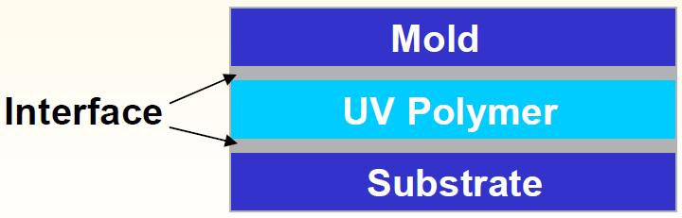
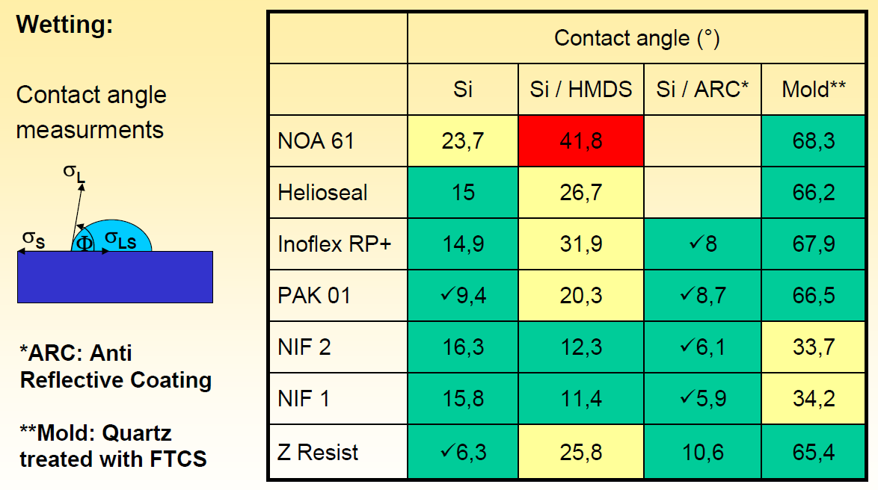
Adhesion mold/UV polymer/substrate
Ideally:
No adhesion between mold/UV-polymer.
Strong adhesion between substrate/UV polymer.
Interface reaction:
Mechanical adhesion, wetting, specific adhesion that is mainly caused by inter-molecular bindings.
σ is surface tension (N/m), also called surface energy (energy/m²=N/m)
Resist
For substrate (Si, Si/HMDS, Si/ARC), low contact angle (small Φ) is better.
For mold, high is better.
But here, all resists still “wet” the mold (Φ<90º)
Note: those resists are just examples, none of them are popular – in fact currently there is no single UV-resist that gains enough popularity.
Holger Schmitt, Christoph Lehrer

Slide 15
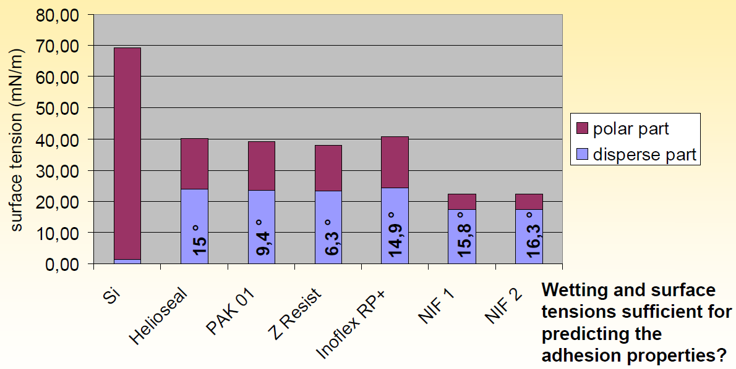
Surface tension of various materials
Contribution to total surface tension: polar and disperse part.

Slide 16
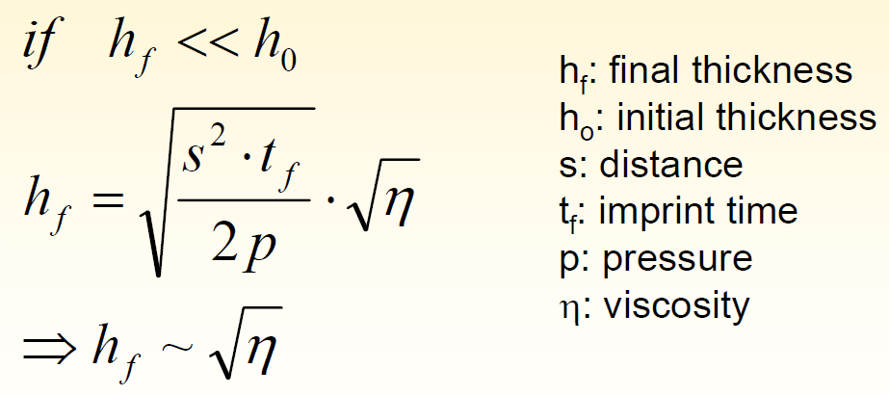
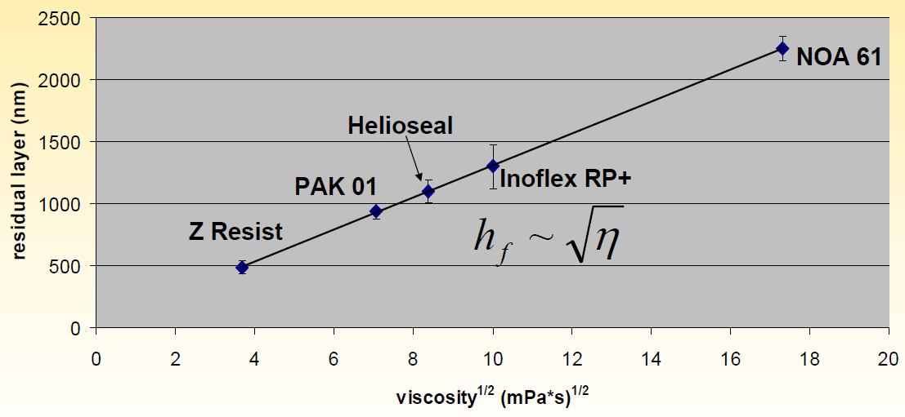
Residual layer thickness
For drop-dispensed resist (not spin coating)
Thin (<<100nm) residual layer leads to less dimensional accuracy loss, so low viscosity (high flow rate) is desired.
Conclusion:
UV sealant and UV glue not appropriate.
Certainly, residual layer thickness also depends on initial dispensed drop volume.

Slide 17
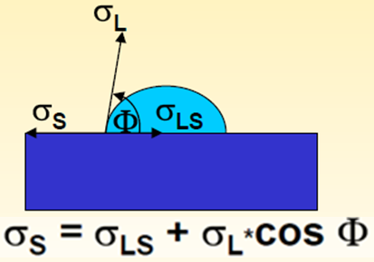
Summary for resist
Curing chemistry: ideally it should be compatible with oxygen, so no need of vacuum.
Curing speed: higher is better for faster imprint, typically few seconds curing time.
Viscosity: lower is better, to fill large features faster, to have thinner residual layer.
Surface energy: since the resist has to “wet” the mold (contact angle <90 degree) for imprint using low pressure, both the mold and the resist have to have low surface energy for easy separation. Low surface energy resist may not adhere (wet) the Si substrate, making spin coating difficult or leading to resist peel off upon separation. One strategy is to coat an under-layer (PMMA, PMGI, ARC…) that binds well with the resist having low surface energy.
If mold is coated with mold release agent (very low surface energy), the resist may still “wet” the mold if it also has low surface energy. (i.e. all the σ in the equation is small, one can still have Φ<90º)

Slide 18
Nanoimprint lithography (NIL)
Overview.
Thermal NIL resists.
Residual layer after NIL.
NIL for large features (more difficult than small one).
Room temperature NIL, reverse NIL, NIL of bulk resist (polymer sheet, pellets).
UV-curable NIL.
Resists for UV-NIL.
Mold fabrication for thermal and UV-NIL.

Slide 19
Mold for thermal and UV-curing NIL
Mold: also called template, stamp, master.
Mold release agent: also called releasing layer, anti-sticking coating.
Separation: also called de-molding, de-embossing, release.
Overview:
Usually fabricated from Si, quartz or nickel, though polymer mold is becoming more popular and available.
Feature fabrication at 1x vs. 4x for optical projection lithography, and critical dimension (CD) control at 1x is more challenging.
For instance, photomask needs ∼250 nm resolution to print 65 nm features; NIL mold needs to be 65nm.
Desired properties:
Compatible to mold release agent coating.
Mechanically durable (for reuse).
Chemically durable (for cleaning).
Low CTE mismatch with substrate (coefficient of thermal expansion).

Slide 20
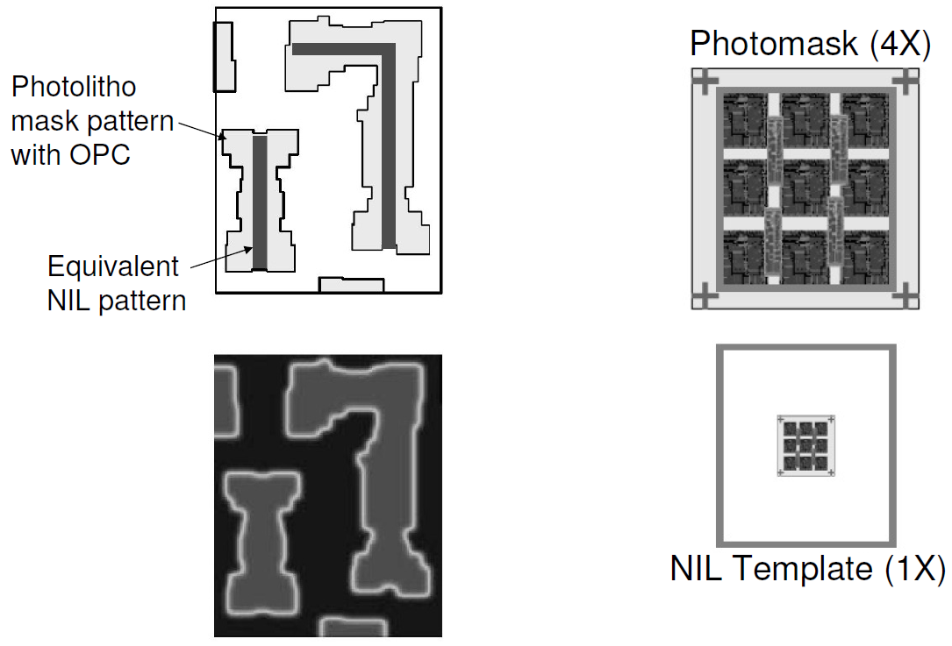
Comparison with photomask
Optical projection lithography mask with OPC & equivalent NIL mold.
OPC: optical proximity correction

Slide 21
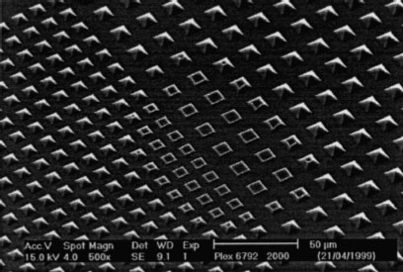
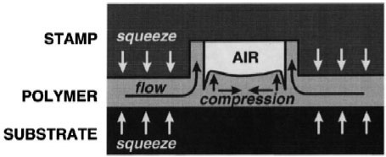
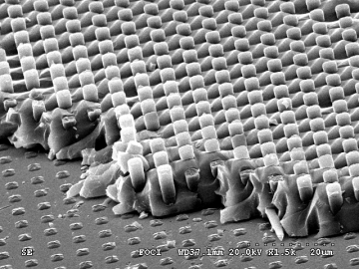
Mold issues: profile, roughness, sticking
Sidewall angle (θ)
Silicon
θ < 90°
θ = 90°
θ > 90°
PMMA
Roughness (R_{a})
Polymer flow and filling property
Align and imprint
Resist deform
Sticking
De-mold
Si

Slide 22
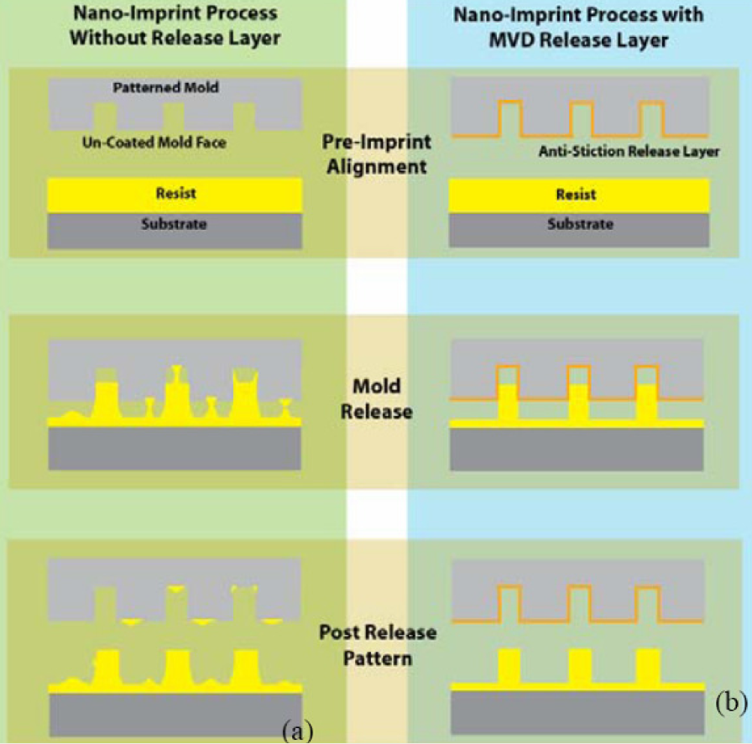
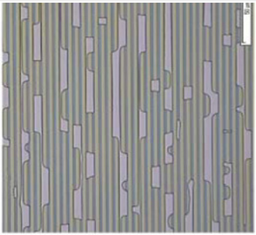
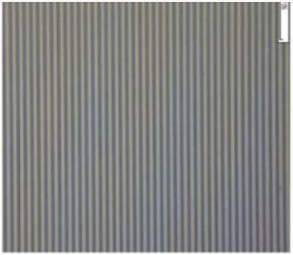
Importance of anti-stick coating
NIL using a mold without (top) and with (bottom) anti-stick coating
Resist peeled off

Slide 23
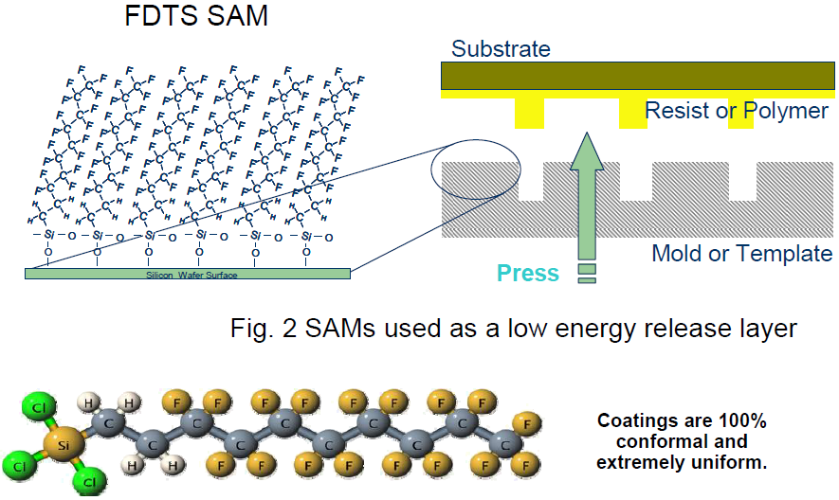
Mold release agent: teflon-like coating
Same idea as anti-stick cooking ware coating, but mono-layer.
(SAM: self assembled monolayer)
FDTS: (1H,1H,2H,2H)-Perfluoro decyl trichloro silane, works with SiO₂ surface
Silane treatment by simple vacuum coating:
Clean wafer by oxygen plasma, put wafer and a drop of silane inside a container, and vacuum the container. After >5 hours, take wafer out and bake 150ºC for 20min to stabilize the silane coating.

Slide 24
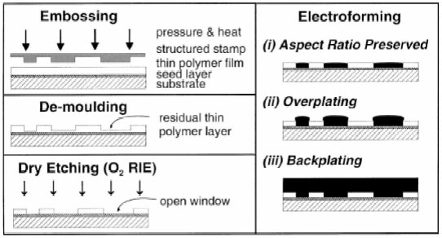
Ni mold
Si or SiO₂ mold is most popular, but they are brittle.
Metal mold is more robust and durable, used for making CD/DVDs.
More difficult to fabricate, takes days for electroplating to 100s μm thick.
Thickness is not uniform: much thicker (>2×) plating near wafer edges, need polishing back.
Direct silane anti-stick coating to Ni not working, needs sputtering a thin (10nm) SiO₂.
More used for hot-embossing onto thick plastic sheets for micro/nano-fluidics applications.
Source: Microelectron. Eng. 57-58 (2001) 375-380

Slide 25
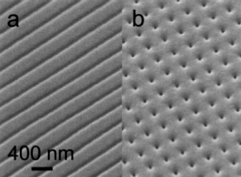
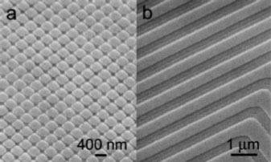
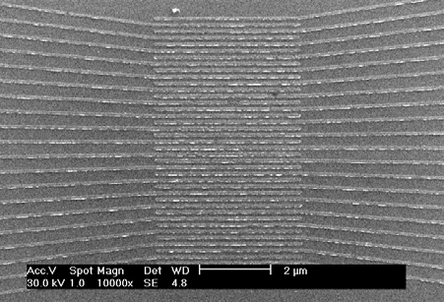
SEM images of Ni molds
Mold by electroplating
Mold by e-beam lithography and liftoff
Easier to pattern metal by liftoff.
But metal structure by lift-off doesn’t have vertical profile (Δ-shaped), and is of low height.
The underneath Si is still brittle.
SEM image a of Ni/Si mold showing 90nm channel-length inter-digited electrodes.

Slide 26
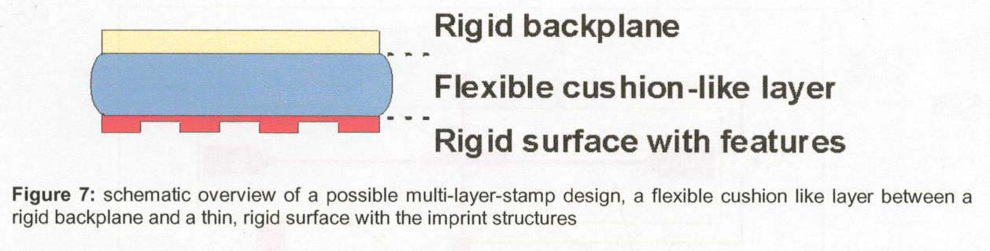
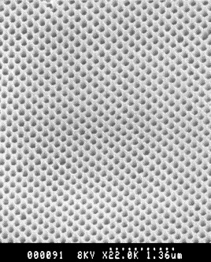
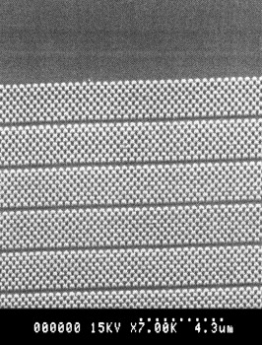
Soft PDMS/PMMA (rigid) mold for UV-NIL
glass…
PDMS
PMMA
Mold: PMMA top layer cast and bonded on a PDMS buffer and a glass carrier.
Resist pattern: 0.1atm imprint pressure, triangular lattices of 300nm period and 200nm pillar diameter.
PDMS alone can be used as UV-NIL mold, but its nanostructure is not hard enough and will bend/collapse during NIL even at low pressure. It is good for μm-feature size UV-NIL.
Roy, “Enhanced UV imprint ability with a tri-layer stamp configuration”, MEE 2005

Slide 27
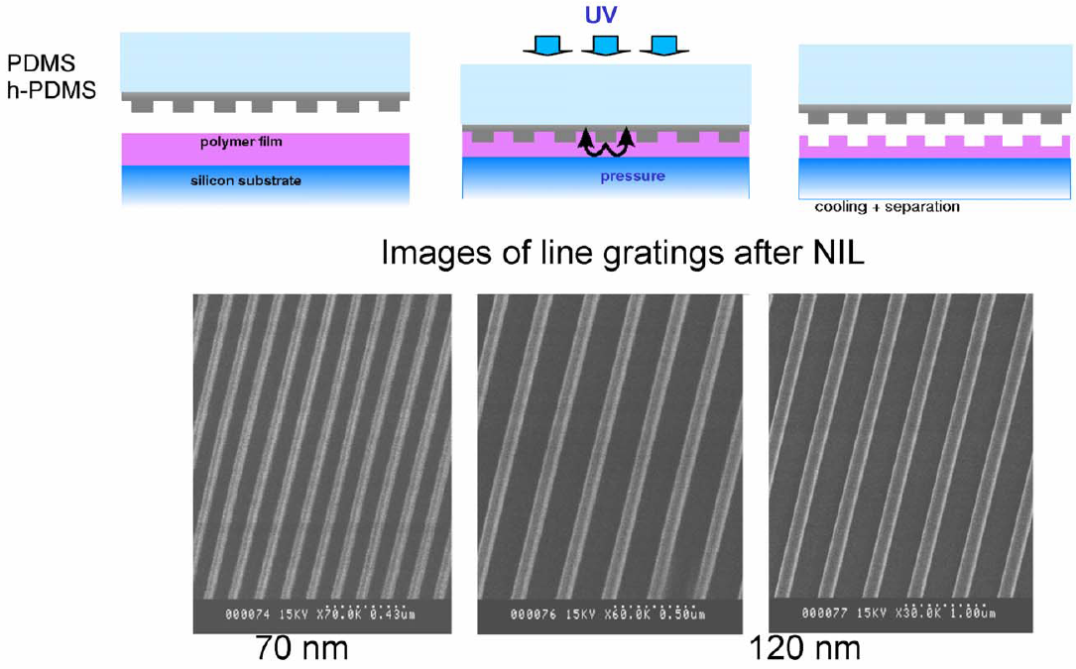
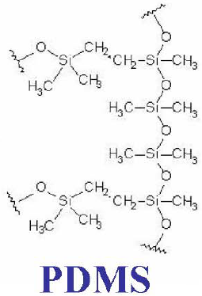
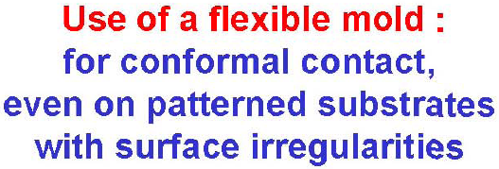
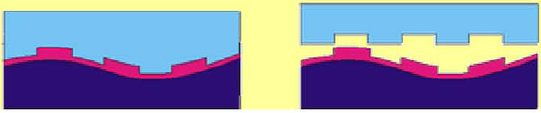
Soft PDMS/hard PDMS mold for UV-NIL
Hard PDMS: more cross-linked PDMS, but more brittle and less flexible

Slide 28
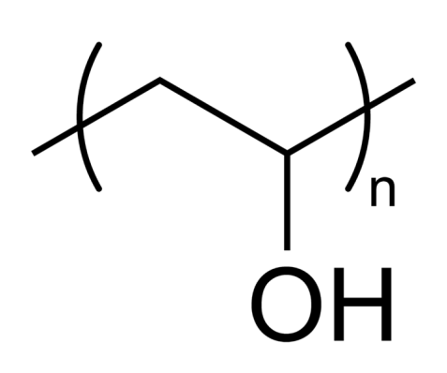
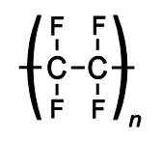
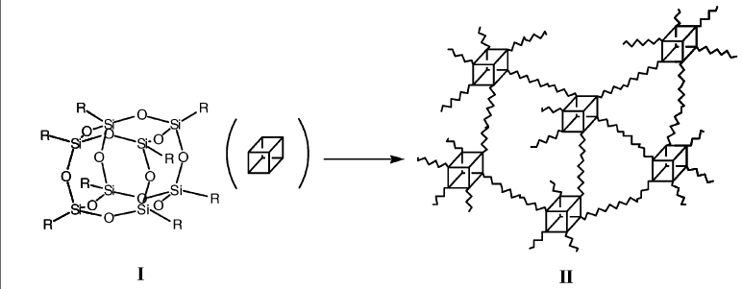
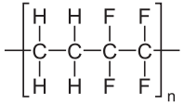
Other polymer mold materials
PVA (polyvinyl alcohol): water soluble, can be one-time use mold (imprint and dissolve the mold with water)
PTFE (Teflon, polytetrafluoroethylene): can be molded using a silicon mold at high temperature (>250ºC). Low surface energy (no need for mold release agent), high strength, can do thermal NIL at high temperature.
ETFE (ethylene tetrafluoroethylene): similar to PTFE, but mold is easier to fabricate from a master mold.
SSQ (silsesquioxane): similar to HSQ. After cross-linking the material is like SiO₂, which is easy to coat with mold release agent.
In principle, all cross-linked polymer can be used as NIL mold; however, most of them cannot be treated with mold release agent.
Barbero, “High resolution nanoimprinting with a robust and reusable polymer mold” (ETFE), Advanced Functional Materials, 2419 (2007)

Slide 29
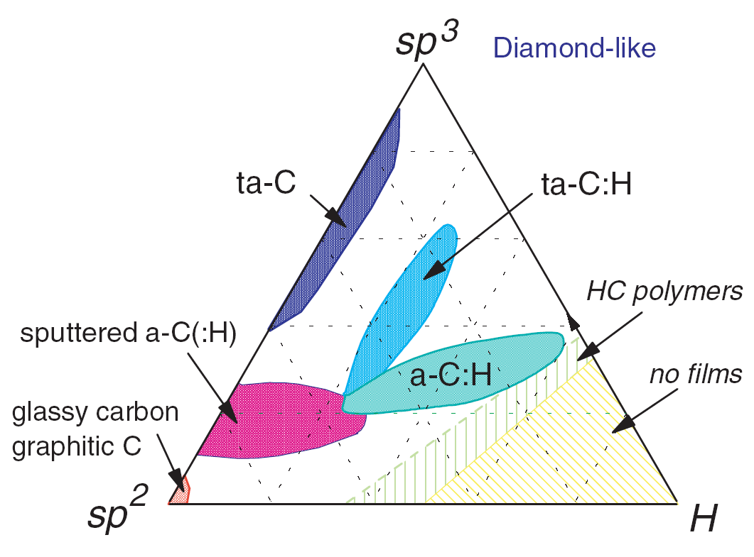
Diamond mold
Diamond is hardest, but too expensive. Use diamond like carbon (DLC) film instead for mold.
DLC is a synthetic meta-stable form of carbon.
Amorphous network consisting of various fractions of hydrogen, SP² and SP³ hybridized carbon.
Common synthesis techniques
    Pulsed laser deposition
    Ion beam deposition
    Plasma enhanced chemical vapor deposition (PECVD)
    And many other techniques
PECVD deposition uses hydrocarbon plasma in the presence of energetic ion bombardment.
Ternary Phase Diagram¹
Why DLC is a good mold material?
  Excellent hardness and wear resistance → 30-35 Gpa.
  Low energy surface → 35-50mN/m, may not need anti-stick coating.
  Controllable band gap → 1 to 3.5eV, for UV transparency.
  High chemical and corrosion resistance.
  Can be deposited on both Quartz and Si.
However, DLC deposition is very challenging, not very available.
J. Robertson, Materials Science and Engineering R 37 (2002), 129-281

Slide 30
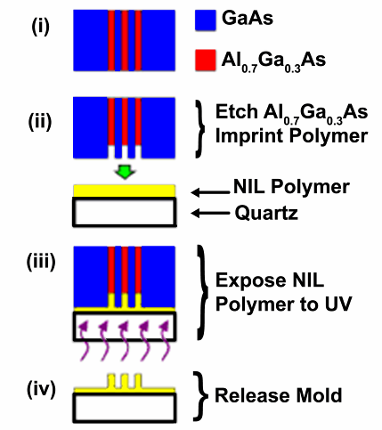
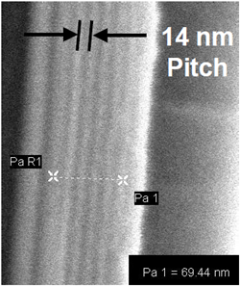
Mold by MOCVD and selective wet-etching
Precise control of pitch and line-width.
By far the highest resolution (∼6nm) NIL is demonstrated using such a mold.
Otherwise, it is very difficult to write 14nm pitch grating using e-beam lithography.

Slide 31
Mold fabricated by nature
Cicada Wings: a mold from Nature
The cicada wings consist of ordered hexagonal close-packed arrays of pillars with a spacing of about 190nm.
The height of the pillars is about 400nm and the diameters at the pillar top and bottom are about 80nm and 150nm, respectively.

Slide 32
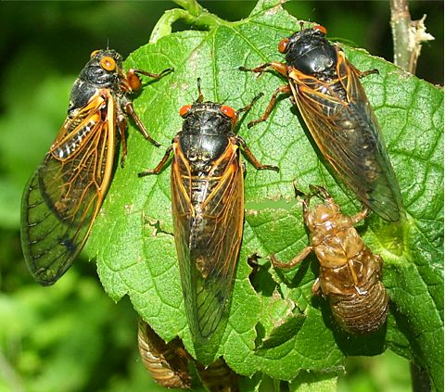
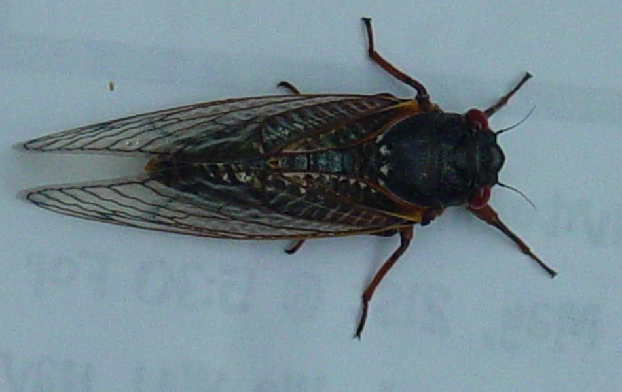
Properties of cicada wings
Cicada wings have sufficient stiffness, chemical stability and low surface tension for NIL.
These properties originate from the arrangement of highly crystalline chitin nano-fibers embedded in a matrix of protein, polyphenols and water, with a small amount of lipid.
Crystalline chitin interacts with the protein matrix via hydrogen bonding, which gives stiffness and chemical stability to the structure.
The Young’s modulus of these cicada wings can be as high as 7–9GPa. Although far lower than silicon (up to 131GPa), it is sufficient for imprinting into PMMA.
There is a layer of wax on the surface of the wings, which contains esters, acids, alcohols, and hydrocarbons. This layer gives low surface tension, so no need of anti-stick coating.

Slide 33
Results of NIL using cicada wing mold
Pressure ∼40 bar; temperature ∼190℃, 70℃ higher than the T_{g} of PMMA; imprint time 3min.
PMMA
The pitch between the wells is about 190nm, the well diameter is about 150nm, and the depth is found to be about 400nm; these are consistent with the mold.

Slide 34
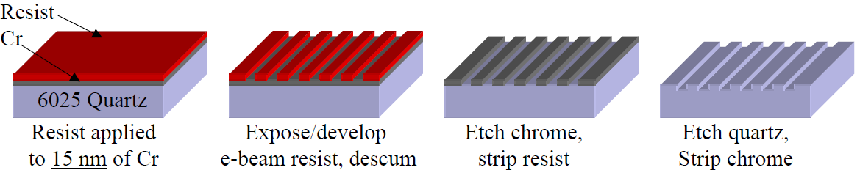
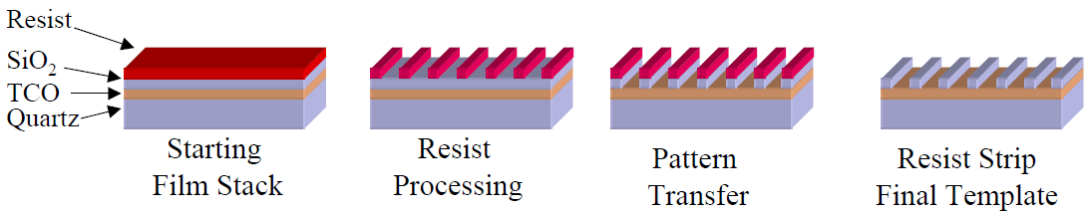
Mold fabricated by engineer
Mold fabricated by e-beam lithography and RIE.
RIE gas Chemistry: Cr – Cl₂/O₂; SiO₂ – CF₄/O₂
If no Cr RIE etch facility (no Cl₂ gas), Cr can be patterned readily by liftoff.
Mold with TCO (transparent conducting oxide)
Incorporating TCO film in the mold has the following advantages:
Mold written by EBL without charge build-up.
Final molds are easily inspected with SEM (no charging).
It is still transparent for UV-NIL.

Slide 35
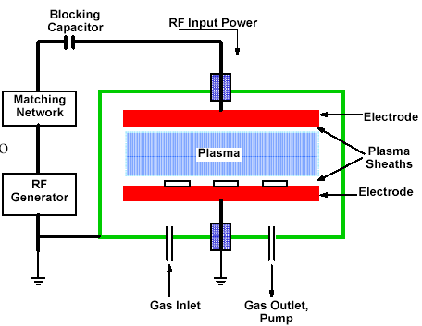
Parallel plate etchers (regular RIE, low density plasma)
Both chemical reaction and physical sputtering process occur.
Plasma etch mode:
  Pressure: 100 – 1000mTorr
  Voltage drop (self-bias) 10 - 100V
Reactive ion etch (RIE) mode:
  Pressure: 10 - 100mTorr
  Voltage drop 100 - 700V
RIE has high voltage drop, so is more directional/anisotropic than plasma etch.
Negative charge accumulate/positive ion bombard here
- - - - - - - - - - - -
No accumulation on grounded electrode
Parallel plate etcher is low density plasma system: most gas molecules are NOT ionized or excited, so the reactive species and ions have very low density, leading to low etch rate.
This is sputter deposition configuration; for etching, the two electrodes need to be reversed, and wafer put on the electrode not grounded.

Slide 36
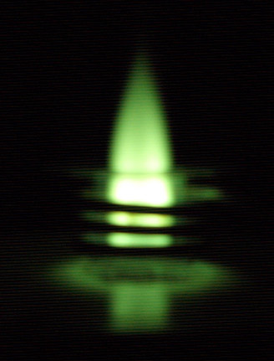
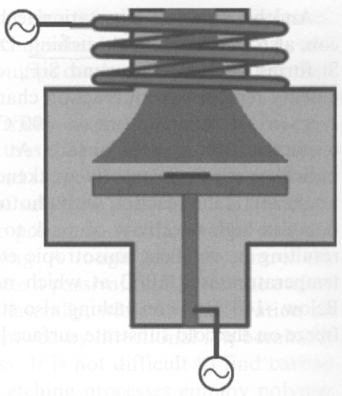
High density plasma system
Inductively coupled plasma (ICP)
(four systems at Waterloo)
ICP power
(for dense plasma)
plasma
RF bias power
(similar to RIE, parallel plate)
Picture of an analytical ICP viewed through green welder’s glass
High AC magnetic field in the coil, so electrons move in circles with long path, leading to higher collision and ionization probability.
Plasma density 10¹¹ - 10¹² ions/cm³.
Independent control of RF bias (ion energy, directionality) and ion density (ICP plasma density, chemical etching rate).
High etching rate than RIE, but may be less anisotropic due to increased chemical etching.
ICP etcher can be used as a pure RIE etcher by turning off the ICP component.

Slide 37



Etching issues for mold fabrication
Etch should be vertical or very near vertical.
NO negative slope allowed
Trenching undesirable
Smooth sidewalls desirable
Uniform depth
Uniform critical dimension (CD)
RIE trenching
mask
quartz
ICP etching offers better process control (ICP-inductively coupled plasma)
Quartz ICP etching using Cr as mask
Cr mask etch followed by quartz etch.
200nm depth for 30nm features (aspect ratio 7:1)
Etch rate 85nm/min.
Selectivity over Cr >170:1 (very high).
89-90°profile (very vertical)
Smooth and trenching free.

Slide 38



ICP quartz mold etch: process control
Control of trenching by DC bias
Control of profile by temperature
Quartz etch using Cr mask
100nm Cr etch using resist as mask
resist
Process gases: Cl₂, O₂ (+He).
Cr etch rate >15nm/min.
Uniformity <±4% (200mm wafer)
Profile >85°.
Delta CD<50nm.
CD control < ±1%.
Selectivity Cr : resist > 0.5 : 1 (resist dependent)
quartz
Cr

Slide 39


Pillar array mold fabrication from a grating mold
white: Cr; purple: SiO₂; blue: resist; black: silicon
Grating mold over large (up to 4” wafer with 200nm period) can be fabricated by interference lithography
Pillar array (2D) mold fabricated from grating (1D) mold by two NILs (at orthogonal directions or not)

