Slide 1
Scanning probe microscopy (SPM) and lithography
Atom and particle manipulation by STM and AFM.
AFM oxidation of Si or metals.
Dip-pen nanolithography (DPN).
ECE 730: Fabrication in the nanoscale: principles, technology and applications
Instructor: Bo Cui, ECE, University of Waterloo; http://ece.uwaterloo.ca/~bcui/
Textbook: Nanofabrication: principles, capabilities and limits, by Zheng Cui

Slide 2
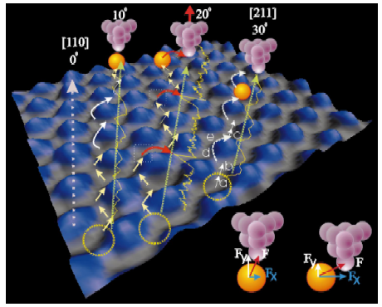
Pushing/pulling atoms using STM
STM Lithography:
Atomic scale patterning technique
Manipulation of both single atoms or molecules
Can be used, for example, quantum data storage with extremely high storage density (one atom per bit).
Atom movement mechanism:
When lateral force F_{x} exceeds the hopping barrier, the atom jumps to the adjacent row.
High electric field polarizes the molecule and may make it jump from the surface to the tip or tip to the surface.
However, this might not be well controllable, then one should avoid too high electric field (so atom remains close to substrate surface all the time) and use attractive van der Waals force to pull the atoms.
Hla et al., Phys. Rev. B 67, 201402 (2003)

Slide 3
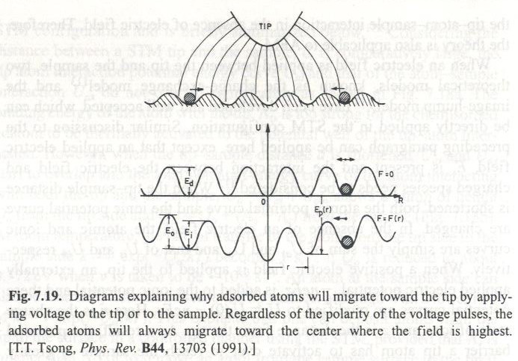
Diffusion of atoms

Slide 4
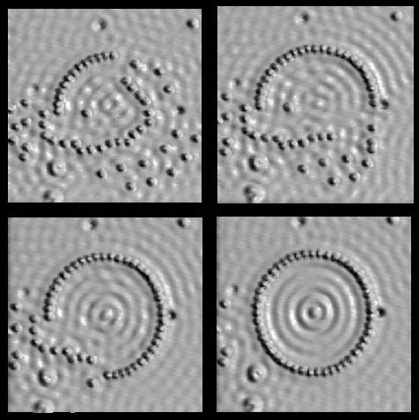
Atomic manipulation by STM
Circular corral (radius 71.3Å), 48 Fe atoms on copper (111).
Quantum-mechanical interference patterns
M.F. Crommie, C.P. Lutz, D.M. Eigler. Science 262, 218-220 (1993)

Slide 5
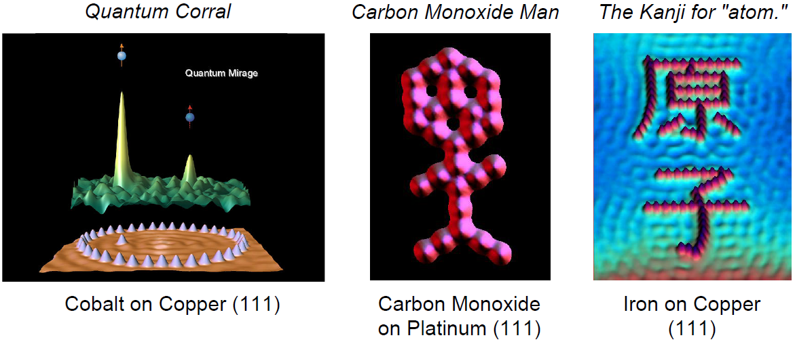
STM nano-patterning at IBM
The presence of a quantum mirage might be used to represent one bit of data in a region far smaller than any current electronic device can manage.
M.F. Crommie, C.P. Lutz, D.M. Eigler, Science 262, 218-220 (1993).
M.F. Crommie, C.P. Lutz, D.M. Eigler, Nature 363, 524-527 (1993).

Slide 6
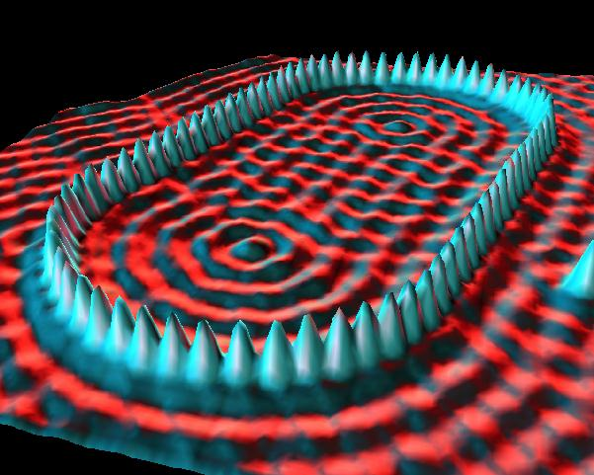
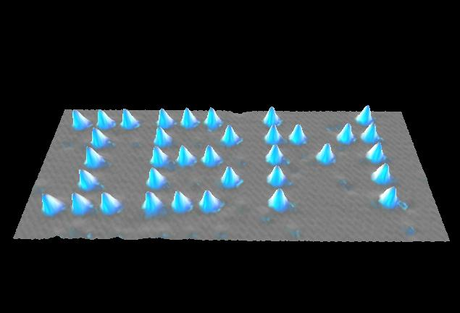
More STM nano-patterning at IBM
Title : Stadium Corral
Media : Iron on Copper (111)
Title : The Beginning Media : Xenon on Nickel (110)

Slide 7
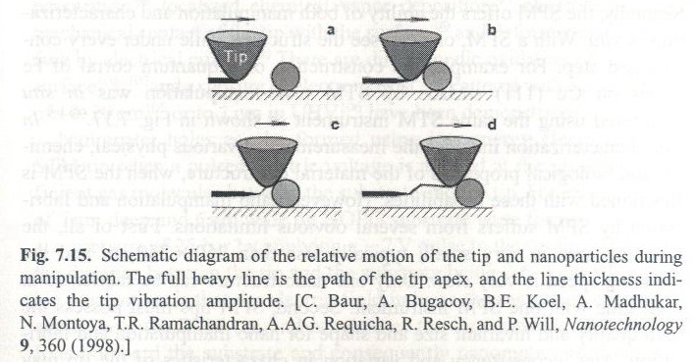
Manipulation of nanoparticles by AFM

Slide 8
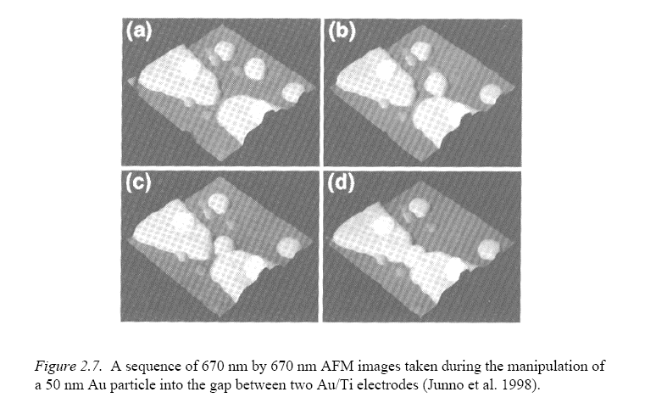
Manipulation of nanoparticles by AFM

Slide 9
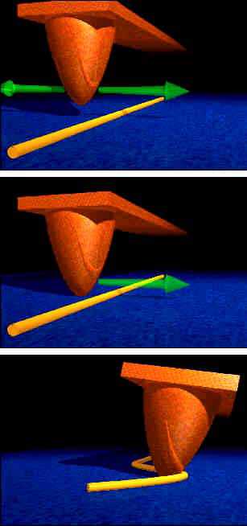
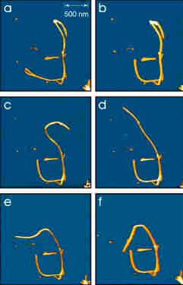
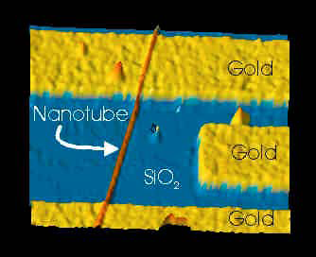
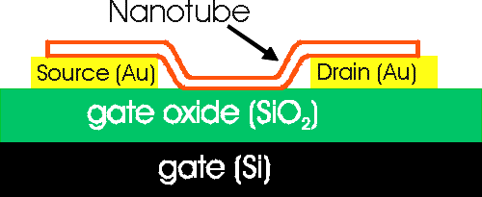
AFM manipulation of carbon nanotube
IBM nanotube manipulation for position nanotube on transistors.

Slide 10
Scanning probe microscopy (SPM) and lithography
Atom and particle manipulation by STM and AFM.
AFM oxidation of Si or metals.
Dip-pen nanolithography.

Slide 11
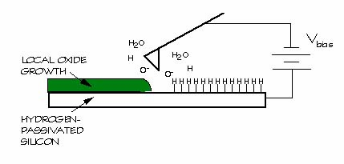
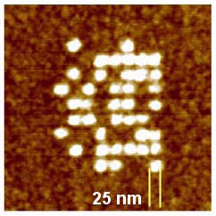
AFM oxidation (STM also works)
Voltage bias between a sharp probe tip and a sample generates an intense electric field at the tip, which leads to oxidation of silicon or anodization (oxidation) of metals.
Resulting oxide affected by experimental parameters
Voltage (typically from 5-10V)
Tip Scan Speed (stationary to tens of µm/s)
Humidity (20% to 80%)
Detected current can be used for process control

Slide 12
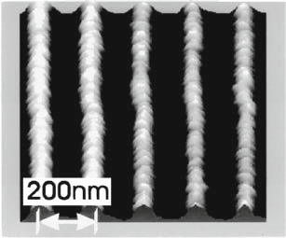
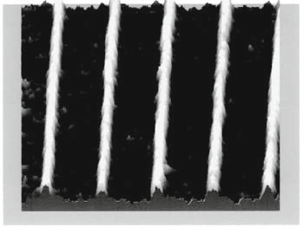
AFM oxidation mechanism
This is an electrochemical process, even though it is not done in bulk liquid (but actually there is always liquid when operated in air).
The high field desorbs the hydrogen on the silicon surface and enables exposed silicon to oxidize in air (the oxidation rate is enhanced by the presence of the accelerating field).
That is, the negatively biased tip induces a high electric field which ionizes the water molecules from the ambient humidity to produce OH⁻ ions that act as an oxidant.
The electric field enhances the vertical drift of these ion species away from the tip towards the surface where they react with underlying atoms to form a localized oxide beneath the tip.
Since the oxidation process requires an electrical current, both the tip and substrate must have some conductivity.
Fig. 4.12 AFM images of oxide lines produced at (left) 61% of humidity (line 91nm wide); and (right) 14% humidity (22nm wide).

Slide 13
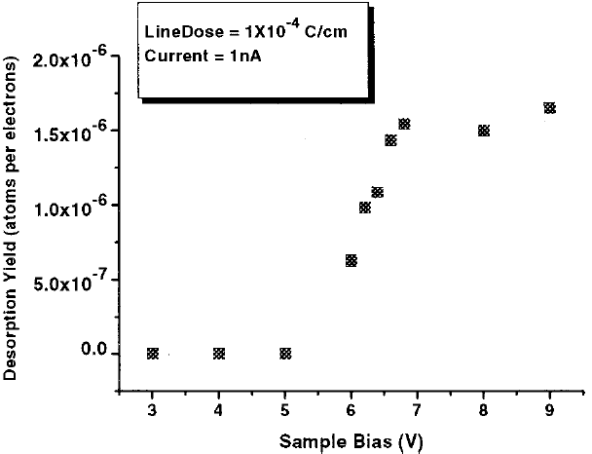
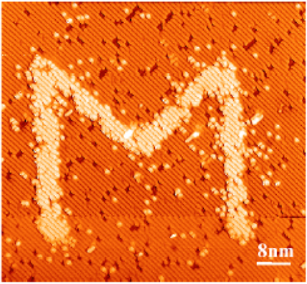
De-passivation of Si:H by STM
H- terminated Si resulted from HF etch of Si whose top surface (∼2nm) is usually oxidized in air.
STM image of a Si(100)–2×1–H surface. M corresponds to a STM induced hydrogen desorption obtained with a constant current of 2nA, an electron dose of 4×10⁻⁴ C/cm, and a sample bias voltage of 6V.
Hydrogen desorption yield as a function of the sample bias voltage.
Syrykh, “Nanoscale desorption of H-passivated Si.100.–231 surfaces using an ultrahigh vacuum scanning tunneling microscope”, JAP, 85, 3887-3892 (1999).

Slide 14
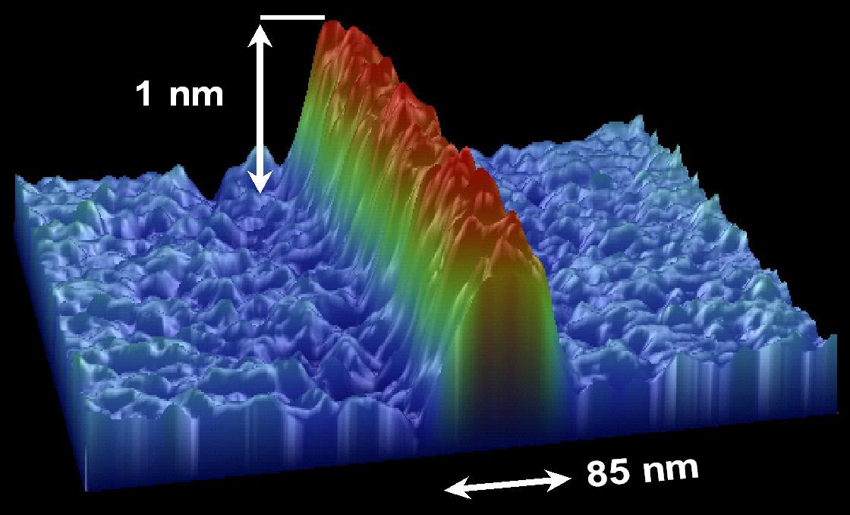
Silicon dioxide line on silicon written by AFM oxidation
Though the height is only ∼1nm, it is enough to etch deep into Si using hot KOH solution with etching selectivity (Si:SiO₂) ∼1000:1.
Silicon dioxide line on silicon written & profiled by AFM

Slide 15
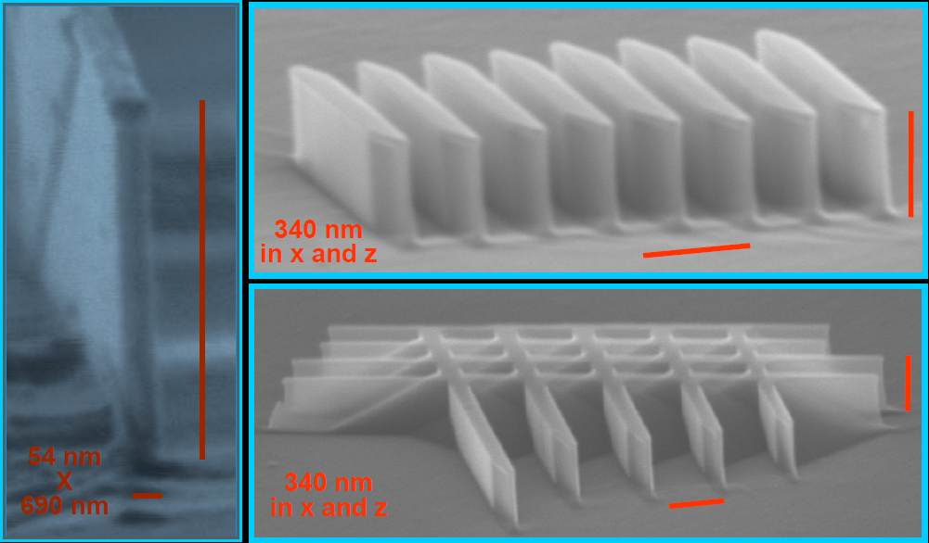
Etching into Si by KOH using SiO₂ as mask
Produced by chemical etching of AFM written lines
(111) plane
(111) plane
However, such high aspect ratio anisotropic vertical etching can only be achieved along certain directions ((111) plane) on (110) Si wafer.

Slide 16
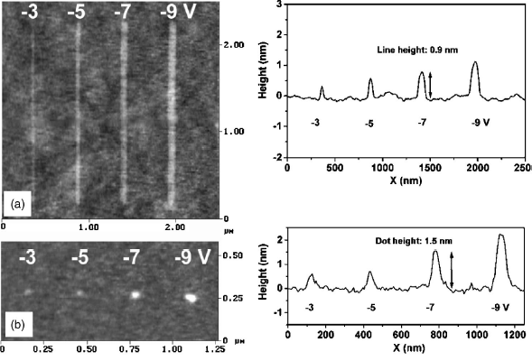
AFM oxidation: dependence of voltage
AFM tip-induced Si oxidation structures patterned on Si substrate with applied DC voltage from -3 to -9V and 500ms at 60% ambient humidity. Minimum features size 10nm.
A. Tseng and A. Notargiacomo, J. Nanosci. Nanotechnol. 5, 683 (2005).

Slide 17
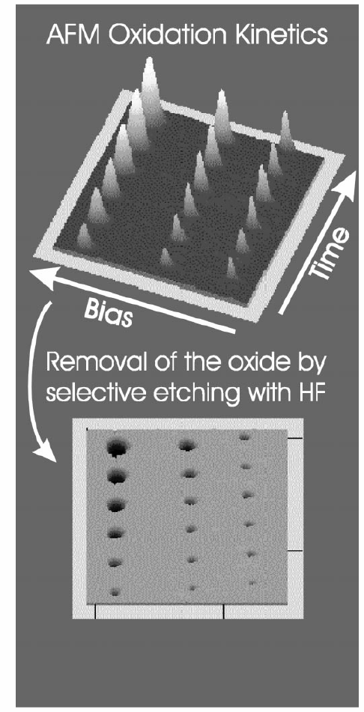
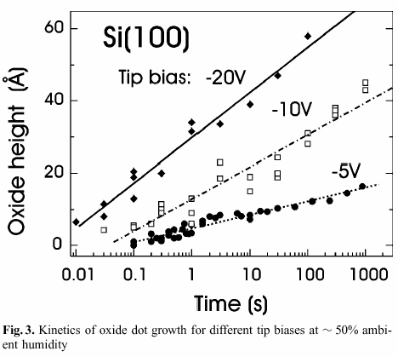
AFM oxidation on Si
Oxide height depends on voltage and time.
Oxidation and HF etch can also occur simultaneously by carrying out AFM oxidation in diluted HF solution. This way one can achieve arbitrary deep holes by fixing the tip at one location for extended time.
Ph. Avouris et al, App. Phys. A 66, S659 (1998)

Slide 18
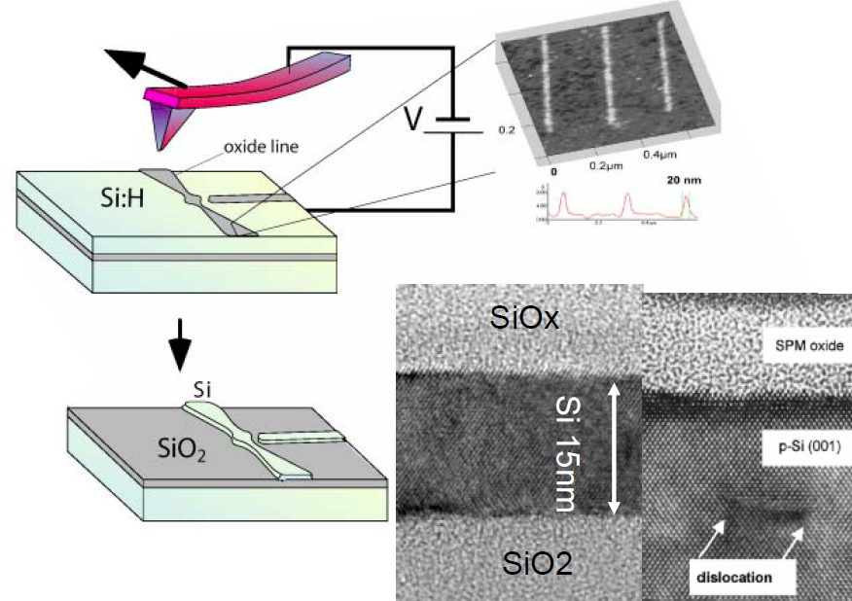
Nano-oxidation on SOI wafer
The patterned oxide is used as mask to etch Si underneath.
Besides crystalline and SOI silicon, oxidation can also be performed on amorphous Si.

Slide 19
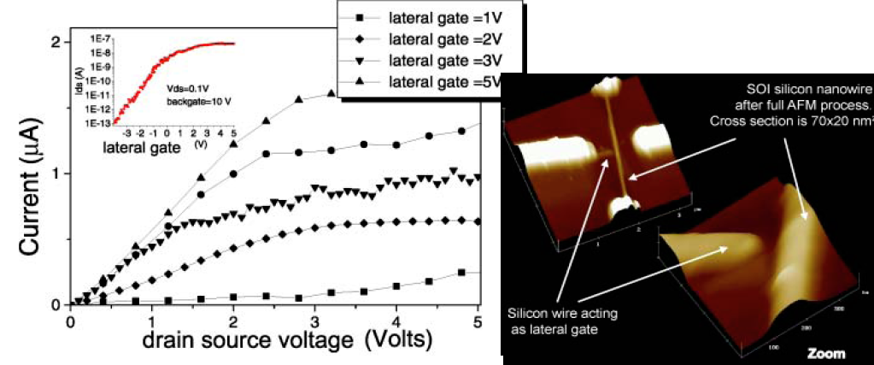
Nano-FET by AFM oxidation on SOI wafer
FET: field effect transistor
SOI: silicon on insulator (SiO_{x})
The final device is in silicon, which sits on top of oxide.
The gate is besides, rather than on top of, the channel.
V.B. et al. Microelectronic Engineering, Vol. 61-62 (1) (2002) pp. 517-522

Slide 20
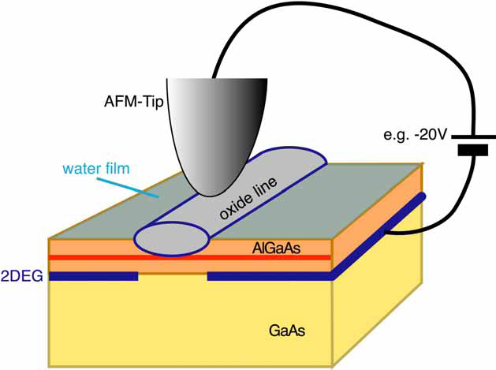
AFM oxidation of III-V semiconductors
Direct patterning of AlGaAs/GaAs
High mobility two-dimensional electron gas (2DEG)
below sample surface
Matsumoto et al., APL 68, 34 (1996); Held et al., APL 73, 262 (1998)

Slide 21
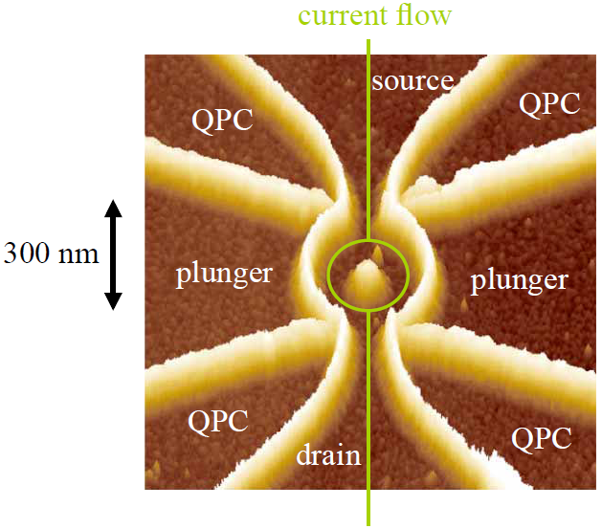
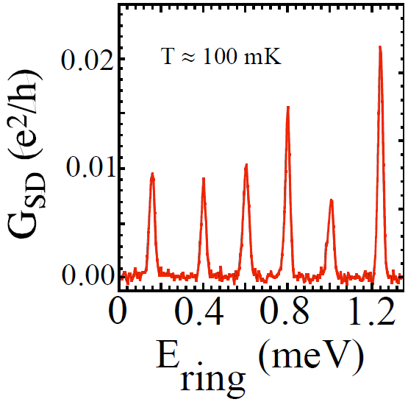
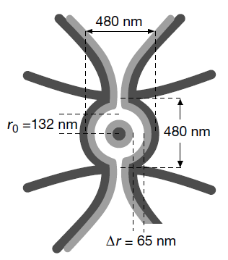
AFM anodization of GaAs
Quantum ring with Coulomb blockade
Fuhrer, “Energy spectra of quantum rings”, Nature, 413, 822-825 (2001)

Slide 22
Scale up using tip array

Slide 23
50 × 1 parallel lithography over 1cm × 1cm
50 parallel AFM tips oxidizing (100) silicon. The pattern is then transferred to the bulk Si using KOH etch.
The lines are on a 200μm period, the cantilever’s spacing.
The blue box in the bottom left represents the scan area of a typical AFM.

Slide 24
Scanning probe microscopy (SPM) and lithography
Atom and particle manipulation by STM and AFM.
AFM oxidation of Si or metals.
Dip-pen nanolithography.

Slide 25
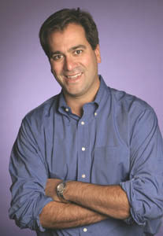
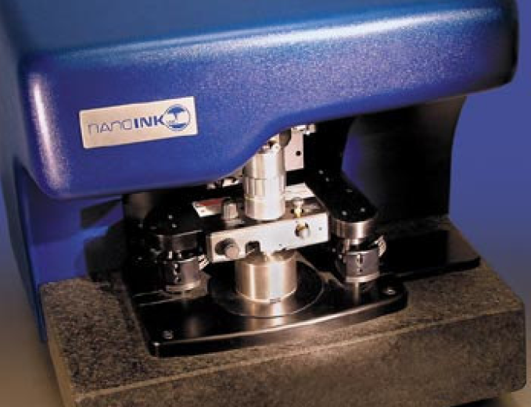
Dip pen nanolithography (DPN)
Revolutionary science developed at Northwestern University.
Allows for deposition of inks, including DNA and other biomaterials, at nm resolution.
For ultra-high-density gene chips with direct write of DNA onto substrate….
It resembles micro-contact printing, yet it creates pattern (rather than duplicating pattern), and is very slow.
DPN is commercialized by NanoInk, founded by Mirkin who invented DPN.
Chad Mirkin (Northwestern)

Slide 26
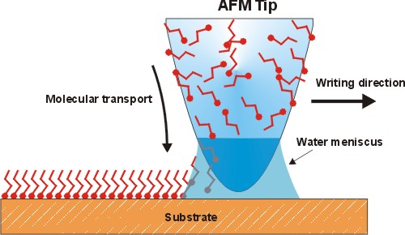
Dip-pen nanolithography (DPN)
Tip is dipped in chemical “ink” and transfers nanoparticles, biomolecules, etc. to substrate through contact “writing”.
In a high-humidity atmosphere, a nanoscale water droplet condenses between the AFM tip and the substrate.
The drop of water acts as a bridge over which the ink molecules migrate from the tip to the substrate surface where they are deposited.
Demonstrated resolution: 15nm.
By far DPN is the most widely used SPM-based patterning techniques, because other methods (e-beam lithography, FIB, photolithography…) cannot handle liquids important for chemical and bio-applications.
The competing technique is micro-contact printing (faster, though lower resolution).
It is still used for research, not for production.

Slide 27
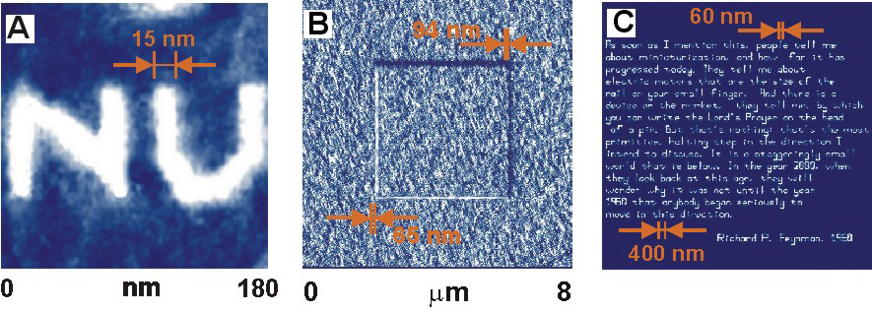
Dip pen nanolithography patterns
Ultra-high resolution pattern of mercaptohexadecanoic acid on atomically-flat gold surface.
DPN generated multicomponent nanostructure with two aligned alkanethiol patterns.
Richard Feynman's historic speech written using the DPN nanoplotter.

Slide 28
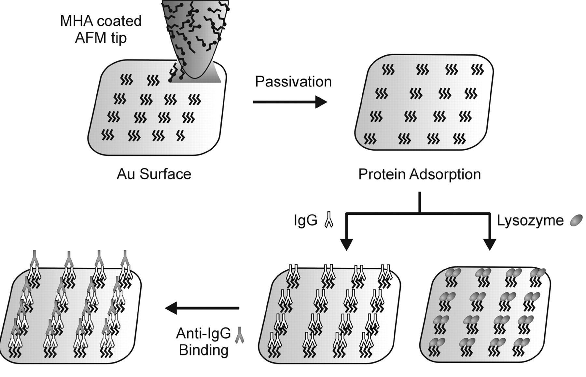
Protein patterning by DPN
MHA: mercaptohexadecanoic acid
Science, Vol 295, Issue 5560, 1702-1705, 1 March 2002

Slide 29
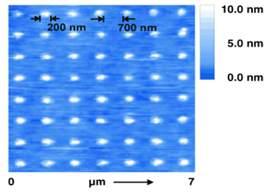
Direct-Write DNP for protein array
Rabbit anti-body IgG assembled on an MHA dot array by DPN.
After treatment with a solution containing lysozyme, goat/sheep anti-IgG, human anti-IgG, and rabbit anti-IgG;
A control protein nano-array
After exposure to a solution containing lysozyme, retronectin, goat/sheep anti-IgG, and human anti-IgG (no change).
Height profiles of TM(tapping mode)-AFM images

Slide 30
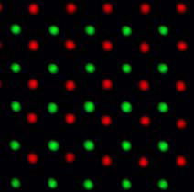
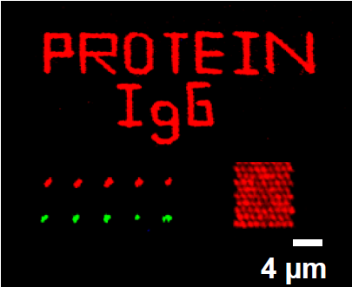
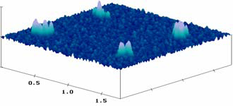
Bio-matter patterning by DPN
Ultrahigh density DNA arrays
fluorescent image
Protein nanostructures
Virus nano-arrays

Slide 31
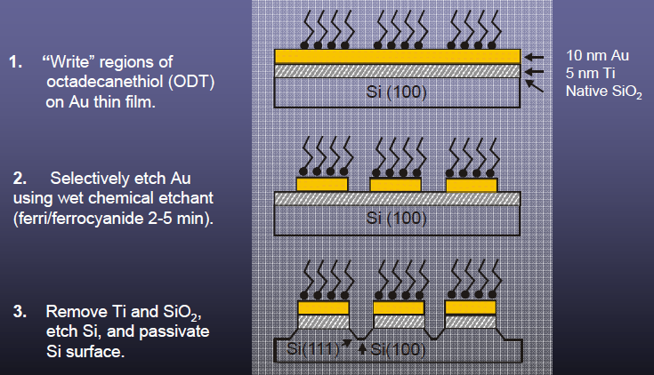
Etch barrier templates for solid-state nanostructures
SAM (self assembled mono-layer)
This kind of application (SAM plus wet-etch) is also the classical application for micro-contact printing.

Slide 32
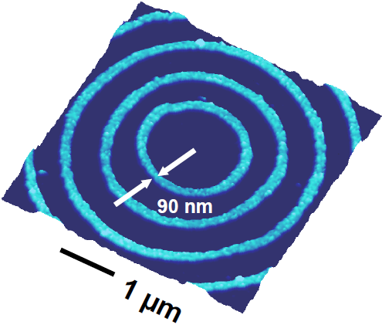
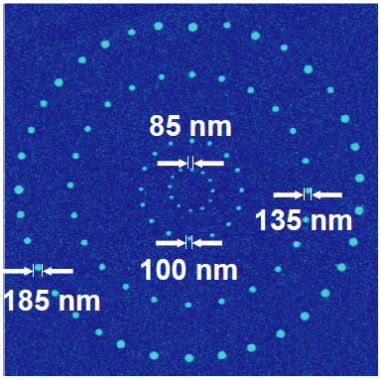
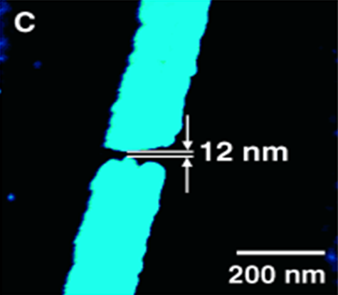
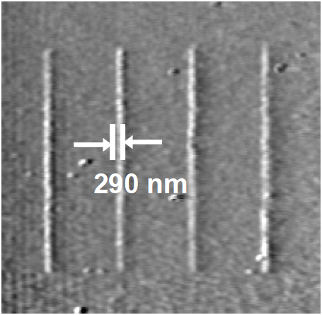
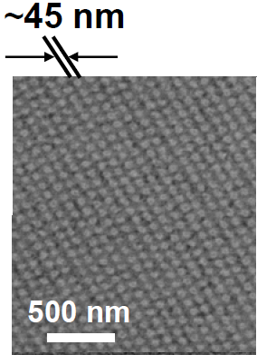
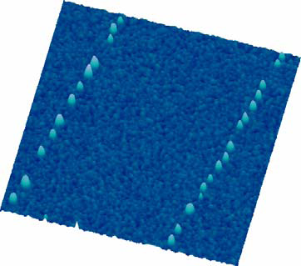
Hard material patterning by DPN (plus wet-etch)
Silver nanostructures
Gold nano-gap on Si/SiO₂
Gold Nanostructures
Not by wet-etch
Silicon nanostructures
Single nanoparticle lines
Sol-gel materials (>100 different oxides can be patterned)

Slide 33
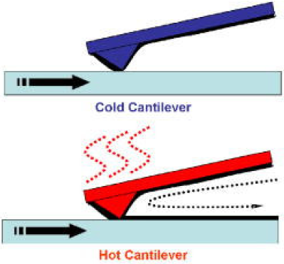
Thermal DPN
Conventional DPN:
Dynamic control difficult, unable to “turn-off” deposition quickly, causing contamination and smearing.
Metrology not possible without unintended deposition or prior cleaning of probe tip
Thermal DPN:
Heating element integrated into cantilever
Allows use of “inks” that are solid in ambient conditions (become liquid at high temperature)
Deposition easily turned on/off by modulating heating element
Surface imaging possible without smearing/contamination
Nelson and King, “Direct deposition of continuous metal nanostructures by thermal dip-pen nanolithography”, APL, 2006.

Slide 34
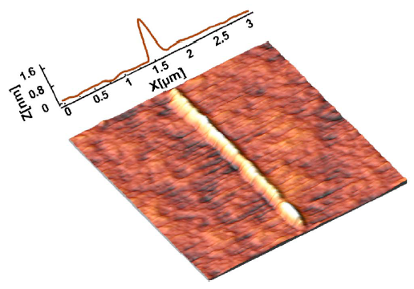
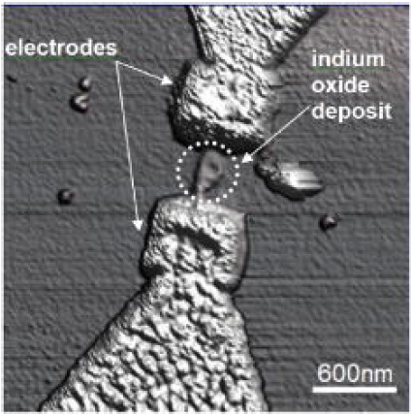
Thermal DPN
Thermal time constant of 1-10μs.
Temperature-sensitive cantilever resistance (2-7kΩ for 25-550°C) is used for temperature calibration.
Indium as one deposition metal (melt @ 156.6°C).
Loading: indium substrate scanned with 500nN contact force with tip temperature of ∼1030°C (heat loss to substrate and surrounding In film important).
Continuous lines deposited by reheating cantilever while contacting substrate.
Dimensions depend on tip loading, temperature, speed, and repetitions.
Successful deposition for: 250-800°C, 0.01-18μm/s, 32-128 raster scans, on borosilicate glass, quartz and silicon substrates.
Deposited pattern: 50-300nm wide, 3-12nm high.
Can be used like nano-soldering for circuit repair.

Slide 35
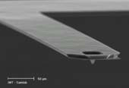
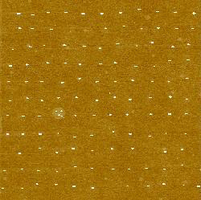
Nanoscale dispensing
Pattern liquids, e.g. biomolecules, suspensions, by surface chemistry.
Parallel probes for multi-material deposition.
Glycerol on SiO₂, image size 10μm x 10μm
dots size 50–100nm
Tip can be fabricated by FIB milling

Slide 36
DPN applications
International Institute for Nanotechnology
Northwestern University

Slide 37
One application: cancer diagnosis using tumor markers
Antibody/antigen array that binds specifically to tumor marker antigen/antibody.
Tumor marker:
Found in the blood, other body fluids, or tissues.
High level of tumor marker may mean that a certain type of cancer is in the body.
Examples of tumor markers include CA 125 (ovarian cancer), CA 15-3 (breast cancer), CEA (ovarian, lung, breast, pancreas, and gastrointestinal tract cancers), and PSA (prostate cancer).
Currently, the main use of tumor markers is to assess a cancer's response to treatment and to check for recurrence.
Scientists continue to study these uses of tumor markers as well as their potential role in the early detection and diagnosis of cancer.
Mirkin, “Multiplexed Detection of Protein Cancer Markers with Biobarcoded Nanoparticle Probes”, JACS, 2006.

Slide 38
Parallel dip-pen nanolithography
A dip-pen nanolithography that has an array of 55,000 pens that can create 55,000 identical patterns.
However, here each pen is not individually and independently addressed/controlled, which is not necessary when writing identical arrays (though some tips may hit the surface and get damaged due to lack of feedback).
The background shows some of the 55,000 miniature images of a 2005 US nickel made with dip-pen lithography. Each nickel image with Thomas Jefferson's profile (in red) is made of a series of 80nm dots. The inset (right) is a SEM image of a portion of the 55,000-pen array.
Mirkin, “Massively parallel dip-pen nanolithography with 55 000-pen two-dimensional arrays”, Angewandte Chemie International Edition, 2006

Slide 39
Summary for DPN
DPN is a unique scanning-probe-based lithographic tool for generating high-resolution patterns of chemical functionality.
The combination of resolution, registration, and direct-write capability offered by DPN makes it a promising tool for patterning soft organic and biological nanostructures.
More efforts should be put in improving the speed and in transforming it into massively parallel process to be a powerful production tool in life science.
Single crystal silicon probes

