Slide 1
Photolithography and resolution enhancement techniques (RET)
Photolithography and resolution limit
Immersion lithography
Off-axis illumination (OAI)
Phase-shift mask (PSM)
Optical proximity correction (OPC)
Double processing
ECE 730: Fabrication in the nanoscale: principles, technology and applications
Instructor: Bo Cui, ECE, University of Waterloo; http://ece.uwaterloo.ca/~bcui/
Textbook: Nanofabrication: principles, capabilities and limits, by Zheng Cui

Slide 2
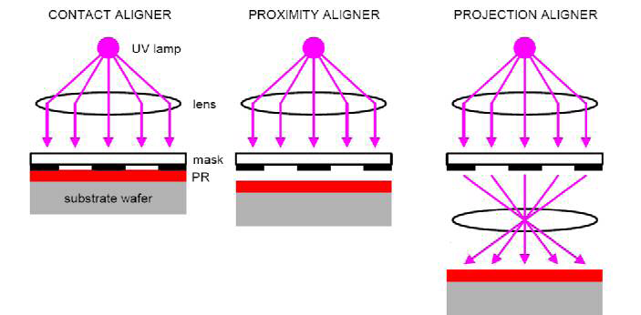
Optical lithography
Contact aligner Proximity aligner Projection aligner
Mask in contact with photo-resist film
(Gap=0 μm)
Gap (order 10μm) between mask photoresist
Resolution:
Like photography, imaging
(g=gap, t=resist thickness)
Contact and proximity is for research (simple, cheap equipment).
Projection for IC production, long mask life, image reduction (4×).

Slide 3
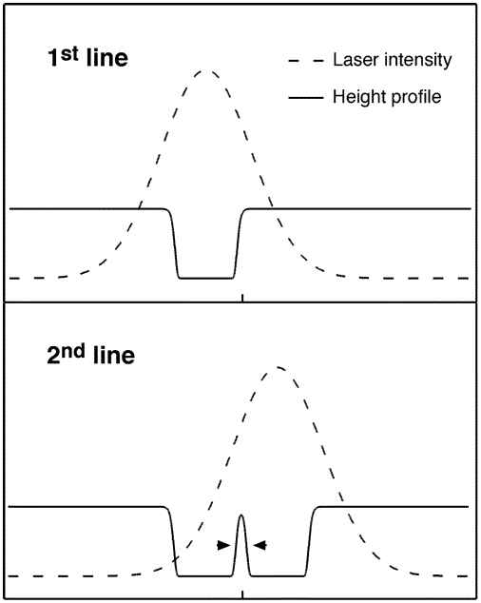
It is easy to make small, but difficult to make dense
To put a lot of transistors on a chip, they need to be close to each other.
Pitches are limited by physics – minimum line-widths are not!
The IC term for lithography is “half pitch”, though “resolution” is still used.
Threshold intensity here will give W<<2.5μm
W
2.5 μm
Linewidth + spacewidth = pitch
HP: half pitch
80nm
2.5μm laser beam can pattern 80nm line-width!
But it won’t be able to pattern a grating with pitch <2.5 μm.
Nano. Lett. 6(10), 2358(2006)

Slide 4
What is hard about nanolithography?
light
light
mask
lens
Ideal light
intensity
Actual light
intensity
Sharp dose profile “blurred” dose profile
photoresist
Θ

Slide 5
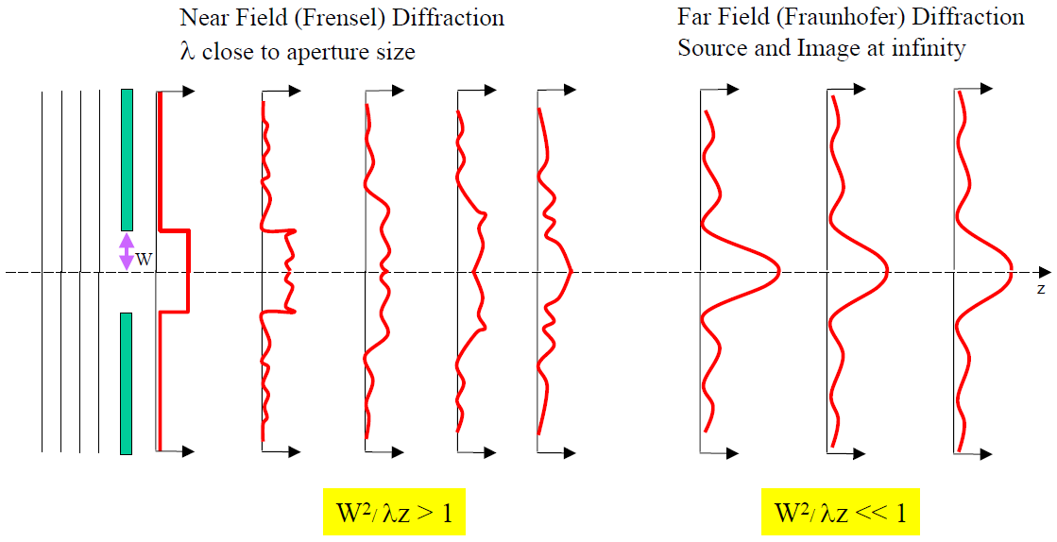
Fresnel & Fraunhofer diffraction (from an aperture)
Light intensity profile
Contact Proximity Projection

Slide 6
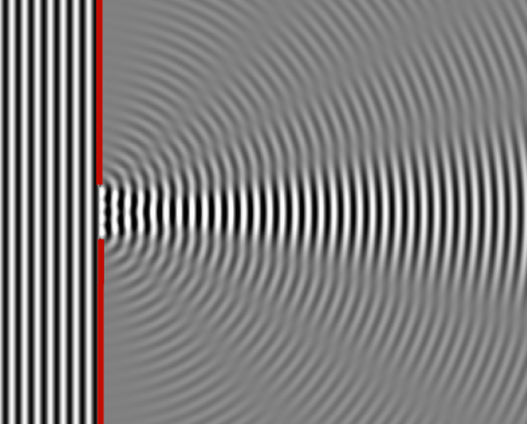
Fresnel & Fraunhofer diffraction (from an aperture)
Near field Far field
Notes:
The HP (half pitch, ~resolution) is limited by diffraction of light.

Slide 7
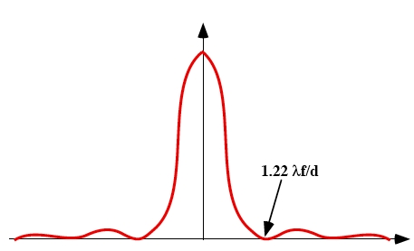
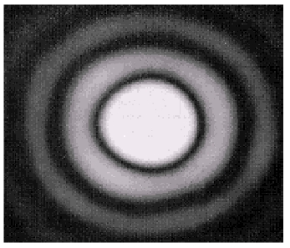
Light diffraction through a small circular aperture (Airy disk)
Airy pattern
Image by a point source forms a circle with radius 1.22λf/d surrounded by diffraction rings (Airy pattern).
1.22 λf/d

Slide 8
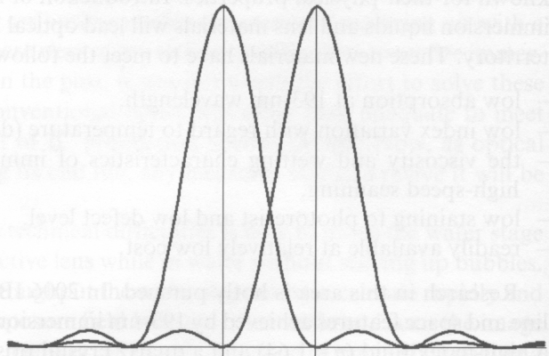
Rayleigh resolution criteria (for circular aperture)
Rayleigh resolution
R
NA= n⋅sinα, numerical aperture
NA: the ability of the lens to collect diffracted light

Slide 9
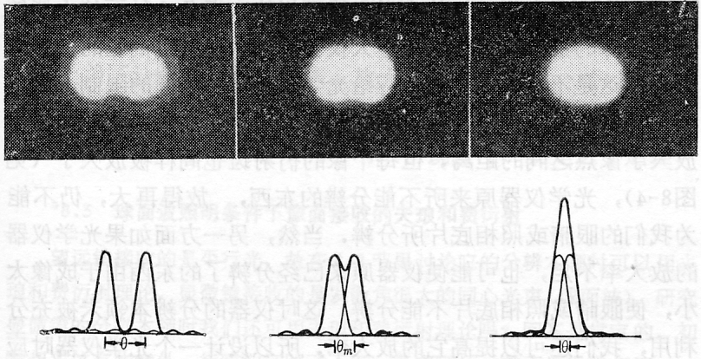
Rayleigh resolution criteria (for circular aperture)
Well-resolved Just resolved Not resolved

Slide 10
Generalized resolution (half pitch)
k₁ represents the ability to approach physical limits depending on:
Lenses: aberrations.
Resists: contrast.
Equipment and process control in manufacturing.
To increase resolution: reduce λ and k₁, increase NA;
But this also reduces depth of focus (a bigger issue for lithography).
For NA ≤ 0.5
For NA > 0.5
Depth of Focus or Depth of Field (DOF):

Slide 11
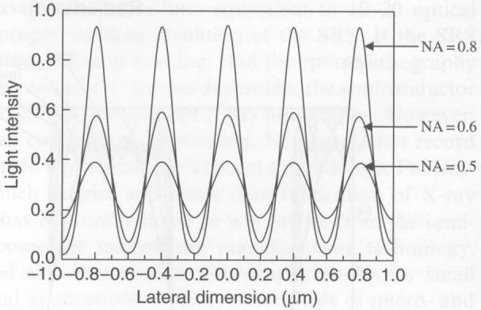
NA: its influence on optical imaging by numerical simulation
0.2μm pitch grating imaged through a projection optical system at λ=248nm.
Increase NA:
Resolve better the line image (higher image contrast)
Gives brighter image (higher image intensity).

Slide 12
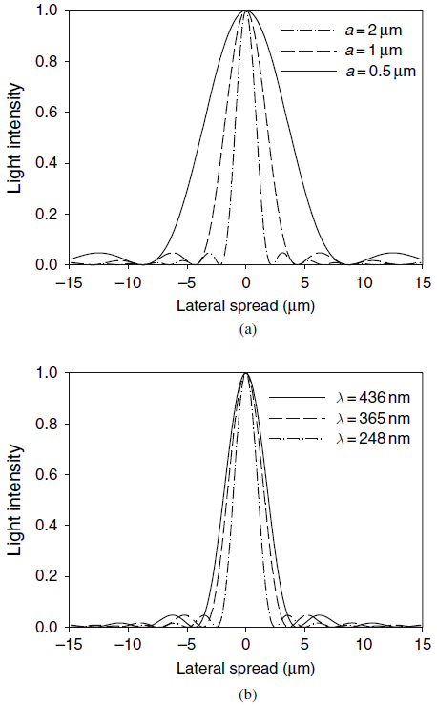
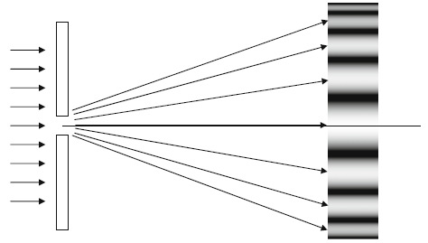
Diffraction from a slit
Minimum when a⋅sinφ=mλ, or sinφ=mλ/a, or
a= mλ/sinφ
m=1, 2…
a
φ
If put a lens in-between, resolution (similar to Rayleigh resolution criteria )
R=0.5λ/sinα=0.5 λ/NA (i.e. for slit, k₁=0.5)
Light intensities of three single-slit diffractions:
(a) at 436-nm wavelength; and (b) for 1μm slit width.

Slide 13
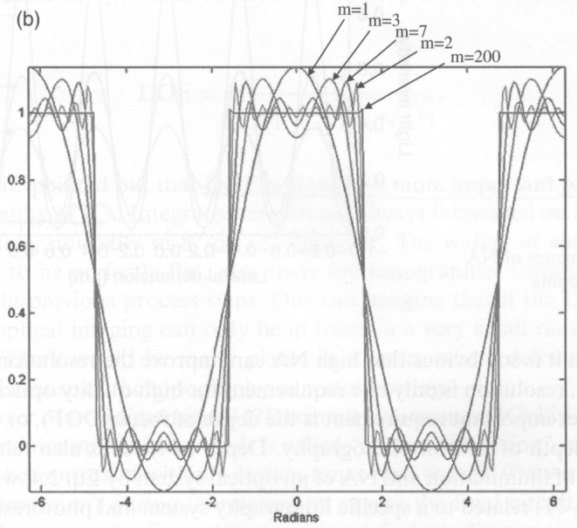
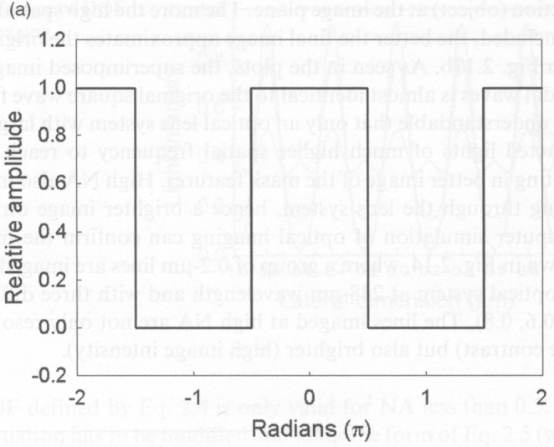
NA: effect of including increasing numbers of diffracted orders on the image of a periodic slit array
Mask image with diffraction
Mask image without diffraction
0
Grating pattern
For smaller NA (smaller sinα), fewer diffracted orders (smaller m) will be collected to form the image, so the details of the slit (sharp corners) are lost.
When talking about resolution, we need at least m=1.
The way to increase resolution is to increase the NA of the lens (and reduce λ).

Slide 14
Increase resolution by reducing λ
Mercury arc lamps
Excimer lasers (nanosecond pulse)
g-line → i-line → KrF → ArF
436 nm → 365 nm → 248 nm → 193 nm
1
0.44×
R>>λ R>λ R∼λ R<<λ

Slide 15
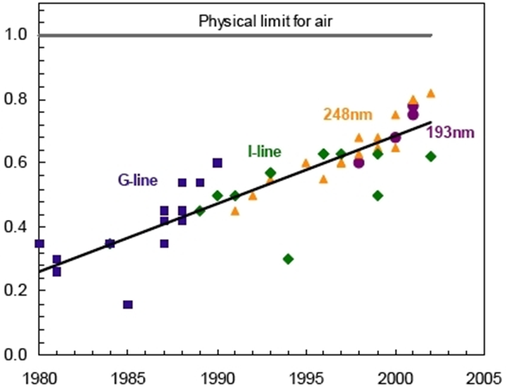
Increase resolution by increasing numerical aperture NA to approach 1
The physical limit to NA for exposure systems using air as a medium between the lens and the wafer is 1.
The practical limit is somewhere ∼0.93 (collecting angle α=68º, huge lens ∼500kg).
One issue for large NA is polarization of illumination light near Brewster’s angle.
Therefore, the resolution limit for 193nm exposure systems:
Numerical aperture (NA)
NA=numerical aperture
=n⋅sinθ
Year of system introduction

Slide 16
Photolithography and resolution enhancement techniques (RET)
Photolithography and resolution limit
Immersion lithography
Off-axis illumination (OAI)
Phase-shift mask (PSM)
Optical proximity correction (OPC)
Double processing

Slide 17
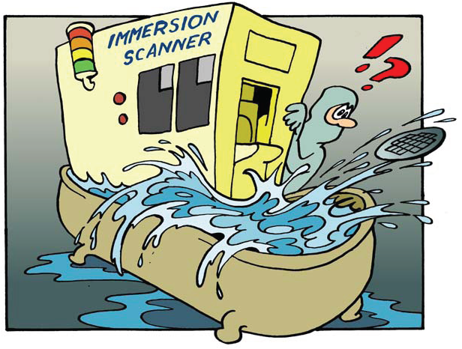
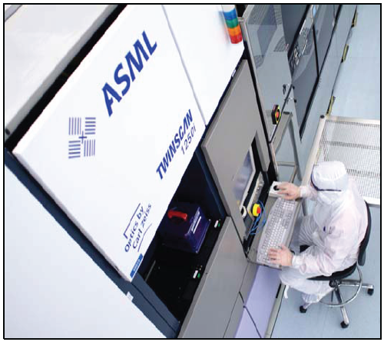
Increase resolution by increasing NA to beyond 1: immersion lithography
Very simple idea. Indeed, immersion is NOT new for optical imaging: oil immersion in optical microscope has been used for a century.
But Immersion lithography is highly complex, and was adopted by semiconductor industry only recently (since 2004).
From research idea to development
Like chemical mechanical polishing (CMP) used for IC interconnection, immersion lithography has been considered as impractical at the beginning.

Slide 18
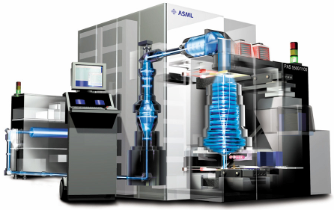
“Total” immersion
In principle, one can put the entire exposure system inside water and use lens having n multiplied by n_{water}.
This is equivalent to use a light source having λ reduced by a factor n_{water}.
Water
Reticle
(Mask)
n_{water} =1.44 at 193nm.
So λ: 193→134nm.
Wafer
193 nm Excimer Laser Source
Computer Console
Exposure Column
(Lens)
However, total immersion is not practical, and is not necessary.

Slide 19
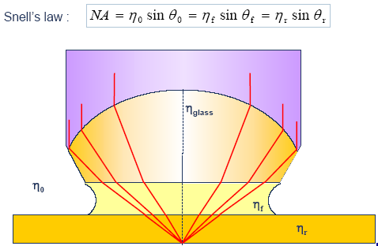
Immersion between projection lens and wafer
n>1
The medium between the lens and the wafer must:
Have an index of refraction >1
Have low optical absorption at 193nm
Be compatible with photoresist and the lens material
Be uniform and non-contaminating
NA=n × sinα ∝ n
Can be >1 for n>1
Surprisingly, ultrapure water meets all of these requirements:
n = 1.44, absorption of <5% at working distances of up to 6mm, compatible with photoresist and lens, non-contaminating in it’s ultrapure form.

Slide 20
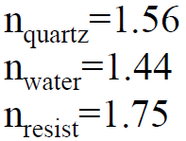
Why immersion lithography increases resolution?
Fundamentally, light is a carrier of information on the mask. When more light is collected, more information is collected, leading to higher resolution – can resolve denser line array pattern.
Air
Water immersion
θ
For NA=0.9, inside lens sinθ=0.9/1.56=0.58 (θ=35.5º)
Total internal reflection for sinθ>1/1.56=0.64 (θ=39.8º)
Inside lens sinθ=1.44 × 0.9/1.56=0.83 (θ=56º)
So light, which is internally total-reflected for air, can now be collected to form image in the resist.
Collect light up to θ=35.5º;
Collect light up to 56º (angle inside lens)
NA=0.9 in air; NA=1.44×0.9=1.3 in water

Slide 21
Immersion increases/decreases depth of focus (DOF)
For NA ≤ 0.5
For NA > 0.5
Depth of Focus or Depth of Field (DOF):
According to this equation, immersion decreases DOF by 1/n (NA increases by n).
However, if we want to keep the same resolution when using immersion, that is, the same NA, then the DOF will be increased by n×.
In this sense, we say that immersion can increase DOF while maintaining the same resolution.

Slide 22
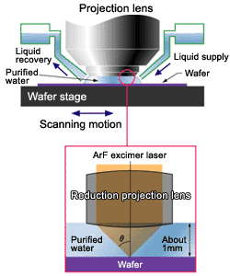
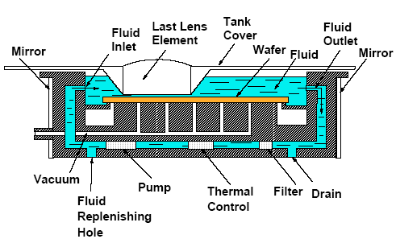
Immersion lithography system: $30M
Water out
Water in

Slide 23
Immersion at higher refractive indices
Limitations of water immersion:
nsinθ ≤ 0.93×min(n_{glass}, n_{fluid}, n_{resist})
Indices of refraction for water immersion.
SiO₂: 1.56
Water: 1.435
Resists: ∼1.70
n_{glass} > n_{fluid}
θ
1
0.93 × 1.435 = 1.33
n
glass
NA≤1.33 for water
n
fluid
θ
2
High-index fluid needs high-index lens material.
Options for high index immersion lithography
Glass.
BaLiF₃: n=1.64
Lutetium aluminum garnet (Lu₃Al₅O₁₂, LuAG): n=2.1
Pyrope (Mg₃Al₂Si₃O₁₂): n=2.0
Fluid: cyclic organics, such as decalene: n=1.64 - 1.65

Slide 24
Issues with immersion lithography
Mechanical issues and hydrodynamics
Throughput 100 wafer/hour, order of 50 dies each wafer, so 5000 exposures/hour, or <1sec for each exposure. Therefore, water in, expose, water out, stage move, all within 1sec.
Bubble formation disturbing the image (defect)
Stage vibrations transferred to lens
Heating of immersion liquid upon exposure
New defect mechanisms at wafer level
Interaction of photoresist with immersion liquid
Fluid contamination (defect)
Polarization effects degrading contrast

Slide 25
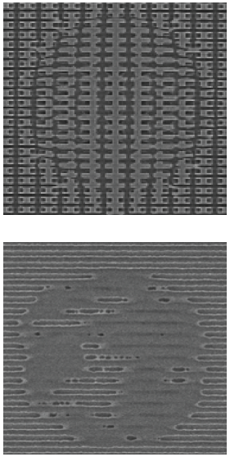
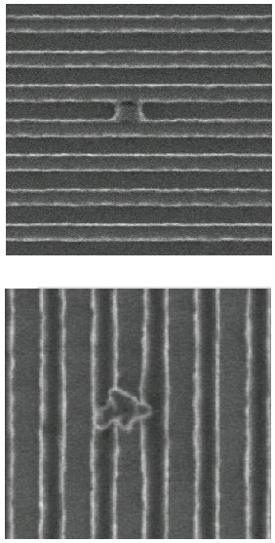
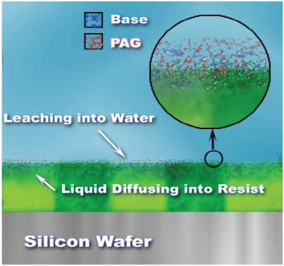
Major challenge: defect in immersion lithography
Resist/TC – water interaction
(TC=top coating?)
Air bubbles
Water marks and drying stains
(Try to make super-hydrophilic surface)
Particles from water

Slide 26
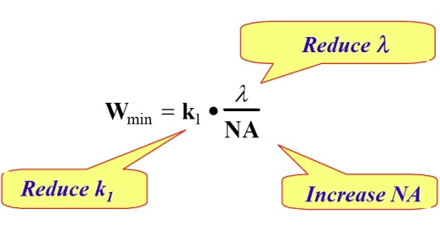
Photolithography - k₁
k₁ is a complex factor of several variables in the photolithography process such as:
Quality of the photoresist
Use of resolution enhancement techniques (RET)
Off-axis illumination (OAI)
Phase shift masks (PSM)
Optical proximity correction (OPC).
The practical lower limit for k₁ is thought to be about 0.25 (for single exposure).
Reduction of k₁ factor until 193-nm optical lithography was introduced.

Slide 27
Photolithography and resolution enhancement techniques (RET)
Photolithography and resolution limit
Immersion lithography
Off-axis illumination (OAI)
Phase-shift mask (PSM)
Optical proximity correction (OPC)
Double processing

Slide 28
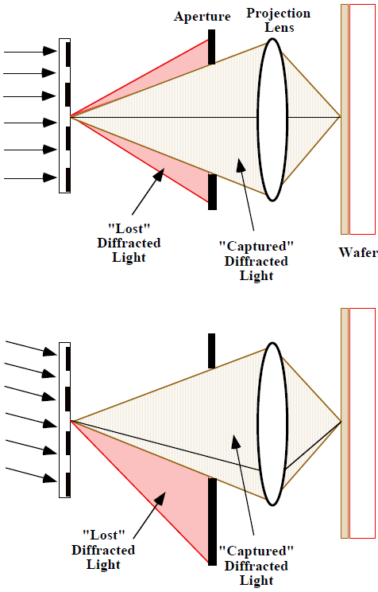
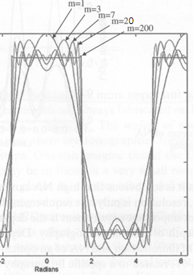
Off-axis illumination (OAI)
“Off-axis illumination” allows some of the higher order diffracted light to be captured and hence can improve resolution.
(OAI also improves depth of focus)
Along axis
“Lost” diff-racted light
“Captured” diffracted light
Off axis
axis
“Lost” diff-racted light
“Captured” diffracted light
Higher order contains feature details

Slide 29
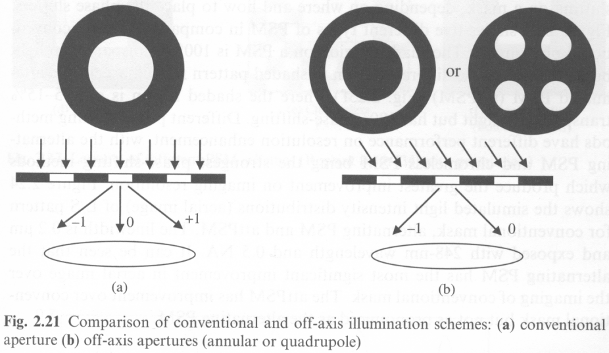
Off-axis illumination
Conventional illumination Off-axis illumination
Annular
Quadrupole
Diffracted light collected up to first order
Now second order diffracted light can be collected, so higher resolution
-2
-1
Quadrupole: most effective for line/space pattern (depends on line orientation, best for vertical or horizontal line/space pattern), less for isolated features.
Annular OAI: less resolution enhancement, but orientation independent.
Easiest and cheapest RET, state-of-art OAI apparatus are programmable for each set of masks.

Slide 30
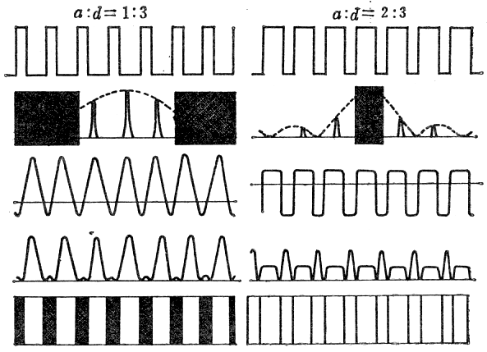
Off-axis illumination (OAI)
Fig. 2.21 (previous slide) is misleading. In IC industry, only m=0 and +1 (or -1) order diffracted light is collected. No need of second order.
-1
0
+1
-1
0
For small lens (small NA) without OAI, only 0 order is collected to form image on the resist. Uniform exposure across the wafer (no grating pattern, “DC” signal only).
For small lens but with OAI, now both 0 and -1 order is collected. -1 order carries the information of the grating. The exposure profile in the resist will be sinusoidal.
Grating
Diffraction
Amplitude
Intensity (square of amplitude)
Final image
Left: 0, +1, -1 order collected.
Right: all except 0 order diffraction is collected. Square profile but with a DC offset (since 0 order information is lost).

Slide 31
Photolithography and resolution enhancement techniques (RET)
Photolithography and resolution limit
Immersion lithography
Off-axis illumination (OAI)
Phase-shift mask (PSM)
Optical proximity correction (OPC)
Double processing

Slide 32
Phase shift masks (PSM)
No phase shift
λ/2 phase shift
Constructive interference
Destructive interference
Reduced contrast
Reduced line-width
Improved contrast, higher resolution (HP)
PSM changes the phase of light by 180° in adjacent patterns, leading to destructive interference rather than constructive interference.
Improves contrast of aerial image on wafer. Making k₁ smaller.

Slide 33
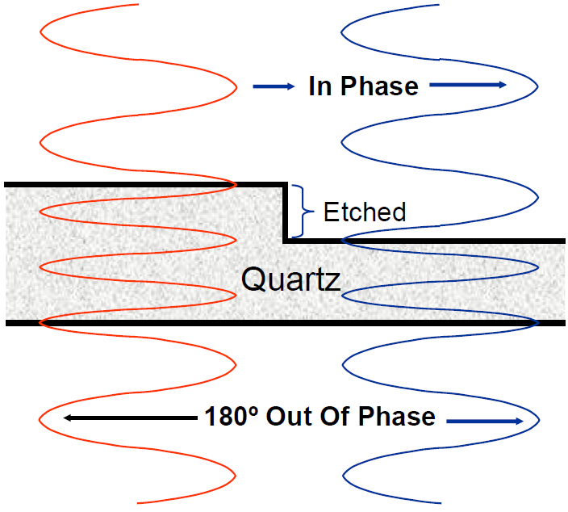
Phase shift masks fabrication
Standard mask
Chrome
Etch depth:
(λ/2)/(1.56-1)=172nm
n(quartz)=1.56
Quartz
0º
180º
Phase-shift mask
Quartz etched to induce shift in phase
Need two patterning steps with accurate alignment.
Fabrication cost 10× that of binary mask.

Slide 34
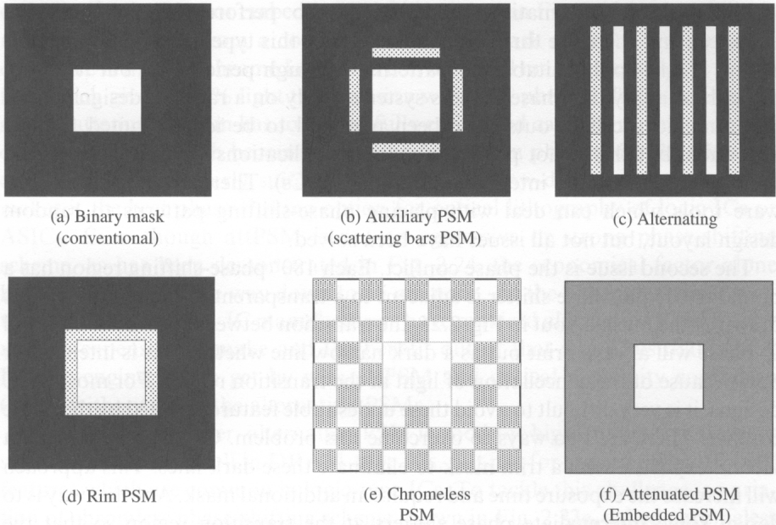
Different phase-shift mask schemes
Shaded region: 100% transparent, but 180º phase shift
0% transparent
100% transparent
5-15% transparent, 180º phase shift
similar to (b) (auxiliary PSM)
No Cr metal: 100% transparent everywhere

Slide 35
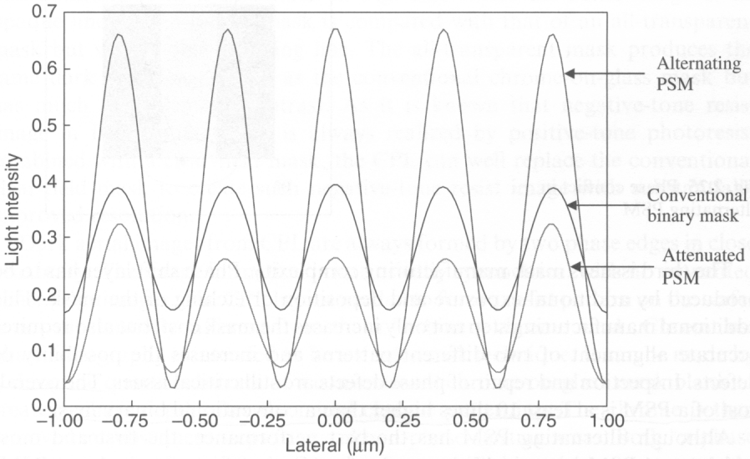
Comparison of binary, alternating and attenuated PSM
Phase conflict
0º
Mask
0º
0º
180º
Resist
Positive resist after development
Alternating PSM gives highest contrast, but
It is good only for periodic structures (memory cell), not for random patterns (CMOS).
Phase conflict may happen → undesired dark regions at the boundary of 0º and 180º phase.
In reality, the attenuated PSM is most widely used.

Slide 36
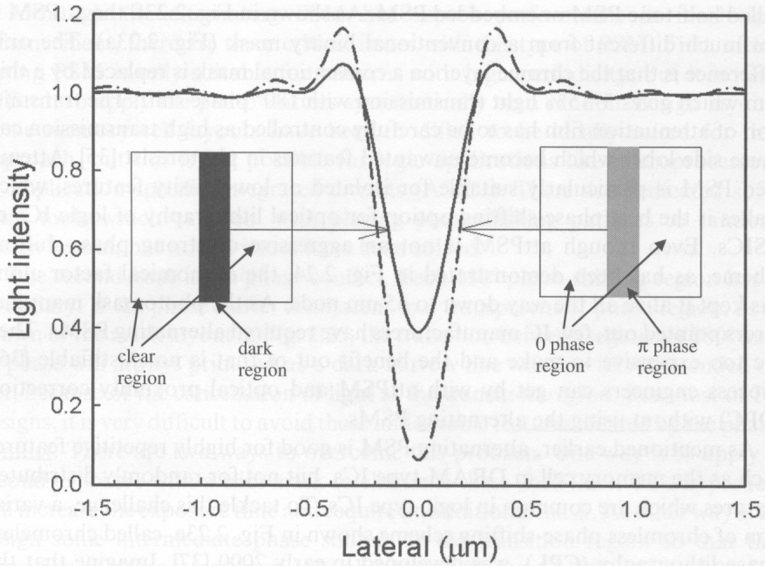
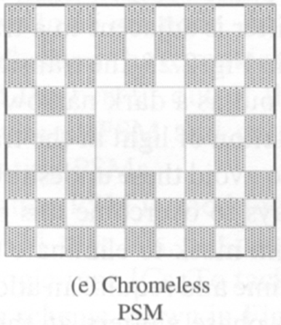
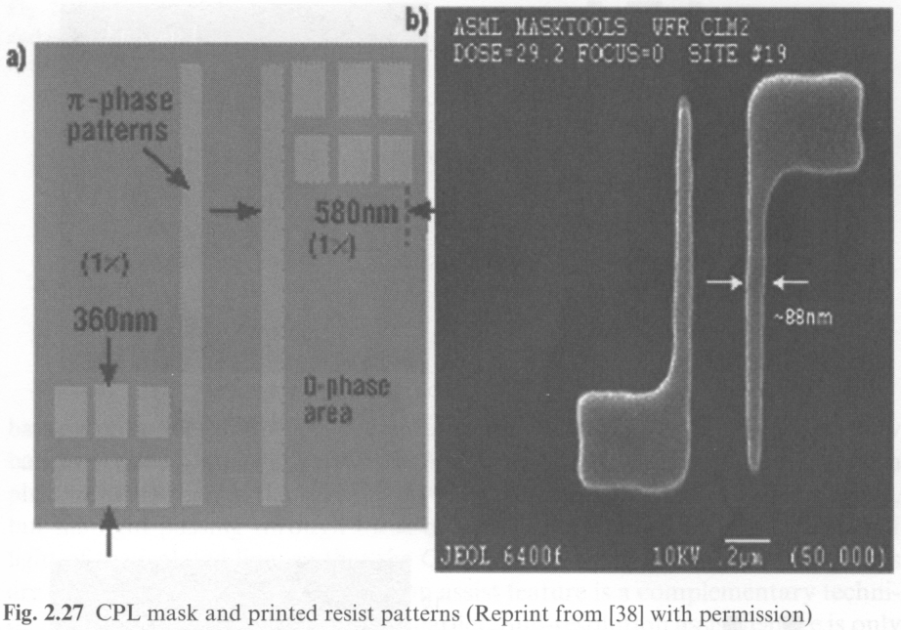
Chromeless phase lithography (CPL)
Binary mask
Cr-less phase mask
0º
0º
180º
No Cr metal: 100% transparent everywhere
Printed resist pattern
Comparison of CPL with conventional binary mask
CPL has better image contrast, thus higher resolution.
CPL mask

Slide 37
Photolithography and resolution enhancement techniques (RET)
Photolithography and resolution limit
Immersion lithography
Off-axis illumination (OAI)
Phase-shift mask (PSM)
Optical proximity correction (OPC)
Double processing

Slide 38
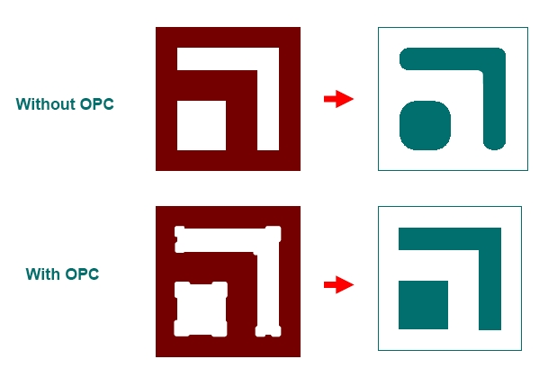
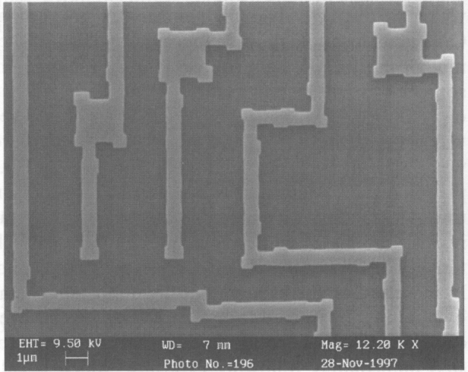
Optical proximity correction (OPC)
Presence or absence of other features nearby (proximity) will affect the optical behavior.
Sharp features are lost because higher spatial frequencies are lost due to diffraction.
These effects can be calculated and can be compensated for.
This improves the resolution by decreasing k₁.
Photo-mask
Pattern for negative resist
Transparent
SEM image of photomask with OPC features

Slide 39
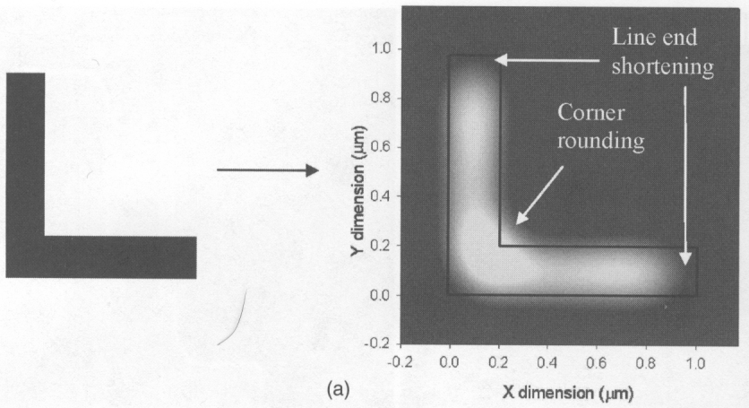
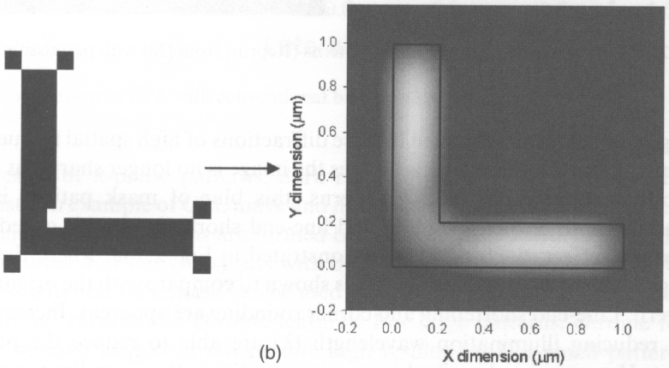
Optical proximity effect and its compensation by adding/taking away sub-resolution features
Optical proximity effect result in corner rounding and line-end shortening.
Sub-resolution squares
Optical proximity correction: modifies the mask design to restore the desired pattern.
The sub-resolution features won’t appear in the resist.

Slide 40
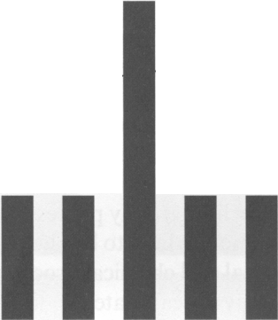
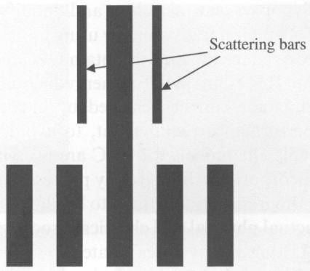
Optical proximity correction: biasing or adding scattering bars
Desired dose in resist
Biasing (making isolated line wider) Adding (sub-resolution) scattering bars
Scattering bars
Dense line

Slide 41
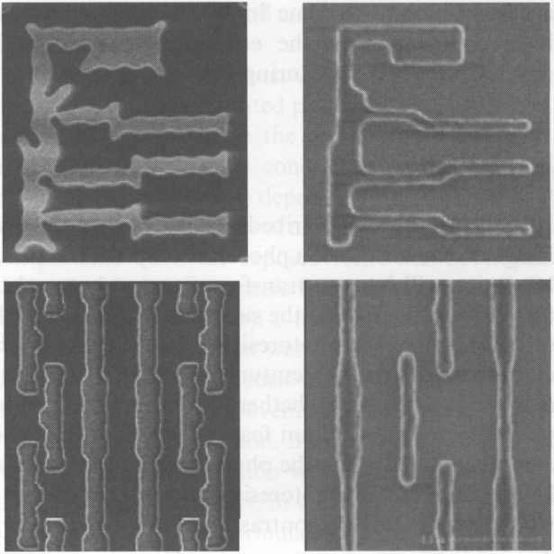
Inverse lithography technology (ILT)
(ultimate solution for OPC)
Mask
Resist pattern
Design the photomask by working out how an ideal image is generated. I.e. working backwards to find the “perfect” mask that can generate the ideal image.
Very complicated math, data file for such a mask ~1000GB.
Still limited by the resolution (pixel size) of the lithography used to make the mask.
Top: aggressive ILT mask.
Bottom: non-aggressive OPC mask.
Notes:
In ILT, every pixel of the mask is optimized, lots of calculation. For less aggressive OPC, only feature edges/corners need to be considered for modification.

Slide 42
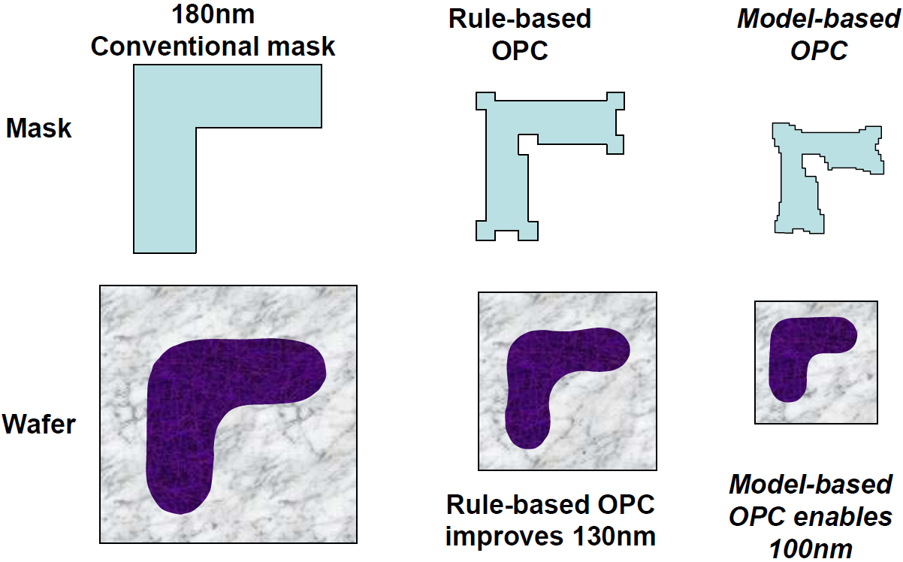
Optical proximity correction (OPC): summary

Slide 43
Photolithography and resolution enhancement techniques (RET)
Photolithography and resolution limit
Immersion lithography
Off-axis illumination (OAI)
Phase-shift mask (PSM)
Optical proximity correction (OPC)
Double processing

Slide 44
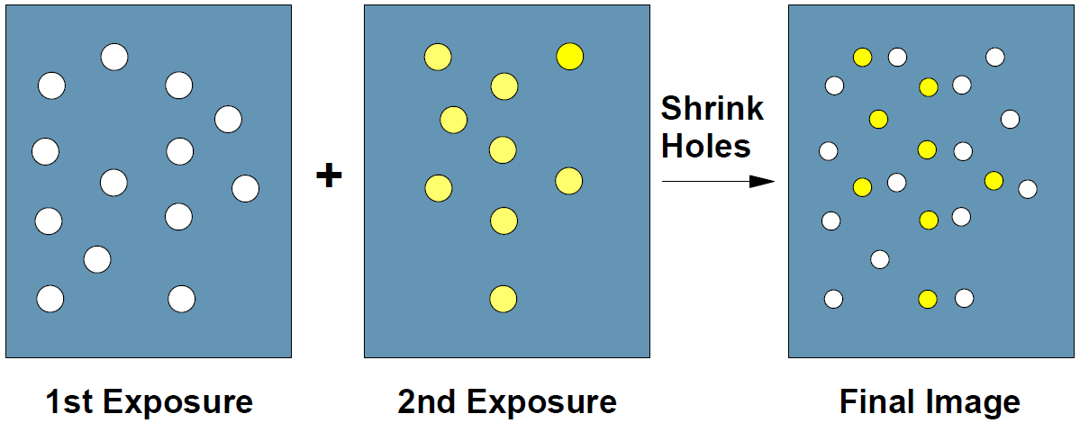
Pitch splitting to improve resolution (half pitch)
Divide patterns on a mask into two masks, resulting in larger separation between features.
Expose the resist twice using the two masks. (double exposure)
For complete separation of cross talk, two exposures and two pattern transfers by etching is carried out. (double patterning)
Finally, feature sizes are trimmed back (optional).

Slide 45
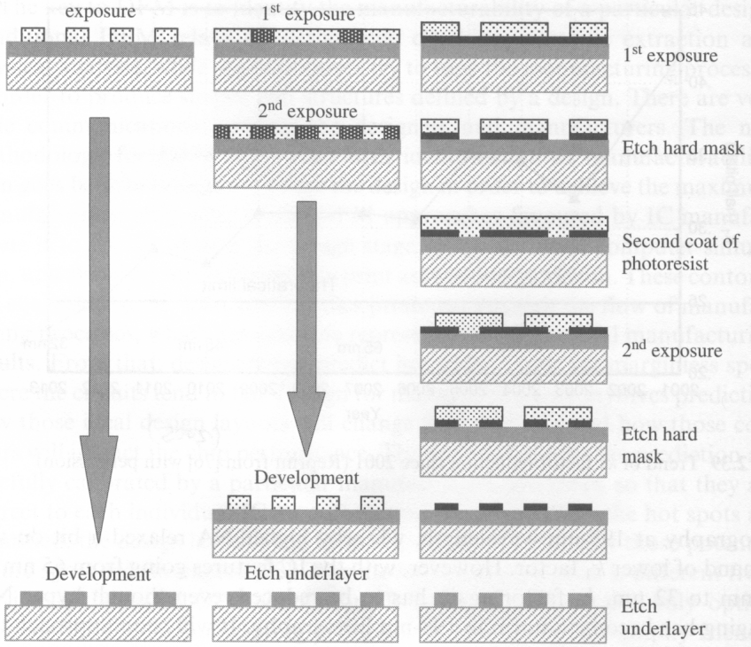
Double processing (double exposure and double patterning)
Single processing
Double exposure
Double patterning

Slide 46
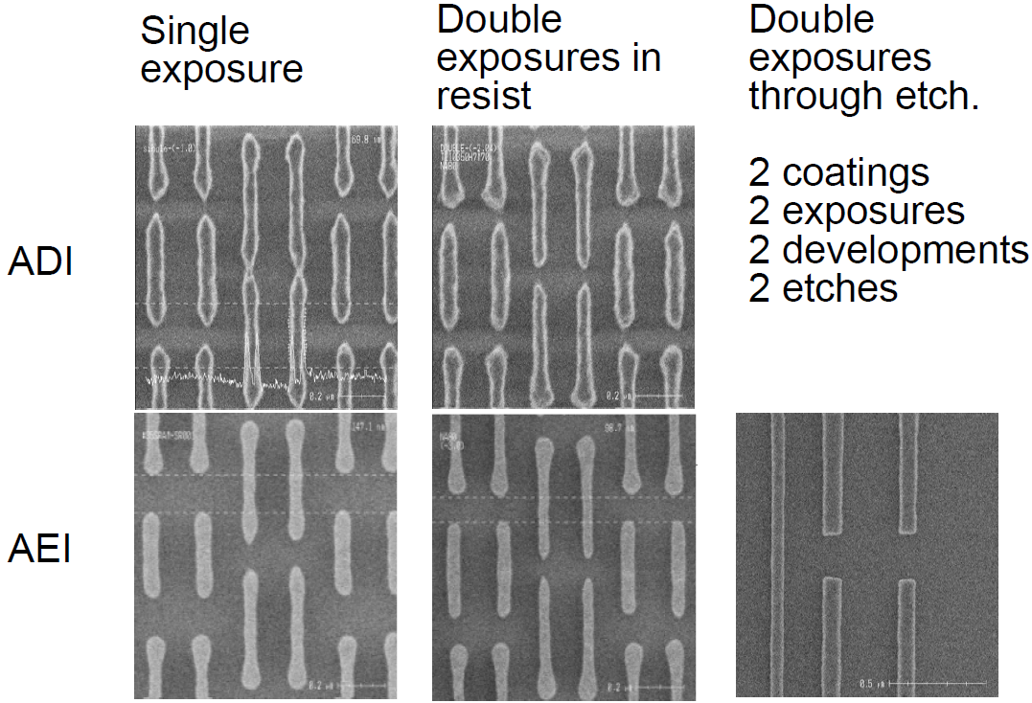
Comparison: single exposure, double exposure, double patterning
Resist
After resist development
After etch into sub-layer
Double patterning

Slide 47
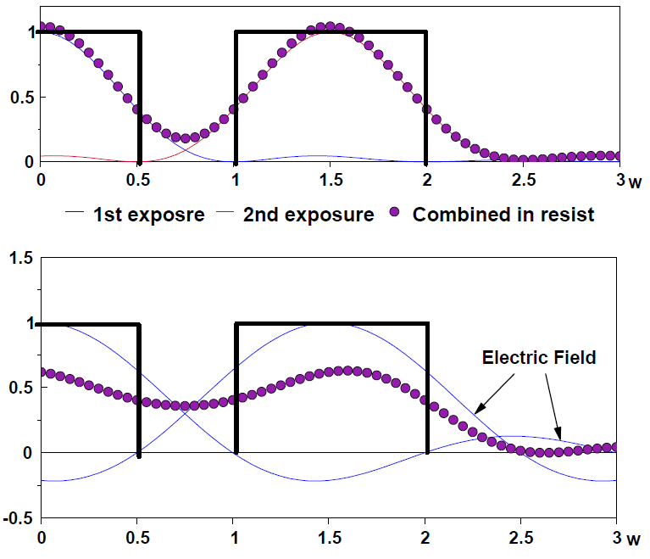
Why double exposure has higher resolution than single exposure?
Combined intensity in resist
Incoherent combination of light with double exposure.
(Intensity=E₁²+E₂²)
Coherent combination with single exposure.
(Intensity in gap=(E₁+E₂)²>E₁²+E₂²
Intensity ↓ in the pattern area)
In IC industry partial coherence is used that is better than coherence for high resolution, but still worse than incoherence.
Ideally, the resist is memory-less and/or non-linear, then double exposure = double patterning

Slide 48
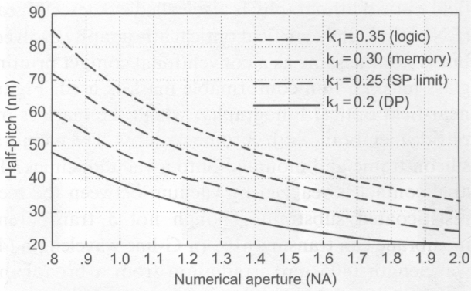
Doubling patterning outlook (as of 2006)
K₁ factor:
The practical limit for single processing is 0.25
Double processing can bring it to < 0.2
Lowest risk route to 32nm half pitch in time
But worst in terms of CoO (cost of ownership)
Two masks per critical layer
Reduced throughput by a factor of 2
Add cost to second etch step
Need very precise alignment between the two exposures.
Therefore, any development improving CoO is a plus for double processing

Slide 49
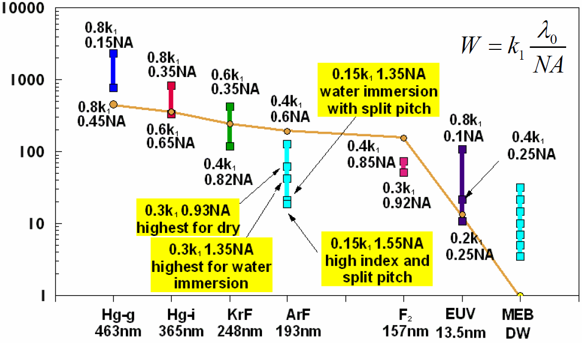
Resolution of exposure tools
R
Resolution in half pitch (nm)
Wavelength
MEB DW=multiple electron beams direct write

