Slide 1
Scanning probe microscopy (SPM) and lithography
Atom and particle manipulation by STM and AFM.
AFM oxidation of Si or metals.
Dip-pen nanolithography (DPN).
Resist exposure by STM field emitted electrons.
Indentation, scratching, thermal-mechanical patterning.
Field evaporation, STM CVD, electrochemical deposition/etching.
Scanning near field optical microscope (SNOM) overview.
Nanofabrication using SNOM
ECE 730: Fabrication in the nanoscale: principles, technology and applications
Instructor: Bo Cui, ECE, University of Waterloo; http://ece.uwaterloo.ca/~bcui/
Textbook: Nanofabrication: principles, capabilities and limits, by Zheng Cui

Slide 2
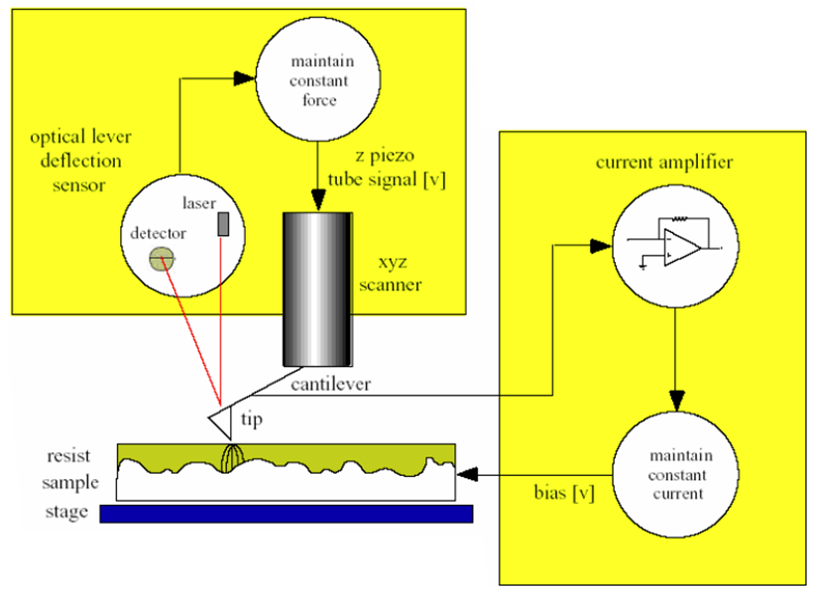
Field emission lithography (resist exposure)
The tip acts as a source of electrons to expose the resist like e-beam lithography.
The field emission current is used as feedback signal to control tip-sample spacing.
Both AFM and STM can be used for resist exposure.
Force feedback
Current feedback

Slide 3
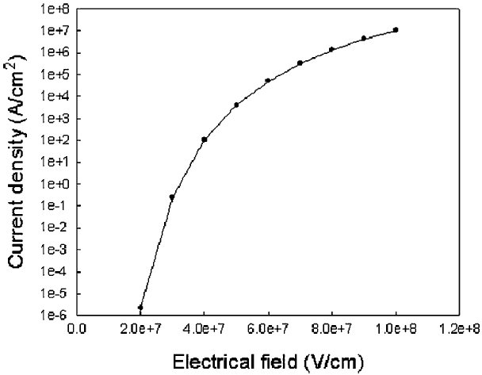
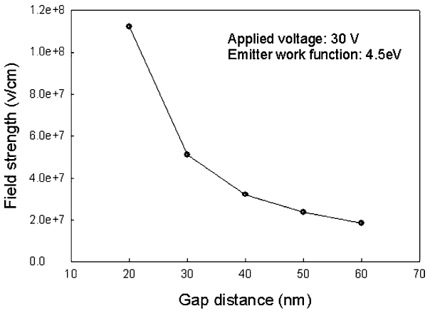

Field emission
Electron emission at high electrical field
(Folwer–Nordheim theory)
Field strength vs. gap distance between a probe tip and counter electrode.
For 4×10⁷V/cm, gap=35nm, so resist thickness of 30nm is OK, which is often just good enough for pattern transfer by liftoff or direct etch.
Higher voltage allows thicker resist.
Assume tip area is (20nm)², then at 4×10⁷V/cm, current=80×(20×10⁻⁷)²=0.3nA (typical EBL I<1nA)

Slide 4
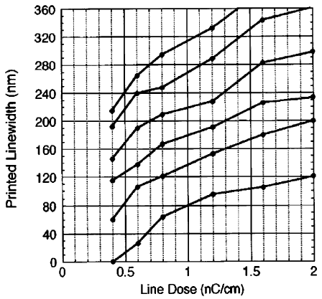
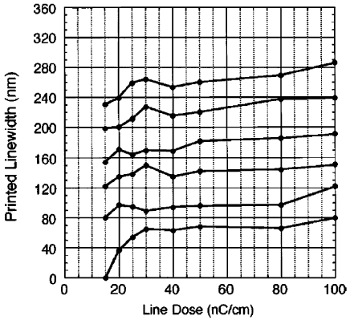
Resist sensitivity: ∼30× slower than EBL
Low energy exposure is the key feature of STM/AFM-based lithography.
After emitted at low energy (few eV), electrons lose energy due to inelastic scattering with resist molecules as well as gain energy from the high electric field.
Such process is perceived less efficient in breaking the molecular chain of polymer resist than in the case of electrons with initial high energy (>10keV for EBL).
The positive side, low energy means no proximity effect.
Comparison of line patterns vs. exposure dose:
(left) Conventional e-beam lithography (EBL) at 30 kV; (right) STM lithography at 40–60 V.

Slide 5
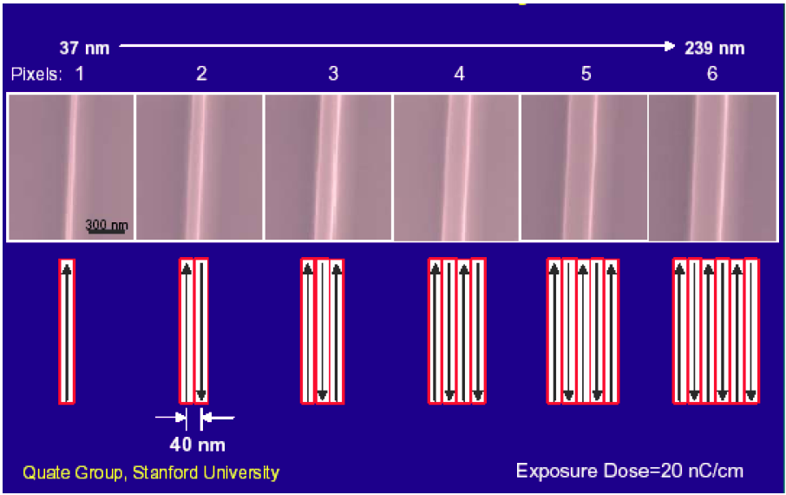
Field emission lithography: results in resist
One pass
Three passes
Resolution is ∼20-40nm, limited mainly by beam lateral diverging (since no focusing lens).

Slide 6
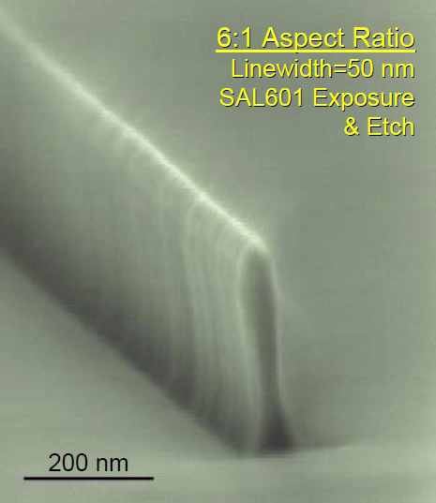
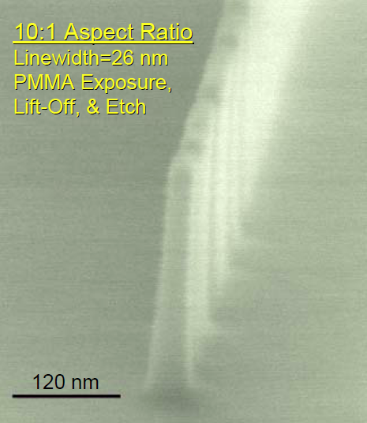
Field emission lithography: pattern transfer
SAL is a chemically amplified photoresist, as well as EBL resist.
Direct etch using resist as mask Liftoff metal, then etch using metal as mask

Slide 7
Scanning probe microscopy (SPM) and lithography
Atom and particle manipulation by STM and AFM.
AFM oxidation of Si or metals.
Dip-pen nanolithography (DPN).
Resist exposure by STM field emitted electrons.
Indentation, scratching, thermal-mechanical patterning.
Field evaporation, STM CVD, electrochemical deposition/etching.
Scanning near field optical microscope (SNOM) overview.
Nanofabrication using SNOM

Slide 8
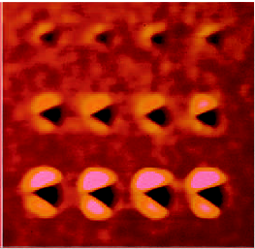
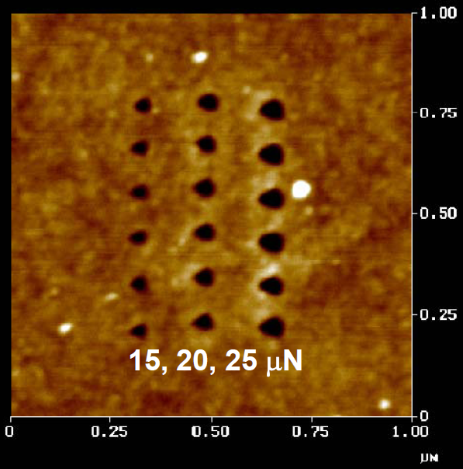
AFM-based nanofabrication: nanoindentation
Popular early examples of nanofabrication using an AFM probe, since it is so simple.
This approach allows site-specific nanoindentation, and straightforward imaging of the resulting indents immediately after indentation.
Nano-indentations made with an AFM on a diamond-like carbon thin film.

Slide 9
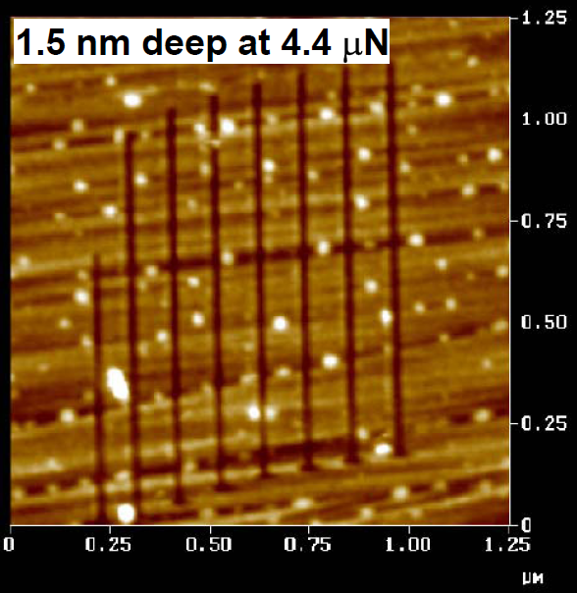
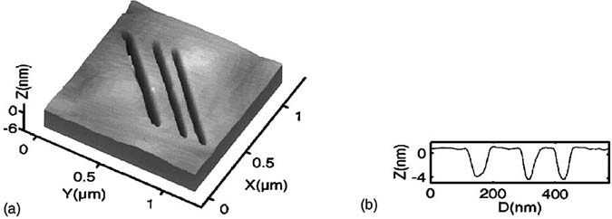
AFM lithography: scratching
Material is removed by AFM tip scratching.
SAM (self-assembled mono-layer) can also be removed by tip scratching, which is the inverse process of dip-pen nanolithography.
As a nanofabrication method this is fairly limited due to the tip wear and debris produced on the surface.
Advantage: precise alignment (imaging then lithography), no additional steps (such as etching the substrate) needed, though the scratch is usually very shallow.
It can also be used to characterize micro-wear processes of materials.

Slide 10
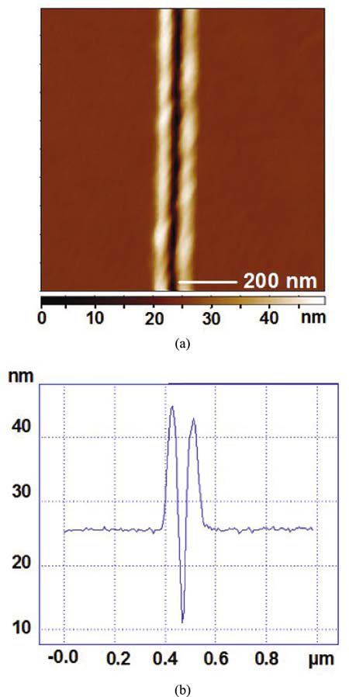
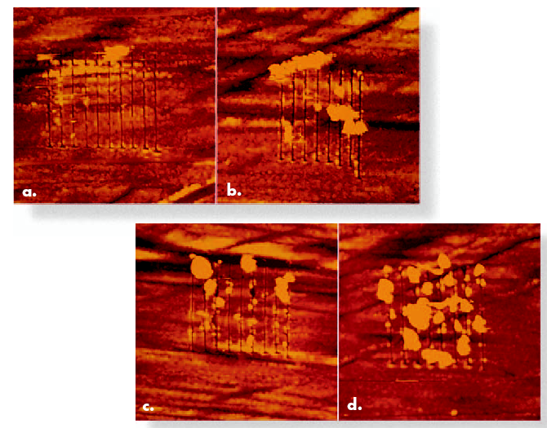
Scratching results
Scratch into PMMA using Si tip, 15nm deep
2 µm scans
Scratch patterns made with an AFM on a diamond-like carbon thin film. Lots of debris.

Slide 11
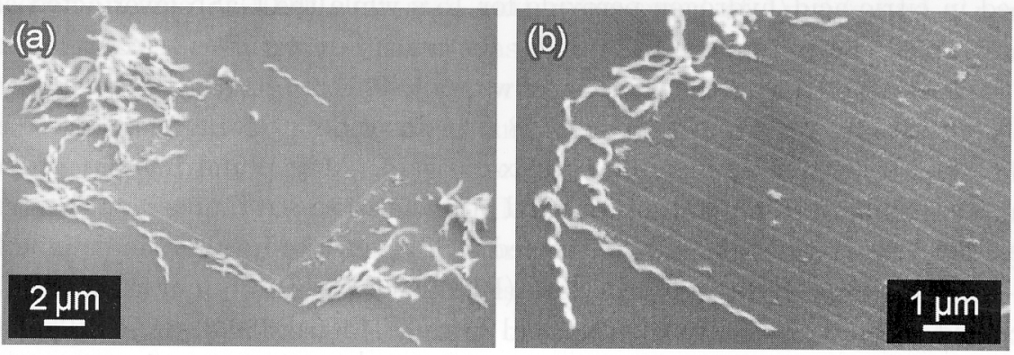
Scratching Si using diamond tip
Diamond is very hard, no wear (tip long life-time).
One grain of diamond attached to Si AFM tip.
Very stiff cantilever with spring constant 820N/m (∼1N/m for normal tip).
The silicon was machined using diamond tip cantilever at a normal load of 2403μN.
Pitch 157nm
Pitch 470nm

Slide 12
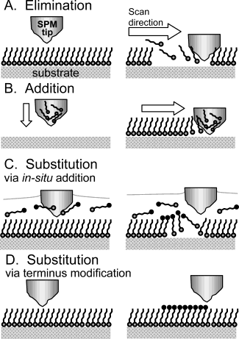
Fabrication using self-assembled mono-layers (SAM)
Schematic diagram illustrating the principles of elimination, addition, and substitution lithographies with a scanning probe
In general, the probe images the surface first with nondestructive imaging parameters, to find an area suitable for patterning.
Elimination was achieved by the removal of the SAM in proximity of the probe by mechanical or electrical means.
A probe coated with a molecular “ink” was brought into contact with a nominally “bare” substrate. The ink transferred from the probe to the surface (dip-pen nanolithography).
In the first substitution pathway, the tip removed the SAM while scanning, and an in-situ addition of a different molecule into the bare region occurred (substitution via elimination and in-situ addition).
The alternative substitution via SAM terminus modification occurred by the probe modifying the head groups of the SAM through electrochemical or catalytic interaction.
Kramer, “Scanning probe lithography using self-assembled monolayers”, Chem. Rev. 103, 4367-4418 (2003). (good review paper, 52 pages)

Slide 13
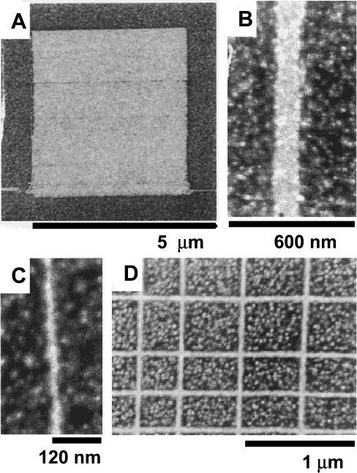
Fabrication using self-assembled mono-layers by electrical “scratching” (desorption)
Mercaptomethylethanamide (MMEA, HSCH₂CONHCH₂CH₃) produces homogeneous, dense, and stable mono-layers on Au substrates.
It protects gold from further thiol (i.e. –SH) adsorption but did not function as a protective layer against cyanide etch of Au.
C₁₆SH protects Au against cyanide etch. It will cover wherever MMEA is “scratched” away.
Au square, that was protected by C₁₆SH against cyanide etch
Au here is etched away
SEM images showing Au features created through:
STM-based lithography on a MMEA/Au substrate (I_{t} =50pA; V_{b} =10V; 15μm/s).
Immersing the sample into a solution of C₁₆SH for 30s.
Cyanide etching of the gold.
5μm×5μm square by 1024 consecutive scanning lines.
25 passes with the tip.
1 pass with the tip.
Test grid single line patterns several μm-long. No proximity effect was seen at the crossing points.
Kramer, “Scanning probe lithography using self-assembled monolayers”, Chem. Rev. 103, 4367-4418 (2003). (good review paper, 52 pages)

Slide 14
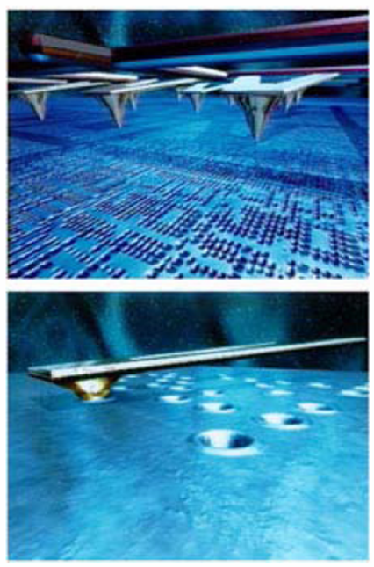
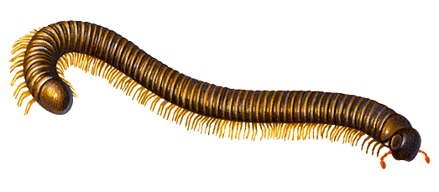
Millipede: thermal-mechanical data storage on a polymer
Tips are brought into contact with a thin polymer film. Each tip is independently controlled.
Bits are written by heating a resistor built into the cantilever to a temperature of ∼400ºC. The hot tips softens the polymer and briefly sinks into it, generating an indentation.
For reading, the resistor is operated at lower temperature, ∼300ºC. When the tip drops into an indentation, the resistor is cooled by the resulting better heat transport, and a measurable change in resistance occurs.
The 1024-tip experiment achieved an areal density of 200Gbit/in².
Very ambitious idea, totally different from previous data storage technologies.
This project was finally not successful commercially, partly due to too much power needed (too much heat need to be dissipated).
Millipede

Slide 15
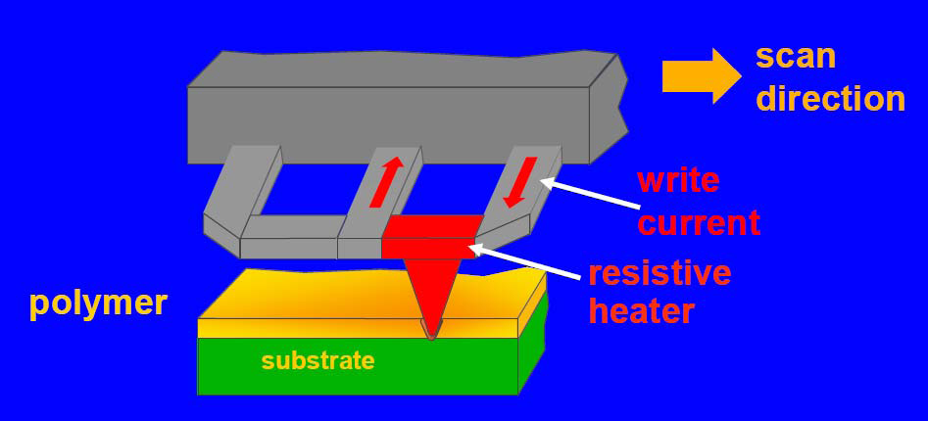
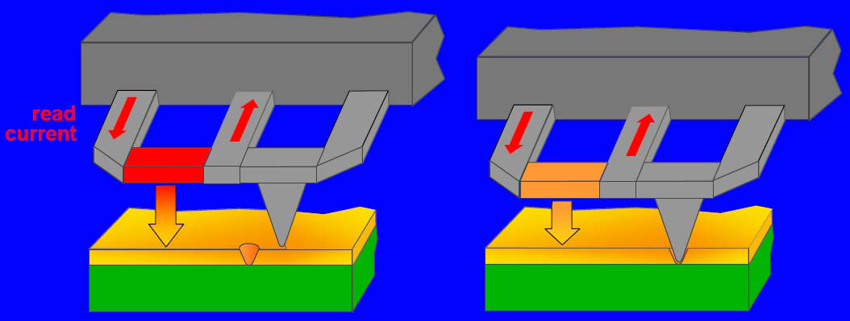
IBM Millipede – write and read
Resistance change:
ΔR/R ≈ 10⁻⁴/nm
D. Wouters, U. S. Schubert, Angew. Chem. Int. Ed. 2004, 43, 2480-2495.

Slide 16
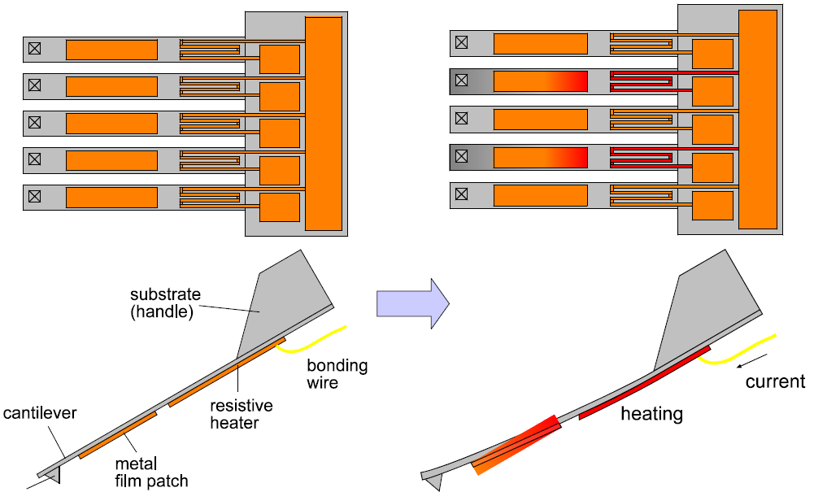
Thermal bimetallic actuation
expand
tip
Bi-metal means two metal films one on top of another, here with different thermal expansion.
Go to http://en.wikipedia.org/wiki/Bi-metallic_strip for a nice video.

Slide 17
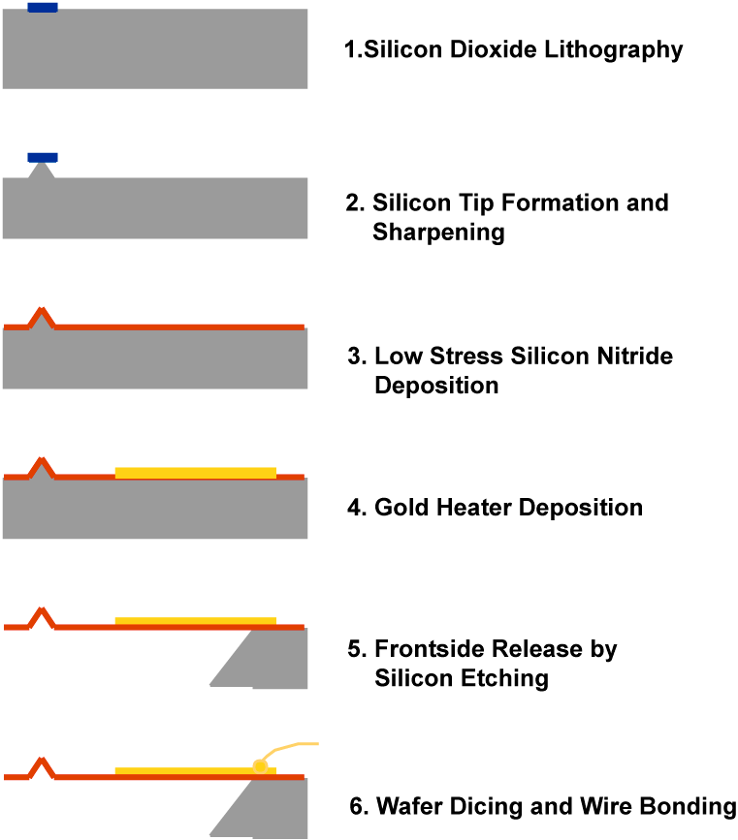
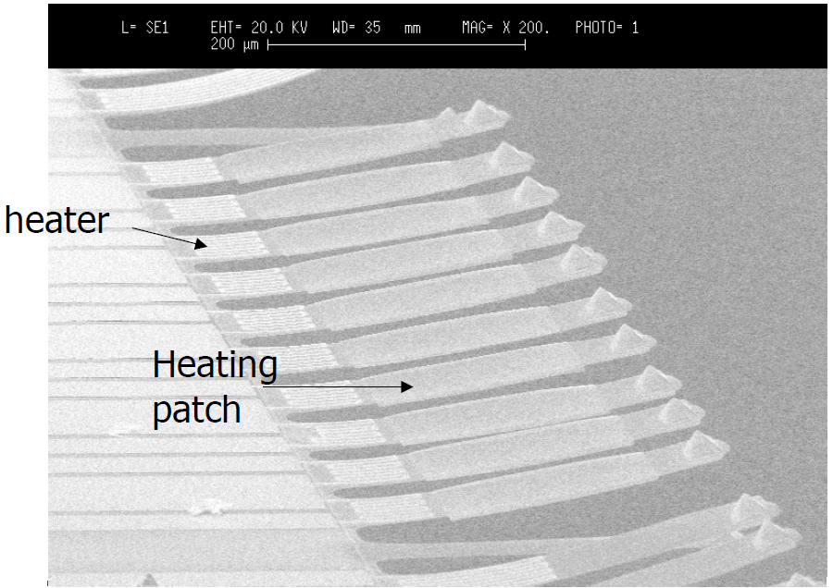
Silicon nitride probe arrays fabrication

Slide 18
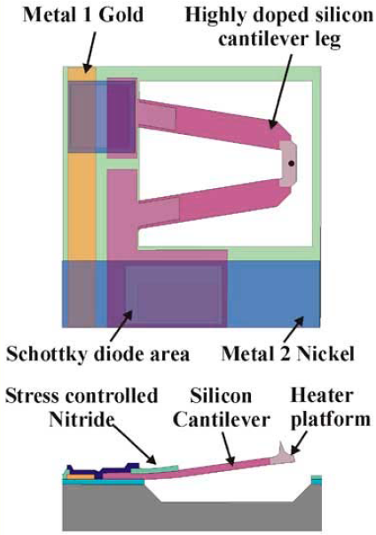
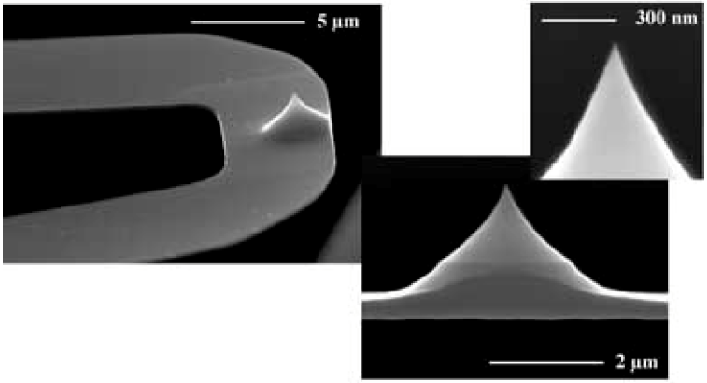
IBM Millipede tips
Tip height: ∼1.7μm
Tip height homogeneity in an array: ±50nm
Tip radius: <20nm

Slide 19
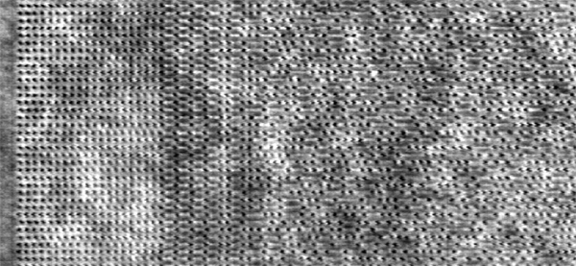
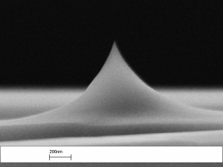
The Millipede data storage
Read/write tip, radius at tip apex a few nm, tip-height 500 - 700 nm
700 nm
All the nanoscale pits in the array were written simultaneously by the millipede cantilever array.
Storage density > 1TBit/in², φ of indentations ≈ 15 nm, pitch ≈ 25 nm.
This is the most successful demonstration of large scale nano-patterning using SPM tip-based nanofabrication.

Slide 20
Scanning probe microscopy (SPM) and lithography
Atom and particle manipulation by STM and AFM.
AFM oxidation of Si or metals.
Dip-pen nanolithography (DPN).
Resist exposure by STM field emitted electrons.
Indentation, scratching, thermal-mechanical patterning.
Field evaporation, STM CVD, electrochemical deposition/etching.
Scanning near field optical microscope (SNOM) overview.
Nanofabrication using SNOM

Slide 21
Field evaporation
Field evaporation: ions or atoms can be directly pulled out of material surface under extremely high electrical field.
Material deposition was easily observed from a gold tip due to its low threshold field for field evaporation (3.5V/Å), and gold surface is inert to chemical contamination.
If a tungsten tip was used in combination with a gold substrate, a pit in Au was formed, which is because tungsten has much higher threshold in field evaporation (5.7V/Å).
However:
Field evaporation alone cannot completely explain the material deposition process: heating by field emission current may also be responsible for the deposition.
Field emission current occurs at much lower threshold field than that of field evaporation. For gold tip, the field emission current becomes considerable at 0.6V/Å.
High field emission current heats up tip apex, causing melting/flowing of tip material.
This can also explain why the material deposition from the tip is sustainable despite continuous loss of material from the tip.
For this reason, a negative bias to the tip is preferable because negative bias is the correct configuration for field emission (of electrons that heat the tip apex) to occur.
Experimental observation also confirmed that negative bias of the tip produced much more stable deposition.
Another speculation about the mechanism of tip material deposition process is the formation of nano-bridge between the tip and sample surface (next slide).

Slide 22
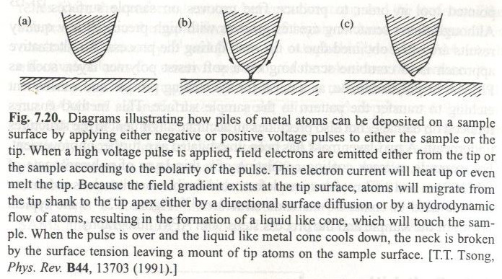
Nano-deposition by field evaporation…
One possible mechanism: liquid transfer
The tip can also act as a liquid metal ion source (LMIS), which when brought in close proximity (∼100nm) to a substrate, can be used for local metal deposition.
Similar to LIMS for FIB, except that here “focusing” is due to close proximity.

Slide 23
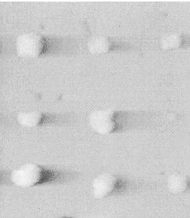
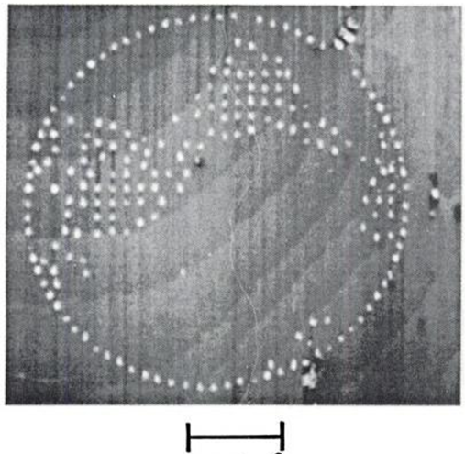
Field evaporation
Advantages:
Small features: 10nm.
Disadvantages:
Limited to dots.
Low throughput, small area.
10-40nm Au dots
Simplified map of the world on an Au (111) substrate. (Au dots on Au substrate)
Au dot diameter ∼10nm.
The emission process is highly reproducible.
Not that slow since pulse with a width of as low as 10ns can be used.
200nm
Bessho, Iwasaki, Hashimoto, JAP 79, 5057 (1996).
Mamin, JVST B, 9, 1398 (1991).

Slide 24
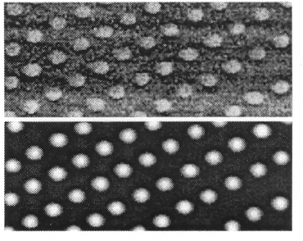
STM/AFM CVD (chemical vapor deposition)
The process is similar to focused electron beam induced deposition, but with quite different mechanism.
Organometallic gas molecules are decomposed at the high field around tip apex, and a microscopic plasma (ionized gas) between tip and substrate is formed.
Tip is negatively biased (for field emission of electrons), with current 100-500pA.
There is a threshold bias voltage for different precursor gases: 27V for iron carbonyl gas but 15V for tungsten carbonyl.
The deposited film contains about 50% of metal, with rest being carbon contamination and small amount of oxygen (this is like electron-beam induced deposition).
AFM image
Size depends on: voltage pulse amplitude & duration, tip - substrate distance.
(for fixed current, distance increases with voltage)
MFM image
Fe nano-particles by STM CVD using Fe(CO)₅ precursor gas.
MFM: magnetic force microscope.
Wirth, Field, Awschalom, von Molnar, “Magnetization behavior of nanometer-scale iron particles”, PRB 57 14028 (1998).

Slide 25
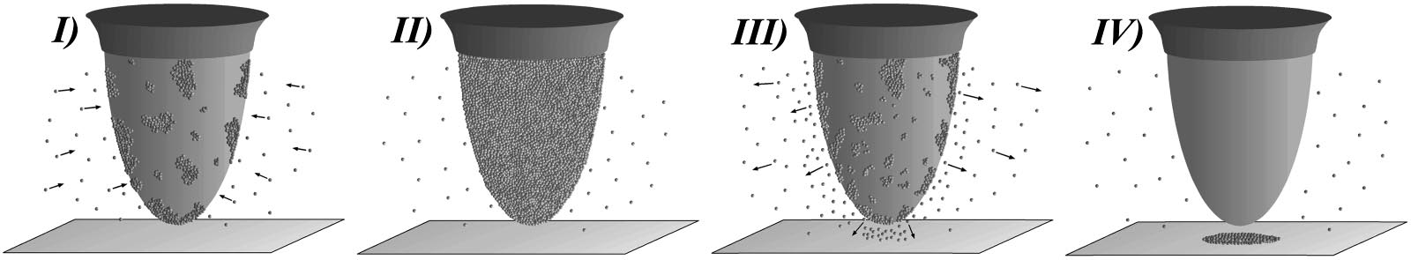
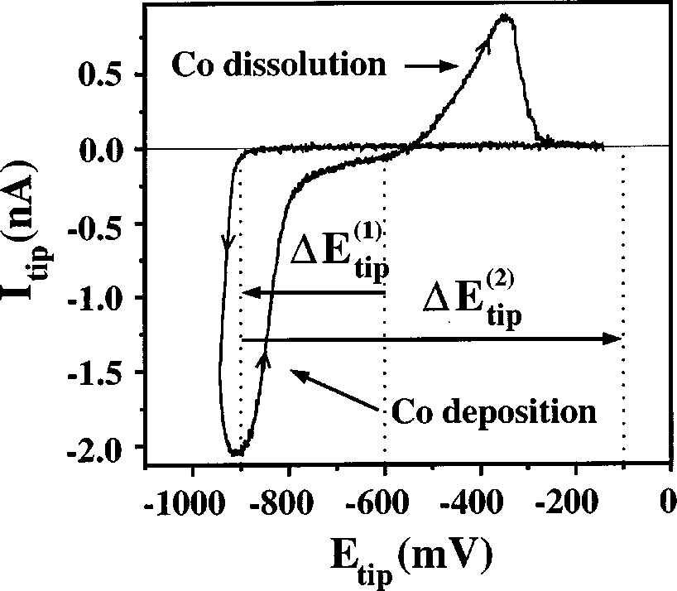
Local electrochemical deposition and etching
Substrate in solution, tip as local counter-electrode.
Schematic illustration of the mechanism at the STM tip. (I) Deposition of Co from the electrolyte onto the uncovered part of the tip. (II) Co-covered STM tip. (III) Complete dissolution of previously deposited Co causing an increase of the Co²⁺ concentration near the tip according to the diffusion profile. (IV) Co dissolved from the very end of the tip is deposited locally onto the substrate.
Current–voltage characteristics of Co deposition onto a Au STM tip from 0.25M Na₂SO₄/1mM CoSO₄ as recorded in the STM cell (AFM tool is used, not STM). The potentials are quoted against a saturated calomel electrode (SCE). The arrows indicate the cycling direction of the voltage at a sweep rate of 10mV/s.
Hofmann, Schindler and Kirschner, “Electrodeposition of nanoscale magnetic structures”, APL 73, 3279 (1998).

Slide 26
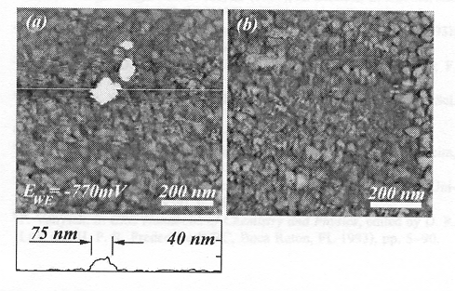
Local electrochemical deposition: result
Since the tip/substrate gap is large (0.1-1μm), so is the deposited/etched structures.
Co on Au
STM image of three Co dots on a Au surface. The tip was withdrawn 20nm from the Au surface during deposition; E_{WE}=-770mV (WE: working electrode). The line profile shows the cross section of dot A in the STM image. The variations in the dot size are compatible with corresponding variations in the measured tip loading current/time characteristics.
STM image of the same Au surface after stripping off the Co dots by adjusting E_{WE} to -300mV.

Slide 27
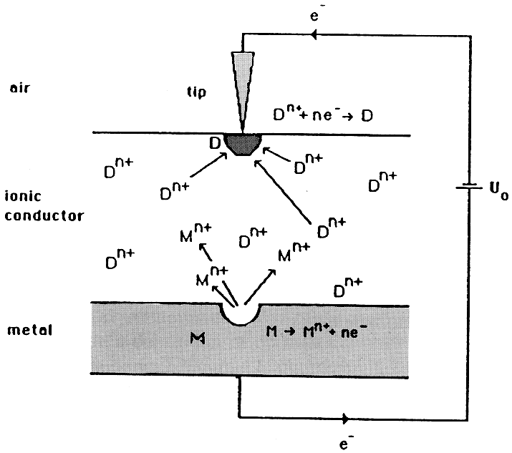
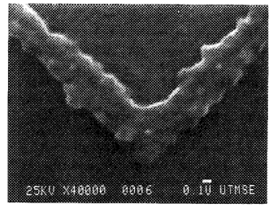
Local electrochemical deposition and etching
Simultaneous deposition (onto polymer near tip apex) and etching (the substrate) through a thin spin-coated ionically conductive polymer film.
(NOT in liquid solution, but the polymer acts like a liquid environment)
SEM image of Ag lines deposited on Nafion film. Tip material is tungsten, bias 5V, current 0.5nA, scan rate 90nm/sec.
Tip reaction: Ag⁺ + e⁻ -> Ag;
Substrate reaction: Ag -> Ag⁺ + e⁻.

Slide 28
Scanning probe microscopy (SPM) and lithography
Atom and particle manipulation by STM and AFM.
AFM oxidation of Si or metals.
Dip-pen nanolithography (DPN).
Resist exposure by STM field emitted electrons.
Indentation, scratching, thermal-mechanical patterning.
Field evaporation, STM CVD, electrochemical deposition/etching.
Scanning near field optical microscope (SNOM) overview.
Nanofabrication using SNOM

Slide 29
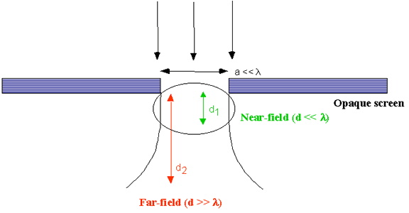
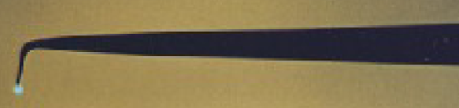
Far-field and near-field optics
Far-field optics
  Geometric optics based on traditional optical element (lens)
Near-field optics
  Spatial confinement of light in x, y and z.
  Form of lens-less optics with sub-wavelength resolution.
  Independent of the wavelength of light being used.
Review paper: Tseng, “Recent developments in nanofabrication using scanning near-field optical microscope lithography”, Optics & Laser Technology, 39, 514-526 (2007).
Near-field probe (50nm)

Slide 30
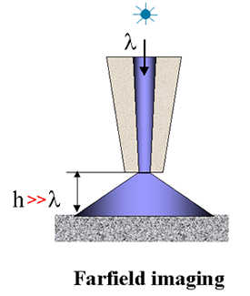
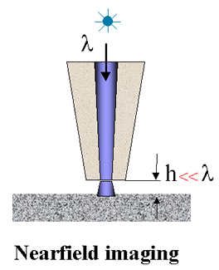
Near field scanning optical microscope (NSOM)
or Scanning near field optical microscope (SNOM)
NSOM is a scanning optical microscopy technique that enables users to work with standard optical tools beyond the diffraction limit.
It works by exciting the sample with light passing through an aperture formed at the end of a single-mode drawn optical fiber, whose diameter is only tens of nanometers.
Broadly speaking, if the aperture-specimen separation is kept roughly less than half the diameter of the aperture, the source does not have the opportunity to diffract before it interacts with the sample, and the resolution of the system is determined by the aperture diameter as oppose to the wavelength of light used.
An image is built up by raster-scanning the aperture across the sample (or fix the aperture while scanning the sample) and recording the optical response of the specimen through a conventional far-field microscope objective.
Far field

Slide 31
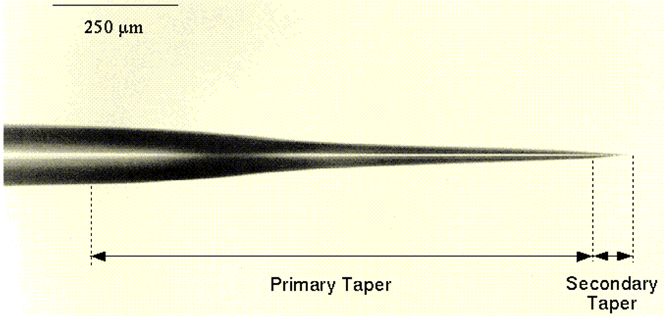
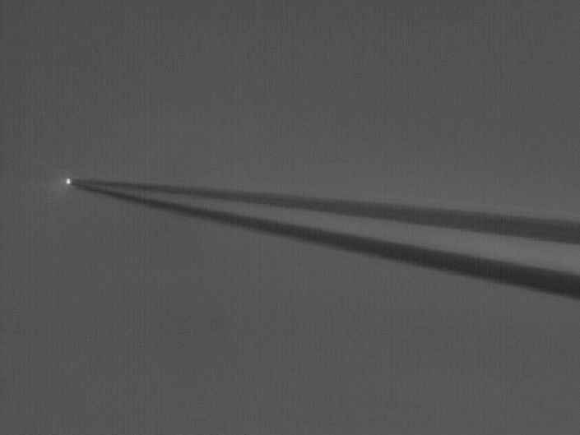
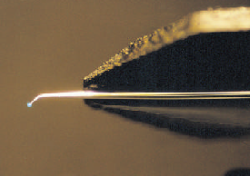
Melt-drawn straight NSOM tip
Fiber tip by Nanonics Inc.
Melt drawn from a single optical fiber with the core material already removed.

Slide 32
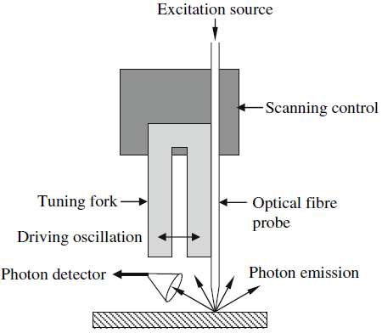
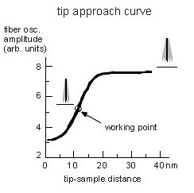
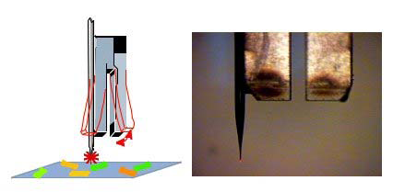
Tuning fork based shear-force detection
Tip distance control: beam deflection method, shear force measurement, piezoelectric tuning fork, cantilever normal force.
The farther away from sample surface, the less damped vibration.
Control system keeps the optical probe at constant distance from the sample.

Slide 33
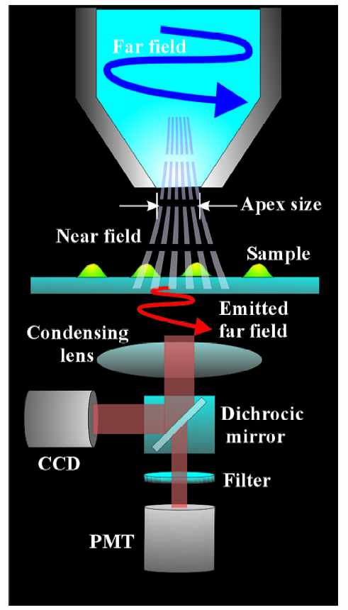
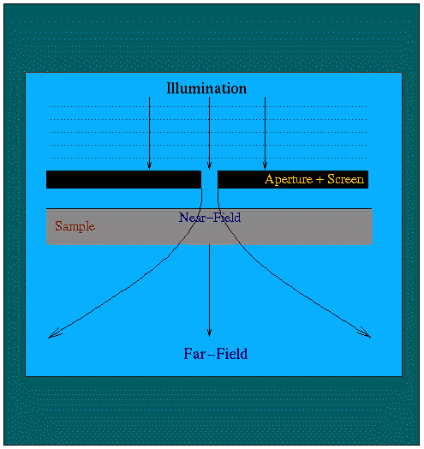
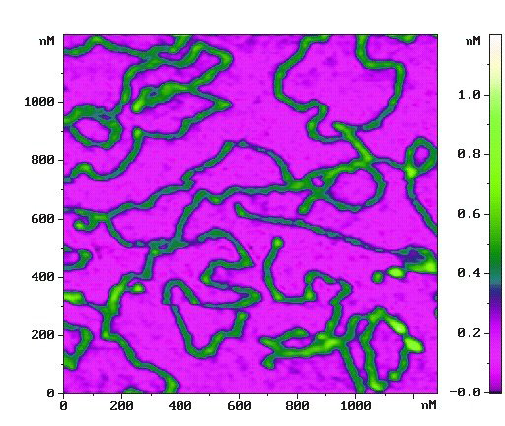
Near-field microscope (for imaging)
Near field illumination
Far field detection
DNA
Near field illumination, far field detection

Slide 34


NSOM transmission efficiency of fiber tips
Fiber material – glass, intensity strongly dependent on dielectric properties of tip.
When φ<<λ/2, optical mode cannot propagate (cut-off regime), intensity decreases exponentially - typical transmissions only ∼10⁻⁴ to 10⁻⁶.
Possible solutions to decrease propagation loss
  Multiple tapered probes
  Metal coatings
The probe edge is coated with Al.
The metal film (∼100nm thick) increases the light coupling into the fiber aperture and better defines its shape.

Slide 35

Near-field optical techniques
(for transparent substrate)
Apertured probe (SNOM) – evanescent waves from tapered fiber probe are used either to illuminate sample or couple near-field light from sample into fiber.
Apertureless probe (ASNOM) – small (sub-wavelength) tip scatters near-field variations into far field.
Notes:
Ok so as many of you may already know, sub-wavelength imaging has been made possible recently primarily through the use of tapered fiber probes manufactured with metal coatings over a sub-wavelength sized aperture. Light can then be coupled into or out of the fiber through the evanescent waves which propagate extremely close to this metal surface. This imaging technique has become a powerful tool for high resolution microscopy and has seen widespread use in recent years. Its primarily limitation is the amount of light that can be coupled into or out of the fiber, which limits the SNR. The skin depth of the metal coating at the tip, and the fact that light transmission decreases rapidly as the aperture size decreases are the main reasons for this and these limitations have made it difficult to achieve higher resolution with fast image acquisition rates.
To overcome some of these limitations apertureless techniques have been developed that rely on small sub-wavelength size metal tips that act as nanoantennas to scatter the optical near-field of the sample itself. This technique is useful in overcoming the light level problems. Also, it is much easier to fabricate extremely small metal or semiconductor tips, and it’s the local scattering from these tips that determine the resolution of the imaging systems.

Slide 36
Apertureless probe (ASNOM)
Sample is transparent Sample is opaque, reflection measurement
(opaque)
Tip scatters both illuminated near field of sample (a) and (undesirable) incident far field (b).
Advantages:
  Far field illumination and detection allows for use of conventional optics.
  Higher light intensity near the tip than SNOM.
Drawbacks:
  Reflection from surface creates strong background.
  Background field causes interference effects that are hard to suppress.
Notes:
So here some pictures of apertureless near-field setups. Typically people use generic AFM tips as the local scatterer. They vibrate these tips up and down at a well-controlled frequency and by detecting light at that frequency they can measure the amount of light being scattered by the tip. if you notice this picture right here, you can see that the tip can work two ways. Either the sample can scatter the near-field of the illuminated tip, or the tip can scatter the near-field of the illuminated sample. It seems like people generally are controlling which situation occurs by controlling the incident angle of the illumination light. Some people also have been arguing that higher resolutions can be achieved if you allow both situations to happen simultaneously, but my understanding behind how this happens is a little hazy.

Slide 37
Scanning probe microscopy (SPM) and lithography
Atom and particle manipulation by STM and AFM.
AFM oxidation of Si or metals.
Dip-pen nanolithography (DPN).
Resist exposure by STM field emitted electrons.
Indentation, scratching, thermal-mechanical patterning.
Field evaporation, STM CVD, electrochemical deposition/etching.
Scanning near field optical microscope (SNOM) overview.
Nanofabrication using SNOM.

Slide 38

Near-field lithography: direct serial writing
Serial writing/exposure of a photo-resist using fiber tip, like photolithography, but with high resolution and is very slow.
1μm
Tapping mold image of a lithography test pattern. The Aurora-3 used nanolithography software to write into S1805 photoresist. Scan size 25μm.

Slide 39

Comparison of apertured and apertureless SNOM
Apertured: low light intensity, slow writing, tip very difficult to make small and flat at the end.
For typical wavelengths, if the aperture is 100nm, less than third orders of magnitude of light can pass through; when it reaches 50nm, only 1/10⁷ light makes it through.
Apertureless: metal tip easy to make tiny, so demonstrated higher resolution (40nm). Light is greatly enhanced at the metal tip due to “lightning rod” (surface plasmon resonance) effect. However, stray light everywhere that may expose resist nearby.
Both: good only for thin resist (sub-50nm) since it is near (evanescent) field.
Apertured
Apertureless

Slide 40


Two photon near-field optical lithography
790nm cannot expose SU-8, but 790/2=395nm can.
Line-width measured by AFM
Peak power: 0.45×10¹²W/cm²
Achieve ∼λ/10 resolution by focusing femto-second laser beam onto Au coated AFM tip in close proximity to SU-8.
Two-photon polymerization occurs in SU-8 over confined regions due to local enhancement of electromagnetic field by surface plasmon on metal AFM tip.
Different from two-photon lithography in that here the field is “focused” (enhanced) by the tip, not by a focusing lens.
Yin et. al., Appl. Phys. Lett. 81 3663 (2002)
4

Slide 41

SNOM photo-patterning of SAM (self assembled monolayer)
UV exposure in the presence of oxygen oxidizes the SAM, weakening its binding to Au.
oxidation
replacement
b). FFM image of a 39nm-wide line of dodecanethiol written into an SAM of mercaptoundecanoic acid.
c). 40nm lines of mercaptoundecanoic acid written into dodecanethiol by reversed procedure.
FFM: friction force microscope.

Slide 42

SNOM material removal by laser ablation
Laser peak power 12mJ/83fs=0.14×10¹² W/cm², high enough to melt and vaporize Au.
Nano-lines ablated on Au substrate by apertureless SNOM coupled with by ultrafast laser of 83fs FWHM:
AFM image
Relationship between feature size and laser fluence

Slide 43

SNOM photo-CVD (chemical vapor deposition)
Since the CVD precursor gas, diethylzinc (DEZ), has strong absorption at λ<270nm, an Ar⁺ laser operated at the second harmonic (λ=244nm) is selected for near-field photo-dissociation of DEZ.
Al-coated UV optical fiber tip with an aperture of 60nm.
60nm
Zn nano-dots deposited on glass substrate by SNOM photo-dissociation:
Shear-force image.
Cross-sectional profile taken along the white dashed line in panel (a)
There are many more types of SNOM nano-patterning methods, see the review paper.
Review paper: Tseng, “Recent developments in nanofabrication using scanning near-field optical microscope lithography”, Optics & Laser Technology, 39, 514-526 (2007).

