Slide 1
Lithography using self assembly: block co-polymer self assembly, porous anodized aluminum oxide and nano-sphere lithography
Di-block copolymer self assembly overview.
Guided (directed, aligned) self assembly.
Block copolymer lithography.
Anodized aluminum oxide (AAO) overview.
Nanofabricating using AAO template
Those are the three most important self-assembly techniques, widely used for nanofabrication, with numerous publications each year.
Basically, for those who don’t have access or don’t like too much EBL, FIB or imprint, they can often use self-assembly fabrication to demonstrate their idea.
The most significant advantage of self-assembly is low cost.
The biggest limit: only periodic pattern can be created, usually without long range ordering.
ECE 730: Fabrication in the nanoscale: principles, technology and applications
Instructor: Bo Cui, ECE, University of Waterloo; http://ece.uwaterloo.ca/~bcui/
Textbook: Nanofabrication: principles, capabilities and limits, by Zheng Cui

Slide 2
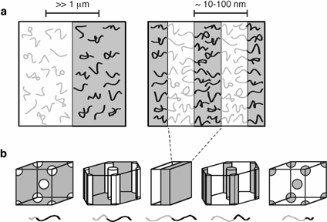
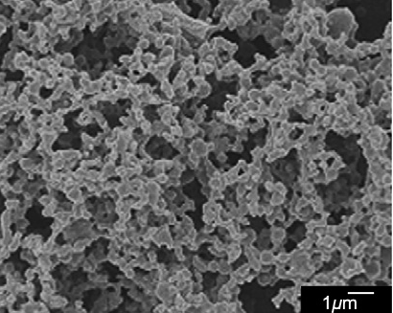
Phase separation of block copolymers
Phase separation of a blend of PMMA and PS homo-polymer
PMMA, PS was dissolved
A mixture of PMMA (M_{w}=93.9 kg/mol) and polystyrene (PS, M_{w}=194.9 kg/mol) (PS/PMMA=70/30, w/w) was dissolved in tetrahydrofuran (THF) to form a 5 wt% solution.
Polymer film was made by spin-cast the solution on glass slide.
Exposure to cyclohexane at 70ºC to dissolve PS.
A blend of two incompatible homo-polymer separates into distinct phases on a large scale (left), whereas block copolymers micro-phase separate into periodic domains (right).
Basic morphologies obtained by different block copolymer compositions.
Ma, “Fabrication of super-hydrophobic film from PMMA with intrinsic water contact angle below 90º”, Polymer, 48, 7455-7460 (2007).

Slide 3
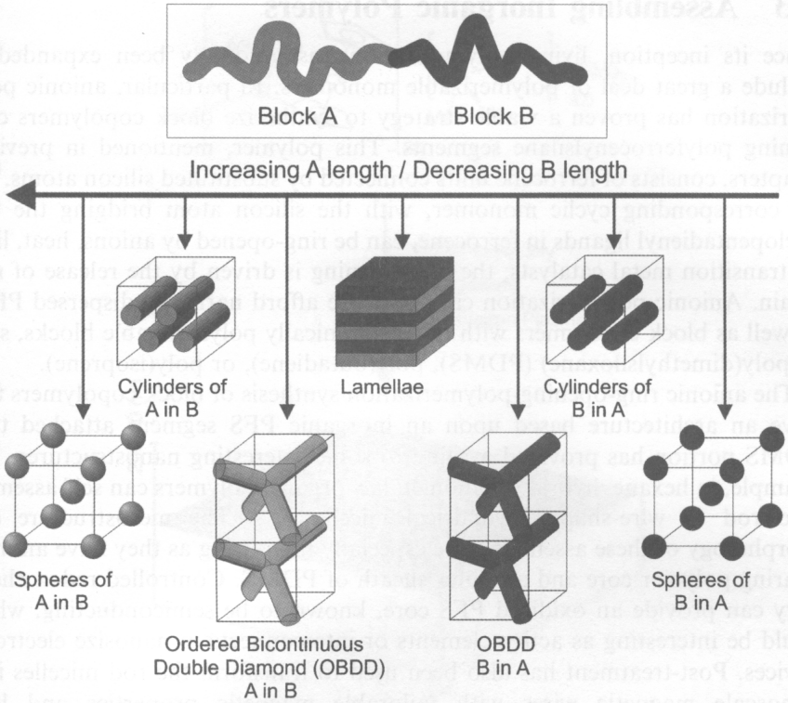
Typical self assembly behavior for linear block copolymers
“Nanochemistry: a chemical approach to nanomaterials” by Ozin

Slide 4
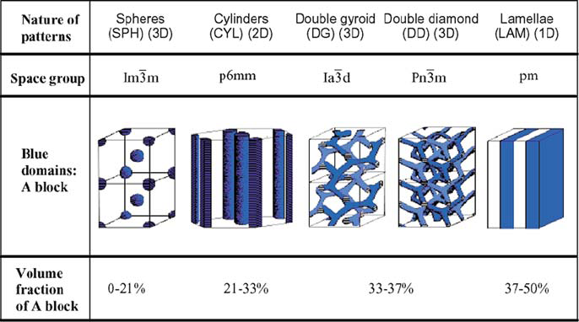
Typical self assembly behavior for linear block copolymers
Block copolymer self-assembly study is started in the bulk phase, as shown above; whereas thin film is desired for nanofabrication and device application.
When film thickness is well controlled, hole/pillar array or line array pattern can be created.

Slide 5
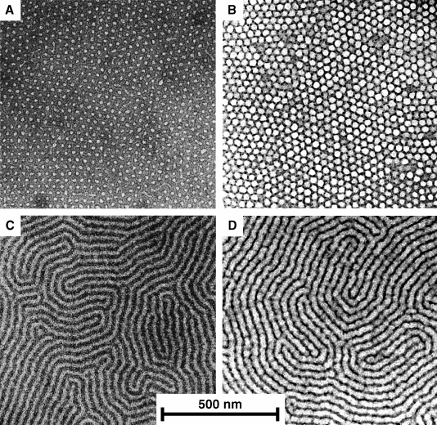
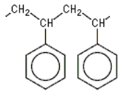
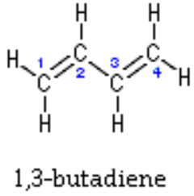
One example: self-assembly of PS-PB di-block copolymer
PS: polystyrene
PB: polybutadiene
Pillar array
Line array
The most attractive feature of block copolymer self assembly is the extremely high resolution, easily get features down to 10nm.
TEM images of PS-PB diblock copolymer film masks (a,c) and lithographically patterned silicon nitride (b,d).
C. Harrison, Science

Slide 6
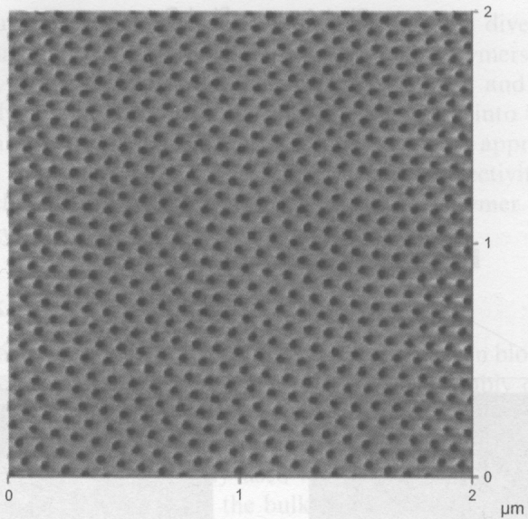
Block copolymer thin films
Film applied by drop casting, dip coating, and spin coating.
Film is then treated to increase the degree of ordering.
Such as annealing above the order-disorder transition temperature for several days.
Or annealing at the presence of solvent vapor (toluene...) to swell the film and make the polymer more mobile.
One way to achieve alignment is through directional solidification strategy
Such as using a temperature gradient – the film is heated to above order-disorder transition and cooled in the presence of such gradient; so that the ordered phase nucleates at the cool end that serves as a template and orient the rest of the film.
Annealing film in the presence of a gradient in solvent vapor has similar effect.
Film ordered by controlled solvent evaporation.
Advanced Material, 16, 226 (2004)

Slide 7
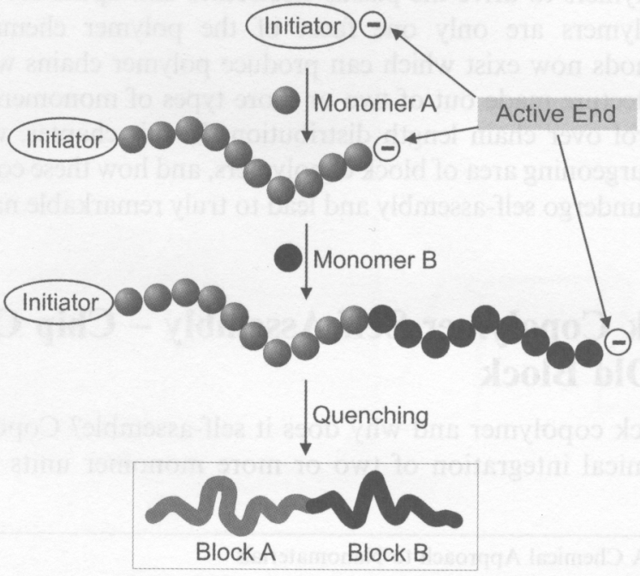
Synthesis: anionic living polymerization

Slide 8
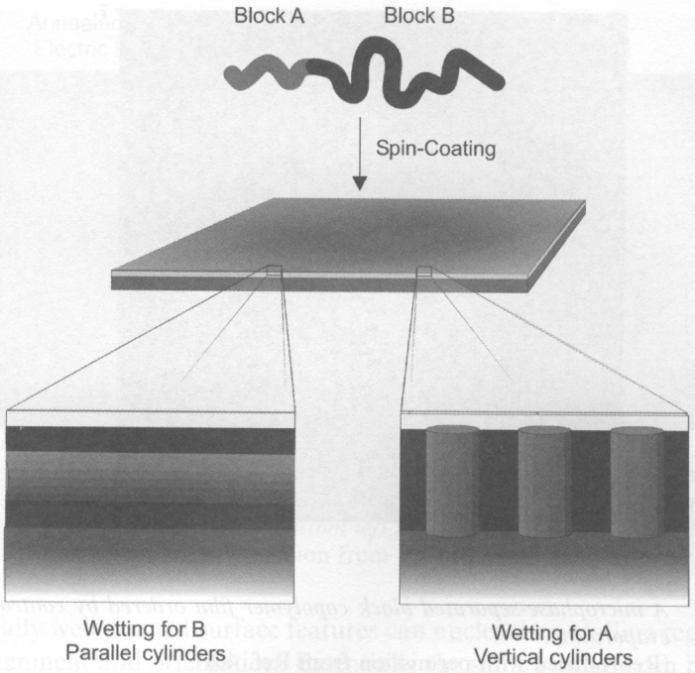
Block copolymer thin films: effect of substrate wetting
Block A is shorter than B
Arranged to minimize surface (interface) energy
B
A
B
A forms cylinders embedded in B
A B A
(left) will result in line array (grating) pattern
(right) will result in hole/pillar array pattern

Slide 9
Lithography using self assembly: block co-polymer self assembly, porous anodized aluminum oxide and nano-sphere lithography
Di-block copolymer self assembly overview.
Guided (directed, aligned) self assembly.
Block copolymer lithography.
Anodized aluminum oxide (AAO) overview.
Nanofabricating using AAO template

Slide 10
Guided block copolymer self assembly for long range ordering and periodicity
Micro-phase separated block copolymer can be directed/aligned by:
Electric field
Shearing force
Surface control of wettability
Chemical pattern on surface
Nano-structured surface
Spatial confinement by surface relief pattern in substrate and mold
Void in a range of porous host

Slide 11
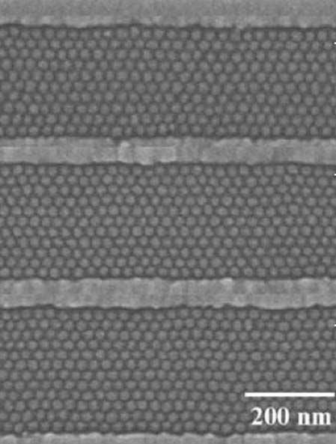
Alignment by pre-patterning the substrate
Spherical domains assembled from PS–PFS (polystyrene-polyferrocenyldimethylsilane) block copolymer inside patterned SiO₂ grooves.
The 1.5 wt.% PS-PFS block copolymer in toluene solution was spin-coated onto the grooved substrate and then annealed at 140ºC for 48h to obtain a monolayer of spherical PFS domains in a PS matrix within the substrate grooves.
Ross, “Templated self-assembly of block copolymers: effect of substrate topography”, Adv. Mater. 15, 1599–1602 (2003).

Slide 12
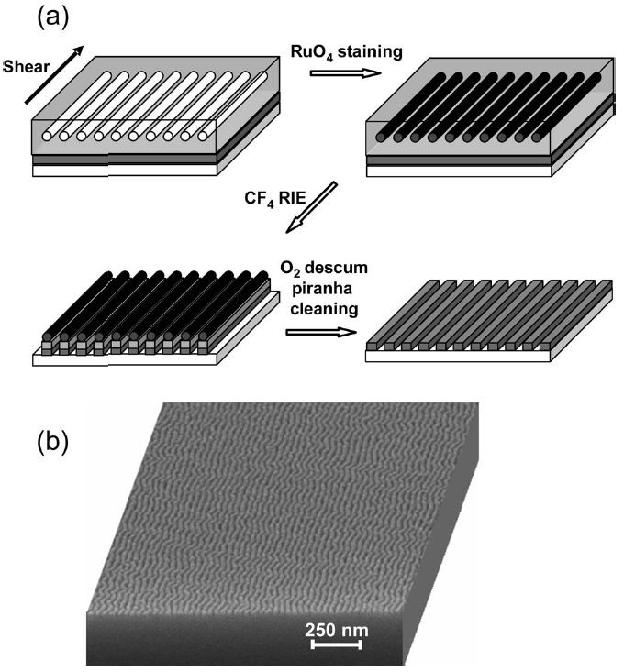
Alignment by shear force
(here for silicon nano-wire fabrication)
Press
Co-polymer on substrate
Pull
One way to create shear force.
Fabrication process for a Si nano-wire grid polarizer using block copolymer lithography.
SEM image of the finished Si nano-wire grid on fused silica.
Here the etch contrast is increased by staining the block copolymer by 2 min exposure to the vapor from 0.5% aqueous RuO₄, which selectively reacts with the PS block and increases its etch resistance, thus permitting Si nanowires of greater aspect ratio to be fabricated.

Slide 13
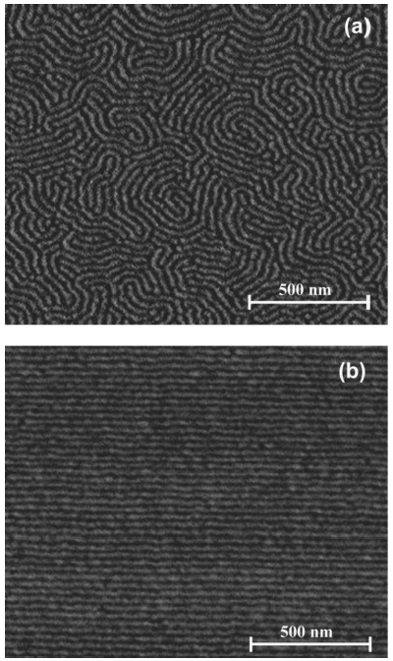
Alignment by shear force (for silicon nano-wire fabrication)
Tapping mode AFM phase images of PS–PHMA thin films on top of an α-Si layer on a fused silica substrate:
Quiescently annealed
Shear aligned.
Glassy (hard) PS cylinders are shown as light in a dark rubbery (soft) PHMA matrix.
Polystyrene-b-poly(n-hexyl methacrylate) (PS–PHMA) diblock copolymer with a molar mass of 21 and 64 kg/mol for the respective blocks.
Pitch=30nm
Chaikin, “Silicon nanowire grid polarizer for very deep ultraviolet fabricated from a shear-aligned diblock copolymer template”, Optics letters, 32(21), 3125-3127 (2007).

Slide 14
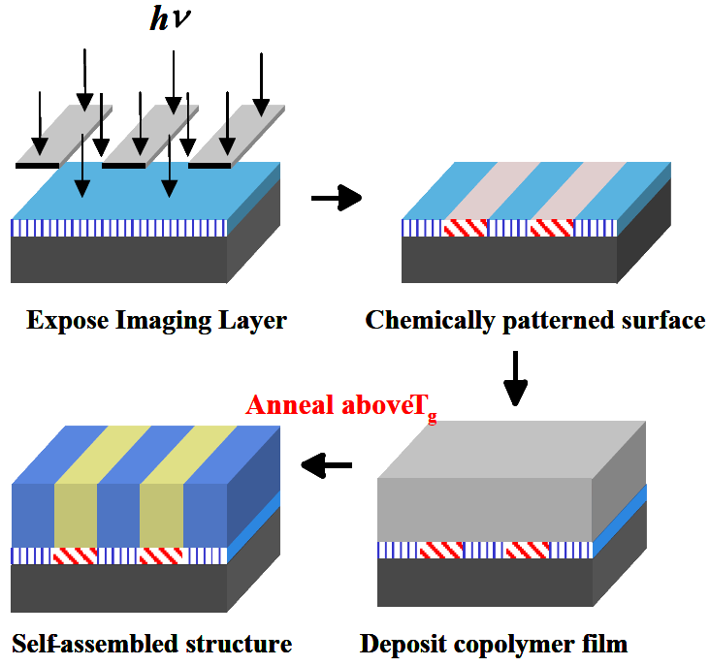
Templated self-assembly of block copolymers
Polystyrene “brushes” by EUV-IL (interference lithography) and surface initiated nitroxide mediated living free radical polymerization
The PS brush pitch should match that of PS-PMMA self assembly pitch.

Slide 15
Polymerization of block-copolymers on
chemically pre-patterned substrates
Polystyrene-block-methyl meth acrylate (PS-b-PMMA), L₀ = 48nm
Thermodynamics dominates interface widths and domain sizes.
When L_{s}=47.5nm≈L_{o}=48nm, block copolymer is almost defect free.
Here chemically patterned grating with polystyrene “brush”
P. F. Nealey, H. H. Solak et al. Nature 424 (2003)

Slide 16
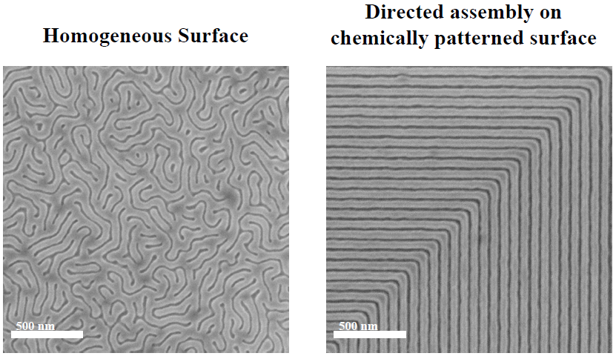
Directed assembly of block copolymer blends into non-regular device oriented structure
Block copolymer materials that naturally form simple periodic structures were directed to assemble into non-regular device oriented patterns (here an elbow) on chemically nano-patterned substrates.
Mark P. Stoykovich, Marcus Müller,Sang Ouk Kim, Harun H. Solak, Paul F. Nealey, Science, 308, 1442-1446 (2005).

Slide 17
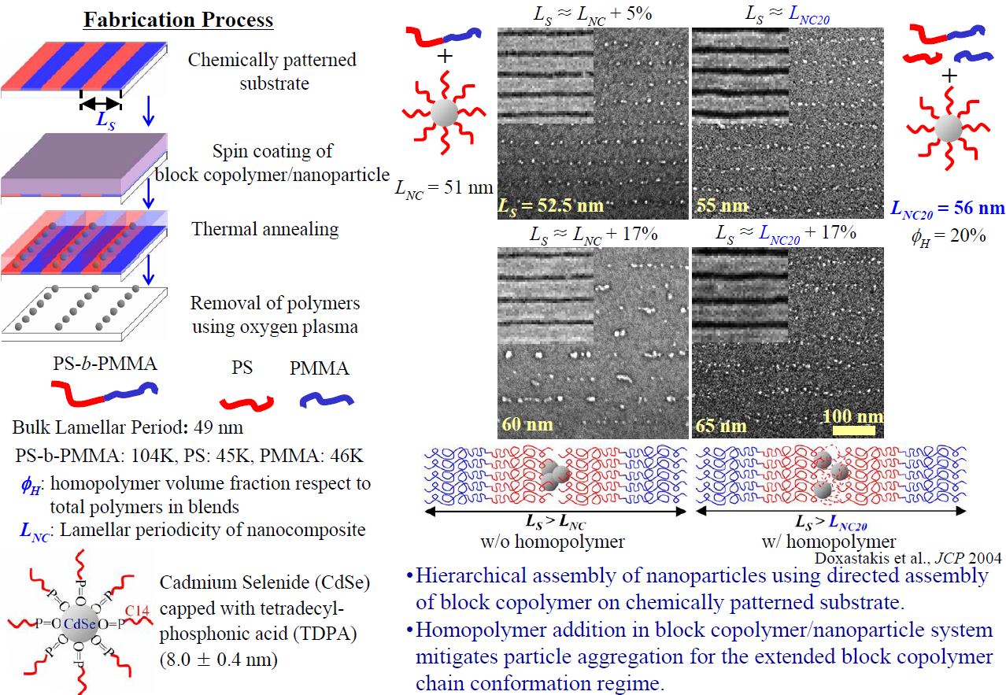
Directed assembly of nanoparticle filled block copolymer

Slide 18
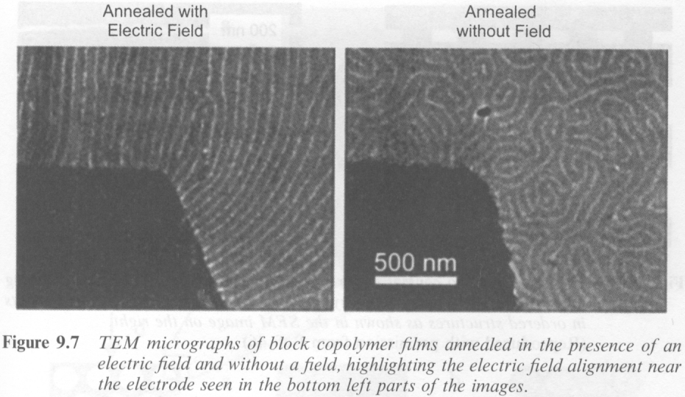
Alignment by electric field
“Local control of microdomain orientation in diblock copolymer thin films with electric fields”, Science, 273, 931 (1996)

Slide 19
Lithography using self assembly: block co-polymer self assembly, porous anodized aluminum oxide and nano-sphere lithography
Di-block copolymer self assembly overview.
Guided (directed, aligned) self assembly.
Block copolymer lithography.
Anodized aluminum oxide (AAO) overview.
Nanofabricating using AAO template

Slide 20
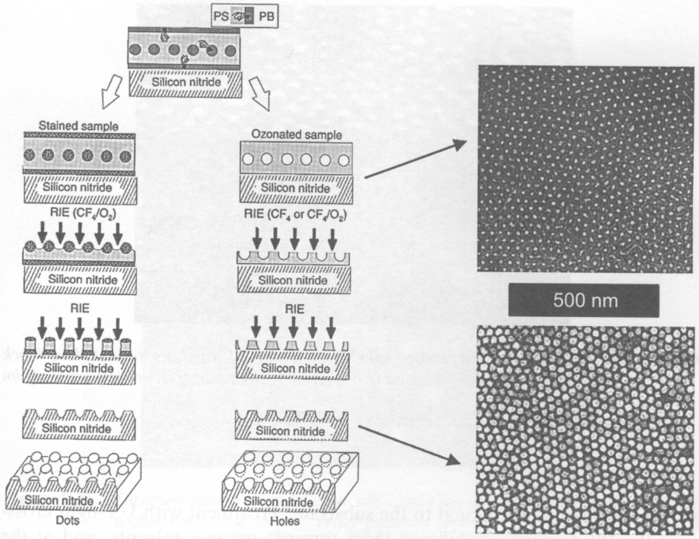
Block copolymer lithography (add pattern transfer)
PS: polystyrene
PB: polybutadiene
Ozone breaks down PB’s C=C double bond.
OsO₄ vapor reacts with PB’s double bond.
Stain with OsO₄
Degrade with ozone
O_{s} is a hard RIE mask

Slide 21
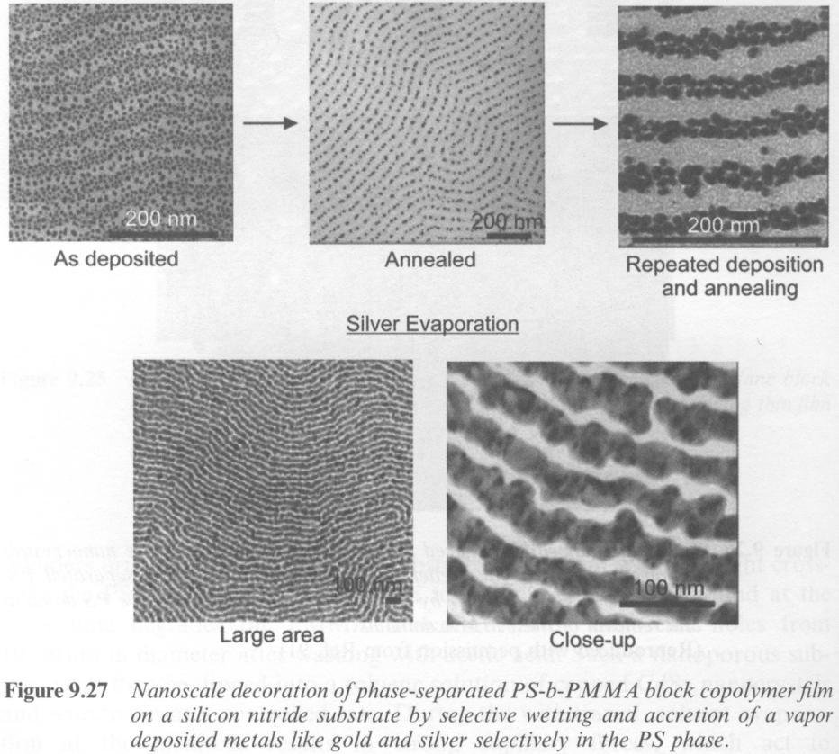
Synthesis of nanowires by wetting
Wettability masks:
Au and Ag go to (“wet”) PS phase
In, Pb, Sn go to PMMA phase
Gold (or Ag) metal vapor-deposited onto a preformed PS-b-PMMA template.
After annealing at 180°C for 1 min., gold nanoparticles segregate selectively to the PS domains and form chains.
Repeated deposition and short-time annealing increases the metal loading, forming continuous conductive nanowires.
Nature, 414, 735 (2001).

Slide 22
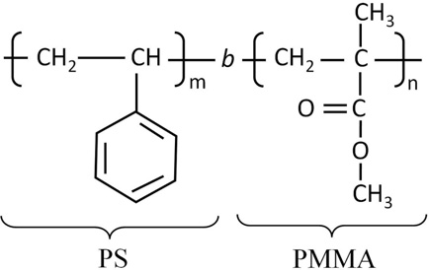
Block copolymer lithography using PMMA-PS
After deep UV-exposure, polymer chain of PMMA is cut (PMMA is a positive deep UV lithography resist), making it more soluble in solvent.
Whereas the polystyrene (PS) chain is cross-linked, making it hard to dissolve by solvent.
Therefore, PMMA can be selectively removed by solvents like acetic acid afterwards.
(PMMA chain can also be broken by UV light at λ=365nm, but need very long time exposure, ∼1 h at 40mW/cm² intensity)

Slide 23
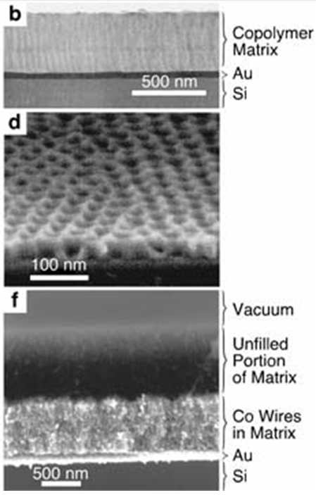
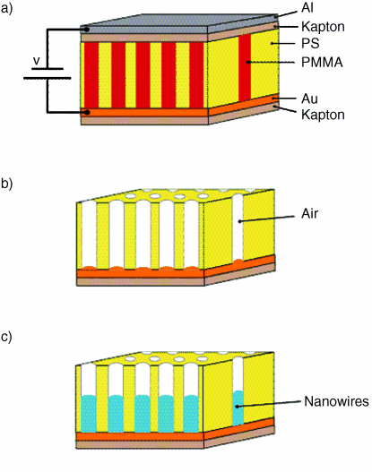
Nanofabrication of vertical nanowires by electroplating
Electric field is for vertical alignment of self-assembly
Aligned by electric field during annealing.
PS 71%, to obtain 14nm PMMA cylinder.
Deep UV simultaneously degrades PMMA and cross-link PS.
Acetic acid dissolve PMMA but not cross-linked PS (polystyrene).
Methanol is added to aqueous plating solution to better wet hydrophobic PS membrane.
Science, 290, 2126 (2000)

Slide 24
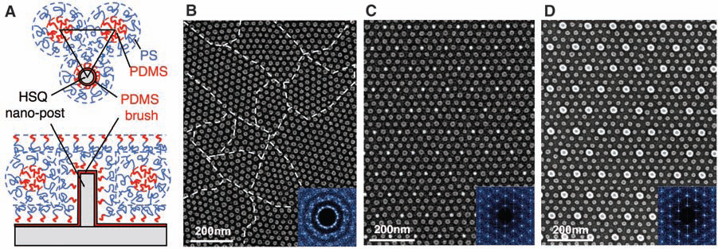
Density multiplication (here by 9×) lithography
Top-down and side-view schematics showing the arrangement of PS-b-PDMS block copolymer molecules in the region surrounding a single post made from cross-linked HSQ resist (by e-beam lithography). The post and substrate surfaces have been chemically functionalized by a monolayer of short-chain PDMS brush.
A poorly ordered monolayer of BCP (block co-polymer) spherical domains formed on a flat surface ( without template guidance). The boundaries between different grain orientations are indicated with dashed lines. The inset is a 2D Fourier transform of the domain positions that shows the absence of long-range order.
C-D. SEM images of ordered BCP spheres formed within a sparse 2D lattice of HSQ
For the moment, this is considered as the most promising route for bit-patterned magnetic recording media fabrication (make the mold for nanoimprint lithography), up to 10Tbits/in² for pitch ∼8nm.
Ross, “Graphoepitaxy of self-assembled block copolymers on two-dimensional periodic patterned templates”, Science, 321, 939-943 (2008).

Slide 25
Lithography using self assembly: block co-polymer self assembly, porous anodized aluminum oxide and nano-sphere lithography
Di-block copolymer self assembly overview.
Guided (directed, aligned) self assembly.
Block copolymer lithography.
Anodized aluminum oxide (AAO) overview.
Nanofabricating using AAO template

Slide 26
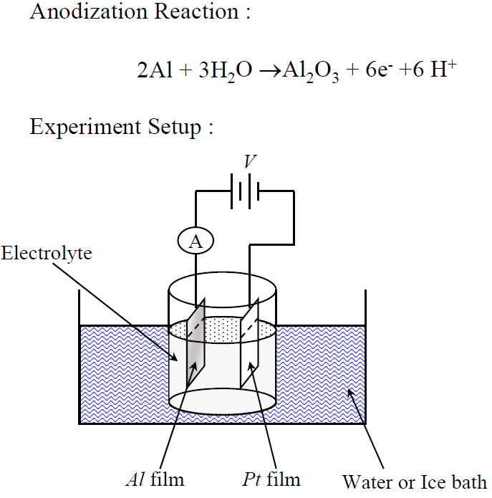
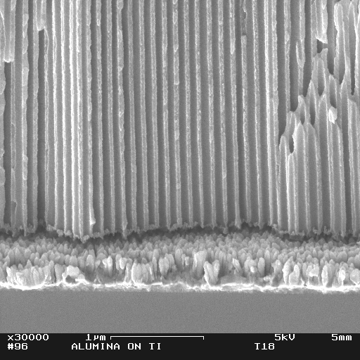
Aluminum anodization setup
Porous anodized aluminum
Al₂O₃
2Al + 3H₂O → Al₂O₃ + 3H₂ [ΔG = -8.65 × 10⁵J]
Anodization:
A direct current is passed through an electrolytic solution where the Al sheet is used as the anode.
Two processes: dissolving and oxidation
Naturally formed triangular pore arrays
Electrolyte:
Oxalic acid, phosphoric acid, sulfuric acid …

Slide 27
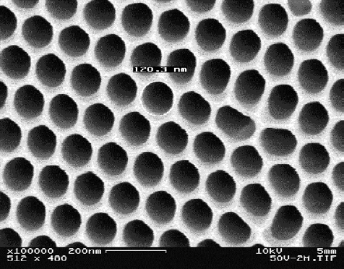
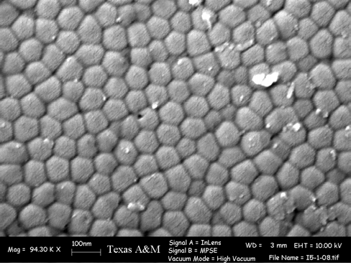
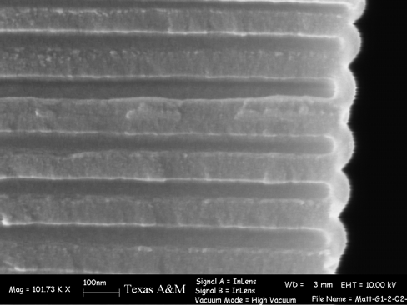
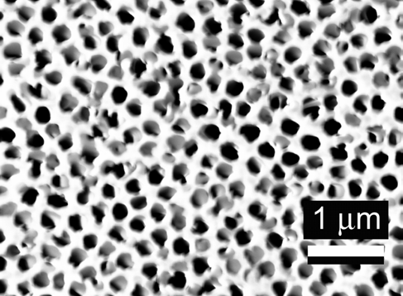
Porous Al₂O₃ membranes
Bottom surface of the AAO showing the barrier layer
Top surface of the AAO
Cross section of the AAO
AAO filter from Whatman Inc.

Slide 28
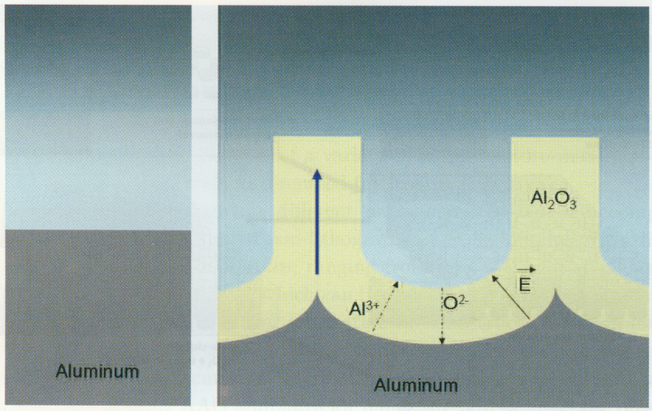
Nano-pore formation mechanism
Two types of electrical current due to 1) oxide growth, 2) its dissolution.
The barrier has to be thin to be “transparent” for anions OH⁻ and O²⁻.
These ions interacts with Al³⁺ ions, which can also move under electric field.
The wall is “pushed” upward by the continuous anodization at the oxide/Al interface.
Other mechanisms have also been reported.

Slide 29
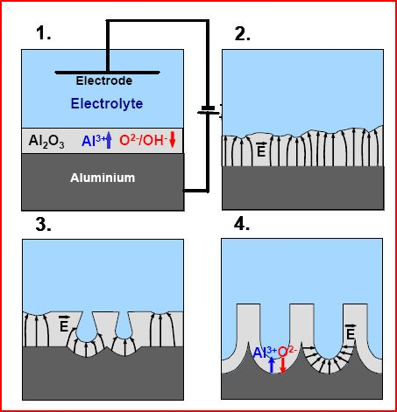
Nano-pore formation mechanism
Schematic diagram of the pore formation at the beginning of the anodization.
Formation of barrier oxide on the entire area.
Local field distributions caused by surface fluctuations.
Creation of pores by field-enhanced or/and temperature-enhanced dissolution. Some pores stop growing due to competition among pores.
Stable pore growth.

Slide 30
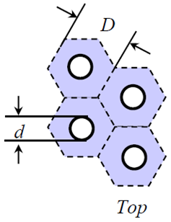
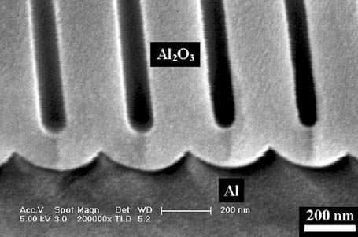
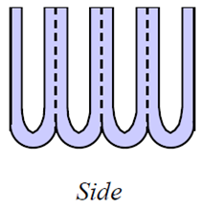
Pore dimensions
Controlling parameters: voltage, electrolyte, temperature and time.
Cell size D ∼ 2.5×V (nm), V is voltage with a unit volt.
Pore size d ∼ V (nm), depends on pH; but pore can be enlarged in acids.

Slide 31
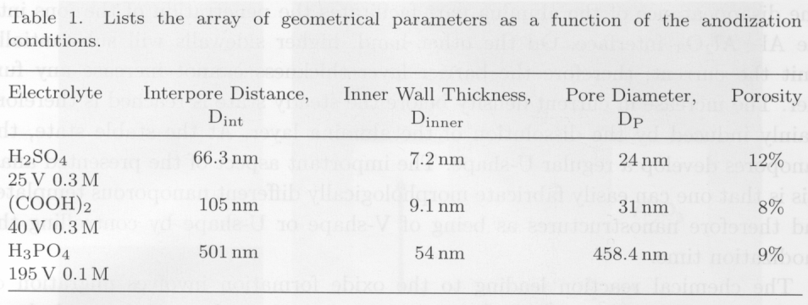
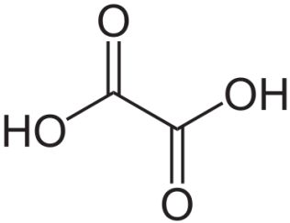
Common acids for AAO
Sulfuric acid generally gives smallest pore diameter and largest pore density.
Standard deviation of pore diameter usually is within 10%.
Oxalic acid

Slide 32
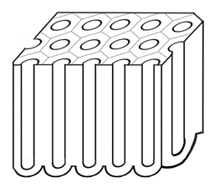
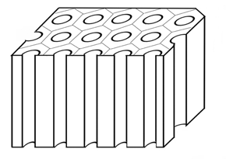
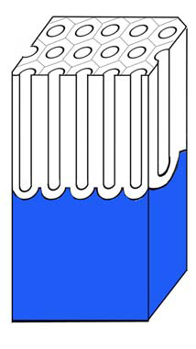
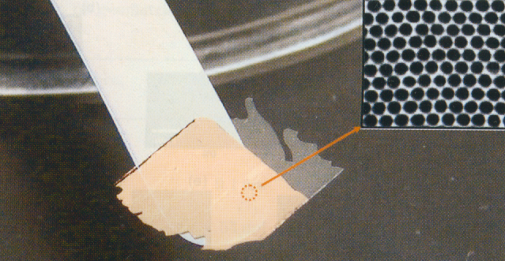
AAO membrane production
Al₂O₃
Al
Wet-etch Al Etch barrier
(using HgCl₂)
Free standing ∼10μm-thick AAO membrane, with Au plated for better viewing contrast.
Commercial membrane: thickness ∼60μm, pore size down to 20nm (one side only!)
Application: filter, as template for nano-wire production.

Slide 33
Chemistry involved in nanofabrication using AAO
Removing Al without attacking AAO: saturated HgCl2
Al + HgCl₂-----Al³⁺ + Hg, room temperature
Removing AAO without attacking Al: It is not easy for Al to dissolve in H2CrO4 aqueous.
6%H₃PO₄ + 1.8%H₂CrO₄, 60ºC, 2h
Removing the barrier layer at the bottom without attacking too much the AAO pores.
5%H₃PO₄, 30ºC, 30min

Slide 34
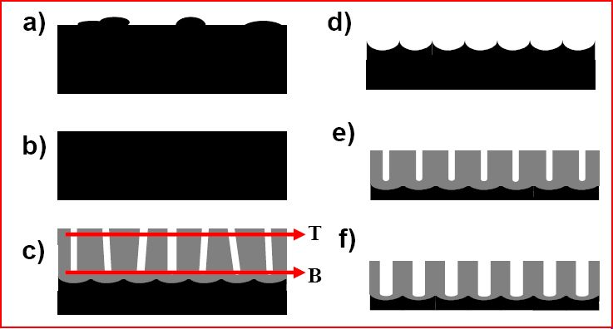
Two-step anodization process to improve periodicity
Stages of the formation of self-ordered alumina: a) Annealing at 500ºC for 3h to increase grain size; b) electro-polishing in a solution of 1/4 HClO₄ + 3/4 C₂H₅OH for 4 min at 8V with agitation; c) first anodization; d) selective dissolution of the formed oxide layer; e) second anodization under the same conditions as the first anodization; and f) if needed, isotropic etching in 1M phosphoric acid at 30ºC to widen the pores.

Slide 35
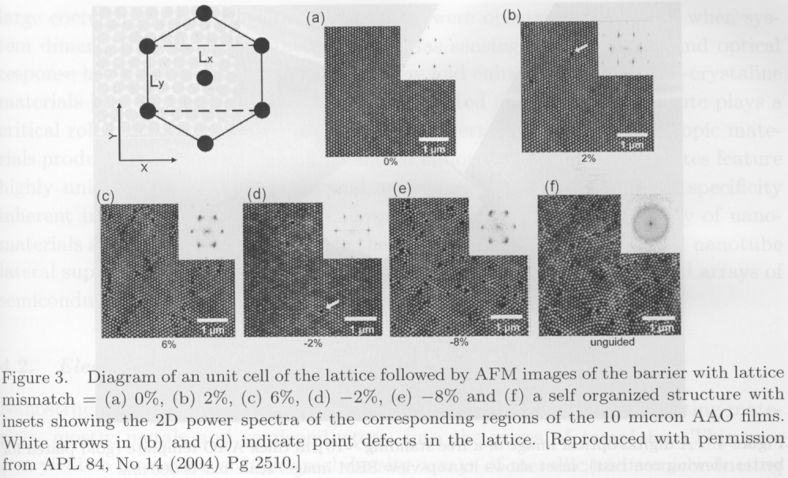
Pre-pattern Al surface can also improves periodicity
Al is pre-patterned by FIB
“Order–disorder transition of anodic alumina nanochannel arrays grown
under the guidance of focused-ion-beam patterning”, page 2509-2511.

Slide 36
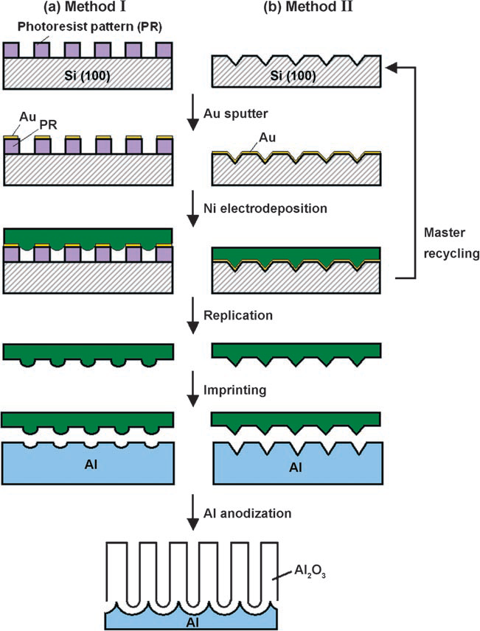
Pre-pattern Al surface using imprint with a Ni mold
Imprint pressure order 1000atm!!
(regular imprint into resist 20atm)
Schematic diagram of the fabrication of ideally ordered anodic alumina using Ni imprint stamps that can be replicated from:
a resist pattern (method I).
a silicon pattern (method II).
Woo Lee, Ran Ji, Caroline A. Ross, Ulrich Gçsele, and Kornelius Nielsch, “Wafer-Scale Ni Imprint Stamps for Porous Alumina Membranes Based on Interference Lithography”, Small, 2006.

Slide 37
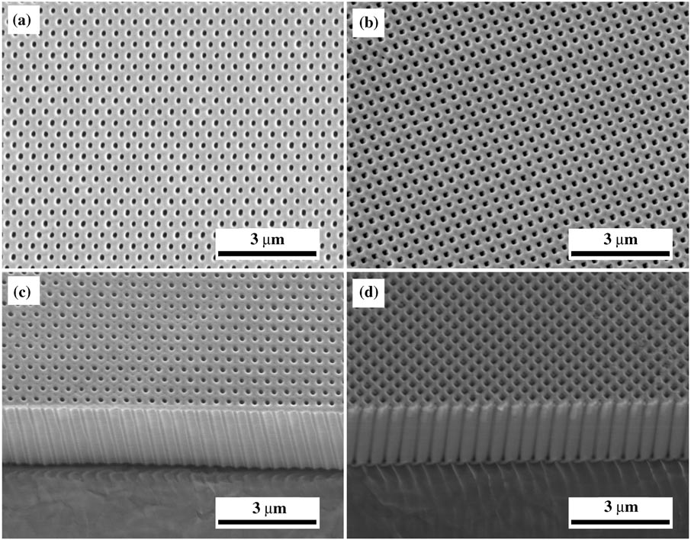
Ideally ordered AAO by imprint pre-pattering Al
SEM images of long-range-ordered anodic alumina with a) hexagonal and b) square arrangements
of nano-pores. c,d) Oblique views of the cross sections.
AAO
No other way can get such a high aspect ratio periodic pattern.
From same group, “Fast fabrication of long-range ordered porous alumina membranes by hard anodization”, Nature Materials, 2006.

Slide 38
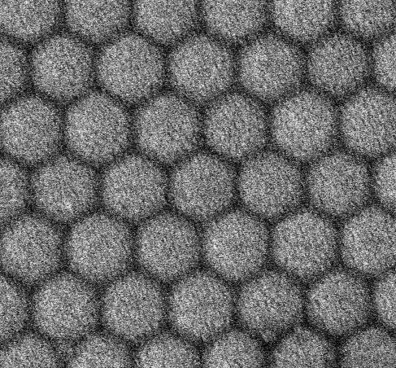
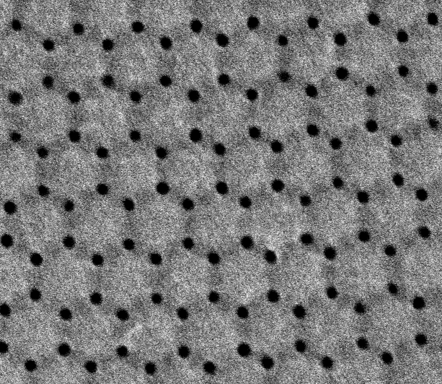
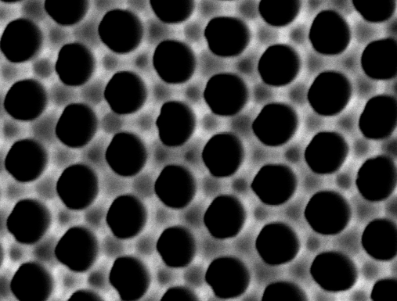
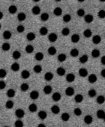
Novel structure of AAO film
Anodization using 0.8 M H₂SO₄ + 0.1 M Al₂(SO₄)₃ solution. Addition of Al₂(SO₄)₃ allows higher current density/voltage, which leads to this new structure. A discovery by “accident”.
a
b
HCl/CuCl₂ 40min
Open in H₃PO₄
HCl/CuCl₂ 60min
d
c
SEM of AAO with novel structure. (a) View of bottom, just removing the Al substrate in a mixed solution of HCl/CuCl₂ (immersing for 20min); (b) extending the immersing time till 40 min, small pores appear; (c) extending the immersing time till 60 min; (d) after immersing in 5% H₃PO₄, the normal nano-pores are opened, surrounded by six small pores. The scale bar is 100nm.
Shiyong Zhao, Arthur Yelon and Teodor Veres. “Novel structure of AAO film fabricated by constant current anodization” Adv. Mater. 19(19), 3004, 2007.

Slide 39
Lithography using self assembly: block co-polymer self assembly, porous anodized aluminum oxide and nano-sphere lithography
Di-block copolymer self assembly overview.
Guided (directed, aligned) self assembly.
Block copolymer lithography.
Anodized aluminum oxide (AAO) overview.
Nanofabricating using AAO template.

Slide 40
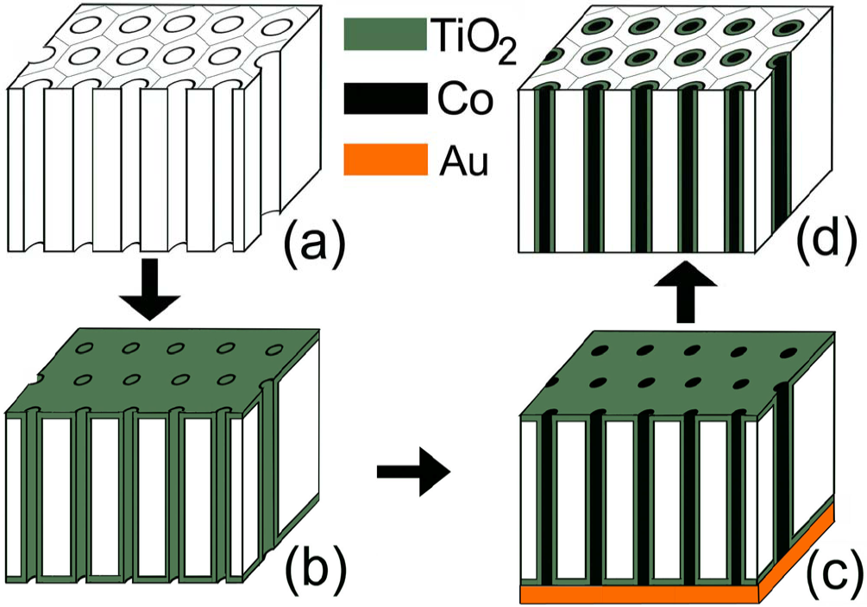
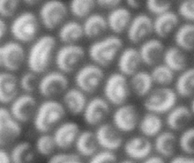
Shrink pore diameter by isotropic coating onto AAO
The pore spacing and the pore diameter are coupled to each other and determined by the applied voltage of anodization.
Pores are easy to enlarge using subsequent wet etching after anodization.
It is more challenging to shrink the pore size.
Co nanowires in TiO₂ nanotubes
Au electrode
TiO₂ is coated by isotropic sol–gel deposition technique
Z. Ye, H. Liu, I. Schultz, W. Wu, D. G Naugleand I. Lyuksyutov, Nanotechnology 19, 325303 (2008).

Slide 41
Deposition of TiO₂ nanotubes using Sol-Gel method
Bare AAO TiO₂ nanotubes after dissolving AAO
AAO coated with TiO₂ Cross section of TiO₂ nanotubes
Recipe: TiF₄+ H₂O → TiO₂+ HF at 60ºC and pH = 2

Slide 42
Electroplating of nanowires
Aspect ratio: 50μm/60nm ∼800
This extremely high aspect ratio is hard to achieve by lithography plus etching

Slide 43
Other nanofabrication routes using AAO
VLS: vapor-liquid-solid method for nano-wire growth, see
http://en.wikipedia.org/wiki/Vapor-liquid-solid_method

Slide 44
Patterning GaN using AAO
Nano-pore array in GaN by RIE using AAO as mask
Nano-pillar array in GaN by metal liftoff using AAO, followed by GaN RIE.

Slide 45
Grow carbon nanotube into AAO pores

Slide 46
Nanotubular super-capacitor for energy storage
MIM: metal-insulator-metal
here TiN (“metal”), Al₂O₃ and TiN, all deposited by atomic layer deposition (ALD).
Due to the enormous interface area, the capacitance is huge (C ∝ area), with peak (discharge) power up to 10⁶ W/kg.
Energy stored = ½ CV² ∝ C.
“Nanotubular metal–insulator–metal capacitor arrays for energy storage”, Nature Nanotechnology, 2009.

Slide 47
AAO on wafers
Al foils are interesting but limited. It is not microfabrication compatible.
Al films on wafers are. AAO on flat surface may be used for data storage with high density.
Only 300nm Al

Slide 48
Magneto-optics of Ni nanowires
Pitch ∼70nm
Challenges for AAO using thin Al film:
The deposited Al is usually not as pure as Al sheet due to oxidization or (cross-) contamination during film deposition. (Al atom is so reactive)
Al film is usually too thin for two-step anodization, thus poor periodicity.
Electrochemical polish would also be extremely difficult to control for thin films.
Nanotechnology 17 5764 (2006)

Slide 49
Thicker alumina templates on silicon wafers
Al is thicker here, for polishing
M. Dresselhaus, MIT

Slide 50
Nano-wire by alumina template
(results using the steps in previous slide)
Pore oblique view Cross-section (φ∼100nm) Filled with nano-wire
Here Al film is >2μm. Some pores are not filled by metal

