Slide 1
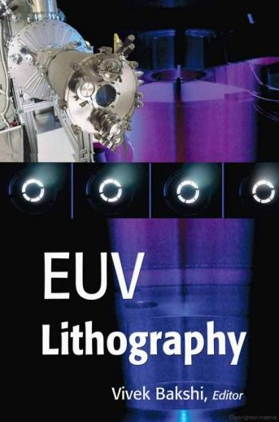
Slide #17 (Why need…) and #24 (Bragg reflectors) are inserted later on.
Extreme UV (EUV) lithography
Overview, why EUV lithography?
EUV source (hot and dense plasma).
Optics (reflection mirrors).
Mask (absorber on mirrors).
Resist (sensitivity, LER, out-gassing).
Contamination control.
Textbook page 16-20. You can read the book by Vivek if you want to learn more.
http://books.google.ca/books?id=91XeKLC9MUEC&pg=PA393&lpg=PA393&dq=Elemental+absorption+at+13.5nm&source=bl&ots=u2vsBa2dgr&sig=a1JKcj0vE6Gx7X-_6m_zUR9CT5k&hl=en&ei=QZsQSpTVKZS8M5aT2FI&sa=X&oi=book_result&ct=result&resnum=1#PPR7,M1
Use Firefox to open the file, since somehow IE doesn’t work properly
ECE 730: Fabrication in the nanoscale: principles, technology and applications
Instructor: Bo Cui, ECE, University of Waterloo; http://ece.uwaterloo.ca/~bcui/
Textbook: Nanofabrication: principles, capabilities and limits, by Zheng Cui

Slide 2
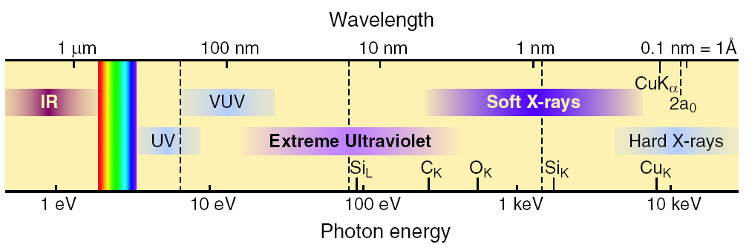
Electromagnetic spectrum
Visible is 400 - 700nm (1.7 to 3eV)
UV down to about 170 nm (∼7eV)
VUV- Vacuum UV (starts where N₂ is absorbing) then there is FUV (far UV) & EUV
EUV/soft x-ray, 2-50nm
  47nm is the λ for the Ne-like-Ar X-ray Laser (capillary discharge laser).
But for EUV lithography, it is at ∼13.5nm (92eV).

Slide 3
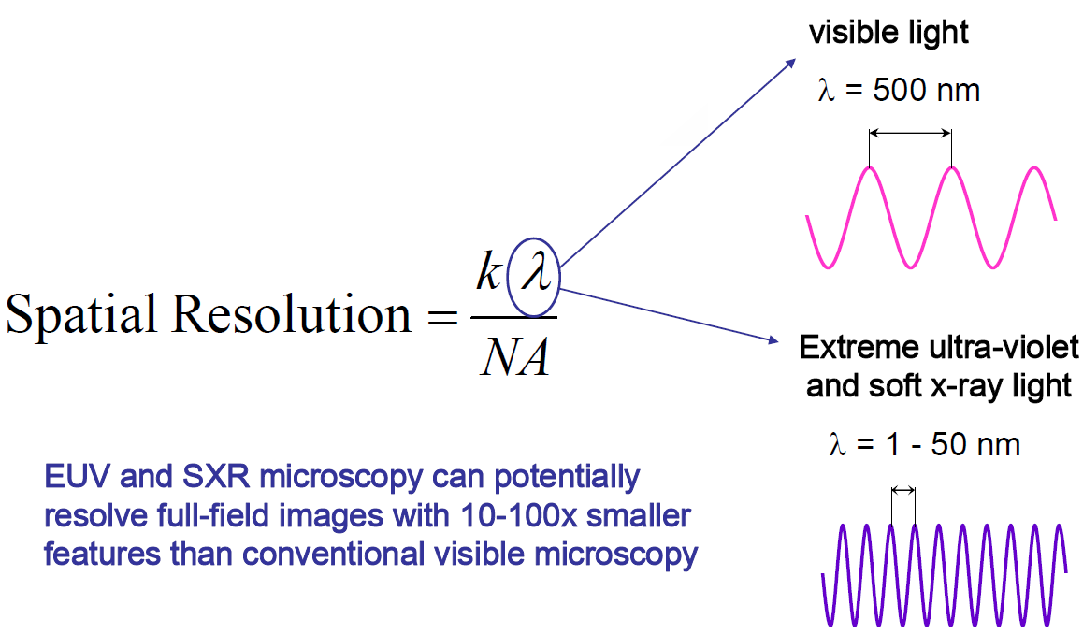
Why EUV lithography?
Shorter λ gives higher resolution.
No need of resolution enhancement techniques.
Relax the requirement for NA.
For EUV lithography, λ=13.5nm where efficient “lens” (reflected mirror) exists.

Slide 4
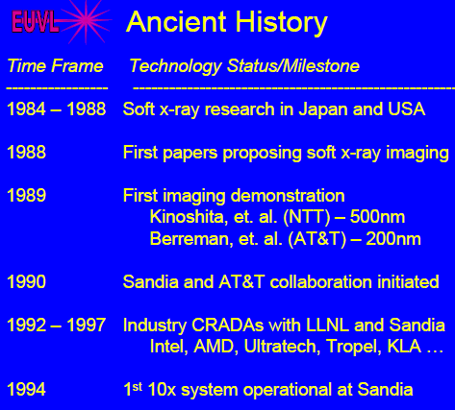
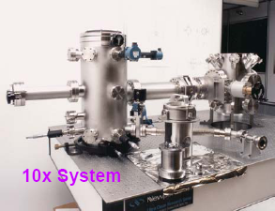
Some history of EUVL (not long)
10× reduction, namely feature size in mask is 10× that of in resist
In 1994, EUVL is not considered as a feasible lithography; instead x-ray lithography and e-beam lithography are believed to be the successors to optical lithography.
Today, EUVL is regarded as one of the two most promising next generation lithography.

Slide 5
Transitions to EUV is a big jump
Big jump from 193 to ∼13 nm. Before this has about ¼ increase in energy. Now >10x
There are only so many “tricks” to increase this gap, and they are very expensive … we must go to a shorter wavelength!
Mask Maker’s Holiday: “large” k₁
Mask Maker’s Burden: “small” k₁
In 2004, it is predicted that EUVL will become mass production tool in 2009. Today it is believed that DUV lithography (λ=193nm) with immersion (maybe with a little double processing) will be used for 32nm generation production, thus delaying the need for EUV.

Slide 6
Transitions in optical lithographic technologies

Slide 7
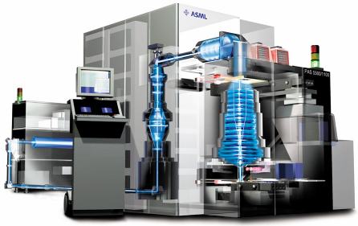
Why not the next excimer line?
Current 193nm DUV lithography
Lenses are very effective and perfectly transparent for 193nm and above, so many are used: a single “lens” may be up to 60 fused silica surfaces.
System maintained at atmospheric pressure.
Exposure field 26x32mm².
Steppers capable of exposing 109 steps per 300mm wafer, and produce >100 wafers per hour. Exposure times ∼10-20ns (one pulse of excimer laser).
Reticle
(Mask)
Wafer
193 nm Excimer Laser Source
Exposure Column
(Lens)
Computer Console
www.tnlc.ncsu.edu/information/ceremony/lithography.ppt

Slide 8
Current 193nm deep UV (DUV) lithography: mask material
Photo-masks today are made from fused silica.
Fused silica has a number of advantageous properties.
    Chemical stability.
    Transparency for ultraviolet light.
    No intrinsic birefringence (i.e. refractive index is polarization independent).
    A low coefficient of thermal expansion.
A low coefficient of thermal expansion: 0.5ppm/ºC.
      If a mask changes temperature by 0.1ºC, then the distance between two features separated by 50mm will change by 2.5 nm.
      This change in registration can be absorbed into overlay budgets, after reduction by 4× (i.e. pattern on resist misaligns by 2.5/4=0.6nm, OK).

Slide 9
Why not the next excimer line (157nm)?
Why not a stop at 157nm?
Fused silica and atmospheric oxygen become absorptive by 157nm, so even incremental decreases in wavelength (by only 36nm) start to require a major system modification: vacuum exposure, use CaF₂ as lens material (resist materials also different).
CaF₂ has a crystalline structure (not “glassy/amorphous” like fused silica), with significant birefringence (i.e. light propagation through the lens depends on the polarization relative to crystalline orientation).
The coefficient of thermal expansion of CaF₂ is 19ppm/ºC, versus 0.5ppm/ºC for fused silica.
The 2.5nm of mask registration error for fused silica now becomes nearly 100nm (25nm after ¼ reduction, still too high).
Below 157nm, no excimer laser line has the required output power.
The development of EUV lithography further makes 157nm lithography unnecessary.

Slide 10
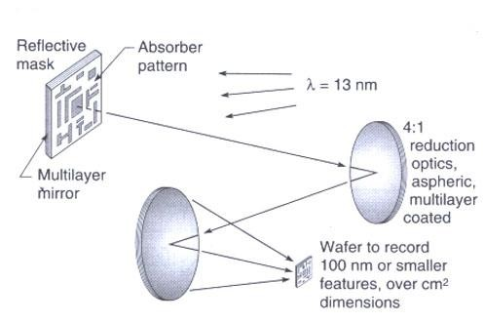
EUV lithography (EUVL) characteristics
EUV radiation is strongly absorbed in virtually all materials, even gases, so EUV imaging must be carried out in a near vacuum.
There is no refractive lenses usable - EUVL imaging systems are entirely reflective.
But EUV reflectivity of individual materials at near-normal incidence is very low, so “distributed Bragg reflectors” are used.
The best of these reflectors functions in the region between 11 and 14nm (Si/Mo material)

Slide 11
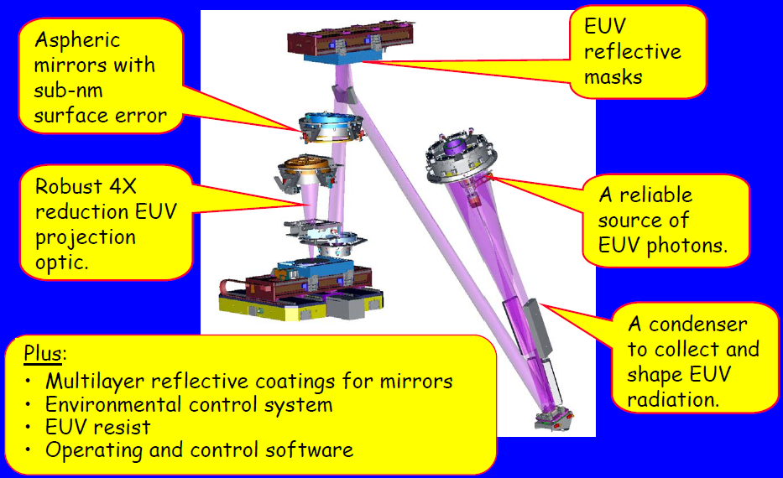
Schematic of EUV lithography system
EUVL alpha-tool

Slide 12
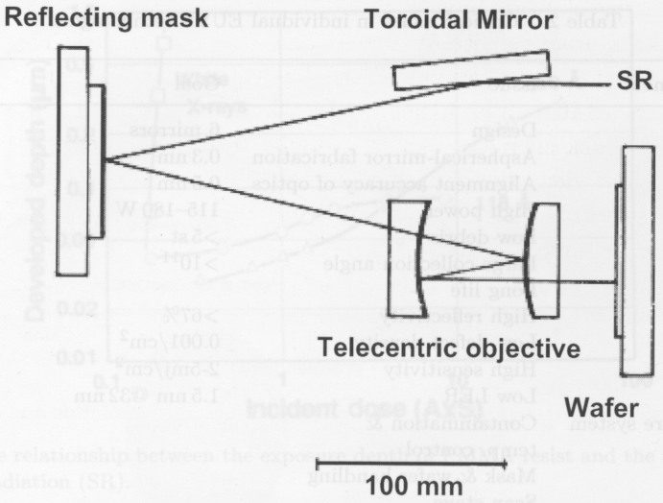
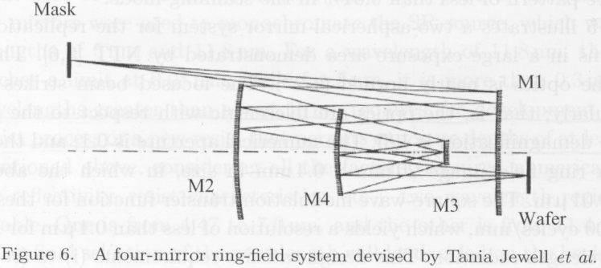
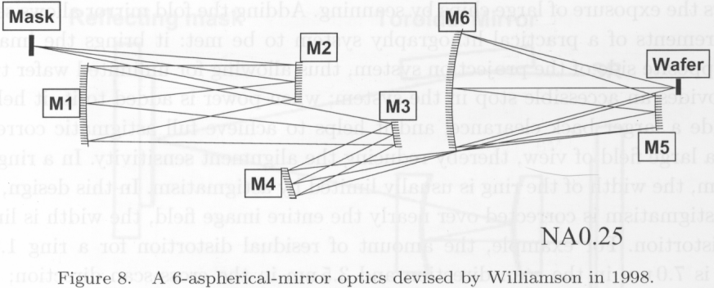
A few optical designs (using reflective lens/mask)
Synchrotron radiation
An early simple two-mirror system
A four-mirror system, holes in M4 to let light pass through.
A six-mirror system having NA 0.25

Slide 14
Extreme UV (EUV) lithography
Overview, why EUV lithography?
EUV source (hot and dense plasma).
Optics (reflection mirrors).
Mask (absorber on mirrors).
Resist (sensitivity, LER, out-gassing).
Contamination control.

Slide 15
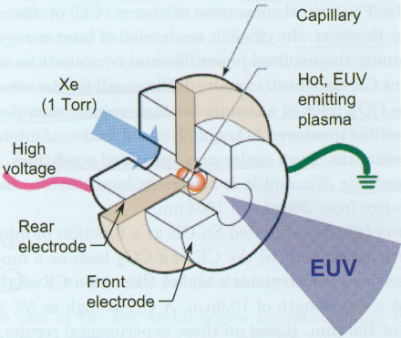
EUV @13.5nm plasma radiation source
Light sources must match the wavelengths at which Mo/Si multi-layers have high reflectivity.
The only viable source for 13.5nm photons is a hot and dense plasma
(synchrotron radiation also creates EUV, but very expensive and huge size.)
  Powerful plasma: temperature of up to 200,000ºC, atoms ionized up to +20 state.
  Emit photons by (e - ion) recombination and de-excitation of the ions.
  Plasma must be pulsed: pulse length in pico- to nanosecond range
  Plasma is produced by powerful pulsed laser or electric arc (discharge) of up to 60000A peak current.
Laser Produced Plasma (LPP)
Discharge Produced Plasma (DPP)
Plasma
(consists of ionized vapor of the target material)
target
(or Sn vapor)
laser pulse (ns)
laser
∼100μm

Slide 16
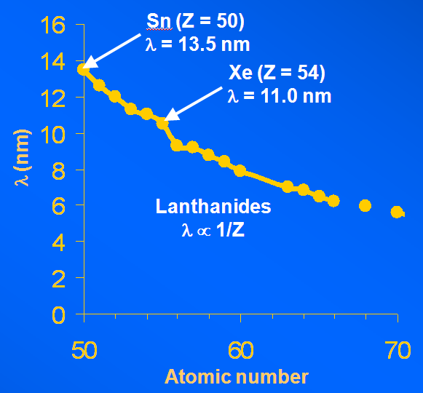
Plasma radiation source for 13.5nm: Sn
Plasma: ionized gas, similar to the plasma used for reactive ion etching (RIE). But in regular RIE, only <10% gas molecules are ionized; here all ions are ionized, and to a high ionization state (up to Sn²⁰⁺).
Since the mass of electron is << that of ion, electrons transfer little of its energy to ions upon collision. As a result, electrons and ions are not in thermal equilibrium in a plasma, with electrons much “hotter” than ions.
Emission peak wavelength (nm)
versus atomic number
Laser produced Sn plasma
Target, Z=50 [Kr]5s²4d¹⁰5p² Sn
Laser wavelength, λ 1.064μm
Laser flux, φ 1 x 10¹¹ W/cm²
Electron temperature, T_{e} 48.8eV
Electron density, n_{e} 9.88 x 10²⁰ cm⁻³
(300K is 26meV, 1eV is 1.15×10⁴K)
Ion distribution
Sn X 0.046 (Sn¹⁰⁺) (4.6%)
Sn XI 0.243
Sn XII 0.306
Sn XIII 0.330
Sn XIV 0.068

Slide 17
Why need ionization state >10 to produce EUV?
Energy level E=-13.56 Z²/n² (eV). For this “free” electron, it “sees” Z=50-38=12 positive charges. So when it jumps to the n=4 level, it should emit a photon with energy 13.56×12²/4²=122eV, which is the same order as 92eV for 13.5nm wavelength.
Sn atom
e
Sn¹²⁺
n=5 (4 electrons)
n=4 (18)
n=3 (18)
n=2 (8)
n=1 (2)
n=4 (10 electrons)
n=3 (18)
n=2 (8)
n=1 (2)
+50
+50

Slide 18
Extreme UV (EUV) lithography
Overview, why EUV lithography?
EUV source (hot and dense plasma).
Optics (reflection mirrors).
Mask (absorber on mirrors).
Resist (sensitivity, LER, out-gassing).
Contamination control.

Slide 19
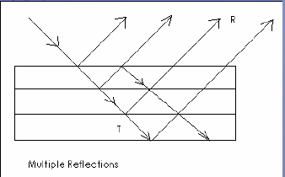
Optics for EUV lithography (EUVL): overview
All solids, liquids, and gasses absorb 13.5nm photons, so no longer refracting/ transparent lens. (A beam of EUV light is absorbed in 100nm - thick of H₂O)
EUVL uses mirrors coated with multiple layers of molybdenum and silicon that can reflect 70% light.
The other 30 percent is absorbed by the mirror.
Without the coating, light would be almost totally absorbed by the mirror (almost no reflection).
If the thicknesses and compositions of all films are carefully controlled, the reflected light will constructively interfere, resulting in the brightest possible reflection.
Multiple reflections

Slide 20
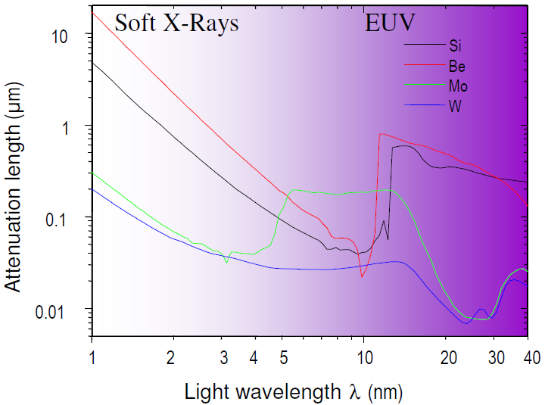
Why Si/Mo and 13.5nm?
Absorption in solids for EUV and soft x-rays
For high reflection, the absorption should be low (i.e. attenuation length should be large). So Mo, Si, Be are good candidates at ∼10-15nm.
I=I₀e^{-αt}=I₀e^{-t/μ}
t: depth into the material
α: absorption coefficient
μ: attenuation length
Mo/Si ∼40 layer pairs give ∼70% reflectance where Mo and Si are most transparent.
Mo/Be is higher (at λ=11nm) but narrower Δλ; and more importantly, Be is toxic.

Slide 21
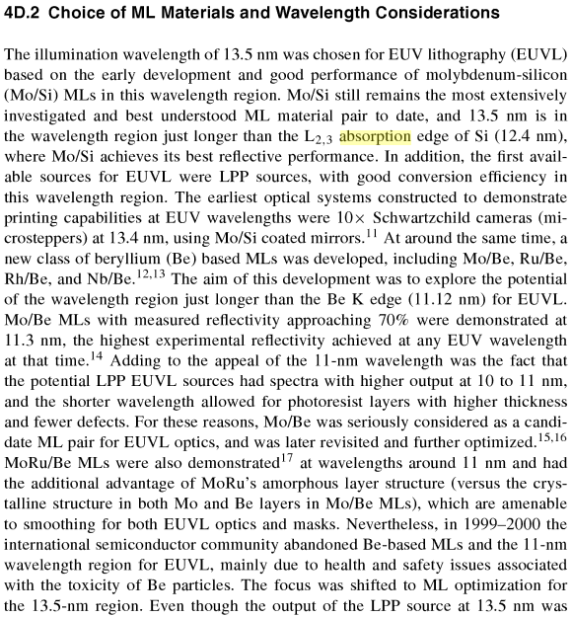
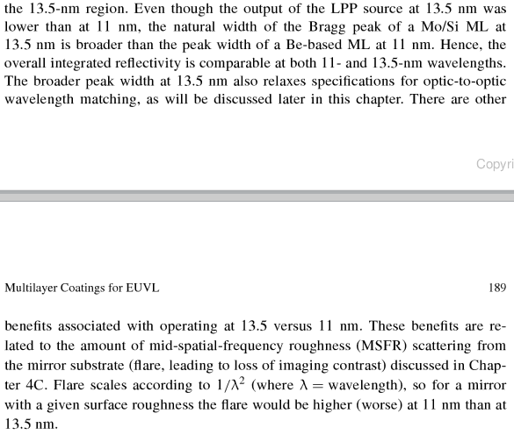
Why Si/Mo and 13.5nm?

Slide 22
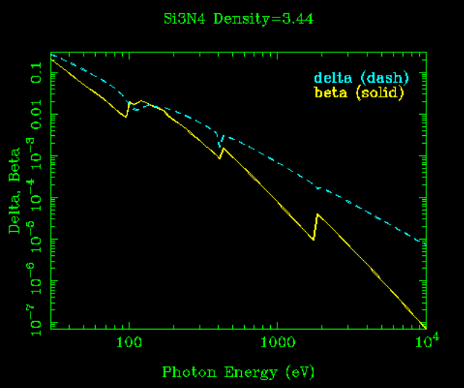
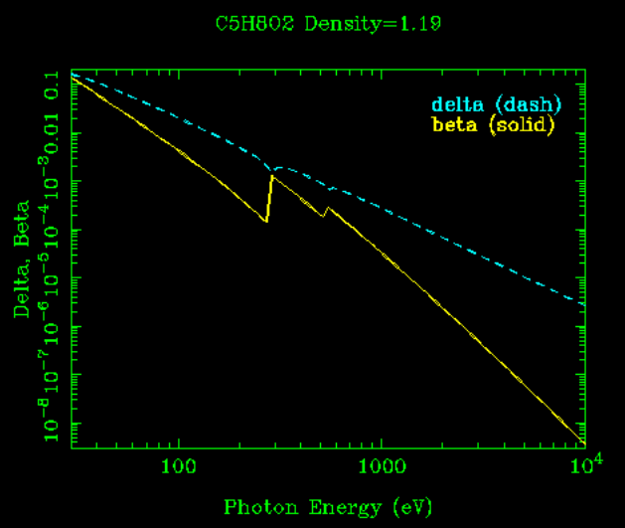
Refractive index at EUV
n=1-δ-iβ (δ, β<<1), n is close to 1, so low reflection
Si₃N₄
PMMA
Refractive index is very closer to 1.0 for shorter wavelength (higher photon energy). So no “optics” for x-ray (>>100eV).
For λ=13.5nm, photon energy = 92eV, so δ, β is not negligible (>0.01), making reflective optics possible.
Amplitude reflection r=(n₁-n₂) /(n₁+n₂) for normal incidence at each interface.
r has order of 0.01/2, or order 1% at each reflection. Need many interfaces to achieve high total reflection. E.g., 50 layers will give order 50% reflection.
http://www-cxro.lbl.gov/, lots of information there

Slide 23
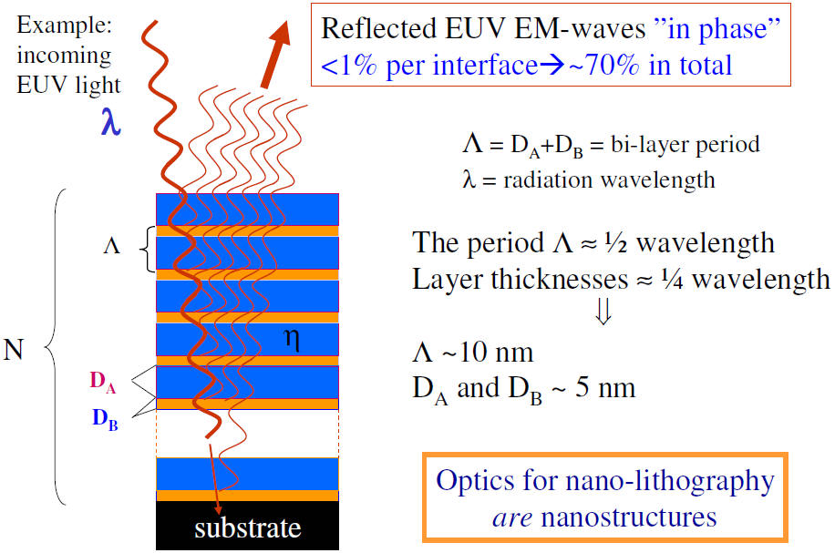
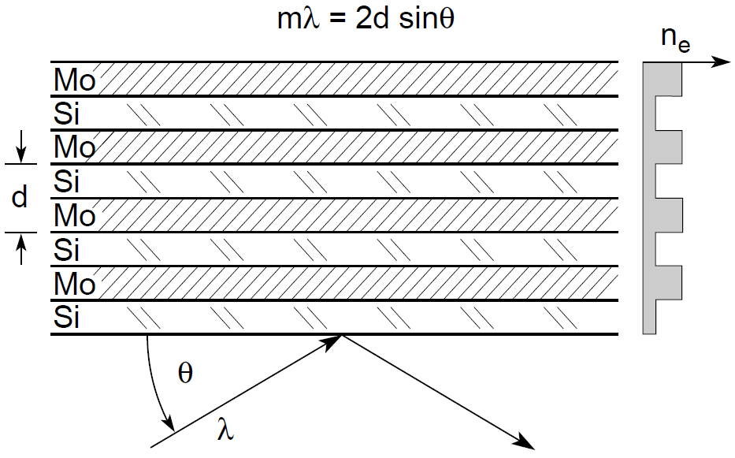
Multilayer EUV mirrors – Bragg reflectors
(for normal incidence)
m=1, 2…
(refractive index)
Amplitude reflection r=(n₁-n₂) /(n₁+n₂) for normal incidence at each interface.
For normal incidence, if D_{A} ∼ D_{B}, then each layer ∼λ/4=/3.4nm for λ=13.5nm.
Since the angle of incidence changes across the mirror, so do the required Mo/Si layer thicknesses.
Acceptable surface roughness: 0.2nm RMS, corresponding to a phase shift error of 10º.

Slide 24
Bragg reflectors
Assume one layer is much thinner, and refractive index of the thicker layer is n≈1.
For maximum reflection, the “sub-beam” must be all “in phase”, namely the optical path difference n(L₂-L₁)≈L₂-L₁=mλ (m is integer)
For the case that the two layers have similar thickness, if L₃-L₁=λ, then L₂-L₁=λ/2. So it seems that the reflection should be zero. “Fortunately”, the reflectivity r=(n₁-n₂) /(n₁+n₂) has opposite sign at the two interfaces, which means there is a “half wave loss” (equivalent to an extra optical path of λ/2 or - λ/2) at the interface where r<0. As a result, equivalently L₂-L₁=λ or 0.
L₁
L₂
D
θ
θ
A
θ
C
d
L₁
L₂
L₃
B
L₂-L₁=(AB+BC)-AD
AB=BC=d/sinθ
AD=ACcosθ; (AC/2)tanθ=d; so AD=2d(cosθ)²/sinθ
L₂-L₁ =2d/sinθ-2d(cosθ)²/sinθ=2dsinθ=mλ
This is the same equation as x-ray diffraction for materials analysis, where d is the crystal lattice constant.
r>0
r<0

Slide 25
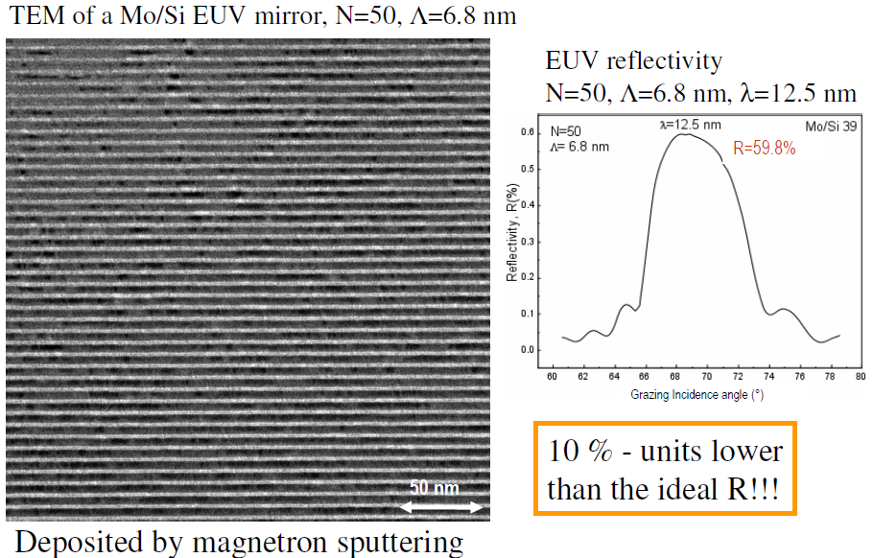
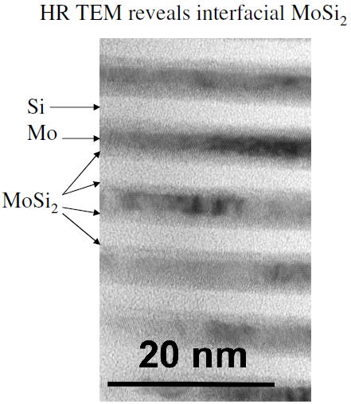
TEM images of EUV mirrors

Slide 26
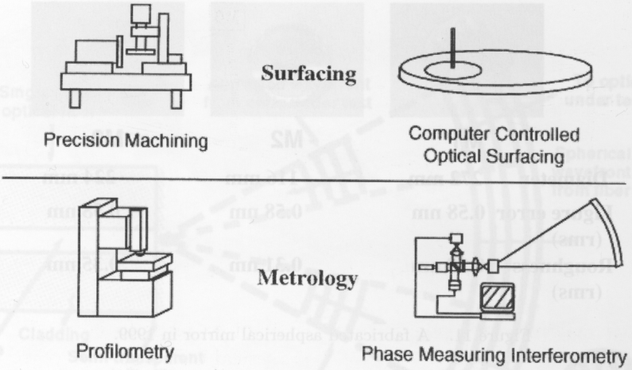
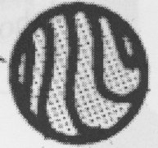
Fabrication and measurement of aspheric mirror
Interference fringe pattern
Mirror accuracy sub-1nm globally, GREAT engineering achievement.
Analyze the interference fringe, compare it pixel-by-pixel with the calculated interference fringe pattern for an ideal perfect mirror.
Analyzing the Fourier transformed pattern rather than the wave front directly gives improved accuracy.

Slide 27
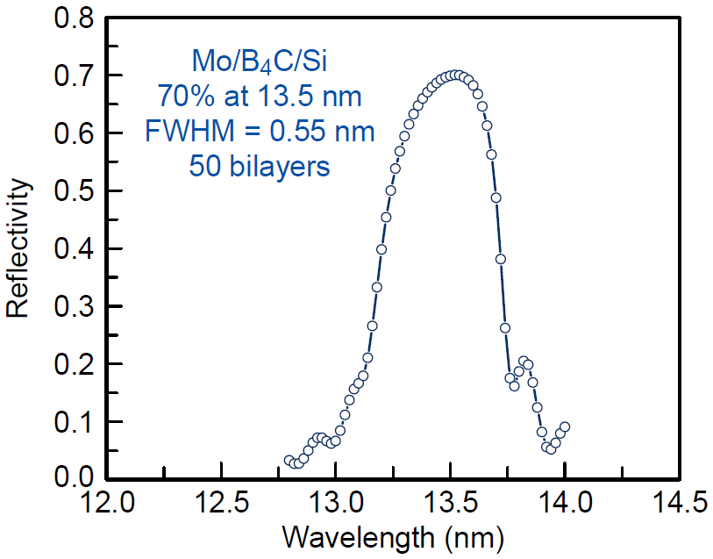
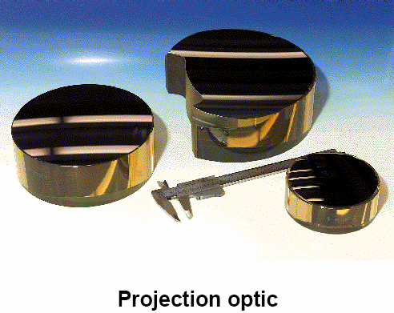
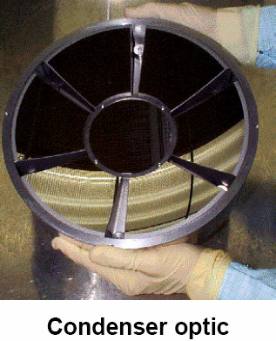
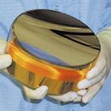
Photos of EUV mirrors

Slide 28
Extreme UV (EUV) lithography
Overview, why EUV lithography?
EUV source (hot and dense plasma).
Optics (reflection mirrors).
Mask (absorber on mirrors).
Resist (sensitivity, LER, out-gassing).
Contamination control.

Slide 29
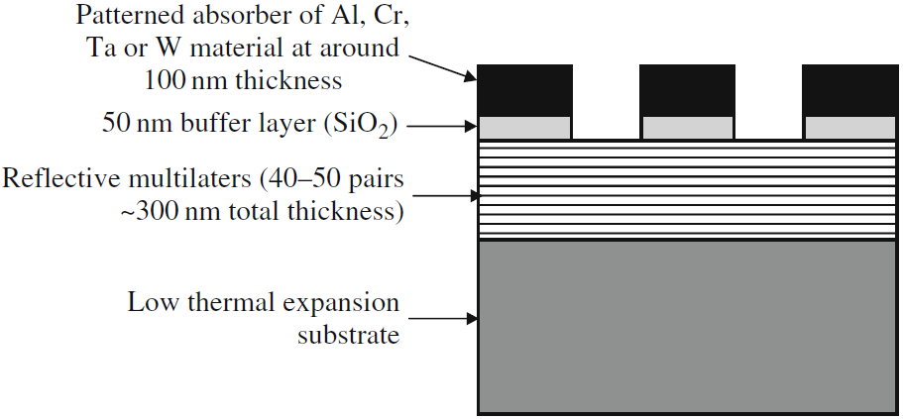
Mask for EUV lithography
(TiO₂ doped SiO₂ amorphous glass from Corning)
In principle, one can use a transmission mask (like common photolithography) by putting the absorber pattern on a thin (sub-100nm, thus transparent) membrane, but such mask is not robust.
There can also be a capping layer (11nm Si) above the multilayer, to protect the multilayer during the following mask-making processes.

Slide 30
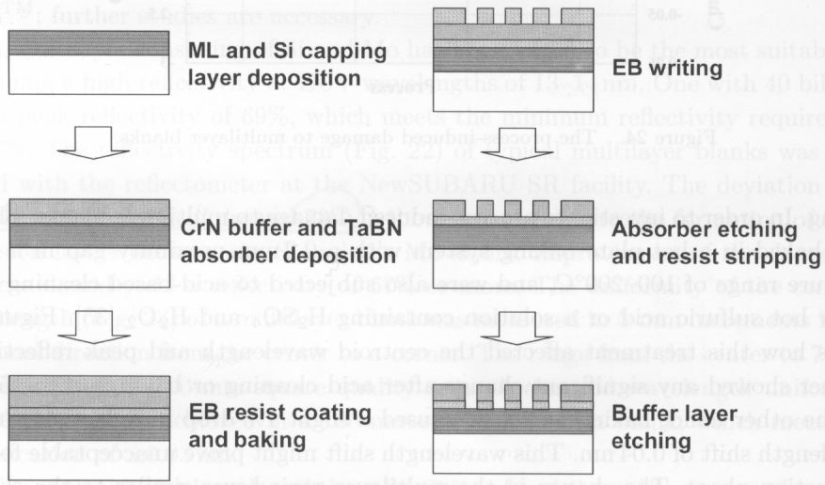
EUV mask fabrication: pattern by e-beam lithography
(by DC magnetron sputtering)
(the buffer layer can also be SiO₂)
(use ICP RIE Cl₂ gas)
ICP: inductively coupled plasma
(use ICP RIE Cl₂/O₂ gas)
Defects easy to print into resist, so NO defect is allowed in a completed mask.
Many defects can be repaired by local heating, focused ion beam milling….

Slide 31
Extreme UV (EUV) lithography
Overview, why EUV lithography?
EUV source (hot and dense plasma).
Optics (reflection mirrors).
Mask (absorber on mirrors).
Resist (sensitivity, LER, out-gassing).
Contamination control.

Slide 32
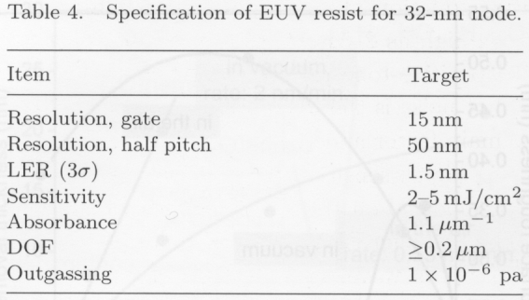
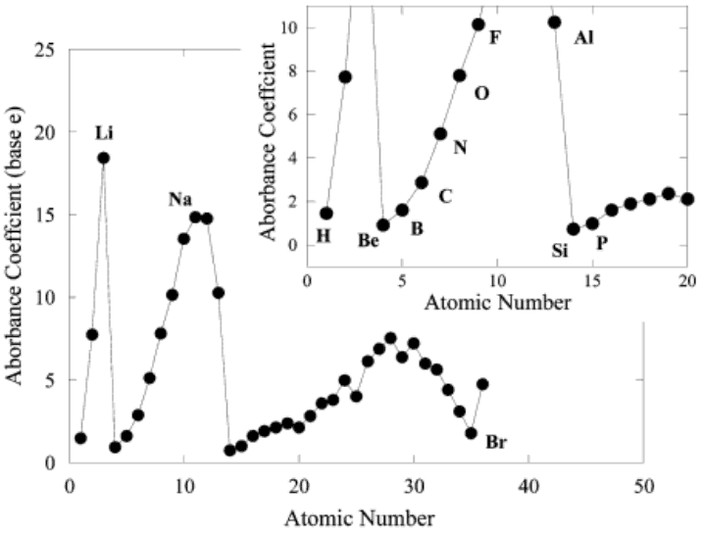
Resist for EUV lithography
Resist requirements:
High Sensitivity (so allowing weak sources)
High resolution (for small feature sizes)
Low LER (line edge roughness)
Minimal out-gassing (contaminate optics)
Most conventional resists are patternable at EUV.
(32nm?)
(depth of focus)
Absorbance in EUV
The EUV absorbance in organic materials occurs by inner-shell electrons and is therefore - differently from optical lithography - independent of molecular structure.
The absorption of molecules is then equal to the sum of the atomic absorptions.
The strongest absorbing atoms in resists and PAGs are F > O >> N > C, Cl, S, H.
(μm⁻¹)
(PAG: photo-generated acid, for chemically amplified resist)

Slide 33
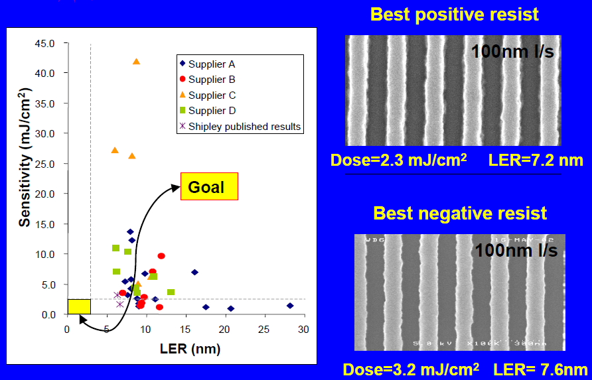
Resist LER (line edge roughness)
LER is due to:
Shot (statistical) noise. At EUV, photons have high energy, therefore low counts and high LER due to statistical photon number fluctuation.
Shot noise needs to be compromised with resist sensitivity. High sensitivity (fewer photons per exposure) leads to high shot noise. Roughly LER∝(dose)^{-1/2}.
Uncontrolled diffusion of photo-acid.
Scattering of secondary electrons in resist and substrate.
For 32nm node, need
Sensitivity: 2-5mJ/cm²
LER: 1.5nm
2mJ/cm²→1.36 photon/nm²(!!)

Slide 34
Extreme UV (EUV) lithography
Overview, why EUV lithography?
EUV source (hot and dense plasma).
Optics (reflection mirrors).
Mask (absorber on mirrors).
Resist (sensitivity, LER, out-gassing).
Contamination control.

Slide 35
Contamination and damage to EUV optics
Debris with low velocity will deposit to the mirrors, causing contamination. (debris for Sn or Li source, not for Xe gas source)
Debris with high velocity could damage the optics by sputtering material off the lenses.
Contamination of lens (due to resist out-gassing…): EUV irradiation leads to photochemical reactions that cause hydrocarbons to adsorb to the mirror and mask, reducing mirror’s reflectivity.
Contamination removal methods includes:
  UV (λ>185nm) irradiation in ozone atmosphere at 150ºC.
  Synchrotron radiation.
  DUV (deep UV, λ=172nm) radiation (simple and efficient).

Slide 36
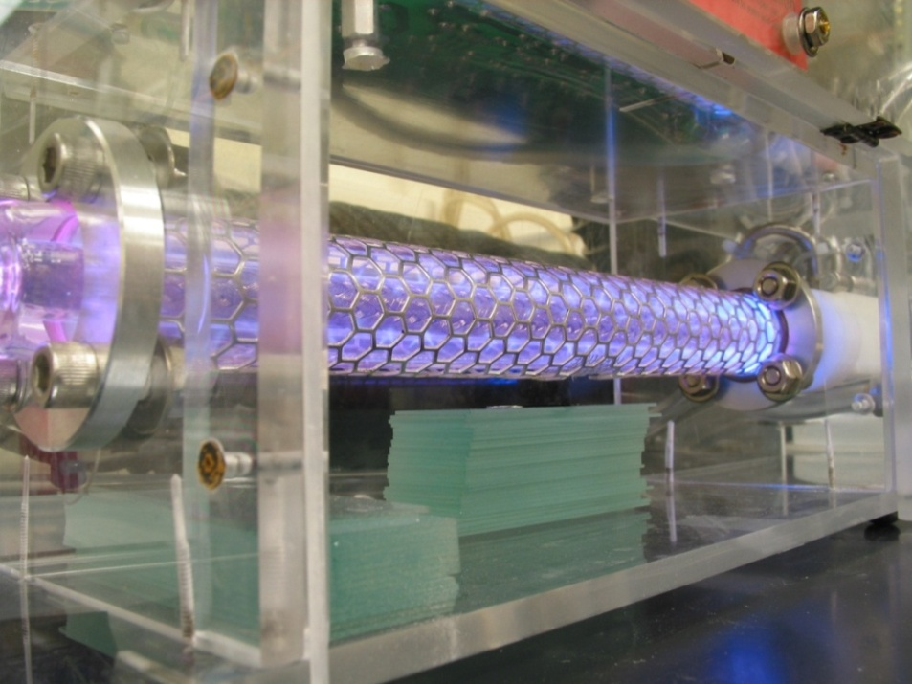
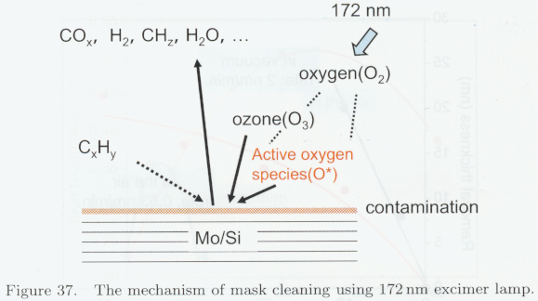
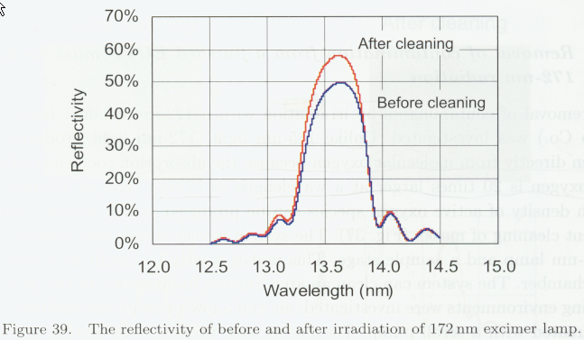
Hydrocarbon contamination removal by 172nm excimer DUV (deep UV) lamp
DUV at this short wavelength produces oxygen radicals directly from molecular O₂, which react with oxygen gas to form ozone. The reactive ozone & DUV oxidize contaminants and they evaporate.
(Longer wavelength, e.g. 185nm, won’t work)

Slide 37
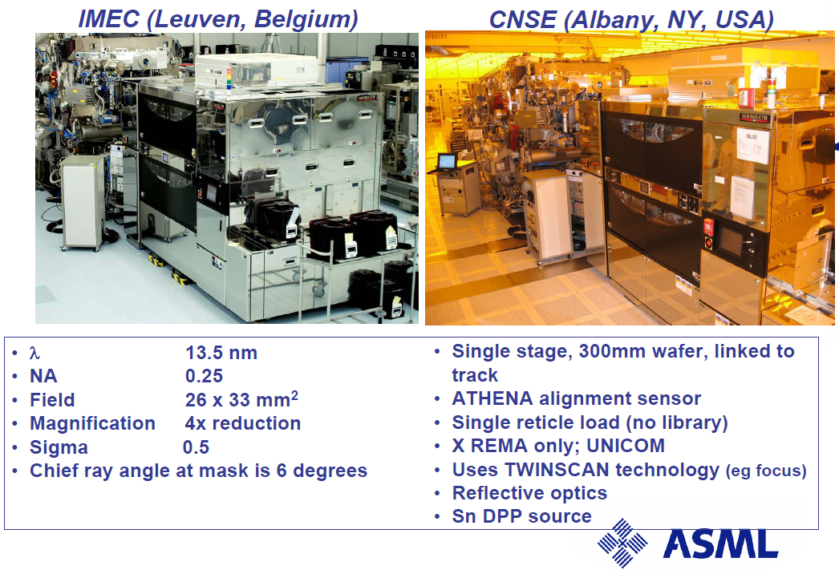
EUVL alpha demo systems and results
As of 2007, two alpha demo tools are at research centers

Slide 38
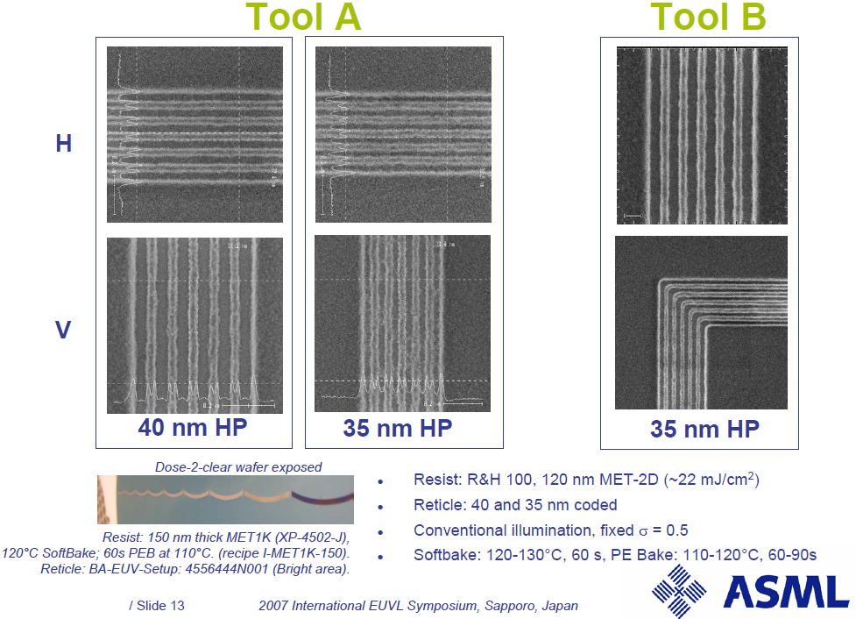
HP: half pitch, for periodic grating structure

