Slide 1
X-ray lithography (XRL)
Overview and resolution limit.
X-ray source ( electron impact and synchrotron radiation).
X-ray absorption and scattering.
X-ray lithography resist (PMMA and SU-8).
X-ray lithography mask (absorber on membrane).
LIGA process (for high aspect ratio metal structure).
Zone plate for x-ray focusing and x-ray microscopy.
ECE 730: Fabrication in the nanoscale: principles, technology and applications
Instructor: Bo Cui, ECE, University of Waterloo; http://ece.uwaterloo.ca/~bcui/
Textbook: Nanofabrication: principles, capabilities and limits, by Zheng Cui

Slide 2
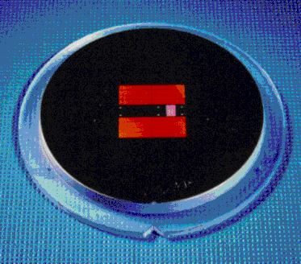
X-ray lithography: mask membrane materials
Absorber Structure
X-ray mask membrane materials:
Thin (1-2μm) membranes from silicon, silicon nitride, boron nitride, titanium or diamond, for high resolution (<100nm) using longer wavelength (few nm). Very difficult to make and fragile.
Thick (>100μm) “sheets” from graphite, beryllium or kapton (polyimide), for high aspect ratio (low resolution >1μm, LIGA process) using shorter wavelength (<5Å).
Requirement:
Good x-ray and optical (for alignment) transmission
Compatible with plating of Au absorber
Radiation resistant
Good mechanical stability, low internal stress (no bending or deformation)
Good thermal conductivity (no overheating)
Compatible with established mask making processes and equipment
Membrane
Mask Frame
Optical image of a mask

Slide 3
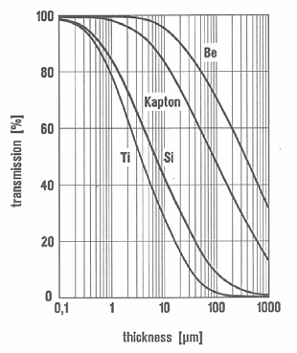
Popular membrane materials
Beryllium (Z=4): best transmission, thick sheets possible, good thermal conductivity
but: toxic, no optical transparency, expensive.
Rigid graphite (Z=6): acceptable transmission, thick sheets possible, good thermal conductivity, cheap.
but: poor surface roughness and no optical transparency (difficult for alignment).
Diamond (Z=6): acceptable transmission, good thermal conductivity, optical transparency
but: free-standing in bigger format critical, expensive.
Silicon based (Si, SiC, Si₃N₄ Z=14): acceptable transmission, optical transparency, established MEMS material
but: thin membrane, poor cooling properties, fragile
Titanium (Z=22): acceptable transmission
but: thin membrane, poor cooling properties, no optical transparency
Lower Z→higher transmission
Kapton is polyimide

Slide 4
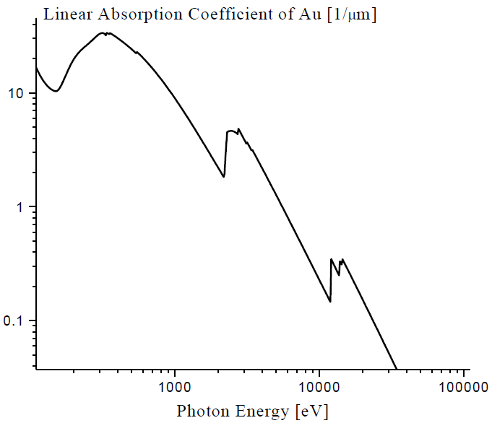
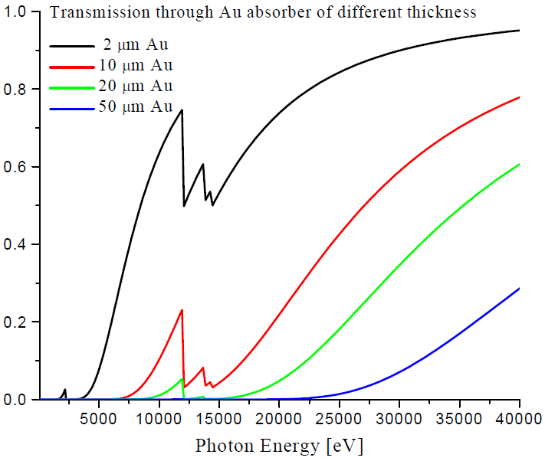
X-ray mask: absorber (high Z material Au, W, Ta)
Linear absorption coefficient of Au (1/μm)
Transmission through Au of different thickness
2μm
10μm
20μm
50μm
1.24Å
For 10keV, need Au >10μm thick for <10% transmission, can be done by Au electroplating, yet difficult to have high resolution (<<1μm).
For 1kV (1.24nm), need μm/9=110nm in order to have transmission =1/e=37%.

Slide 5
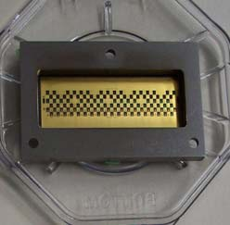
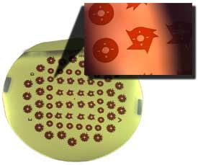
Various x-ray masks: Ti and Si “membrane”
X-ray mask – Ti thin film membrane
X-ray mask – silicon substrate
Pattern area (6.5 x 2.5 cm2)
Ti mask: FZK IMT
100μm thick Si wafer, 30μm of Au absorber
Thick Au is needed to prevent exposure in blocked area when using thick (mm) resist for high aspect ratio resist structure. Thick resist requires short wavelength (less absorption in resist and Au) and high dose in order to fully expose resist bottom.

Slide 6
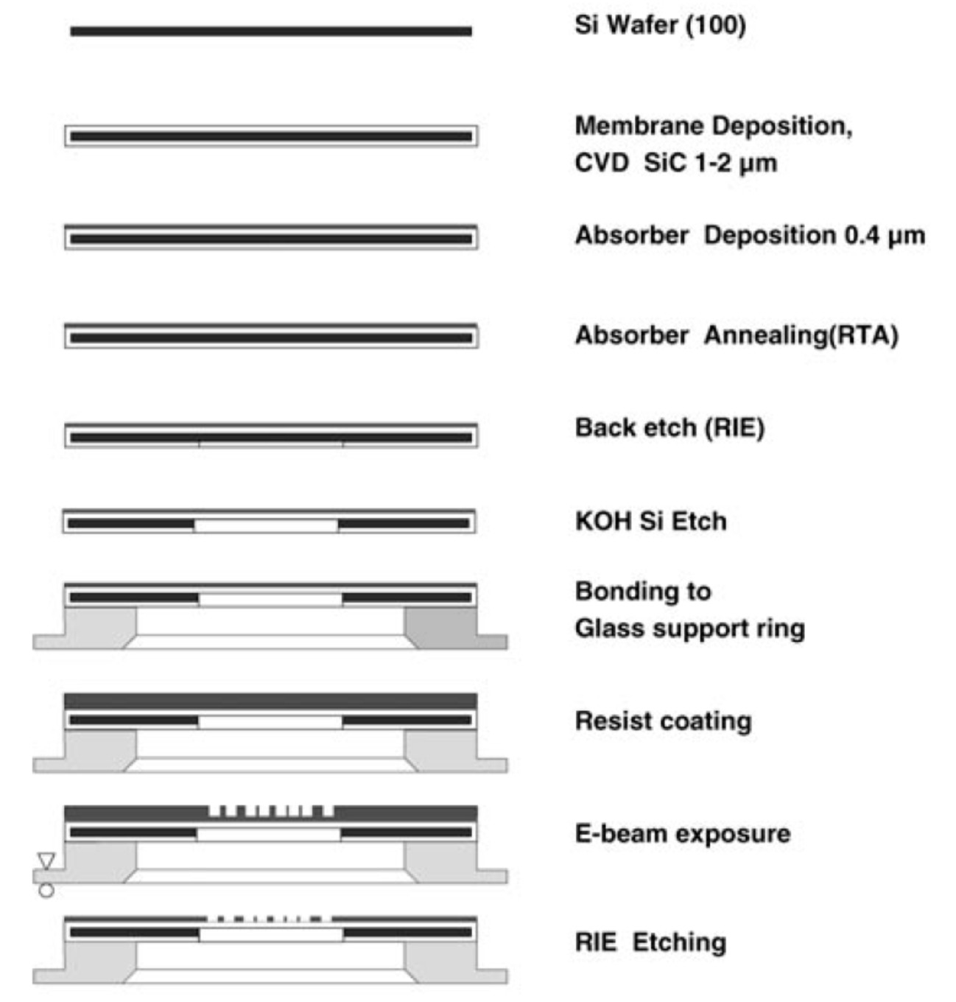
Patterning absorber: high resolution fine features by e-beam lithography
Here SiC is used, instead of Si₃N₄
For high resolution, longer wavelength (higher absorption) is desirable, to allow thin absorber and thin membrane/resist.
Cerrina, J Phys D, 2000
RIE Au? Perhaps W of Ta

Slide 7
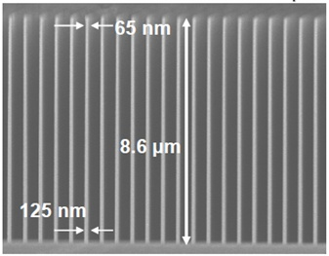
KOH etching of single crystal silicon is anisotropic
The etching rate R: R(111)<<R(110)<R(100), R(111)/R(100)∼few 100. Basically, the denser the crystalline plane, the lower the etching rate. (111) plane is densest (more Si atoms per unit area).
The etching rate of SiO₂ is about 1/1000 that of R(100), so SiO₂ can be a good etching mask.
However, for wafer-through etching (etch 0.5mm), better use Si₃N₄ as etching mask, whose etching rate in KOH is negligible.
Typical etchant contains 20-50% KOH in water at temperature 50-90ºC (room temperature is also OK, but etch much slower, need days to etch through 0.5mm-thick wafer).
High aspect ratio Si grating Silicon nitride membrane
Si (110) wafer (NOT (100))
(100)
LPCVD silicon nitride
(1,1,0)
(100) Si wafer
Silicon (100)
θ
(-1,1,1)
(-1,1,-2)
(111)
The angle between (111) and (100) is cosθ=1/√3, so θ=54.74º.

Slide 8
X-ray lithography (XRL)
Overview and resolution limit.
X-ray source ( electron impact and synchrotron radiation).
X-ray absorption and scattering.
X-ray lithography resist (PMMA and SU-8).
X-ray lithography mask (absorber on membrane).
LIGA process (for high aspect ratio metal structure).
Zone plate for x-ray focusing and x-ray microscopy.

Slide 9
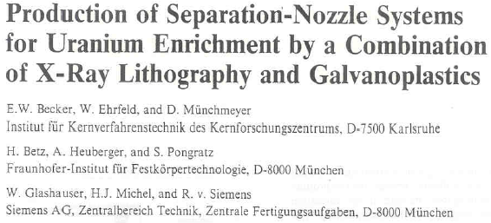
LIGA: introduction
LIGA: LIthographie Galvanik Abformung. (German name)
It is a fabrication process for high aspect ratio (height/width) microstructures consisting of three major process steps.
X-ray lithography (LI=lithographie) to generate primary microstructures. Nowadays similar process but using other lithographies is also called LIGA.
Electroplating (G=Galvanik) to produce molds in metals such as Ni.
Molding (A=Abformung) using the metal mold to batch produce secondary microstructures in polymers, metals, ceramics…
First publication on LIGA appeared in 1982.
Today, more and more prototypes are fabricated by LIGA.
Some LIGA companies have been founded to provide professional services to users

Slide 10
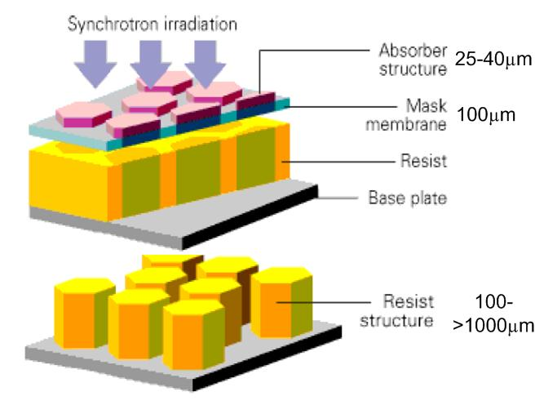
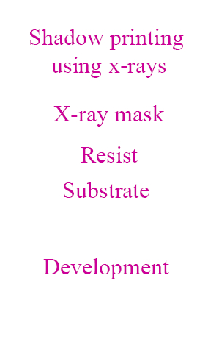
LIGA process flow

Slide 11
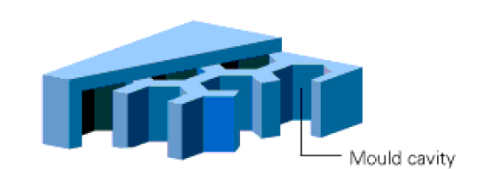
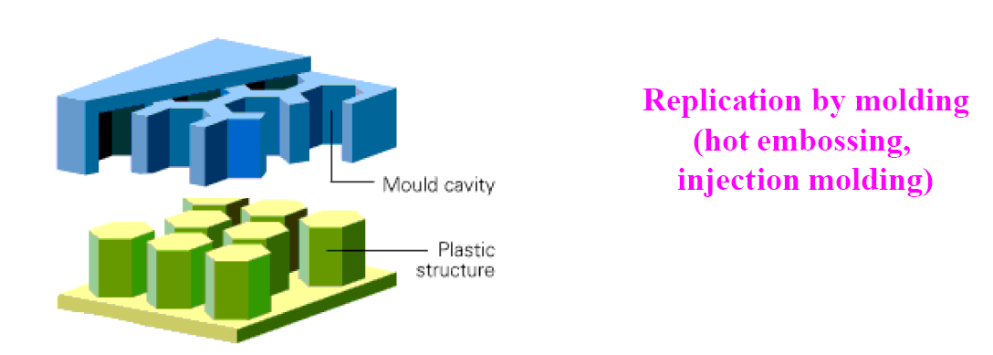

Slide 12
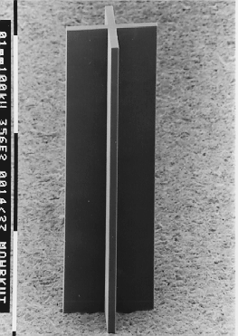
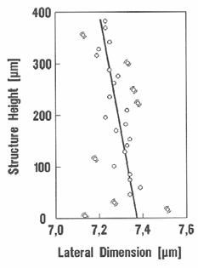
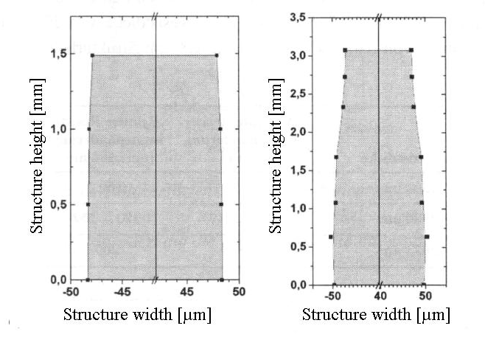
Why is LIGA interesting
Very high aspect ratio (height : width > 100 : 1) structures can be achieved.
Have more material selectivity in final products (metal, polymer or even ceramics).
Vertical and better surface roughness in sidewall
Vertical sidewall slope < 1μm/mm
Surface roughness <30-50nm (peak to valley)
It can be applied in both MEMS and traditional precision manufacturing.
Patterning accuracy – DXRL (deep XRL, few Å)
Patterning accuracy – UDXRL
(ultra-deep x-ray lithography, <1Å)
Ph.D. Thesis Jürgen Mohr, IMT/FZK, 1987
Ph.D. Thesis Sven Achenbach, IMT/FZK, 2000

Slide 13
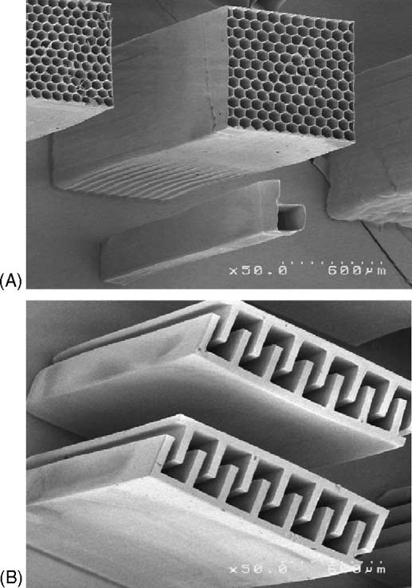
LIGA problems
X-ray source (synchrotron radiation) very expensive.
Long time exposure and develop. But SU-8 is >100× faster than PMMA.
Other competing technology are rapidly catching up: LIGA-like process using UV lithography with SU-8 resist (see below); deep silicon etching capable of etching through a 0.5mm Si wafer with vertical sidewall.
Structure by photolithography (NOT x-ray lithography) in SU-8, a negative tone photoresist (and x-ray, e-beam resist).
(A) SEM image of honeycomb structures with designed sidewall width of 6μm and a height of 2000μm. The micro-feature next to the honeycombs is an Arabic number “6” with designed width of 7μm and a height of 2000μm. (aspect ratio 2000:7 )
(B) Micro-comb structures with designed thickness of 40μm and height of 2000μm.
“A numerical and experimental study on gap compensation and wavelength selection in UV-lithography of ultra-high aspect ratio SU-8 microstructures”, Wang, Sensors and Actuators B, 2005.

Slide 14
Why optical lithography can have high resolution (7μm) in so thick resist (2000 μm)?
SU-8 is a negative resist
The SU-8 resist profile after development should be wider at the bottom (by Δx).
But the bottom is less exposed due to absorption of x-ray. So bottom can be actually narrower.
(In the extreme situation, no exposure at bottom, then the width at resist bottom should be 0 after development)
A well balance between the two trends can lead to a vertical sidewall for very high aspect ratio structure.
In addition, here the pattern is isolated. There is no physical limit of feature size for isolated pattern. For dense grating pattern, the HP (half pitch) will be limited by the R given above.
g
Resist (SU-8)
t
Δx
(∼R)
g: gap
t: thickness

Slide 15
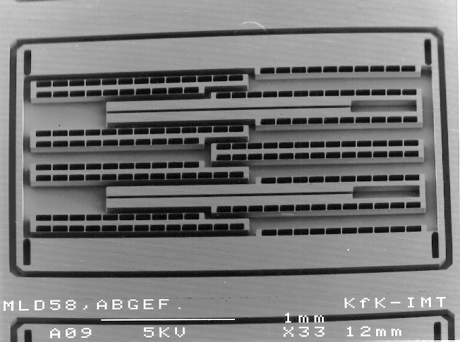
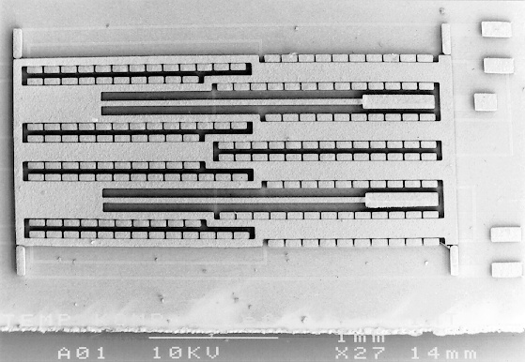
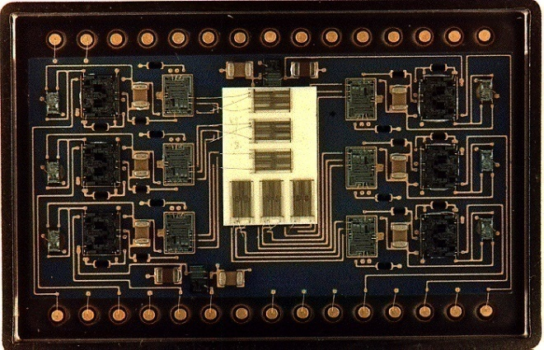
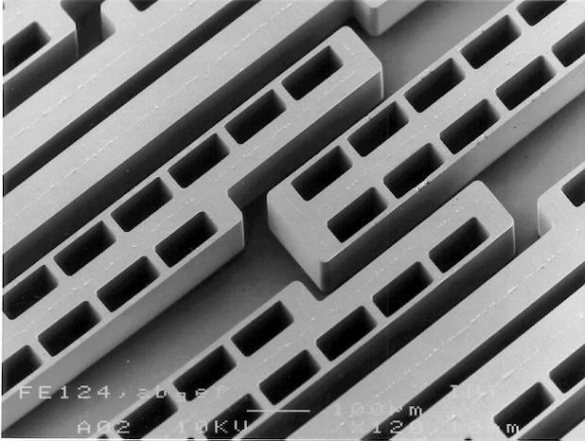
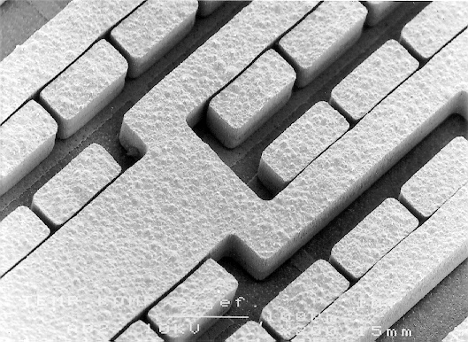
Applications of LIGA: MEMS
LIGA Acceleration Sensor
PMMA structure
Ni - structures 120 μm high
Detail
Redundant Sensor System
MEMS: Micro-electro-mechanical systems

Slide 16
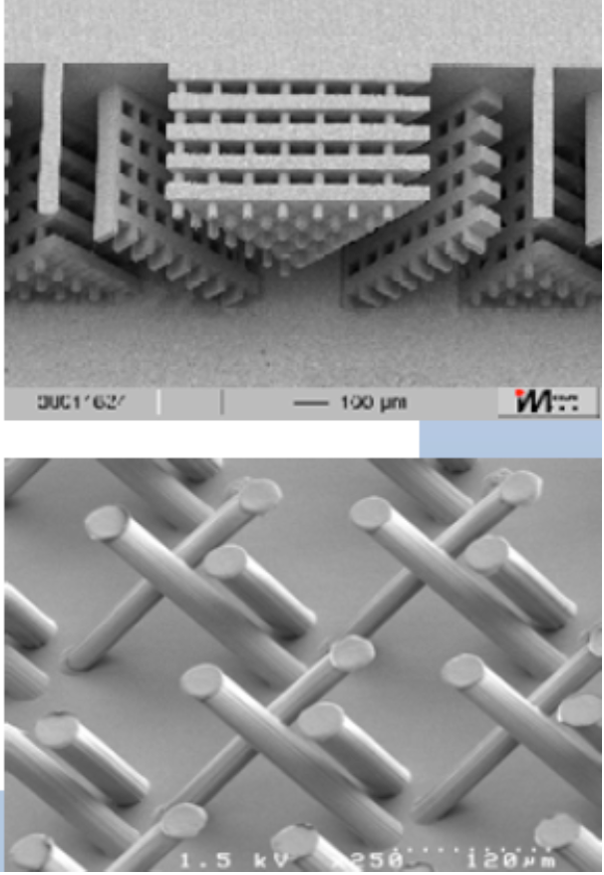
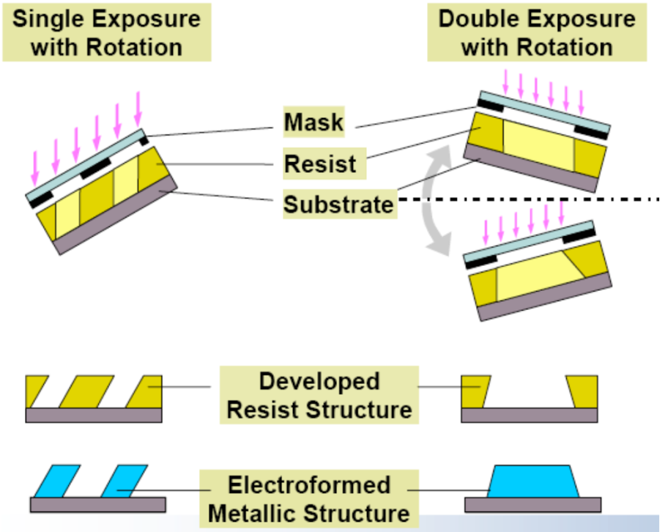
3D structure fabrication by LIGA
(using multiple exposures with rotation)

Slide 17
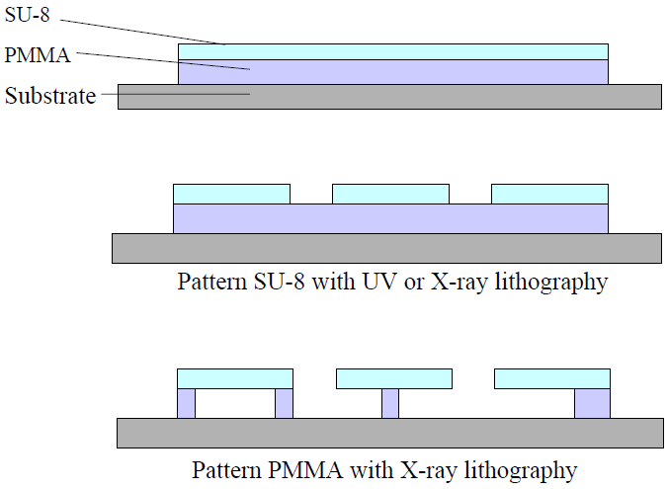
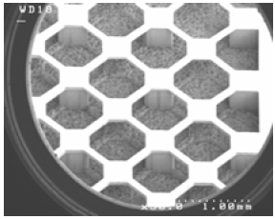
3D structure fabrication by LIGA
(using PMMA and SU-8 stack)
PMMA won’t be exposed at doses sufficient for exposing SU-8
Here SU-8 is already cross-linked, thus won’t be affected by further exposure to x-ray.

Slide 18
X-ray lithography (XRL)
Overview and resolution limit.
X-ray source ( electron impact and synchrotron radiation).
X-ray absorption and scattering.
X-ray lithography resist (PMMA and SU-8).
X-ray lithography mask (absorber on membrane).
LIGA process (for high aspect ratio metal structure).
Zone plate for x-ray focusing and x-ray microscopy.

Slide 19
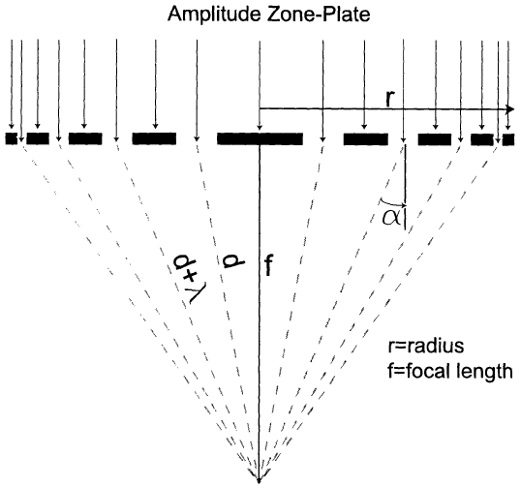
How zone-plate works
Maximum light intensity at the focal point if the light from each non-blocked zone interfere constructively (“in-phase”).
Zone 1 2 3 4 5 6 7 8

Slide 20
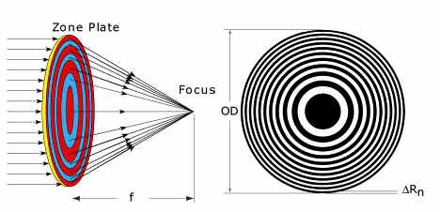
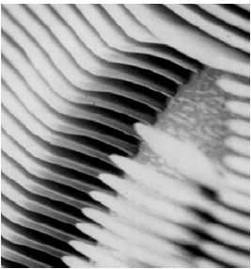
Fresnel lenses (zone plates): overview
There is only reflection optics for soft x-ray and no optics for hard x-ray.
Zone plate is the only option for focusing and imaging in this wavelength range.
Number of zones is up to 10000-20000, materials – Au, Pt and other heavy metals.
Width of the outmost zone (i.e. spatial resolution) can be as small as 15nm, and the radius of zone plates is up to 2mm.
Most zone plate is fabricated by e-beam lithography, followed by electroplating of heavy metals into the trenches in resist, with aspect ratio limited to about 1:10.
Zone-plate schematic.
High aspect ratio metal pattern by EBL and electroplating

Slide 21
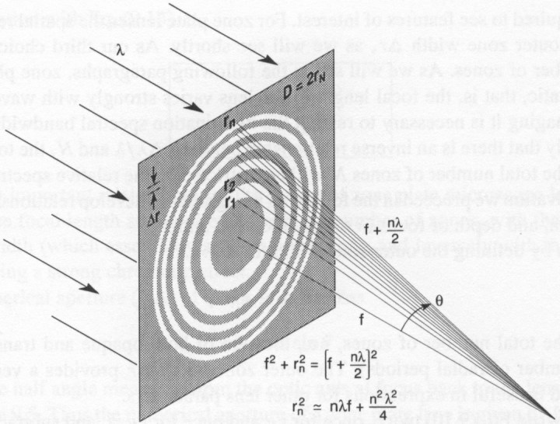
Zone-plate equations
The area between r₁ and r₂ is transparent, that between r₂ and r₃ is blocked, that between r₃ and r₄ is transparent…
Here we assume r₁ is such that the distance from r₁ to focal point is f+λ/2.
n=1, 2, 3……N
Assume Nλ<<f
D≡2r_{N}
Δr: outermost zone width
R: resolution
Those equations are good for the case of Nλ<<f, which is equivalent to small NA.
NA is always small for hard x-ray, but less so for soft x-ray zone plates.
The area of each zone is π(r_{n}²-r_{n-1}²)=πλf=constant, so each zone contributes equally to the intensity at focal point.

Slide 22
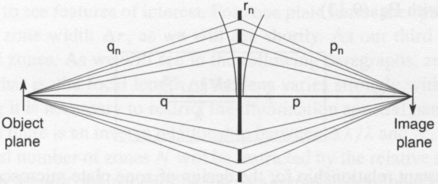
Zone-plate is indeed a lens
Try your best to understand this slide. It won’t be included in exams
We know that for a regular optical lens, the equation is
Therefore, a zone plate is like a lens, with magnification equal to p/q.
independent of n for r_{n}=(nλf)^{1/2}, which is the same as before.
David Attwood, “Soft x-rays and extreme ultraviolet radiation”, Cambridge University Press.

Slide 23
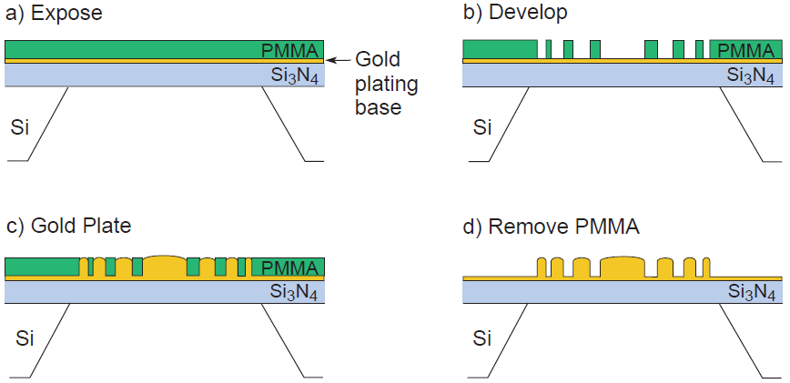
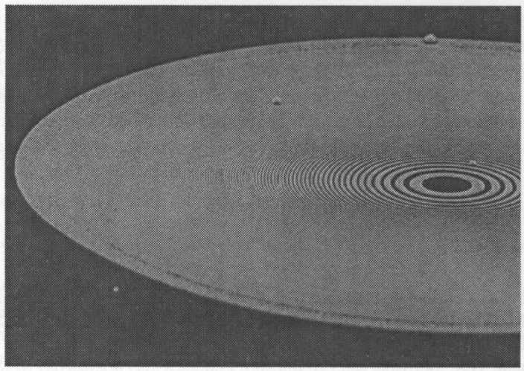
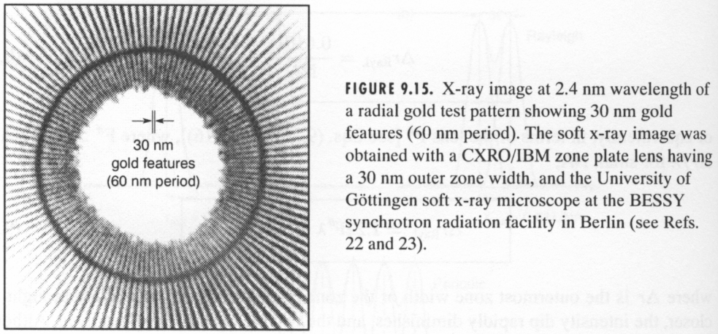
Zone plate fabrication: e-beam lithography + electroplating
Zone plate with 100nm-thick gold with a 30nm outer zone width and 300 zones. It is used to form the image on the right side with 30nm resolution.

Slide 24
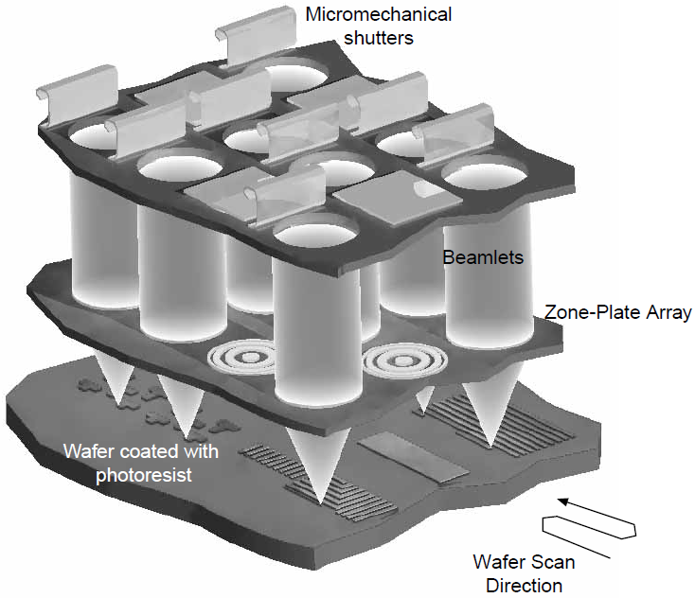
Focusing x-ray: zone plate array lithography
It seems that only MIT, where x-ray lithography is invented, is still working on this topic. Now a hot research area is x-ray imaging using zone-plate optics.

Slide 25
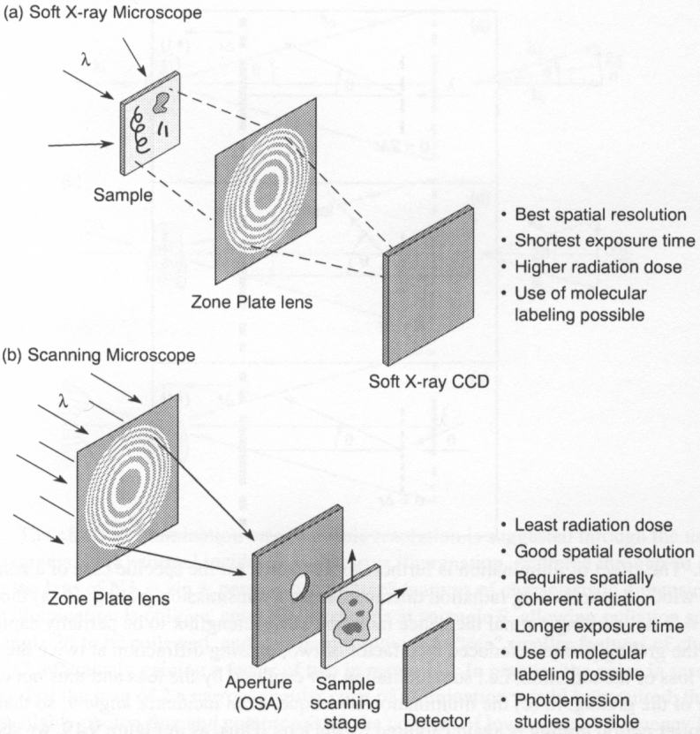
Other application of zone plate: x-ray (including soft x-ray, i.e. EUV) microscopy

Slide 26
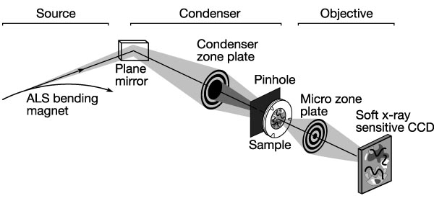
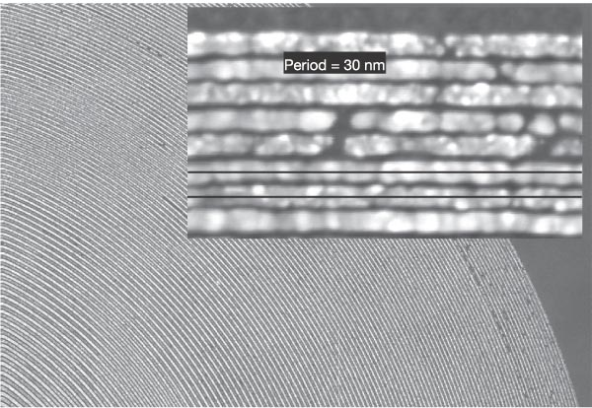
X-ray imaging - highest resolution achieved
This microscope covers a spectral range of 250eV (5nm) to 1.8keV (0.7 nm), so that primary K and L atomic resonances of elements such as C, N, O, Al, Ti, Fe, Co and Ni can be probed.
Best spatial resolution achieved: 15nm lines. Sub-10nm is on the way.
Outer zone-width=15nm, Au is 80nm thick.
Zone plate fabrication is the most challenging task for x-ray microscopy
W. Chao, ... David Attwood, “Soft X-ray microscopy at a spatial resolution better than 15 nm”, Nature 435, 1210-1213 (2005).

Slide 27
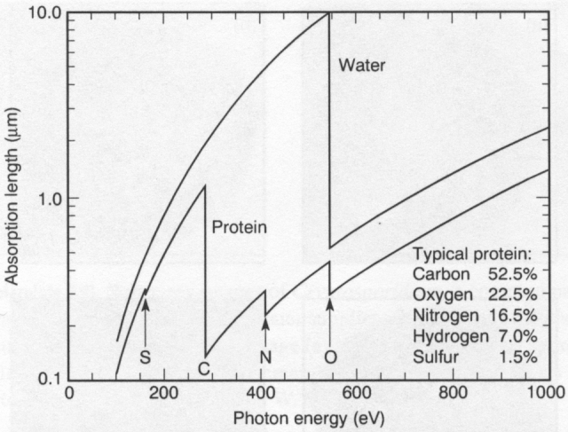
Application in bio-imaging
2.3nm
Absorption length for soft x-rays in water and a generic protein as a function of photon energy.
Natural contrast in the water window, between the carbon and oxygen absorption edges, where the high carbon content protein is absorbing where water is relatively transparent.
Imaging of thicker objects (∼10μm, size of typical mammalian cells) requires operation in the lower λ part of the water-window where the transmission is higher, such as λ=2.4nm from synchrotron radiation or N₂ laser-produced plasma.

Slide 28
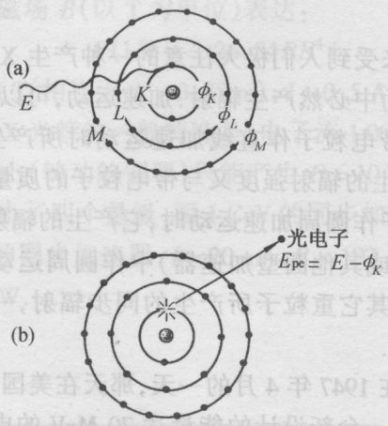
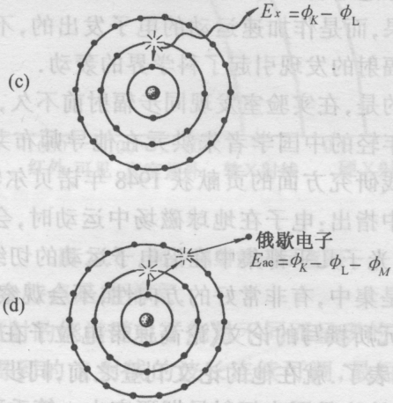
X-ray absorption: photoelectric absorption dominates at <10keV
The picture below is similar to electron bombardment x-ray source (see slide #14), where core electron is kicked off by an incident electron. Here it is kicked off by x-ray (the incident x-ray is absorbed/lost).
In the relaxation process, the lower (than incident x-ray photon) energy photon is a fluorescent x-ray, while the lower energy electron is an Auger electron.
X-ray
(fluorescent x-ray)
Photon (x-ray)
atom
1. A high energy x-ray photon impinges on an atom
(Auger electron)
Electron (low energy)
Photon
(fluorescent x-ray)
Photo-electron
3. The atom relaxes to its ground state by emission of a photon or electron
2. An inner-shell (here K-shell) electron (photo-electron) is knocked out of the atom.
Auger-electron
Electron
(Auger electron, emitted from M-shell)
φ_{k} is the energy level of the K-shell…

Slide 29
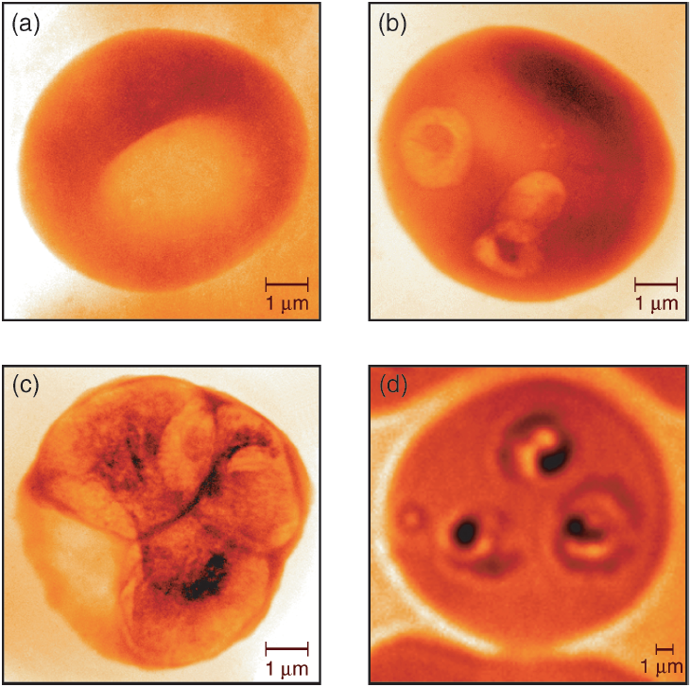
Malaria infected red blood cells
λ=2.4nm from bending magnet synchrotron radiation at ALS (Berkeley).
Image resolution: ∼40nm
Uninfected cell
Newly infected cell
36 hours after infection.
Image with visible light microscopy, for comparison.
More photos at:
http://www.cambridge.org/catalogue/catalogue.asp?isbn=9780521029971&ss=res
Magowan C. et. al, “Intra-cellular structures of normal and aberrant plasmodium falciparum malaria parasites imaged by soft s-ray microscopy”, PNAS 94, 6222 (1997)

Slide 30
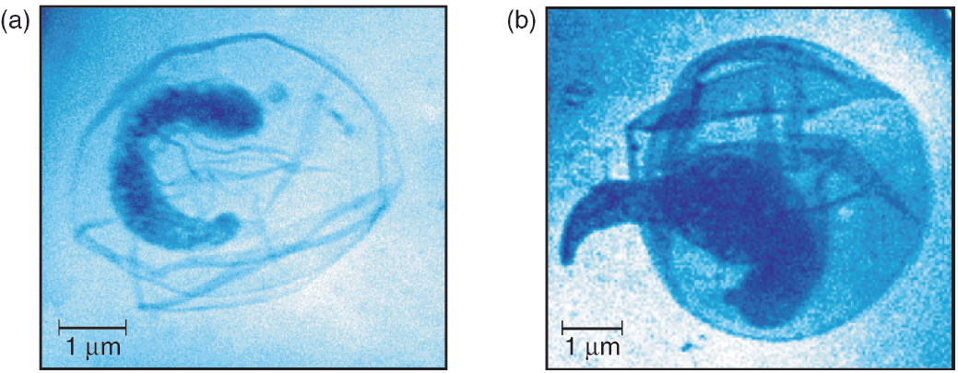
Soft x-ray images of Cryptosporidium
Cryptosporidium is a common parasite found in lakes and rivers, and occasionally in municipal water supplies that may cause death.
Images taken at 2.4nm wavelength
The last of four sporozoites still in its protective oocyst.
A sporozoite emerging from the oocyst

Slide 31
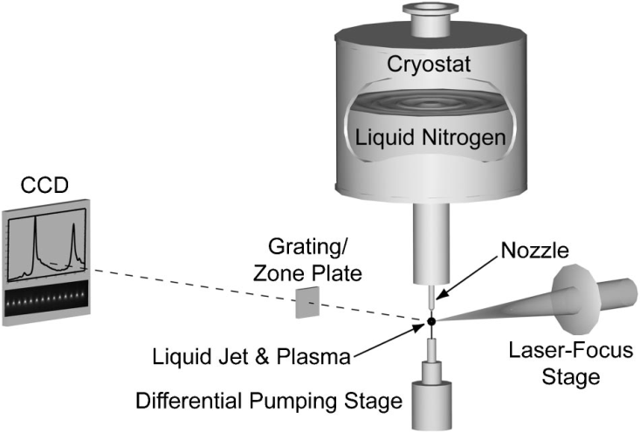
Liquid-nitrogen-jet laser-plasma source for compact soft x-ray microscopy
Along with EVU source development, LPP (laser-produced plasma) source is becoming more popular for x-ray imaging, due to its compact size compared to synchrotron radiation.
Hydrogen-like and helium-like nitrogen ions emit strongly at λ=2.478nm (Ly-α) and λ =2.879nm (He-α), which is in the lower part of the water-window.
Nitrogen is relatively inert, with minimal debris contamination or damage.
Jansson, “Liquid-nitrogen-jet laser-plasma source for compact soft x-ray microscopy”, Review of scientific instruments 76, 043503 (2005).

