Slide 1
The History of Common Law and Statute Law in Canada
Douglas Wilhelm Harder, M.Math.
Department of Electrical and Computer Engineering
University of Waterloo

Slide 2
Outline
This talk will cover common law in Canada
The introduction by Henry II
The Supremacy of Parliament
The Constitution Acts of 1867 and 1982
The Charter of Rights and Freedoms
The regulation of professional engineering
Legal basis of contract law and liability in tort

Slide 3
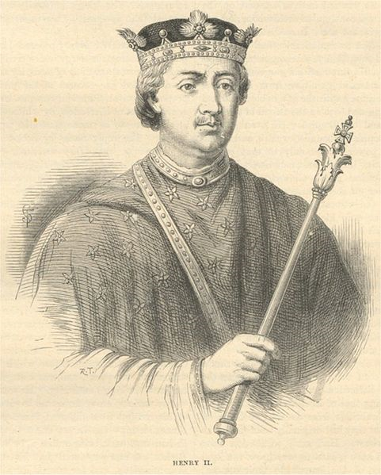
History
In Canada, all regions other than Québec use common law as the basis for law
It is based on English common law:
In 1154, King Henry II introduced a unified system of laws to be common to all his realms
Judges would resolve disputes on an ad hoc basis
These decisions were recorded and discussed which founded rules based on stare decisis from a longer Latin phrase:
“To maintain decisions and to not affect what has been established”
This is also known as the rule of precedence
Judges are allowed to modify precedence based on changes to society and adjust their judgements to suit the particular details

Slide 4
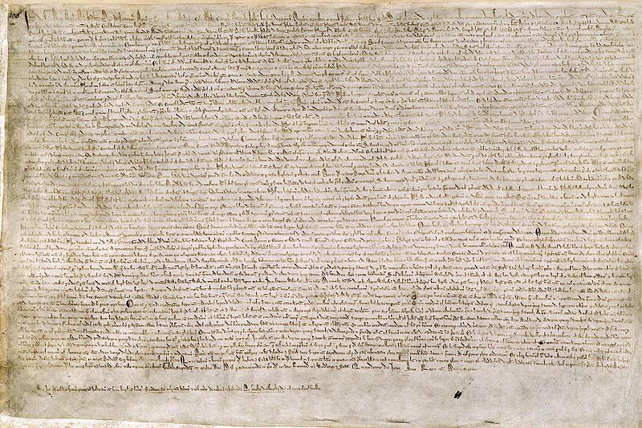
History
King John, the son of Henry II, sealed the Magna Carta in 1215, sixty-one years after the introduction of a common law
At this point, common law was the only law in England
Magna Carta laid the foundations for Parliament which, of the centuries, was invested with the power to create laws

Slide 5
History
Parliament became a second source of law:
A statute or a statute law is law written by the legislative body
These are usually normalizations or codifications of various common law precedence
Statute law takes precedence over common law
Exceptions exist: the Act of Supremacy of 1534 of King Henry VIII
In Canada, the federal and provincial legislatures are allowed to enact statutes

Slide 6
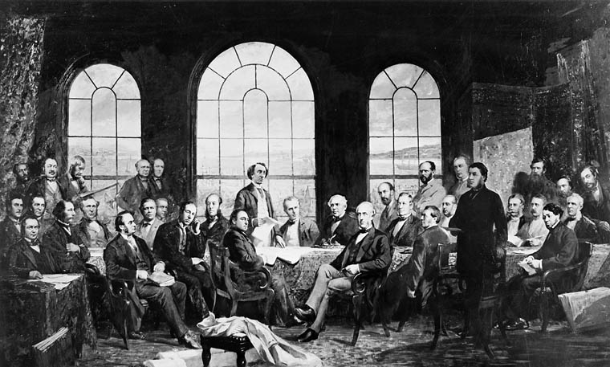
The Canadian Constitution Act 1867
The document which defines the authorities of Parliament, of the federal government, and the provincial governments is the Canadian Constitution Act of 1867
Viewable at http://laws.justice.gc.ca/en/Const/

Slide 7
The Canadian Constitution Act of 1867
The Constitution Act of 1867 states the powers of the federal and provincial governments
Section 91 lists twenty-nine areas exclusive to federal legislation
Public debt and property, Trade and commerce, Taxation for federal purposes, Statistics, Defence, Currency and coinage, Banking, Weights and measures, Bankruptcy, Patents, Copyrights, Criminal law
Section 92 lists sixteen areas exclusive to provincial legislation
Taxation for provincial purposes, Hospitals, Municipal institutions, Local business and public works, Incorporation, Property and civil rights, Punishments and “generally all matters of merely local or private nature within the province”

Slide 8
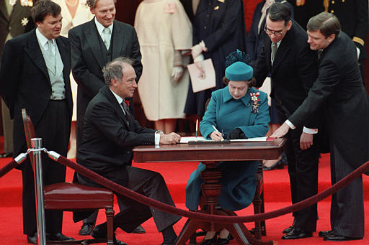
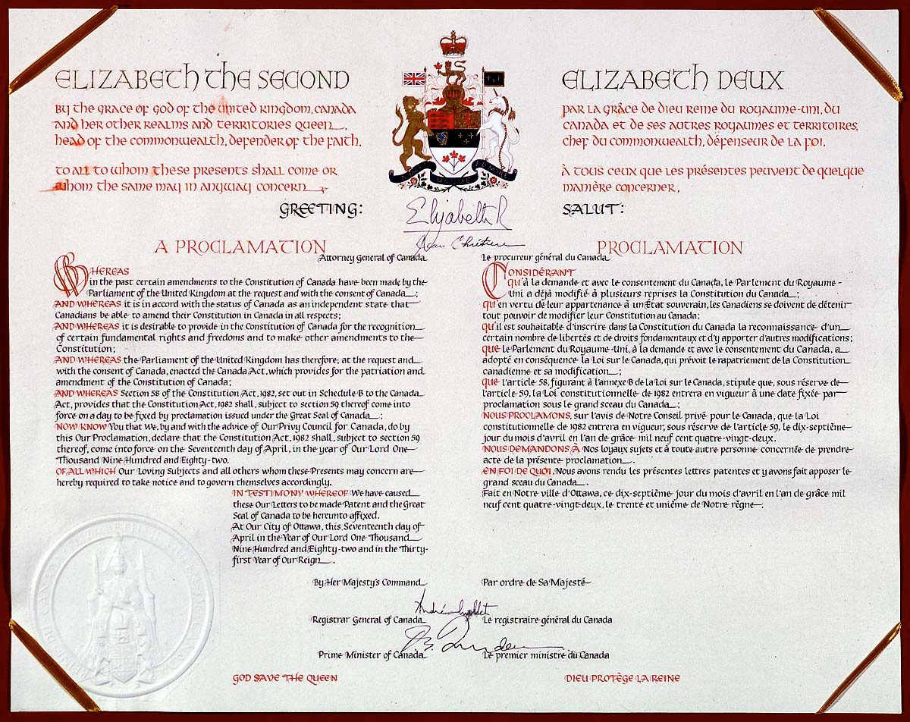
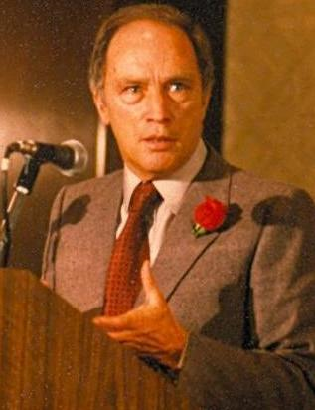
The Canadian Constitution Act of 1982
The Constitution Act of 1982 introduced the Charter of Rights and Freedoms
Ron Poling

Slide 9
The Canadian Constitution Act of 1982
The Constitution Act of 1982 states:
Primacy of Constitution of Canada
52. (1) The Constitution of Canada is the supreme law of Canada, and any law that is inconsistent with the provisions of the Constitution is, to the extent of the inconsistency, of no force or effect.
The Charter of Rights and Freedom which enshrines:
Fundamental freedoms
2. Everyone has the following fundamental freedoms:
Freedom of conscience and religion;
Freedom of thought, belief, opinion, and expression, including freedom of the press and other media of communication;
Freedom of peaceful assembly; and
Freedom of association.

Slide 10
Statute Law and Common Law
To demonstrate the relationship between common law and statute law, consider the case of the Alberta statute Individual Rights Protection Act
The Charter of Rights and Freedoms listed specific freedoms
This act did not extend protection to gays and lesbians whose rights were violated as a result of their sexual orientation
The Supreme Court of Canada, on April 2, 1998, observed that while sexual orientation was not explicitly listed in the Charter, it is reasonable that it should be included
The Charter is an example of a statute law; the extension is an example of common law

Slide 11
Delegation of Authority
Authority may be delegated by either the provincial or federal governments other bodies
Provincial governments provide for municipalities which have their own by-laws, codes, etc.
Regulatory bodies (such as Professional Engineers Ontario) may have specific responsibilities

Slide 12
Professional Engineering and the Law
The engineer must be aware of:
The basis of Law in Canada
Relevant statutes
The theory of common law and relevant cases which have defined precedence
Additional regulations, standards, codes, by-laws and rules

Slide 13
Professional Engineering and the Law
As a demonstration, the Professional Engineers Act of Ontario is a statute which defines the practice of professional engineering provides for:
The self-regulation of the profession through the Association
Licences and Certificates of Authorization
Appropriate committees including the Complaints, Discipline, and Fees Mediations committees
Liability insurance
Discipline and enforcement

Slide 14
Professional Engineering and the Law
Most engineering services are provided under contract
Contracts are a common-law concept
It is critical to understand the relevant cases
Certain aspects are covered by statute:
Limitations Act (Ontario)
Intellectual property acts (Canada)
Construction Lien Act (Ontario)
Competition Act (Canada)
Statute of Frauds (Ontario)

Slide 15
Professional Engineering and the Law
Engineers must also be aware of the tort of negligence
Tort is also founded in common law
It is equally critical to understand the relevant cases
Again, certain aspects are covered by statute:
Limitations Act (Ontario)
Workplace Safety and Insurance Act (Ontario)
I.e., worker’s compensation

Slide 16
Summary
This talk covered a history of common law in Canada
The introduction by Henry II
The Supremacy of Parliament
The Constitution Acts of 1867 and 1982
The Charter of Rights and Freedoms
The regulation of professional engineering
Legal basis of contract law and liability in tort

Slide 17
References
[1] Gordon C. Andrews, Canadian Professional Engineering and Geoscience-Practice and Ethics, Nelson Education Ltd., 2009.
[2] Professional Engineers Act General R.R.O. 1990, Regulation 941.
http://www.e-laws.gov.on.ca/html/regs/english/elaws_regs_900941_e.htm
[3] Professional Engineers Act General R.R.O. 1990, Regulation 941.
http://www.e-laws.gov.on.ca/html/regs/english/elaws_regs_900941_e.htm

Slide 18
Copyright and Disclaimer
These slides are Copyright © 2010 by Douglas Wilhelm Harder. All rights reserved.
These slides are made publicly available on the web for anyone to use
No warranty is given that any information in these slides is correct
The use of these slides in studying for the PPE is fully at your own risk
If you choose to use them, or a part thereof, for a course at another institution, I ask only three things:
That you inform me that you are using the slides,
That you acknowledge my work, and
That you alert me of any mistakes which I made or changes which you make, and allow me the option of incorporating such changes (with an acknowledgment) in my set of slides
Sincerely,
Douglas Wilhelm Harder, MMath
dwharder@alumni.uwaterloo.ca

