Slide 1
The Engineering Profession
Douglas Wilhelm Harder, M.Math.
Department of Electrical and Computer Engineering
University of Waterloo

Slide 2
Outline
This talk focuses on the profession and the Association
What is a profession?
The engineering profession
The Professional Engineers Act and Ontario Regulation 941
The objects of the Association
An overview followed by
Licensing (regular, temporary, provisional, and limited)
Titles and abbreviations and the engineer’s seal
Certificates of Authorization and consulting engineers
Engineering interns and students
Advertising
A case study

Slide 3
What is a Profession?
A definition of a profession:
A self-selected self-disciplined group of individuals who hold themselves out to the public as possessing a special skill derived from training and education and are prepared to exercise that skill in the interests of the public.
Hon. H.A. MacKenzie
Opening Address for the debate on the Professional Engineers Act
Ontario Legislature, 1968

Slide 4
What is a Profession?
Other common characteristics
Skills based on theoretical knowledge
Extensive period of education and institutional training
Work autonomy
Public service
High status and rewards
Individual clients
Middle-to-high–class occupations
Mobility

Slide 5
What is a Profession?
These characteristics have resulted in the following:
Legal recognition
Professional associations
Testing of competence
Licensed practitioners
Code of Ethics
Self-regulation
Control of remuneration and advertising

Slide 6
The Engineering Profession
Numerous definitions appear in Section 1 of the Professional Engineers Act, R.S.O. 1990, CHAPTER P.28
“Professional engineer” means a person who holds a licence...
“Licence” means a licence to engage in the practice of professional engineering...
The “practice of professional engineering” means any act of planning, designing, composing, evaluating, advising, reporting, directing or supervising that requires the application of engineering principles and concerns the safeguarding of life, health, property, economic interests, the public welfare, or the environment, or the managing of any such act.

Slide 7
The Engineering Profession
Any act of planning, designing, composing, evaluating, advising, reporting, directing or supervising that
requires the application of engineering principles and
concerns the safeguarding of life, health, property, economic interests, the public welfare, or the environment,
or the managing of any such act
Planning was added in 2010

Slide 8
The Engineering Profession
Any act of planning, designing, composing, evaluating, advising, reporting, directing or supervising that
requires the application of engineering principles and
concerns the safeguarding of life, health, property, economic interests, the public welfare, or the environment,
or the managing of any such act

Slide 9
The Engineering Profession
Any act of planning, designing, composing, evaluating, advising, reporting, directing or supervising that
requires the application of engineering principles and
concerns the safeguarding of life, health, property, economic interests, the public welfare, or the environment,
or the managing of any such act
Economic interest and the environment were added in 2010

Slide 10
The Engineering Profession
Any act of planning, designing, composing, evaluating, advising, reporting, directing or supervising that
requires the application of engineering principles and
concerns the safeguarding of life, health, property, economic interests, the public welfare, or the environment,
or the managing of any such act
This last clause was added in 2010

Slide 11
The Engineering Profession
This last clause is new:
It states that anyone who engages in the management of any act [of ...] that requires the application of engineering principles and concerns the safeguarding [of ...] requires a licence

Slide 12
The Act and Regulations
You are required to examine two documents:
The Professional Engineers Act and Ontario Regulation 941
The relationship is given in Section 7 in the Act
Regulations
7.(1) Subject to the approval of the Lieutenant Governor in Council and with prior review by the Minister, the Council
may make regulations...
This is followed by 33 clauses...

Slide 13
Principal Object of the Association
From Section 3 of the Act:
...to regulate the practice of professional engineering and to govern its members, holders of certificates of authorization, and holders of [other] licences...in order that the public interest may be served and protected

Slide 14
Additional Objects of the Association
Additional objects are stated in Section 4 of the Act
To establish, maintain and develop standards of
1. knowledge and skill among its members.
2. qualification and practice for the practice of professional engineering
3. professional ethics among its members
4. To promote public awareness of the role of the Association
5. To perform such other duties and exercise such other powers as are imposed or conferred upon the Association by or under any Act.

Slide 15
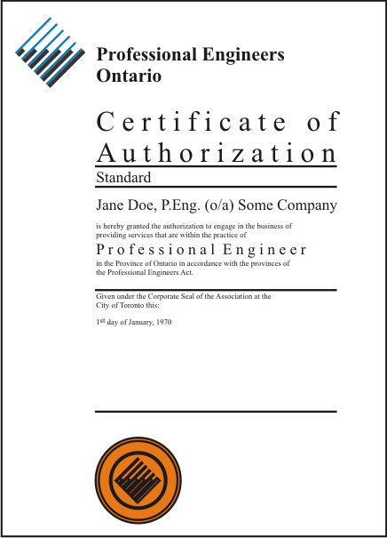
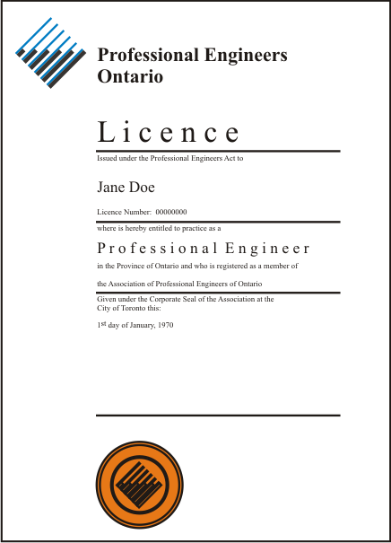
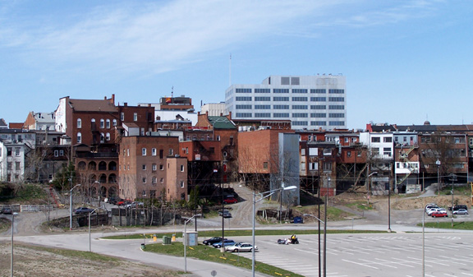
Overview
Issues certificates of authorization (CofA)
to individuals or business organizations
to engage in the business of providing
professional engineering services
to the public
Issues licences
to individuals to engage
in the practice of
professional engineering
At least one licenced professional
engineer must responsibility for
and supervises the services
provided by the holder of a CofA
The professional engineer
is employed by a business
organization to perform
engineering services
for the organization
The holder of the CofA
provides professional
engineering services to
the public usually through
contracts

Slide 16
Licences
The first means by the Association of regulating the industry of professional engineering is by issuing licences
The scope of the services which may be offered by a professional engineer are limited by:
The competence of the practitioner
The type of licence issued

Slide 17
Licences
The practitioner is required to ensure that he is competent to take on a particular engineering task
Most licences do not limit the practices which may be engaged in
Later, we will see that in the Code of Ethics
It is the duty of a practitioner ... to act at all times with competence in the performance of any professional engineering services that are undertaken
The definition of misconduct includes
undertaking work the practitioner is not competent to perform by virtue of the practitioner’s training and experience

Slide 18
Licences
The Association issues four types of licences:
Regular Licence
Provisional Licence
Temporary Licence
Limited Licence

Slide 19
Regular Licence
The requirements for a Regular Licence are specified in the Act 14(1)
at least 18 years old
From O.Reg. 941, has
1. a bachelor’s degree in an accredited engineering program from a Canadian university or equivalent
5. O.Reg. 941 33(1)(5) written the PPE
From O.Reg. 941 33(1), has 2. 48 months of engineering experience 3. at most 12 months of which is from co-op education placements 4. 12 months of engineering experience in Canada
is of good character

Slide 20
Regular Licence
The holder of a regular licence is also a member of Professional Engineers Ontario
The licence does not specify the field of engineering in which the practitioner is to study—it is up to the practitioner to ensure he or she is competent for the project

Slide 21
Provisional Licence
The requirements for a Provisional Licence are specified in the Act 14(7)
They are identical to that of a Regular Licence with the exception of paragraph 4 requiring 12 months of engineering experience in Canada
Other restrictions from O.Reg. 941 44.1(2)
1. It is valid for 12 months
2. The holder must be supervised by a professional engineer and all final drawings, specifications, plans, reports or other documents must be signed and sealed by that supervisor

Slide 22
Temporary Licence
A temporary licence is issued to professional engineers from other provinces or territories
Restrictions are covered in O.Reg. 941 Sections 42, 43, 44
42. The temporary licence must specify:
The project, employer or client, collaborating engineer, and time period
43. The requirement are the fee and one of
residence in Canada and membership in an association with equal qualifications
qualifications equal to that of Ontario
wide recognition (a specialist) in field related to the project
44. Lists conditions for which collaboration is not required

Slide 23
Limited Licence
A limited licence limits the practices of professional engineering which the holder may engage in
Restrictions are covered in O.Reg. 941 Sections 45 and 46
Section 45 states the limited licence must specify the limitations and that the licence must be returned when the holder ceases to provide those services
Section 46 states the requirement including
Education
Experience
Payment
Writing the PPE
Good character
The right to regain the licence upon resumption of services

Slide 24
Titles and Abbreviations
By O.Reg. 941 55.1, holders of regular, temporary, and limited licences may identify themselves with titles and abbreviations
Type of Licence | Regular or Temporary | Limited
Title | Professional engineer or Engineer | Limited Engineering Licensee
Abbreviation | P.Eng. | LEL

Slide 25
Titles and Abbreviations
Identifying oneself as an engineer (under most circumstances) is an offence according to the Act:
40(2)(a) Every person who is not a holder of a licence or a temporary licence and who uses the title “professional engineer” or an abbreviation or variation thereof as an occupational or business designation is guilty of an offence and on conviction is liable for the first offence to a fine of not more than $10,000 and for each subsequent offence to a fine of not more than $25,000

Slide 26
The Engineer’s Seal
A practitioner is contracted to prepare documents
e.g., final drawings, specifications, plans, reports, etc.
The practitioner indicates that he or she has prepared or checked the document and takes responsibility for its content affixing his or her personal seal and signing and dating that seal
It must be a signature—initials are not sufficient
The document is said to be sealed
It is a statement to others that they can, with a high degree of confidence, depend upon the contents of the document for the furtherance of their projects

Slide 27
The Engineer’s Seal
Guidelines:
The date must be legible
The original should be kept unsealed by the licensee, only copies should be sealed and distributed
Documents prepared for an employer to be used in-house need not be sealed
Digital copies may have digital seals, though the document must then be protected by, for example, a digital document
It is a mark of reliance, not a guarantee

Slide 28
The Engineer’s Seal
The use of a seal by an unlicensed individual is an offence according to the Act:
40(2) c Every person who is not a holder of a licence or a temporary licence and who...uses a seal that will lead to the belief that the person is a professional engineer is guilty of an offence and on conviction is liable for the first offence to a fine of not more than $10,000 and for each subsequent offence to a fine of not more than $25,000
Misuse of the seal by a licenced practitioner is defined as misconduct by O.Reg. 941
72(2)(e) Professional misconduct means... Signing or sealing a [drawing] not actually prepared or checked by the practitioner

Slide 29
Licences and Consulting Engineers
We have examined the four types of licences which an individual can hold
Regular licence (a member of PEO and a P.Eng.)
Provisional licence
Temporary licence
Limited Licence
and the purpose of the engineer’s seal
Many engineers work as employees
Special designations may be given to those who engage in independent practice: consulting engineer

Slide 30
Consulting Engineer
A Consulting Engineer is a designation and not a licence
It identifies that the engineer has significant experience in independent practice where he or she has provided services directly to the public
A recognition of experience, not technical knowledge
Reference: Alison Piper, What does it take to call yourself a consulting engineer?
Engineering Dimensions, March/April 2001

Slide 31
Certificates of Authorization
The second means by the Association of regulating the industry of professional engineering is by issuing Certificates of Authorization (C of A)
A licence authorizes an individual to practice the profession of engineering
It requires a C of A for a practitioner or business organization to offer engineering services to the public

Slide 32
Certificates of Authorization
Professional engineers can practice their profession as
An employee of another business organization
An owner of a business organization
As an individual for personal projects
However, for a professional engineer or a business organization for whom he or she is employed to offer engineering services to the public, this requires a C of A
A practitioner contracted to provide services to a business organization is not an employee and therefore the practitioner requires a C of A

Slide 33
Certificates of Authorization
Either a professional engineer or a business organization (the applicant) may apply for a C of A
The requirements for a C of A are given in Section 47 of O.Reg. 941:
47. The requirements and qualifications for the issuance of a certificate of authorization are:
Designation of a professional engineer who is responsible for and who will supervise the services provided by the applicant
The status of the designant within the organization
Have appropriate insurance
The next three slides focus on these sections

Slide 34
Certificates of Authorization
1. The applicant must designate, as the person or persons who will assume responsibility for and supervise the services to be provided by the applicant within the practice of professional engineering, one or more Members or holders of temporary licences each of whom has at least five years of professional engineering experience following the conferral of a degree ... or the completion of an equivalent engineering education

Slide 35
Certificates of Authorization
2. The application for the certificate of authorization must state that the persons named in paragraph 1 are,
the applicant for the certificate of authorization,
employees of the applicant,
partners in the applicant, or
employees of partners in the applicant,
and will devote sufficient time to the work of the applicant to carry out the responsibilities set out in paragraph 1

Slide 36
Certificates of Authorization
3. The applicant must certify in a form that will be supplied by the Registrar that, the applicant
is insured against professional liability i.a.w. 74(1),
is participating in the Indemnity Plan of the OAA...,
has other insurance i.a.w. 74(2)(b),
is not required to have professional liability insurance because...of pollution, nuclear, aviation or shipping hazards, or
will comply with section 74...by notifying each person to whom the applicant intends to provide professional engineering services that the applicant is not insured in accordance with the minimum requirements of that section

Slide 37
Certificates of Authorization
Section 48 lists the information which must be supplied by the applicant of a C of A to the Registrar
Section 49 indicates the duration of the C of A:
Subject to earlier expiry under subsection (2), a certificate of authorization,
is valid from the date of issue and expires one year after the last day of the month in which the certificate was issued; and
is renewable on the date of expiry...
Where the [designants] are all holders of temporary licences, a C of A expires on the latest date of expiry of the last to expire of such temporary licences.

Slide 38
Consulting Engineer
The Act requires that Regulation 941 defines a consulting engineer:
7(1)23 providing for the designation of members of the Association as consulting engineers, prescribing the qualifications and requirements for designation as a consulting engineer, ...
Regulation 941 has Sections 56-71 devoted to defining and regulating the definition of a consulting engineer

Slide 39
Consulting Engineer
56(1) The Council shall designate as a consulting engineer every applicant for the designation who,
is a Member;
is currently engaged, and has been continuously engaged, for not less than two years ... in the independent practice of professional engineering in Canada;
has ... had five or more years of professional engineering experience ...;
has passed the examinations prescribed ...

Slide 40
Consulting Engineer
60. For the purpose of this Regulation, a Member shall be deemed to be in the independent practice of professional engineering if the Member,
holds a certificate of authorization and is primarily engaged in offering or providing services ... to the public; or
is a partner in or employee of a holder of a certificate of authorization, is designated ... as a person who will assume responsibility for and supervise the services ... and is primarily engaged in offering or providing ... services ... to the public.

Slide 41
Engineering Interns and Students
Two classes of persons whose interests are related to that of the Association include:
Engineering Interns (EITs)
Engineering Students
These are defined in Sections 32.1 and 32.2, respectively, in Ontario Regulation 941

Slide 42
Engineering Interns
The requirements for engineering interns are that the individual:
Provides written notice
Is enrolled in the Association’s engineering intern program
Has applied for a licence
Meets or is enrolled to meet the academic requirements for a licence
A fee of $75 per year

Slide 43
Engineering Interns
The privileges include:
Membership in the local Chapter including:
Voting rights in Chapter elections, and
The possibility of serving as a Chapter executive
Attending annual meetings of Members and meetings of the Council but no voting privileges
Membership in committees unless blocked by the Act, the Regulations or the by-laws
May receive:
Notice of annual meetings, election results, and all engineering-intern-specific documents and information
Issues of the Engineering Dimensions

Slide 44
Engineering Students
The requirements for engineering students are that the individual:
Signs up online
Is enrolled in the Association’s student program
Student Membership Program (SMP) at www.peo.on.ca
Is enrolled in an accredited Canadian engineering program
No membership fee
Access to http://www.engineeringstudents.peo.on.ca/

Slide 45
Engineering Students
The privileges include:
Attending annual meetings of Members and meetings of the Council but no voting privileges
Attend local Chapter events
May receive:
Notice of annual meetings, election results, and all engineering-student-specific documents and information
Issues of the Engineering Dimensions (electronic version)

Slide 46
Advertising
75. A Member or holder of others licences or a certificate of authorization may advertise only:
in a professional and dignified manner
in a factual manner without exaggeration
in a manner that does not directly or indirectly criticize a Member or holder or an employer of a Member or holder; and
without reference to or use of the professional seal of the Member or holder or the seal of the Association
Recall 72(g): professional misconduct means breach of...regulations, other than an action that is solely a breach of the code of ethics

Slide 47
Case Study
From Journal of Commerce: Western Canada’s Construction Newspaper
Professional Engineers Ontario wins court order banning Toronto man
The Professional Engineers Ontario (PEO) has obtained a court order against a Toronto man, X, requiring that he refrain from engaging in the practice of professional engineering.
X and his company, Y Inc., also have been ordered to refrain from providing professional engineering services to the public and from using an engineering seal, PEO said.
In a statement, PEO said an investigation revealed that X and Y Inc. had provided engineering drawings and documents to a contractor and a local building department that purported to bear the engineering seals and signatures of two professional engineers.
This was done in support of a shoe store renovation in the Z area.
X and Y Inc. were also ordered to pay costs to PEO in the amount of $3,000.
PEO said X has never held a license to practise professional engineering and neither he nor Y Inc. have ever held a certificate of authorization (C of A) in Ontario.
The order was obtained under the Professional Engineers Act in the Ontario Superior Court of Justice, Toronto.
Under the act, only individuals who are licensed by PEO may engage in the practice of professional engineering.
Further, only those individuals or entities who hold a certificate of authorization from the provincial engineering association may offer or provide professional engineering services to the public.
The order was sought after a complaint was received by PEO from two professional engineers who reported that copies of their engineering seals and signatures were placed on electrical and mechanical engineering drawings filed with the local building department without their knowledge or consent.
A PEO spokesman said the association on average engages in two such prosecutions a year.
There was one such prosecution last year, one in 2007 and three in 2006.
Professional Engineers Ontario administers the Professional Engineers Act. It grants licenses to practise professional engineering and offer engineering services to the public under certificates of authorization.

Slide 48
Summary
This talk focused on the engineering profession
The characteristics of a profession
The engineering profession
The Professional Engineers Act and Ontario Regulation 941
The objects of the Association
Aspects of the profession including:
Licensing (regular, temporary, provisional, and limited)
Titles and abbreviations
The engineer’s seal
Certificates of Authorization
Consulting engineers
Engineering interns and students
Advertising

Slide 49
References
[1] Professional Engineers Act R.S.O. 1990, CHAPTER P.28
http://www.e-laws.gov.on.ca/html/statutes/english/elaws_statutes_90p28_e.htm
[2] Professional Engineers Act General R.R.O. 1990, Regulation 941.
http://www.e-laws.gov.on.ca/html/regs/english/elaws_regs_900941_e.htm
[3] What is Professional Engineering? http://www.peo.on.ca/registration/LR.html
[4] Frequently Asked Questions about Professional Practice http://www.peo.on.ca/public/FAQ_of_ProfessionalPractice.html
[5] Use of the Professional Engineer’s Seal http://www.peo.on.ca/Guidelines/UseOfTheProfEngSeal2010.pdf
[6] JOC News Service, Professional Engineers Ontario wins court order banning Toronto man, Journal of Commerce, August 26, 2009. http://www.journalofcommerce.com/article/id35069

Slide 50
Copyright and Disclaimer
These slides are Copyright © 2010 by Douglas Wilhelm Harder. All rights reserved.
These slides are made publicly available on the web for anyone to use
No warranty is given that any information in these slides is correct
The use of these slides in studying for the PPE is fully at your own risk
If you choose to use them, or a part thereof, for a course at another institution, I ask only three things:
That you inform me that you are using the slides,
That you acknowledge my work, and
That you alert me of any mistakes which I made or changes which you make, and allow me the option of incorporating such changes (with an acknowledgment) in my set of slides
Sincerely,
Douglas Wilhelm Harder, MMath
dwharder@alumni.uwaterloo.ca

