Slide 1
The Charter of Rights and Freedoms
Douglas Wilhelm Harder, M.Math. LEL
Department of Electrical and Computer Engineering
University of Waterloo
Waterloo, Ontario, Canada
ece.uwaterloo.ca
dwharder@alumni.uwaterloo.ca
© 2013 by Douglas Wilhelm Harder. Some rights reserved.

Slide 2
Outline
An introduction to the engineering profession, including:
Standards and safety
Law: Charter of Rights and Freedoms, contracts, torts, negligent malpractice, forms of carrying on business
Intellectual property (patents, trade marks, copyrights and industrial designs)
Professional practice
Professional Engineers Act
Professional misconduct and sexual harassment
Alternative dispute resolution
Labour Relations and Employment Law
Environmental Law

Slide 3
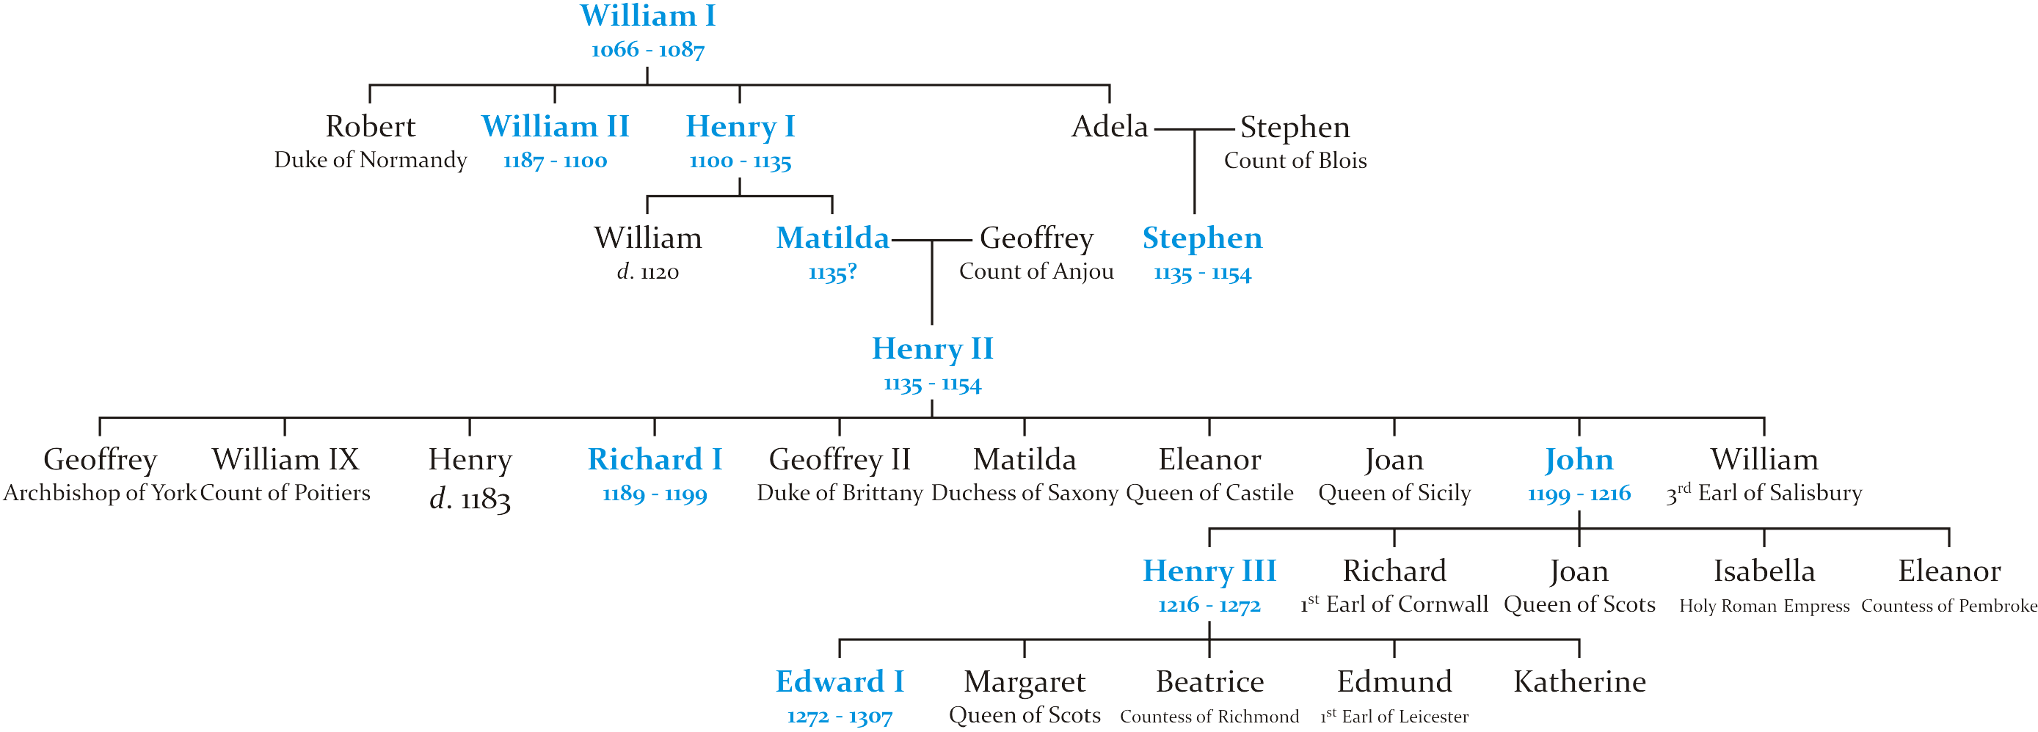
Magna Carta
When Henry I became king when his brother died, the abuses of his brother caused Henry I to limit his powers by issuing a Charter of Liberties in 1100

Slide 4
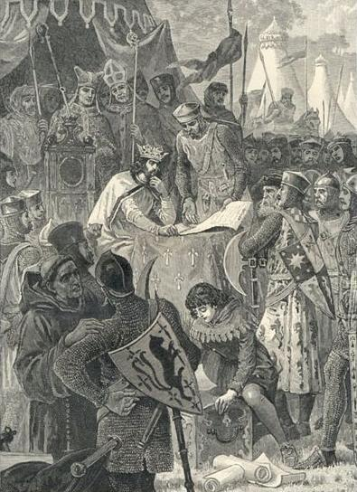
Magna Carta
The Magna Carta, or Great Charter, was signed in 1215 by King John at Runnymede
The taxes, excesses and arbitrary rule of King John caused his barons to rebel against his rule
John also lost Normandy and submitted to Pope Innocent III
The Magna Carta, based on the Charter of Liberties, was forced on King John
Pope Innocent III annulled the Charter, but it has never-the-less remained in force despite papal interference

Slide 5
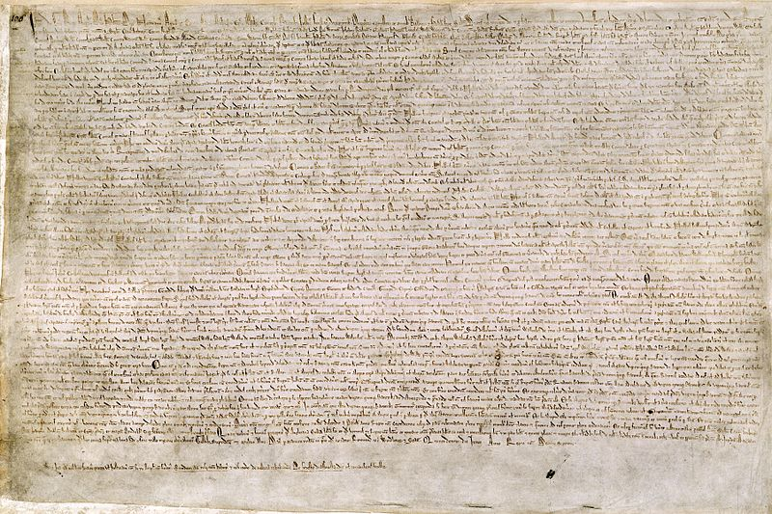
Magna Carta
While the charter was central to the establishment of Parliament, it also contained a clause enshrining the right to due process — it is still in effect today in Britain:
29. NO Freeman shall be taken or imprisoned, or be disseised of his Freehold, or Liberties, or free Customs, or be outlawed, or exiled, or any other wise destroyed; nor will We not pass upon him, nor condemn him, but by lawful judgment of his Peers, or by the Law of the land. We will sell to no man, we will not deny or defer to any man either Justice or Right.

Slide 6
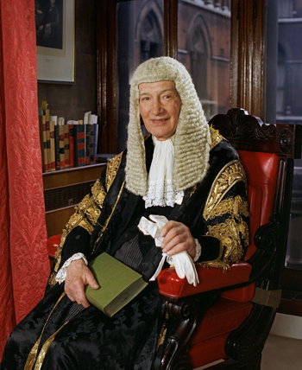
Magna Carta
In the words of Lord Denning, one of England’s premiere jurists, describes it as:
“the greatest constitutional document of all times – the foundation of the freedom of the individual against the arbitrary authority of the despot”

Slide 7
Habeas corpus
The concept of habeas corpus, or “may you have the body” requires that a person under arrest must be brought before a judge
First recorded use was in 1305 under King Edward I:
habeas corpus ad subjiciendum
King Henry II issued similar writs with similar effect 150 years before this
Habeas corpus simply guarantees any detention forbidden by law

Slide 8
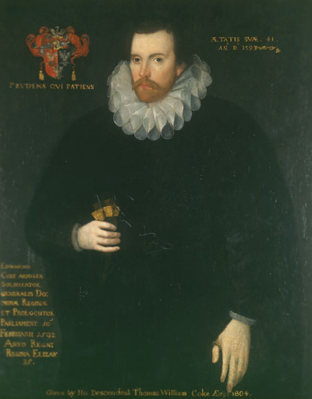
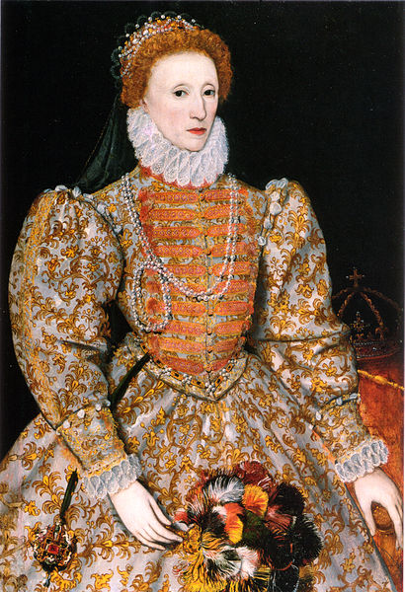
Other Constitutional Acts
Sir Edward Coke was appointed Attorney General by Queen Elizabeth and is considered one of England’s finest jurist of that time
He was first to argue that many of the articles in the Magna Carta apply all and not just the nobility

Slide 9
Other Constitutional Acts
The Petition of Rights, 1628
Restricts non-Parliamentary taxation, forced billeting of soldiers, imprisonment without cause, and the use of martial law
The Habeus Corpus Act, 1679
This strengthened and codified the writ of habeas corpus
The Bill of Rights, 1689
No interference by the monarch with respect to taxation, laws, the freedom of having arms for defence, and the election of members of parliament
Freedom to petition the monarch without fear of retribution
The freedom of speech and debate in Parliament
No excessive bail and no cruel and unusual punishments
No standing army at a time of peace without Parliamentary approval

Slide 10
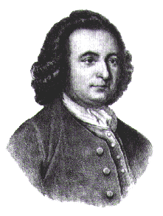
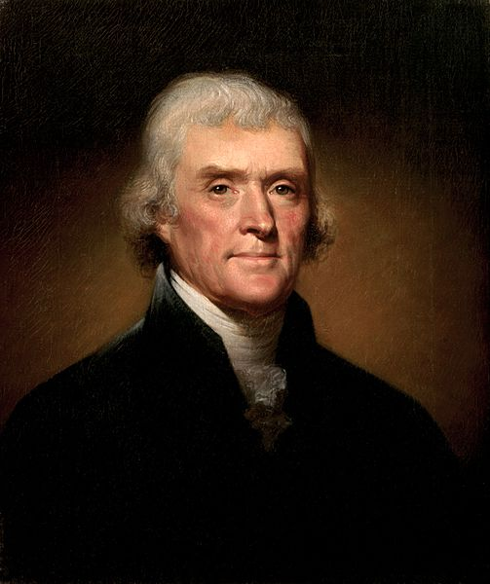
The United States Constitution
A next significant step in liberty was with the founding of the United States of America
George Mason authored the Virginia Declaration of Rights, 1776
Thomas Jefferson drafted the Declaration of Independence, signed July 4, 1776
Both (and others) criticized the Constitution of 1789 for lacking any statement of rights
The Bill of Rights consisted of ten amendments to the Constitution and came into effect in 1791

Slide 11
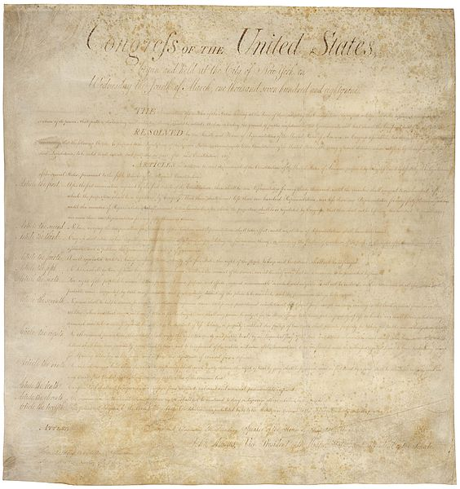
Bill of Rights

Slide 12
Bill of Rights
The Bill of Rights:
Freedom of religion, speech, the press, and assembly
The right to keep and bear arms
Protection from quartering of troops
Protection from unreasonable search and seizure
Due process, double jeopardy, against self-incrimination, and eminent domain
Trial by jury; rights of the accused to confront witnesses, a speedy and public trial, and right to counsel
Civil trial by jury
Prohibition of excessive bail and cruel and unusual punishment
Protection of rights not enumerated in the Constitution
Powers of the states and people

Slide 13
Bill of Rights
By integrating the Bill of Rights into the Constitution, this prevents any simple majority of the House of Representatives and the Senate to remove these rights
Removing or amending these rights requires a further constitutional amendment
This requires

Slide 14
Bill of Rights
Recall that the United States is a common-law country
Any interpretation of either the Constitution including any amendments requires one to understand not only the wording, but also precedence set with the interpretation
For example, in Board of Education of Kiryas Joel Village School District v. Grumet, 1994, Justice David Souter, writing for the majority, concluded that “government should not prefer one religion to another, or religion to irreligion.”

Slide 15
14th Amendment
As a demonstration that interpretation changes over time, the 14th amendment to the constitution in 1868:
In Dred Scott v Sandford, 1857, the Supreme Court held that people of African descent could not be U.S. citizens
The 14th amendment corrected this
In Plessy v Ferguson, 1896, using the 14th amendment, the Supreme Court held that the states could impose segregation so long as they provided similar facilities — the “separate but equal” doctrine
In Brown v Board of Education, 1954, again using the 14th amendment, the Supreme Court held that state laws establishing separate public schools for black and white students unconstitutional

Slide 16
Why Discuss Britain and the States?
Both Britain and the United States are common-law countries and both have had unwritten or written constitutions for many hundreds of years
The interpretation of the constitutional documents is a matter which we will see in Canada, too, even though we’ve only had our constitution patriated in the last half century

Slide 17
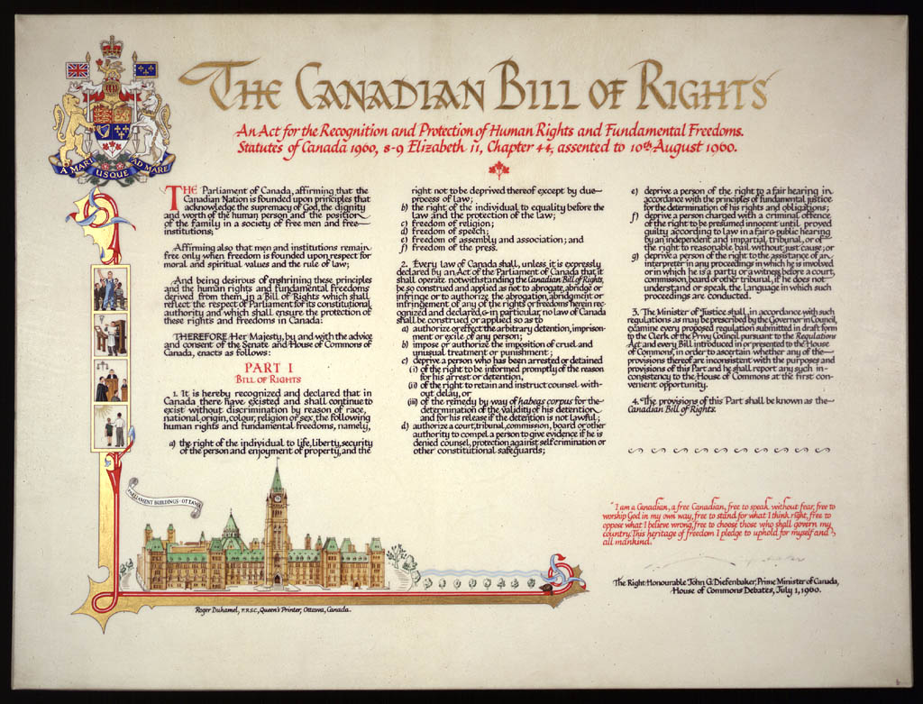
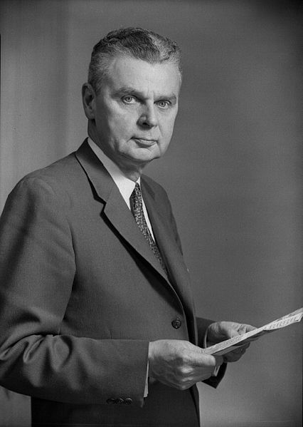
Canadian Bill of Rights
Prime Minister John Diefenbaker’s government introduced the Canadian Bill of Rights in 1960
The right to life, liberty, security and enjoyment of property
Equality under the law
Freedom of religion, speech, assembly and association, and the press

Slide 18
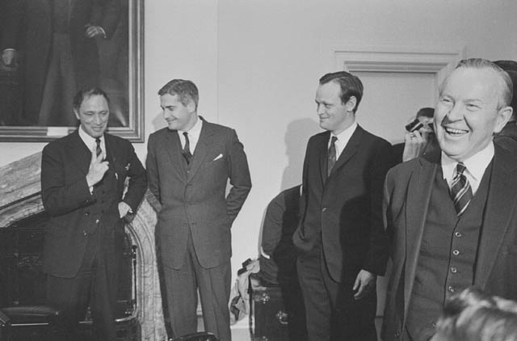
Pierre Elliot Trudeau
Here is a photograph of four Liberal Prime Ministers
Lester B. Pearson (right) abolished the death penalty and was awarded the Nobel Peace Prize
Pierre Elliot Trudeau is to the left
© National Archives Of Canada
Duncan Cameron / Library and Archives Canada

Slide 19
Pierre Elliot Trudeau
Pierre Elliot Trudeau was already a champion of liberty in Canada who, as Minister of Justice, introduced the Criminal Law Amendment Act, 1968-69
This act made numerous changes:
It decriminalized homosexuality
Allowed for abortions and contraception
Regulated lotteries, gun possession, drinking and driving offences, harassing phone calls, misleading advertising and cruelty to animals
“there’s no place for the state in the bedrooms of the nation”
User:Lawrytd

Slide 20
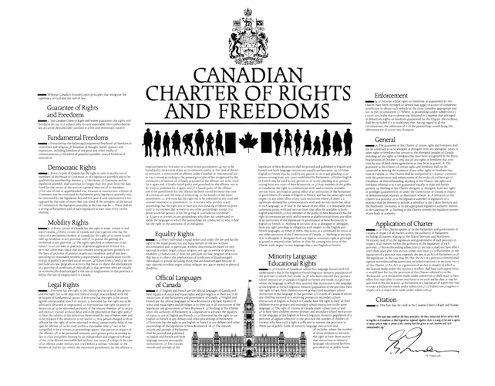
Pierre Elliot Trudeau
Weaknesses in the Canadian Bill of Rights and the success of the U.S. Bill of Rights led Trudeau to require the incorporation of the Charter in the Constitution Act, 1982
It forms the first 34 sections of the Act
Fundamental freedoms
Democratic, mobility, legal and equality rights
Official languages of Canada
Minority language education rights
Enforcement, general, and application
It is also subject to the notwithstanding clause (s. 33)

Slide 21
Guarantee of Freedoms
The Charter begins with:
1. The Canadian Charter of Rights and Freedoms guarantees the rights and freedoms set out in it subject only to such reasonable limits prescribed by law as can be demonstrably justified in a free and democratic society.
In Regina v Oakes, 1986, Chief Justice Dickson developed the Oakes test for violations:
There must be a pressing and substantial objective
The means must be proportional
The means must be rationally connected to the objective
There must be minimal impairment of rights
There must be proportionality between the infringement and objective
User: Mjpresson

Slide 22
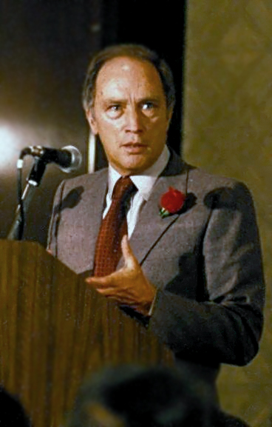
Freedoms
The fundamental freedoms of Canadians are:
Everyone has the following fundamental freedoms:
(a) freedom of conscience and religion;
(b) freedom of thought, belief, opinion and expression, including freedom of the press and other media of communication;
(c) freedom of peaceful assembly; and
(d) freedom of association.
Chiloa

Slide 23
Democratic Rights
The democratic rights are:
Every citizen of Canada has the right to vote in an election of the members of the House of Commons or of a legislative assembly and to be qualified for membership therein.
(1) No House of Commons and no legislative assembly shall continue for longer than five years from the date fixed for the return of the writs at a general election of its members. (2) The war, invasion or insurrection exception…
There shall be a sitting of Parliament and of each legislature at least once every twelve months.

Slide 24
Mobility Rights
The mobility rights include:
(1) Every citizen of Canada has the right to enter, remain in and leave Canada. (2) Every citizen of Canada and every person who has the status of a permanent resident of Canada has the right
a) to move to and take up residence in any province; and b) to pursue the gaining of a livelihood in any province.

Slide 25
Legal Rights
The legal rights include:
Everyone has the right to life, liberty and security of the person…
Everyone has the right to be secure against unreasonable search or seizure.
Everyone has the right not to be arbitrarily detained or imprisoned.
Everyone has the right on arrest or detention to be informed promptly of the reasons therefore, to retain and instruct counsel without delay and to be informed of that right, and the habeas corpus clause.
Any person charged with an offence has the right to be informed of the specific offence, be tried within a reasonable time, not be compelled to be a witness, be presumed innocent, not be denied reasonable bail, be tried by a jury if the maximum punishment is five or more years, not be found guilty unless the action constituted an offence, not to be tried again, and receive a lesser punishment.

Slide 26
Legal Rights
The legal rights include:
Everyone has the right not to be subjected to any cruel and unusual treatment or punishment.
A witness who testifies in any proceedings has the right not to have any incriminating evidence so given used to incriminate that witness in any other proceedings, …
A party or witness in any proceedings who does not understand or speak the language in which the proceedings are conducted or who is deaf has the right to the assistance of an interpreter.

Slide 27
Equality Rights
The next section is a guarantee of equal rights:
15. (1) Every individual is equal before and under the law and has the right to the equal protection and equal benefit of the law without discrimination and, in particular, without discrimination based on race, national or ethnic origin, colour, religion, sex, age or mental or physical disability. . (2) Subsection (1) does not preclude any law, program or activity that has as its object the amelioration of conditions of disadvantaged individuals or groups including those that are disadvantaged because of race, national or ethnic origin, colour, religion, sex, age or mental or physical disability.

Slide 28
Remaining Sections
The next sections cover the official languages of Canada, minority language education rights, the enforcement of the Charter, and other general sections

Slide 29
Application
Section 32 states that the Charter only applies to the federal and provincial governments:
32. (1) This Charter applies a) to the Parliament and government of Canada in respect of all matters within the authority of Parliament including all matters relating to the Yukon Territory and Northwest Territories; and b) to the legislature and government of each province in respect of all matters within the authority of the legislature of each province.
(2) S. 15 (equality rights) does not come into effect until 1985.
We will next look at the Canadian Human Rights Act and the Ontario Human Rights Code

Slide 30
Notwithstanding Clause
However, the charter need not apply if the legislature says so:
(1) Parliament or the legislature of a province may expressly declare in an Act of Parliament or of the legislature that the Act or a provision thereof shall operate notwithstanding a provision included in section 2 or sections 7 to 15. . (2) An Act or a provision of an Act in respect of which a declaration made under this section is in effect shall have such operation as it would have but for the provision of this Charter referred to in the declaration. . (3) A declaration made under subsection (1) shall cease to have effect five years after it comes into force or on such earlier date as may be specified in the declaration.
(4) Parliament or the legislature of a province may re-enact a declaration made under subsection (1).
(5) Subsection (3) applies in respect of a re-enactment made under subsection (4).

Slide 31
Notwithstanding Clause
Basically, any Act of Parliament or of a legislature may violate the fundamental freedoms, the legal rights or the equality rights of Canadians as long as the act expressly says it is doing so
The assumption is that no legislature will explicitly tell Canadians that a particular law is removing their rights without telling them
All other rights are inalienable
Recall that five years is the maximum time that any legislature can sit before an election
If the next sitting does not find a majority to support re-enacting the declaration, it is no longer in effect and the act or provision can be challenged under the Charter

Slide 32
Charter of Rights and Freedom
Criticisms:
It gives significantly increases judicial power
This contrasts with the concept of Supremacy of Parliament
Michael Mandel asserts that the Charter makes Canada more like the United States with emphasis on individual and corporate rights, as opposed to group and social rights

Slide 33
Charter of Rights and Freedom
Note that the notwithstanding clause creates a hybrid between the British and American systems
The charter is a written collection of rights embedded in the Constitution Act, 1982
The notwithstanding clause, however, protects the Supremacy of Parliament
In the words of Jean Chrétien, it prevents the Supreme Court from legalizing hate speech or child pornography as freedom of expression

Slide 34
Use of the Clause
To date, the federal government has not used the clause
Alberta attempted to use the clause to protect its Marriage Act to include an opposite-sex-only definition of marriage
The Supreme Court, however, found the law to be ultra vires – marriage is strictly a federal matter
The Parti Québécois automatically included the wording in all of its laws in 1982
Bill 101 was found to be unconstitutional because it restricted commercial signs in any language other than French
Bill 178 used the clause to insulate it from the Charter
When it was criticized by the UN Human Rights Committee, Robert Bourassa finally amended the law so as to not require the clause
Saskatchewan unnecessarily employed the clause in back-to-work legislation
Thomas Kierans

Slide 35
Interpretation of the Charter
The Supreme Court of Canada is the final interpreter of the Constitution and therefore also the Charter
If a legislative body does not accept the ruling of the Supreme Court, their only possible option is the notwithstanding clause—and that is only one small component of the Constitution Act
In theory, the Parliament of Canada could remove the Supreme Court of Canada with a simple majority vote (the Supreme Court Act is not more than a federal statute)

Slide 36
Interpretation of the Charter
We will look at how the Section 15 has been interpreted over the past three decades
The burden of proof that a violation of equality rights is always on the claimant
The current test is from Andrews v Law Society of British Columbia, 1989:
Is there differential treatment on analogous or enumerated ground?
Does this ground cause prejudice or stereotyping?

Slide 37
Interpretation of the Charter
The critical words in the section are:
Every individual is equal before and under the law and has the right to the equal protection and equal benefit of the law without discrimination and, in particular, without discrimination based on race, national or ethnic origin, colour, religion, sex, age or mental or physical disability.
This suggests that the list that follows may not be exhaustive…

Slide 38
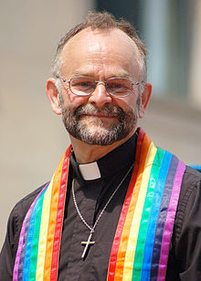
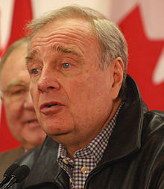
Interpretation of the Charter
The case of Egan v Canada, 1995, saw a gay couple in a conjugal relationship since 1948 and they claimed that the partner, Nesbit, should receive a spousal allowance
They lost on a split case (4-1-4), but it was clear that sexual orientation would be included in Section 15
The case of Halpern v Canada, 2003, found that the common-law definition of marriage as being between one man and one woman violated the Section 15
Two marriages performed to years prior by Brent Hawkes were declared legal
The federal government enacted the Civil Marriage Act in 2005 under Prime Minister Paul Martin
Marc Lostracco
Kate Gottli

Slide 39
Interpretation of the Charter
Other analogous grounds on which the government cannot discriminate include:
Marital status
Off-reserve aboriginal status
Citizenship

Slide 40
Interpretation of the Charter
At the same time, there are numerous grounds under which the government may discriminate:
Employment status
Being a litigant against the Crown
Membership in the military
Being a new resident of a province
Begging and extreme poverty

Slide 41
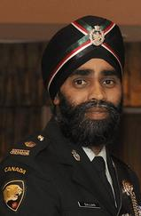
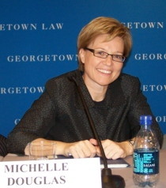
Consequences in the Military
Two consequences of the Charter affected the Canadian Military in the following decade:
Women were allowed to serve in the combat arms
I was the section commander of the first female infanteer in the Lincoln and Welland Regiment during her basic military training
A woman from my boot camp became the first female sergeant in my regiment
Women were finally (!?) allowed to wear kilts when serving in Scottish regiments in 1990
Sikhs were permitted to wear turbans in uniform
Homosexuals were permitted to serve in the military in 1992
http://www.gaymilitarysignal.com/0901Douglas.html
Lt. Col. Singh

Slide 42
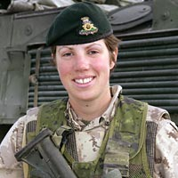
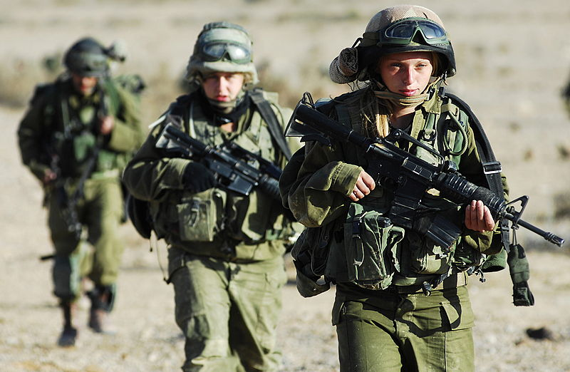
Consequences in the Military
Two consequences of the Charter affected the Canadian Military in the following decade:
In 2006, the first female infanteer died in combat
Note: infantryman → infanteer c.f., musketeer
In discussions with:
A female infanteer sergeant from my regiment
A female artillery officer from the 56th Field Artillery Regiment
A female combat engineering officer from the 31 Combat Engineer Regiment
it is clear that there are no issues with women in the combat arms…
Israel has also accepted women into the combat arms
DND
Karakal Winter Training

Slide 43
Summary
The history of the codification of rights and freedoms goes back to Norman England
Starting with the Magna Carta, numerous statutes provided for the rights of citizens
The United States enshrined the rights of its citizens in the Constitution as the first 10 ammendments
Canada passed its Bill of Rights in 1960
When Canada patriated its Constitution in 1982, Pierre Elliot Trudeau ensured the Charter was part of that Constitution
There is a notwithstanding clause
The Supreme Court can and will interpret the Charter

Slide 44
References
[1] Constitution Acts, http://laws-lois.justice.gc.ca/eng/Const/page-15.html#h-39
[2] Wikipedia, http://www.wikipedia.org/
These course slides are provided for the ECE 290 class. The material in it reflects Douglas Harder’s best judgment in light of the information available to him at the time of preparation. Any reliance on these course slides by any party for any other purpose are the responsibility of such parties. Douglas W. Harder accepts no responsibility for damages, if any, suffered by any party as a result of decisions made or actions based on these course slides for any other purpose than that for which it was intended.

