Slide 1
Common Law: Introduction and History
Douglas Wilhelm Harder, M.Math. LEL
Department of Electrical and Computer Engineering
University of Waterloo
Waterloo, Ontario, Canada
ece.uwaterloo.ca
dwharder@alumni.uwaterloo.ca
© 2013 by Douglas Wilhelm Harder. Some rights reserved.

Slide 2
Outline
An introduction to the engineering profession, including:
Standards and safety
Law: Charter of Rights and Freedoms, contracts, torts, negligent malpractice, forms of carrying on business
Intellectual property (patents, trade marks, copyrights and industrial designs)
Professional practice
Professional Engineers Act
Professional misconduct and sexual harassment
Alternative dispute resolution
Labour Relations and Employment Law
Environmental Law

Slide 3
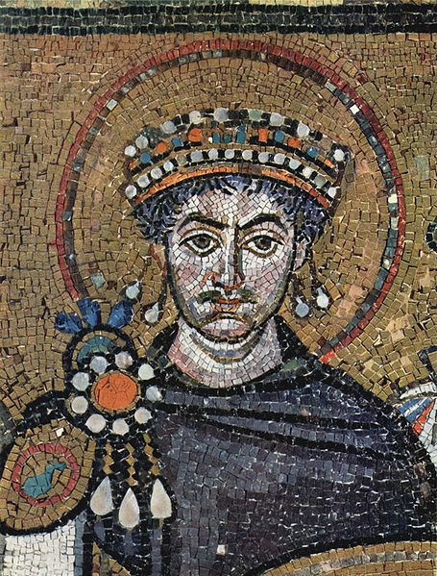
Civic Law
To understand the development of law, we must understand European history
Greek
Roman
British

Slide 4
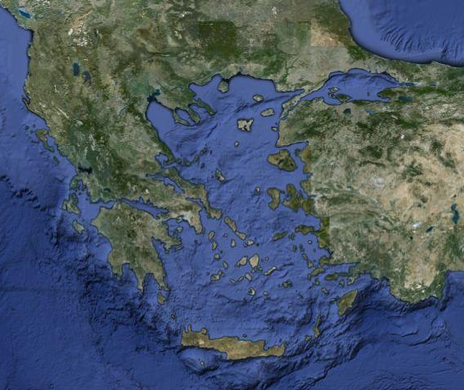
Greece
The Aegean Sea is a tectonic plate that straddles the Eurasian and African continents
The subduction zone and divergent movements result in a mountainous region with many islands

Slide 5
Greece
It is in this region that the Greek city-states developed
These were self-governing cities that were autonomous and independent
They were developed in a standard style, with an agora, acropolis, gymnasia, theatres, etc.
Plato’s The Republic is an analysis of the organization of these city-states
The term for these was polis (pl. poleis)
Derived words include:
Policy
Politics
Police

Slide 6
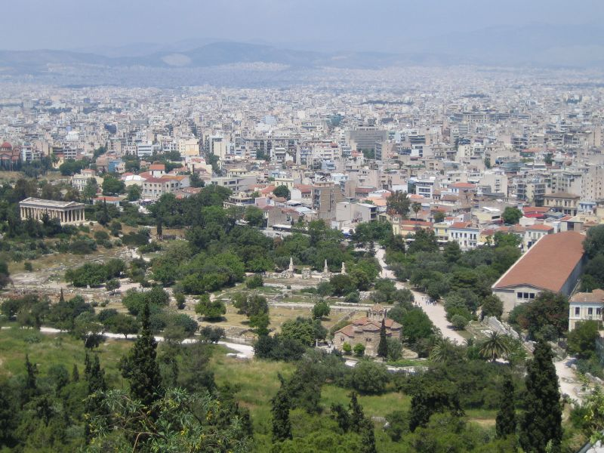
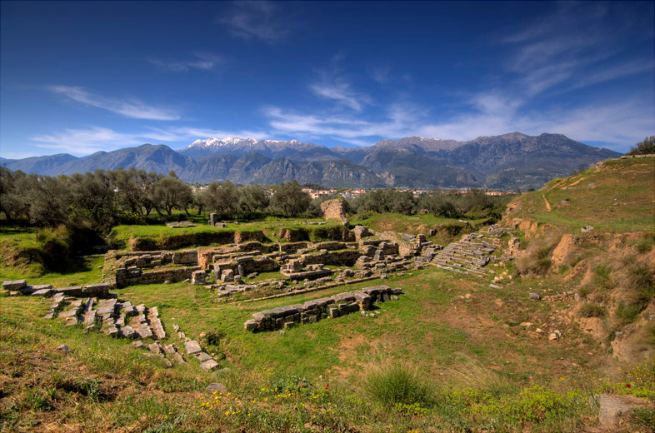
The Polis
Jeanhousen
Dennis and Aimee Jonez
Κούμαρης Νικόλαος
Hansueli Krapf

Slide 7
The Republic
Plato’s The Republic was written approximately 380 BCE in which he discusses ethics, justice, the just man and just polis
Plato uses Socrates to convey his ideas
The question: Who is happier, a just or unjust man?
Bertrand Russell organizes the books as follows:
Books 1-5: In attempting to define justice, we arrive at a Utopia: the ideal community run by guardians
Books 6-7: What is a philosopher, as philosophers are to rule Utopia
Books 7-10: the benefits and drawbacks of various forms of government, including timocracy, oligarchy, democracy and tyranny
The conclusion is that justice is better than injustice

Slide 8
The Roman Republic and Empire
The Roman Republic grew out of the Roman Kingdom
The term Senate comes from the Latin word senex for ‘old man’
During the kingdom, these were advisors to the king
When the king and his family were expelled in 509 BCE, new political institutions were developed

Slide 9
The Roman Republic and Empire
The Roman Republic grew out of the Roman Kingdom
The term Senate comes from the Latin word senex for ‘old man’
During the kingdom, these were the male patriarchs of the leading clans
When the king and his family were expelled in 509 BCE, new political institutions were developed

Slide 10
The Roman Republic
In the Roman Republic had an unwritten constitution set down by precedence and it evolved over time
There were elected legislative assemblies
These made laws
The Senate was filled by aristocrats
The senators made senatus consultum
Senators acted as judges
The executive aspect was initially filled by two elected consuls
They had a one-year term and each could veto the other
Later, other positions were created to ensure no one individual had too much power
For example, the censor maintained the census, supervised public morality and administered government finances
A dictator could be elected for six months at a time crisis

Slide 11
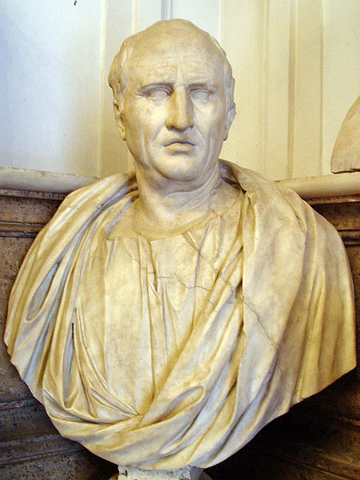
The Roman Republic
During this time, orators could speak on behalf of individuals and causes, but they could not take fees to do so
Orators were individuals skilled in rhetoric
Their purpose was to inform, persuade or motivate audiences
Cicero is the most renown Roman orator
User: Glauco92

Slide 12
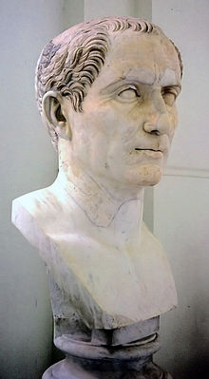
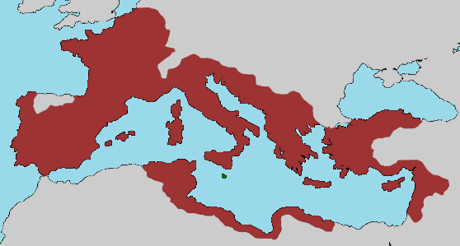
The Roman Republic
A constitutional crisis began approximately 133 BCE when a series of wars resulted in the polarization of Roman society into the wealthy and poor
It ended with Julius Caesar being elected dictator and then being elected dictator in perpetuo in 44 BCE — the year he was killed
Andreas Wahra
Alvaro qc

Slide 13
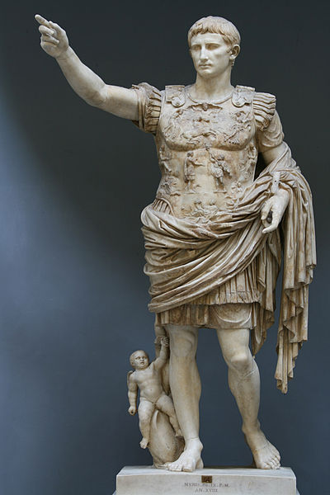
The Roman Empire
With the assassination of Julius Caesar, his nephew Octavian who declared himself Augustus
He declared himself imperator or “commander”
At this time, he maintained the Senate to keep the appearance of the Roman Republic — a time called the Principate
Till Niermann

Slide 14
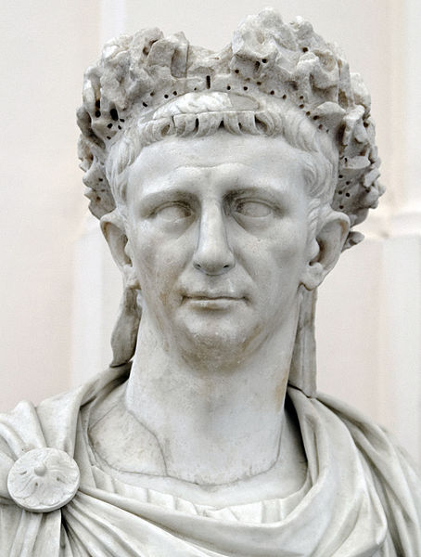
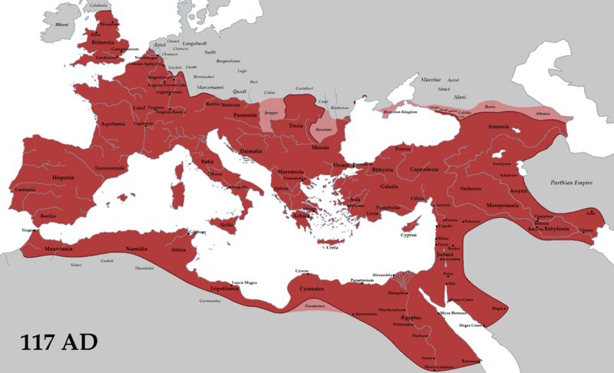
The Roman Empire
It was Caesar Claudius (41 – 54 CE) who legalized the profession of advocates
Claudius took a significant interest in the administration of justice
Most importantly, however, was that lawyers were now a profession within the Empire
User: Tataryn77
Marie-Lan Nguyen

Slide 15
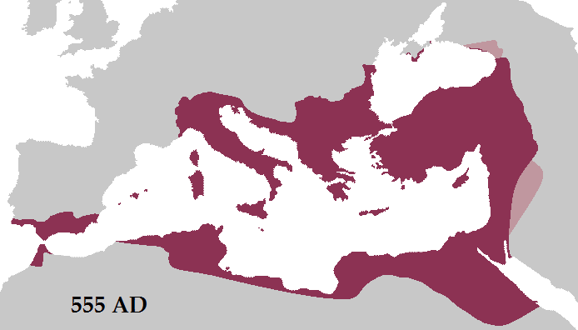
The Roman Republic and Empire
By 527 CE:
Any pretence of the Roman Republic was removed Dominate
The western Roman Empire collapsed
The capital was moved to Byzantium, renamed Constantinople
Jurisprudence was guided by a millennium of laws and precedence
Emperor Justinian I was determined to codify legal practice

Slide 16
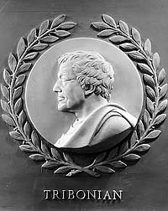
The Roman Republic and Empire
The Corpus Juris Civilis, the body of civil law, was prepared under his direction
The Code was a compilation imperial enactments
The Digest was a collection of extracts from the writings of Roman jurists
The Institutes is a student textbook
This would form the sole basis for law from the date of its issue forward
New laws were published in a fourth work:
New Constitutions (New Laws)

Slide 17
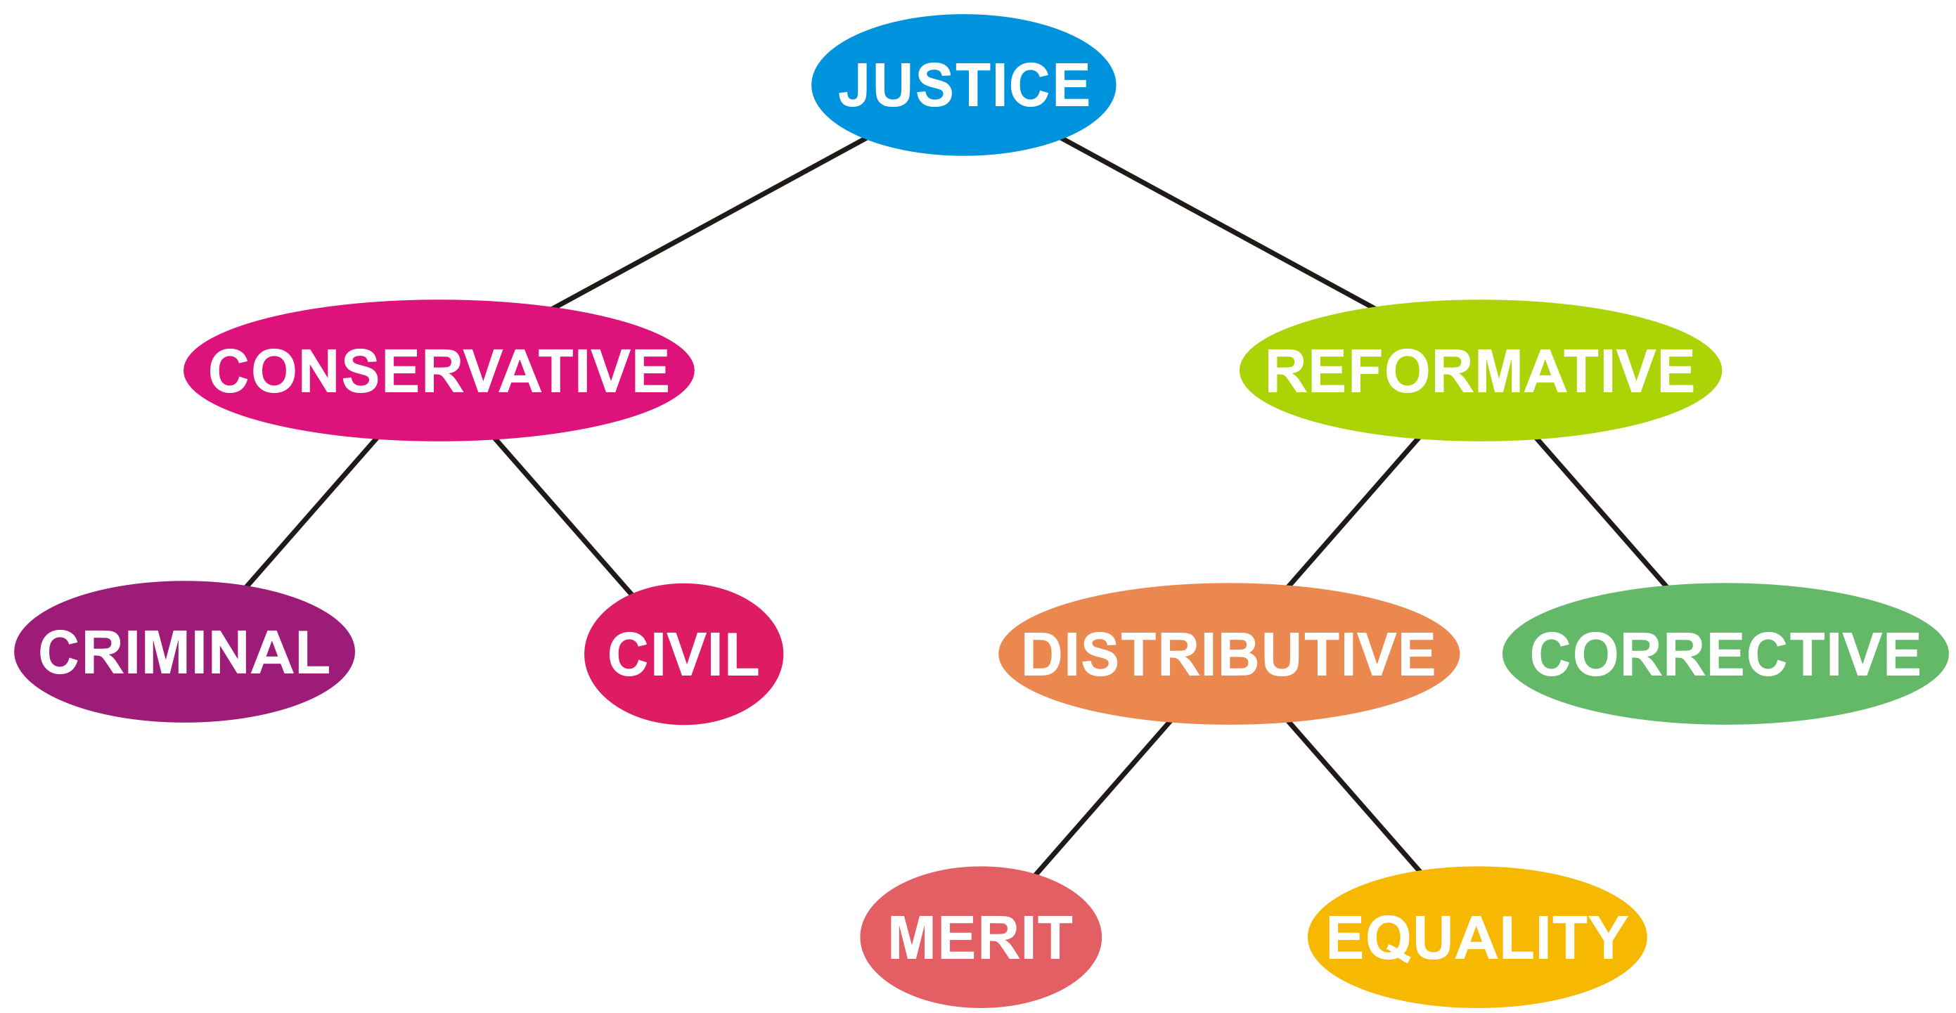
Civil Law as a Legal System
We have already used the terms “civil law” and “criminal law” when distinguishing the two conservative aspects of justice
This is one use of the term “civil law” and the one we will use in this course

Slide 18
Civil Law as a Legal System
Another different definition of “civil law” is any legal system that is based primarily on the interpretation of a legal code
The Corpus Juris Civilis defines a civil law system
The majority of countries in the world use legal system based on civil law

Slide 19
Civil Law as a Legal System
Subsequent codes defined civil legal systems throughout Europe, including:
The Bavarian Codex Maximilianeus bavaricus civilis of 1756
The Prussian Allgemeines Landrecht of 1794
The West Galician Code of 1797
The Frenche Code Napoléon of 1804
In civil law, a judge is bound only to interpret the civil code to each specific case
The decisions of one judge need not affect the decisions of another

Slide 20
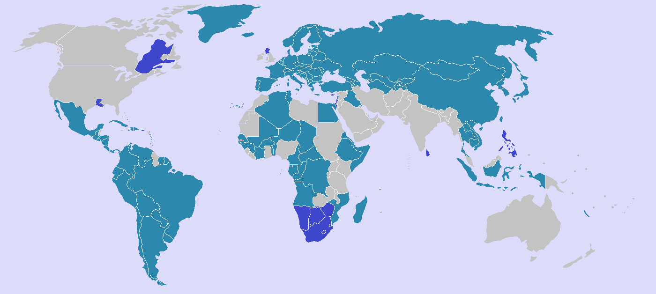
Civil Law as a Legal System
Legal codes form the basis of all civil law countries, including all countries coded in blue on this map

Slide 21
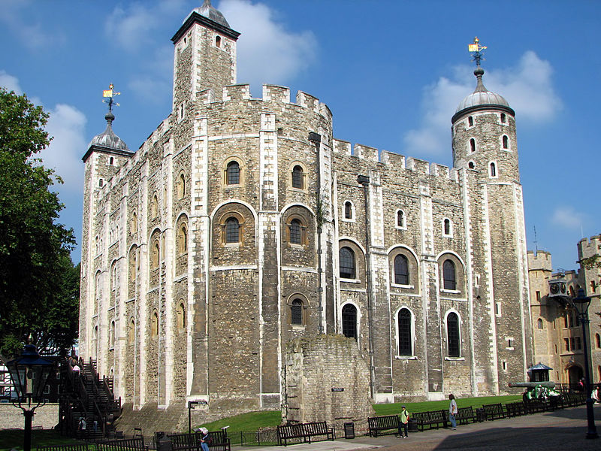
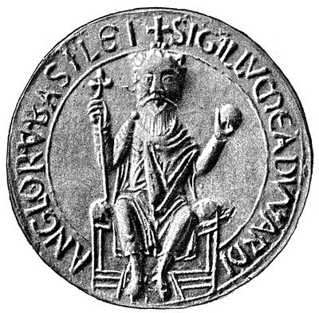
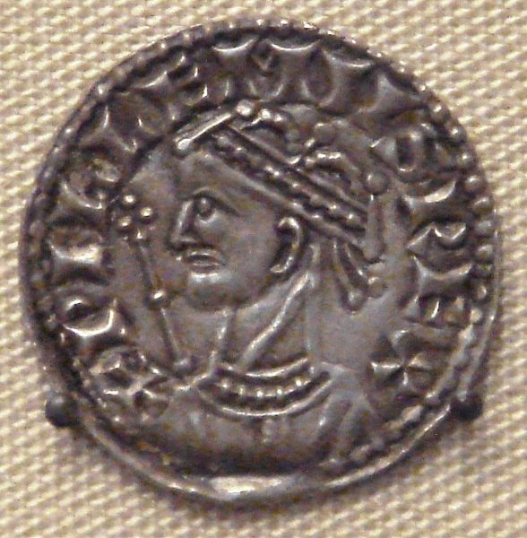
Common Law
When William the Conqueror invaded England in 1066, that would lead to the Norman subjugation of the native Angles, Saxons and other Germanic tribes that had migrated to England centuries earlier (c.f., Anglo-Saxon)
William and his son, Henry I, both promised to uphold the laws of the defeated Anglo-Saxon king, Edward the Confessor
Bernard Gagnon
Seal of Edward the Confessor
William the Conqueror

Slide 22
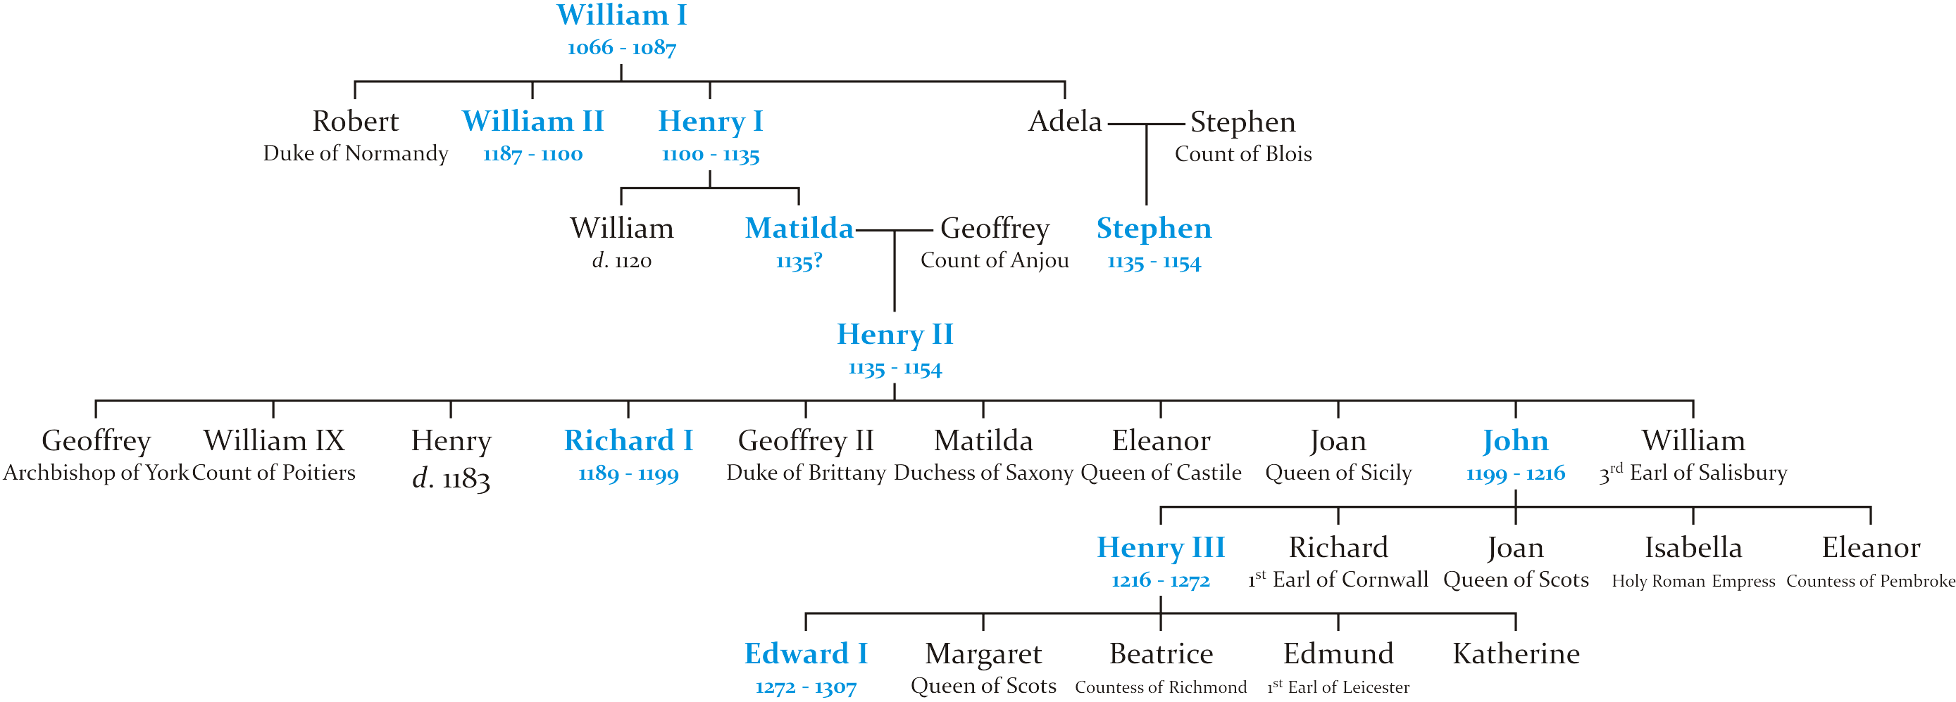
Common Law
King Henry II (r. 1154 – 1189) was the fifth Norman king of England
The civil war between Matilda and Stephen left England overrun with mercenaries — he designated Henry II to be his heir
Many nobles were also fighting in the crusades

Slide 23
Common Law
King Henry II (r. 1154 – 1189) was the fifth Norman king of England
With numerous ecclesiastical and civil courts with overlapping jurisdictions, and there were numerous issues with existing court rulings
He would intervene where he felt it was necessary and introduced reforms
Starting in 1176, travelling judges were sent throughout England in an attempt to enact a law common to all the lands of Henry II
These judges presided over both civil and criminal cases

Slide 24
Common Law
The travelling judges would render decisions in an ad hoc basis given Anglo-Saxon traditions and customs
These decisions would be recorded, and the judges would meet in London to discuss their decisions
Given a situation, if a particular ruling was agreed upon, it would form a precedence (stare decisis) that would bind future rulings
Stare decisis comes from a longer Latin phrase that translates as “to maintain decisions and to not affect what has been established”
Interpretations of traditions and customs would become fixed over time based on these precedents and thus there would be a common interpretation through England

Slide 25
Common Law
Incidentally, it is the intrusion of this more unified approach to law on the rights of ecclesiastic law that drew the ire of Thomas Becket, the Archbishop of Canterbury, who was then murdered
Henry II would have had members of the church who committed secular crimes be subject to his courts — something that the Catholic Church objected to
It seems little has changed in over 800 years

Slide 26
Common Law
The king travelled with a curia regis, or “king’s court”, which dealt with all executive, legislative, judicial, or diplomatic issues which may arise
As the king travelled, his courts would hear appeals from his subjects
The 1166 Assize of Clarendon was an act of Henry II that began the transition for the trying of felonies from trials by ordeal or battle to trials by jury requiring the examination of evidence and inquiry through trials by jury
Other similar acts transferred power from the local barons to the royal court and its judges

Slide 27
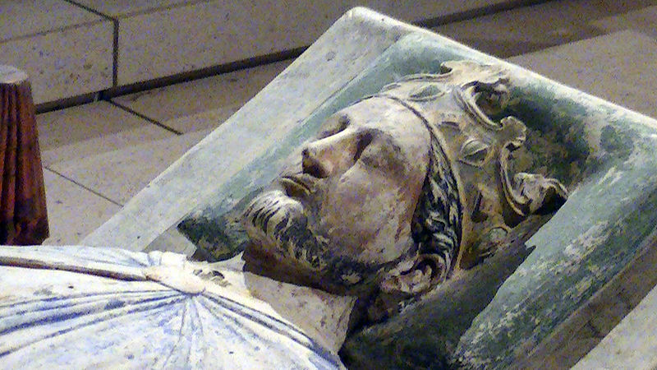
Common Law
The novel Ivanhoe recalls the conflicts between the Norman lords, the Saxons, the Catholic Church and Jews in England in 1194

Slide 28
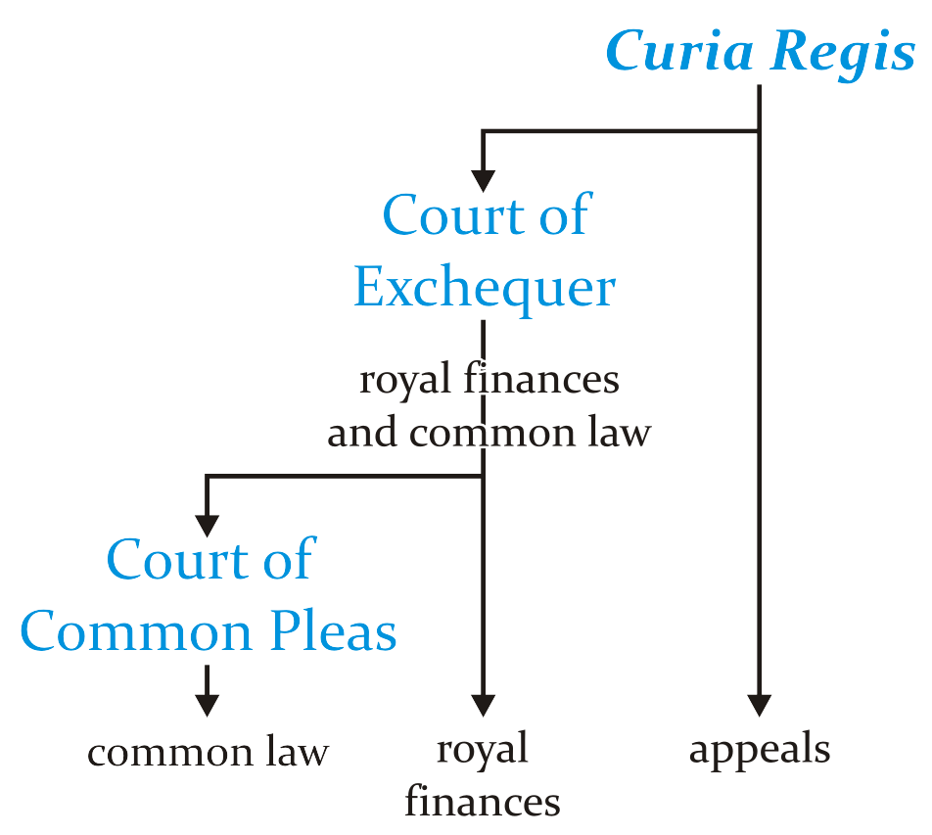
Common Law
During the 1190s, the Court of Exchequer was split from the King’s Court (or curia regis)
It heard matters of both royal finances and questions of common law above the jurisdiction of local courts
Soon thereafter, the Court of Common Pleas was created to deal strictly with common law issues
Its decisions would set precedence for local courts

Slide 29
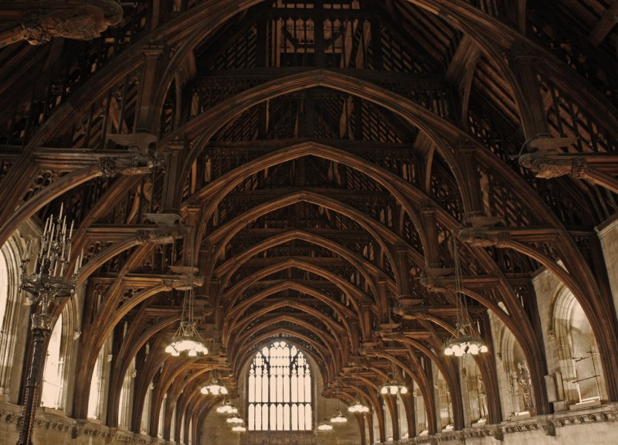
Common Law
The Magna Carta, or Great Charter, was signed in 1215 by King John at Runnymede
Clause 17 required that ordinary lawsuits are held in a fixed place
The Court of Common Pleas sat at Westminster Hall
This was the largest hall in Europe and its roof was an engineering feat of the time
With its significant power, this court became strict and conservative in its rulings
Gemma Minihan
http://ighthammote.co.uk/tag/westminster-hall/

Slide 30
Common Law
Due to the harshness of the Court of Common Pleas, soon after Magna Carta, the Court of Exchequer would often hear cases of common law if there was any question of debt to the king
This began a competition between the two courts for supremacy over the other — one that would last for 700 years

Slide 31
Equity
When it seems unjust to apply the full force of the law, a subject could appeal to the king for equity
Equity, n.
3. The recourse to general principles of justice (the naturalis æquitas of Roman jurists) to correct or supplement the provisions of the law.

Slide 32
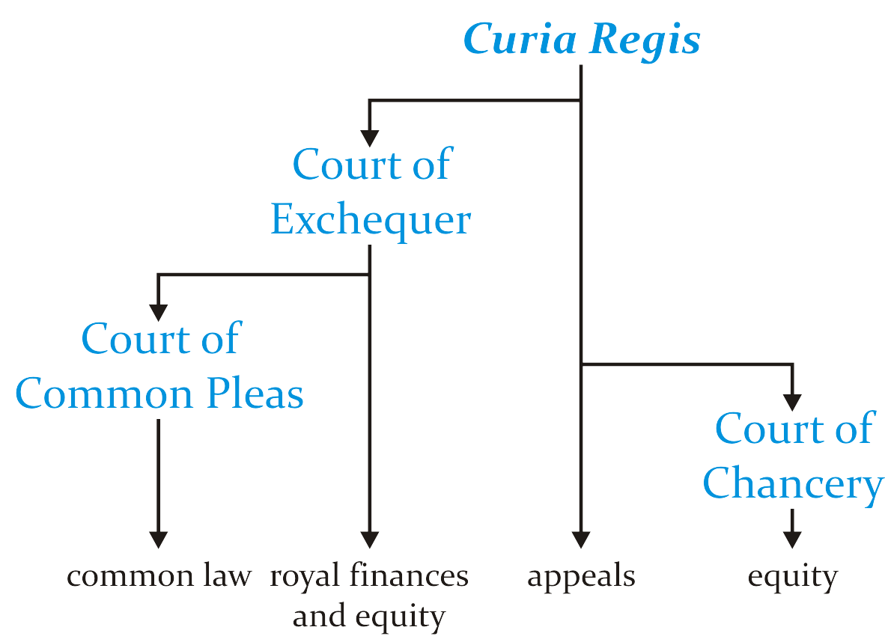
Equity
The Lord Chancellor, a member of the curia regis, was one of the highest ranking ministers of the King and responsible for the running of the courts
King Edward I referred petitions to the Court of Chancery
This became a court of equity,
Its purpose was to “mitigate the rigor of common law”

Slide 33
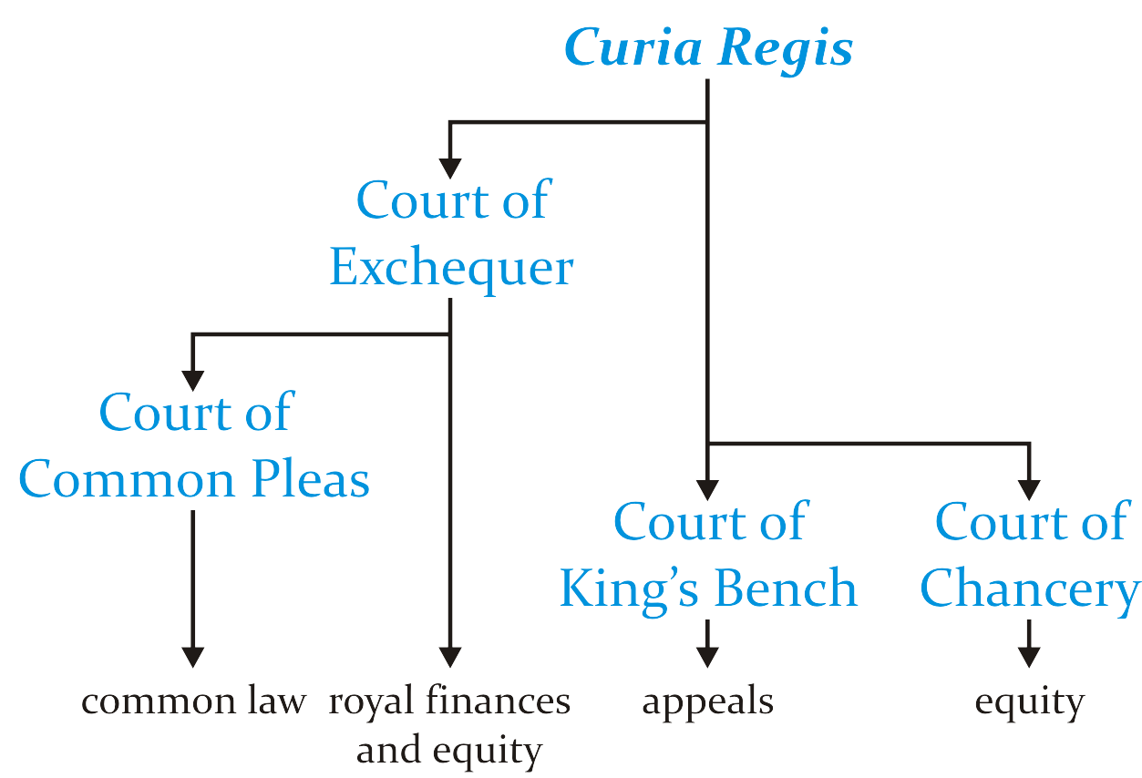
Equity
Finally, to add another court into the mix, the curia regis was reformed as the Court of King’s Bench
This became the court of appeals from either local courts or the Court of Common Pleas

Slide 34
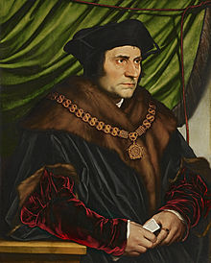
Equity
Lord Chancellors were drawn for a long time from the clergy
Being untrained in law, decisions of this court were often varying
Thomas More (1478 – 1535) was the first lawyer to be Lord Chancellor
All Chancellors after this point were lawyers
Records of decisions were kept, and doctrines on equity began to be formed

Slide 35
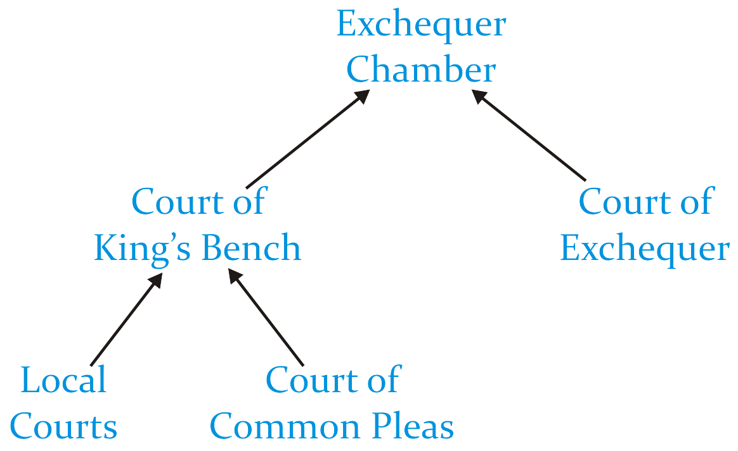
Equity
Edward III introduced an Exchequer Chamber which could hear appeals from lower courts
Over time, issues with the Court of Chancery, including tardiness and expense, caused many of the cases of equity to be transferred to the Court of Exchequer
There was always competition between the various courts
Which court had jurisdiction over a given matter?

Slide 36
Supreme Court
With the founding of the United States, the authors of the Constitution developed a single Supreme Court to decide matters of constitutional law
In Britain, it would be almost another century before the lower courts were merged and a single Supreme Court was introduced
Supreme Court of Judicature Acts of 1873 and 1875
All courts were now required to consider questions of equity and of common law
Canada would follow suit

Slide 37
Common Law Today
Today, the legal system known as common law refers to those systems where, in addition to statutes and regulations, legal decisions made by judges are binding on judges below them
There are three sources of law:
Acts of the legislatures
Regulations, codes, by-laws, etc.
Precedence set by previous judges

Slide 38
Common Law Today
Therefore, when studying any matter of common law, it is necessary to understand decisions made in previous cases
For example, significant components of contract law are entirely within the realm of common-law precedence
While there are some Acts of Parliament that affect the forming of contracts, e.g., the Statute of Fraud and the Competition Act, most issues surrounding contracts lies entirely in understanding precedence

Slide 39
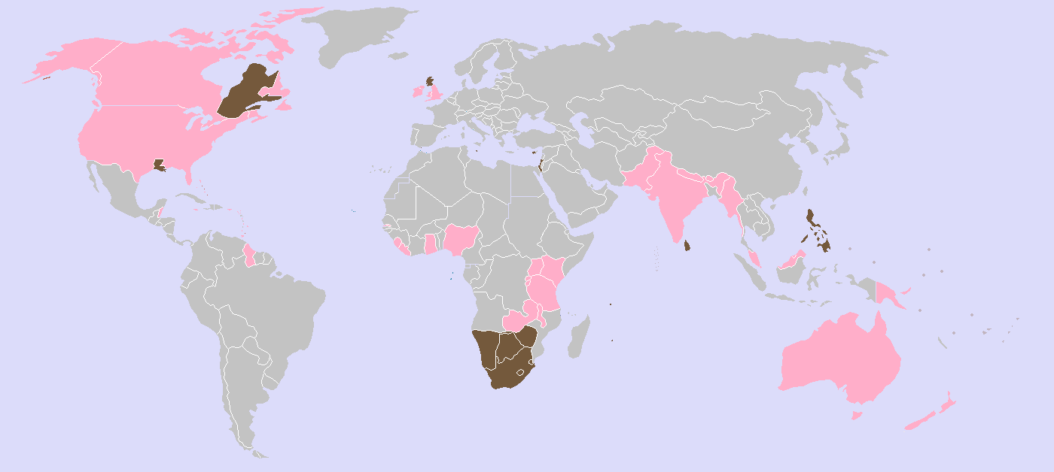
Common Law Today
Common law is used primarily in the United Kingdom and former British colonies
Most are in the Commonwealth of Nations

Slide 40
Common Law Today
The few exceptions are either former British mandates or associated with the United States
Israel
The Philippines
Liberia

Slide 41
Common Law Today
Some places use a hybrid of both common and civil law
In Quebec, federal law is common, while provincial law is civil

Slide 42
Common Law Today
One phenomenon in common law is that judges in one country have the option of citing decisions made by judges from other common law countries
One nice observation, the Supreme Court of New Zealand cites Canadian decisions more often than any other common-law country
Throughout this course, an understanding of common law and where it came from is necessary in order to make sense of both contract law and tort law

Slide 43
References
[1] D.L. Marston, Law for Professional Engineers, 4th Ed., McGraw Hill, 2008.
[2] Julie Vale, ECE 290 Course Notes, 2011.
[3] Wikipedia, http://www.wikipedia.org/
These course slides are provided for the ECE 290 class. The material in it reflects Douglas Harder’s best judgment in light of the information available to him at the time of preparation. Any reliance on these course slides by any party for any other purpose are the responsibility of such parties. Douglas W. Harder accepts no responsibility for damages, if any, suffered by any party as a result of decisions made or actions based on these course slides for any other purpose than that for which it was intended.

