Slide 1
Contract Law: Consideration
Douglas Wilhelm Harder, M.Math. LEL
Department of Electrical and Computer Engineering
University of Waterloo
Waterloo, Ontario, Canada
ece.uwaterloo.ca
dwharder@alumni.uwaterloo.ca
© 2013 by Douglas Wilhelm Harder. Some rights reserved.

Slide 2
Outline
An introduction to the engineering profession, including:
Standards and safety
Law: Charter of Rights and Freedoms, contracts, torts, negligent malpractice, forms of carrying on business
Intellectual property (patents, trade marks, copyrights and industrial designs)
Professional practice
Professional Engineers Act
Professional misconduct and sexual harassment
Alternative dispute resolution
Labour Relations and Employment Law
Environmental Law

Slide 3
Contract Law
The five essential elements of a contract are:
An offer is made and accepted
There is mutual intent to enter into the contract
Consideration
Capacity to contract
Lawful purpose

Slide 4
Consideration
For an agreement to be legally binding, each party must have a reason for entering into the contract: something which would have made them consider entering into the contract

Slide 5
Definition
Consideration, n.
The taking into account of anything as a motive or reason; a fact or circumstance taken, or to be taken, into account; a reason considered.
Something given in payment; a reward, remuneration; a compensation, equivalent.
Law. Anything regarded as recompense or equivalent for what one does or undertakes for another's benefit; especially, in the law of contracts, ‘the thing given or done by the promisee in exchange for the promise’ (Langdell 1880 §45). It may itself be a promise. No promise is enforceable without consideration, unless made by deed.
www.oed.com

Slide 6
Definition
For fun, the first legal use of the word consideration:
1530
Yf the promyse be so naked that there ys noo maner of consyderacyon why yt sholde be made, then I thynke hym not bounde to performe yt.
If the promise be so naked that there is no manner of consideration why it should be made, then I think him not bound to perform it.
www.oed.com
St. German’s Secunde Dyaloge Doctour & Student xxiv. f. lxiii

Slide 7
Alternate Considerations
What if you want to enter into a legally binding contract where you are getting absolutely nothing in return?
How do you demonstrate to the courts that you have actually given the matter serious consideration despite the fact that you potentially stand to gain nothing?

Slide 8
Alternate Considerations
Recall that making an irrevocable offer gives the offeror nothing in return: the only one to benefit from an irrevocable offer is the offeree
In that case, the offeror seals the contract:
The presence of a seal is an outward demonstration that you have, in fact, considered the contract and wish to enter into a legally binding agreement despite the fact you will potentially get nothing out of it

Slide 9
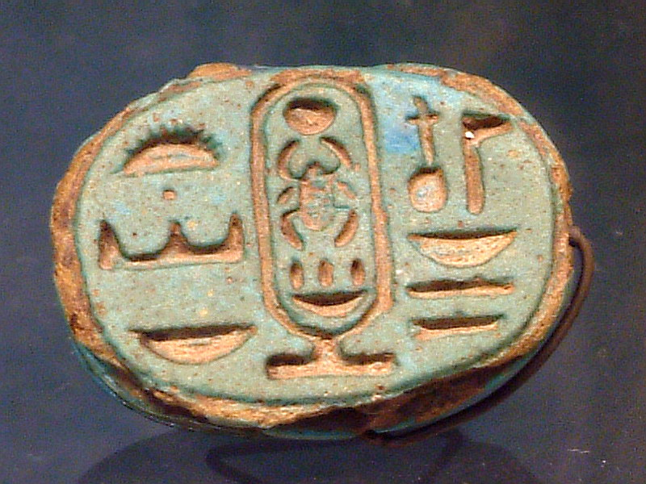
Alternate Considerations
A seal indicates that consideration has been given to an agreement and that the party wishes it to be legally binding
Guillaume Blanchard
http://www.kcdecorativeseal.com/
JP7

Slide 10
Alternate Forms
In Household Fire Insurance Company v Grant, 1878-9, Mr. Grant applied for shares of a company, a letter containing a notice of allotment was posted, but the letter failed to arrive
The company went bankrupt and Grant was asked for the outstanding payments on the shares
http://en.wikipedia.org/wiki/Household_Fire_and_Carriage_Accident_Insurance_Co_Ltd_v_Grant

Slide 11
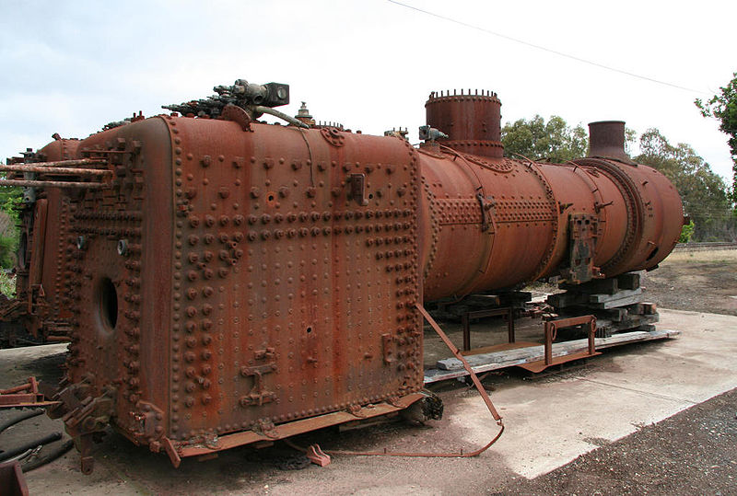
Acceptable Consideration
Consider Bainbridge v Firmstone, 1839
Bainbridge was in possession of a number of boilers and Firmstone requested permission to weigh the two of the boilers. Firmstone promised that he would, within a reasonable period of time, restore the boilers in working order.
Marcus Wong

Slide 12
Acceptable Consideration
Consider Bainbridge v Firmstone, 1839
After weighing the boiler, Firmstone refused to reassemble it claiming that Bainbridge had not received consideration and therefore no legally binding agreement existed
In his ruling, Patteson, J. said
“The consideration is, that Bainbridge, at Firmstone’s request consented to allow Firmstone to weigh the boilers. I suppose Firmstone thought he had some benefit; at any rate, there is a detriment to Bainbridge from his parting with the possession for even so short a time.”
Basically, being deprived of an item is as much consideration as receiving something

Slide 13
Acceptable Consideration
Consider Chapel v Nestle, 1960
Nestlé was offering a record if patrons would send in three wrappers of a particular 6d chocolates and 1/6
Chapel, the copyright owners to the record sought an injunction as they sold their records for 6/8 and the Copyright Act required that the copyright holders were entitled to 6.25 % of the price
Nestlé claimed the price was 1/6 and 1.125d per record was thus owed to Chapel
The House of Lords found that the wrappers were part of the consideration and thus upheld the injunction

Slide 14
References
[1] D.L. Marston, Law for Professional Engineers, 4th Ed., McGraw Hill, 2008.
[2] Julie Vale, ECE 290 Course Notes, 2011.
[3] Wikipedia, http://www.wikipedia.org/
These course slides are provided for the ECE 290 class. The material in it reflects Douglas Harder’s best judgment in light of the information available to him at the time of preparation. Any reliance on these course slides by any party for any other purpose are the responsibility of such parties. Douglas W. Harder accepts no responsibility for damages, if any, suffered by any party as a result of decisions made or actions based on these course slides for any other purpose than that for which it was intended.

