Slide 1
The Constitution Acts, 1867 and 1982
Douglas Wilhelm Harder, M.Math. LEL
Department of Electrical and Computer Engineering
University of Waterloo
Waterloo, Ontario, Canada
ece.uwaterloo.ca
dwharder@alumni.uwaterloo.ca
© 2013 by Douglas Wilhelm Harder. Some rights reserved.

Slide 2
Outline
An introduction to the engineering profession, including:
Standards and safety
Law: Charter of Rights and Freedoms, contracts, torts, negligent malpractice, forms of carrying on business
Intellectual property (patents, trade marks, copyrights and industrial designs)
Professional practice
Professional Engineers Act
Professional misconduct and sexual harassment
Alternative dispute resolution
Labour Relations and Employment Law
Environmental Law

Slide 3
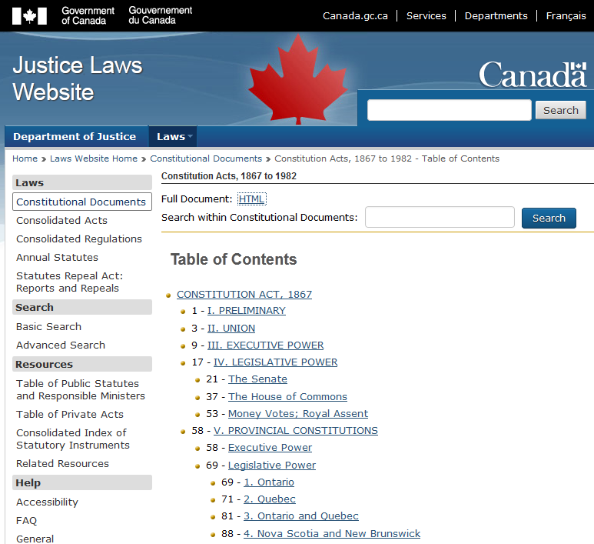
The Constitution
The Constitution Acts of 1867 and 1982 are the defining acts of Canada as a country
They lay the framework for the organization and operation of the government of Canada
http://laws.justice.gc.ca/eng/Const/

Slide 4
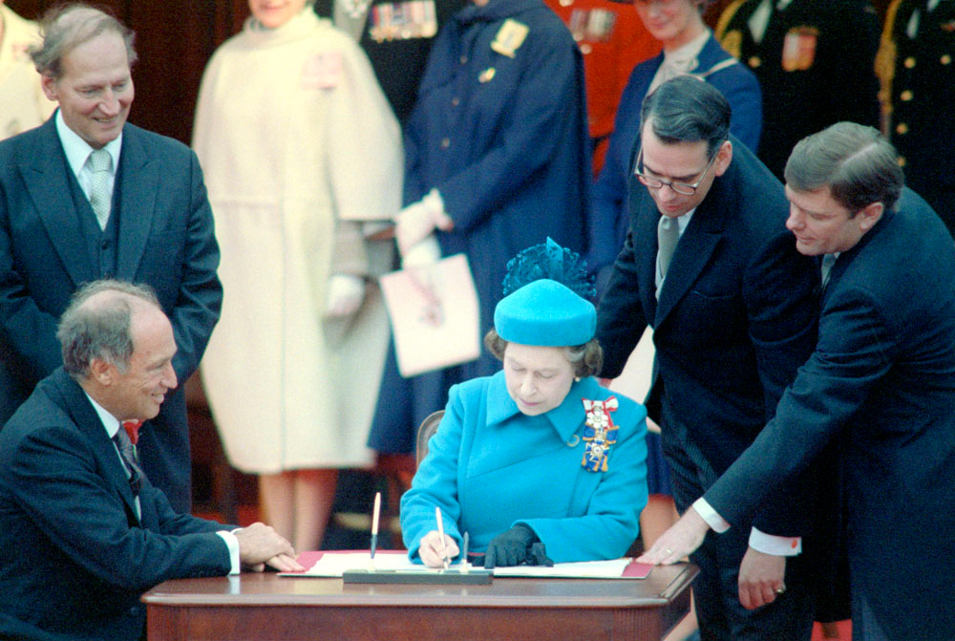
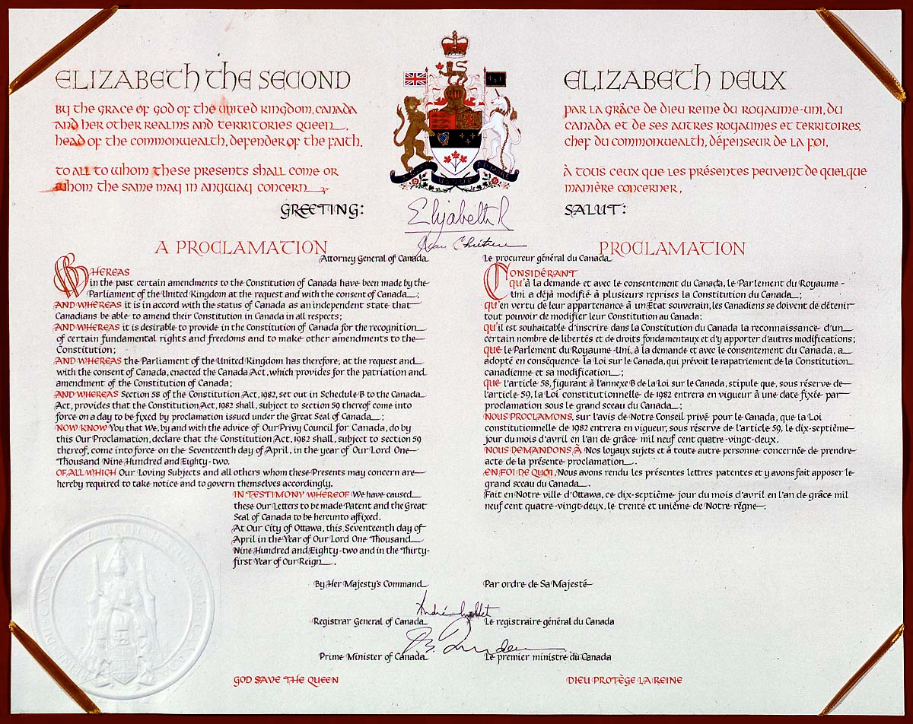
Patriation
The constitutional documents of Canada were patriated on April 17, 1982 under Pierre Elliot Trudeau and was signed by Her Majesty Queen Elizabeth II
Note: 1982417 is prime…

Slide 5
Constitution Act, 1867
The Constitution Act, 1867, defines:
Canada as a union of provinces
The executive power of the government
The legislative powers of the Senate and House of Commons
The executive and legislative powers of the provinces
These define the composition and running of the government and the various legislative bodies, e.g.,
Duration of House of Commons
50. Every House of Commons shall continue for Five Years from the Day of the Return of the Writs for choosing the House (subject to be sooner dissolved by the Governor General), and no longer.

Slide 6
Taxation and Expenditures
The constitution requires that any public spending or tax must come from the House of Commons
No other agency (private or governmental) can compel the government to spend money or raise taxes
53. Bills for appropriating any Part of the Public Revenue, or for imposing any Tax or Impost, shall originate in the House of Commons.

Slide 7
Distribution of Legislative Powers
Canada is a federation of provinces
The Head of State of Canada is the Queen who is represented by the Governor General
The Heads of States of each of the provinces is also the Queen, who is represented by the Lieutenant Governors
There is no hierarchy among the governors—they all directly represent Queen Elizabeth II

Slide 8
Distribution of Legislative Powers
What happens if the federal government passes a law on engineering and it is in opposition with a clause in the Professional Engineers Act, Ontario?
Which takes precedence?

Slide 9
Distribution of Legislative Powers
The constitution clearly marks out those matters in which the federal legislative bodies may pass legislation and those matters in which the provinces may act exclusively

Slide 10
Federal Powers
1A. The Public Debt and Property.
2. The Regulation of Trade and Commerce.
2A. Unemployment insurance.
3. The raising of Money by any Mode or System of Taxation.
4. The borrowing of Money on the Public Credit.
5. Postal Service.
6. The Census and Statistics.
7. Militia, Military and Naval Service, and Defence.
8. The fixing of and providing for the Salaries and Allowances of Civil and other Officers of the Government of Canada.
9. Beacons, Buoys, Lighthouses, and Sable Island.
10. Navigation and Shipping.
11. Quarantine and the Establishment and Maintenance of Marine Hospitals.
12. Sea Coast and Inland Fisheries.
13. Ferries between a Province and any British or Foreign Country or between Two
Provinces.
14. Currency and Coinage.
15. Banking, Incorporation of Banks, and the Issue of Paper Money.

Slide 11
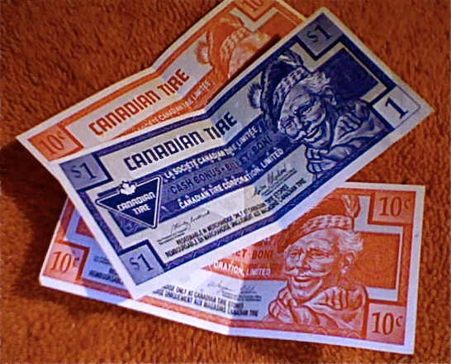
Federal Powers
16. Savings Banks.
17. Weights and Measures.
18. Bills of Exchange and Promissory Notes.
19. Interest.
20. Legal Tender.
21. Bankruptcy and Insolvency.
22. Patents of Invention and Discovery.
23. Copyrights.
24. Indians, and Lands reserved for the Indians.
25. Naturalization and Aliens.
26. Marriage and Divorce.
27. The Criminal Law, except the Constitution of Courts of Criminal Jurisdiction, but including the Procedure in Criminal Matters.
28. The Establishment, Maintenance, and Management of Penitentiaries.
29. Such Classes of Subjects as are expressly excepted in the Enumeration of the Classes of Subjects by this Act assigned exclusively to the Legislatures of the Provinces.
User: Tomasz Piwowarek

Slide 12
Provincial Powers
2. Direct Taxation within the Province in order to the raising of a Revenue for Provincial Purposes. 3. The borrowing of Money on the sole Credit of the Province.
4. The Establishment and Tenure of Provincial Offices and the Appointment and Payment of Provincial Officers.
5. The Management and Sale of the Public Lands belonging to the Province and of the Timber and Wood thereon.
6. The Establishment, Maintenance, and Management of Public and Reformatory Prisons in and for the Province. 7. The Establishment, Maintenance, and Management of Hospitals, Asylums, Charities, and Eleemosynary Institutions in and for the Province, other than Marine Hospitals. 8. Municipal Institutions in the Province.
9. Shop, Saloon, Tavern, Auctioneer, and other Licences in order to the raising of a Revenue for Provincial, Local, or Municipal Purposes.

Slide 13
Provincial Powers
10. Local Works and Undertakings other than such as are of the following Classes:
Lines of Steam or other Ships, Railways, Canals, Telegraphs, and other Works and Undertakings connecting the Province with any other or others of the Provinces, or extending beyond the Limits of the Province:
Lines of Steam Ships between the Province and any British or Foreign Country:
Such Works as, although wholly situate within the Province, are before or after their Execution declared by the Parliament of Canada to be for the general Advantage of Canada or for the Advantage of Two or more of the Provinces.
11. The Incorporation of Companies with Provincial Objects.
12. The Solemnization of Marriage in the Province.
13. Property and Civil Rights in the Province.
14. The Administration of Justice in the Province, including the Constitution, Maintenance, and Organization of Provincial Courts, both of Civil and of Criminal Jurisdiction, and including Procedure in Civil Matters in those Courts.
15. The Imposition of Punishment by Fine, Penalty, or Imprisonment for enforcing any Law of the Province made in relation to any Matter coming within any of the Classes of Subjects enumerated in this Section.
16. Generally all Matters of a merely local or private Nature in the Province.

Slide 14
Ultra Vires
If a federal or provincial law infringes on the matters on which the other has jurisdiction, that law (or clause) will be declared by a court to be ultra vires, i.e., beyond the powers
We will see ultra vires again when we look at corporations

Slide 15
Ultra Vires
Example: the draft federal Canadian Securities Act was to create a national securities regulator
There is significant harmony between the provinces and territories, but there are differences
The question posed to the Supreme Court was:
“Is the proposed Canadian Securities Act within the legislative authority of the Parliament of Canada?”
The Supreme Court ruled that the matter within the act was outside the control of the federal legislature

Slide 16
Ultra Vires
The Regulation of Trade and Commerce.
Included in the decision of the Supreme Court was:
“... Canada’s problem is that the proposed Act reflects an attempt that goes well beyond these matters of undoubted national interest and concern and reaches down into the detailed regulation of all aspects of securities. In this respect, the proposed Act is unlike federal competition legislation, which has been held to fall under s. 91(2) of the Constitution Act, 1867. It would regulate all aspects of contracts for securities within the provinces, including all aspects of public protection and professional competence within the provinces. Competition law, by contrast, regulates only anti-competitive contracts and conduct — a particular aspect of economic activity that falls squarely within the federal domain. In short, the proposed federal Act overreaches the legislative interest of the federal government.”

Slide 17
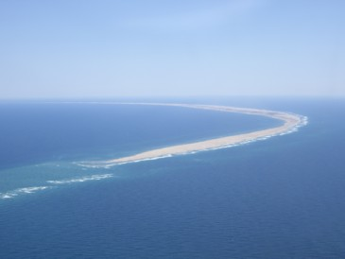
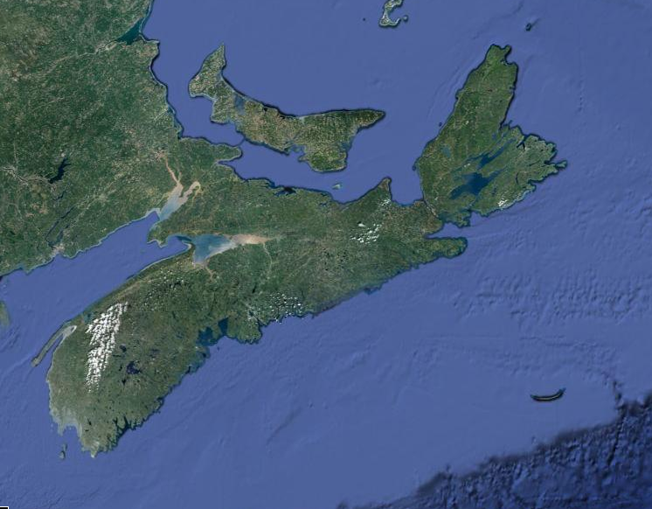
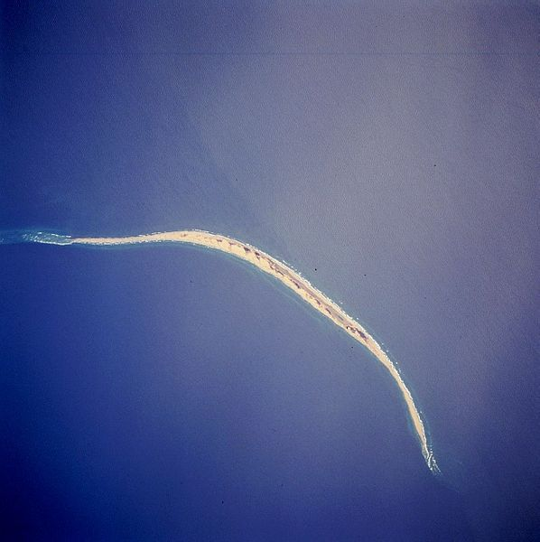
Sable Island?
Territorially, Sable Island belongs to Nova Scotia
User: HiFlyChick
© 2013 Terrametrics

Slide 18
Judicature
The Constitution Act, 1867, also describes aspects of the judiciary; however, the Supreme Court is not included in this document
The Supreme Court of Canada is regulated by the Supreme Court Act, 1985
General Court of Appeal, etc.
101. The Parliament of Canada may, notwithstanding anything in this Act, from Time to Time provide for the Constitution, Maintenance, and Organization of a General Court of Appeal for Canada, and for the Establishment of any additional Courts for the better Administration of the Laws of Canada.
It is possible for an Act of Parliament to abolish this court…

Slide 19
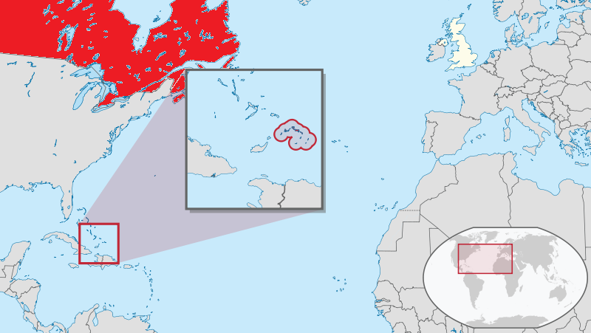
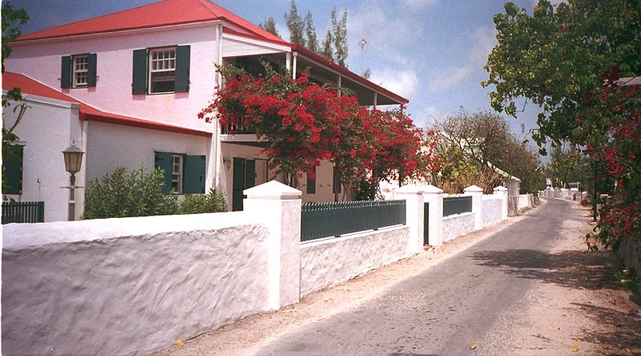
Admission of Other Colonies
Turks and Caicos, the most southeasterly islands in the Bahamian chain of islands, has proposed joining Canada
This would require a constitutional amendment
user: TUBS

Slide 20
Constitution Act, 1982
The core of the Constitution Act, 1982, is the Charter of Rights and Freedom
We will discuss the Charter in our next topic

Slide 21
Changing the Constitution
Prior to 1982, the Constitution Act, 1867, was the British North America Act, 1867 and was an act of the British parliament
Any change to this act required a simple majority of the British Houses of Commons and Lords
Fortunately, it has been 800 years since the Magna Carta and precedence barring such unilateral actions is clear
When the United Kingdom declared war in 1914, Canada was automatically a party to that declaration
In 1939, Canada was sufficiently distinct that its declaration of war was independent
The Canada Act, 1982, was passed in the British parliament granting Canada its own constitution

Slide 22
Changing the Constitution
As the constitution is now a Canadian Act, it must include in it a formula for constitutional changes
General procedure for amending Constitution of Canada
38. (1) An amendment to the Constitution of Canada may be made by proclamation issued by the Governor General under the Great Seal of Canada where so authorized by
(a) resolutions of the Senate and House of Commons; and
(b) resolutions of the legislative assemblies of at least two-thirds of the provinces that have, in the aggregate, according to the then latest general census, at least fifty per cent of the population of all the provinces.

Slide 23
References
[1] Constitution Acts, http://laws-lois.justice.gc.ca/eng/Const/index.html
[2] Wikipedia, http://www.wikipedia.org/
These course slides are provided for the ECE 290 class. The material in it reflects Douglas Harder’s best judgment in light of the information available to him at the time of preparation. Any reliance on these course slides by any party for any other purpose are the responsibility of such parties. Douglas W. Harder accepts no responsibility for damages, if any, suffered by any party as a result of decisions made or actions based on these course slides for any other purpose than that for which it was intended.

