Slide 1
Discipline and Enforcement
Douglas Wilhelm Harder, M.Math. LEL
Department of Electrical and Computer Engineering
University of Waterloo
Waterloo, Ontario, Canada
ece.uwaterloo.ca
dwharder@alumni.uwaterloo.ca
© 2012 by Douglas Wilhelm Harder. Some rights reserved.

Slide 2
Outline
An introduction to the engineering profession, including:
Standards and safety
Law: Charter of Rights and Freedoms, contracts, torts, negligent malpractice, forms of carrying on business
Intellectual property (patents, trade marks, copyrights and industrial designs)
Professional practice
Professional Engineers Act
Professional misconduct and sexual harassment
Alternative dispute resolution
Labour Relations and Employment Law
Environmental Law

Slide 3
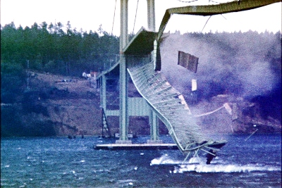
Mistakes
Engineers are human beings—they make mistakes
The goal is not to eliminate mistakes but rather to minimize the effects and to create a culture and work environment that reduces the likelihood of innocent mistakes occurring
In some cases, mistakes are unavoidable
Prior to the construction of the Tacoma Narrows Bridge, no engineer considered wind as a possible factor in the construction of a suspension bridge
The first Apollo mission saw the astronauts almost destroy the control panel when they loosened their straps
Barney Elliott

Slide 4
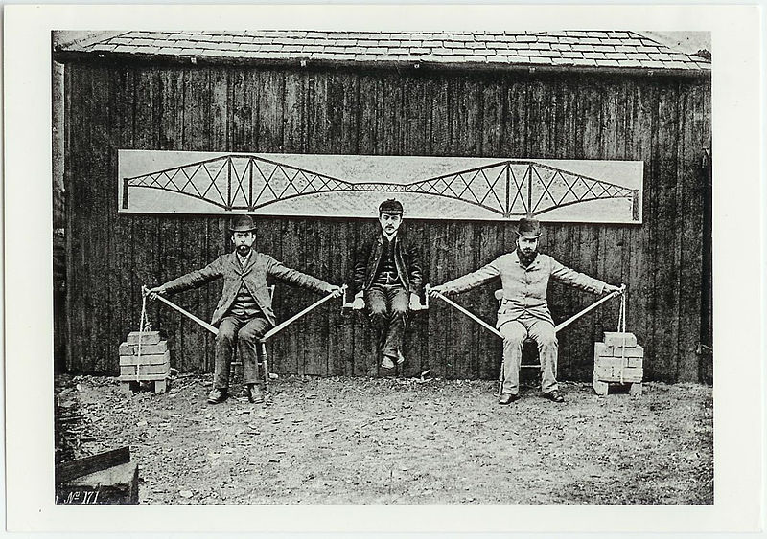
Mistakes
In other cases, mistakes result from carelessness or poor engineering practice
We will start by looking at the mistakes made in the Quebec Railway Bridge
The design was a cantilever bridge:
The lower members are under compression
The upper members in tension

Slide 5
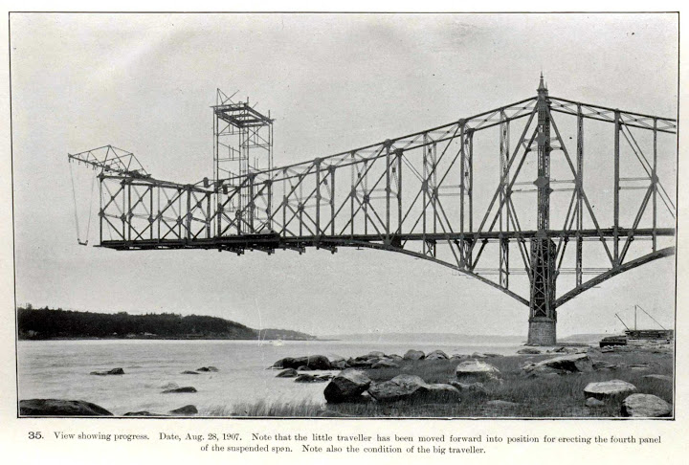
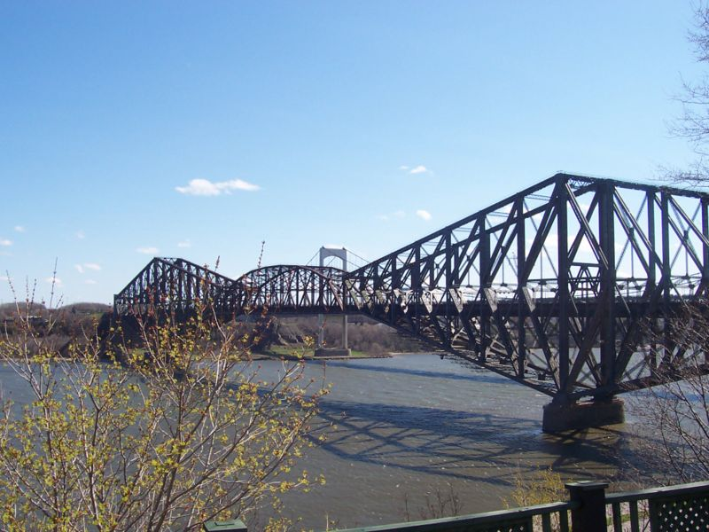
Mistakes
When the bridge was rebuilt, it was much more solid
User:Sébastien Savard

Slide 6
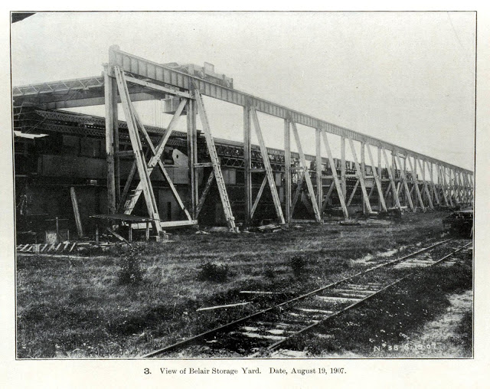
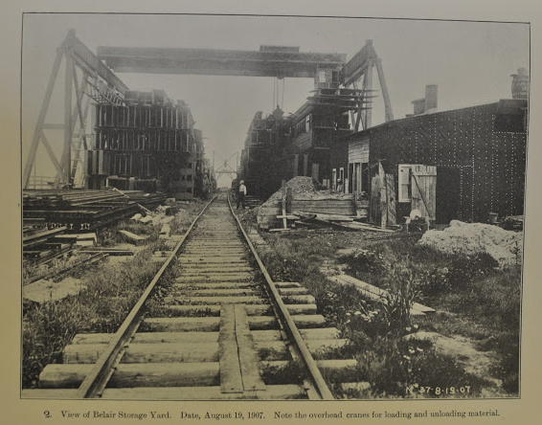
Mistakes
As only half the bridge was built, it was possible to inspect the members still in fabrication
“The work done by the Phoenix Bridge Company in making the detail drawings and in planning and carrying out the erection and by the Phoenix Iron Company in fabricating the material was good, and the steel used was of good quality. The serious defects were fundamental errors in design.”

Slide 7
Mistakes
There was insufficient money to perform anything more than the absolute minimum number tests required.
Response:
Engineering is not about getting the job done at the cheapest possible rate—it’s about reasonable pay for engineering work
A practitioner shall uphold the principle of adequate compensation for engineering work.

Slide 8
Mistakes
Cooper had designed bridges across North America and this was to be greatest work
Cooper, however, was almost 70 years old at the time of the disaster and had only visited the construction site twice
Response:
The idea of competence and that an engineer can have his or her licence revoked, suspended or limited in cases where the practitioner is found incompetent

Slide 9
Mistakes
There were bent members for almost a month prior to the collapse and workers were missing work rather than work on a bridge they felt was dangerous
Response:
Listen to your contractors and workers: you might have an engineering degree, but they will, at least for a few decades, more experience than you
Do not be embarrassed if you make a mistake—contractors know engineers are human, too, and they appreciate it when they acknowledge their mistakes...

Slide 10
Mistakes
The engineers all argued as to the cause of the bent members even though the inspectors stated that they were true when installed
They were bent while they were being built in Phoenix
They were damaged while being unloaded from the trains
They were damaged while being installed
Norman McLure was the only engineer who recognized the danger
Response:
An emphasis that engineers must co-operate in working with other professionals engaged on a project and that engineers should act towards other practitioners with courtesy and good faith

Slide 11
Mistakes
Cooper had curved members added to the structure for esthetic reasons—these increased the secondary stresses and added difficulties to fabrication
Response:
The focus that public safety is paramount

Slide 12
Mistakes
No set of final designs was ever prepared—all work was based on designs that had modifications and calculations using different notations
Response:
Any final designs, plans, drawings, or any other document must be sealed, dated and signed by the engineer
Contractors and officials are taught that a drawing should only be relied upon if it has been correctly sealed

Slide 13
Mistakes
The failure on the part of the Quebec Bridge and Railway Company to appoint an experienced bridge engineer to the position of chief engineer was a mistake.
Hoare restarted work after Norman McLure stopped construction two days prior to the collapse
Hoare seemed to be more interested in maintaining the schedule
Response:
The maxim that an engineer should not undertake work the practitioner is not competent to perform by virtue of the practitioner’s training and experience

Slide 14
Mistakes
The bridge was designed by Szlapka, the chief designer for the Phoenix Company and Cooper approved this design without thoroughly checking the calculations
Response:
The understanding that it is wrong to seal any final drawing, specification, plan, report or other document not actually prepared or checked by the practitioner

Slide 15
Mistakes
Cooper refused to submit his designs to an engineer who would have been appointed by the Ministry of Railways and Canals
Cooper claimed this would undermine his authority
Response:
Difficult—engineers have egos, and in some cases, great engineers have greater egos
Engineers must understand it does not undermine their authority to have someone else validate their work

Slide 16
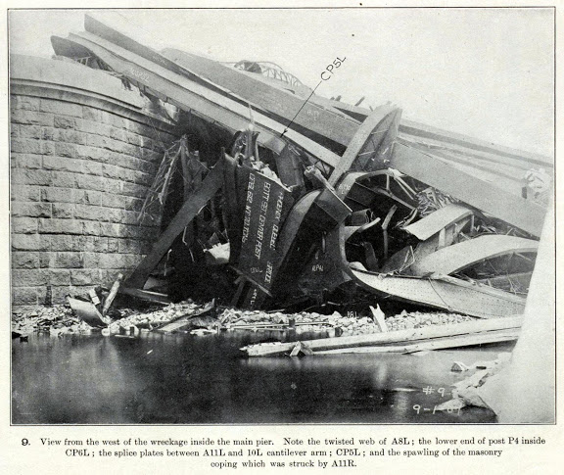
The Aftermath

Slide 17
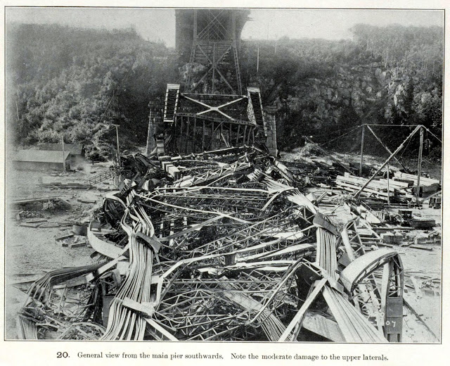
The Aftermath

Slide 18
The Aftermath

Slide 19
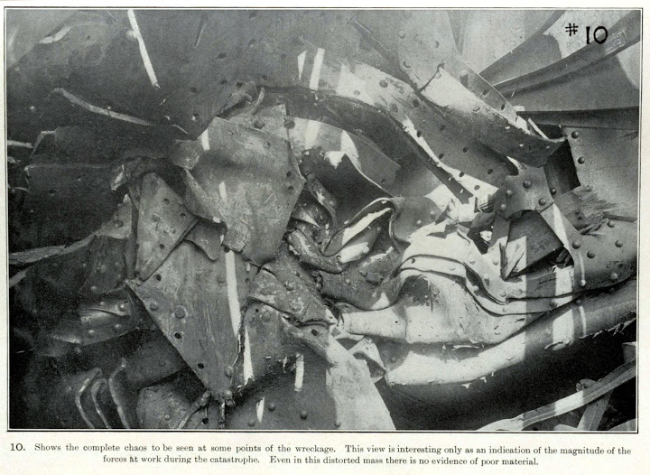
The Aftermath

Slide 20
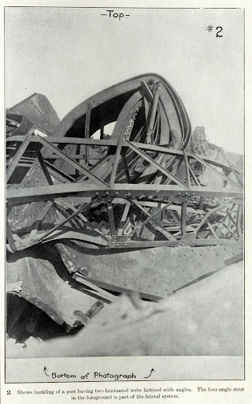
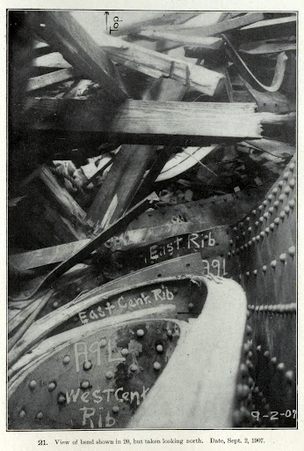
The Aftermath

Slide 21
Incompetence
Incompetence
28. (3) The Discipline Committee may find a member of the Association or a holder of a temporary licence, a provisional licence or a limited licence to be incompetent if in its opinion,
the member or holder has displayed in his or her professional responsibilities a lack of knowledge, skill or judgment or disregard for the welfare of the public of a nature or to an extent that demonstrates the member or holder is unfit to carry out the responsibilities of a professional engineer; or
the member or holder is suffering from a physical or mental condition or disorder of a nature and extent making it desirable in the interests of the public or the member or holder that the member or holder no longer be permitted to engage in the practice of professional engineering or that his or her practice of professional engineering be restricted.

Slide 22
Professional Misconduct
As a consequence of a number of engineering disasters, behaviour detrimental to acceptable practice and these have been collectively labeled as professional misconduct

Slide 23
Professional Misconduct
Section 72 (2) of O.Reg. 941 gives the definition of professional misconduct
You do not have to memorize these—they will be provided for you on both the mid-term and final examinations

Slide 24
Professional Misconduct
72. (2) For the purposes of the Act and this Regulation, “professional misconduct” means
(a) negligence; that is, an act or an omission in the carrying out of the work of a practitioner that constitutes a failure to maintain the standards that a reasonable and prudent practitioner would maintain in the circumstances

Slide 25
Professional Misconduct
72. (2) For the purposes of the Act and this Regulation, “professional misconduct” means
(b) failure to make reasonable provision for the safeguarding of life, health or property of a person who may be affected by the work for which the practitioner is responsible

Slide 26
Professional Misconduct
72. (2) For the purposes of the Act and this Regulation, “professional misconduct” means
(c) failure to act to correct or report a situation that the practitioner believes may endanger the safety or the welfare of the public

Slide 27
Professional Misconduct
72. (2) For the purposes of the Act and this Regulation, “professional misconduct” means
(d) failure to make responsible provision for complying with applicable statutes, regulations, standards, codes, by-laws and rules in connection with work being undertaken by or under the responsibility of the practitioner

Slide 28
Professional Misconduct
72. (2) For the purposes of the Act and this Regulation, “professional misconduct” means
(e) signing or sealing a final drawing, specification, plan, report or other document not actually prepared or checked by the practitioner

Slide 29
Professional Misconduct
72. (2) For the purposes of the Act and this Regulation, “professional misconduct” means
(f) failure of a practitioner to present clearly to the practitioner’s employer the consequences to be expected from a deviation proposed in work, if the professional engineering judgment of the practitioner is overruled by non-technical authority in cases where the practitioner is responsible for the technical adequacy of professional engineering work

Slide 30
Professional Misconduct
72. (2) For the purposes of the Act and this Regulation, “professional misconduct” means
(g) breach of the Act or regulations, other than an action that is solely a breach of the code of ethics

Slide 31
Professional Misconduct
72. (2) For the purposes of the Act and this Regulation, “professional misconduct” means
(h) undertaking work the practitioner is not competent to perform by virtue of the practitioner’s training and experience

Slide 32
Professional Misconduct
72. (2) For the purposes of the Act and this Regulation, “professional misconduct” means
(i) failure to make prompt, voluntary and complete disclosure of an interest, direct or indirect, that might in any way be, or be construed as, prejudicial to the professional judgment of the practitioner in rendering service to the public, to an employer or to a client...

Slide 33
Professional Misconduct
72. (2) For the purposes of the Act and this Regulation, “professional misconduct” means
(i) ... and in particular, without limiting the generality of the foregoing, carrying out any of the following acts without making such a prior disclosure:
Accepting compensation in any form for a particular service from more than one party.
Submitting a tender or acting as a contractor in respect of work upon which the practitioner may be performing as a professional engineer.
Participating in the supply of material or equipment to be used by the employer or client of the practitioner.
Contracting in the practitioner’s own right to perform professional engineering services for other than the practitioner’s employer.
Expressing opinions or making statements concerning matters within the practice of professional engineering of public interest where the opinions or statements are inspired or paid for by other interests,

Slide 34
Professional Misconduct
Note that any secret commissions are also considered criminal under the Criminal Code of Canada:
Secret commissions
426. (1) Every one commits an offence who
directly or indirectly, corruptly gives, offers or agrees to give or offer to an agent or to anyone for the benefit of the agent — or, being an agent, directly or indirectly, corruptly demands, accepts or offers or agrees to accept from any person, for themselves or another person — any reward, advantage or benefit of any kind as consideration for doing or not doing, or for having done or not done, any act relating to the affairs or business of the agent’s principal, or for showing or not showing favour or disfavour to any person with relation to the affairs or business of the agent’s principal; or

Slide 35
Professional Misconduct
with intent to deceive a principal, gives to an agent of that principal, or, being an agent, uses with intent to deceive his principal, a receipt, an account or other writing
in which the principal has an interest,
that contains any statement that is false or erroneous or defective in any material particular, and
that is intended to mislead the principal.
Privity to offence
(2) Every one commits an offence who is knowingly privy to the commission of an offence under subsection (1).
Punishment
(3) A person who commits an offence under this section is guilty of an indictable offence and liable to imprisonment for a term not exceeding five years.

Slide 36
Professional Misconduct
What is an indictable (in’dītebel) offence?
It requires either an indictment following a preliminary hearing to determine if there is a prima facia case
Allows for a trial by jury
Can apply for a pardon after ten years
Also known as a felony
This contrasts with summary conviction offences:
Maximum sentence is 6 months or a fine of $5,000
Must be charged within six months and no fingerprints required
Can apply for a pardon after five years
Also known as a misdemeanor

Slide 37
Professional Misconduct
72. (2) For the purposes of the Act and this Regulation, “professional misconduct” means
(j) conduct or an act relevant to the practice of professional engineering that, having regard to all the circumstances, would reasonably be regarded by the engineering profession as disgraceful, dishonourable or unprofessional

Slide 38
Professional Misconduct
72. (2) For the purposes of the Act and this Regulation, “professional misconduct” means
(k) failure by a practitioner to abide by the terms, conditions or limitations of the practitioner’s licence, provisional licence, limited licence, temporary licence or certificate

Slide 39
Professional Misconduct
72. (2) For the purposes of the Act and this Regulation, “professional misconduct” means
(l) failure to supply documents or information requested by an investigator acting under section 33 of the Act

Slide 40
Professional Misconduct
72. (2) For the purposes of the Act and this Regulation, “professional misconduct” means
(m) permitting, counselling or assisting a person who is not a practitioner to engage in the practice of professional engineering except as provided for in the Act or the regulations

Slide 41
Professional Misconduct
72. (2) For the purposes of the Act and this Regulation, “professional misconduct” means
(n) harassment; that is, engaging in a course of vexatious comment or conduct that is known or ought reasonably to be known as unwelcome and that might reasonably be regarded as interfering in a professional engineering relationship

Slide 42
Summary
Don’t be negligence
Try to preserve life, health, and property
Correct or report dangerous situations
Comply with statutes, regulations, codes, by-laws, etc.
If you didn’t author it, at least check what you seal, sign and date
If a non-technical authority requires a dangerous deviation from a design, you must point this out clearly and preferably in writing
Abide by the Professional Engineers Act and O.Reg. 941
Only engage in work in which you are competent
Disclose any potential conflicts of interest first
Don’t be disgraceful, dishonorable, or unprofessional
Abide by terms, conditions or limitations of your licence/certificate
Provide documents or information for any investigation
Don’t encourage those who are not licensed to practice
Don’t harass people

Slide 43
Complaints and Discipline
When an incident occurs, or when a member of the public feels that a practitioner has been less than competent, they may register a complaint
All complaints are reviewed by a Complaints Committee
Those complaints that are found to have merit are forwarded on to the Discipline Committee

Slide 44
Complaints and Discipline
With any complaint, the complainant can discuss the complaint with the Complaint Review Councillor
This councillor can review how a complaint was handled and may offer additional information to the complainant in the case where a complaint was not found to have merit
This position is there for transparency; to help the public understand why a particular complaint was not forwarded on for discipline

Slide 45
Complaints and Discipline
The Discipline Committee will hold a hearing for each complaint and determine whether there has been an incident of either incompetence or professional misconduct
If a practitioner is found guilty of either of these, the Discipline Committee may then apply a penalty

Slide 46
Penalties
Powers of Discipline Committee
(4) Where the Discipline Committee finds a practitioner guilty of professional misconduct or to be incompetent it may, by order,
(a) revoke any licence or Certificate of Authorization of the practitioner

Slide 47
Penalties
Powers of Discipline Committee
(4) Where the Discipline Committee finds a practitioner guilty of professional misconduct or to be incompetent it may, by order,
(b) suspend any licence or certificate of the practitioner for a stated period, not exceeding 24 months

Slide 48
Penalties
Powers of Discipline Committee
(4) Where the Discipline Committee finds a practitioner guilty of professional misconduct or to be incompetent it may, by order,
(c) accept the undertaking of the practitioner to limit the professional work of the practitioner in the practice of professional engineering to the extent specified in the undertaking

Slide 49
Penalties
Powers of Discipline Committee
(4) Where the Discipline Committee finds a practitioner guilty of professional misconduct or to be incompetent it may, by order,
(d) impose terms, conditions or limitations on the licence or certificate of the practitioner including but not limited to the successful completion of a particular course or courses of study, as are specified by the Discipline Committee

Slide 50
Penalties
Powers of Discipline Committee
(4) Where the Discipline Committee finds a practitioner guilty of professional misconduct or to be incompetent it may, by order,
(e) impose specific restrictions on the licence or certificate including but not limited to,
requiring the practitioner to engage in the practice of professional engineering only under the personal supervision and direction of a member,
requiring the Member to not alone engage in the practice of professional engineering,
requiring the practitioner to accept periodic inspections by the Committee of documents and records in the possession or under the control of the practitioner in connection with the practice of professional engineering,
requiring the practitioner to report to the Registrar on such matters in respect of the practitioner’s practice for such period of time, at such times and in such form, as the Discipline Committee may specify

Slide 51
Penalties
Powers of Discipline Committee
(4) Where the Discipline Committee finds a practitioner guilty of professional misconduct or to be incompetent it may, by order,
(f) require that the practitioner be reprimanded, admonished or counselled and, if considered warranted, direct that the fact of the reprimand, admonishment or counselling be recorded on the register for a stated or unlimited period of time

Slide 52
Penalties
Powers of Discipline Committee
(4) Where the Discipline Committee finds a practitioner guilty of professional misconduct or to be incompetent it may, by order,
(g) revoke or suspend for a stated period of time the designation of the member or holder by the Association as a specialist, consulting engineer or otherwise

Slide 53
Penalties
Powers of Discipline Committee
(4) Where the Discipline Committee finds a practitioner guilty of professional misconduct or to be incompetent it may, by order,
(h) impose such fine to a maximum of $5,000, to be paid by the practitioner to the Treasurer of Ontario for payment into the Consolidated Revenue Fund

Slide 54
Penalties
Powers of Discipline Committee
(4) Where the Discipline Committee finds a practitioner guilty of professional misconduct or to be incompetent it may, by order,
(i) subject to subsection (5) in respect of orders of revocation or suspension, direct that the finding and the order of the Discipline Committee be published in detail or in summary and either with or without including the name of the practitioner in the official publication of the Association and in such other manner or medium as the Discipline Committee considers appropriate in the particular case

Slide 55
Penalties
Powers of Discipline Committee
(4) Where the Discipline Committee finds a practitioner guilty of professional misconduct or to be incompetent it may, by order,
(j) fix and impose costs to be paid by the practitioner to the Association

Slide 56
Penalties
Powers of Discipline Committee
(4) Where the Discipline Committee finds a practitioner guilty of professional misconduct or to be incompetent it may, by order,
(k) direct that the imposition of a penalty be suspended or postponed for such period and upon such terms or for such purpose as the Discipline Committee may specify, including but not limited to,
the successful completion by the member or the holder of the temporary licence, provisional licence or limited licence of a particular course or courses of study,
the production to the Discipline Committee of evidence satisfactory to it that any physical or mental incapacity in respect of which the penalty was imposed has been overcome

Slide 57
Penalties
Powers of Discipline Committee
(4) Where the Discipline Committee finds a practitioner guilty of professional misconduct or to be incompetent it may, by order,
or any combination of them.

Slide 58
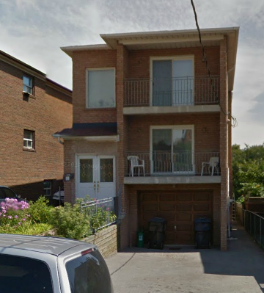
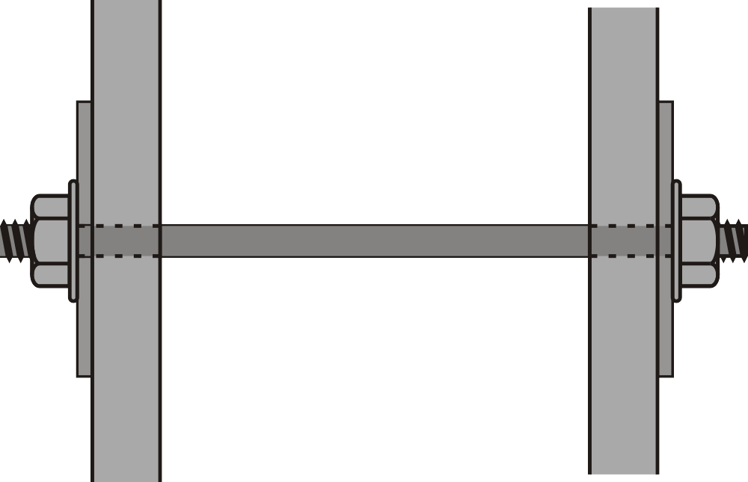
Reasons and Decisions
Mark Parete retained a professional engineer to inspect damage to his home caused by settlement and to recommend remedies. This engineer recommended that 29 helical piers be installed under three of the four foundation walls four tie-back rods run from the rear foundational wall to the front of the house. He provided drawings with the required loading data and these were submitted to the City of Toronto. The engineer obtained a quote for $43,950 from EBS which the owner felt was too expensive.
Google Streetview

Slide 59
Reasons and Decisions
Next, the owner obtained a geotechnical report which further indicated that repairs to a retaining wall were also necessary.
Two months later, the owner received a quote of $35,000 from ABM (owned by Bob Hayter), which used push piers. The first engineer expressed concern over the load-carrying capacity of the push piers; however, Parete awarded the contract to ABM. The first engineer resigned from the project and responsibility was passed to Stephen Hamann, a structural engineer retained by ABM. (Hamann had worked with ABM for four years.) The first engineer indicated his drawings no longer applied to the push piers. Hamann submitted a drawing using 29 push piers and four tie-back rods. He estimated the work should take one month starting late August or early September.

Slide 60
Reasons and Decisions
To accomplish this work, a General Review Commitment Certificate was required. It stated that:
Make periodic visits to the site ensuring conformity with the plans
Record, report on, and rectify deficiencies
Review other reports relevant to the work being done
Hamann took on the position of the engineer reviewing the certificate.
Work started late and the owner complained to Hamann at the start of September to complain about the slow pace of work, yet Hamann did not visit the site in September, October, November and it was not until December 16 that he visited the site. By this time, the foundation work was complete and Hamann was not able to make any personal observations on the work done by ABM. ABM said they used only 21 push piers and no tie-backs as the cracks had been reduced to less than one-quarter of an inch.

Slide 61
Reasons and Decisions
On December 17, Hamann certified that the work performed was carried out in general accordance with the structural drawings and the Ontario Building Code; he did not affix his engineering seal.
A few days later, ABM went out of business and Hayter could not be located.
Four months later, it was documented that one inch cracks still existed and cracks had appeared in the repaired exterior brick wall. The owner had reasons to believe that only 19 piers had been installed.
Hamann admitted the allegations and his admission appeared to be voluntary, informed and unequivocal.
Gazette Nov/Dec 2006

Slide 62
Reasons and Decisions
Discussion:
Was Stephen Hamann guilty of professional misconduct?
If “yes”, which items?

Slide 63
Reasons and Decisions
Don’t be negligence
Try to preserve life, health, and property
Correct or report dangerous situations
Comply with statutes, regulations, codes, by-laws, etc.
If you didn’t author it, at least check what you seal, sign and date
If a non-technical authority requires a dangerous deviation from a design, you must point this out clearly and preferably in writing
Abide by the Professional Engineers Act and O.Reg. 941
Only engage in work in which you are competent
Disclose any potential conflicts of interest first
Don’t be disgraceful, dishonorable, or unprofessional
Abide by terms, conditions or limitations of your licence/certificate
Provide documents or information for any investigation
Don’t encourage those who are not licensed to practice
Don’t harass people

Slide 64
Reasons and Decisions
The discipline committee found him guilty of:
Section 72(2)(a): negligence; that is, an act or an omission in the carrying out of the work of a practitioner that constitutes a failure to maintain the standards that a reasonable and prudent practitioner would maintain in the circumstances.
Section 72(2)(d): failure to make responsible provision for complying with applicable statutes, regulations, standards, codes, by-laws and rules in connection with work being undertaken by or under the responsibility of the practitioner.
Section 72(2)(g): breach of the Act or regulations, other than an action that is solely a breach of the code of ethics.

Slide 65
Reasons and Decisions
The discipline committee found him guilty of:
Section 72(2)(i): failure to make prompt, voluntary and complete disclosure of an interest, direct or indirect, that might in any way be, or be construed as, prejudicial to the professional judgment of the practitioner in rendering service to the public, to an employer or to a client
Section 72(2)(j): conduct or an act relevant to the practice of professional engineering that, having regard to all the circumstances, would reasonably be regarded by the engineering profession as disgraceful, dishonourable or unprofessional.

Slide 66
Reasons and Decisions
Accordingly, the panel orders the following:
that Hamann be reprimanded;
that the fact of the reprimand be recorded on the Register;
there will be publication of the proceedings with the name of the member in Gazette; and
that Hamann shall write and pass the following examinations:
Professional Practice Examination,
98-Civ-B8 Management of Construction;
in the event that Hamann does not write and pass the examinations within 12 months, his licence will be suspended until they are passed;
in the event that Hamman does not write and pass the examinations within 24 months, his licence shall be revoked; and
that Hamann pay the costs of the proceeding fixed in the sum of $5,000 within 90 days of the date of this hearing.

Slide 67
Reasons and Decisions
Follow up: Stephen Hamann continues to be a professional engineer practicing in Toronto and he continues to have the designation of consulting engineer
He made a mistake, and he corrected for it

Slide 68
Enforcement
When a professional engineer or a holder of a Certificate of Authorization or other licence fails to live up to the standards set by the Association, they are judged and disciplined by professional engineers
When an individual who does not hold a licence or a Certificate of Authorization engages in the practice of professional engineering, the Association has no authority to discipline that individual
In this case, the Association will enforce the terms by having a court grant an injunction against the individual or business organization

Slide 69
Enforcement
Order directing compliance
39. (1) Where it appears to the Association that any person does not comply with this Act or the regulations, despite the imposition of any penalty in respect of such non-compliance and in addition to any other rights it may have, the Association may apply to a judge of the Superior Court of Justice for an order directing the person to comply with the provision, and upon the application the judge may make the order or such other order as the judge thinks fit.

Slide 70
MCSE
Please see Case History 4.1 in Andrews http://www.peo.on.ca/enforcement/Software_engineering_page.html
MCSE is a designation given to those who complete a technical course offered by Microsoft Corporation; the course is only about a year long, usually at a community college. This program started in the early 1990s while SYDE was an accredited program at UW! There was legitimate concern that the title made confusion possible in Canada: it would be reasonable to expect that the holder of such a license graduated from an accredited university.
In 2001, PEO (and others) met with Microsoft to explain how this designation contravened Canadian law, at which point Microsoft agreed to use only the acronym. One year later, they reversed this decision, telling certificate holders to use the full title. One argument was that the full title carried more weight.

Slide 71
Mr. Stolarchuk
An application was brought under Section 39 of the Professional Engineers Act in the Ontario Superior Court of Justice at 130 Queen Street West, Toronto, Ontario, on July 23, 2002 before the Honourable Mr. Justice Somers. The association obtained the following Order against Dan Stolarchuk of Toronto:
A DECLARATION that Dan Stolarchuk breached s. 12(1) of the Act in that, without a licence, he held himself out as engaging in the business of providing, to the Ontario public, services that are within the practice of professional engineering
AN ORDER that Stolarchuk refrain from holding himself out as engaging in the business of providing, to the public in Ontario, services that are within the practice of professional engineering, unless and until he obtains a licence from PEO;

Slide 72
Mr. Stolarchuk
A DECLARATION that Stolarchuk breached s. 40(2)(a) of the Act in that, without a licence, he used the title “professional engineer” and the abbreviated title “P.Eng.” as occupational or business designations
AN ORDER that Stolarchuk refrain from using the title “professional engineer” or any abbreviations or variation thereof as an occupational or business designation in Ontario unless and until he obtains a licence

Slide 73
Mr. Stolarchuk
A DECLARATION that Stolarchuk breached s. 40(2)(b) of the Act in that, without a licence, he used the titles “professional engineer” and “P.Eng.”, terms which would lead to the belief that he could engage in the practice of professional engineering
AN ORDER that Stolarchuk refrain from using, by any medium, the term “professional engineer” or any variation or abbreviation thereof that will lead to the belief that he provides, to the public in Ontario, services within the practice of professional engineering, unless and until he obtains a licence
AN ORDER that Stolarchuk turn over to a representative of PEO all promotional materials, business cards, and any other business stationery or printed materials and signage using the title “professional engineer” and/or “P.Eng.”, in combination with his name and/or any other term in violation of this Order, within 21 days of the date of this Order

Slide 74
Mr. Stolarchuk
AN ORDER that Stolarchuk pay to PEO its costs of this matter fixed at $6,750.
The association was represented by Dana M. Peebles of McCarthy Tétrault.
The investigation leading to the subsequent application began after PEO received information that Stolarchuk had misrepresented himself as a professional engineer to fellow employees at a Toronto company, as well as describing himself as a “Field Applications Engineer” and “R.D. Engineer” in a resume.
Affidavits in support of the association’s application were filed with the court. Mr. Stolarchuk attended in person. After reviewing the material and hearing brief submissions from Mr. Peebles and Mr. Stolarchuk, the Honourable Mr. Justice Somers handed down the order in favour of the association.
Gazette, January/February 2003

Slide 75
Sean A. Clyke
In December, 2004, Mr. Clyke was ordered to refrain from using the term “professional engineer” and the abbreviation “P.Eng.” and required to pay to PEO its costs of this matter fixed at $6,607.41
In August, 2006, Mr. Clyke was, again, found guilty of representing himself as a professional engineer and consequently fined for a total of $45,000
Gazette, Mar/Apr 2005
Gazette, Sep/Oct 2006

Slide 76
Wiktor Kwiatek
In November 2003, 73-year old Kwiatek, P.Eng., was found guilty of incompetence and professional misconduct under 72(2)(a), (b), (d), (g), (h) and (j) and his licence was revoked
He inspected a fence and determined it was “structurally adequate, built in accordance with prevailing construction practice in Ontario”
One month later, it was blown over in a wind storm
Gazette, Sep/Oct 2004

Slide 77
Wiktor Kwiatek
In 2006, he used a facsimile of a seal to approve a crane inspection despite there being visible cracks in the structure
A subsequent investigation found he had sealed approximately 60 other inspections since his licence was revoked
Enforcement was used to obtain a court order preventing him from using the term “professional engineer”, “P.Eng.” or using the seal and he was required to pay $2,500
Gazette, Nov/Dec 2006

Slide 78
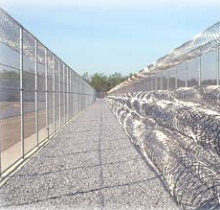
Imprisonment
Imprisonment can occur if an individual fails to comply with a court order and that court finds the individual in contempt as a result
Andrew Bardwell

Slide 79
Mohammad Hafeez
Toronto Man Jailed 30 Days for Repeated Violations of Professional Engineers Act
Mohammad Hafeez, of Toronto, was jailed June 10, 2005 for 30 days and ordered to pay costs to PEO of $19,863.81, after he was found in contempt of a previous Order of the Ontario Superior Court of Justice for violating the Professional Engineers Act. The previous Order was made by the Honourable Justice Trafford on November 7, 1995. Mr. Hafeez is not, and has never been, licensed as a professional engineer in the Province of Ontario.
The Honourable Madam Justice Sachs handed down the sentence in the Ontario Superior Court of Justice. The application was brought after an investigation by PEO revealed that in the spring of 2000, Mr. Hafeez had described himself as a “structural engineer” and an “engineer” to clients and another person while working on a construction project in the City of Toronto.

Slide 80
Mohammad Hafeez
Toronto Man Jailed 30 Days for Repeated Violations of Professional Engineers Act
Under the terms of the 1995 Order, Mr. Hafeez was ordered to:
refrain from using the title “professional engineer” or an abbreviation or variation thereof as an occupational or business designation;
refrain from using a term, title or description that will lead to the belief that he may engage in the business of professional engineering; and
surrender to PEO, site signs, seals or title blocks in his possession containing the words any business cards “professional engineer”, “engineer”, “engineering”, or any abbreviation thereof.
The Court also heard that Mr. Hafeez had previously been convicted on four separate occasions of misrepresenting himself as “an engineer” while working on various projects in the Greater Toronto Area between April 1993 and June 1998. Fines were levied in the combined total of $85,000.
Gazette, Jul/Aug 2005

Slide 81
References
[1] Professional Engineers Act, http://www.e-laws.gov.on.ca/html/statutes/english/elaws_statutes_90p28_e.htm
[2] Ontario Regulation 941,
http://www.e-laws.gov.on.ca/html/regs/english/elaws_regs_900941_e.htm
[3] Julie Vale, ECE 290 Course Notes, 2011.
[4] Wikipedia, http://www.wikipedia.org/
[5] Criminal Code of Canada
http://laws-lois.justice.gc.ca/eng/acts/C-46/page-197.html#h-112
[6] Canada Labour Code
http://laws-lois.justice.gc.ca/eng/acts/L-2/
These course slides are provided for the ECE 290 class. The material in it reflects Douglas Harder’s best judgment in light of the information available to him at the time of preparation. Any reliance on these course slides by any party for any other purpose are the responsibility of such parties. Douglas W. Harder accepts no responsibility for damages, if any, suffered by any party as a result of decisions made or actions based on these course slides for any other purpose than that for which it was intended.

